Slide 1
GenAI and Alix
Leveraging the Power Of GenAI
Julio P. Roque
VP, Product Development /
Head of APP SEC
Check in code: artificial1

Slide 2
GenAI Primer
Don’t scream! It’s important.

Slide 3
What is GenAI?
A Very Short History of Generative AI
Early Experiments (1950s–1980s)
  Began with rule-based systems and simple statistical models to generate text.
ML and Neural Networks (1990s–2000s)
  Shifted to early Recurrent Neural Networks (RNNs), etc.
Modern Generative Models (2010s)
  Breakthroughs with Variational Autoencoders (VAEs) (2013) and Generative Adversarial Networks (GANs) (2014) enabled realistic image, text, and audio generation.
Transformers and Large-Scale Systems (Late 2010s–2020s)
  Transformer architecture (2017) paved the way for massive LLMs (e.g., GPT), extending generative AI into many domains like text, images, and beyond.
Today
  Large-scale models and abundant data fuel widespread adoption and integration across industries, including creative content, code generation, and multi-modal AI.
Notes:
The point here is that GenAI has been an EVOLUTION and not a REVOLUTION. It has been in development for many uears

Slide 4
Transformer architecture?
What is it, and why was it so important?
The Transformer Architecture
    Introduced with the paper “Attention Is All You Need.”
    Think of it as a system that reads an entire sentence (or paragraph) at once rather than word-by-word.
    It uses a technique called attention to figure out which parts of the sentence are most important, helping it understand context better.
    Became the foundation for many state-of-the-art models (e.g., GPT, BERT, DALL·E) due to its superior performance and ability to train faster on large datasets.
Why It’s Important
  It learns faster: Since it doesn’t have to go word-by-word like older models, it can train on more data in less time.
  It handles context well: It remembers relationships between words, even if they’re far apart. This means it can generate more coherent and natural-sounding text.
  It’s very flexible: The same basic design can work on text, images, audio, and more

Slide 5
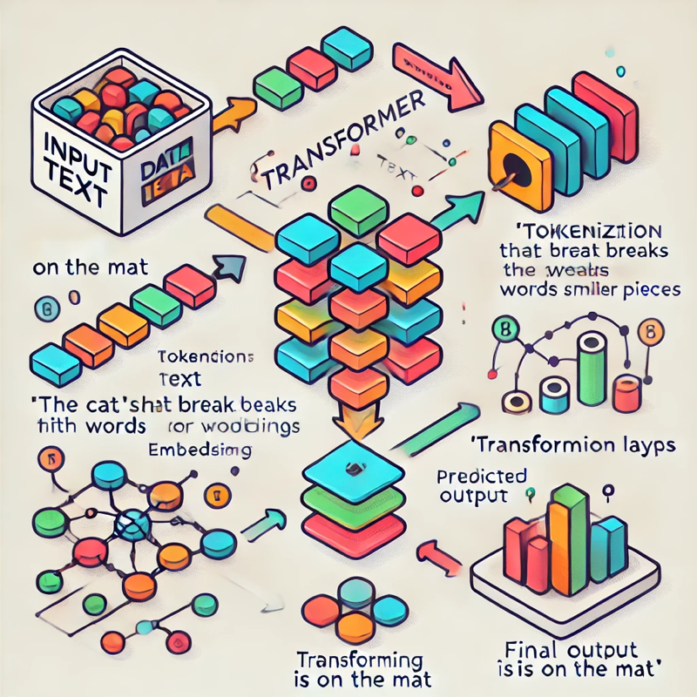
Transformer Architecture – “Attention Is All You Need”
The foundation for all modern GenAI systems – How GenAI is ”Trained”
IT’S NOT MAGIC!
GenAI LLMs are just sophisticated statistical models.
Raw text data is converted into predictions using the architecture’s components (tokenization, embeddings, self-attention, and layers).

Slide 6
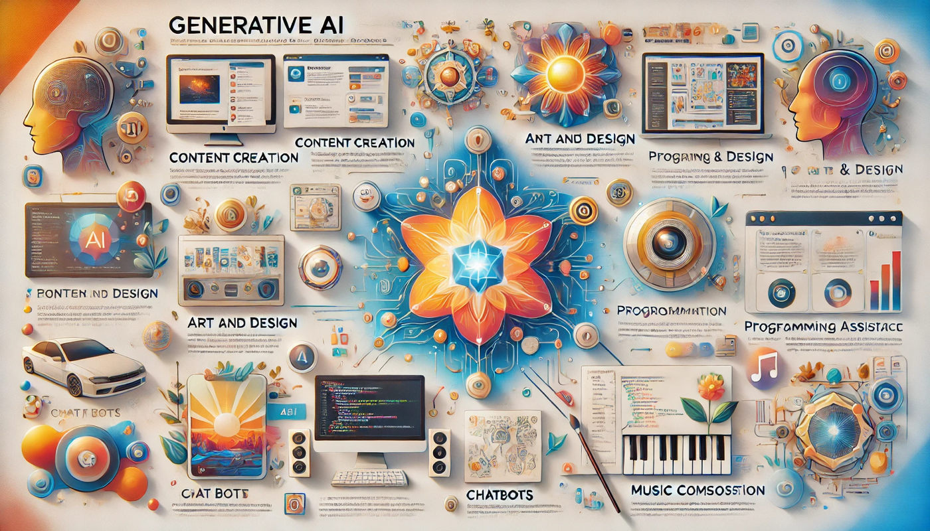
Generative AI: Key Applications in Action
The possibilities! - Most images in this presentation were created using GenAI

Slide 7
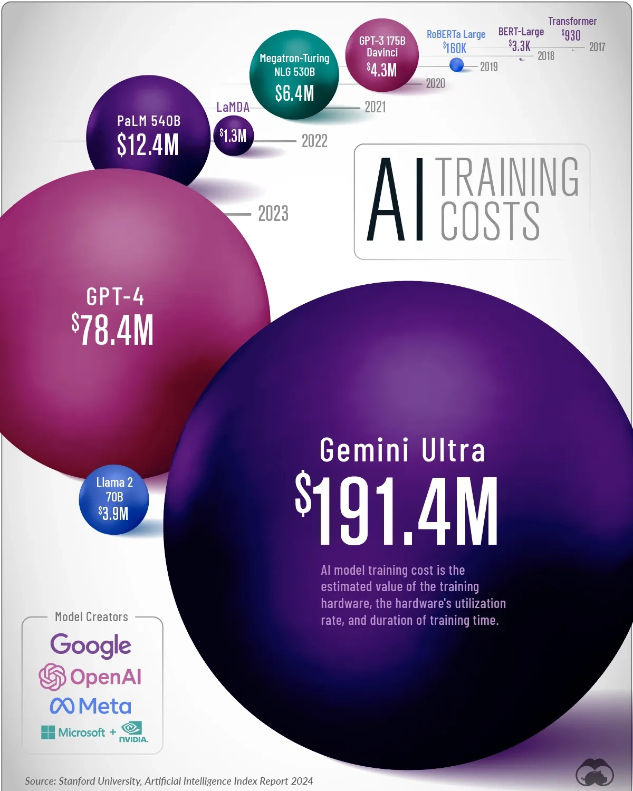
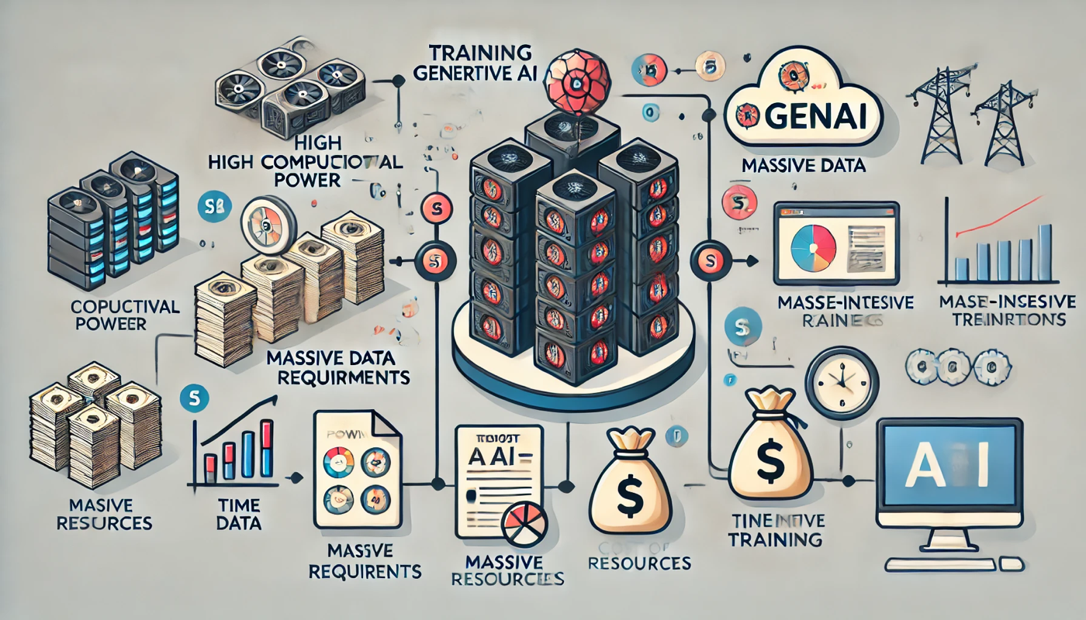
Power Has A Cost. Why?
”Training” a model is expensive and takes time.

Slide 8
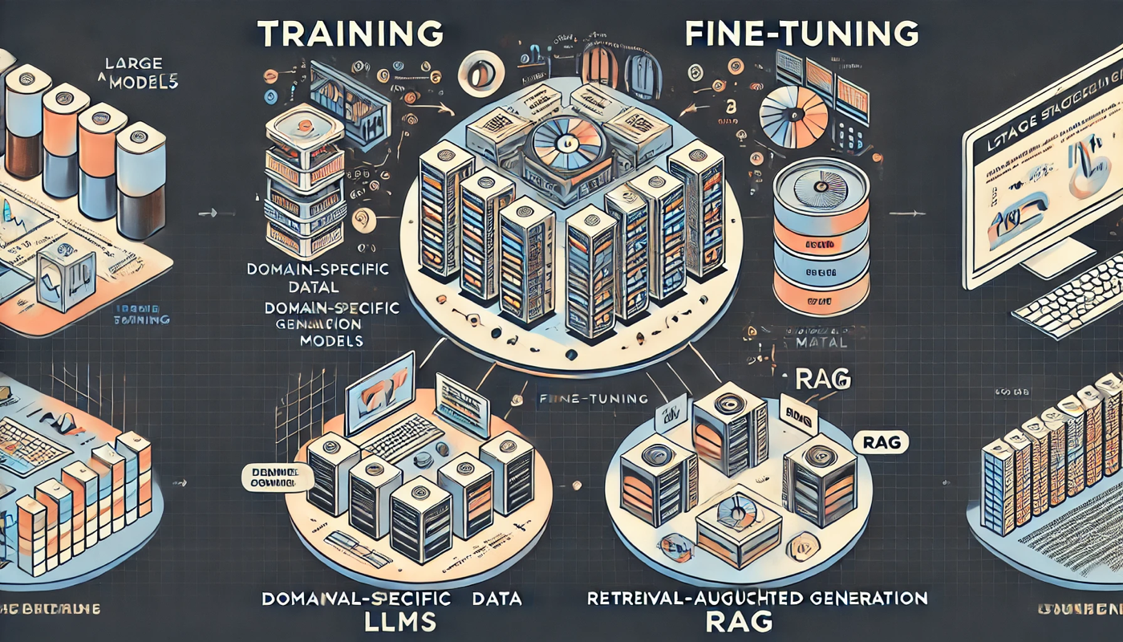
Wow! Is That What Hexagon Did With Alix?!
No, and very few companies do unless you are OpenAI, Microsoft, Google, etc.

Slide 9
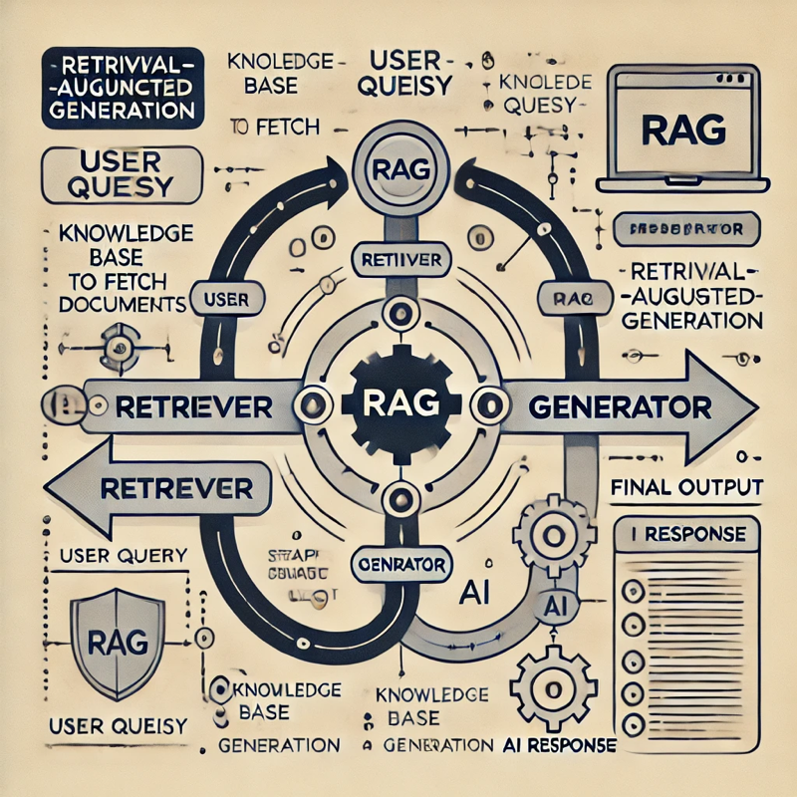
Alix Focused Knowledge Strategy
Alix’s goal is not for fancy images. Alix must be the authoritative source for HxGN ALI products.
Retrieval Augmented Generation (RAG)
Take all your products and specialized documents and place them in a sophisticated vector database (e.g., knowledge base).
When a question is asked, search the knowledge base for the specific information, send it to the LLM to make sense of all the information, and then provide the answer.
Fine-Tuning
”Adjust” the base training of the LLM to make it “tuned” to your specific needs. Example:
  Change Infor EAM to HxGN EAM
  Teach the LLM the unique differences between Pl/SQL and EAM’s Flex SQL

Slide 10
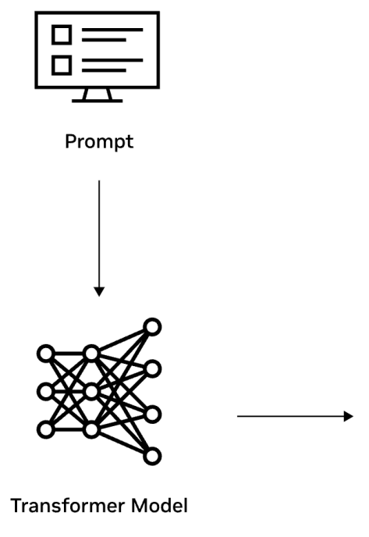
A Practical Example
How RAG delivers targeted result for Alix
Does HxGN EAM support escalation management with features like text, phone, VoIP, and Teams integration, ensuring that issues are resolved quickly?
HxGN EAM offers robust escalation management capabilities with native support for email notifications. While it doesn't provide out-of-the-box integration for text messaging, phone, VoIP, or Microsoft Teams, these functionalities can be achieved through custom integrations using tools like Databridge Pro or the Python Framework. These tools enable the development of custom connectors and scripts to facilitate seamless communication between HxGN EAM and external systems.
KB

Slide 11
Alix – A Formal Introduction

Slide 12
Alix
Digital Assets AI Assistant
“Leverage GenAI to empower our customers, enabling them to securely and effortlessly maximize the benefits of our products, industry expertise, and technology knowledge.”

Slide 13
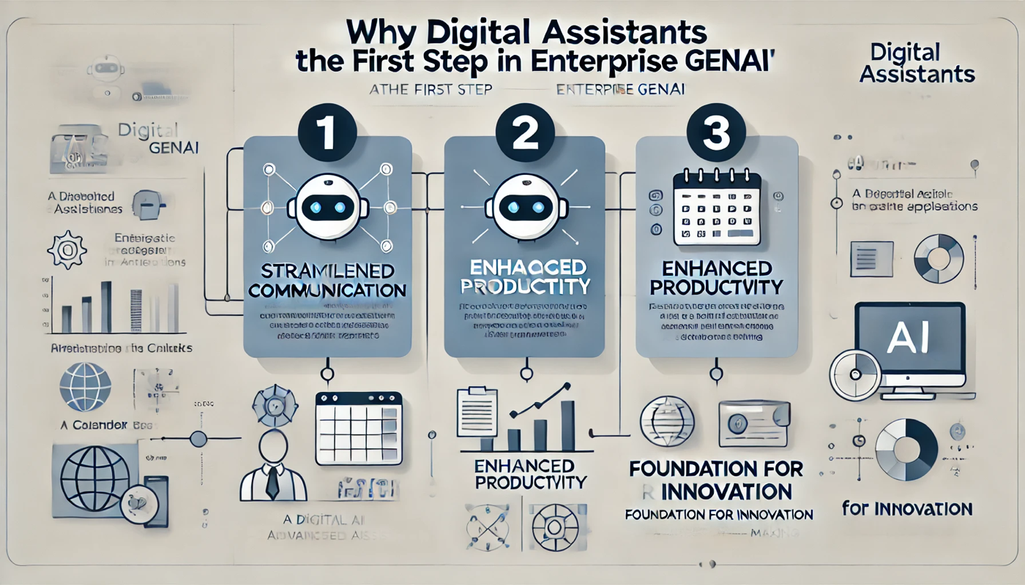
Wait! Why an AI Digital Assistant?
Why not use GenAI in some other fancy way?

Slide 14
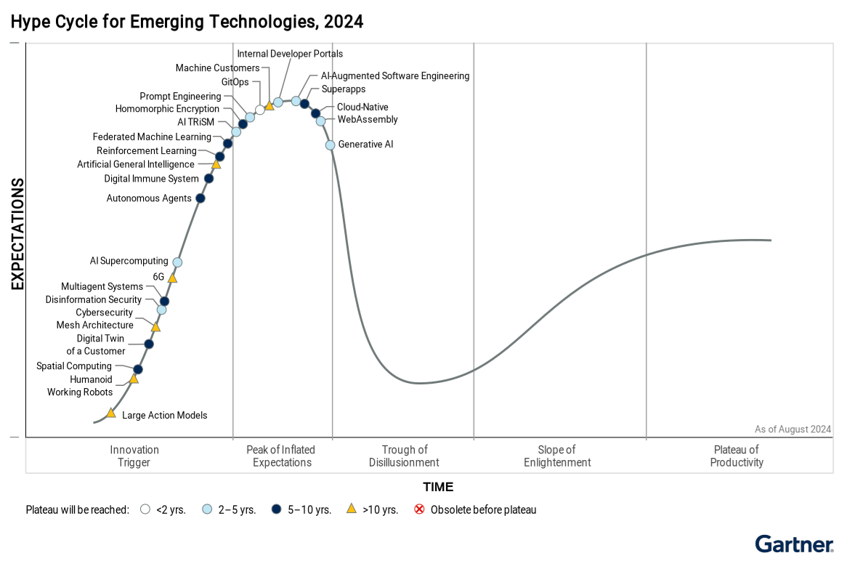
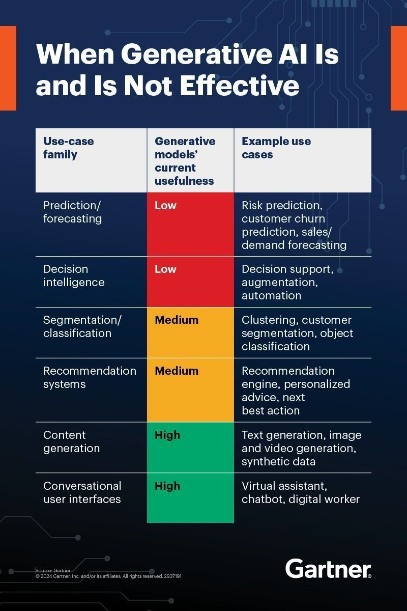
Key to Success? – Focus on Correct Use Case

Slide 15
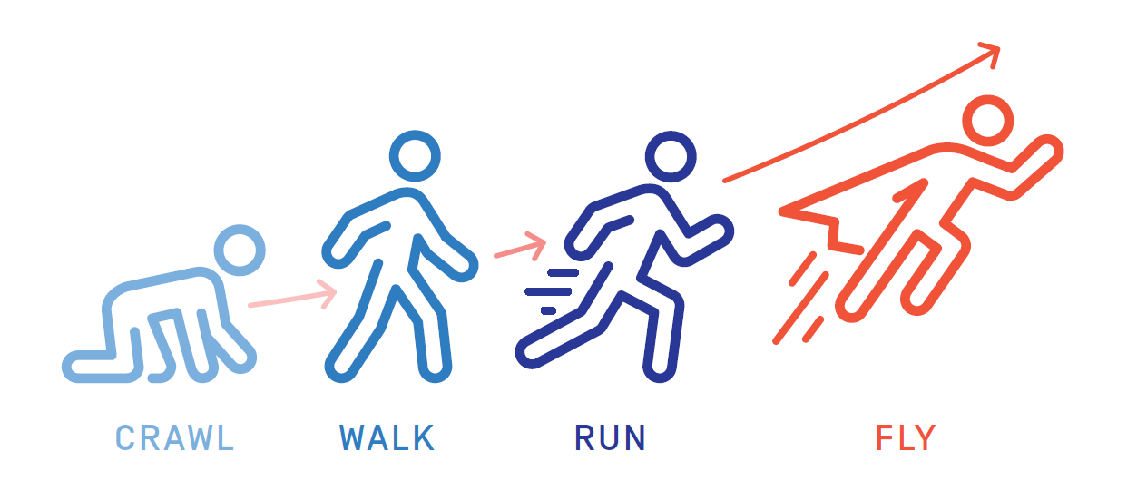
Wait! Why No Tenant Data or Agents Today?
Lay the foundation, Build for the future

Slide 16
The Crawl, Walk, Run Approach
What does it mean for Alix?
Crawl
In EAM, how do I create a WO?
Walk
In EAM, how many WO were created last month for asset #123456?
Run
In EAM, create a WO for asset #12345 to replace it. Assign it to Julio.
RAG/Fine-Tuning
Agentic RAG
Agents

Slide 17
Alix - HxGN Digital Assets AI Assistant (Crawl Phase)
Addressing the needs of our customers the right way
Key Features:
Enterprise Gen AI for the Digital Assets product group:
  EAM and Python Studio released November 2024
  Databridge Pro released February 2025
  AKMS scheduled Q2 2025
  J5 scheduled for Q3 2025
No commercial LLM was used. Alix does not leverage or rely on any commercial GenAI LLM models (e.g., CoPilot, GPT, etc.).
  Hosted in AWS EKS Cluster (Kubernetes)
  High availability and disaster recovery via multiple availability zones.
  Multi-language support (English, French, German, Spanish, Italian, Portuguese, Chinese, Japanese, Korean, Arabic, and Hindi)
Safeguards:
Not connected to the internet
  No storage of data history or prompts outside the active session, and only the last five questions
  No reinforce learning
  No data was used, nor will any ever be used for training
Enhanced security measures via a Guardrail system to scrutinize user inputs, providing guardrails on specific categories:
  Privacy, Intellectual Property, Specialized Advise, Competitor Search, Non-Violent Crimes, Sex Crimes, Child Exploitation, Indiscriminate Weapons, Hate, Self-Harm, and Sexual Content.
  Politics and religious content

Slide 18


Our Promise, Our Commitment
Alix Value Proposition
Data Security
Privacy
Accuracy
Accessibility
Crucial to protect sensitive information, prevent unauthorized access, and maintain trust.
The same level of security as your Tenant's data.
Your information is yours. Full trust in the privacy of your questions, answers, and data
Your data was NOT, nor will EVER be, used to train Alix.
Commitment to the accuracy of answers.
Product knowledge not available to any other GenAI in the world.
The authoritative source for the Digital Assets products.
Like out products - multi-language support for a diverse user community.

Slide 19
Before I leave you…
Julio’s Fuzzy Rabbit Axiom for a GenAI systems
If you ask any GenAI system to create a picture of a rabbit,
DON’T COMPLAIN if the picture is not what you wanted because you wanted,
a white rabbit with green eyes, red fur, and jumping on one foot!
For Alix and EAM, what does Julio’s Fuzzy Rabbit Axiom mean?
Got to Alix and asked this question,
What's the proper way to ask Alix a question?

Slide 20
Thank you!
Q&A

