Slide 1

Advanced Concepts for Work Order Generation and Scheduling
Bennet Creed
Vice President, Business Development
Notes:
Introduction and overview

Slide 2
Founded in 2009 by experienced EAM consultants and project managers
Headquarters in Birmingham, AL with consultants across North America
More than 20 years of experience with EAM, MP2, and other products
Active partner to Hexagon and other companies
Certified by Hexagon for Functional and Technical Consulting
Notes:
Information about EAM Solutions

Slide 3

Is EAM Working Against You?
The File Cabinet
Manual follow-ups
Reactive maintenance
Inconsistent work order creation
Paper reports and lists of data
Wrong KPIs or Metrics
Notes:
Is EAM Working Against You?
How can software work against you? Use examples of Excel and Word
Many times organizations just use a CMMS or EAMS system as an electronic file cabinet or catalog of work done.
When there is a problem, or if routine maintenance finds an issue, how do you create follow-up work orders?
This may just be a manual process where you create a work order and dispatch it as another breakdown – if there’s even a work orders
Reactive maintenance becomes the rule – just keep things running
Planning and scheduling fall to the side because these get in the way of fire fighting
In fact, because of fire fighting, a lot of work may be completed but never documented
Because of deficiencies in planning and scheduling, reports don’t return correct or accurate equipment or work order information

Slide 4
The Challenge
Reactive Maintenance
Planned and Event Driven Maintenance
Work requests, maybe
Work orders created manually, as needed
Uncaptured work
If you see it, fix it
If they tell you, think about fixing it
This is the easy path
Automatic work order generation
  Time intervals
  Meter and usage intervals
  Event driven work order generation
    Monitored conditions
    Trends
  Qualitative inspection results
  Alert Management
  Incoming Data
Notes:
The Challenge is moving from a Reactive or simple PM mode to a more advanced planned or predictive maintenance mode
Reactive maintenance is a short-term solution taken every day
You may or may not get work requests, and these may just be verbal or email
Work orders are created as needed – demand driven maintenance
A lot of work may not be captured
Planned and Event driven maintenance
Planned – using PM Schedules and Maintenance Patterns to full advantage
Letting they system autogenerate work orders, instead of manually running the process
Bringing data into the system to triggers work orders
Monitored conditions – temperatures, pressures, and other readings can triggers new work orders without human intervention
Data trending from external systems, or from data pushed into EAM from another system (like SCADA or production controls)
Inspection results – daily equipment and facility inspections triggering follow-up work orders
Alert Management and System Integration can go a long way to move you away from Reactive Maintenance
This is how the system can work for you – by eliminating a lot of manual intervention

Slide 5
What next?
Start asking questions
Identify the EAM tools you need
Understand the data you need to simplify workflow
Document your workflow
Develop technical tools for enablement
Test the process
Notes:
Start asking questions about the process
Where do work orders start?
What triggers new work orders?
How can we simplify the process?
How can we capture events before equipment breaks?
Identify the tools you need to meet these goals
We’re going to talk about those tools in this session, and go in-depth in our breakout tomorrow
Understand the data you need to simplify workflow
Controlling labor hours?
Measuring equipment downtown and sources of downtime?
Inspection, test, and gauge data?
Document your workflow – make how you manage work orders consistent
Include EAM tools in this workflow, such as Inspections or Operator Checklists
Develop technical tools for enablement
System integration to bring data into EAM through Databridge Pro or REST APIs
Custom reports and analytics
Dashboards, like Equipment 360
Test the process
Work with your stakeholders, form Request to Closing, to make sure it work
Make sure you’re getting the data you need to make good decisions and enhance maintenance scheduling

Slide 6
EAM Tools
Dynamic Checklists
Standard WOs
Checklists & Inspections
Maintenance Patterns
Deferred Maintenance
WO Scheduling Tools
Databridge Pro or REST APIs
Notes:
So let’s talk through some of the tools to enhance how and when work orders are released and scheduled.
It can all start with the Task Plan Checklist – and one that is dynamic.
From there you move into having a library of standard jobs – templates of common work or pre-defined work
Instead of just PM Schedules, you can move into Maintenance Patterns. These are more complex schedules of planned and routine maintenance
And if an Activity needs to wait – think about using the Deferred Maintenance process. Set Work Order Activities into a “Parking Lot” until you have time to complete these.

Slide 7
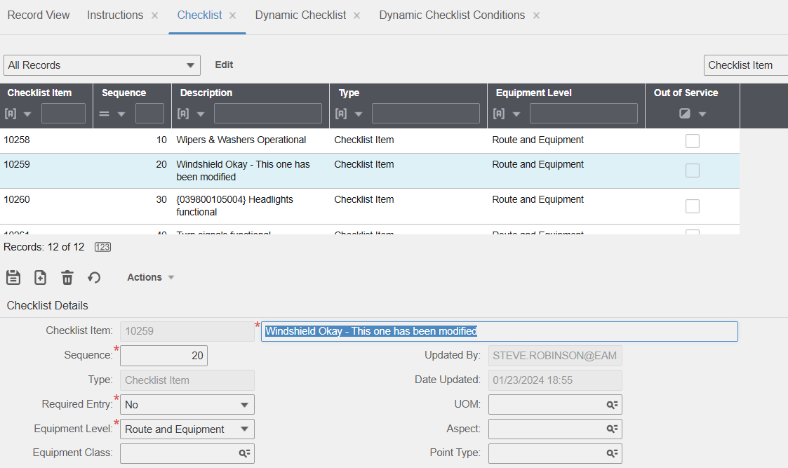
Templates and Tasks
Standard WO
Library of common job
Associate templates to events
Task Plan
Library of common steps
Associate steps to Activities on Standard WO templates
Group them by Problem Codes
Associate them to Inspections and Maintenance Patterns

Slide 8

Dynamic Checklists & Inspections
Library of standard Task lists, but with a twist
Logical options in the Tasks
More than just for PM Schedules
  Safety Inspections
  Vehicle Inspections
  Building Rounds
Release Follow-up Work Orders
History of Inspections on Equipment

Slide 9
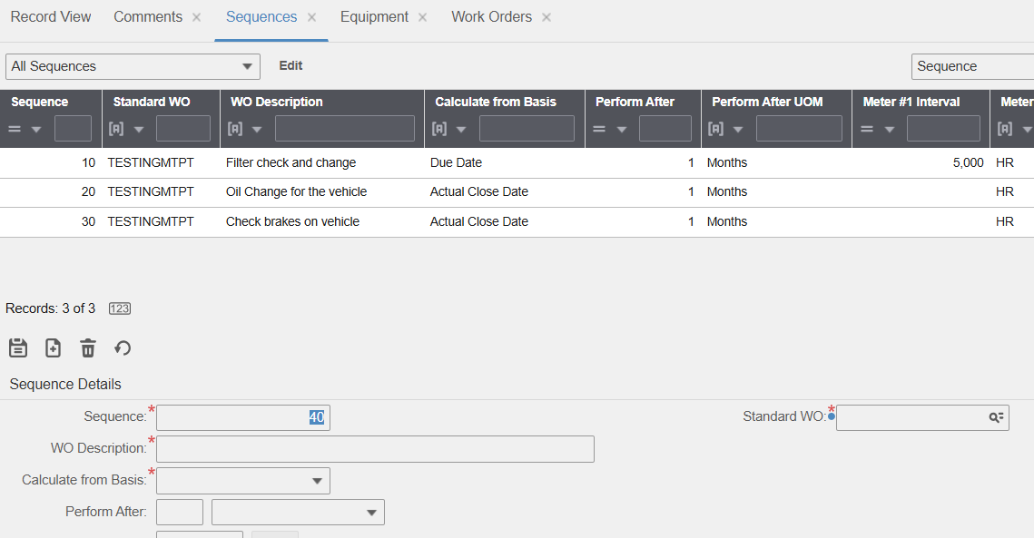
Maintenance Patterns
More than scheduled maintenance
Recurring complex maintenance with even intervals
Release by time or meter interval
Automatically release
Usage meters
Alert Management

Slide 10

Event Based Maintenance
Standard tools for integration
REST and SOAP APIs
Databridge Pro
Configured place to keep data in EAM
Quantitative data
Meters
Inspections
Test Results
Qualitative data
Alert Management

Slide 11
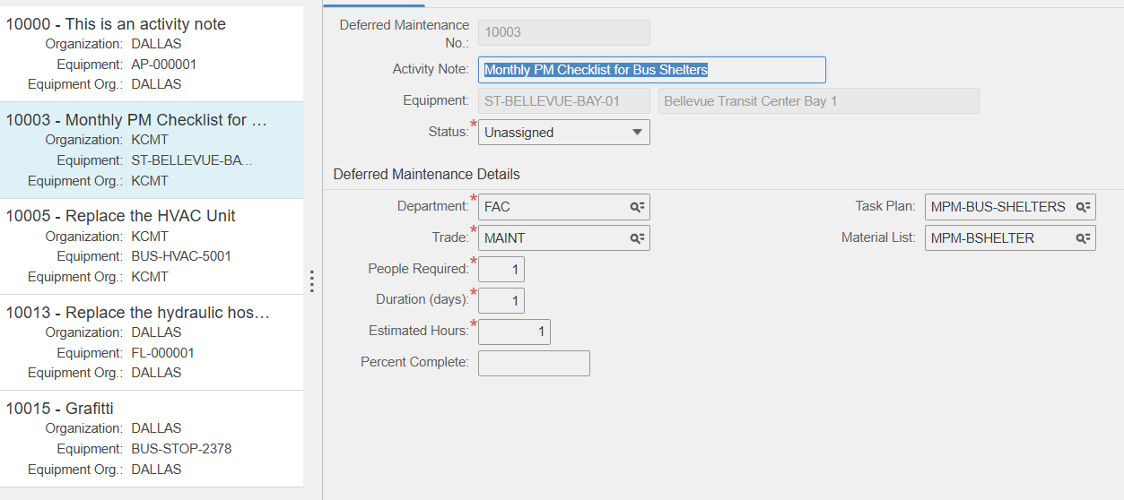
Deferred Maintenance
One or more WO Activities is delayed
Parking lot for Activities
Reassignment later
Recombine left-over Activities
Cancel redundant Activities
Update Activity Schedules

Slide 12
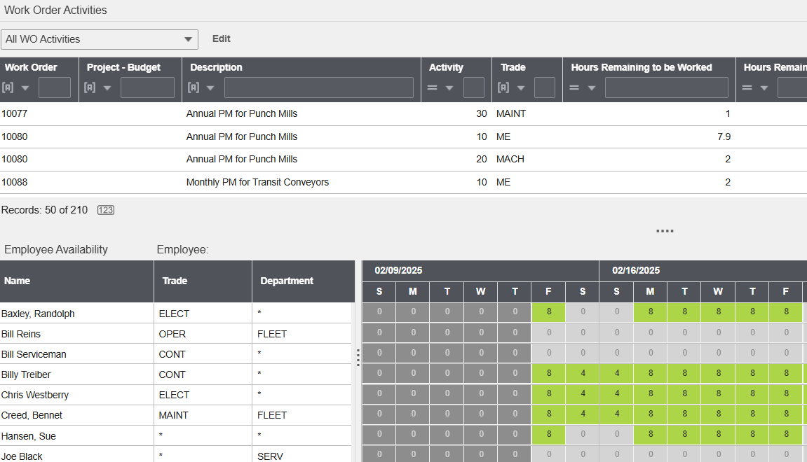
Graphic Schedules
Work Order Dataspy
Start sorting and organizing in the WO module
WO Scheduling
Scheduling by individual, Trade, or Department
WO Daily Scheduling
Deeper level of planning & scheduling
WO Load Balancing

Slide 13
Upcoming Session
David Kennemore
Live EAM System
Audience Participation
Follow-up
VP of Professional Services
Nearly 20 years of EAM implementation experience
Real system and screens to show EAM in action
We want your questions and feedback while David shows you these features in EAM
Contact us with any additional questions!

