Slide 1
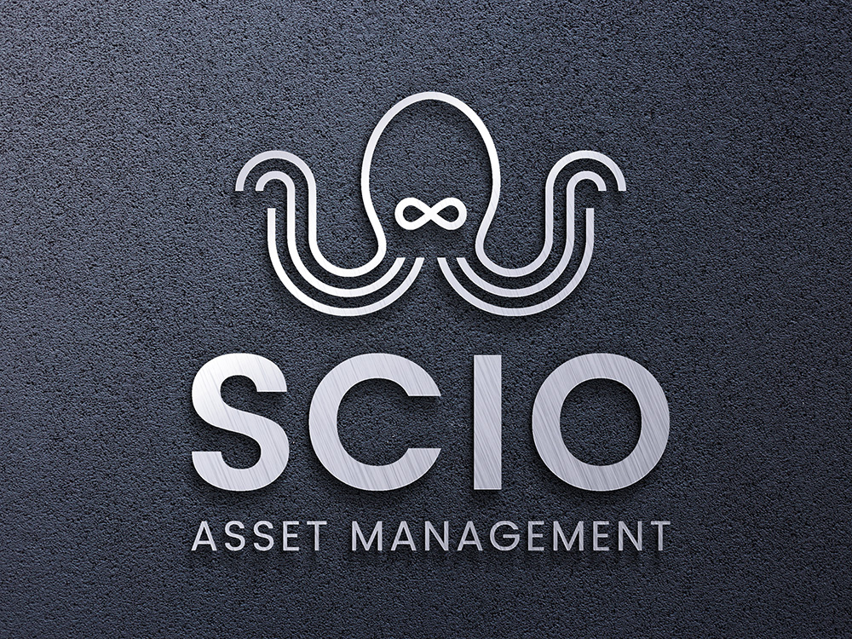
Notes:
Hi, I’m Paul Daoust, founder and managing director at SCIO Asset Management. In my 30 years I’ve learned a lot about asset management. Most of it I learned the hard way through the school of hard knocks. I’ve concluded that operational leaders have a very difficult job. Worse, they are underserved, they generally have poor feedback and foresight systems, and not a lot of tools in their toolbelt designed them to deliver superior business outcomes. At SCIO we’re working hard to change that.

Slide 2
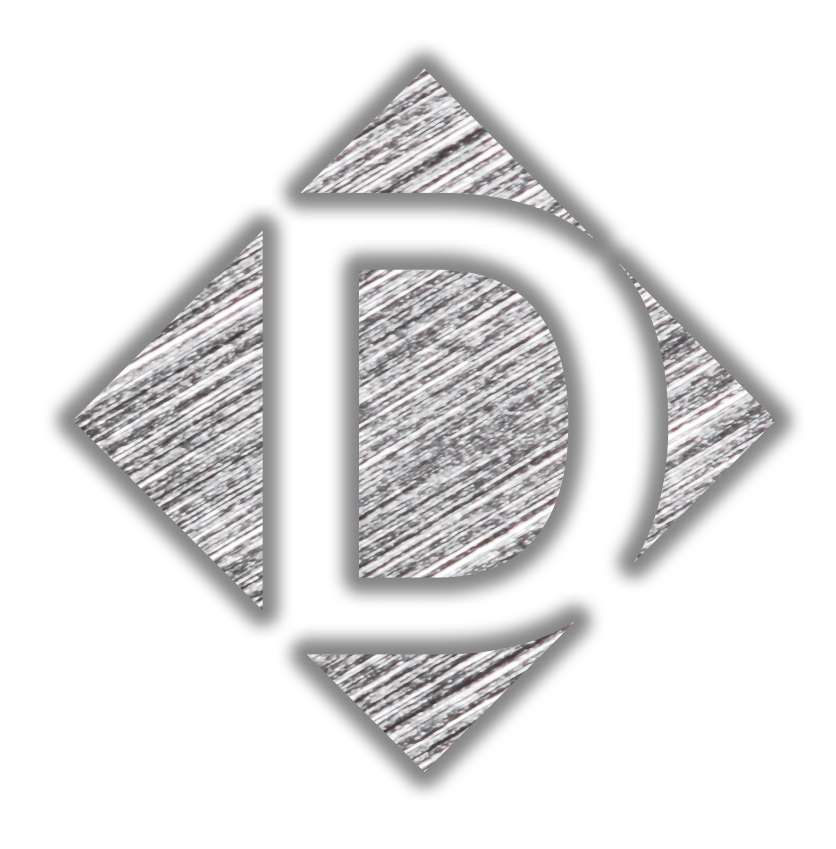
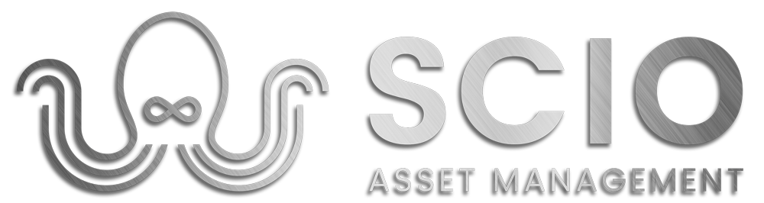
Meet SCIO
SCIO (Latin “to know, understand”) is an applied knowledge and decision technology and asset management solution provider
SCIO provides a strategic operational leadership management framework and sensemaking solution to manage, lead, and govern to achieve operational performance excellence
How? We supercharge leaders’ agency to control the controllable to realize maximum durable value and deliver mission success
Our motto: SEE. THINK. DECIDE. ACT.

Slide 3
Asset Management Identity Crisis
Asset Management definition is the coordinated activities of an organization to realize value from its assets
Varied interpretation from “fix my maintenance” to “holistic and strategic management system for managing assets”
Two types of activities: transactions <<<<< decisions
EAMs are essential and do a lot, but they don’t do everything
A keystone OMS solution built for leaders’ strategic decision-making is missing from our toolset, solution architecture
Forms a powerful 1-2 punch to achieve operational excellence

Slide 4
Primary Functions of Modern EAMs
Asset Information Management
Asset Planning & Acquisition
Asset Operations and Maintenance
Condition Monitoring & Predictive Maintenance
Asset Performance Management
Compliance and Risk Management
Mobile Functionality
Supports advanced analytics, business intelligence
Integration: ERP, GIS, BIM, HR
Intrinsically more tactical, transactional, data, and process focused than strategic, holistic, or decision-centric

Slide 5
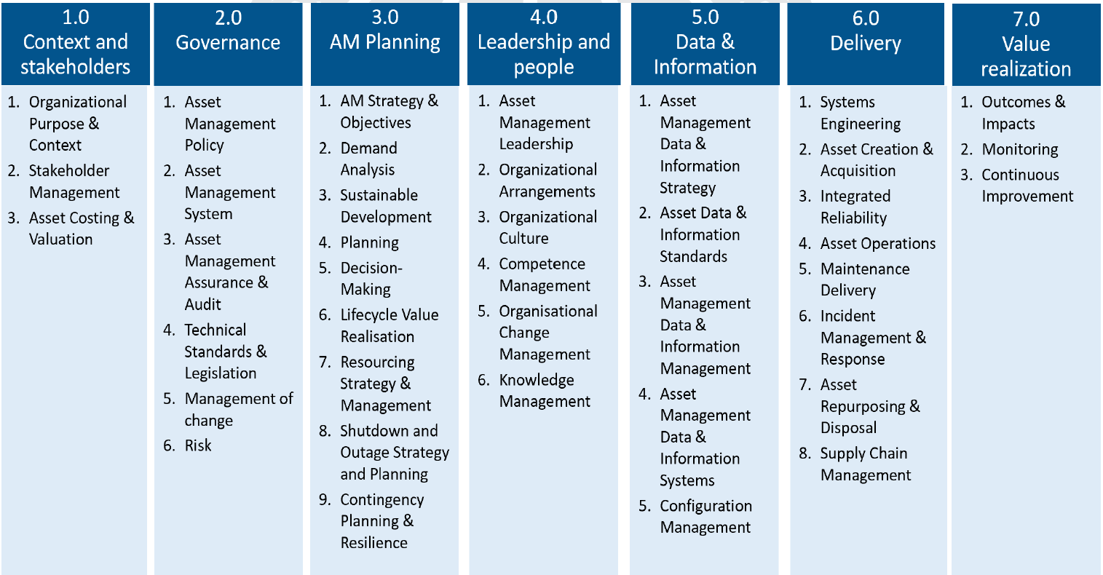
The Wide Asset Management View
Source: GFMAM Asset Management Landscape v3.0 (40 Subjects in 7 Subject Areas)

Slide 6
HxGN EAM vs Asset Management System
While HxGN EAM provides robust support for many ISO 55000 and GFMAM requirements, organizations should understand that implementing the software alone doesn't create a compliant asset management system. They need to:
Develop an overarching asset management strategy and policy
Establish appropriate organizational structures and processes
Create a supportive organizational culture
Define clear roles and responsibilities
Implement appropriate governance mechanisms
The software should be viewed as an enabling tool within a broader asset management framework, not as the framework itself. Organizations need to develop their asset management system holistically, using Hexagon EAM to support and enable their chosen approach.
Source: SCIO Asset Management with Claude 3.5 Sonnet (Pro) AI

Slide 7
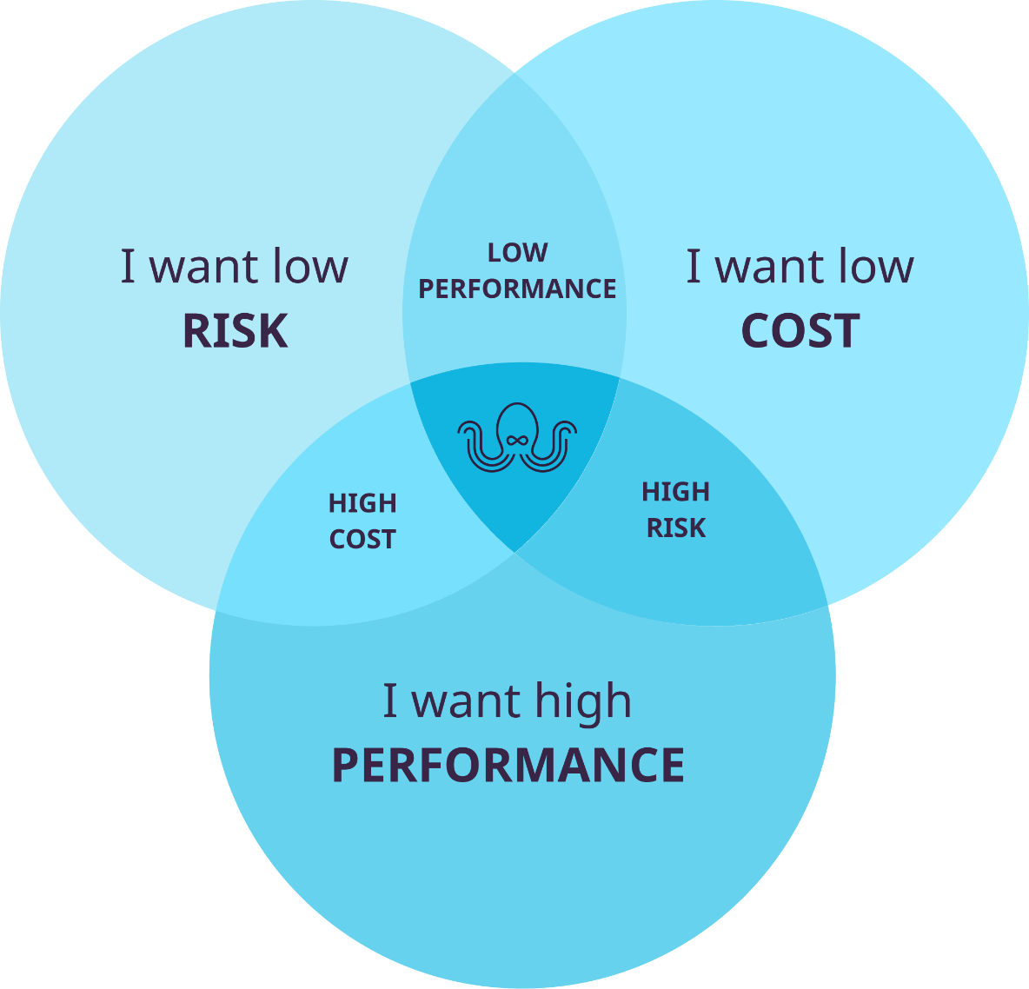
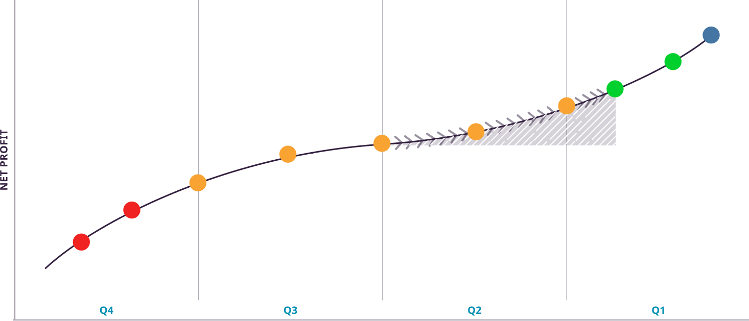
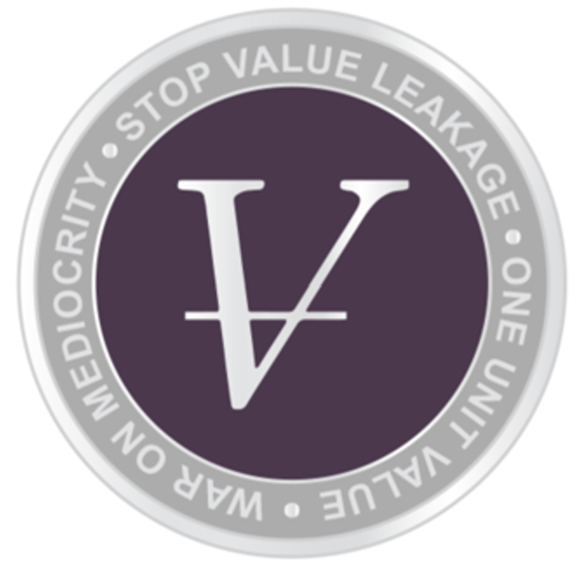
The Wicked Villain is Value Leakage
Value at Stake? Massive!
Increase production +6%
Reduce maintenance cost -45%
Non-financial performance improved
LEADERS’ JTBD: RUTHLESS REALLOCATION OF FINITE RESOURCES TO HIGHER-VALUE ACTIVITIES; MORE WITH LESS
Notes:
If this is the solution, what is the problem are we solving? Value leakage, which is defined as the value you could be delivering as business outcomes but are not, missed opportunity and fully controllable.
The curve you see here is what I call the “Beauty.” It comes from McKinsey & Co. but I’ve also seen it applied in operational performance benchmarking. Orient: Performance on y-axis, quartiles on x-axis. The curve is a power law that rises from left to right in a serpentine S-curve logit (logistic distribution) function as performance improves . Each tail rises more dramatically with a plateau in the middle. Plotted on the curve are data points signifying performers at each decile.
Poor performers in Q4 (red) will have unhappy stakeholders, it’s not a sustainable placement as organizations will either improve or be bought up or go out of business. On the other end, the top performers in Q1 (green) have happy stakeholders especially . But why is the curve rising? Isn’t there diminishing returns? No, for two reasons – these organizations already have improvement and innovation in their culture and the way they manage provides COMPOUNDING value returns. And these pacesetters (far right, blue) are raising the bar for everyone else.
That leaves the mushy middle, Q2 and Q3 where fully half of the organizations reside. This is what I call the mediocrity zone – not bad, but not great either. There’s a gravity well that sucks to the middle that is hard to escape. Organizations can continue to reside there if their stakeholders are happy enough, they might be modestly profitable. Shouldn’t stakeholders want more? Yes, they should if there’s net value at stake.
Notice the curve is rising the whole way – this means there’s a potential business case for improving the relative position. The difference between average and top quartile performance is massive (hatched zone)! It can be a challenge to enter the first quartile. There’s about 10% turnover every year. But the odyssey can reward those smart and courageous enough to try.
How do you get there? Well, you must optimize how you manage your assets. All asset owners owe their stakeholders high performance, low cost, at acceptable risk. Sure, these are trade-offs, but there is an optimal mix within the business context of each organization. Every organization has a mixed bag of quality practices. If you want to see it, there’s generally plenty of inefficiency and ineffectiveness in those practices. Good practice can get you to the middle, but you will stagnate. You need great practices to break free into first quartile.
It is the job-to-be-done of leaders to ruthlessly reallocate their vast and scarce resources to higher-value activities – create more value with fewer resources.
The value leakage problem is wicked because our operations are complex adaptive systems. It’s difficult for leaders to understand all the things that contribute to their business outcomes. Their system of management is perfectly designed to deliver the results their getting, (W. Edwards Deming). But they don’t have good visibility or feedback from the many things that contribute to those outcomes. Their management system is obscure. SCIO aims to change that

Slide 8
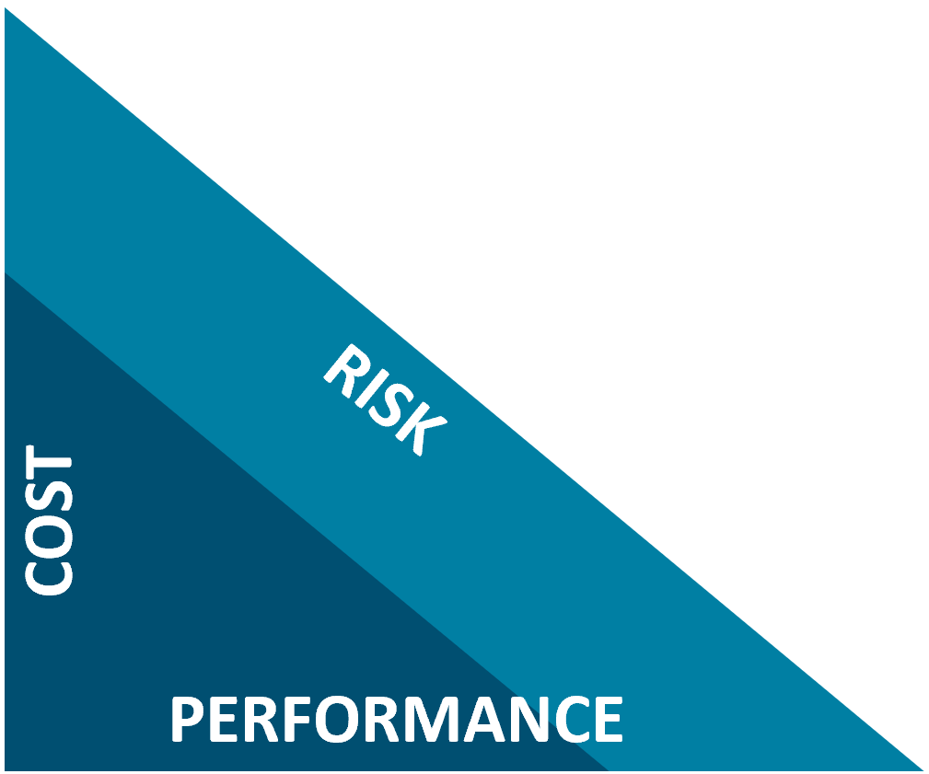

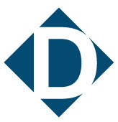
Value Chain Model
PEOPLE
PROCESS
ASSETS
THE CRUX
TECHNOLOGY
THE COALFACE
Σ
“The success of an organization is nothing but a sum of all of its decisions.”
Notes:
All organizations have people, process and technology, these are our resource inputs
The unique thing about asset intensive organizations is they have to apply those three thing through their assets to generate value
Value can be financial or non-financial and include production/service revenue, cost, customer service, safety, environment, sustainability, reputation
At the coal face (where value is won and lost) is where we manage asset cost, performance, and risk (something I call the magic CPR triangle)
But there’s one thing missing from this model – the choices on which activities we undertake with our
Most organizations have a mixed bag of quality activities in its practices, some good others less so
The key to success is to make choices allocating those vast and scarce resources to higher-value activities
Decisions are the crux. However, what decisions and how they are made are not visible
SCIO aims to change this – get more value with fewer resources to improve our productivity and raise our position on the Beauty curve
The success of an organization is nothing but a sum of all its decisions

Slide 9
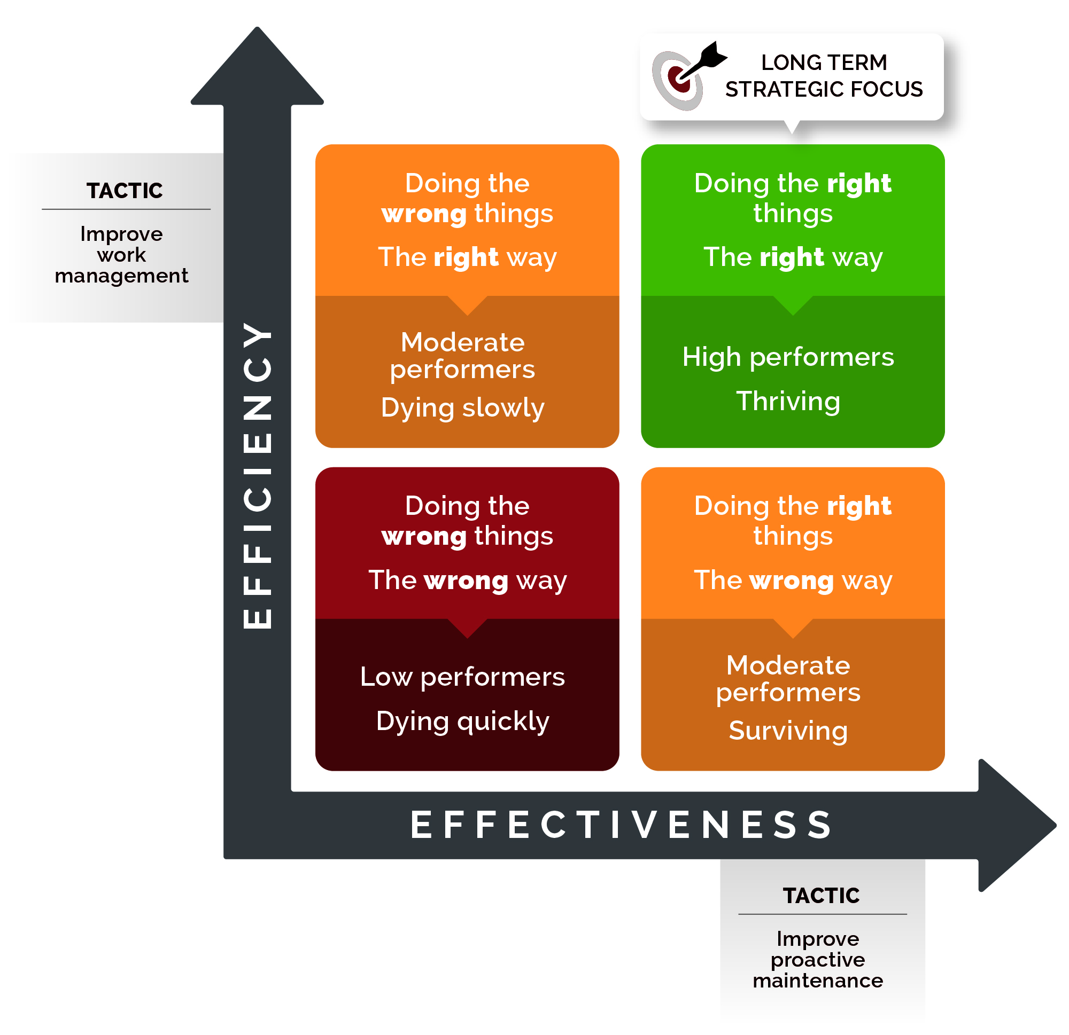
Effectiveness >>> Efficiency as a Value Lever
Source: Conscious Asset

Slide 10
Bridge AM Gap: Create Common Ground
Operational Leadership Management Perspective (P&L Site or Business Unit Levels)
Expectations
Collaborative Island of Resolution (System Level)
Top-Down Meets Bottom-Up
System 1 AMP
System 2 AMP
System 3 AMP
System 4 AMP
System 5 AMP
System 6 AMP
System 7 AMP
System 8 AMP
System 9 AMP
System 10 AMP
System N AMP
…
Capabilities
Practitioner Equipment Management Perspective (Asset Level)
N
…

Slide 11
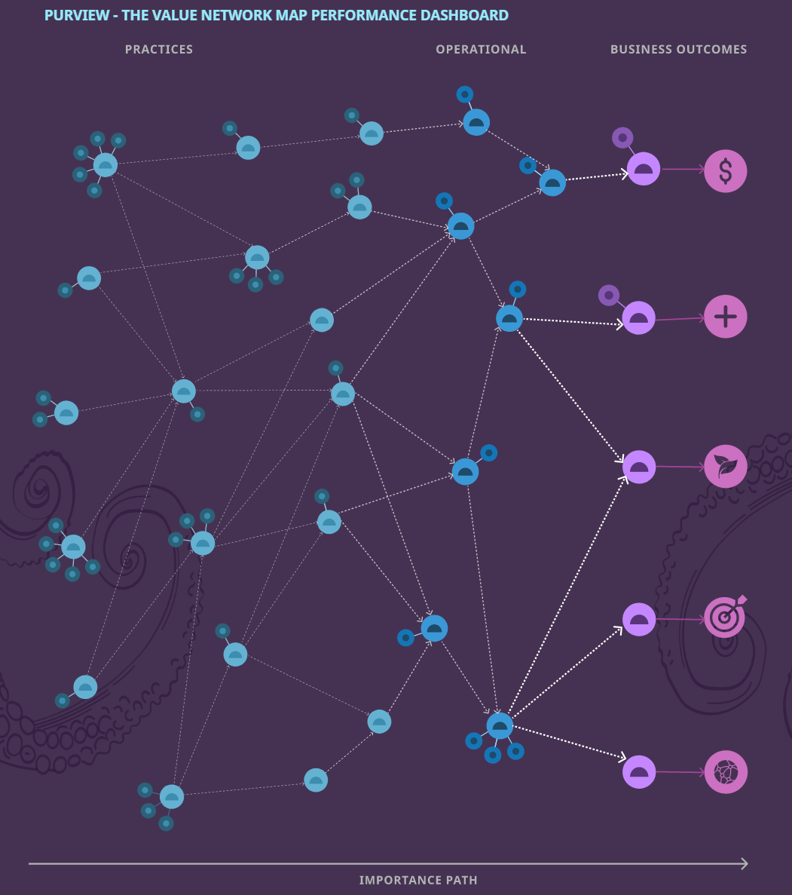
Operational Asset Management System
Operations Strategy Deployment
Operational Risk Management
Asset Investment Planning
Asset Performance Management
SEE
THINK
Asset Condition Management
Value Network Map (Feedback)
DECIDE
Are we doing what we said?
Is it giving us the desired results?
Decision Intelligence Framework
Performance Dashboard
Value Network Map
ACT
Governance

Slide 12

Operations Asset Management Sensemaking Machine
Value Delivery (Value Leakage)
EOMS Model-Based Complex System Application
+ Codify Deep Asset Management Domain Elicited Expert Knowledge
+ Knowledge Graph Semantic Stochastic Web of Meaning
+ Agentic Knowledge Augmented Generation AI
= Quantitative Feedback to Foresight for Leadership Agency
EOMS Application
Assets
Decisions
(the crux)
People
OAM Sensemaking Machine
Technology
Metrics
Plans
Practices
Governance
Notes:
Our Operations are complex adaptive systems. Embrace the complexity.
Sensemaking machine. Knowledge flywheel. Source of feedforward and feedback.:
Adaptive complex systems; embrace the complexity
Dynamic cause/effect & relationship strength on value network map
Bootstrap with deep AM domain expertise
Enhance, predict, advise, negotiate, recurse with intelligent agentic LLM AI
Stochastic Semantic Ontology:
Subject + Activity + Object
Hierarchical taxonomies

Slide 13
SCIO’s OAM Solution: Sin Qua Non
A novel new keystone missing in today’s solution architectures, tech solutions
The business case is eliminating existing value leakage already in the business
Leaders grossly underserved, need their own toolset to better manage, lead, govern
How AM is offered or delivered not seen as the solution to Leaders’ problems
D&A led DX have poor ROI – insight is unfinished business, un-strand that ROI
The objective isn’t all the perfect data; allocating resources to higher-value activities is
Decisions are the crux, create value in the Knowledge-Decisions arena from DIKDAR
Bridges gaps objectives in leadership-practitioners, strategy-tactics, cause-effect
Complements existing EAM, APM, etc. solutions. It’s an “&” proposition
THE TIME IS RIGHT: GIVE LEADERS THE TOOLSET THEY DESERVE
Notes:
Sin Qua Non (sin-kwah-NON) – Latin “without which, nothing”

Slide 15
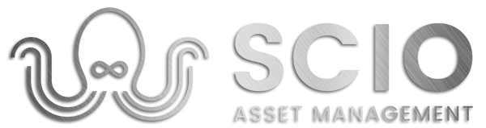
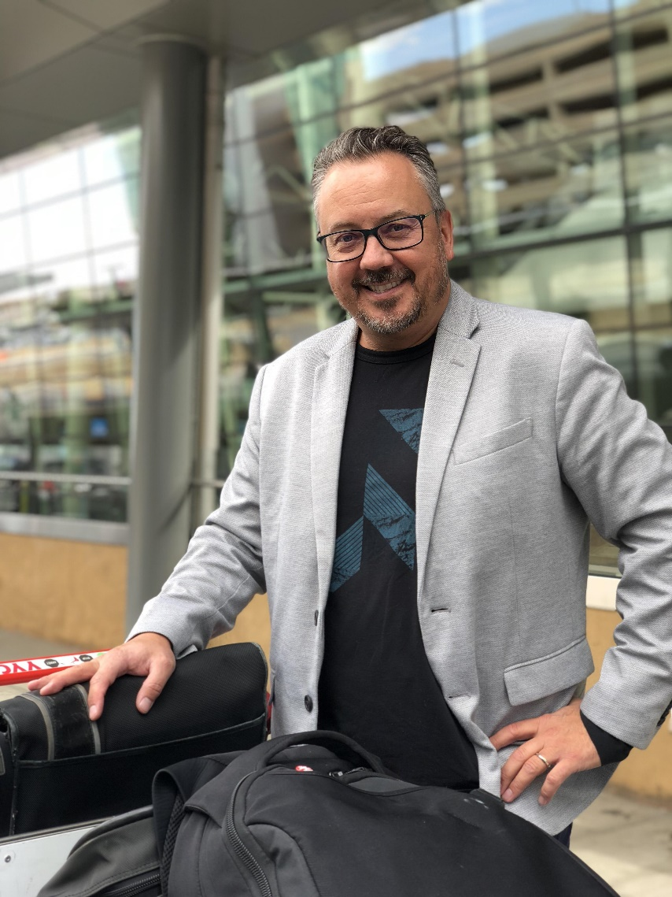
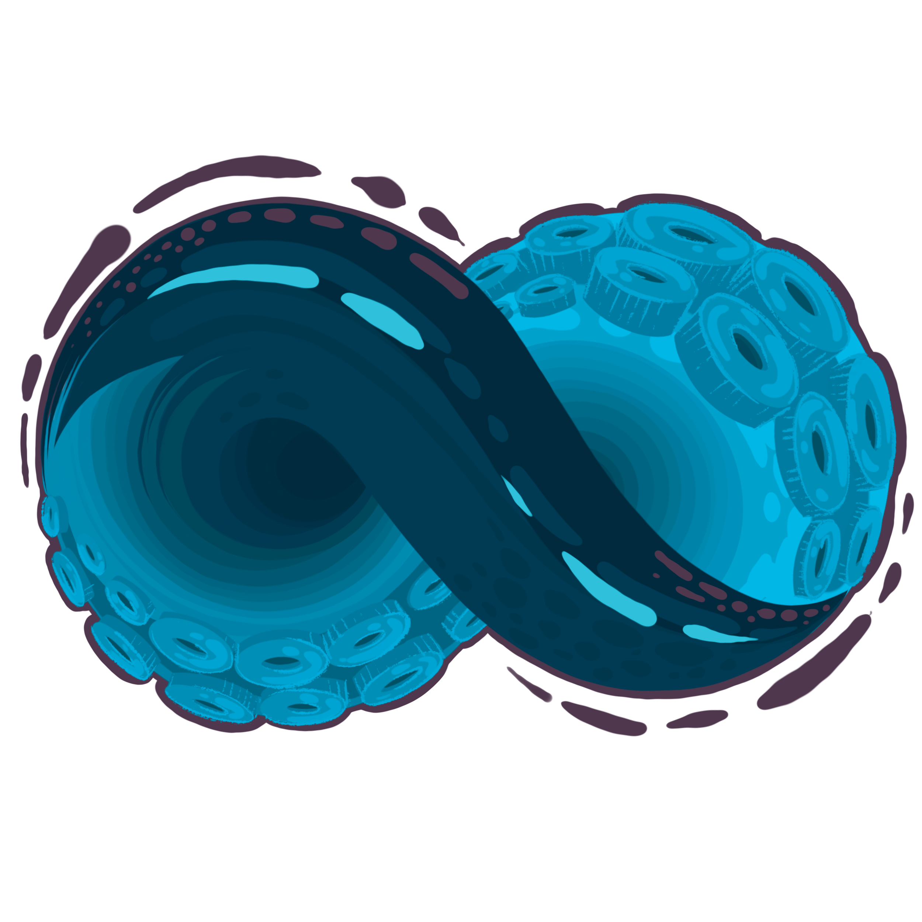
Meet the Founder – Paul Daoust
Knowledge & Decision Enthusiast, Innovator Agitator & Changemaker, Operational Excellence & Asset Management Leader
Over 25 years of experience in engineering, maintenance & reliability, asset and operations management in utility, energy, mining, and cleantech
Calgary Chapter President at PEMAC Asset Management Association of Canada
Calgary Chapter Director at Society of Decision Professionals (SDP)
Founder, Managing Director
Scio Asset Management Inc.
www.scioam.com
paul@scioam.com
Founder, Grand Poobah
The Asseteers Community of Learning & Sharing
www.theasseteers.org
www.linktr.ee/pdaouster

Slide 16
What Do You Get with OAM?
Benefits Delivered
Better, more consistent, durable outcomes
Increased visibility, transparency, and accountability
Feedback & foresight empowering leaders agency to manage, lead, govern
Increased organizational capabilities through competencies
Quality decisions allocating finite resources to higher-value activities
Optimal assets: lower cost, higher performance at acceptable risk
OAM is an “&” thing: Sine qua non
Notes:
& thing: missing link, keystone solution, bridge/connector between leadership and practitioners, lynchpin complementing what’s already there (EAM), catalyst to want to attack value leakage

Slide 17
Who is OAM For?
Buyers:
  COO for operations agency
  CFO as finance partner enabling operational discipline
  CTO as IT partner offering operation leadership toolset
Users:
  Operations line leadership
  Asset Management professionals
  Operations support, technical centres of excellence
Sales Channels:
  Direct, asset operators
  Systems integrators
  Stakeholders/owners
  Management consultants
Leap Forward Now!
Notes:
Sin Qua Non (sin-kwah-NON) – Latin “without which, nothing”

Slide 18
Setting Conditions for OAM Success
Relentless pursuit of compounding value creation
Play the infinite game, act now, bring home the mission
Curiosity to question and solve more problems
Unique (20%); Not Special (80%)
Bridge leadership & practitioner objectives, strategy & tactics
Recast incentives, challenge constraints, innovate change
Coalface where value is won or lost
Develop asset planning super forecasters
Do not shunt your own organization
Embrace complexity; lean into uncertainty
Good decisions, bad outcomes is acceptable
Okay that happened, now where do we go from here?
OAM is an “&” thing: Sine qua non
Notes:
& thing: missing link, keystone solution, bridge/connector between leadership and practitioners, lynchpin complementing what’s already there (EAM), catalyst to want to attack value leakage

