Slide 1

Avoid Asset Tagging Pitfalls Considerations to Develop the Optimal
Asset Management Program
Lou Peeples
CMMS Consultant

Slide 2
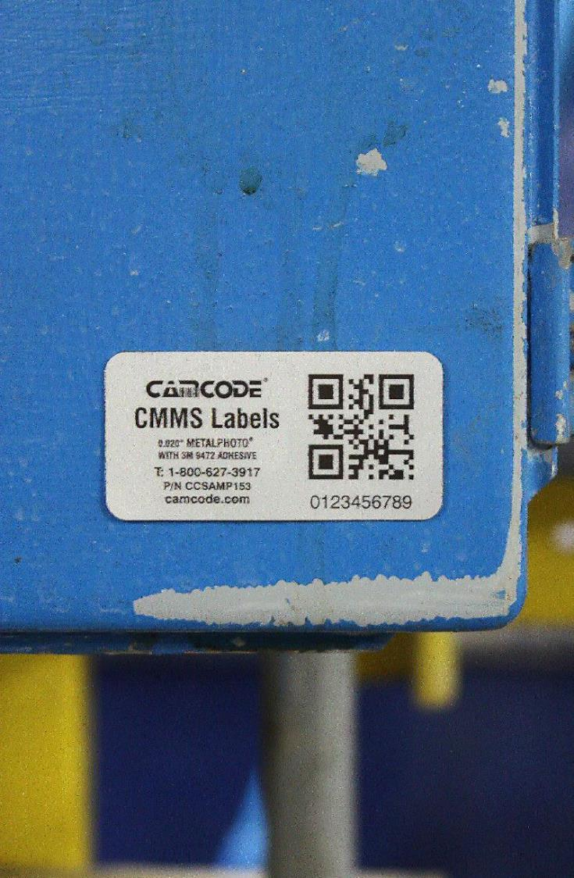
Agenda
Where are we now?
Why use bar code labels?
How to plan a labeling project
Who uses labels?
How to choose the right label options
Label installation & tagging consistency
What goes on the labels?
Innovative QR code uses
Sequential vs asset specific data
End user examples
Conclusions

Slide 3

Where Are We Today?

Slide 4

State of Asset Management
Most companies have poor data quality and poor visibility of their asset database
  Multiple legacy database systems
  multiple software reporting different information
  Poor data acquisition
  inability to find what you are looking for
  Data entry error
  eliminate the issue of human error
  Manual systems: no use of automated collection
  Asset management is not considered core business
  Limited or no data governance policies

Slide 5
Why Use Bar Codes?

Slide 6
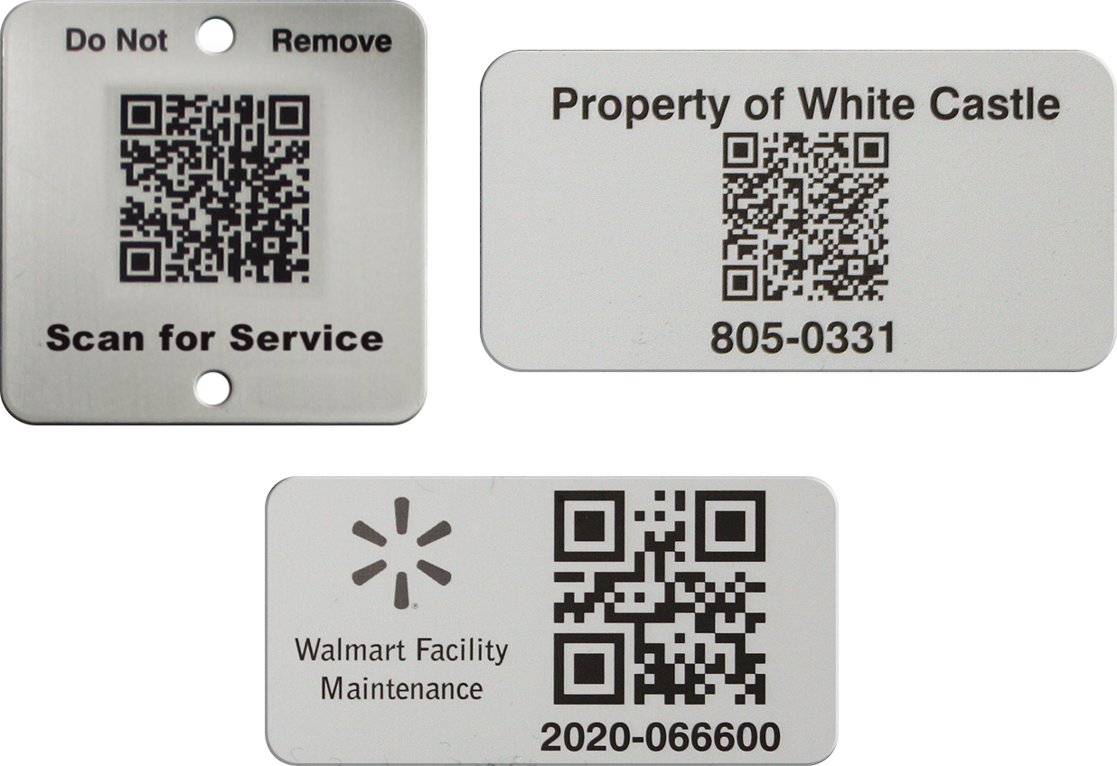
QR Code Label Benefits
Understanding a QR Code Label’s Purpose
Bar code labels are license plates to access that assets record in your database, quickly and accurately

Slide 7

Data Control
  You can manage the information more effectively with an access point to your database
  Utilize all of the information available to manage the equipment
  Have a visual roadmap of what your inventory looks like
  Ability to attach specific documents to an asset
  Maintenance Records

Slide 8


Salt River Project Actual Data
  Service requests and work orders are written on the correct asset 100% of the time
  Average time to write an SR before Camcode asset tags and management system:
  7-30 minutes
  Average time to write an SR after installing asset tags and management system: 30 seconds
  Techs can provide real time updates on services provided
  Hydro SR time reduction is 290 manhours for 12 months
  Generation SR time reduction is 4813 manhours for 12 months

Slide 9
How To Plan & Execute A Labeling Initiative For An Asset Management Program Implementation?

Slide 10
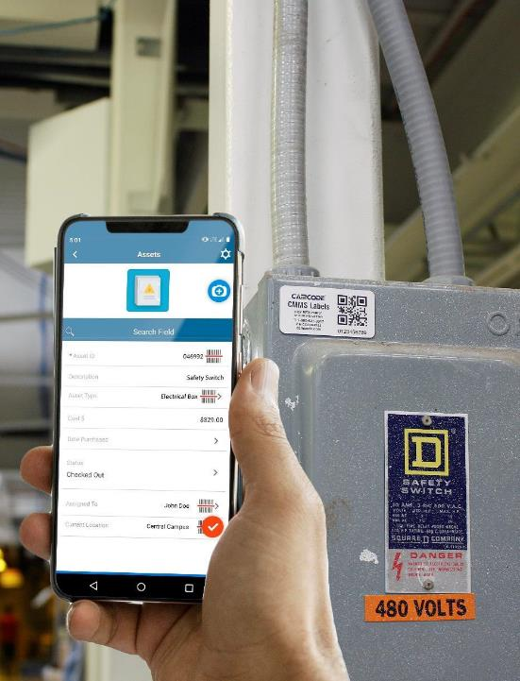
Who Uses Bar Code Labels?
  Anyone who needs to create or satisfy work orders or inspections will potentially utilize the bar code, including:
  Facility managers
  Maintenance managers and staff
  Internal technical staff
  Vendors

Slide 11
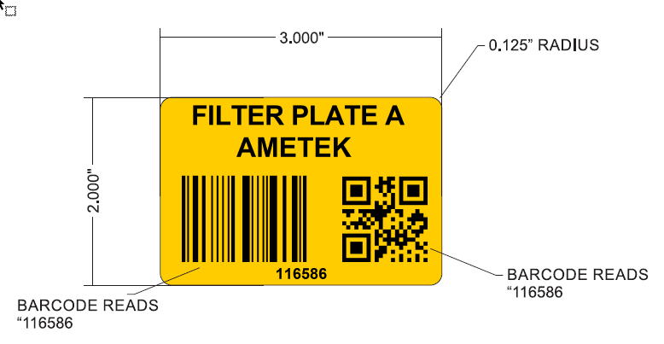
Top 5 Label Considerations
What surface(s) are the labels going to be attached to?
What’s the best label material?
How will the label be attached?
Size of the label?
How many assets will be labeled and tracked?

Slide 12
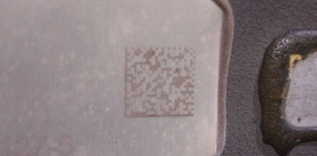
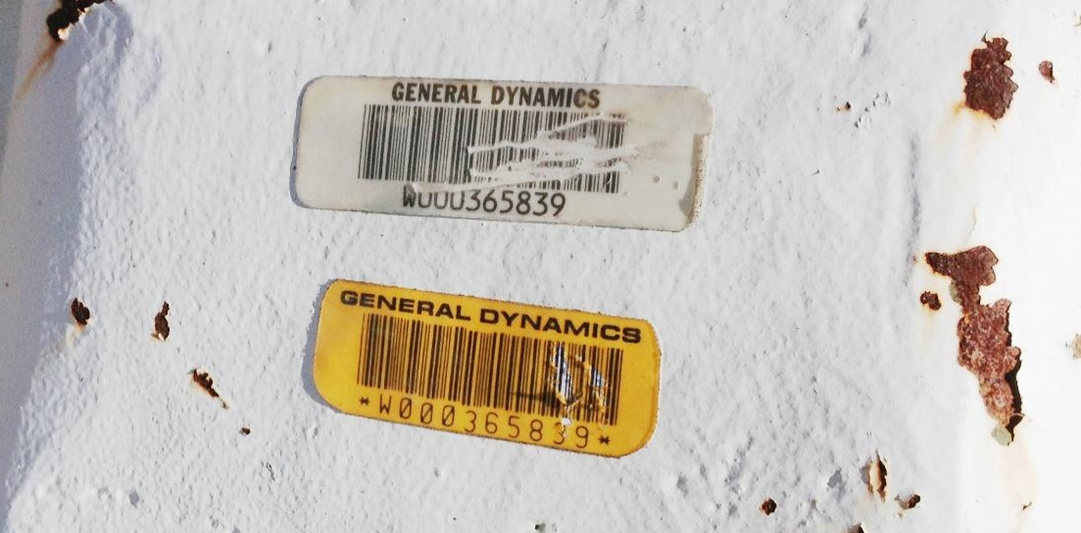

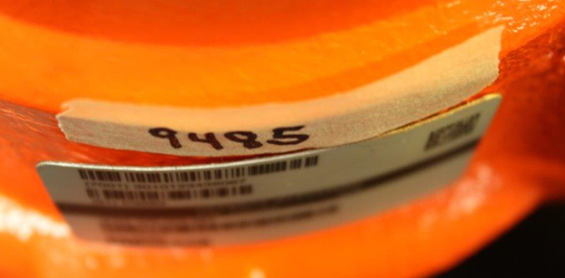
Label Material & Attachment are CRITICAL

Slide 13
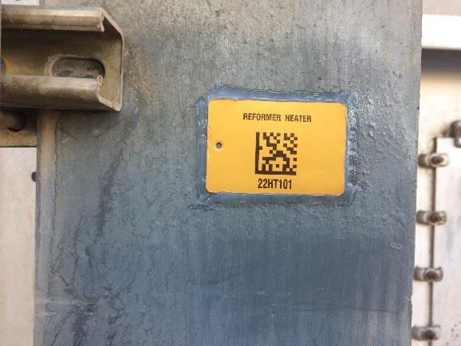
1. Surfaces to be Labeled
  This answer helps determine your label material and attachment
  Curved or irregular surfaces require a flexible label material
  Harsh or high contact environments may require a thicker metal label to guarantee readability
  High energy and low energy surfaces require different adhesives
  Porous or coated surfaces such as Teflon or CARC require special adhesives
  Surface prep is critical

Slide 14
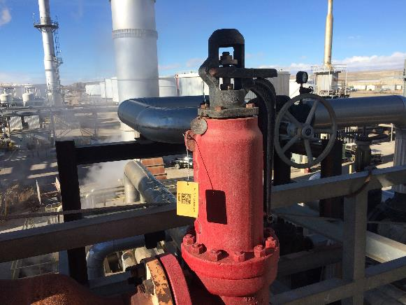
2. Label Material
  First, look at the environment
  Indoor vs outdoor
  UV exposure
  Weather exposure - Temps
  Abrasion
  Harsh chemicals
  Corrosion

Slide 15
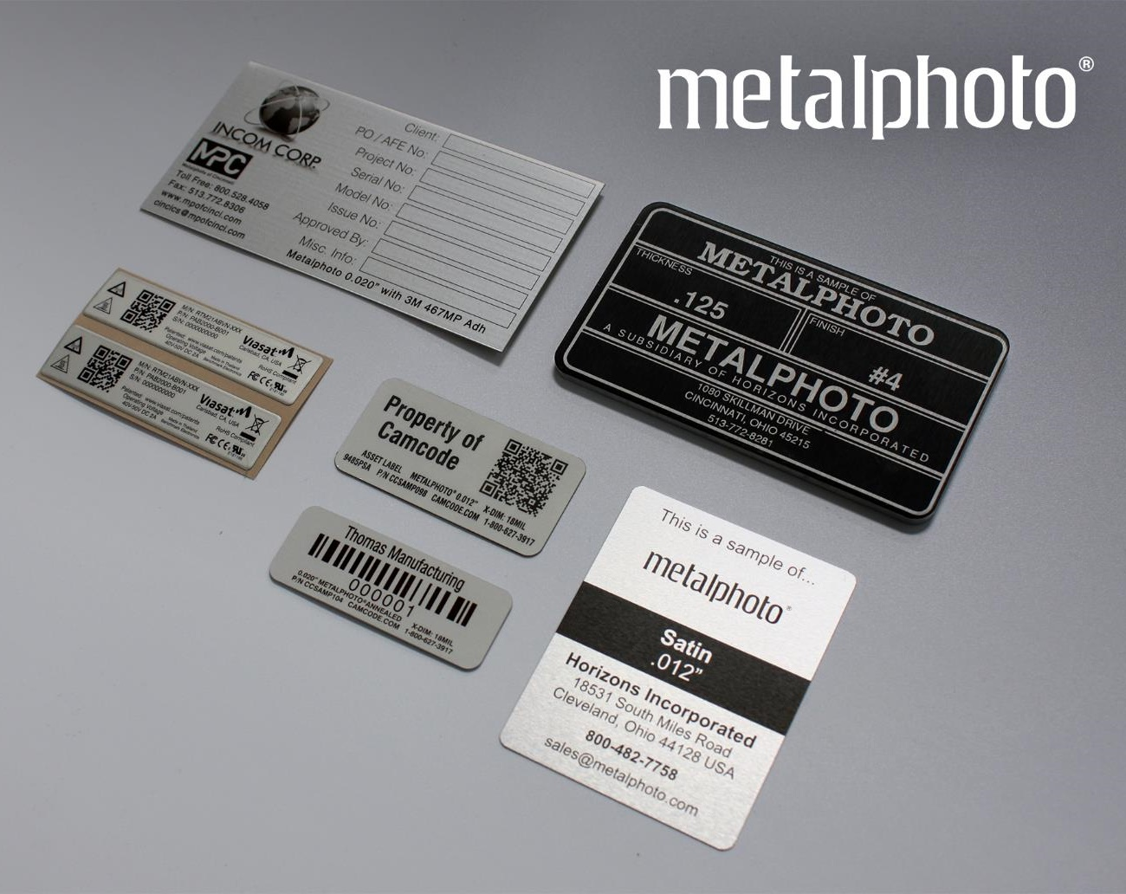
Label Materials
Polyesters
Metalphoto Photosensitive Anodized Aluminum
  Lasts 30+ years Imaged using a photosensitive process and features a sub-surface image that offers superior resistance to:
  UV/weather damage/Chemical exposure/Abrasion/Extreme heat or cold
Stainless Steel

Slide 16
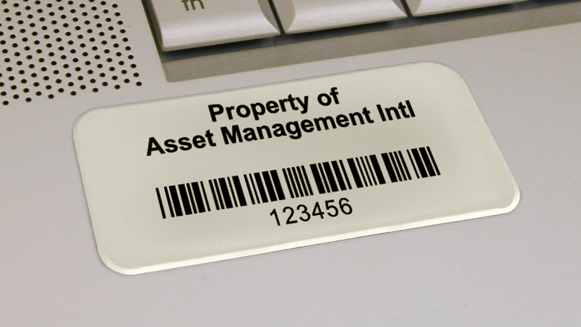
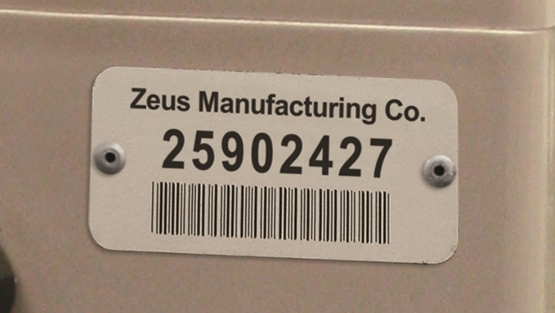
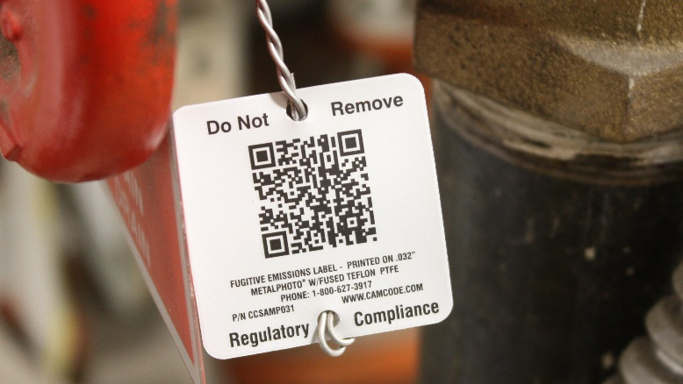
3. The Right Attachment Method Is Critical
  Every environment is different, even in the same project or application
  Different methods of attachment:
    Adhesive
    Depends on surface & environment
    Mechanical Attachment
    Labor intensive to install
    Hanging Tag
    Good for limited label space, requires tie off point
  Most adhesives have temperature limits
  ranging from -40° to 400°

Slide 17
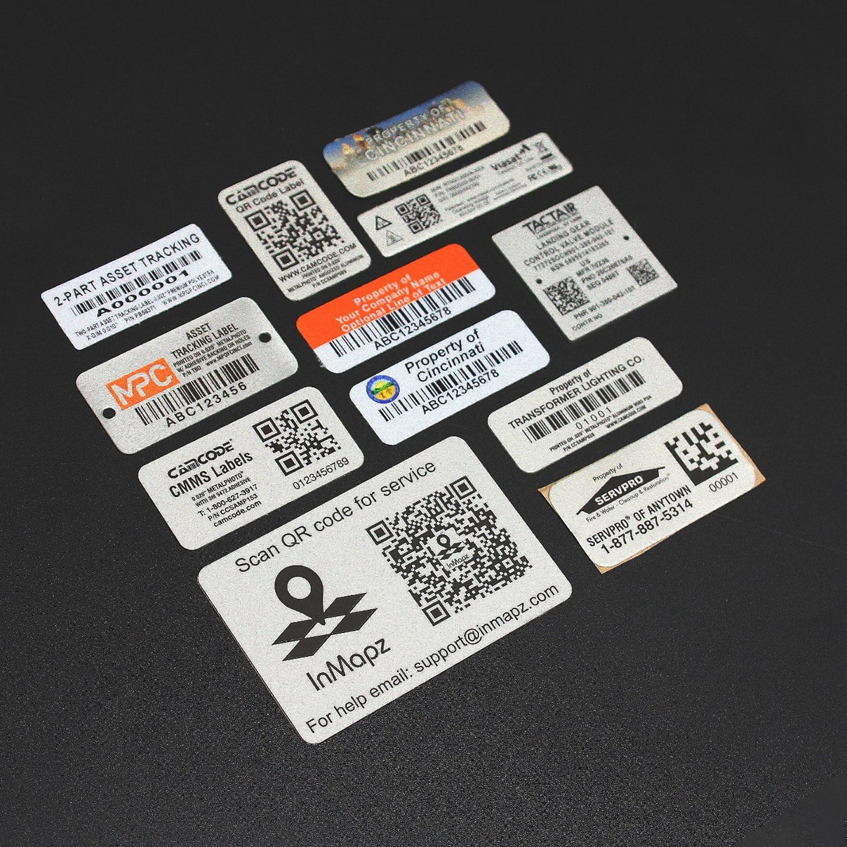
4. Size of Label
  What is the right label size?
  What information must be on the label?
    QR code, Code 39 or Code 128?
    Human readable information?
    P&ID location?
    Company contact info?
  Room on the asset and how visible?
  Commonize on a single size

Slide 18

5. How Many Assets And Which Ones?
  What is an asset?
  Categorized by dollar amount
  Importance of being tracked
  Anything that is critical to how your company functions
  Why do we want to track these assets?
  Need quick access to service records
  Planning preventative maintenance
  Is this in our inventory or not?
  Where is the asset located?

Slide 19
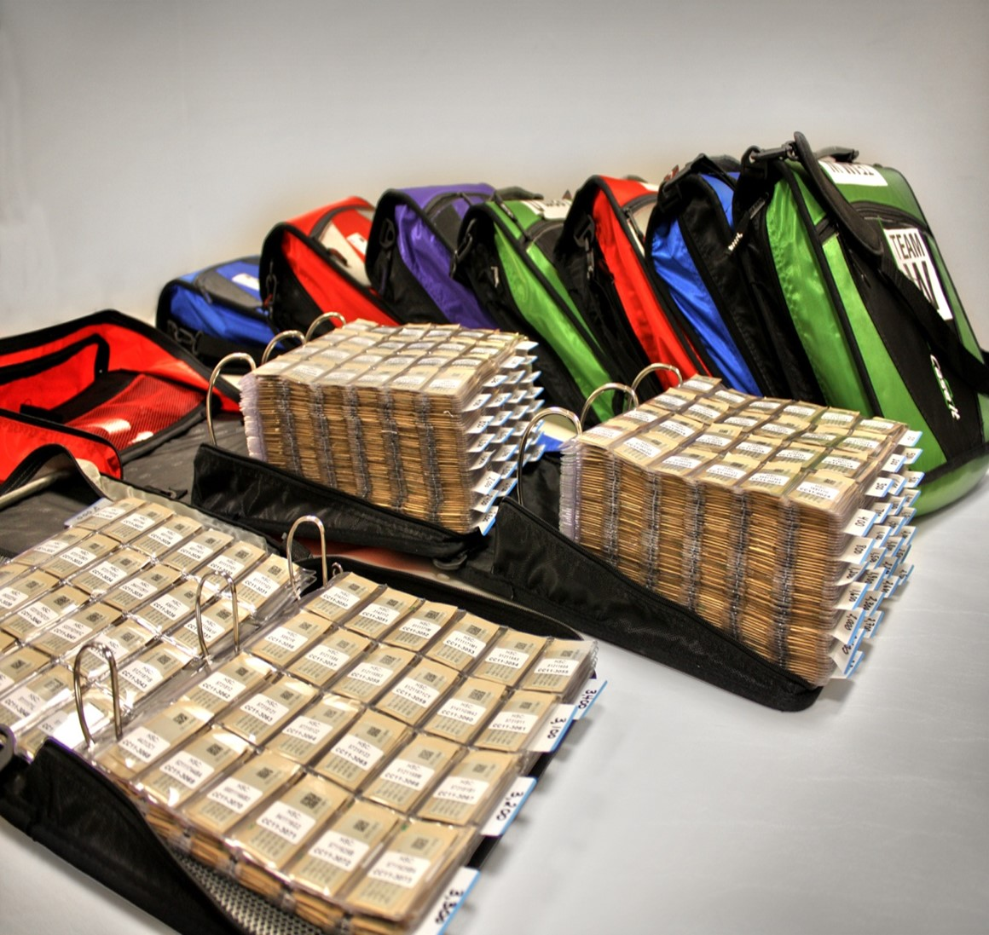
Label Content, Kitting and Installation
  Bar code manufacturing
  Sequential numbers vs. asset specific tags will help dictate how the labels are packaged to you
  Kitting for installation vs. sending bags of tags
  Bar code installation
  What is the optimal plan for the most
  cost-efficient installation?
  Project Timeline can be weather
  dependent (Adhesive 50F)

Slide 20
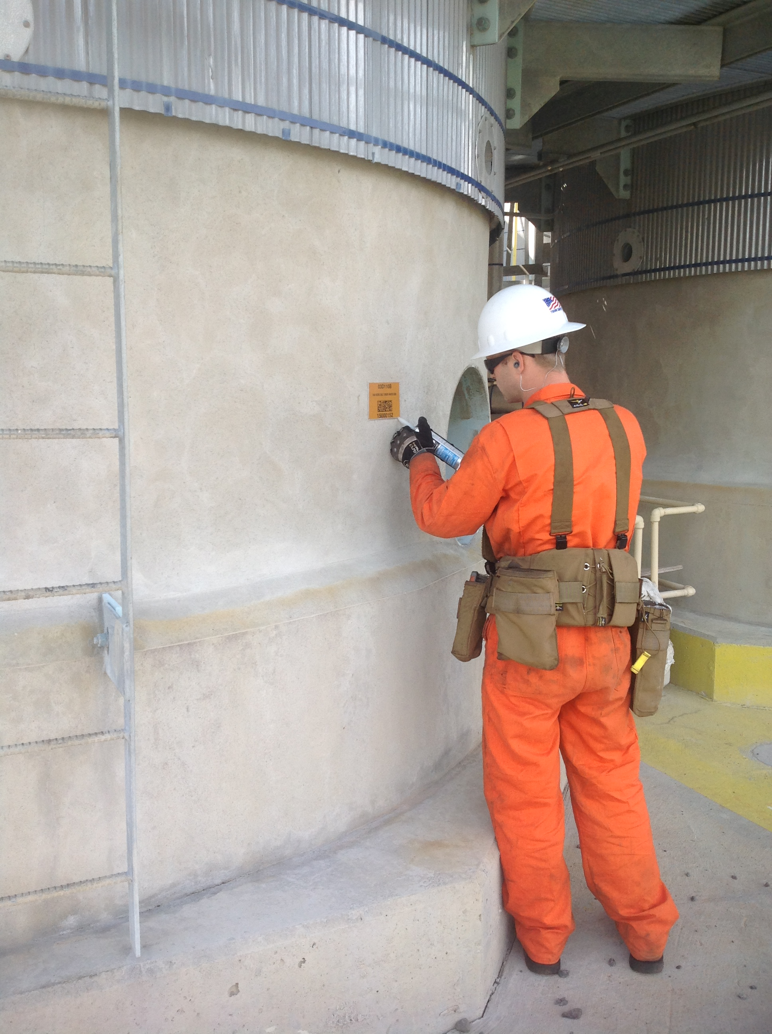
What Is The Optimal Plan For The Most Cost-Efficient Installation?
  Facility locations?
  Number of assets per location
  Resource considerations vs. time/cost
  Outsource labor or use internal?

Slide 21

Label Location is Also Important
  Tagging improperly results in lost labels/tags, lost time, lost data, lost revenue
  Pro Tip: Develop a playbook with software consultants and your labelling provider to ensure your org has a consistent policy across all locations
  With so many assets in its database, a Playbook was necessary for staff (from engineering to maintenance) to understand what the asset tag looks like, where the
  tag is applied to tracked assets and
  how to apply a tag in the event
  it is required

Slide 22
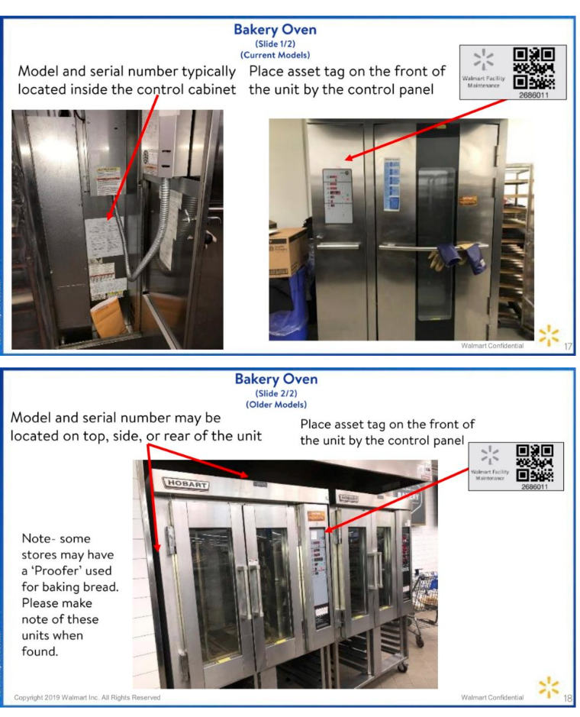
Ensure Tagging Consistency
  Permanence – Get It Right The First Time
  Tagging improperly will result in lost tags, thus lost data
  Time is the greatest cost, not tags
  Incomplete or incorrect data capture
  Commonality
  Corporate-wide policy allows facilities to work from a set of common rules
  Lowers costs so each plant is not reinventing the wheel
  Lowers maintenance costs as every engineer and maintenance staff understands what tag, how to attach it, where it is etc.

Slide 23
What Should Be On
The Labels?

Slide 24
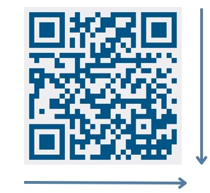
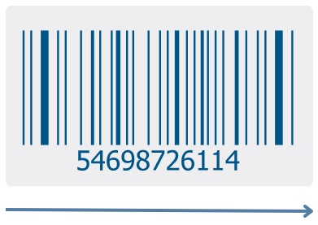
QR Code vs. Linear Barcode
  QR Codes
  Can encode URLs as well as strings of numbers and letters
  Can sustain damage to 30% of the symbol code and still scan
  Smaller size allows for smaller labels, more label data
  Today, 100% of our customers use QR codes
  Barcodes
  Barcode width increases as you add characters, increasing costs
  Any damage to or marring of code can ruin its ability to be scanned
  Unable to link to URLs and online information

Slide 25
Sequential Data
Asset Specific Data
  Pre assigned serial numbers prior to tag manufacturing
  Must be 100% confident in your data
  Can add unique descriptions
  Higer installation costs since you match the label to the asset
  Packaging/kitting for easier installation
  A sequential range provides a license plate method to your assets
  Starting a sequence at a number like 0001, provides more flexibility and allows more tags to be ordered
  More tags ordered = lower per piece price
  Lowers installation costs by adding a label when a record is created
  Easier to tag assets that are changed
  or added

Slide 26
End User Examples

Slide 27

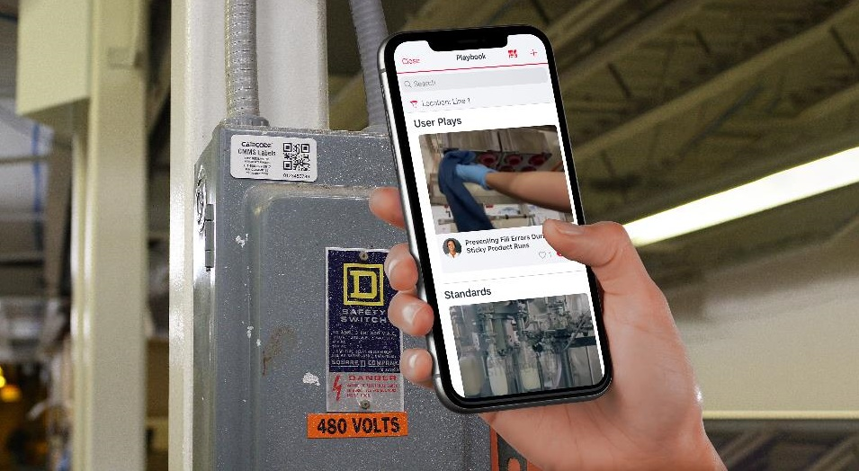
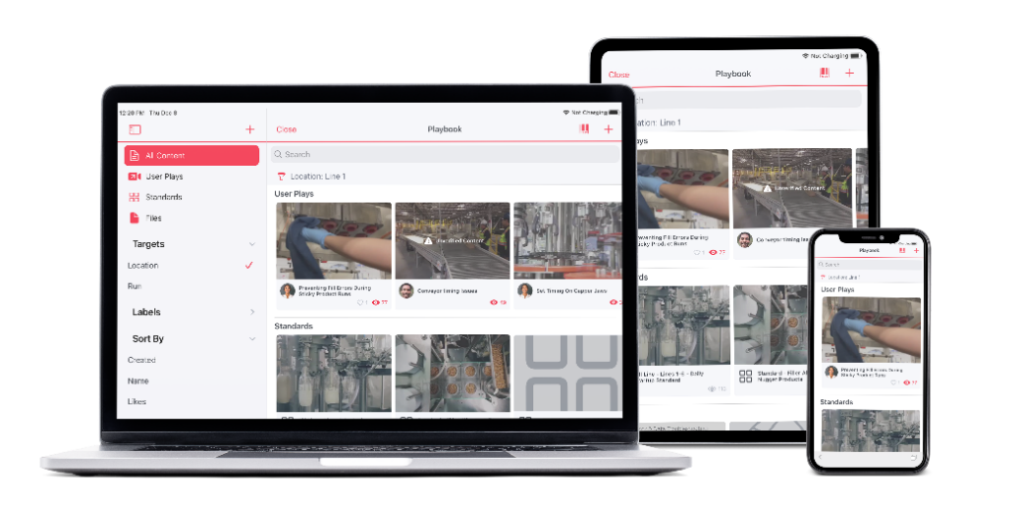
  Post uses asset labels featuring a QR code that links to instructional videos on how to operate and maintain that particular piece of labelled equipment
  This provides several business benefits:
  Allows operators and maintenance workers to quickly and easily access vital information
  Ensures that the information is correct for that specific machine
  Ensures the information is up-to-date
  All this saves labor hours and dollars

Slide 28


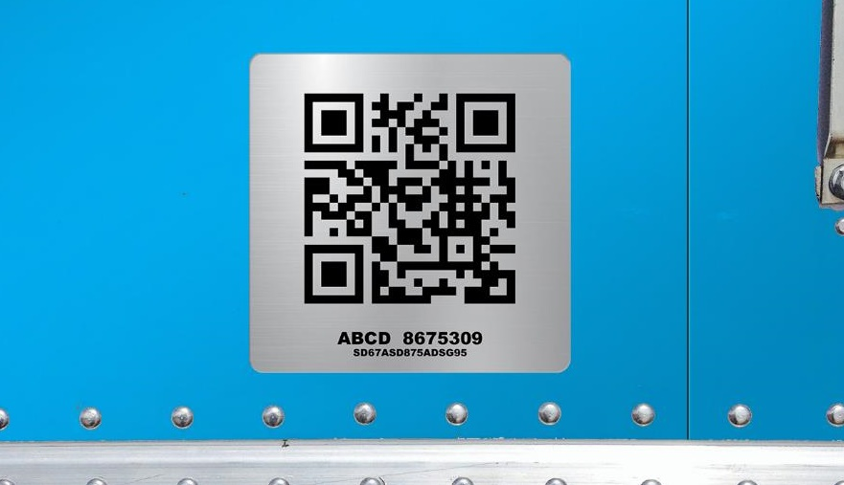
  Amazon uses QR code tags on the outside of their truck
  fleet to track location and information on each truck
  Each QR code contains two pieces of data:
    the truck’s Amazon assigned unit number
    the truck’s VIN number and manufacturer information
  For regulatory, compliance or maintenance service requests, the code can provide both Amazon and manufacturer information quickly and accurately
  Upon entering and leaving each distribution center, the QR code is scanned, recording time entering, leaving, and at each center
  This provides accurate and easily accessible information needed to make critical business decisions on fleet management

Slide 29
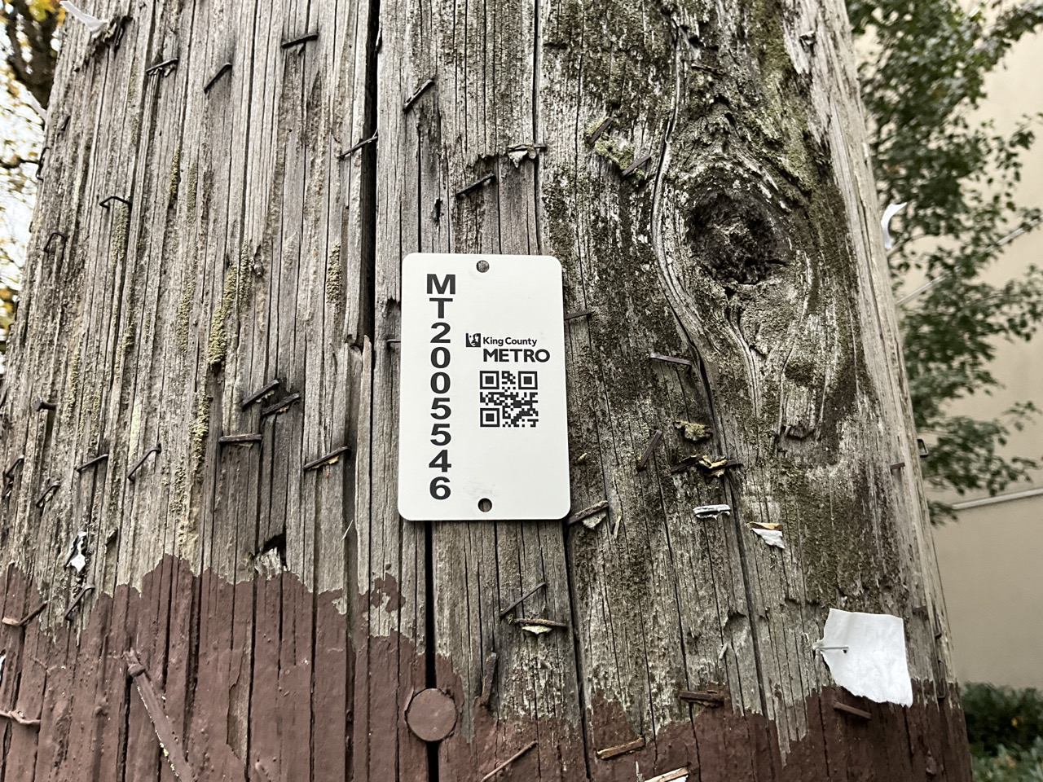


Slide 30

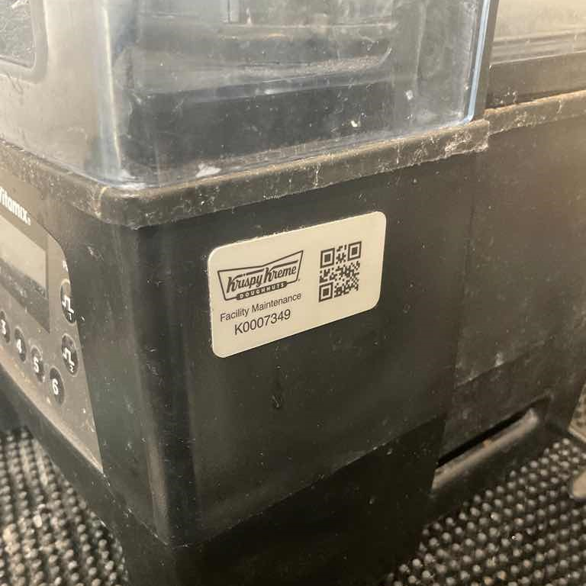
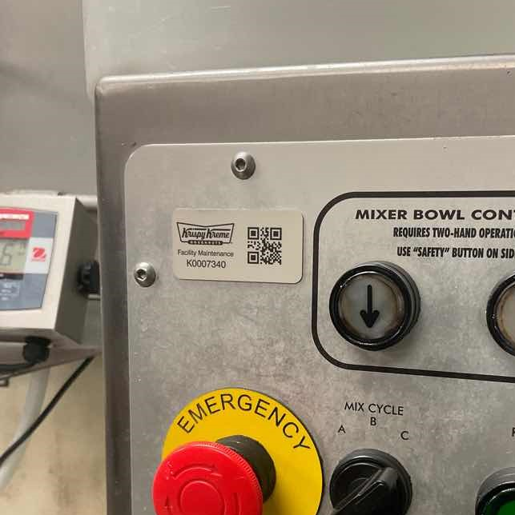

Slide 31
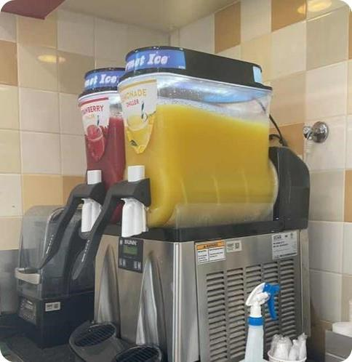
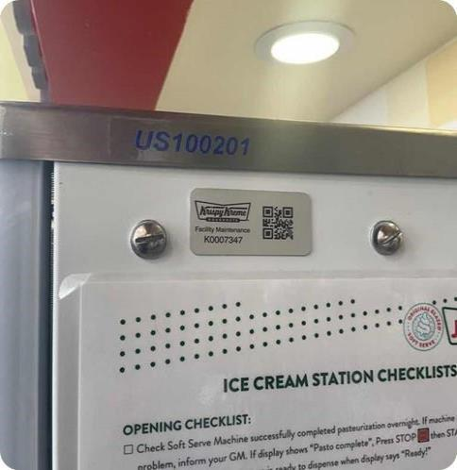

Slide 32
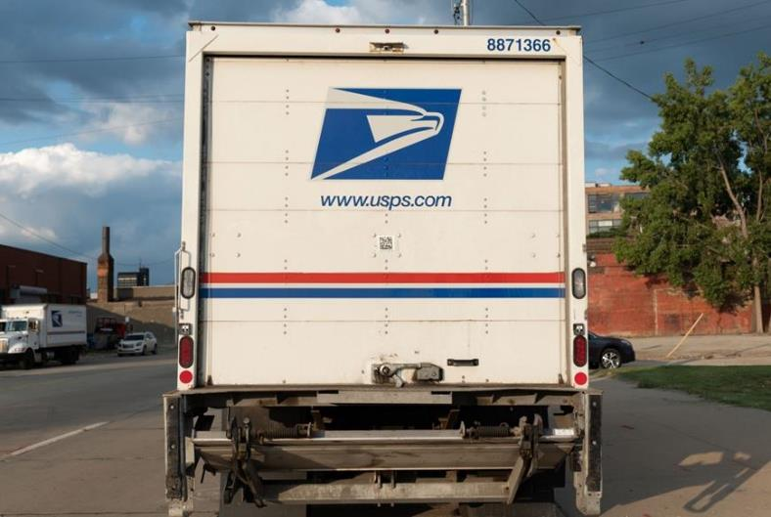


Slide 33
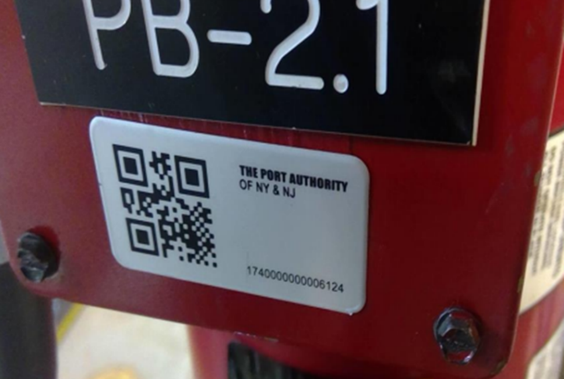



Slide 34
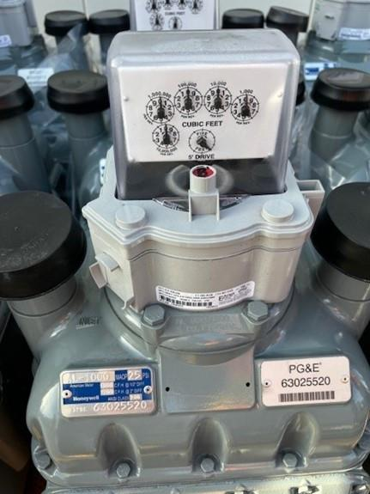


Slide 35
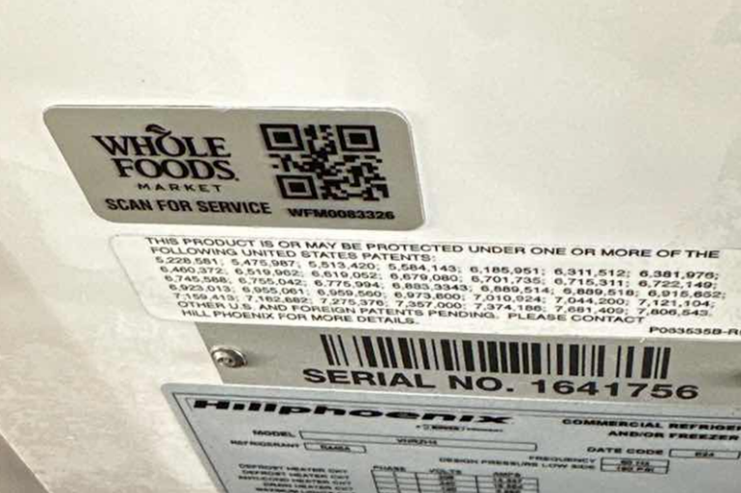


Slide 36
Conclusions
100% accurate database
        Categorized by dollar amount
        Importance of being tracked
Fast access to find assets with bar code tag
        Average time to find the asset information in Max and WO is 9 min
More accurate maintenance tracking
        Start/stop times
        Faster reaction times
Opportunity to clean-up database
        Re-associate physical assets
Tags not lasting, reprints etc.
        20+ years
        Using the correct tag on the correct asset

Slide 37

Thank You
Any Questions?
Lou Peeples
CMMS Market Leader
Camcode
313-506-0481
Lpeeples@camcode.com
SCAN FOR FREE LABEL SAMPLES!

