Slide 1
Document Management in HxGN EAM
James Sanwald
Pre-Sales
Hexagon

Slide 2
Agenda
SECTION 1
Existing Capability
SECTION 2
Recent Enhancements
SECTION 3
Setup Options

Slide 3
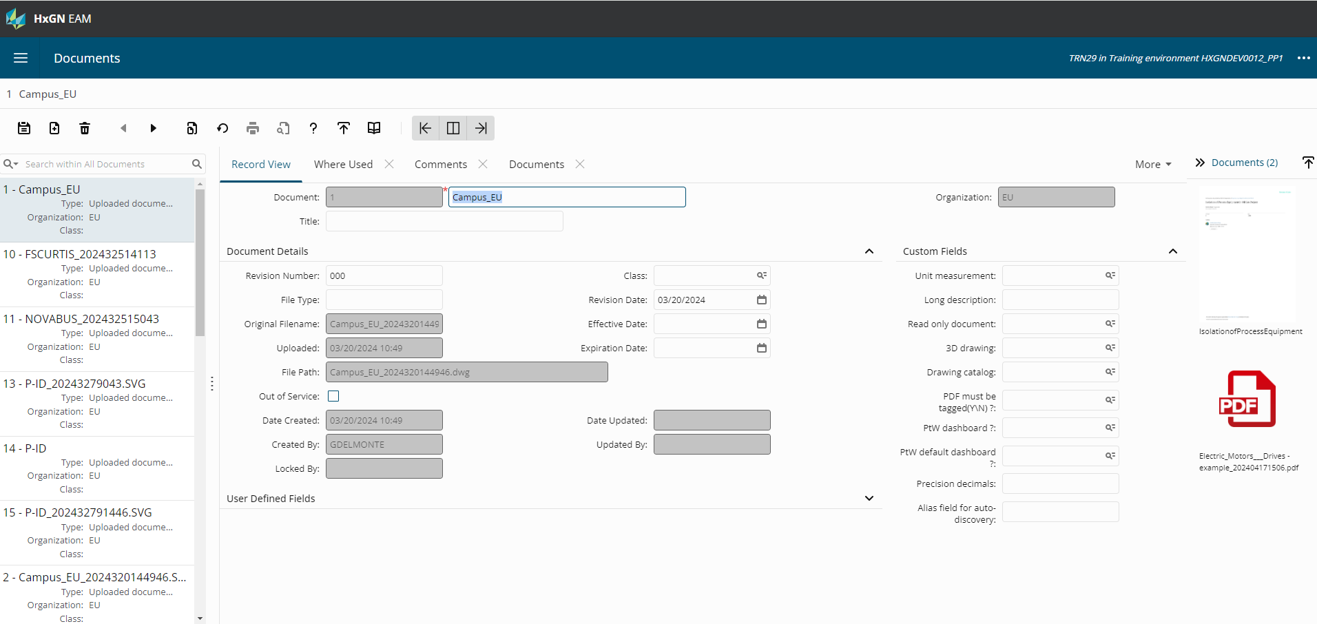

Document Management
Document Viewing
Document Create / Upload
Versioning / Upload History
Locking / Unlocking
Document API

Slide 4
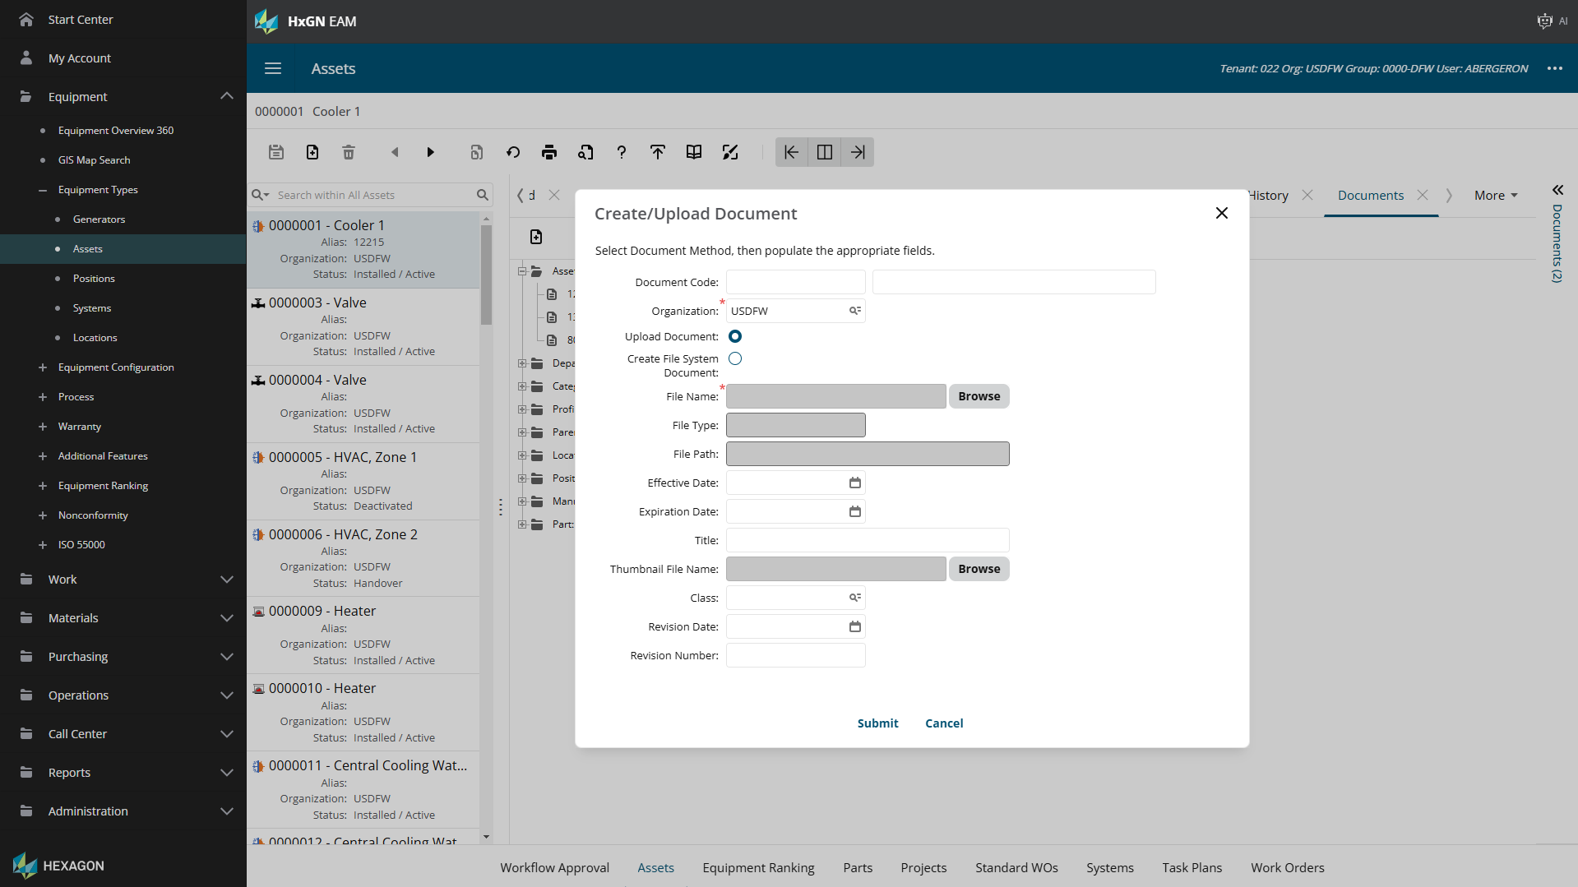
Document Management
Document Viewing
Document Create / Upload
Versioning / Upload History
Locking / Unlocking
Document API

Slide 5
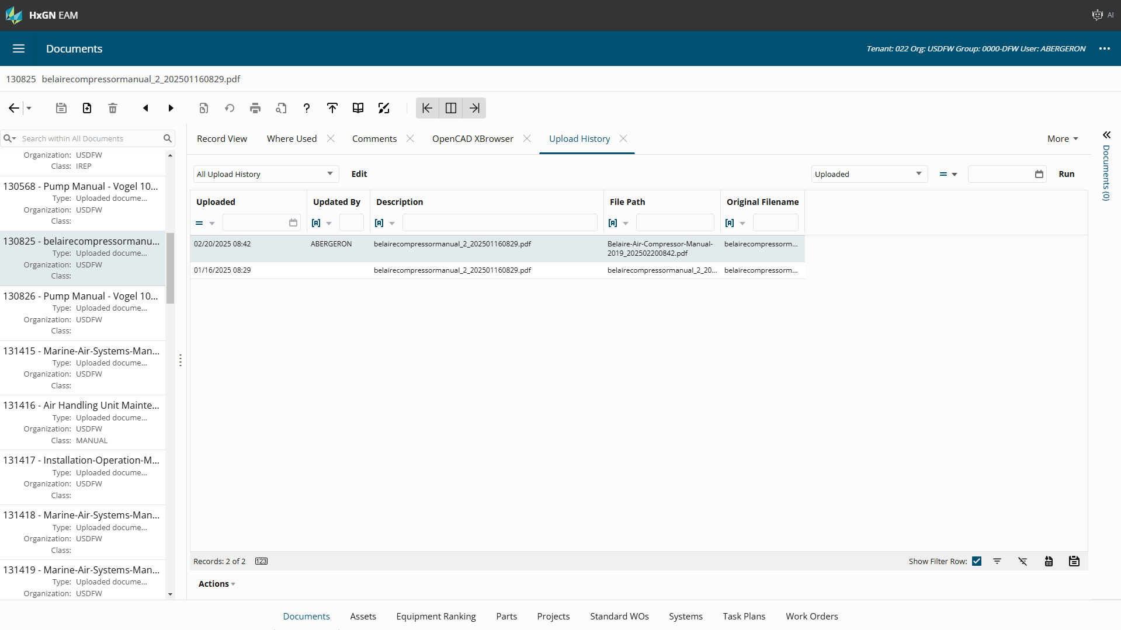
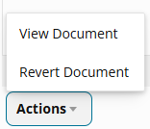
Document Management
Document Viewing
Document Create / Upload
Versioning / Upload History
Locking / Unlocking
Document API

Slide 6
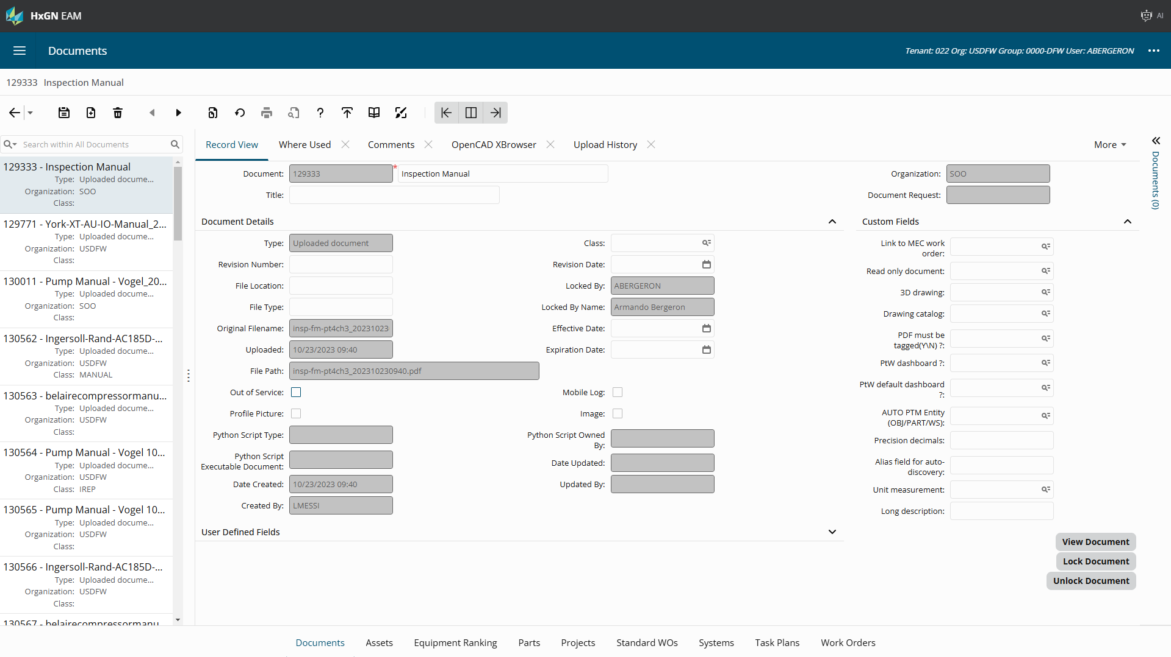
Document Management
Document Viewing
Document Create / Upload
Versioning / Upload History
Locking / Unlocking
Document API

Slide 7
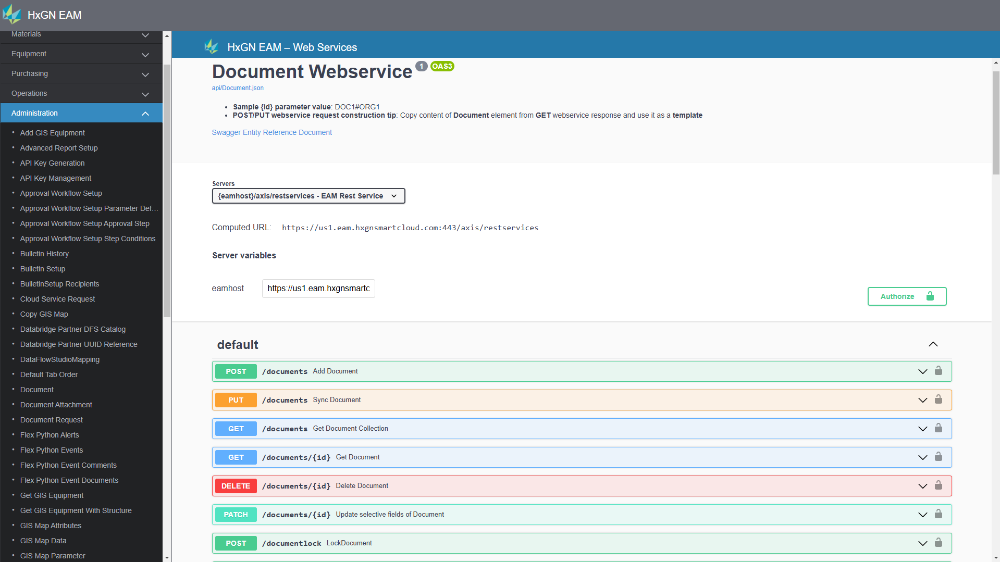
Document Management
Document Viewing
Document Create / Upload
Versioning / Upload History
Locking / Unlocking
Document API

Slide 8
Agenda
SECTION 1
Existing Capability
SECTION 2
Recent Enhancements
SECTION 3
Setup Options

Slide 9
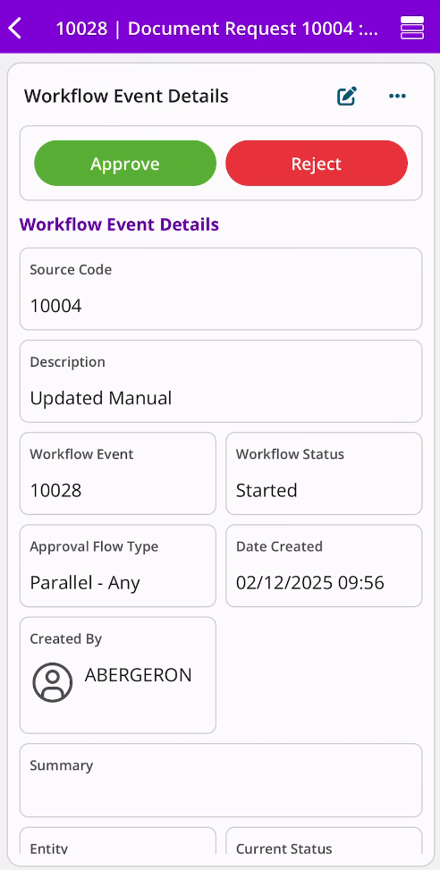
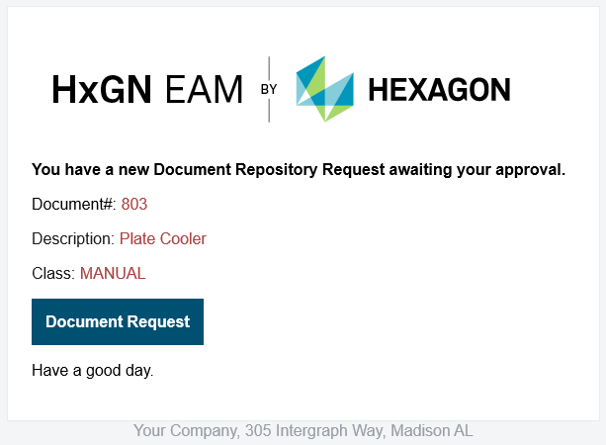
Document Repository Requests
Unfinished
Awaiting Approval
Approved
Cancelled
Rejected
This new screen allows document requests to be submitted for both creating and updating a document. You can incorporate document locking and approval workflow to streamline the approval process.

Slide 10
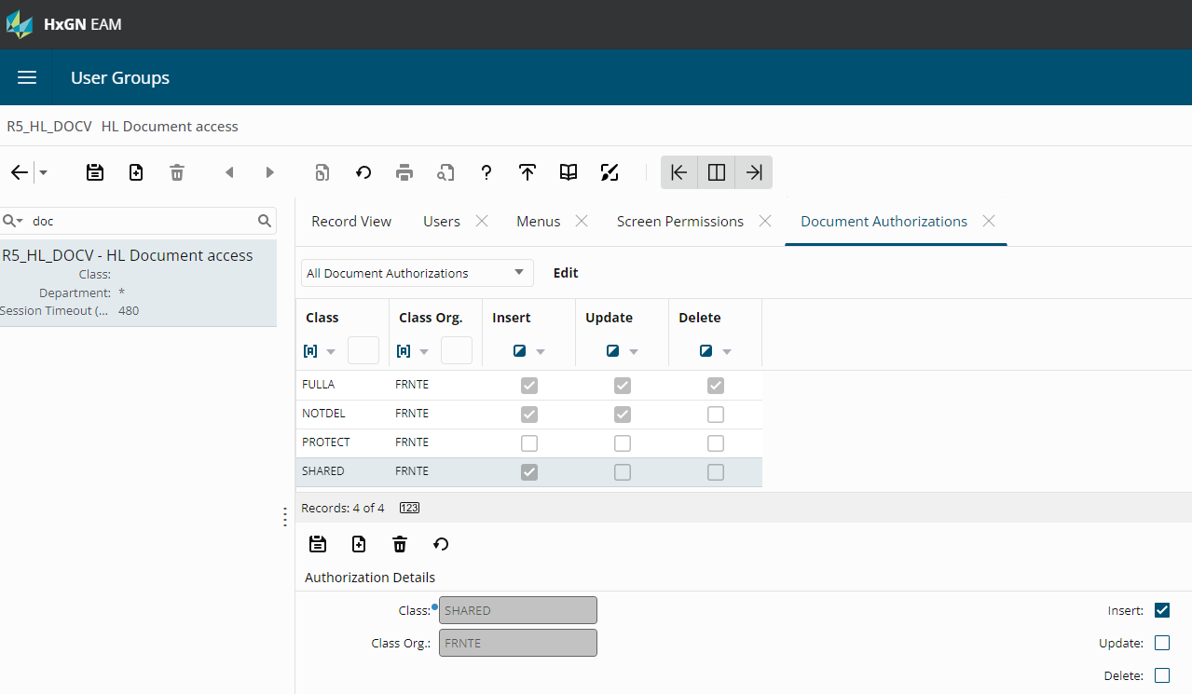
Document Authorizations
This enables document authorizations for uploaded documents based on the document class. When document authorization is enabled, only the documents of authorized classes appear in the documents list of values. If the document has a class not authorized in the user group, the document will not appear in the list.
If no class if provided, no rule is applied. This supports document security for uploaded documents only. This document security is governed by the install parameter: DOCUAUTH

Slide 11
Agenda
SECTION 1
Existing Capability
SECTION 2
Recent Enhancements
SECTION 3
Setup Options

Slide 12
Setup Options: EAM Parameters
Install Parameter | Mobile | Description
DOCUAUTH |  | Determines if authorization on document class will be enabled by user groups. YES - User group authorizations are enabled. NO - User group authorizations are NOT enabled.
DOCCOMM |  | Controls the organization that can be selected during the upload of new documents.
DOCOPEN |  | If set to ON, the system will try to open the document in another window if the user decides to view the document. If set to OFF, the document will always be downloaded instead.
DOCOVRWR |  | Set to YES to allow Uploaded Documents to be updated. A copy of the previous document is maintained in the document history. Set to NO to prevent updating Uploaded Documents.
SCALEFIT |  | Determines if image documents will auto-scale to size of the browser
RELTDOCS |  | Determines if the Document Preview sidebar displays only documents that are directly associated to the selected record; or if the sidebar displays additional documents associated to child entities of the selected record.
Note: not a comprehensive list

Slide 13
Setup Options: EAM Parameters
Install Parameter | Mobile | Description
DWPCMASK | X | Determines if the Digital Work user has to wait for the photo upload to be successful when using the Quick Document Upload - Take a Picture option on the record view.
DWPICMAX | X | Determines the maximum number of concurrent photo uploads possible when using the Quick Document Upload - Take a Picture option on the record view in Digital Work.
DWPICSIZ | X | Determines the maximum file size in MB, for the photo to be uploaded when using the Quick Document Upload - Take a Picture or Select from Image Library option on the record view in Digital Work.
MOBDOCUL | X | Specify a suffix that will be appended to the document file name when uploaded from the mobile device to the base application server.
MOBFSIZE | X | The maximum file size, in MB, that Mobile is allowed to add as attachment.
Note: not a comprehensive list

Slide 14
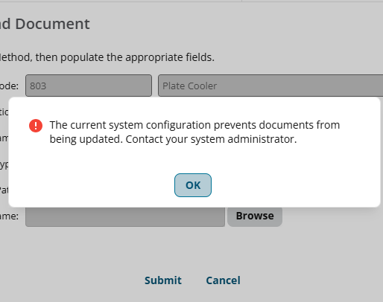
Install Parameter: DOCOVRWR
Set to YES to allow Uploaded Documents to be updated. A copy of the previous document is maintained in the document history. Set to NO to prevent updating Uploaded Documents.
This will restrict the Document Repository Request screen from updating any existing uploaded documents.

Slide 15


