Slide 1
Driving Asset Management Success with Effective MRO Strategies
Tim Gilmer
Director of Reliability Services - ABS Consulting

Slide 2

Agenda
Why is MRO Important?
Risk-Based Approach
Reliability Based Maintenance (RBM)
Asset Criticality
Asset Strategy Optimization
Spare Parts Analysis
Other Considerations
Procurement Improvements
Reporting Metrics
Key Takeaways

Slide 3
Why is MRO Important?
Average losses due to downtime
    Power Plant = $160K/hr
  Oil Refinery (400K b/d) = $100K/hr (margin)
  Auto Assembly Line = $500K/hr
  Manufacturing Plant = $250K/hr
At this rate, if you are down one 8-hour shift it will cost between $1.2 and $4.0 million. After just a few shifts, you would reach the value of the entire Spare Parts Inventory.
Why don’t we just purchase enough spares so that we would never have a lengthy outage?

Slide 4
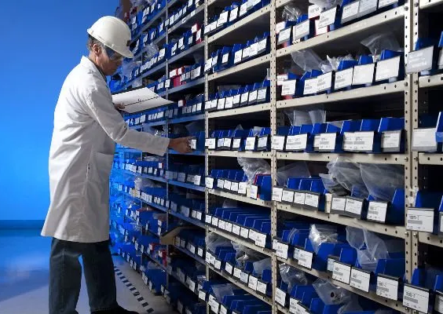
Why is MRO Important?
Excess Inventory Risks
Carrying Costs – can add up to 20% or more!
  Insurance costs (~ 5% of total inventory)
  State tax (depends on the state)
  Loss of access to capital (~ 5% of total inventory value)
  Embedded costs
  Buildings
  Utilities
  Wages / Salaries
  Increase of Satellite Stores

Slide 5
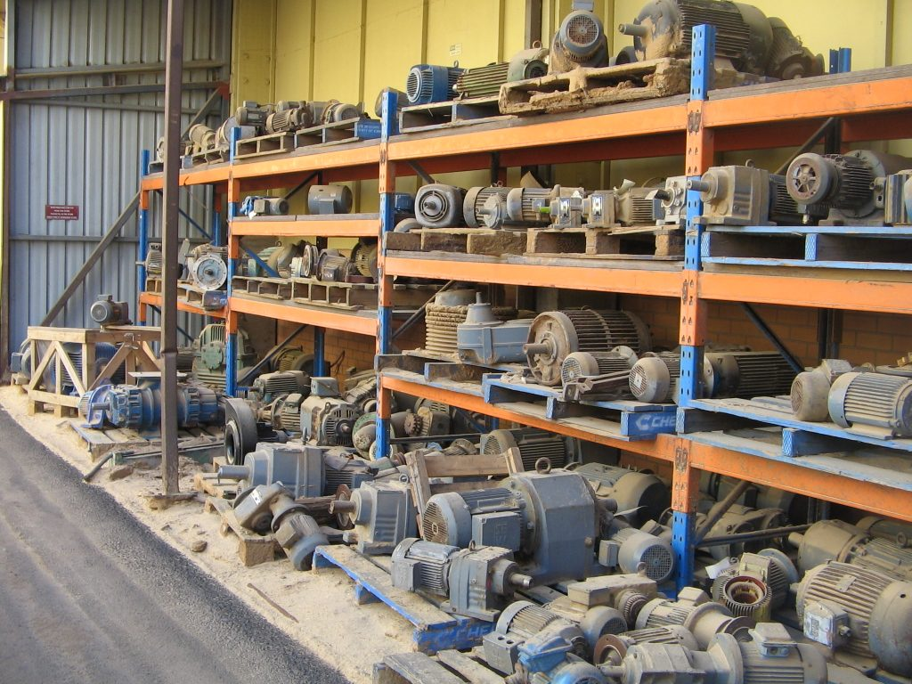
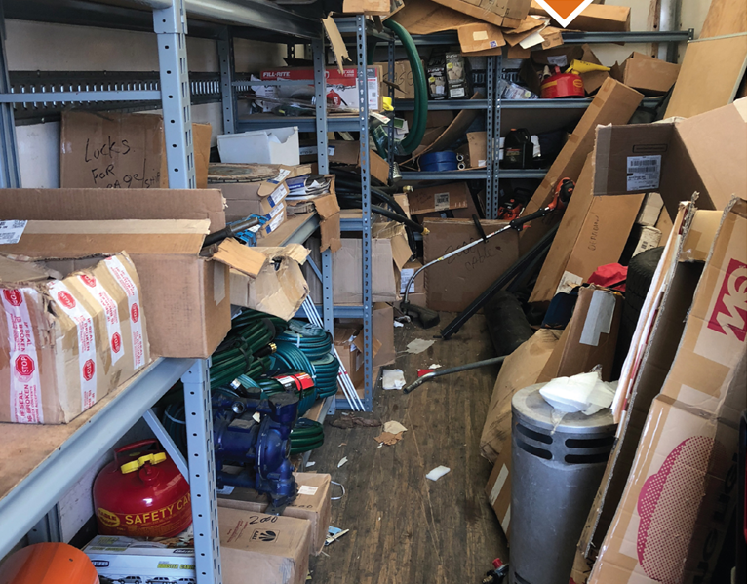
Why is MRO Important?
Additional Risks
  Poor space allocation
  Overstocking causes unnecessary moves
  Part deterioration over time
  Obsolescence

Slide 6



Reliability Based Maintenance (RBM)
Risk-Based Focused Approach to Improve Asset Reliability
Logic-Based and Financially Responsible
Reduce Downtime and Focus Time and Energy
Assigning Criticality is the Key
Assets / Strategies / Parts
Asset Criticality
Reliability Strategies
Spare Part Criticality

Slide 7
Reliability Based Maintenance (RBM)
A prescriptive, standardized approach to develop and sustain an effective maintenance program that ensures optimal asset reliability and availability
Reliability Based Maintenance Methodology
MAL
ACR
ASO
SPA
MRA
CIP
Identify
Assets
Prioritize
Assets
Optimize
Asset Strategy
Analyze
Spare Parts
Monitor
Analytics
Continuous
Improvement

Slide 8
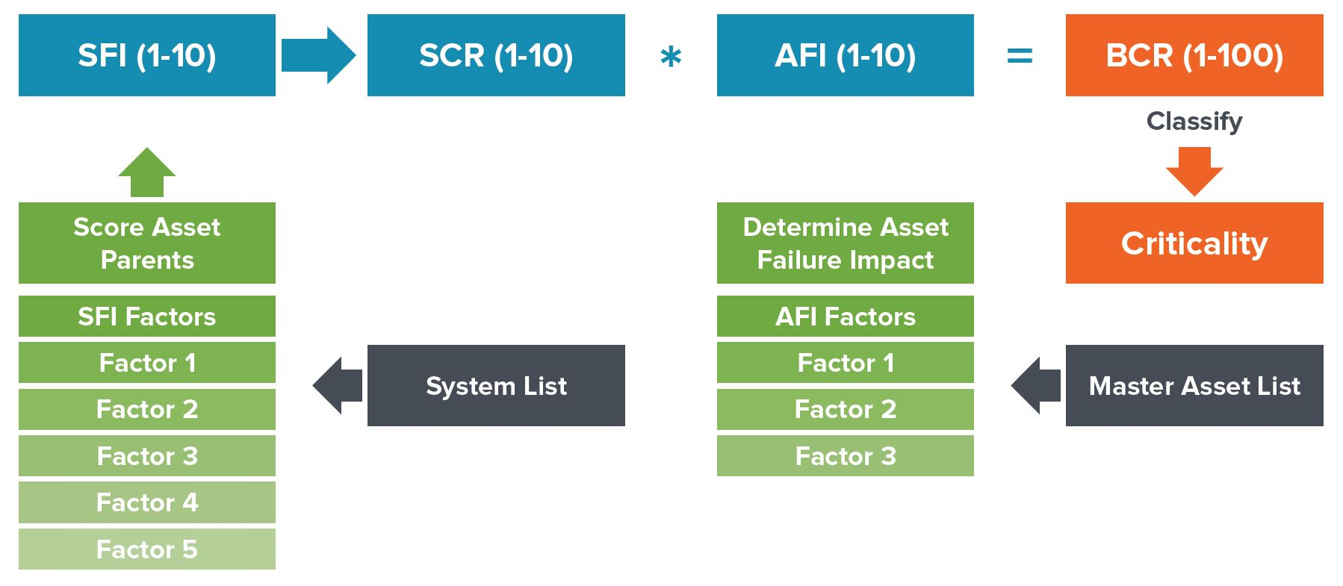
Why is Asset Criticality Important?
Provides a detailed profile of characteristics that make
each asset critical.
Gives focus to ensure that reliability strategies are based on calculated risk rather than perception.
Supports the prioritization of daily CMMS workflow processes such as planning, scheduling and material procurement
Acts as a primary mechanism for prioritizing
improvement activities.

Slide 9
Asset Strategy Optimization
Leverage Critical Assets
Identify Dominant Failure Modes
Identify Maintenance Tasks
Identify Critical Parts
Identify Predictive Indicators
Develop Justification for Change
Develop Reporting / Metrics
Identify Failure Mode and Strategy
Does the condition occur in the equipment service life?
Wrong Condition
Design New Task
Remove Task
No
Yes
APPLICABLE
Task is Beneficial in Restoring or Maintaining Inherent Reliability
Does the Task Correctly Address the Failure Mode?
Task is Not Applicable
Change Strategy
Re-Write task steps
Accept No Planned Maintenance
Other Options
Task is Applicable
REASONABLE
Ensure Task is Justified
Is the Task Reasonable?
Task is Not Reasonable
Extend Intervals
Make conditional v. calendar based
Other options
Schedule and Perform Task
Task is Reasonable

Slide 10
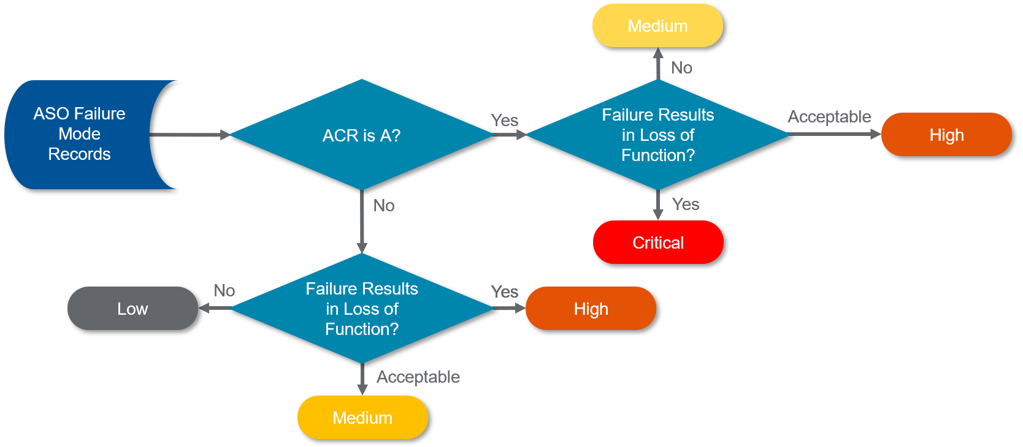
Spare Parts Analysis
Criticality of the maintainable asset to which it belongs
Potential loss of function asset that the part failure (or absence of) can cause
Determine Stocking Strategy
Determine EOQ and ROP
Assess Potential Insurance Spares
BOM development for Critical Assets

Slide 11

Other Considerations
Asset Lifecycle Program
  Identify Critical Spares
  Identify Existing Parts
  Asset Retirement & Parts Removal
Storeroom layout / security
Implement Planners
Technology (entry / checkout / return)
Leverage CMMS
Cycle Counts – Critical parts
Obsolescence Analysis

Slide 12

Procurement Improvements
Relationships are Key
Local storage (team with local companies)
Share Information across sites
Track vendor performance - especially for critical parts, adjust contracts as often as necessary to improve your position
Update Lead-Times

Slide 13

Reporting and Metrics
Start with Baseline Reports
Leverage CMMS Data
Integrate into Key SOPs
Tie to Performance Goals
  Department / Site / Corporate
  Personnel
  Vendors
Leverage Visualization Tactics

Slide 14

Key Takeaways
Risk-Based Approach
Focus Efforts
Criticality
  Assets
  Strategies
  Parts
Procurement Improvements
Reporting / Metrics
Continuous Improvement

Slide 15
Questions?

Slide 16


Thank You
www.abs-group.com
Tim Gilmer
Director – Reliability Services
ABS Consulting
+1 864-237-3360
tgilmer@absconsulting.com
linkedin.com/company/absgroup
@_absgroup

