Slide 1
EAM Capital Planning:
From Request to Requisition!
Chris L. Santo
Sr. Application Architect
Central Arizona Project

Slide 2
Outline
SECTION 1
Introduction
SECTION 2
What is the Central Arizona Project?
SECTION 3
Capital Planning: The Old Way
SECTION 4
EAM, Capital Planning Requests - Implementation
SECTION 5
Capital Planning: The New Way

Slide 3

Introduction
Chris Santo, MSIS, MBA, MSCS, CRL
30 years of experience in several
organizations and different roles in tech
(1994 – present)
Current: Central Arizona Project
2005-2012
Oracle Applications Developer
2012-2015
Manager, Maintenance Information
2015-2020
Manager, Application Development
2020-present
Senior Applications Architect,
(Maintenance & Engineering)

Slide 4
Outline
SECTION 1
Introduction
SECTION 2
What is the Central Arizona Project?
SECTION 3
Capital Planning: The Old Way
SECTION 4
EAM, Capital Planning Requests - Implementation
SECTION 5
Capital Planning: The New Way

Slide 5
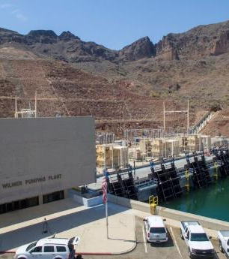
Central Arizona Project
336-mile aqueduct that runs from Lake Havasu to Tucson
There are 14 pumping plants that lift water nearly 3,000 feet.

Slide 6
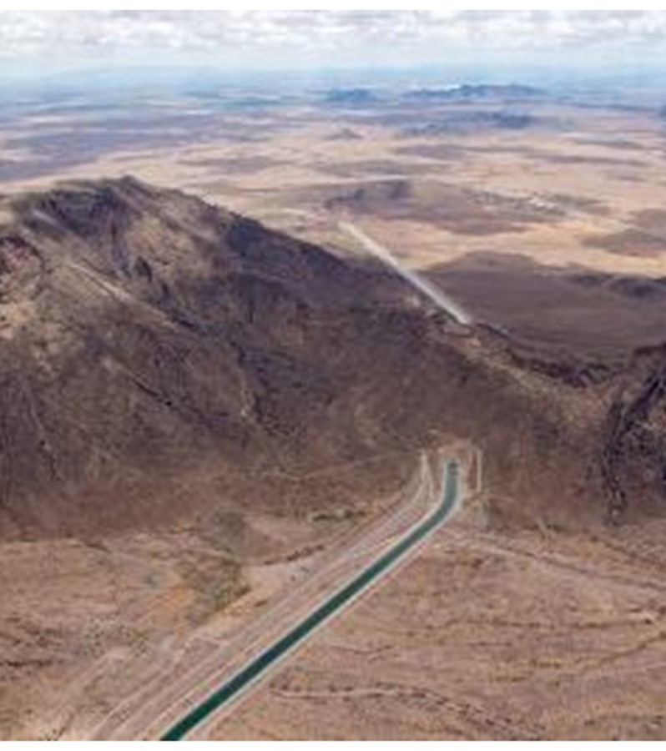
Central Arizona Project
336-mile aqueduct that runs from Lake Havasu to Tucson
There are 14 pumping plants that lift water nearly 3,000 feet.
The system contains 10 siphons and 4 tunnels.

Slide 7
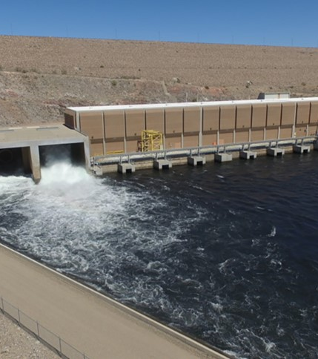
Central Arizona Project
336-mile aqueduct that runs from Lake Havasu to Tucson
There are 14 pumping plants that lift water nearly 3,000 feet.
The system contains 10 siphons and 4 tunnels.
Lake Pleasant storage reservoir, which includes the New Waddell Dam and Waddell Pump-Generating Plant

Slide 8
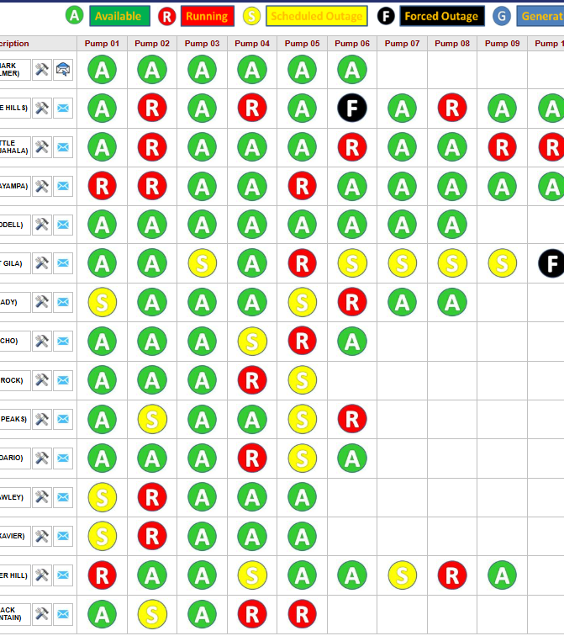
Central Arizona Project
There are 109 pumping units across the 15 plants.
MMD – Maintenance Management Dashboard shown, custom development showing almost real-time operations (updated every 5 minutes)

Slide 9
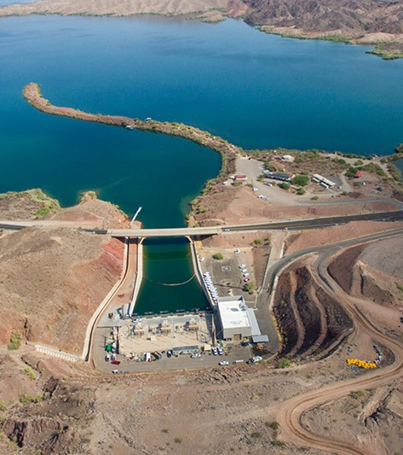
Central Arizona Project
Mark Wilmer Pumping Plant is the first and largest plant in the system.

Slide 10
Central Arizona Project
Mark Wilmer Pumping Plant is the first and largest plant in the system.
There are six pumps at 66,000 HP each that life water more than 800 vertical feet over Buckskin Mountain.

Slide 11
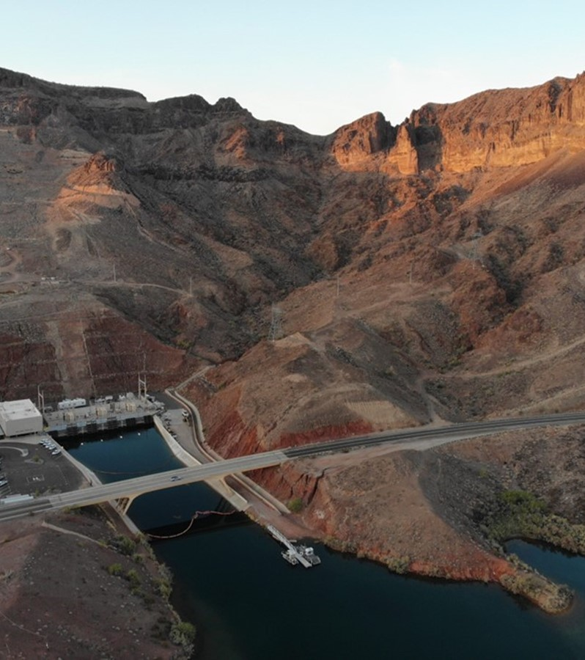
Central Arizona Project
Mark Wilmer Pumping Plant is the first and largest plant in the system.
There are six pumps at 66,000 HP each that life water more than 800 vertical feet over Buckskin Mountain.
With all six pumps running at Mark Wilmer Pumping Plant, an Olympic-sized swimming pool would fill in about 23 seconds!

Slide 12
Central Arizona Project
Biennial Budgeting Process
Start
CAP’s fiscal year aligns with the calendar year.
CAP begins the preparation of a biennial (every two year) budget as part of its overall financial planning process.

Slide 13
Central Arizona Project
Biennial Budgeting Process
Start
Preparation
CAP’s fiscal year aligns with the calendar year.
CAP begins the preparation of a biennial (every two year) budget as part of its overall financial planning process.
Budget preparation involves almost everyone from the district over a 5-month period.

Slide 14
Central Arizona Project
Biennial Budgeting Process
Start
Preparation
Review
CAP’s fiscal year aligns with the calendar year.
CAP begins the preparation of a biennial (every two year) budget as part of its overall financial planning process.
Budget preparation involves almost everyone from the district over a 5-month period.
Budget is reviewed with CAP’s customers and stakeholders--typically municipal and industrial (M&I), tribal and agricultural.
Budget is reviewed individually by members of the board of directors

Slide 15
Central Arizona Project
Biennial Budgeting Process
Start
Preparation
Review
Approval
CAP’s fiscal year aligns with the calendar year.
CAP begins the preparation of a biennial (every two year) budget as part of its overall financial planning process.
Budget preparation involves almost everyone from the district over a 5-month period.
Budget is reviewed with CAP’s customers and stakeholders--typically municipal and industrial (M&I), tribal and agricultural.
Budget is reviewed individually by members of the board of directors
Budget is formally presented to the finance, audit and power committee.
(subset of the board)
The budget is approved by the board of directors.

Slide 16
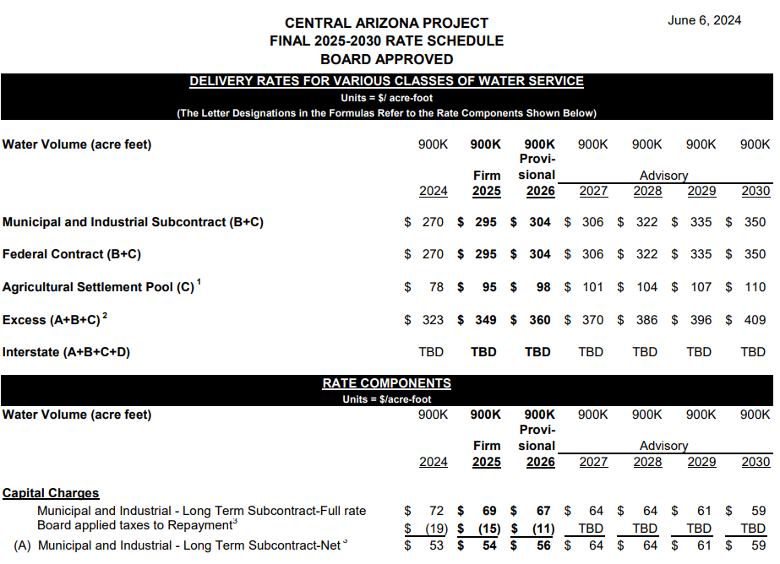
Central Arizona Project
Water Rates
The approved budget determines water rates for an acre-foot of water.
An acre-foot is equal to 325,851 gallons of water and is enough water for three average single-family homes for a year.
Water rates contain a capital component that is typically between $40M-$60M annually.
This is 18-20% of the overall budget.

Slide 17
Outline
SECTION 1
Introduction
SECTION 2
What is the Central Arizona Project?
SECTION 3
Capital Planning: The Old Way
SECTION 4
EAM, Capital Planning Requests - Implementation
SECTION 5
Capital Planning: The New Way

Slide 18


Capital Planning: The Old Way
The “planning” was from multiple sources, including:
Sidesheets from each Maintenance Area (West/Central/South)

Slide 19


Capital Planning: The Old Way
The “planning” was from multiple sources, including:
The rogue Sharepoint List created by a Maintenance Planner as a hacked add-on site on an internal server used by engineering running Project Server Subscription Edition

Slide 20

Capital Planning: The Old Way
Problems with the “planning” …
The most convincing (or, loudest) managers / engineers got their projects funded in the budget.

Slide 21

Capital Planning: The Old Way
Problems with the “planning” …
Finance lacked confidence in the process.
We often had to budget available projects into a pre-determined capital budget “number” that was driven by the water rates, instead of the other way around.

Slide 22

Capital Planning: The Old Way
Problems with the “planning” …
Uncle Gary.

Slide 23

Capital Planning: The Old Way
Problems with the “planning” …
Uncle Gary.
He’d go around like Santa Claus asking everyone (managers, engineers, planners, supervisors, etc.) what projects they needed.
The projects were entered to a mysterious private finance spreadsheet, and it was called the “long-term financial plan.”

Slide 24
Outline
SECTION 1
Introduction
SECTION 2
What is the Central Arizona Project?
SECTION 3
Capital Planning: The Old Way
SECTION 4
EAM, Capital Planning Requests - Implementation
SECTION 5
Capital Planning: The New Way

Slide 25



EAM to the Rescue!
We’ve been long-time EAM customers, since Datastream 7i in 2001.
We learned about EAM Capital Planning Requests functionality around 2019.

Slide 26
EAM to the Rescue: Goals
Goal 1
Centralize all capital planning in EAM.
Eliminate the rogue lists and sidesheets.

Slide 27
EAM to the Rescue: Goals
Goal 1
Goal 2
Centralize all capital planning in EAM.
Eliminate the rogue lists and sidesheets.
Create a transparent, risk-based priority model to determine which projects are funded.

Slide 28
EAM to the Rescue: Goals
Goal 1
Goal 2
Goal 3
Centralize all capital planning in EAM.
Eliminate the rogue lists and sidesheets.
Create a transparent, risk-based priority model to determine which projects are funded.
Empower anyone in the company to enter “concepts” to have them go through the budget review process.
Standardize the budget review process.

Slide 29
EAM to the Rescue: Goals
Goal 1
Goal 2
Goal 3
Goal 4
Centralize all capital planning in EAM.
Eliminate the rogue lists and sidesheets.
Create a transparent, risk-based priority model to determine which projects are funded.
Empower anyone in the company to enter “concepts” to have them go through the budget review process.
Standardize the budget review process.
Have a single report that shows all approved capital projects over the 10-year long-term financial horizon.

Slide 30

EAM to the Rescue: Goals
(Chris’s Goal)
Hey maybe we can use this for operational budgeting, too?
Most thought we’d be lucky to get it successfully implemented for capital projects.

Slide 31
Implementation
Step 1
Determine all data that needs to be tracked on a capital planning form

Slide 32
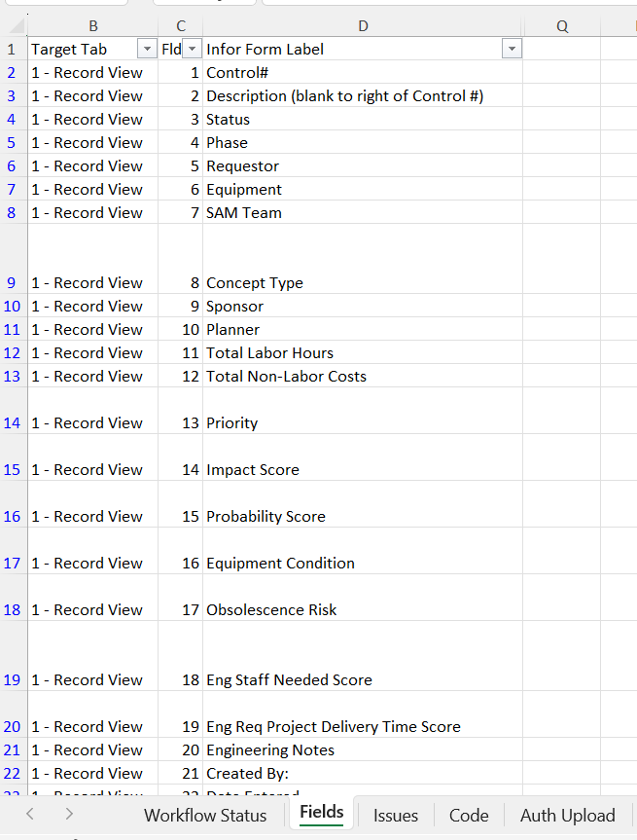
Implementation
Step 1
Determine all data that needs to be tracked on a capital planning form
Spreadsheet was used to capture all relevant fields from the stakeholders.
Fields were mapped to record view, or a custom tab.
We ended up needing a second custom tab called Details because the record view couldn’t handle the large fields that were required.

Slide 33
Implementation
Step 2
Determine the workflow/approval process.

Slide 34
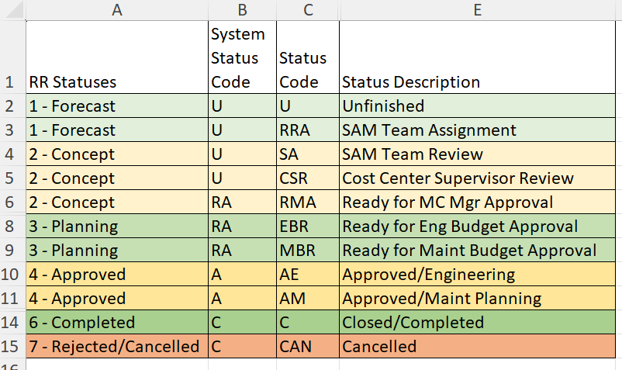
Implementation
Step 2
Determine the workflow/approval process.
Working with the major stakeholders, we determined the different statuses required and approval steps.

Slide 35
Implementation
Pro Tip #1
Issues/requests/bugs/ concerns from different people needed to be managed and tracked.

Slide 36
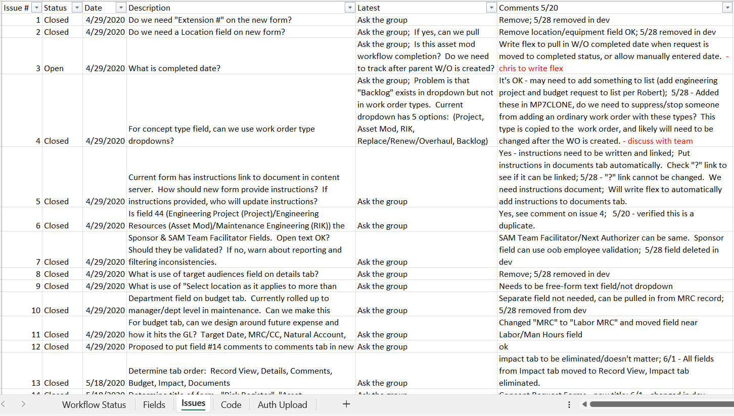
Implementation
Pro Tip #1
Issues/requests/bugs/ concerns from different people needed to be managed.
An issues list was managed in Excel and reviewed monthly during implementation.

Slide 37
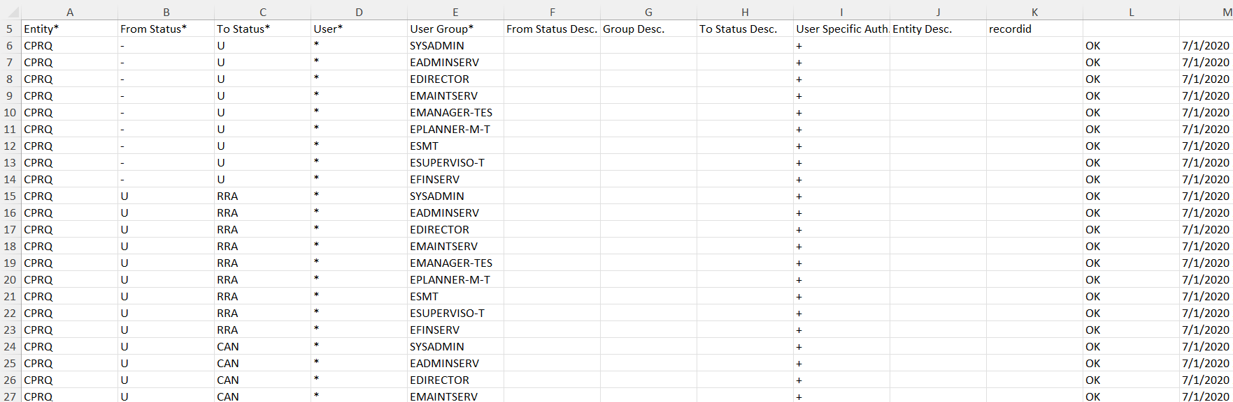
Implementation
Pro Tip #2
We ended having 150 status authorizations. We used the upload utility to maintain these.

Slide 38
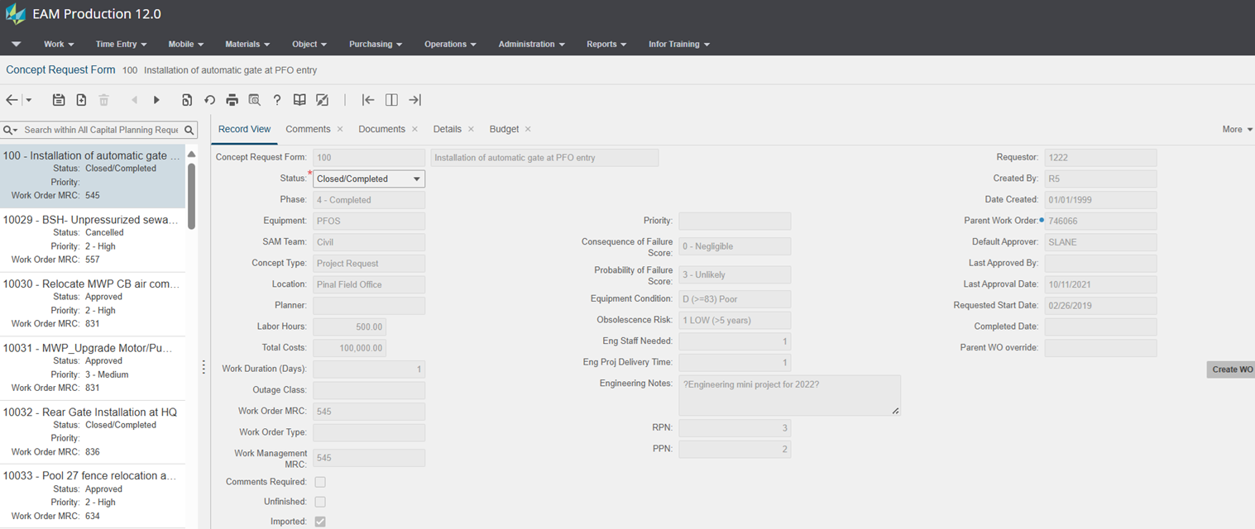
Capital Planning: Record View

Slide 39
Capital Planning: Record View
Three-digit concept request forms were in-flight requests imported from legacy sharepoint lists and sidesheets.
(Oracle SQL script was used)

Slide 40
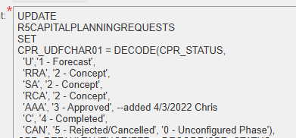
Capital Planning: Record View
Phases are a high-level grouping of status codes. Phases are updated via post-insert/post-update Flex Business Rules.
Statuses are configured via System Codes / Status Authorizations

Slide 41
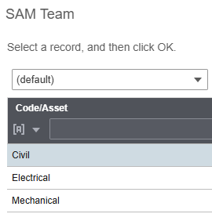
Capital Planning: Record View
SAM Teams are Strategic Asset Management Teams, consisting of a cross functional team that reviews/approves most asset modifications.

Slide 42
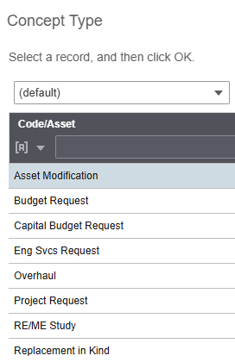
Capital Planning: Record View
Eight different concept types driving forms to different approval processes/inboxes.

Slide 43
Capital Planning: Record View
Labor Hours / Total Costs are aggregated from the Budget tab. Flex Business Rule updates this.

Slide 44
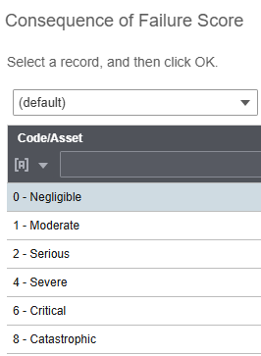
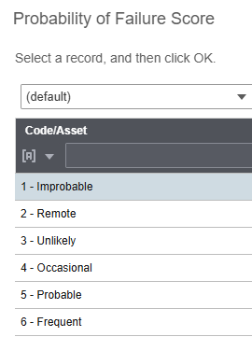
Capital Planning: Record View
Risk Scoring includes Consequence and Probability of Failure, Equipment Condition, Obsolescence Risk.

Slide 45
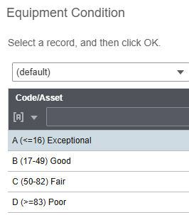
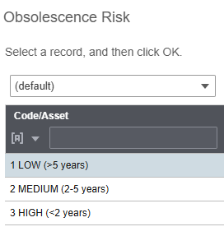
Capital Planning: Record View
Risk Scoring includes Consequence and Probability of Failure, Equipment Condition, Obsolescence Risk.

Slide 46
Capital Planning: Record View
Risk Scores are summarized as RPN / PPN
Updated via Flex Business Rule
RPN – Risk Priority Number (likelihood/consequence)
PPM – Project Priority Number

Slide 47
Capital Planning: Record View
Planners can create a parent work order connected to the concept request form.

Slide 48
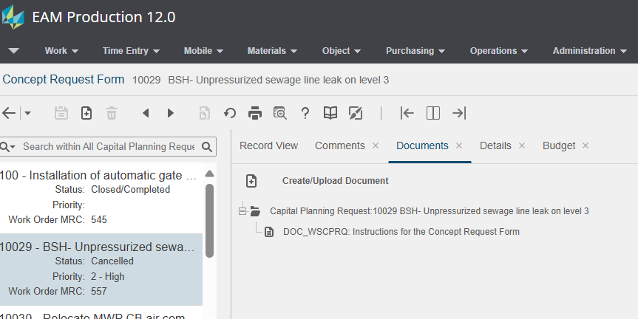
Capital Planning: Documents Tab
Instructions Document auto-attached to each new concept request form by way of post-insert Flex Business Rule. Other relevant supporting documentation can also be attached.

Slide 49
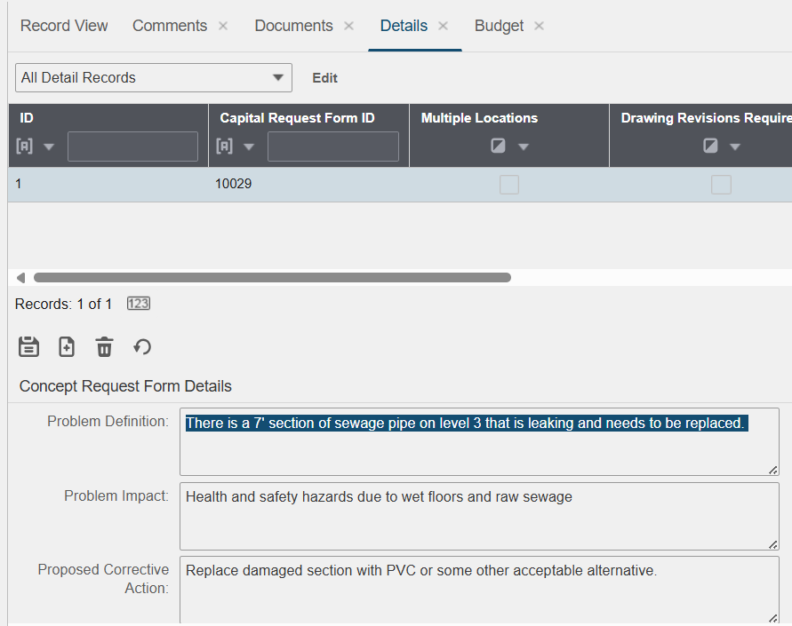
Capital Planning: Details Tab
Details fields such as problem definition, impact, proposed action, etc, needed to be “free format text” fields. Not enough were available on record view. Flex Business Rule prevents more than one detail record from existing for each concept request form.

Slide 50
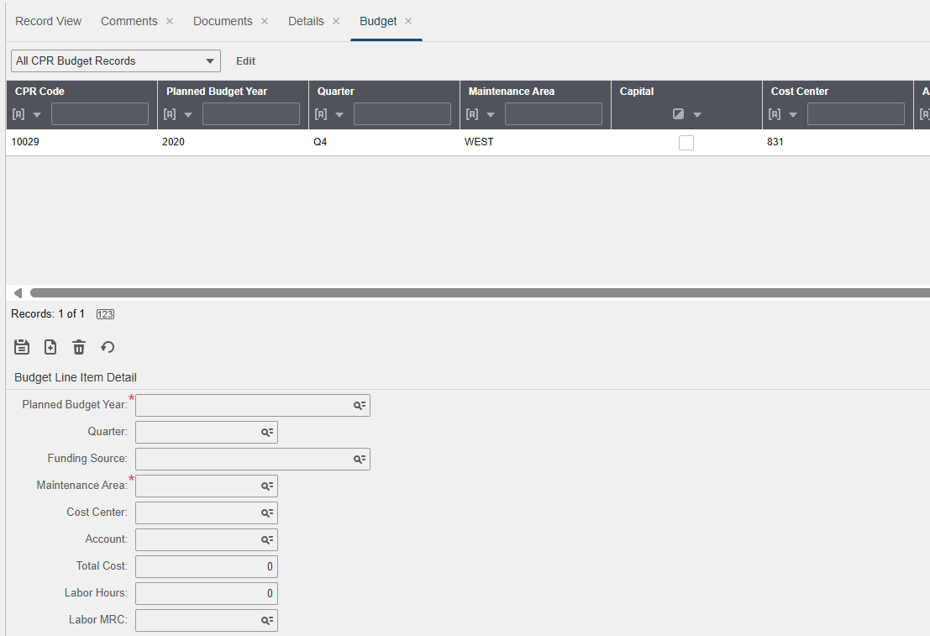
Capital Planning: Budget Tab
Budget dimensions such as year, quarter, cost center, account, funding source, maintenance area, labor hours, labor MRC, etc., can all be entered here.
Multiple budget lines can be entered.
Total Dollar / Total Labor Hours are summarized on record view.

Slide 51
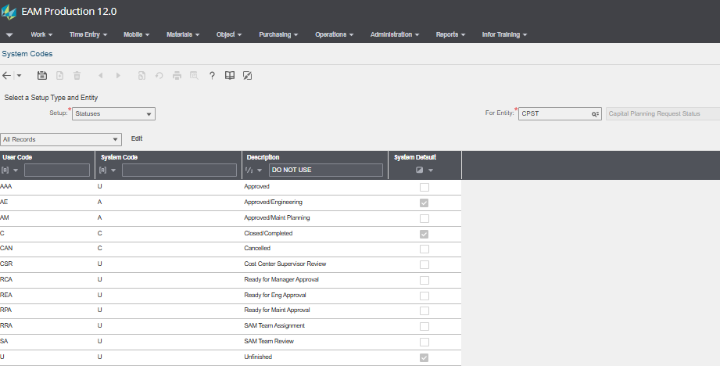
Capital Planning: Status Codes
Our workflow status codes were mapped to the system status codes available for the capital planning request form.

Slide 52
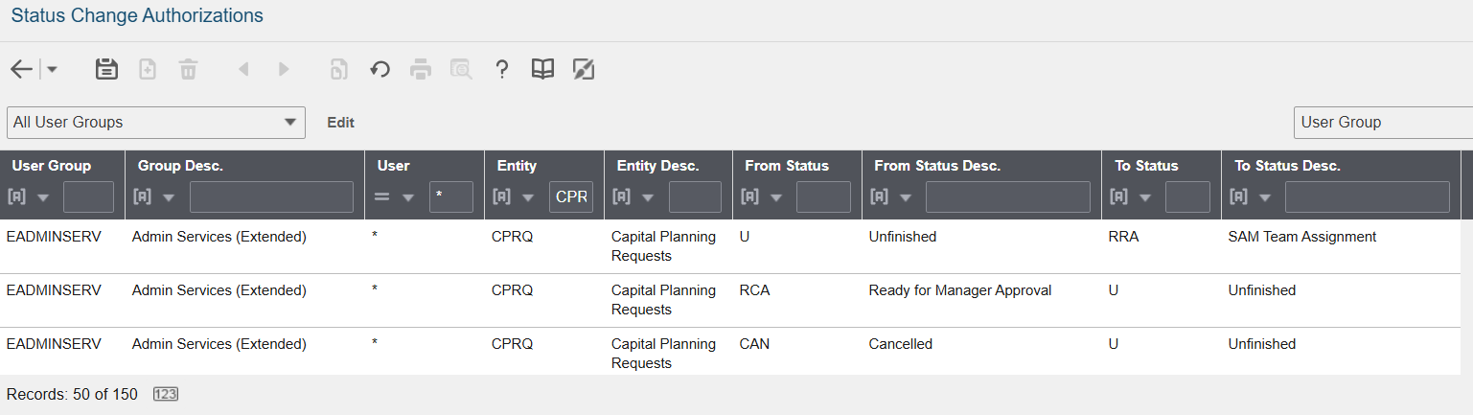
Capital Planning: Status Authorizations
Status authorizations authorize valid status changes (from/to) by user group

Slide 53
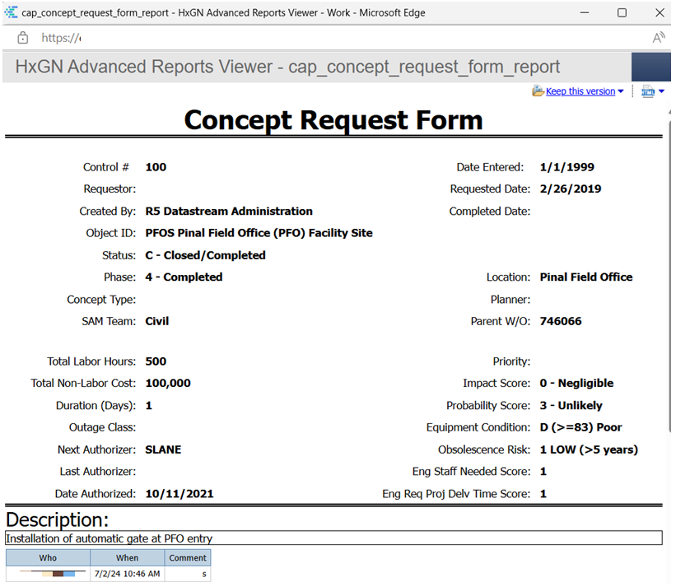
Capital Planning: Print Icon!
Print Icon was implemented with Extensible Framework with extensive help from our friends at Stratum Consulting!

Slide 54

Capital Planning: Print Icon!
Print Icon was implemented with Extensible Framework with extensive help from our friends at Stratum Consulting!

Slide 55
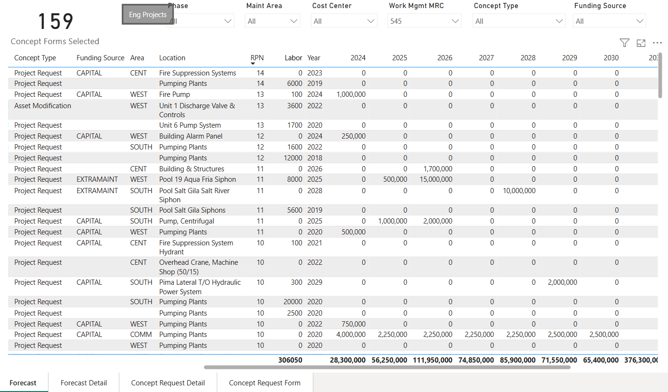
Capital Planning: Power BI Report
Power BI Report summarizes concept request forms, shows 10 year lookahead and allows sort by RPN/PPN

Slide 56
Capital Planning: Power BI Report
Engineering Manager calls this the “easy button” because it filters forms to engineering projects only.

Slide 57
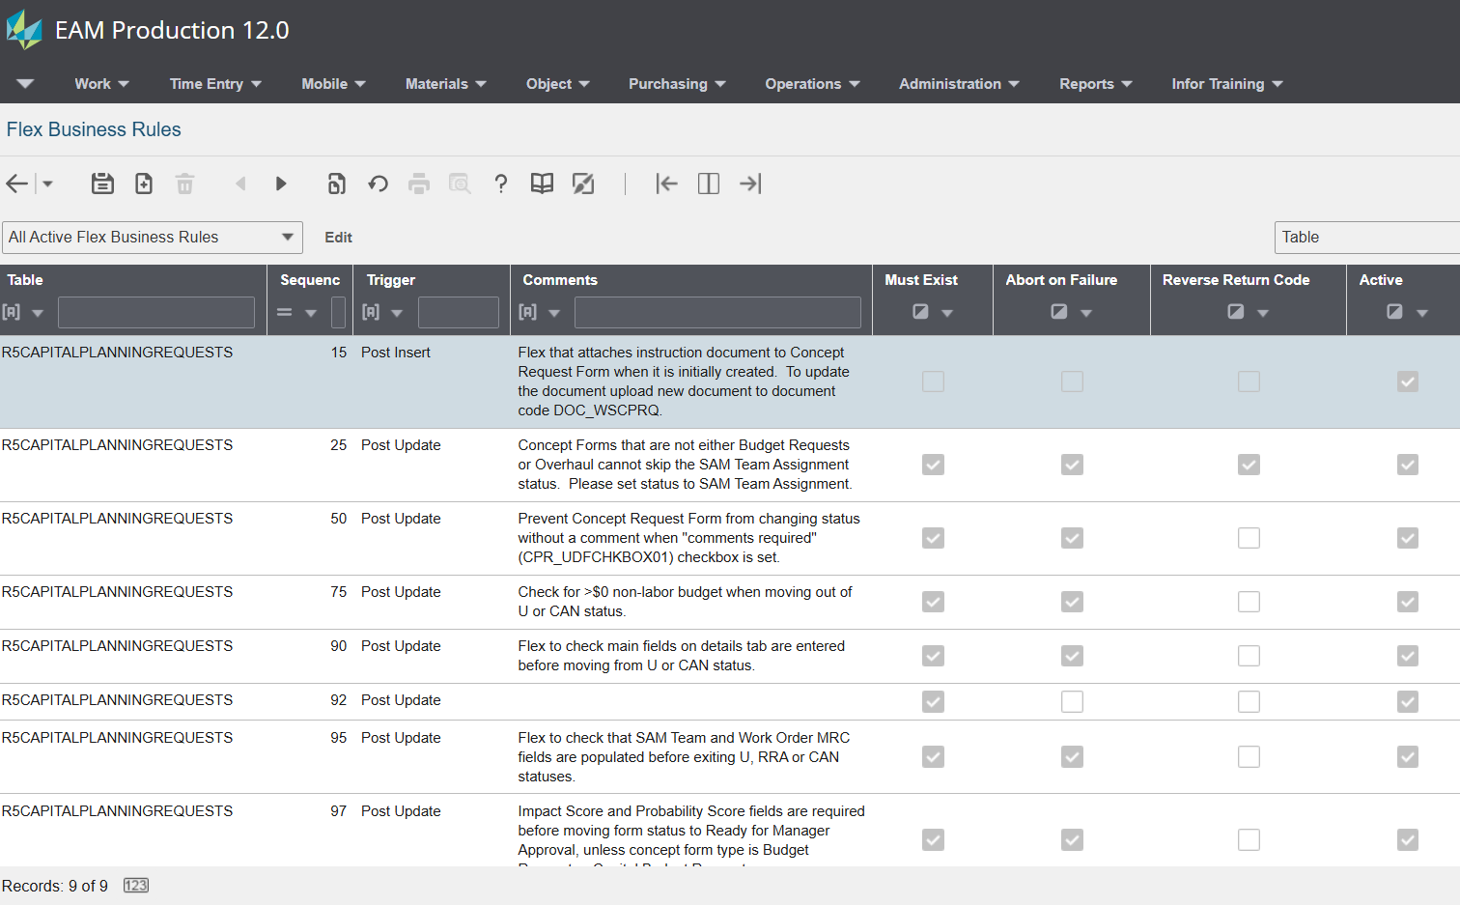
Capital Planning: Flex Business Rules
Several Flex Business Rules were implemented to support the process. These must be tested after each patch/upgrade!

Slide 58
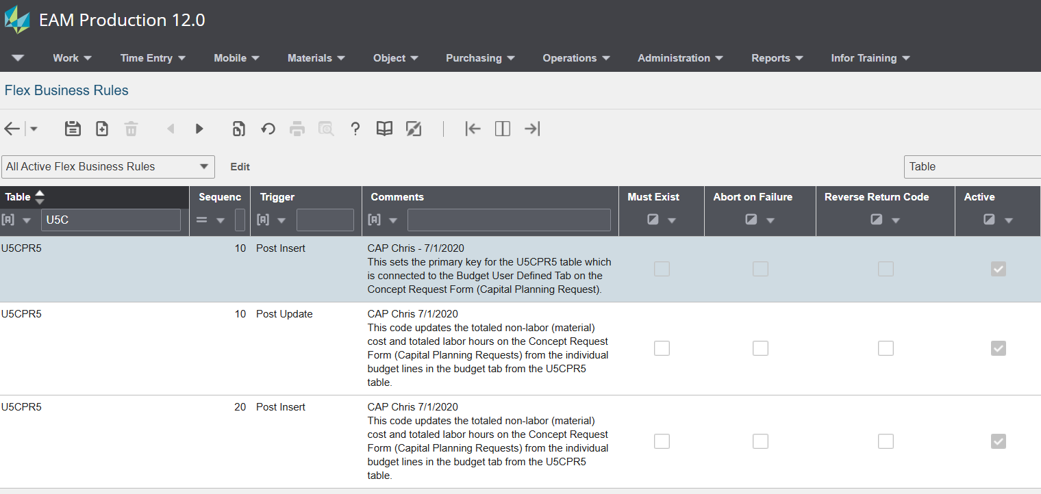
Capital Planning: Flex Business Rules
Flex Business Rules can be placed on the tables created by the custom tabs, too!

Slide 59
Outline
SECTION 1
Introduction
SECTION 2
What is the Central Arizona Project?
SECTION 3
Capital Planning: The Old Way
SECTION 4
EAM, Capital Planning Requests - Implementation
SECTION 5
Capital Planning: The New Way

Slide 60

Were we rescued?
We implemented Capital Planning in late 2020.
It’s 2025. How are we doing?

Slide 61
How was the rescue? Goals
Goal 1
Centralize all capital planning in EAM.
Eliminate the rogue lists and sidesheets.

Slide 62

How was the rescue? Goals
Goal 1
Centralize all capital planning in EAM.
Eliminate the rogue lists and sidesheets.
Success!
All capital projects for the 2026-27 biennial budget are now in EAM as a Concept Request Form (renamed from Capital Planning Request)

Slide 63
How was the rescue? Goals
Goal 1
Goal 2
Centralize all capital planning in EAM.
Eliminate the rogue lists and sidesheets.
Create a transparent, risk-based priority model to determine which projects are funded.

Slide 64
How was the rescue? Goals
Goal 1
Goal 2
Success!
No more outspoken engineers, managers, planners, IT people.
Capital Projects are formally reviewed quarterly by the managers.
Capital Projects that are rated high-risk / high-impact are scrutinized by management.
If you rate it high impact, you’d better be ready to defend your rating.
Centralize all capital planning in EAM.
Eliminate the rogue lists and sidesheets.
Create a transparent, risk-based priority model to determine which projects are funded.

Slide 65
How was the rescue? Goals
Goal 1
Goal 2
Goal 3
Centralize all capital planning in EAM.
Eliminate the rogue lists and sidesheets.
Create a transparent, risk-based priority model to determine which projects are funded.
Empower anyone in the company to enter “concepts” to have them go through the budget review process.
Standardize the budget review process.

Slide 66
How was the rescue? Goals
Goal 1
Goal 2
Goal 3
Success!
Reliability Engineers, Maintenance Technicians, Maintenance Planners, Vehicle Fleet and Engineering Services are all using the process and system
Centralize all capital planning in EAM.
Eliminate the rogue lists and sidesheets.
Create a transparent, risk-based priority model to determine which projects are funded.
Empower anyone in the company to enter “concepts” to have them go through the budget review process.
Standardize the budget review process.

Slide 67
How was the rescue? Goals
Goal 1
Goal 2
Goal 3
Goal 4
Centralize all capital planning in EAM.
Eliminate the rogue lists and sidesheets.
Create a transparent, risk-based priority model to determine which projects are funded.
Empower anyone in the company to enter “concepts” to have them go through the budget review process.
Standardize the budget review process.
Have a single report that shows all approved capital projects over the 10-year long-term financial horizon.

Slide 68
How was the rescue? Goals
Goal 1
Goal 2
Goal 3
Goal 4
Centralize all capital planning in EAM.
Eliminate the rogue lists and sidesheets.
Create a transparent, risk-based priority model to determine which projects are funded.
Empower anyone in the company to enter “concepts” to have them go through the budget review process.
Standardize the budget review process.
Have a single report that shows all approved capital projects over the 10-year long-term financial horizon.
Success!
Power BI provides 10-year lookahead by way of the “Easy Button”

Slide 69
EAM to the Rescue: Goals
(Chris’s Goal)
Hey maybe we can use this for operational budgeting, too?
What about Chris’s Goal?

Slide 70
EAM to the Rescue: Goals
(Chris’s Goal)
Hey maybe we can use this for operational budgeting, too?
All Maintenance Departments are entering their budgets as
type=“Budget Request”.
Operational budgets in Maintenance are entered through EAM and summarized in Power BI for the 2026-27 budget.

Slide 71
EAM to the Rescue!
“Maintenance and Engineering are the model of the organization for capital planning and budgeting. They went from the worst to the best over two budget cycles.”
--- Doug Dunlap, Accounting Manager

Slide 72

Capital Planning: The Only Way
Wait!
We forgot someone!

Slide 73

Capital Planning: The Only Way
Uncle Gary Retired!
So, now he’s happy and successful, too!

Slide 74
Other Projects – CAP Maintenance Information
EAM Reservations – To manage pump outage requests
HxGN EAM Mobile – Digital Work app on cell phones (on-premise)
EAM Custom Screens/Forms –
  Protective Device Settings Change Form
  ICS/Industrial Control System Change Form
Scan Automation – automated attach of scanned documents from multi-function copier/scanner machines to work order in EAM
(uses Azure Computer Vision and PowerShell scripts)
BAIM, a legacy on-premise integration de-supported in 2006 between EAM and Oracle EBS for procure-to-pay, project costing and payroll
Activity Scheduling – automatic daily scheduling from activity start/end dates
MMD, Maintenance Management Dashboard – almost real-time operational dashboard on a budget (razor pages / SQL Server / IIS / SCADA data)

Slide 75


Thank You!
Chris L. Santo
Sr. Applications Architect
Central Arizona Project
csanto@cap-az.com

