Slide 1
Getting the Basics Right: Capturing Data in Work Orders
Péter JURCSÓ
Application Engineer – Business System Analyst
Geneva - Switzerland

Slide 2
The dream: zero unplanned downtime
Modern maintenance and asset performance management is based on data
Important amount of this data comes from real people on the field
“A journey of a thousand miles begins with a single step” (Lao Tzu) 千里之行，始於足下
The road to advanced EAM usage starts with, and impossible without
correct work order data

Slide 3

Managing the Digital Thread: Data is the key
With large, complex and expensive assets with long lifecycles the real focus is the digital data
The software will change - the data stays
Installations are often designed and built by one generation, operated and maintained by the next
Work order data
Document Management
CAD
PLM
ERP
3D SCANS
GIS
EAM
SCADA
IoT
and more…
Notes:
Correlating maintenance issues with (solved) manufacturing non-conformities.
Tuning operational performance with respect to as-commissioned test data.
Facilitate and organize waste management / recycling based on raw material specifications.

Slide 4

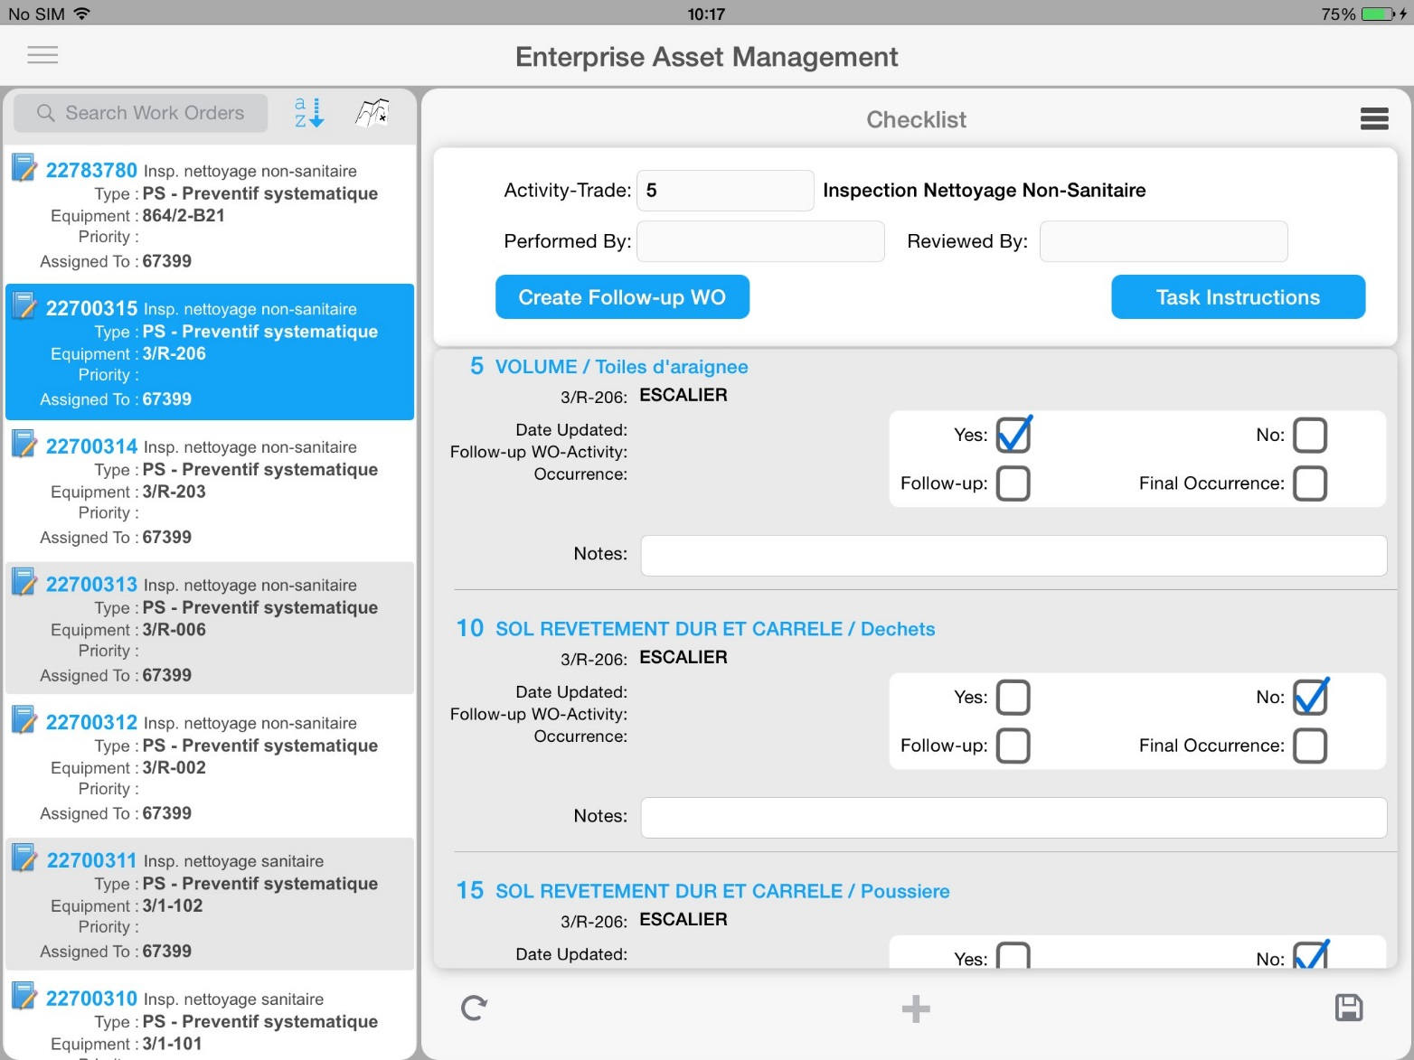
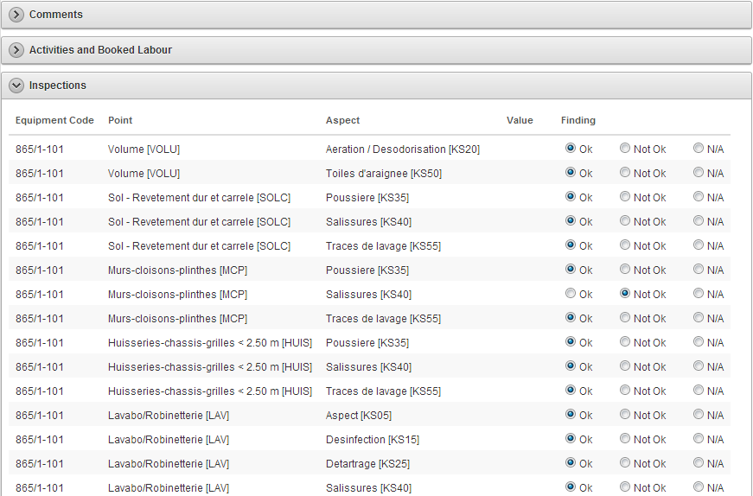
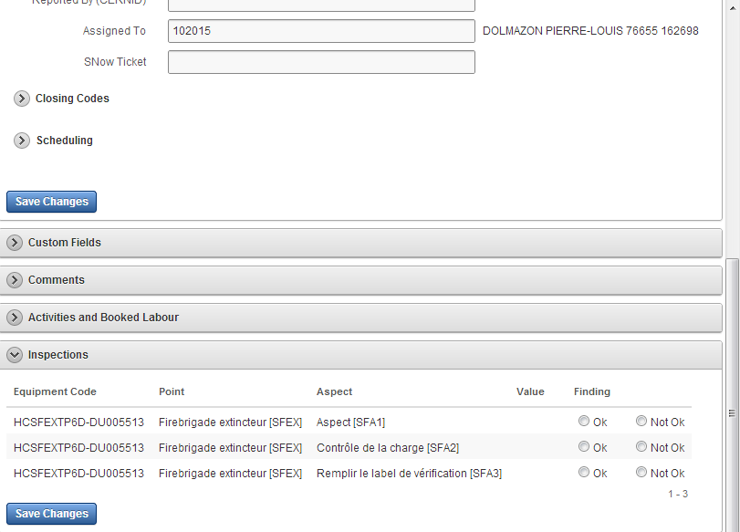
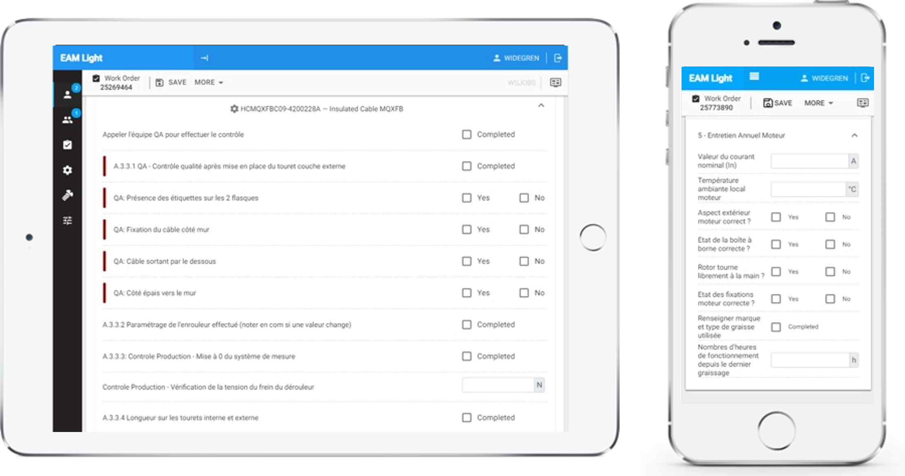
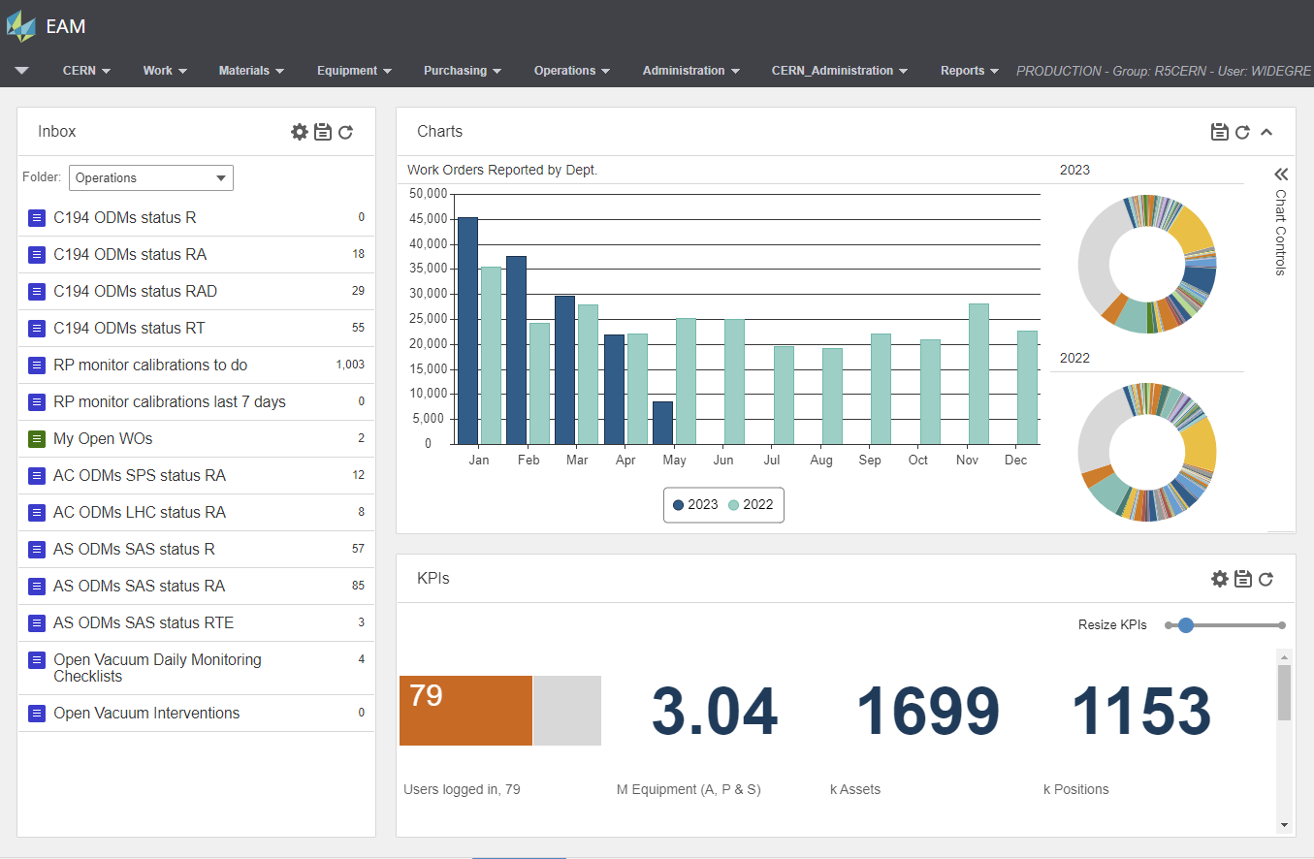
Data from known sources: dedicated user accounts
Trust and respect but audit
Connected to Employee record
More useful autocompleted data
Work assignment
Accountability
Even for sub-contractors
Not everybody needs the same type of account
Requires more system administration

Slide 5
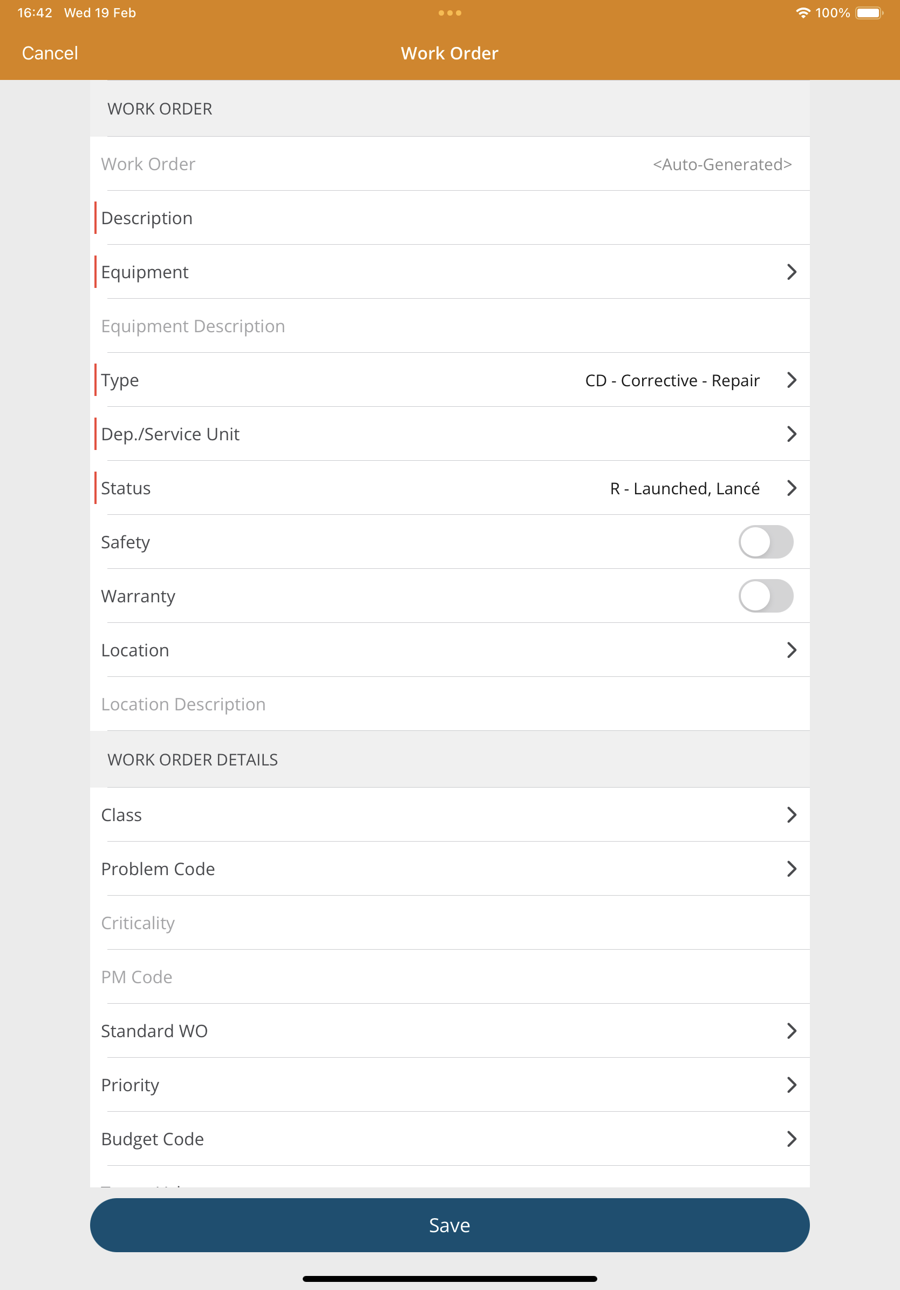
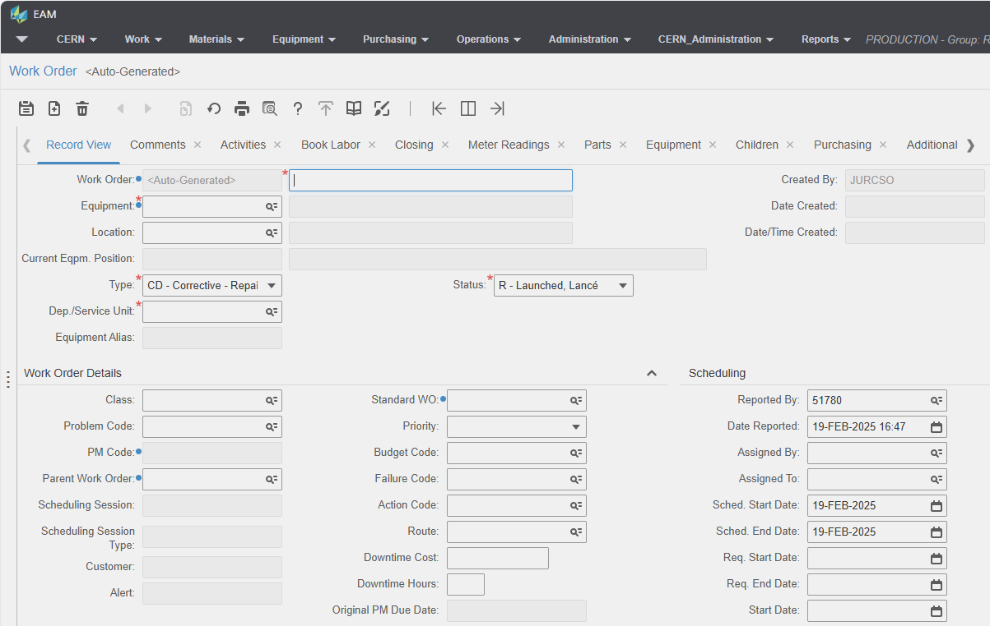
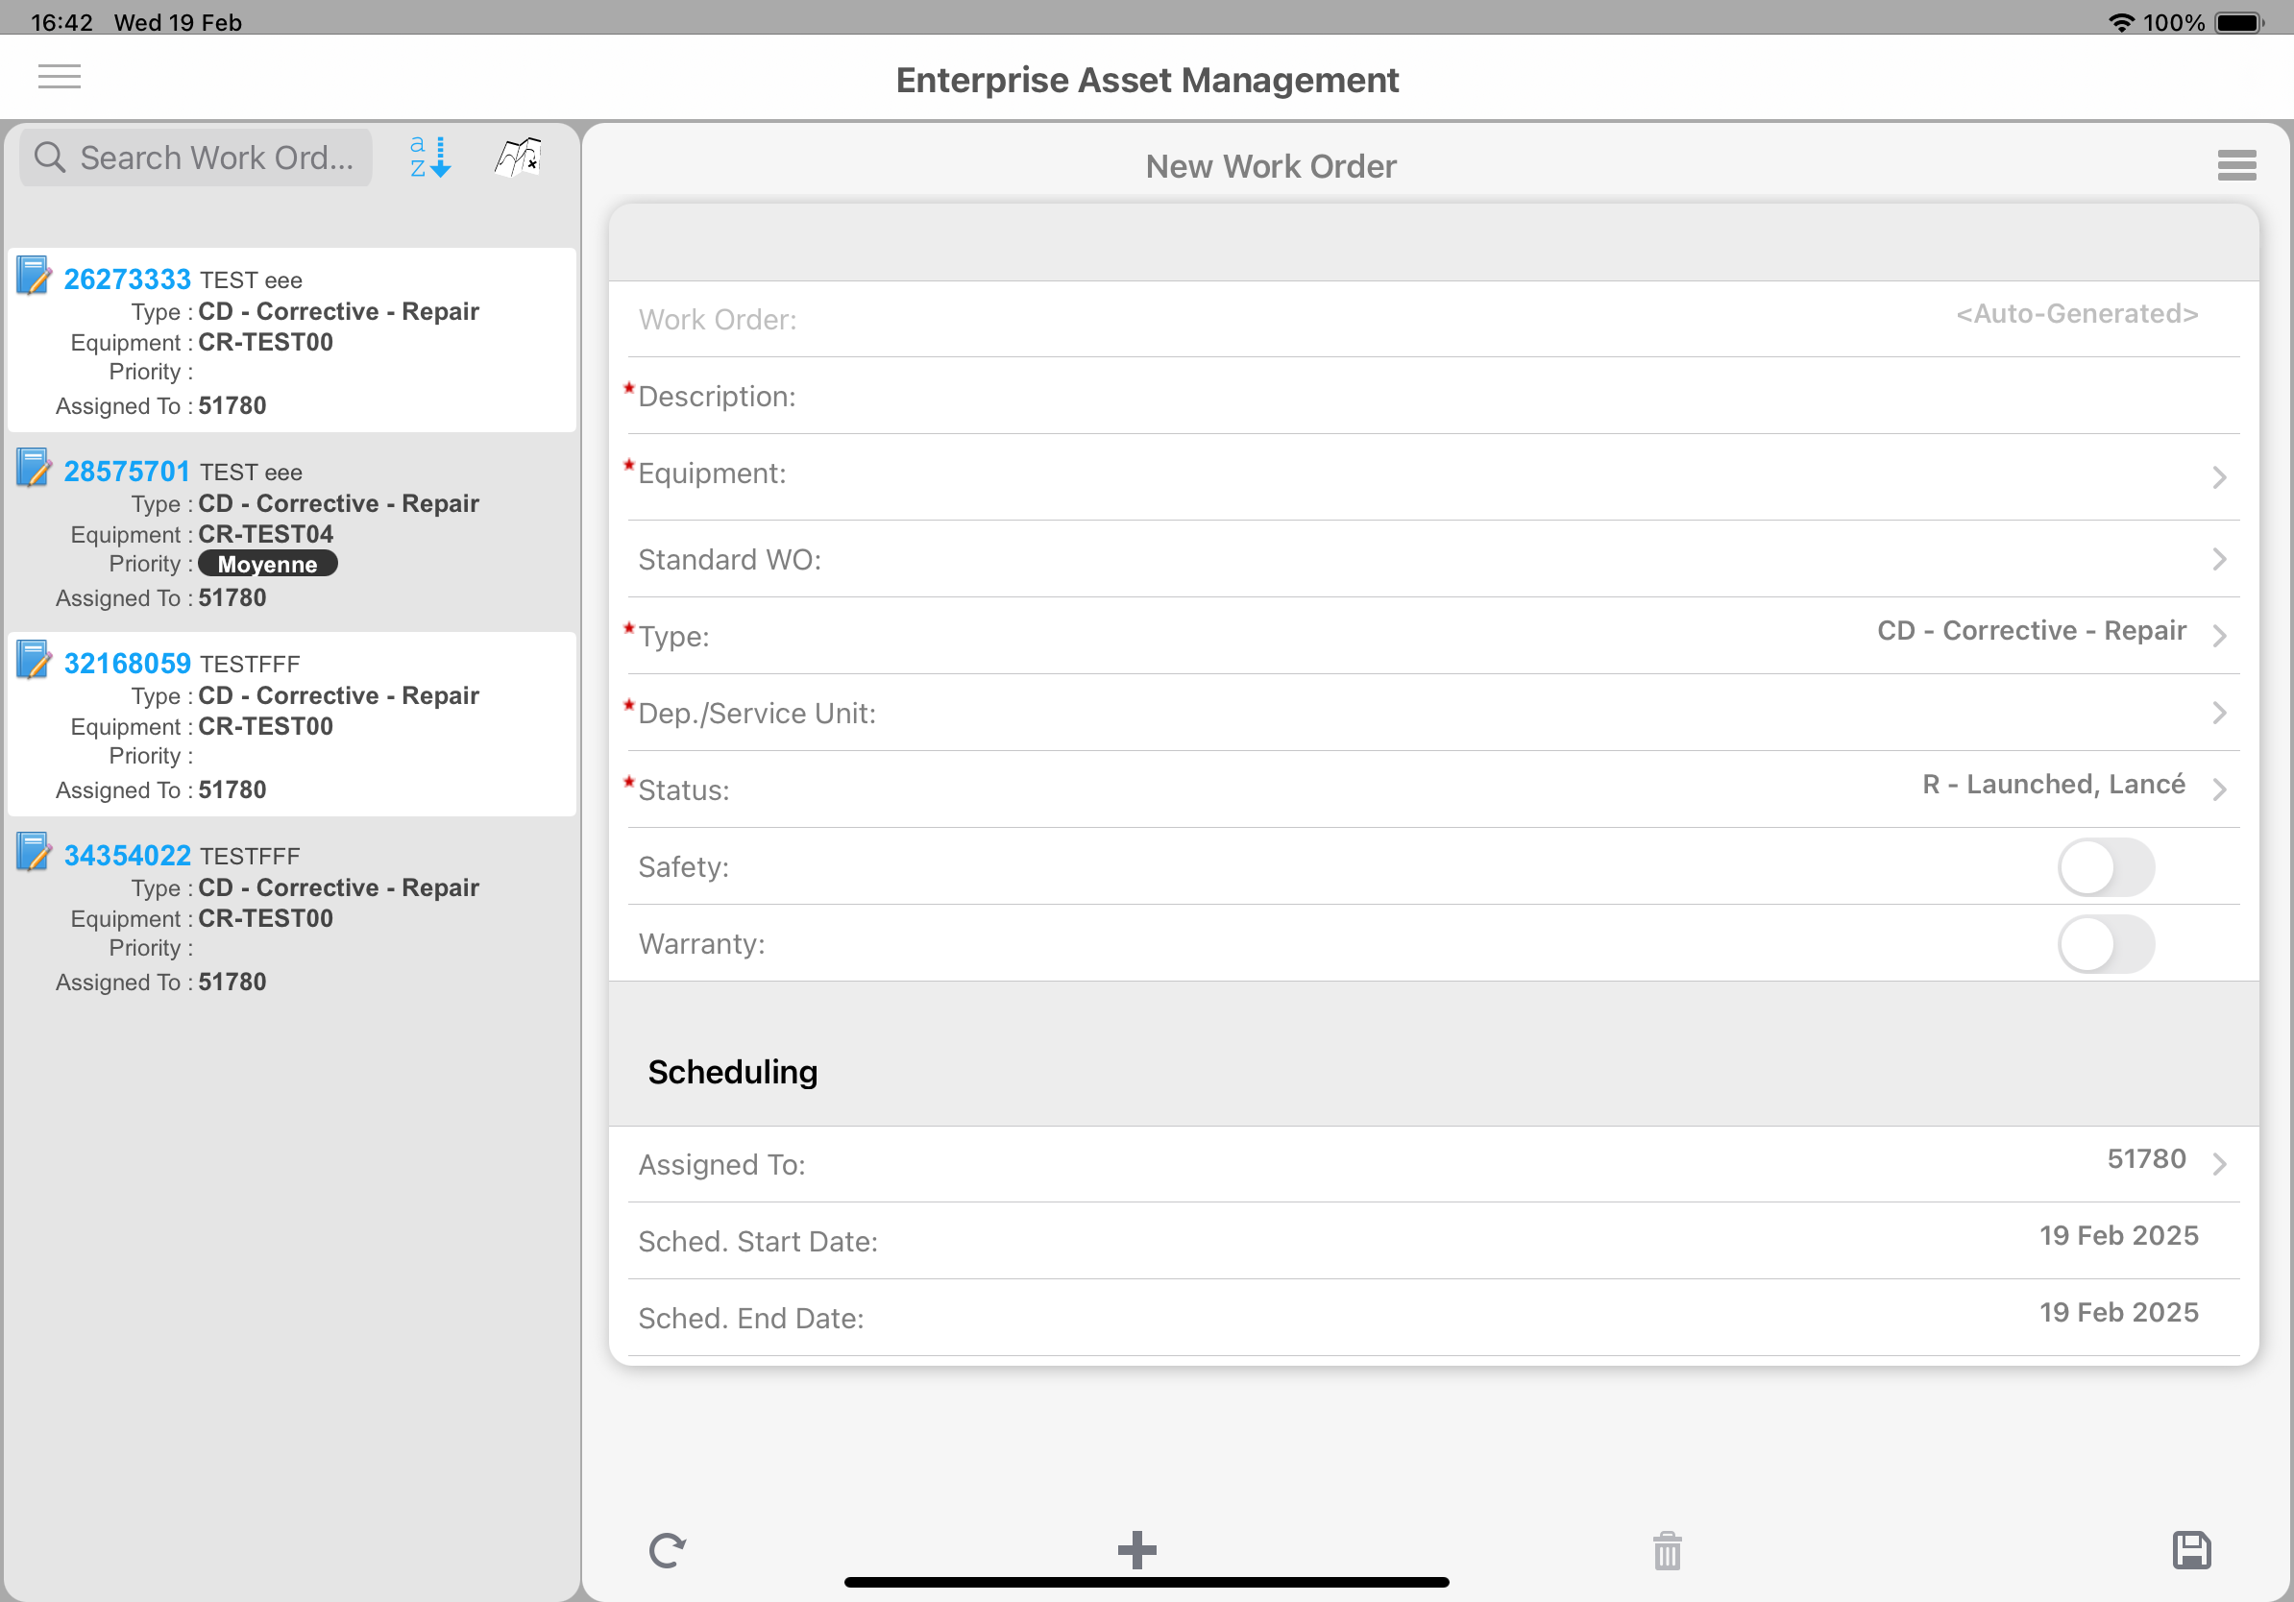
Work order creation
The quality data capture starts at the work order creation
Equipment
Description
Work order type
Department
Initial status
These are the elements of the simplest
work order, already providing lots of
useful information …
…only when the data is correct!

Slide 6
Good initial data: responsibility of the creator
Equipment
  Proper complementary information like Department and Location are crucial
  Classes, categories, responsible, criticality etc. are useful
Description
  Provide the precise enough wording to prepare the participants
Work order type
  Base of primary classification
Department
  Inherited from the equipment
Equipment, Description, Department, WO Type, Initial Status, Created by, Date Created, Reported by, Date Reported

Slide 7
Already pre-filled information
Important to have dedicated user account to store specific information
Created by and Date created
Reported by and Date reported
Scheduled start date and end date is today
Additional fields could be
also populated automatically
Equipment, Description, Department, WO Type, Initial Status, Created by, Date Created, Reported by, Date Reported

Slide 8
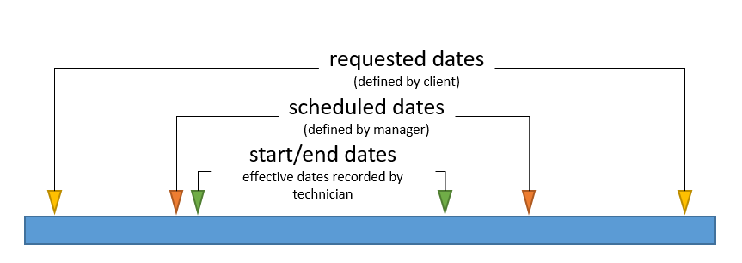
Dates
Reported Date
Requested dates
Scheduled dates
Start and end dates
Correct dates are the corner stones
of every reliability and performance indexes!
Requested dates, Scheduled dates, Start & End dates
Equipment, Description, Department, WO Type, Initial Status, Created by, Date Created, Reported by, Date Reported

Slide 9
Basic performance indicators
Few example KPIs with without additional data entry
Maintenance to repair ratio
Mean time between failures
Average time between repairs
Most maintained equipment
Most repaired equipment
Work distribution between departments
Basic reliability calculation Crow-AMSAA method
  Without failure mode knowledge
Requested dates, Scheduled dates, Start & End dates
Equipment, Description, Department, WO Type, Initial Status, Created by, Date Created, Reported by, Date Reported

Slide 10
Codification with closing codes: invaluable
Failure mode separation is the basis of advanced reliability analysis
Problem code
Failure code
Cause code
Action code
General or equipment specific codes
Basis of Weibull analysis
Closing codes
Requested dates, Scheduled dates, Start & End dates
Equipment, Description, Department, WO Type, Initial Status, Created by, Date Created, Reported by, Date Reported

Slide 11
Meter readings
Whenever is possible, automate it
Update with every work order
Basic for usage based preventive maintenance plans
Additional analysis possibilities for time vs usage
Meter readings
Closing codes
Requested dates, Scheduled dates, Start & End dates
Equipment, Description, Department, WO Type, Initial Status, Created by, Date Created, Reported by, Date Reported

Slide 12
Record what was done
Comments
Useful specific information
Hard to process automatically
AI could help to propose closing codes
Photos
"A picture is worth a thousand words"
Easy to capture with modern smartphones
Before – during – after images help the later analysis
Comments, Documents
Meter readings
Closing codes
Requested dates, Scheduled dates, Start & End dates
Equipment, Description, Department, WO Type, Initial Status, Created by, Date Created, Reported by, Date Reported

Slide 13
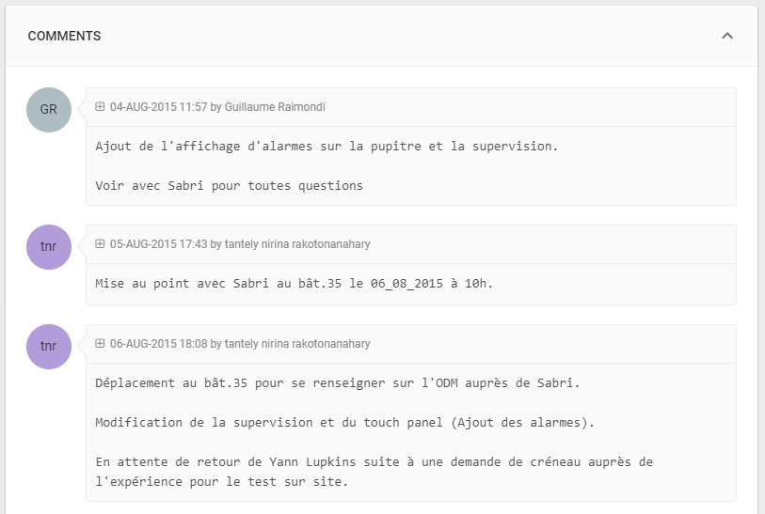
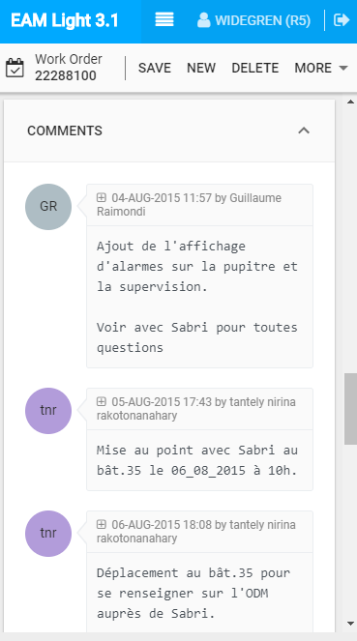
Easy to capture WO conversations
Quick overview of already entered comments
  When and by whom
Easy to add new comments
Simple to email WO link to colleagues for information or to request more details

Slide 14
Activities
Activity information provides a quantum leap in the work order data
More employee related information:
trades, required people and time estimates
More complete description of the work
Opens possibility to more detailed data recording
Activities
Comments, Documents
Meter readings
Closing codes
Requested dates, Scheduled dates, Start & End dates
Equipment, Description, Department, WO Type, Initial Status, Created by, Date Created, Reported by, Date Reported

Slide 15
Additional elements in activities
Activity information provides a quantum leap in the work order data
Possibility to record who did what and when
Ad-hoc or Material list based
part usage with direct issue
Additional cost recording
Part Usage, Booked Hours, Extra Cost
Activities
Comments, Documents
Meter readings
Closing codes
Requested dates, Scheduled dates, Start & End dates
Equipment, Description, Department, WO Type, Initial Status, Created by, Date Created, Reported by, Date Reported

Slide 16

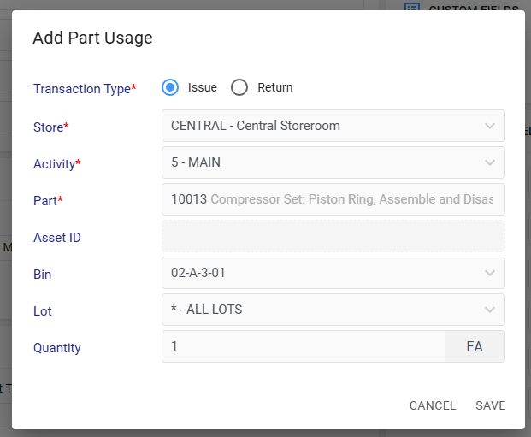
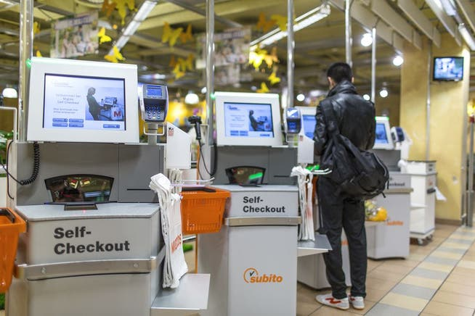
Part usage
Less and less stores have dedicated storekeepers
Self service issue is preferred
Direct issue in
work order
the most timely
way to record it

Slide 17
Detailed activities: Checklists
Structured information
Helps guiding during the activity
Possibility to enter notes and to create follow-up work orders
Checklists items grouped by activities and/or equipment (for route work orders)
Supporting e-signatures for formal processes
Checklists
Part Usage, Booked Hours, Extra Cost
Activities
Comments, Documents
Meter readings
Closing codes
Requested dates, Scheduled dates, Start & End dates
Equipment, Description, Department, WO Type, Initial Status, Created by, Date Created, Reported by, Date Reported

Slide 18
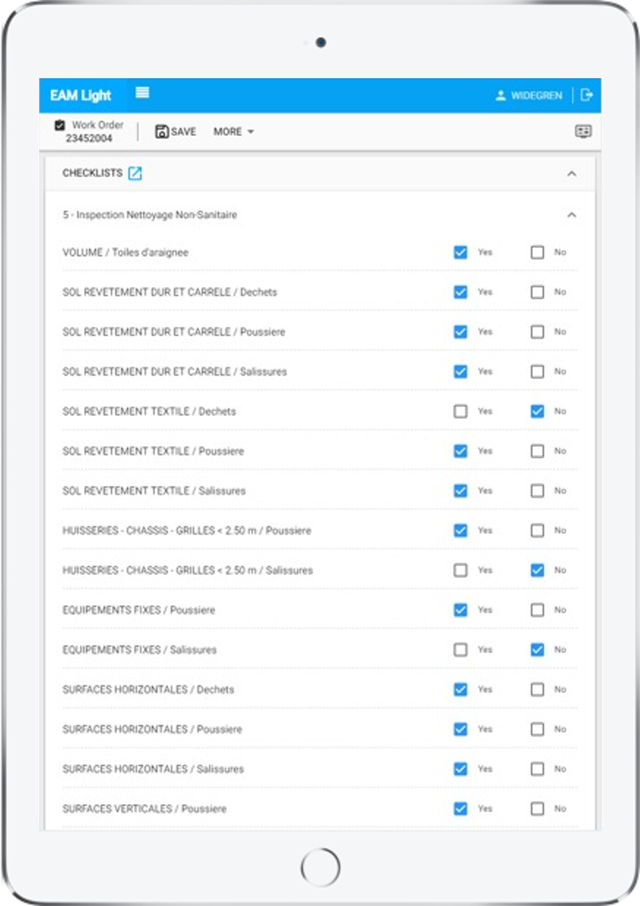

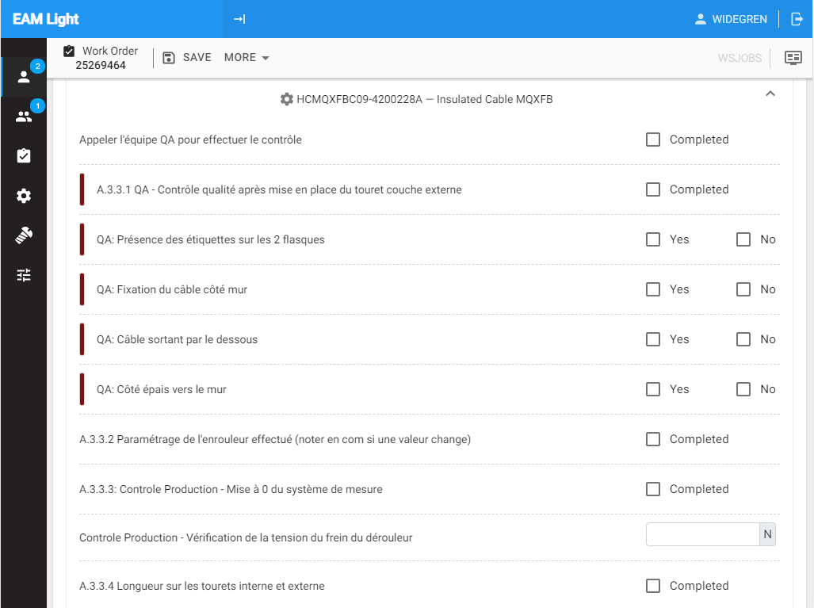
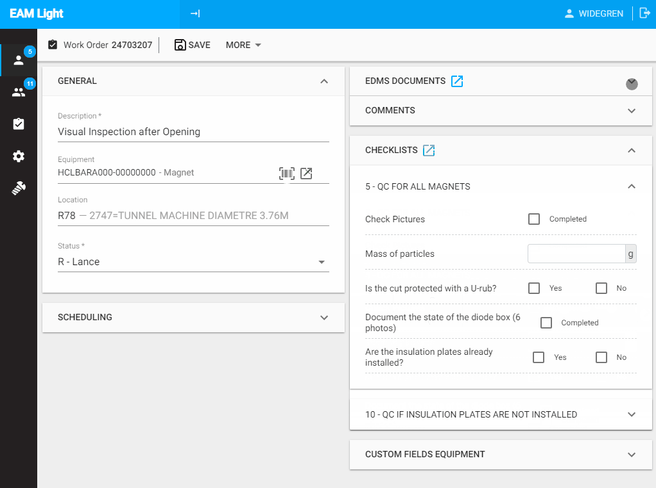
EAM Light Checklists on tablets: Easier than paper!

Slide 19
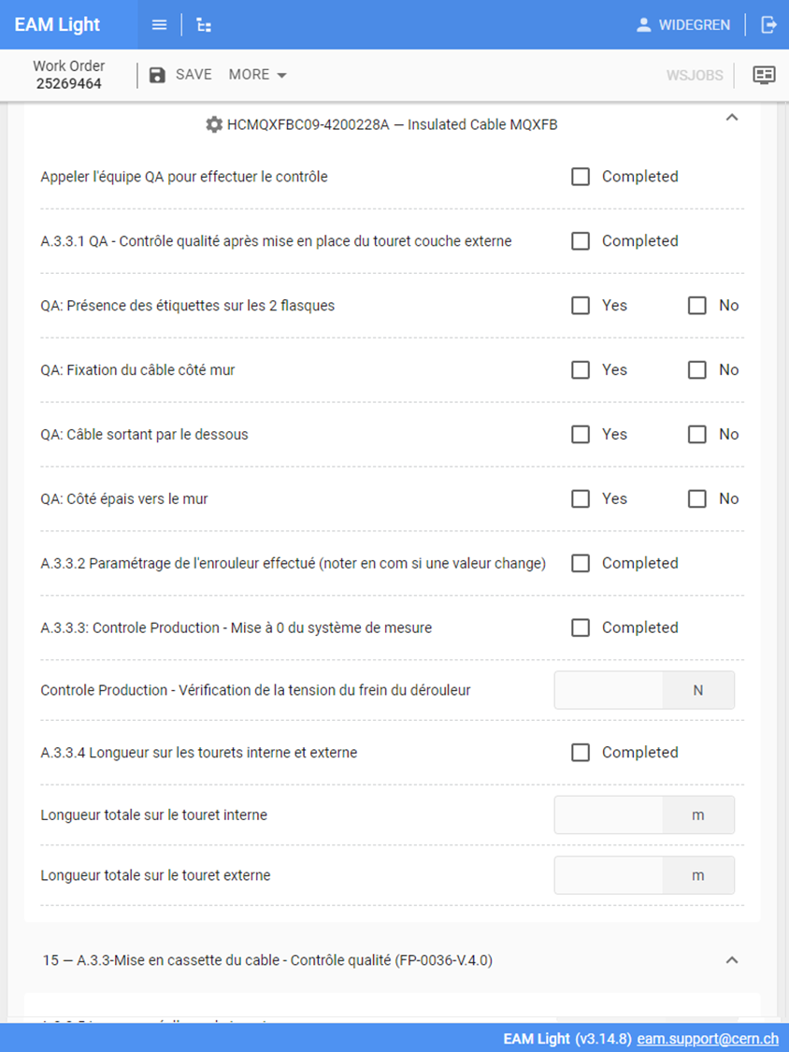
The need for EAM Light
HxGN EAM’s work order functionality is complex
EAM Light is a web application that provides a limited sub-set of the most used functions
The responsive design allows it to be used on both mobile devices as well as desktops
The purpose is to provide a simple and intuitive tool that can be used with little or no training and without on device deployment on the field
Make it even simpler than notes on paper!

Slide 20
Data quality issues
Better is no data than wrong data
Easy to pick the first option
Documentation is part of the work, the time should be reserved for it
Simplified interfaces can improve data quality but not magic solutions

Slide 21
Work order information pyramid
Checklists
Comments, Documents
Meter readings
Closing codes
Requested dates, Scheduled dates, Start & End dates
Equipment, Description, Department, WO Type, Initial Status, Created by, Date Created, Reported by, Date Reported
Part Usage, Booked Hours, Extra Cost
Activities
All stands on the
dedicated individuals on the field!
Provide training and explain the why the work order data is needed
Collect the right data:
only that data, what will be really used
Collect at the right place and time:
where and when it happens
Explain how the data was used
Dedicated individuals

Slide 22

Conclusions
All indicators are as good as the underlying work order data
Work order data is entered by real people, dedicated individuals on the field
Already a small amount of correct data could provide crucial insights

Slide 23
Questions?

