Slide 1
How to Leverage AI to Determine MRO/Spare Parts Criticality and Stocking Strategies
Jeromy Risner
Director, Solution Engineering
Maintenance and Reliability Professional
Verusen
Notes:
Spent most of my career in maintenance and reliability. I started out in PdM consulting and turning wrenches to correct problems we identified.
That path led to implementing maintenance best practices across many industry verticals including chemical and general manufacturing, mining, and food & beverage

Slide 2
Who is Verusen?

Slide 3
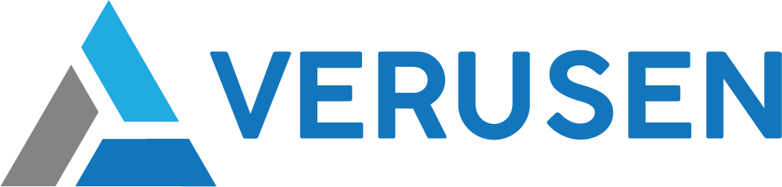
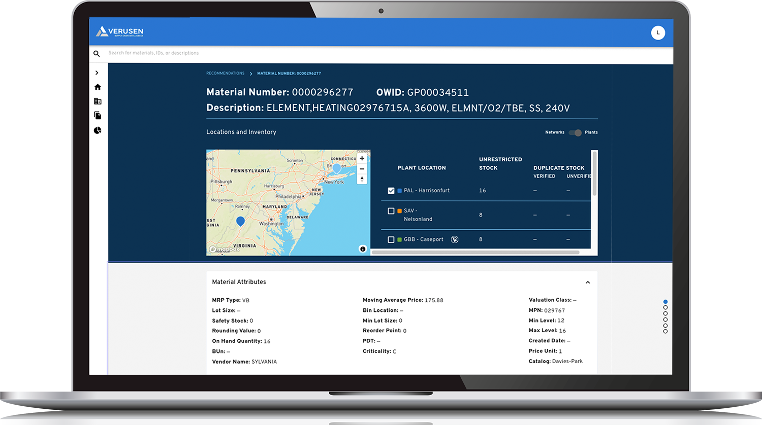
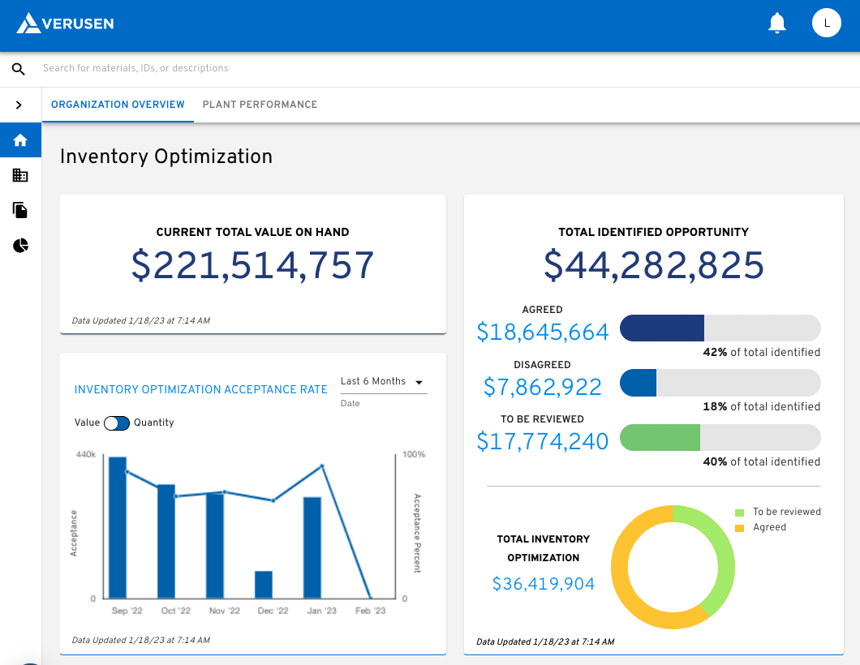

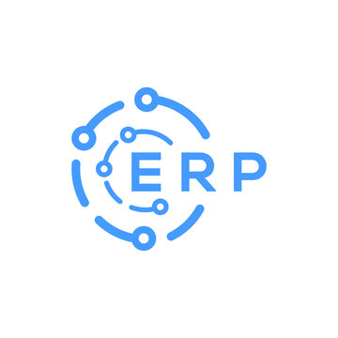

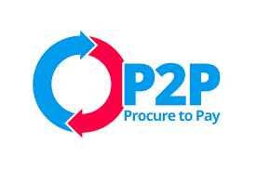




MRO Platform
We Ingest
Data Sources
We Deliver
Business Results
Material Flows, Consumption, Purchase Orders, Inventory Stocking Policies, Locations, BOMs, Lead Times (data as is)
Working Cap Reduction Without Increasing Risk, Improved Service Levels, Material Visibility, Reduced Unplanned Asset Downtime, Material Criticality, Ops/Procurement Alignment
USE CASES
Material Search and Discovery | Item Criticality Recommendations | Always On Inventory Optimization | Spare Part Sharing Support | Drive Organizational Alignment | Supplier & Category Spend Analysis | Network Modeling
Notes:
With our trained AI solution, we routinely ingest our client’s data from their ERP and/or EAM, process it with our LLM in our graph database, and deliver results.
Helping you find your materials effectively and efficiently using NLP.
This graph database also understands and recommends material criticality, which is the foundation for the next key function, setting stocking strategies or optimizing inventory.
So, while I’m not focusing on this solution, I am focusing on the foundational element of assessing material criticality to drive effective stocking strategies.

Slide 4
System of Record + System of Intelligence
Hexagon EAM Role | Verusen’s Complementary Role
Manages inventory transactions (e.g., receipts, issues, transfers) | Analyzes historical transaction data to identify patterns and optimize inventory policies
Stores part master data (e.g., ABC classification, min/max levels) | Provides AI-driven recommendations for criticality, stocking levels, duplication, networking, sharing
Manages purchase orders and procurement workflow | Optimizes procurement decisions by identifying lead time risks, PPV, tail spend, supplier alternatives
Relies on manual user input for classification & min/max levels | Recommends, but the user is the ultimate decision-maker to reduce guesswork

Slide 5
What is Criticality?
Notes:
So what is criticality in the context of MRO inventory?
…the importance or necessity of a specific item in maintaining the continuity and reliability of operations.
It is a measure of how essential an item is to the functioning of equipment or processes, as well as the potential impact on operations if the item is unavailable.

Slide 6
Why Criticality?
Notes:
Why do we care?
Discussion
To ensure we appropriately manage materials.

Slide 7

Margin sinkhole
Production downtime
Increased maintenance costs
Inflated inventory value
Inflated carrying costs
Risk of obsolescence
Damage, deterioration, shrinkage
Notes:
“inventory isn’t an asset, though we keep it on our books as such. It is working capital that is not working.”
If it wasn’t a waste of money, we’d stock plenty of everything. Overstock and surplus wouldn’t be a concern.
However, for most organizations, carrying too much inventory cuts into our margins, which reduces our competitiveness and jeopardizes our businesses.

Slide 8

Striking a balance
The right parts at the right time at the lowest total cost of ownership
OR
Providing maximum service level from minimum inventory at the lowest cost
Notes:
So we care about criticality to set the right stocking policies and to manage materials effectively. And to improve uptime and reliability.
But stocking policies have to be balanced with cost.
We can stock a spare tire in our car because it’s a relatively low cost item that carries a high risk of operational impact.
We wouldn’t stock a spare transmission because the costs outweigh the risk or likelihood of failure.

Slide 9
MRO Material Criticality
Maintenance spares & materials
Notes:
So, we understand why criticality matters.
Show of hands… who has criticality ranking for their spare parts or mro inventory?
Is it trusted, current, and consistently applied?
The reason I ask is most organizations I’ve worked with over the past 15 years would say “we have criticality for parts” but it’s not trusted or evenly applied.
It seems to be more emotional and less objective, lacks granularity.
Roughly 70% of materials will be “critical,” meaning, nothing is critical.

Slide 10



Criticality methods
Checklist
New part
Periodic review
Binary
Checkbox in ERP/EAM
Best of Breed
Automation
Continuous
Binary • Emotional • Lack of Process • Siloed Decisioning • Outdated Data
Notes:
So how are organizations assessing and assigning criticality today?

Slide 11
Sample logic
Start
Insurance
or HSE?
Y
A
“A”
Asset?
Y
N
Capital
Spare?
Y
B
“B”
Asset?
Y
N
Fast?
Y
Price
< $250?
Y
C
“C”
Asset?
Y
Other Considerations:
Material Type
Specific Vendor
Supplier Risk
Work Order Priority
On BOM
N
N
Asset
Ties?
N
D
Notes:
This could be done w/ pen/paper when parts are added and at a specific review interval?
Could be done w/ excel and/or BI (rules based)
Could be done w/ a best of breed solution designed specifically for the unique challenges/requirements of MRO

Slide 12

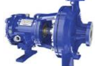
Automated Process to Assess Material Criticality
?
B
C
?
Material
Operations
Procurement
Operational Risk
Example
Bearing issued to “B” critical asset (reduced capacity)
Is the item critical?
Bearings inherit “B” criticality from asset
Is the risk mitigated?
Multiple suppliers
Very short lead time
Operational risk is lessened
Material Master
Material type
Commodity code
Criticality flag?
Safety or EHS?
Supplier(s)
Average price
Work Order History
Criticality of asset?
Reactive vs proactive?
Safety or EHS?
BOM or APL
BOM criticality?
Asset criticality?
Purchase Order History
Multiple suppliers?
Lead time?
Lead time variance?
Purchase price?
Expedited?
Hold requirements
(QA, regulatory)?
Notes:
Operations & Maintenance aligned with
Procurement & Materials Management
(FYI, this is a pillow block bearing used on a hammer mill). Perhaps the bearing criticality is unknown initially. Verusen leverages historical work order information and BOM data if available and finds the item has been issued to a hammer mill.
The hammer mill is “B” critical (won’t stop production, but will reduce capacity). The bearing inherits the asset criticality “B” as a starting point.
Verusen can then leverage procurement rules to escalate or de-escalate the operational risk of the bearing.
Having multiple suppliers and short lead time (as calculated from actual PO receipts), verusen recommends the risk to operations is mitigated to a degree and recommends Risk Code “C.”
With operations and procurement aligned on objectives, Verusen can now recommend a stocking level appropriate for the risk.

Slide 13
Leveraging AI
Notes:
Why leverage AI?
Assets vs materials > volume
..asset function rarely changes. Understanding it’s criticality to uptime, reliability, safety is often understood and hopefully documented
...for every asset, you may have 10’s or 100’s of materials. So for a chemical plant where I was the reliability guru for 6 years, we had around 1000 assets,
But we had closer to 30k unique sku’s and as you know, some of those items aren’t related to assets at all.
into scope alone indicates if you’re using manual processes you are likely not keeping up with where materials are used, how they’re used, or how they’re sourced.
All of which is subject to change day to day.
With AI, all of this can be monitored and factored into stocking strategies to ensure every item is stocked appropriately, minimizing cost and maximizing uptime.

Slide 14

Leverage Criticality To Drive Better Decisions
Why It’s Important
Current Inventory Policy Decision Making
Distinguish Critical and Non-Critical Parts
Enhanced Alignment Between Supply Chain and Maintenance/Ops
Adapt to Changes in Sourcing and Usage
Direct Impact on Stocking Strategies
Excess
Inventory
Stockouts
*Often gut-based/emotional approach
Verusen’s approach is to understand and apply criticality to every material, enabling operations team to make better informed, risk based inventory policy decisions
Notes:
Talk Track:
Distinguish Critical and Non-Critical Parts: Ensure accurate prioritization for better resource allocation.
Enhanced Alignment Between Supply Chain and Maintenance/Ops: Improve collaboration with a shared understanding of criticality.
Adapt to Changes in Sourcing and Usage: Keep criticality relevant with Verusen’s dynamic approach.
Direct Impact on Stocking Strategies: Optimize stocking levels by aligning inventory policies with criticality insights.
Lettie Notes:
Risk = probability x impact
Stockouts
Increases unplanned downtime
Potential HSE impact
Schedule Inefficiency
Emergency PO’s
Loss of customer trust
Excess Inventory
Higher working capital costs
Increased preservation requirements
Space inefficiency
Increased carrying costs
Parts Criticality Evaluation & Optimization
Risk based approach based on probabilistic modeling
Additional
Prob (1%, 99% service level) you wont have on hand and impact when you dont have on hand
Help you go through ever part and give you reccos so it will be dynamic … so you can have convo about every part

Slide 15
Leverage Criticality To Drive Better Decisions
Why It’s Important
New Inventory Policy Decision Making
Distinguish Critical and Non-Critical Parts
Enhanced Alignment Between Supply Chain and Maintenance/Ops
Adapt to Changes in Sourcing and Usage
Direct Impact on Stocking Strategies
Probability
Impact
*Risk based approach with probabilistic modeling
Verusen’s approach is to understand and apply criticality to every material, enabling operations team to make better informed, risk based inventory policy decisions
Notes:
Talk Track:
Distinguish Critical and Non-Critical Parts: Ensure accurate prioritization for better resource allocation.
Enhanced Alignment Between Supply Chain and Maintenance/Ops: Improve collaboration with a shared understanding of criticality.
Adapt to Changes in Sourcing and Usage: Keep criticality relevant with Verusen’s dynamic approach.
Direct Impact on Stocking Strategies: Optimize stocking levels by aligning inventory policies with criticality insights.
Lettie Notes:
Risk = probability x impact
Stockouts
Increases unplanned downtime
Potential HSE impact
Schedule Inefficiency
Emergency PO’s
Loss of customer trust
Excess Inventory
Higher working capital costs
Increased preservation requirements
Space inefficiency
Increased carrying costs
Parts Criticality Evaluation & Optimization
Risk based approach based on probabilistic modeling
Additional
Prob (1%, 99% service level) you wont have on hand and impact when you dont have on hand
Help you go through every part and give you reccos so it will be dynamic … so you can have convo about every part

Slide 16
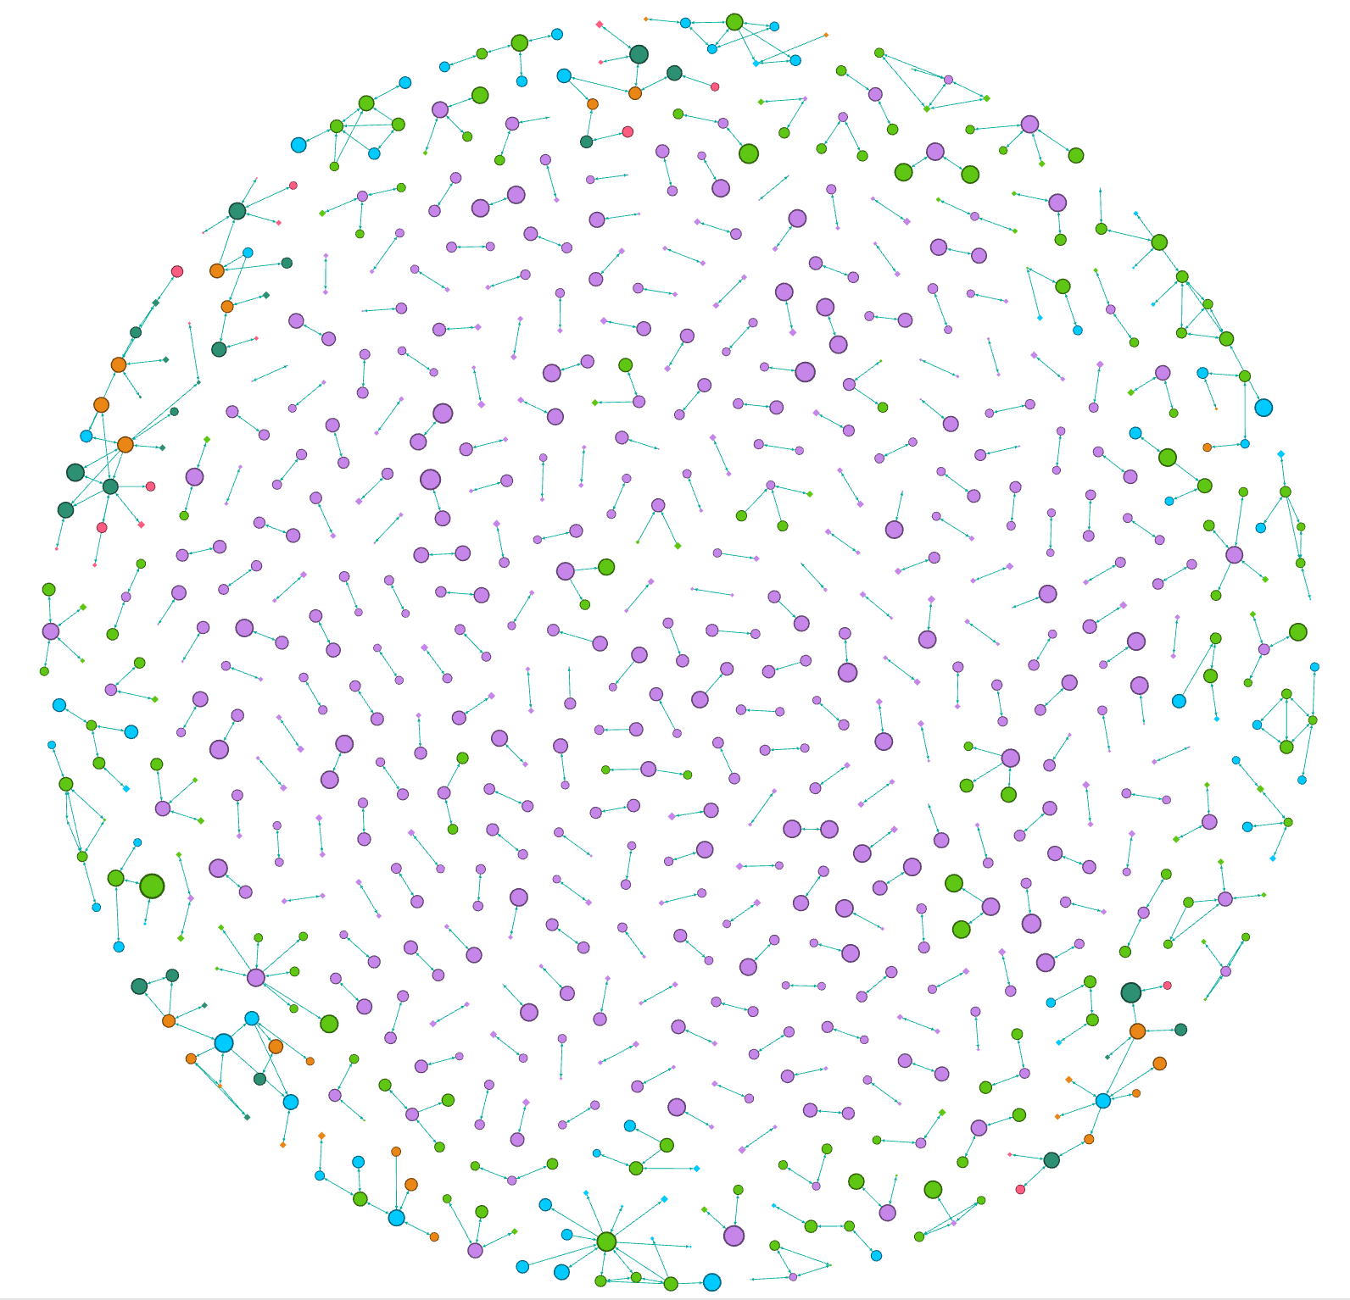
Verusen’s Material Graph: The Core of the Verusen Platform
Solving MRO’s toughest challenges begins with overcoming traditional data issues
51MM+ MRO Materials
Billions of MRO Transactions
We’ve cultivated data partnerships with industry associations, distributors, and select manufacturers and continue to grow our dataset.
We’ve aggregated, anonymized and analyzed “shop floor” decisions, issuances, purchase orders, work orders, and anything else that yields material insight.
MRO Specific
Modern LLM Technology
We’ve optimized multiple NLP and data engineering preprocessing techniques specific to MRO (e.g., abbreviations, UoM, etc.)
We utilize an LLM optimized for our graph that we’ve fine tuned to the nuances of MRO materials.
Our MRO material graph, the most complete and accurate of its kind,
enables us to uniquely identify trends in your data
while allowing us to get up and running day one without prolonged training

Slide 17
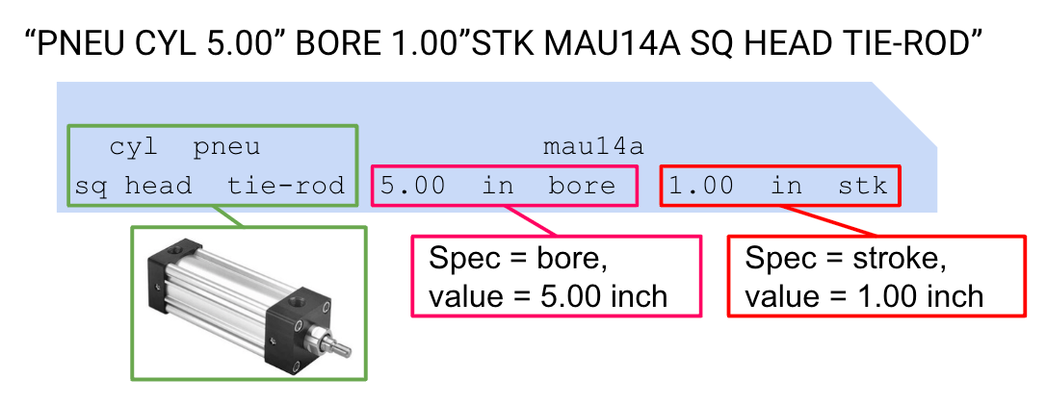

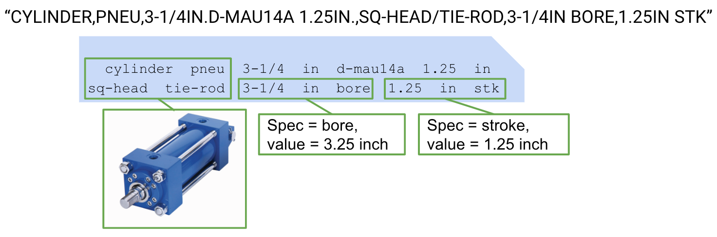
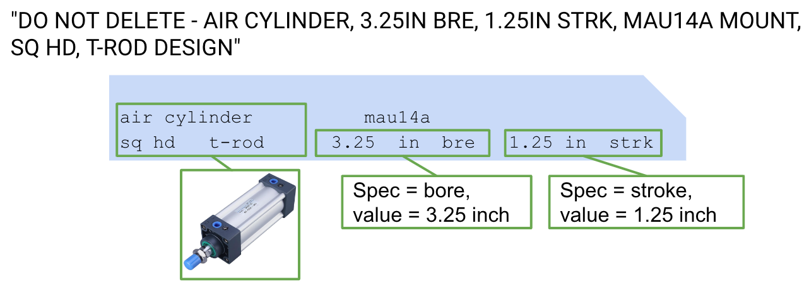

The Verusen material graph
identifying commonality, duplication
De-abbreviation
Seemingly like material not identified as duplicated due to mismatch in important product specifications (bore, stroke)
dimensional comparison
Numeric Normalization
ignores non-relevant text
Data Preprocessing:
De-Abbreviation
Numeric normalization
Dimensional comparisons
Ignoring non-relevant text
Prescriptive AI Models Used:
Large Language Models (LLMs)
Graph Databases
User-in-the-loop feedback models
Matching Material identified as Duplicate in Form and Specifications
Identified via Similarity Graph
Notes:
As an example of what a Graph db can do, let’s look at this pneumatic cylinder…
Tokenized nouns, modifiers, and attributes, de-abbreviation, ignoring irrelevant text, AI can recognize and be further fine-tuned and trained to understand like materials.
What’s the advantage?
If you have great, clean, structured data at one site within an organization, and “valve” at another site, site 2 can leverage insights from site 1. Where is that cylinder used? On a highly critical asset? What’s the cylinder’s criticality ranking and when was it last evaluated? Where it being sourced and at what price? What’s the suppliers performance look like? Is it highly variable or very consistent? How many do they keep in stock?
From criticality, to pricing and sourcing and stocking levels, AI can understand these factors and facilitate efficiency, effectiveness, and timeliness to ensure you remain competitive by minimizing cost and maximizing uptime.

Slide 18

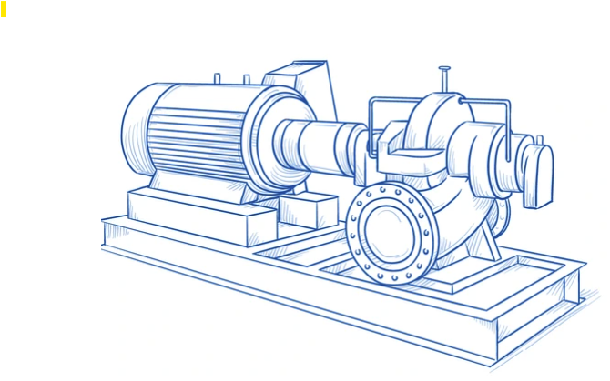
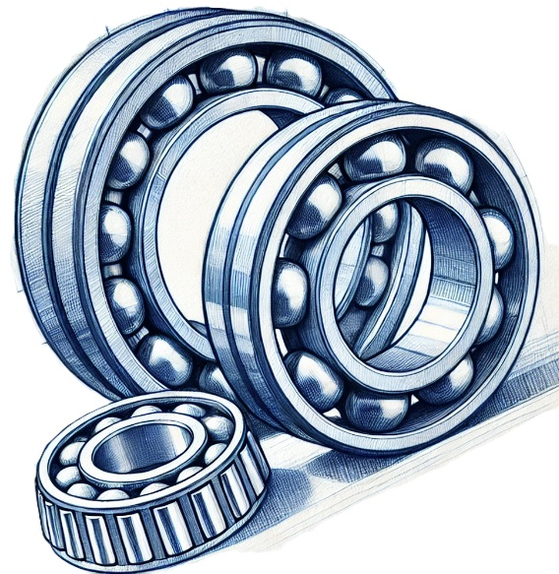

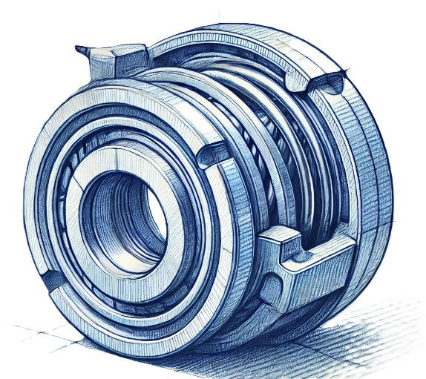

Machine learning
BOM or Usage
Criticality
Operational Risk
Multiple suppliers
Short lead-time
Coupling
Insert
A
B = 95%
Multiple suppliers
Short lead-time
Bearings
A
B = 95%
Single supplier
Custom build
Long lead-time
Impeller
A
A = 98%
Pump 802
Criticality = A
Production Critical
Multiple suppliers
Short lead-time
Mechanical
Seal
A
B = 95%
Train the model
A = 98%
Cleaning Supplies
D
D = 80%
Notes:
One more additional piece of AI we need to cover.
let’s take a quick look at machine learning. Here we have a critical asset with a BOM or Usage…
Can leverage any existing data, so if the BOM is incomplete, you can leverage historical wo’s to determine what materials have been issued to this asset.
Business logic may dictate that some items, regardless of where they’re used, may maintain a certain criticality ranking, while with other items it may depend on where those materials are used or even how they’re used. But when it comes to stocking strategies, you may want to balance criticality w/ supply chain constraints & procurement logic for strategic organizational buy-in!

Slide 19

Client Optimization Journey
12-24 MONTHS
LONG TERM & BEYOND
$62MM
Optimization Opportunity
$21MM Realized in <12 months
Acceptance of Verusen recommendations
(site and network level stocking policies)
Leverage of the Verusen Trusted Ecosystem
$41MM+ Long Term Potential Inventory Reduction
Continued network/spare parts sharing
Realizing burndown on slower moving inventory
Continued rundown of nonstock
Ongoing redisposition of SLOB targeting additional $21MM in value
+18MM
-47MM
RISK
$427
MM
Active Increases
-19.3MM
Active Decreases
-5.8MM
Networking
-1.8MM
-2.5MM
Repairable
VMI
-3.5MM
Deduplication
-21MM
Tail Spend & PPV
$365
MM
SLOB
$344
MM
Starting
SOH Inventory
Improved
SOH Inventory
Optimal
SOH Inventory
Notes:
Once our customers are brought onboard, we provide a high level overview of savings & reduction opportunities.
This customer began with an inventory value of over 400M. increases in active materials were recommended to mitigate risk/minimize downtime, while surplus in active materials are identified which can be consumed down to optimal levels.
With multiple sites spread out across different regions, Network optimization found an additional 19M in surplus (think: consolidating insurance spares and transferring materials)
And by leveraging our “repair-ready” partner, materials were identified that could be repaired instead of replaced for additional savings.
Moving fast turning, low value items to VMI can further reduce inventory value on hand.
Additionally, our material graph identified duplication where surplus can be reduced through consolidation. And finally, tail spend and PPV provide opportunity to leverage purchasing power to get better pricing and effective sourcing.
The total opportunity is 62M.
In the first 12 months after go-live, they realized 21M through accepting stocking recommendations.
There’s ongoing opportunity in efforts that may require some change management and project focus. However, optimization will continue to provide ongoing value.
When you move forward with us, these are the typical outputs and insights you will gain.
1:36

Slide 20
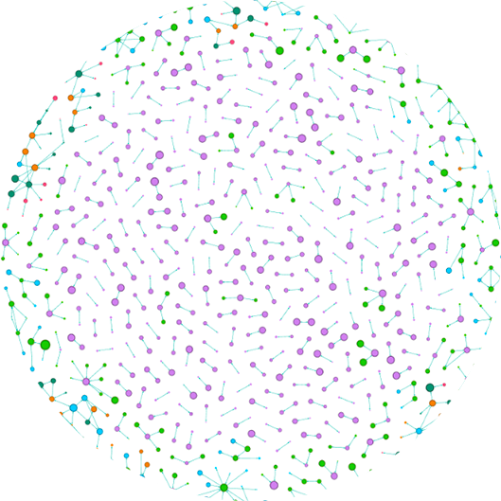

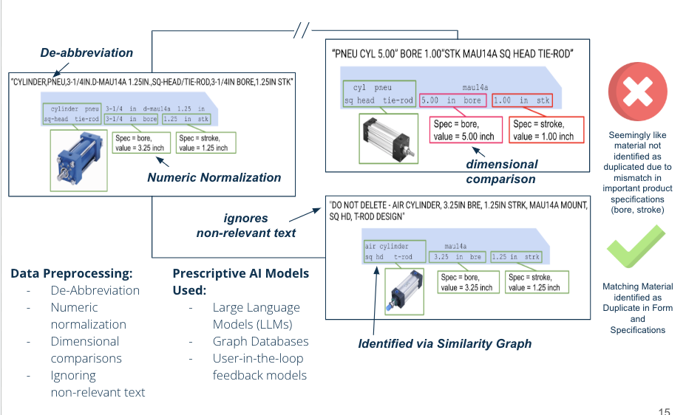
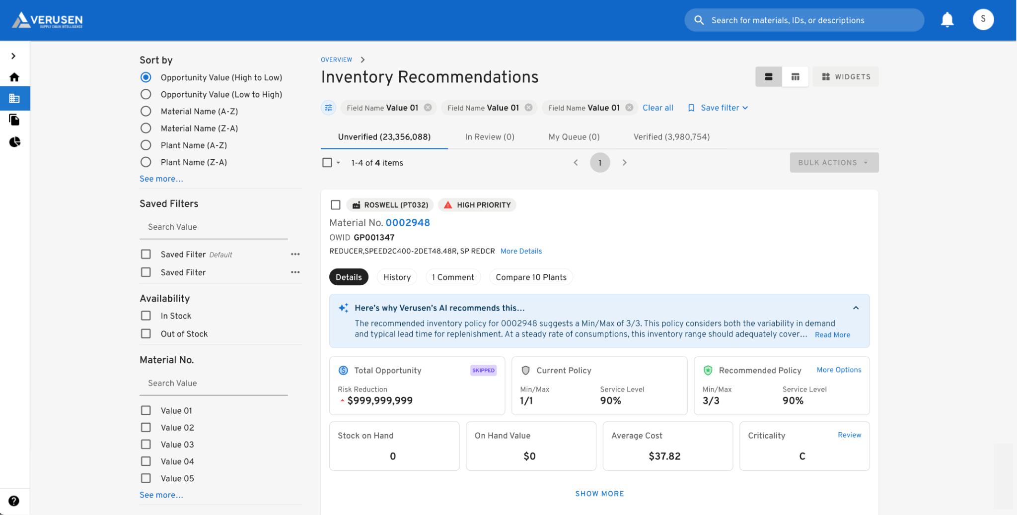
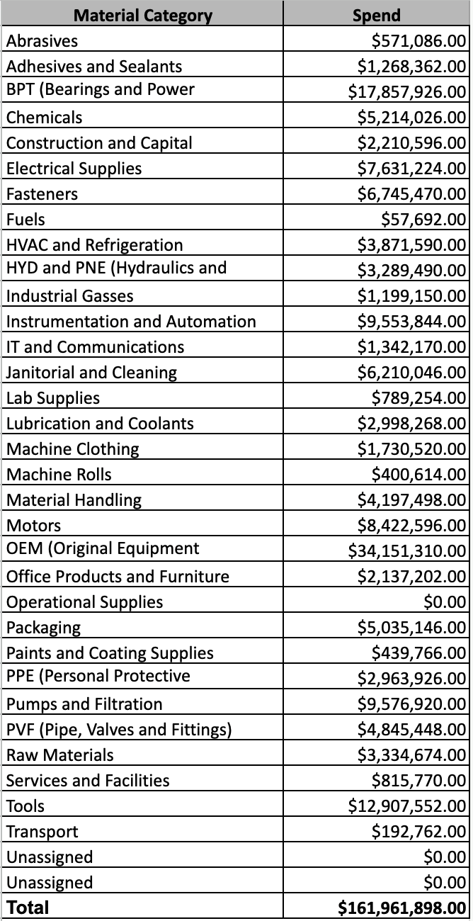
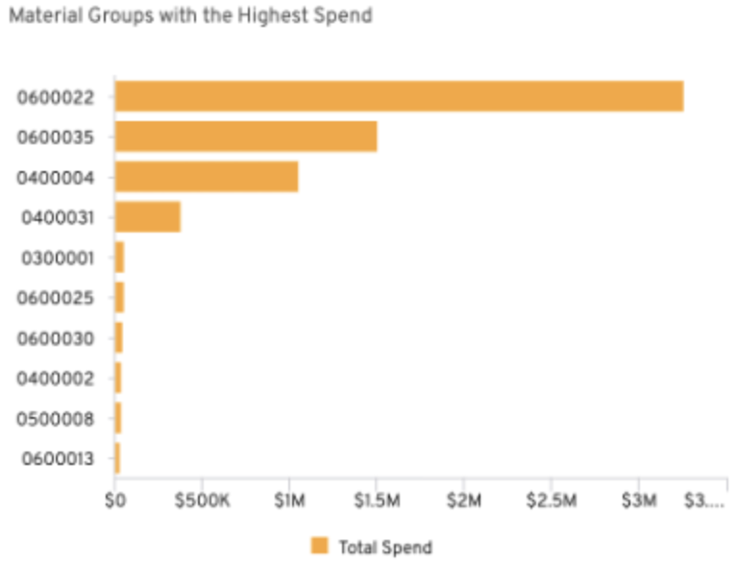
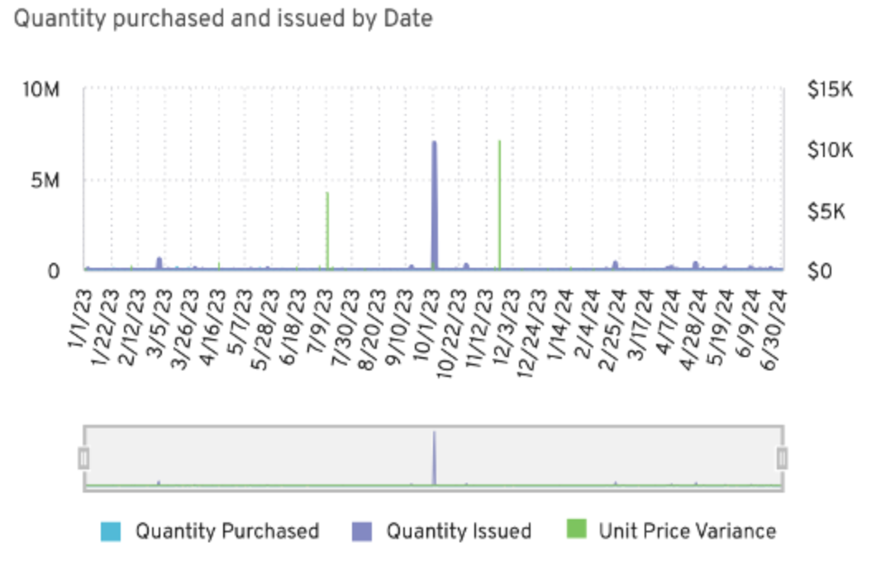
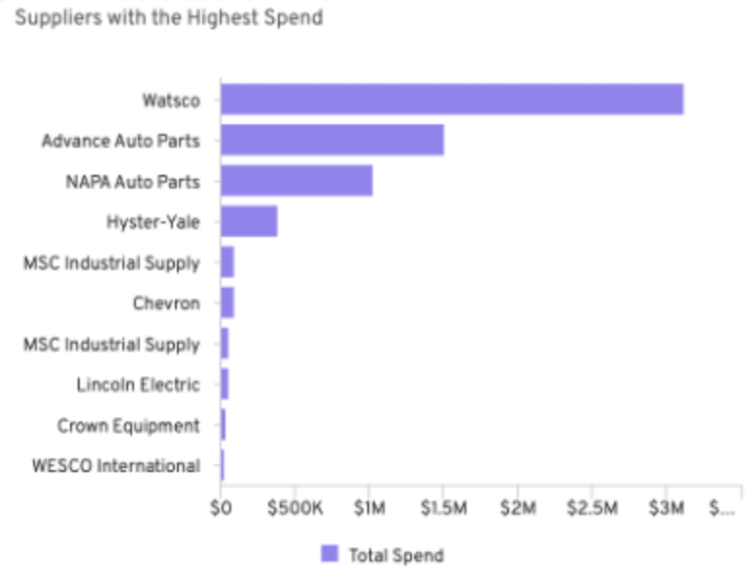
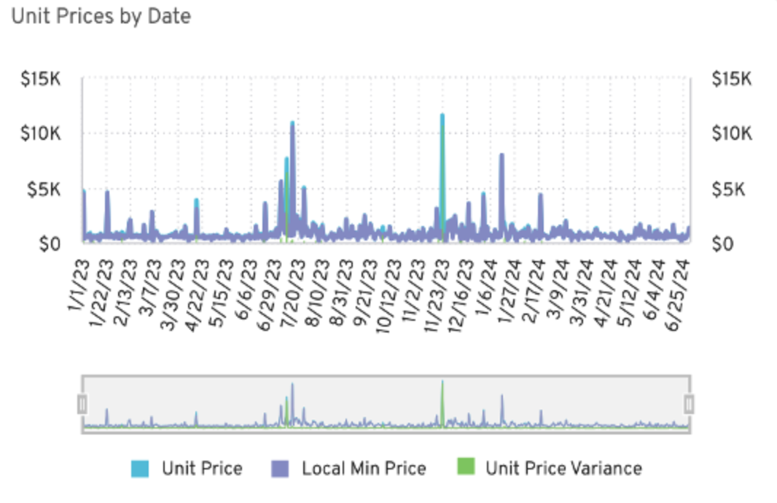
How Verusen uses Purpose-built AI for MRO
Verusen Material Graph
Deep Learning
User-in-the-Loop Models
Large Language Models (LLMs) &
Natural Language (NLP) Processing
The Foundation for Verusen’s Platform
Foundation for Inventory & Criticality Recommendations
Foundation for Duplicates & Search & Discovery
Ingested and trained on 50M+ unique MRO materials & $9B+ material transactions
Industry leading materials knowledge graph
Uses Stochastic Modeling, Machine Learning (ML), User-in-the-loop AI, and business logic
Right materials are stocked at the right levels
Understands complex material attributes to identify contextual relationships
Leverages Graph Databases
GenAI IO Explainability
AI Material and Spend Categorization
Foundation for Trust
Foundation for Scalability
Leverages generative AI to explain the "why" behind suggestions
Builds user trust and accelerates execution
Reduces manual effort, high costs & inconsistencies
AI-driven automation, “Out of the Box” 80%+ accuracy and scalability

Slide 21
Summary
Criticality is essential for effective MRO inventory management
AI enables objective, scalable, dynamic criticality assessments
Optimized stocking levels reduce costs and mitigate risks
Notes:
Key Takeaways
Criticality is essential for effective MRO inventory management.
AI enables objective, scalable, and dynamic criticality assessments.
Optimized stocking levels reduce costs and mitigate risks.
Call to Action
Explore AI-driven tools for MRO management.
Pilot criticality-driven inventory strategies in your organization

Slide 22
THANK YOU!

Slide 23
CTA
Pilot criticality-driven inventory strategies in your organization
Explore AI-driven tools for MRO management

Slide 24


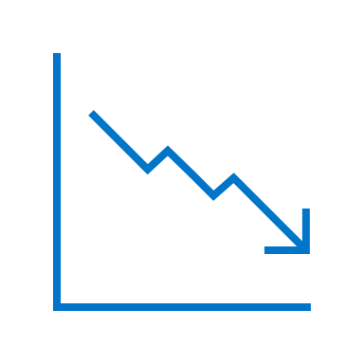

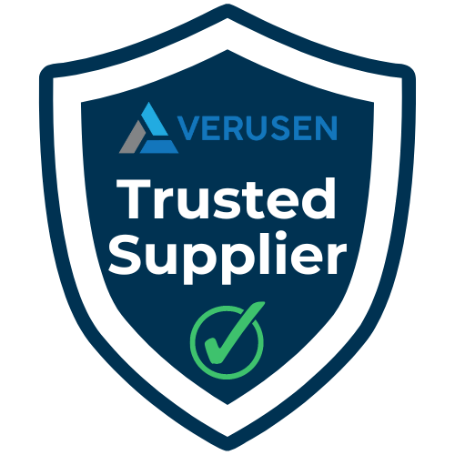


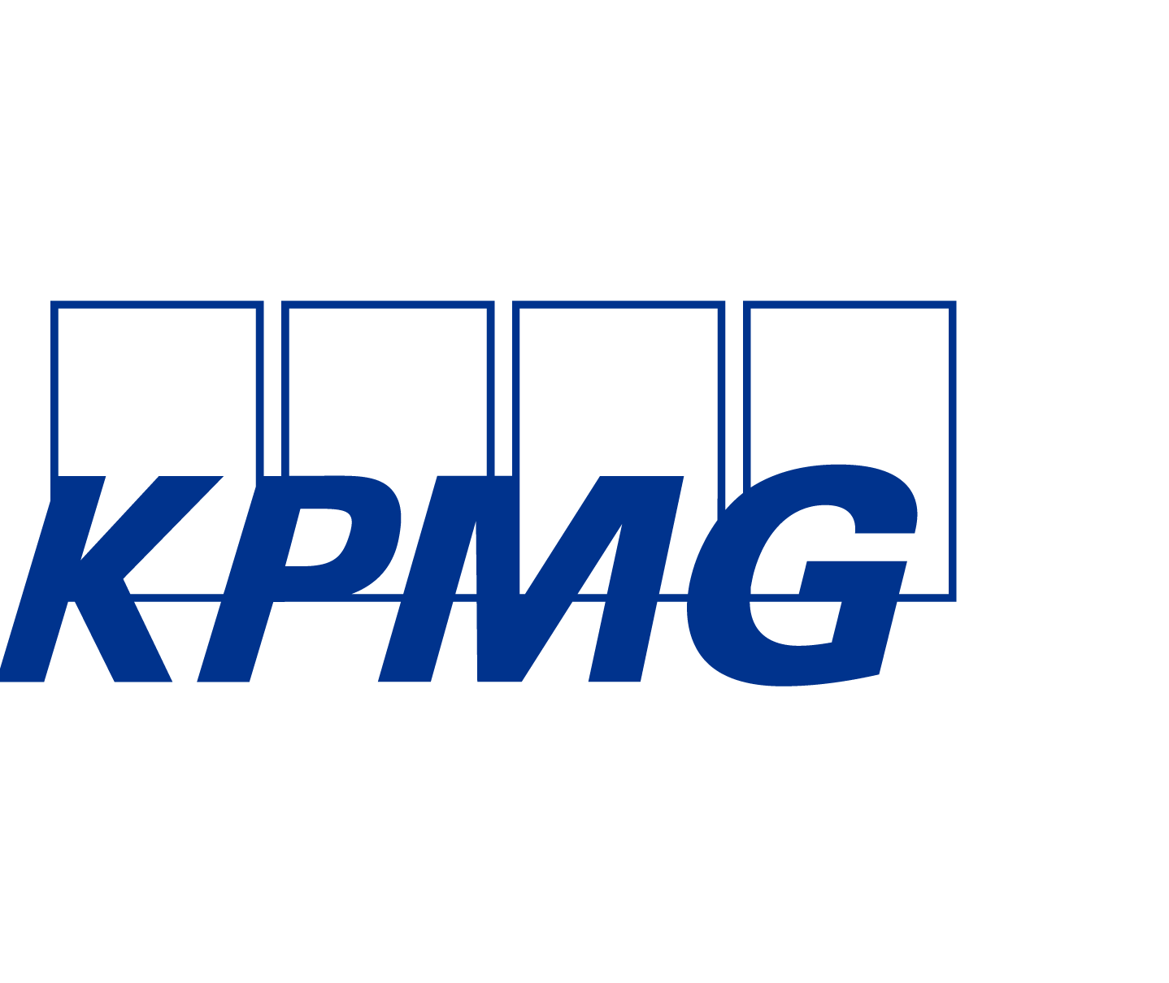
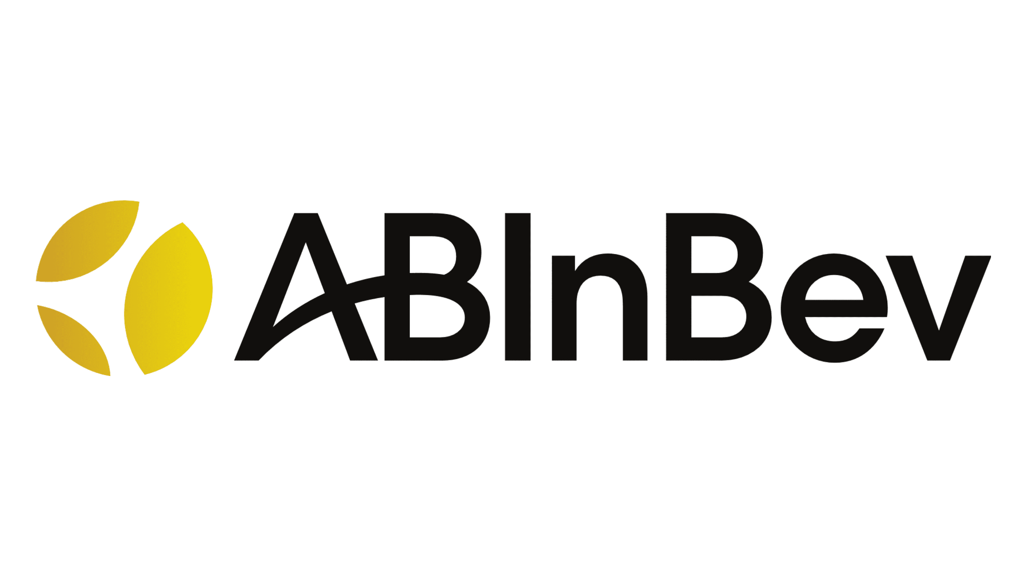
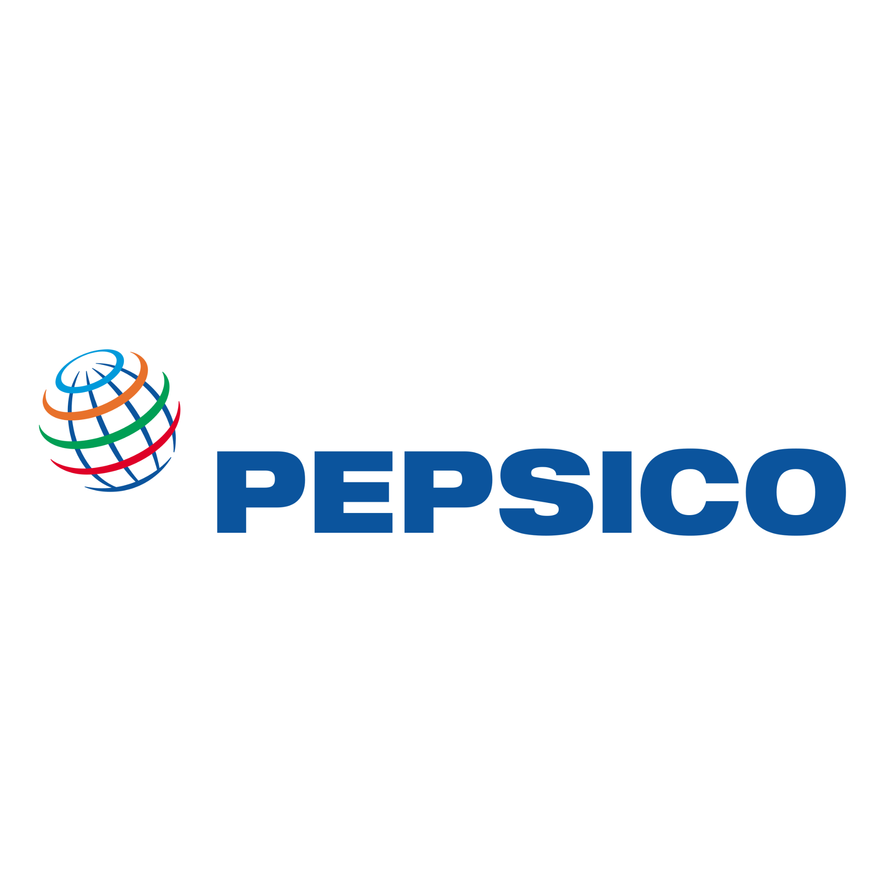








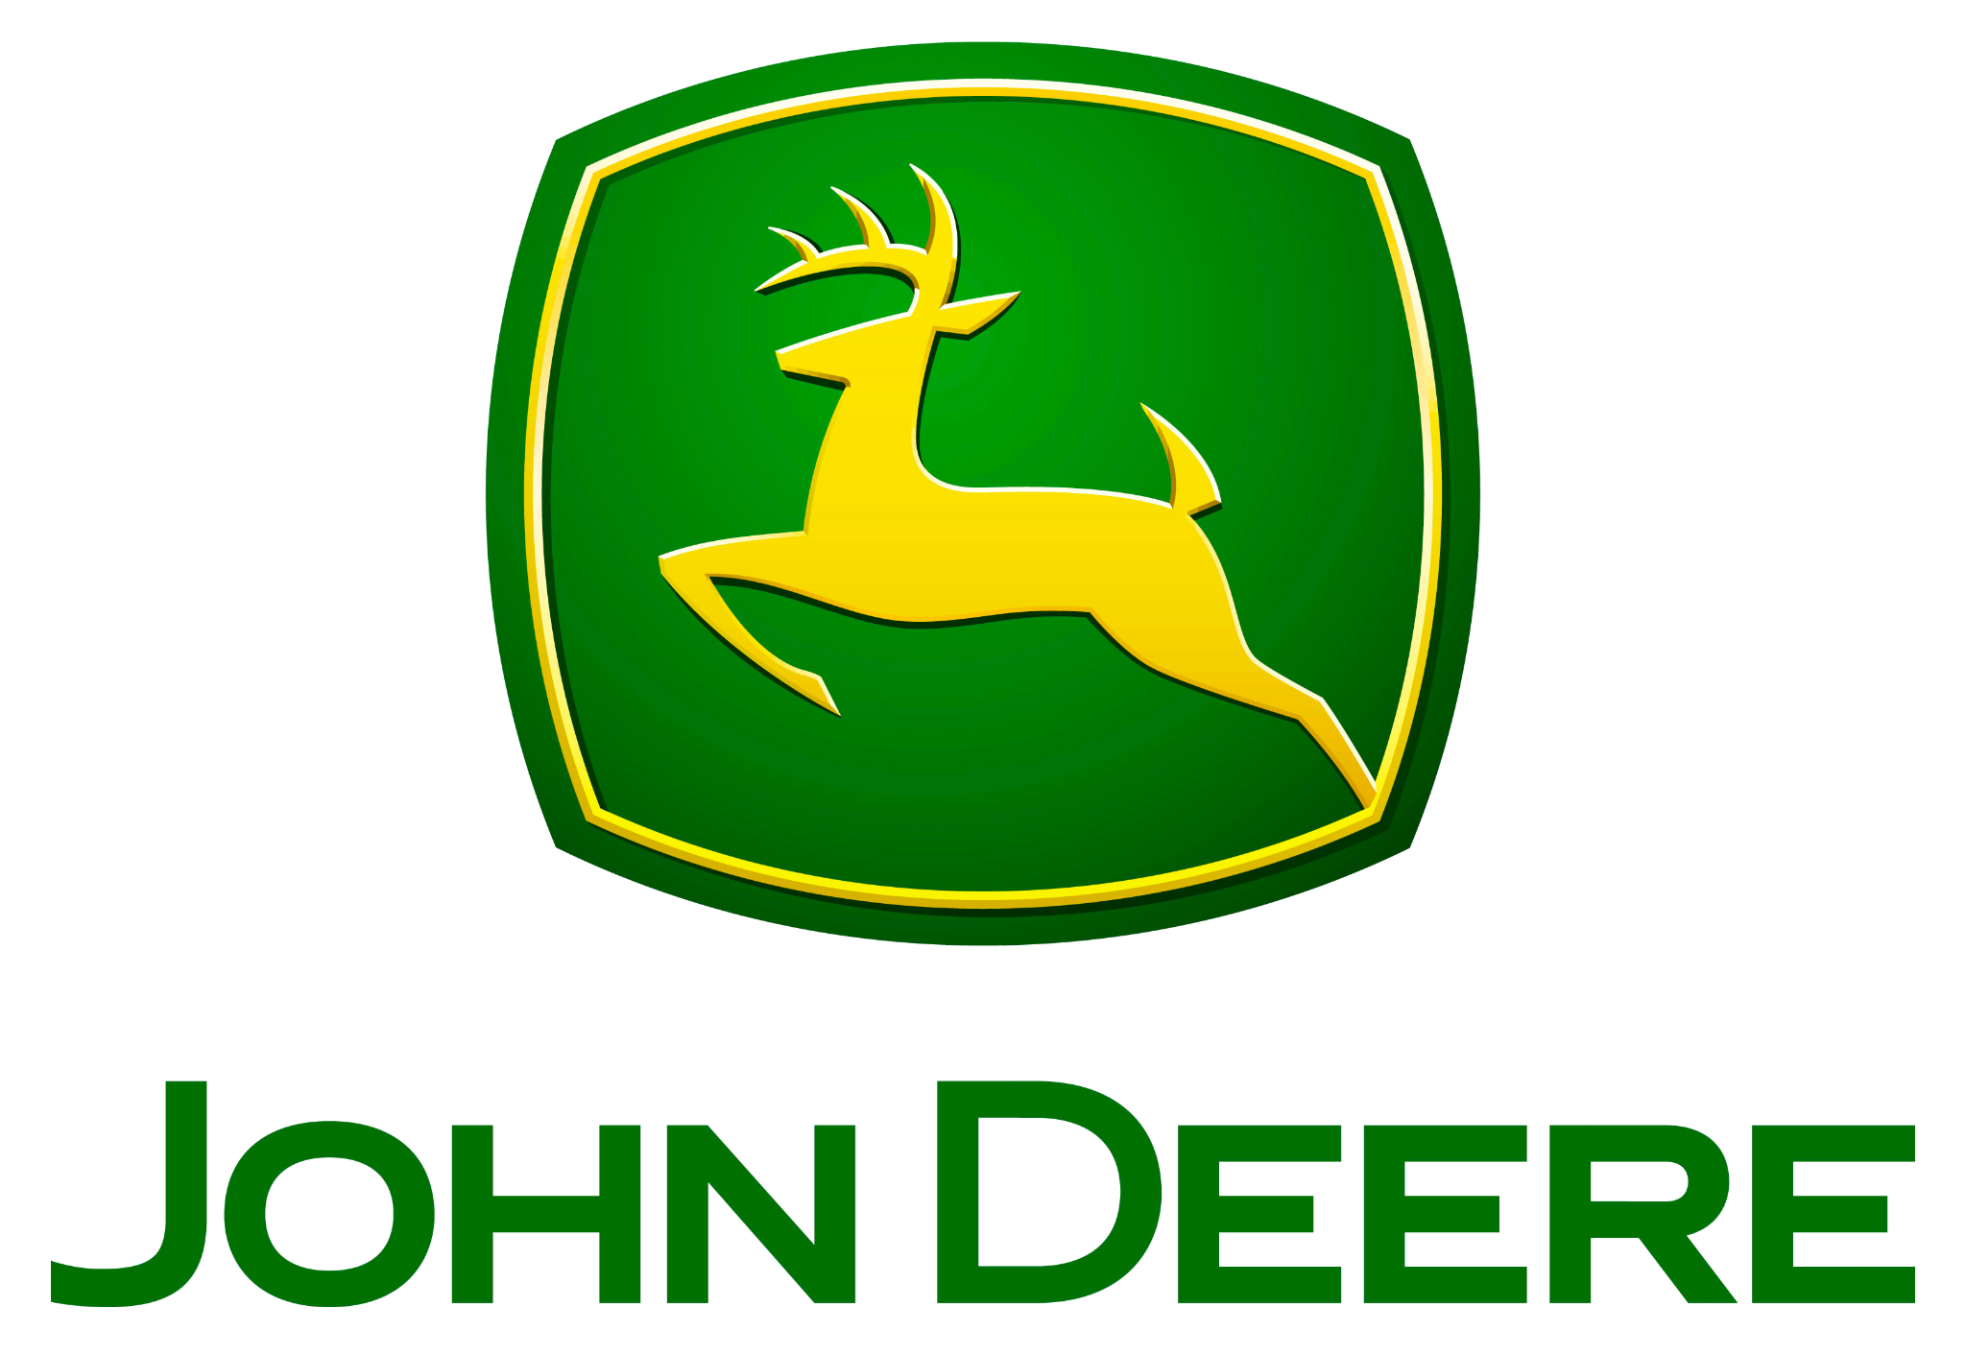









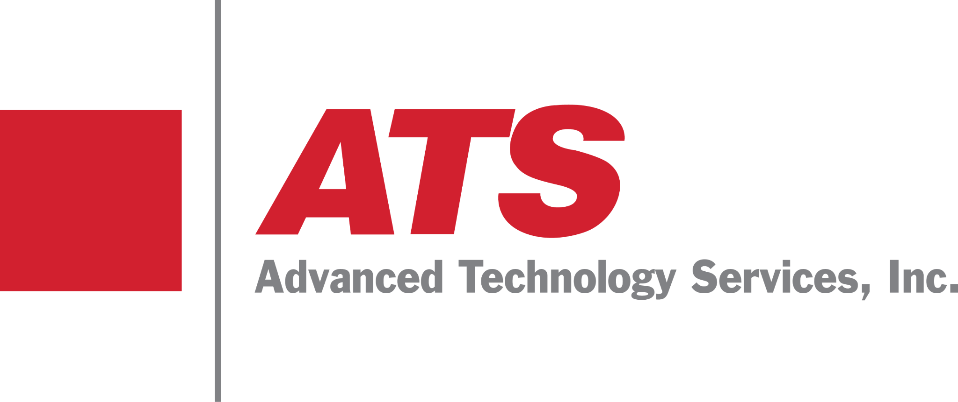

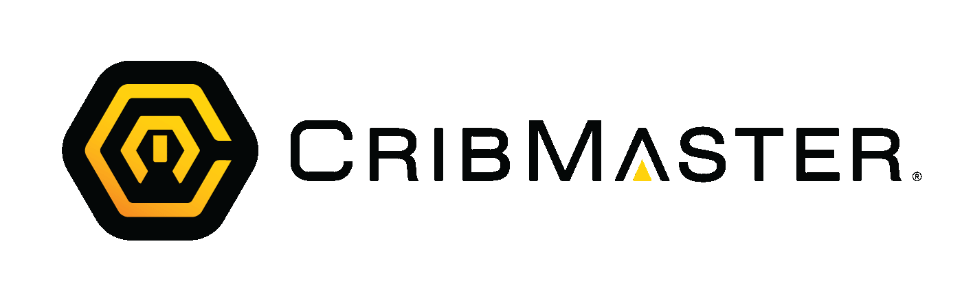




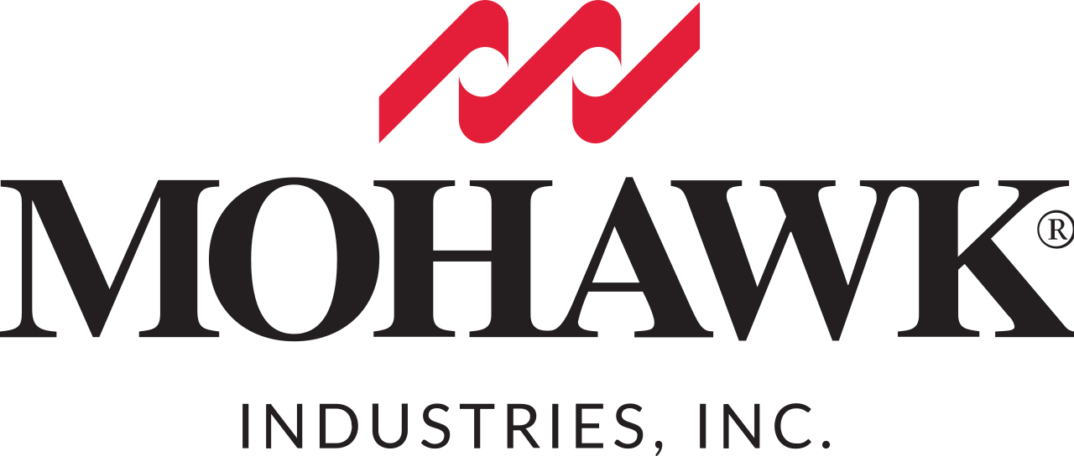

AI-Powered MRO Inventory Optimization
51M+
Unique MRO Materials
Ingested & Trained
$9B+
Material Transactions
Managed & Trained
14.9%
Net Decrease of
Working Capital
2.8%
Improvement in
Uptime
Selected Enterprise Customers
Partners
Notes:
Verusen’s sole focus is on the unique challenges and requirements of MRO material optimization, and
as you can see, we’ve had the privilege of working with industry leaders across various industries. These companies and their data provide 10’s of millions of materials and billions of transactions with which our AI models are trained.
This experience has given us a deep understanding of the unique challenges companies face when it comes to managing MRO inventory. Our AI is exclusively trained on mro inventory to to empower organizations to make smarter purchasing decisions.
38s

