Slide 1
Implementing HxGN EAM Using the Change Management Model ADKAR at San Jose Water Company
‘Q’ Quang Tran and Darien Young
San Jose Water Company

Slide 2
Agenda
SECTION 1
San Jose Water introduction
SECTION 2
Operations Department
SECTION 3
ADKAR
SECTION 4
Distribution Systems Department

Slide 3
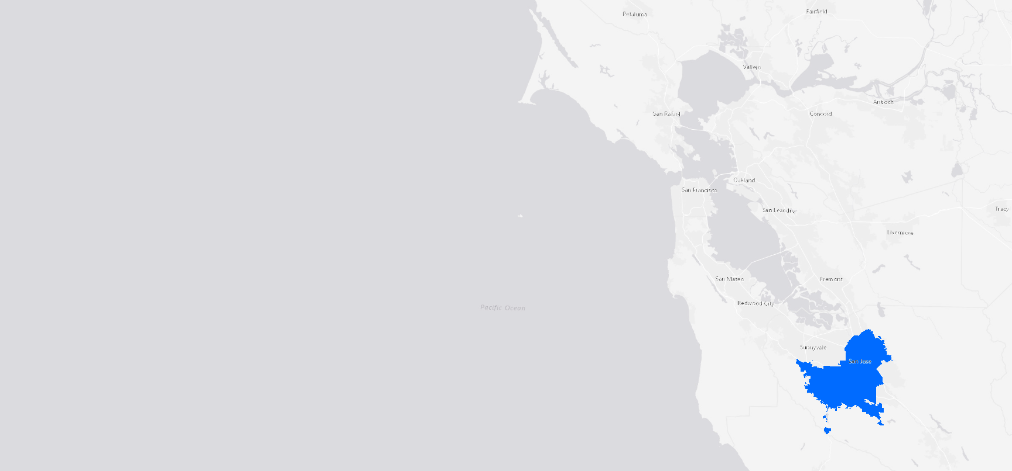
System Overview
Established in 1866
Provide water service to over 1 million people
3 water treatment plants
2,400 miles of pipe
340 pumps and motors
100 wells
120 tanks and reservoirs
20,000 fire hydrants
34,000 valves
234,000 meters and service lines
Notes:
Covering approximately 178 square miles
3 water treatment plants
Covering approx. 2400 miles of pipe etc.

Slide 4
Operations Department:
HxGN EAM Implementation
Who? | Operation Department Three end user groups: Operation Supervisor, Crew Trucks, Technicians
What? | Transition from a 20+ year old work order management system (Oracle WAM) to a new enterprise asset management system (HxGN EAM)
When? | December 2, 2021
Where? | San Jose Water
Why? | System reliability, digital transformation, efficiency, data collection, data quality, employee satisfaction, and more

Slide 5
High-Level Project Phases
Pre-project groundwork
Gained awareness of challenges and issues through interviews and job shadowing
Discussed ideas of how the future could be
Started with designated point of contact in each end user group
Began speaking with IT systems owners
Initial development: 2017-2021
Create naming and structural hierarchy of SJW Assets to be imported into EAM
Create and review import Excel sheets to be used with Import Utility application
Integration with supporting IT infrastructure: RDS and AWS
Notes:
Andy to talk about Key Takeaway #2: Awareness and desire can start much earlier, even years earlier, before CM was formalized

Slide 6
Outcomes and Lessons learned
Outcome: Performing interviews and job shadowing allowed for quick adoption of HxGN EAM and less resistance to switching from old system (WAM).
Lessons Learned: How interviews were done and how SJW shadowed jobs increased prep time and increased instances of revision to implementation plan
Outcome: HxGN EAM and its Preventative Maintenance module allowed San Jose Water to gather and use meaningful data. Helped Operation accurately identify areas needed to scale up.
Lessons Learned: Consultant standard UAT period was not sufficient time for SJW to discover issues and inconveniences from operating HxGN EAM in normal usage

Slide 7
Change management is the application of a structured process and set of tools for leading the people side of change to achieve a desired outcome.
(ProSci.com, 2022)

Slide 8
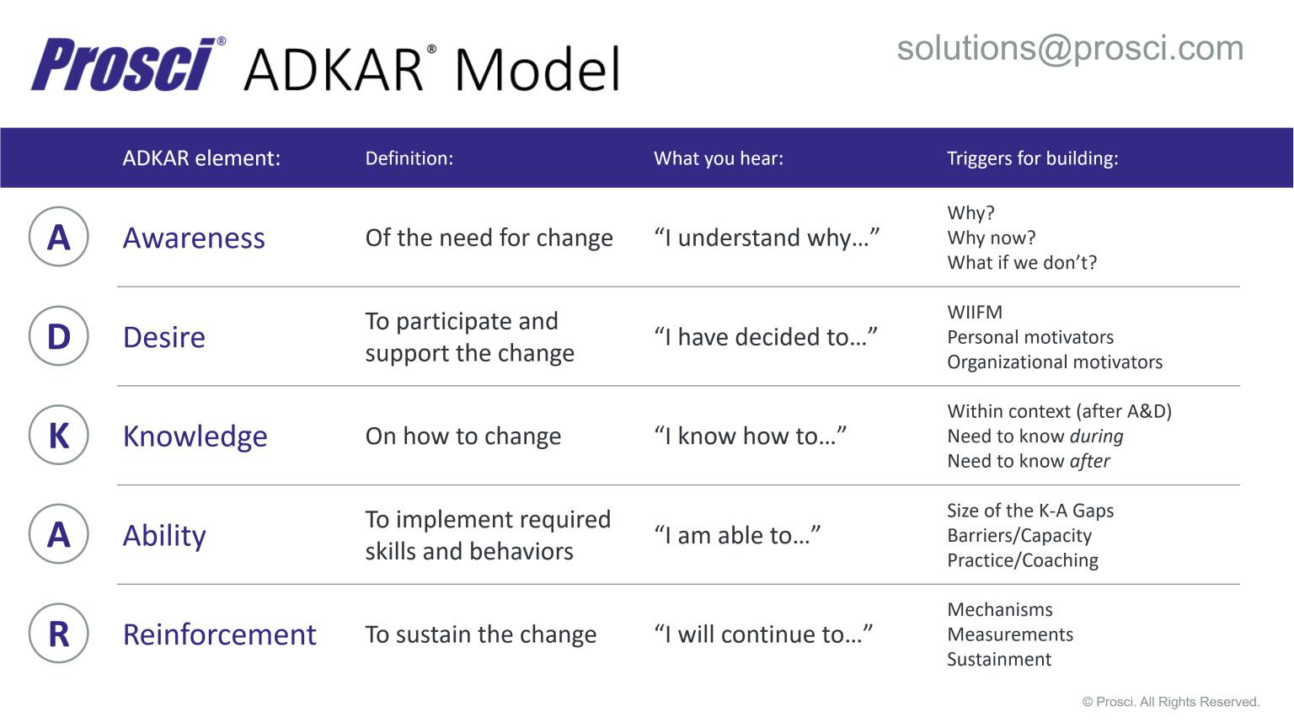
Image from ProSci.com

Slide 9
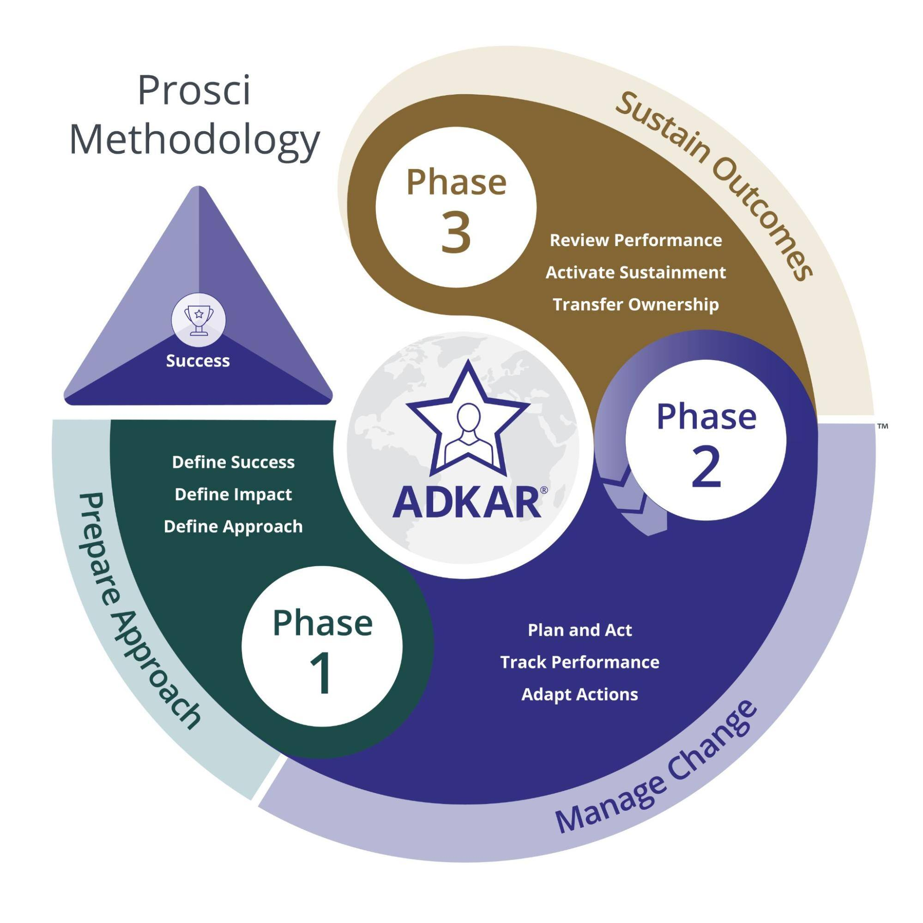
Prosci 3-Phase Process
Image from ProSci.com

Slide 10
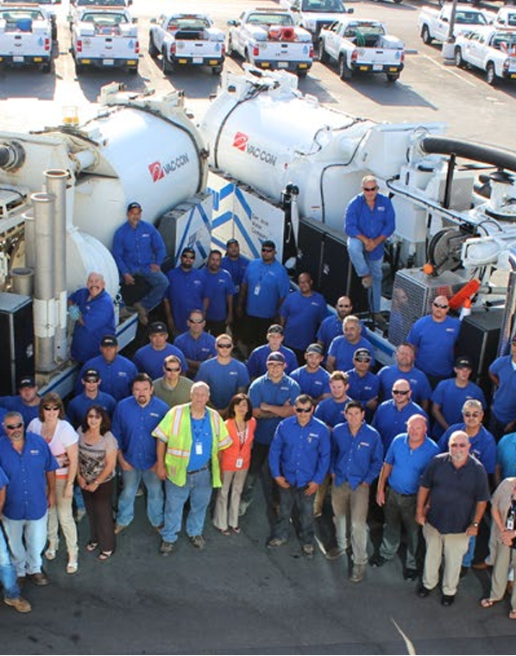
Distribution Systems Department
Approximately 80 plus employees
Approx. 20,000 fire hydrants
Approx 500,000 plus pipes, valves, and other assets
Notes:
Largest department
80 + employees running a 24/7 operation

Slide 11
Project Goals
Paper → Digital
Mobile devices
Automation of processes
Integration with Customer Information System
Integration with GIS
  Interactive mapping for work scheduling, dispatching work execution, and defect locating
Custom checklists to guide work and data collection
Change in workflow and responsibilities
Notes:
Utilized ADKAR as the change management method to successfully achieve these goals

Slide 12


Distributions Systems Department
Awareness
Hesitation to the switch
  Why?
  Why Now?
  What if we don’t?
Notes:
Hesitation to the switch
Users were unsure why we were pushing a new software direction
Wondering why this change is occuring now instead of later
Explained to them the why
Outdated software and its no longer being supported
Why now
Issues have occurred which we can not resolve
Software is retired by the developers
What if we don’t
Current system there won’t be any good support for the old system as time progresses
Current issues will get worse as time goes on
Efficiency may drop due to more issues

Slide 13

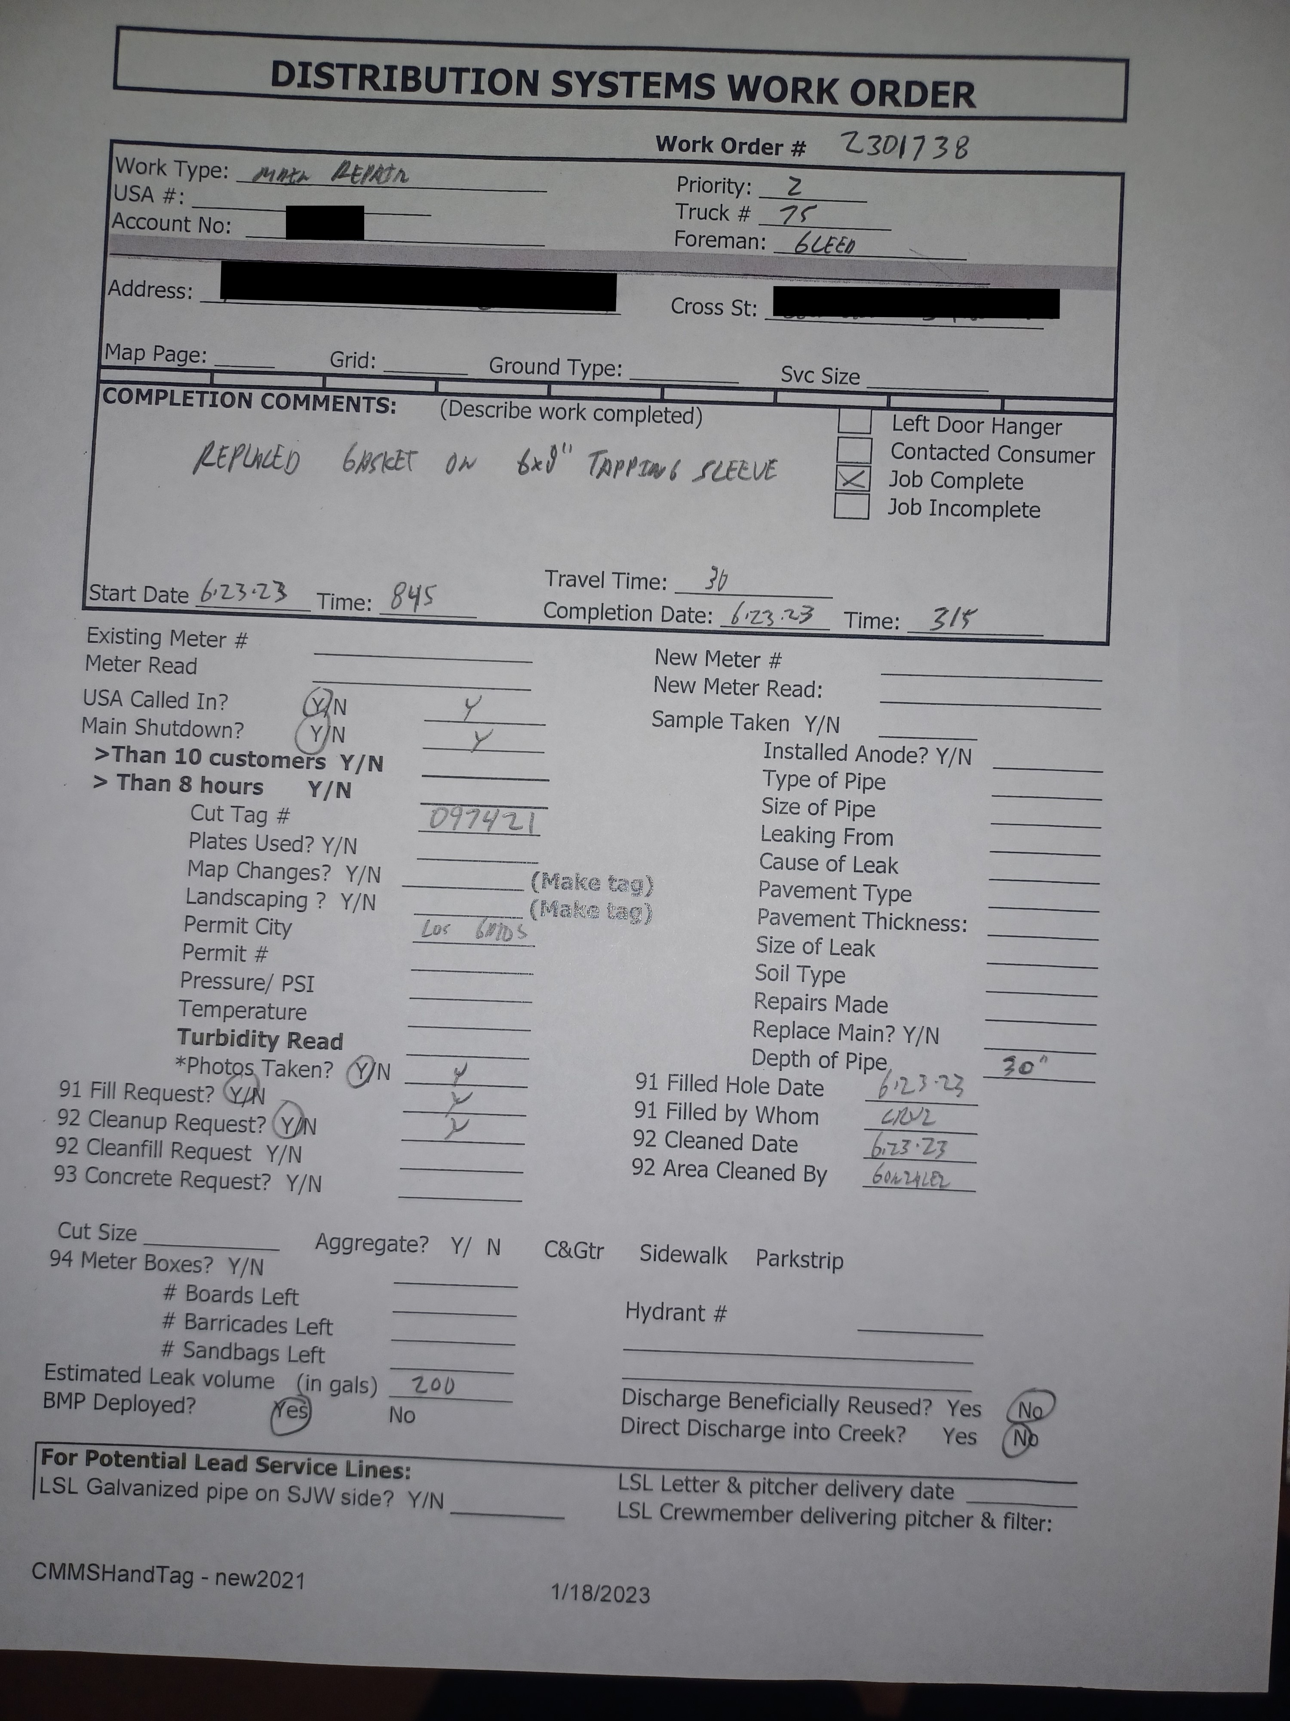
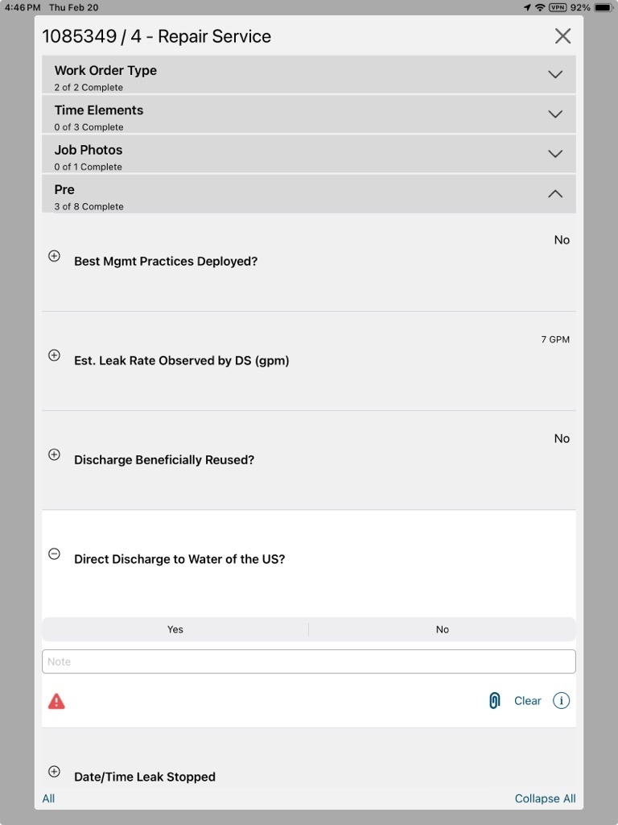
Distributions Systems Department
Desire
Changes in workflow and processes
  Removing paper entry
  Change of responsibilities
Expressing benefits of the change
  Optimized workflows
  Automations
Notes:
Changes in workflow and processes
Removing paper entry
entry into mobile devices to replace their current WO recording
Automating some of their mundane processes
What we did is emphasize the benefits of the changes
Faster WO completion and WO review
More time efficient and less emailing photos and documents
All in one package so they no longer have to look in multiple places to pull up WO data
Recording WO info in the database with no lag
Recording and analyzing booked labor

Slide 14

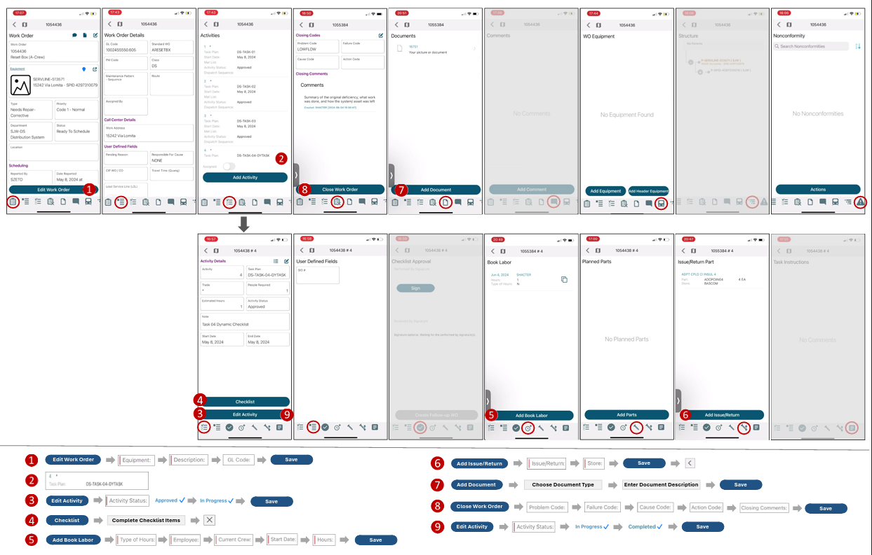
Distributions Systems Department
Knowledge
Lack of Technological Know how
  Task focused job helps
Extended User Acceptance Testing (UAT)
  Identifying areas of concern from the users
Notes:
Lack of technological know how
Users didn’t understand how the mobile devices worked
Having great difficulty understanding the application
What we did in this stage
Created SOPs to be easily read and understood
Explaining how features worked
Checklists
Booked labor
Picture and document attachments to WOs
Automations
Mobile WOs
Extensive in classroom trainings and practice sessions
Extended UAT

Slide 15
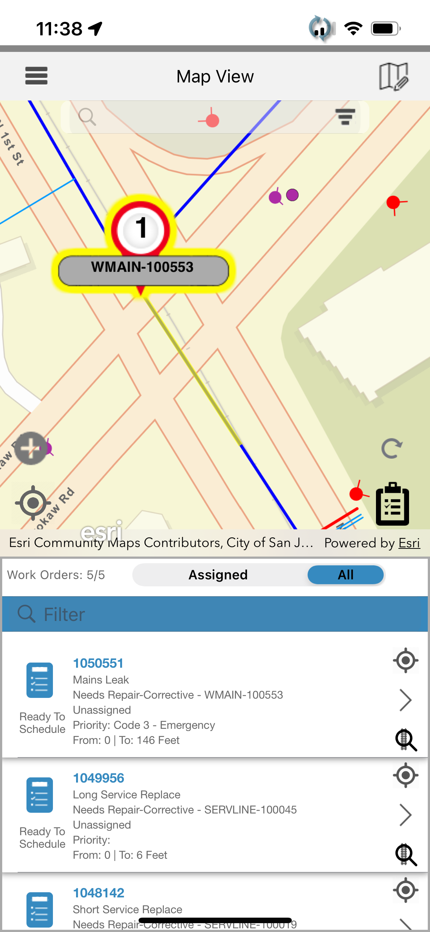
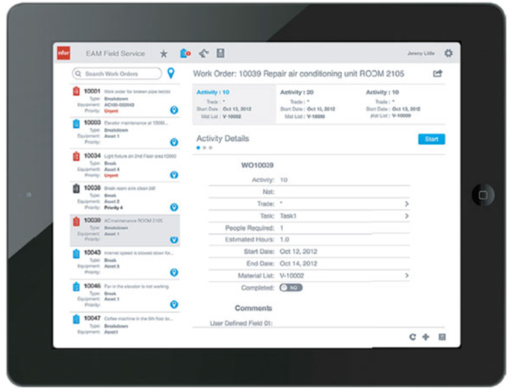
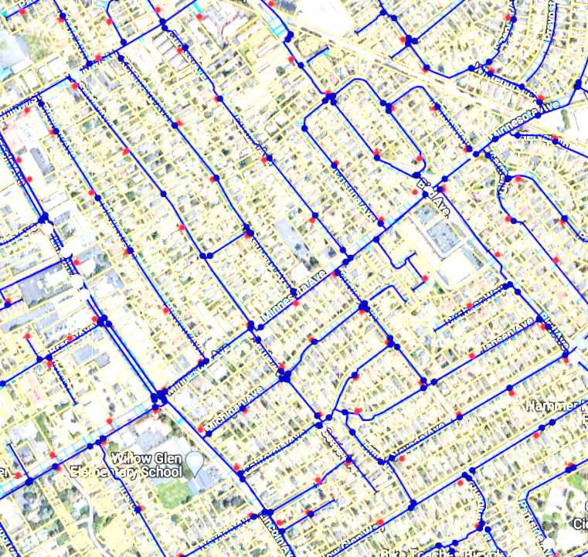
Distributions Systems Department
Ability
Shadowing users in the field
  Gain confidence in what they learned
  Knowing that they are supported
Notes:
Shadowing users in the field
We are able to answer their questions and issues right then and there
This gives confidence in what they learned
Knowing that they are supported
Helps to build rapport with them
Vital down the road when issues occur

Slide 16

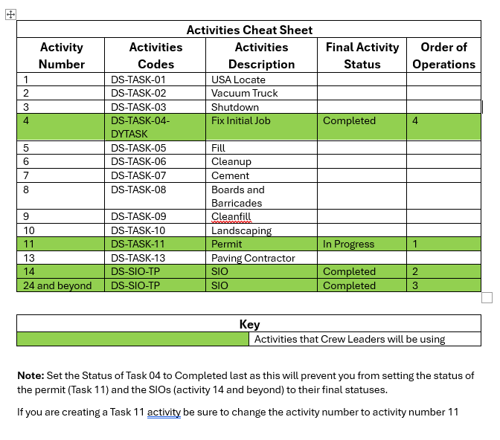
Distributions Systems Department
Reinforcement
Identifying areas with the most issues and addressing them
Maintaining constant communication with end users
Notes:
Using the JIRA ticket system to gain information on issues that pop up
Identifying trends in the support tickets
And analyzing if we need to do a follow up learning session on any single topic
An example of an area of concern is the activites
We created an extra job help and had additional training for users to understand this process

Slide 17
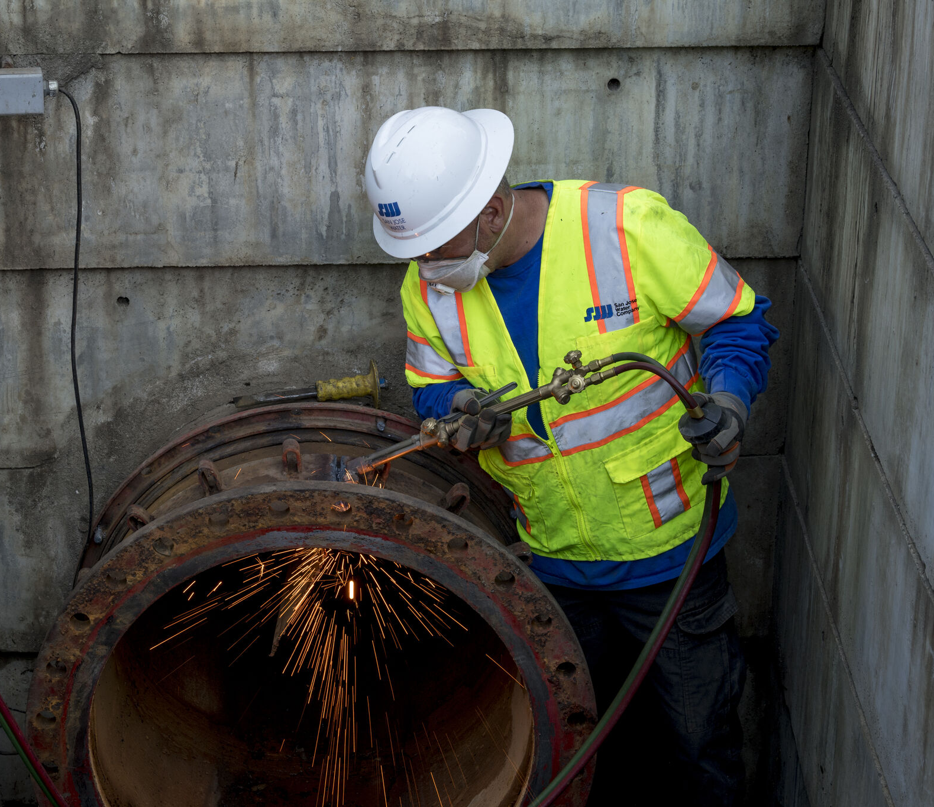
Key Takeaways
Understanding your users Abilities
Scale the UAT Process
Documentation is key
Emphasize the “Why” in the beginning
Gaining Rapport with the Users
Notes:
Key Takeaways
Understand the technological ability of your users when bringing them over from a pen and paper process to a fully digital process
- This can also be an old software to a new software
Scale your UAT time frame to match the size and complexity of the department
Emphasize the “Why” the changes are occuring in the very beginning during the Awareness and Desire stages, so users become more open to the changes
Document as much as you can that way its easier to understand their current processes and the changes you are making to those processes
Gain good rapport with the users so that they are more open to when issues happen and are open to telling you the issues so you can resolve them in a timely fashion

Slide 18
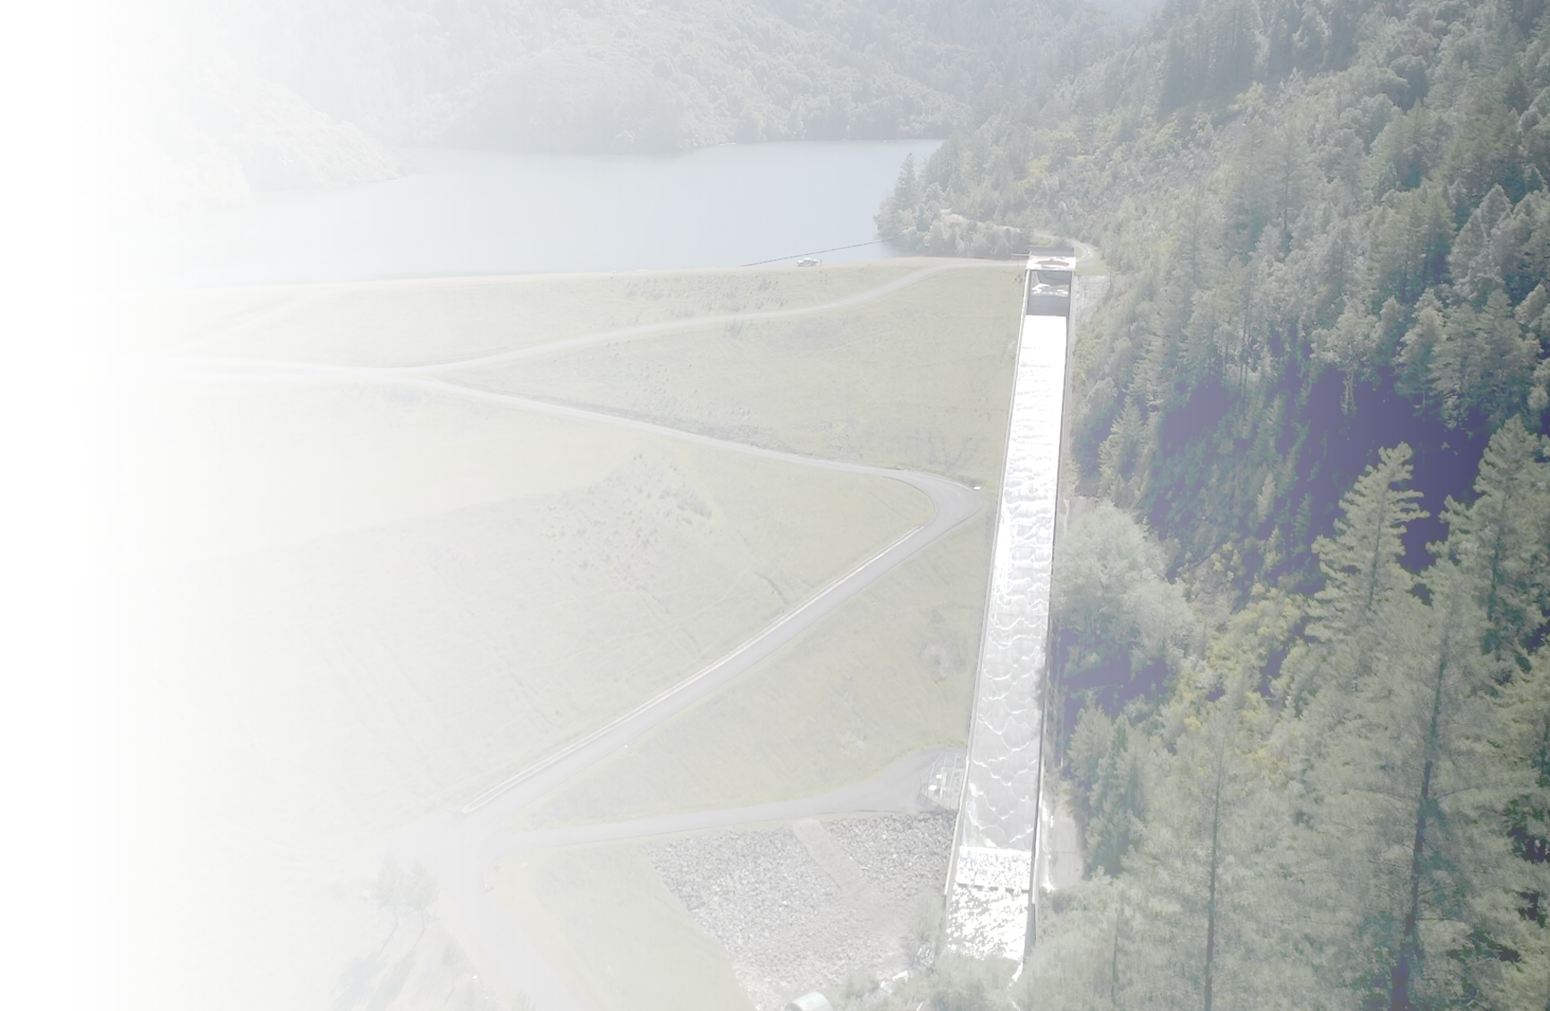
Contact Information
Quang ‘Q’ Tran
Senior Systems Analyst
quang.tran@sjwater.com
Darien Young
Systems Analyst
darien.young@sjwater.com

