Slide 1

Data Visualization with Power BI and HxGN EAM
Leveraging analytics for informed decision-making
Notes:
---
In this presentation, we will explore how Power BI, a business analytics tool developed by Microsoft, can be used with HxGN EAM to create insightful visualizations that enable organizations to make data-driven decisions.

Slide 2


Slide 3


Agenda
Introductions
Why Visualizations
HxGN EAM Visualization Options (Build 12.2)
Power Bi Pre-Requisites
Connecting Power Bi to HxGN EAM (Demo)
Data Visualization Examples (Demo)
Conclusion
Q&A

Slide 4





Stratum Introductions
Clay Bush – President/Founder
Bio - Married, Kids – College Senior and a College Sophomore
Clemson Fan, Mountain Bike, Snowboard, Cooking
Home – Colorado
Marcela Rascon – VP
BI & Analytics
Bio – Tennis and Pickle Ball Extraordinaire, Loves winters in Arizona, and Mother to Dog Rafa and Roger
Home – Colorado
Eric Faith – VP
Business Development
Bio – Married, 2 Sons. Newly minted grandfather. Hockey fan, and enjoy time with Grandpups, Rowan, Reese, and Cash
Home – Indiana

Slide 5

Why Do We Need Data Visualization?
Effective Communication
Data visualization enhances communication by translating complex data into visual formats that are easier to understand.
Identifying Trends
Visualizing data helps in quickly identifying trends and patterns that might not be apparent in raw data.
Easy Insights into Data
Charts and dashboards allow us to gain insights from data, facilitating better decision-making processes.
Notes:
Data visualization is essential for effective communication, as it simplifies complex data into clear, accessible visuals that support better storytelling and faster decision-making. It helps in identifying trends by uncovering patterns, correlations, and anomalies that might otherwise go unnoticed, enabling more accurate forecasting and deeper insights. Visualizations also provide easy insights into data, offering quick access to key metrics and interactive exploration, empowering users to independently understand and act on the information. Together, these benefits drive informed decision-making and improved business outcomes.

Slide 6
Data Visualization Options
Out of the Box Options
  Cognos Reports
  Cognos enables users to extract, transform, and analyze data from HxGN EAM in real time, offering insights into asset performance, maintenance operations, and other key metrics through customizable dashboards and reports.
Equipment Overview 360
  Equipment 360 provides insights into equipment performance, maintenance needs, and operational efficiency.
Organization Overview 360
  Organization 360 offers comprehensive data visualization of organizational structures and performance metrics.
API Options
Integration with Power BI
  Power BI enhances HxGN EAM functionalities by enabling the creation of tailored reports and visualizations via the use of APIs with or without a Datalake.
Data Displays
  Custom Displays showing active work order information allowing team members to tailor their data visualization needs to specific business requirements.
Notes:
HxGN EAM provides several out of the box solutions that can be used for data visualization. These include the Org 360, Equipment 360, and Custom Solutions such as Stratum’s Big Board. Power BI is a separate tool that can be used in conjunction with HxGN EAM to create custom visualizations and reports.

Slide 7
Connecting
Power Bi & HxGN EAM

Slide 8
Pre-Requisites
HxGN EAM Connector License
  A Connector License is necessary for integrating Power BI with HxGN EAM, enabling seamless data connectivity.
  HxGN EAM Grid (View) development knowledge
  A basic understanding of user defined grids and views within the HxGN EAM application.
Power BI Desktop Application
  The Power BI Desktop application must be installed to create and publish reports before sharing them.
Power BI Pro or Premium License
  A valid Power BI Pro or Premium license is required to access advanced features and functionalities of Power BI.
Notes:
To use Power BI with HxGN EAM, you will need a HxGN EAM Connector License, proficiency in HxGN EAM Views and Grids, Power BI Desktop application, and optional Power BI Pro or Premium License to publish reports to work with corporate SharePoint / OneDrive sites or Organization / Equipment 360 HxGN EAM modules. We will explore the pre-requisites in more detail in the following slides.

Slide 9

Power Bi Desktop vs Power Bi Web
Development vs Consumption
  Desktop is for building and designing.
  Web is for viewing and sharing.
  Data Connectivity and Modeling
  Desktop offers advanced modeling.
  Web is limited to pre-configured data.
  Publishing and Sharing
  Desktop publishes reports.
  Web manages sharing, collaboration and scheduled data refresh cycles.
Notes:
1. Development vs. Consumption
Power BI Desktop: Primarily used for creating, designing, and testing complex reports and datasets. It includes advanced data modeling features, DAX calculations, and custom visuals.
Power BI Web: Focused on consuming, sharing, and collaborating on reports. Users can view and interact with published reports, but report creation and data modeling are limited.
2. Data Connectivity and Modeling
Power BI Desktop: Supports a wide range of data connectors and allows advanced data modeling, such as relationships, measures, calculated columns, and creating queries in Power Query.
Power BI Web: Limited to viewing reports with pre-configured data models. It cannot create or modify datasets beyond basic features like creating calculated measures.
3. Publishing and Sharing
Power BI Desktop: Reports created in Desktop need to be published to the Power BI Service (Web) for sharing and collaboration.
Power BI Web: Provides sharing, scheduling refreshes, setting up workspaces, and managing permissions for collaboration with other users.
Would you like a deeper dive into any of these differences?

Slide 10

Configuration
User Defined Grids (Views)
  Properly configuring views and grids to use within Power BI to enhance data visualization and user experience.
    🟢 Advantage: Out of the Box functionality and “faster” configuration.
    🔴 Disadvantage: Performance
Databridge Pro with Datalake
  Utilizing a Datalake allows for efficient HxGN EAM data retrieval without grids, improving analytic capabilities and data synchronization.
    🟢 Advantage: Flexibility to leverage high volumes of data from multiple systems that consist of structured and unstructured datasets.
    🔴 Disadvantage: Learning curve & cost.

Slide 11

Connecting Power Bi to HxGN EAM (Demo)
Setup
  HxGN EAM Authentication: API Key
  Grid Configuration
  Power Bi Desktop
    Query Setup & Parameters (API)
    Model View
    Publishing Reports
  Power Bi Web
    Scheduled Data Refresh

Slide 12
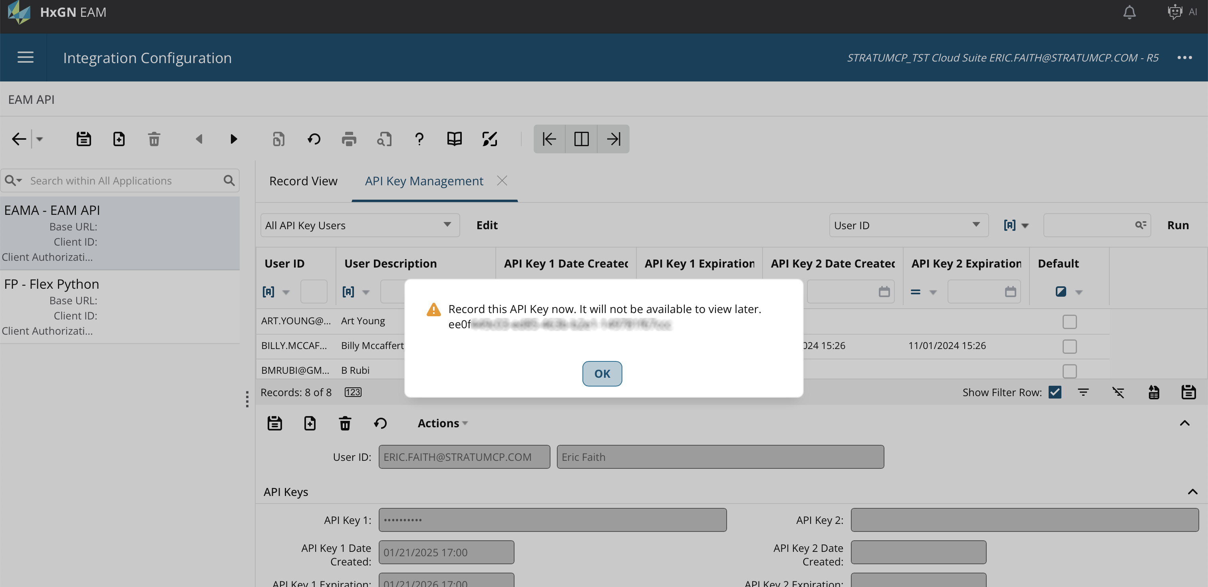
API Key Setup in HxGN EAM

Slide 13
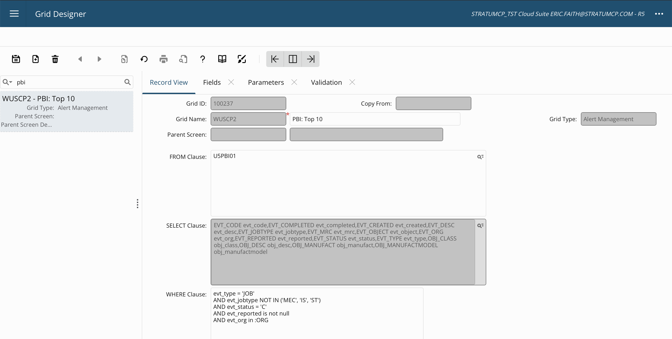
Grid Setup in HxGN EAM

Slide 14
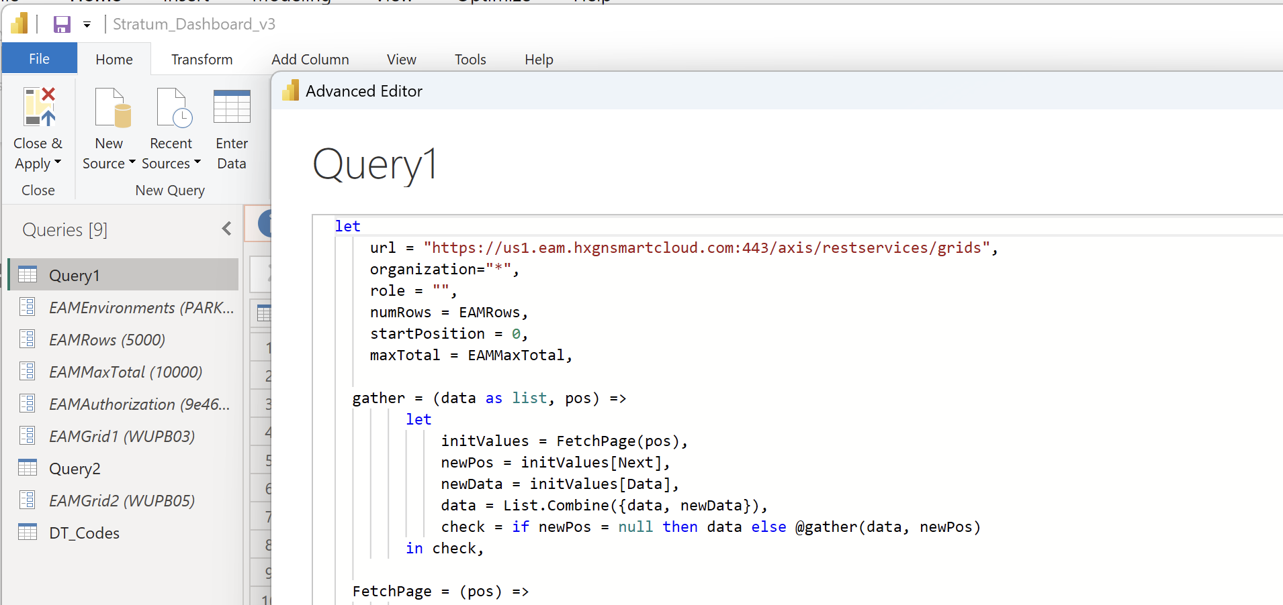
API setup with Power BI

Slide 15
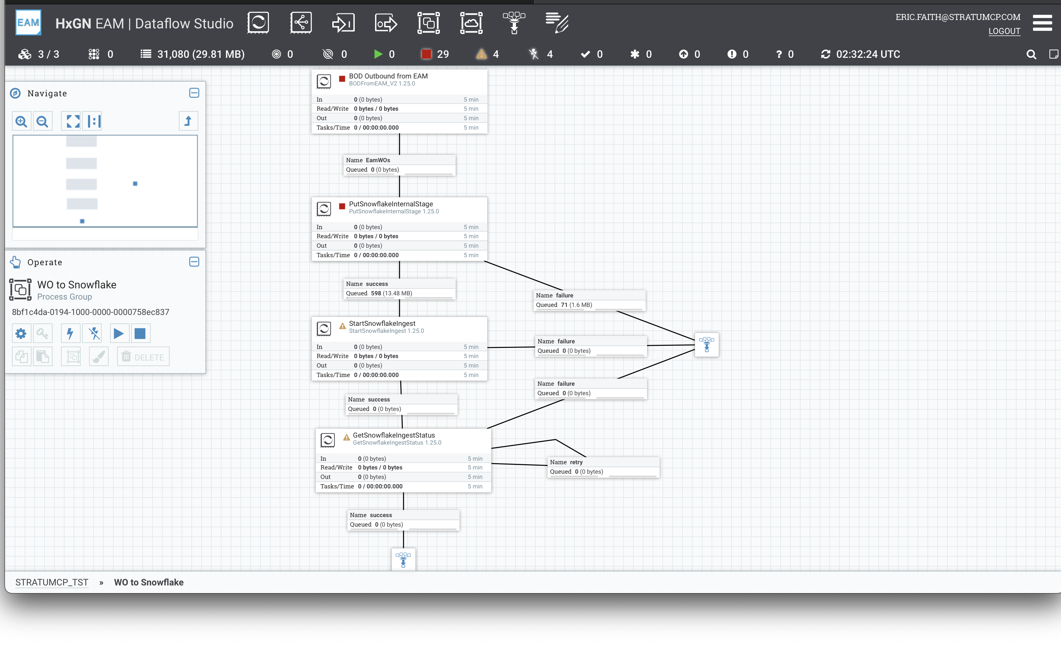
Datalake and Databridge Pro

Slide 16

Data Visualization Examples (Demo)
Cognos
Equipment 360
Org 360
Digital Display Boards
Power BI

Slide 17
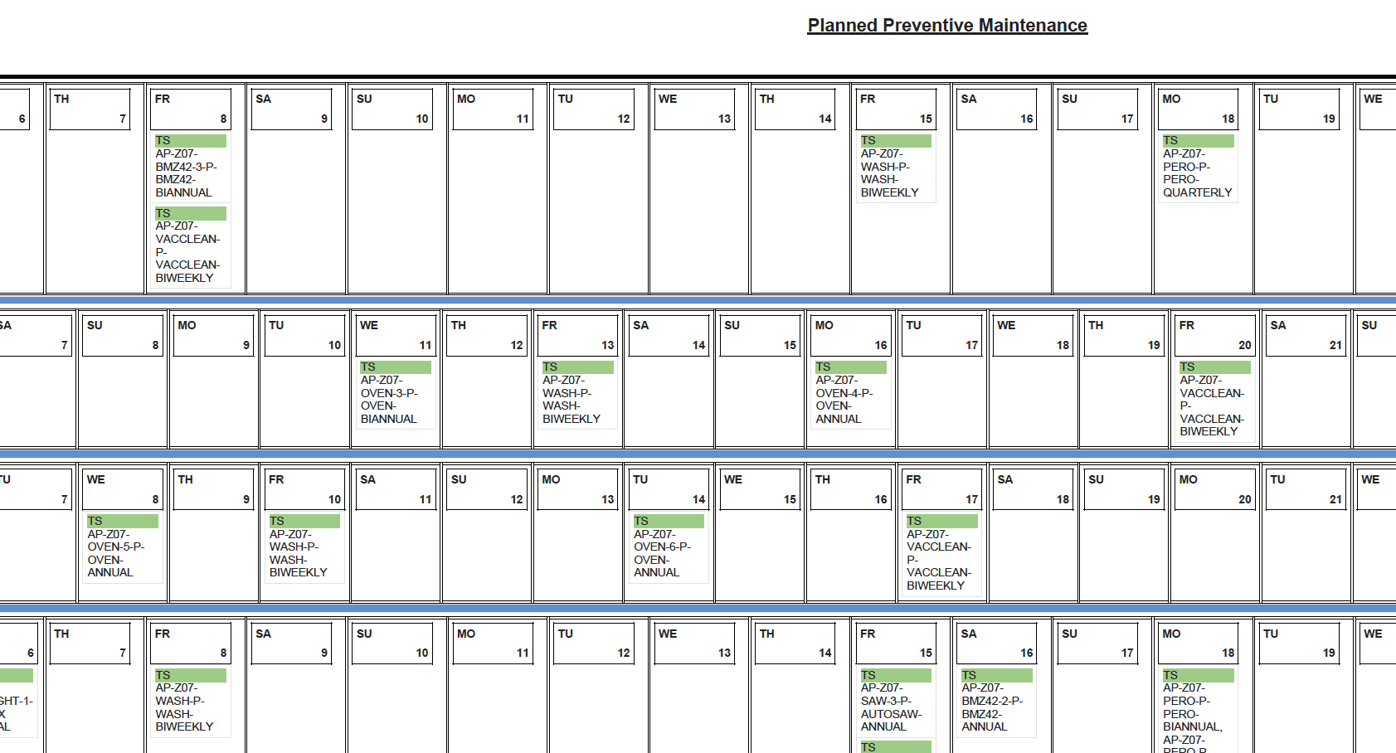

Slide 18
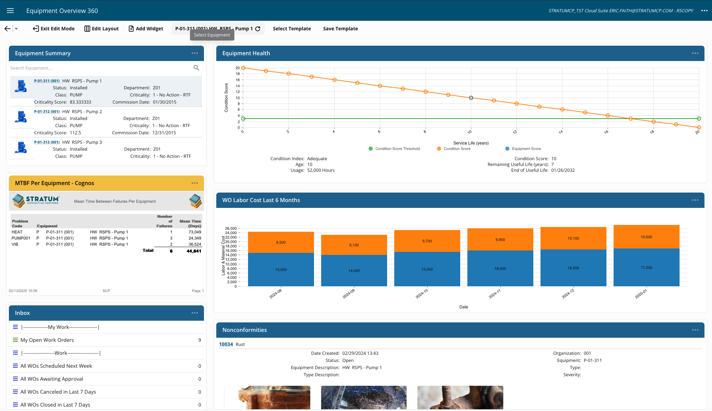

Slide 19
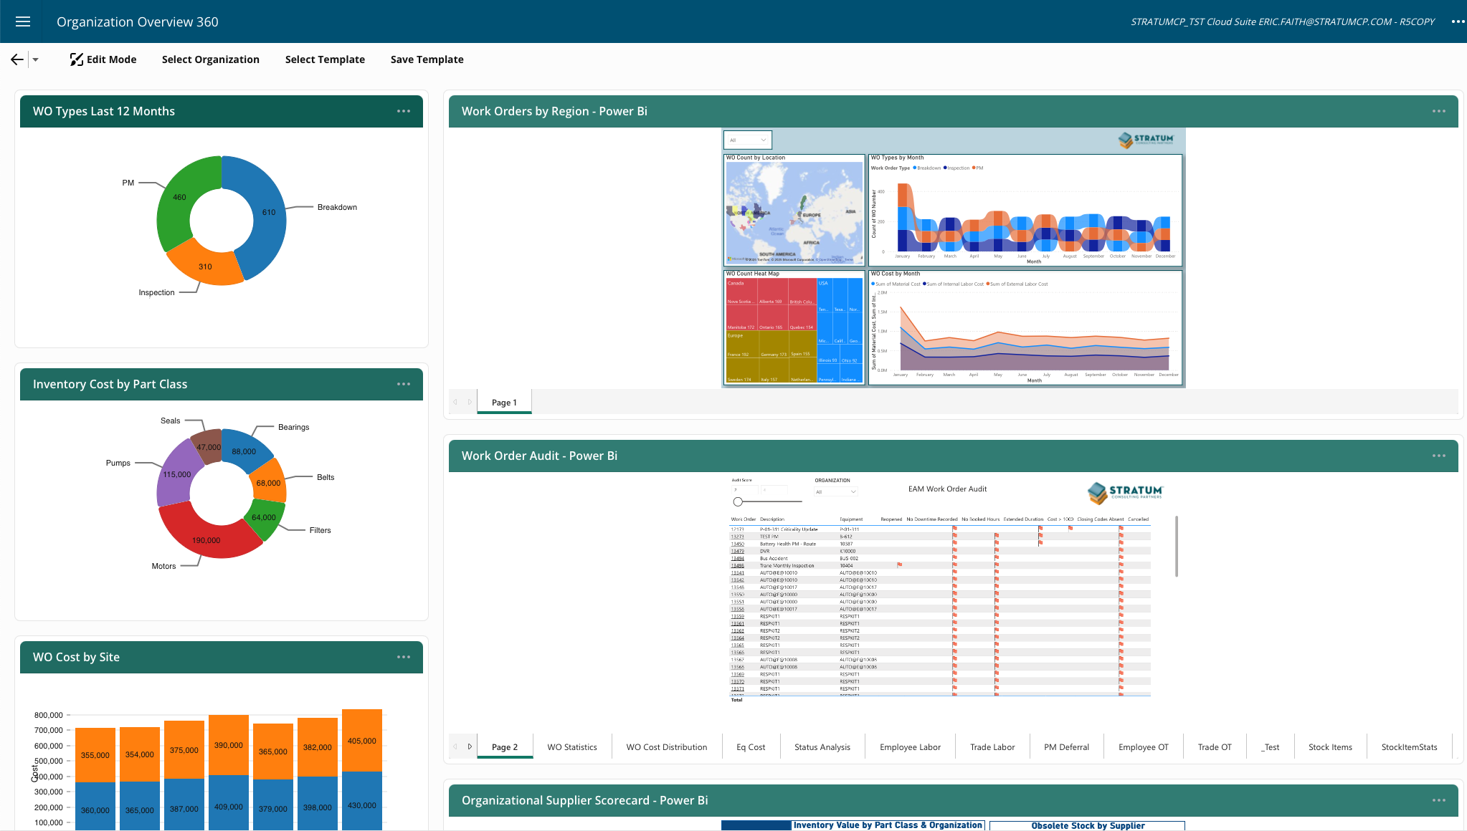

Slide 20
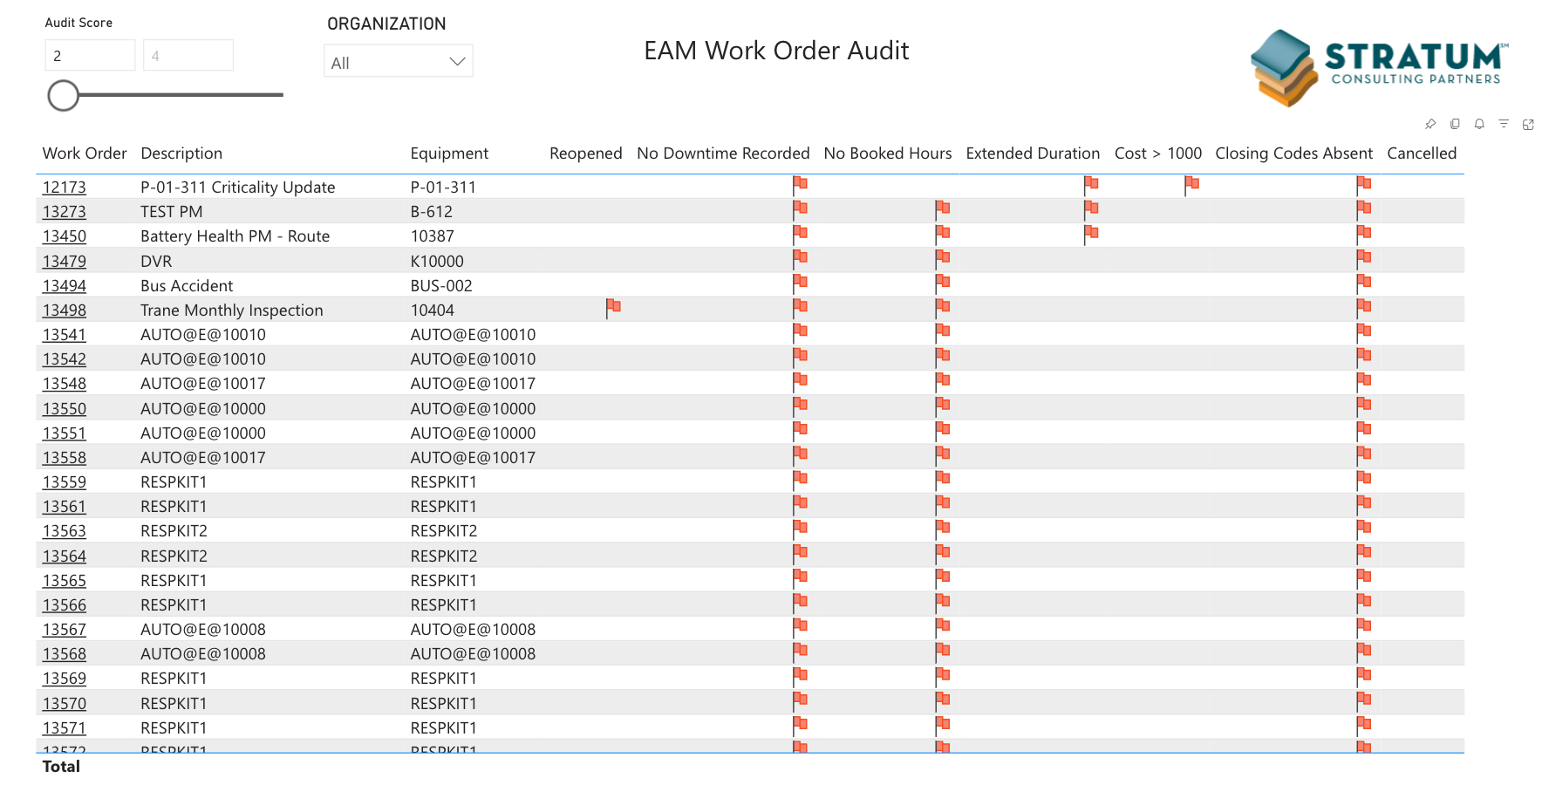

Slide 21
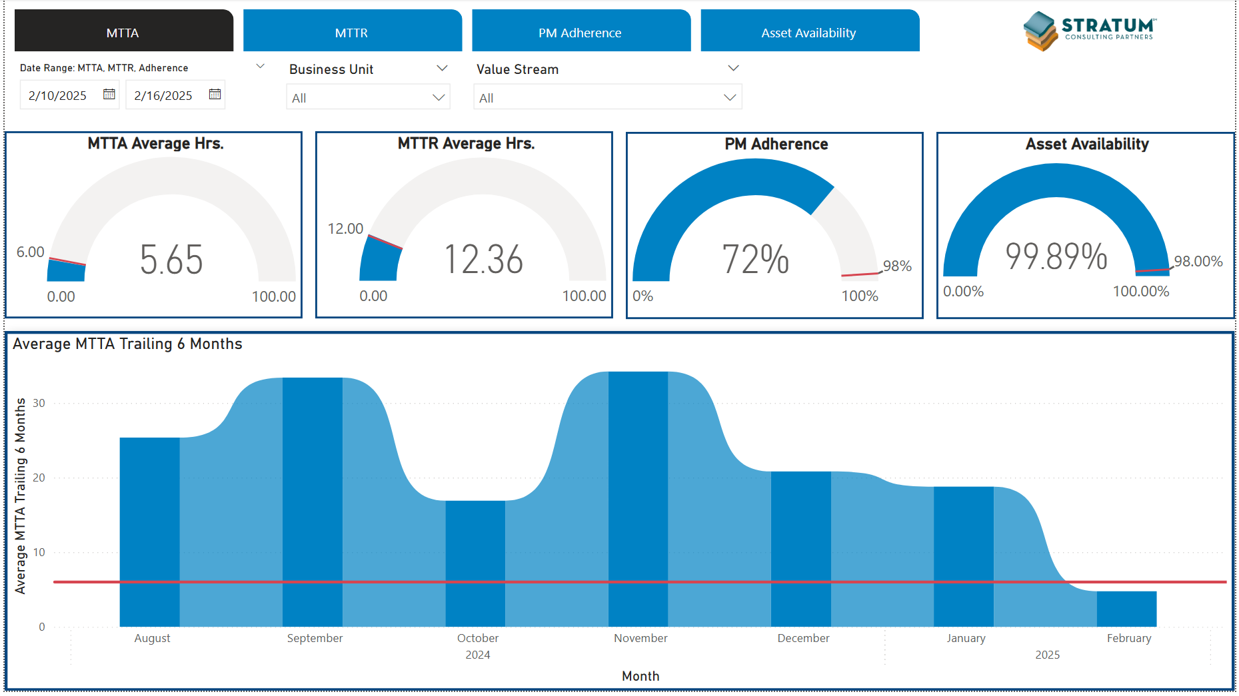

Slide 22
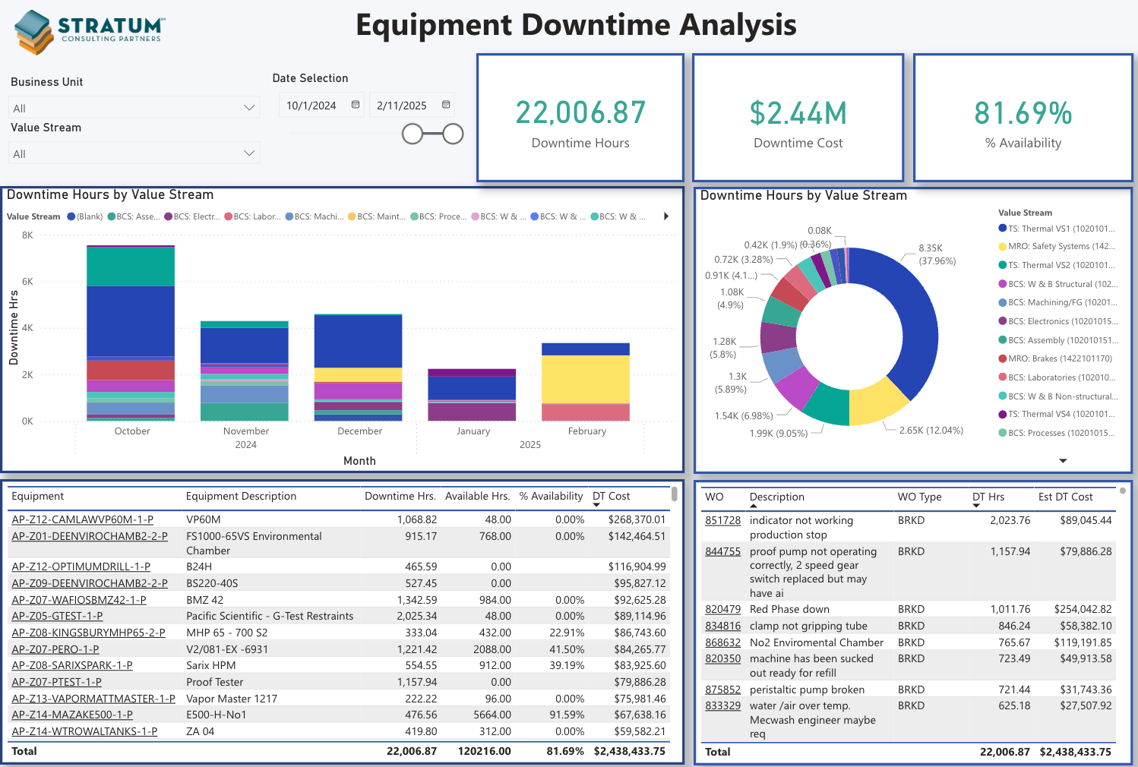

Slide 23
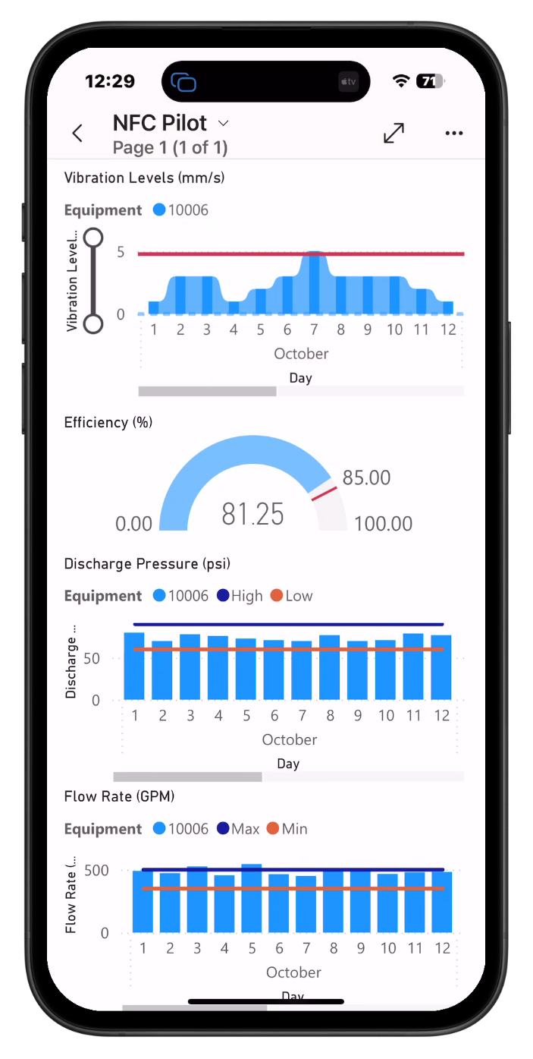
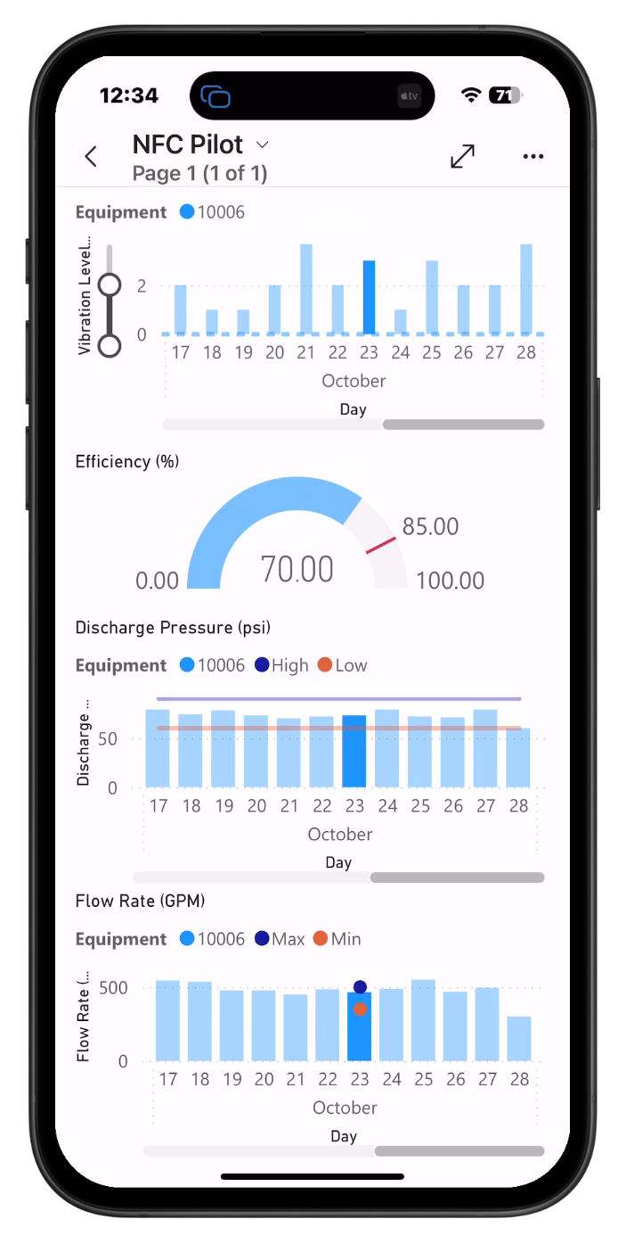
NFC Scan

Slide 24

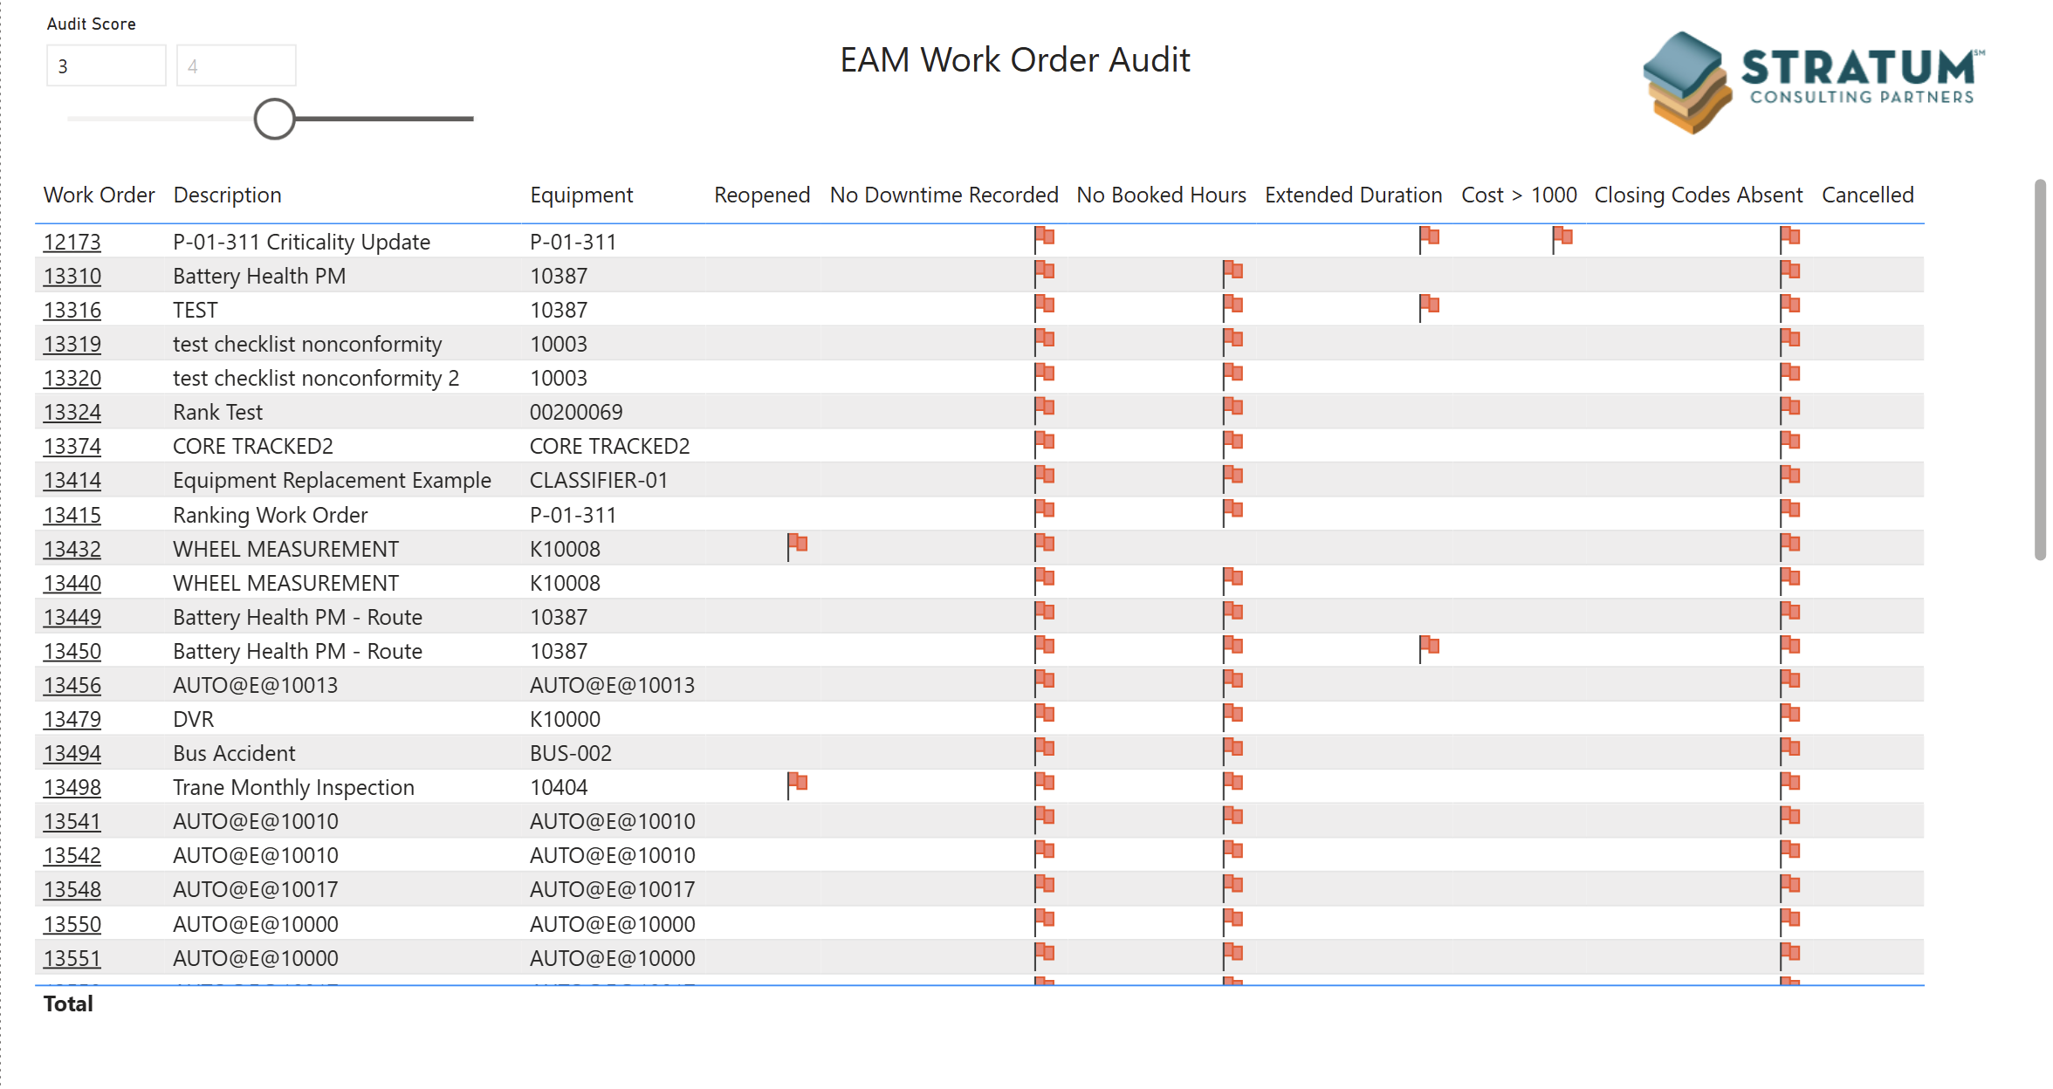
Power BI Examples
Work Audit
🔴 BEFORE: Auditing multiple work orders for missing data took various inboxes, reports and time.
🟢 AFTER: Power BI allows users to easily see and link to HxGN EAM work orders that are missing data and over cost.
Work Analysis
🔴 BEFORE: Lack of visibility into response times and repair response times (SLA for equipment).
🟢 AFTER: Clear communication and visibility into key work metrics that enabled proactive maintenance and improved uptime.

Slide 25
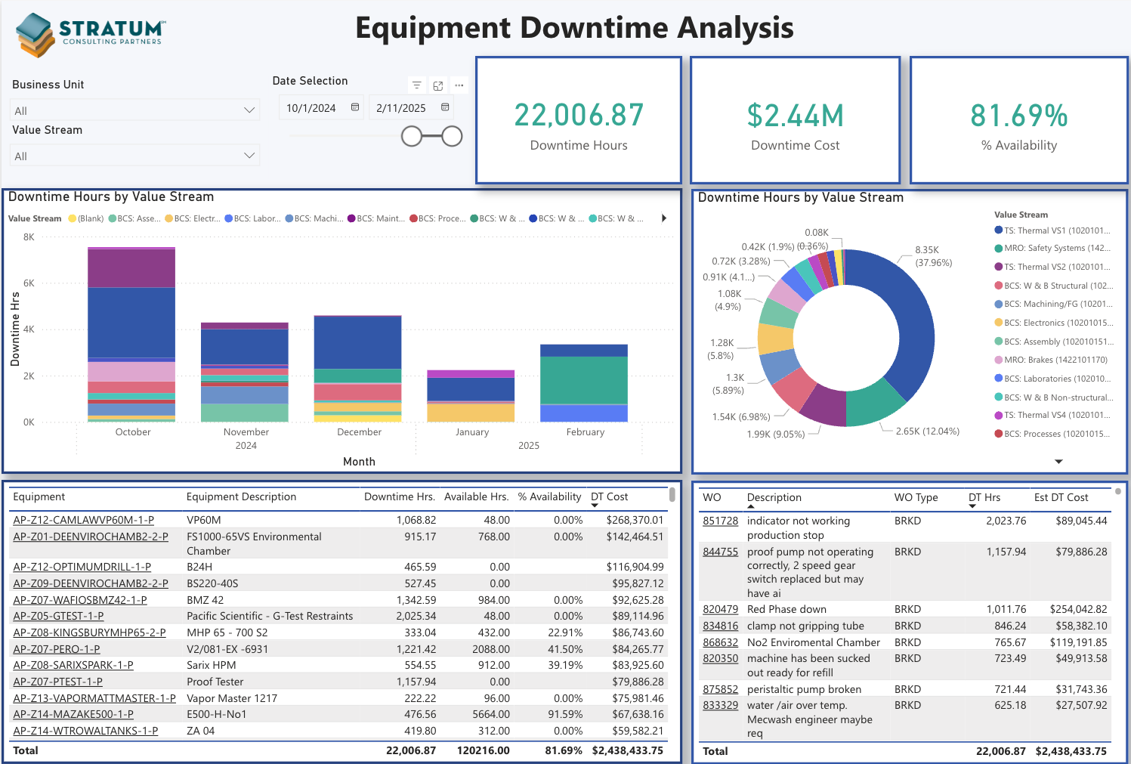
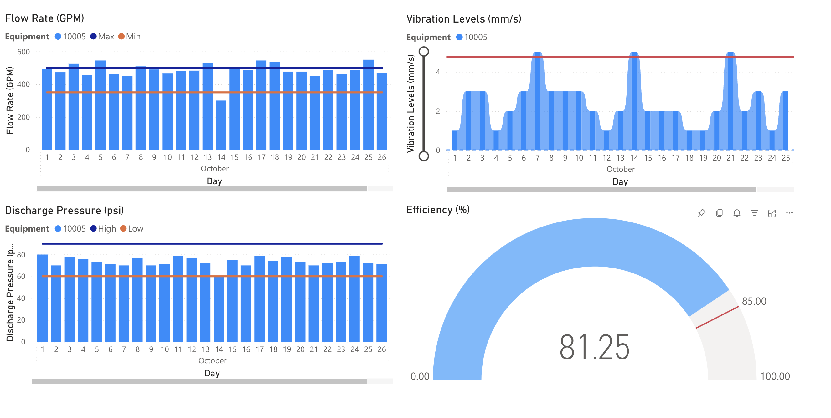
Power BI Examples
Downtime Analysis
🔴 BEFORE: Minimal “quick” visibility into plant Business Units regarding downtime hours, cost, and availability.
🟢 AFTER: Visually see Business Units and Value Streams with highest downtime hours and cost. Quickly link to HxGN EAM equipment and WO.
NFC Tags & Power BI
🔴 BEFORE: Limited “quick” visibility into the status and health of critical assets when at the location of the physical asset.
🟢 AFTER: NFC tags with Power BI allow for a “one touch” solution into seeing asset history and current analytics.

Slide 26
Conclusion
Custom Visualizations
  Power BI allows users to create tailored visualizations that meet specific business needs, enhancing data comprehension.
Data-Driven Decisions
  Organizations can leverage insights from Power BI to make informed decisions that significantly impact business outcomes.
Reporting Capabilities
  Power BI provides robust reporting tools to present data insights effectively, aiding in communication and understanding.
Notes:
Power BI is a powerful tool that can be used to create custom visualizations and reports using data from HxGN EAM. By leveraging the insights derived from visualizations, organizations can make data-driven decisions that drive business success.

Slide 27
Q&A
Thank you for your time and enjoy the rest of Streamline 2025!

