Slide 1
EAM – Ranking Your Equipment
Marcel van Wingerden
EAM Product Owner
Hexagon
February 2025

Slide 2

Equipment Ranking in EAM
  Agenda:
  Equipment Ranking in HxGN EAM.
  Ranking with RCM / RCA in HxGN EAM.
  Not on the agenda are:
  RCM / RCA as a process.
  Performance Formulas – These calculate a weighted Performance score based on, for example, condition rating, MTBF, MTTR, any additional variables you decide.
Notes:
Note:
Performance formulas can only be associated to equipment via an Equipment Ranking of Type Condition Index.
There is a maximum of 6 variables.

Slide 3
Equipment Ranking in EAM
  What is it?
  Automatic process to calculate an equipment’s score for a particular metric.
  Uses a configurable hierarchical structure of formulas to solve a ranking calculation, as defined by your organization.
  Inputs into these calculations:
    Work order and operator checklists.
    Any other data within the HxGN EAM database can be used as input.
    Individual equipment surveys.
Notes:
Examples of other data could be:
Inspection data
Meter readings
The number of nonconformities entered the last 2 years

Slide 4
Equipment Ranking in EAM
  There are five types of rankings:
  Condition Index with the following Condition Protocols:
    Age, Usage, Decay Curve.
    Condition Inspection.
  Criticality Index.
  Facility Condition Index.
  Reliability Index (the original).
  Risk Priority Index.
  All are survey based, except the Age, Usage, and Decay Curve based condition protocols.
Notes:
Survey based means you or the system will answer one or more questions.
The three exceptions are not survey based, meaning the system has a defined method to calculate the rank.

Slide 5
Equipment Ranking in EAM
  Each type updates different result fields on the equipment record:
Type | Fields updated on the Equipment screens
Condition Index | Condition Score and Condition Index May also update the Correction Score
Criticality Index | Criticality Score and Criticality
Facility Condition Index | Facility Condition Index
Reliability Index | Reliability Ranking Score, Reliability Ranking Index (multiple indexes are possible)
Risk Priority Index | Risk Priority Number and the Risk Priority Index
Notes:
If you have multiple reliability rankings, make one the default so it shows on the Record View of the equipment screens.
Note that the Facility Condition Index is a number. It usually is text on the others.

Slide 6
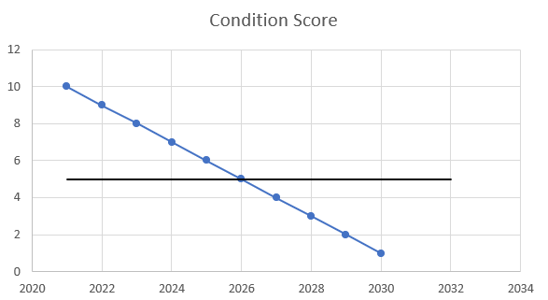
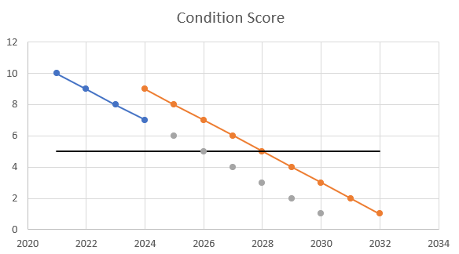
Equipment Ranking – Condition Index
  The Condition is Age Based
  Service Life (years) must be entered.
  Linear score degradation.
  Correction score handling.
Notes:
The horizontal line depicts the condition threshold. After it is intercepted, the condition is unacceptable.
Note the correction in 2024 from 7 (expected) to 9 (correction).
Trend will reset from the last correction date.

Slide 7
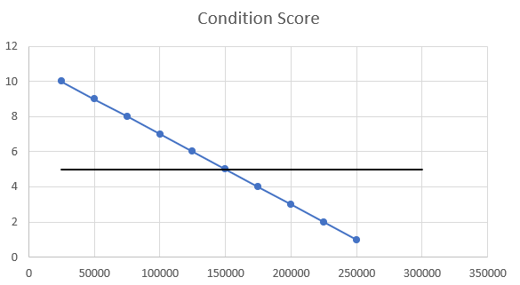
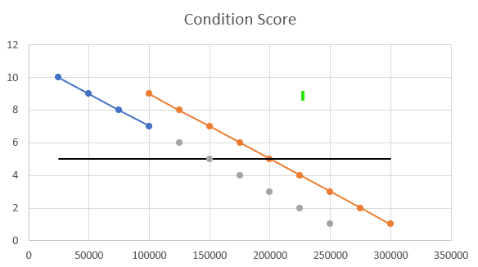
Equipment Ranking – Condition Index
  The Condition is Usage Based
  Service Life Usage must be entered.
  X-axis shows miles or kilometers instead of years.
  Further like Age Based Conditions.

Slide 8
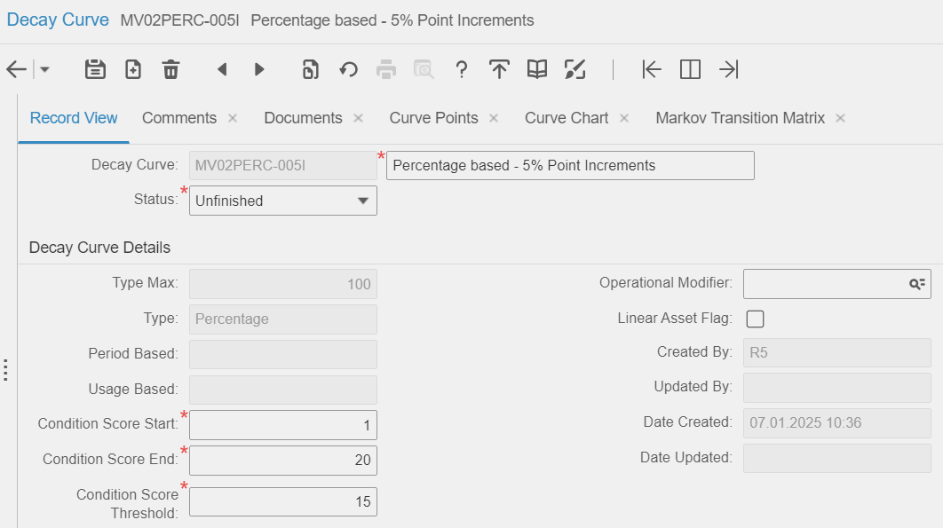
Decay Curves
  The Condition is Decay Curve Based
  Age or Percentage of Age.
  Usage or Percentage of Usage.
  The percentage-based curves
  have an advantage in that they
  handle equipment with different
  service lives equally well.
  Also note the condition score
  goes up from 1 to 20. In case
  the better conditions are
  represented by lower values.
  Enter Curve Points.

Slide 9
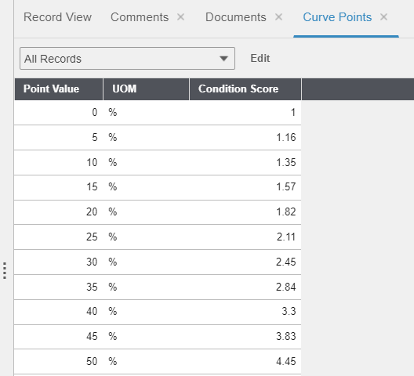
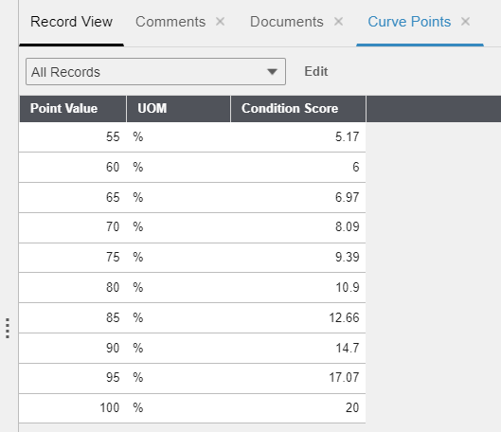
Decay Curves – Curve Points
By DTI Invitation Only - Offer Valid until November 30th, 2024

Slide 10
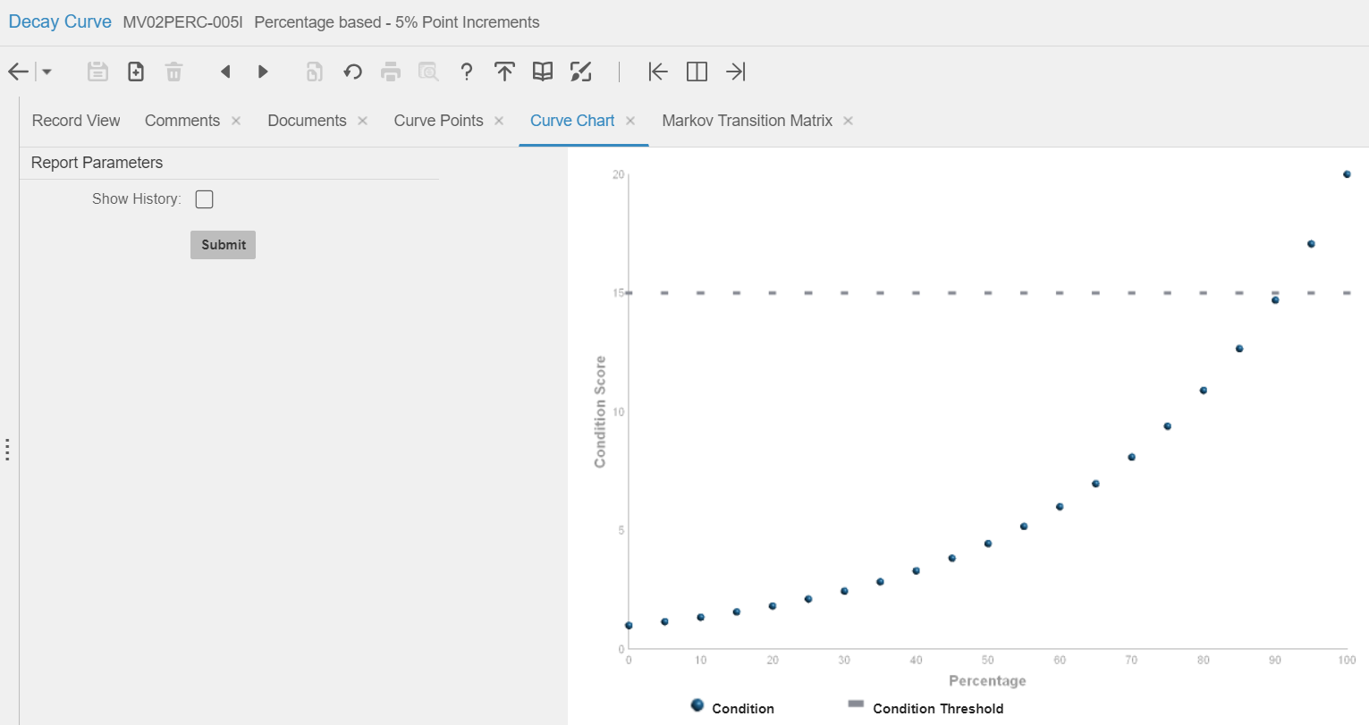
Decay Curves – Curve Chart
By DTI Invitation Only - Offer Valid until November 30th, 2024

Slide 11
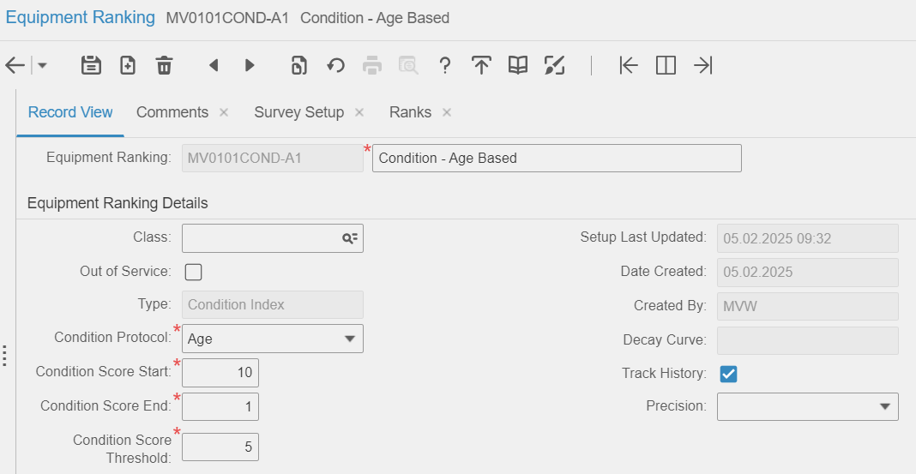
Equipment Ranking – Condition Index
  Age Based Condition Protocol selected
By DTI Invitation Only - Offer Valid until November 30th, 2024
Notes:
Because Condition Protocol is Age,
Decay Curve is protected.
And there is no work required on the Survey Setup tab.
That Track History means the system will add a record on the Ranking History tab each time it calculates a score.

Slide 12
Equipment Ranking – Survey Based
Survey based ranking process is as follows
  You answer survey questions on the Ranking Survey tab.
    The easiest way: Via work order or operator checklists.
    Just as easy: Automatically by running (your) queries.
    If there is no other option, then manually on the Ranking Survey tab.
  System interprets the answers.
  System calculates the score (number).
  System determines the associated index (text, qualitative).
  For example, good, low, or diamond.

Slide 13
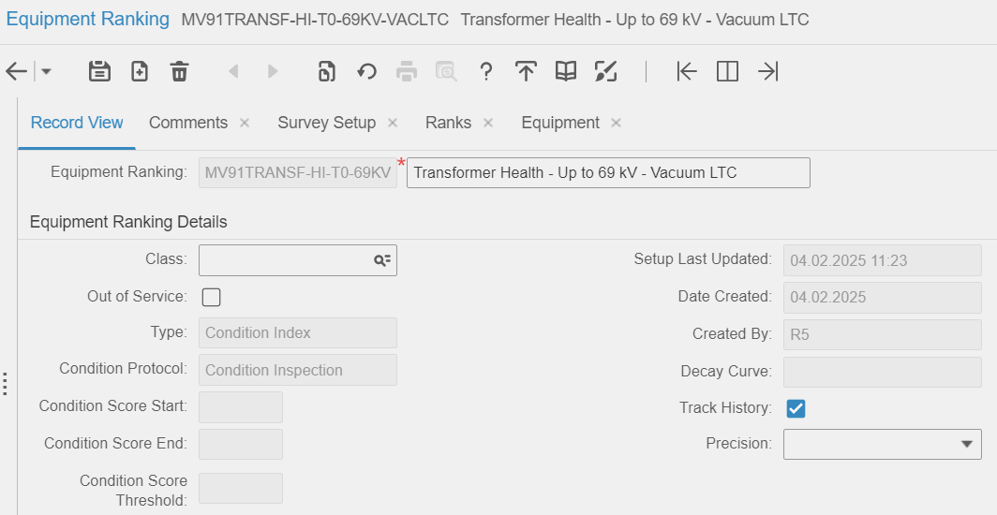
Equipment Ranking – Survey Based
Survey based ranking
Notes:
Note the Type and Protocol. Still a Condition Index, but the Protocol is Condition Inspection which makes it survey based.
Also note condition score start and end are protected. Formulas defined on the Survey Setup will now determine the score.

Slide 14
Equipment Ranking in EAM
  How does it calculate that score?
  Answer a question. (Does it look good? How do you rate it?)
  Quantify this answer if not already so. Yes = 1 / No = 0.
  Possibly normalize this answer. Apples to apples.
  Roll up this now normalized quantitative answer to the next higher level.
  Apply the answers to a variable in a formula. ( 2 * ( Q1 + Q2 ) + Q3 ).
  Roll up the answer to the next higher level in the branch.
  Maximum number of levels per branch is three.
  Once at the top (the root), the formula at that level determines the final score.
By DTI Invitation Only - Offer Valid until November 30th, 2024
Notes:
Answer a question examples
Does the equipment look good for its age? Yes / No
How would you rate the equipment on a scale from 1 to 5?

Slide 15
Example – Transformer Health
Number | Condition | Weight | Score
1 | Dissolved Gas Analysis | 10 | 0,1,2,3,4
2 | Load History | 10 | 0,1,2,3,4
3 | Power Factor | 10 | 0,1,2,3,4
4 | Infra-red | 10 | 0,1,2,3,4
5 | Oil Quality | 6 | 0,1,2,3,4
… | … | … | …
24 | Overall LTC Condition | 5 | 0,1,2,3,4
$Health=( 0.6∗\frac{\sum_{n=1}^{21}{{Weight}_{n}∗{Score}_{n}} }{\sum_{n=1}^{21}{4∗{Weight}_{n}}}+0.4∗\frac{\sum_{n=22}^{24}{{Weight}_{n}∗{Score}_{n}} }{\sum_{n=22}^{24}{4∗{Weight}_{n}}}$ ) * 100
Notes:
There is a total of 24 main questions or branches to a Transformer inspection.
Note the division by the weight * 4. That will reduce the result to a number between 0 and 1.
Note the last 3 conditions are not deemed that relevant (0.4 rather than 0.6) because they relate to the Load Tap Changer (LTC).

Slide 16
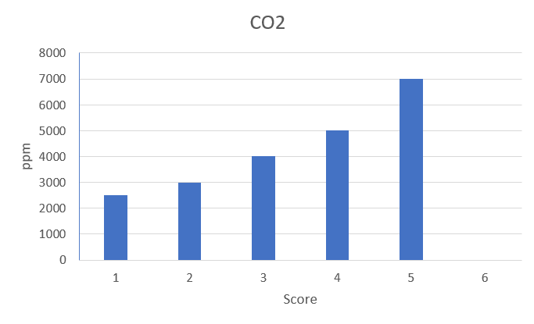
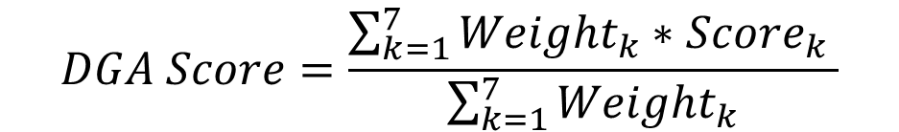
Example – Dissolved Gas Analysis
Seven gases are checked.
Score ranges from 1 to 6.
Weight is different per gas as follows:
  CO and CO2 is 1
  CH4, C2H6 and C2H4 is 3
  C2H2 is 5
  H2 is 2
Each gas has its own score chart.
$$DGA Score=\frac{\sum_{k=1}^{7}{{Weight}_{k}∗{Score}_{k}} }{\sum_{k=1}^{7}{{Weight}_{k}}}$$
Notes:
Note that the Score 6 is given if the ppm is > 7000
CO = Carbon monoxide
CO2 = Carbon dioxide
CH4 = Methane
C2H6 = Ethane
C2H4 = Ethylene
C2H2 = Acetylene
H2 = Hydrogen

Slide 17
Example – Dissolved Gas Analysis
Condition | DGA Score Thresholds | Score
Good | DGA < 1.2 | 4
Acceptable | 1.2 <= DGA < 1.5 | 3
Caution | 1.5 <= DGA < 2 | 2
Poor | 2 <= DGA < 3 | 1
Very Poor | DGA >= 3 | 0
Number | Condition | Weight | Score
1 | Dissolved Gas Analysis | 10 | 0,1,2,3,4
By DTI Invitation Only - Offer Valid until November 30th, 2024

Slide 18
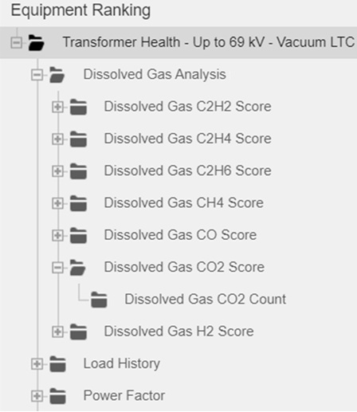
Equipment Ranking – Survey Setup
Number | Condition | Weight | Score
1 | Dissolved Gas Analysis | 10 | 0,1,2,3,4
2 | Load History | 10 | 0,1,2,3,4
3 | Power Factor | 10 | 0,1,2,3,4
… | … | … | …
By DTI Invitation Only - Offer Valid until November 30th, 2024
Notes:
Checkout the nodes:
The root called Transformer Health
Level 1 called Dissolved Gas Analysis
Level 2 Dissolved Gas CO2 Score
Level 3 Dissolved Gas CO2 Count.
Lowest Level.
And in this case also the question level.

Slide 19
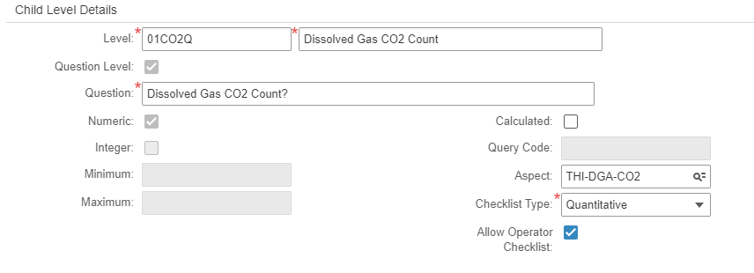
Equipment Ranking – Survey Setup
  Level 3: 01CO2Q - Dissolved Gas CO2 Count
By DTI Invitation Only - Offer Valid until November 30th, 2024
Notes:
Note:
Level Code – Sometimes logic helps.
Numeric / Integer or none
Calculated / Query Code
Checklist if Aspect and Checklist Type are entered

Slide 20
Equipment Ranking – Survey Setup
  Level 2: 01CO2 - Dissolved Gas CO2 Score
Above the question level in this
branch. But in another branch, this
could be the question level.
Formula = :01CO2Q
Simplest of formulas. It basically
passes the answer to the Question
to the Next higher level.
By DTI Invitation Only - Offer Valid until November 30th, 2024

Slide 21
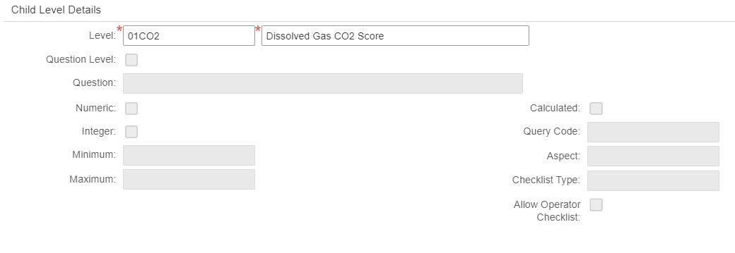
Equipment Ranking – Survey Setup
  Level 2: 01CO2 - Dissolved Gas CO2 Score
By DTI Invitation Only - Offer Valid until November 30th, 2024

Slide 22
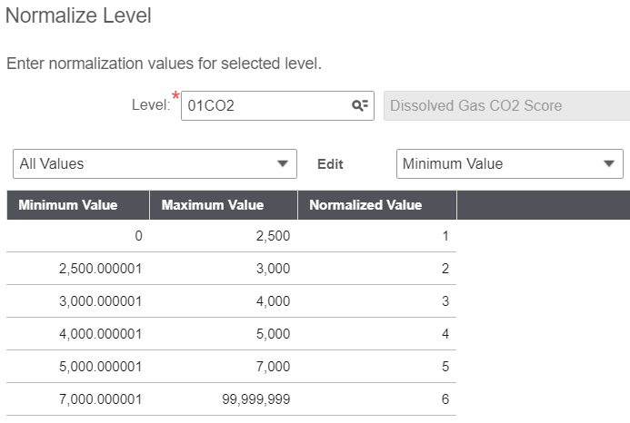
Equipment Ranking – Survey Setup
  Level 2: 01CO2 - Dissolved Gas CO2 Score
Above the question level in this
branch. But in another branch, this
could be the question level.
Formula = :01CO2Q
Simplest of formulas. It basically
passes the answer to the Question
to the Next higher level. But …
Normalize Level based on this answer.
By DTI Invitation Only - Offer Valid until November 30th, 2024
Notes:
Why normalize here: The parts per million for all these gases will show a variety of values. And what is OK for CO2 maybe devastating for CH4.

Slide 23
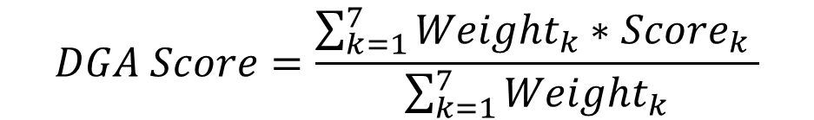
Equipment Ranking – Survey Setup
  Level 1: HI01 - Dissolved Gas Analysis
Formula = (:01H2*2 + :01CH4*3 + :01C2H6*3 + :01C2H4*3 + :01C2H2*5 + :01CO + :01CO2) / 18
Normalize Level based on
the outcome which will be
between 1 and 6 to a score
between 0 and 4.
$$DGA Score=\frac{\sum_{k=1}^{7}{{Weight}_{k}∗{Score}_{k}} }{\sum_{k=1}^{7}{{Weight}_{k}}}$$
Condition | DGA Score Thresholds | Score
Good | DGA < 1.2 | 4
Acceptable | 1.2 <= DGA < 1.5 | 3
Caution | 1.5 <= DGA < 2 | 2
Poor | 2 <= DGA < 3 | 1
Very Poor | DGA >= 3 | 0
By DTI Invitation Only - Offer Valid until November 30th, 2024

Slide 24
Equipment Ranking – Survey Setup
  Level 0 (the root): Transformer Health
Formula =
(
.6 * ( :HI01*10 + :HI02*10 + :HI03*10 + :HI04*10 + :HI05*6 + …
:HI19 + :HI21 + :HI21 ) / 384 +
.4 * ( :HI22*6 + :HI23*3 + :HI24*5 ) / 56
) * 100
$Health=( 0.6∗\frac{\sum_{n=1}^{21}{{Weight}_{n}∗{Score}_{n}} }{\sum_{n=1}^{21}{4∗{Weight}_{n}}}+0.4∗\frac{\sum_{n=22}^{24}{{Weight}_{n}∗{Score}_{n}} }{\sum_{n=22}^{24}{4∗{Weight}_{n}}}$ ) * 100
By DTI Invitation Only - Offer Valid until November 30th, 2024

Slide 25
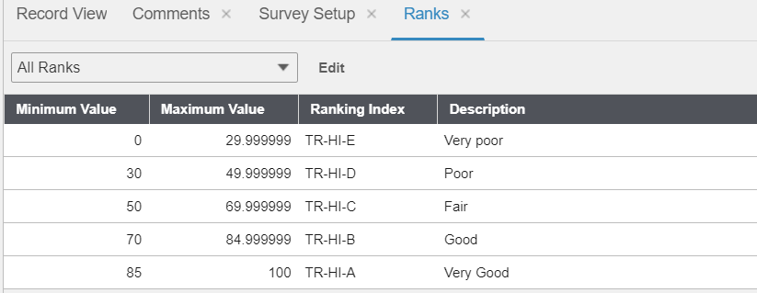
Equipment Ranking – Ranks
  Level 0 (the root): Transformer Health
  Use formula to determine overall Score.
  The score will be a number between 0 and 100.
  Then find the related index on the Ranks tab.
By DTI Invitation Only - Offer Valid until November 30th, 2024

Slide 26
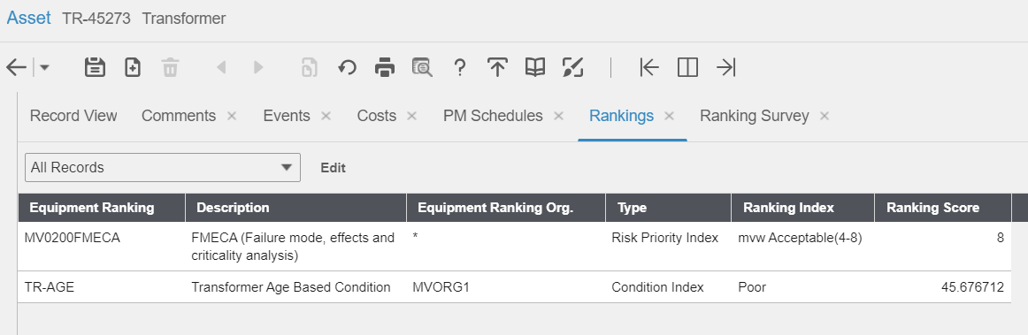
Assets – Rankings
  Associate rankings to your assets, positions, and systems.
Notes:
The asset has multiple rankings.
Of every type of ranking, there can only be one. Exception is the Type Reliability Ranking.
Note that you do not have to do RCM to get a FMECA score. Just create a ranking for it.

Slide 27
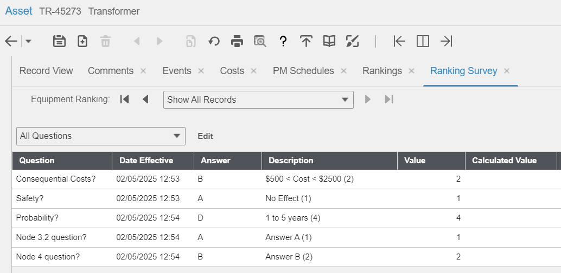
Assets – Ranking Survey
  Answer the survey before calculating the score.
By DTI Invitation Only - Offer Valid until November 30th, 2024
Notes:
Note that every answer (here only A, B, and D are used) has a numeric value.
IMPORTANT: These are the questions for the FMECA from the previous slide. The Age Based condition protocol has no questions. Remember, it is not survey based.
IMPORTANT: Formulating the questions properly is important. Even I do not remember what is meant with question 4 and 5.

Slide 28
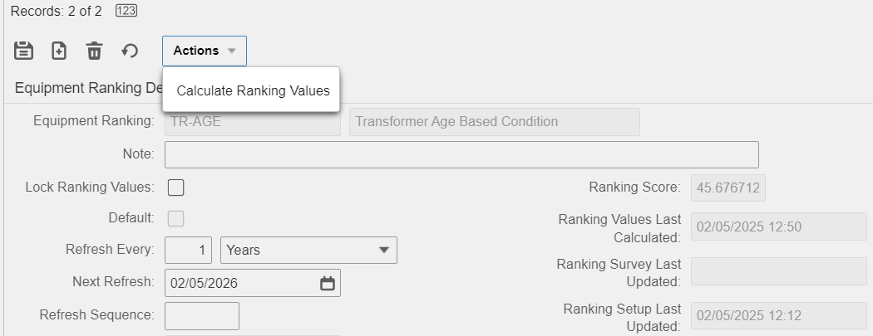
Assets – Rankings
  Then click Actions and Calculate Ranking Values on the Rankings tab.
Notes:
Note that you can have the system automatically calculate the score like a PM Schedule.

Slide 29
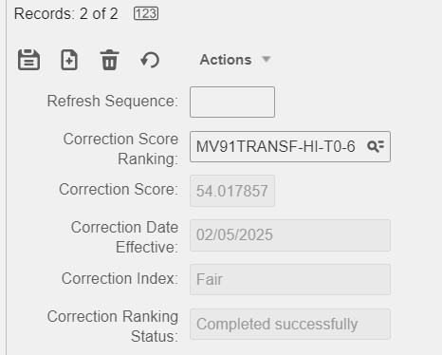
Assets – Rankings
  Now add a Correction Condition Inspection to the Age Based protocol on the Rankings tab.
  Can be added to any condition index with an age,
  a usage, or a decay curve based Condition protocol.
  The age, usage, or decay curve based protocol
  calculates on a regular frequency.
  The correction survey/inspection happens based on
  a PM (every 5 years?) or ad-hoc whenever required.

Slide 30
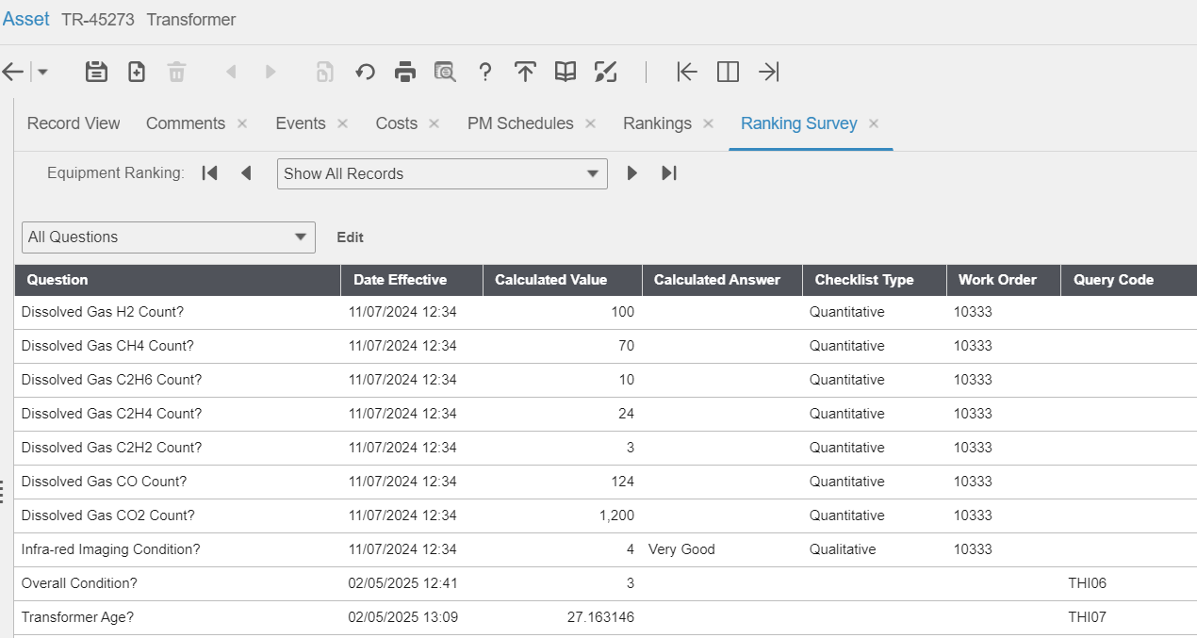
Assets – Ranking Survey
  Did you
  complete an
  inspection work
  order with the
  transformer
  health
  checklist?
  If you did …
Notes:
Note the work order reference. Those are checklist lines. From an inspection in November 2024.
Note the Query Code. Those answers came from a query you defined.
All executed at calculation time.

Slide 31
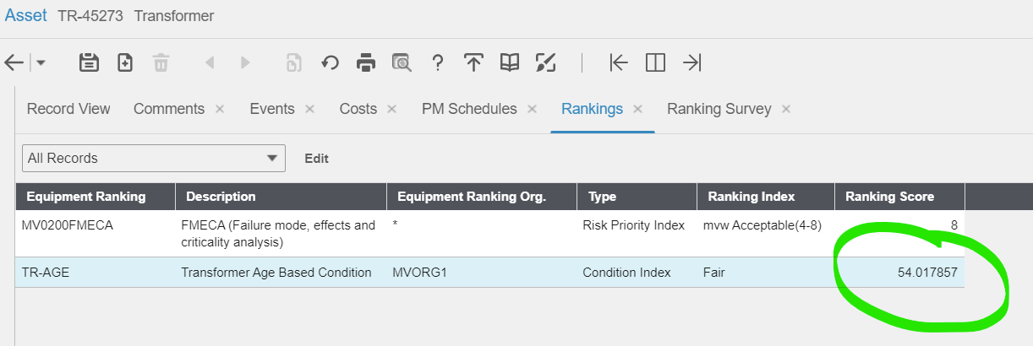
Assets – Rankings
  The ranking score will now include results from the latest inspection.
Notes:
The work order inspection results indicated a better condition. It went up with about 8 points from 45.7 to 54 rounded.

Slide 32
Ranking with RCM / RCA in EAM
  Reliability Centered Maintenance and Root Cause Analysis both rank on Risk
  They calculate the Risk Priority Number (RPN).
  And the associated Risk Level (qualitative).
  RPN = Probability Rating * Consequence Severity.
  Lower RPN is better.

Slide 33
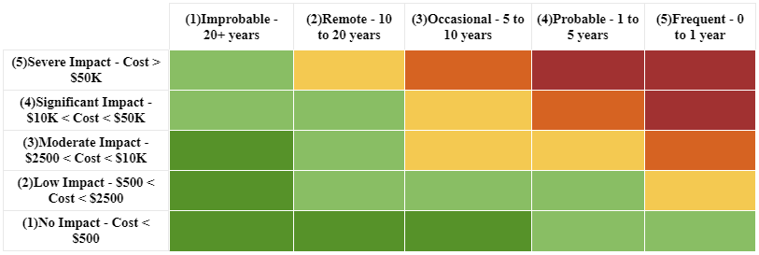
Risk Matrix Setup
  Probability * Consequence = RPN (= Risk Level)
Event Probability | Rating
Improbable - 20+ years | 1
Remote - 10 to 20 years | 2
Occasional - 5 to 10 years | 3
Probable - 1 to 5 years | 4
Frequent - 0 to 1 year | 5
Consequence for Costs | Severity
No Impact - Cost < $500 | 1
Low Impact - Cost < $2500 | 2
Moderate Impact - Cost < $10K | 3
Significant Impact - Cost < $50K | 4
Severe Impact - Cost > $50K | 5
Risk Level | Threshold
Desirable | >= 1
Acceptable | >= 4
Undesirable | >= 9
Unacceptable | >= 13
Catastrophic | >= 20
Notes:
Consequences are for cost in this example. But consequences for safety, environment, company image are also often included.

Slide 34
Ranking with RCM / RCA in EAM
  System calculates RPN per Equipment
  Failure Modes have a probability, and a consequence associated.
  Failure mode RPN is the Probability Rating * the Consequence Severity.
  Do this for every failure mode of the equipment.
  Take the worst (highest) RPN and apply to the equipment.
  Mitigation (PM, inspection, etc.) reduces the Probability Rating in EAM.
  Failure Mode RPN then uses the Mitigated Probability Rating * the Consequence Severity.

Slide 35


