Slide 1
The Importance of Choosing the Right Implementation Partner
Stephan Schomberg
Solutions Director
Elevotec Inc.

Slide 2
Outline
SECTION 1
Introduction / Who is Elevotec?
SECTION 2
Providing Solutions
SECTION 3
Tools & Methodology
SECTION 4
Training
SECTION 5
Lessons Learned & Summary

Slide 3
Speaker Bio
Stephan Schomberg
Project Management for 25+ years ERP and EAM
Project Management Implementations
  Over 100 locations successfully implemented across NA
  15 different industries (everything from bagels to airplanes)
Application expert and certified in both Infor ERP and Hexagon EAM
Developed supply chain strategies for several fortune 500 companies.

Slide 4
Introduction
During this presentation we will talk about the many aspects of asset management application implementations and how to succeed while mitigating known risks.
Along with key lessons learned, we will link the importance of attaining project deliverables to the completeness of knowledge transfer during the implementation.

Slide 5

Who Is
Elevotec Inc is a Canadian Company providing solutions for Enterprise Asset Management, Enterprise Resource Planning and Business Intelligence.
We are a proud Chanel Partner of Infor and Hexagon that has spent over 10 years working closely with Product Development, Product Sales, Product Support and Consulting Services to deliver sound solutions, value and quality implementations.
Our products are:
  HxGN EAM – Enterprise Asset Management,
  Infor LN, CSIE - Enterprise Resource Planning,
  Infor BIRST - Business Intelligence
We combine our “Enable, Evolve and Elevate” approach with our capabilities to help customers succeed in both Commercial and Public Sectors, aligning there needs to the best solution and implementation.

Slide 6
Providing Solutions
How do you define a “good” Implementation Partner?
Through our experience, we’ve come to understand there are 2 types of approaches regarding implementations.
Consider the following choice:
A partner that performs only the tasks that are assigned.
Vs.
A partner that provides solutions and works with you to
entrench those solutions in your organization.

Slide 7
Providing Solutions
Whether it is:
Determining how to improve or
Choosing an application
Implementing best practices
Solving unrelated issues as you go
Staying until the job is done right
Supporting the organization long term
Choosing the right solution partner is far more important
than choosing the right software.

Slide 8
Providing Solutions
So, what are some important things to consider?

Slide 9
Providing Solutions
To be a great solution provider and implementation partner you need to understand more than the application you are implementing.
You need to understand business processes, people, and change management.
There is a big difference between implementing and successfully entrenching the processes and training in the organization.
“85% of large implementations fail to achieve their goals”

Slide 10
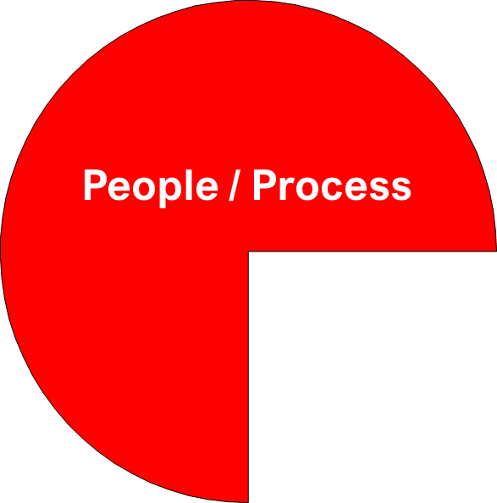
What Determines Implementation Success?
People / Process
Technology

Slide 11
Balanced Focus
People / Process
Money, time, and planning, for hardware, software and systems often take priority.
Training, and staff development along with process redesign, implementation planning and change management are also important.
Put the attention and resources in the right proportion.
Technology

Slide 12

Consider This…
“Raising the Bar” on the work force​
Resources on a learning curve​
Additional processes/data being managed​
Increased focus on accuracy​
Preparing for “real-time” reporting​
Current Skill sets/training/capability​
Do we need business basics training?​
Process understanding ​
not just “a process” but all
upstream/downstream linkages​
Legacy Practices ​
Do we spend time with the system to
accommodate poor practices or eliminate
poor practices?​

Slide 13
Communication is the key to success​
“Say what you're going to do and do what you say”
Use Simple Project Management tools​
Project Charter​
    Definition, Goals, Scope, Deliverables, Timing​
  It should be simple and understandable use business terms.​
Project Schedule; consider an Agile approach​
If you need a full-time person to manage the schedule it is too complicated use calendars for near time events.​
Regular meetings or scrum calls​
RAID tracker (Risks, Actions, Issues, Decisions) ​
Go live business planning and check list​
Go / no go evaluation and meeting​

Slide 14
Simplifying and ​
Standardizing ​Processes​
Understanding your business processes and Best practices​
What is the “Customer Decoupling point” for your products​
-Make to stock​
-Assemble to order​
-Make to order​
-Engineer to order​
Is your business Discrete vs Process driven manufacturing​
Removing non-value-added tasks​
Understanding the up and downstream effects of process changes.

Slide 15
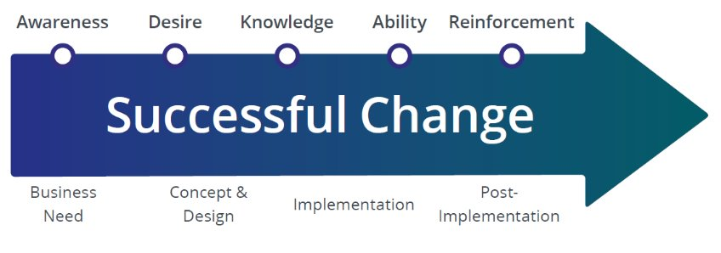
Change Management​
Have a plan from the start!

Slide 16
Change Management​
Prosci ADKAR® ​Model
​Awareness represents a person’s understanding of the nature of the change, why the change is being made, and the risk of not changing. Awareness includes information about the internal and external drivers that created the need for change, as well as “what’s in it for me?” ​
Desire shows the user the benefits and helps them want to participate in the process to achieve these benefits. Desire is achieved when an individual genuinely says, “I will be part of this change.”​
Knowledge-building will only be effective when an individual has Awareness of the need for change and Desire to participate in the change. Any training activities that attempt to build Knowledge before achieving these first two ADKAR elements will be ineffective​
Ability is turning Knowledge into action. Ability means tangibly applying and demonstrating intellectual understanding in a real-world environment. Change leaders impact project success by intentionally providing time, resources and coaching to help impacted employees develop new skills and behaviors.​
Reinforcement is the final element, and it is critical. While making a change is hard, sustaining a change over the long term is even more difficult. It is human nature to revert to what we know.​

Slide 17
Simplifying and ​
Standardizing ​Processes​
Understanding your business processes and Best practices​
What is the “Customer Decoupling point” for your products​
-Make to stock​
-Assemble to order​
-Make to order​
-Engineer to order​
Is your business Discrete vs Process driven manufacturing​
Removing non-value-added tasks​
Understanding the up and downstream effects of process changes.

Slide 18
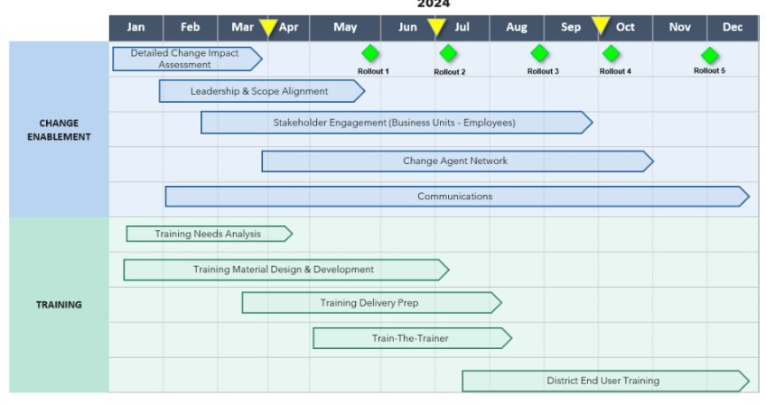
Linking Training to Change

Slide 19
Training
Training should have four components
  Overview – we explain their role in the process (Inputs and Outputs)
    -What is changing, what is staying the same
  Working Demonstration – we demonstrate the correct way to do the tasks using real life examples.
  Hands on – we let them enter information using real life data. That they can continue to practice.
  We leverage the users for testing, which also strengthens their ability and confidence.

Slide 20
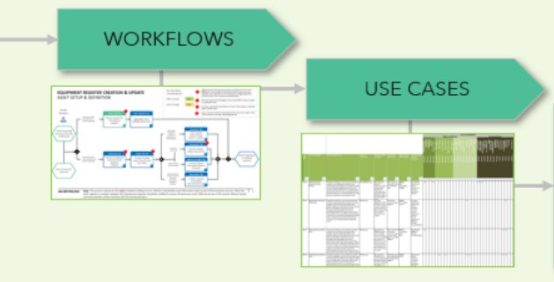
Training
Inputs

Slide 21
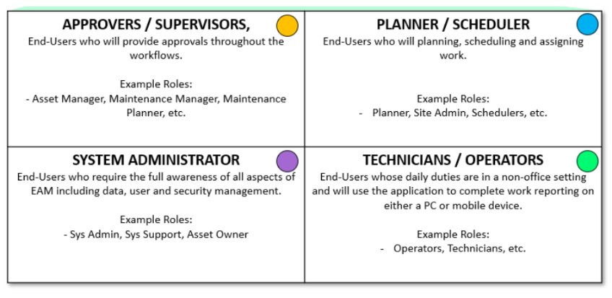
Training
Role Based

Slide 22
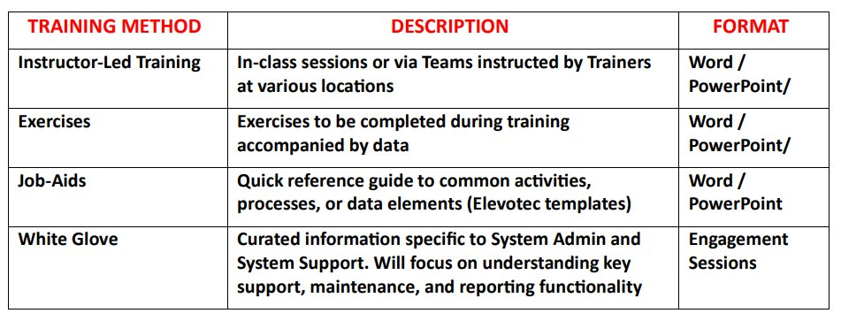
Training
Methods

Slide 23
Testing
Testing real-life scenarios​
Using test exercises to validate​
Having the users involved in testing is a good way to train and also, to find out things you may not have considered.​
Repetition is the best way to entrench learning​

Slide 24
Testing
Build and Configuration
Unit testing will be carried out first by the project team and will include the Elevotec consultants and with the assistance of the Asset Owner and the System Admin.
Once these initial tests are performed, we will invite key users, testers, and potential trainers to also go through the functional test scenarios that apply to processes.
Gap analysis and fixes will be made to any issues and retesting will be done on those scenarios along with any regression testing that is required. This will continue until we are satisfied that the application is ready to be used.
UAT (user acceptance testing) will be performed in each District to support the roll-out and transition to the new modernized system structure and data sets.

Slide 25
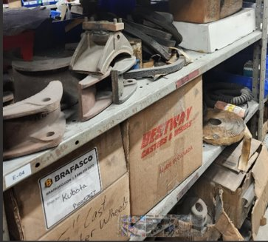
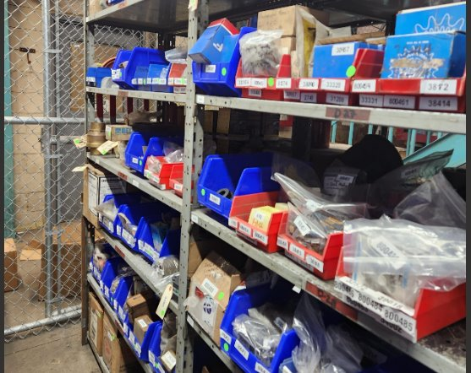
Solving Issues as You Go
People / Process
Before After

Slide 26
Multi-site Roll-outs
Implementation Readiness
Plant readiness review​
  Condition of the data (PM’s, Asset data, etc.)​
  Current reporting accuracy​
    Size of Inventory adjustments?​
    Period end issues?​
    Timeliness of reporting?​
Staff knowledge, capabilities, attitude and availability?​
Determining a Roll-out Sequence​
  Review Business Goals​
  Review other projects at the Shops​
  Determine resource availability​
  Plant managers views and buy in.​
  Align implementation timing with business needs and Financial calendar.

Slide 27
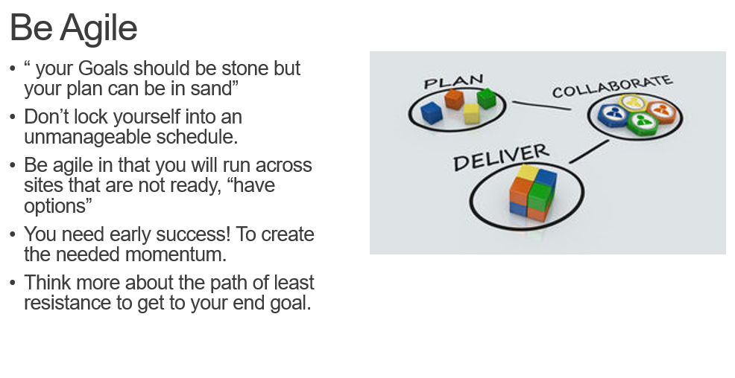
Agile

Slide 28
Sequence stages of roll-out
Sequence stages of
roll-out
Shop 1
Shop 2
Shop 3
Shop 4
Shop 5
Shop 6

Slide 29

Go / no go Meeting
Current vs New system review
Training Evaluation
Cut over steps
Check list
Go Evaluation
Decision

Slide 30
Importance Of Validating your implementation
A common problem with many projects today is that nobody verifies that the project met it’s deliverables.
That the training and processes are entrenched
That the value expressed in the business case has been attained.
“You can’t manage what you don’t measure”…

Slide 31
Measurement
Techniques
During the project
  Depending on a company's Project Management maturity, they will use different techniques to measure.
After a project is complete?
  Most companies are just glad it is done and want to move on to the next one. This can be a big mistake because it is important to also measure to improve the next project.

Slide 32
Measurement
Criteria
The criteria should have the following characteristics.
  Based on project goals or deliverables
  Simple to understand
  Fare and impartial (applied to all)
  Easy to create and maintain (if required)
  Publishable
    This last point is important to speed up the process of compliance.
Measurement can give you important insight
  Additional training may be required
  Change management success or failure
  Commitment to new processes
  Attitude

Slide 33

Turning Challenges into lessons learned
Challenges
  No such thing as “cookie cutter”
    Each Shop is unique in some way
  Expect some resistance to change
  Raising the bar on our workforce.
  Hidden system monsters (Excel –zilla)
  Legacy Practices

Slide 34
Review / Summary
“85% of large implementation fail to achieve their goals”
Having an implementation partner that understand your business.
Has a proven methodology for success.
You can trust to truly put your interests first.
Will deliver long lasting solutions not just task management.
Has the confidence to challenge you when you are off track.
And
Has a templated approached for all the above to save you both time and money.

Slide 35

Thank you!
Enable • Evolve • Elevate

