Slide 1
Transforming MRO Inventory Optimization with AI
Enhancing Criticality, Inventory, and Uptime
Jeromy Risner
Director, Solution Engineering
Maintenance and Reliability Professional
Verusen
Notes:
Original Title: Leverage AI to Reduce Downtime | By Identifying Critical Spares and Ensuring Appropriate Stocking Levels
Maintenance and reliability professional whose career started with PdM and corrective maintenance as a reliability specialist and teaching vibration analysis and laser shaft alignment
Implemented maintenance best practices across many industry verticals including chemical and general manufacturing, mining, oil & gas, and food & beverage
Implemented mechanical integrity programs, FMEA, RCFA, and many other reliability tools and methodologies

Slide 2
Who is Verusen?

Slide 3
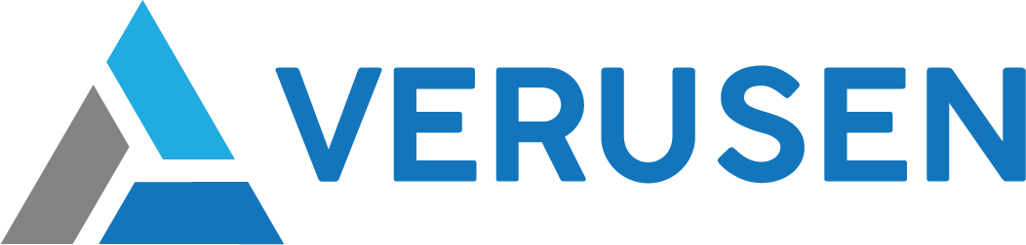
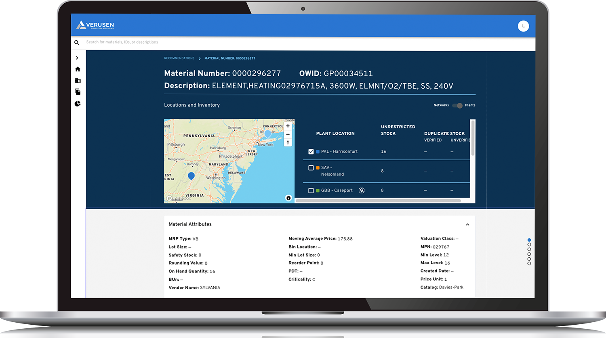
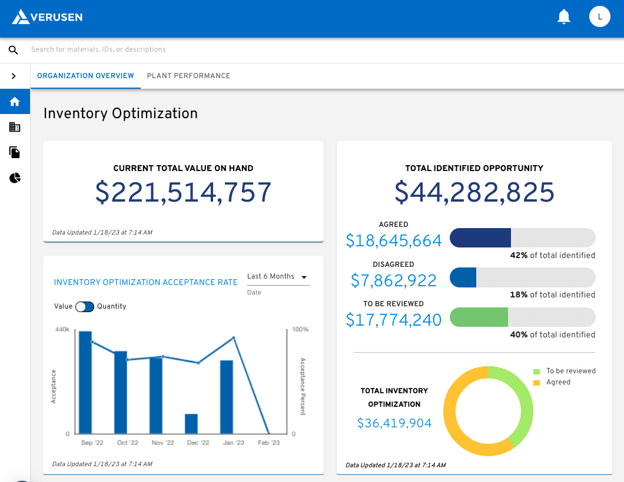



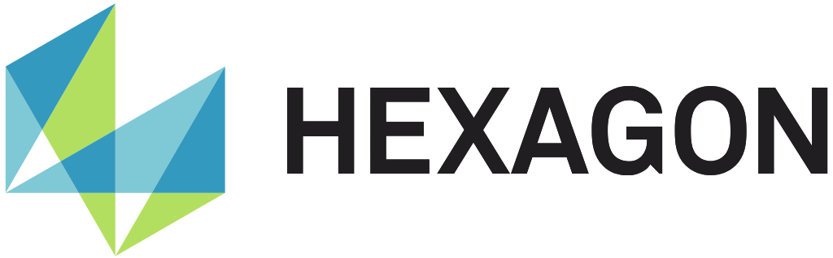
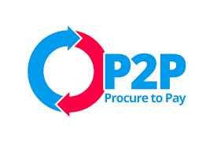




MRO Platform
We Ingest
Data Sources
We Deliver
Business Results
Material Flows, Consumption, Purchase Orders, Inventory Stocking Policies, Locations, BOMs, Lead Times (data as is)
Working Cap Reduction Without Increasing Risk, Improved Service Levels, Material Visibility, Reduced Unplanned Asset Downtime, Material Criticality, Ops/Procurement Alignment
USE CASES
Material Search and Discovery | Item Criticality Recommendations | Always On Inventory Optimization | Spare Part Sharing Support | Drive Organizational Alignment | Supplier & Category Spend Analysis | Network Modeling
Notes:
With our trained AI solution, we routinely ingest our client’s data from their ERP and/or EAM, process it with our LLM in our graph database, and deliver results.
Helping you find your materials effectively and efficiently using NLP.
This graph database also understands and recommends material criticality, which is the foundation for the next key function, setting stocking strategies or optimizing inventory.
So, while I’m not focusing on this solution, I am focusing on the foundational element of assessing material criticality to drive effective stocking strategies.

Slide 4
System of Record + System of Intelligence
Hexagon EAM Role | Verusen’s Complementary Role
Manages inventory transactions (e.g., receipts, issues, transfers) | Analyzes historical transaction data to identify patterns and optimize inventory policies
Stores part master data (e.g., ABC classification, min/max levels) | Provides AI-driven recommendations for criticality, stocking levels, duplication, networking, sharing
Manages purchase orders and procurement workflow | Optimizes procurement decisions by identifying lead time risks, PPV, tail spend, supplier alternatives
Relies on manual user input for classification & min/max levels | Recommends, but the user is the ultimate decision-maker to reduce guesswork

Slide 5
What is MRO materials optimization?
Notes:
car? spare parts? how do you decide?
tire/fuse. why not a fuel pump or a spare transmission?
why not 4 tires? <driving toward likelihood, risk, cost>
why not wiper blades? <availability, speed>
balancing cost and risk

Slide 6


Striking a balance
The right parts at the right time at the lowest TCO (total cost of ownership)
OR
Providing maximum service level from minimum inventory at the lowest cost

Slide 7
Why do we care?

Slide 8

Margin sinkhole
Production downtime
Increased maintenance costs
Inflated inventory value
Inflated carrying costs
Risk of obsolescence
Damage, deterioration, shrinkage
Notes:
“inventory isn’t an asset, though we keep it on our books as such. It is working capital that is not working.”

Slide 9
How to Optimize?
Notes:
Now we understand why it’s so important, let’s review how to optimize, but first…

Slide 10
Typical Approaches
Notes:
What are some typical approaches?
New part is added to inventory, engineering or maintenance provides initial stocking recommendation… based on best guess? Install base and likelihood of failure, OEM recommendations? Are the parts from the OEM? Is there an incentive to overstock? Are they doing their best to cover a possible warranty claim? Do they have incentive to recommend a low number?
Typically initial level set, not revisited until a production comes to a screeching halt, maintenance troubleshoots, identifies a part that failed, goes to find it. It’s not there. <stockout occurs>… typically response… we had a min of 5, let’s raise it to 10… emotional reaction, not necessarily financial.

Slide 11
Calculating the MIN
Historical Usage
Lead time usage + Safety stock
How do we calculate usage?
How do we calculate lead time?
What makes MRO unique?
SOH/QOH = 59
Current Min/Max = 50/100
Good or bad?
Monthly usage past 25 months oldest to latest: 20, 0, 0, 0, 0, 0, 0, 0, 0, 0, 0, 0, 0, 0, 0, 0, 0, 21, 0, 0, 20, 41, 0, 0, 0
Lead time over same period. 1 PO receipt. Issue to receipt date: 9 days
Historical Receipts
Notes:
If we can remove the emotional component, we can come to a mathematical, financial decision.
Q: what makes mro inventory unique? <<<Lumpy, intermittent demand>>> Breakfix. if everything was planned/sch we could move a lot of inv to “just-in-time” order as needed. so our stocking levels are primarily for break/fix or corrective.
So it’s the random nature of failures that makes MRO unique.

Slide 12
Demand Considerations
Historical Usage
Lead time usage + Safety stock
Average = 3.9
Good or bad?
Vs Forecast
Moving average, Single exponential smoothing, Double, Triple, Adaptive, Least squared fit, Smoothed least squares, Trend seasonal, Smoothed trend seasonal, Demand interval analysis, MTBD, Crostons?
Monthly usage past 25 months oldest to latest: 20, 0, 0, 0, 0, 0, 0, 0, 0, 0, 0, 0, 0, 0, 0, 0, 0, 21, 0, 0, 20, 41, 0, 0, 0
Lead time over same period. 1 PO receipt. Issue to receipt date: 9 days
Historical Receipts
Notes:
Using a real-world data set, we have an item w/ very lumpy, intermittent demand
What happens if we calculate average monthly usage?
What other approaches are there?
easy or hard? how do we approach it?

Slide 13
Lead Time Considerations
Lead Time: PO issue to receipt
Total Lead Time: Delays? Lead time buffer(s)
Lead Time Usage: Usage during lead time
100
0
Internal + Supplier + Freight
Total Lead Time
Notes:
just stick w/ total LT

Slide 14
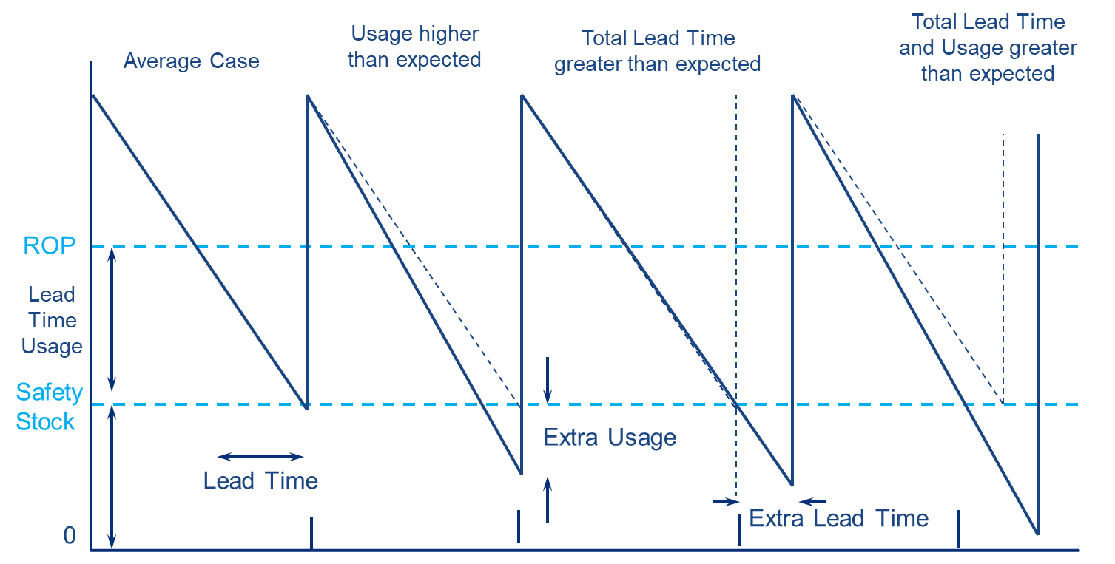
Now Calculate the MIN
Lead Time Usage + Safety Stock
Time to add the safety stock
common formula for safety stock is:
Notes:
HAVE to understand variance/variability
have to understand overshoot (issues size larger than usual and/or lead time longer than usual)
white board MAX/MAX/SS and illustrate overshoot (variance/variability)> SS covers variance and is determined by svc level..
Service Level: The probability or percentage of time that inventory will meet demand without stockouts. A higher service level means fewer stockouts but requires more safety stock. Service levels are often set according to business goals, customer expectations, or industry standards.
Z-score in safety stock calculations comes from the field of statistics and represents the number of standard deviations a particular value is from the mean in a normal distribution. In inventory management, the Z-score helps quantify the level of confidence that the inventory will meet demand, based on a desired service level.
Example: 98% svc level = 2.33 std deviations. 95% = 1.65 std deviations or z-score

Slide 15
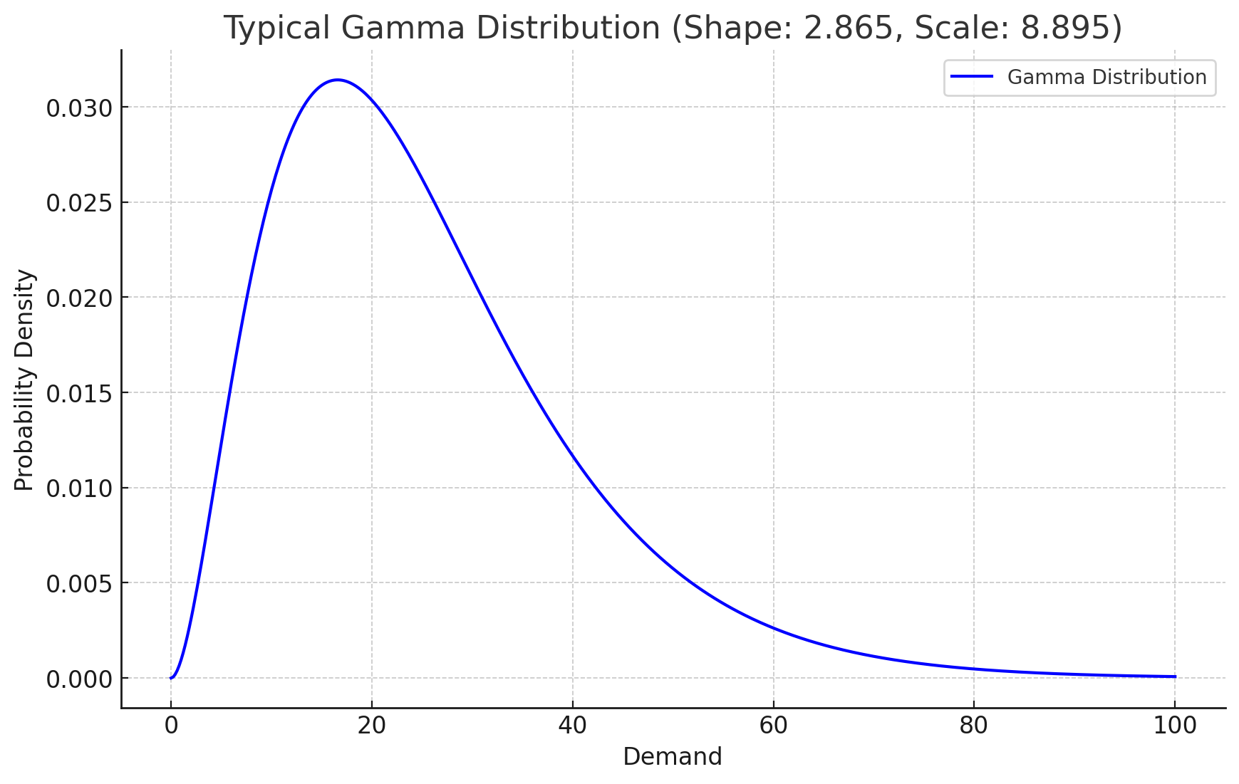
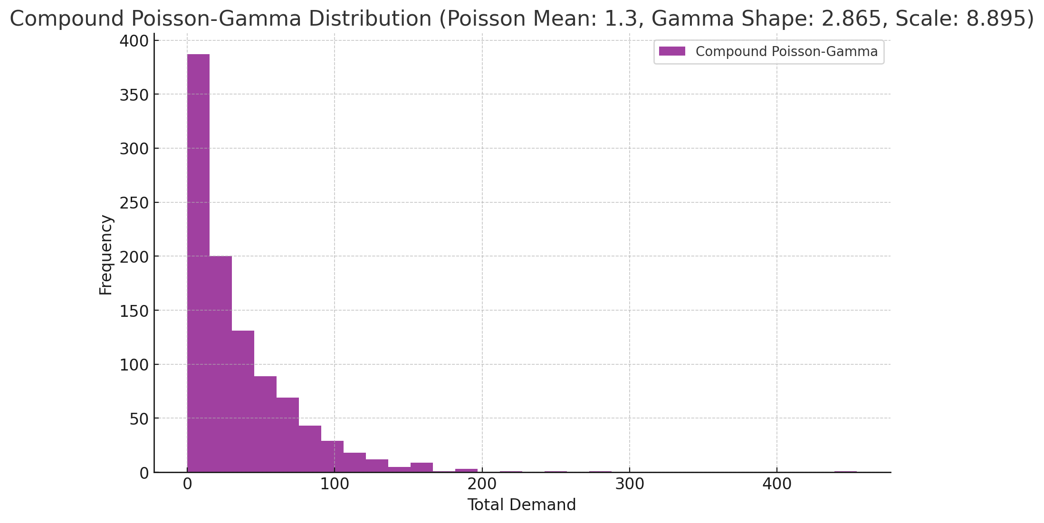
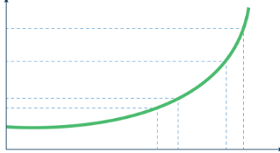
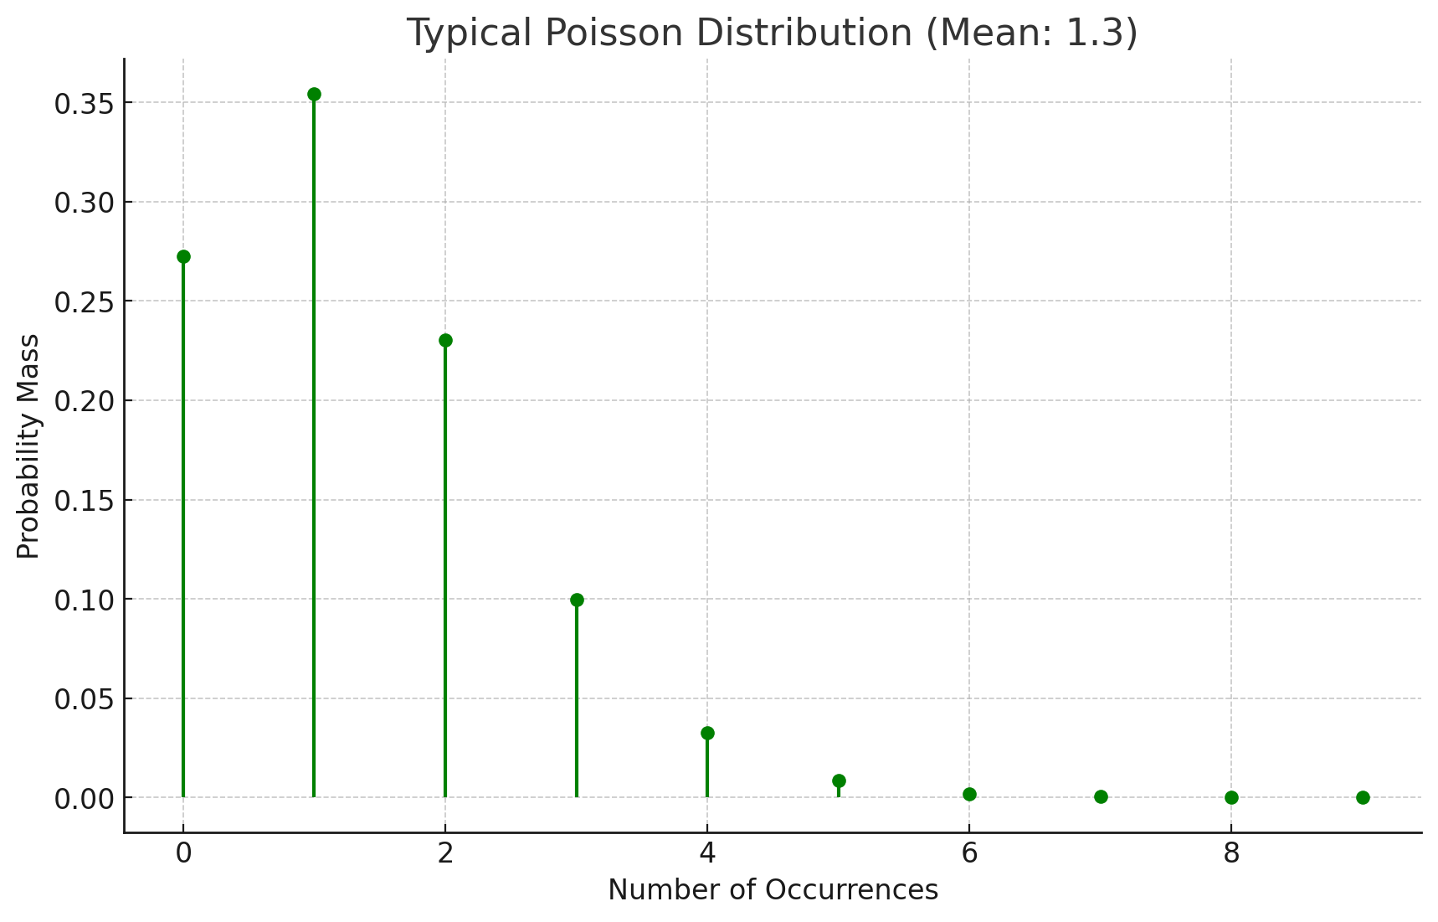
Can AI Help?
Historical Usage
Lead time usage + Safety stock
Stochastic probability for demand
Expected demand = 20.4 per month, 65.6 variance²
Stochastic probability for lead time
Stochastic probability for lead time usage (unified Poisson-gamma distribution)
7.65 (in 9 days LT), 214.75 variance²
Distributed over a service level field against reorder points
Min for 95% service level = 32
Max = Min + lead time usage (vs EOQ)
Min/Max = 32/40
Monthly usage past 25 months oldest to latest: 20, 0, 0, 0, 0, 0, 0, 0, 0, 0, 0, 0, 0, 0, 0, 0, 0, 21, 0, 0, 20, 41, 0, 0, 0
Lead time over same period. 1 PO receipt. Issue to receipt date: 9 days
Historical Receipts
Notes:
So is the 3.9 good or bad? Likelihood of issue size? 20
Remember the soh? 59. assume next issue is 20, takes us to 39, still good. Next issue in a month or so? Likely 20, takes us to 19. reorder how many?
Sound good?
AI > automatically select the right math and combine unique models to give accurate predictions. With the human-in-the-loop, our feedback can further refine and train the model. Regression testing allows us to take years of history, ignoring the pasts 2 years or so, run the simulations, then reveal the past 2 years to see how accurate the simulations were.
Not going to happen manually or with speadsheets and/or BI
note: Compare and Contrast
Poisson = Counting Events (like placing orders or demand events).
Gamma = Measuring Time/Effort (how long between demand, how long is the lead time).
The Poisson distribution is like keeping a tally of how many things happen. The Gamma distribution, on the other hand, is better for when you care about the total time or energy needed when those things happen.

Slide 16
Typical Challenges?

Slide 17
1
Misalignment

Slide 18

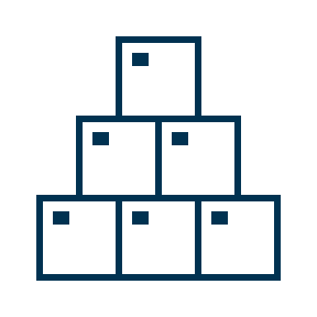
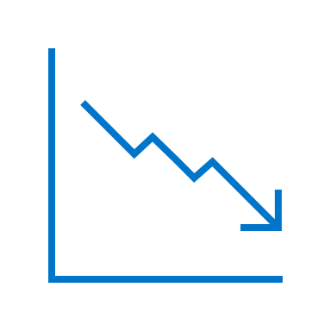

Collaboration
Maintenance & Operations
increase uptime & availability
efficiency & throughput
regulatory compliance
Procurement & Supply Chain
control costs
reduce spend & working capital
strategic sourcing
Finance
reduce working capital
improve return on assets
control costs
Notes:
ineffective, inefficient processes (what to stock, how to stock it, when do you revisit stocking levels, is data current and sufficient)
people have misaligned incentives (procurement controlling cost/spend while operations & M&R are rewarded for uptime)
supply chain risk (constantly changing
data is inconsistent, incomplete, poor descriptions, sometime multiple systems (ERP, EAM/cmms, multiple versions, nonconsolidated)

Slide 19
2
Understanding RISK
Notes:
old suburban, old porsche
Balance criticality w/ supply chain constraints & procurement logic for strategic organizational buy-in!

Slide 20

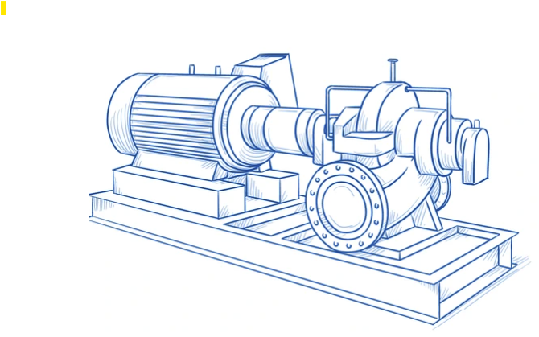
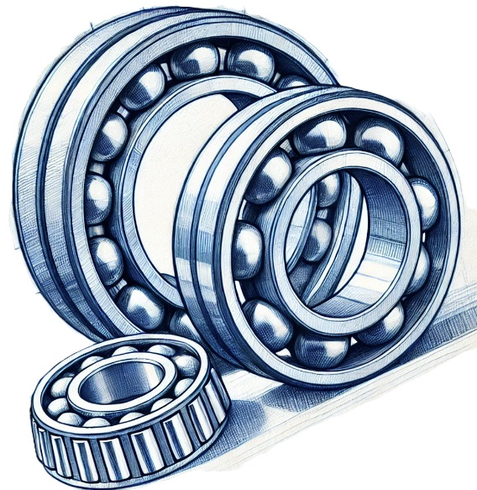

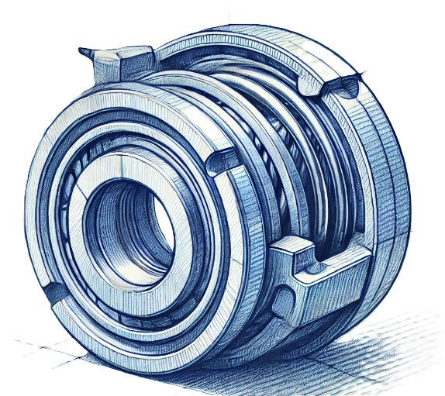

Material Risk
BOM or Usage
Criticality
Operational Risk
Multiple suppliers
Short lead-time
Coupling
Insert
A
B = 95%
Multiple suppliers
Short lead-time
Bearings
A
B = 95%
Single supplier
Custom build
Long lead-time
Pump 802
Criticality = A
Production Critical
Impeller
A
A = 98%
Multiple suppliers
Short lead-time
Mechanical
Seal
A
B = 95%
Cleaning Supplies
D
D = 80%
Notes:
old suburban, old porsche
Balance criticality w/ supply chain constraints & procurement logic for strategic organizational buy-in!

Slide 21
Sample Process Flow
Start
Insurance
or HSE?
Y
A
“A”
Asset?
Y
N
Capital
Spare?
Y
B
“B”
Asset?
Y
N
Fast?
Y
Price
< $250?
Y
C
“C”
Asset?
Y
Other Considerations:
Material Type
Specific Vendor
Supplier Risk
Work Order Priority
On BOM
N
N
Asset
Ties?
N
D
Notes:
This could be done w/ pen/paper when parts are added and at a specific review interval?
Could be done w/ excel and/or BI (rules based)
Could be done w/ a best of breed solution designed specifically for the unique challenges/requirements of MRO

Slide 22



Criticality Methods
Checklist
New part
Periodic review
Binary
Checkbox in ERP/EAM
Best of Breed
Automation
Continuous
Binary • Emotional • Lack of Process • Siloed Decisioning • Outdated Data

Slide 23
3
Time management
2080 vs 100,000
Notes:
white board exercise:
Q; how many working hours in a year?
2080 hrs per yr. vacay. 2000 x 60 - 120,000 minutes for 100k parts = 1.2 min per part
reality is 30-34 hrs per wk productive time… after meetings, breaks, lunches, travel time, etc.
however…
who sets MRO inventory stocking policies at your plants or facilities?
typical role: inv mgr or materials mgr
role entails: stocking policies, cycle counting/auditing, vendor selection & negotiation, lead time management, cost control, ERP management, analysis & reporting, documentation (parts in/out, msdss, etc.), criticality, labeling/control, compliance, obsolescence mgmnt, disp, maintain fit for svc
so lets assume, they give 50% of their time to stocking policies alone.
15hrs per week x 50 wks x 60 min = 45000 minutes. 100k/45k = 27 seconds per part to rvw 100k
flip the script
lets say each material needs 20 minutes for effective rvw.
100k x 20 = 2MM minutes 2MM divided by 45k available minutes… 44+ years

Slide 24
4
Business is NOT Static
Notes:
If you did manage to solve the time management problem and evaluate all stocking policies in a year, it’s time to start over again if you really want to be competitive
Business is not static. M&A’s,
Fluctuations in production due to market conditions
Supply chain challenges & constraints: hurricanes, pandemics, availability
Maintenance requirements: where used, how used (has the install base changed? Are assets aging out/deteriorating, or reliability program implemented that’s decreased demand on break/fix parts?

Slide 25
With so many parts in a catalog, we must automate with technology

Slide 26



What Does Good Look Like?
Consistent, Accurate, Trustworthy Data
Operations + Procurement Objectives & Alignment
Capture Tribal Knowledge
(outside of systems)
Inventory stocking policies
Parts criticality
Overmax identification
At-risk inventory
Parts sharing
Disposition
Vendor compliance
Tail-spend
VMI
Disposition
Notes:
Consistent input data set
Specific system of records that hold the data
Periodic decisioning (i.e., 2x per year)
Operations-oriented decisions
Inventory stocking policies
Parts criticality
Overmax identification
At-risk inventory
Parts sharing
Disposition
Procurement-oriented decisions
Vendor compliance
Tail-spend
VMI
Disposition

Slide 27
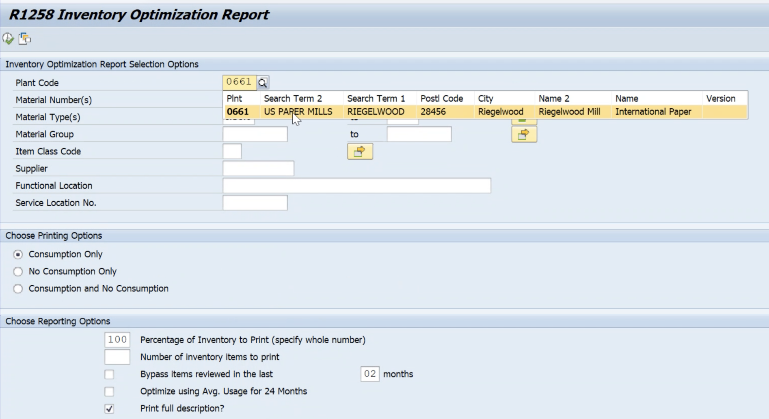
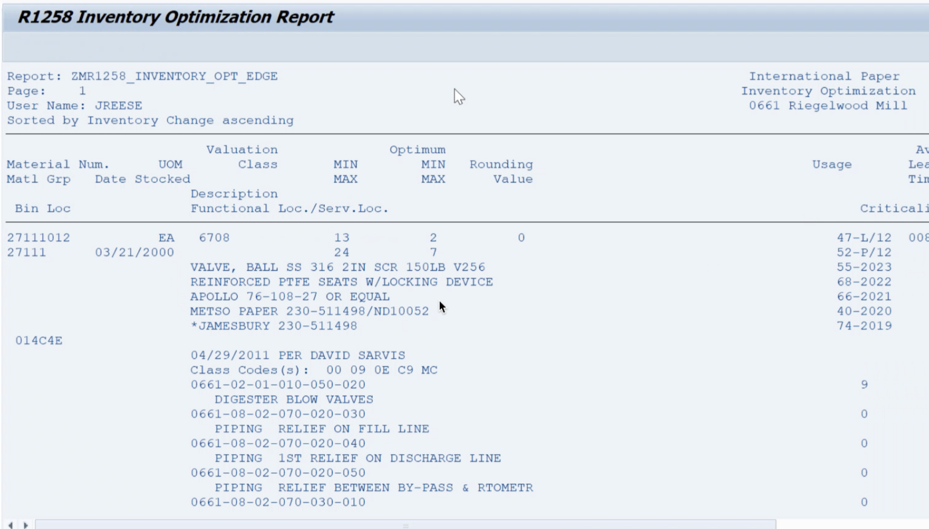
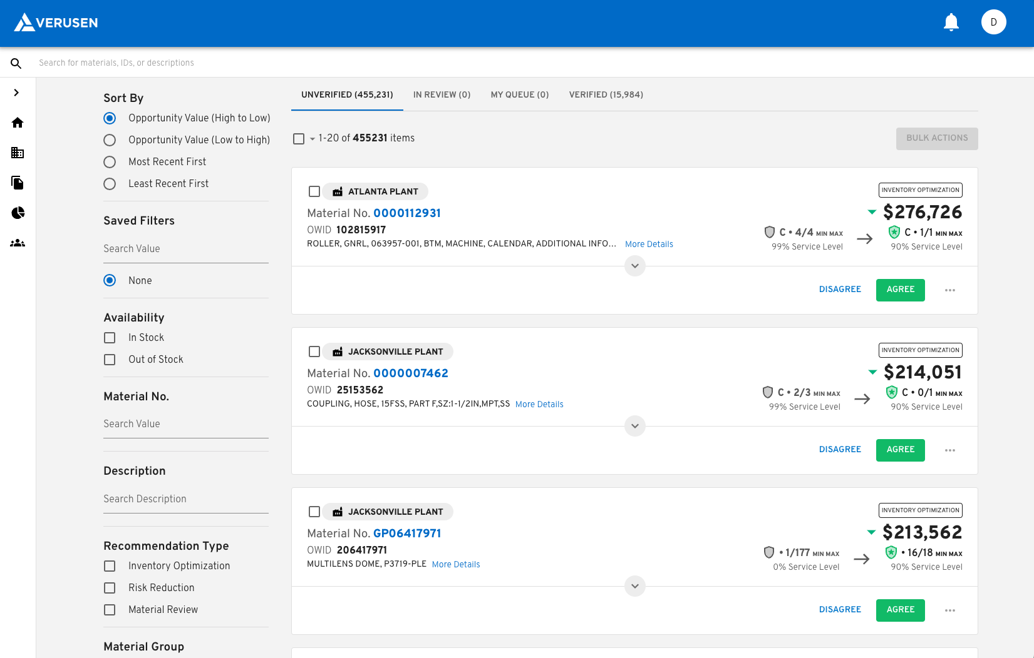
Technology?
AI / Large Language Model / Natural Language Processing
Continuous, automated
Time to value
Easy user adoption
Certified connectors back to systems
No required data cleanse prerequisites
Notes:
What to look for in an MRO inventory optimization technology
Has it been trained on MRO materials specifically? Can it recognize similarity between parts to understand duplication even with incomplete, unclear data?
Is it easily integrated? Not just a reporting solution or static one off analysis?

Slide 28

Client Optimization Journey
12-24 MONTHS
LONG TERM & BEYOND
$62MM
Optimization Opportunity
$21MM Realized in <12 months
Acceptance of Verusen recommendations
(site and network level stocking policies)
Leverage of the Verusen Trusted Ecosystem
$41MM+ Long Term Potential Inventory Reduction
Continued network/spare parts sharing
Realizing burndown on slower moving inventory
Continued rundown of nonstock
Ongoing redisposition of SLOB targeting additional $21MM in value
+18MM
-47MM
RISK
$427
MM
Active Increases
-19.3MM
Active Decreases
-5.8MM
Networking
-1.8MM
-2.5MM
Repairable
VMI
-3.5MM
Deduplication
-21MM
Tail Spend & PPV
$365
MM
SLOB
$344
MM
Starting
SOH Inventory
Improved
SOH Inventory
Optimal
SOH Inventory
Notes:
Once our customers are brought onboard, we provide a high level overview of savings & reduction opportunities.
This customer began with an inventory value of over 400M. increases in active materials were recommended to mitigate risk/minimize downtime, while surplus in active materials are identified which can be consumed down to optimal levels.
With multiple sites spread out across different regions, Network optimization found an additional 19M in surplus (think: consolidating insurance spares and transferring materials)
And by leveraging our “repair-ready” partner, materials were identified that could be repaired instead of replaced for additional savings.
Moving fast turning, low value items to VMI can further reduce inventory value on hand.
Additionally, our material graph identified duplication where surplus can be reduced through consolidation. And finally, tail spend and PPV provide opportunity to leverage purchasing power to get better pricing and effective sourcing.
The total opportunity is 62M.
In the first 12 months after go-live, they realized 21M through accepting stocking recommendations.
There’s ongoing opportunity in efforts that may require some change management and project focus. However, optimization will continue to provide ongoing value.
When you move forward with us, these are the typical outputs and insights you will gain.
1:36

Slide 29
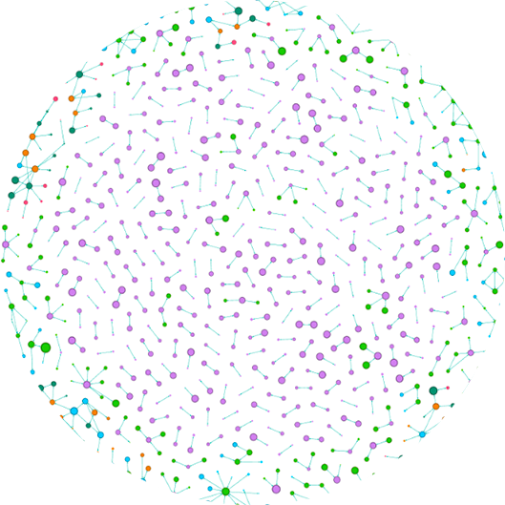

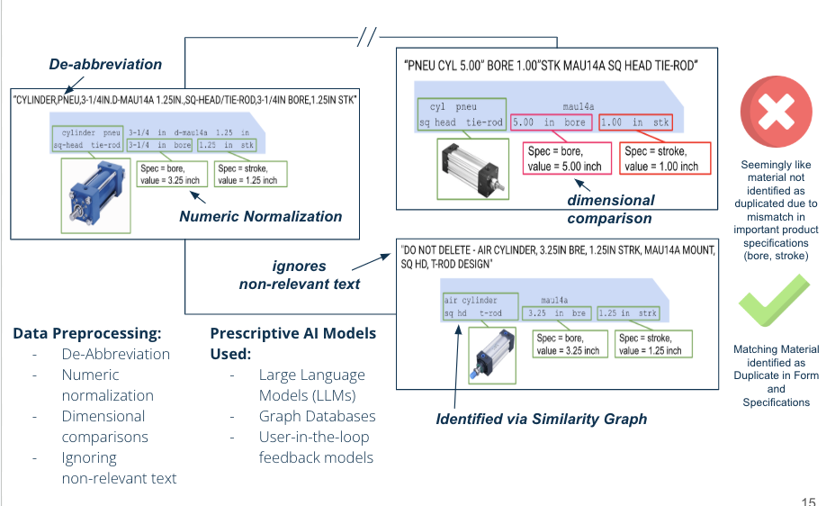
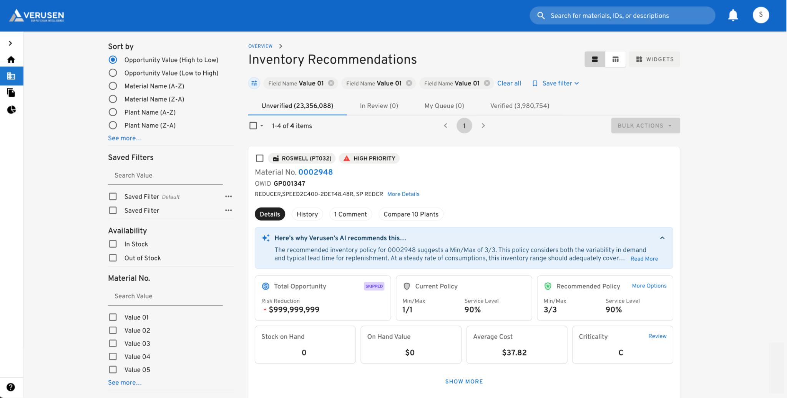
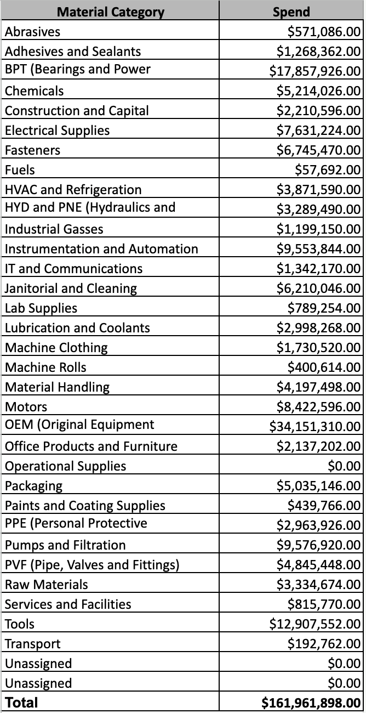
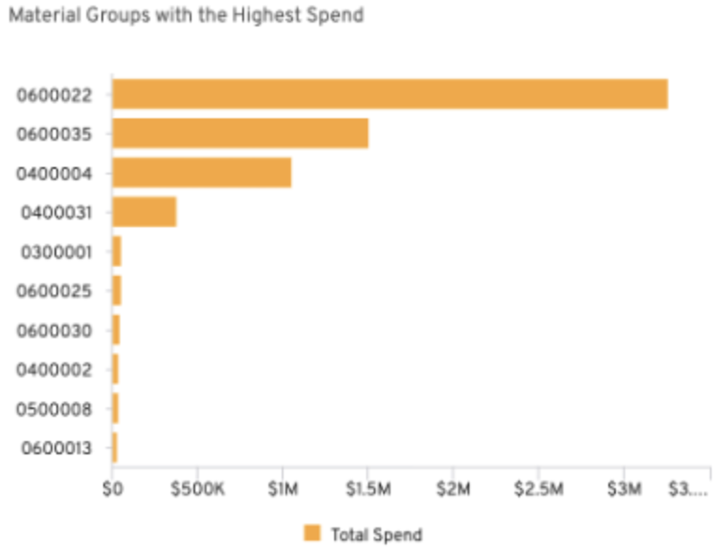
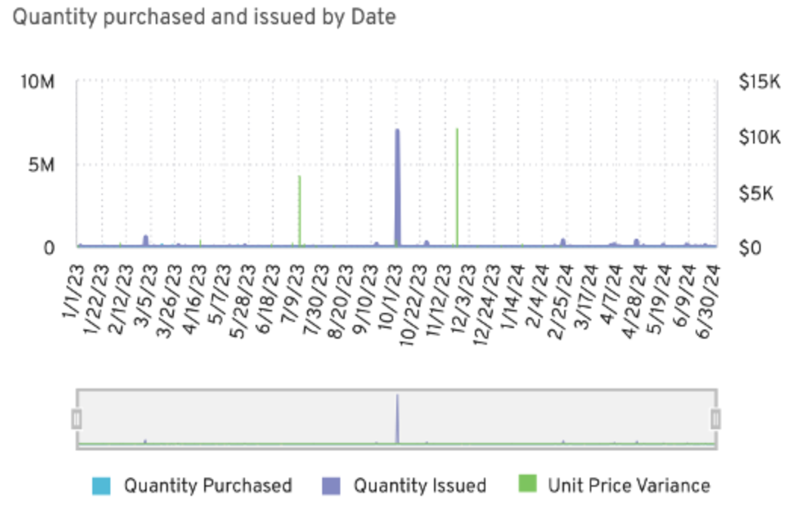
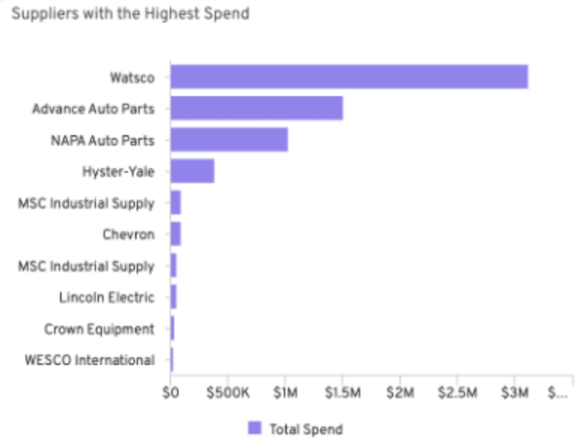
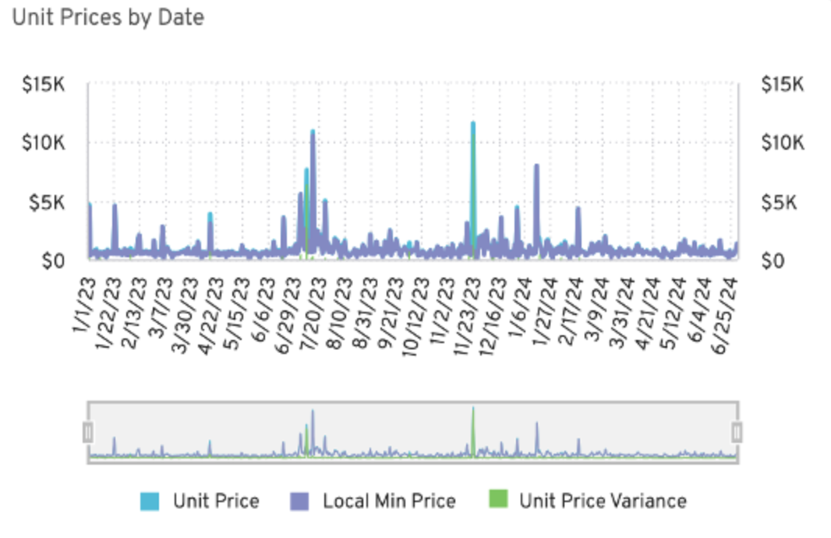
How Verusen uses Purpose-built AI for MRO
Verusen Material Graph
Deep Learning
User-in-the-Loop Models
Large Language Models (LLMs) &
Natural Language (NLP) Processing
The Foundation for Verusen’s Platform
Foundation for Inventory & Criticality Recommendations
Foundation for Duplicates & Search & Discovery
Ingested and trained on 50M+ unique MRO materials & $9B+ material transactions
Industry leading materials knowledge graph
Uses Stochastic Modeling, Machine Learning (ML), User-in-the-loop AI, and business logic
Right materials are stocked at the right levels
Understands complex material attributes to identify contextual relationships
Leverages Graph Databases
GenAI IO Explainability
AI Material and Spend Categorization
Foundation for Trust
Foundation for Scalability
Leverages generative AI to explain the "why" behind suggestions
Builds user trust and accelerates execution
Reduces manual effort, high costs & inconsistencies
AI-driven automation, “Out of the Box” 80%+ accuracy and scalability
Notes:
AI / Large Language Model / Natural Language Processing
Continuous, automated
Time to value
Easy user adoption
Certified connectors back to systems
No required data cleanse prerequisites

Slide 30
Business is not static, neither is Optimization

Slide 31
THANK YOU!

Slide 32
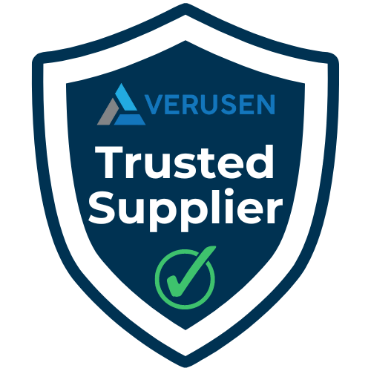


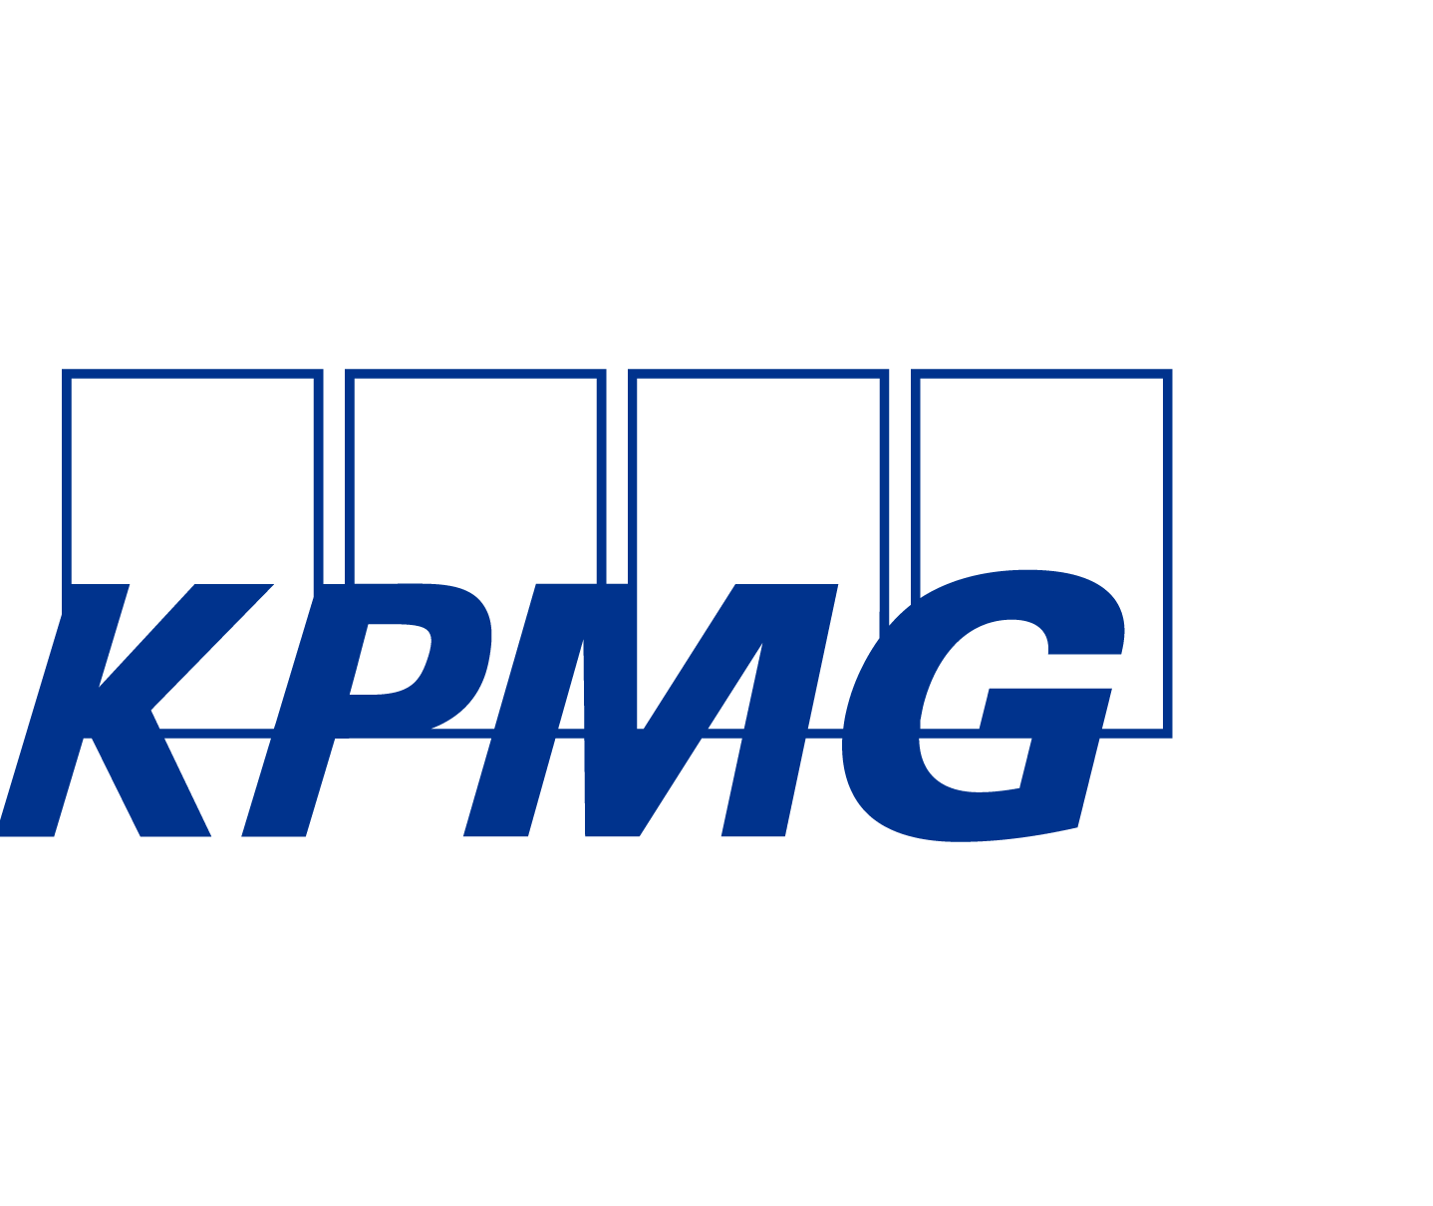
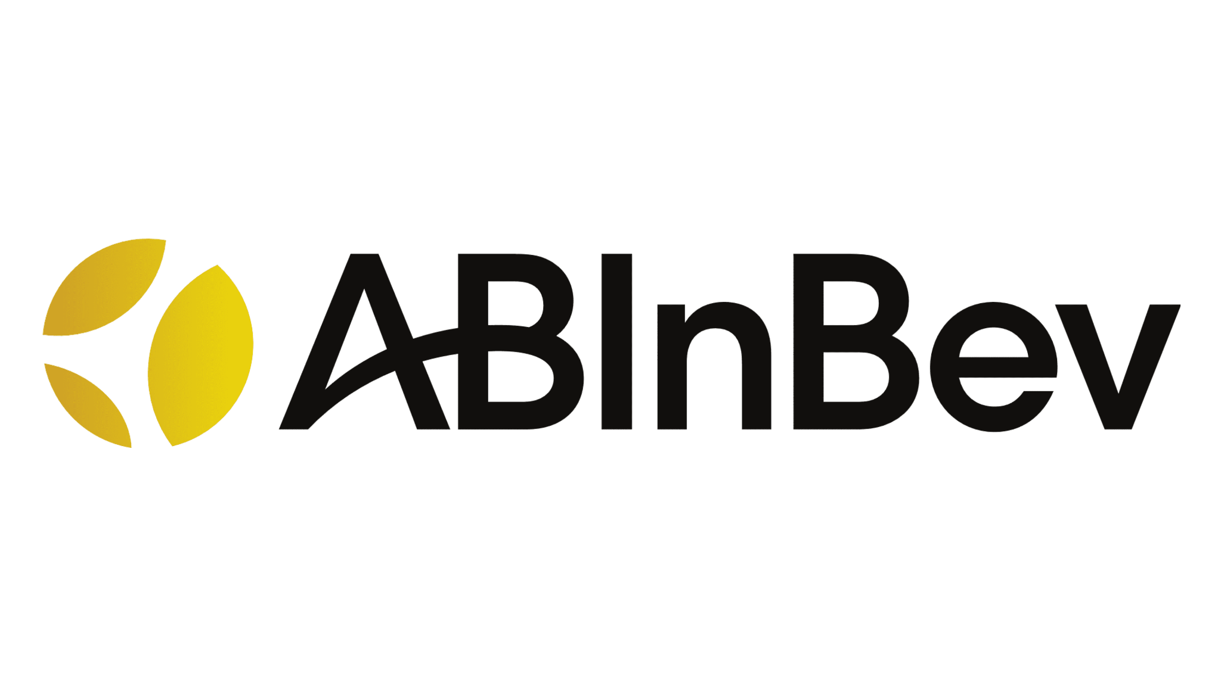
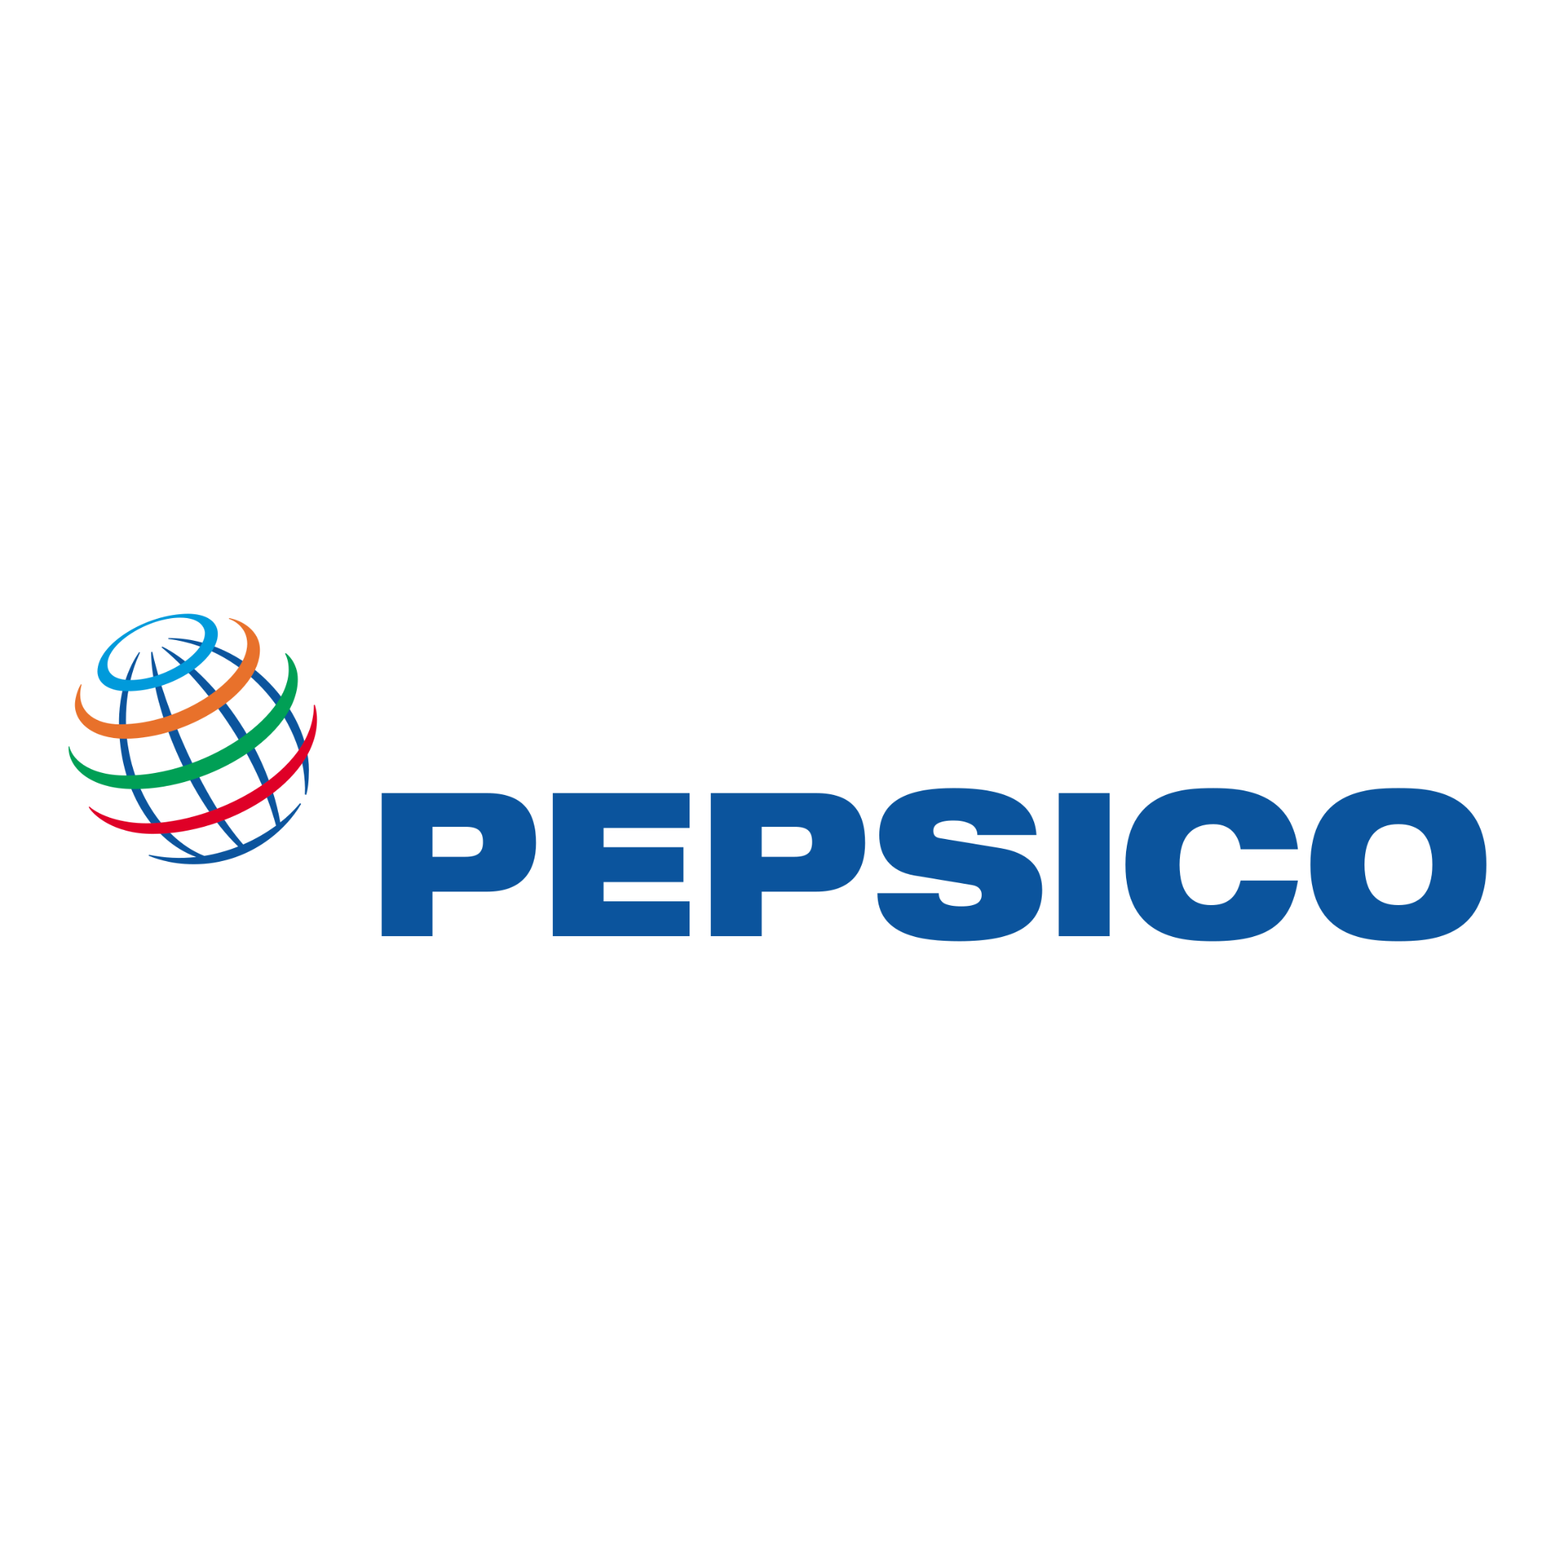








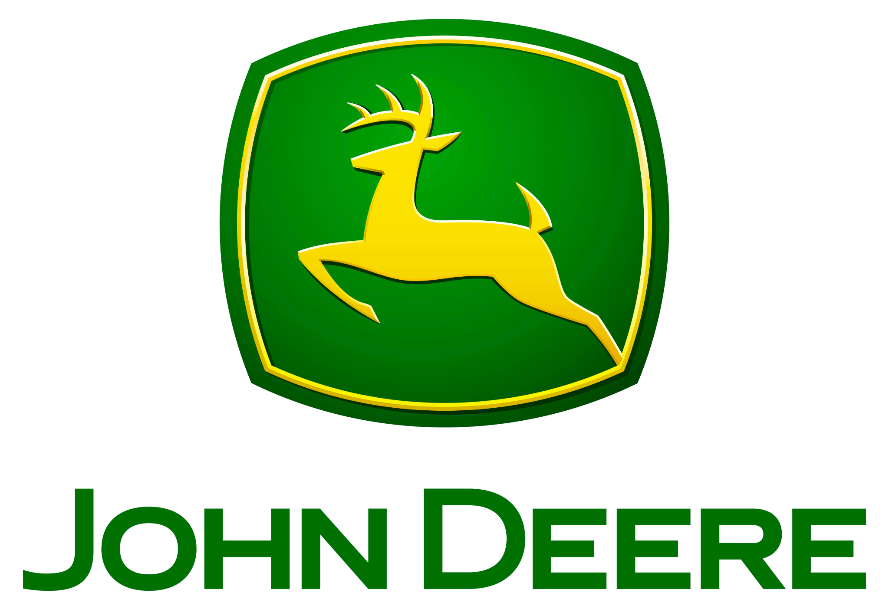
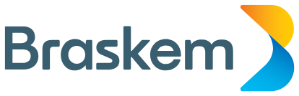
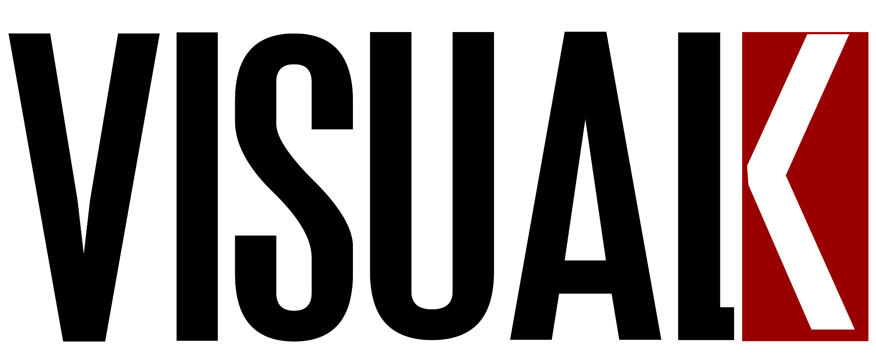

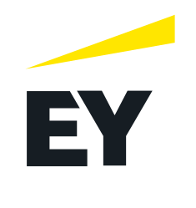
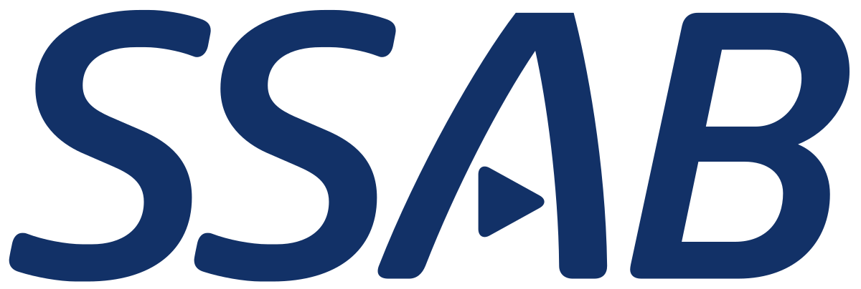




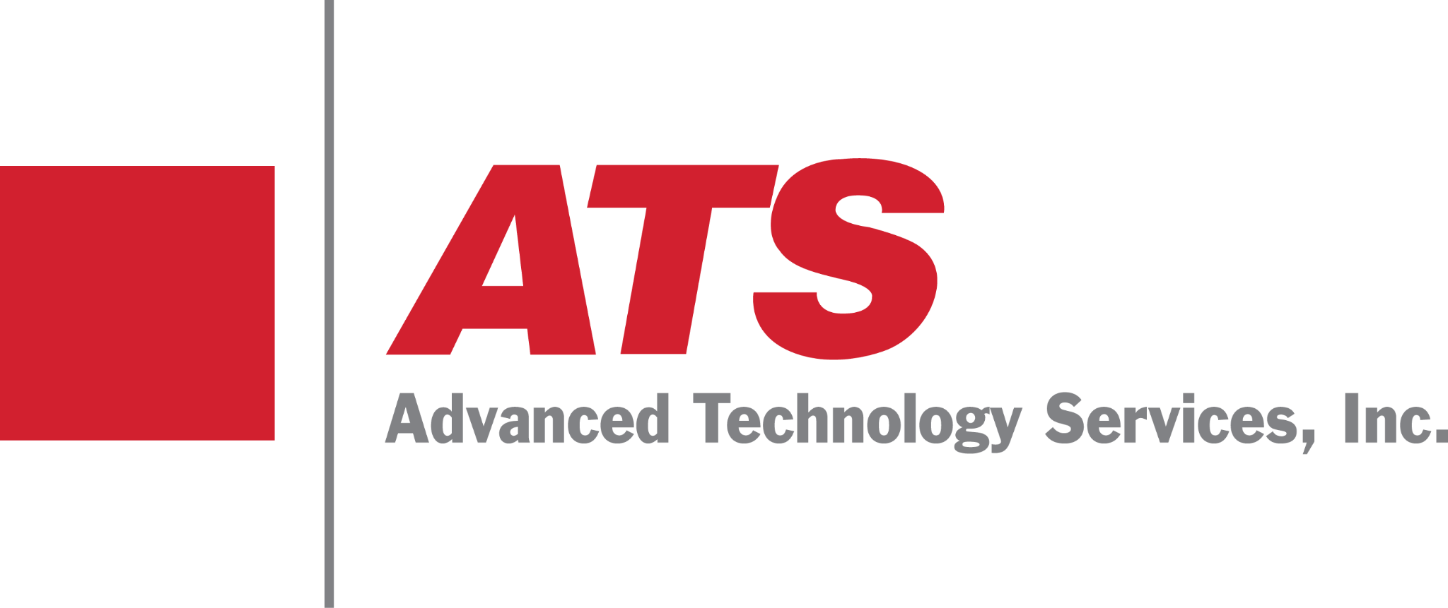

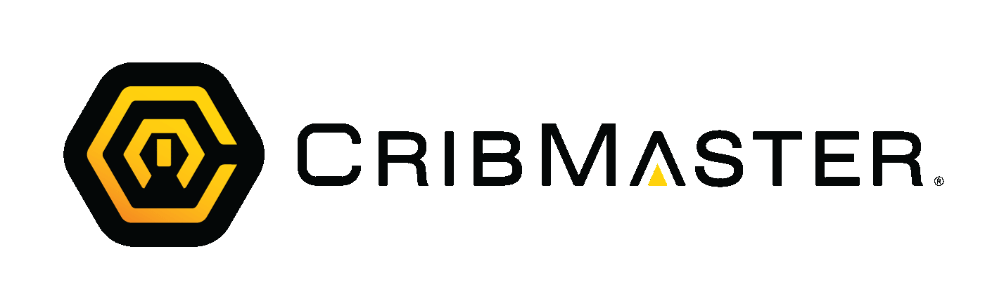

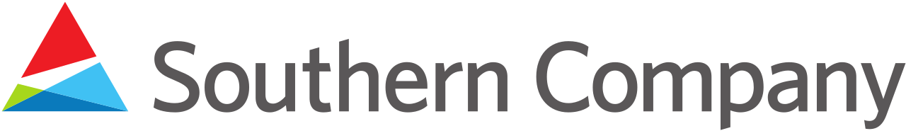


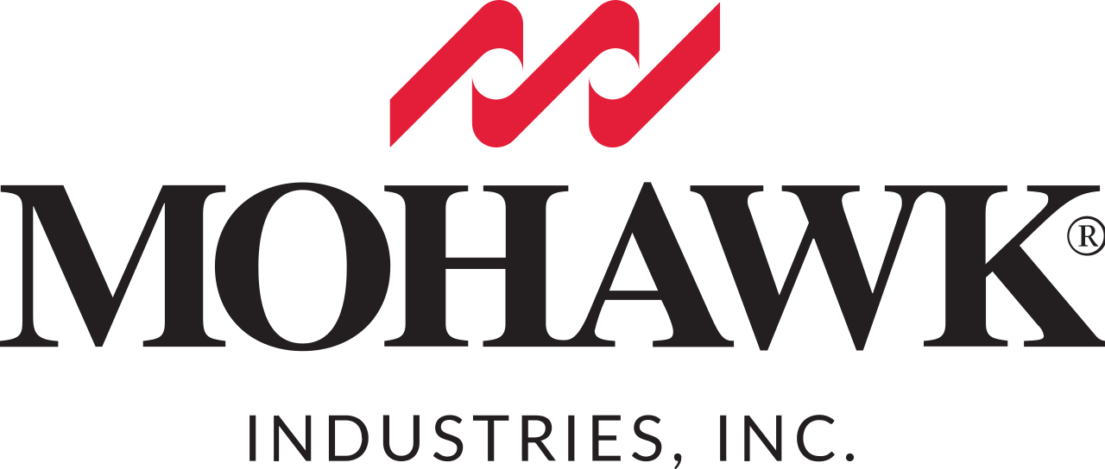
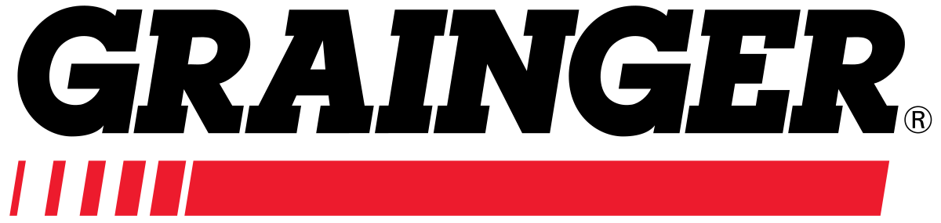
AI-Powered MRO Inventory Optimization
51M+
Unique MRO Materials
Ingested & Trained
$9B+
Material Transactions
Managed & Trained
14.9%
Net Decrease of
Working Capital
2.8%
Improvement in
Uptime
Selected Enterprise Customers
Partners
Notes:
Verusen’s sole focus is on the unique challenges and requirements of MRO material optimization, and
as you can see, we’ve had the privilege of working with industry leaders across various industries. These companies and their data provide 10’s of millions of materials and billions of transactions with which our AI models are trained.
This experience has given us a deep understanding of the unique challenges companies face when it comes to managing MRO inventory. Our AI is exclusively trained on mro inventory to to empower organizations to make smarter purchasing decisions.
38s

Slide 33
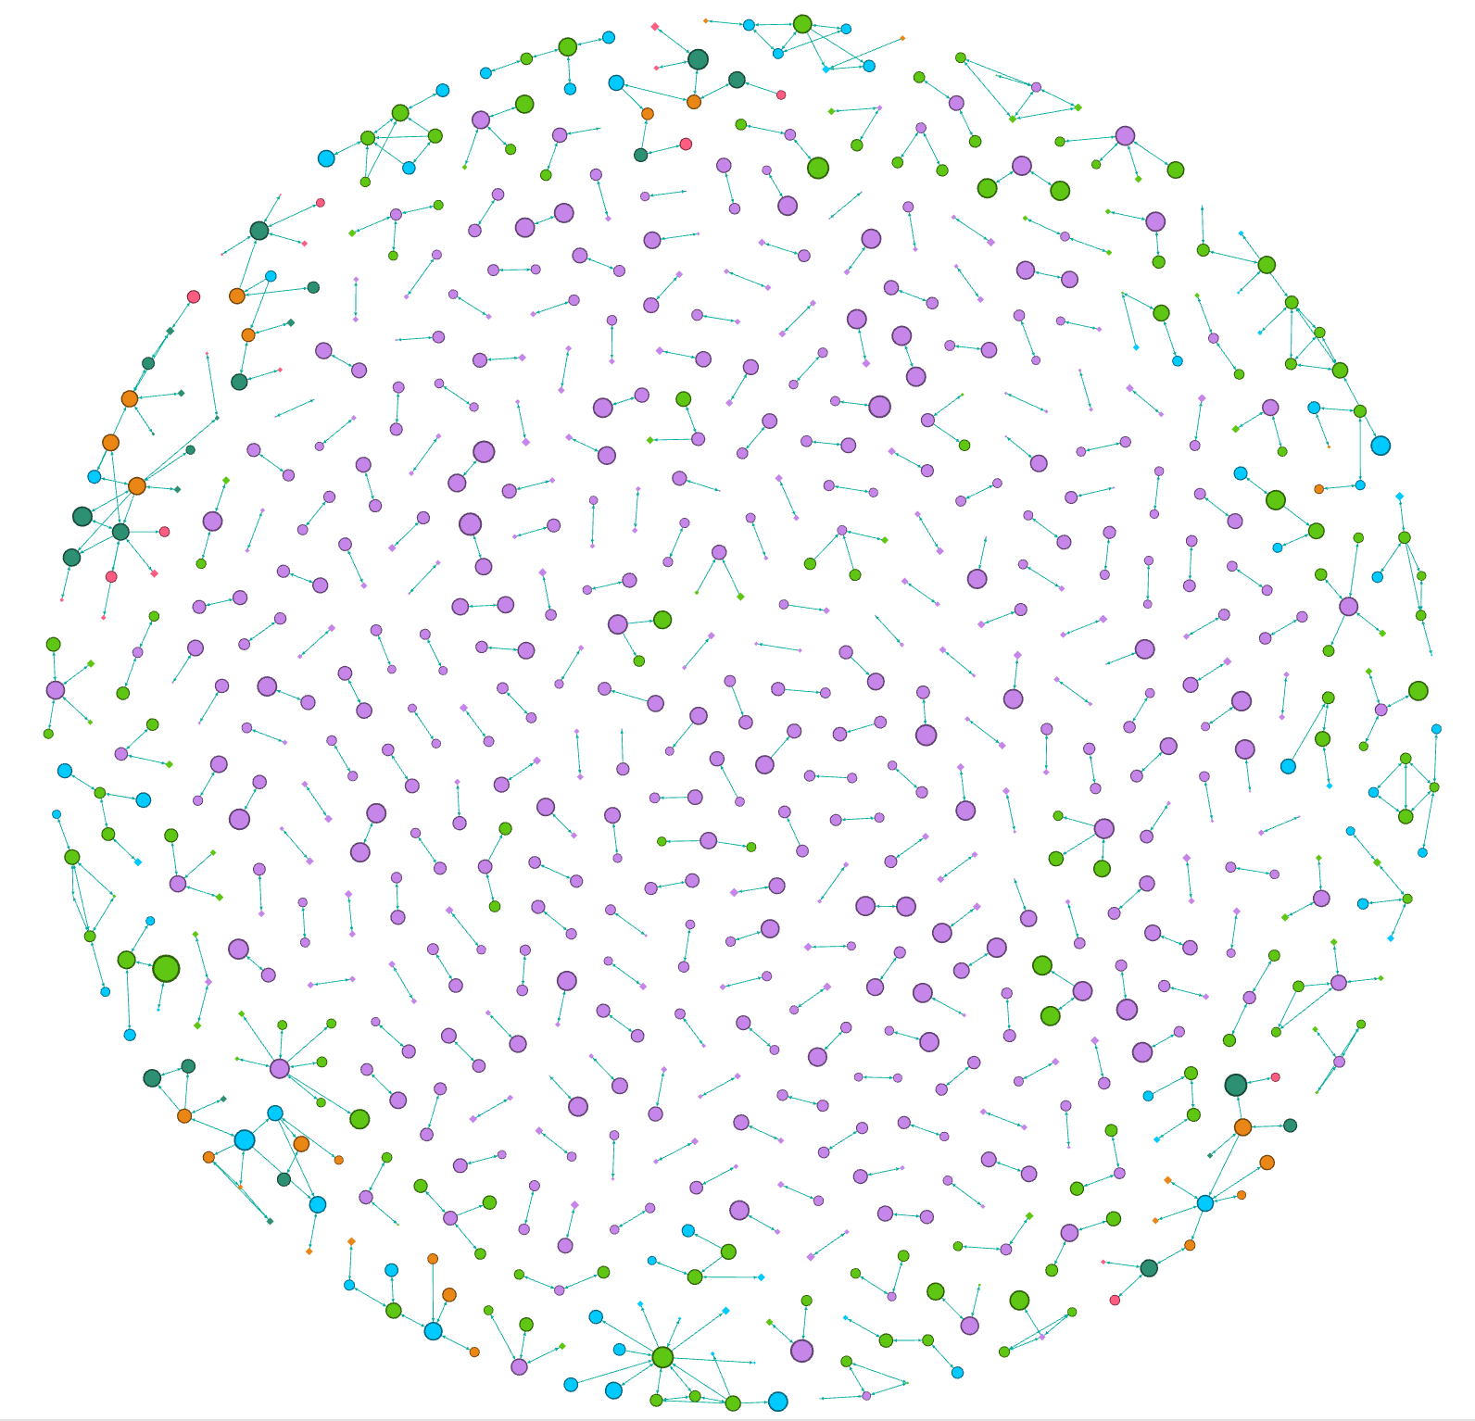
Verusen’s Material Graph: The Core of the Verusen Platform
Solving MRO’s toughest challenges begins with overcoming traditional data issues
51MM+ MRO Materials
Billions of MRO Transactions
We’ve cultivated data partnerships with industry associations, distributors, and select manufacturers and continue to grow our dataset.
We’ve aggregated, anonymized and analyzed “shop floor” decisions, issuances, purchase orders, work orders, and anything else that yields material insight.
MRO Specific
Modern LLM Technology
We’ve optimized multiple NLP and data engineering preprocessing techniques specific to MRO (e.g., abbreviations, UoM, etc.)
We utilize an LLM optimized for our graph that we’ve fine tuned to the nuances of MRO materials.
Our MRO material graph, the most complete and accurate of its kind,
enables us to uniquely identify trends in your data
while allowing us to get up and running day one without prolonged training

