Slide 1

Unlocking the Power of Asset Data – Fueling AI, APM, & AIP through Effective Data Management & Governance
Jason Chomic
Director of Asset Management Services

Slide 2
Outline
SECTION 1
What is Asset Master Data?
SECTION 2
What does Asset Master Data Enable?
SECTION 3
Mapping to Asset Management Activities
SECTION 4
Advancing Asset Master Data Management – 3 Step Process

Slide 3
What is Asset Master Data?
Master data goes beyond being static—it shapes the essential information we collect about an asset. It defines key elements like history and operational status, even if those details aren’t directly stored within it.
Asset Master Data encompasses a wide range of structured information about an organization's physical assets
Asset Identification: Unique identifiers like system IDs, RFID tags, barcodes, and serial numbers.
Asset Description: Make, model, size, specs.
Location Data: Building, floor, room, coordinates.
Ownership, Maintenance History, Operational Status, Purchase/Acquisition Information, Warranty

Slide 4

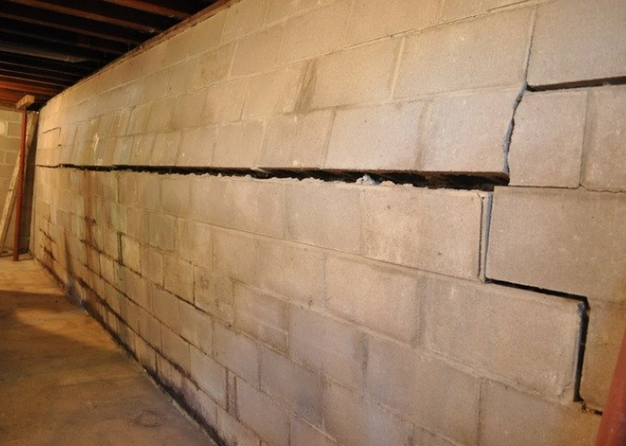

Foundation Check?

Slide 5
Suboptimal Asset Master Data?
Data Challenges
Organizational Pain
Inaccurate or Inconsistent Data
Missing or Incomplete Data
Outdated or Irrelevant Data
Decision-Maker Distrust
Multiple Versions of Reports
Excessive Manual Effort
Delayed Insights
Integration Challenges

Slide 6
What Does Asset Master Data Enable?
Informed Decisions
Optimized Asset Performance
Planned Maintenance Activities
Complete and accurate data
Insights to asset performance
Predictive understanding
Investment planning
Advanced functionalities
Performance tracking
Proactive maintenance
Efficiency gains
Condition data integration
Performance mapping
Informed planning
Preventative maintenance
Efficient resource allocation
Condition monitoring
Safety & Compliance
Strategic Asset Mgmt Throughout Lifecycle
Regulatory adherence
Inspection records
Safety standards
Emergency preparedness
Risk mitigation
Lifecycle management
Investment planning
Informed decision-making
Strategic resource allocation
Data governance

Slide 7
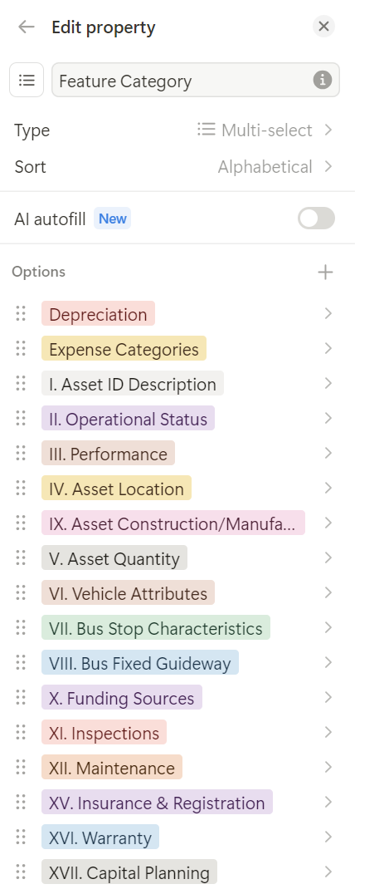
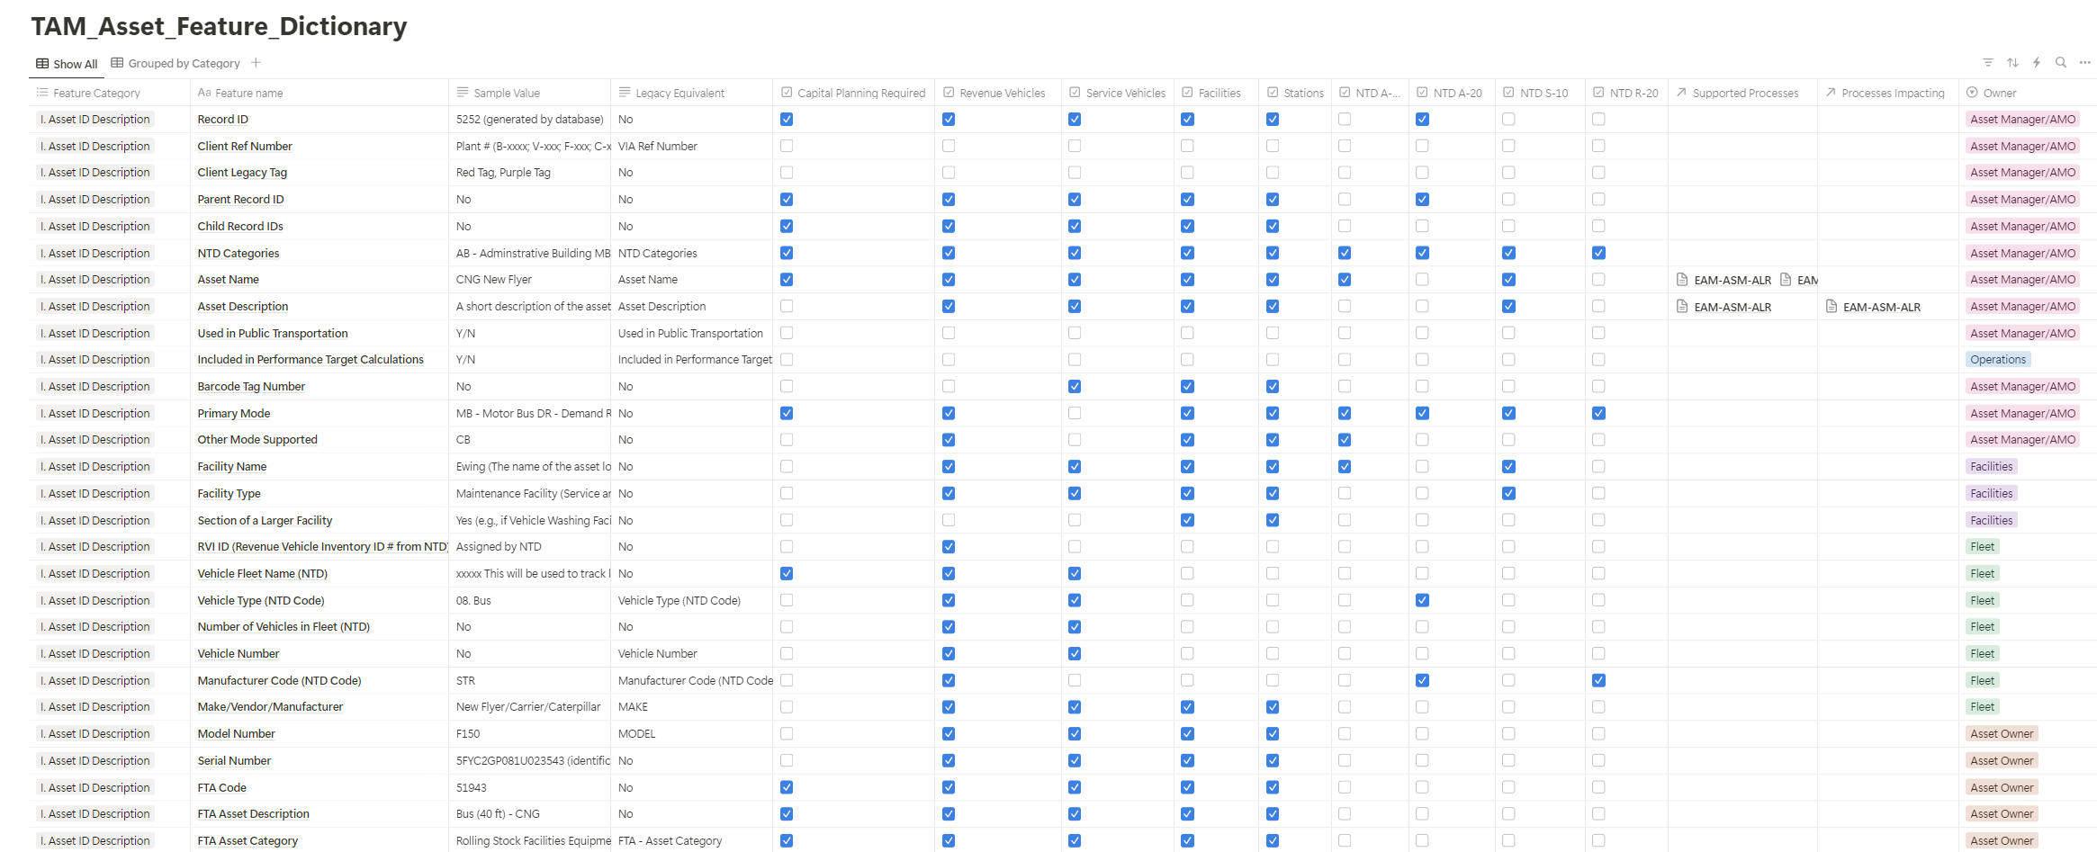
Mapping to Asset Management Activities: Transit Asset Feature Dictionary

Slide 8
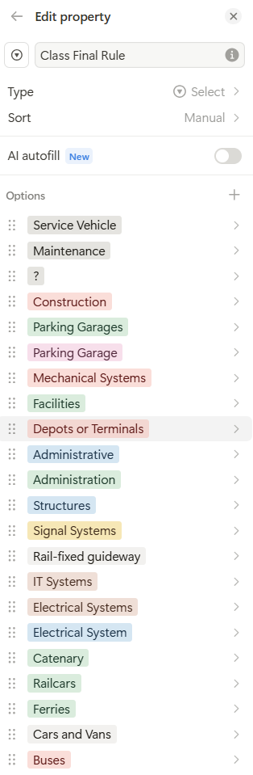
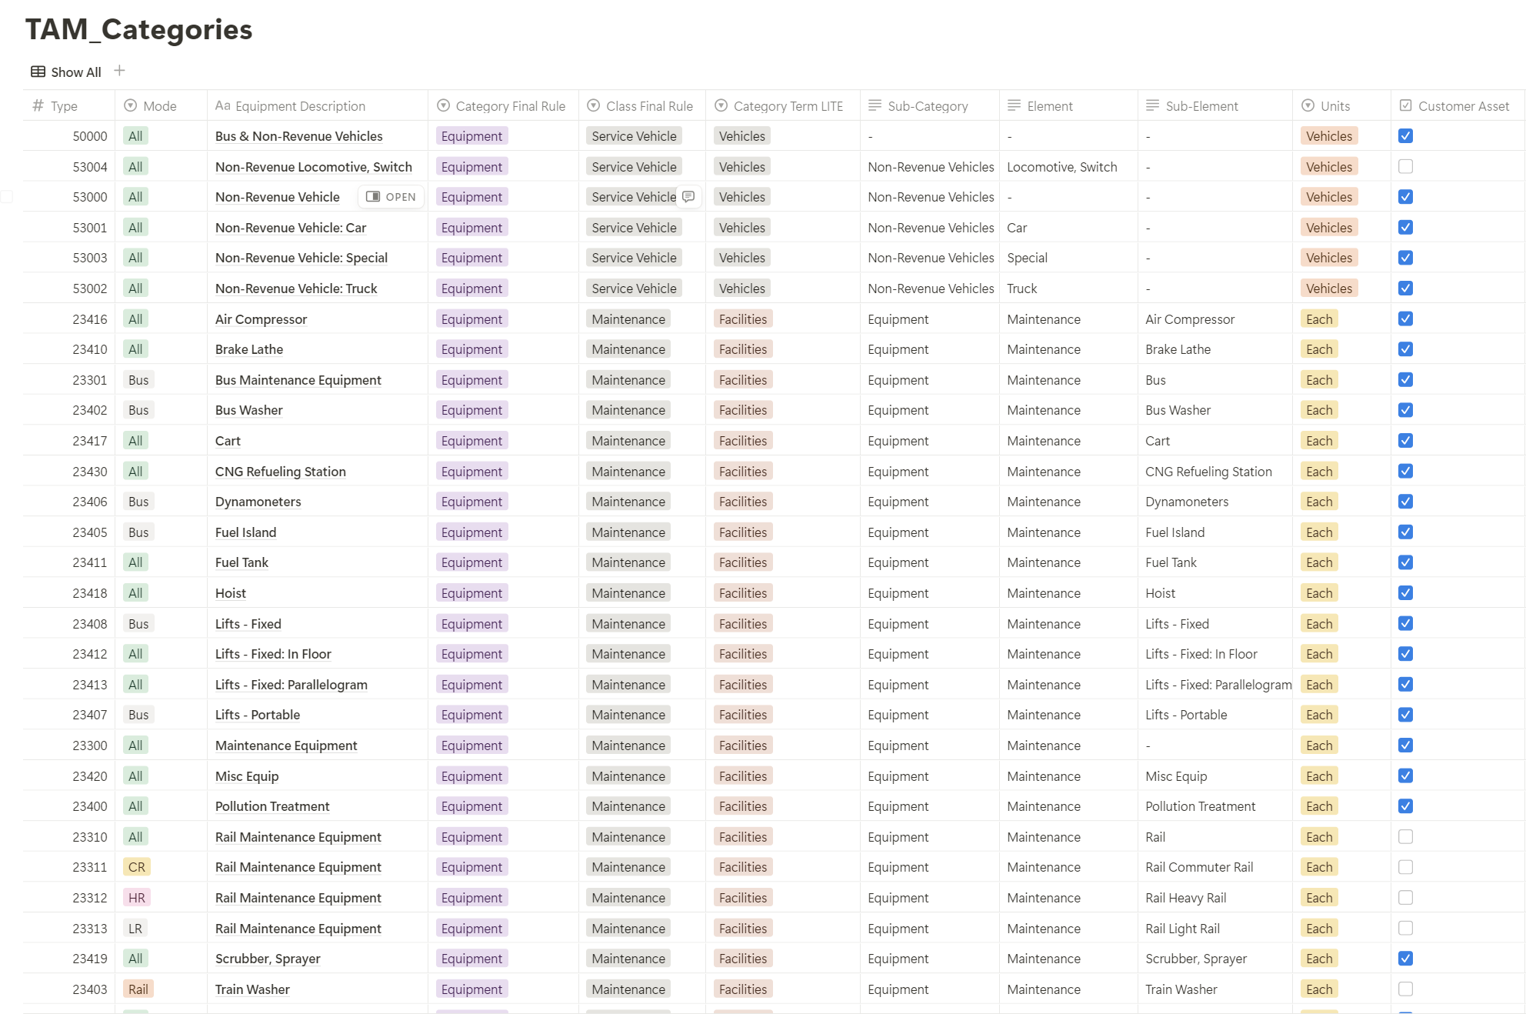
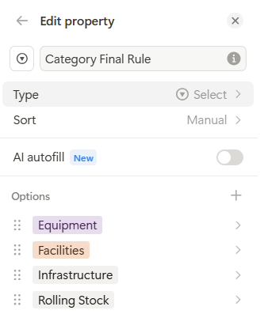
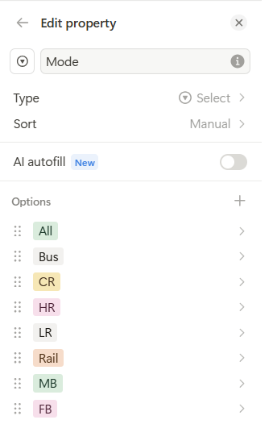
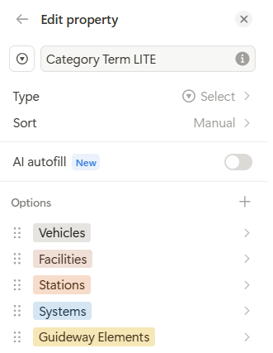
Mapping to Asset Management Activities: TAM Categories

Slide 9
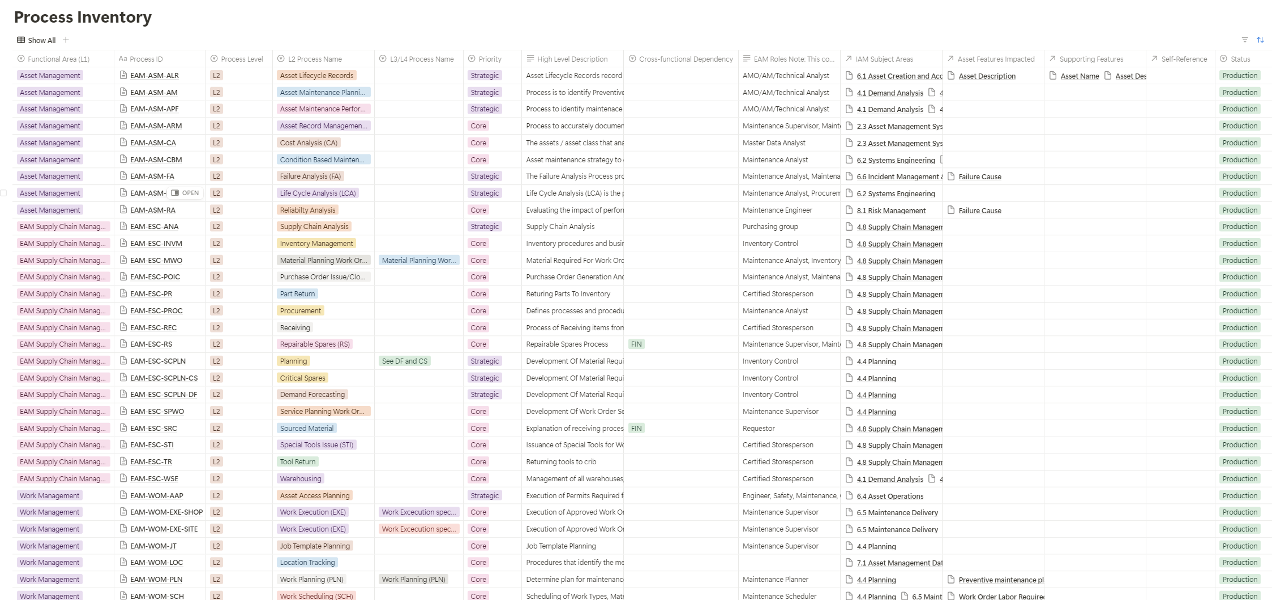
Mapping to Asset Management Activities: Process Inventory

Slide 10
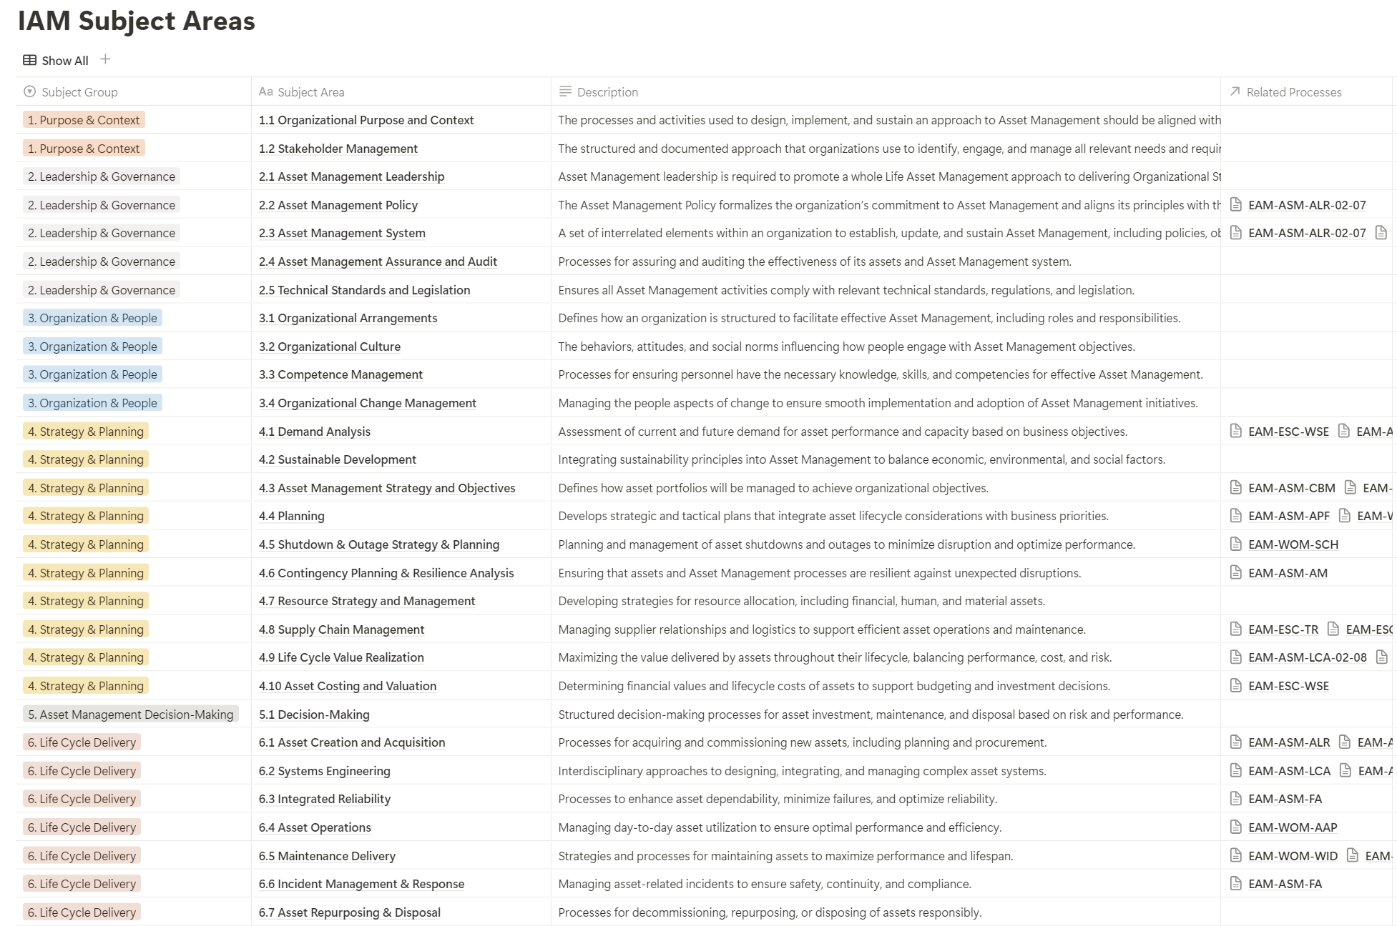
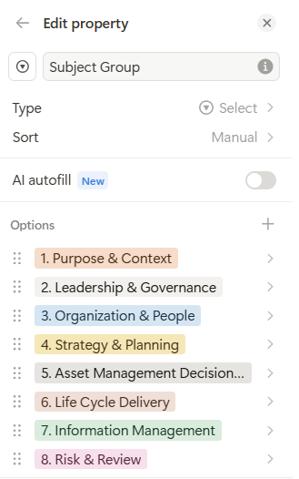
Mapping to Asset Management Activities: IAM Subject Areas

Slide 11
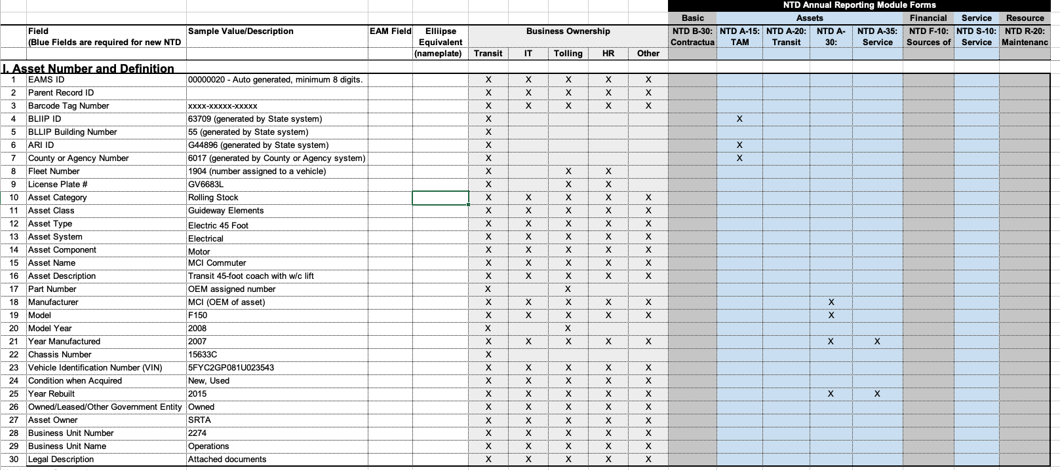
How to Advance Asset Master Data Management: A 3-Step Journey
1) Catalog Data
2) Establish Data Governance
3) Actively Manage Data
Full Lifecycle
Storage to Archive/Deletion
Standards, Ownership & Monitoring

Slide 12
How to Advance Asset Master Data Management: Step 1 (Catalog Data)
What does your organization have today? Where is it? What do we need for tomorrow?

Slide 13
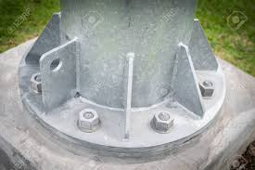
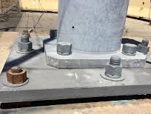
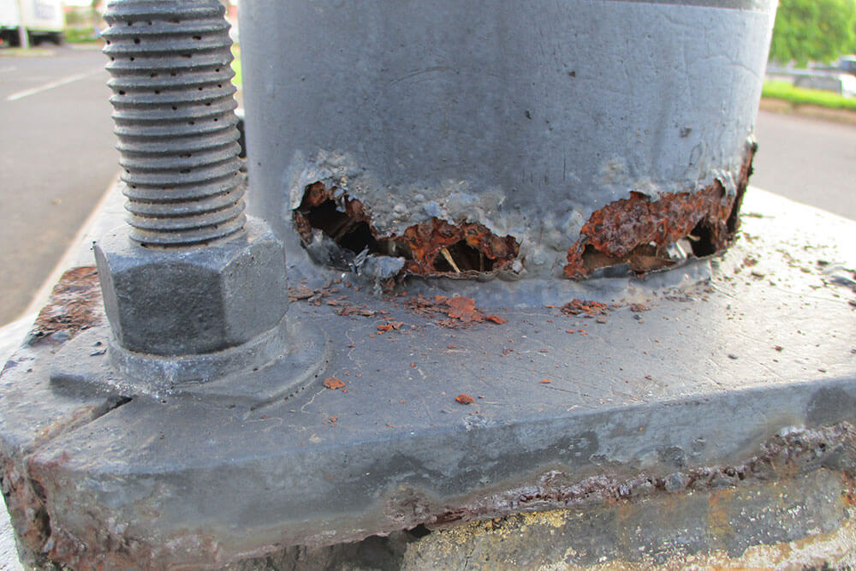
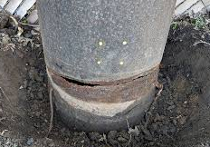
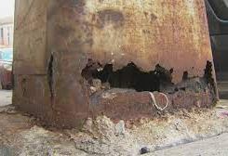
How to Advance Asset Master Data Management: Step 2 (Data Governance)
Standards
Ownership
Monitoring
Standards – Ensure asset information is collected, structured and to the right level of detail.
        Asset Groupings (Classifications)
        Required Attributes by Asset Grouping
        Definition and Allocation of Criticality
        Assessment and Recording of Asset Conditions
        - Pavement Condition Index (PCI: 0-100)
        - FTA/DOT - Facility Condition Assessment (1 Poor – 5 Excellent)
Excellent (5)
Good (4)
Adequate (3)
Marginal (2)
Poor (1)

Slide 14



How to Advance Asset Master Data Management: Step 2 (Data Governance)
Standards
Ownership
Monitoring
Ownership – Aligning data responsibility to organizational structure

Slide 15
How to Advance Asset Master Data Management: Step 2 (Data Governance)
Standards
Ownership
Monitoring
Ownership – Aligning data responsibility to organizational structure
Organic Ownership
Department/Group Level Ownership
Role Level Ownership
Not documented
Lack of clarity
Legacy knowledge
Facilities
Engineering
Finance
Maintenance
Technical Services
IT
Business Process Owners
Data Provider
Maintainer
Stewards
Information User

Slide 16
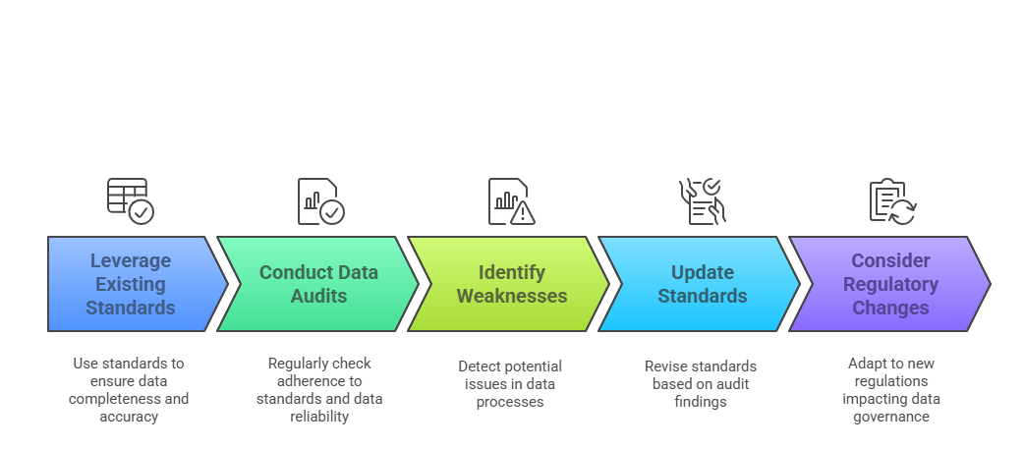
How to Advance Asset Master Data Management: Step 2 (Data Governance)
Standards
Ownership
Monitoring
Monitoring - Involves continuous oversight of asset data to ensure accuracy and reliability.
Notes:
little more context around the circle in the asset master data management. sentence or two on each example. Assess, update, audit.

Slide 17
How to Advance Asset Master Data Management: Step 3 (Actively Manage Data)
Storage - Defined Asset Registry/Source of Truth
Asset On-boarding Processes (New Data)
Asset Data Updates/Improvements (Ex: GIS)
Asset Disposal Processes
Archive
Data Deletion Process

Slide 18
Summary
Catalog Data
Data Governance Model (Standards, Ownership & Monitoring)
Actively Manage Data
Notes:
Catalog Data – Define the data elements that are valuable to your organization.
Data Gov. Model – Define Standards, Who owns what data, Monitoring practices to ensure Standards are being met.
Actively Manage Data – Define the processes for your data. Adding new, how will it get updated, how will it be retired?

Slide 19

Questions?
Jason Chomic, Director of Asset Management Services
Jason.Chomic@21Tech.com | (517) 795 - 6840

