Slide 1

Please Read Before Editing
Please explore all slide options to see which format fits your content the best. If you run into any issues during editing or need additional slide options, please reach out to Streamline@DigitalThinker.com
Presentation font is Arial Nova (Light, Regular, Bold). This should be available to everyone but, if not, Arial is the next preferred.
Colors to use in addition to black are listed below:
Light Green Accent Color: 3BA40F

Slide 2
Why Work and Inventory Should Work Together
Phillip Bragg
Pre-Sales Manager
Hexagon

Slide 3
Outline
SECTION 1
Why?
SECTION 2
Blocking and tackling
SECTION 3
Run Plays
SECTION 4
Pass Plays
SECTION 5
Take you team to the Superbowl

Slide 4


Slide 5
Why Work and Inventory Should Work Together
Reduce downtime
Optimize technician efficiency
Track costs
Understand lifecycle costs
Minimize risk
Optimize Inventory levels
Optimize purchasing

Slide 6
Simple…but hard
Parts Inventory
Holding cost

Slide 7
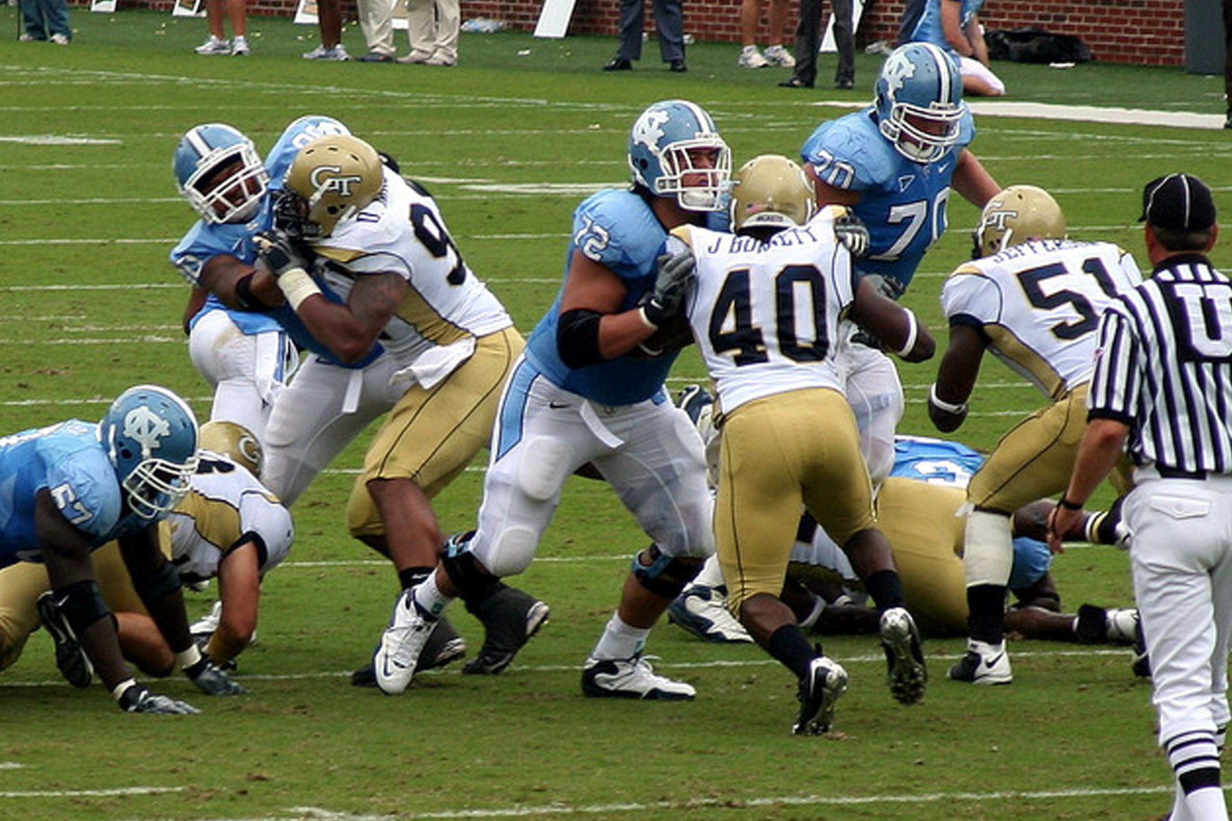

Slide 8
The basics
What do you need and where is it used
Registering part demand and auto requisitioning
Linking to purchasing

Slide 9
What do you need and where is it used
Parts
Association with assets
          Install parameter AUTOPART

Slide 10
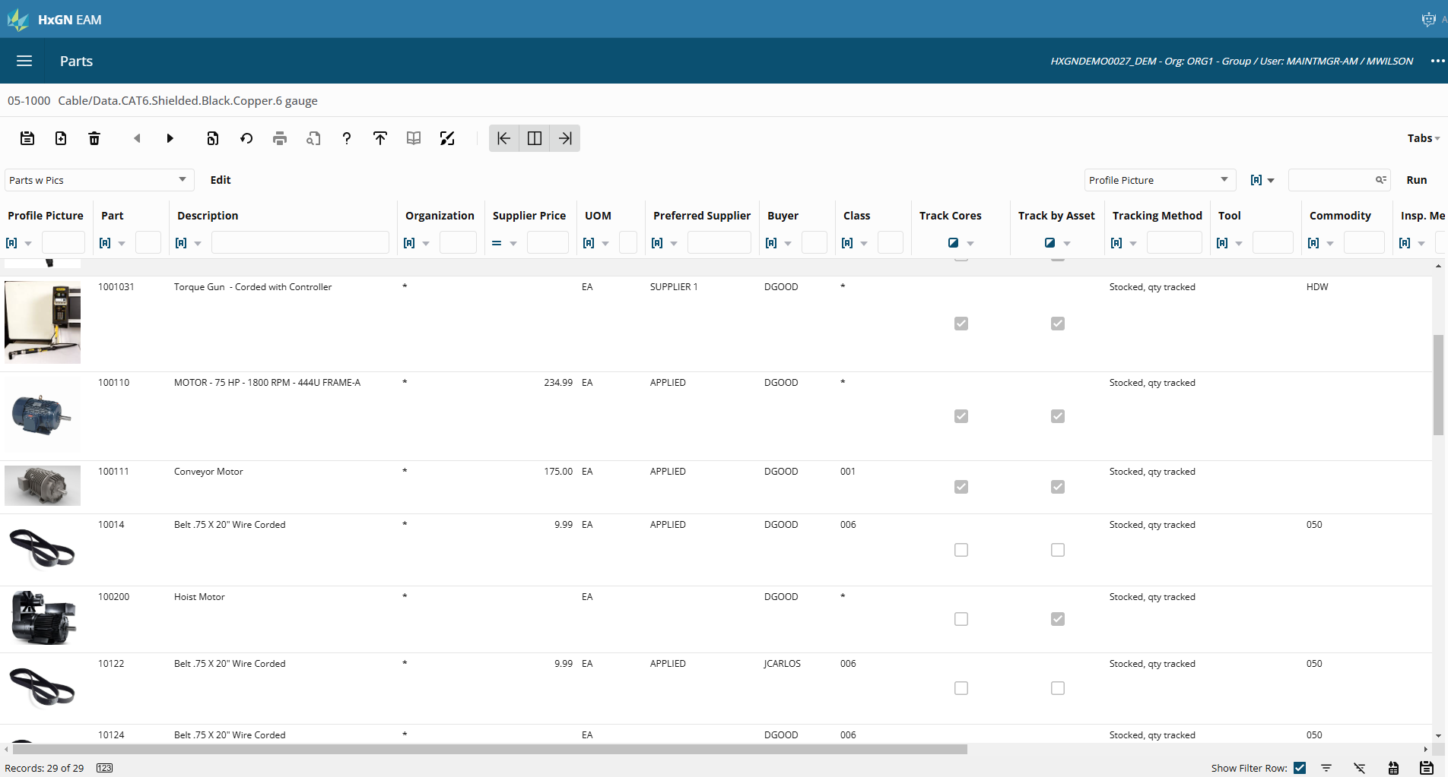

Slide 11
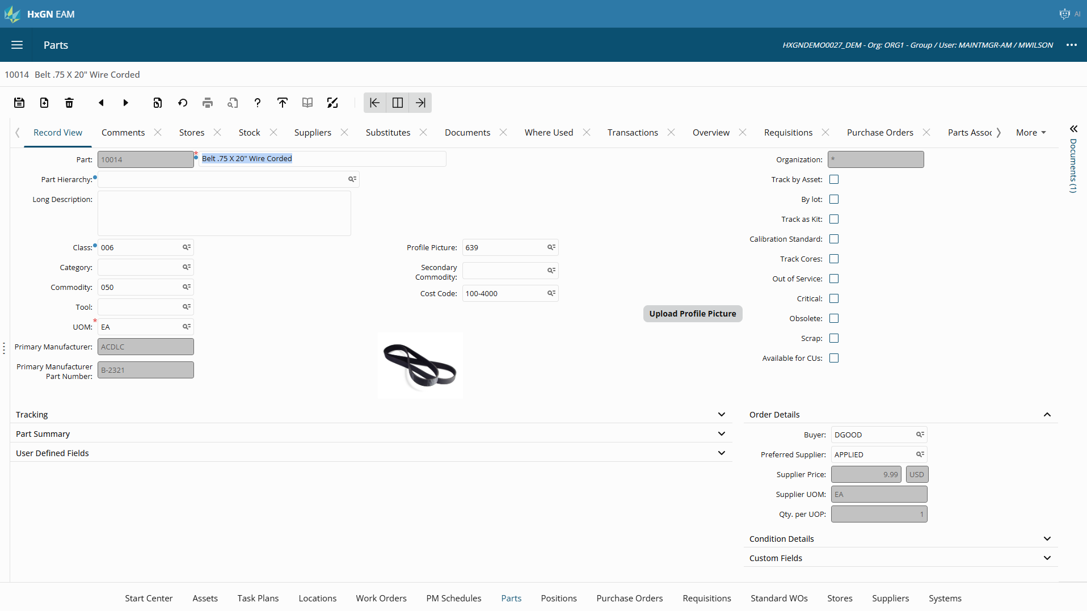

Slide 12
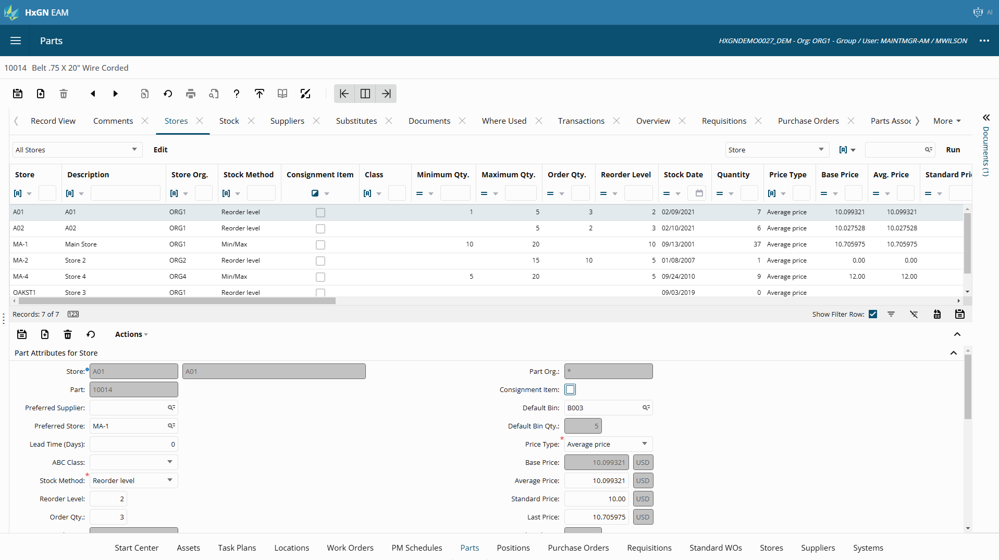

Slide 13
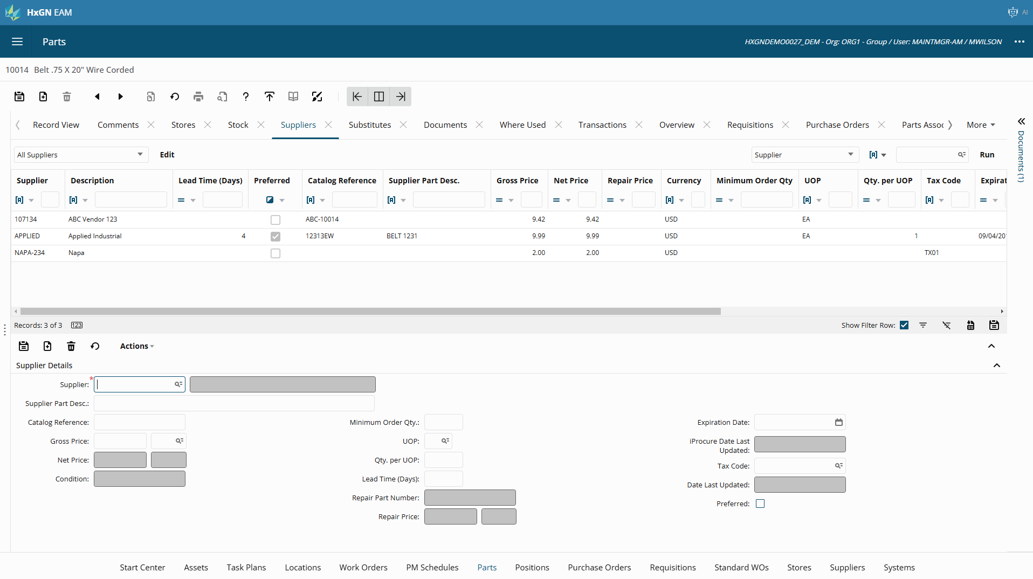

Slide 14
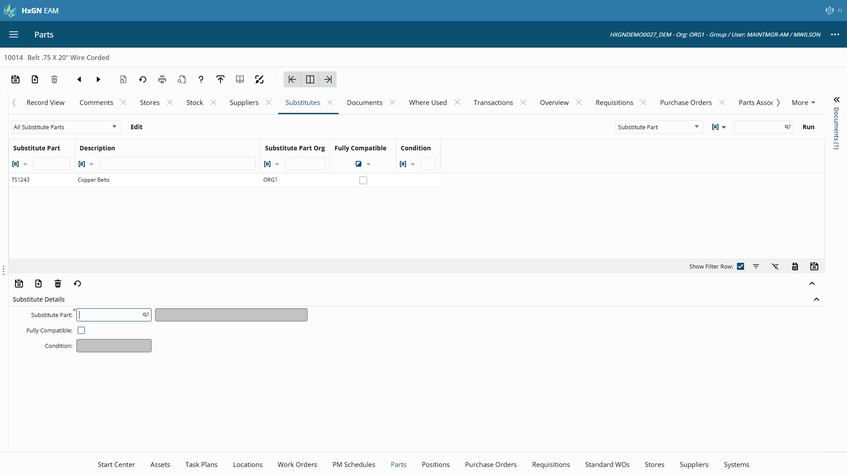

Slide 15
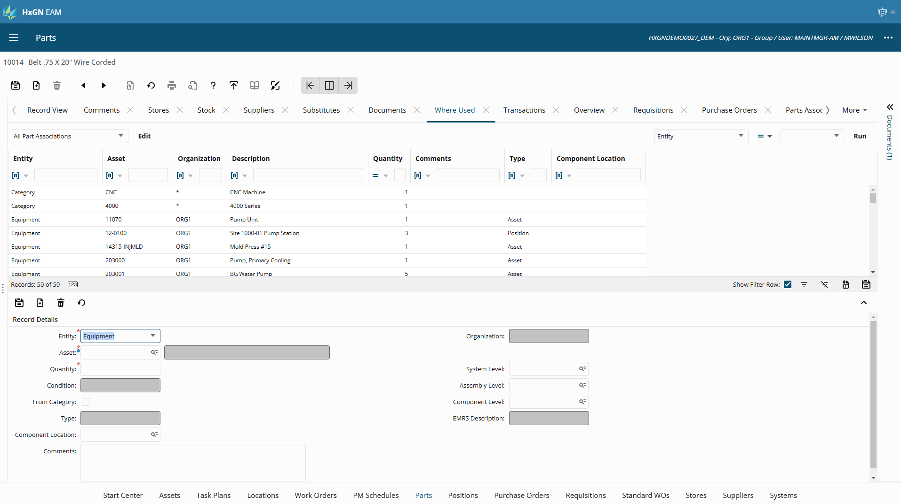

Slide 16
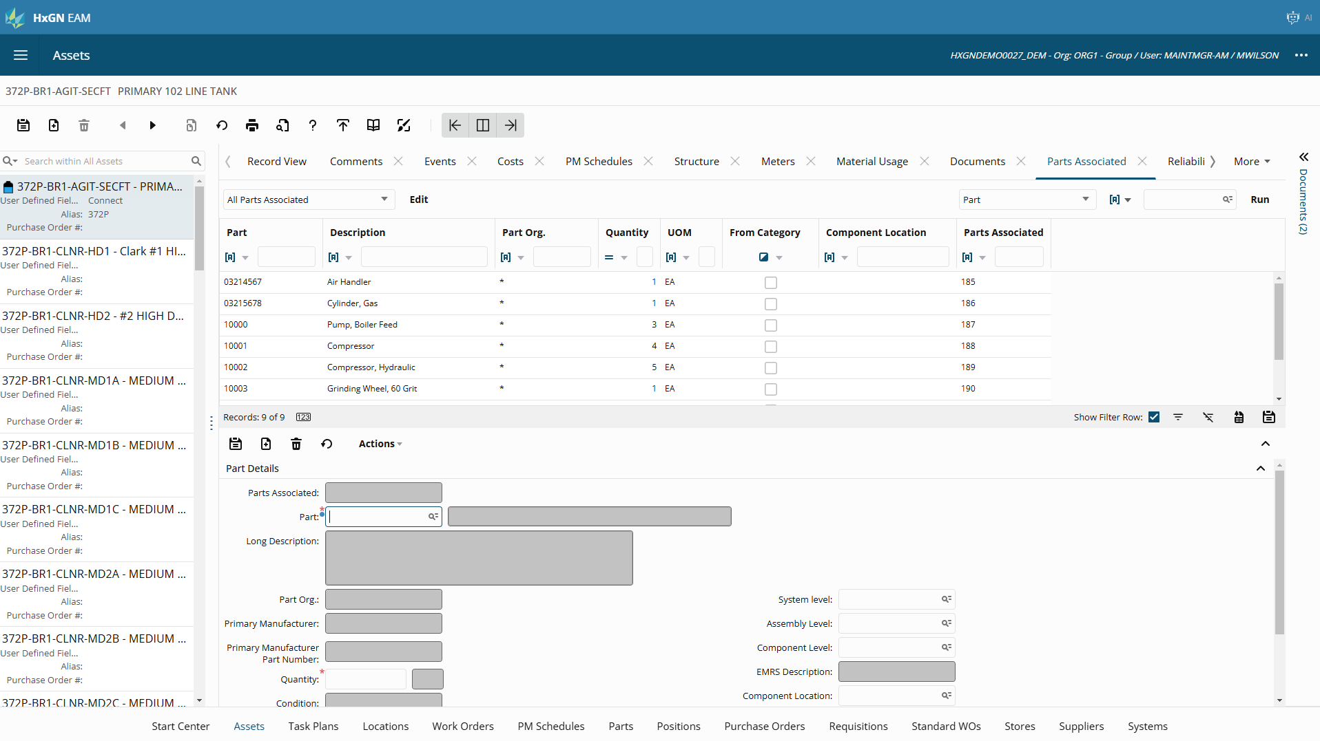

Slide 17
Registering part demand and auto requisitioning
Reorder methods and auto requisition
          Min/Max
          Reorder level
          On demand
Part demand
          Issuing parts
          Reserving parts
          Allocating parts
Direct requisition

Slide 18
Linking to purchasing
Work
Materials
Purchasing

Slide 19
Purchasing- ERP/Finance centric
EAM
Databridge Pro
Finance
Supplier MRO Parts Cost Codes
Supplier Items
Cost Codes
Purchasing Request
Requisition
Purchase Order
Reference
Purchase Order
Update MRO Inventory
Receiving
Invoice MRO PO
MRO Inventory, Transfer, Adjust
Inventory Level Adjustments

Slide 20
Purchasing- EAM Centric
EAM
Databridge Pro
Finance
Supplier’s Cost Codes
Vendor Cost Codes
Requisition
Purchase Order
Receipts
Service Receipts
Invoice
Accounts Payable
Journal Entries
General Ledger

Slide 21


Slide 22
Intermediate level
Electronic Parts Catalog
Store-to-store transfers
Repairable spares
Part conditions
Part warranties
Part inspections

Slide 23
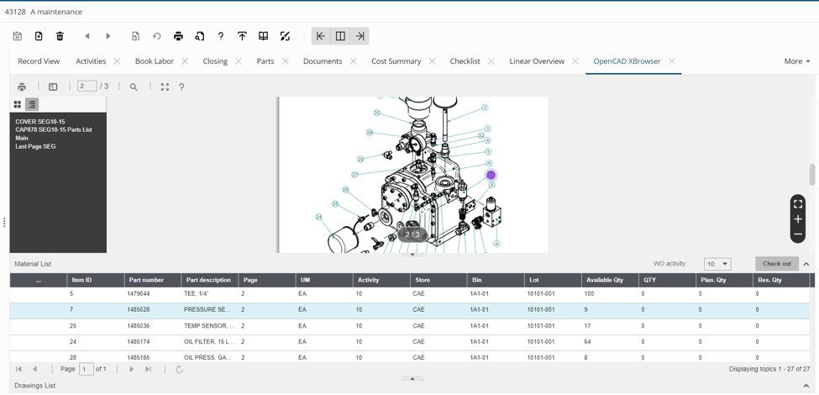
Electric Parts Catalog

Slide 24


Slide 25
Advanced Level
EOQ calculations
ABC Analysis
Forecast reporting

Slide 26
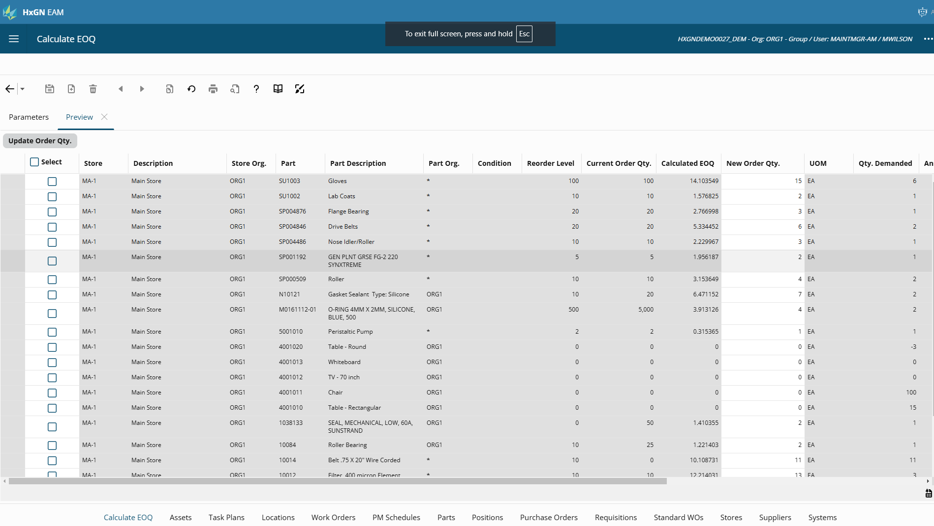

Slide 27
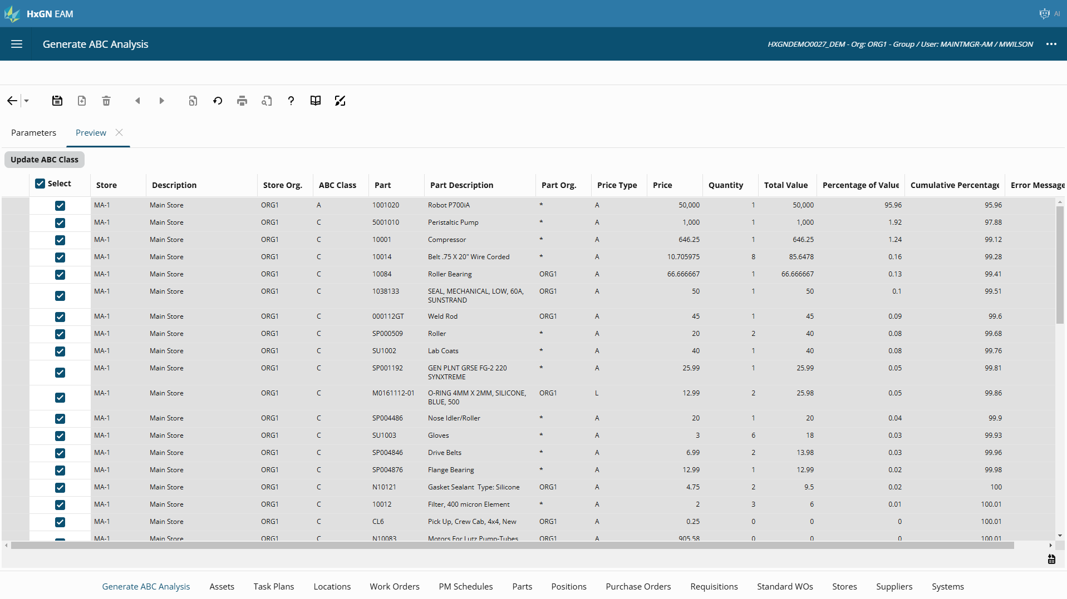

Slide 28
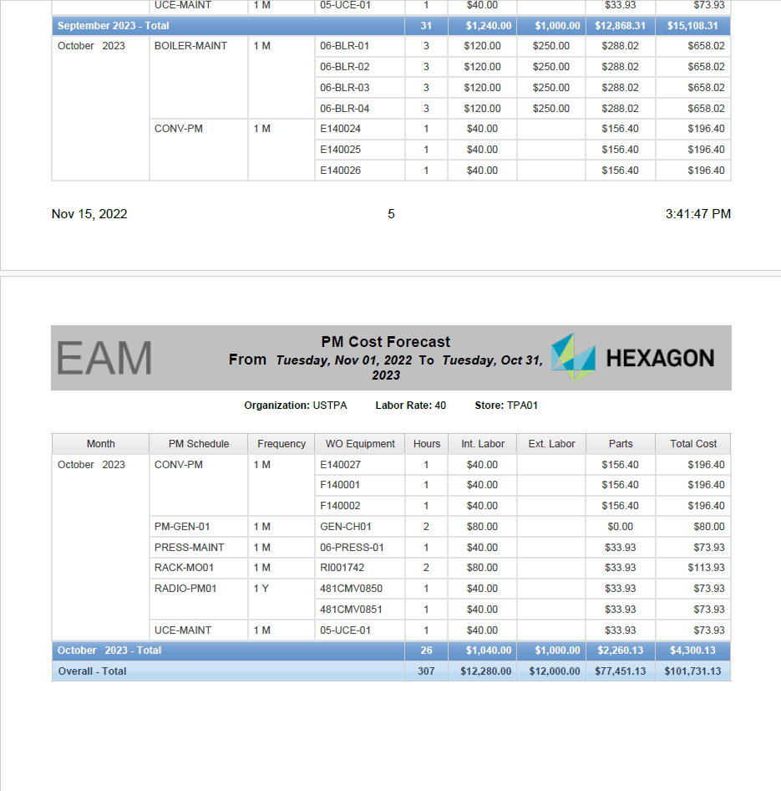

Slide 29


Slide 30
How to take your team to the big game
Build a plan
Call in an expert??
Get your Install parameters and org options right (46/22)
Get purchasing on board
Import utility is your friend
Small steps over time make big changes
  10 parts a day = 2600 parts a year!

Slide 31

Q&A

Slide 32


