Slide 1


Slide 2

A Case Study in Work Planning for Pipeline Operations
Jaime Thompson
Southern Star Central Gas Pipeline
EAM Planning & Scheduling Specialist

Slide 3
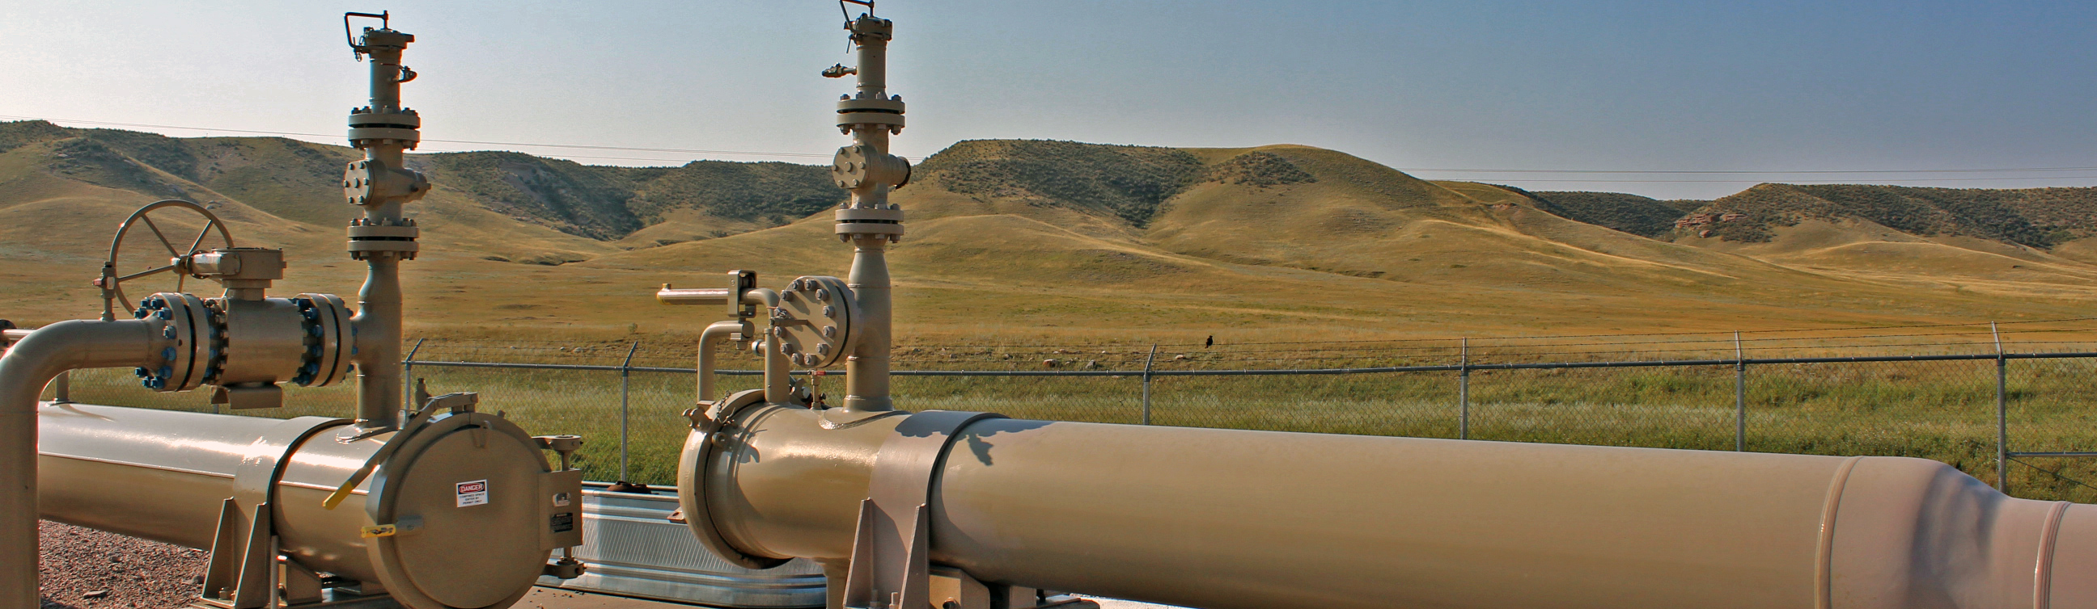

Streamline Conference
February 2026

Slide 4

Who is Southern Star?
Southern Star's corporate heritage dates back to 1904.
Much of today's Southern Star was formed from parts of various local distribution companies. In 2003, our company adopted its current name of Southern Star Central Gas Pipeline Inc.
Today, Southern Star is a leading transporter of natural gas to America's heartland, with approximately 5,800 miles of natural gas transmission pipeline in the Midwest and Mid-Continent regions of the United States.
Headquartered in Kentucky, our pipeline operates in Kansas, Oklahoma, Missouri, Wyoming, Colorado, Texas, and Nebraska.
Our company has grown to more than 600 team members.

Slide 5
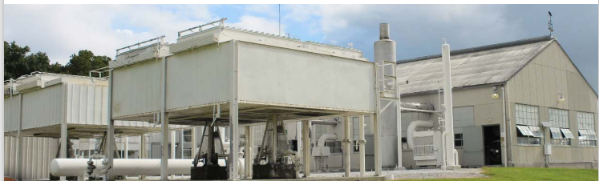
EAM Journey

Slide 6
EAM Journey Timeline
EAM product selected- Spring 2018
September 2018- EAM Staff hired
Transitional work from legacy system to EAM platform
Spring 2019- Optimo Route partnership begins
June 2019- Go LIVE!

Slide 7
EAM Journey- navigating change
Obstacles
Assets spread across 8 states
Need to account for drive time to/from locations for work orders
Driving instructions/Optimize driving routes
Group work orders by geolocation
Schedule multiple employees to the same location at the same time
Advantages
Company locations/regions already established
Qualifications already established in EAM
Oracle to EAM integration for Employee time off exceptions
Work Order status, priority, start/end dates, trade and estimated time established in EAM

Slide 8
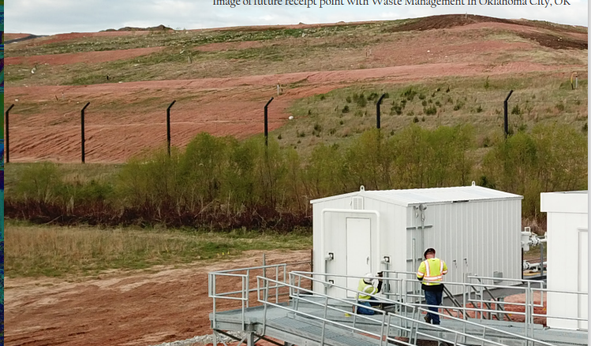
Optimo Route application for Work Order Scheduling

Slide 9
Optimo Route in Action
Optimo Route provides an environment to view and plan out work orders based on asset, location, qualifications required, time restrictions, requested employee and priority.
Mapping layers are available to view
Employee details are available including scheduled hours, time off, qualifications and normal driving range
Work order details are available including work order/activity, asset, skills/trade required, GPS, priority, and timeframe.
Flexibility to balance routes among employees, plan all or selected work orders, coordinate multiple employees to one work order/GPS at the same time.

Slide 10
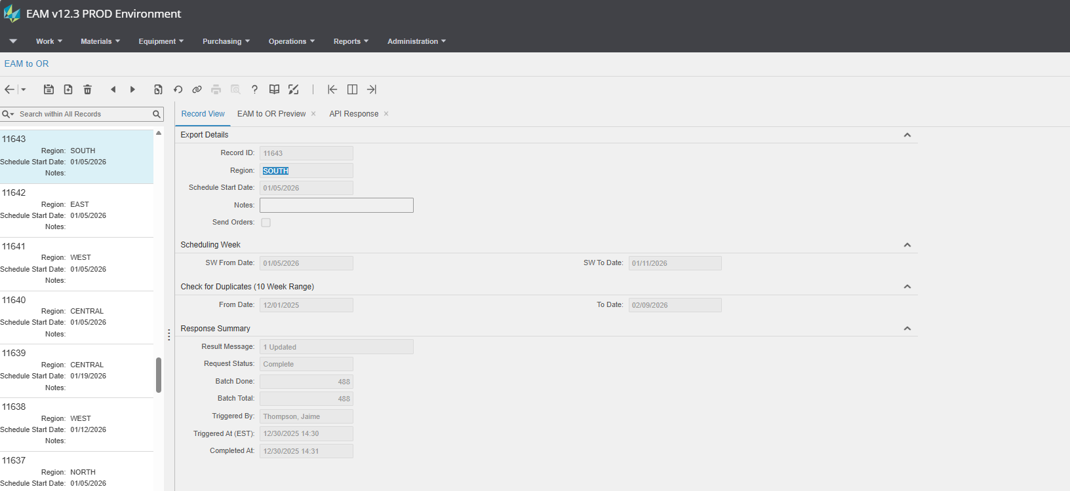
Optimo Route in Action
EAM to Optimo Route integration

Slide 11
Optimo Route in Action
Considerations in our integration:
Division of labor was broken up by Region
All work orders/activities in Scheduling status will be polled
Duplication of work orders into Optimo Route
We chose to place a filter in the integration to weed out duplicate work orders within a rolling 10-week timeframe.
We created a tab in the integration to report error issues that can be double checked by Schedulers.

Slide 12
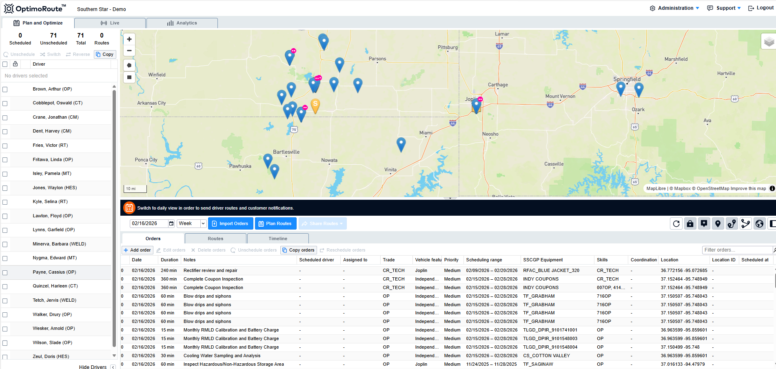
Optimo Route in Action

Slide 13
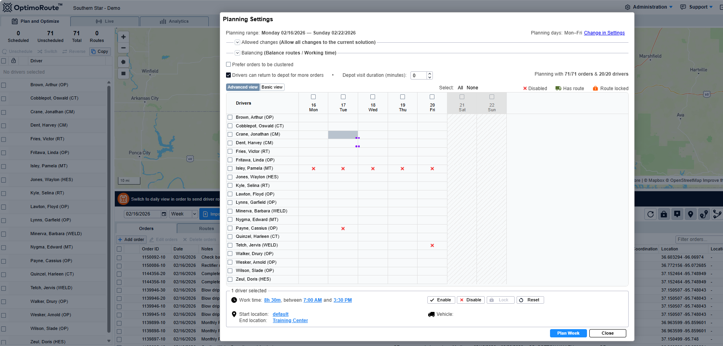
Optimo Route in Action

Slide 14
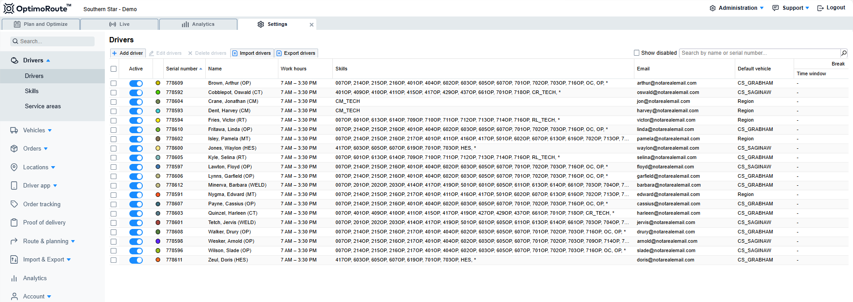
Optimo Route in Action

Slide 15
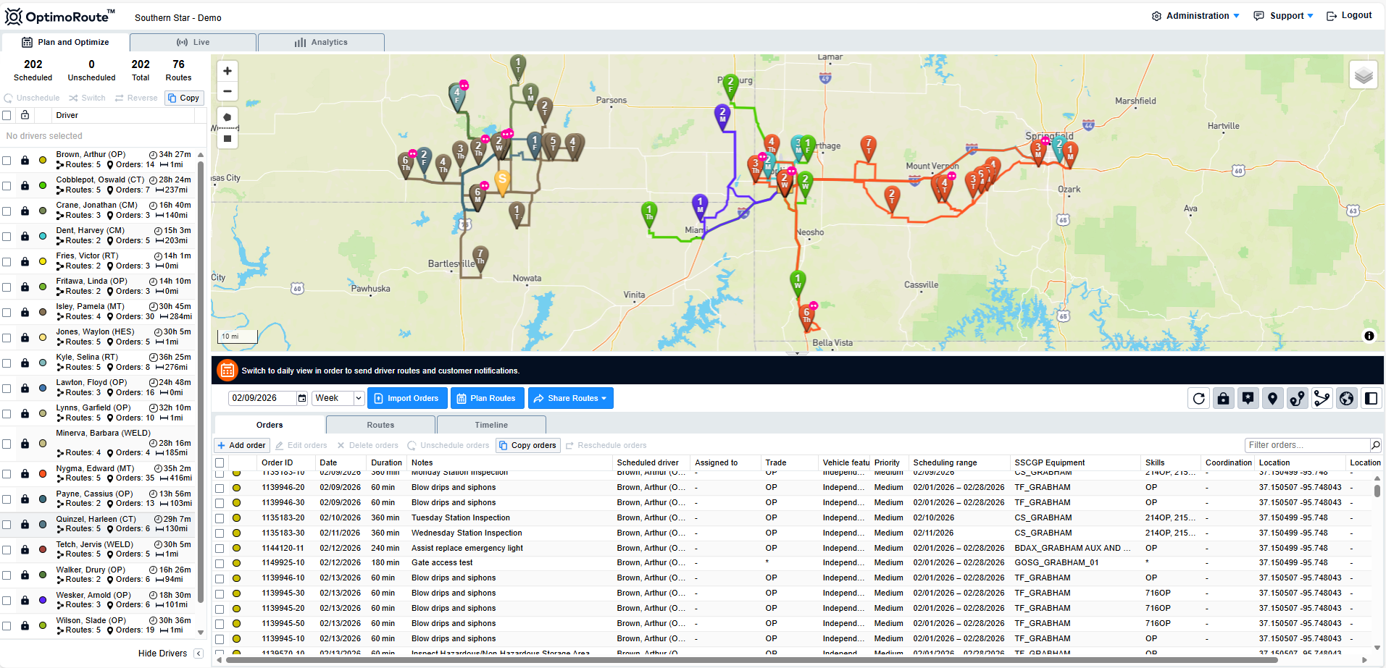
Optimo Route in Action

Slide 16
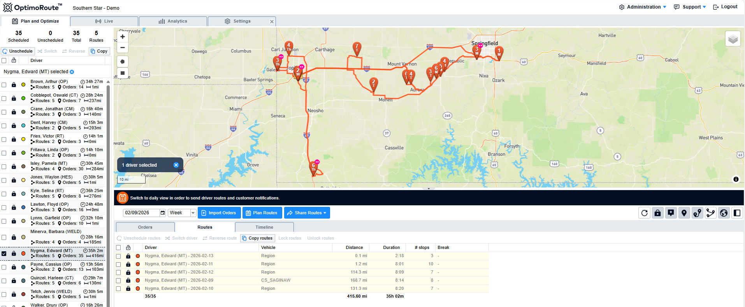
Optimo Route in Action

Slide 17
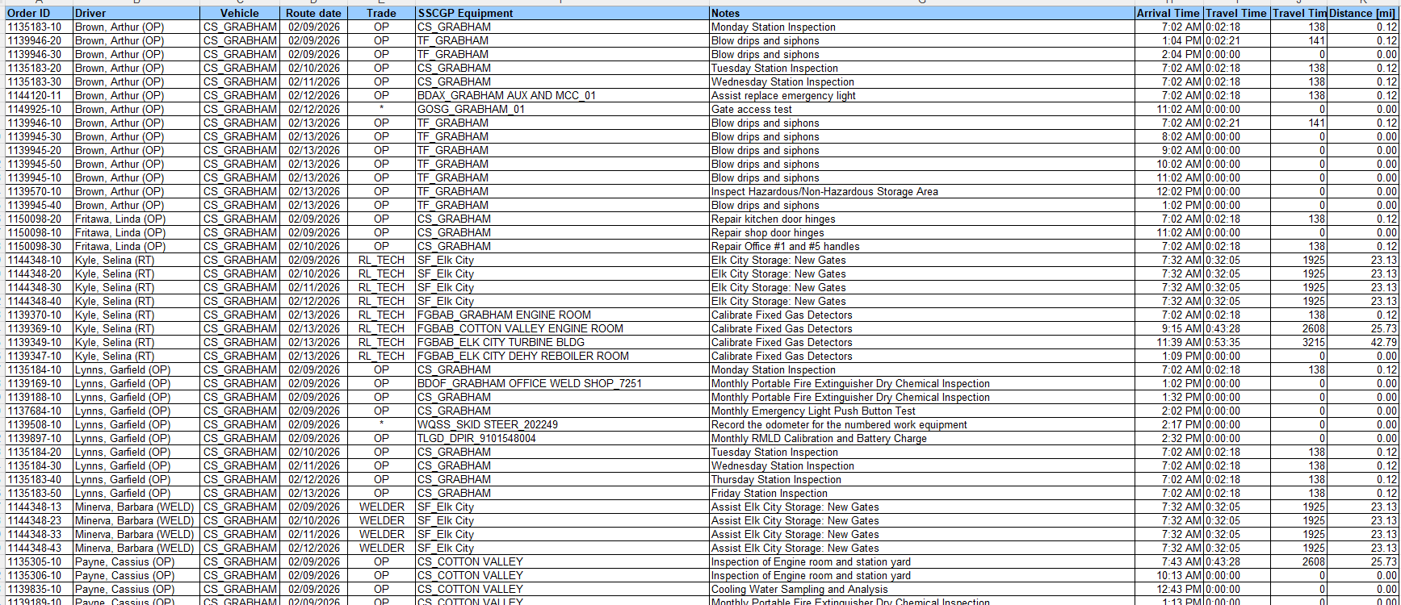
Optimo Route in Action

Slide 18
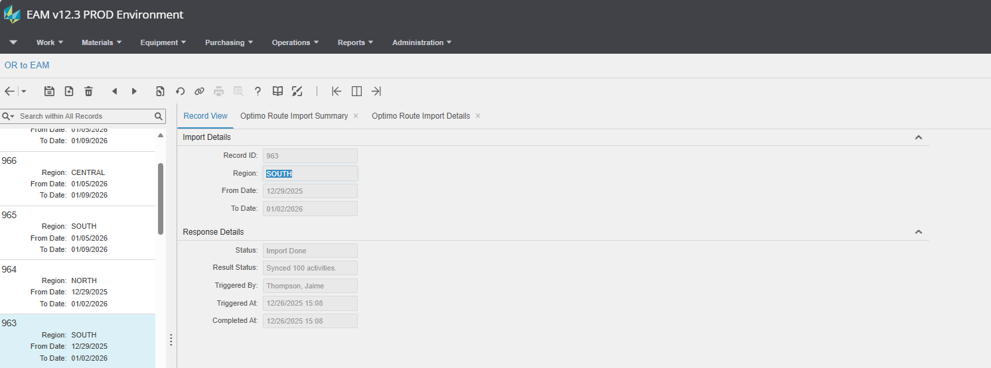
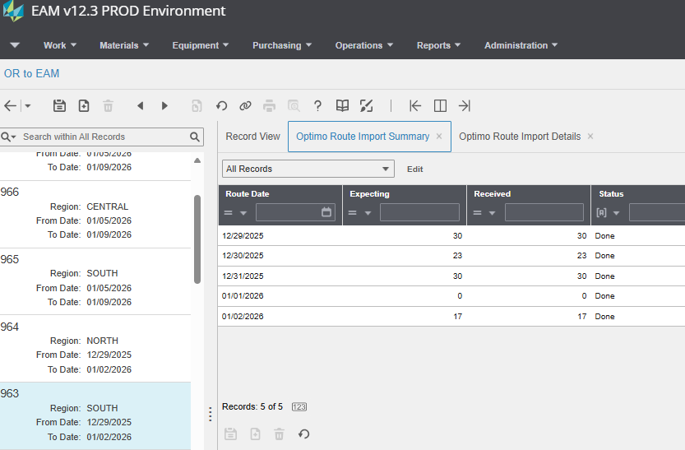
Optimo Route in Action
Optimo Route to EAM integration

Slide 19
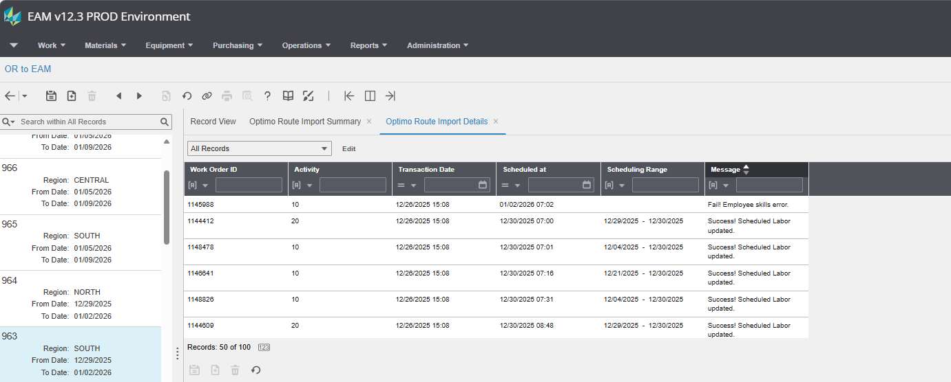
Optimo Route in Action
Optimo Route to EAM integration

Slide 20
Optimo Route in Action
Optimo Route to EAM integration
Scheduled labor is added to the Work Order Activity with the date planned/employee in Optimo Route
Status of the Work order changes from Scheduling to Issued

Slide 22
Questions?

