Slide 1

Asset Performance Management Defined
- How HxGN EAM and HxGN APM work together and how to get started -
Matt Peak
Solution Consultant
Hexagon

Slide 2
Outline
SECTION 1
Removing Barriers
SECTION 2
HxGN EAM & HxGN APM Together
SECTION 3
Operationalize Faster

Slide 3
Outline
SECTION 1
Removing Barriers
SECTION 2
HxGN EAM & HxGN APM Together
SECTION 3
Operationalize Faster

Slide 4


Slide 5
“A good plan…executed now is better than a perfect plan executed next week.” – George S. Patton
But I can’t execute any plan because I…
Don’t have the data.
Don’t know where to start.
It will take too long.

Slide 6
The ‘Old’ Work Processes – Where we might be today…
Equipment Installed & Running
EAM

Slide 7
The ‘Old’ Work Processes – Where we might be today…
Run to Failure
Equipment Installed & Running
EAM

Slide 8
The ‘Old’ Work Processes – Where we might be today…
Run to Failure
Equipment Installed & Running
Failure Occurs
EAM

Slide 9
The ‘Old’ Work Processes – Where we might be today…
Run to Failure
Equipment Installed & Running
Failure Occurs
Work Performed
EAM

Slide 10
The ‘Old’ Work Processes – Where we might be today…
Run to Failure
Equipment Installed & Running
Failure Occurs
Work Performed
Data Captures:
What was done
What parts were used
Who performed the work
What it cost
EAM

Slide 11
The ‘Old’ Work Processes – Where we might be today…
Run to Failure
Equipment Installed & Running
Failure Occurs
Work Performed
Equipment Working
Data Captures:
What was done
What parts were used
Who performed the work
What it cost
EAM

Slide 12
The ‘Old’ Work Processes – Where we might be today…
Run to Failure
Equipment Installed & Running
Failure Occurs
Work Performed
Equipment Working
Data Captures:
What was done
What parts were used
Who performed the work
What it cost
EAM

Slide 13
The ‘Old’ Work Processes – Where we might be today…
Run to Failure
Equipment Installed & Running
Failure Occurs
Work Performed
Equipment Working
What’s not captured:
What failed
How to prevent future failures
If our efforts are effective
EAM

Slide 14


Integrated Work Processes
Findings, Readings, Labor, and Observations
Calculate asset health with detailed equipment data
Valuable data from the checklists and inspections is captured
EAM
Pull in data from connected equipment, operator rounds, and alarms
Work is performed
APM
EAM MOBILE
OTHER SYSTEMS
Historian
Condition Monitoring
J5 Operator Rounds
Workers quickly triage, diagnose, and mitigate issues on EAM Mobile
HxGN APM alerts you to threats
EAM
Advisories and Targeted Work

Slide 15
Working Together Maximize Execution and Effectiveness
Effective Strategy Poorly Executed
Optimized Asset Management
EAM provides a robust platform for the execution of maintenance and other operational tasks.
APM monitors the strategy and the asset to determine its effectiveness.
With EAM and APM working together:
Effectiveness (Performance Management )
Precision PMs
Optimized OEM strategy
Dynamic maintenance strategy
Poor Strategy Executed Well
Execution (Asset Management)

Slide 16

HxGN APM: A prescriptive process
Risk
Monitor
1. Start by ASSESSING failure risks on assets that matter as monetized exposure.
3. Use existing data to MONITOR for emerging threats
Protect
Act
2. Implement a strategy to PROTECT the asset, leveraging work, sensor data, and machine learning.
4. ACT on threats as they emerge, and mitigate risk in HxGN EAM
Assess Risk: PLAN
Protect Assets: DO
Monitor Twin: CHECK
Acton on Threats: ACT

Slide 17
HxGN APM: A prescriptive process
Risk
Monitor
1. Plan
3. Check
Protect
Act
2. Do
4. ACT
Assess Risk: PLAN
Protect Assets: DO
Monitor Twin: CHECK
Acton on Threats: ACT

Slide 18
Assess
Risk, as financial exposure
Do you understand your risk exposure today?
How has this prioritized of your efforts?
Probability
Consequences
Risk
50
500k
250k
percent
dollars
dollars
Assess at the asset level or at the failure mode level.
Assess Risk: PLAN
Protect Assets: DO
Monitor Twin: CHECK
Acton on Threats: ACT

Slide 19
Risk
Monitor
Protections
Act
Measure bearing temps @ …
6 hours ago
Measure motor circuit @ …
6 hours ago
48%
Perform oil analysis
3 months ago
Measure insulation index
15 days ago
+22 Protections
Assess Risk: PLAN
Protect Assets: DO
Monitor Twin: CHECK
Acton on Threats: ACT

Slide 20
Protections
Active monitoring of data with initiation of prescriptive actions that mitigate emerging threats.
Activity Protection
Monitoring maintenance actions for target assets, providing discrepancies, average completion times, and forecast for next interval.
Condition Protections
Condition monitoring on one or more sensor feeds with logging of excursion events for follow-up action.
Pattern Protection
AI/ML model for monitoring chosen sensor feeds and their behavior. Train the model on what looks good.
Assess Risk: PLAN
Protect Assets: DO
Monitor Twin: CHECK
Acton on Threats: ACT

Slide 21
Risk
Coverage
Impact
Bearing Failure
$99,000
94%
$0
NML Failure
$15,499
Fuse Failure
$49
16 of 17 Protected
No Wins or Losses
+14 Failures Modes
Protect
Act
Assess Risk: PLAN
Protect Assets: DO
Monitor Twin: CHECK
Acton on Threats: ACT

Slide 22
Risk
Monitor
Protect
Response
To Act On
10 Active Advisories
Visual inspection
2024-10-05
Bearing temperature are outside of expected..
Check Operational…
2024-10-01
Dead head condition has been detected. Che..
PMP-250-HOUR
2024-10-05
250 running hours inspection is overdue by a..
High
None
+7 Active Advisories
Assess Risk: PLAN
Protect Assets: DO
Monitor Twin: CHECK
Acton on Threats: ACT

Slide 23


Advisories
State: Completed
Actions Taken
Impact: Wins and Losses
Collaboration
Reviewers
Review operating parameters
Ensure designs
Asset Teams
Reliability Team
Operations
Individuals
3
Evidence and troubleshooting history
Trigger date/time
Trigger logic
Failure modes
Priority
Originating Protection
Assess Risk: PLAN
Protect Assets: DO
Monitor Twin: CHECK
Acton on Threats: ACT

Slide 24
Asset Twin
Risk
Exposure
Status
Protection Index
Protections
Twin Start
2019-06-04
Measure bearing temps @ …
6 hours ago
$137k
25%
Mission Expires
2028-06-04
Measure motor circuit @ …
6 hours ago
Last Evaluated
6 hours ago
48%
Perform oil analysis
3 months ago
At Mission Time
Failure Probability
Twin Start
Measure insulation index
15 days ago
+22 Protections
Coverage
Impact
Failure Modes
Response
To Act On
10 Active Advisories
Bearing Failure
$99,000
Visual inspection
2024-10-05
Bearing temperature are outside of expected..
94%
$0
NML Failure
$15,499
Check Operational…
2024-10-01
Dead head condition has been detected. Che..
Fuse Failure
$49
PMP-250-HOUR
2024-10-05
250 running hours inspection is overdue by a..
16 of 17 Protected
No Wins or Losses
+14 Failures Modes
High
None
+7 Active Advisories
ASSESS RISK
PROTECT ASSET
MONITOR TWIN
ACT ON THREATS

Slide 25
Outline
SECTION 1
Removing Barriers
SECTION 2
HxGN EAM & HxGN APM Together
SECTION 3
Operationalize Faster

Slide 26
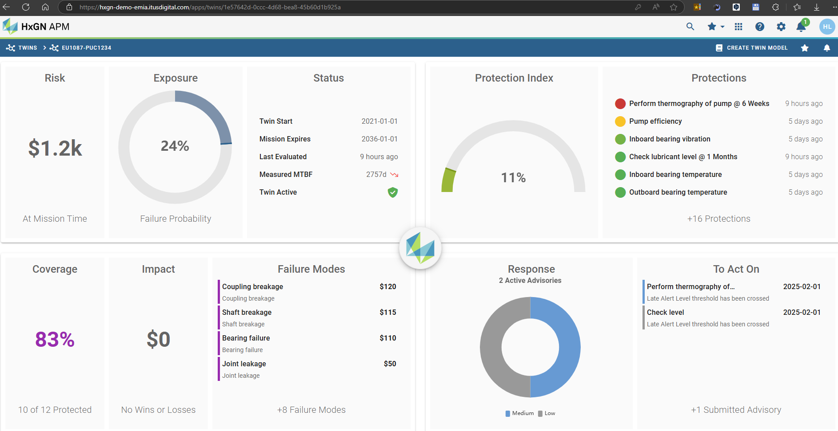
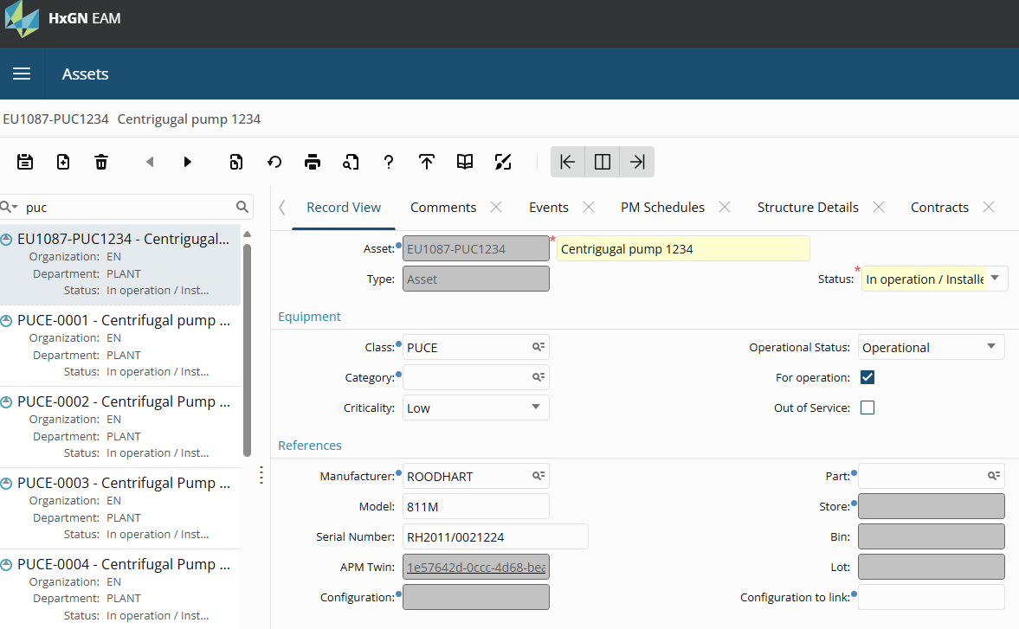
APM Twin / EAM Asset

Slide 27
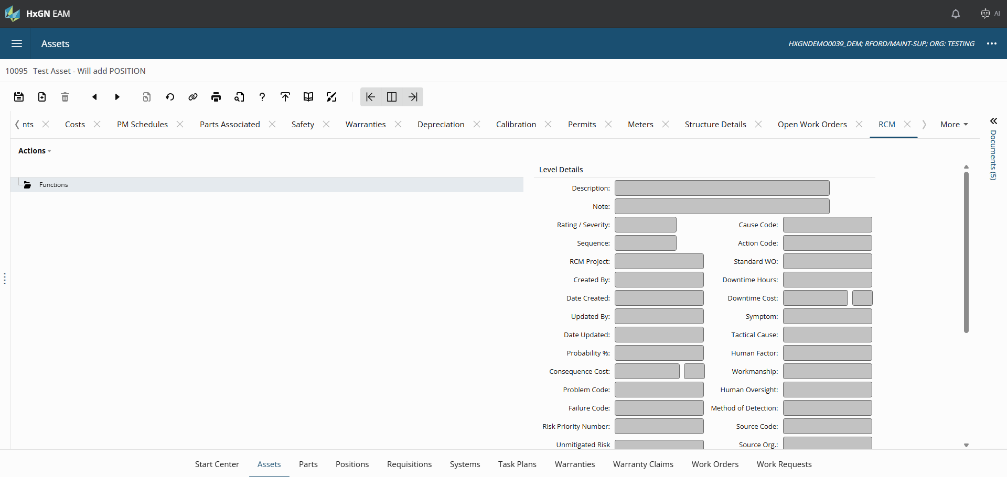

Slide 28
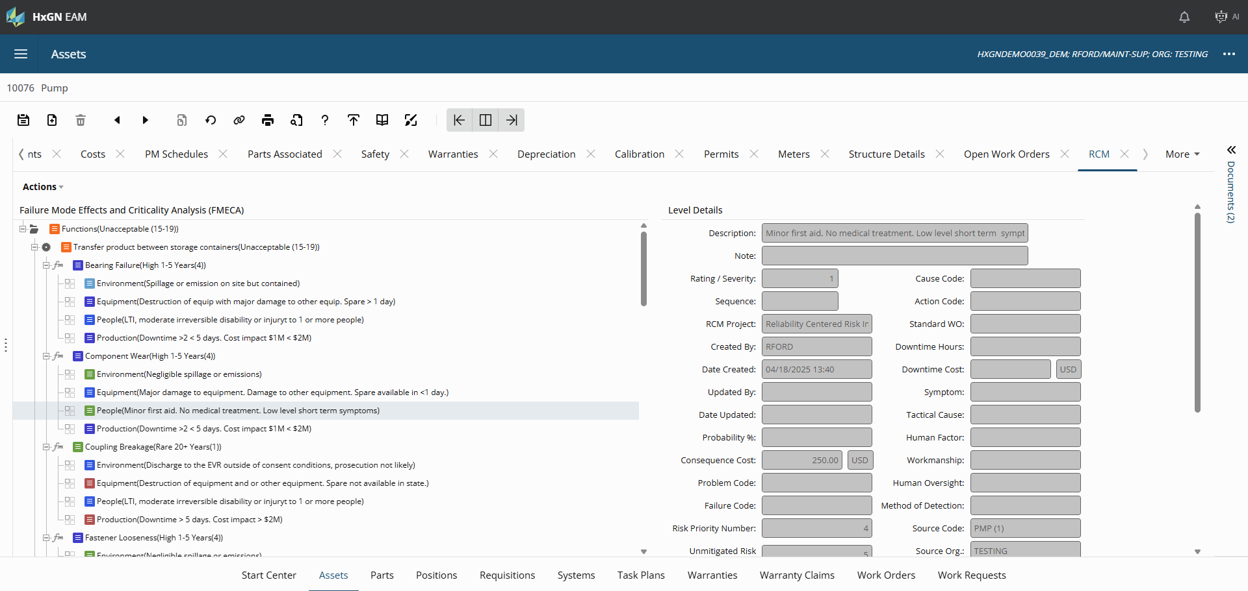

Slide 29
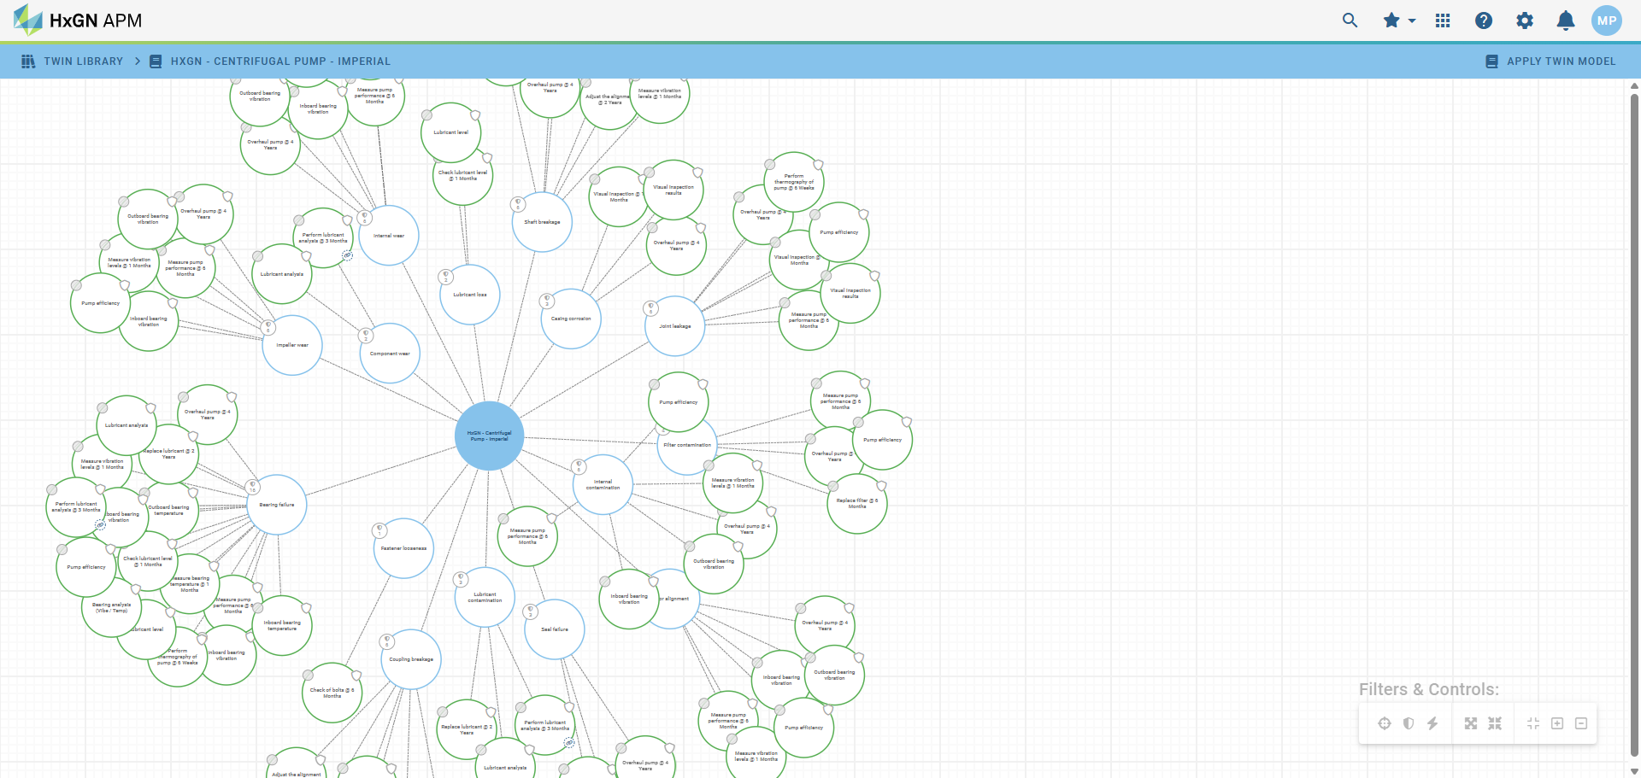
HxGN APM Embedded Twin Library
Asset
Failure Mode
Protections

Slide 30
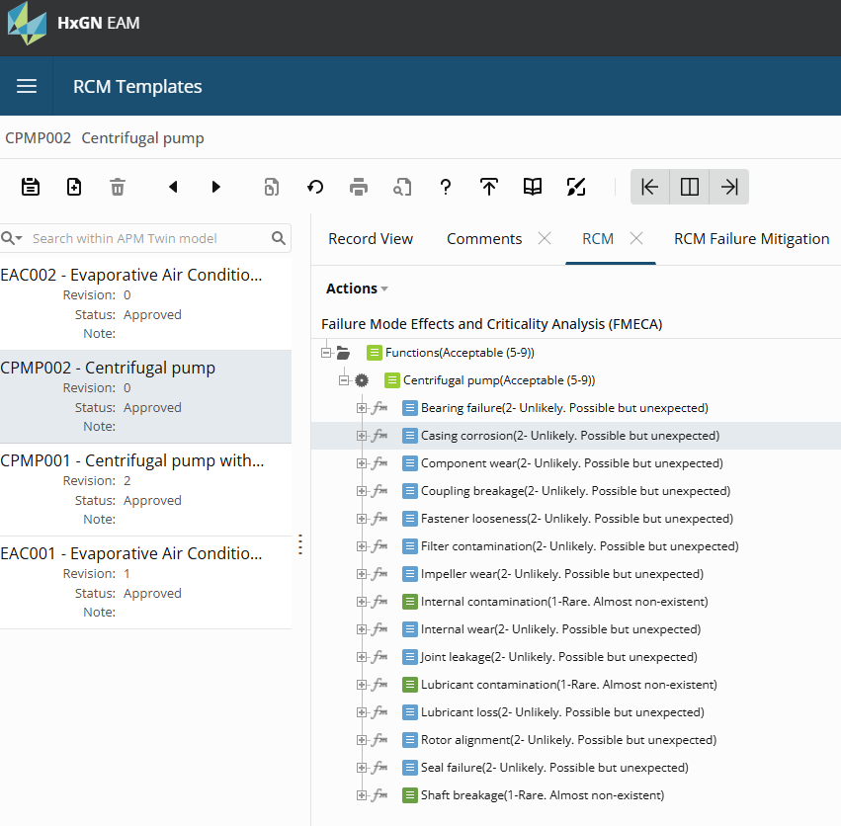
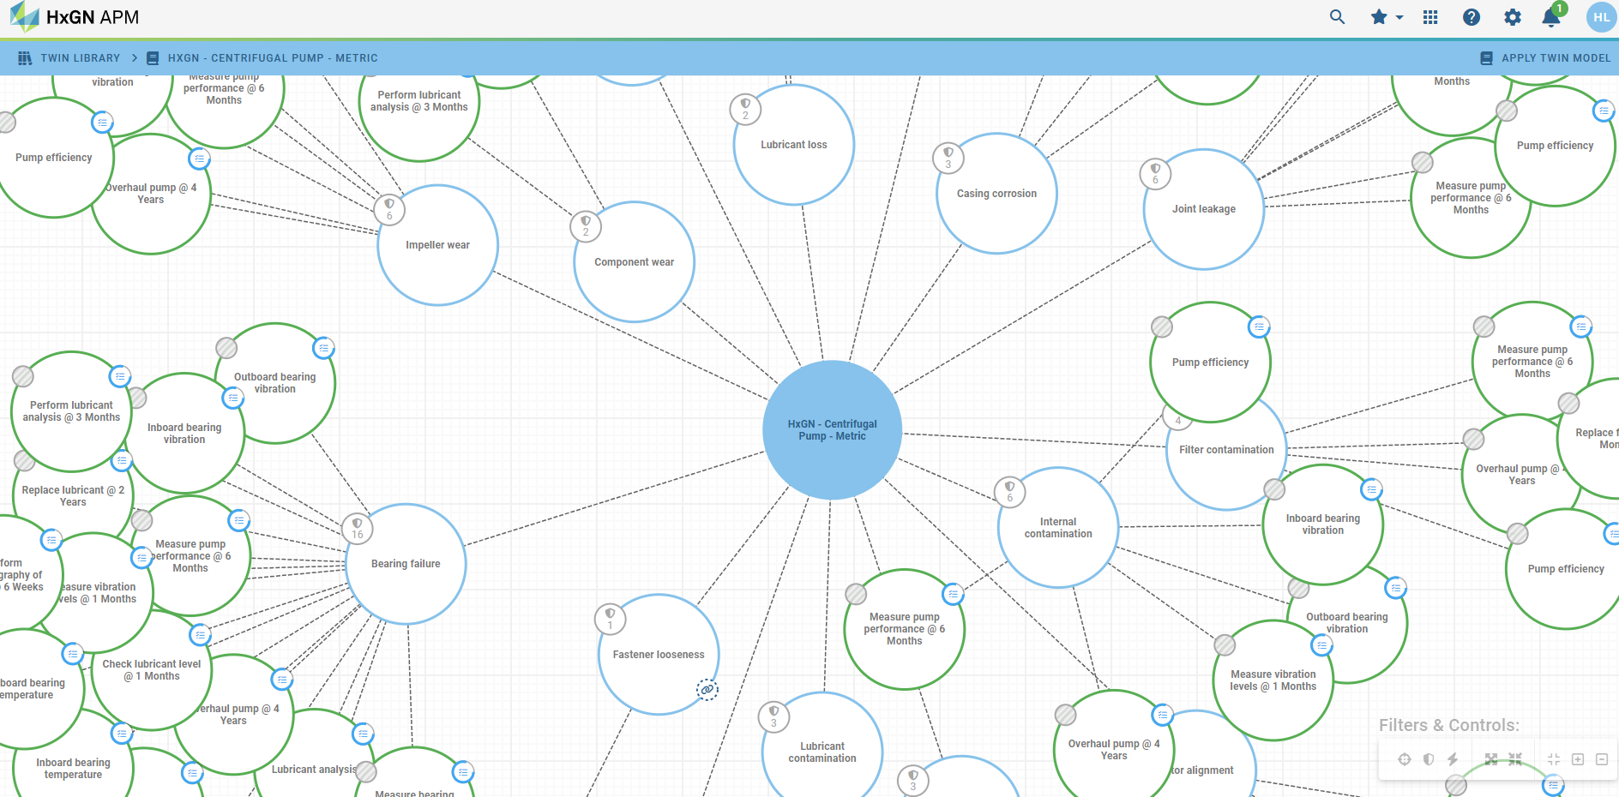
APM Twin / EAM RCM Template

Slide 31
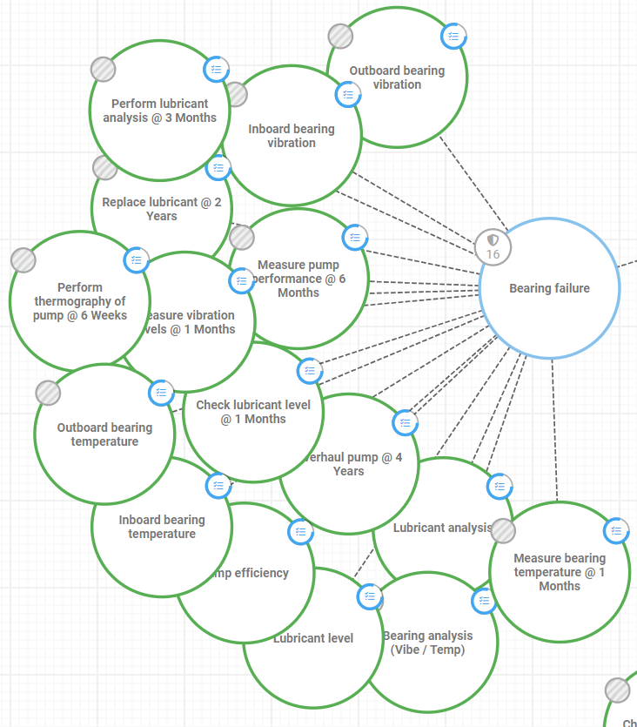
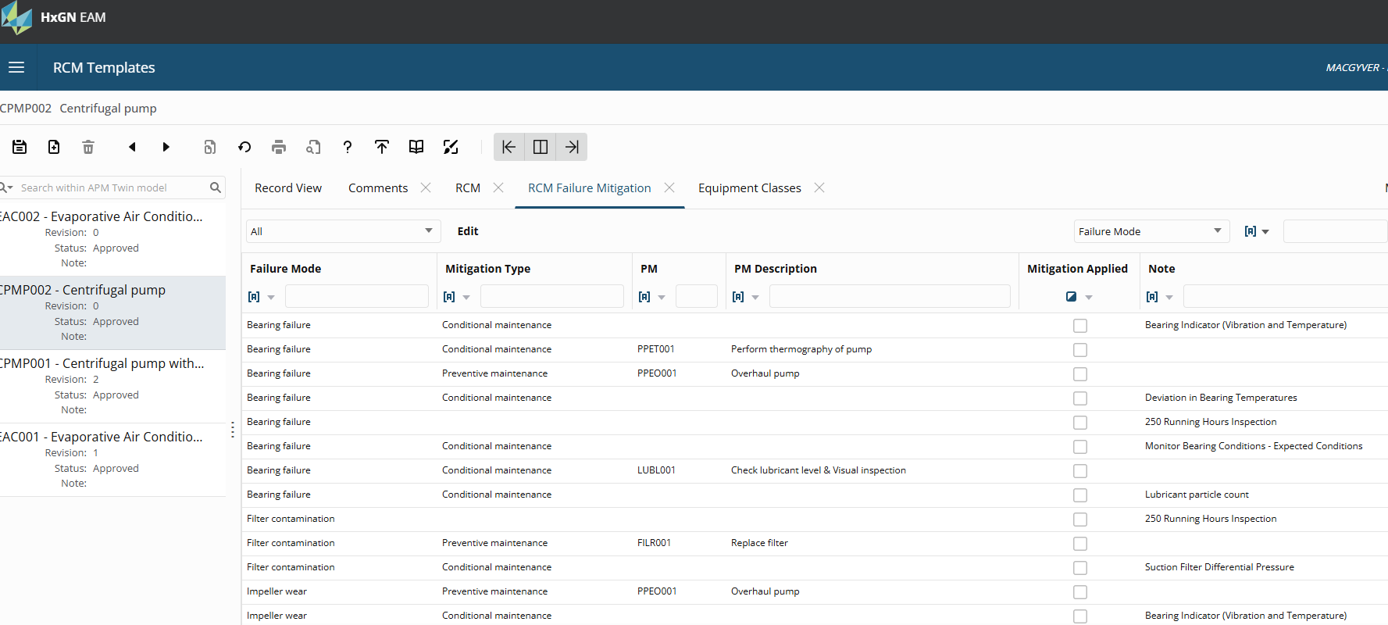
APM Twin / EAM RCM Template

Slide 32
HxGN EAM + HxGN APM
Risk Analysis
Equipment Ranking
Condition survey
Significant risk level
Significant risk level
Performance calculation
Assess Risk
Failure risks analysis
Root Causes Analysis
Work Orders
Act (Advisories)
Failure modes
FMECA
Significant
Failure risk level
Failure Mitigation
Asset Strategies
Monitor Twin
External data Sensors / IoT/ SCADA
Protections (Custom or from the library)
Twin

Slide 33
Outline
SECTION 1
Removing Barriers
SECTION 2
HxGN EAM & HxGN APM Together
SECTION 3
Operationalize Faster

Slide 34

EAM + APM Integration
HxGN EAM
HxGN APM
Assets / Positions / Systems
Assets
EAM is the system of record for:
Assets
Hierarchy
Work Orders
Top 200 assets determined by financial history
APM is the system of record for:
Sensor data
Protections
Advisories
Structure
Structure
Work Orders
Work History
Work Order / Work Request
Advisory
Asset Risk Analyzer
Top 200 assets
Excel Template
Top 200 asset’s work details
Asset Risk

Slide 35






APM Integration Model
Operations Management
Operator Observations
Visual Inspections
Off-line Readings
Operator Interventions
Connected Equipment & Historians
Conditions
Faults
Production Events
Cycles
Yield
Enterprise Asset Management
Maintenance Plans
Work Requests
Assets
Work History
Inspections
Asset Performance Management
Asset Risk Assessment
Strategy Management
Strategy Optimization
Asset Condition & Health
Failure Prediction
Predictive Maintenance
Asset Twin Library
Asset Lifecycle Information Management
Engineering Basis
3D Models
P&IDs
Documents
Alarm Management
Alarm Configuration
Alarm Events
Operator Change
Loop Performance
Existing Strategies
RCM
FMEA RBI
HAZOP
PM Plans
*Future Roadmap – Under Consideration*

Slide 36





HxGN APM Embedded Twin Library
200+ ASSET TWIN MODELS
Covering common industrial equipment classes, including base failure rates.
ASSESS
RISK
PROTECT ASSET
MONITOR
TWIN
ACT ON
THREATS
1700+ FAILURE MODES
1300+ PROTECTIONS
3900+ CONDITIONS
1300+ ACTIONS
Common failure mode definitions which can be extended based upon strategy development rigor.
Activity and Condition protection definitions that include scope, interval, conditions and analytics which are deployed to guard against failure modes occurring.
Interval, condition and analytic driven triggers to notify and advise of emerging failure risk based on protection definitions.
Prescriptive advisories that provide proactive warning of failure risk which can be tuned to your organization and operating context.
HxGN APM ASSET TWIN LIBRARY
Extendable for new & existing strategies

Slide 37

Asset Twin Generator
**ROADMAP**
**ROADMAP**

Slide 38
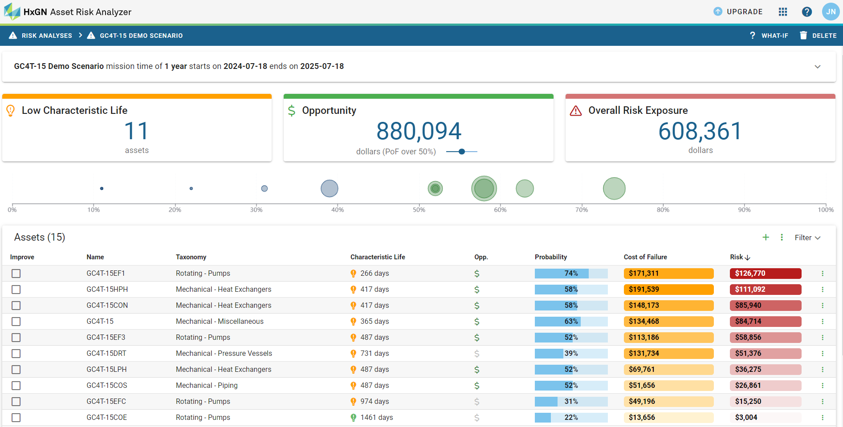

Asset Risk Analyzer
Rapid quantitative assessment of asset risk directly from your EAM work history
Identifies assets performing below industry benchmarks
Pinpoints where you should focus strategy development efforts
Best of all, it is FREE and easy to use
www.assetriskanalyzer.com

Slide 39
We must start somewhere.
Do not let perfect be the enemy of good.

Slide 40
Questions
Add text or image

Slide 41
Enter Header
Add text or image
Add text or image

Slide 42
Enter Heading
Click icon in box to the left to add image. Intended to fill entire side.

Slide 43
Enter Heading
Click icon in box to the right to add image. Intended to fill entire side.

Slide 44
Timeline or Flow
Enter Text Here
Enter Text Here
Enter Text Here
Enter Text Here
Description
Description
Description
Description

Slide 45
Enter Header
Enter Text Here
Enter description
Enter Text Here
Enter description
Enter Text Here
Enter description

Slide 46
Enter Heading
Use bolded green text to emphasize text in a block. Continue text in regular weight and color.

Slide 47
Enter Heading
Steps or Topics
Steps or Topics
Steps or Topics
Steps or Topics
Enter a long or short description. Box will adjust length automatically.
Example
Description
Enter a long
or short
description.
Box will
adjust the length
automatically.
Example of
different description
length.

Slide 48
Please Read Before Editing
Please explore all slide options to see which format fits your content the best. If you run into any issues during editing or need additional slide options, please reach out to events@streamlineconferences.com
Presentation font is Arial Nova (Light, Regular, Bold). This should be available to everyone but, if not, Arial is the next preferred.
Colors to use in addition to black are listed below:
Light Green Accent Color: 3BA40F

