Slide 1
Breaking the Cycle of Doom
How Clarity Restores Stability & Where Real Work Gets Done

Slide 2
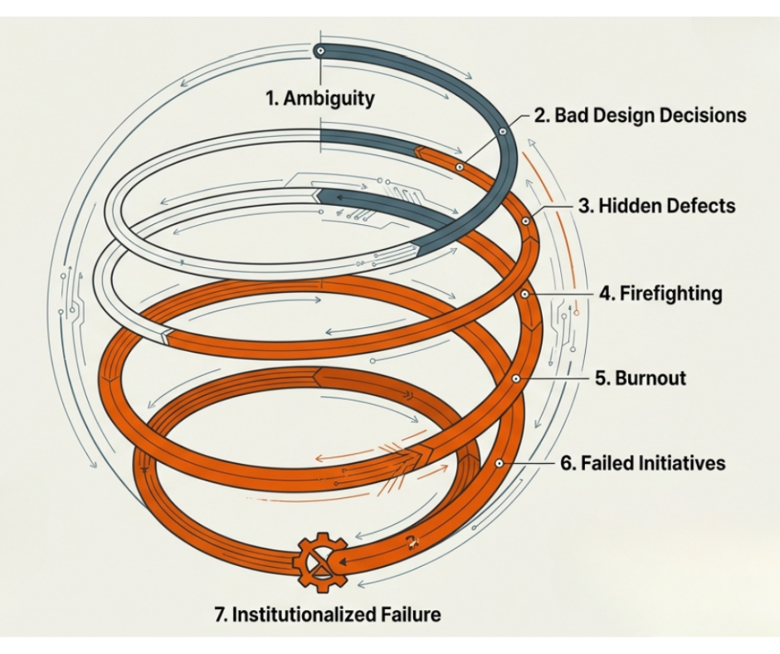

Slide 3
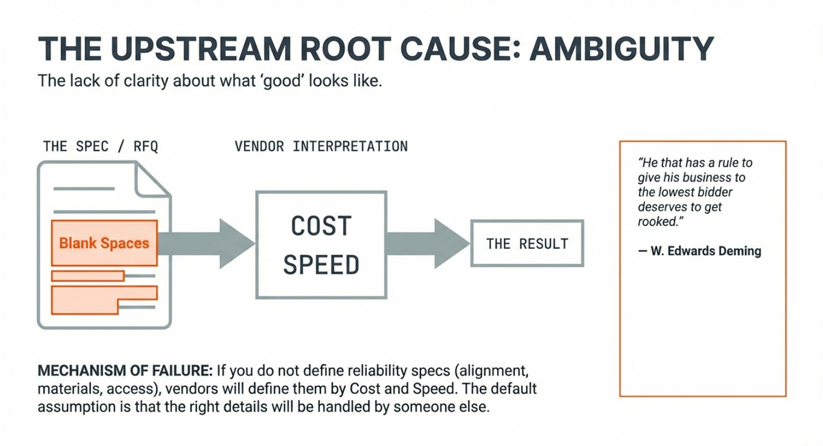

Slide 4
Assumed Clarity vs. Explicit Definition
Assumed | Explicit
Vendor knows best | Alignment tolerances
“Industry Standard” | Current generation supported components
The way we’ve always done it | Material Specifications
 | Access Clearance
 | Torque Spec
 | Operating Temperature

Slide 5
Where does it start?
Chaos starts with a lack of clarity on what “good” looks like. When expectations for design, installation, and maintainability are not explicit, the void is filled by cost and speed.
Without Operational Definitions, there is no communication. A specification must be communicable with the same meaning to the vendor as to the purchaser

Slide 6
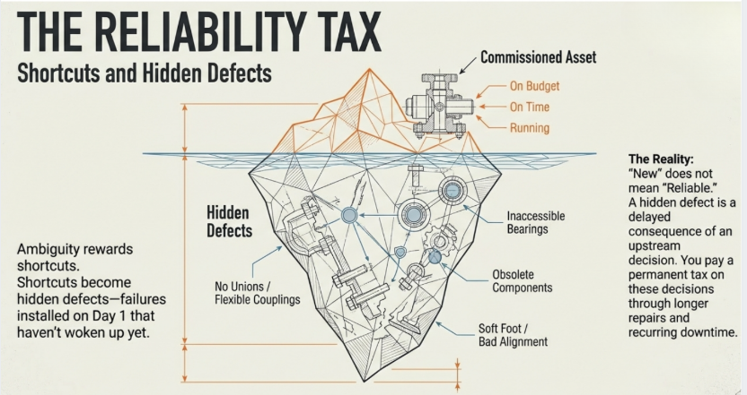

Slide 7

Everything Seemed Fine On The Surface
Just like with the iceberg, everything often seems fine at startup.
  Low rate of production
  The project was on time and under budget
  Everyone is happy that the asset is running

Slide 8
But Then The Bill Of Ambiguity Comes Due
Work orders stack up faster than they can be closed
Preventive maintenance is deferred “we’ll get to it later this week”
Overtime skyrockets
Technicians go from call to call doing the work of six, while the hidden defects “show their teeth”

Slide 9
What this feels like
This can feel like a people problem, “we just need more discipline”
But it is not a people problem
It is the cumulative cost of upstream decisons

Slide 10
“I thought you said it wouldn’t be this way”

Slide 11
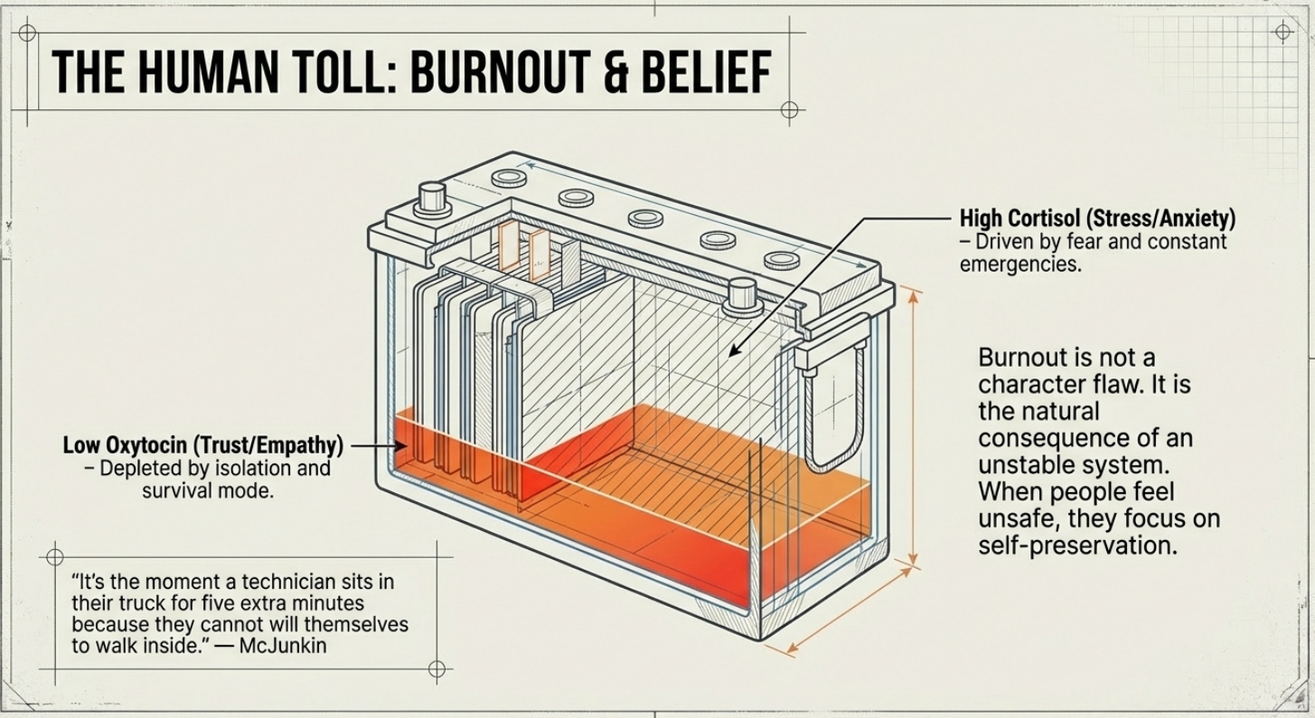

Slide 12
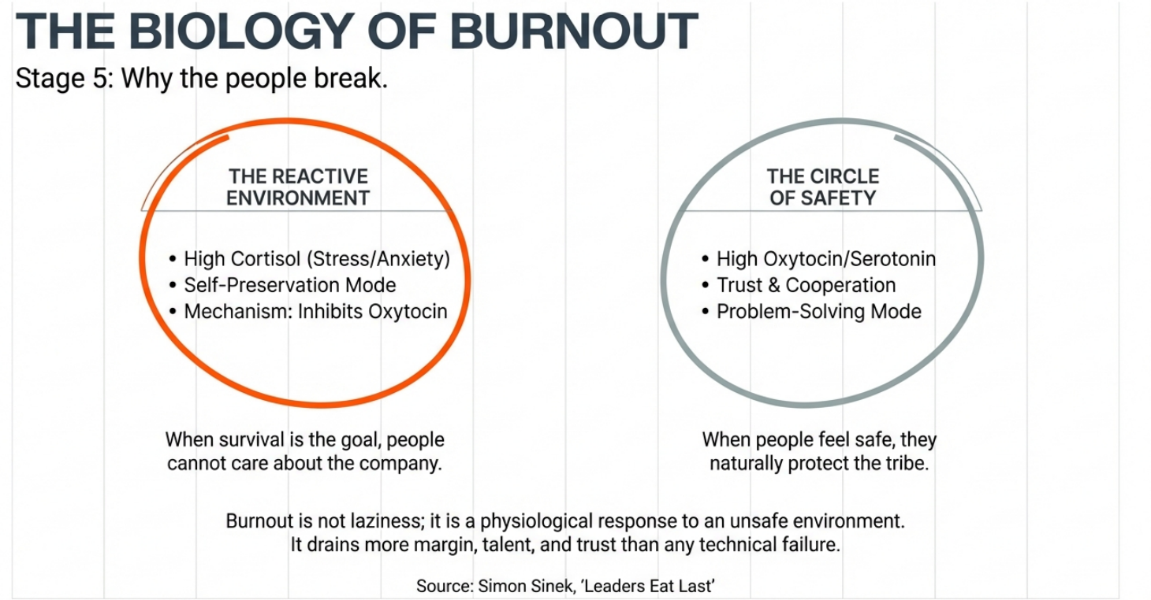

Slide 13
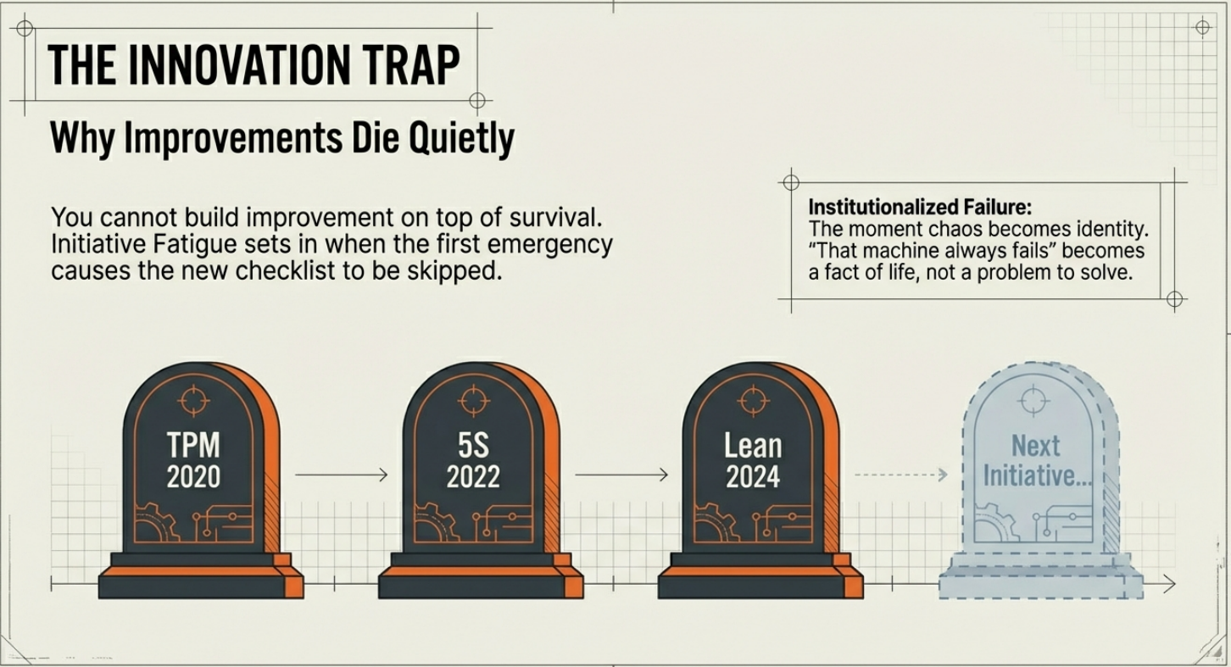

Slide 14
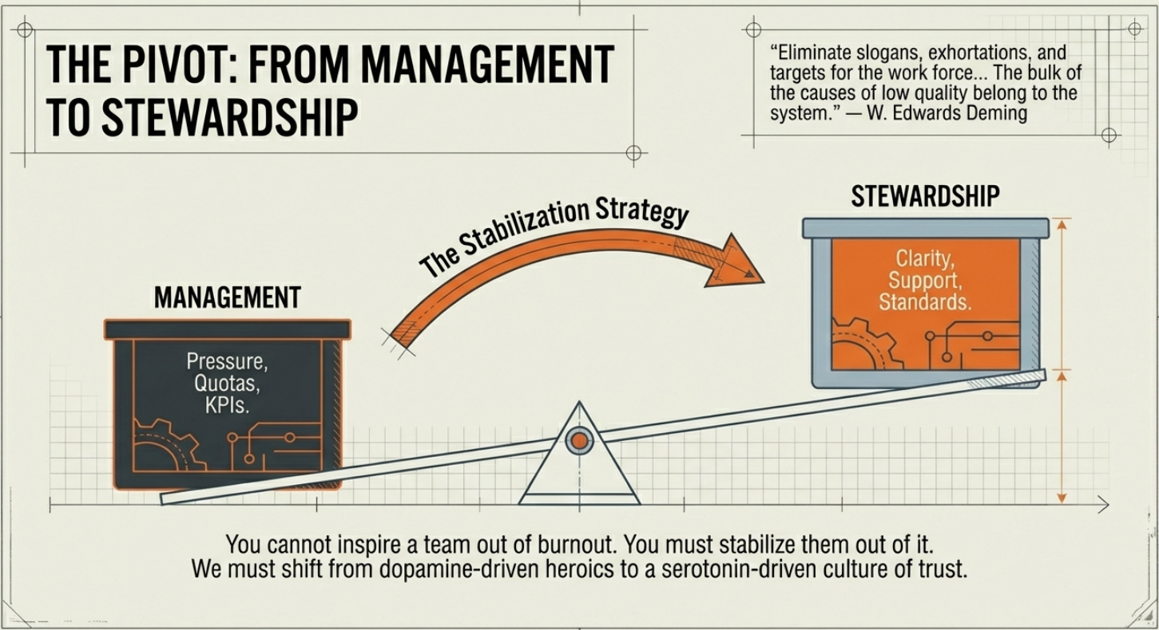

Slide 15
The Drowning Man

Slide 16
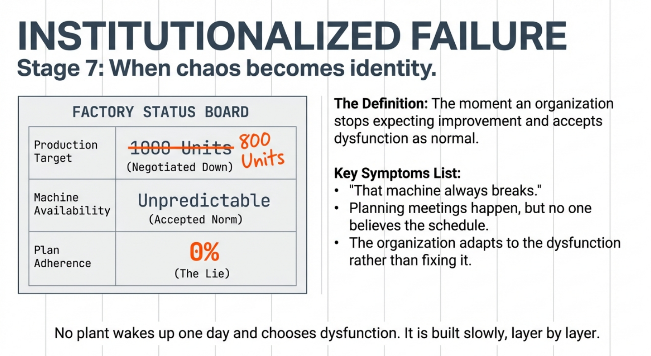

Slide 17

“Just do what you can”
The white flag, the surrender of the idea of a better tomorrow

Slide 18
This does not stop by working harder…
It only gets better when someone decides it matters.

Slide 19
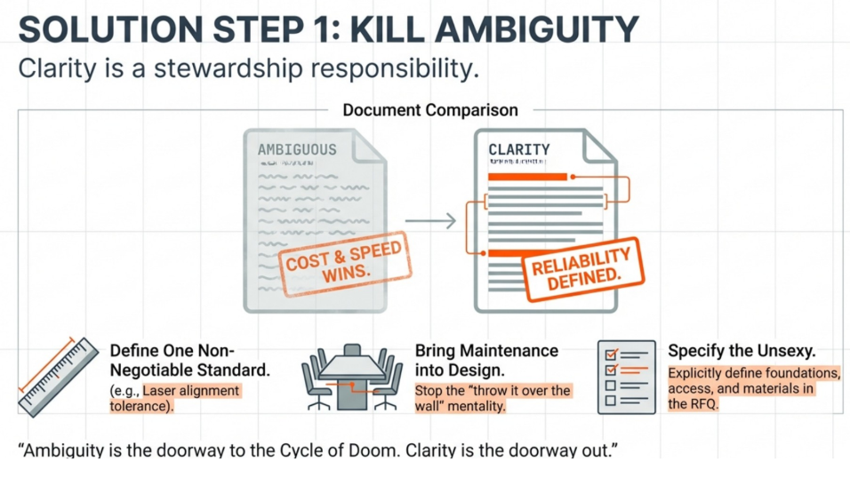

Slide 20
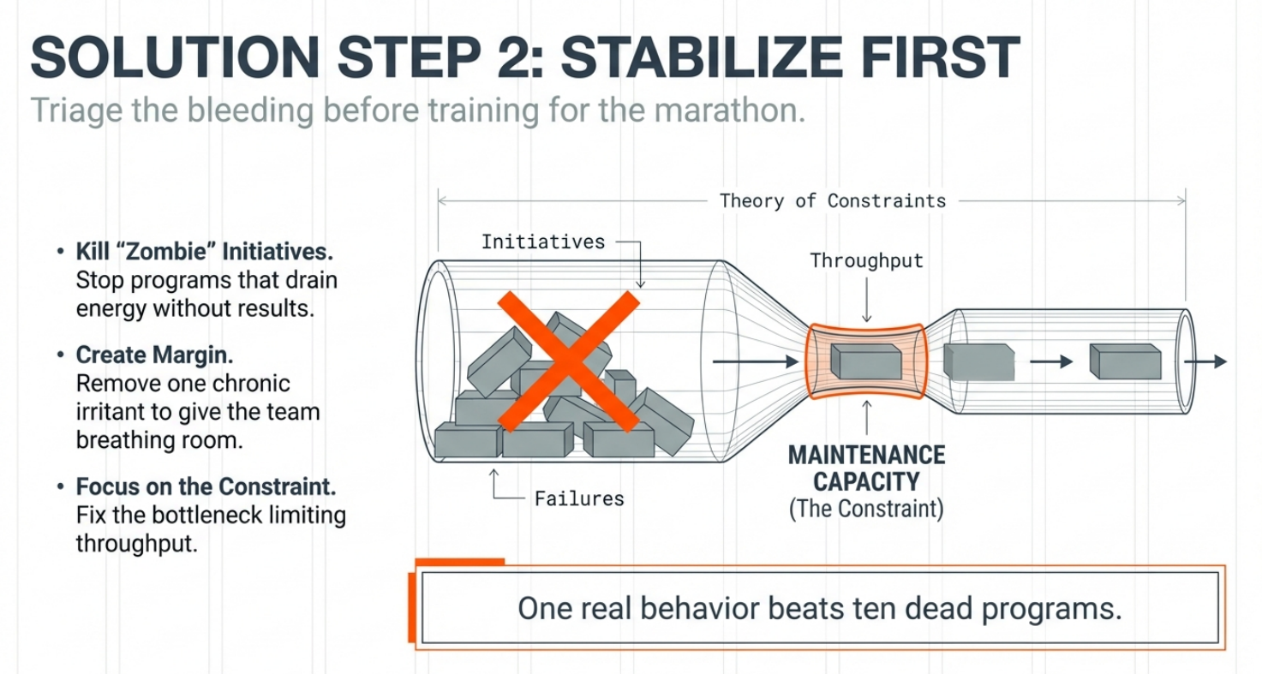

Slide 21
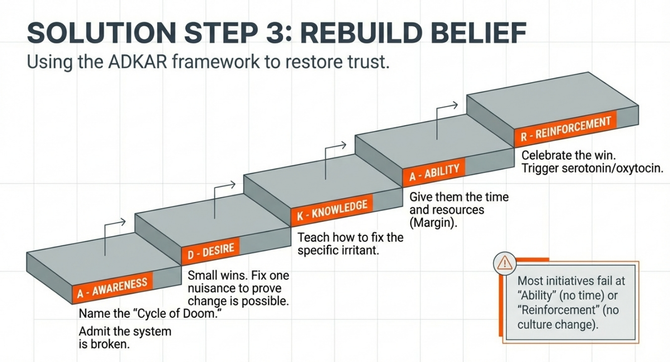

Slide 22
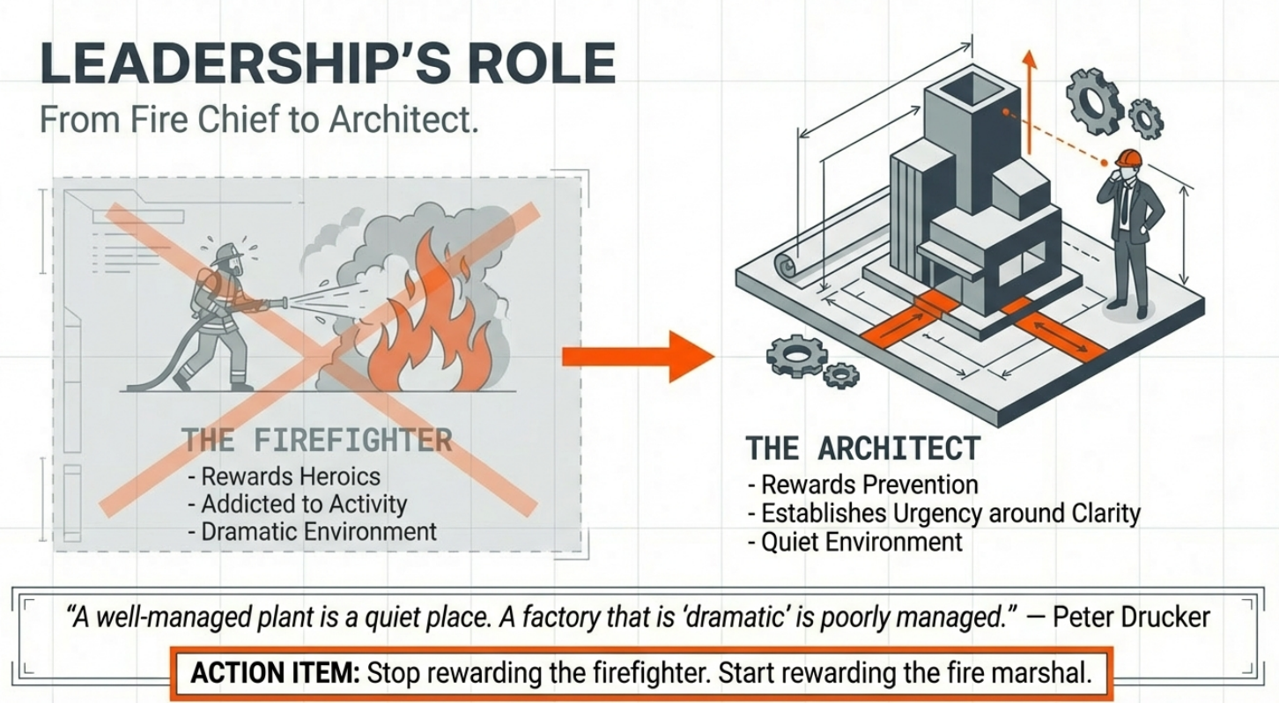

Slide 23
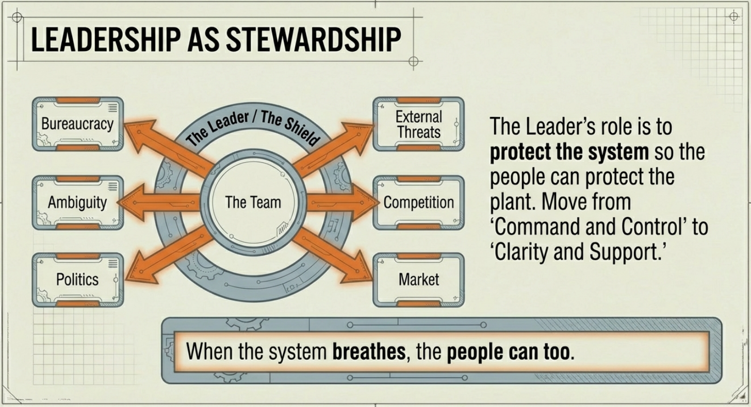

Slide 24
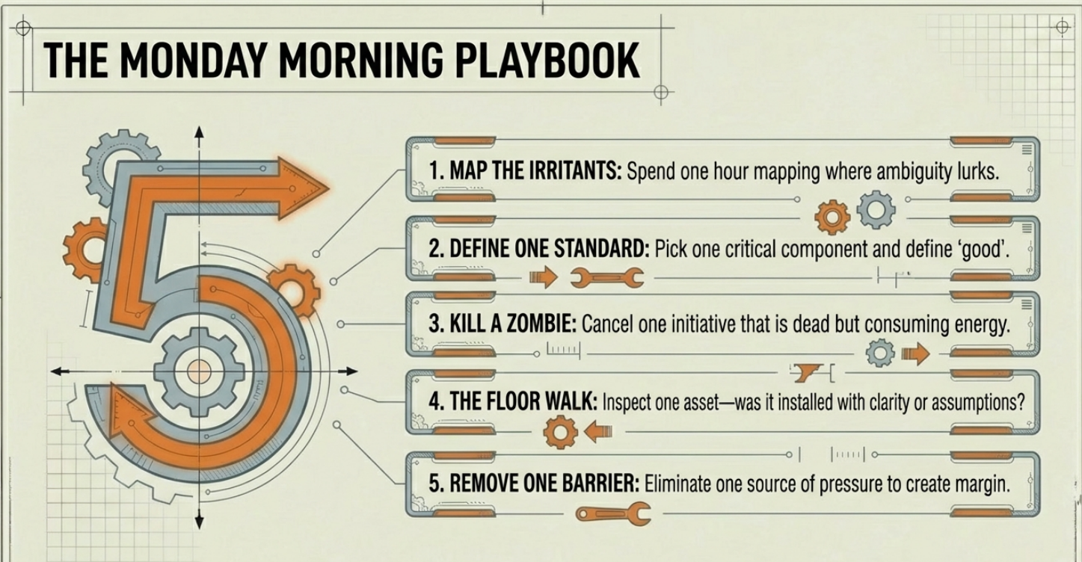

Slide 25
Takeaway
You are either not speaking their language OR you do not understand the business objectives - GW
It takes the leader to stand in the gap, speak the truth, and lead from the front to escape the cycle of doom

Slide 26

Questions?

Slide 27


Thank You

