Slide 1

Building the Backbone: How Foundational Processes and EAM Solutions Transform Facilities Management
Bryan Decker
CEO
Steadfast Operations

Slide 2
Outline
SECTION 1
Setting up A Solid Foundation
SECTION 2
Hexagon EAM: Turning Execution Into Control
SECTION 3
Governance + Operating Rhythm
SECTION 4
A Practical Roadmap
SECTION 5
The Backbone Promise

Slide 3

Setting Up A Solid Foundation

Slide 4

Why This Matters
Every outage has a story: a missed inspection, weak turnover, poor change control, incomplete closeout, wrong part, unclear ownership.
Leaders care about:
availability / uptime risk
safety and regulatory exposure
customer/SLA impact
audit readiness
predictable OPEX and defensible CAPEX
Operators care about:
fewer emergencies
clearer priorities
better planning windows
faster restoration and fewer repeat events
“We don’t ‘manage work’—we manage risk through work.”
Add text or image

Slide 5

The Backbone Model
Foundational programs define how work is done.
Hexagon EAM enforces standards and captures the evidence trail:
assets → work → parts → inspections → costs → history
Outcome: risk-based decision-making and repeatable performance.
“No standards → no reliable data. No reliable data → no control.”
Add text or image

Slide 6

Foundational Program 1: Operations Readiness
Operations Readiness: The “Day-1 Reliability” Program
Applies to:
new builds, expansions, retrofit/refresh, major equipment replacements, vendor transitions
Readiness checklist categories:
people (roles, coverage model, training/certification)
process (SOP/MOP/EOP finalized; change control operational)
tools (Hexagon EAM configured; mobile; reporting)
spares/vendors (critical spares on hand; SLAs active; escalation contacts)
data (assets loaded; PMs active; warranties; test reports; O&M manuals; as-builts)
“Readiness is where reliability is won—before the first real incident happens.”

Slide 7
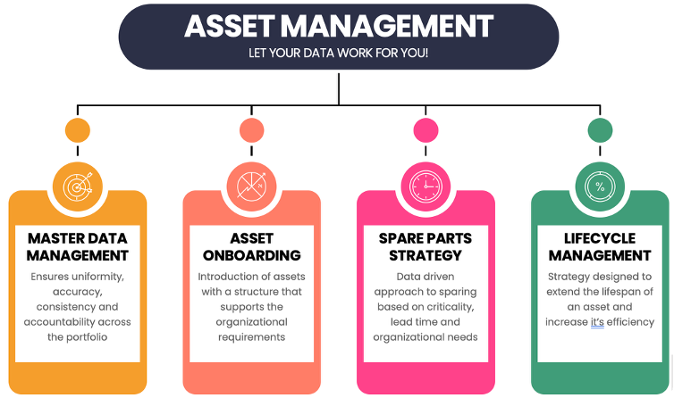
Foundational Program 2: Asset Management
Asset Management: What “Good” Looks Like
Complete and accurate asset hierarchy aligned to how you operate:
campus → building → rooms/whitespace → systems → equipment → components
Criticality tied to consequence (not replacement cost):
safety impact, redundancy impact, customer load impact, time-to-fail exposure
Configuration matters: what’s installed, where, and how it’s configured (feeds change control and readiness).
Lifecycle visibility for major risk assets:
UPS modules, batteries, switchgear, breakers, generators, ATS/STS, chillers
“If we can’t trust the asset register, we can’t trust the operation.”
Add text or image

Slide 8

Asset Management Deliverables (What You Build)
Golden asset register in Hexagon EAM (ownership + governance defined)
Minimum data standards for mission critical assets:
location, manufacturer/model/serial, redundancy group, upstream/downstream dependencies, warranty, PM strategy
Critical asset lists by system and redundancy group (what truly threatens uptime)
Standard job plans / PM library for critical systems
Spare parts classification:
critical spares (no-stockout tolerated), lead times, alternates, vendor agreements
“This is the foundation for controlling uptime risk and capital surprises.”
Add text or image

Slide 9
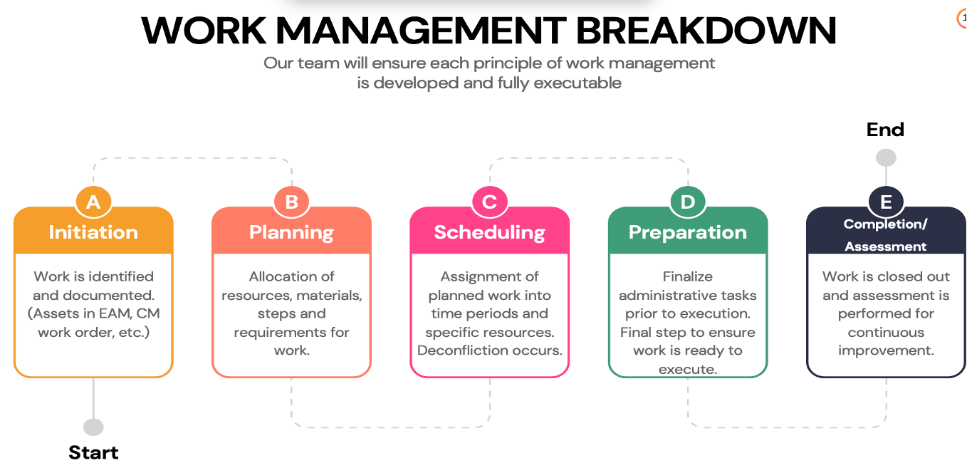
Foundational Program 3: Work Management
Standard workflow:
Initiation → Plan → Schedule → Prepare → Execute → Close → Learn
Mission critical additions:
risk assessment for any work impacting redundancy
MOP/SOP/EOP linkage (Method of Procedure / Standard Operating Procedure / Emergency Operating Procedure)
permit-to-work / LOTO / access controls as applicable
maintenance window management and stakeholder notification
“Work management is change risk management.”
Add text or image

Slide 10

Planning & Scheduling: What Separates Good From Great
Plan quality drives execution quality:
clear scope, prerequisites, parts, tools, permits, steps, backout plan
Schedule discipline:
protect the weekly schedule; define what qualifies as true break-in work
Coordination across teams:
facilities, controls, IT/network, security, vendors—because misalignment creates risk
Closeout discipline:
accurate labor/materials, completion notes, test results, condition readings, cause codes
“If it’s not closed correctly, it didn’t happen—and it can’t protect us later.”
Add text or image

Slide 11

Work Management KPIs That Matter
Planned vs unplanned work (% planned)
Schedule compliance (and reasons for misses)
Work order aging by priority and by criticality
PM compliance on critical assets (including deferrals and approvals)
Maintenance window adherence (started/ended on time; redundancy maintained)
Repeat corrective work on the same asset/system
MTTR for critical systems + restoration time trend
“These KPIs are early warning signals for downtime risk.”

Slide 12
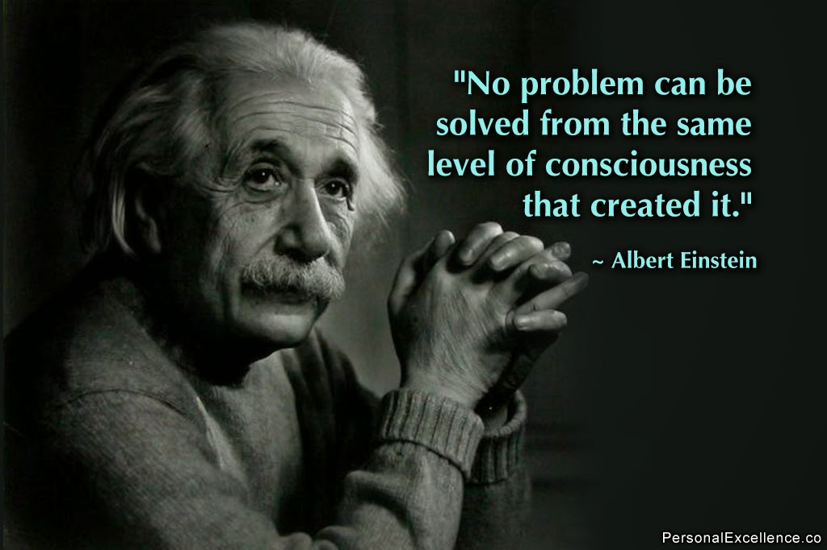
Foundational Program 4: Incident Management
Define tiers clearly:
Alarm/Event (signal) vs Incident (service impact or elevated risk) vs Major Incident (customer/SLA/redundancy breach)
Standardize:
severity levels, response targets, escalation paths, communications templates
Capture near misses:
loss of redundancy, abnormal readings, nuisance trips—these are free lessons
“The best outage is the one you prevented because you treated a near miss seriously.”

Slide 13

Incident Output: Closing the Loop Into Work
Every significant incident produces:
immediate response record
follow-up corrective work orders
preventive actions (procedure update, training, inspection frequency changes, spares adjustments)
Right-size RCA:
major incidents get structured RCA + tracked corrective actions
routine issues get fast causal coding and trend monitoring
“Incident management isn’t reporting—it’s risk reduction”

Slide 14
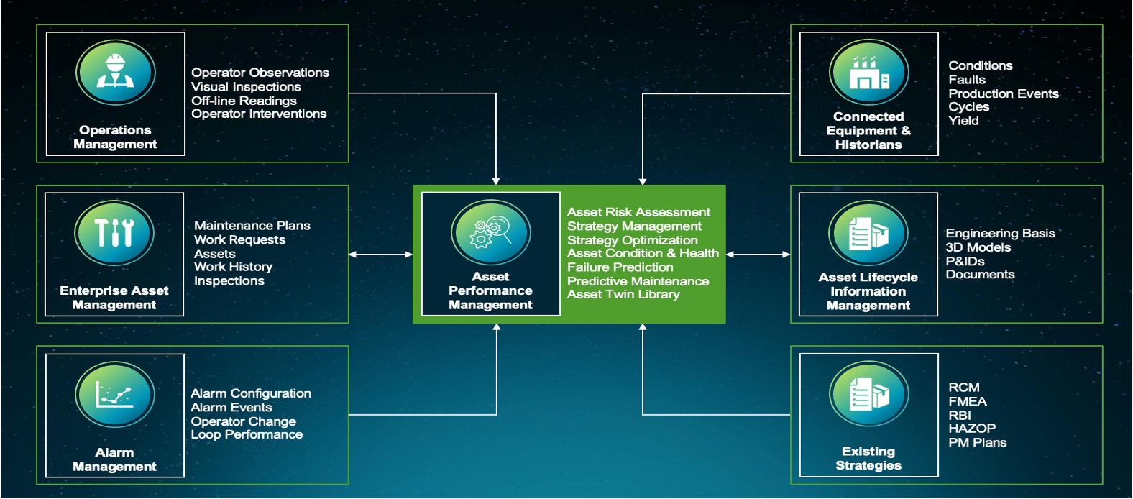
Hexagon EAM: Turning Execution into Control
Add text or image

Slide 15
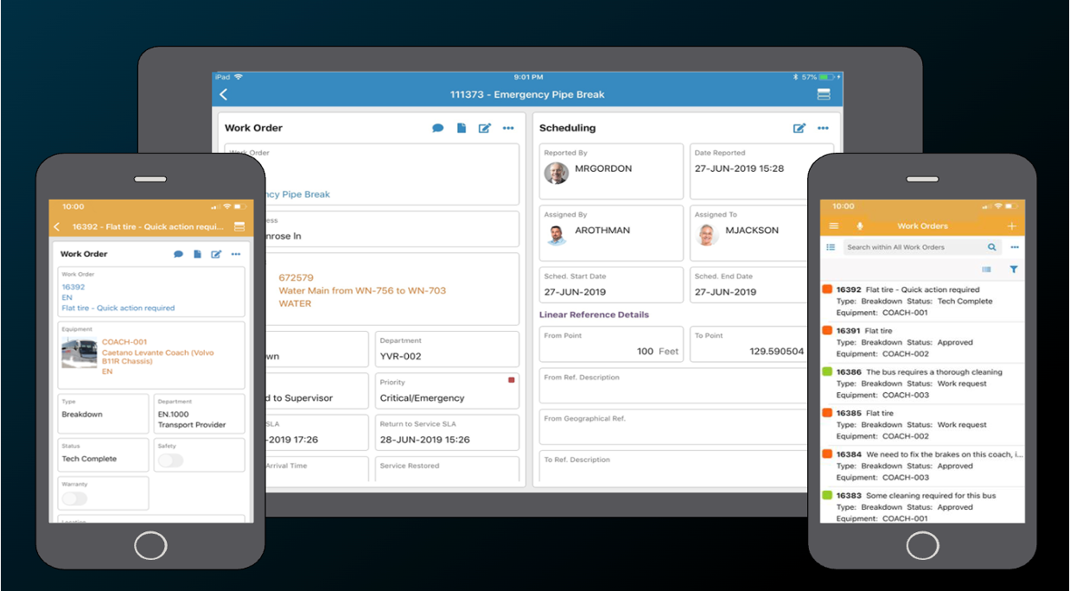
Hexagon EAM’s Role (What “System of Record” Means Here)
Hexagon EAM should be the authoritative record for:
assets and hierarchy
job plans / PMs / inspections
work order history and costs
failure and cause coding
compliance evidence
materials and critical spares
The objective: standardization, traceability, and decisions based on reality.
“Software doesn’t create discipline—but it can enforce it and make it visible.”

Slide 16
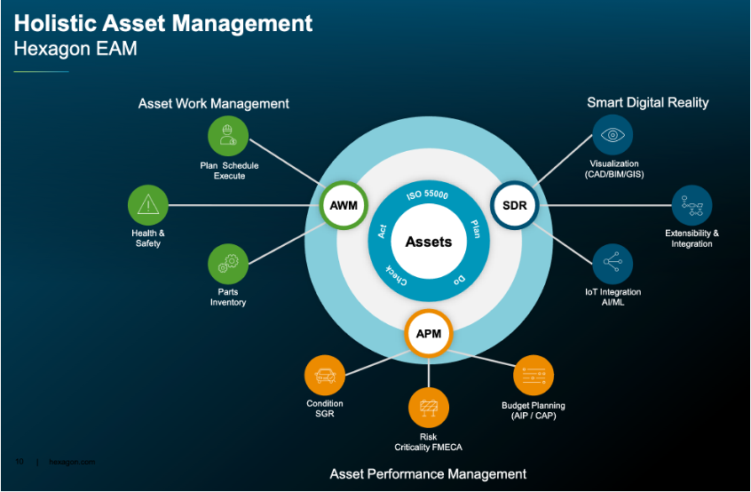
Minimum Viable Data Model
Asset attributes that matter:
redundancy group / system path
upstream/downstream dependency notes
criticality rating
warranty + vendor/service contract linkage
Work order fields that matter:
priority + risk category
planned steps / MOP reference
permits/LOTO indicators
test/verification results
downtime/redundancy impact flag
Failure data:
standardized problem/cause/remedy codes for trend analysis
“Data quality is a leadership expectation, not a side project”

Slide 17

Risk Reduction Use Cases (Powered by Hexagon EAM Data)
Critical PM deferral risk:
show deferrals by redundancy group, required approvals, and cumulative exposure
Repeat failure elimination:
identify chronic assets (same UPS/breaker/CRAH repeatedly) and drive permanent fixes
Compliance evidence on demand:
inspection history, test results, certification records, calibration logs
Critical spares risk:
stockouts, long lead times, consumption patterns tied to failure history
Vendor performance risk:
response time, completion quality, rework rate, cost variance
“We reduce risk by making it measurable, owned, and acted on”

Slide 18

Operational Excellence Use Cases (Availability + Efficiency)
Shift-left from reactive to planned work:
increase planned %, decrease emergency changes
Reliability improvement targeting:
focus on the small set of assets driving most incidents and near misses
Better maintenance windows:
fewer overruns, better coordination, less customer anxiety
CAPEX justification:
replacements based on risk + lifecycle cost + incident history, not age alone
Performance transparency:
dashboards by site/system (electrical vs mechanical), by redundancy group, by vendor
“Excellence is repeatable outcomes—measured, managed, improved”

Slide 19

Governance + Operating Rhythm (The Non-Negotiables)
Define owners for:
asset master data
PM library / job plans / procedures
priority model and triage rules
reporting and KPI review cadence
Operating rhythm:
daily triage + event review
weekly scheduling + readiness for windows
monthly reliability review (bad actors, PM effectiveness, repeat incidents)
quarterly risk/capex review (critical asset condition + exposure)
“If the standards aren’t owned, the operation will drift—and drift creates outages”

Slide 20

A Practical Roadmap (How You Implement Without Disrupting Ops
Phase 1: Stabilize
triage/priority definitions, backlog visibility, critical asset identification, closeout standards
Phase 2: Standardize
asset hierarchy cleanup, PM/job plan standardization, planning/scheduling cadence, inspections structure
Phase 3: Optimize
reliability initiatives (targeted RCA), spares optimization, risk dashboards, capital planning integration
“We build momentum with measurable wins—without betting uptime on a big-bang change”

Slide 21

The Backbone Promise
Less risk: fewer loss-of-redundancy events, fewer major incidents, stronger audit posture
More reliability: higher planned work, better schedule compliance, fewer repeats
More control: defensible decisions on spares, vendors, and capital timing
Final message: Foundations first. Hexagon EAM as the enabler. Operational excellence as the outcome.
“When the backbone is strong, uptime stops being a slogan and becomes a managed result”

Slide 22

Questions

