Slide 1

CERN EAM Light 5.0:
Listen better to the assets
Péter JURCSÓ
Application Engineer – Business System Analyst
Geneva - Switzerland

Slide 2

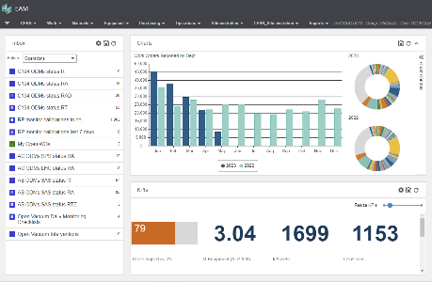
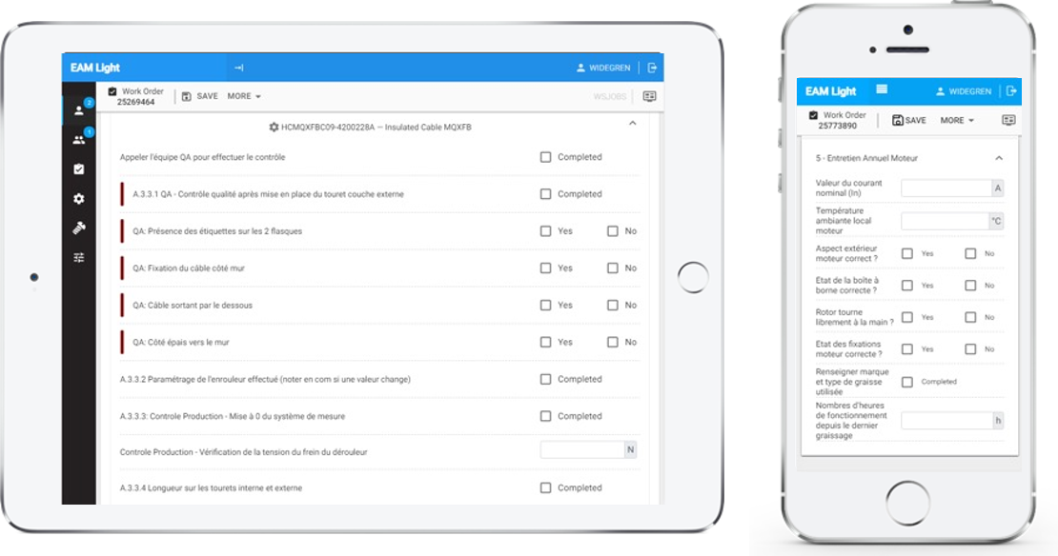
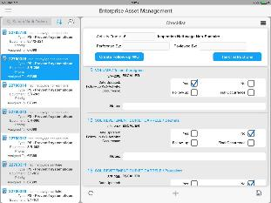
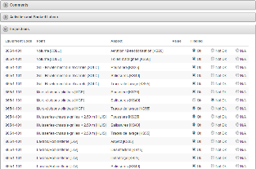
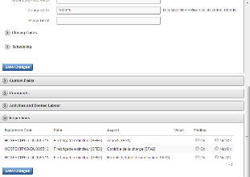
Different profiles – Different needs
HxGN EAM
Full / Expert Web Interface
HxGN EAM Mobile apps
Offline/Online Mobile Application
EAM Light
Simplified / Limited Web Interface
  “One size fits all” does not work for users with significantly different needs
  Simple, configurable and task-targeted user interfaces increase overall efficiency

Slide 3

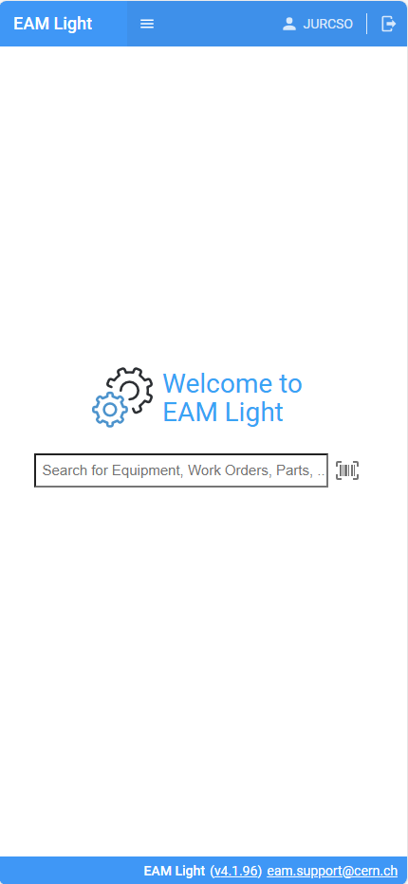
The need for EAM Light
HxGN EAM is a great application packed with functionality and industry best practice
Not all users need all that functionality,
especially not all the time
A web application that provides
a limited sub-set of the most used functions
The purpose is to provide a simple and intuitive tool that can be used
  with little or no training and
  without on device deployment

Slide 4
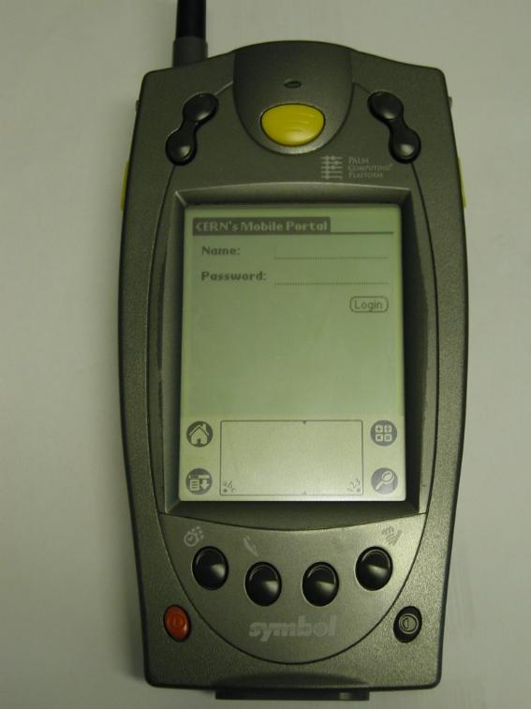
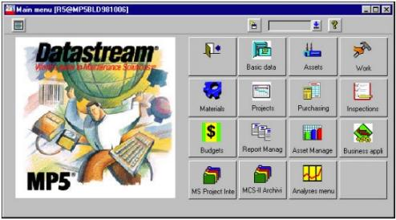
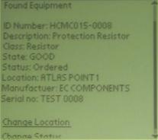
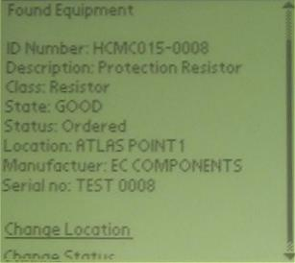

2001 The beginning: WAP
First CERN EAM mobile interface for field workers
API connection to MP5
Operating on Palm Pilot based device
Integrated barcode reader
GSM data and Wi-Fi connection

Slide 5
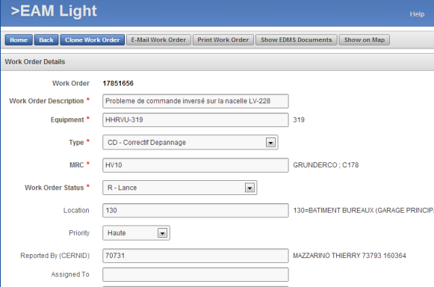
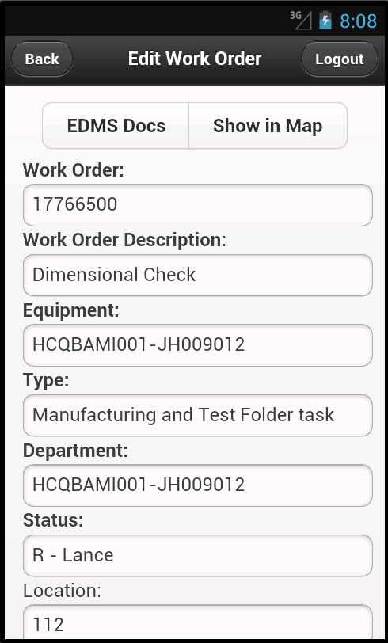
2011 Web based EAM Light
Increasing number
of users
Possibility to use the
same functionality
on different devices
Simple and intuitive
tool for the most used
functions
No installation necessary

Slide 6
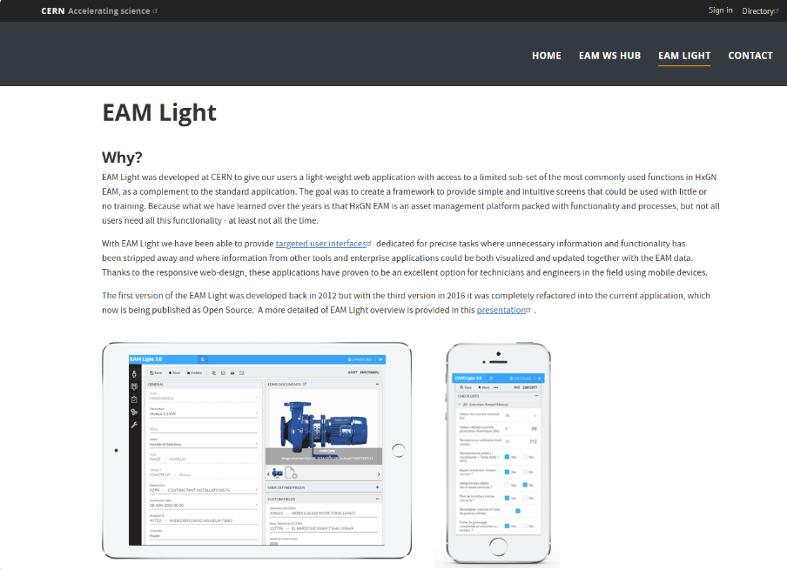

2019 EAM Light Opensource version presented

Slide 7



Typical user profiles
Field workers
Assigned work orders
Team leaders
Departmental work orders
Equipment owners
Work orders and equipment

Slide 8

Field worker
Completion of assigned work orders
  Recording part usage
  Updating meter readings
  Booking hours and dates
  Completing checklist
  Adding documents and photos
Getting information on surrounding
  Unified search barcode QR code scanning

Slide 9

Team leaders
Overview of departmental work orders
especially in case of outsourced work
Assigning work
Updating activities and tasks
Overview of spare part availability
Getting information on surrounding
  Unified search barcode QR code scanning

Slide 10

Equipment owners
Overview of equipment
Reviewing work history on equipment
Registering new equipment
Updating equipment structure and costing

Slide 11
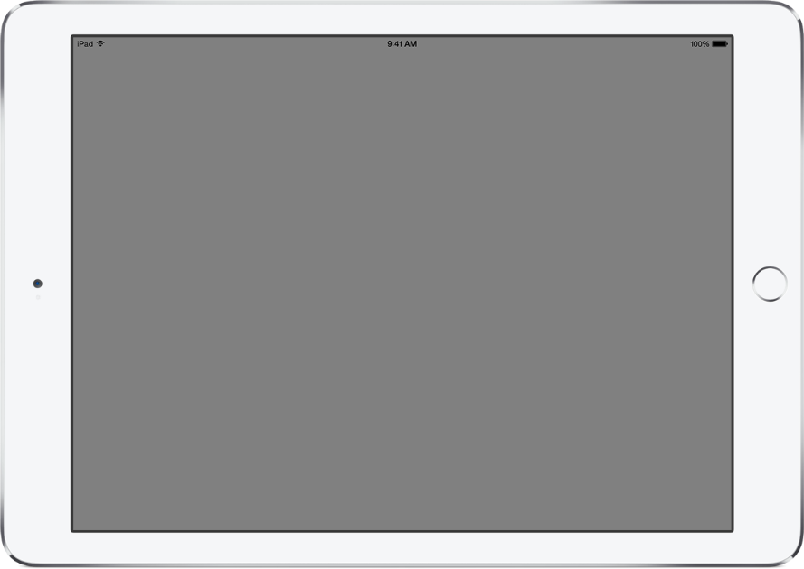
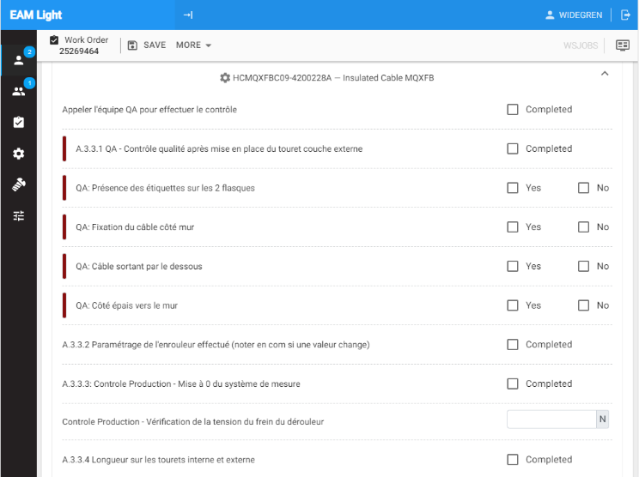
About EAM Light
EAM Light is an opensource complement to HxGN EAM
EAM Light lowers the initial effort to learn a new tool and has proven to also boost the usage of HxGN EAM
Experience shows that many users start with EAM Light’s functionality and continues with more advanced HxGN EAM functionality
An HxGN EAM Connector license, required to use the application, is part of the standard user license since 12.3
Allows developers and system integrators to focus on what they want to do. Not on the how.

Slide 12
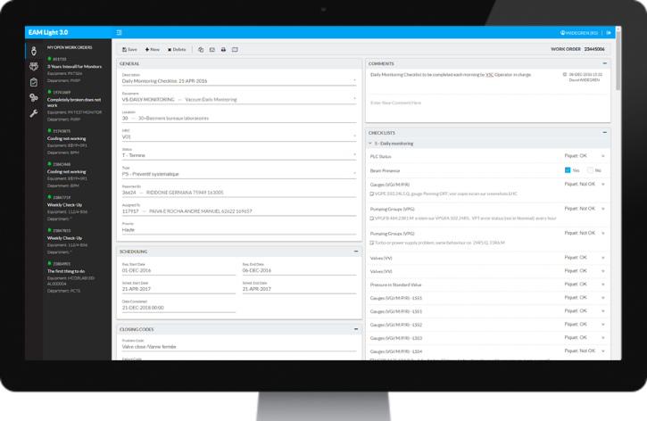
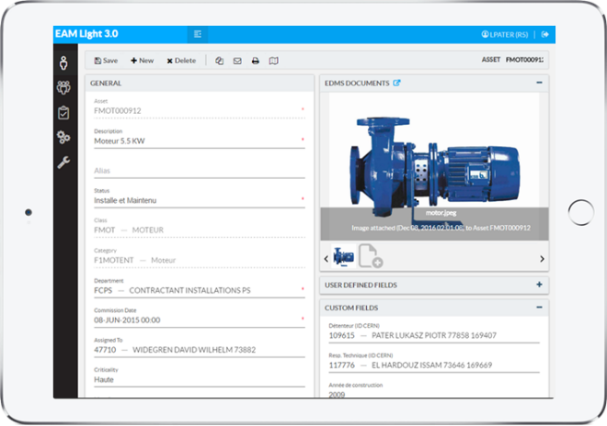
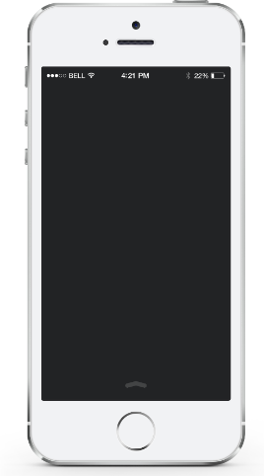
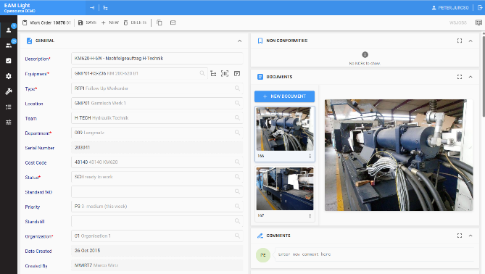
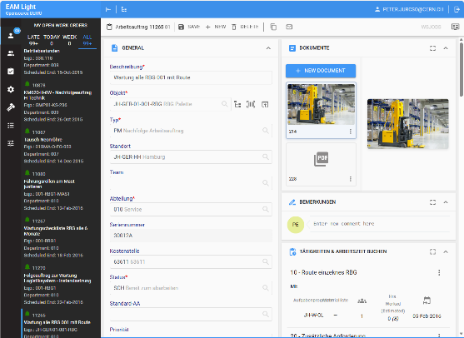
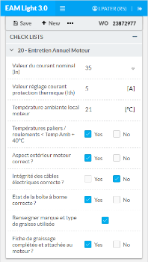
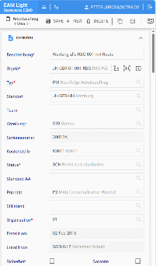
Available anywhere on any device
The responsive design makes EAM Light efficient to work with on any device with a web browser

Slide 13


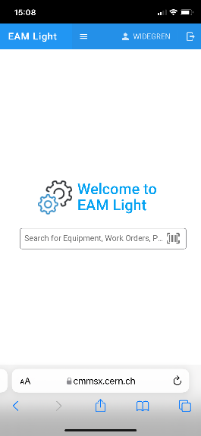
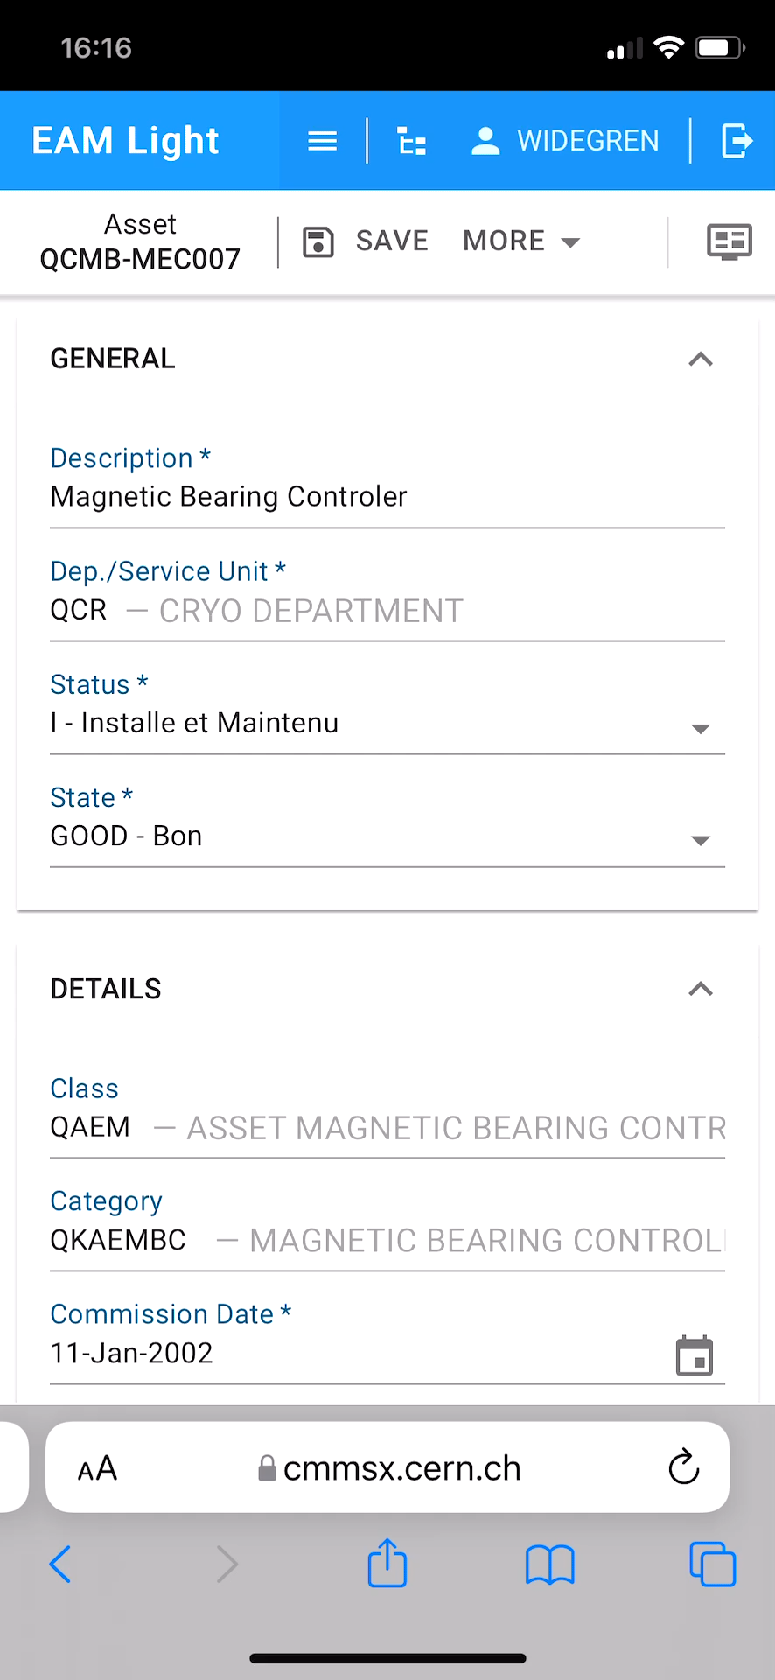
Intuitive to use: No or little training needed
Ideal for simple tasks such as looking up an Asset or Part in the field by scanning a barcode

Slide 14
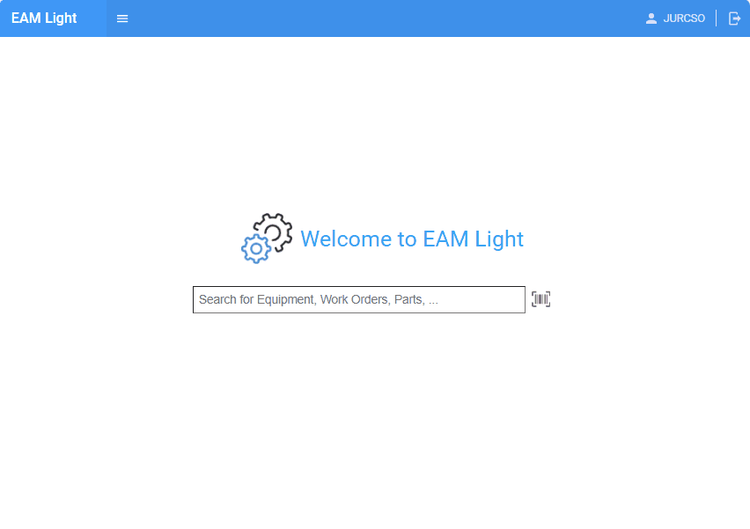
Quick Search
A single Google-like search for Equipment, Parts and Work Orders
  The barcode scanning functionality is integrated
No need to know the equipment type in advance
  The search results will automatically bring the user to the corresponding Equipment (Asset, Position or System), Work order or Part screen
More advanced searches can be done in the corresponding grid

Slide 15
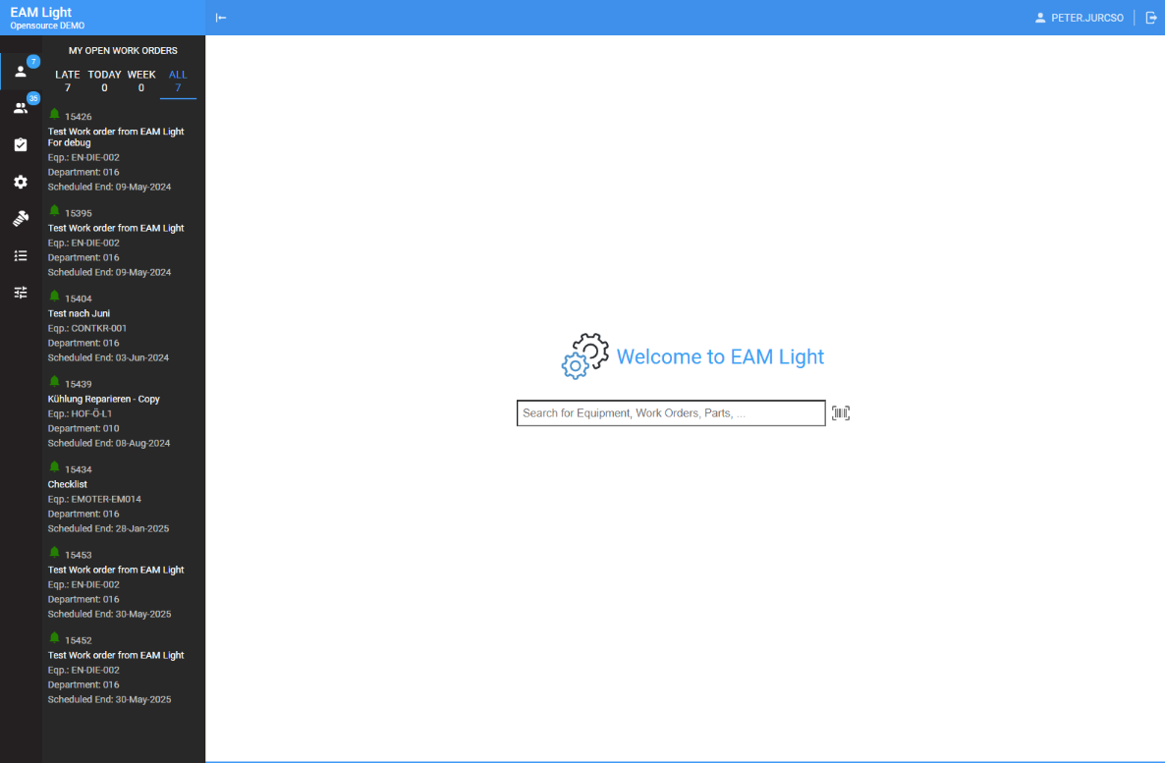
EAM Light: Menus
Open Work Orders assigned to me
Open Work Orders assigned to my Department(s)
Work Order menu
Equipment menu
Materials menu
Lists & Reports
Settings menu
Quick Search
(with barcode scanning option)

Slide 16
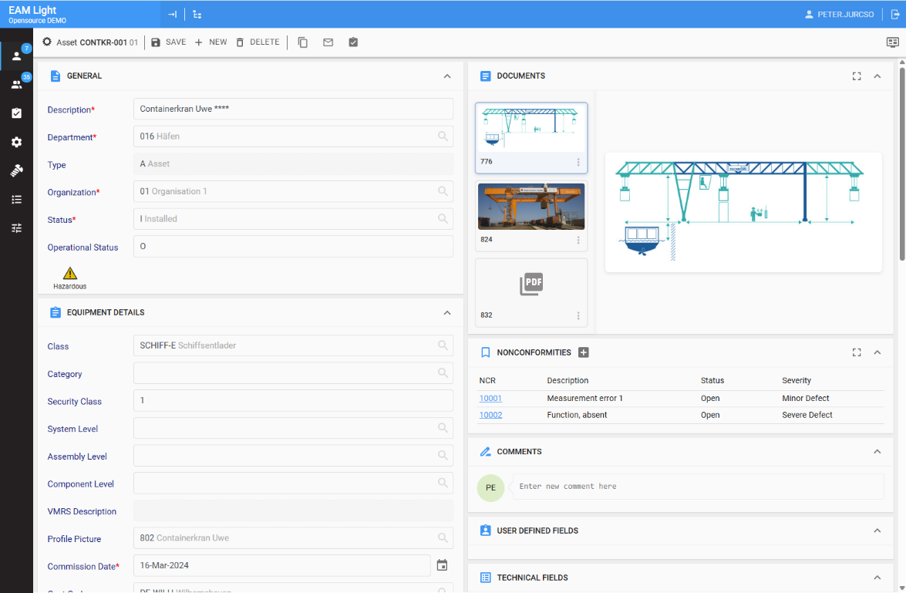


EAM Light Navigation
Copy/Clone
Send email link
Create new Work Order
Region configuration

Slide 17
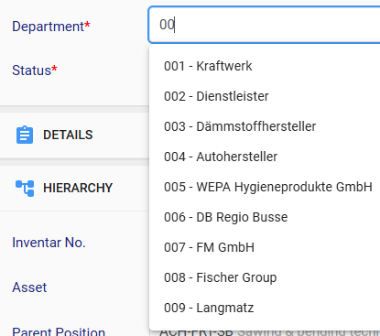
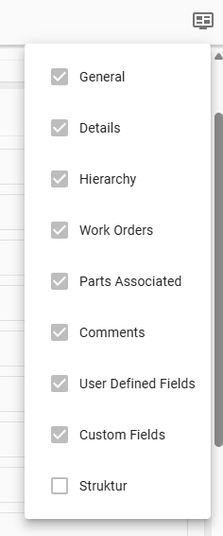
User interface
Record view fields are fully supported, including any layout change made using Screen Designer and clone screens
Autocomplete functionality wherever suitable
Responsive web design providing full functionality on different screen sizes
Barcode (1D, QR and Data Matrix) scanning functionality (for devices with camera) for all fields used for identification
Regions of the application can be temporarily maximized to better use of screen space

Slide 18
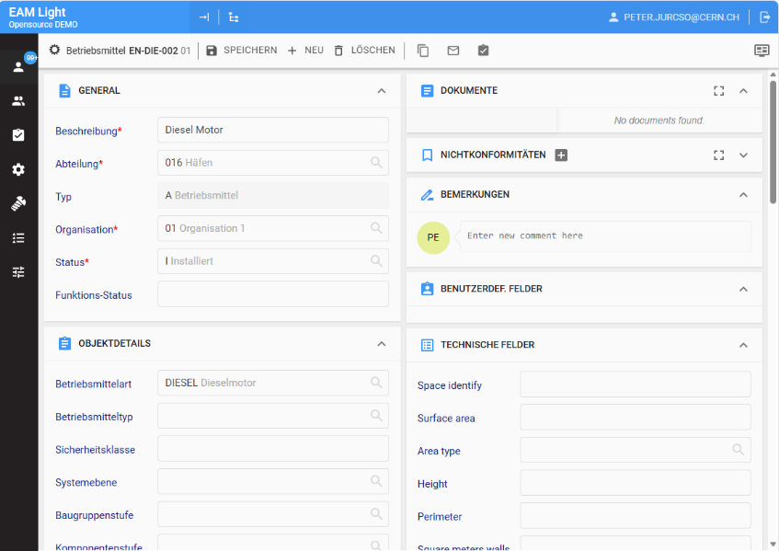
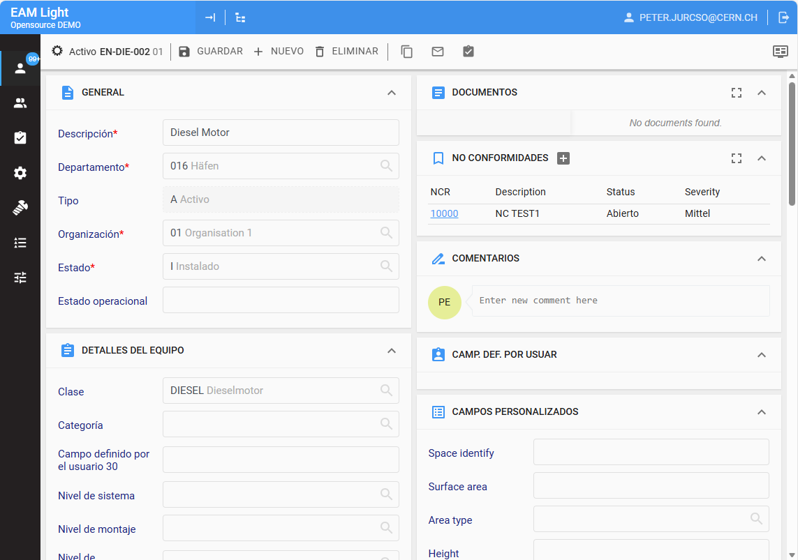
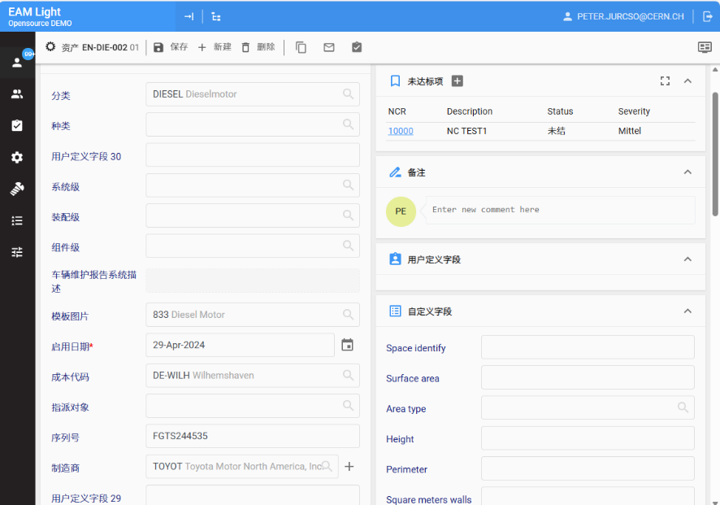
Localization support

Slide 19
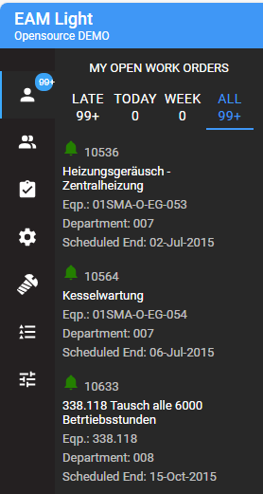
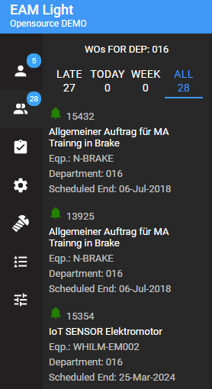
Navigation
Quick access to important Work Orders including scheduling information, based on standard Datapsy:
My work
the open work orders assigned to the user
My Team’s work
the open work orders of one or multiple department
Direct links could be copied and shared
Notes:
Based on Dataspy

Slide 20
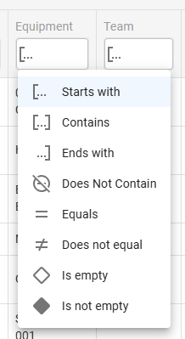
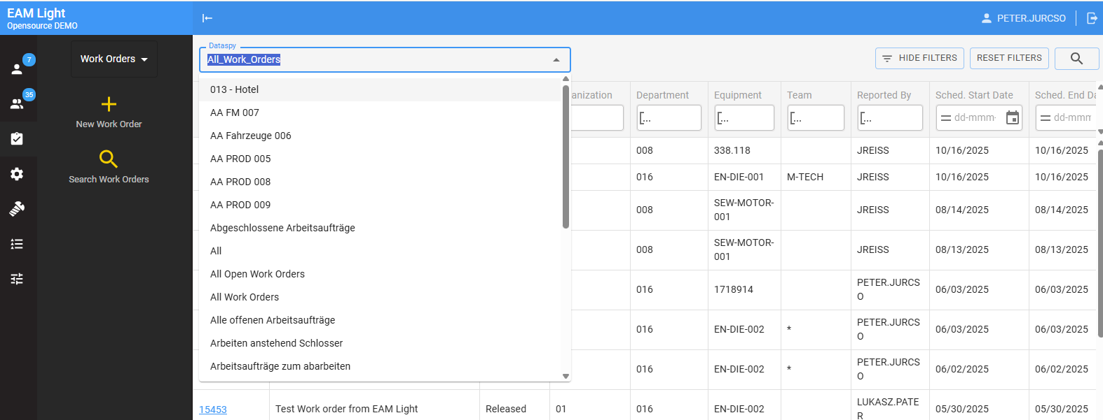
Grid search
Including dataspies and column filters for
Work Orders
Assets
Positions
Systems
NCRs
Locations
Parts
and User Defined Grids!

Slide 21
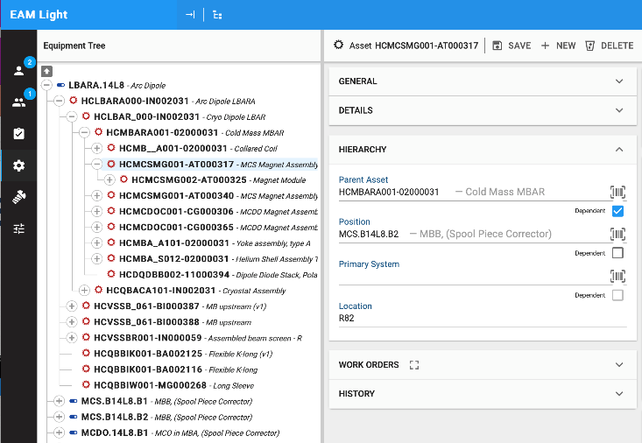

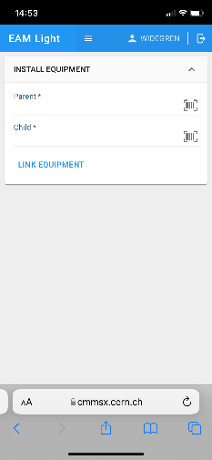
Easy navigation in structures
Equipment structures can easily be shown/hidden, created, updated and navigated in
Dedicated screens have also been created for equipment installation and replacements, using the smartphone camera for barcode scanning

Slide 22
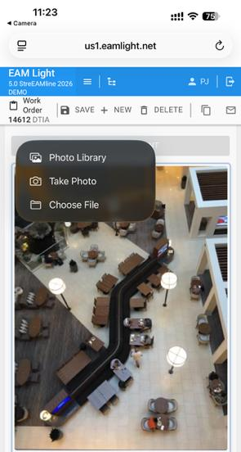
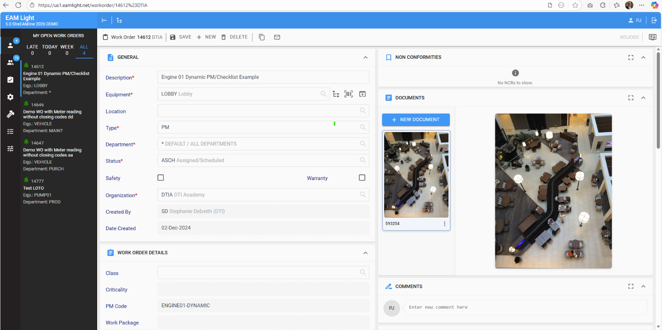
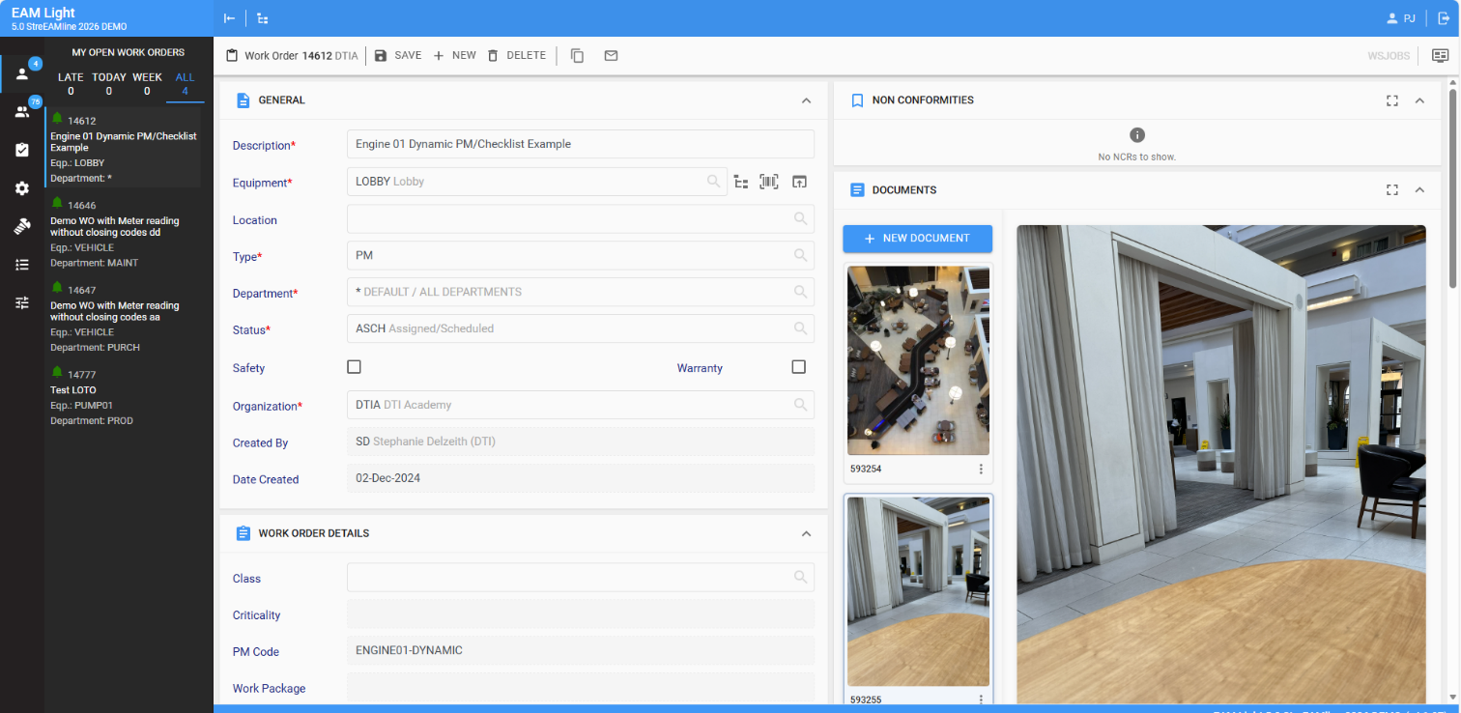
Document management

Slide 23
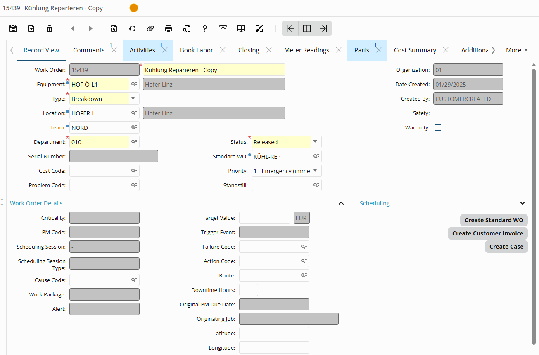
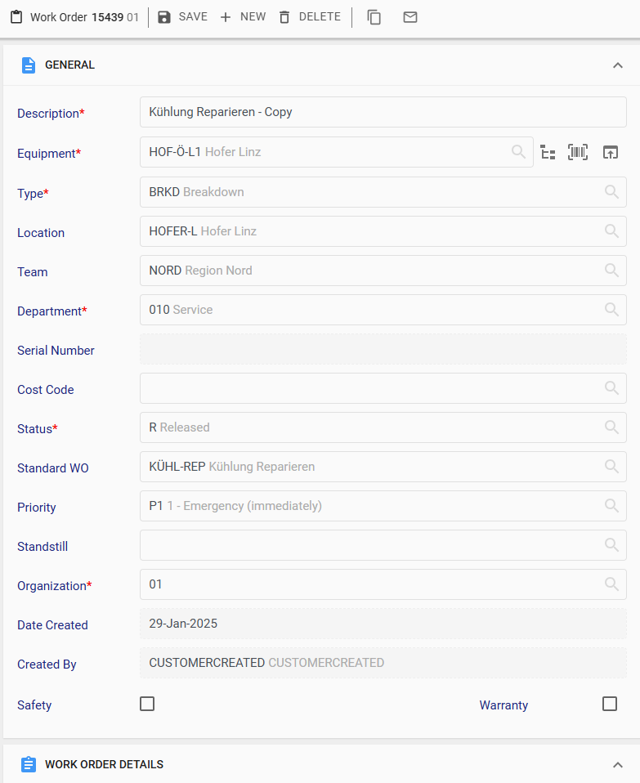
Work Order screen layout comparison

Slide 24
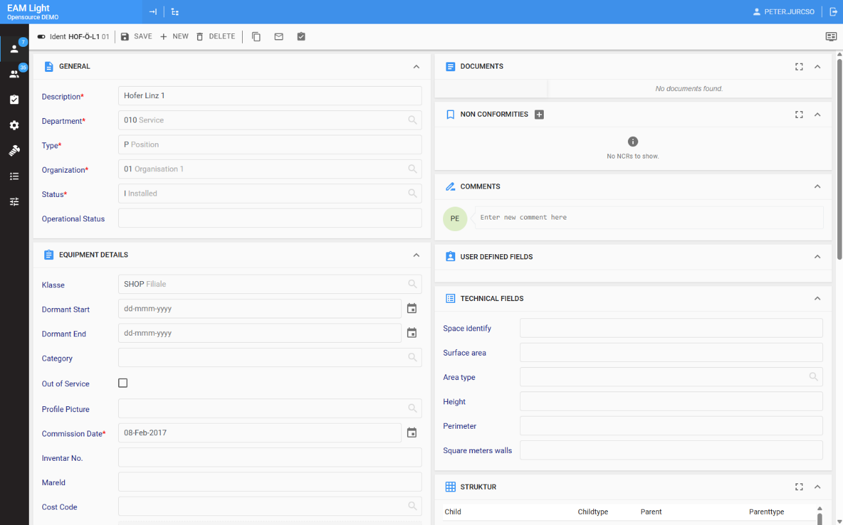
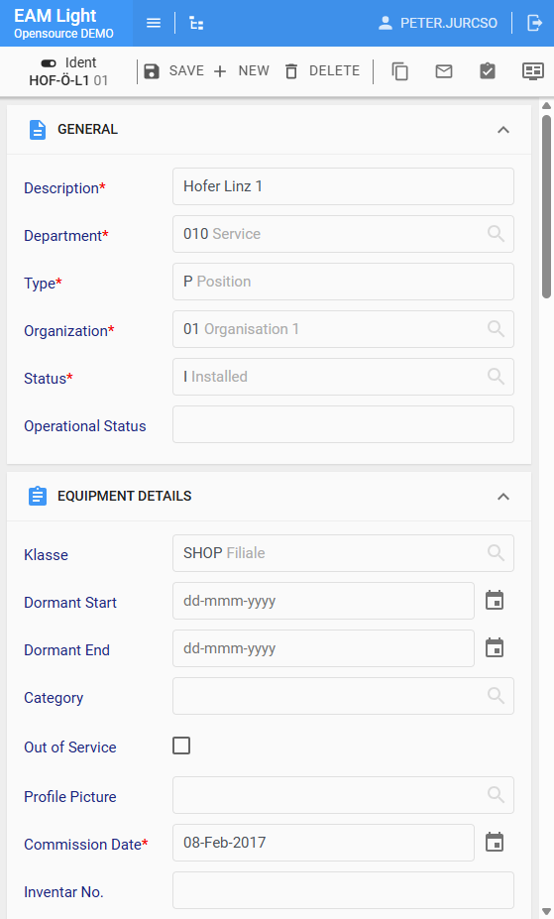
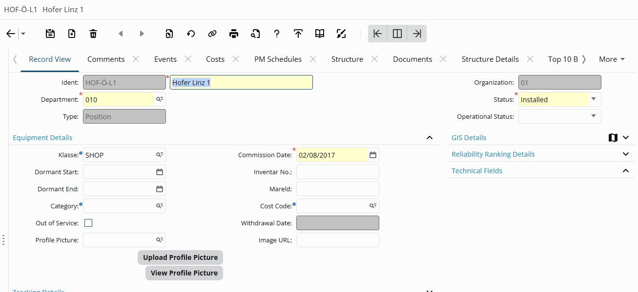
Positions

Slide 25
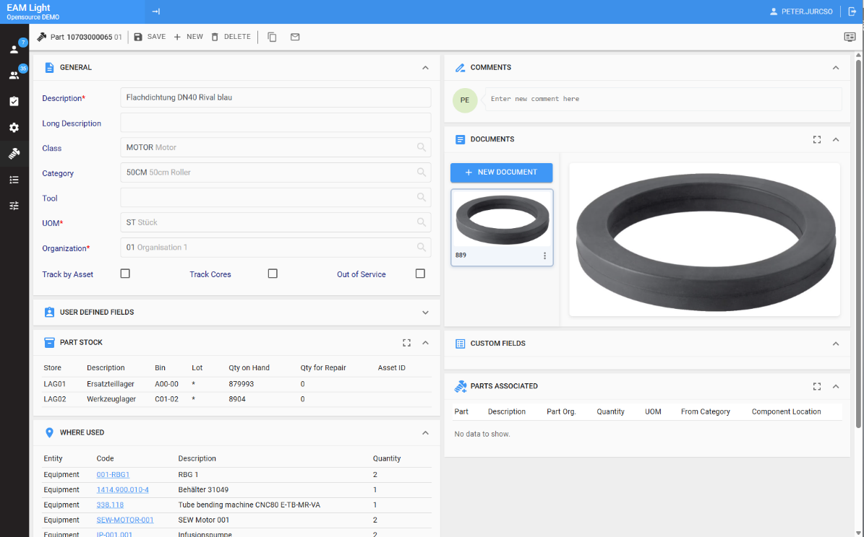
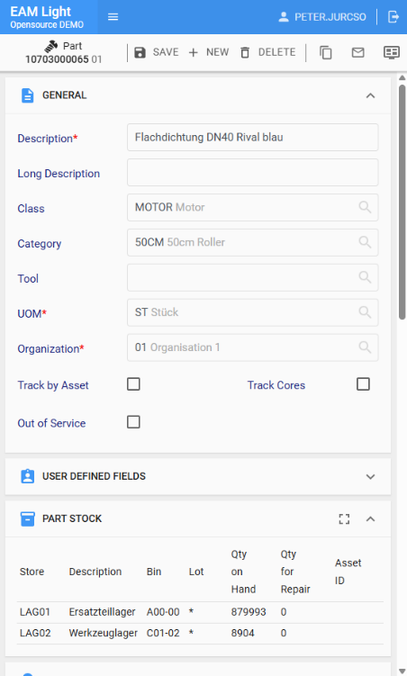
Parts with stock and usage details

Slide 26
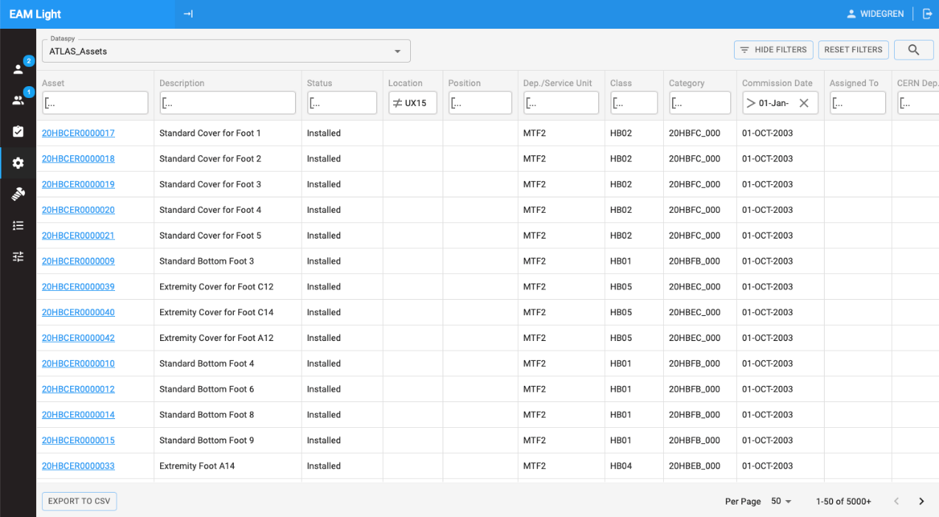
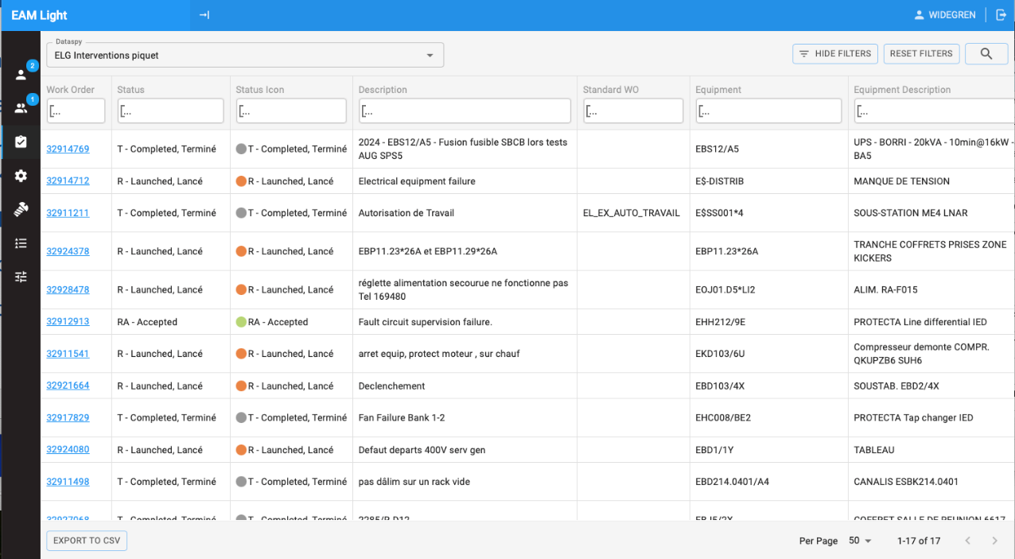
Grids with Dataspies

Slide 27


Checklists
All types of checklist items supported,
including dynamic checklist
Possibility to enter notes and to create follow-up work orders
Checklists items grouped by activities and/or equipment (for route work orders)
Supporting e-signatures for formal processes
Can be used both in landscape and portrait mode
Entered results are automatically pushed to server to avoid data loss – especially important for long checklists

Slide 28




EAM Light Checklists on tablets: Easier than paper!

Slide 29


Part usage

Slide 30


Easy to capture WO conversations
Quick overview of already entered comments.
  When and by whom
Easy to add new comments.
Simple to email WO link to colleagues for information or to request more details.

Slide 31




Example use case:
Meter readings:
By scanning Meter code or
By scanning Equipment identifier

Slide 32

Example use case:
Accessing Part information:
Available quantity in stock
Technical information

Slide 33

Easy configuration
Leveraging the power of Screen Designer functionality in HxGN EAM!
  Text labels can be changed.
  Required / Protected / Hidden options supported.
  Default values available.
  Possible to hide whole regions
As EAM Light supports cloned screens, this open even more possibilities
To use it only two User Defined Grids are required

Slide 34
Reminder
CERN provides absolutely no warranty of any kind with respect to this software. The entire risk as to the quality and performance of this is with the user. In no event will be CERN liable to anyone for any damages arising out the use of this software, including, without limitation, damages resulting from lost data or lost profits, or for any special, incidental or consequential damages.
EAM Light is published under the GNU General Public License v3.0 or later

Slide 35
How to install the software?
EAM Light can be installed on any server operating system supporting Docker
The application also supports both On-Premise and SaaS/Cloud installations of HxGN EAM and is agnostic of database used (SQL Server or Oracle).
EAM Light is available as pre-compiled single Docker image: https://hub.docker.com/r/cerneam/eam-light
To start:
To modify the software, you need to download the Java source code and compile it yourself from
https://github.com/cern-eam
docker run -p 8080:80 -p 9090:9090 –e EAMLIGHT_INFOR_WS_URL=https://[Server URL]/axis/services/EWSConnector
cerneam/eam-light:latest

Slide 36
Required: Supporting grids for each tenant
Page layout
Default page layout
Grid name: PULAYT
Description: Page Layout
From Clause: R5PAGELAYOUT
Select Clause: All fields
Where Clause: 1=1
Grid keys:
PLO_USERGROUP,
plo_elementid,
plo_pagename
Grid name: DULAYT
Description: Default Page Layout
From Clause: R5DEFAULTPAGELAYOUT
Select Clause: All fields
Where Clause: 1=1
Grid keys:
pld_elementid,
pld_pagename

Slide 37
Hexagon EAM Configuration for EAM Light
User Setup
  Hexagon Applications – Connector selected
  Default organization
  Default department
  Optionally additional departments as comma separated list in UDFCHAR10
Employee
  Employee is linked to the EAM user
Fields are required in the default dataspies if they are not yet present
  Work Order: Scheduled End Date, Department, Assigned to
  Work Order Activities Tab: Task plan

Slide 38


Listen to the assets!
Collect the highest quality data
Where is it produced
When is it happening
Directly by the contributors
As easily as possible
EAM Light helps
to listen better on the field!

Slide 39

Questions?

Slide 40



One more thing:
Experience your own EAM Light in 3 minutes
Ensure you are hosted on us1.eam.hxgnsmartcloud.com
(se1.eam.hxgnsmartcloud.com or eu1.eam.hxgnsmartcloud.com)
Navigate to https://eamlight.net/streamline
Follow the instructions to import or create the grids
Ensure Connector is selected and Organization is properly set for the user
Open https://us1.eamlight.net
or scan the QR code with your phone
https://eu1.eamlight.net/?organization=ORG&tenant=TENANT could be used

Slide 41
Required: Supporting grids for each tenant
Page layout
Default page layout
Grid name: PULAYT
Description: Page Layout
From Clause: R5PAGELAYOUT
Select Clause: All fields
Where Clause: 1=1
Grid keys:
PLO_USERGROUP,
plo_elementid,
plo_pagename
Grid name: DULAYT
Description: Default Page Layout
From Clause: R5DEFAULTPAGELAYOUT
Select Clause: All fields
Where Clause: 1=1
Grid keys:
pld_elementid,
pld_pagename

