Slide 1


Equipment Base Data: See the Forest and the Trees
Péter JURCSÓ
EAM Business Application Analyst
CERN, Switzerland

Slide 2
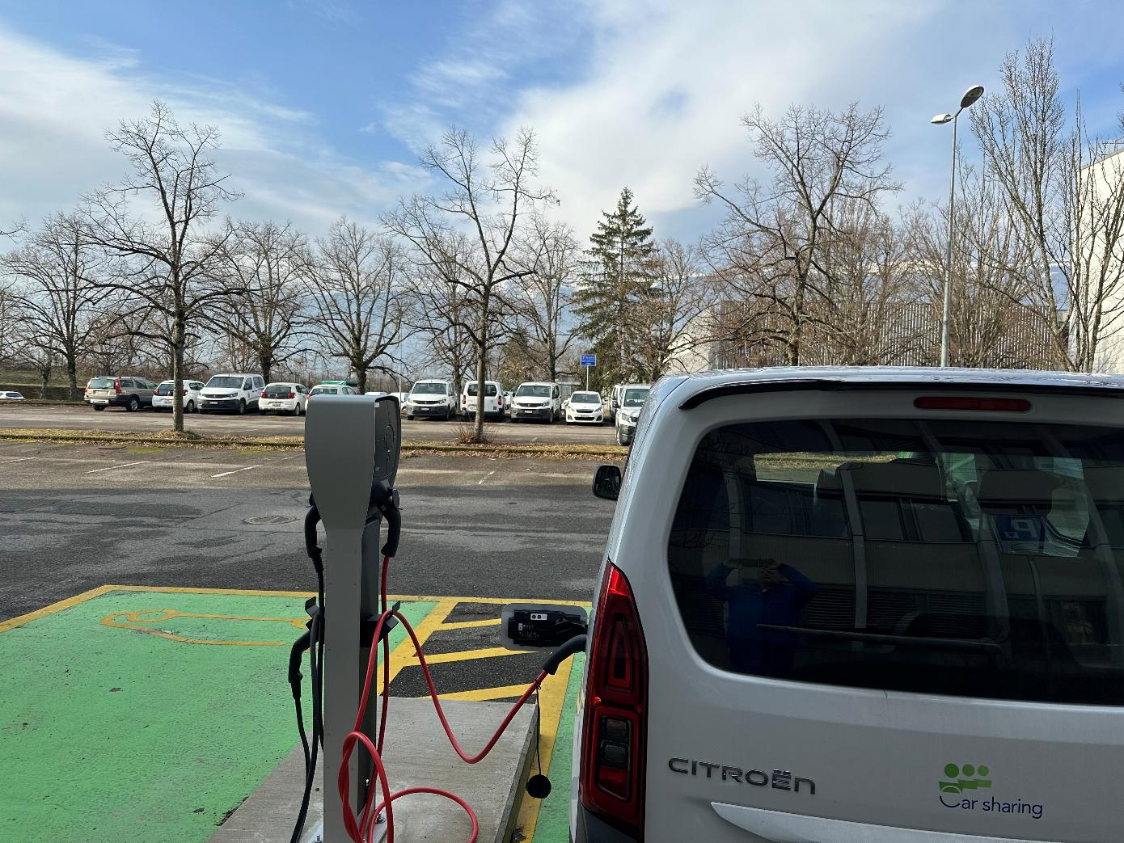
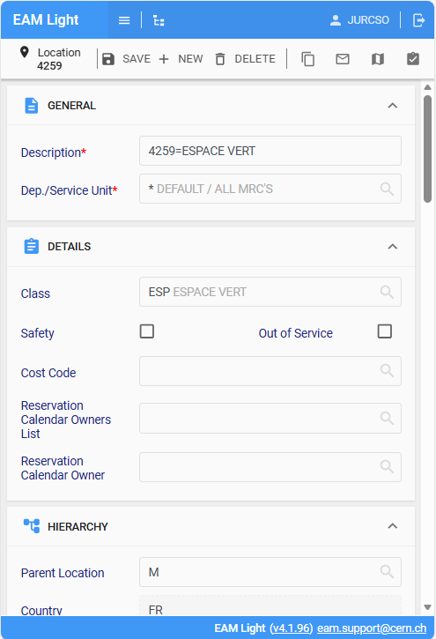
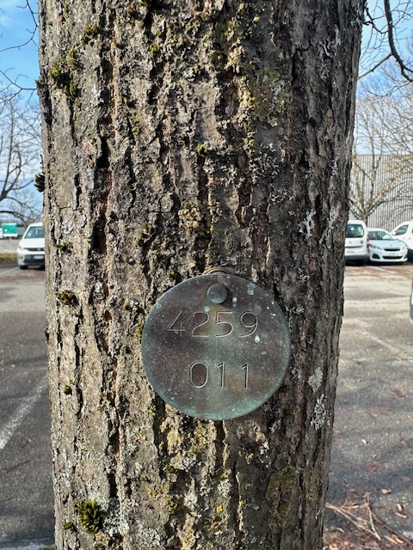
Notes:
Suddenly, something glinted on the tree trunk

Slide 3

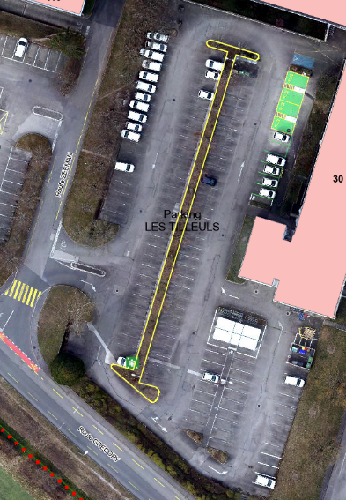
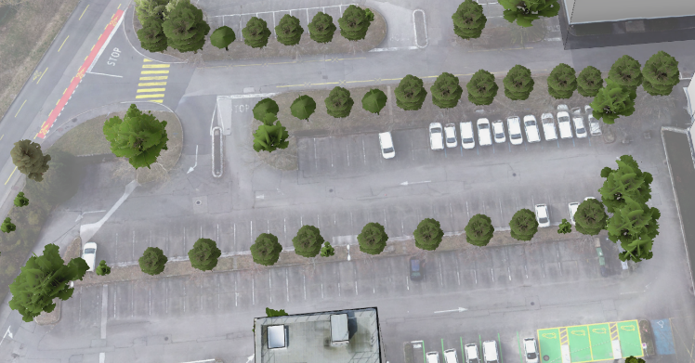
Every CERN parking is a forest
Named after the principal tree type
Every single tree is mapped

Slide 4
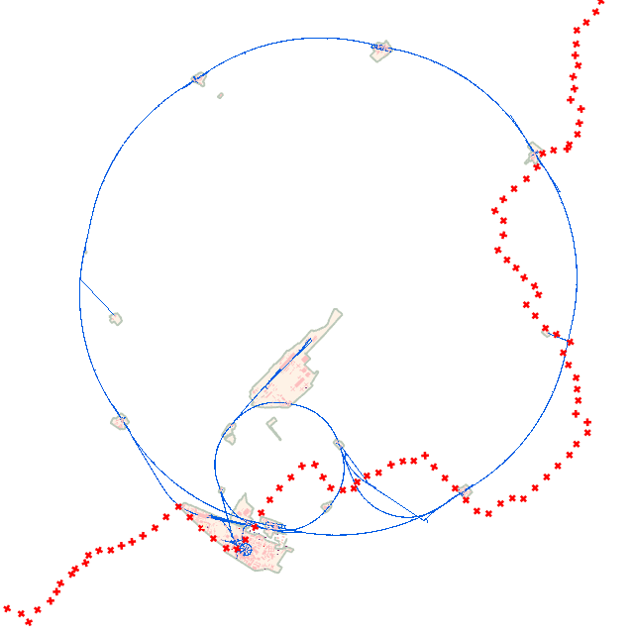
CERN Patrimony
In 2 countries: Switzerland and France
17 sites extend over 1600 acres including
670 buildings from 100 sq ft to 5 acres
45 miles of tunnels
18 miles of roads
60 miles of technical galleries
All registered in Hexagon EAM as equipment
Notes:
CERN welcomes over 8,000 people a day, being members of personnel, contractors and scientific users, as well as more than half a Million visitors a year.

Slide 5
The foundation of any EAM
Events
Equipment data
Knowledge

Slide 6
Equipment types
Position
Asset
System

Slide 7

Location, location, location?
Accelerate intervention
Facilitate planning
GIS integration
Not considered as a hierarchical element: a heritable attribute!

Slide 8
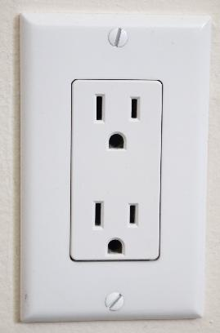
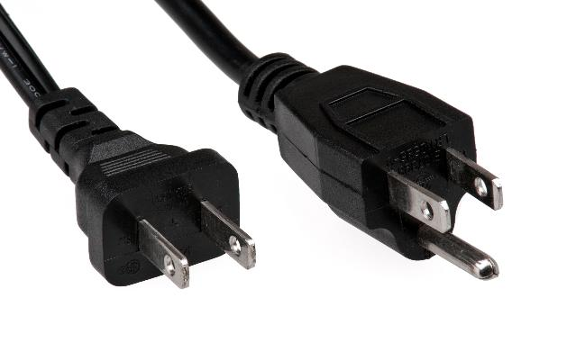
Position or asset?
Main functional position
Static
Functional position #1
Functional position #2
Asset #1
Asset #2
Dynamic

Slide 9
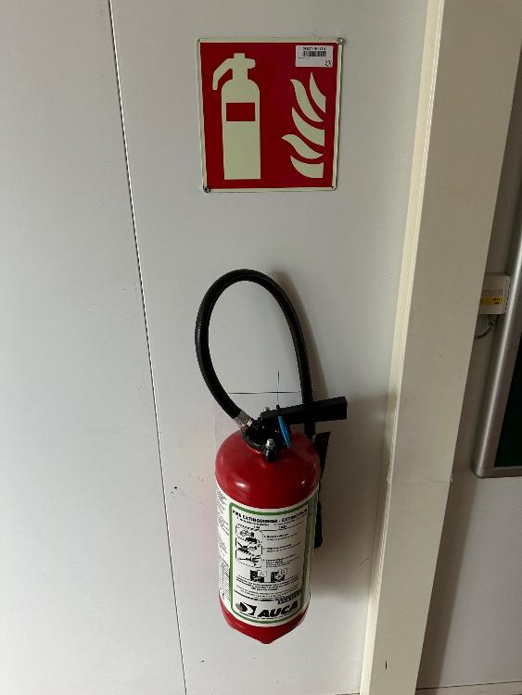
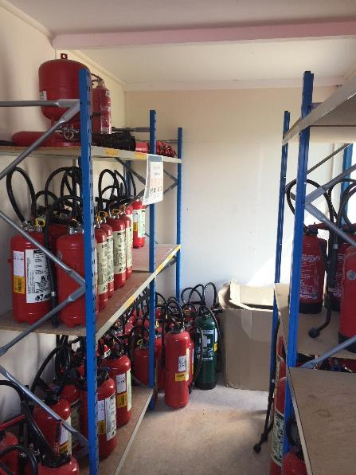
Position and asset: Fire extinguishers
Nearly 10 000, different types
Positions – The hook on the wall
Asset – Extinguisher
Verified, maintained yearly

Slide 10
From need to asset
Functional need at specific place
Design or supplier reference
Individual physical object
Functional position
Interchangeability reference
Part
Individual instance
Asset
Notes:
Functional need at specific place
Design or supplier references
Individual physical object
Functional position
Replaceability identification – Part
Individual instance – Asset

Slide 11
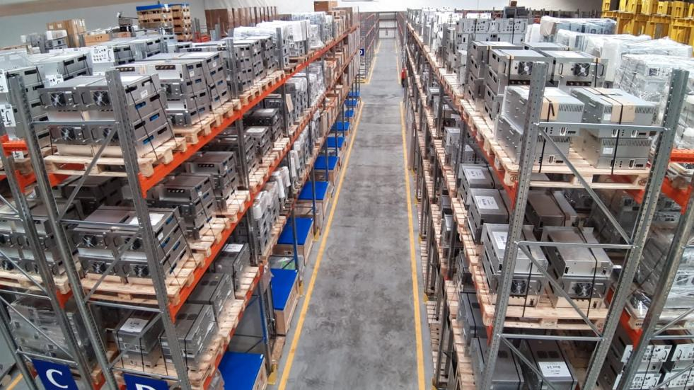
Part tracked by Asset? Part? Asset?
Assets can act a spare parts
Part reference
Mandatory for stock transactions
Replaceability indicator

Slide 12
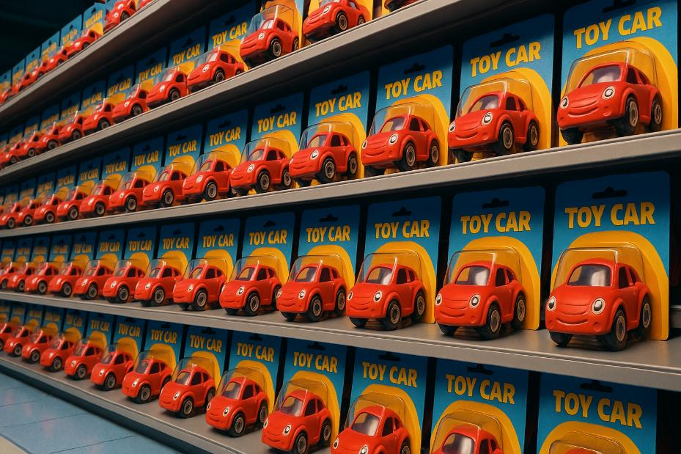
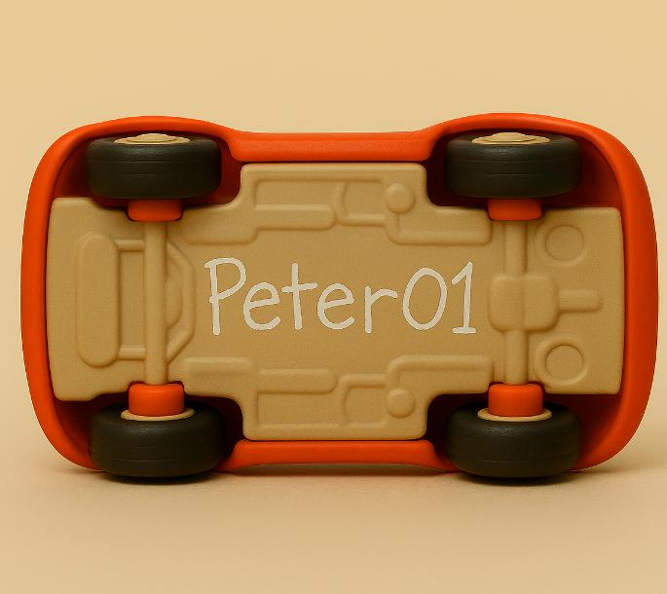
Naming: “How should I call you?”
Unique identification required
Notes:
The name is the promise to keep from fading

Slide 13
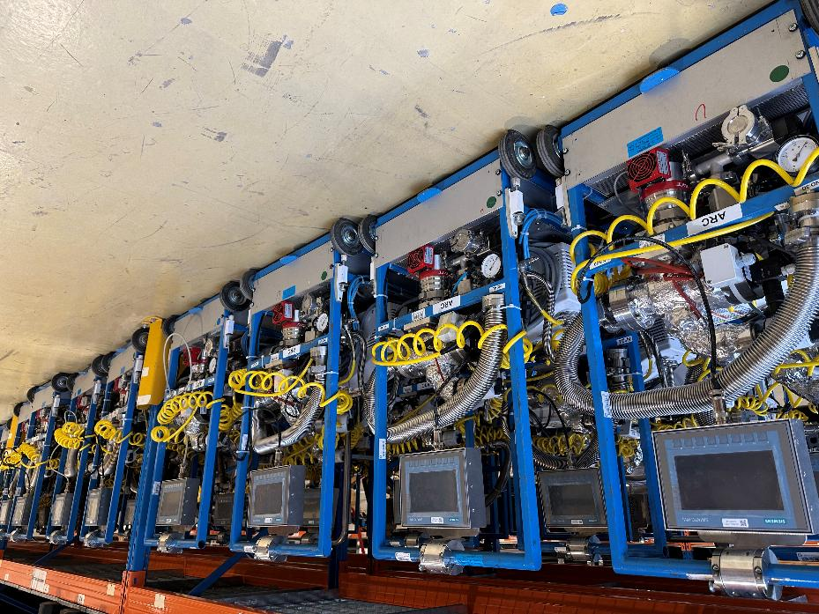
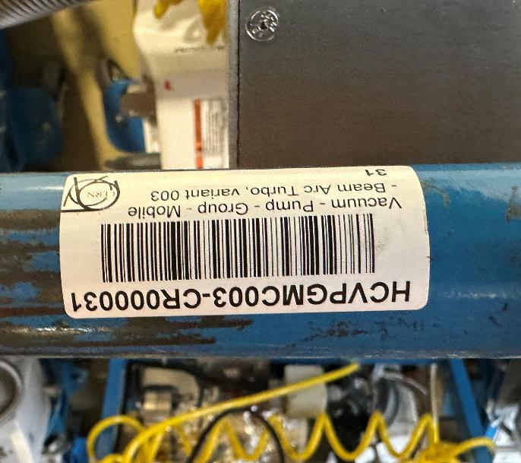
Naming: “How should I call you?”
Unique identification required
Notes:
The name is the promise to keep from fading

Slide 14
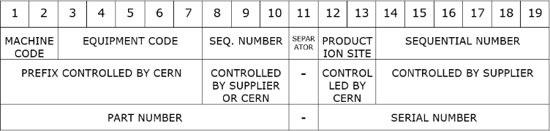

Naming convention to avoid the chaos
Agreement, Acceptance and Application
Could be an existing system
CERN NSN
CERN LHC Naming established in 1997
Notes:
A NATO Stock Number, or National Stock Number (NSN)

Slide 15
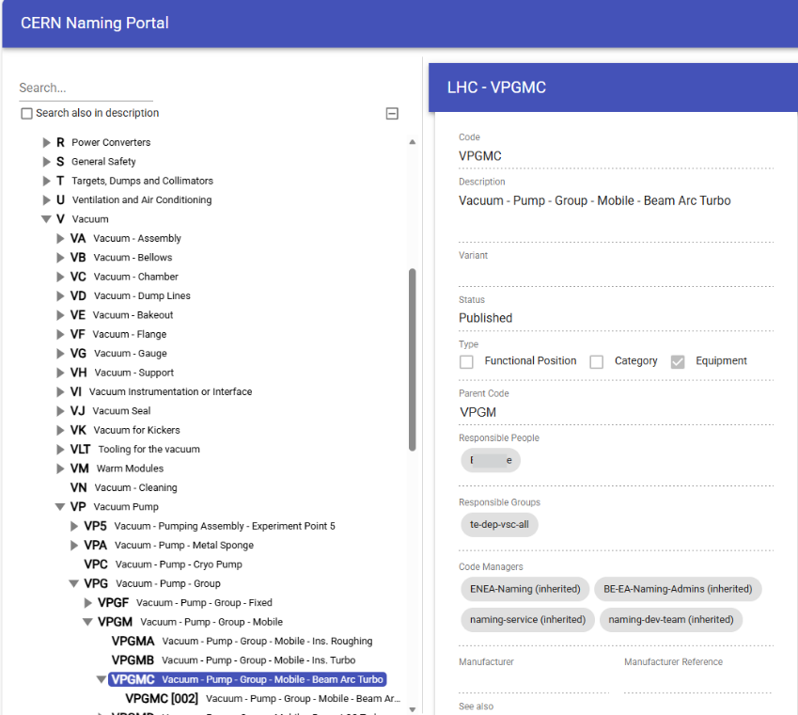

Naming convention to avoid the chaos
Notes:
A NATO Stock Number, or National Stock Number (NSN)

Slide 16
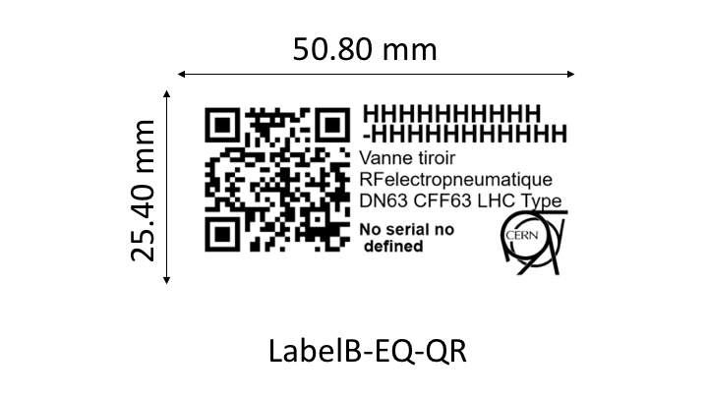
Visible equipment identification
Keep permanent and simple
Equipment code
Description
Manufacturer serial number
Use QR with Level H redundancy (30% restore)
Code only, no weblinks!
CERN Standard sizes: 1x2” and 2x4”

Slide 17

Data integrity using Department security
Full access
Read only
Hidden

Slide 18

Even stricter: Equipment revisions
For critical, regulatory controlled equipment

Slide 19

Commission date
Base of preventive maintenance Regulatory follow up

Slide 20
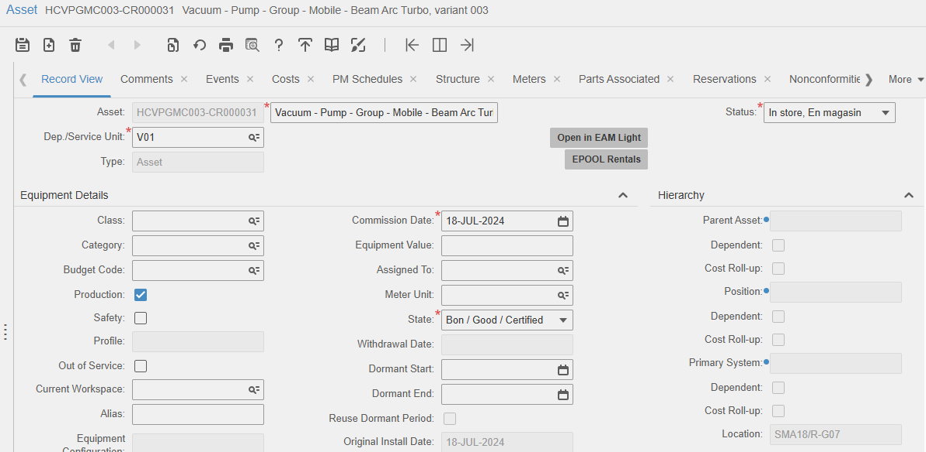
Minimum base data
Equipment code
Description
Status
State
Department
Commission date
Hierarchy: Location or parent

Slide 21
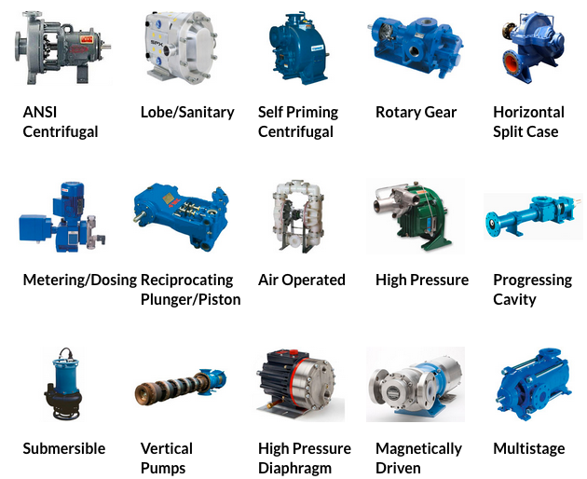
Classes and categories
Class for equipment with common properties
and custom fields
Category for
common activities
Invaluable for work organization

Slide 22
Closing codes: priceless
Failure mode separation is the basis of advanced reliability analysis
Problem code
Failure code
Cause code
Action code
General, equipment class or user group specific codes
Basis of Weibull analysis

Slide 23
Equipment structure
Keep it simple as possible
Cost roll-up not just for cost
Dependency is key
Instead of Equipment Structure tab use
Record view Parent fields
Child Equipment replacement or
Issue transactions
Equipment
System
Functional position #1
Functional position #2
Asset #1
Asset #2
Notes:
Create assets when they are really replaced and reinstalled somewhere else

Slide 24
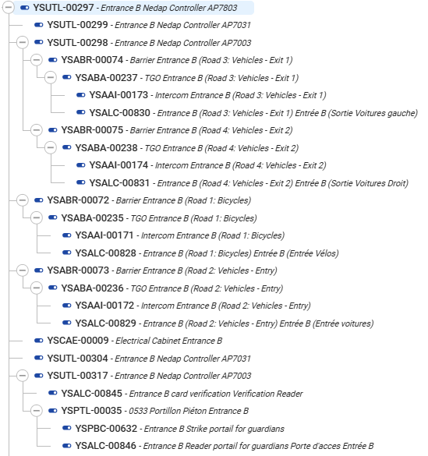
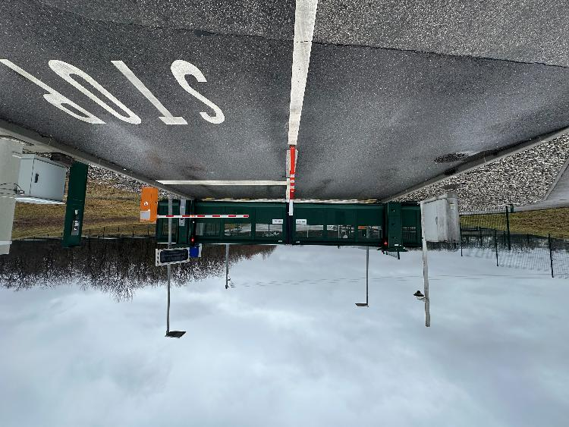
Position only: Access control
Notes:
17 sites

Slide 25
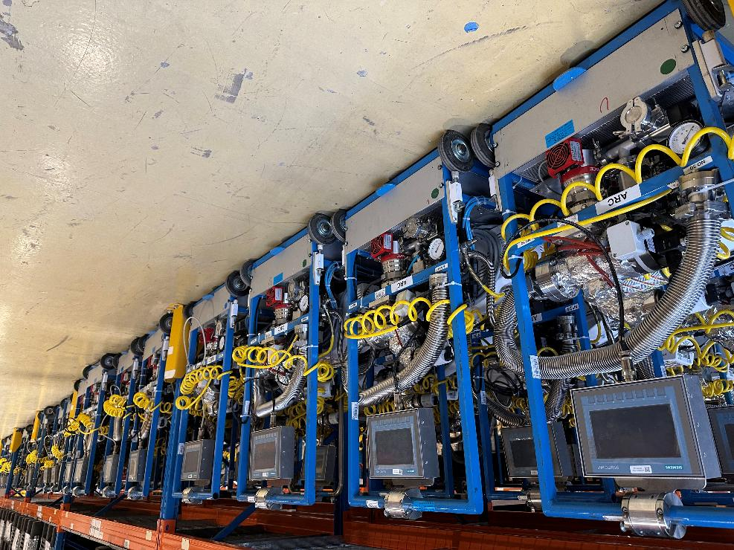
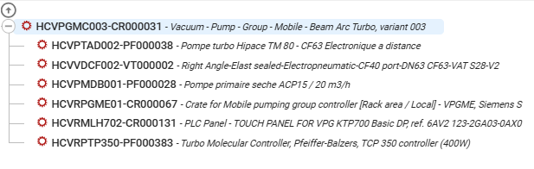
Asset only: Mobile vacuum pumps
Notes:
1.45 × 10⁻¹² psi 0, 0 0 0 0 0 0 0 0 0 0 0 1 PSI Empty as the interstellar space
250,000 welded joints and 18,000 vacuum seals. Total length of 30miles of pipes 0.5 million cubic feet pf volume

Slide 26
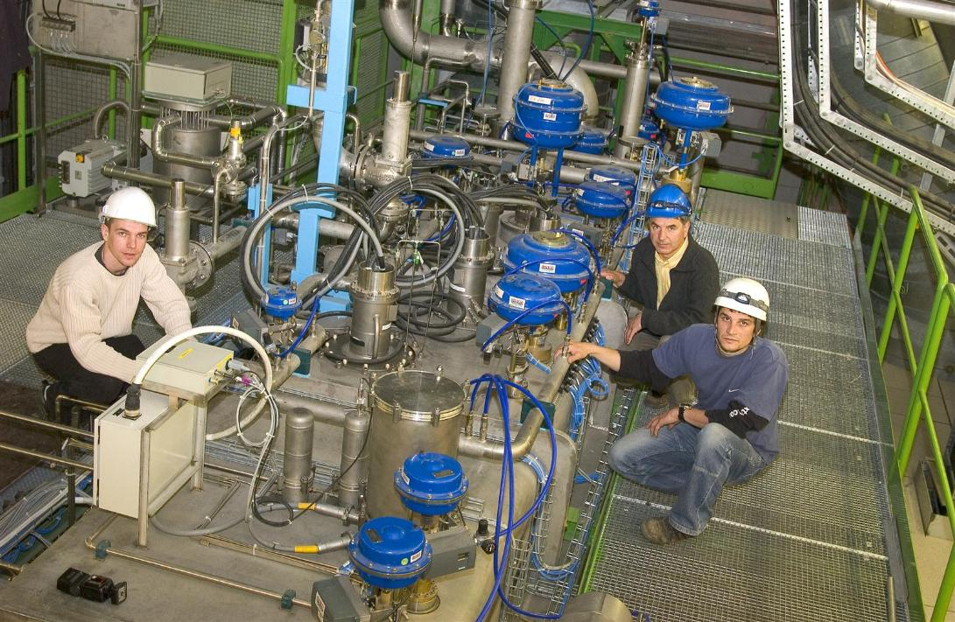
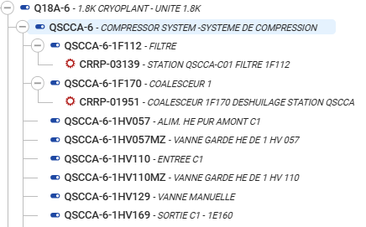
Position and asset: Cryoplant
Notes:
-456F (1.8K) operating temperature)
150 metric tons of Helium – about 35 000 000 cubic feet – 3 times the volume of the Madison Square Garden

Slide 27
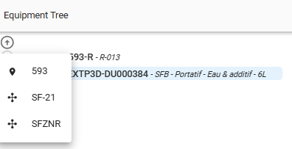
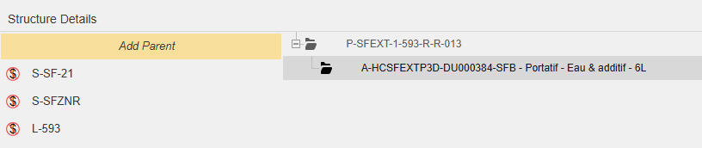
“All parent equipment are equal, but some are more equal than others”
What about the systems?
Secondary hierarchy
Systems vs Primary Systems

Slide 28
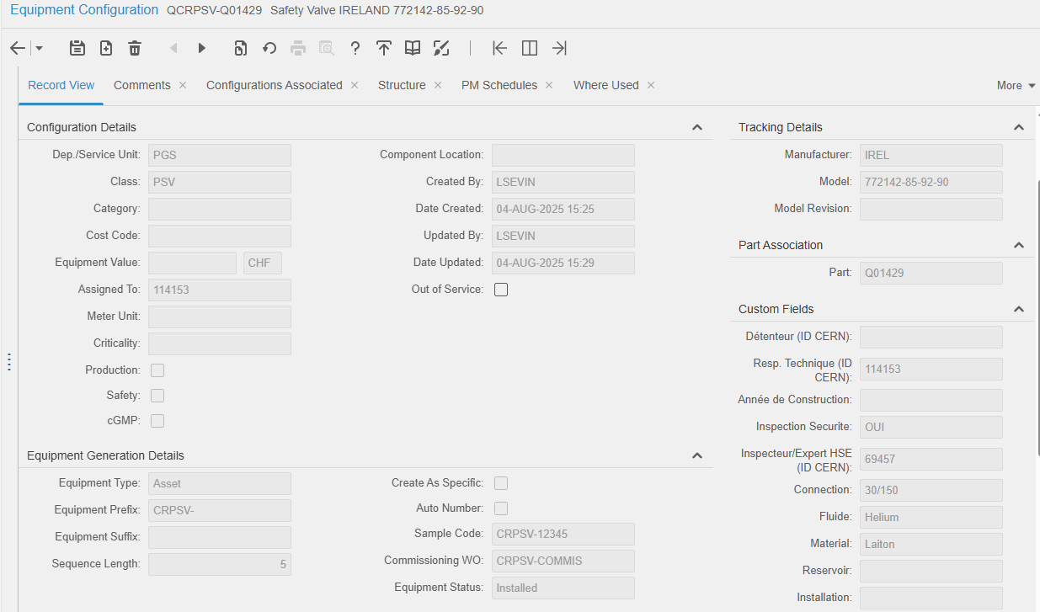
Equipment configuration Equipment generation
Have you ever seen an asset “appearing and operating”?
Extremely powerful functionality
Commissioning work order hierarchy
PM schedules
Warranties, hazards...

Slide 29

Meters
Whenever is possible, automate it
Update with every work order
Basic for usage based preventive maintenance plans
Additional analysis possibilities for time vs usage

Slide 30
Where to have the work orders?
Functional position
Asset
System
Location Cost rollup and dependency to see the complete picture
System
Functional position #1
Functional position #2
Asset #1
Asset #2

Slide 31

Routes to find your way

Slide 32
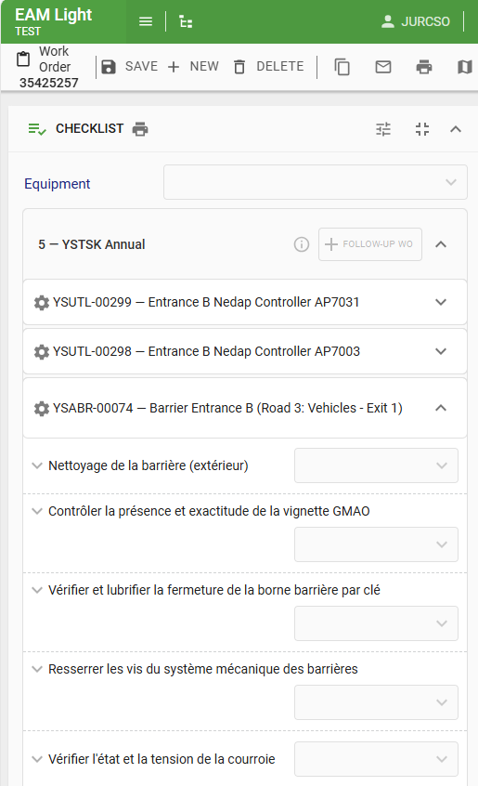
Checklists on routes
Single work order including many equipment:
Reduced administration
Guided the intervention:
Step by step instructions
Follow up of the unexpected

Slide 33
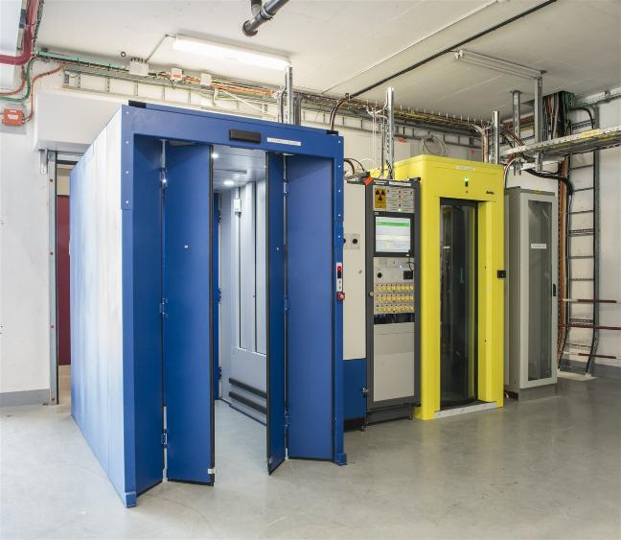
Site access control

Slide 34
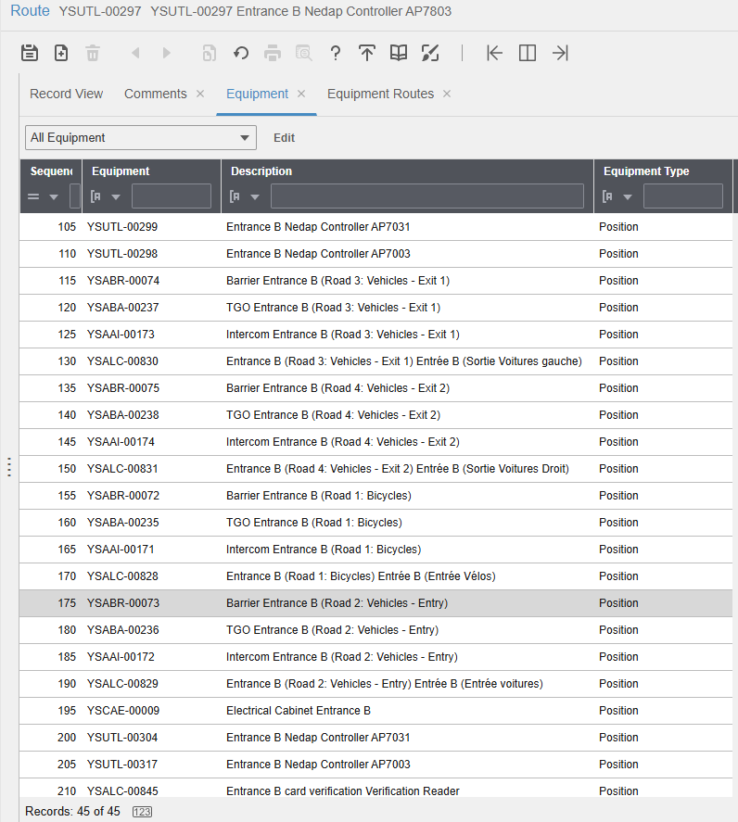
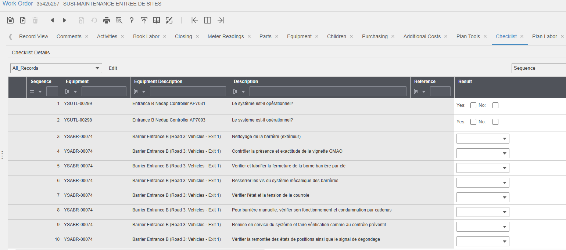
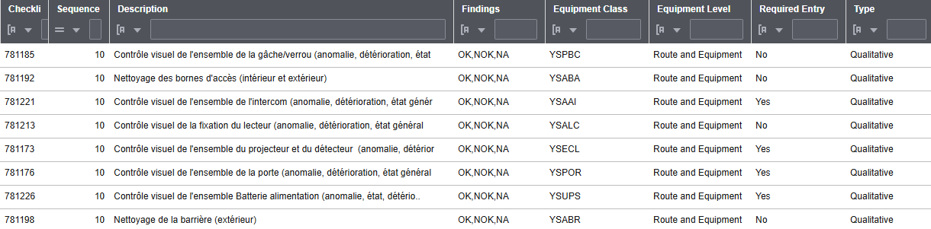
Route example
Route generated from equipment structure
Task plan checklist questions using class/category conditions
Single workorder

Slide 35
Quality base data
Provide training and explain why data is needed
Know the source: dedicated users with their own account
Collect the right data, only that what will be really used
Trust and respect but audit
Equipment base data defines the base quality of everything else!
Equipment configuration
Class, Category
Structure, Location, Route
Meters
Attributes
Department, Status, Commission date
Equipment type, Code, Description
Part code

Slide 36
Thank you!

