Slide 1
Condition Monitoring Secrets of High-Performing Plants
What Top Plants Do Differently — and How to Apply It

Slide 2





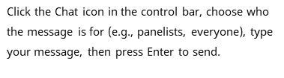

Welcome
How to participate during the webinar
Notes:
No changes

Slide 3
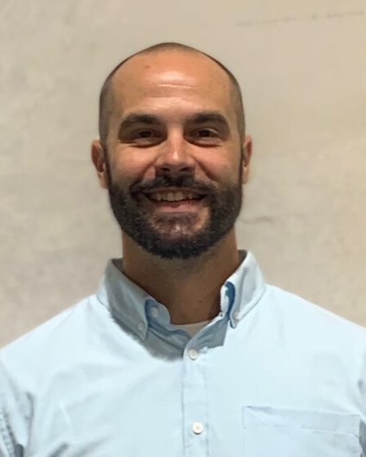


Speakers
Bryan Bieschke, CMRP
VP of Maintenance Programs
Matt Knuth, CMRP, CMRT, CRL
VP of Reliability Solutions

Slide 4
What We’ll Cover Today
The critical practices that set top-performing programs apart
How to turn condition monitoring data into actionable insights
Common mistakes that derail programs—and how to avoid them
Strategies to align condition monitoring with long-term reliability goals

Slide 5

Why Some Programs Succeed (and Others Don’t)
Many plants collect data, few drive results
Technology ≠ reliability
The differentiators are process, people, and culture
Notes:
•Great Place to start, Amissa!
• First thing that comes to mind is “Data Rich/Insight Poor”
•This condition is a highly detrimental problem in modern condition monitoring. It's the paradox of having an overwhelming amount of data from sensors yet lacking the ability to translate that data into meaningful, actionable information that is applied in the right place at the exact right time.
Data without insight is just numbers. If you're using a large dataset that is incomplete, inaccurate, or poorly structured, any analysis you perform will lead to flawed conclusions.
More data DOES NOT equal more reliable. Quality of data over quantity is paramount.
•You’ve all heard me say a million times, “You Can’t Sensor Your Way to Reliability” and again, “More Data DOES NOT equal more reliable on its own.” It’s not about the pre-scripted rabbit hole of generic recommendations your AI system sends you down. It’s about having the right people, with the right expertise sitting at the table together.
•Condition monitoring (CM) is a tactical toolset. It supports reliability, but it is not synonymous with it. CM provides signals. Reliability interprets and responds to those signals in a business-relevant context.
•Peoples tasks are shifting to more analysis and less data collection. Regardless of how you obtain your data SME’s are going to be part of the mix for the foreseeable future to interpret the data, use real world experience, and tell you what to do with the information the data gives you
The differentiator is no doubt culture first, people second and process third. Because if you have a poor overall culture or at least one that doesn’t fully support a reliability culture, the people involved and affected will not subscribe to it and poor processes will be the result. Remember…………The most dangerous phrase is “We’ve

Slide 6


So, what do top performers do differently?
6
Confidential material. Not intended for further distribution.

Slide 7
What Sets Top-Performing Programs Apart
Strong fundamentals lay the foundation for technology
CM
Fundamentals
Build strong maintenance & reliability fundamentals first
Engage shop floor and technical teams early
Define what “good looks like” — and align the business to it
Notes:
No changes

Slide 8
The Culture Behind Top Performance
It’s not just process — it’s people and culture
Goals
Vision
Mission
Culture, communication, and continuous training
Corporate support & avoiding silos
Documented mission, vision, goals, and reliability strategy
Sustaining success through shared accountability
Notes:
No changes

Slide 9
We collect plenty of data — but how often does it drive action?
9
Confidential material. Not intended for further distribution.

Slide 10
Turning Monitoring Data into Actionable Insights
Data only matters when it drives action
Insight
Reliability
Data
Action
Collaboration across teams
Context + expertise = actionable insights
Example: Alerts are only valuable if someone knows what they mean and what to do next
Continuous feedback loop from detection → analysis → action

Slide 11
Even great programs hit roadblocks — what are the most common ones?
11
Confidential material. Not intended for further distribution.

Slide 12

The Consequences of “Alert Overload”
Too many alerts without context kills credibility
Poor setup = alert fatigue and desensitization
No RCA or failure understanding = chasing symptoms
Eliminating defects creates reliability — not just finding them
Notes:
No changes

Slide 13
Common Mistakes That Derail Programs
Avoid the traps that stall progress
"Next Man Up" mentality – no ownership
Lack of training and understanding
Implementation without purpose
"Magpie Syndrome" - chasing shiny tech with no strategy
Notes:
No changes

Slide 14
How to Avoid Those Mistakes
Success comes from clarity, consistency, and collaboration
Train
Implement
Improve
Invest in training and clear ownership
Build processes before platforms
Start small, learn fast, scale smart
Tie every technology decision to reliability outcomes
Notes:
No changes

Slide 15
How can monitoring drive long-term reliability?
15
Confidential material. Not intended for further distribution.

Slide 16
Aligning Condition Monitoring with Long-Term Reliability Goals
Make CBM a strategic driver, not a standalone effort
EHS
Operations
Quality
Engeneering
Reliability
Maintenance
Connect CBM to defect elimination, design improvements, capacity, and safety
Integrate value across EHS, Ops, Quality, Engineering
When all departments are aligned, reliability becomes sustainable
Notes:
No changes

Slide 17

Collaboration is the Glue
Reliability is a team sport
Cross-departmental ownership keeps CBM alive
Shared goals create buy-in
Data must move through the entire reliability ecosystem
Notes:
No changes

Slide 18

Q&A + Discussion
Q:
What's the one action maintenance and reliability teams should take right now to make the biggest impact on their program?
18
Confidential material. Not intended for further distribution.

Slide 19
Q&A + Discussion
Q:
How do we decide which assets to monitor first to get the most value?
19
Confidential material. Not intended for further distribution.

Slide 20
Q&A + Discussion
Q:
What's the best way for condition monitoring data to impact our existing maintenance workflow?
20
Confidential material. Not intended for further distribution.

Slide 21
Q&A + Discussion
Q:
Have you seen a shift during a program from reactive to proactive culture in your experience, how long did it take?
21
Confidential material. Not intended for further distribution.

Slide 22
Key Takeaways
1
Top performers build fundamentals before tech
2
Data must lead to decisions, not dashboards
3
Avoid alert overload and tech-for-tech's-sake
4
Align CBM with business and reliability goals
Notes:
No changes

Slide 23

Closing & Next Steps
Recording sent out after webinar
Uptime UpNow Pilot Program
If you have questions email us directly
agiddens@uptime-solutions.us
mknuth@uptime-solutions.us
bbieschke@uptime-solutions.us
Notes:
No changes

Slide 24
Notes:
.

