Slide 1

Digital Integration of Operations and Maintenance
Streamline 2026

Slide 2



Let's Introduce The Team
Barry Fisk, Account Director,
Federal, State and Local
“Operations Manager”
Phill Bragg,
Manager, Pre-Sales
“Reliability Engineer”
Angel Torres,
Solutions Consultant
“Maintenance Manager”

Slide 3
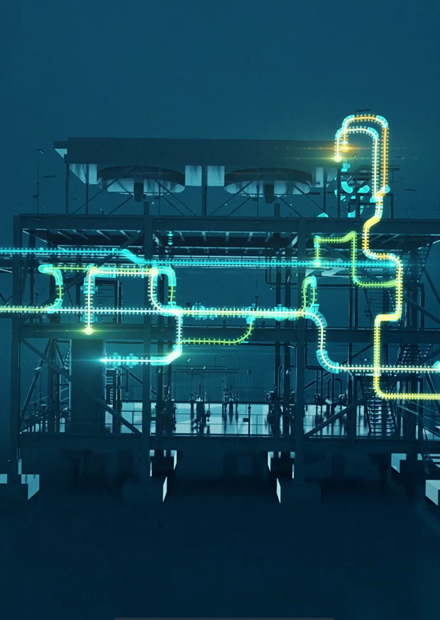
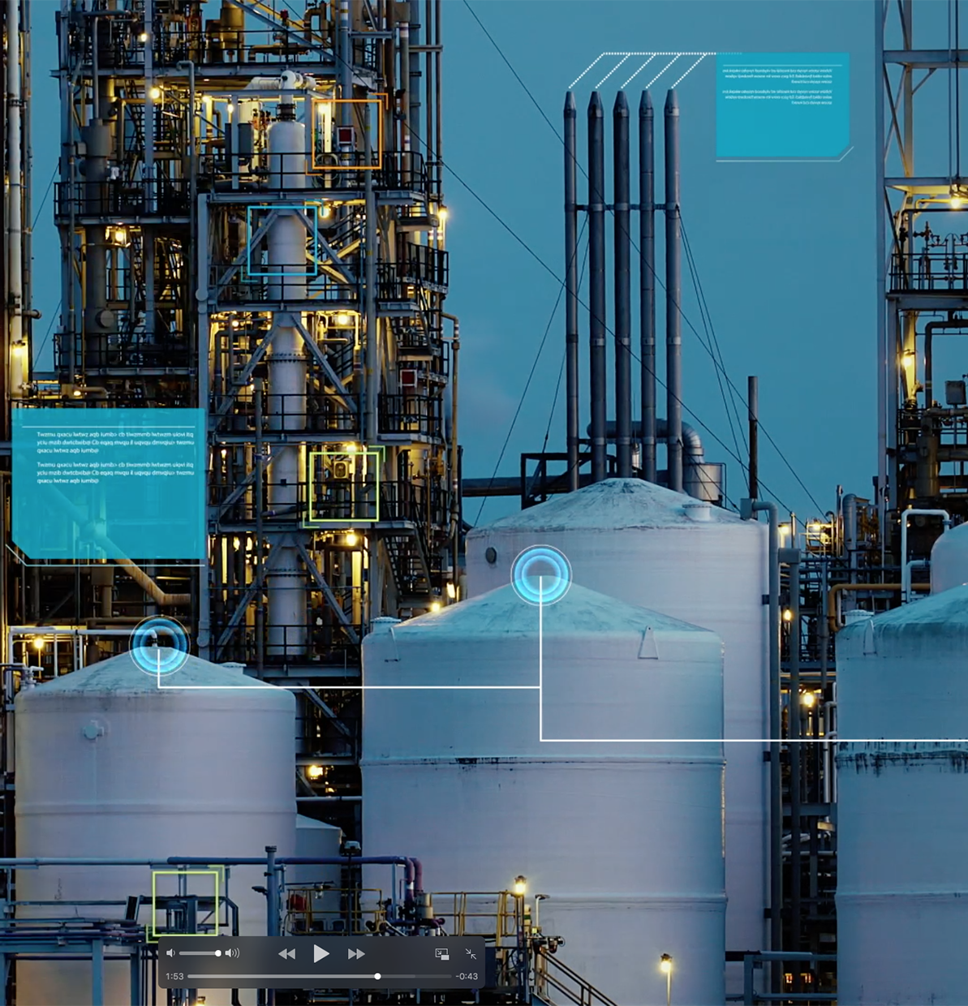

Objectives
Demonstrate how our operations and maintenance solutions are enabling our vision.
Educate you on capabilities & portfolio integration which unlocks new value streams.
Approach
We will simulate a common occurrence at industrial facilities, the morning meeting.

Slide 4
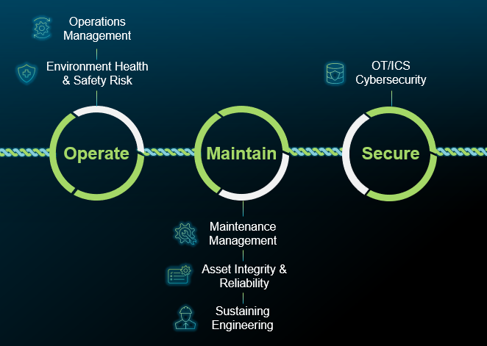
Operations and Maintenance Solutions
Our vision is to deliver solutions that integrate business processes, data, and analytics across the industrial asset lifecycle:
The Operate and Maintain phases require solutions that:
Reduced downtime and risk mitigation
Greater asset visibility and longevity
Improved product quality and cost optimization
Better energy efficiency optimization
Our portfolio is uniquely positioned to offer integrated solutions across the Operate and Maintain phases and unlock new value streams.

Slide 5
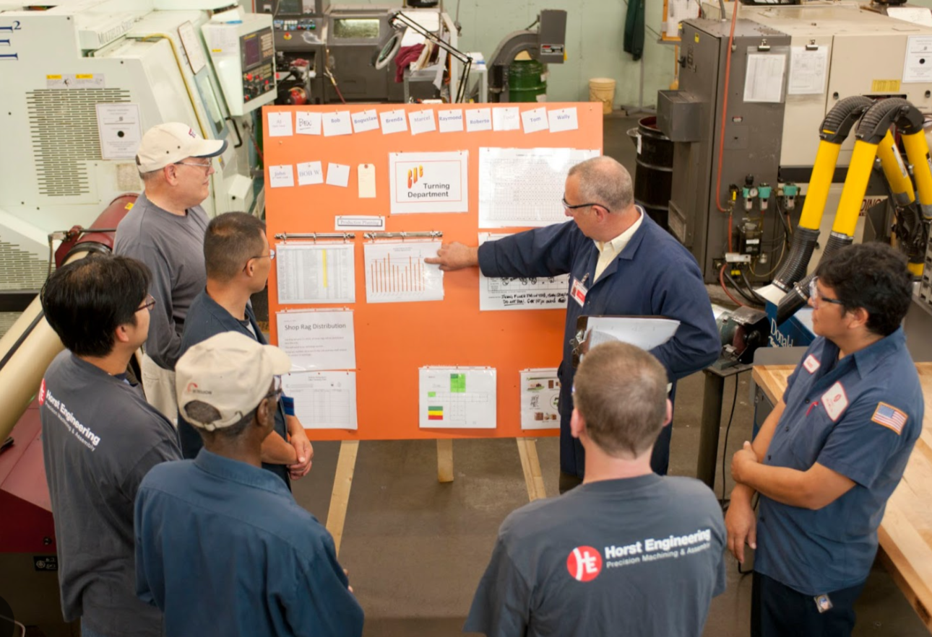

Introducing Today’s Scenario
  Limited context and situational awareness
  Limited visibility to current asset, health & risk data
  Siloed functions and solutions
Morning Meeting
  Inability to make quick data driven decisions
Review status from prior shift
Manage high risk issues
Drive corrective actions
Focus resources where needed
  Inability to drive cross functional workflows

Slide 6
Operations and Maintenance Solutions
Asset Lifecycle Information Management
Asset Performance Management
Procedure Lifecycle Management
Enterprise Asset Management
Operations Management
Control System Effectiveness
Control System Configuration Management

Slide 7
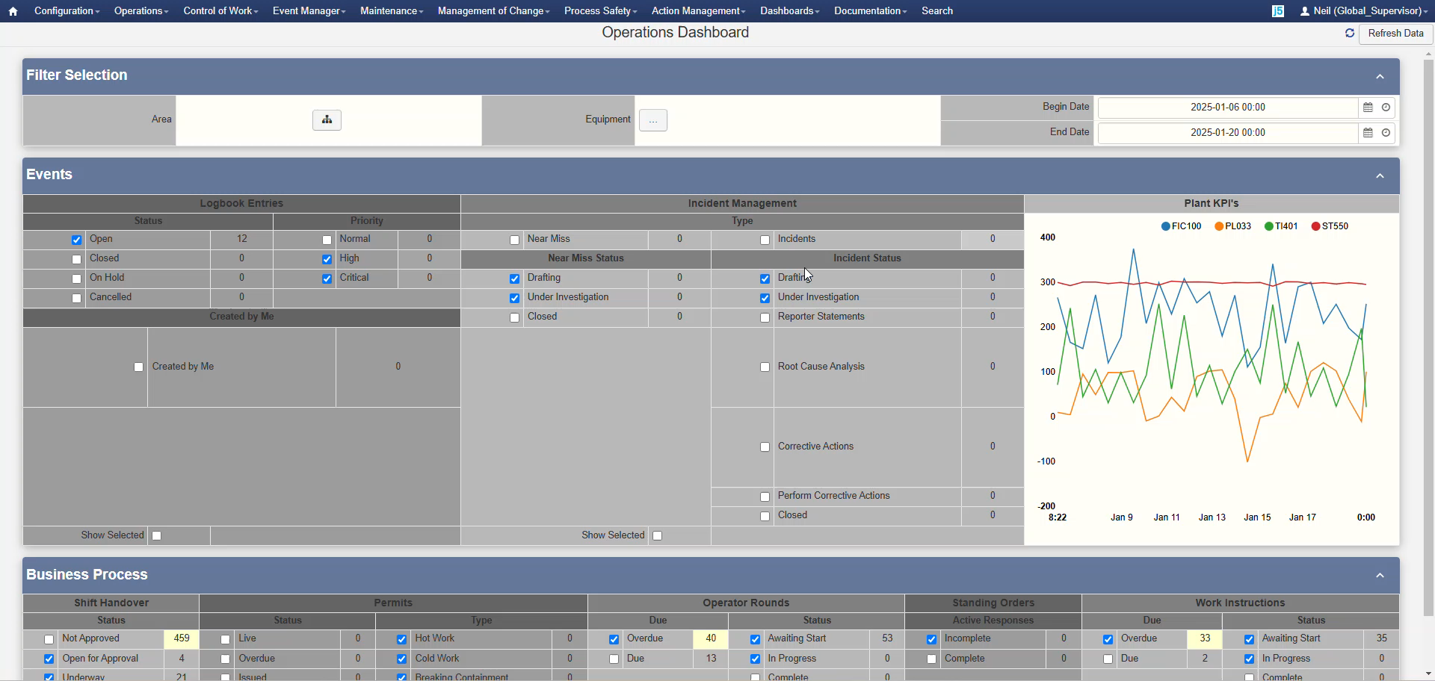

Slide 8
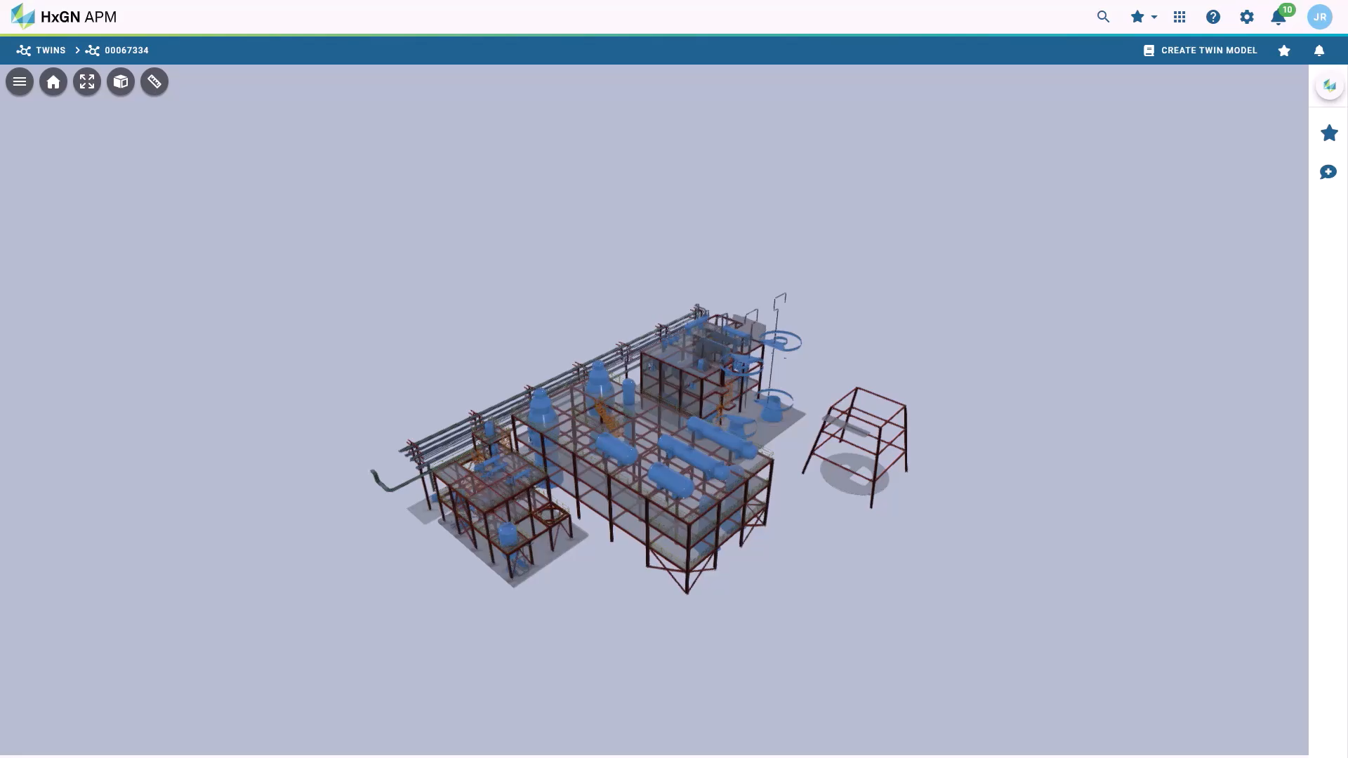

Slide 9
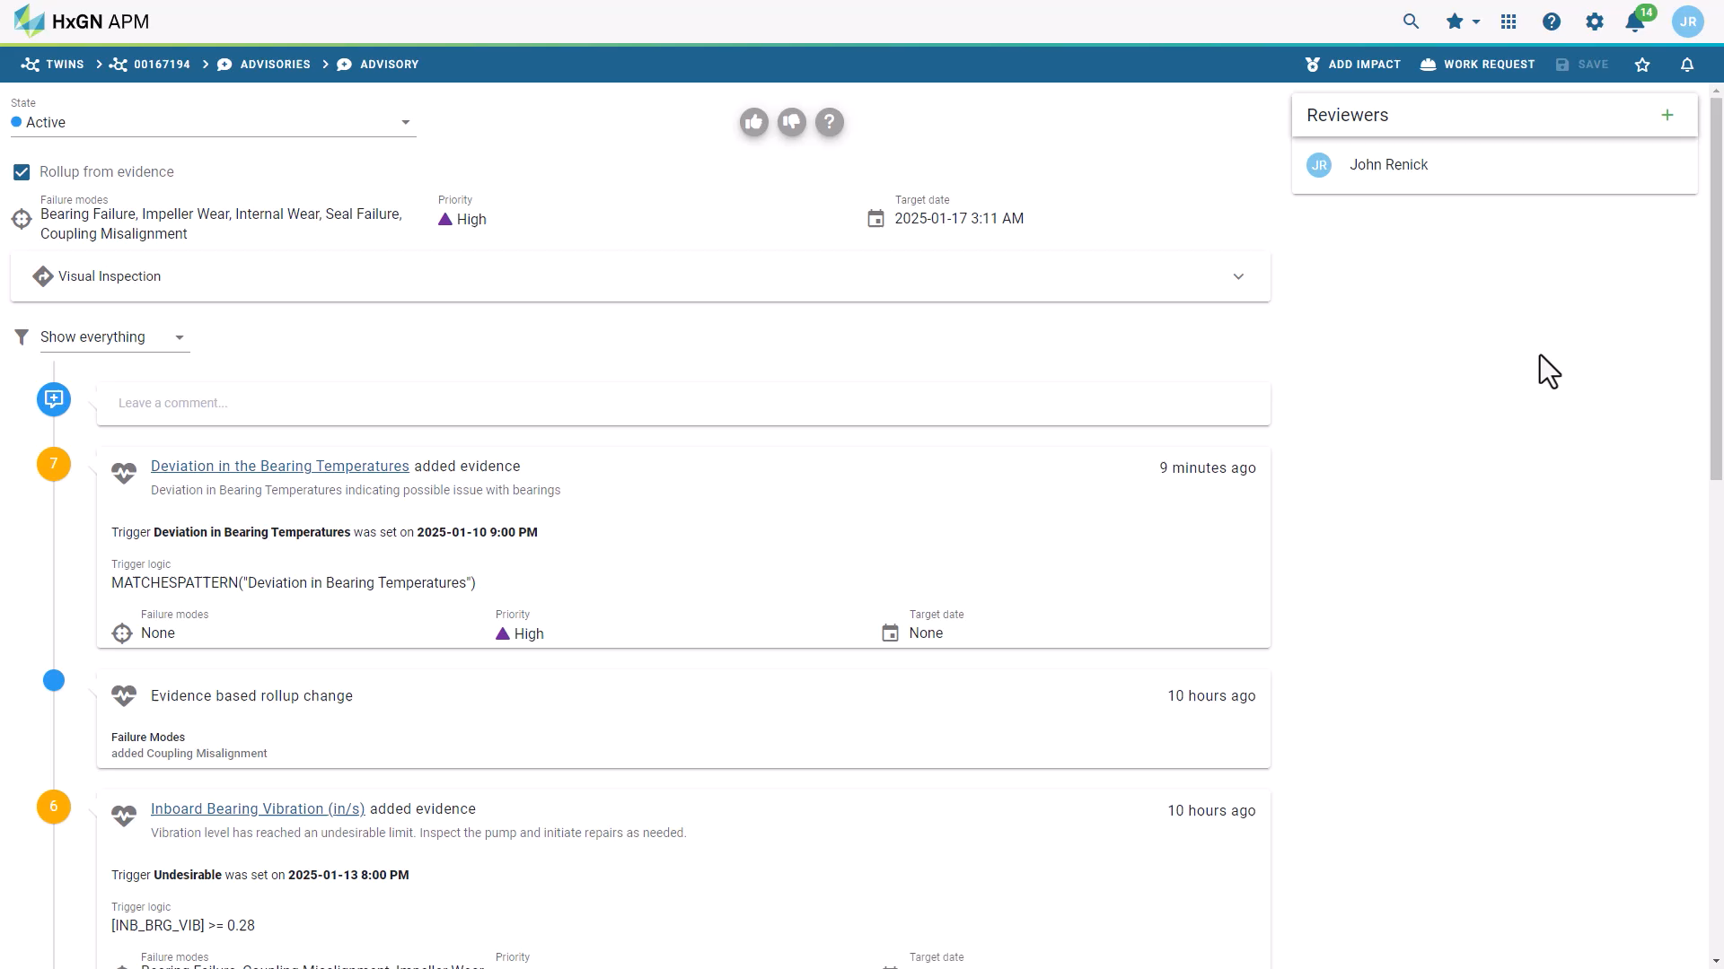

Slide 10
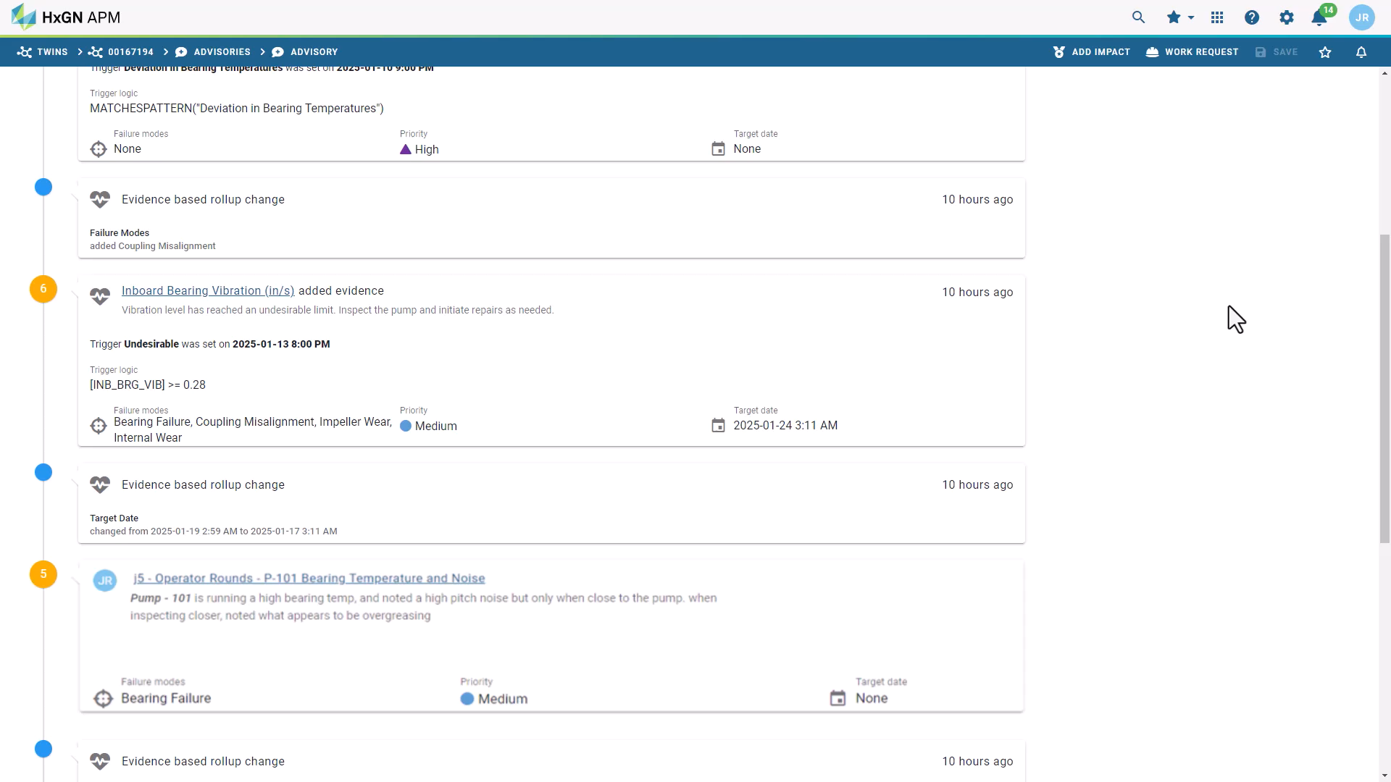

Slide 11

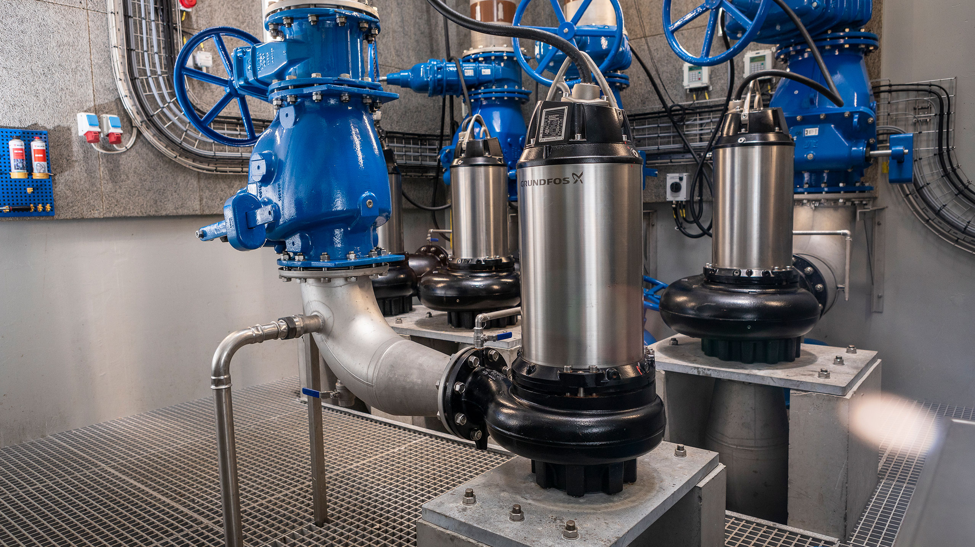

Operations Management insights on Asset Condition

Slide 12
Operations Management
Key Takeaways
Delivered Benefits
Add Context
Ready Access to Data
Identify Potential Issues
Operations personnel are a great source of situational and transient information. Our operations management solution enables operations teams to take photos, add comments, and even record audio in the field, which is invaluable to the maintenance and reliability teams.
These data points can be trended or put into additional operational context so that exception reports can be generated when deviations occur.
Our operations management solution can capture additional data from IIoT devices as data points, which are associated with the asset and can be added to EAM and APM.

Slide 13
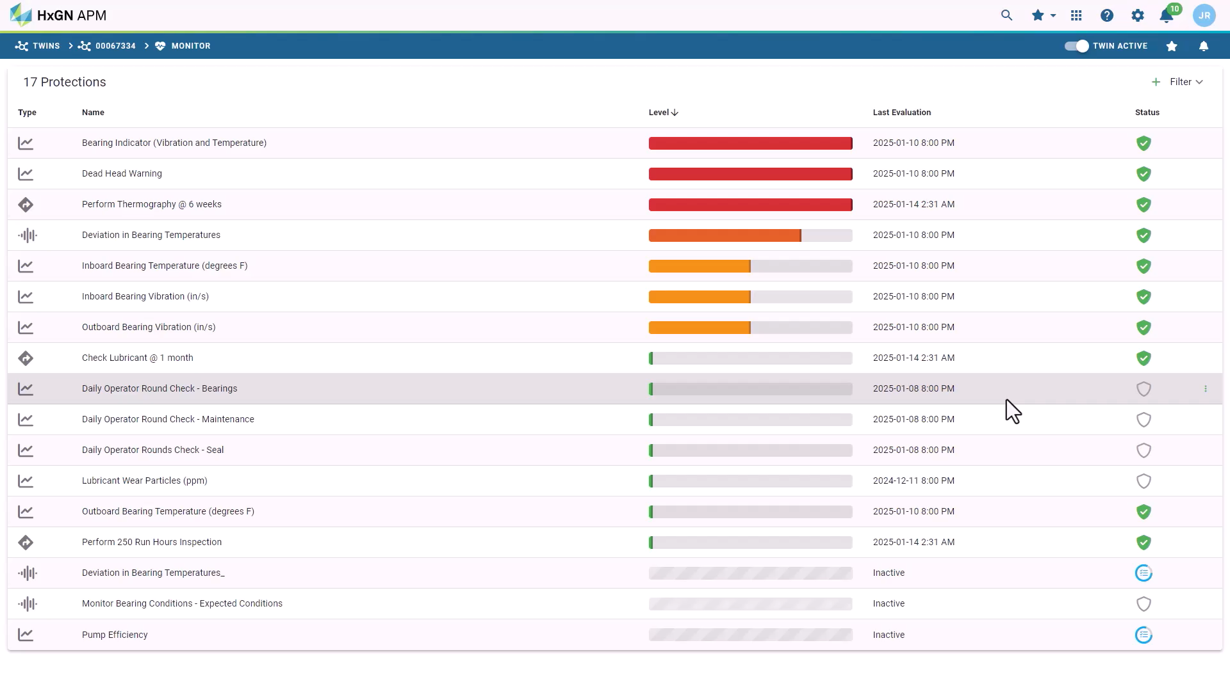

Slide 14
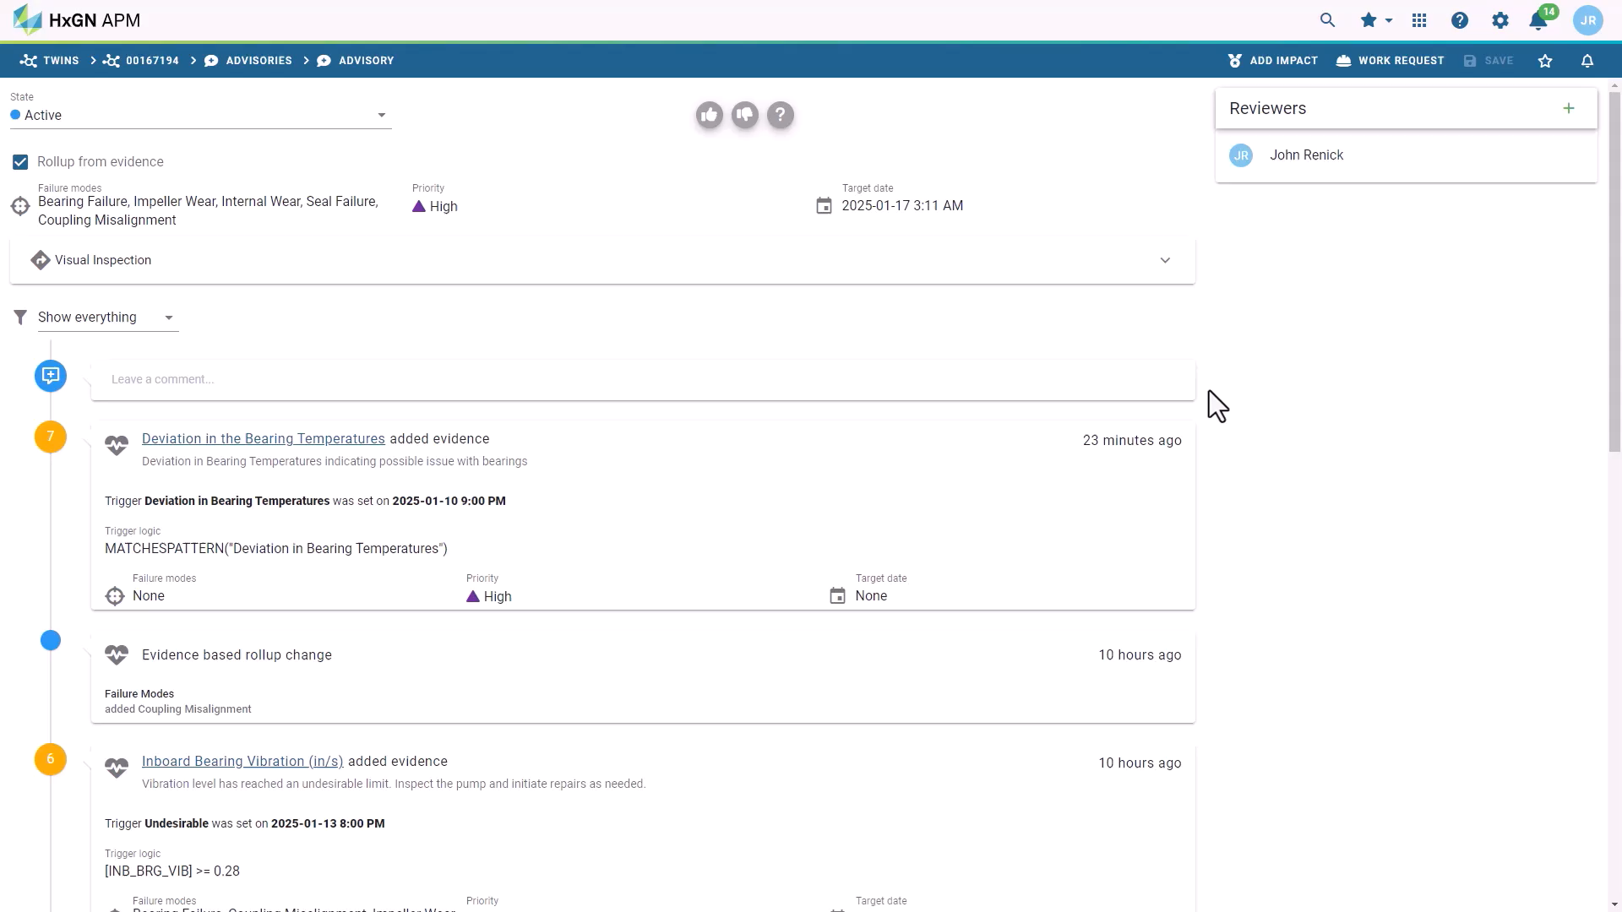

Slide 15
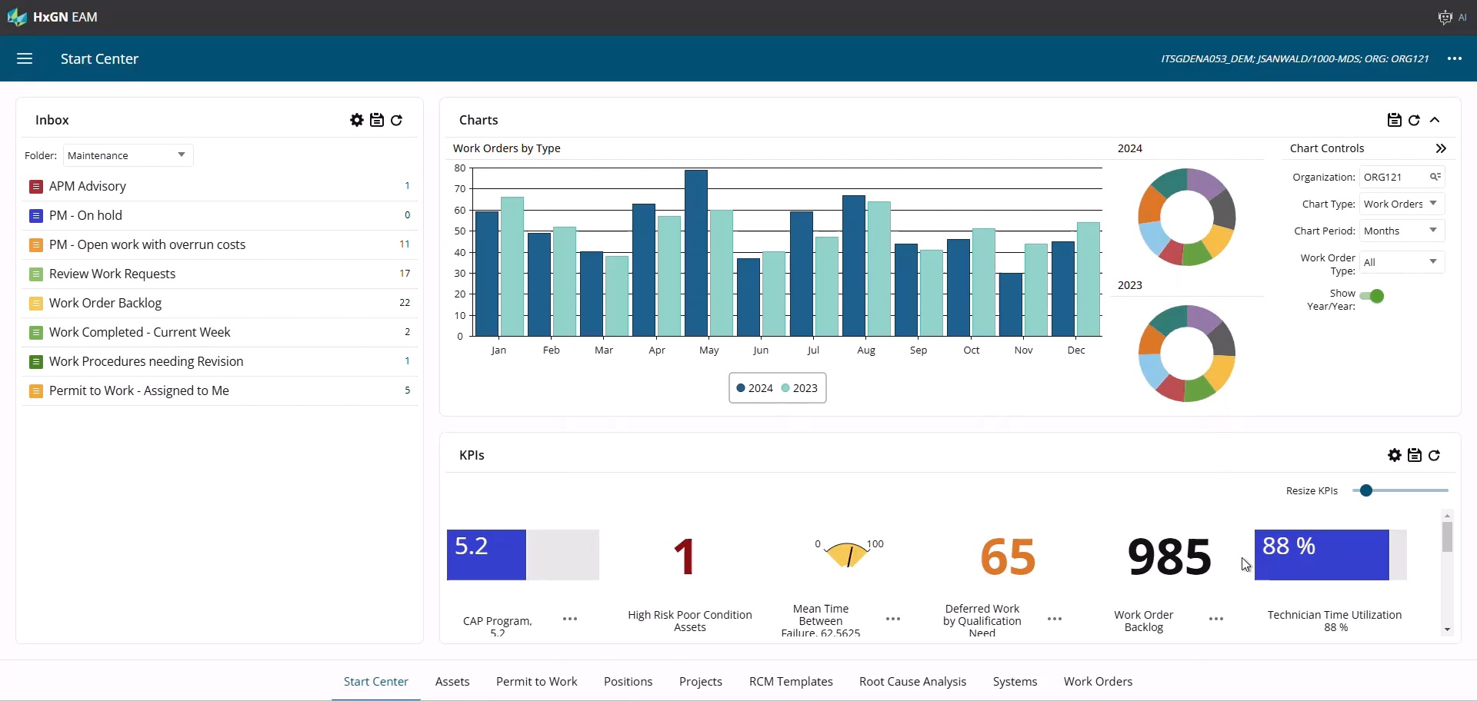

Slide 16
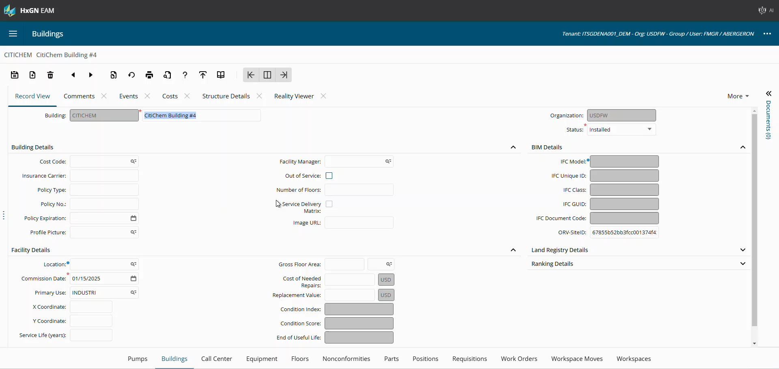

Slide 17

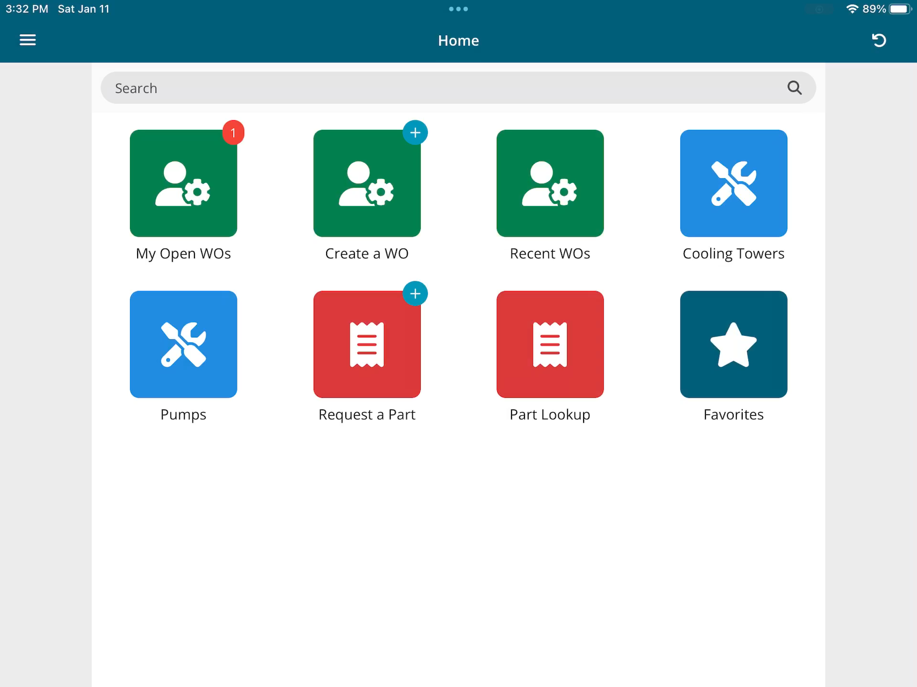

Slide 18
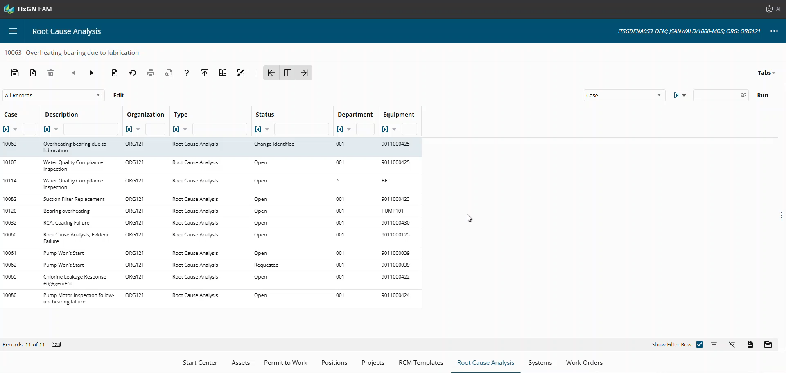

Slide 19
Enterprise Asset Management
Key Takeaways
Delivered Benefits
Act on Emerging Threats
Advanced Visualization
Maximize Efficiency
Utilize integrated APM and EAM solutions to quickly analyze potential problems, make a specific assignment and take the correct action.
Leverage advanced visualization tools to visualize work before going on site, increasing efficiency and safety for the technician.
Enhance productivity of all planners and technicians on-site, increasing efficiency and first-time fix rates, as well as lowering operational costs.

Slide 20
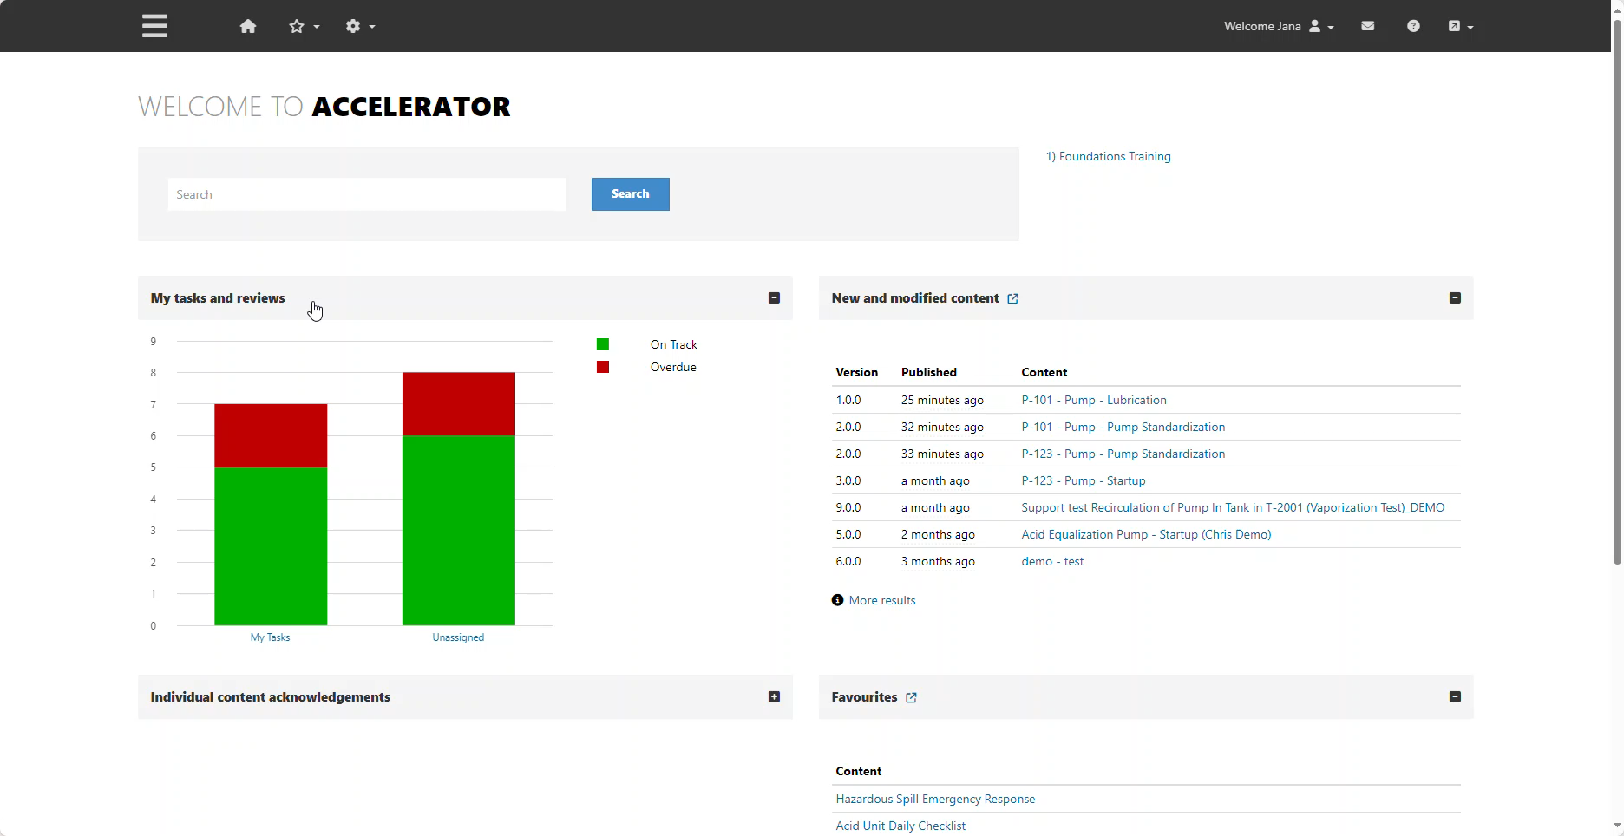
AKMS

Slide 21
Procedure Lifecycle Management
Key Takeaways
Delivered Benefits
Digitize
Reduce Human Error
Associate with Assets to drive improvements
Today the majority of manufacturing and industrial facilities run on standard operating procedures and are often paper-based.
Eliminate using outdated or wrong procedures. Additionally, increase engagement and drive continuous improvement while doing work.
By integrating Procedure Lifecycle Management with EAM and APM, we can associate procedures of different types with the asset and see the impact on asset performance.

Slide 22

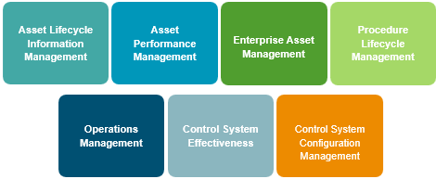
Hexagon’s Portfolio Drives New Value Streams
Automatic Detection of emerging threats in real time
Full situational awareness at their fingertips
Ability to confidently drive corrective actions to mitigate risks
Collaboration and alignment on optimal asset strategy

Slide 23
Our Vision
Our solutions digitally enable our customers to optimize how they operate and maintain their facilities.
Our vision is to deliver value by:
Holistically managing operational risk
Efficient deployment of resources
Optimization of asset performance
Sustainable continuous improvement

