Slide 1

EAM Mobile Workshop
Exploration of EAM Digital Work and EAM Mobile Offline
Matt Peak & Angel Torres
Pre-Sales
Hexagon

Slide 2
Check In Placeholder

Slide 3
Agenda
SECTION 1
Introductions and Logins
SECTION 2
Three License Types
SECTION 3
Digital Work Setup
BREAK!
SECTION 4
Digital Work Exercises
SECTION 5
EAM Mobile Offline

Slide 4


Presenters
Matt Peak, Solution Consultant EAM
Angel Torres, Solution Consultant EAM
Matt Peak is a solution consultant for HxGN EAM, HxGN APM, and Databridge Pro. Matt received his MBA from the Harbert College of Business at Auburn University and prior to his role with Hexagon, served his community as a Deputy Sheriff with the Pima County Sheriff's Department in Arizona. Today, Matt lives in Auburn Alabama where he enjoys spending time with is wife and riding his motorcycle.
Angel is a Hexagon EAM Solution Consultant. Prior to this, Angel served over 20 years as an Officer in the US Marines and had a variety of logistics, maintenance and maintenance management assignments. Angel resides in Irvine, California, and spends his free time enjoying the perfect weather with his family at Disneyland and the beach.

Slide 5
Agenda
SECTION 1
Introductions and Logins
SECTION 2
Three License Types
SECTION 3
Digital Work Setup
SECTION 4
Digital Work Exercises
SECTION 5
EAM Mobile Offline

Slide 6
Agenda
SECTION 1
Introductions and Logins
SECTION 2
Three License Types
SECTION 3
Digital Work Setup
SECTION 4
Digital Work Exercises
SECTION 5
Digital Work Vs. EAM Mobile Offline

Slide 7
Three License Types
https://docs.hexagonali.com/v/u/HxGN-EAM-Digital-Work/12.3+202601

Slide 8
Three License Types
Mobile Requestor
Parity with requestor license
Provides access to Work Request, Parts Requisition, Operator Checklists, Contractor Portal, Case Management Tasks
https://docs.hexagonali.com/v/u/HxGN-EAM-Digital-Work/12.3+202601

Slide 9
Three License Types
Field Work
Parity with EAM Mobile Offline
Targeted towards maintenance work execution. Work Orders, Equipment, Checklists, Inspections, map view etc.
Mobile Requestor
Parity with requestor license
Provides access to Work Request, Parts Requisition, Operator Checklists, Contractor Portal, Case Management Tasks
https://docs.hexagonali.com/v/u/HxGN-EAM-Digital-Work/12.3+202601

Slide 10
Three License Types
Advanced Mobile
Most parity with EAM through browser
Targeted towards supervisors, planners, reliability engineers, warehouse functions, etc.
Field Work
Parity with EAM Mobile Offline
Targeted towards maintenance work execution. Work Orders, Equipment, Checklists, Inspections, map view, etc.
Mobile Requestor
Parity with requestor license
Provides access to Work Request, Parts Requisition, Operator Checklists, Contractor Portal, Case Management Tasks
https://docs.hexagonali.com/v/u/HxGN-EAM-Digital-Work/12.3+202601

Slide 11
Agenda
SECTION 1
Introductions and Logins
SECTION 2
Three License Types
SECTION 3
Digital Work Setup
SECTION 4
Digital Work Exercises
SECTION 5
EAM Mobile Offline

Slide 12
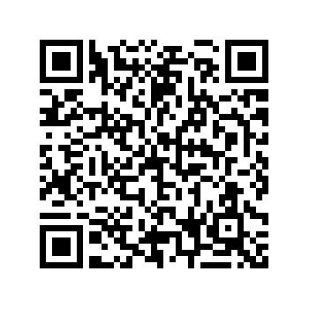
Logins
Environment: https://use1.eambeta.hxgnsmartcloud.com/web/base/logindisp?tenant=HXGNDEV0012_PP1
User: TRNXX – See your table tent for your assigned user.
Password: Stre@mline2026

Slide 13
Digital Work Setup
Objective:
Create a technician profile for digital work
Considerations:
What will the technician be doing?
What will they need access to?
What is their workflow?
Notes:
Technician User – We help them create it
Parts/Inv – They have time to build it up with our help.

Slide 14
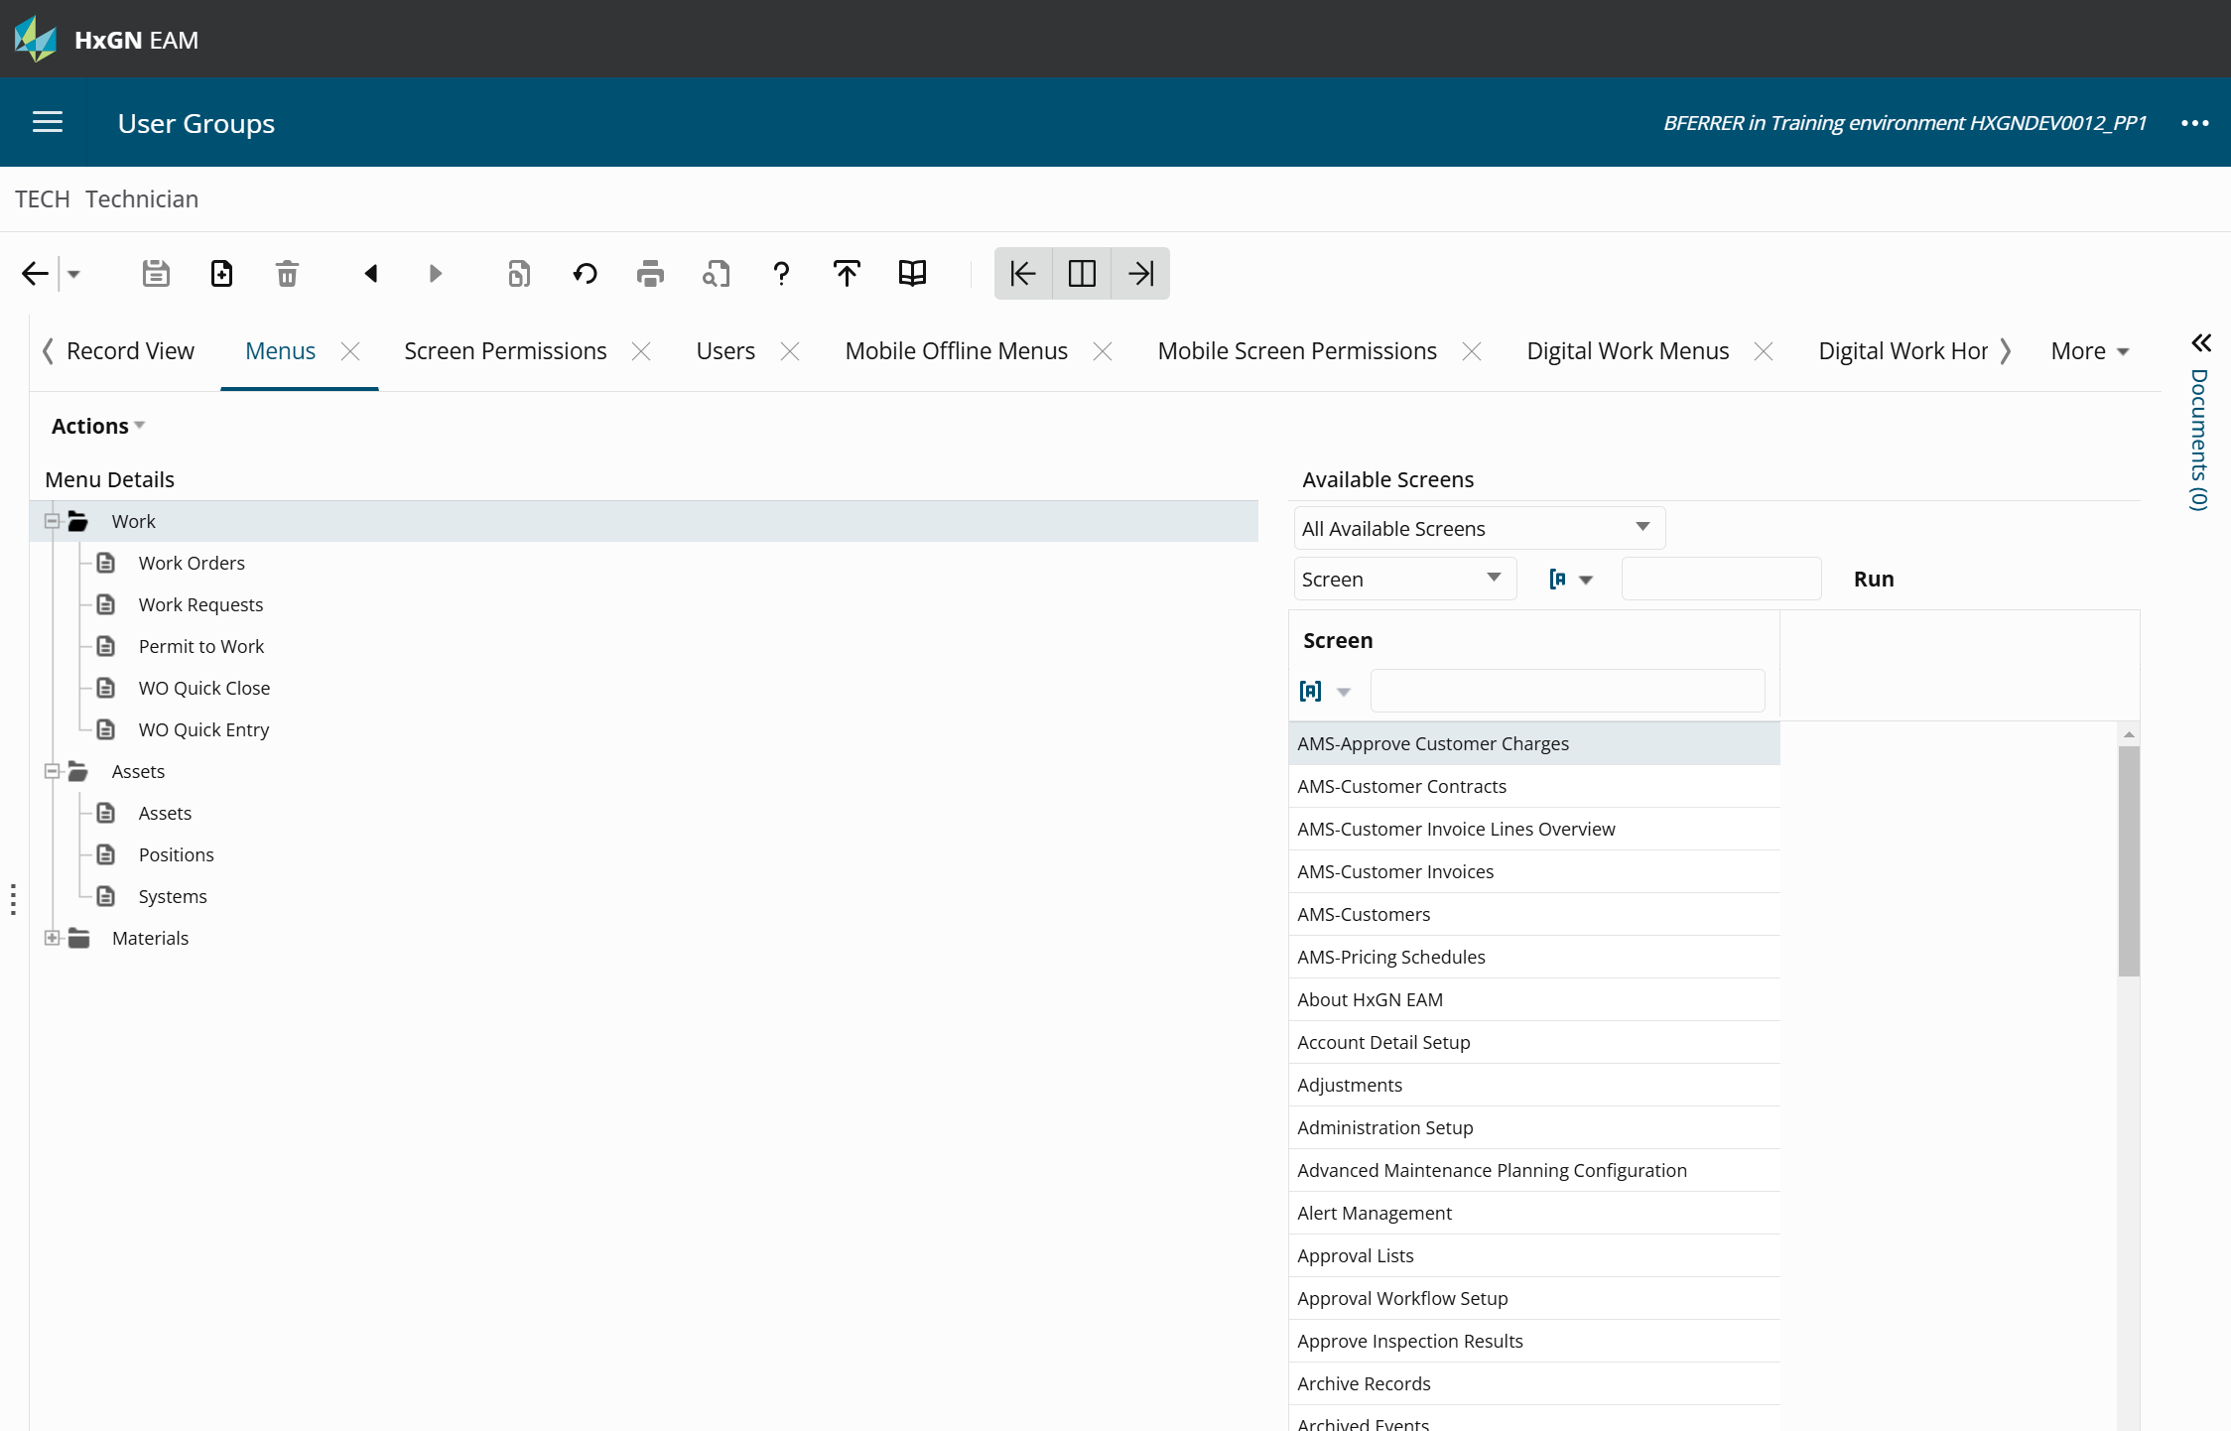
User Group Setup
Define your User Group
Create a technician user group with Field Work access
Ex: “MPeakTECHs”
Notes:
DELETE EXISTING GROUPS – They start from Zero
Can’t. All seem to be associated with another record in system and can’t be deleted. Guidance given for creating their own.

Slide 15
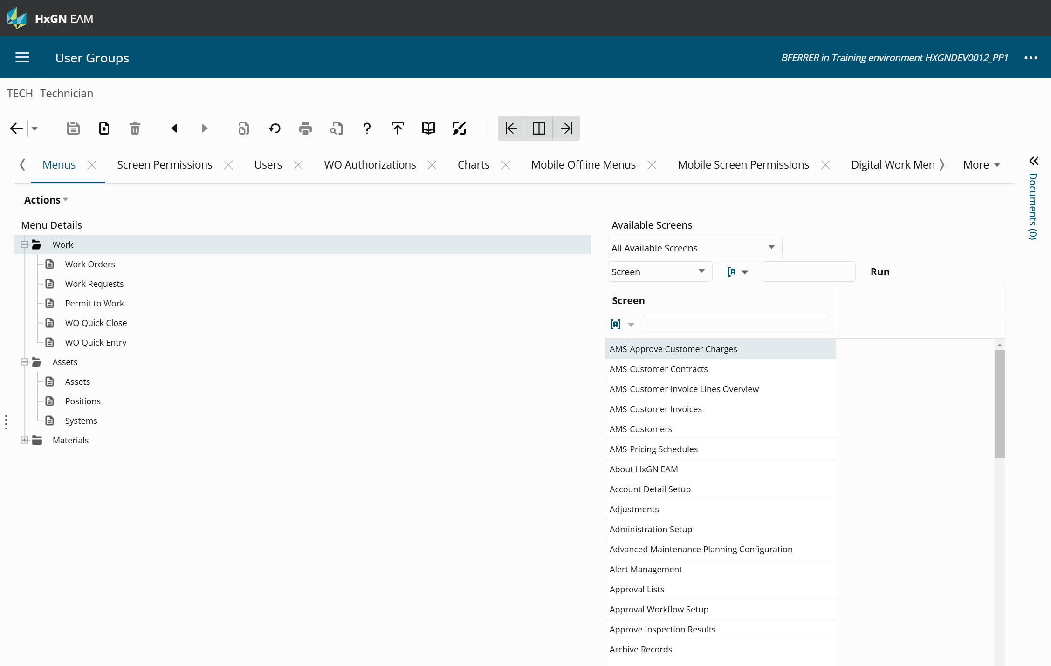
User Group Setup
Add Menus:
User Group → Menus
Create ‘Main Menu’ folders for:
Work
Assets
Reports
Add Work Orders and Asset Screens, associate some reports
Screens Available in Digital Work: https://docs.hexagonppm.com/r/en-US/HxGN-EAM-Digital-Work/12.1/1280393
Notes:
Give them a list of screens to pull in (Assets, Work etc. ) we do
Exercise….Let them build the parts user (they do)
Talking point: Advanced Mobile vs. Field work & the drop down for changing license type.
Techs may not always have internet and need to move back and forth. Parts/Inv will likely have connectivity

Slide 16
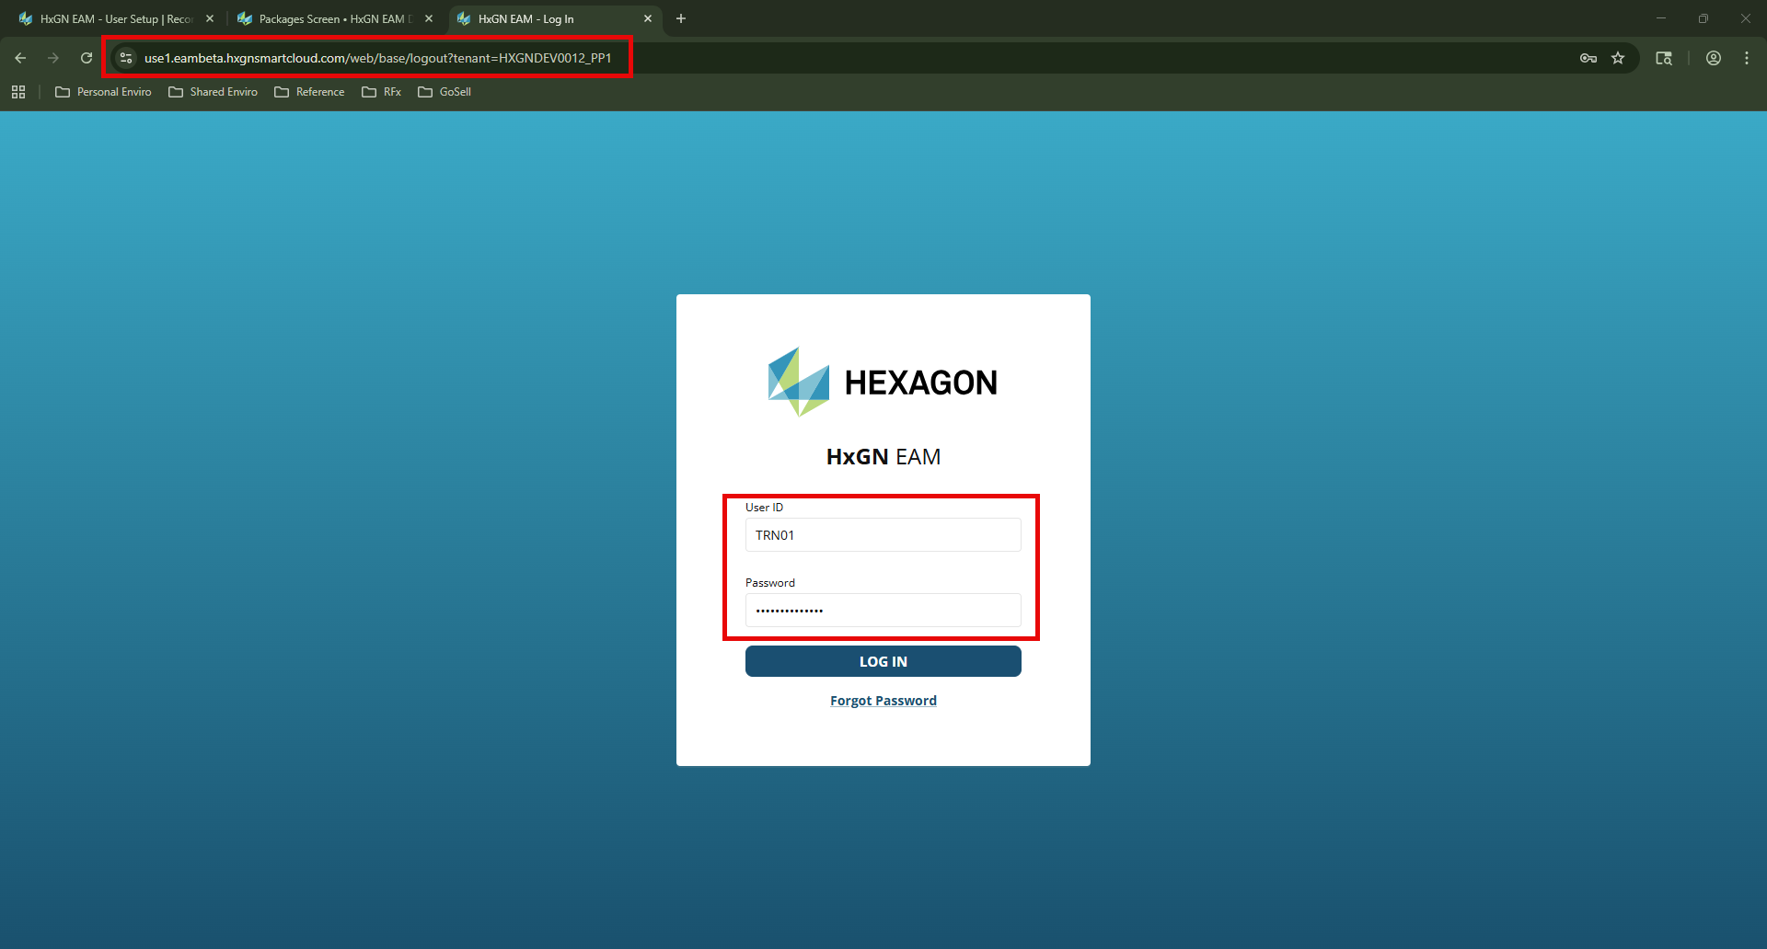

Slide 17
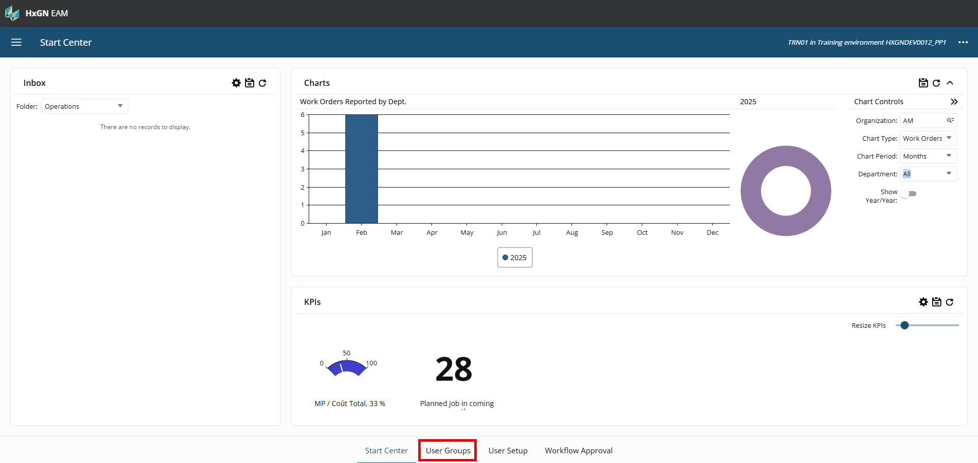

Slide 18
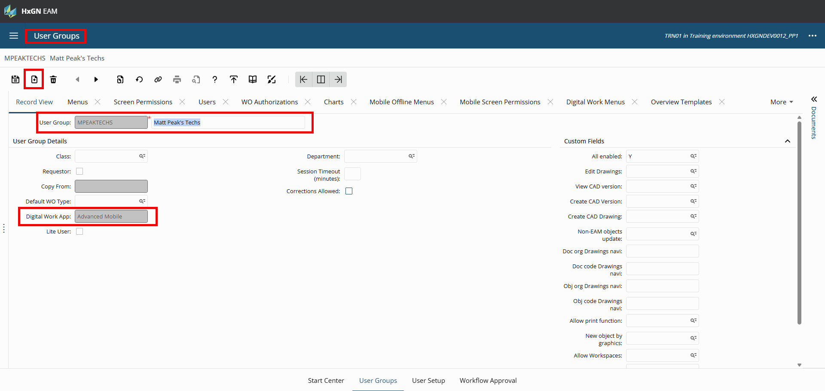

Slide 19
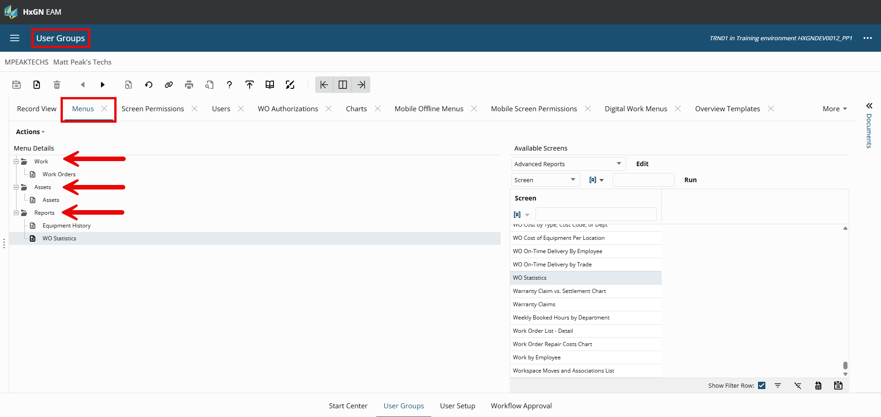

Slide 20
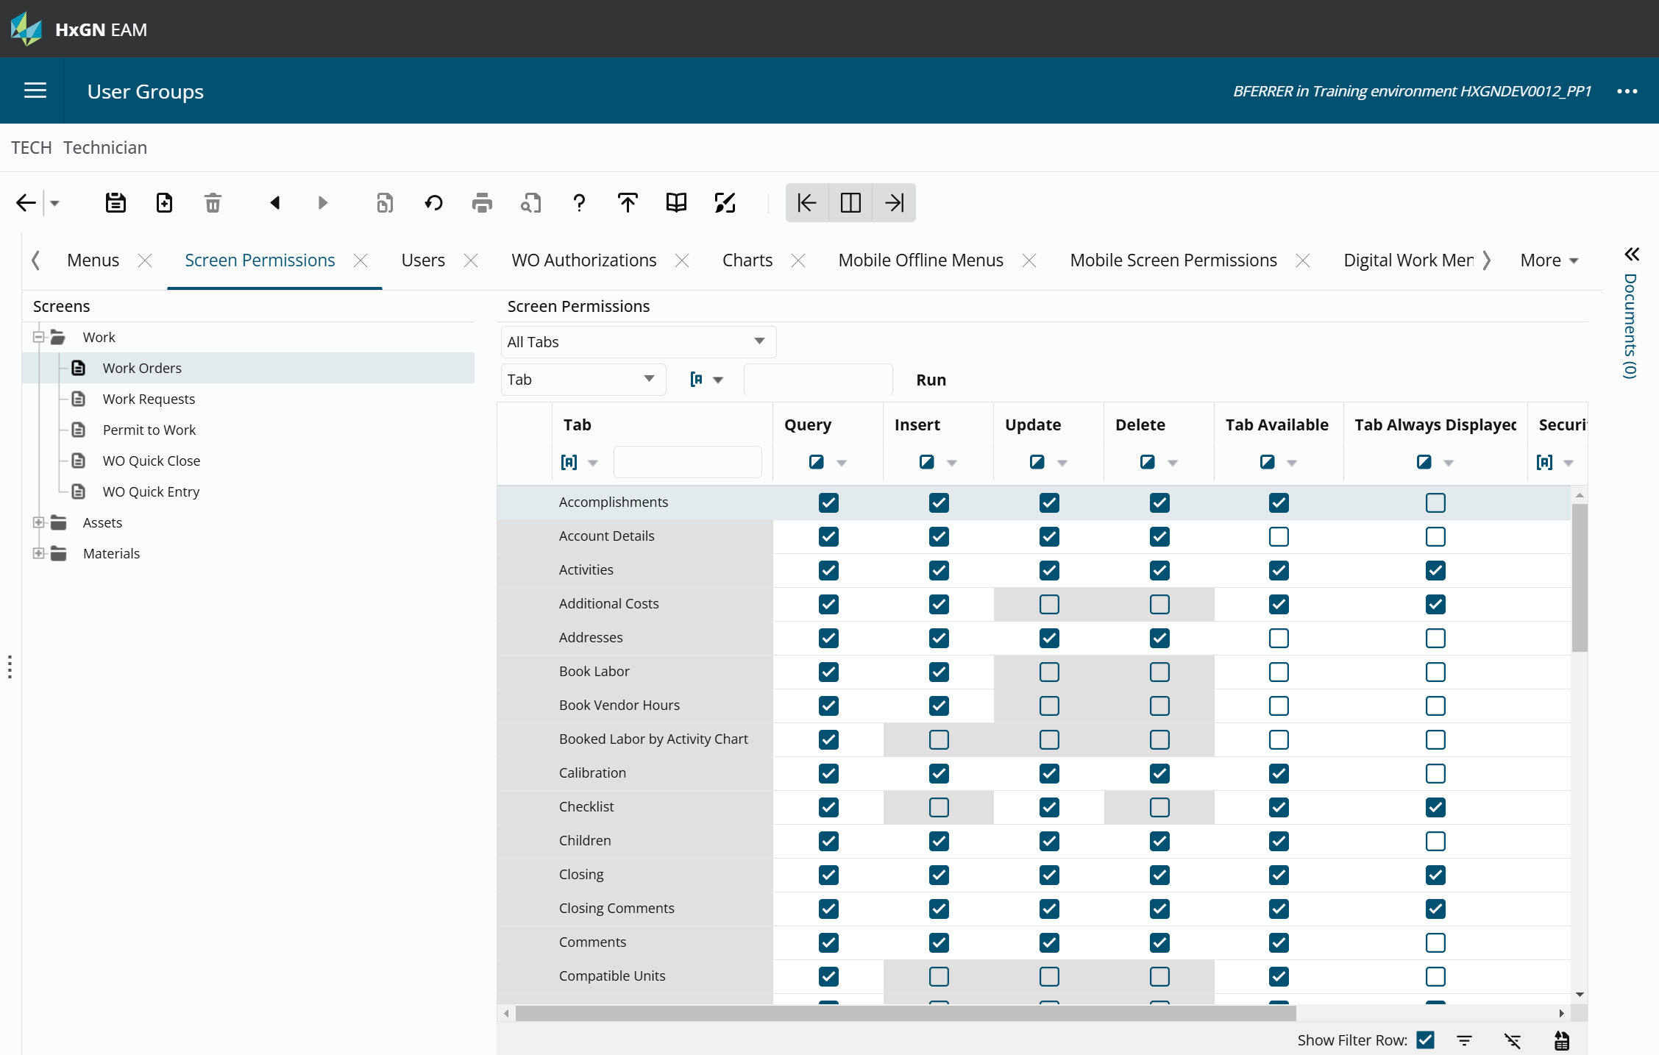
User Group Setup
User Group → Screen Permissions
Update the screen permissions:
Work Orders
Assets
Notes:
Go to User Groups, create Technician

Slide 21
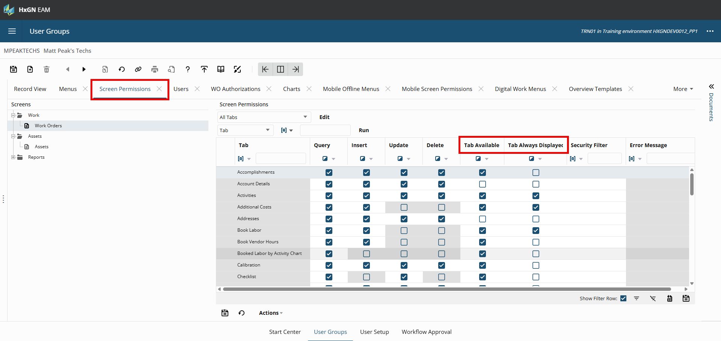

Slide 22
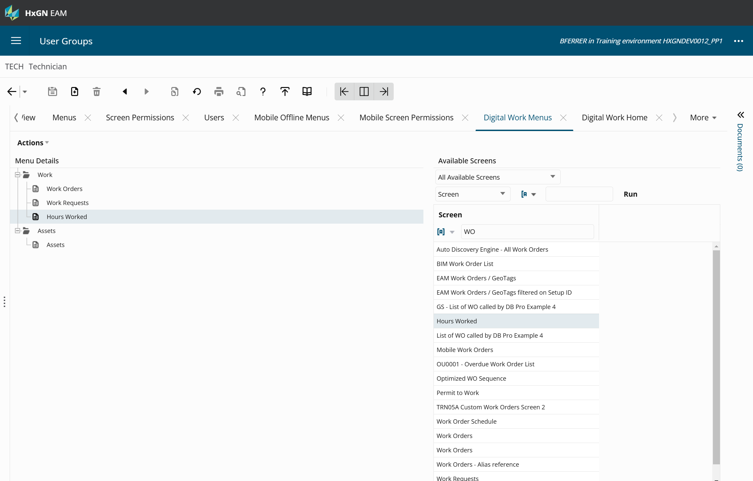
User Group Setup
User Group → Digital Work Menus
Create a menu for:
Work
Assets
Associate screens
Work Order Schedule
Work Orders
Assets
Notes:
Work Requests are weird
12.3 Update: User Groups - Users can now update their user groups from Field Work to Advanced Mobile. When making this update to the Digital Work App field on the record view of the User Groups screen, the system will notify that the associated User Setup records will also be updated for this value. When making this update for the User Setup records, the system validates that the changes made have not caused the licensed number Advanced Mobile users to be exceeded, and provides a warning if this is the case.

Slide 23
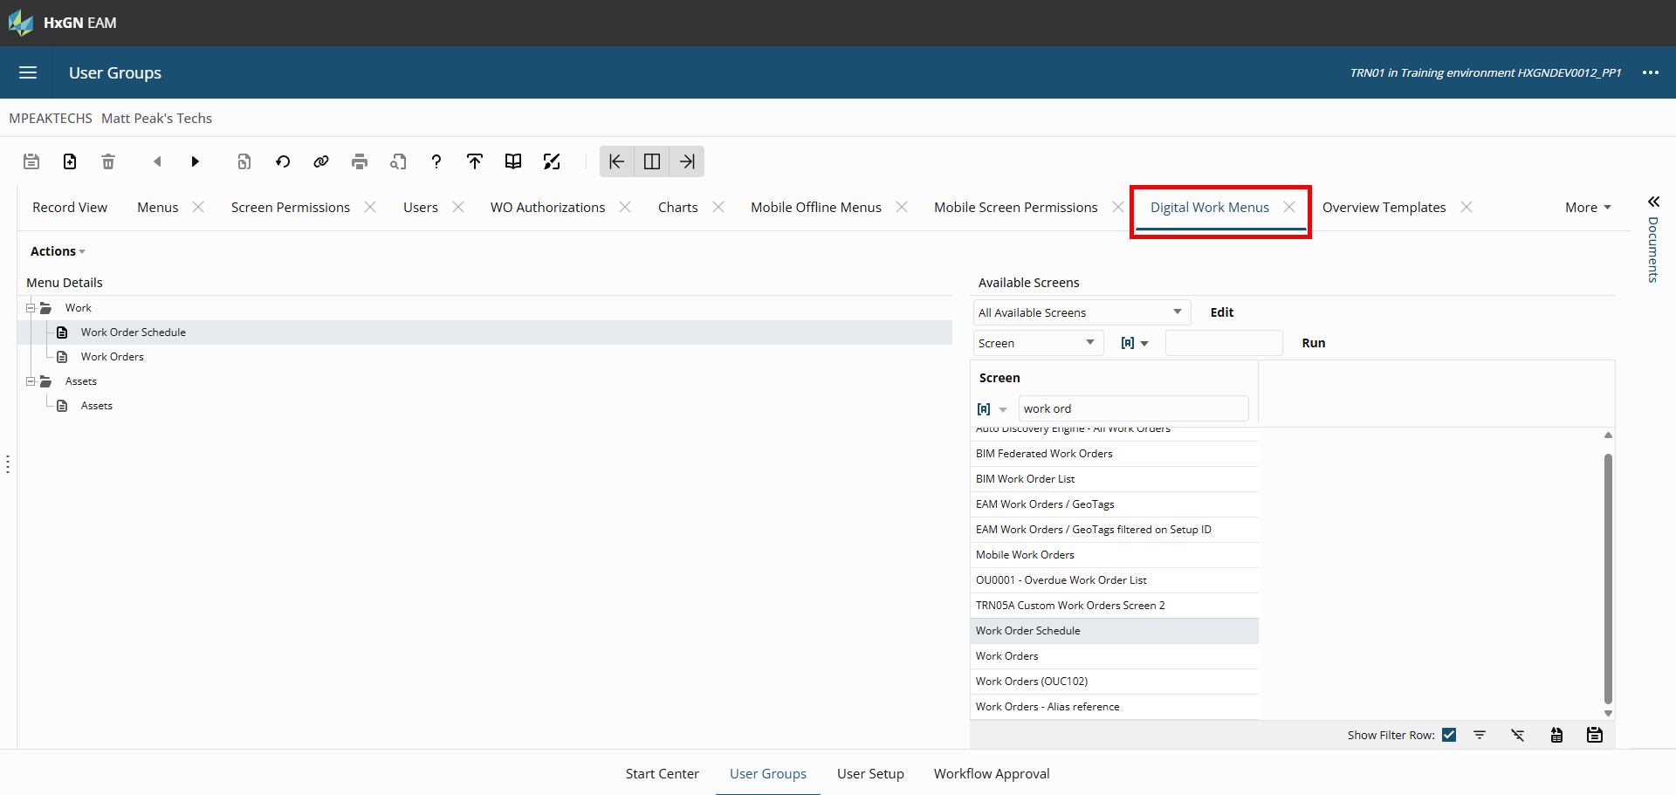

Slide 24
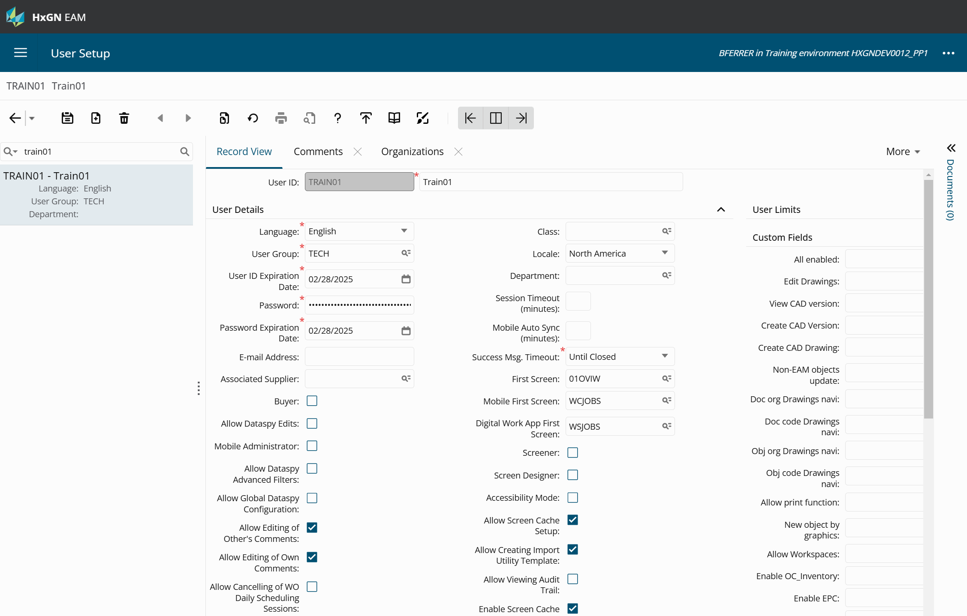

User Setup
Create a User to associate to new user group.
Ex: MPeak
Ensure the following fields are Checked
Mobile Administrator
Allow Changes to Mobile Settings
Allow Mobile Sync Configuration
Mobile
Notes:
Set up first screens

Slide 25
User Setup
Create a User to associate to new user group.
Ex: MPeak
The Digital Work App drop-down is used to control the user’s log in access to the Field Work, Advanced Mobile, or Mobile Requestor apps.
This field does not interact with other check boxes (HxGN EAM products) like HxGN EAM, Mobile, and Requestor.
A user can be marked as both Mobile and Mobile Requestor on the Digital Work App field, or a user can have the HxGN EAM check box cleared, but still have access to Advanced Mobile on the Digital Work App field.
Notes:
Set up first screens

Slide 26
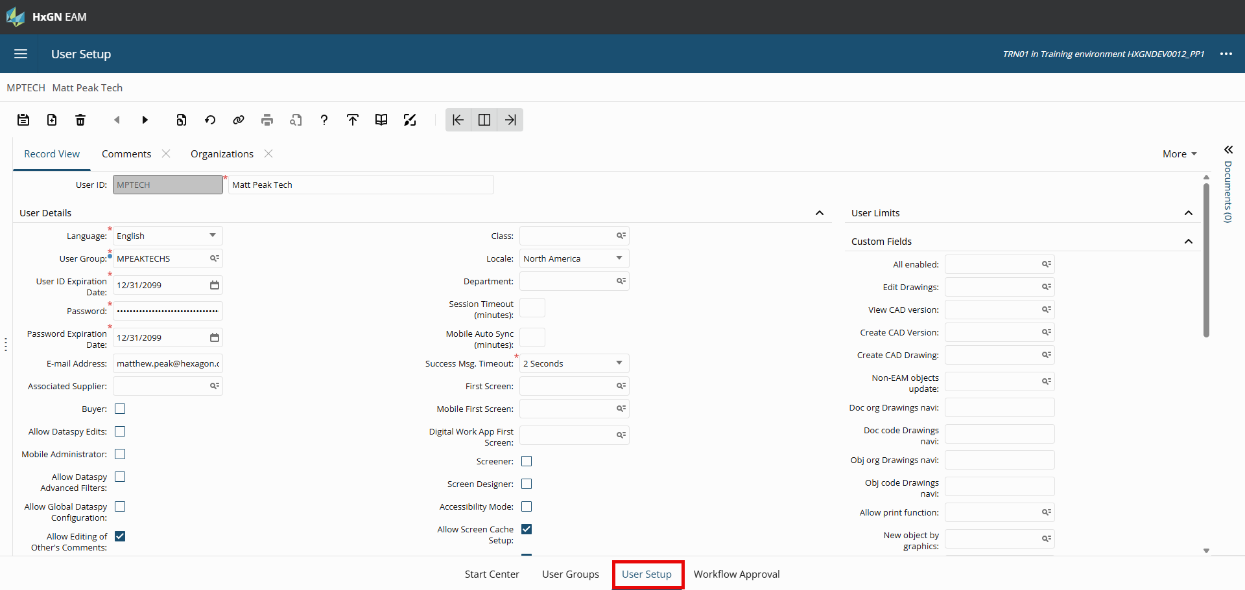

Slide 27
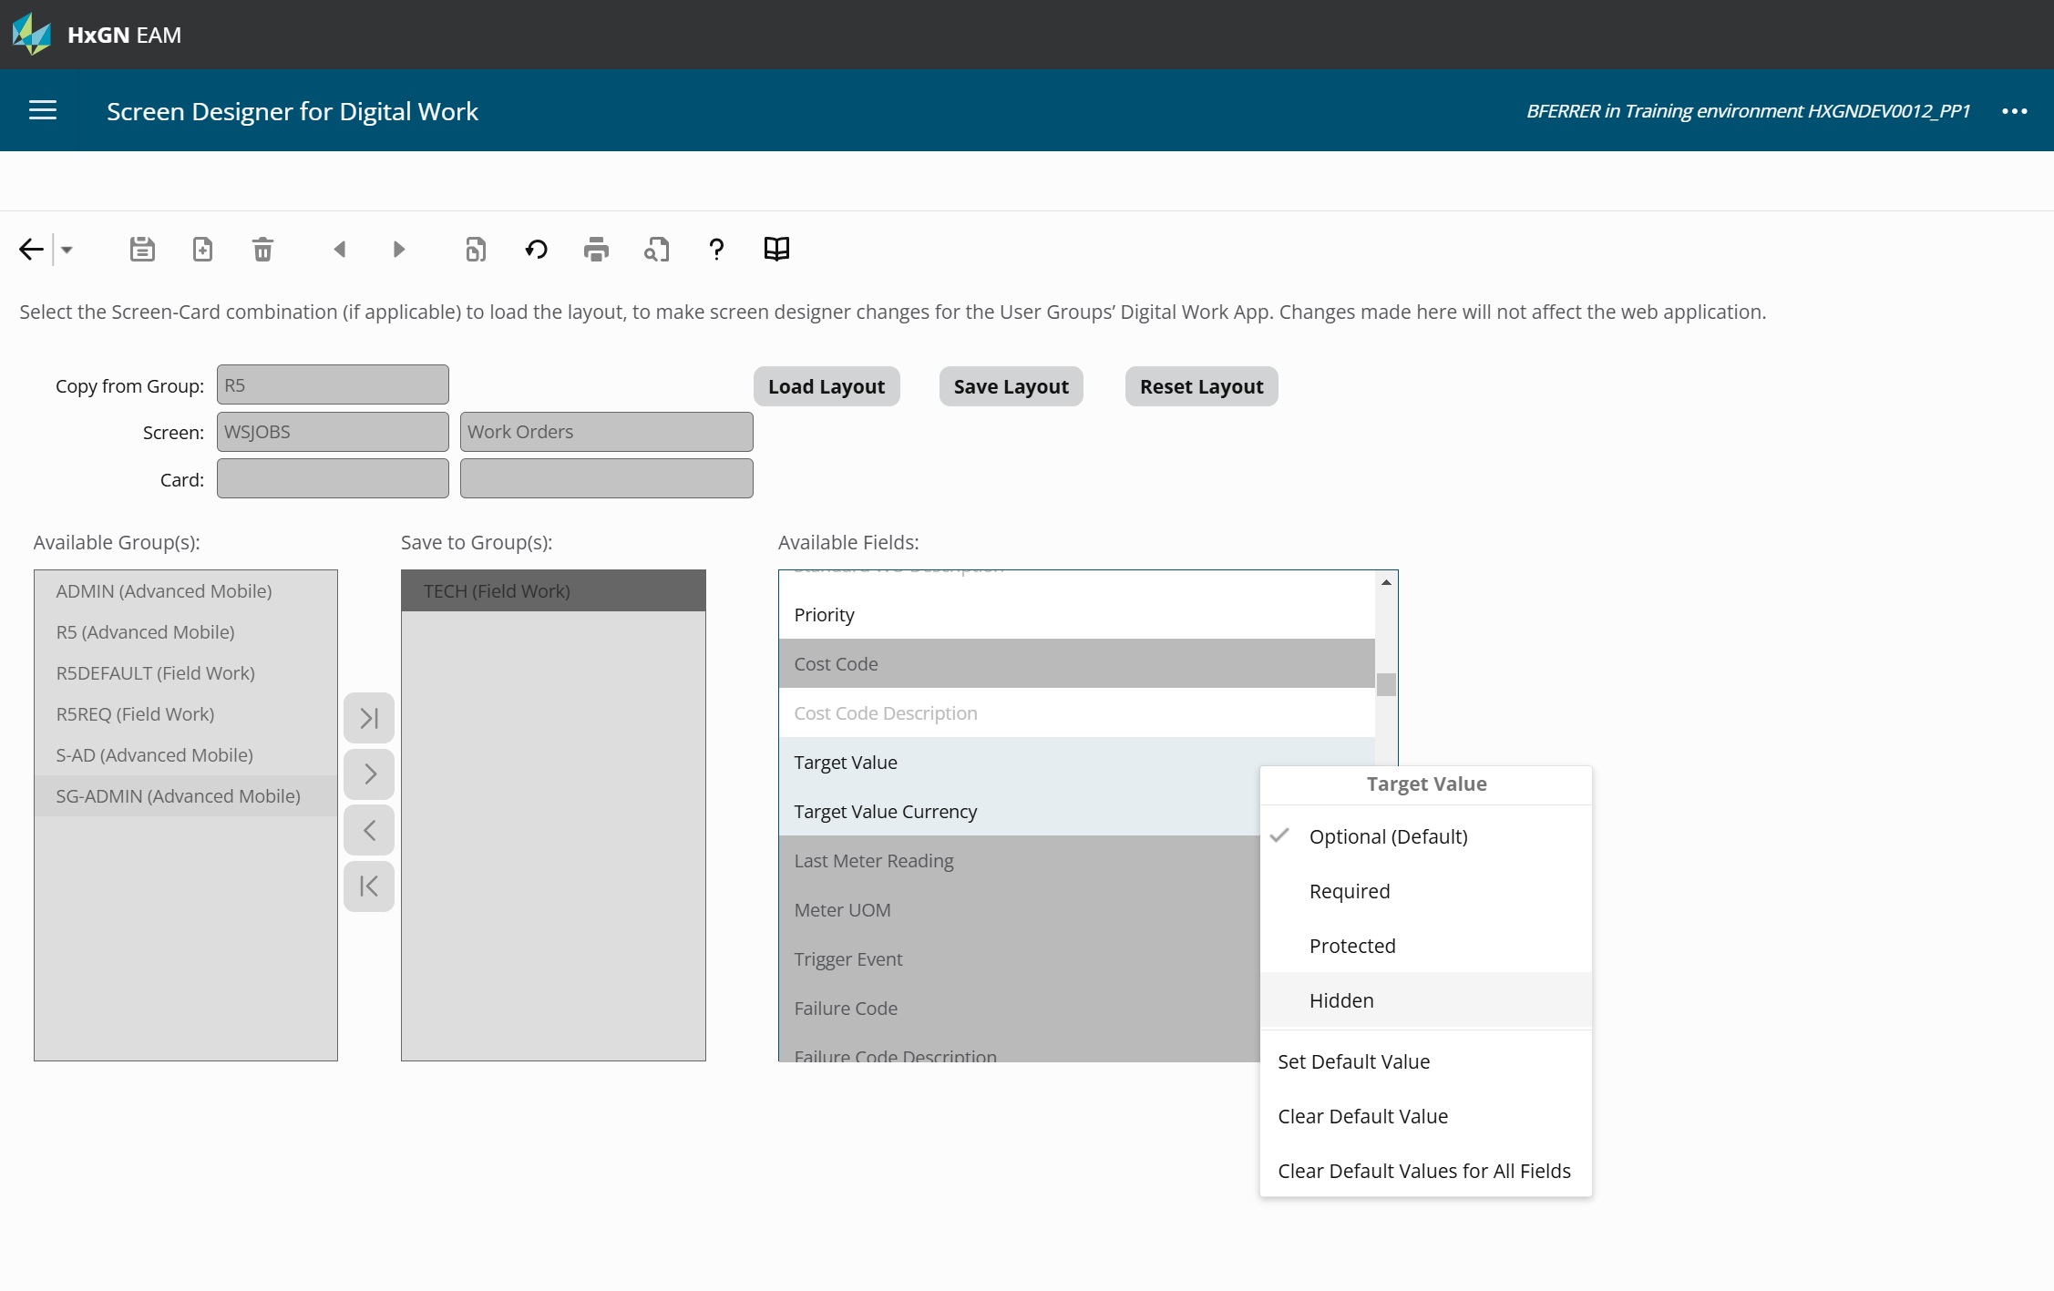
Screen Designer for Digital Work
Screen Designer for Digital Work
Drag fields and section headers up or down, to move positions
Change field attributes
Set default values for fields
Show or hide section headers
Specify whether the section header is part of a new card
Notes:
WSJOBS – Main, Checklist, Parts, Booked Labor, Additional Costs
OSOBJA - Main

Slide 28
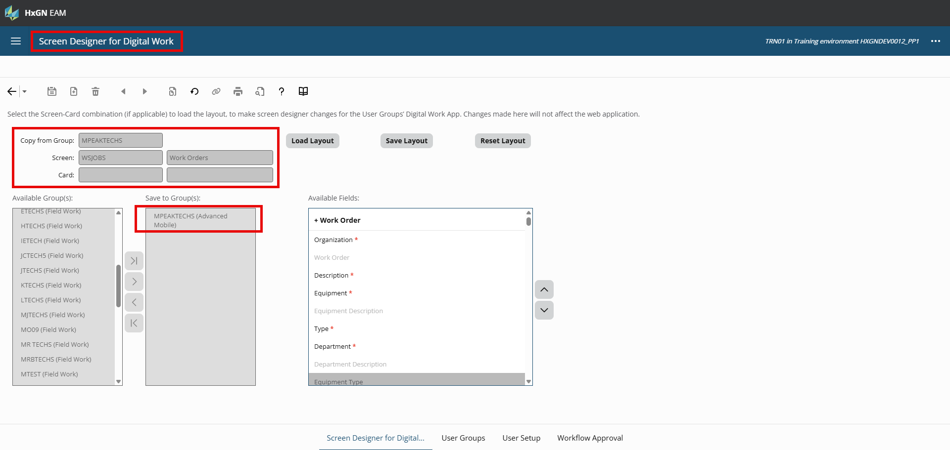

Slide 29
Install Parameters
Parameter | Description | Value
DWBOOKLB | Determines if the book labor record can be edited before submitting the hours worked, when the user touches the Stop button on the activities card in Digital Work. Set to YES to open the book labor edit mode to make corrections to the record before submitting it. Set to NO to automatically book the labor record when the user touches the stop button on the activities card. | NO
DWDEFTAB | Determines if tabs will render like cards, when scrolled on the record view of a screen in Digital Work. Set to ON to load the first 3 tabs set as per tab order, to render after scrolling through the record view cards. Set to OFF to just load the record view and its cards. | ON
DWCHKRUN | Determines if Digital Work will automatically run the dataspy when the user saves the checklist items. Set to ON to run the dataspy when user touches the Save button on the checklists form. Set to OFF to just save the checklist items when the user touches the save button | OFF
DWFILE | Set to YES to make the ‘Select File' option available within Digital Work. Set to NO to remove this option. | YES
DWDOCUDS | Determines if the Digital Work user can enter the document description when using the Quick Document Upload option on the record view. Set to ON to allow entering the document description before upload to the documents tab. Set to OFF to perform the quick document upload without entering the document description. | ON

Slide 30
Install Parameters
Parameter | Description | Value
DWIMGLIB | Set to YES to make the ‘Select from Image Library' option available within Digital Work. Set to NO to remove this option. | YES
DWOLINK | Enables deep linking functions between mobile applications; including navigation links and prompts the user to switch to EAM Mobile Offline from Digital work when the device has lost connectivity. Valid values are ON and OFF. | ON
DWPCMETA | Determines if photo and video metadata will be saved when the Digital Work user uploads a Photo or Video using the Take a Picture or Take a Video options respectively. Set to ON to save the meta data information as part of the file. Set to OFF to not save the meta data information as part of the file. | ON
DWPICT | Set to YES to make the ‘Take a Picture' option available within Digital Work. Set to NO to remove this option. | YES
DWPCMASK | Determines if the Digital Work user has to wait for the photo upload to be successful when using the Quick Document Upload - Take a Picture option on the record view. Set to ON to turn on the masking mechanism which will wait for the photo upload to be successful. Set to OFF to turn off this masking mechanism. | ON
DWROPEN | Determines if the system will open the List or Detail view in Digital Work, after creating a new record. Set to ON to open the detail view. Set to OFF to open list view. | ON

Slide 31
Install Parameters
Parameter | Description | Value
DWPCSAVE | Determines if the Digital Work user will have their photos automatically saved in the default image library when using the Take a Picture option. Set to ON to automatically save the photo. Set to OFF to not save the photo. | OFF
DWVIDEO | Set to YES to make the ‘Record a Video' option available within Digital Work. Set to NO to remove this option. | YES
DWIMGLIB | Set to YES to make the ‘Select from Image Library' option available within Digital Work. Set to NO to remove this option. | YES
DWVOICE | Set to YES to make the ‘Record Voice Memo' option available within Digital Work. Set to NO to remove this option. | YES
DWMAILOP | Determines if the email being sent to a Digital Work user with a Drill Back URL opens the digital work app or not. Set to ON, to open the Digital Work app when accessing the URL. Set to OFF to open the default mobile browser set for the device. | ON
DWNFCKEY | Determines the value to be used as the key when populating data after performing an NFC scan in Digital Work. Specify the key to be used when populating the dataspy search bar after scanning an NFC tag in Digital Work. When using JSON format for an NFC tag and a key/value pair like "AssetID": 32132, “Zip” : 29607 exists, specifying a value of AssetID in this install parameter indicates that the system will populate 32132 in the dataspy search bar.

Slide 32
Install Parameters
Parameter | Description | Value
GLOBPART | Determines if global search is enabled inside the Parts lookup when using barcode scanning or quick filter, on the Parts tab of Work Order for Digital Work. If set to 'YES' , then scanning the bar code/quick filter will do a global search. Leave blank to use the default PART search inside the parts lookup. | YES
GPSLSDMF | Enable Location Based Services Data Recording. The location will be tracked locally as the device moves; however, the latest location will not be sent to the server any more frequently than value specified in this parameter. Valid values are 0 and positive integers >= 5. Set to 0 to disable distance-based location recording. Set to a positive integer >= 5 to enable distance-based location recording and establish the maximum frequency, in minutes, for which the latest location is sent to the server. This parameter applies to the Digital Work app only. If distance-based and time-based location recording are both enabled, Digital Work will only use distance-based location recording. | 30
QUICKLOV | Determines whether the quick filter inside a lookup will default to show the first field in the grid in Digital Work. Set to YES to default the quick filter as the first field in the grid, as set in the dataspy layout in base EAM. Set to NO to make the quick filter default to ‘Code' or Primary key of that lookup. | YES
Organization Option
PTWSIGN | Determines if the Signature field will be available, for capturing a physical signature in the Contractor Sign Off pop-up for Permit to Work in the Digital Work mobile application. If set to YES, then show the Signature field inside pop-up. If NO then this field will not be shown. | YES

Slide 33
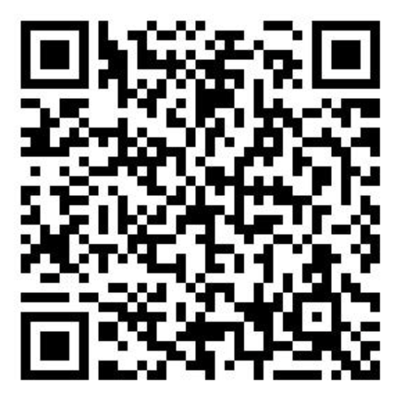
Digital Work App
Log in to Digital Work with the user you created
Settings
If Enable Single Sign On is set to ON: The user must have a valid value for the DYNSSOTN install parameter in EAM Base. The install parameters DXSOFATH and BRSOFATH will only be honored with the Hexagon Cloud.
If Internal Authentication is set to ON, it will provide a mechanism similar to base EAM, wherein - even if the build is configured to support SSO using the SSO configuration screen, it provides an alternate authentication mode which allows for authentication to be handled by EAM. In base EAM, this is done by passing the authentication parameter in the URL of the login. This check box is the Digital Work equivalent.
When this check box is turned ON, the passwords will no longer be managed by the SSO provider but will be at the user level.
If Enable Biometric Login is set to ON, the user can use biometrics to log in (i.e., using either Face or Touch, depending on the configuration of the device and operating system).
Enable Single Sign On and Enable Biometric Login cannot be enabled at the same time. Choose one option. If you choose one and then attempt to enable the other option, the first option is disabled.
The user can Clear Temporary Files in the application before logging in. This will clear the application’s temporary files.
If the user forgets their password, they can reset it by pressing the Forgot Password button (i.e., if the install parameter PASSRSET is set to YES, like in base EAM). This will send an email to the email address configured for the user where it can be reset.
Notes:
Enable Biometric Login
List view preview field editing,

Slide 34
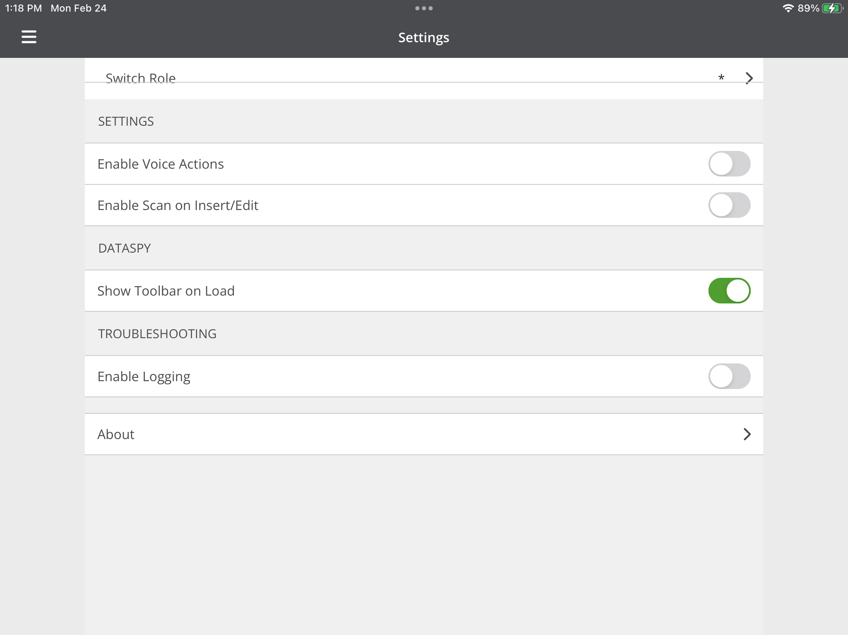
Digital Work App
User’s Settings
View/Enable Logs and troubleshoot issues
View Information such as build version/device name – using the About option
Enable Voice Actions – Allow easy navigation to screens using voice actions by using Go to <Screen/Report> or Open <Screen/Report>
Enable Scan on Insert/Edit – Turning this check box ON, will enable a toolbar with scanning functionality, in the insert/edit mode. This feature will be available for ‘Text’ and ‘Number’ fields only.
Show Extras Toolbar when loading a screen.
Switch Role: Ability to switch roles – if configured in base EAM

Slide 35
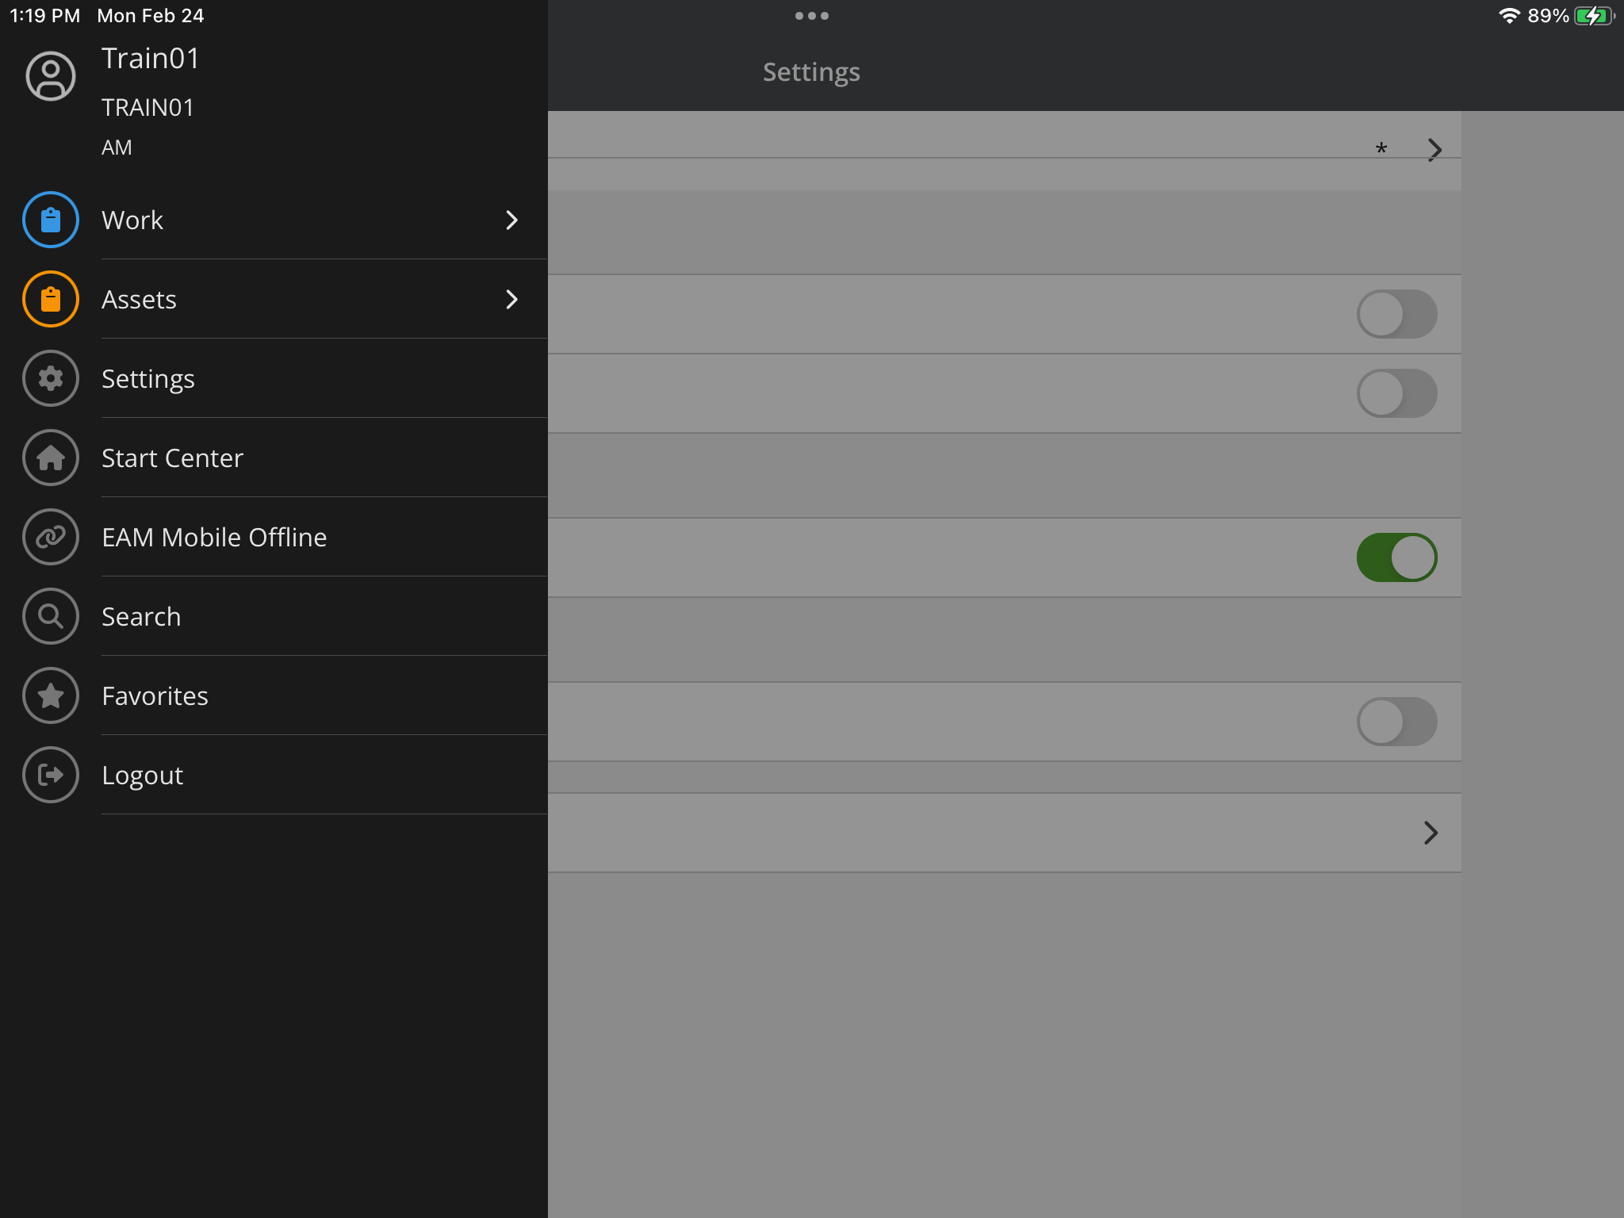
Digital Work App
Other standard menu options
Search: This is the equivalent of using the Jump to Screen feature in base EAM.
Favorites: Ability to make a screen/report as a favorite and accessing it via the Favorites screen.
Start Center: This returns the user to the Start Center.
Logout: Logs the user out of Digital Work.

Slide 36










Digital Work App
List View, first screen that appears
Dataspy Option Icon to select the Dataspies applicable for the logged in user.
Filter/Sort option Filter Sort Icon to filter/sort based on the dataspy selected.
Barcode icon Barcode Icon
NFC Scanning Capability NFC Icon
Search option Search Icon to search/run the dataspy, based on the filter applied. The search performed is a ‘Contains’ search on the summary grid fields, if no filter is applied.
Adding a new record Add Icon, go to the insert mode of the selected screen.
Record View, once record selection is made
Add/Edit Comments: This navigates to the comments tab to add/edit comments
Add/Edit Documents: By selecting this option, the user can:
Take a Picture, Record a Video, Select from Image Library, Record Voice Memo, Select File, Multi-Document Upload, Navigate to the Documents tab
Edit Record
Actions menu
Copy Record, Delete Record, Print Record, etc.

Slide 37
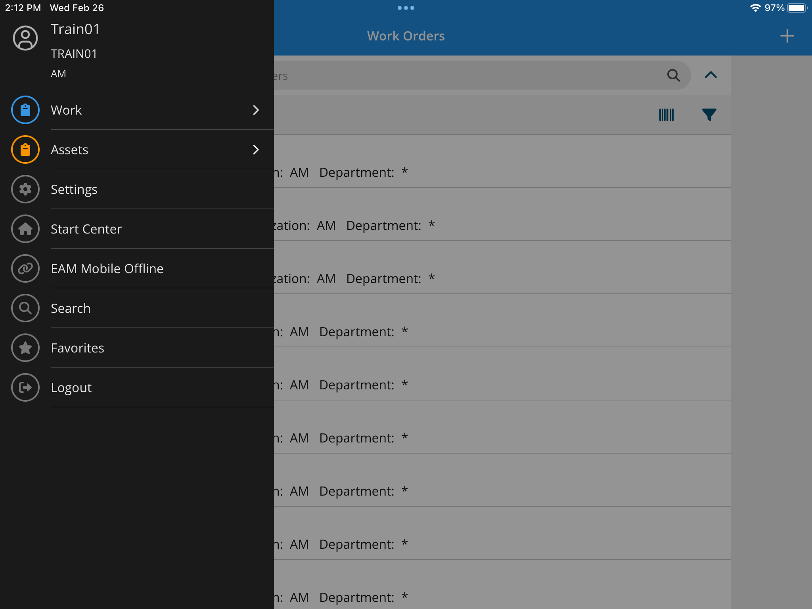
Digital Work
Review work order screens
Review asset screens

Slide 38
Your Turn!
Create a Parts & Inventory User Group
Use the ‘Advanced Mobile’ license type
Create a User for this User Group
Name appropriately so you can distinguish them from your Technician
Add and design Screens
Note the different screens that are available for Field Work vs. Advanced Mobile
Screens Available in Digital Work: https://docs.hexagonppm.com/r/en-US/HxGN-EAM-Digital-Work/12.1/1280393

Slide 39

BREAK!
Think about
What are we missing?
What do we want to see more or less of?

Slide 40
Agenda
SECTION 1
Introductions and Logins
SECTION 2
Three License Types
SECTION 3
Digital Work Setup
SECTION 4
Digital Work Exercises
SECTION 5
Digital Work Vs. EAM Mobile Offline

Slide 41
Digital Work Exercises
Objective:
Make a few tweaks for the user experience
Exercise 1 – Add Reports and a cloned screen
Exercise 2 – Default Tabs
Exercise 3 – Add an Inbox entry to start center, change the dataspy
Exercise 4 – Set up Digital Work Home Screen
Exercise 5 – Edit Dataspies

Slide 42
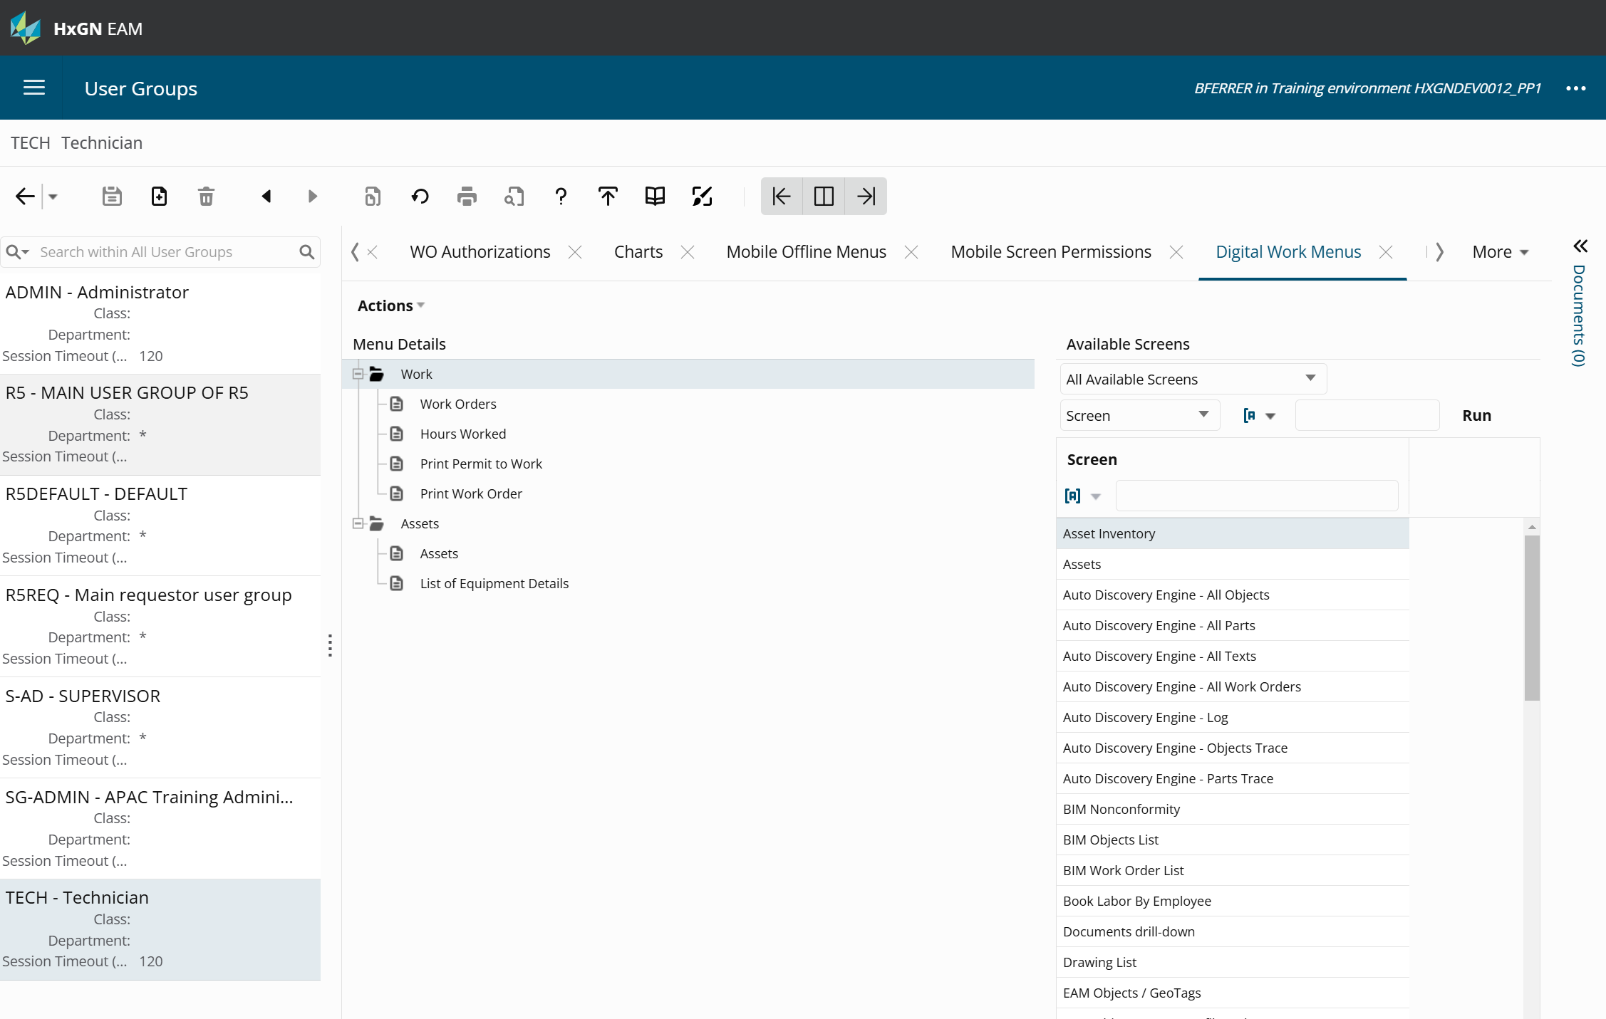
Exercise 1
Add – ‘List of Work Orders’ Report
(WZLWOQ)
Add – ‘Equipment History’ Report
(OZHISL)
Add cloned screen – Inspection Rounds
(JOBSIR)

Slide 43
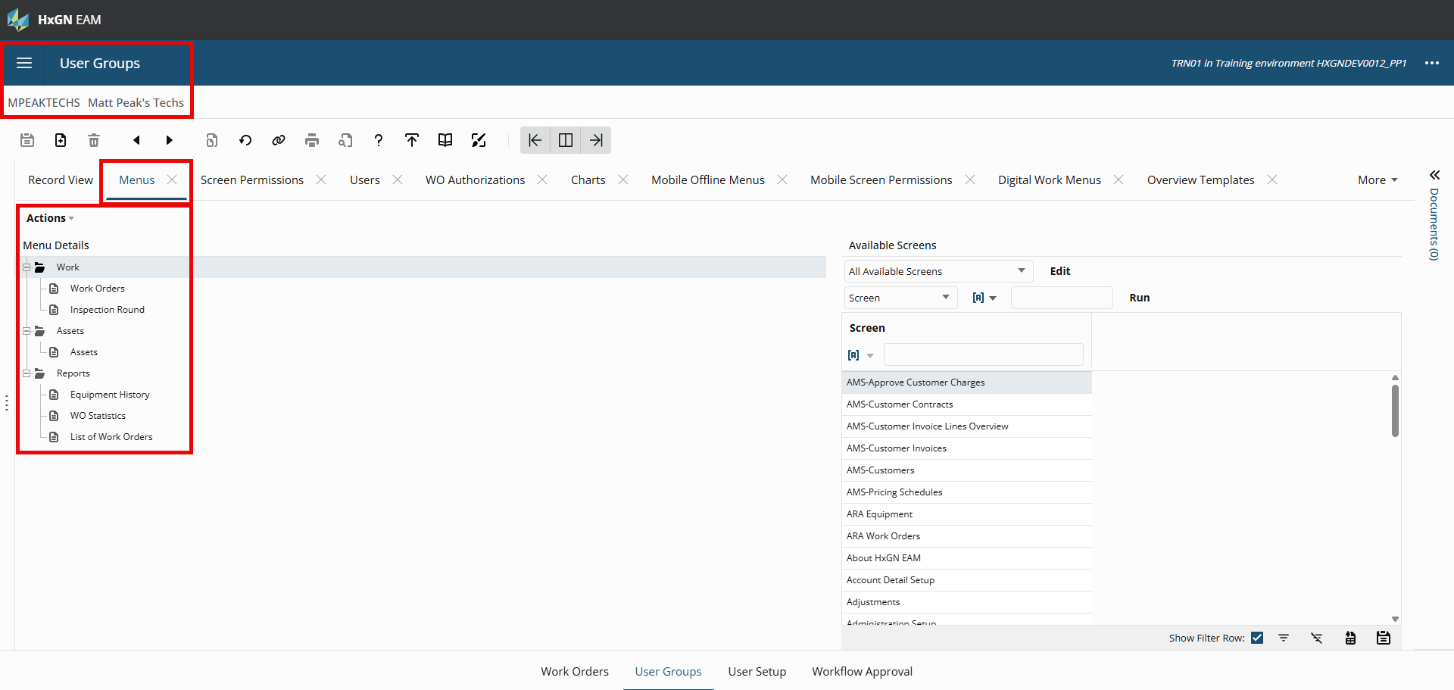

Slide 44
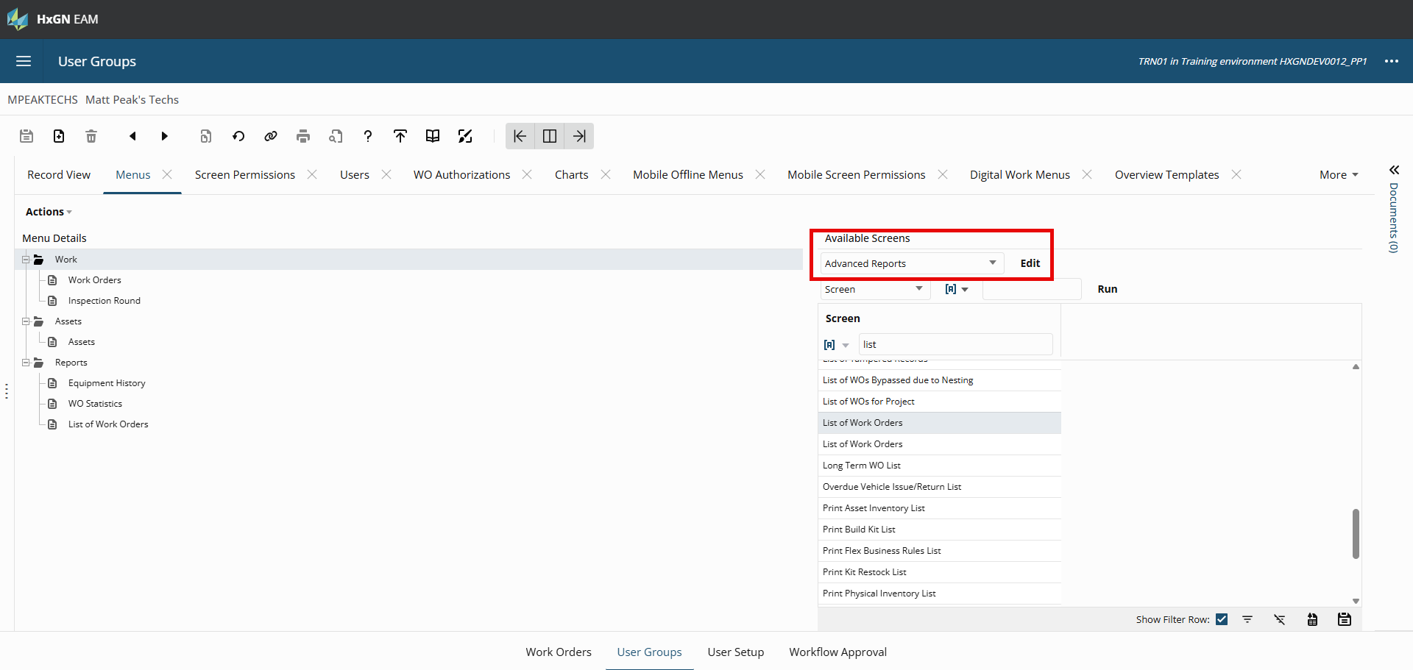

Slide 45
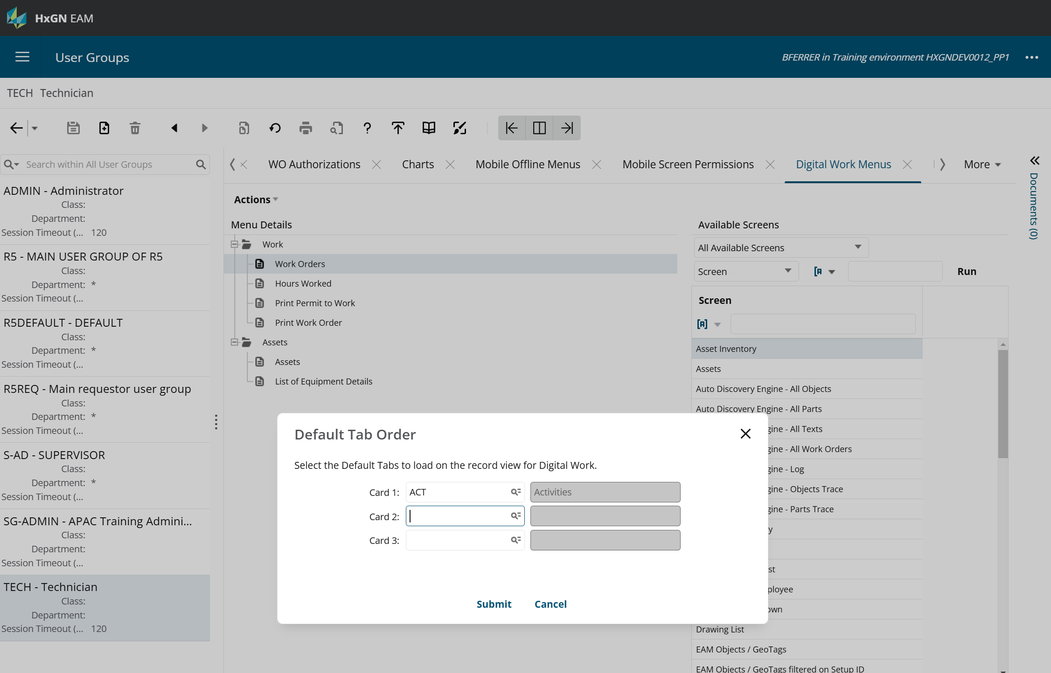
Exercise 2
Set Default tab order

Slide 46
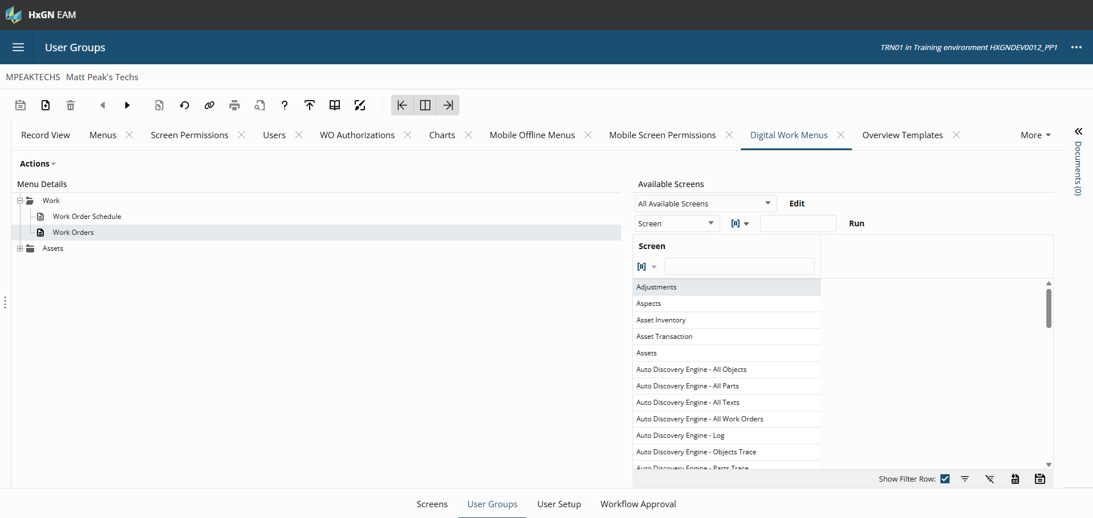

Slide 47
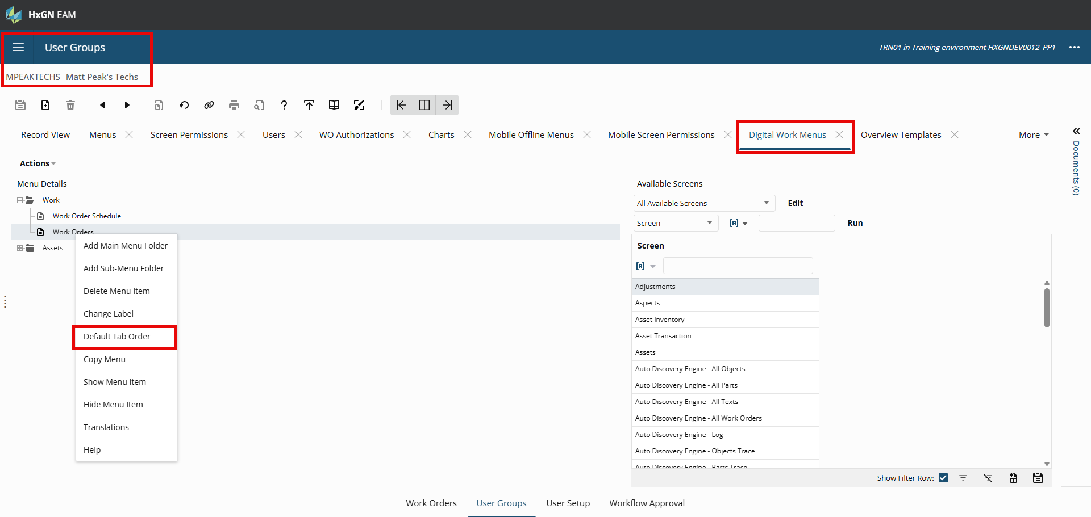

Slide 48
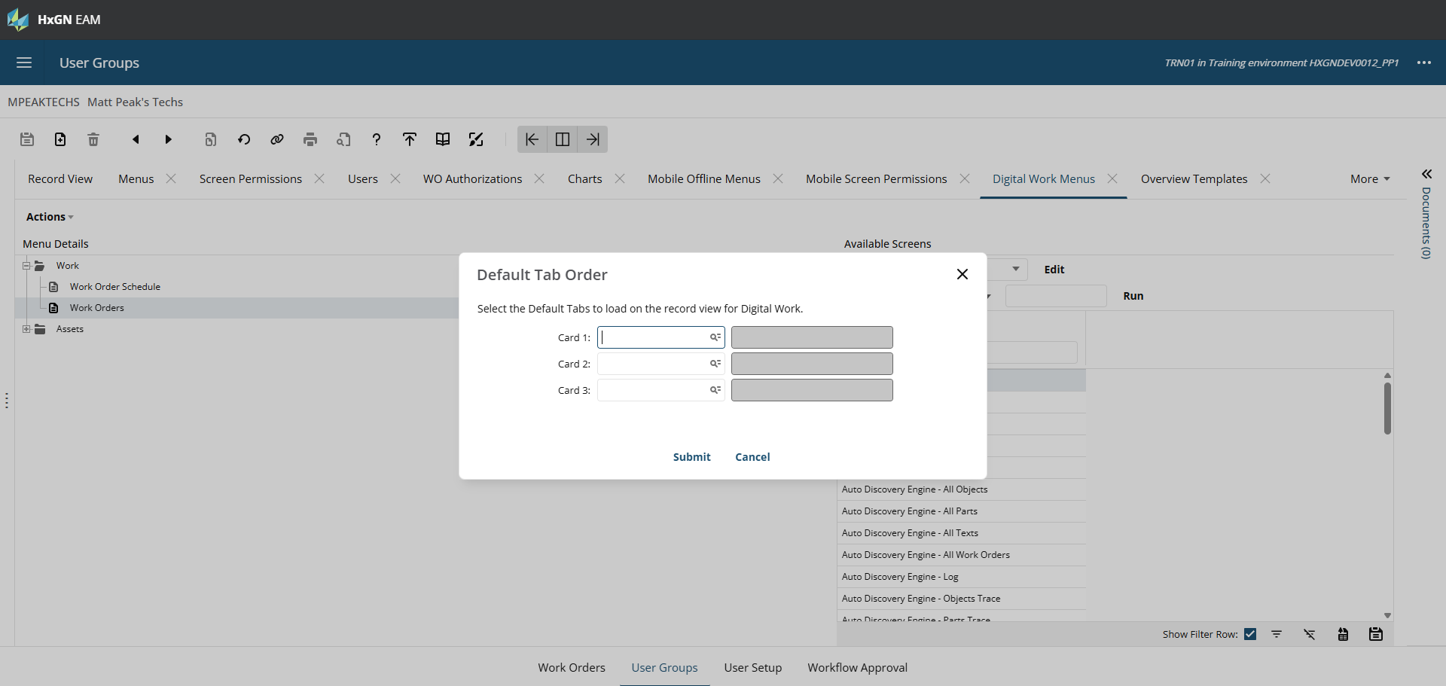

Slide 49
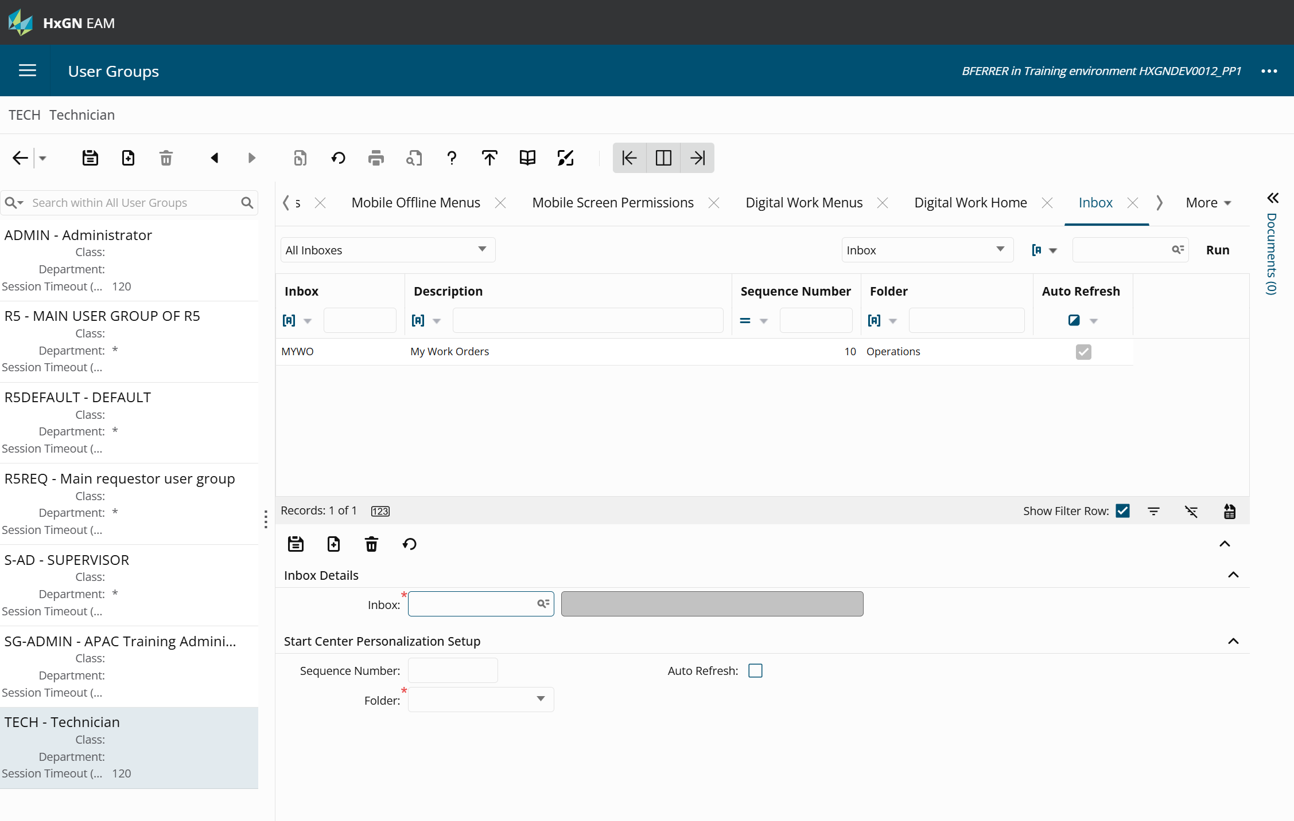
Exercise 3
Add Inbox Entry
Add/Change WO Dataspy

Slide 50
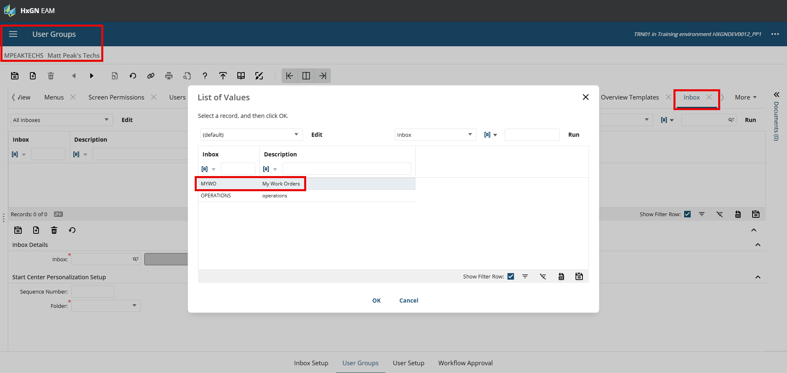

Slide 51
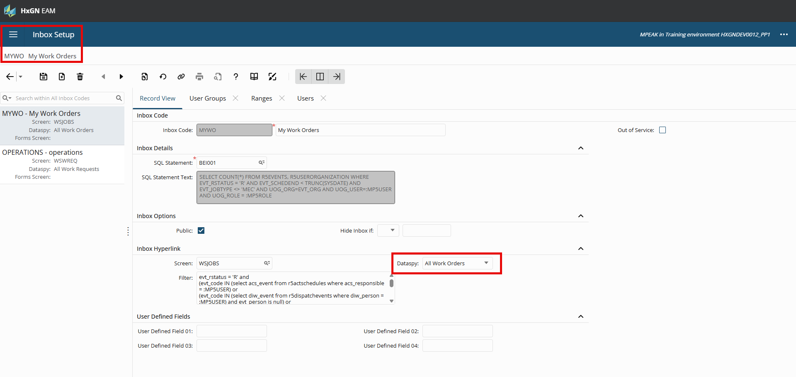

Slide 52
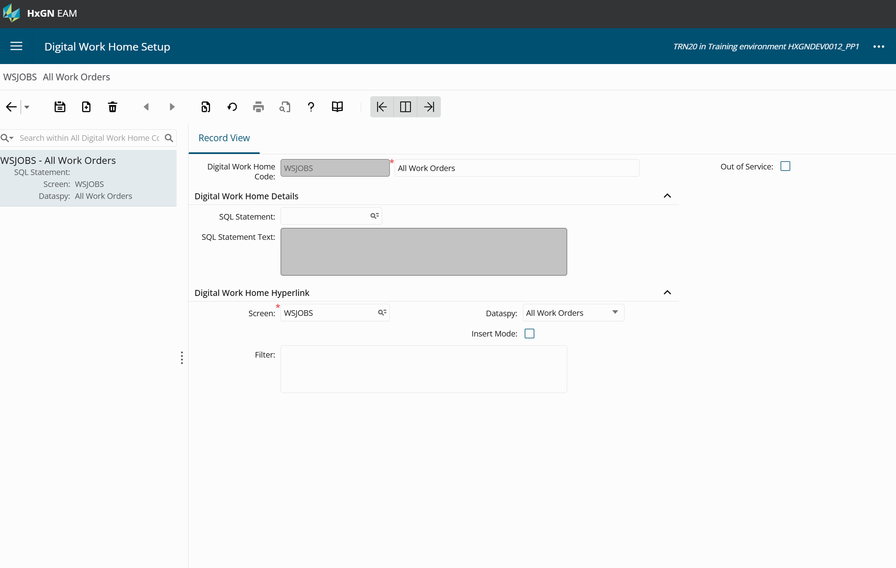
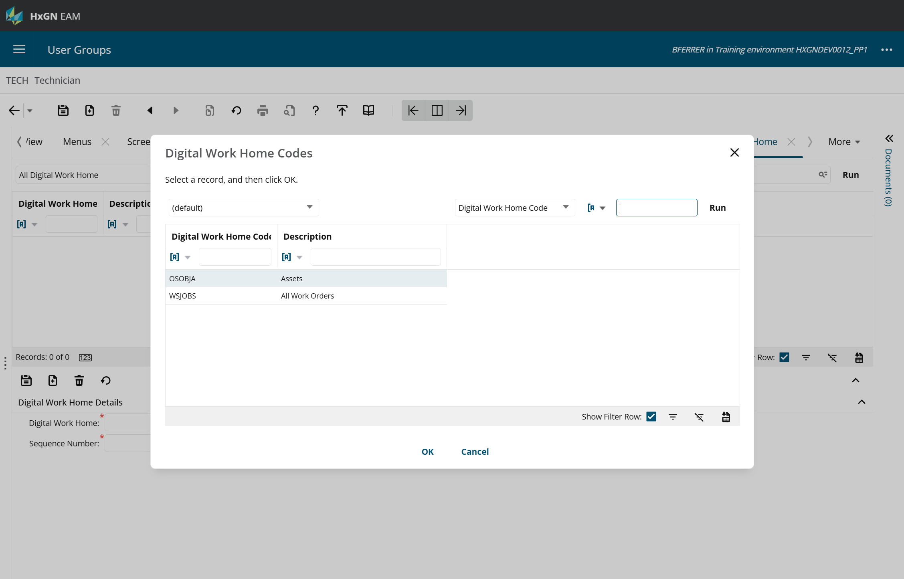
Exercise 4
Set up DW Home Screen
Associate these screens to the user group in Digital Work Home

Slide 53
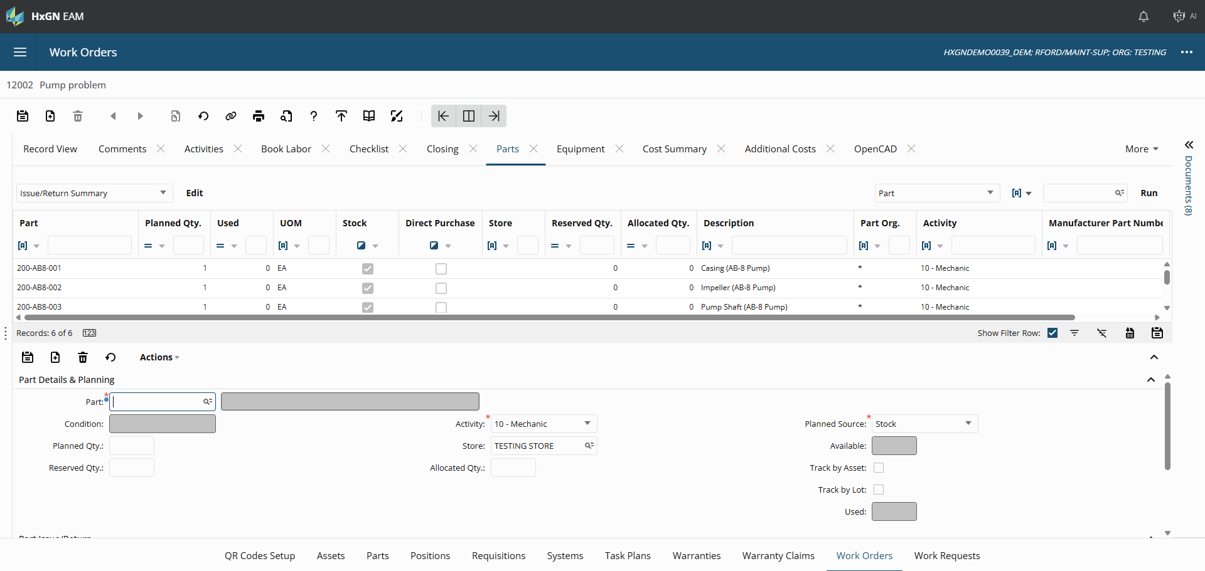
Exercise 5
Edit Dataspies - Parts
Notes:
Note that it’s different screen types for mobile offline and digital work

Slide 54
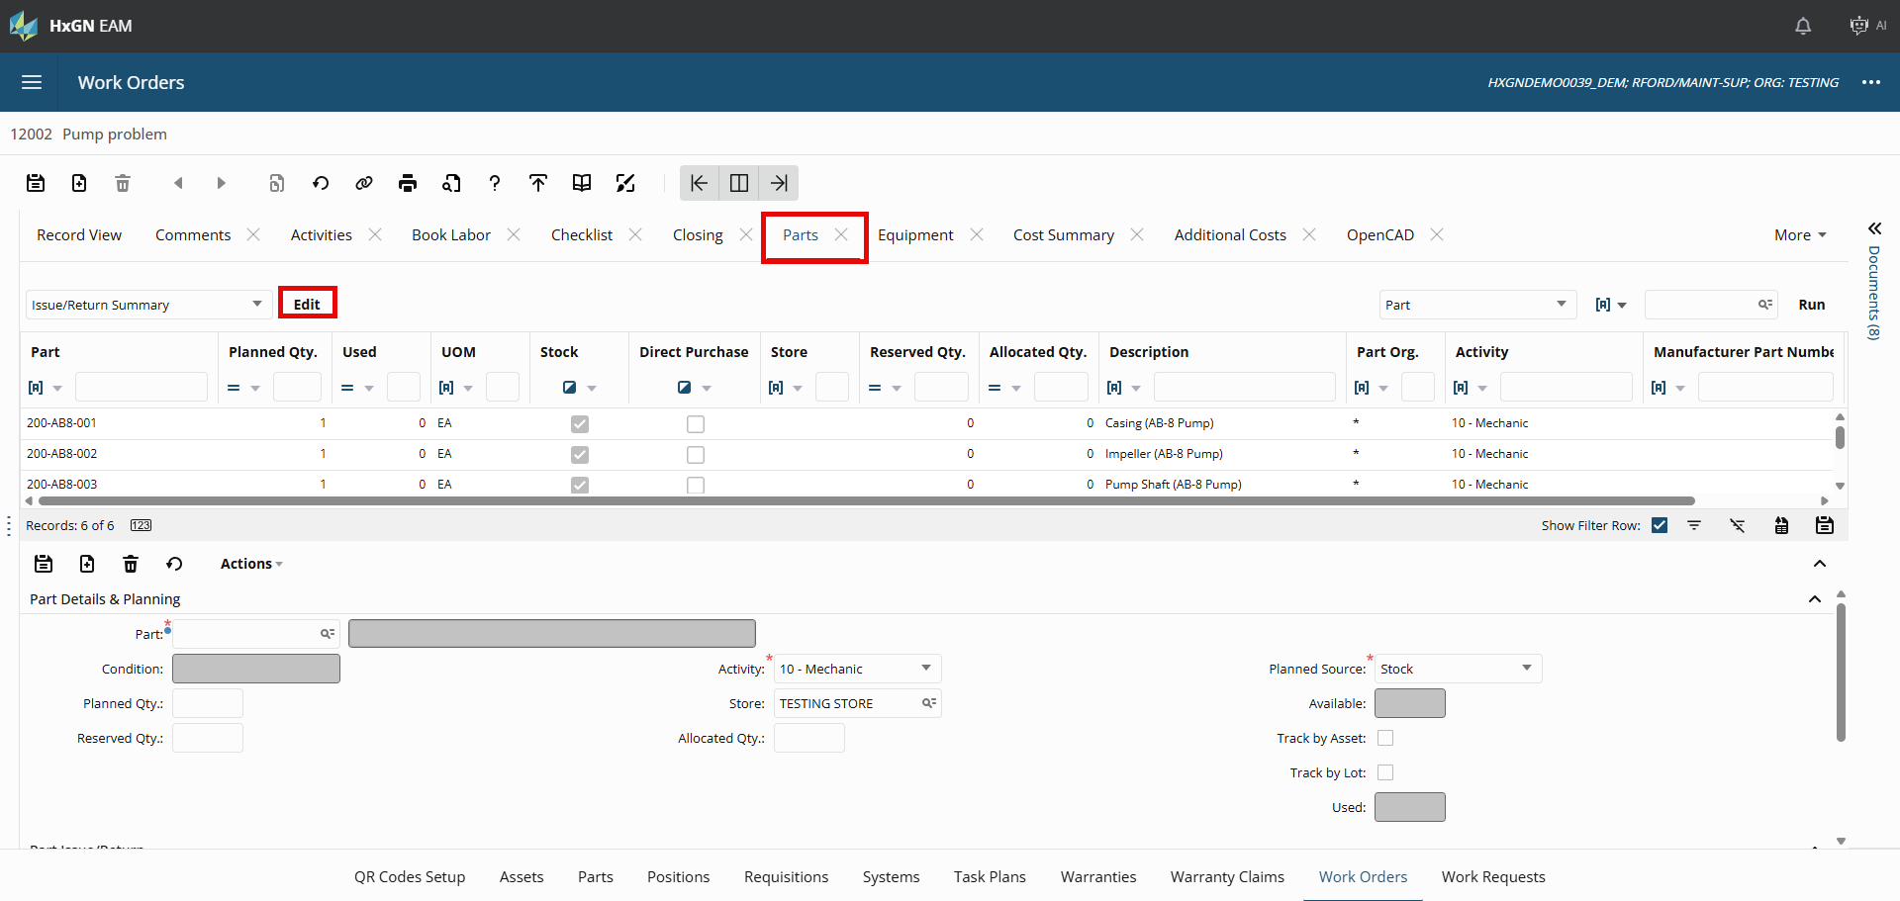

Slide 55
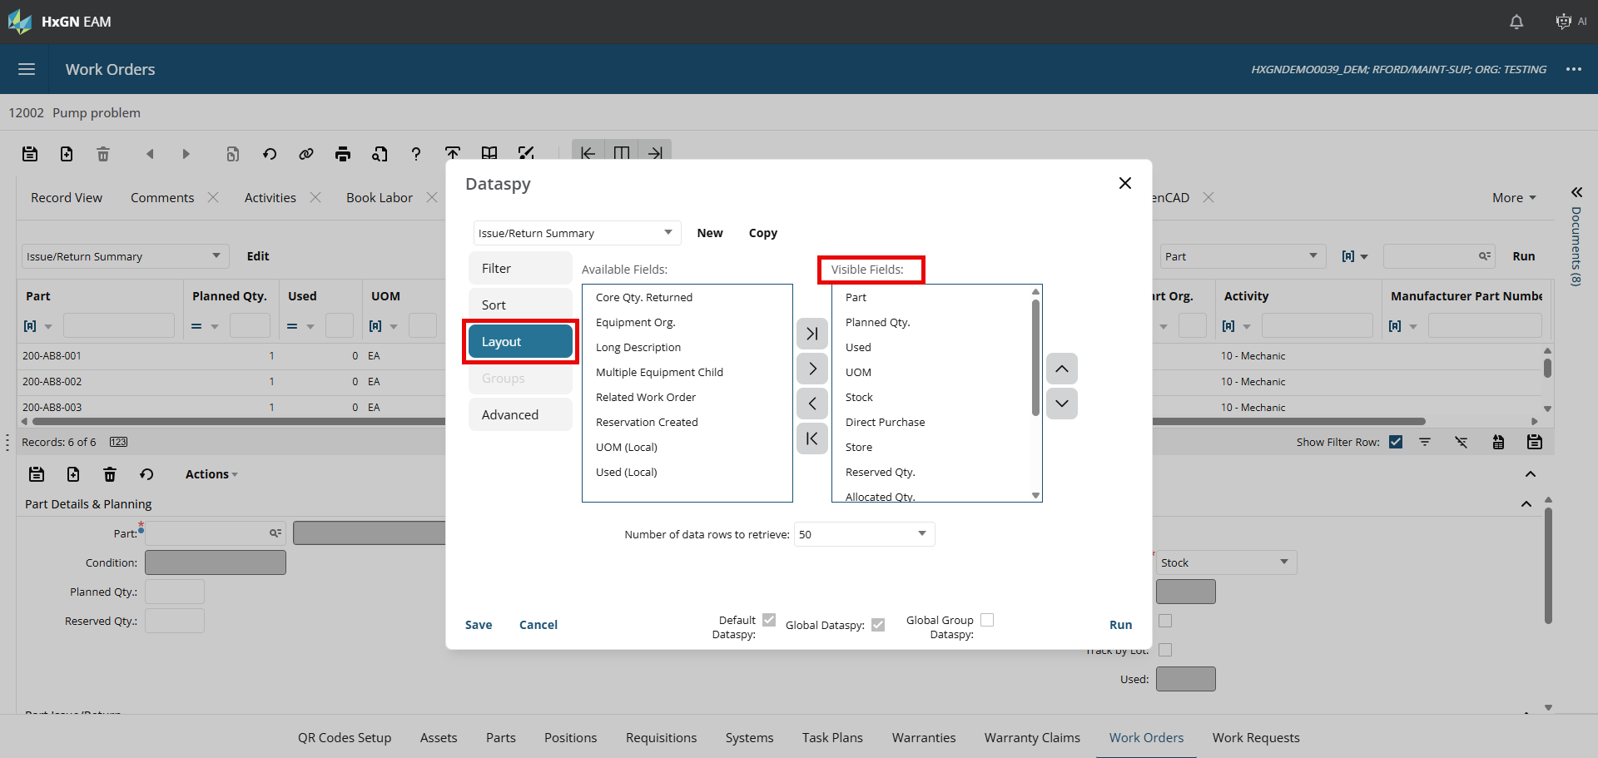

Slide 56
Agenda
SECTION 1
Introductions and Logins
SECTION 2
Three License Types
SECTION 3
Digital Work Setup
SECTION 4
Digital Work Exercises
SECTION 5
EAM Mobile Offline

Slide 57
Differences between mobile apps
Digital Work
Digital Work Menus
Digital Work Home
Reporting
Grids
User Defined Screens
EAM Mobile Offline
Mobile Settings
Mobile Screen Permissions
Mobile Offline Menus
GIS capabilities (online/offline maps)
Work Order Checklists
Breadcrumbs
Notes:
Cloned screens off of copies of screens you have access to works

Slide 58
Mobile Offline Exercises
Objective:
Make a few tweaks for the user experience
Exercise 1 – Change Mobile Work Order Dataspy
Exercise 2 – Mobile Offline Screen Designer
Exercise 3 – Sync Configuration

Slide 59
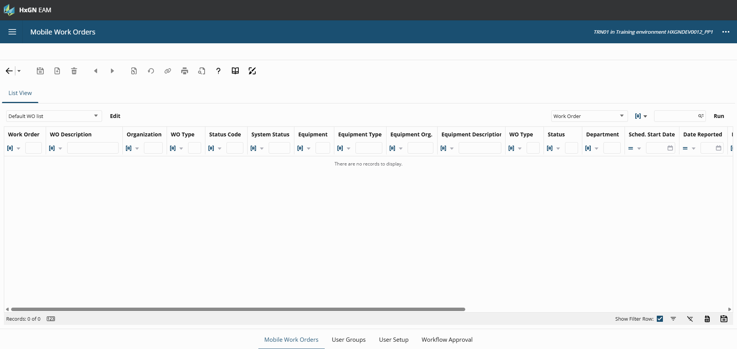
Exercise 1
Change Mobile Work Order Dataspy

Slide 60
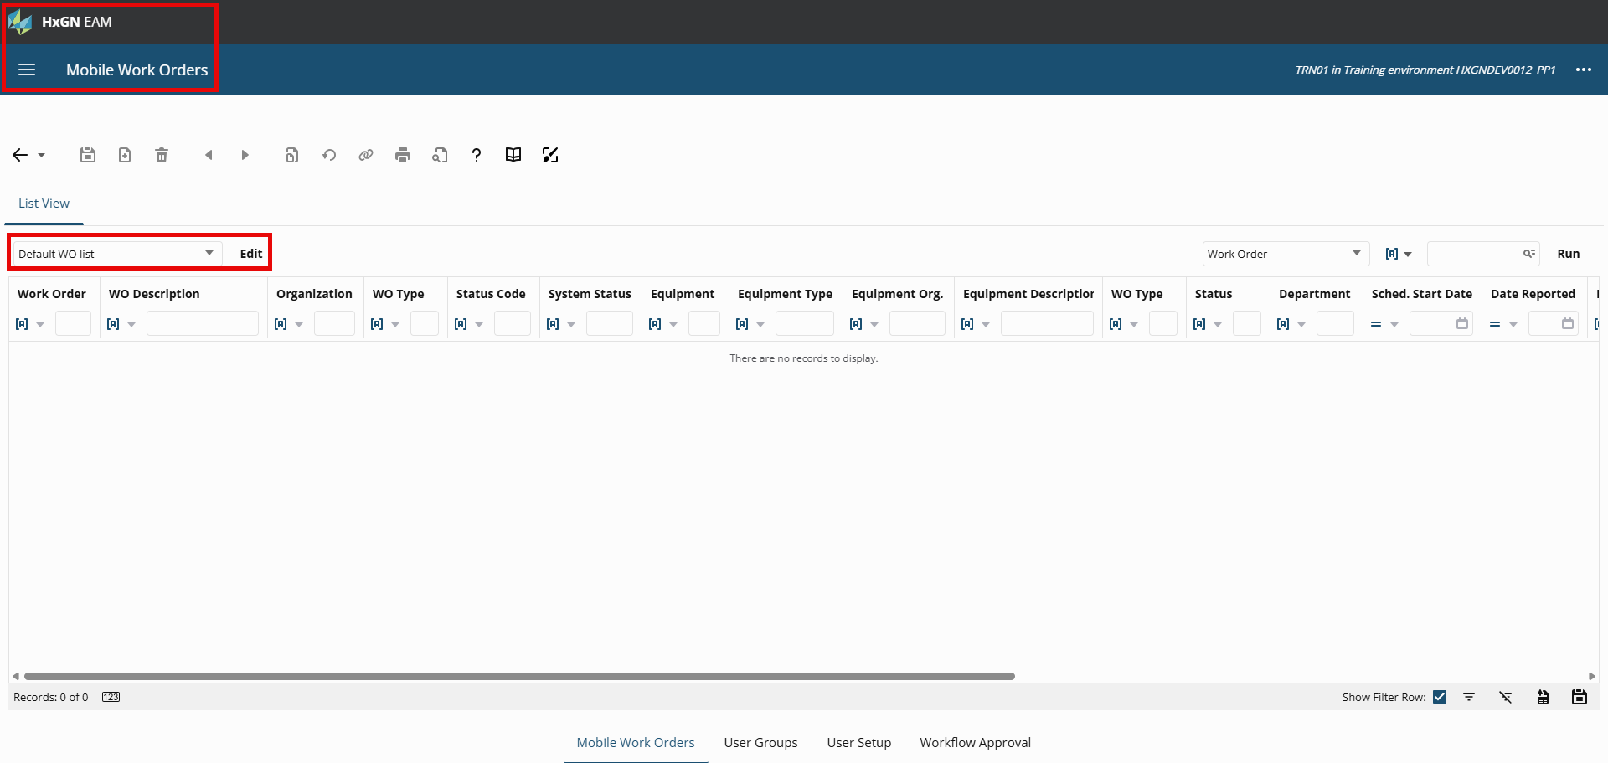

Slide 61
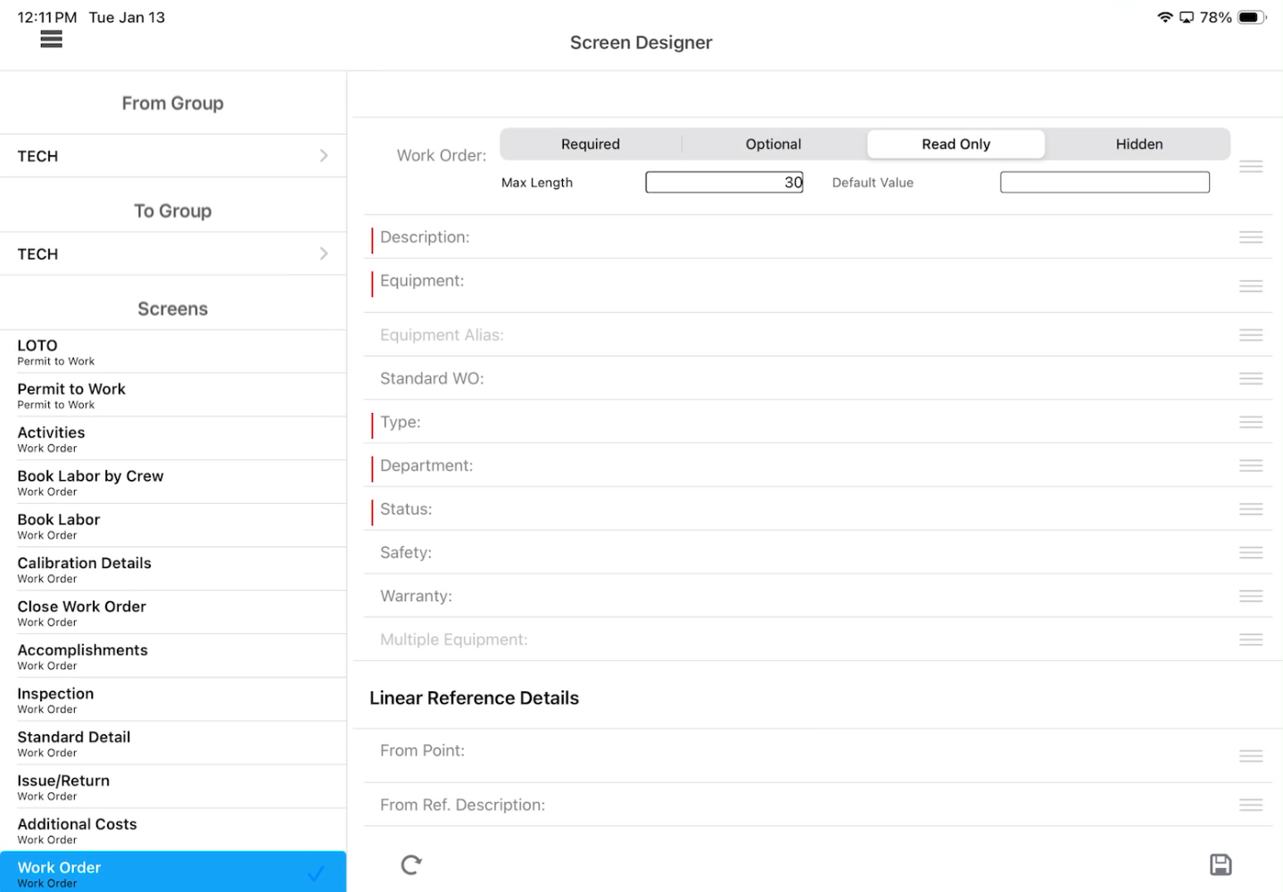
Exercise 2
Mobile Offline Screen Designer

Slide 62
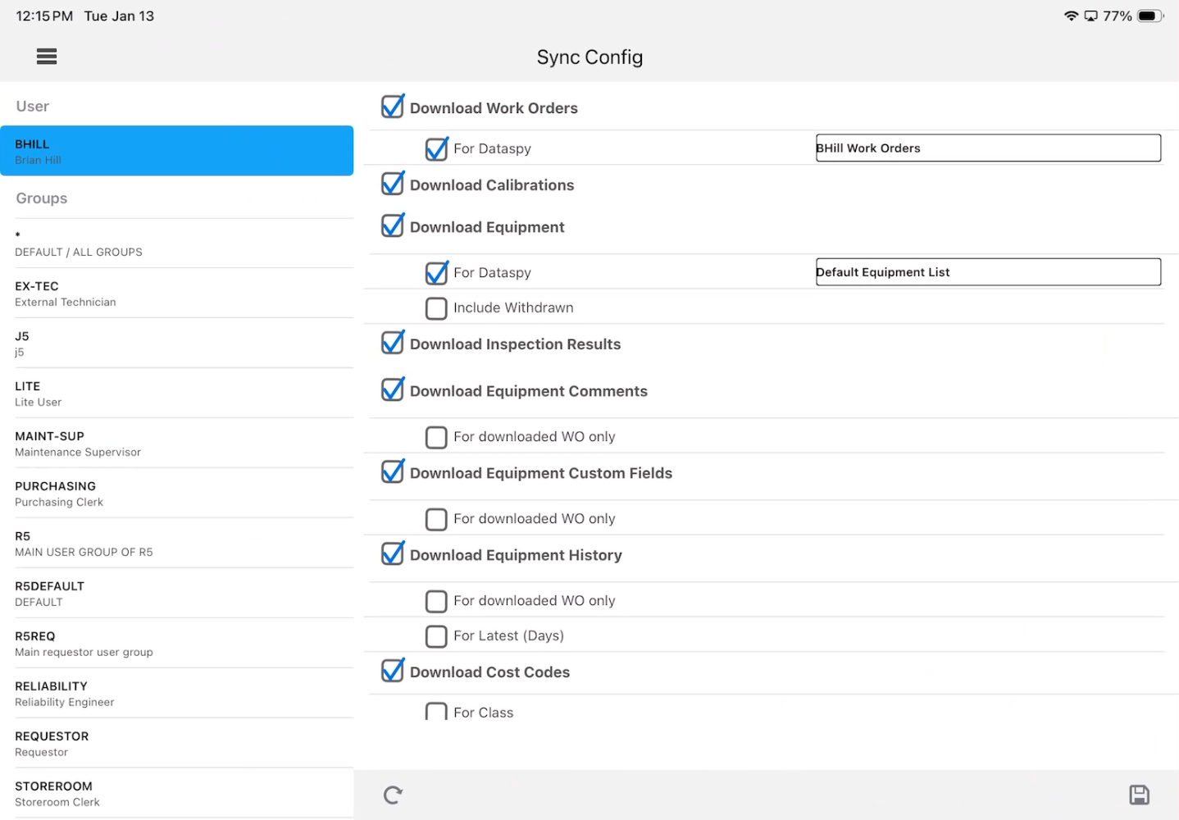
Exercise 3
Sync Configuration

Slide 63
Questions?

Slide 64
Tips (Leave Behind)
Deep links in email notifications
For Digital Work (iOS) - com.hxgn.eam.dux://open?sr=WSJOBS&name=workordernum&value=%1
%1 is the WONUM parameter as defined in the notification setup
For Digital Work in Android:
http://dux.eam.hxgn.com/open?sr=WSJOBS&name=workordernum&value=%1
For Mobile Offline (iOS):
com.hxgn.EAMTransit://open?sr=WCJOBS&WO=workordernum&ACT=1
For Mobile Offline (Android):
http://com.hxgn.eam.transitapp/?sr=wcjobs&wo=workordernum&act=1

Slide 65
Tips (Leave Behind)
Script to update mobile for existing user
DECLARE
vOrg varchar(30);
chk varchar(4);
BEGIN
SELECT ORG_CODE INTO vOrg
FROM R5ORGANIZATION
WHERE ROWID = :ROWID;
IF vOrg = '*' THEN
/*Update specific groups to Advanced Mobile. THIS ONE NEEDS YOUR INPUT! */
UPDATE R5GROUPS
SET UGR_MOBILEAPP = 'FW'
WHERE UGR_CODE IN ('0000-DFW') /* UPDATE YOUR USER GROUPS HERE!!!!!!!!! Rest will run from there */
AND UGR_REQUESTOR = '-';
UPDATE R5USERS A
SET USR_MOBILEAPP =
(SELECT UGR_MOBILEAPP FROM R5GROUPS B WHERE A.USR_GROUP = B.UGR_CODE AND B.UGR_MOBILEAPP IS NOT NULL);
END IF;
END;

Slide 66
Evolution of Digital Work
Enter Text Here
Enter Text Here
Enter Text Here
Enter Text Here
Description
Description
Description
Description

Slide 67
Title With Image

Slide 68
Enter Heading
Click icon in box to the left to add image. Intended to fill entire side.

Slide 69
Enter Heading
Click icon in box to the right to add image. Intended to fill entire side.

Slide 70
Exercise 5
Enable push notifications

Slide 71
Enter Heading
Use bolded green text to emphasize text in a block. Continue text in regular weight and color.

Slide 72
Enter Heading
Steps or Topics
Steps or Topics
Steps or Topics
Steps or Topics
Enter a long or short description. Box will adjust length automatically.
Example
Description
Enter a
long
or short
description.
Box will
adjust the
length
automatically.
Example of
different
description
length.

Slide 73
Please Read Before Editing
Please explore all slide options to see which format fits your content the best. If you run into any issues during editing or need additional slide options, please reach out to events@streamlineconferences.com
Presentation font is Arial Nova (Light, Regular, Bold). This should be available to everyone but, if not, Arial is the next preferred.
Colors to use in addition to black are listed below:
Light Green Accent Color: 3BA40F

Slide 74
Outline
SECTION 1
Enter Text Here
SECTION 2
Enter Text Here
SECTION 3
Enter Text Here
SECTION 4
Enter Text Here
SECTION 5
Enter Text Here

Slide 75
Enter Header
Add text or image

Slide 76
Enter Header
Add text or image

Slide 77
Enter Header
Add text or image
Add text or image

Slide 78
Title With Image

Slide 79
Enter Heading
Click icon in box to the left to add image. Intended to fill entire side.

Slide 80
Enter Heading
Click icon in box to the right to add image. Intended to fill entire side.

Slide 81
Timeline or Flow
Enter Text Here
Enter Text Here
Enter Text Here
Enter Text Here
Description
Description
Description
Description

Slide 82
Enter Header
Enter Text Here
Enter description
Enter Text Here
Enter description
Enter Text Here
Enter description

Slide 83
Enter Heading
Use bolded green text to emphasize text in a block. Continue text in regular weight and color.

Slide 84
Enter Heading
Steps or Topics
Steps or Topics
Steps or Topics
Steps or Topics
Enter a long or short description. Box will adjust length automatically.
Example
Description
Enter a
long
or short
description.
Box will
adjust the
length
automatically.
Example of
different
description
length.

