Slide 1




Session Title
From Chaos to Clarity
Unifying Asset Intelligence and Smart Scheduling
Vivek Chintalaboyina
Robert Maulding

Slide 2


Speaker Intro
Vivek Chintalaboyina, Founder & CEO, IT Xperts Hub
Masters in Computer Science
25 years of experience in Enterprise Software Solutions
Delivered Solutions for various industries
AI / ML Solutions Visionary – Global Leader
Robert Maulding, Senior Business Analyst, Transocean
Masters in Management and Administrative Sciences, B.S. in Nuclear Engineering Technology
13 years Offshore Drilling Industry, 8 years US Navy Nuclear Propulsion Program
EAM implementation training lead and instructor
EAM support Business Analyst, solution tester, and security lead

Slide 3



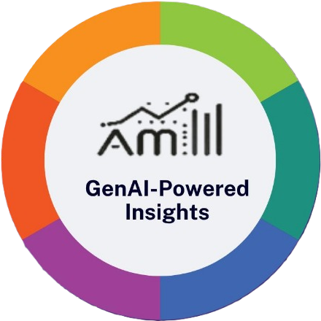
Introduction to IT XPERTS HUB
Trusted HxGN® EAM Solutions Partner for Transocean.
We deliver Innovative Software Solutions by aligning technology to better serve business teams.
Our Expertise:
Enterprise Asset Management
Solutions Consulting & Product Assessment
Cloud Solutions & Enterprise Application Development
SharePoint & Power Platform Solutions
Automated Testing using RPA tools
Our Experience
EAM Solutions: 100+ man years of implementation & solutions development experience
Enterprise Software Solutions: 120+ man years of software solutions development experience
Industry Knowledge: Oil & Gas, Manufacturing, Construction, Retail, Facilities, Hospitality
Our Asset Management Solutions:
Smart Scheduler
Asset Management Dashboard
Testing as a Service (TaaS) with RPA
Asset Management Insights (AMI)
Features of our Edge Solutions
Turnkey off the shelf advanced solutions targeting process and operational extensions to EAM
Native to EAM – built on top of EAM Components
Upgradeable
Hybrid – aligns with HxGN EAM SaaS platform and works with OnPrem
Notes:
SharePoint Solutions: Our SharePoint and Power Platform Solutions team has extensive experience delivering Internal applications that are easy to use and manage. We delivered simple Employee Time tracking applications along with Leave Management, Expense Management and HRMS solutions using SharePoint.
Power Platform: Our Power Platform Solutions experts deliver no-code Power Apps solutions, process automation using Power Automate and extensive PowerBI dashboards. Organization Asset Management Dashboard part of AMI Suite is a product built on top of PowerBI.
Cloud Solutions: Cloud Migrations – focus on Lift & Shift solutions for quicker cloud adoption and ROI. Further optimize Cloud Solution architecture to optimize infrastructure footprint, promote global footprint and cost optimization.
Automated Testing with RPA: We developed Testing as a Service (TaaS) portal empowering customers to streamline their testing processes and enhance efficiency with our automated testing. Our team automated 75 test cases for Base EAM processes for HxGN® EAM product. Allows customers to maintain their business process specific Test Iterations including Regression Test scenarios. Once adopted our automated testing, rest assured, you can initiate regression testing straight from our TaaS portal. Once the testing is complete, customers will receive an email with Test Results. Customer can access their test results on TaaS portal and generate detailed reports for compliance and audit purposes. Future expansion of TaaS portal includes integration with AI. Once integrated with AI, based on history and test case dependency, AI recommends Test Iteration(s) to use instead of testing the entire application, unless required for compliance.
Why Edge Solutions
Focus on productivity and important tasks
Empower users with key information to take preventative action based on history and predictions
All useful information is made accessible from a single screen.
Features of our Edge Solutions
Turnkey off the shelf advanced solutions targeting process and operational extensions to EAM
Native to EAM – built on top of EAM Components
Upgradeable
Hybrid – aligns with HxGN EAM SaaS platform and works with OnPrem

Slide 4
Speaker Intro
Vivek Chintalaboyina, Founder & CEO, IT Xperts Hub
Masters in Computer Science
25 years of experience in Enterprise Software Solutions
Delivered Solutions for various industries
AI / ML Solutions Visionary – Global Leader
Robert Maulding, Senior Business Analyst, Transocean
Masters in Management and Administrative Sciences, B.S. in Nuclear Engineering Technology
13 years Offshore Drilling Industry, 8 years US Navy Nuclear Propulsion Program
EAM implementation training lead and instructor
EAM support Business Analyst, solution tester, and security lead

Slide 5

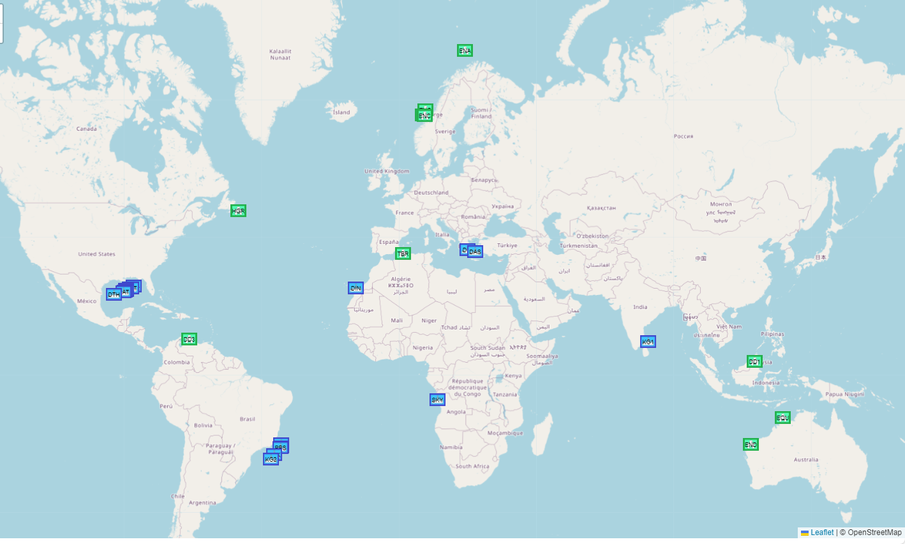
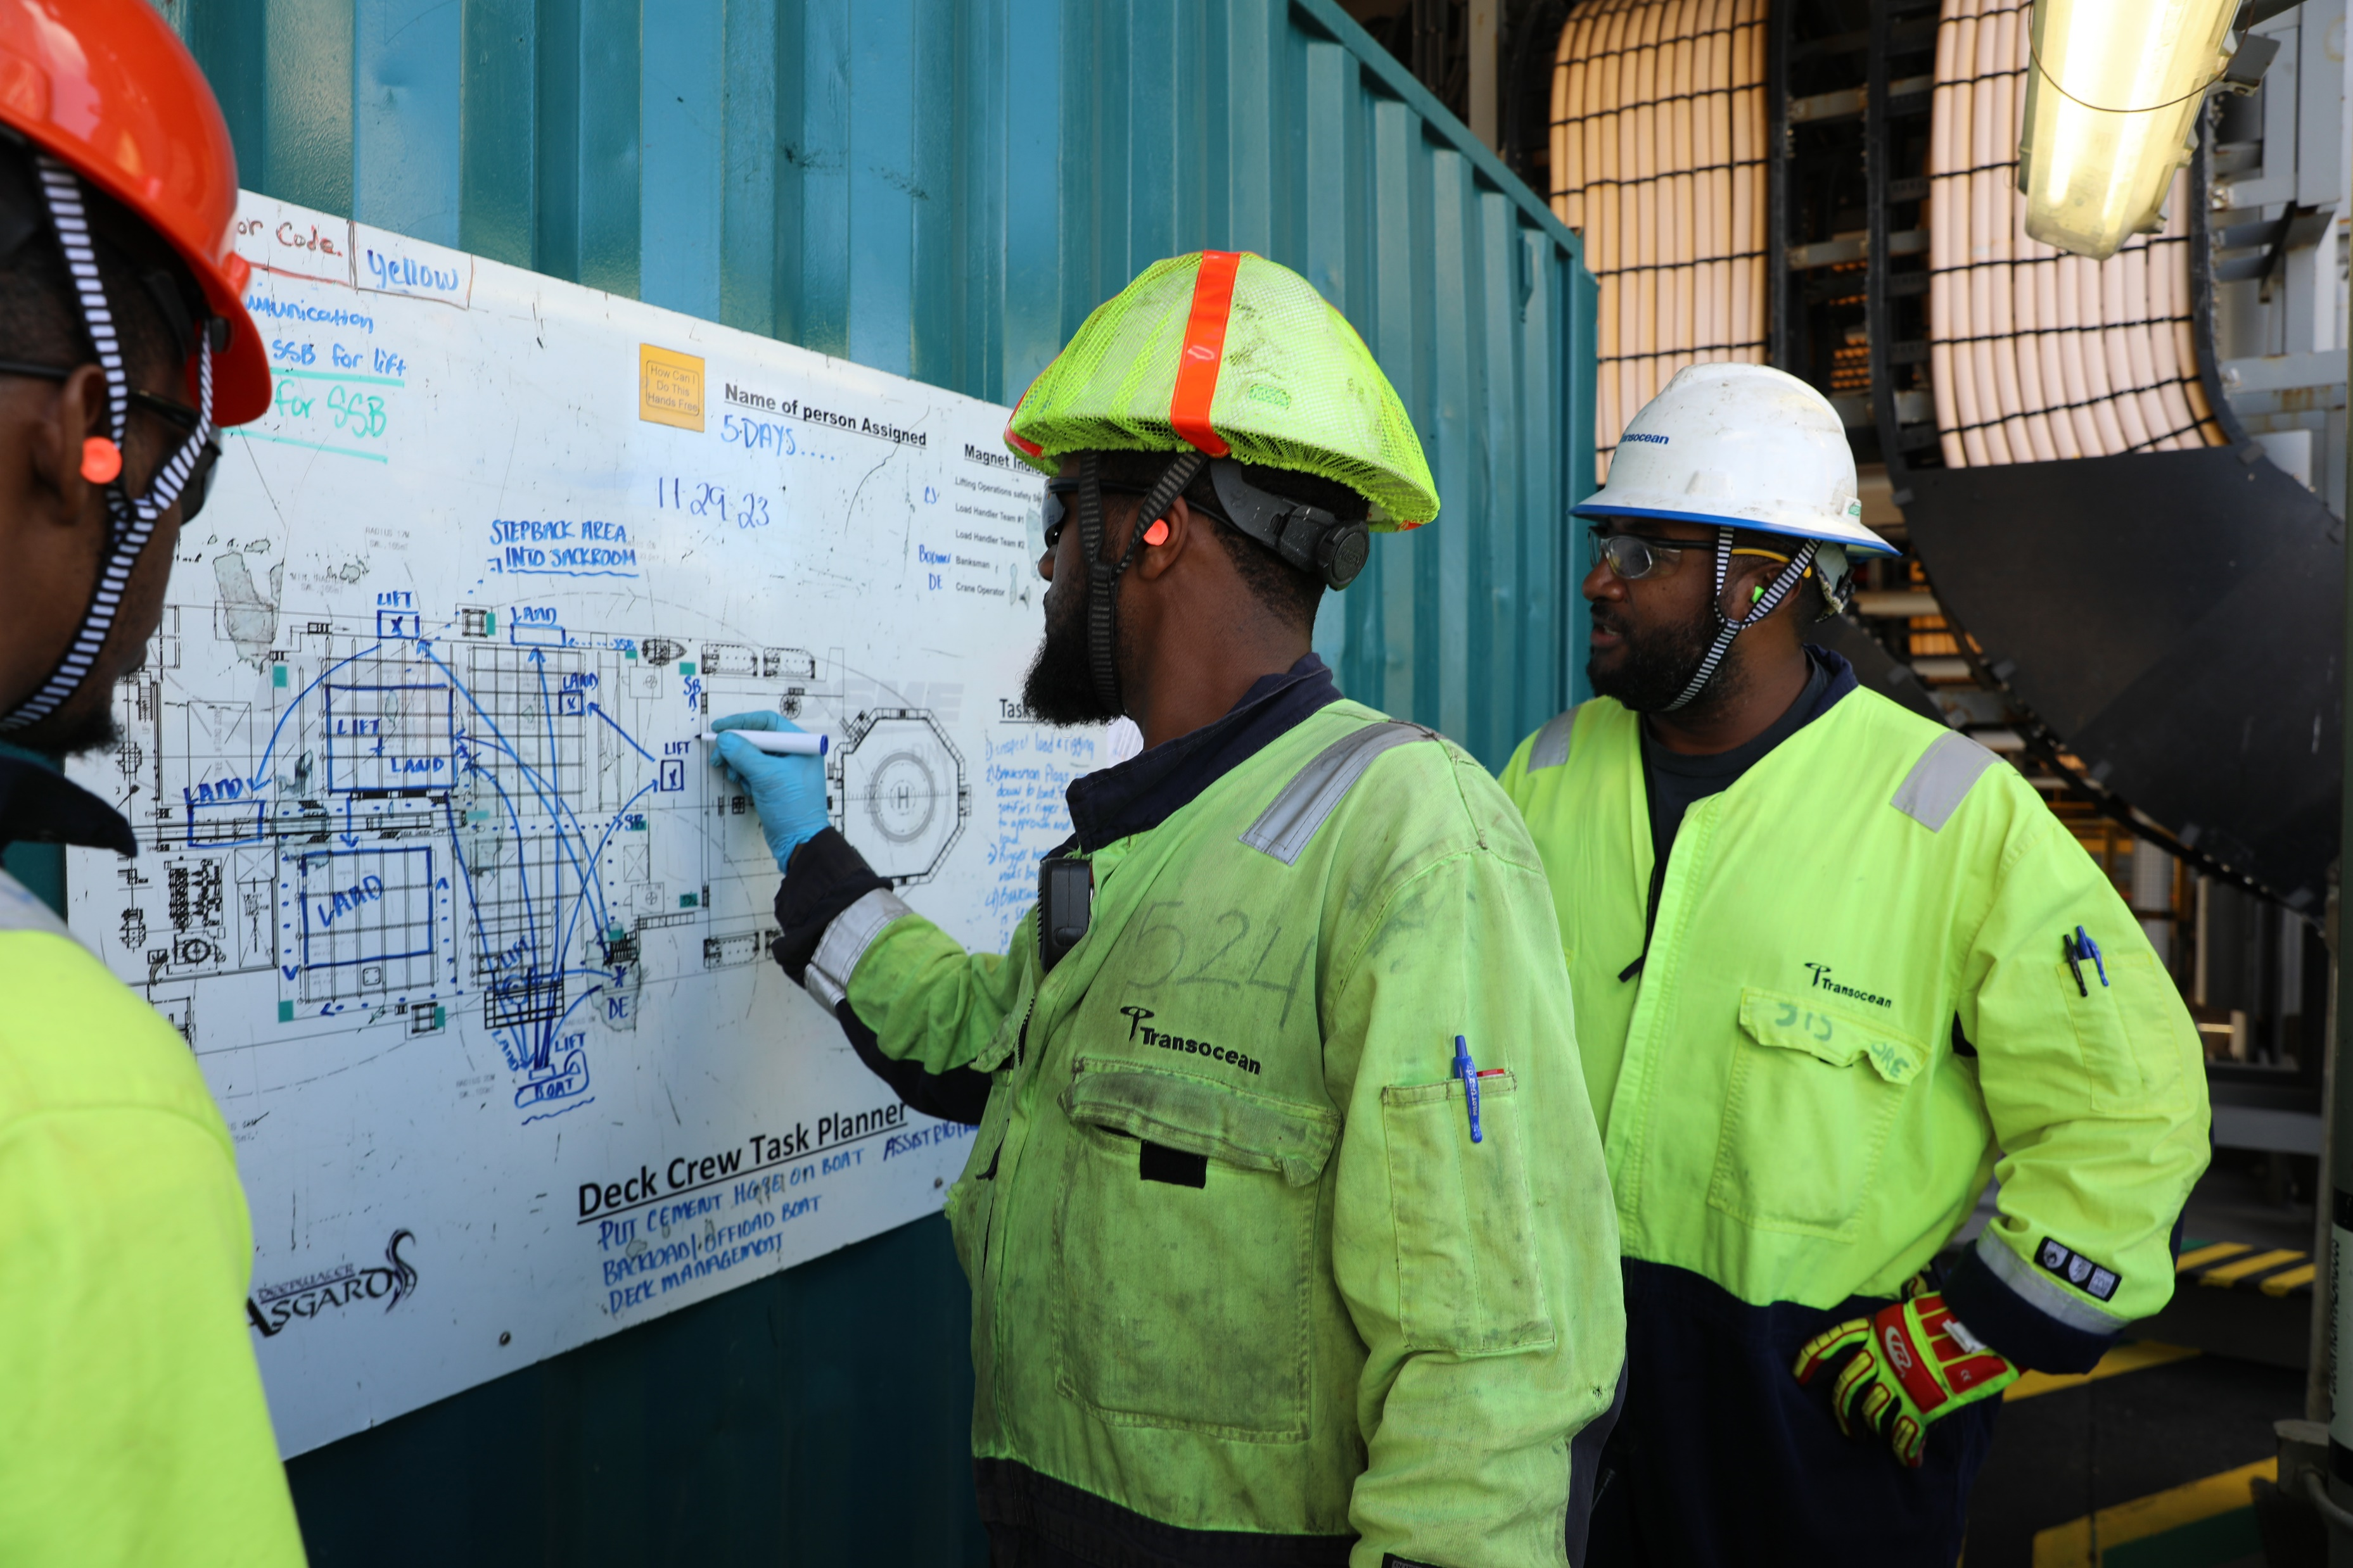
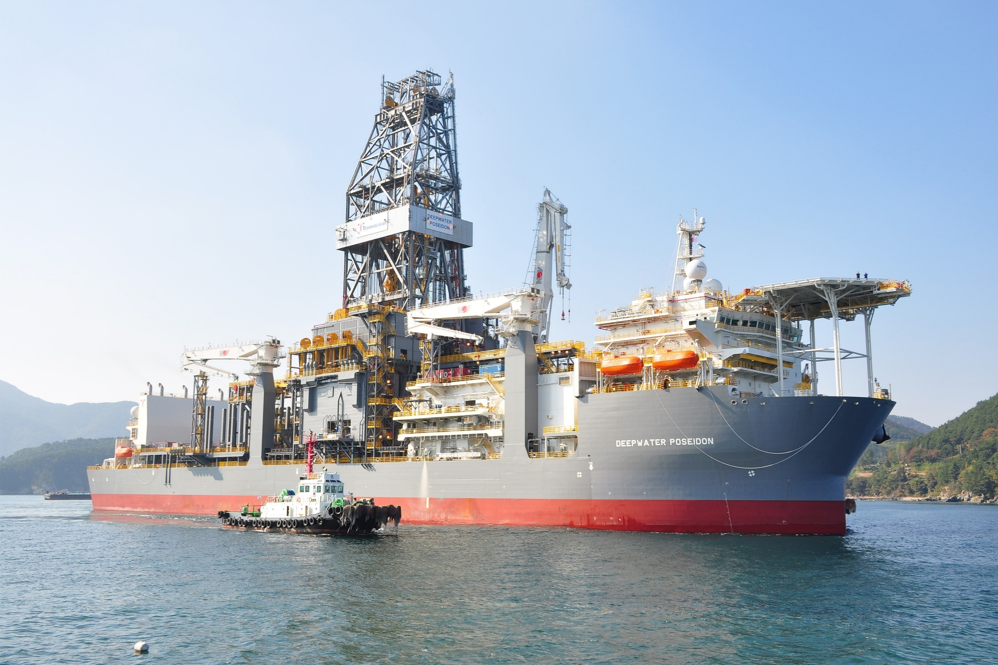
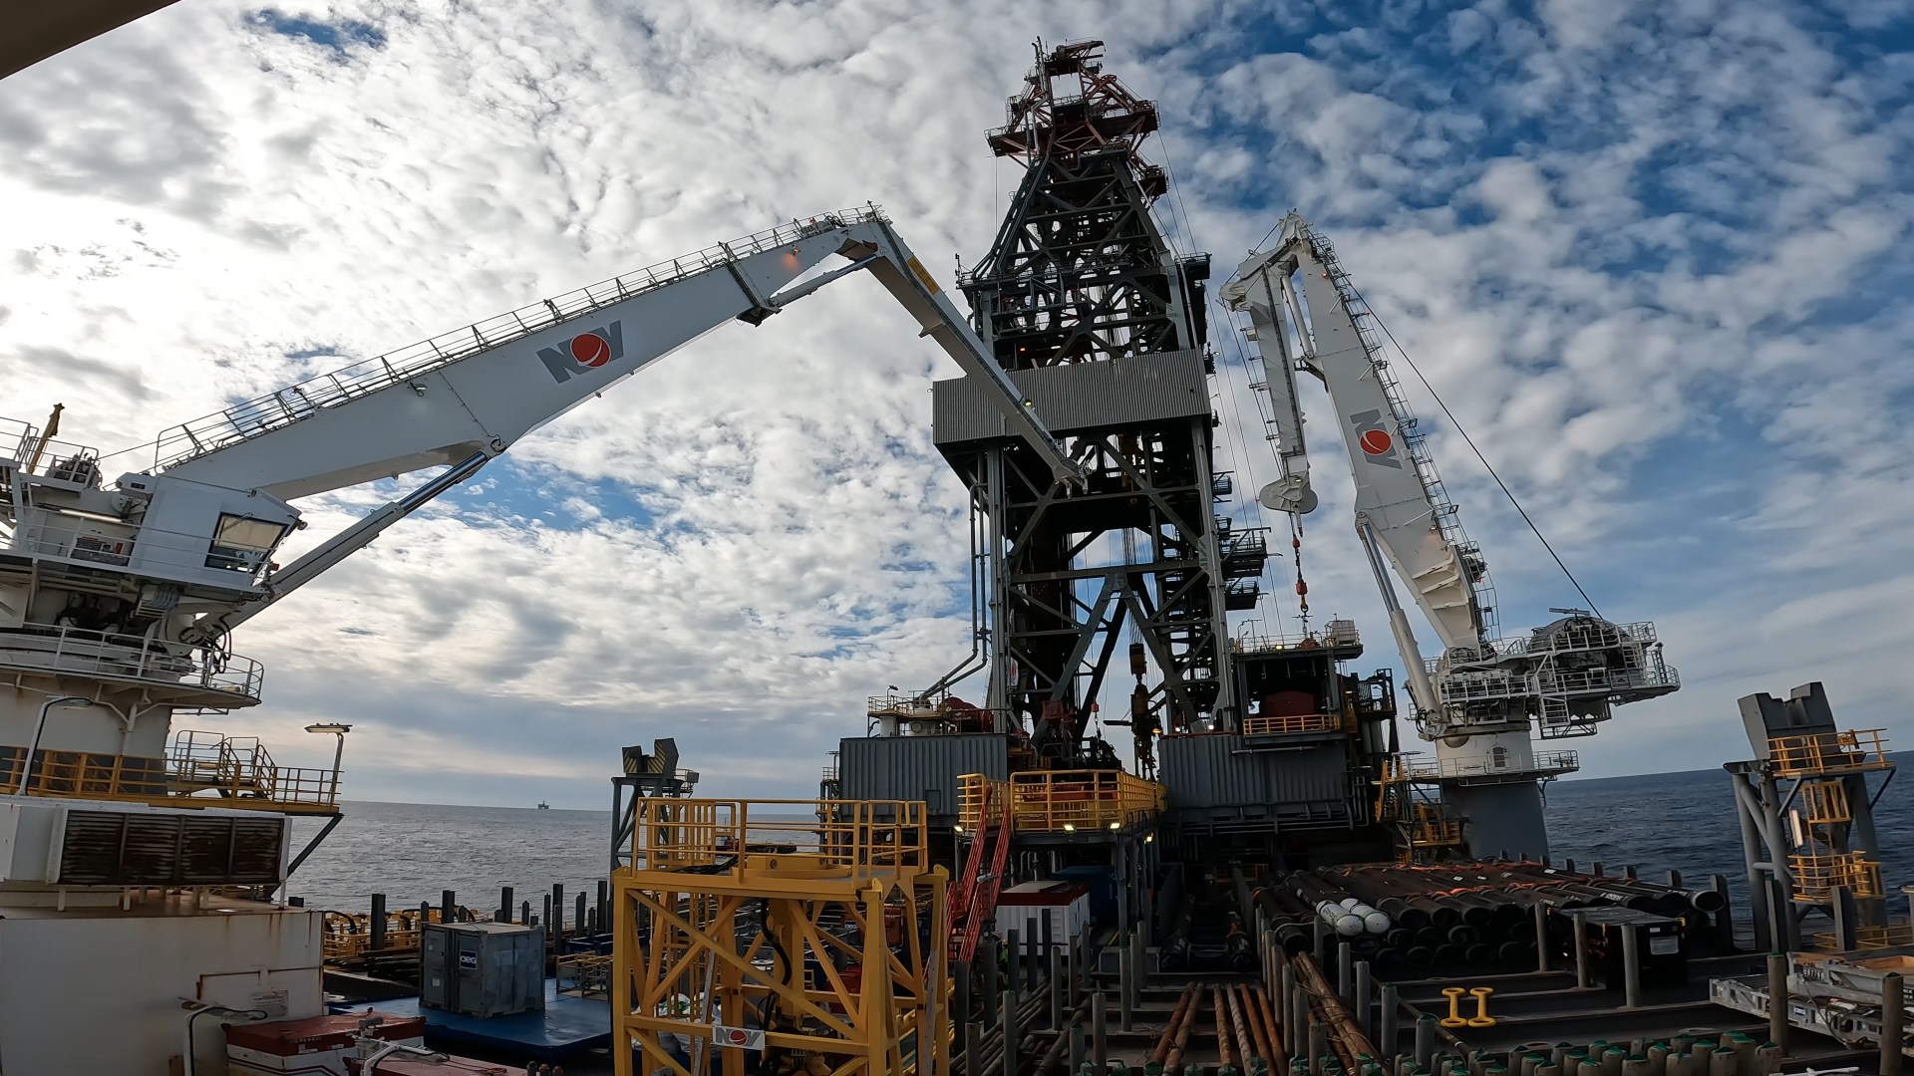

About Transocean
www.deepwater.com
Notes:
About Transocean
Transocean is a leading international provider of offshore contract drilling services for oil and gas wells. The company specializes in technically demanding sectors of the global offshore drilling business with a particular focus on ultra-deepwater and harsh environment drilling services and operates the highest specification floating offshore drilling fleet in the world.
Transocean owns or has partial ownership interests in and operates a fleet of 27 mobile offshore drilling units, consisting of 20 ultra-deepwater floaters and seven harsh environment floaters.
We currently operate across 4 major operating hubs (GOA, BRZ, NWE, AAA) and Rigs spread across 11 countries
As you can see on the slide template in the lower right corner, we are celebrating out 100th year anniversary.

Slide 6
WHY CHAOS & CLARITY?
Industrial downtime is rarely caused by a single issue.
Critical insights are scattered across maintenance, asset usage, and inventory systems
Teams spend more time gathering data than acting on it
Scheduling decisions are often made without full visibility into risk, readiness, or constraints
Clarity matters because:
Downtime is a system problem, not a point failure
AI provides context by connecting operational signals
Smart scheduling turns insight into coordinated action
When intelligence and execution align, reliability becomes predictable.

Slide 7
Reality on the Ground
Why Scheduling Is Hard
Effective scheduling requires a holistic view of all pending and upcoming work.
Common challenges include:
Limited visibility into future and cross-departmental work
Difficulty scheduling across trades, work types, and priorities
Static views that do not adapt to changing conditions
Result: Planners spend more time coordinating work than optimizing it.
Core issue: Lack of unified scheduling visibility.
Why Equipment Failure Analysis Is Hard
Equipment failures rarely have a single root cause.
They are influenced by multiple disconnected data streams:
Maintenance scheduling, execution, and closure data
Failure, problem, cause, and action codes
Equipment usage, meter readings, and IoT alerts
Inventory availability, purchasing delays, and part classifications
The challenge is not a lack of data—it is the difficulty of correlating and contextualizing available data.
The Chaos – Disconnected Information Silos
Maintenance data lives in work orders
Asset health data lives in meters, sensors, and historian systems
Inventory data lives in stores, procurement, and planning systems
Insights are scattered across reports, spreadsheets, and tribal knowledge
Result: Slow analysis, reactive decisions, and recurring downtime

Slide 8
Reality on the Ground …continued
Maintenance Complexity in Focus
Short-, mid-, and long-term schedules constantly change
Overdue work impact reliability and safety
Failures are often analyzed after downtime occurs
Lessons learned rarely influence future scheduling decisions
Reactive planning = repeated failures
Equipment & Usage Data – An Untapped Signal
Meter readings indicate wear and utilization
IoT alerts generate volume but lack context
Usage patterns rarely align with maintenance timing
Without intelligence, signals become noise
Inventory & Supply Chain Impact on Downtime
Parts unavailable when work is ready to execute
Emergency purchases increase cost and delays
Min/Max and ABC/FMS classifications are rarely linked to failure patterns
(Right part, wrong time) or (Wrong part, right time) = downtime
The Missing Link – Connecting the Dots
What’s missing is a unifying layer that:
Correlates failures with usage, work history, and parts
Prioritizes risk instead of reacting to events
Aligns scheduling with asset health and material readiness

Slide 9
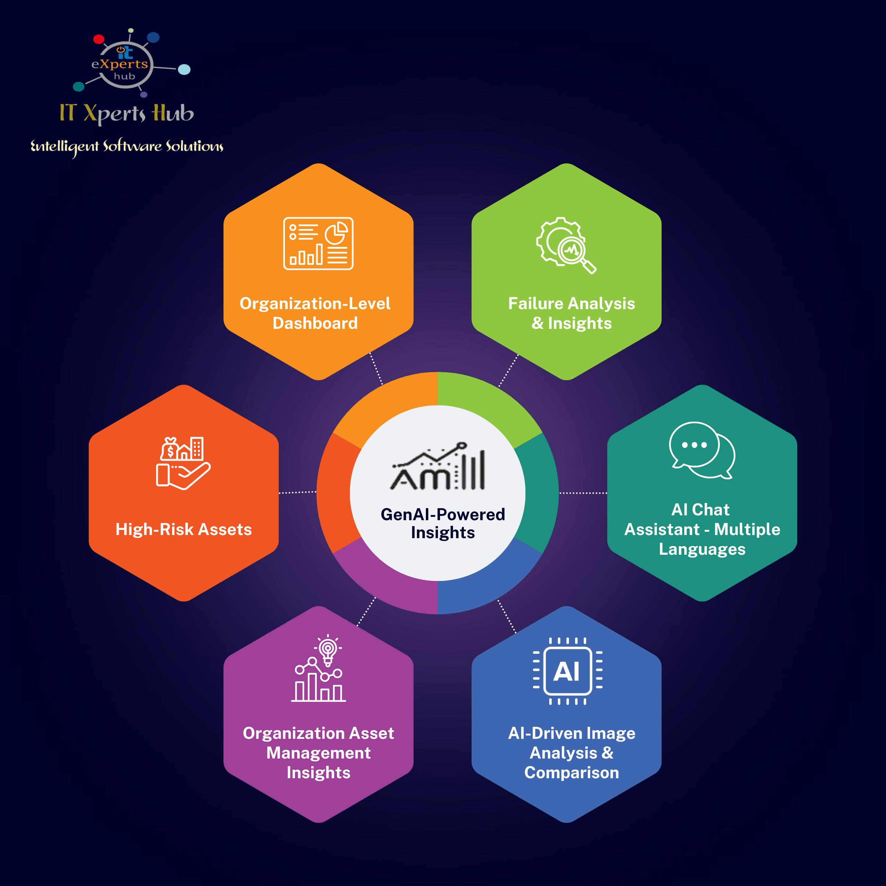
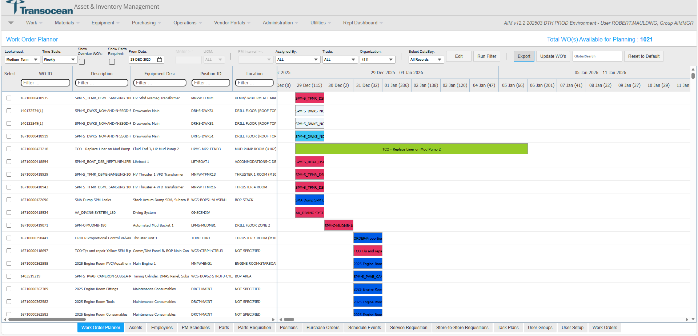
From Chaos to Clarity – A NEW Approach
AI-driven Asset Intelligence
Consolidates work history, failures, and asset data
Identifies high-risk assets and failure trends
Surfaces insights hidden in operational data
Smart Scheduling
Visual, Gantt-based planning
Real-time visibility into workload, resources, and constraints
Continuous adjustment as conditions change
Concept to Capability
Asset Management Insights
Capture maintenance, asset usage, and inventory data
Apply AI to detect patterns, correlations, and risk drivers
Highlight high-risk assets, recurring failures, and key influences
Smart Scheduler
Translate insights into prioritized maintenance actions
Schedule work intelligently with full visibility into workload and resources
Continuously adjust schedules as conditions change
Notes:
Innovative dashboarding solution designed to revolutionize your asset management operations. Delivers focused insights across various aspects of asset management. It enables users to perform in-depth analysis of equipment, stores, and parts. With its advanced features, AMI provides valuable insights into equipment performance, failure rates, store inventory levels, and parts usage, complete with 12-month usage predictions.
Benefits:
🌟 Optimize Asset Utilization: Maximize the use of your assets to get the most out of your investments.
🌟 Minimize Downtime: Reduce downtime with predictive analytics that forecast potential failures and recommend preventive measures along with active and upcoming work opportunities to take preventative action to mitigate the failure.
🌟 Efficient Maintenance Management: Effectively manage maintenance schedules to ensure your operations run smoothly.
🌟 Stay Competitive: Leverage advanced data and predictive analytics to maintain a competitive edge in today’s fast-paced market , by managing assets and inventory effectively.
Key Features: 📅 Plan for the short, mid, and long term with a clear view of all scheduled work. 🔧 Easily rearrange schedules by moving work blocks directly on the Gantt chart. ⏰Instantly identify and manage overdue work with enhanced visibility. 🔄 Empower planners and supervisors to update work details seamlessly without launching the full work order. 🔍 Open and review work orders directly from the scheduler. Upon completion, seamlessly continue with the Smart Scheduler. 🔮 Preview upcoming work details without releasing the actual work order from the PM Schedule. 📆 Release and schedule future work orders effortlessly with our intuitive tool. 👀 Save preferred scheduling views, and let the tool automatically launch them on your next visit for a seamless experience. 🔗 Our versatile framework allows easy extension for Activity or Equipment-based scheduling. Revolutionize your work order and scheduling management with the IT Xperts Hub Smart Scheduler tool. Enhance efficiency, elevate collaboration, and embrace the future of streamlined operations! Our Smart Scheduler's integration capabilities allows it to be integrated with any enterprise solution or can be deployed standalone.

Slide 10
How we brought clarity at Transocean
Transocean vision for Work Order Scheduling
Using Work Order Planner (ITXH Smart Scheduler)
Equipment & Failure Analysis using ITXH AMI (Proof of Concept)

Slide 11
CHALLENGES IN OFFSHORE DRILLING
Around the clock Operations
Frequently changing personnel
Logistics of materials and third-party services
Access to specialized equipment required for maintenance
Lack of a dedicated planner
Notes:
Around the clock Operations
Transocean Rigs are rented out to Customers such as Major Oil Companies typically for a dayrate – as such they expect the rig available and working every day they are paying the dayrate
Frequently changing personnel
Offshore life isn’t for everyone, high turnover exists. The industry can expand and contract quite rapidly as well. There can be times of lots of new folks who are inexperienced, or there can be times when we can’t find room for everyone.
Logistics of materials and third-party services
Parts come in once a week.
Some tasks are highly specialized and require specific people. NDT certified personnel, rope access for working at heights in the derrick, manufacturer overhaul.
Access to specialized equipment required for maintenance
Riser Torque wrenches, laser alignment tools
Lack of a dedicated planner
Most Drillships like shown have capacity for about 200 personnel onboard, semi submersibles perhaps only about 150. Space is limited so many folks wear multiple hats, as such there isn’t a dedicated planner/scheduler onboard.

Slide 12
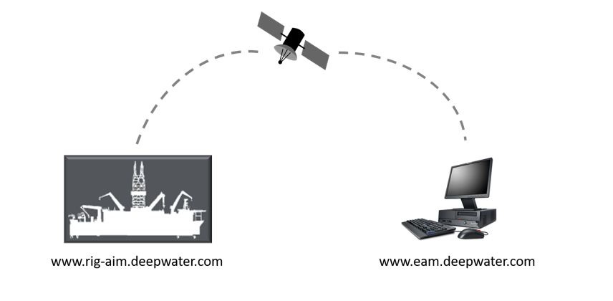
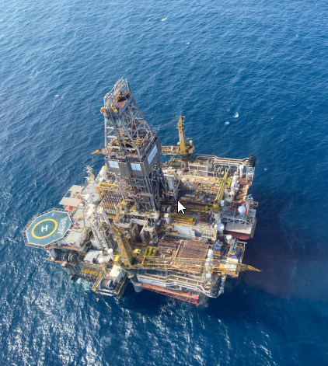

Challenges
Replication – each Rig has its own on-prem instance of EAM.
User Population – 4 people to do 1 job, in Norway it’s 6 people. All sharing the same device.
Crew A
Crew B
Norway
Days
Nights
Notes:
Due to operations offshore, Transocean actually has about 26 on prem instances of EAM using SQL merge replication every 4 hrs to send data back and forth.
Further, we have lots of hands in the cookie jar. Most positions on the Rig are manned by 4-6 or more people.

Slide 13


Chaos to Clarity
Notes:
Chaos definition : complete disorder and confusion
in physics behavior so unpredictable as to appear random, owing to great sensitivity to small changes in conditions.
Ask everyone to close their eyes and picture chaos, what do you see?
As a parent, when I think chaos it’s my child’s room after a playdate. ***Click*** This picture looks like chaos, we got some chess pieces, checkers pieces, a domino, three dice, some cards, some battleship pegs.
Professionally though, what does chaos look like? A messy shop with tools strewn about? Digging through the storeroom looking for parts?
Clarity definition : the quality of being coherent and intelligible. Or the quality of transparency or purity.
Now picture Clarity, how does that look different? ***Click*** We’ve got some nice striped storage cubbies.
Perhaps now you can see the carpet again, everything is put away, the counter is clear
What does that look like on the shop floor though? I’m not taking the easy answer of a clear workbench and tools put away. Clarity for work is having the right, people/parts/tools where and when they need to be there to get the work done.

Slide 14
Transocean vision for WORK ORDER Planner
Background
Current process of work planning and scheduling in EAM is done through an excel like grid where supervisors review Work Orders through use of multiple filters. This method of planning is not very effective and takes significant time to ensure work schedule based on equipment or location is prioritized and grouped together for execution.
Notes:
Background
Current process of work planning and scheduling in EAM is done through an excel like grid where supervisors review Work Orders through use of multiple filters. This method of planning is not very effective and takes significant time to ensure work schedule based on equipment or location is prioritized and grouped together for execution.

Slide 15
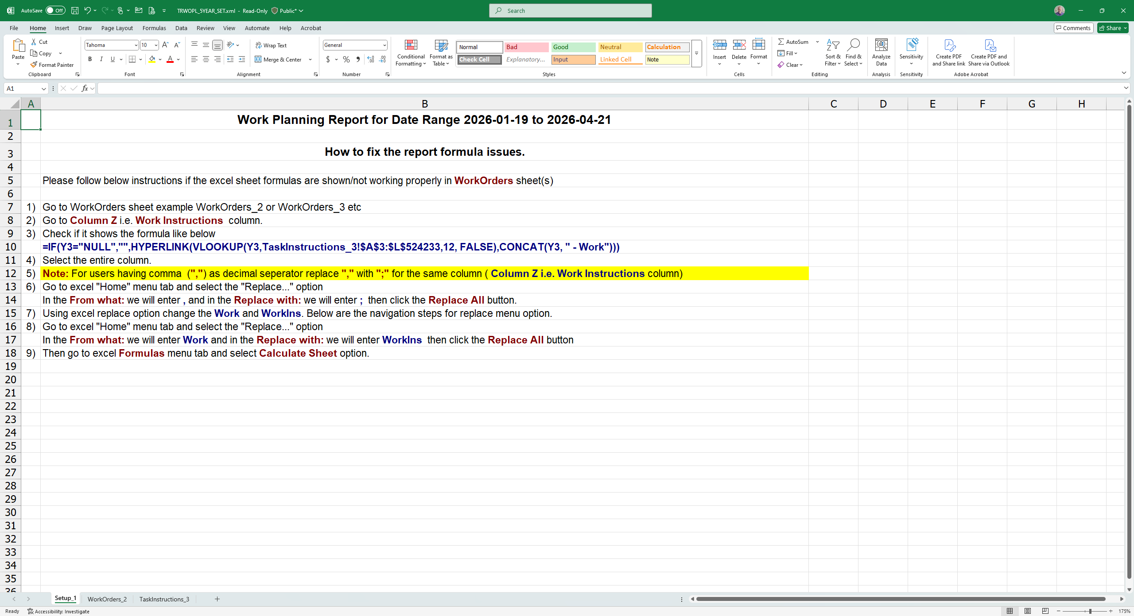
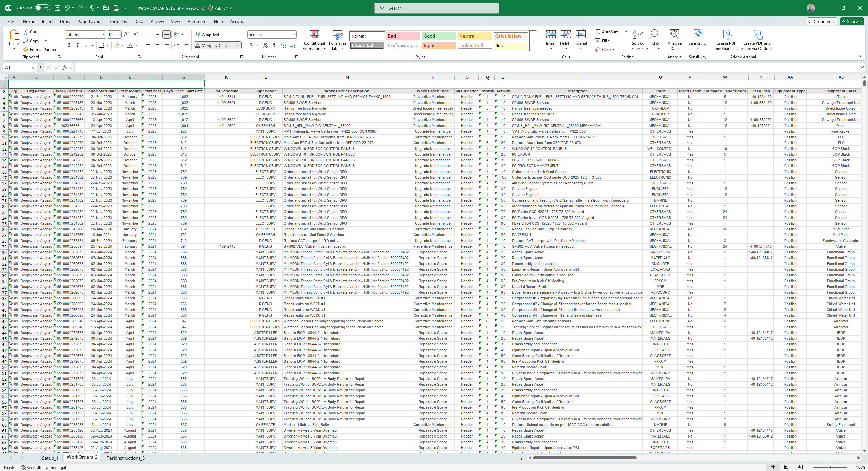
Real Life Chaos
Notes:
Chaos in action – the irony is it actually causes a lack of action due to information overload.
***Click***
It begins with a mega spreadsheet that takes minutes to download – in case you didn’t know, sitting on a rig, minutes feel like hours.
Further, since all the custom asks from the in town business team, the first sheet of the spreadsheet in instructions on how to use this particular spreadsheet.
***Click***
Keep in mind, this is the default 3 month, 90 day lookahead we were working with when users first got access to their “new and improved” maintenance system.
In this scenario
The first many rows display all overdue work, even administrative type tasks for ordering parts, old projects, etc… you had to scroll about 255 rows down to get to the current date since we requested all overdue WO show.
Additionally, we also show all MEC work here, so there isn’t necessarily 8k+ work orders overdue and within 3 months, but that many equipment will need addressed.
This spreadsheet goes from Column A through Column BS (didn’t plan that…) so it has 71 columns of information.
This is chaos…

Slide 16
Transocean vision for WORK ORDER Planner
The Vision
The new module “Work Order Planner” is a more visual, Gantt-chart style, planner tool which allows drag-slide functionality when scheduling work and groups work by equipment and location. The purpose of this new planning tool is to anticipate any spikes in the workload and allow end users to better plan ahead so that additional resources (parts and service personnel) can be mobilized onboard as and when necessary.
Notes:
The Vision
The new module “Work Order Planner” is a more visual, Gantt-chart style, planner tool which allows drag-slide functionality when scheduling work and groups work by equipment and location. The purpose of this new planning tool is to anticipate any spikes in the workload, and allow end users to better plan ahead so that additional resources (parts and service personnel) can be mobilized onboard as and when necessary.

Slide 17
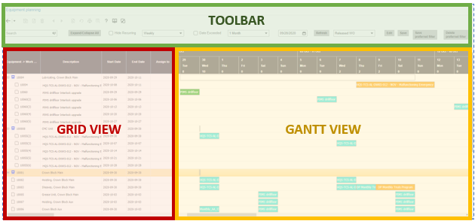
The Ask…
Visual, “Gantt” style planning tool with Drag & Drop functionality
Need ability to see future Duplicate Work Orders, anticipate Usage WO
Ability to group by Equipment and/or Location
Increased ability to foresee upcoming Parts/Service requirements
Anticipate spikes in workload
Exportable
Notes:
Visual, “Gantt” style planning tool with Drag & Drop functionality
Need ability to see future Duplicate Work Orders, anticipate Usage WO
Ability to group by Equipment and/or Location
Increased ability to foresee upcoming Parts/Service requirements
Anticipate spikes in workload
Exportable

Slide 18
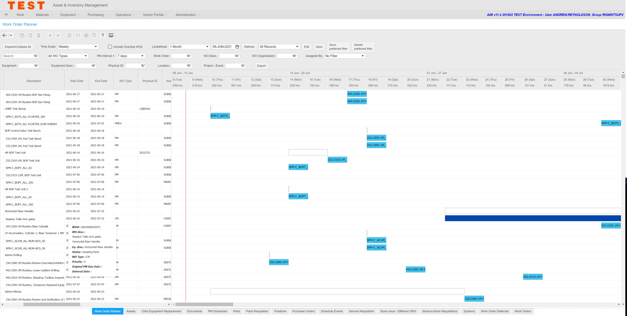
Work Order Planner V1.0
Notes:
I found this screenshot from our initial round of testing back in 2022.
We had multiple filters at the top of the screen.
Not really a “Gannt” view as the dates were sorted properly

Slide 19
Major Updates
Click to Release Future PM
Implement Short/Medium/Long term lookaheads
Bring filters onto column headers in Grid View
Right Click and link to Schedule Event (Project)
Ability to filter by Trade
Usage based PM Forecasting
Dataspy for showing NDT requirements
Checkbox to only show PM that require parts
Preview PM Work Order
Multi-select filters to see multiple results
Notes:
Click to Release Future PM
Allows us to convert visibility into action, begin ordering long lead parts or arranging service personnel.
Implement Short/Medium/Long term lookaheads
Customized to align with Company policy
Bring filters onto column headers in Grid View
Consistent with EAM column filtering
Right Click and link to Schedule Event (Project)
Opportunity Maintenance – plan for short duration shutdowns
Ability to filter by Trade
Lack of a planner, helps show the Work for the individual trades
Usage based PM Forecasting
Approximate placeholder dates for PM that are driven by meters.
Dataspy for showing NDT requirements
NDT or Non Destructive Testing, need specialized personnel to come to the Rig. Identified with UDF Checkbox on Task Plans. Prevents multiple NDT Trips.
Checkbox to only show PM that require parts
Task Plans identified if requiring parts, so we can plan ahead and ensure items transferred or ordered.
Preview PM Work Order
Check to see if Parts or Services required.
Multi-select filters to see multiple results
For HQ Long term planning and coordinating with suppliers. We get asked from vendor how many overhauls in year next or year after. We can select multiple Org where equipment from that vendor exists and pick out that for example 3 rigs have the 900 day PM due in 2026, 5 rigs in 2027, etc…

Slide 20
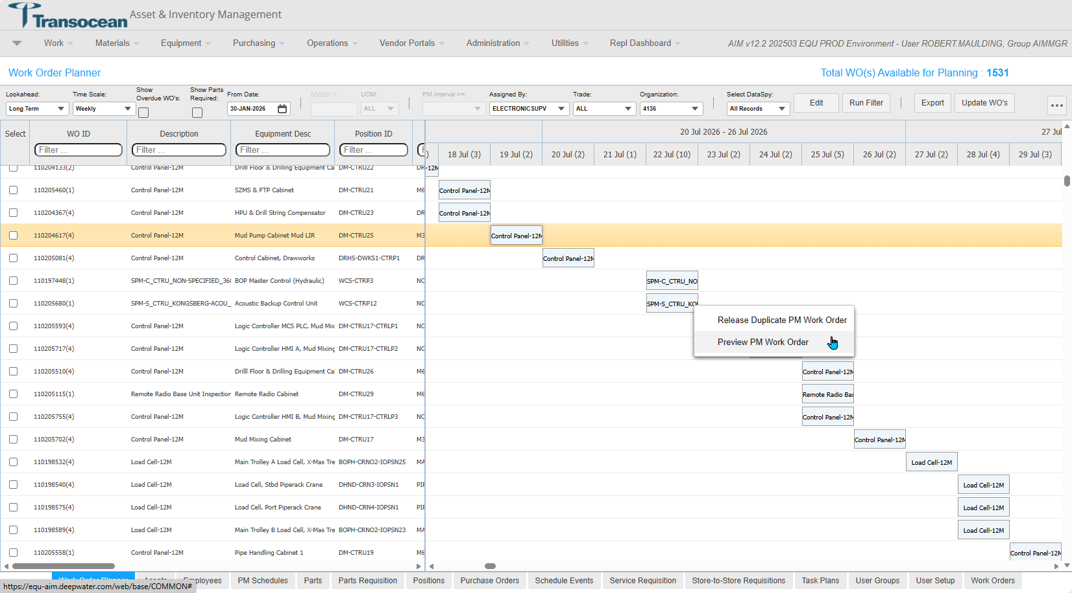
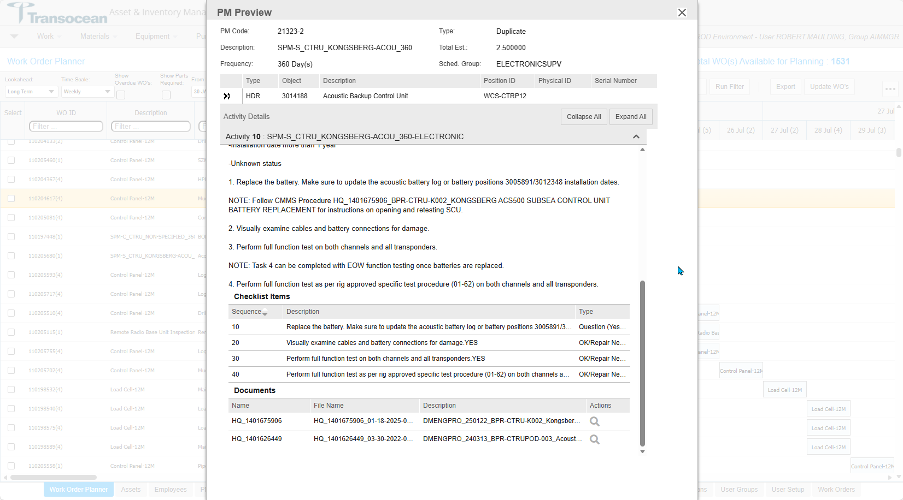
Transocean Equinox Long Term
Notes:
Intended for Management or Sr Maintenance Supervisor to do 5 year lookahead.
Only shows PM WO >360 Day intervals.
Major benefit for budgeting major overhauls
Option on future Work Order to easily preview and decide if it needs released, which is also an option.

Slide 21
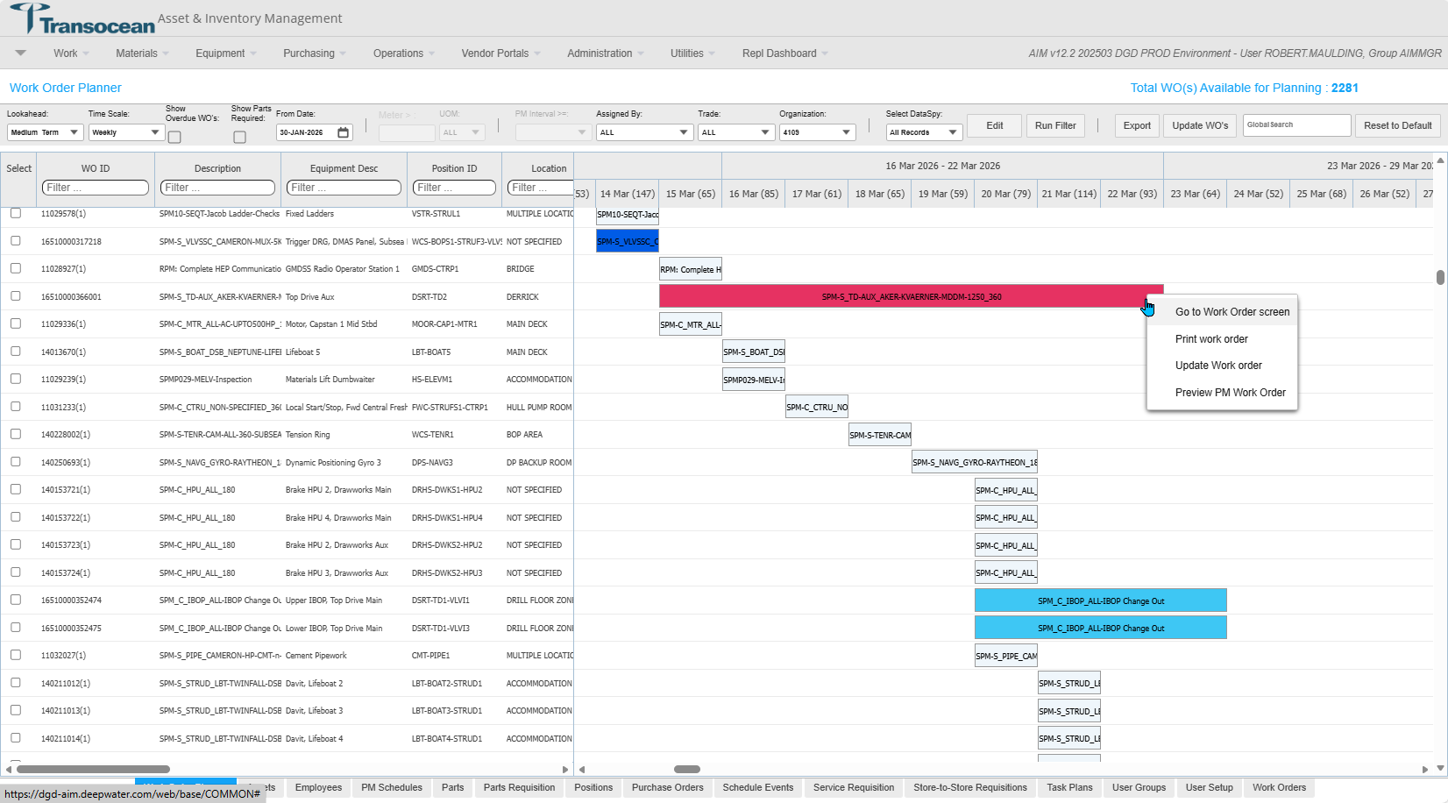
Deepwater asgard Medium Term
Notes:
Medium shows 18 month lookahead
Only shows WO with 90day or greater PM intervals.
Useful for department supervisors to lookahead for Work Orders that may require ordering of parts with long lead times or arranging specialized service personnel to come to the Rig.

Slide 22
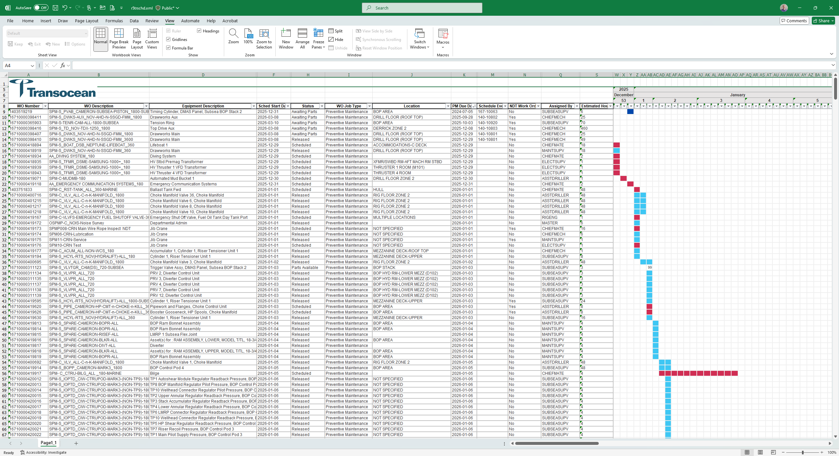
Medium term Export
Notes:
Exportability for wider review or distribution.

Slide 23
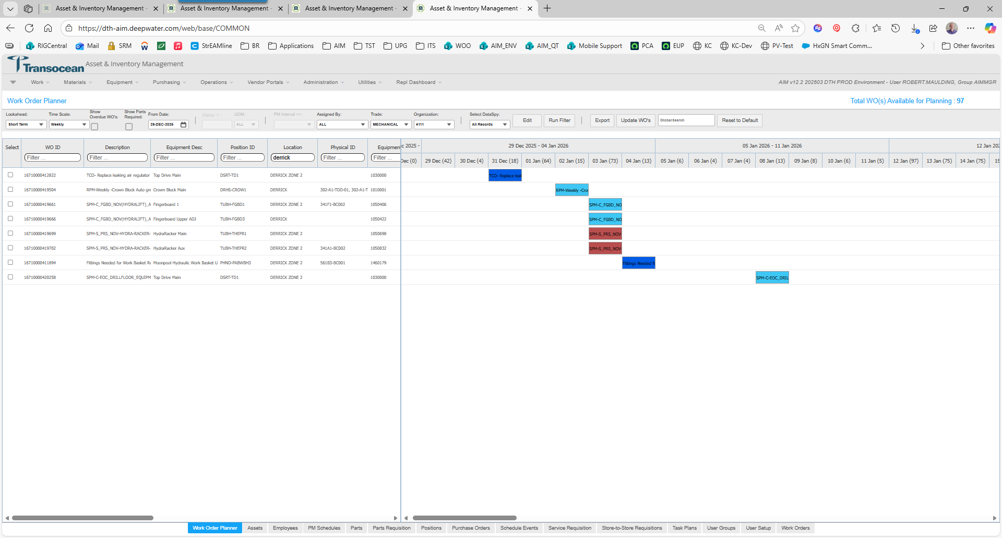
Deepwater Thalassa Short Term
Notes:
Here we go, we are arriving at Clarity.
We've worked or way down the org chart, from Management and Sr Supervisor, then to department heads, now we are at the Technician level.
We are starting with Short Term work defined as a 2 week lookahead of all open work orders.
***CLICK***
This shows Short Term work, for the Mechanical Trade, specifically in the derrick.
The derrick being an area with limited access, it's important to know all the things that need done.
This is how are offshore teams, at all levels are working toward a clearer picture of current and upcoming work.
Now I'll pass it back to Vivek for where we are going next with Asset Management Insights
Transocean has been collaborating with Vivek and team for these insights as they will hopefully soon be guiding our teams to the right focus areas.

Slide 24
Asset Management Insights
Background
Maintenance operations is defined by HQ Team
Maintenance operations enforces field personnel to capture appropriate work completion and closure information
All inventory transactions are tracked in AIM
Challenge
From time to time, Operations perform detailed analysis to review maintenance, breakdown and overall health of the equipment / class / category
Equipment Analysis requires manual review of all the work (preventative and breakdown) performed on the equipment, including its failures and usage – which is very time consuming
Department supervisors to identify High-Risk assets and take preventative action based on the predicted failures
The Vision
An integrated module to identify High-Risk assets to include key metrics and provide a detailed insights for Equipment / Category / Failure
Notes:
Background
Current process of work planning and scheduling in EAM is done through an excel like grid where supervisors review Work Orders through use of multiple filters. This method of planning is not very effective and takes significant time to ensure work schedule based on equipment or location is prioritized and grouped together for execution.
The Vision
The new module “Work Order Planner” is a more visual, Gantt-chart style, planner tool which allows drag-slide functionality when scheduling work and groups work by equipment and location. The purpose of this new planning tool is to anticipate any spikes in the workload, and allow end users to better plan ahead so that additional resources (parts and service personnel) can be mobilized onboard as and when necessary.

Slide 25
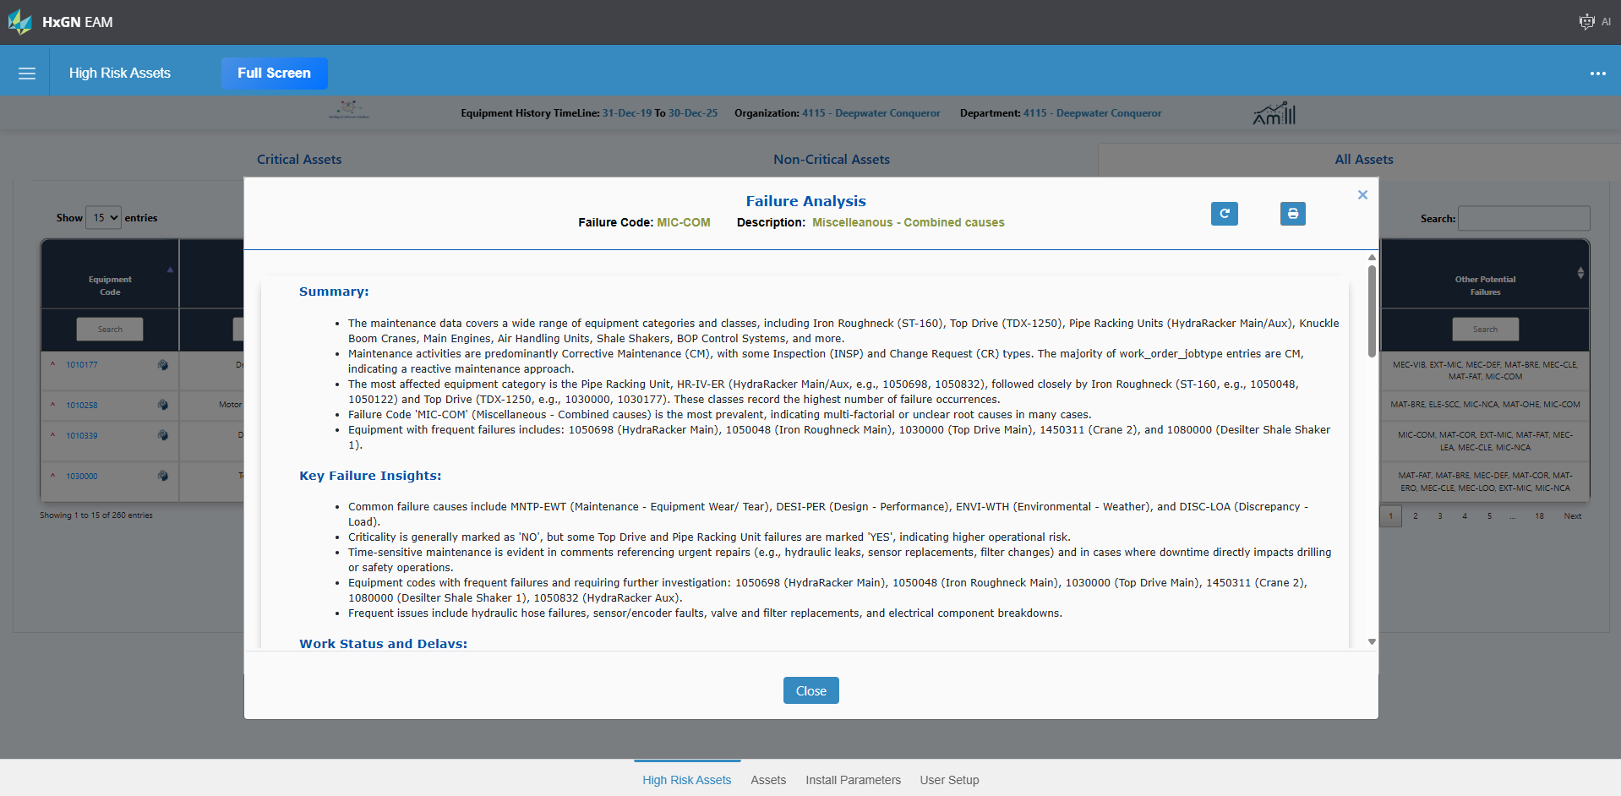
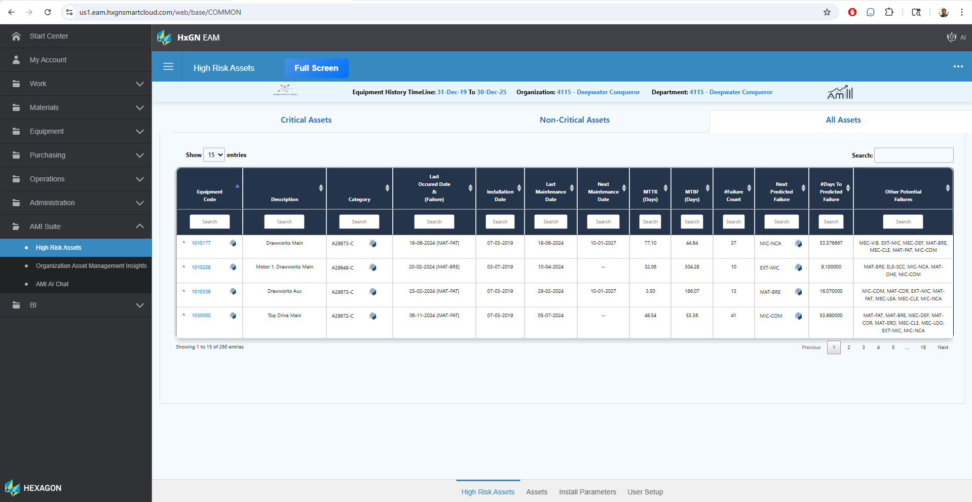
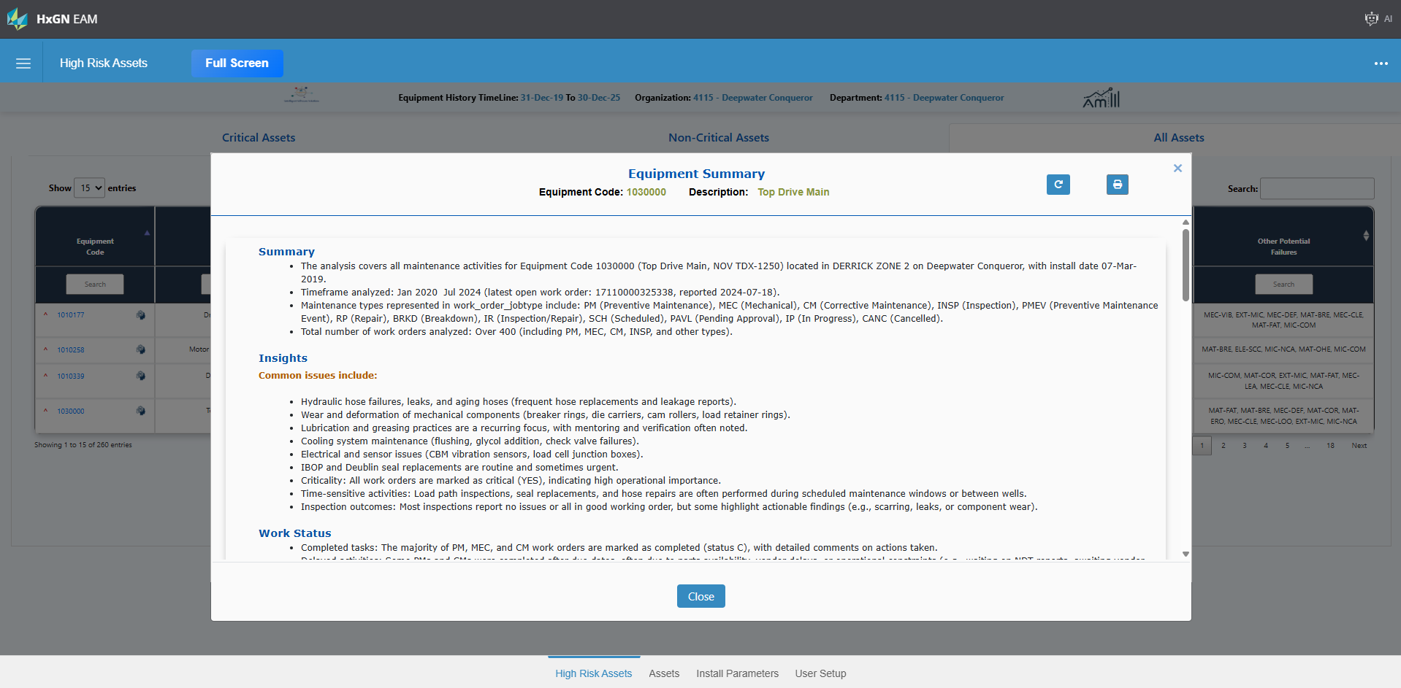
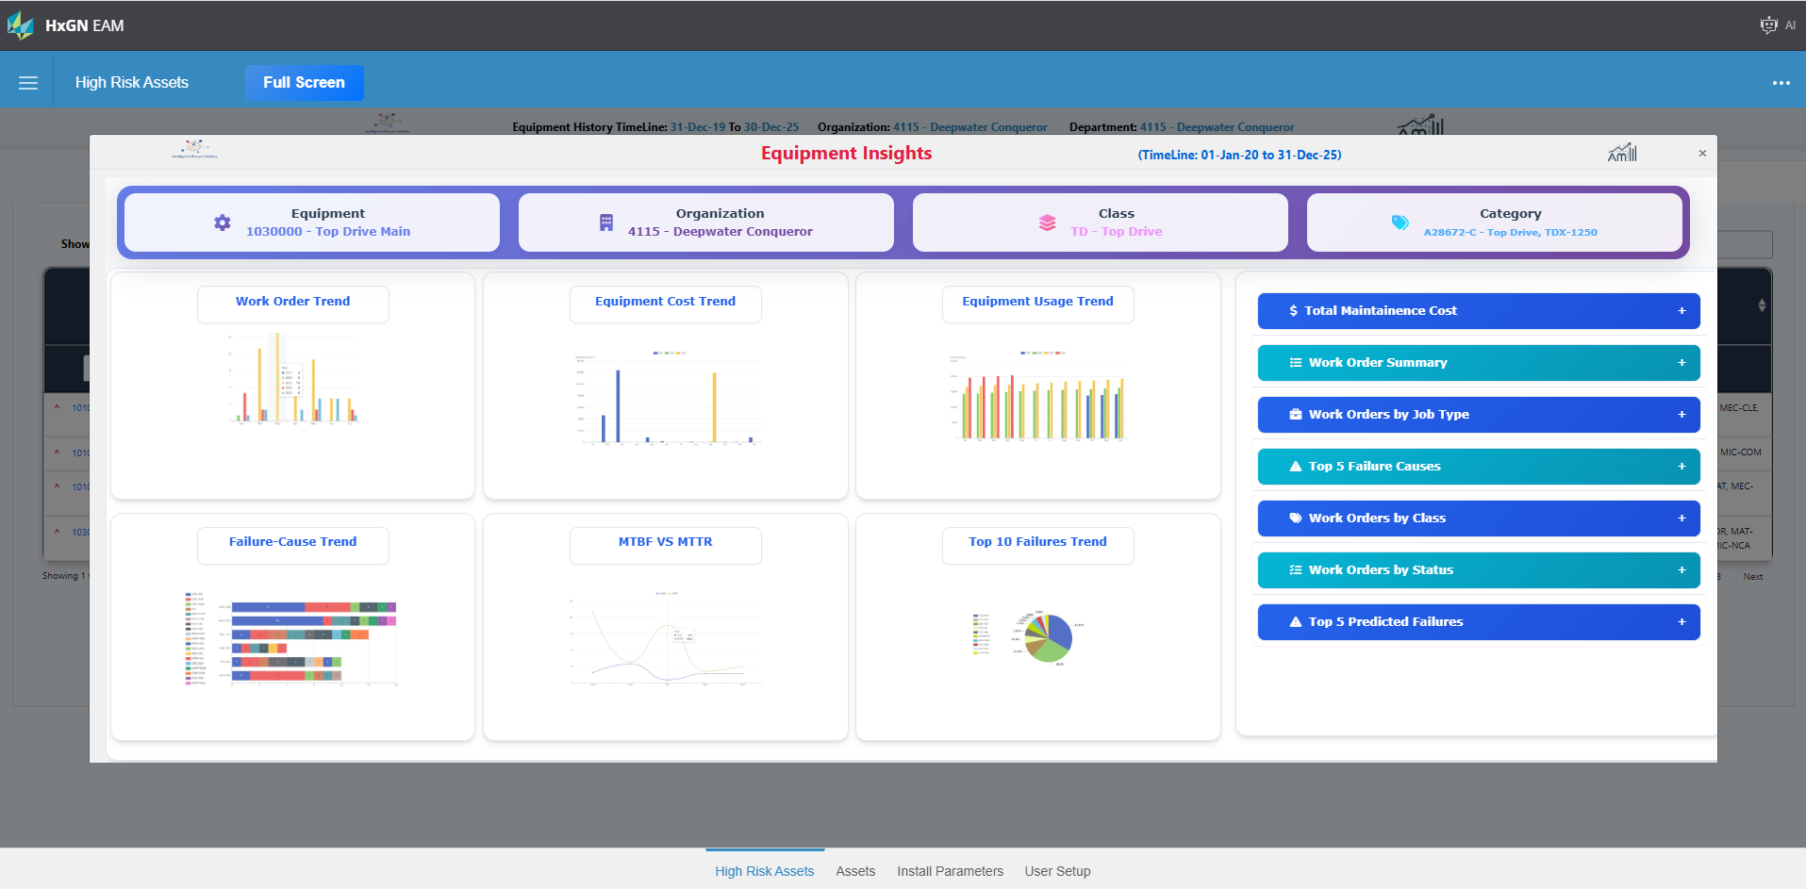
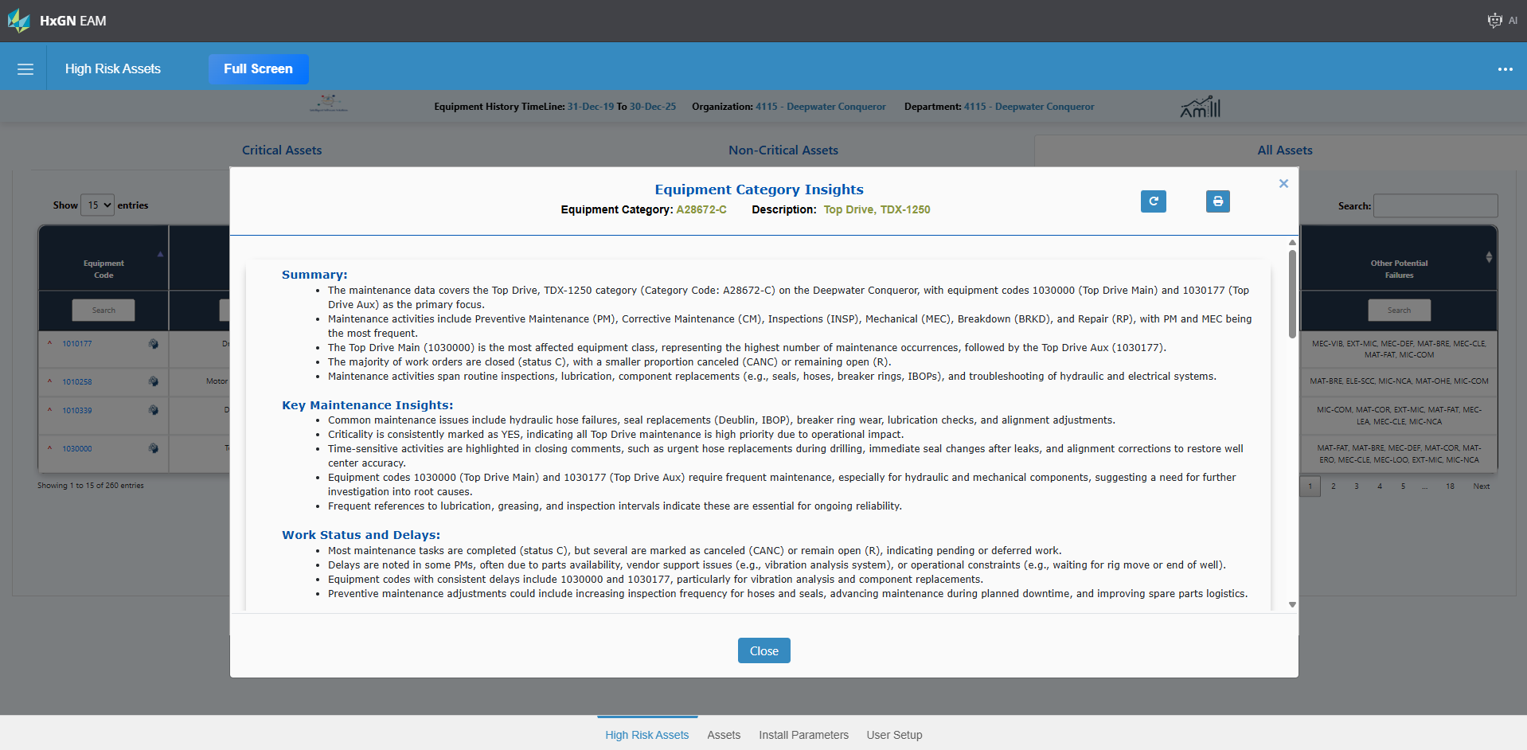
High-RISK ASSETS
At-a-glance view of both critical and non-critical assets, enabling teams to quickly identify high-risk equipment.
Utilizes our AI/ML framework for Asset Management
Key insights available include:
Essential metrics like MTTR (Mean Time to Repair) and MTBF (Mean Time Between Failures)
Last Maintenance Date, Next Maintenance Date, and failure predictions with Days Until Next Failure
Differentiation between Critical and Non-critical assets
Other Potential Failures for a comprehensive risk assessment and resource allocation.
New Request: Include child equipment for dashboard and insights.
Equipment Dashboard: Key metrics to such as work, cost, usage, failure, MTBF vs MTTR and top 10 predicted failures
Equipment Insights (AI): 360^{O} analysis of the equipment – work, cost, failures, actions, technician comments, usage and includes reliability score along with recommendations
Category Insights (AI): 360^{O} analysis of all equipment of this category – work, cost, failures, actions, technician comments along with recommendations
Failure Insights (AI): 360^{O} analysis of all equipment reported this failure in the past – work, cost, failures, actions, technician comments along with recommendations

Slide 26
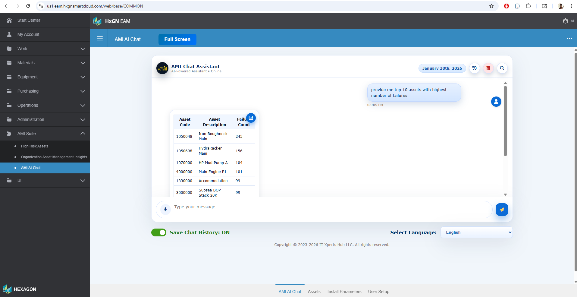
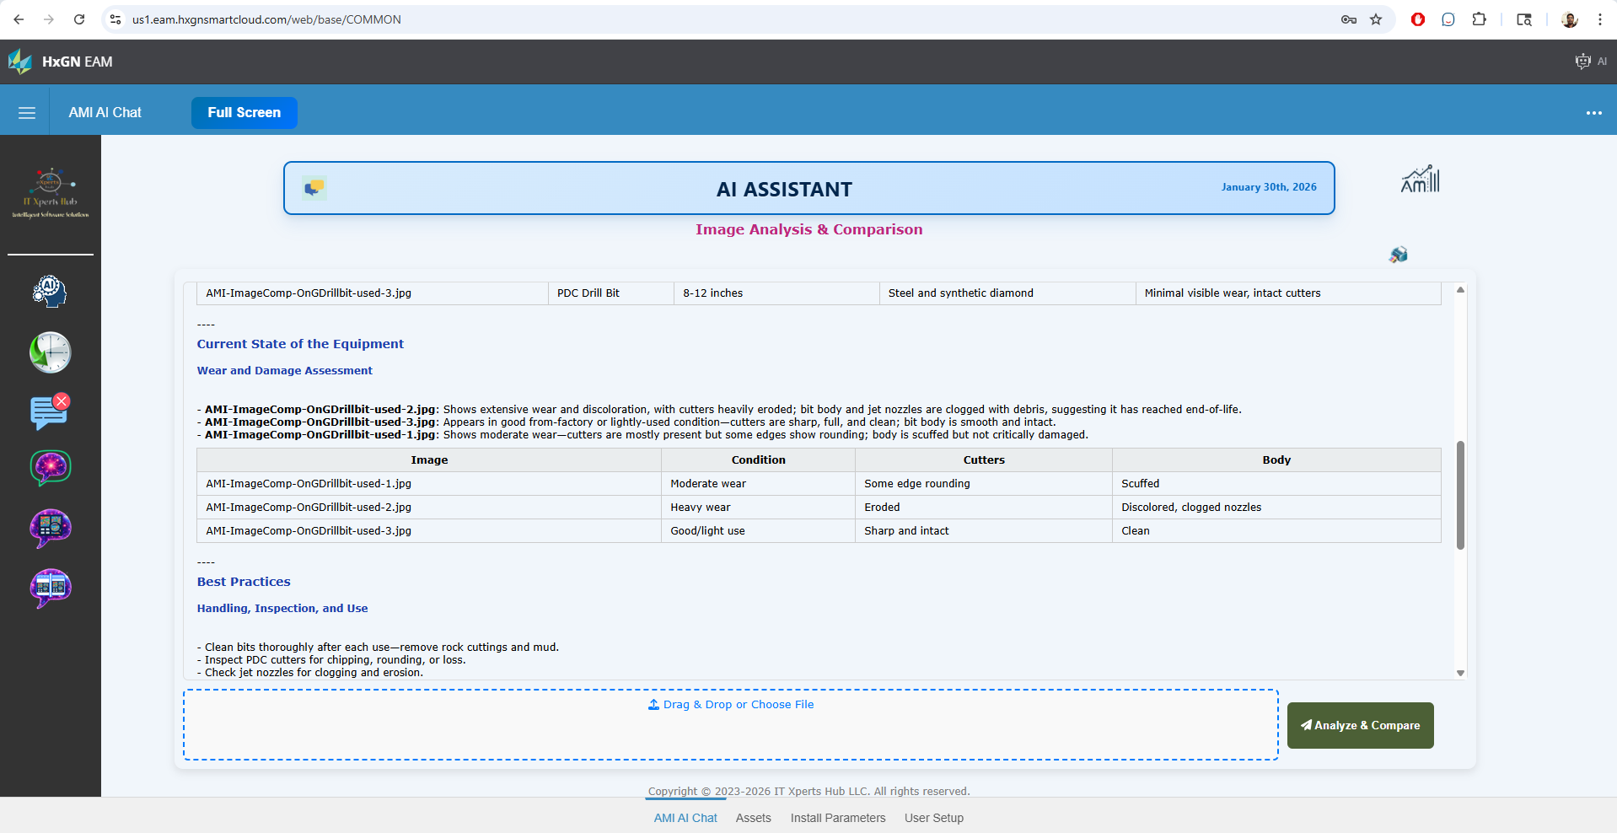
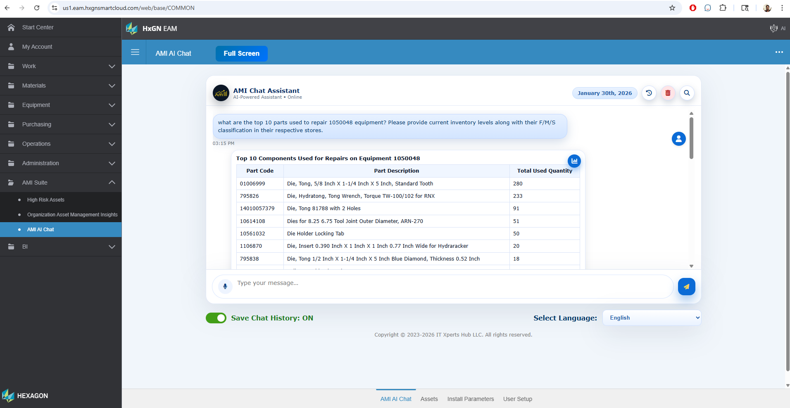
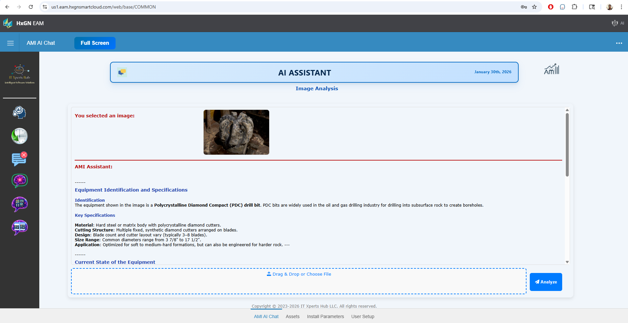
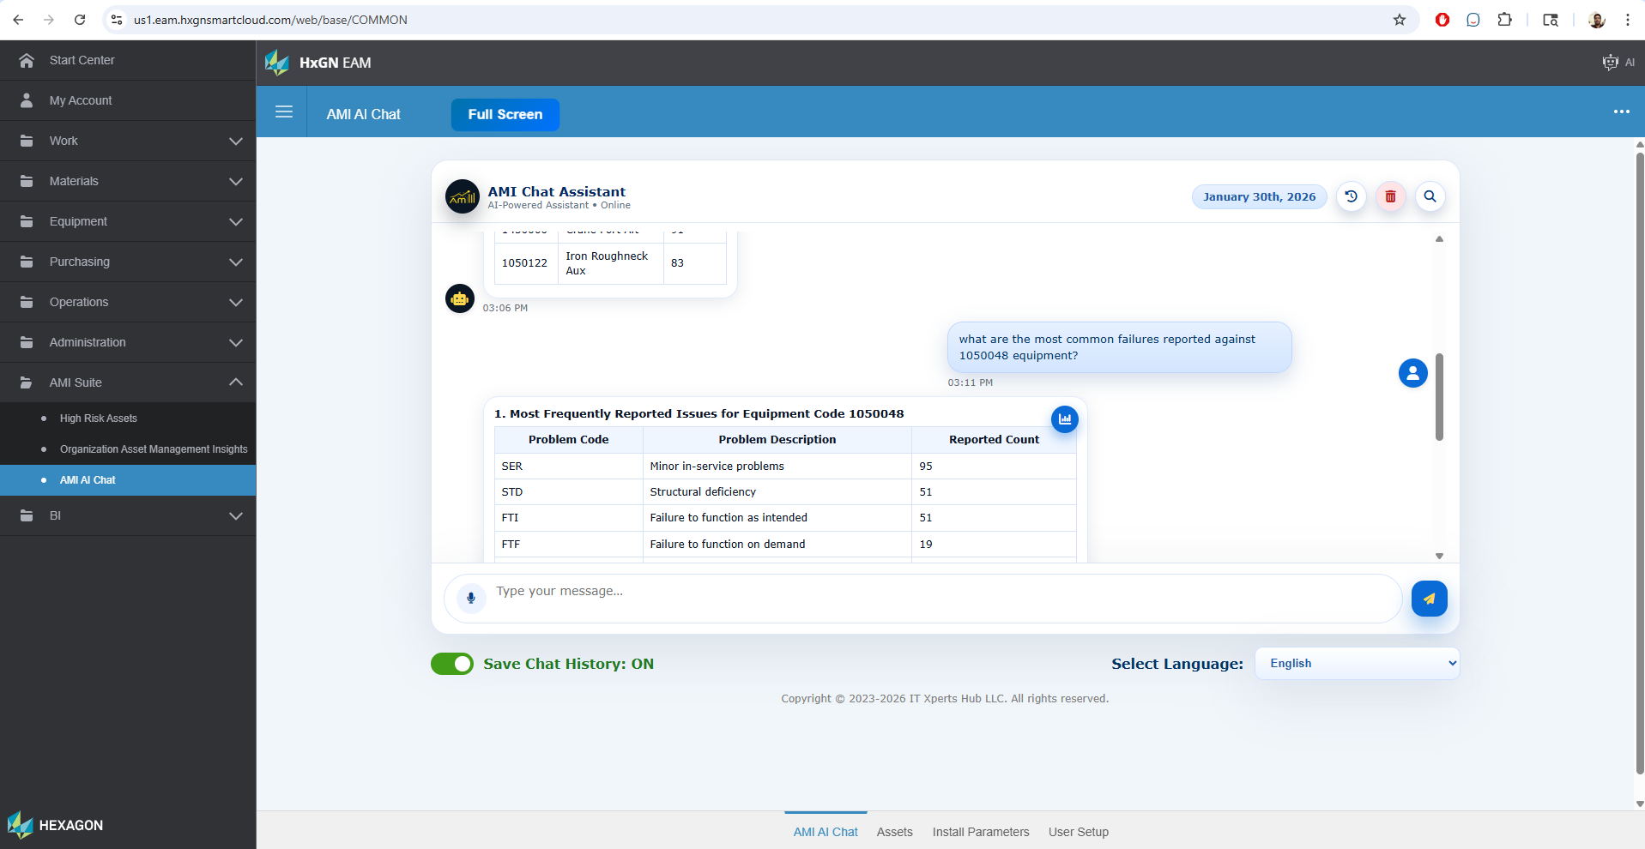
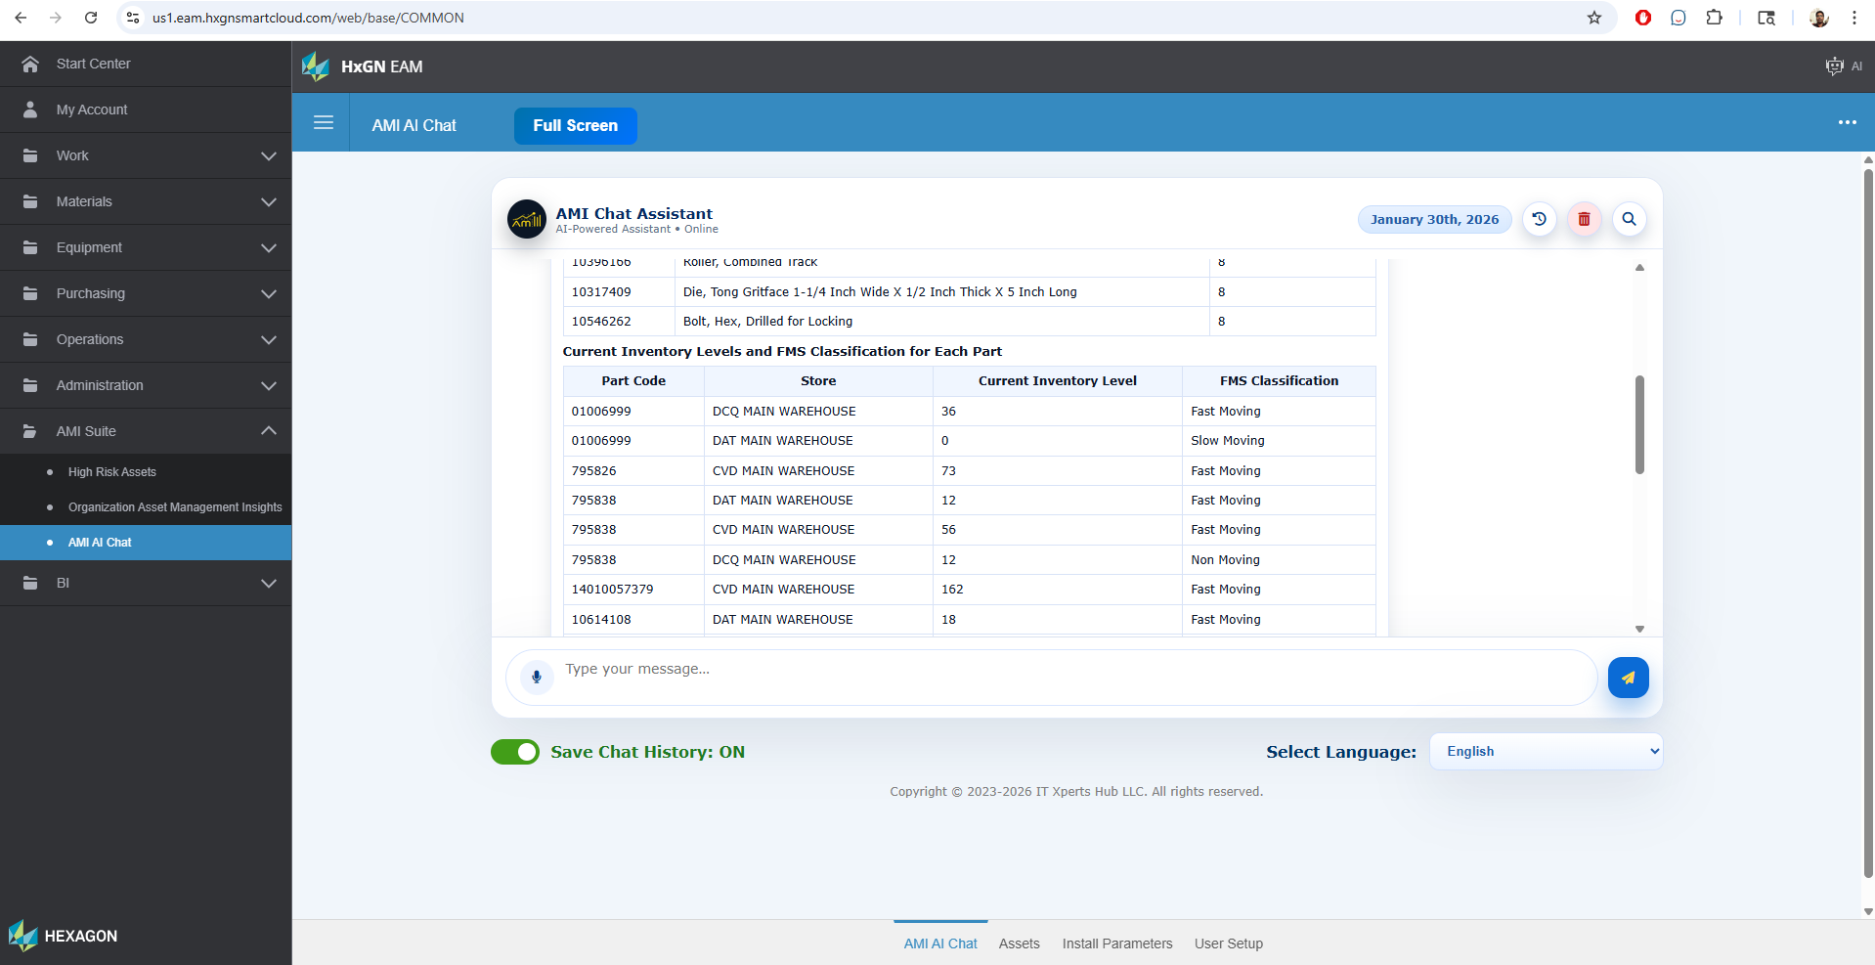
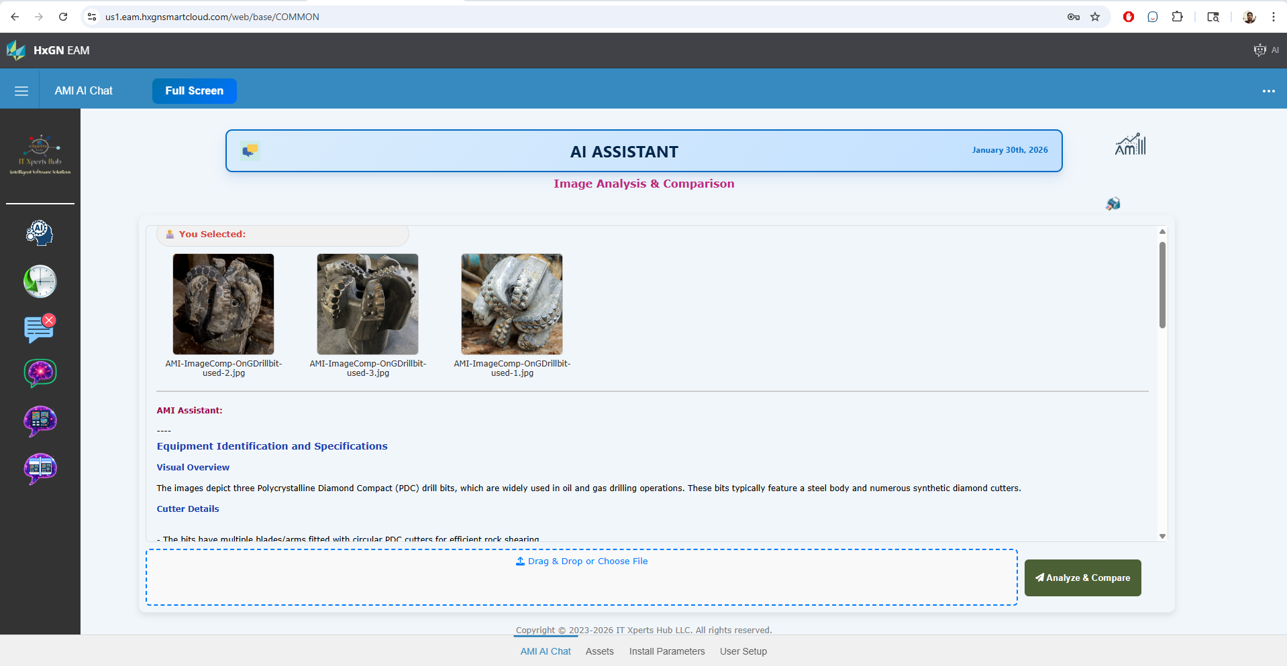
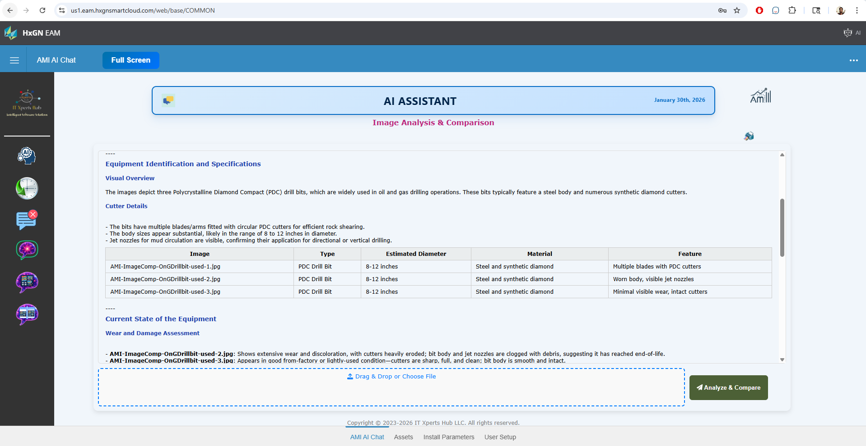
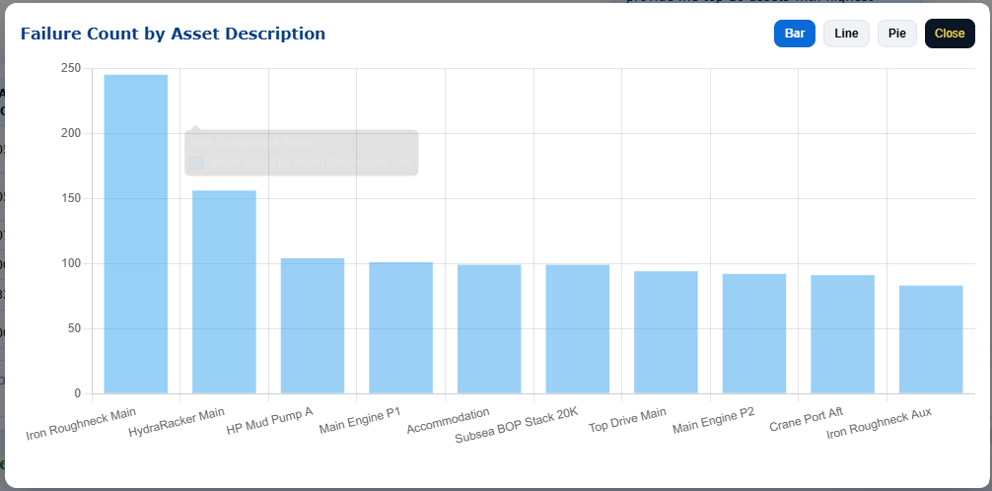
Additional Features of AMI
AMI Chat
Enables users to ask natural language questions about maintenance and operations data in multiple languages
Image analysis & comparison
Analyzes images to elevate equipment condition monitoring. Compares equipment condition in multiple images. Very useful for before and after comparison for work execution and potential extension of analyzing equipment view auto feed.
Documents Summary: Understanding the content of attachments to work orders and / or equipment is a very laborious task as each document to be opened and reviewed. This feature automatically analyzes the contents of the documents attached and provide summary at the document level. Allows users to even ask questions about the document
Video analysis (AI): Like image analysis, video analysis also elevates equipment condition monitoring but at a different level by watching equipment in operation including any noises. Potential extension of analyzing equipment view auto feed where physical monitoring is expensive.

Slide 27
Benefits
Smart Scheduler
📅 Short, medium, and long term planning with a clear view of all scheduled work. 🔧 Easily rearrange schedules by moving work blocks. 🔄 Empower planners and supervisors to update work details seamlessly without launching the full work order. 🔮 Preview upcoming work details without releasing the actual work order from the PM Schedule. 📆 Release and schedule future work orders effortlessly with our intuitive tool. 👀 Save preferred scheduling views, and let the tool automatically launch them on your next visit for a seamless experience.
Overall, 15% reduction in backlog year over year
Department Supervisors spending less time to schedule the work for their respective teams
AMI
Instant dashboard and 360^{O} review & insights
High-Risk Assets to focus on instead of analyzing each equipment or category
Ask maintenance operations questions in natural language
Identify issues that are not visible to the naked eye instantly
Overall, a productivity booster for Maintenance Operations teams across the globe, with more wrench time

Slide 28
Q & A
Thank you

