Slide 1

Greatest Hits
EAM Pre-Sales Team
Hexagon
password: Stre@mline2026

Slide 2



Agenda
40 mins
Training
Overview 360
Business Intelligence
15 mins
Informational
Part Catalog Requests
Root Cause Analysis
Mobile Updates
Documents & Document Requests
5 min Break
40 mins
Training
Workflow Approvals
Equipment Revisions
15 mins
Informational
Email Notifications
Customer Surveys
Equipment Type
Proof of Delivery
RCM Classic
Calibration
5 min Break
40 mins
Training
Contractor Portal
Dynamic Checklist
15 mins
Informational
Bulletins
Tech Studio
WO Dispatching

Slide 3
Agenda
40 mins
Training
Overview 360
Business Intelligence
15 mins
Informational
Part Catalog Requests
Root Cause Analysis
Mobile Updates
Documents & Document Requests
5 min Break
40 mins
Training
Workflow Approvals
Equipment Revisions
15 mins
Informational
Email Notifications
Customer Surveys
Equipment Type
Proof of Delivery
RCM Classic
Calibration
5 min Break
40 mins
Training
Contractor Portal
Dynamic Checklist
15 mins
Informational
Bulletins
Tech Studio
WO Dispatching

Slide 4
Agenda
40 mins
Training
Overview 360
Business Intelligence
15 mins
Informational
Part Catalog Requests
Root Cause Analysis
Mobile Updates
Documents & Document Requests
5 min Break
40 mins
Training
Workflow Approvals
Equipment Revisions
15 mins
Informational
Email Notifications
Customer Surveys
Equipment Type
Proof of Delivery
RCM Classic
Calibration
5 min Break
40 mins
Training
Contractor Portal
Dynamic Checklist
15 mins
Informational
Bulletins
Tech Studio
WO Dispatching

Slide 5
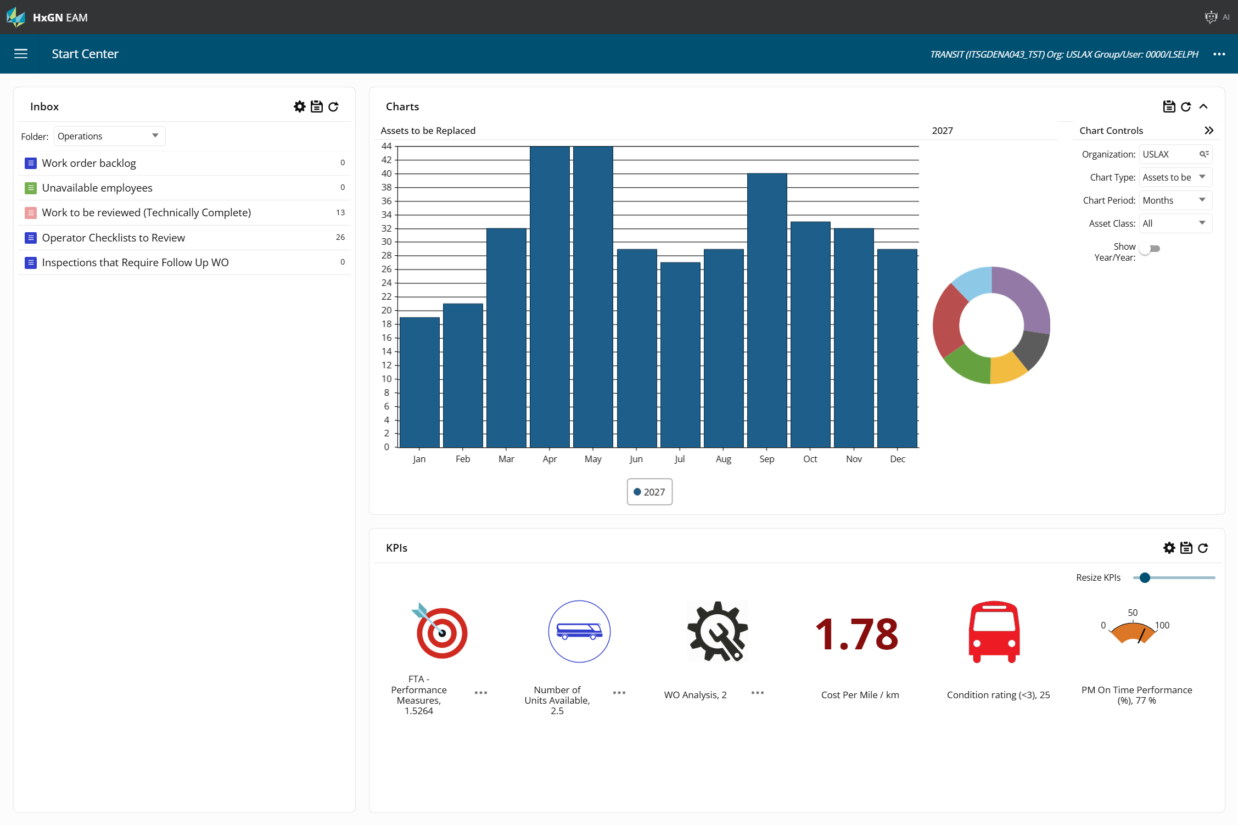
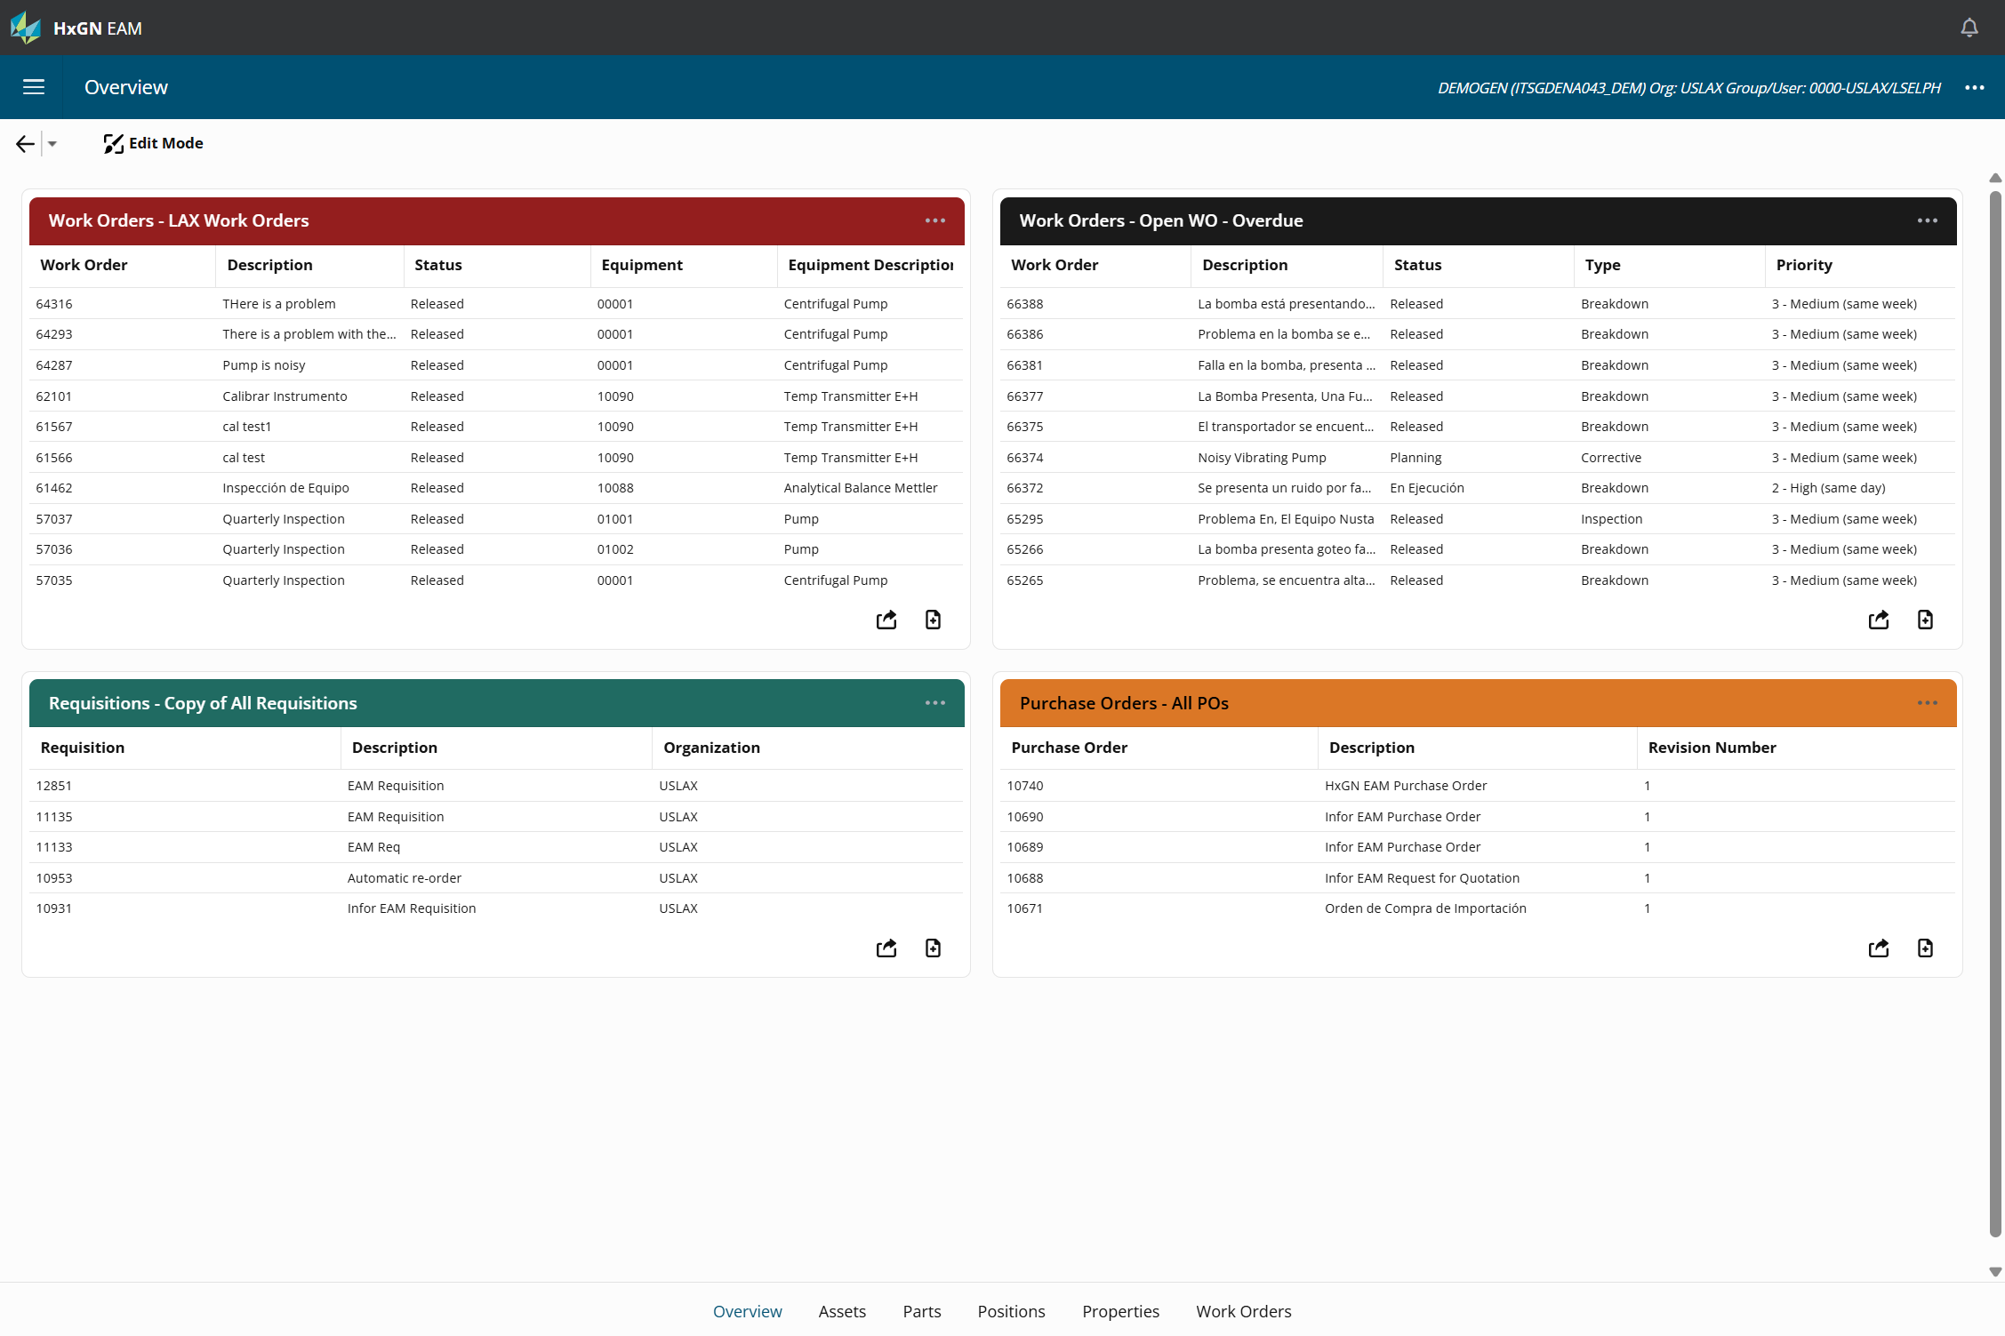
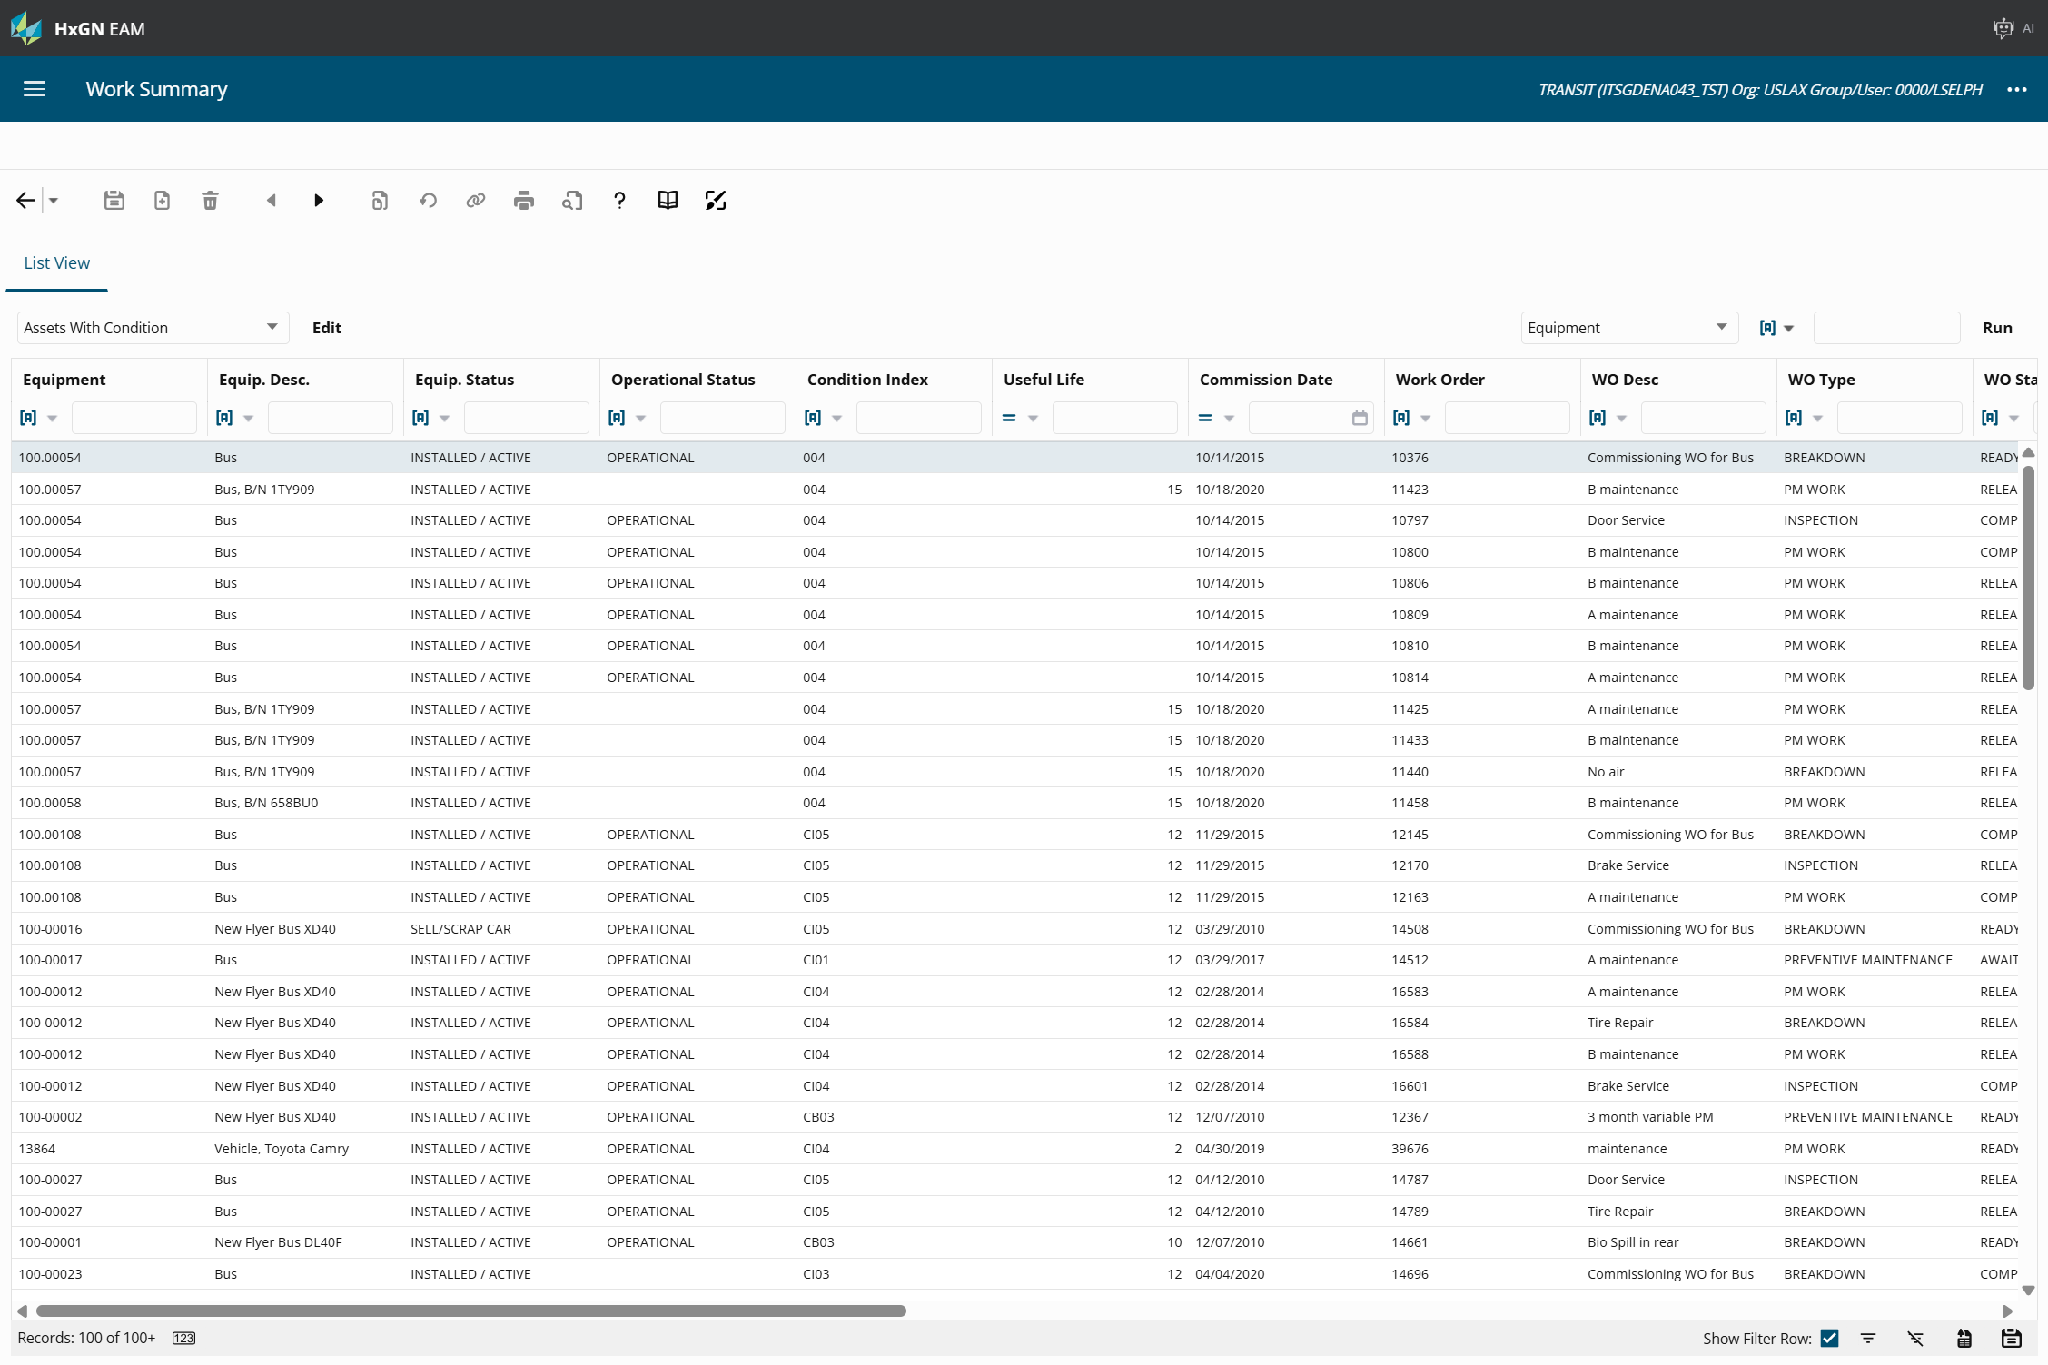
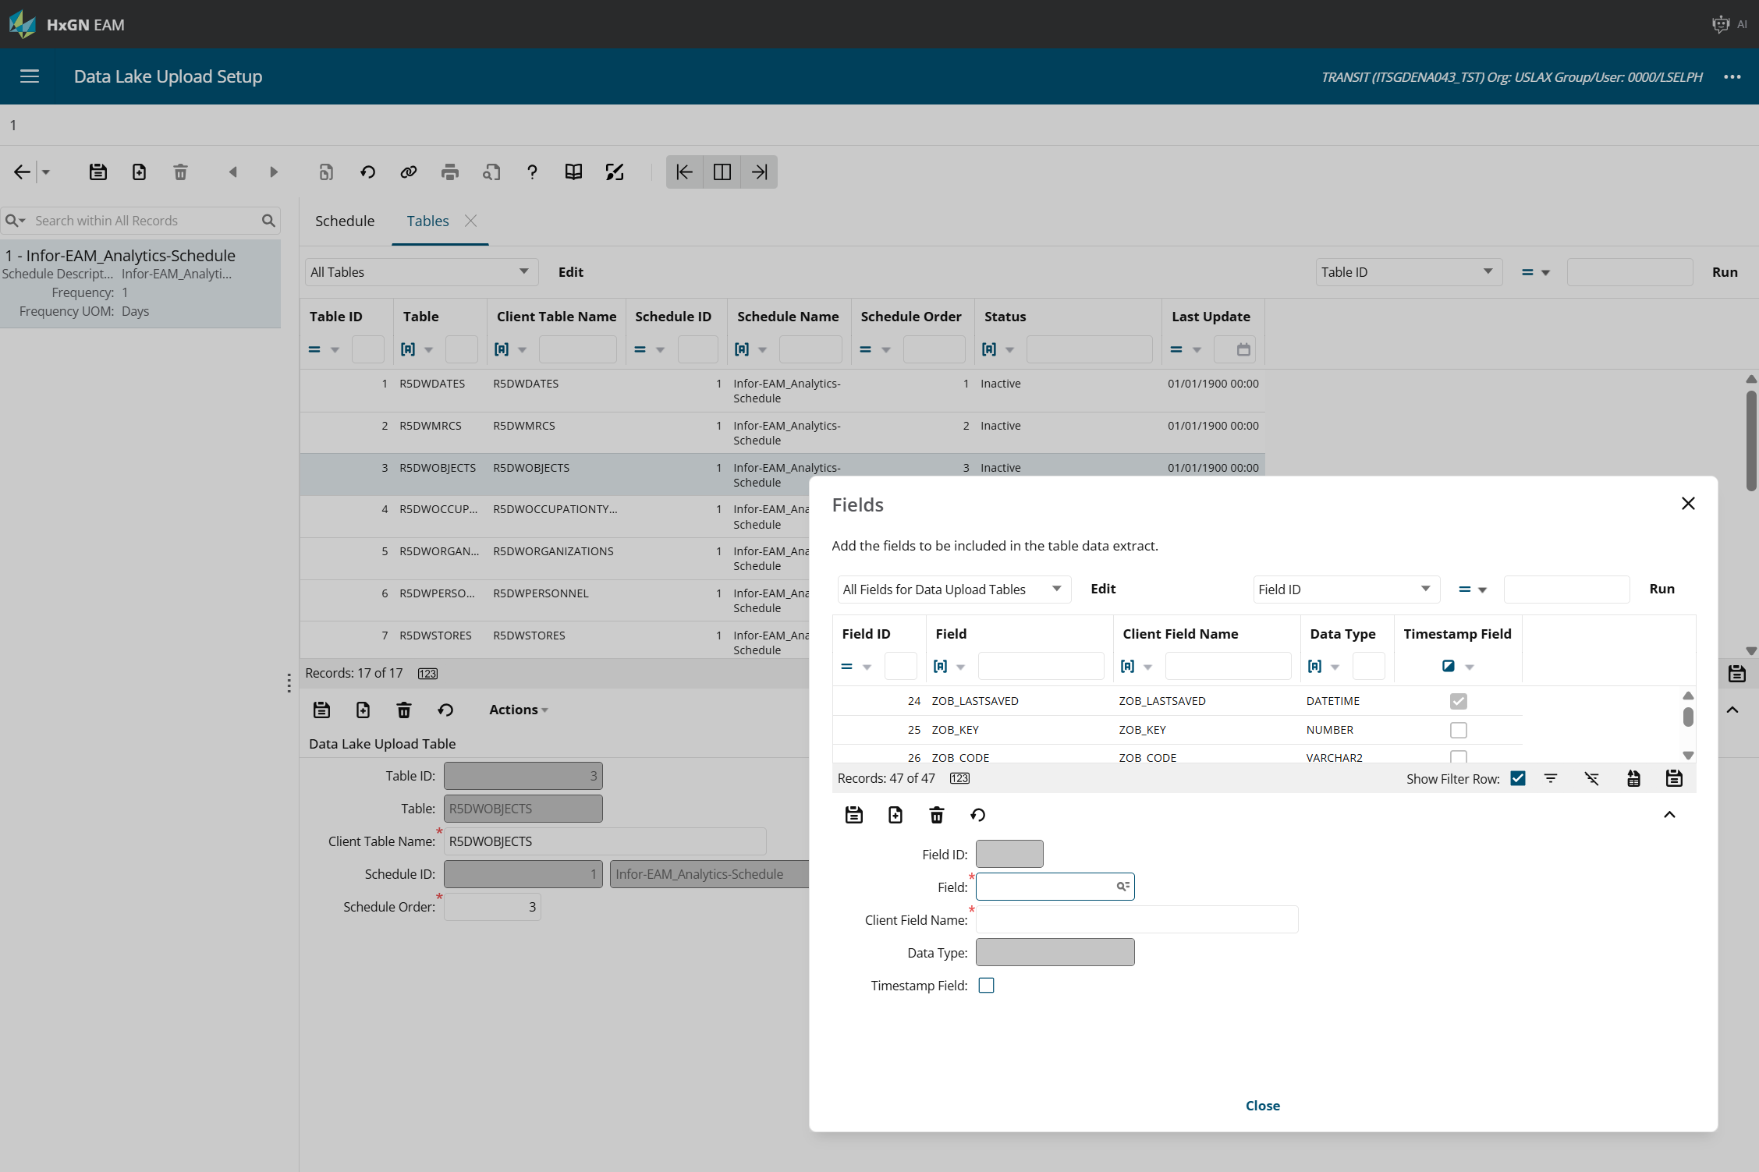
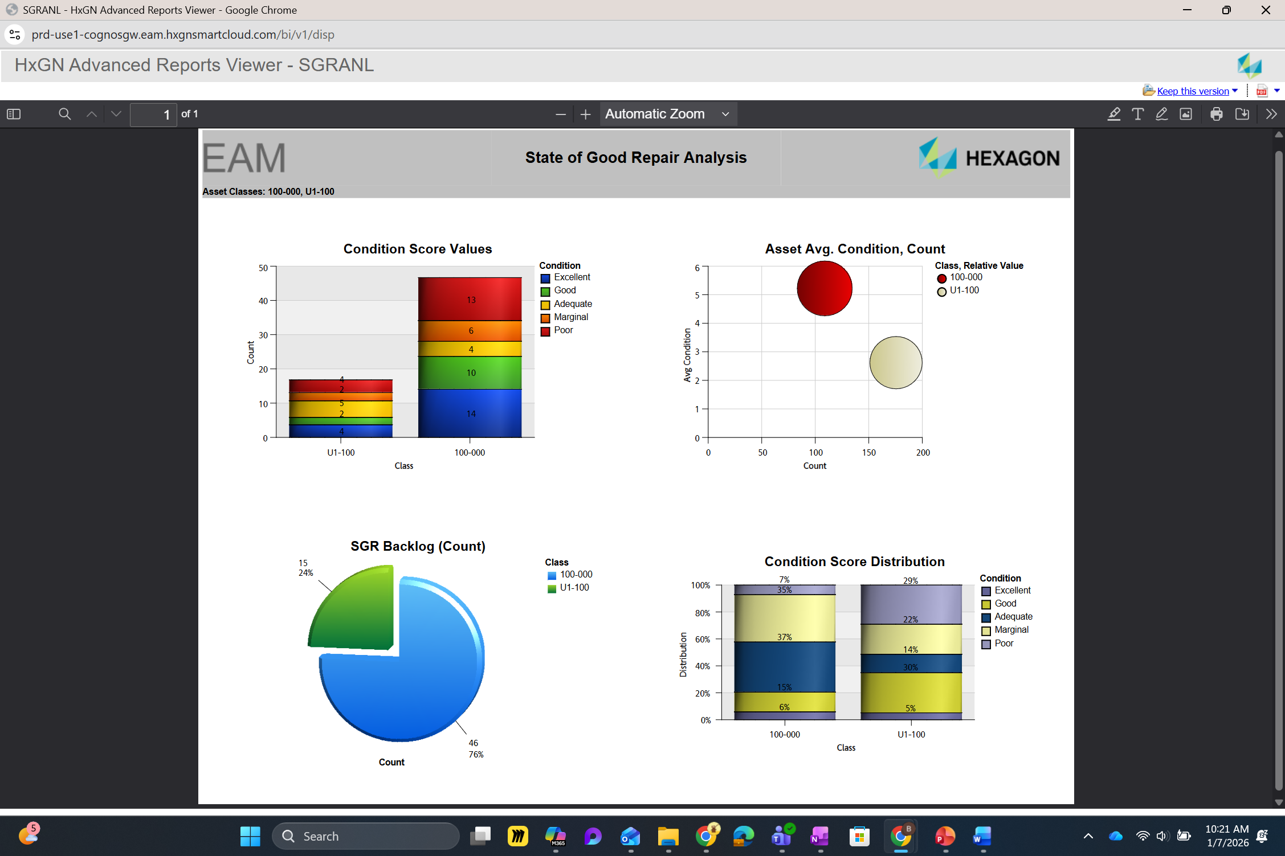
Different Ways for Output

Slide 6
360 Dashboards
Equipment Overview, released 11.7 – visualize key metrics related to assets
Display general and equipment specific information and can be configured to the exact user’s needs and preferences. The overview screen uses widgets that can be selected and configured individually
Organization Overview, released 12.1.1 – expanded the entities but is ORG specific
https://docs.hexagonali.com/r/en-US/HxGN-EAM-Overview-360/12.1.1/1277550

Slide 7
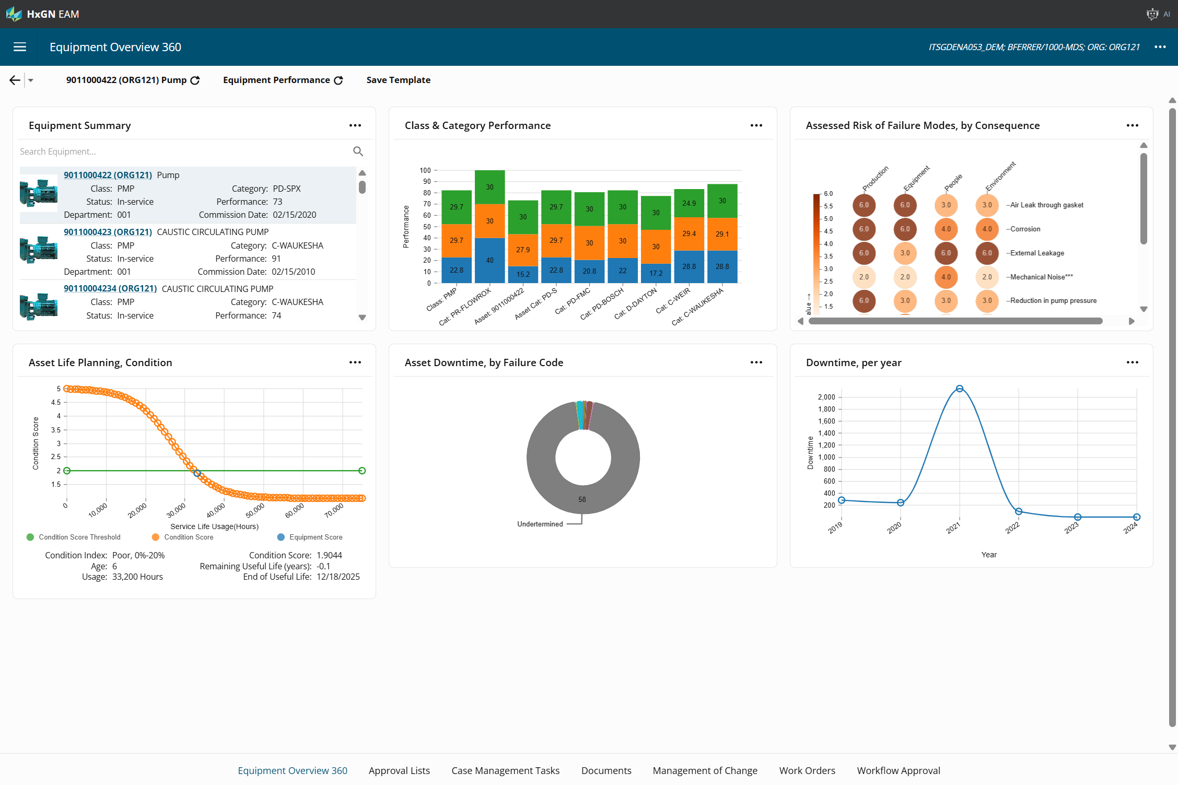
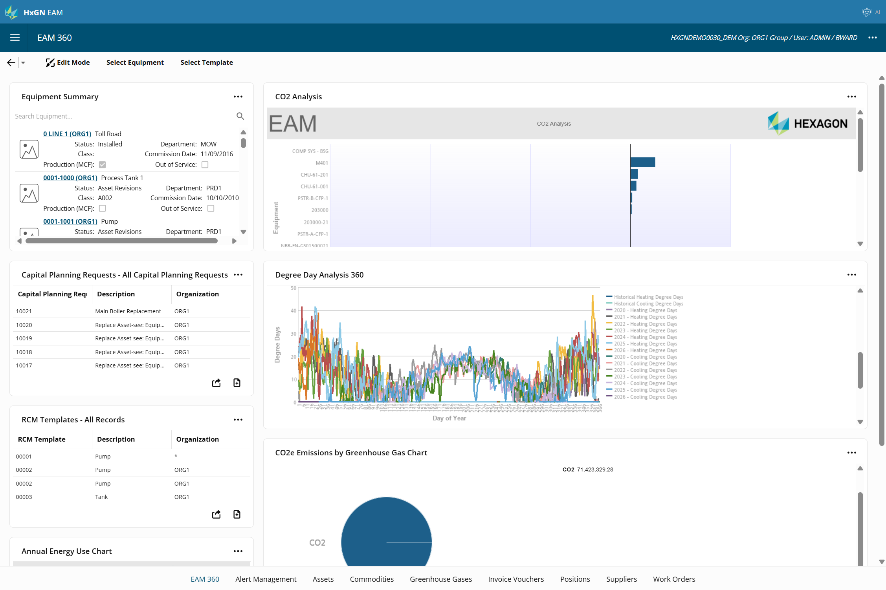
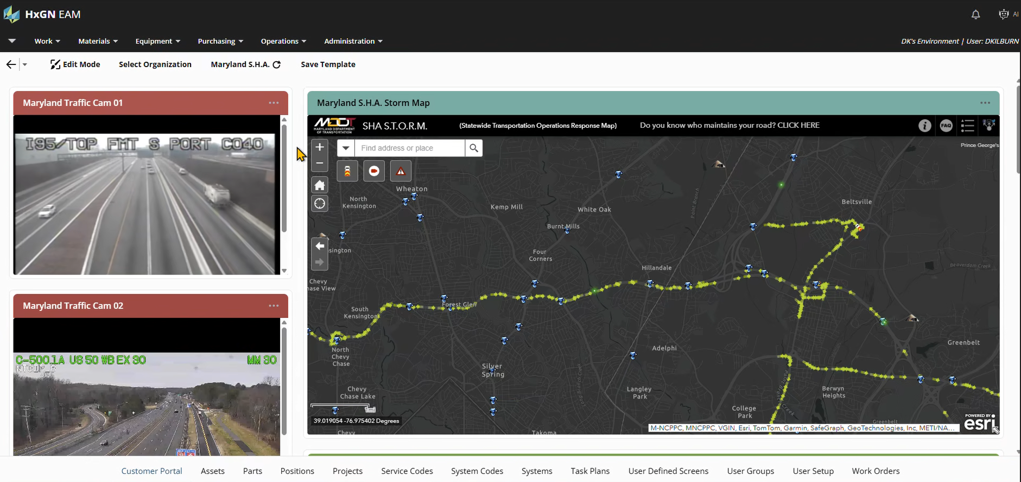
360 Dashboard Samples

Slide 8
Business Intelligence, 12.3
Built-in Business Intelligence Author & Dashboards
Pre-Configured connection to HxGN EAM database
60+ interactive chart types
Directly read tables in HxGN EAM or create custom SQL queries in the SQL Lab
Drag-and-drop ease of use for chart configuration

Slide 9
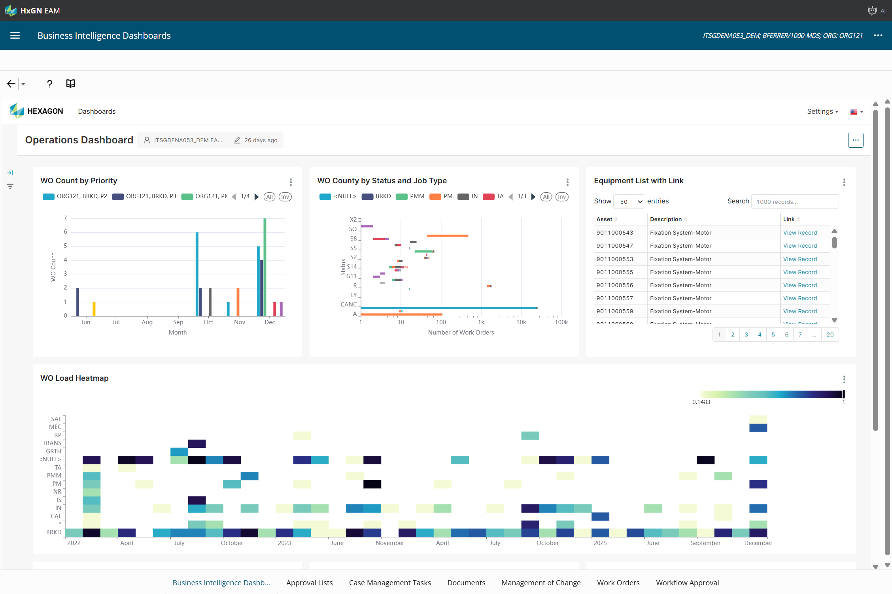
BI Dashboard Sample

Slide 10
Exercise
Create chart 1
Create a dataset (Physical – from EAM database or Virtual – from queries)
1. Click SQL, SQL Lab
2. Database – auto filled
3. Schema – If not auto-filled, select the only value available.
4. Enter SQL:
SELECT wo.evt_code, wo.evt_status, wo.evt_type, wo.evt_mrc, wo.evt_object,wocost.evo_ownlabor, wocost.evo_hiredlabor, wocost.evo_serviceslabor, wocost.evo_stockmaterial, wocost.evo_directmaterial, wocost.evo_tool, wocost.evo_total from r5events wo,r5eventcost wocostwhere wo.evt_code = wocost.evo_even tand wocost.evo_total>0;
5. Save the query

Slide 11
Exercise
Create charts off of the dataset, system takes you to initial chart creation page
1. Click on Charts, create New
2. Choose your Dataset
3. Chart Type: Set to Table.
Make updates in the resulting screen’
1. Set the Dimensions value as: EVT_OBJECT
2. Set Metrics value as: SUM(EVO_TOTAL)
3. Click on Customize, make any appropriate settings

Slide 12
Exercise
Create chart 2
Click Create New Chart
1. Click on Charts, create New
2. Choose r5events dataset
3. Chart Type: Set to Bar Chart
Make updates in the resulting screen’s DATA tab:
1. Set the X-axis value as: EVT_STATUS
2. Set Metrics value as: ‘Count(*)’
3. Set Dimensions value as: EVT_JOBTYPE
Optionally, click CUSTOMIZE tab and update the following properties:
1. In Chart Orientation section, set to Horizontal
a. Note that this swaps settings regarding the X and Y axes in the DATA tab set in prior step.
b. In the Chart Title section:
i. Provide X Axis Title value of ‘Number of Work Orders’
ii. Provide Y Axis Title value of ‘Status’
iii. Review both the X and Y Axis Title Margin values and adjust each if needed.

Slide 13
Exercise Cont’d
c. In the Chart Options section:
i. Show Value – Select this option.
ii. Stacked Style – Set as Stack.
iii. Minor Ticks - Select this option.
3. Click Save. In the popup, set values:
a. Chart Name: WO Count by Status and Job Type
b. Add to Dashboard: Sample (or any name you’d like to supply)
i. After typing a value which did not pre-exist, system will create the value for you to select from dropdown. Select it. Then click ‘Save & Go to Dashboard’
Publish the dashboard - To make the dashboard available in EAM’s BI Dashboards screen, you’ll need to toggle the status of the Dashboard to Published. By default, it is Draft.

Slide 14
Considerations
You have access to the dashboards or you don’t
Being an author takes an advanced reports author license
https://docs.hexagonali.com/v/u/HxGN-EAM-Business-Intelligence/12.3

Slide 15
360s vs Business Intelligence
 | 360 Dashboards | Business Intelligence
Charts | 8 widgets (including reports, url) | 60+ chart types
Shareable | Yes | Not yet
Custom URLs | 1 of the 8 widgets | None
Joins | No | Yes
Calculations | No | Yes
Dataset editing | No | Yes
Refresh | At selection | Set on dashboard

Slide 16
Agenda
40 mins
Training
Overview 360
Business Intelligence
15 mins
Informational
Part Catalog Requests
Root Cause Analysis
Mobile Updates
Documents & Document Requests
5 min Break
40 mins
Training
Workflow Approvals
Equipment Revisions
15 mins
Informational
Email Notifications
Customer Surveys
Equipment Type
Proof of Delivery
RCM Classic
Calibration
5 min Break
40 mins
Training
Contractor Portal
Dynamic Checklist
15 mins
Informational
Bulletins
Tech Studio
WO Dispatching

Slide 17
Part Catalog Requests, 12.3
A new screen to request the creation of new parts or update existing parts; including Supplier Catalog, Manufacturer Parts, Pricing, and Store related information.
Screen additionally supports Changing Part Numbers/Merging of parts.
https://docs.hexagonali.com/v/u/HxGN-EAM-Part-Catalog-Requests/12.3
Notes:
In heavily regulated industries, providing mechanisms to allow for an approval gate to review requested changes prior to them being committed is paramount for heavy-hitter entities such as Parts, Equipment, Documents, etc.

Slide 18
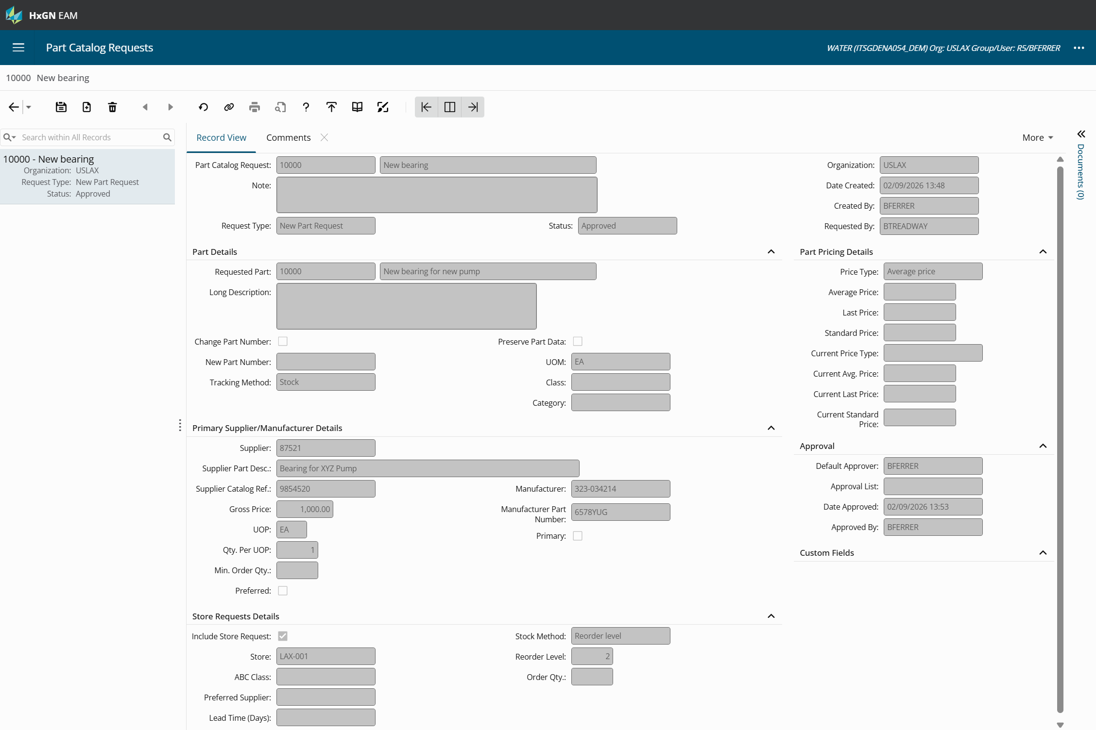

Slide 19
Setup Considerations
Install Parameter AUTOPNUM
Part Catalog Requests leverages same logic as AUTOPNUM for New Part Requests.
The following Parts are not supported by this screen:
Track By Asset
Track By Kit
Repairable Spare
Calibration Standard
Track by Condition
Status Authorizations for CQST

Slide 20
Setup Considerations Cont’d
Install Parameter - PRICELEV
Screen supports PRICELEV of ‘S’ – Store and ‘P’ – Part level.
For PRICELEV of ‘P’, price level is required for every record.
For PRICELEV of ‘S’, pricing details become unprotected when ‘Include Store Request’ is checked.
Note: If Average, Last, or Base Price fields are left empty, updates will NOT take place against the part! Updating the price creates a ‘CORR’ – Correction transaction. Fields can be protected if not desired to ever update pricing from this screen.
Limitation: Pricing will remain protected under the following environment settings:
PRICELEV = ‘P’
MULTIORG = ‘ON’
Part Catalog Request / Part is in a common organization.

Slide 21
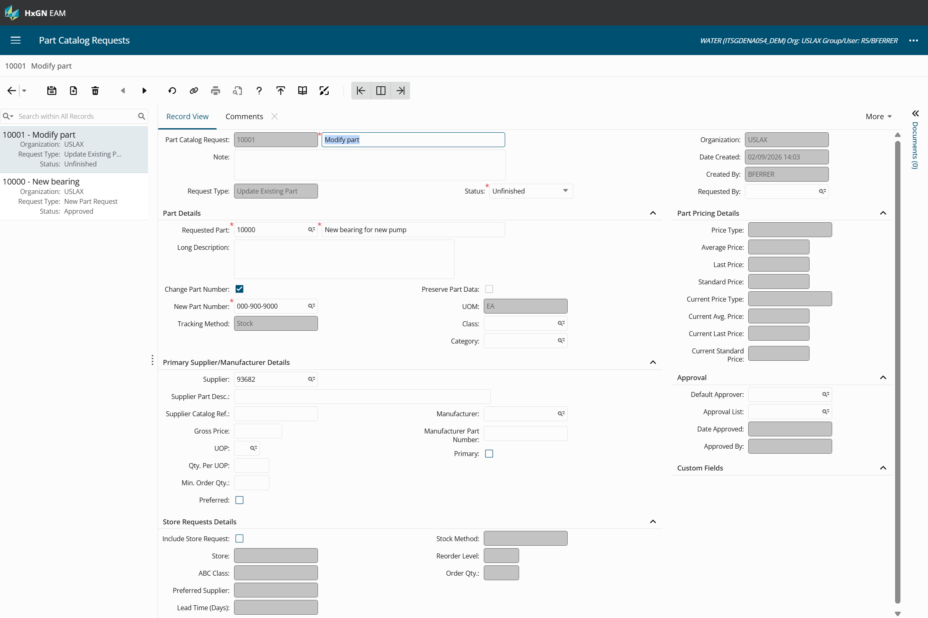
Setup Considerations Cont’d
Once the PCR becomes approved, the system will perform the following based on New Part Request or Update Existing Part:
Part Record View
Supplier Catalog
Updates existing or adds new
Note: Alternate Catalog not added
Manufacturer Parts
Updates existing or adds new
Part Pricing*
*Only if PRICELEV = ‘P’
Comments/Documents
UDF’s and Custom Fields
Store (R5STOCK)*
Pricing when PRICELEV = ‘S’

Slide 22
Root Cause Analysis, 12.0.1
Utilize a systematic process for identifying “root causes” of events based on 5 Whys methodology
“By repeating why five times, the nature of the problem as well as its solution becomes clear.” - Taiichi Ohno
Supports Management of Change and continuous improvement.
Apply findings from Root Cause Analysis to equipment RCM or RCM templates
Notes:
The “5 Whys” is a simple problem-solving technique that helps you to get to the root of a problem quickly, which was originally developed by Sakichi Toyota. It was used within the Toyota Motor Corporation during the evolution of its manufacturing methodologies.
The 5 Whys strategy involves looking at any problem and asking: “Why?” and “What caused this problem?” Very often, the answer to the first “why” will prompt another “why” and the answer to the second “why” will prompt another and so on; hence the name the 5 Whys strategy.

Slide 23
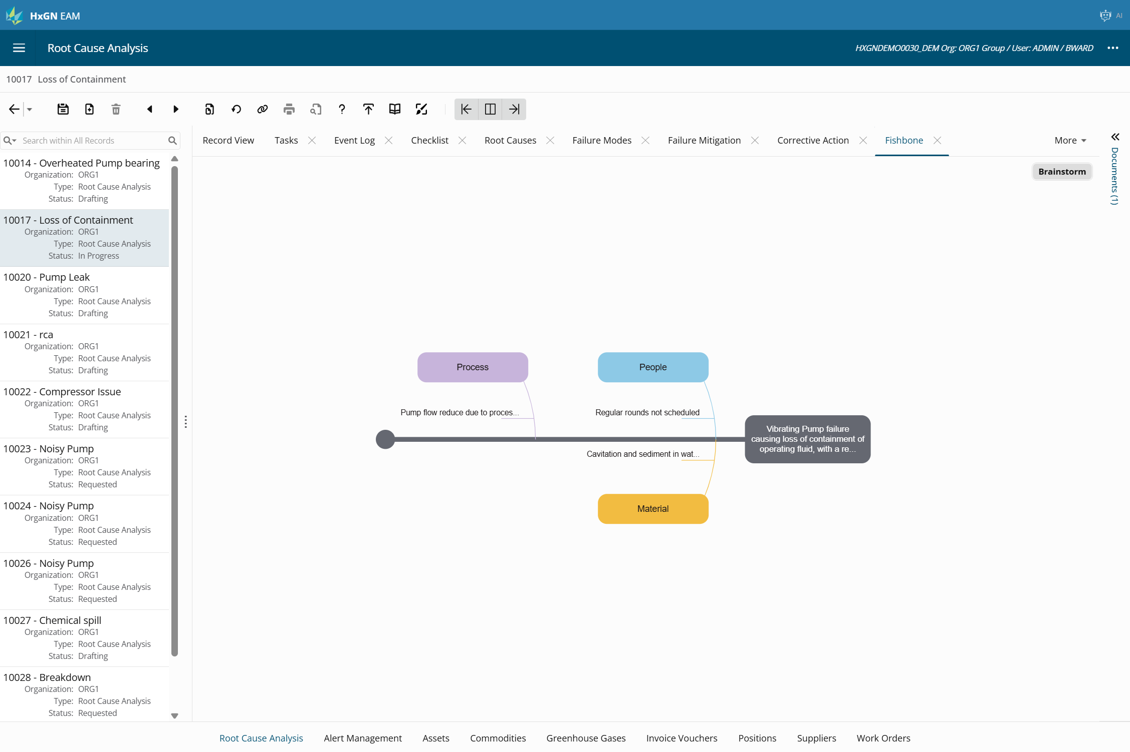
Root Cause Analysis, 11.7-12.0.1
Update maintenance strategies from RCA, find new/missed failure modes and appropriate actions to reduce risk, apply them to RCM analysis template/s and/or equipment
A simpler way to build RCM analysis

Slide 24
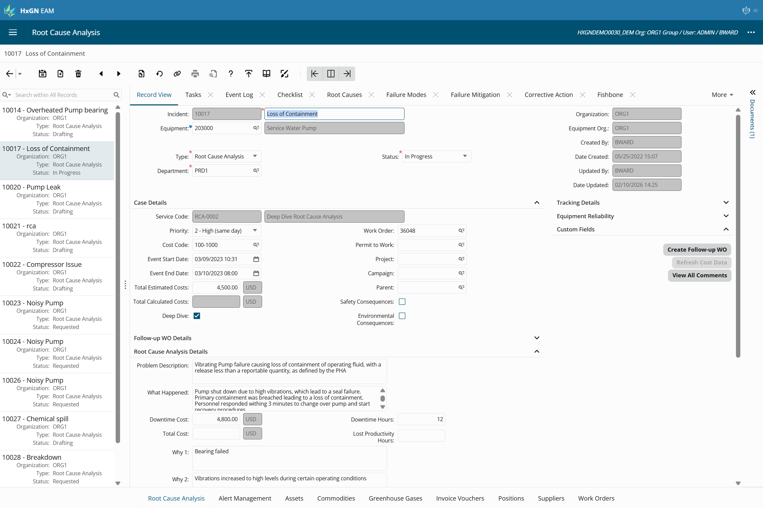

Slide 25
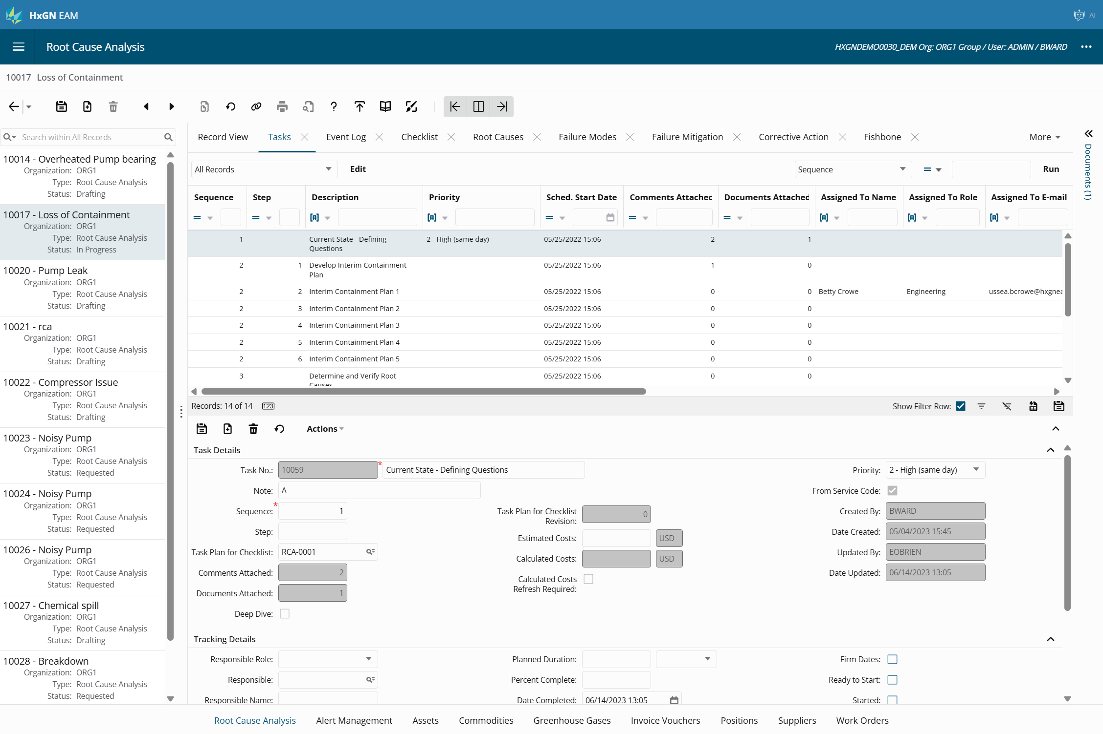

Slide 26
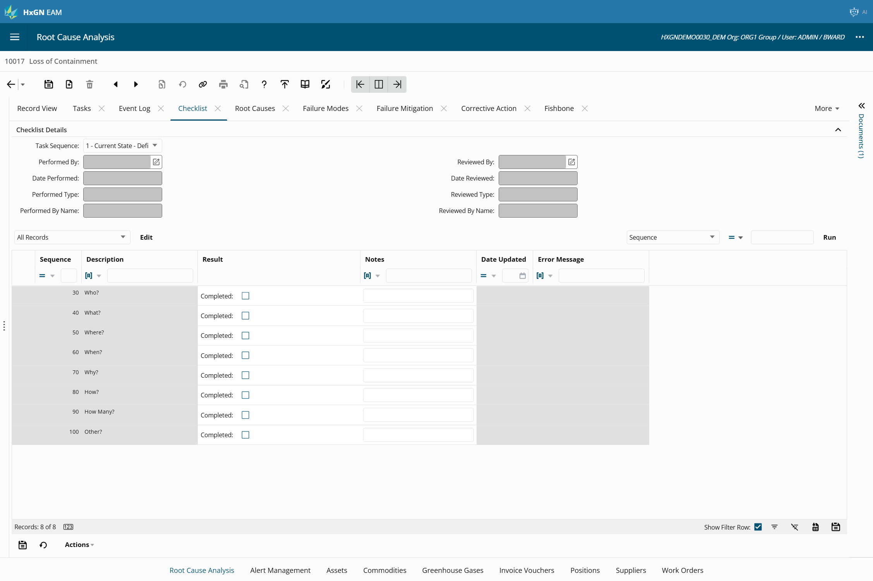

Slide 27
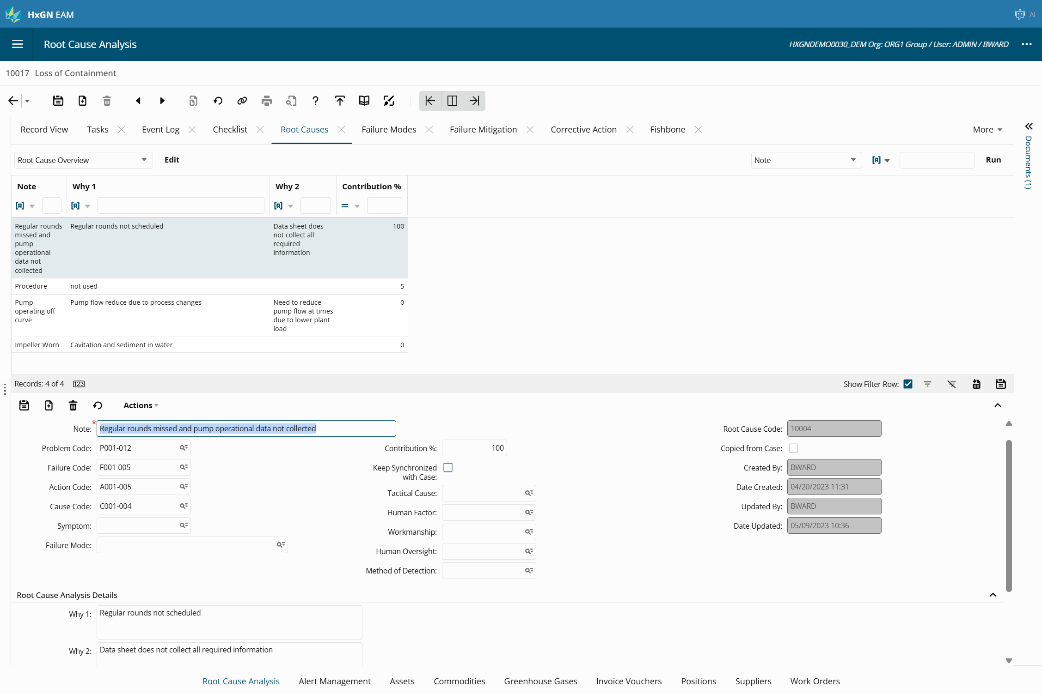

Slide 28
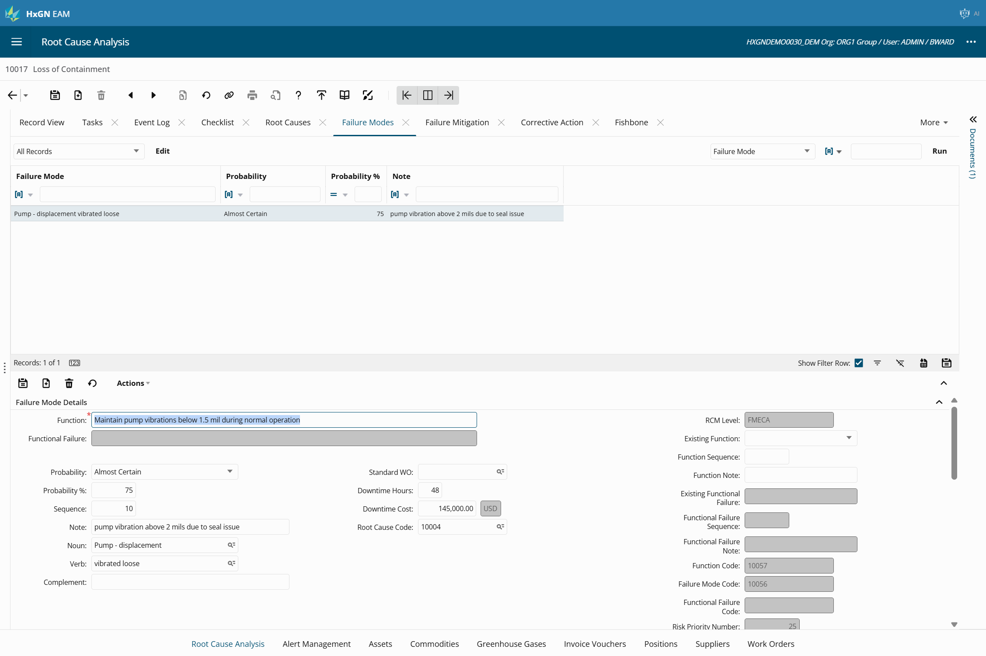

Slide 29
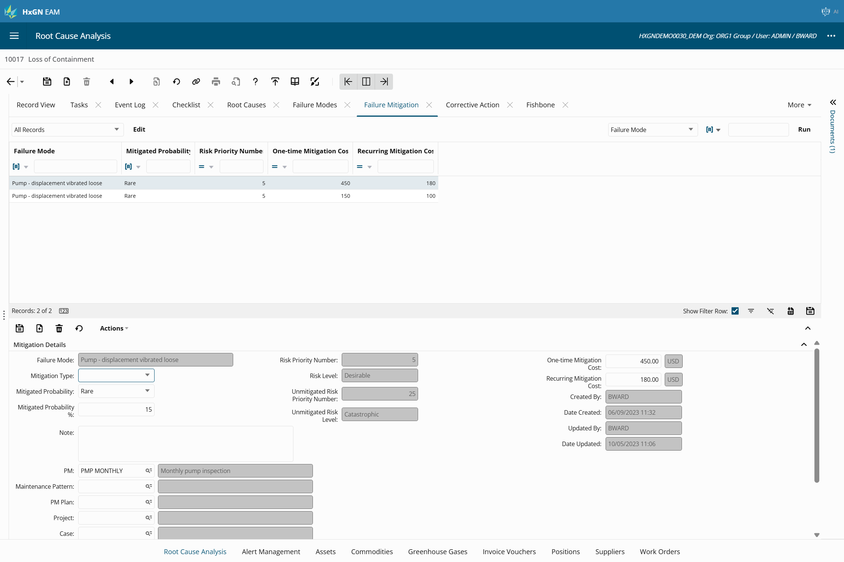

Slide 30
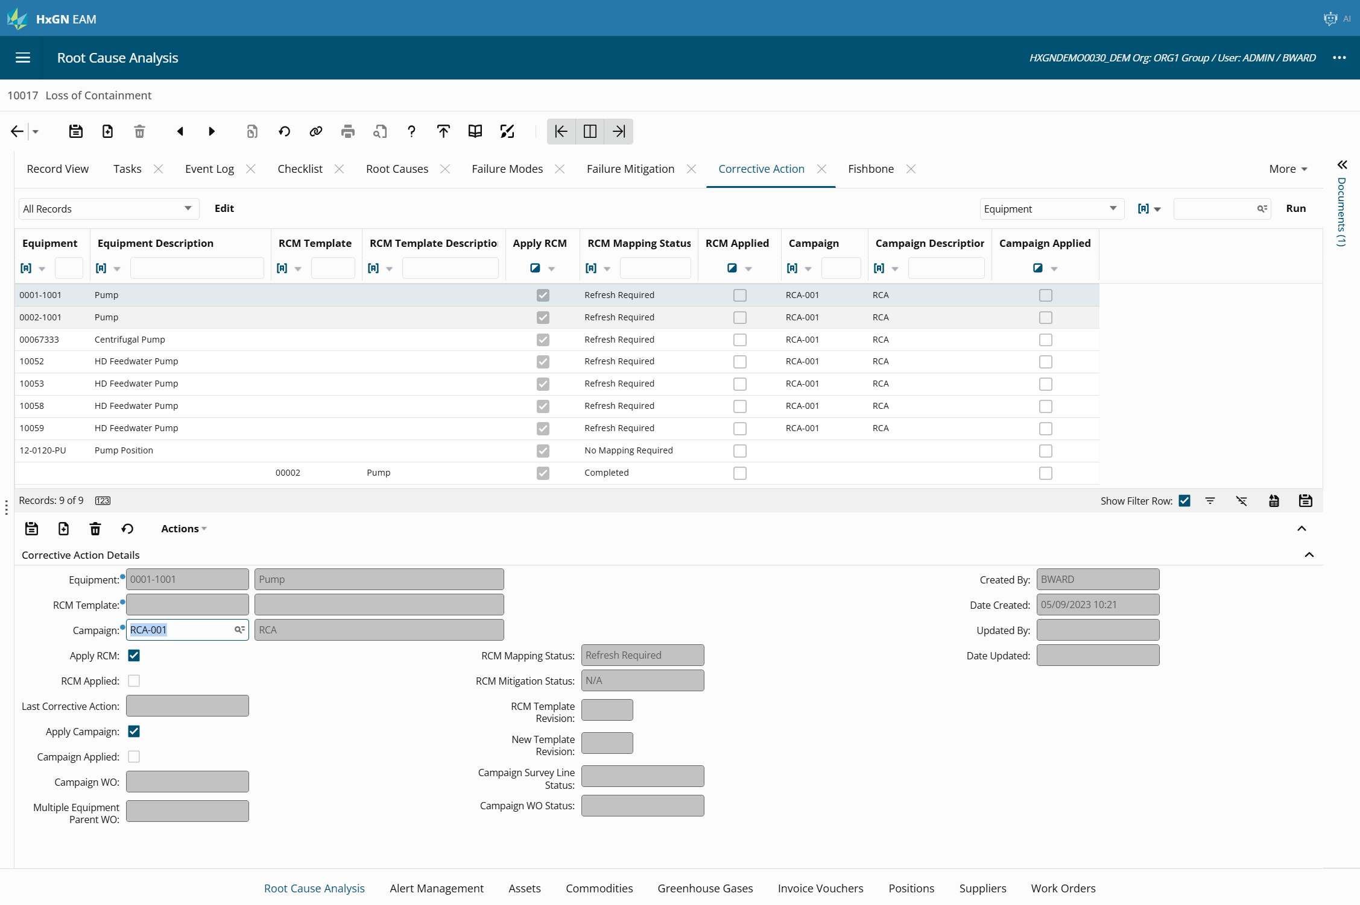

Slide 31
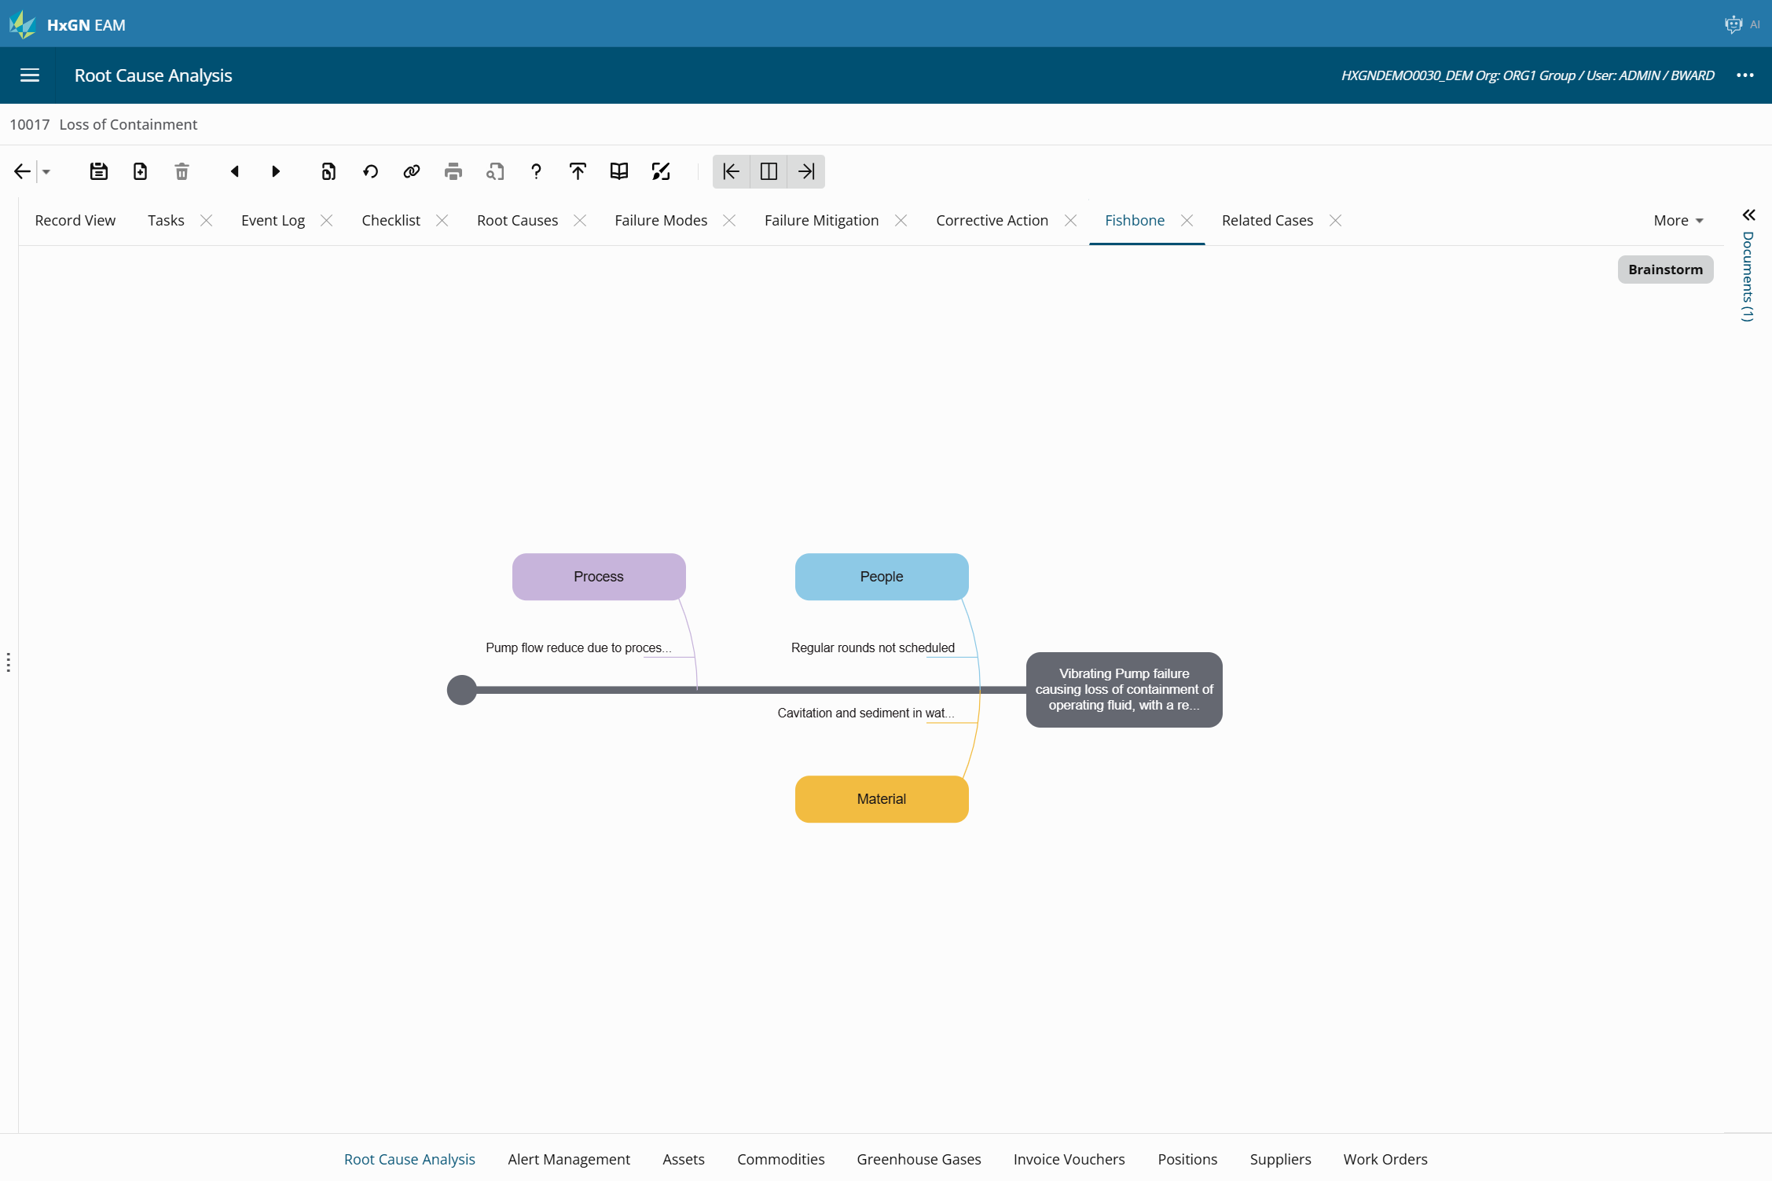
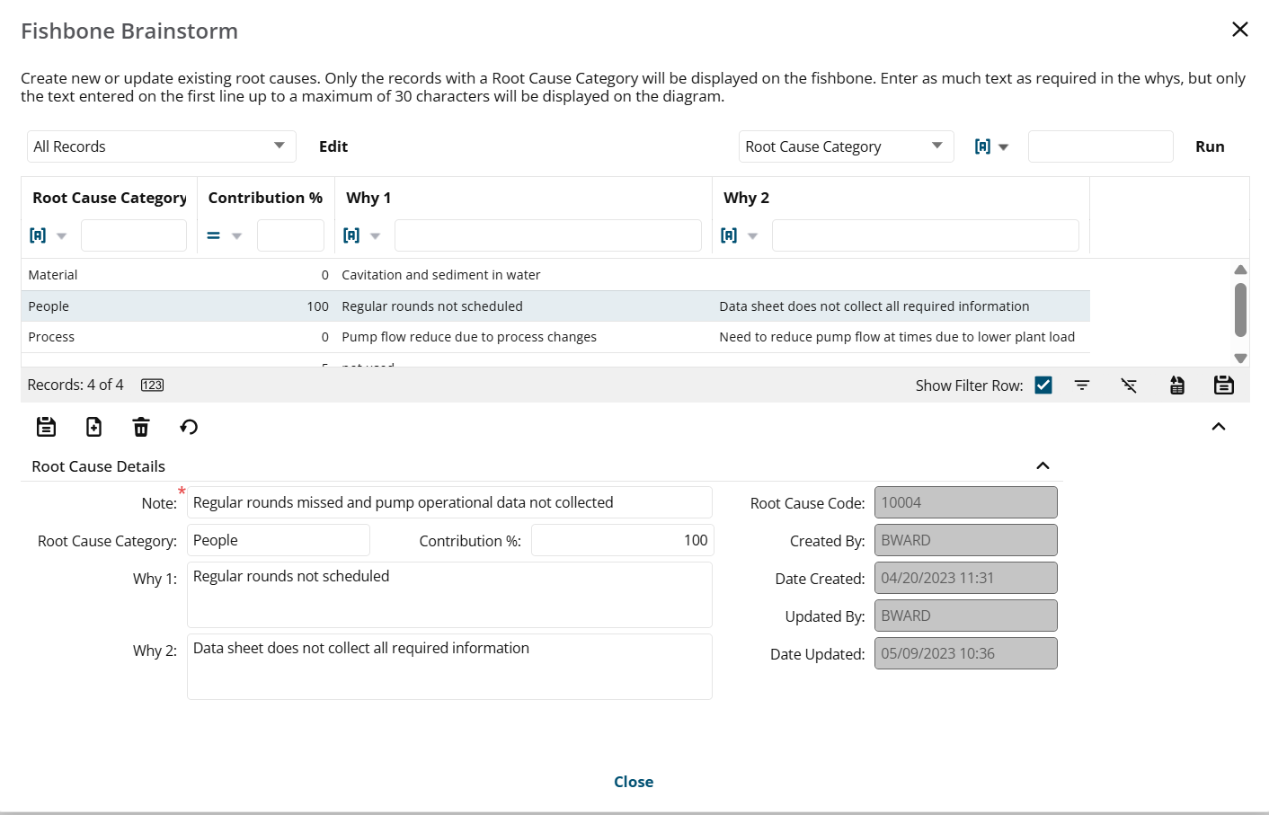

Slide 32
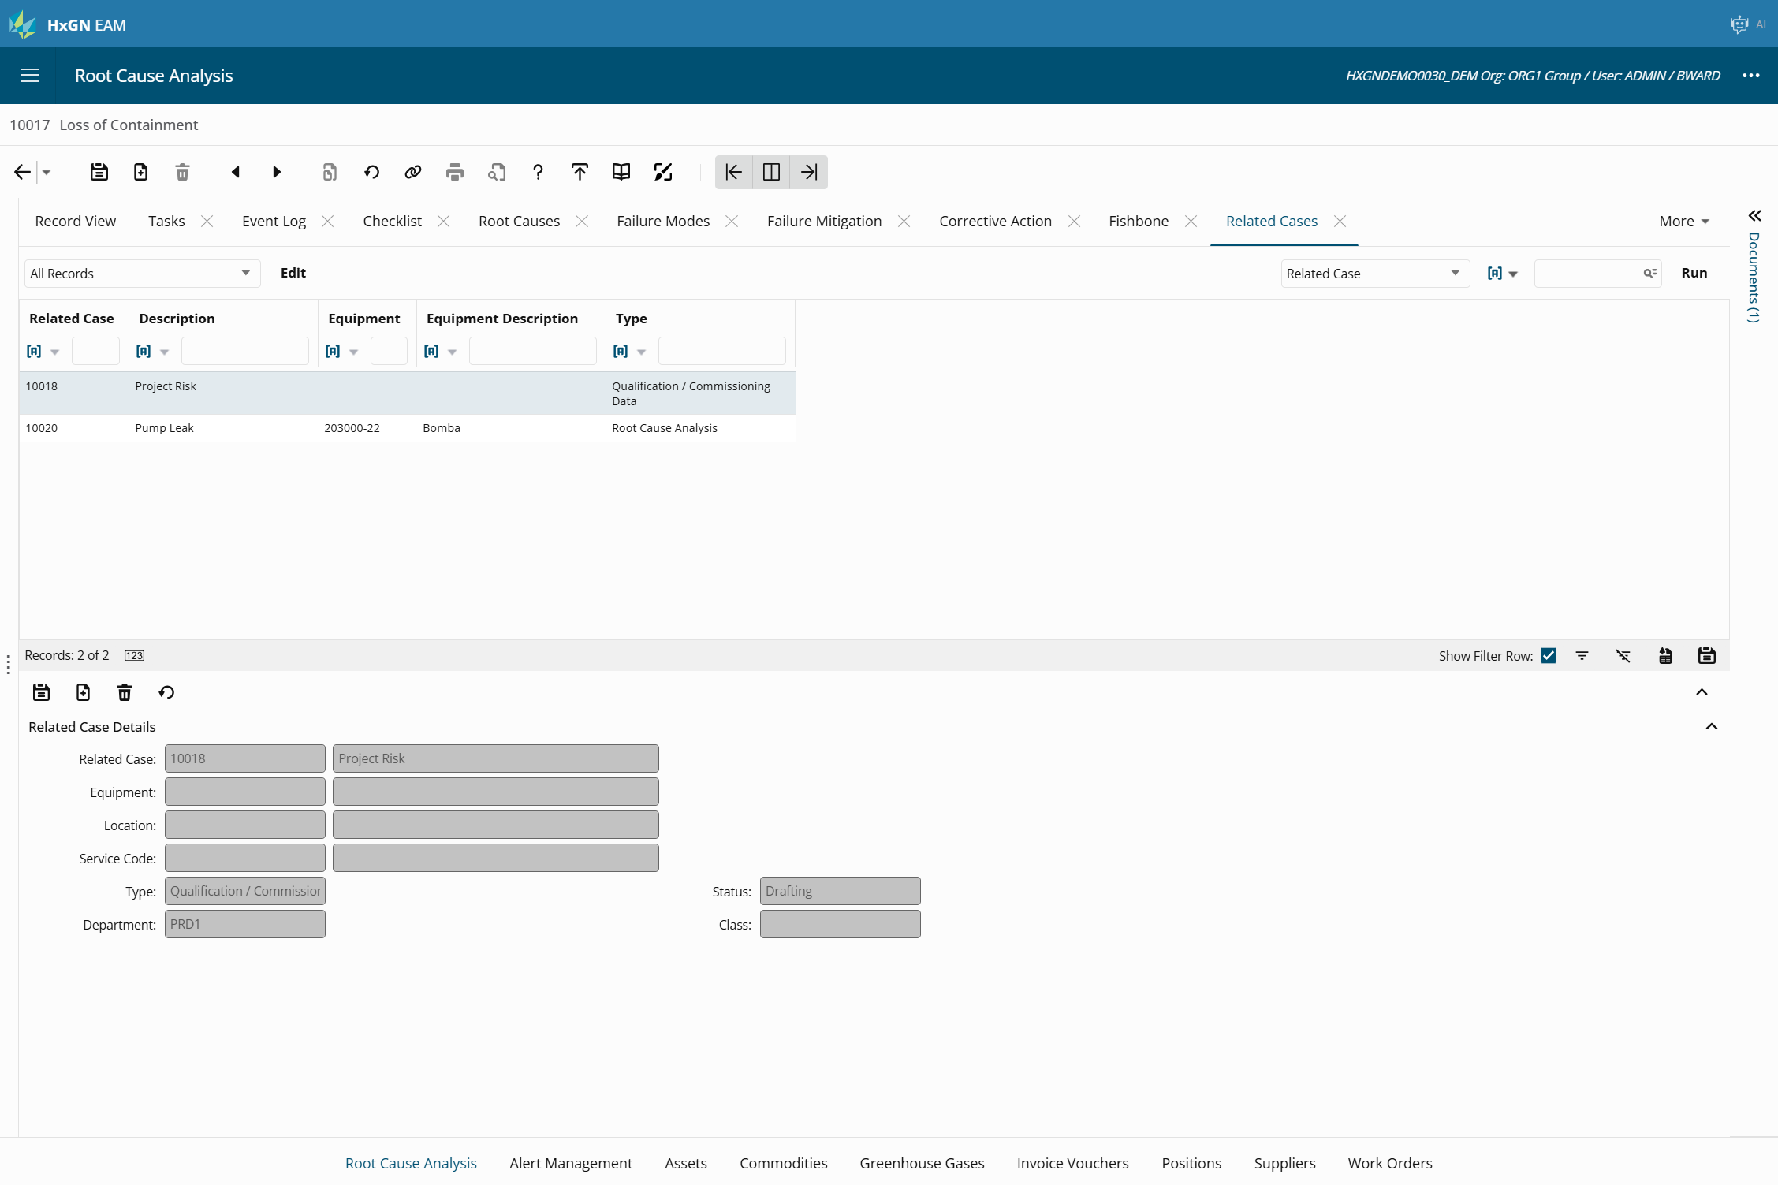

Slide 33

RCA in HxGN EAM
2. Root Causes, Failure Modes
3. Failure Mitigation
5 Why’s (11.7.1)
Multiple Root Causes
Risk Level
Identify PM
Condition Monitoring
Mitigated Probability
Uptime!
1. Root Cause Analysis Case (11.7.1)
4. Corrective Action
Failure Event
RCM Tree
Equipment RCM Template
Apply Mitigation action
Equipment
Downtime Cost
Lost Productivity Hours
Operations
Notes:
Processes- tie in severity with the failure event to the options

Slide 34
Document Enhancements, 12.1 on
Preview sidebar
Thumbnail Generation*
Search document list
Document Requests
Locking/unlocking documents
Checklist item documents visible on WO documents
Upload History

Slide 35
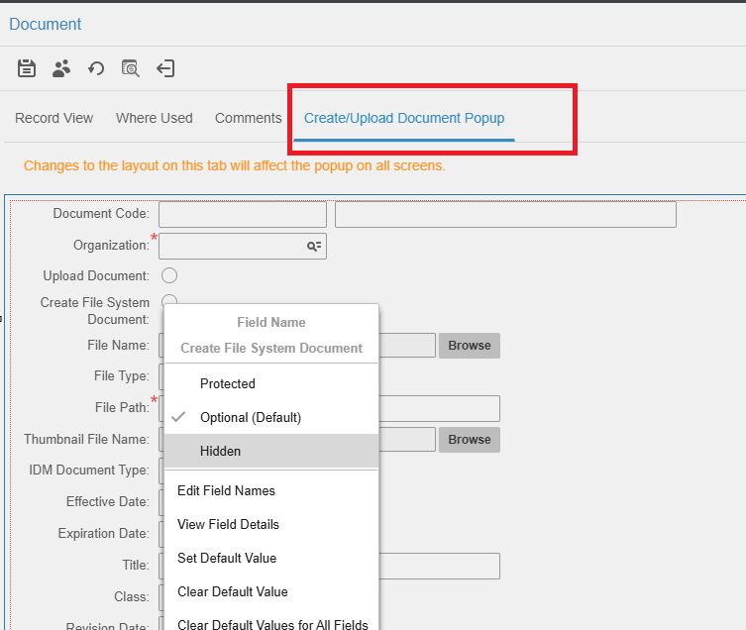

Slide 36
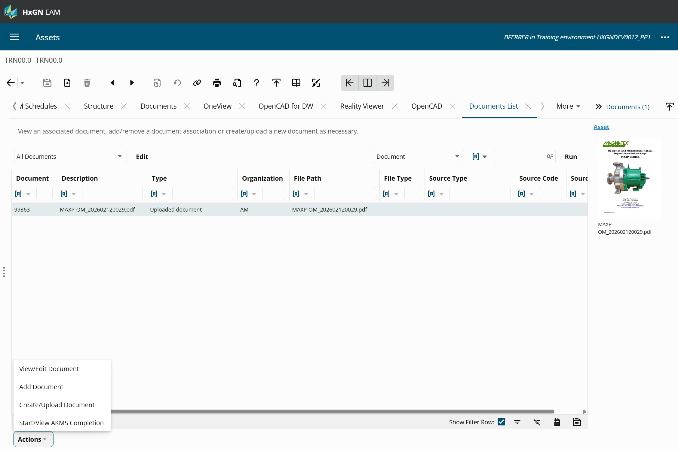

Slide 37
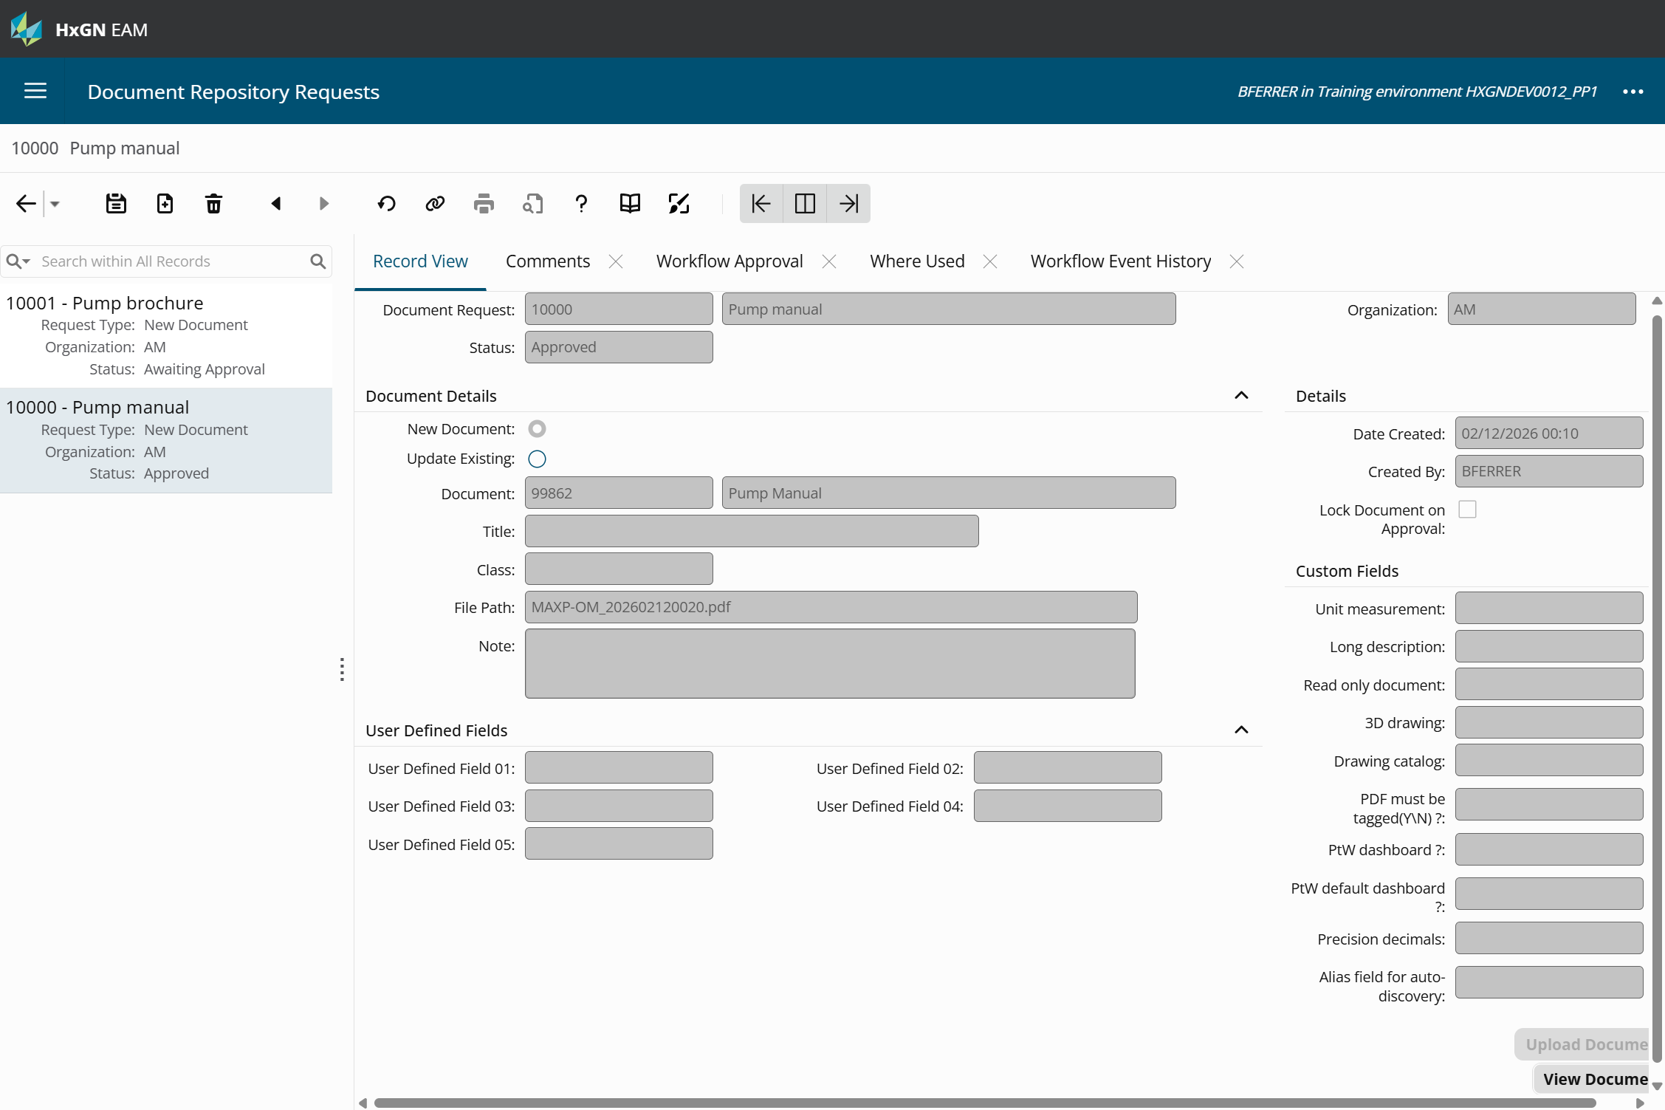

Slide 38
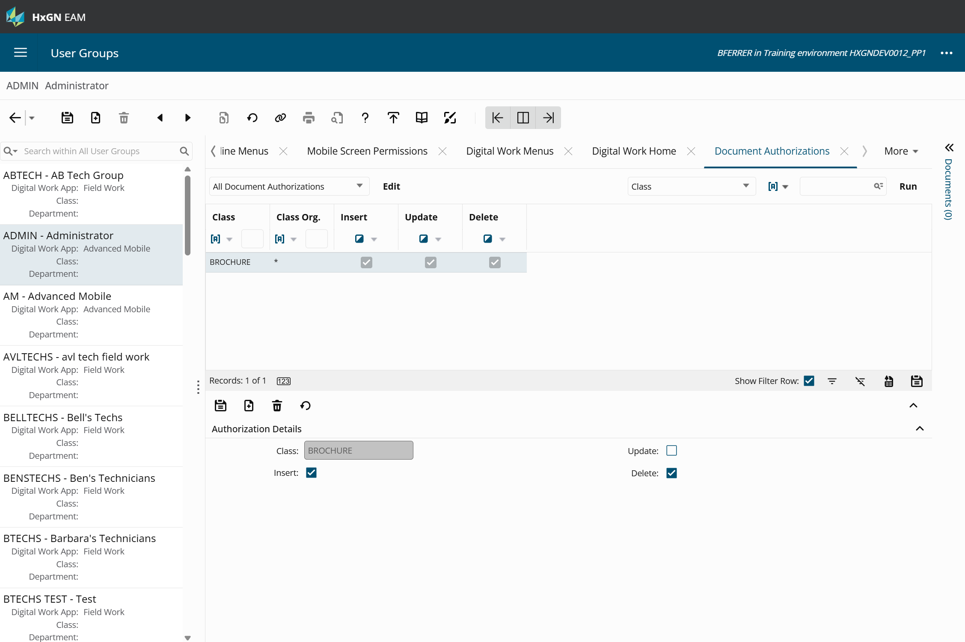

Slide 39
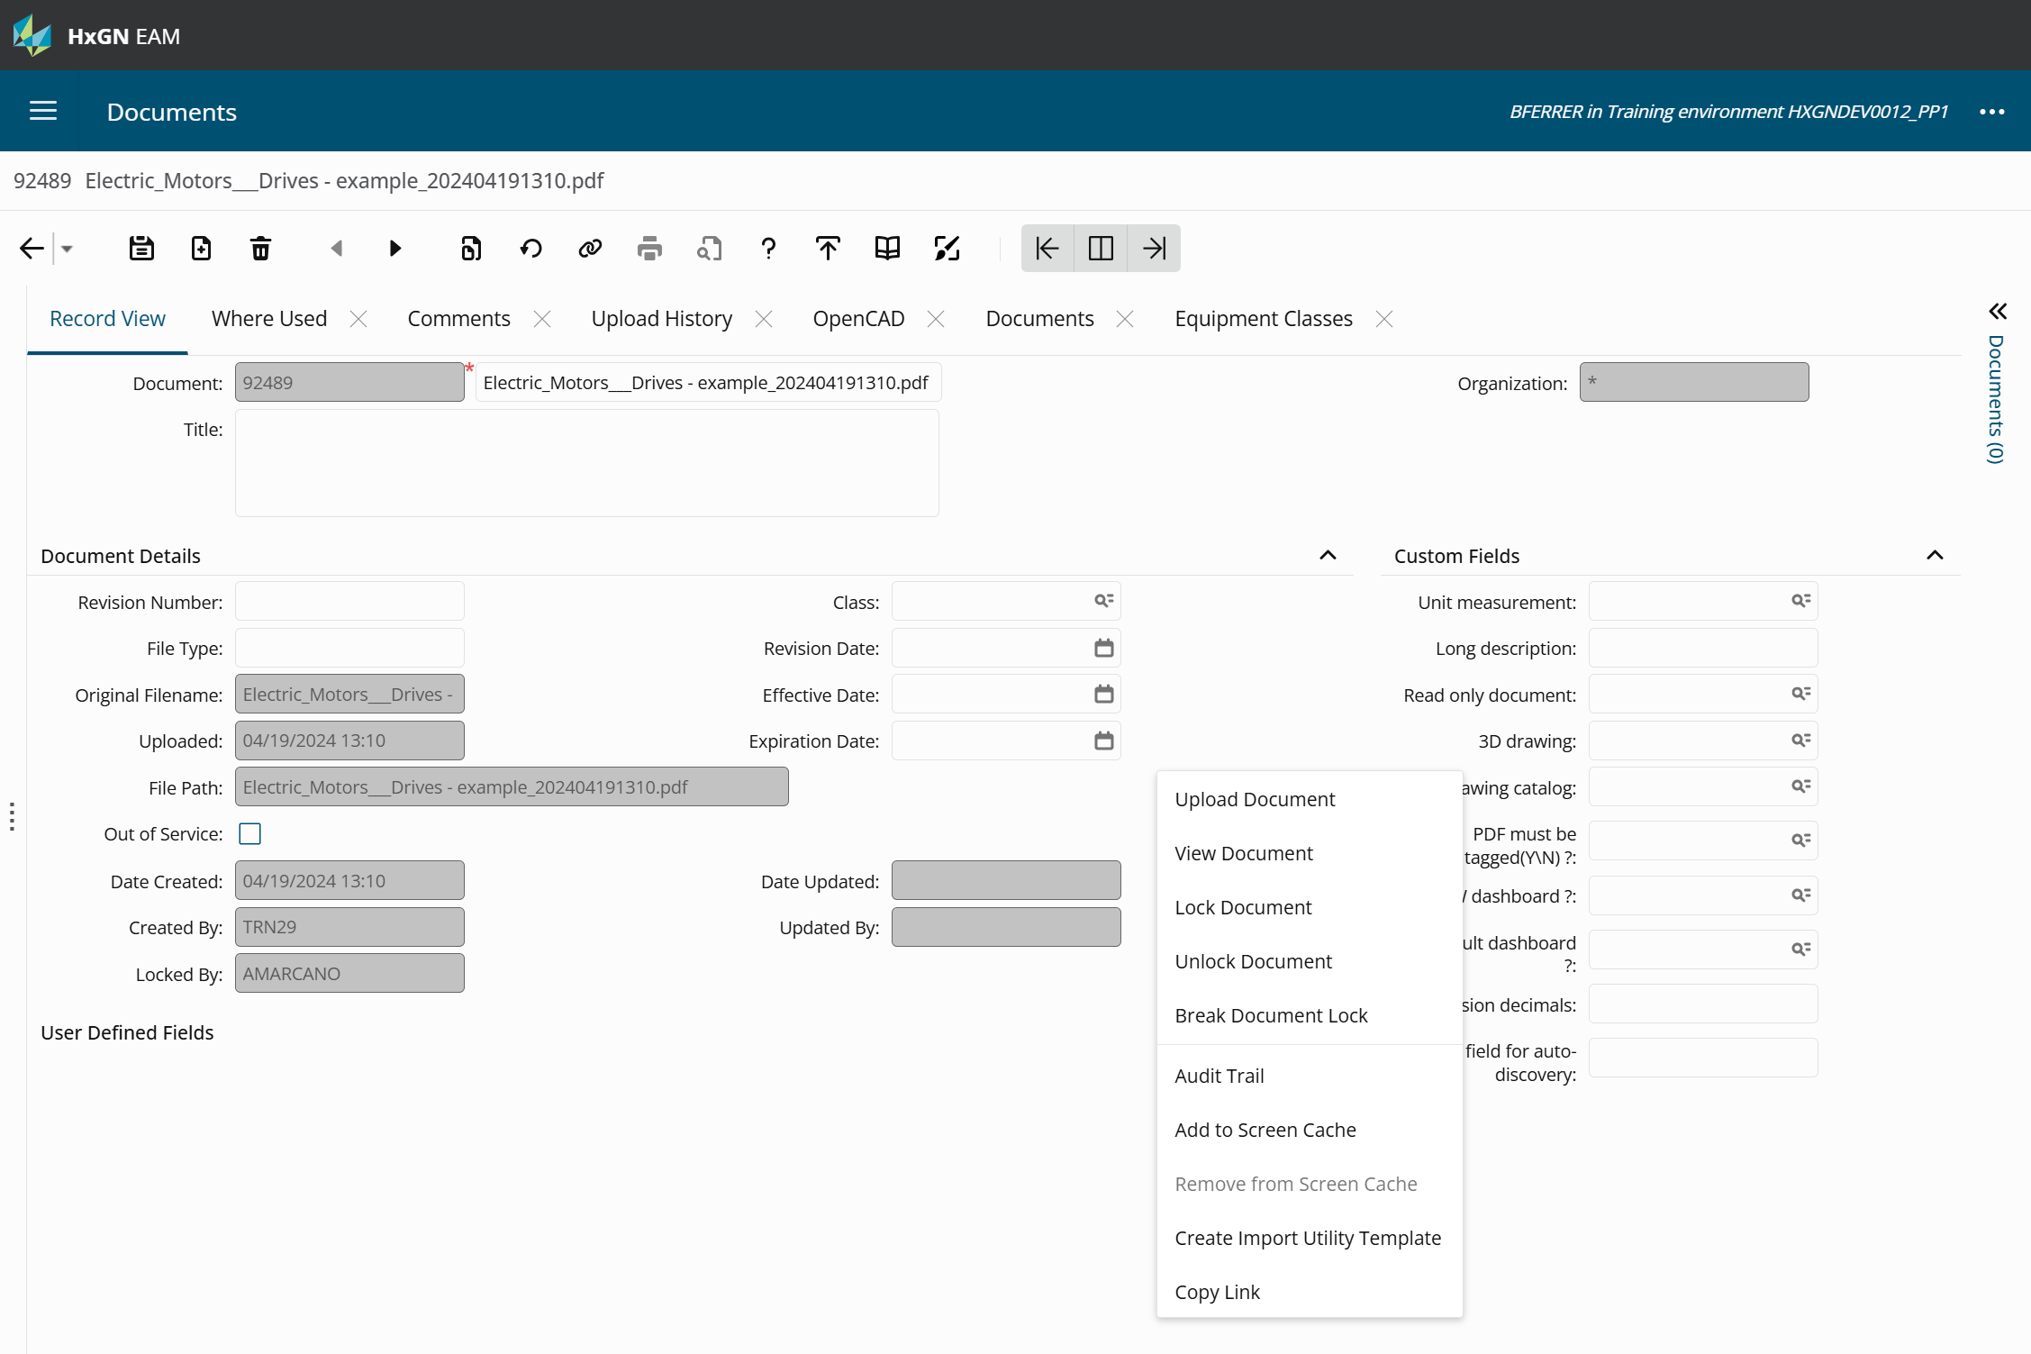

Slide 40
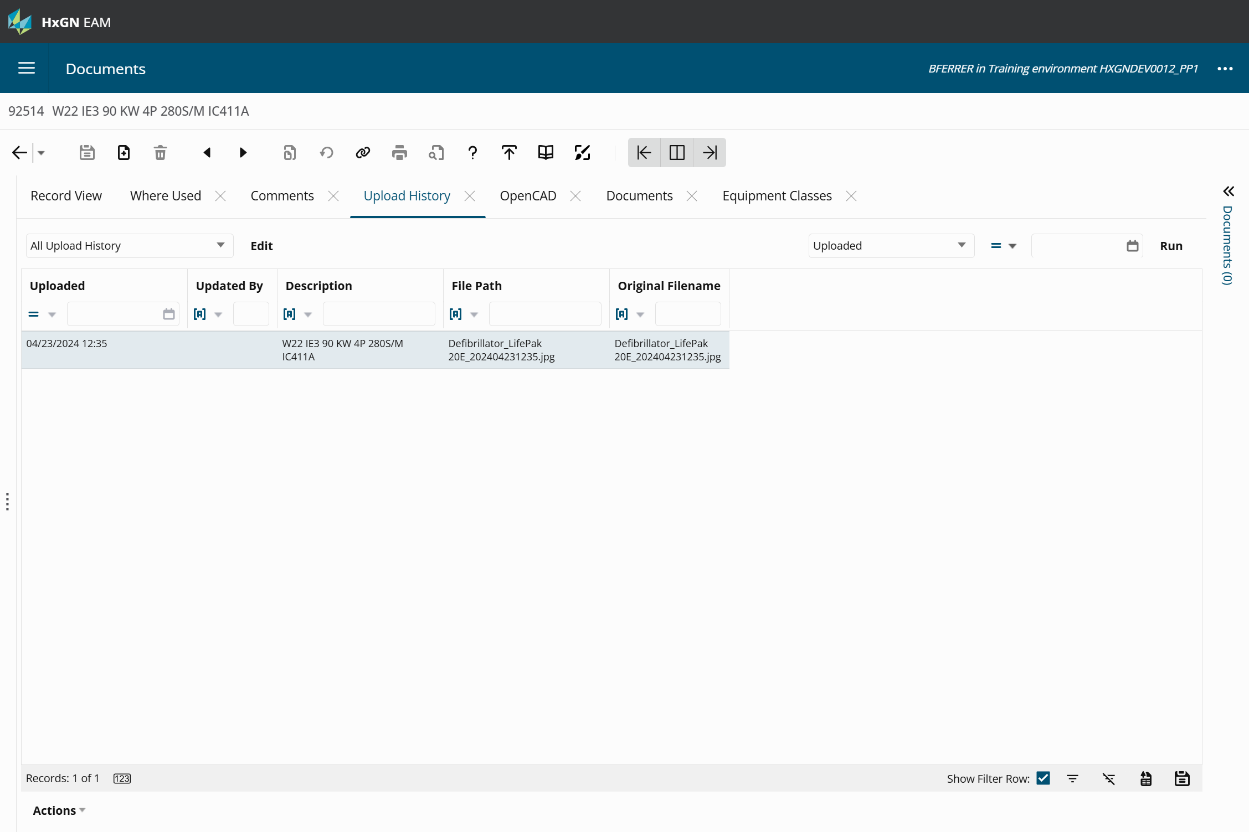

Slide 41
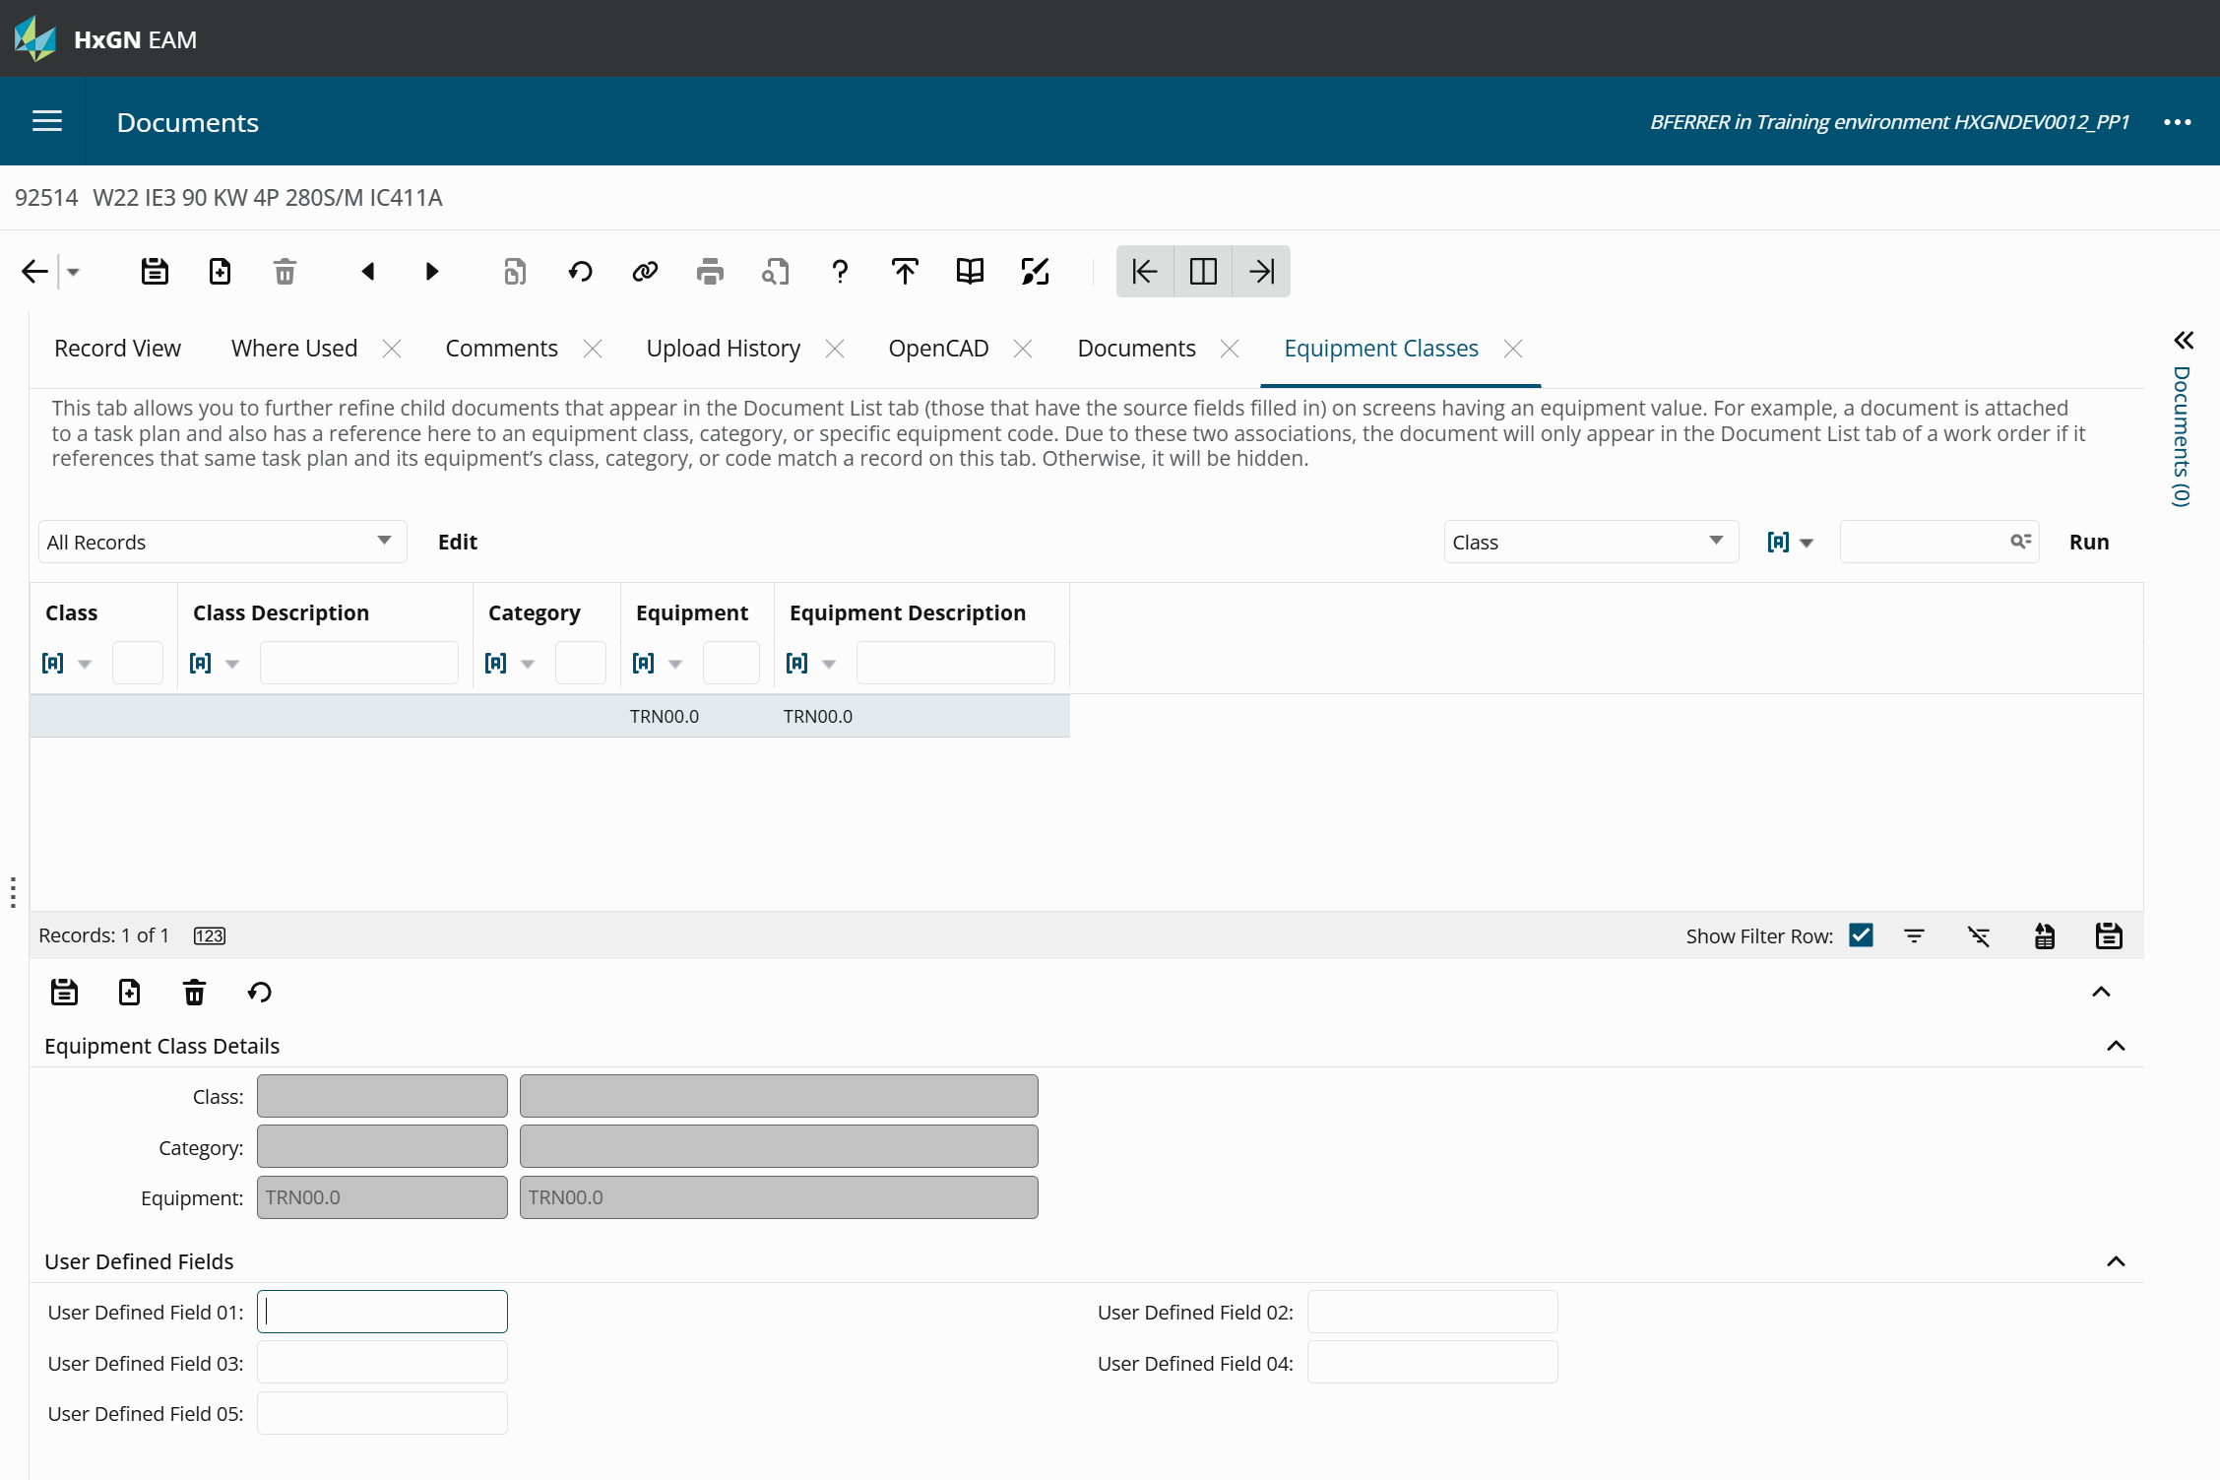

Slide 42

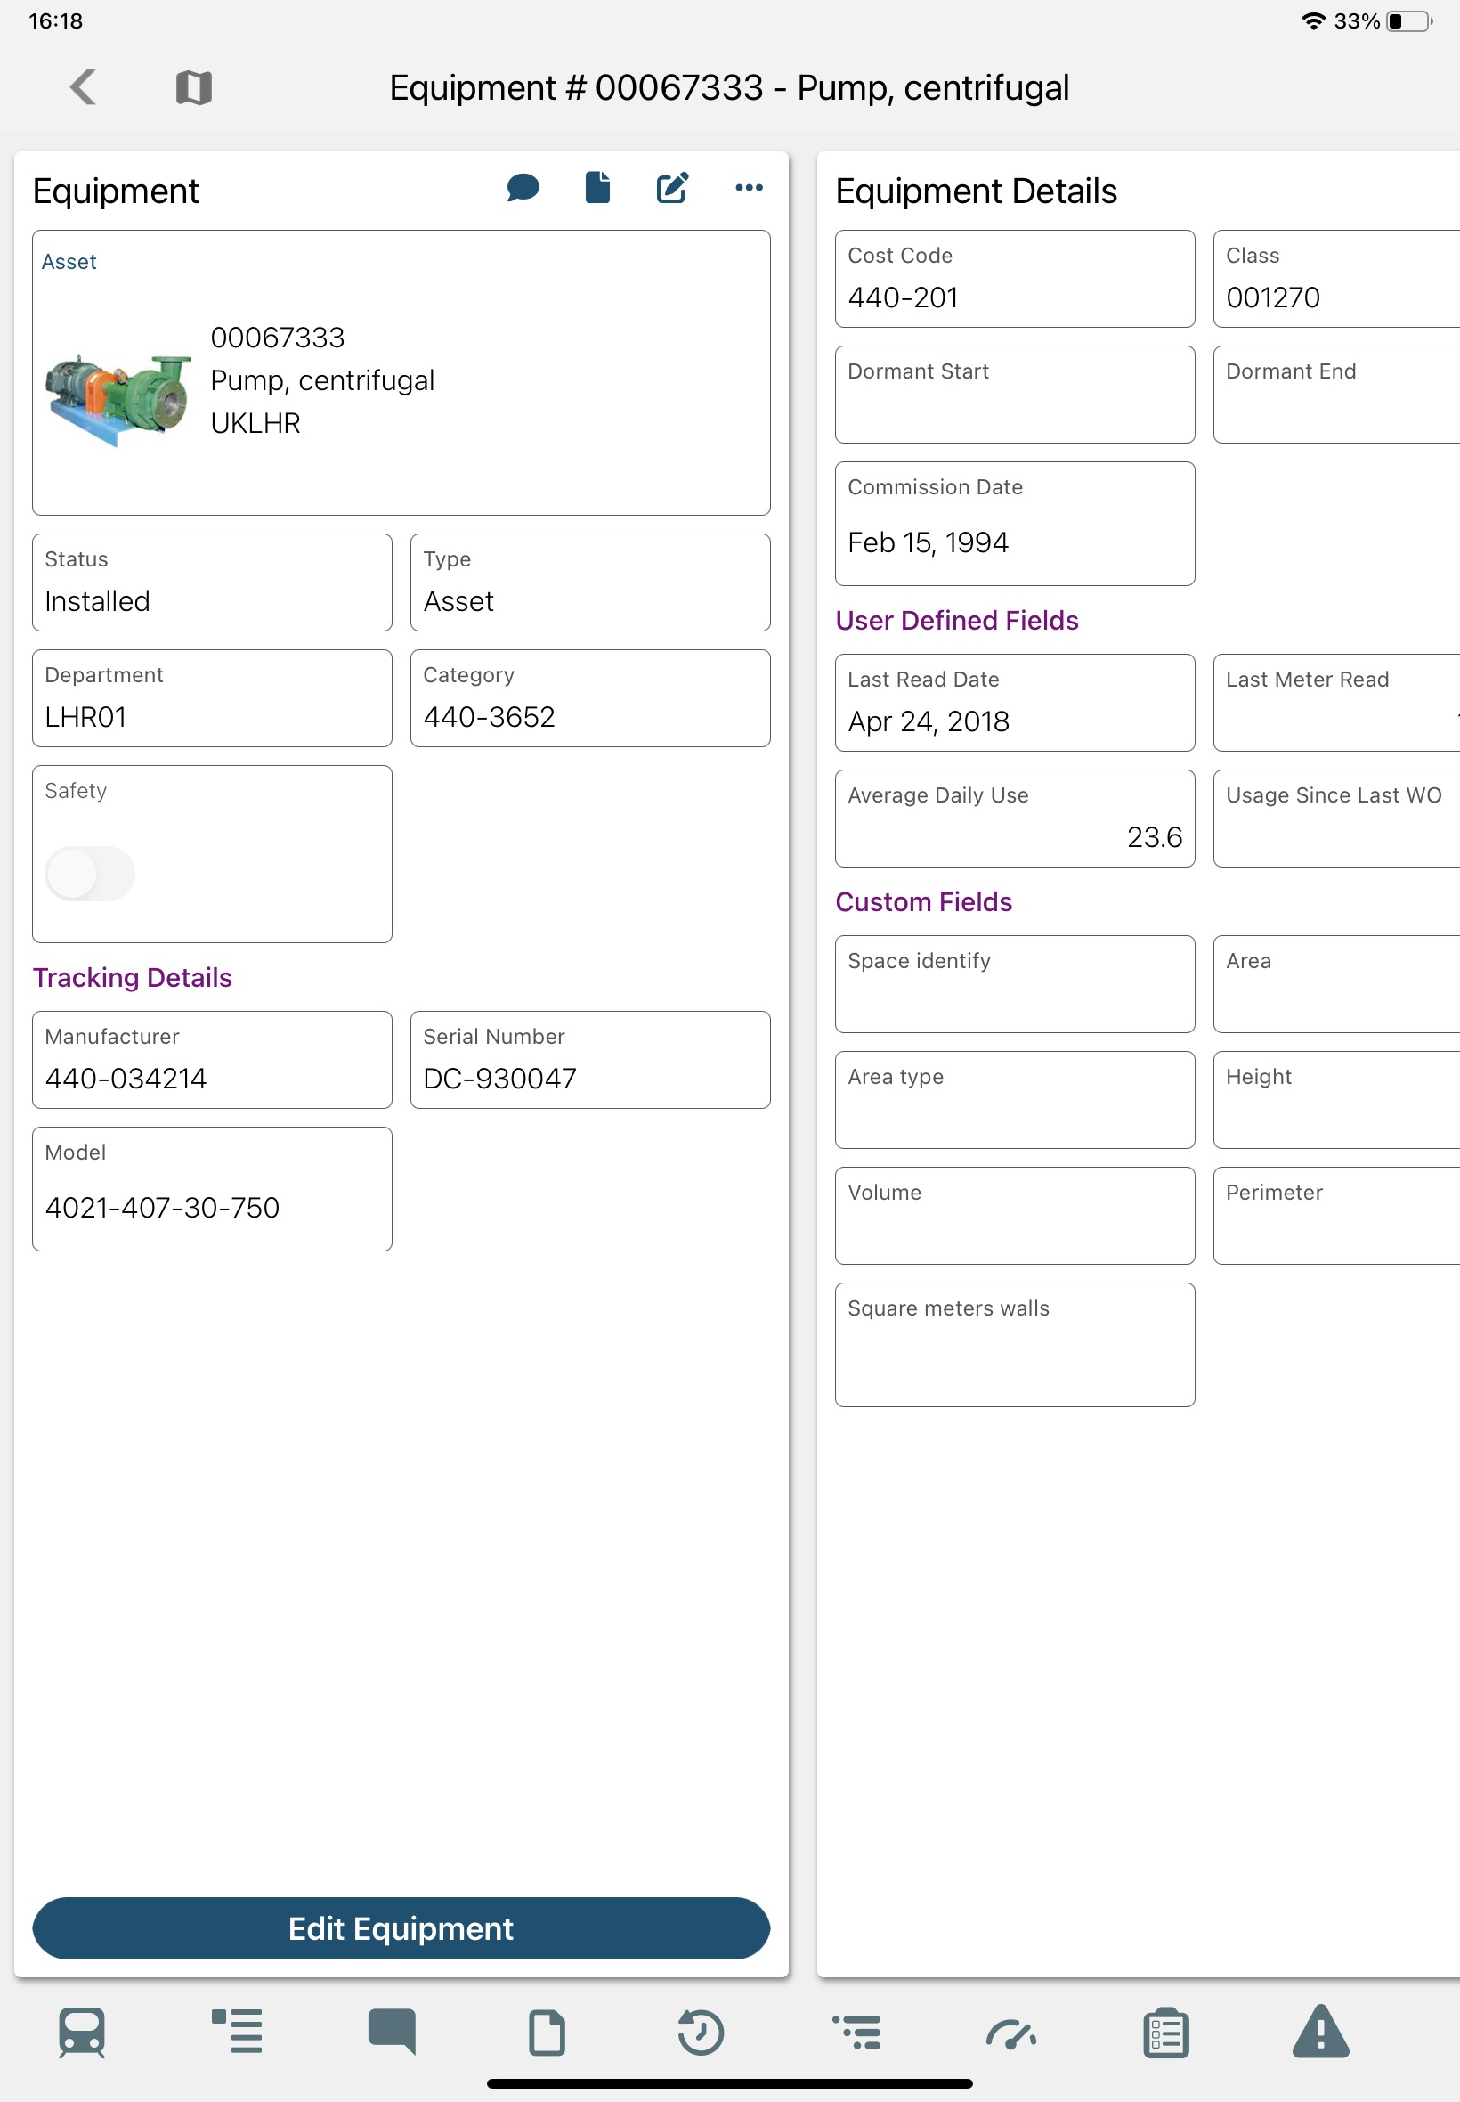
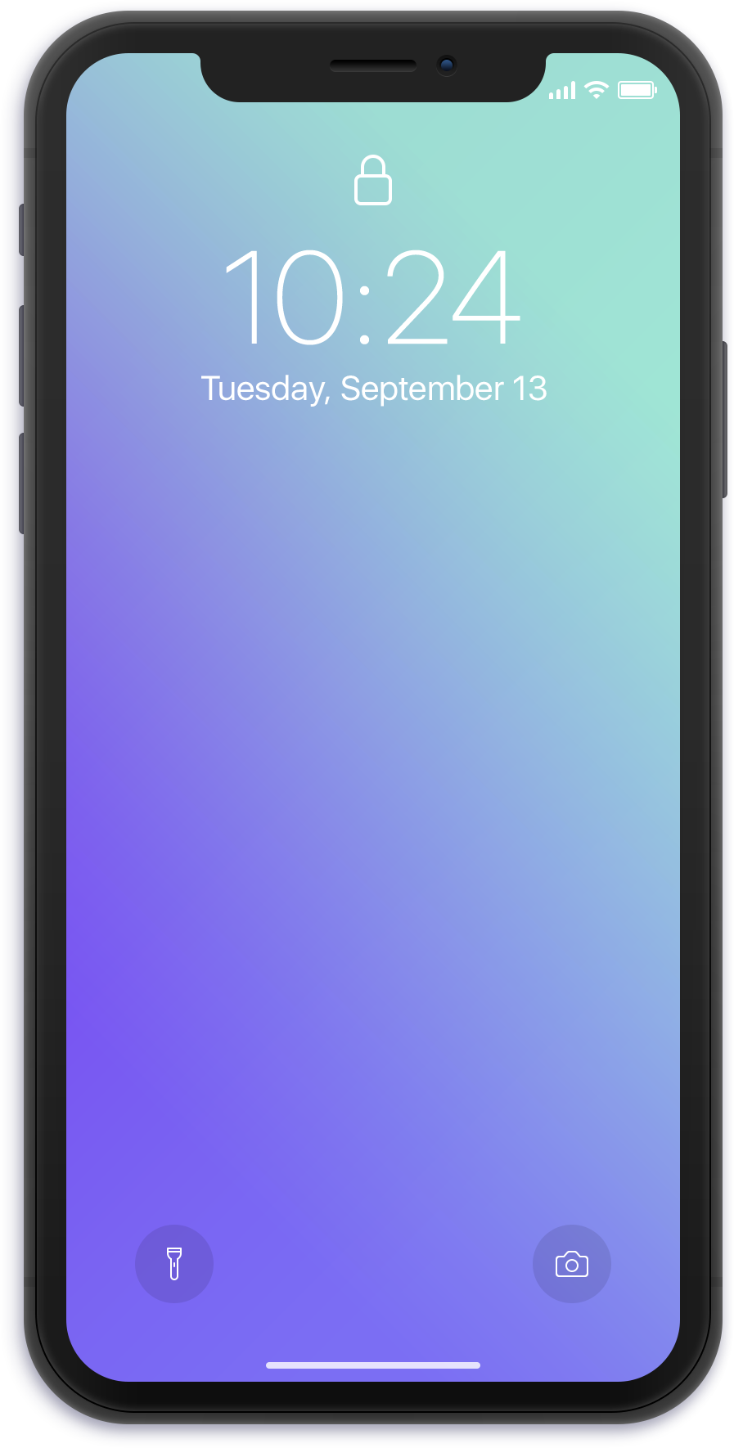
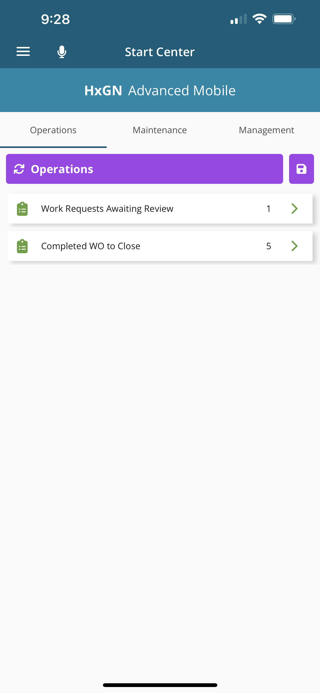
Mobile Updates
Combined Mobile solutions at 12.0
Parity between Digital Work and Mobile Offline (nonconformities, checklists, shortcuts)
Deeplinking to enable transition between the apps
Calibration
Permit to Work/LOTO
GIS Functionalities

Slide 43
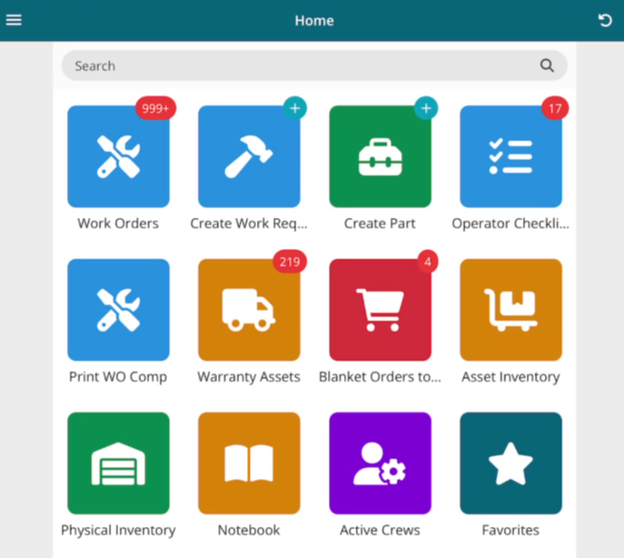
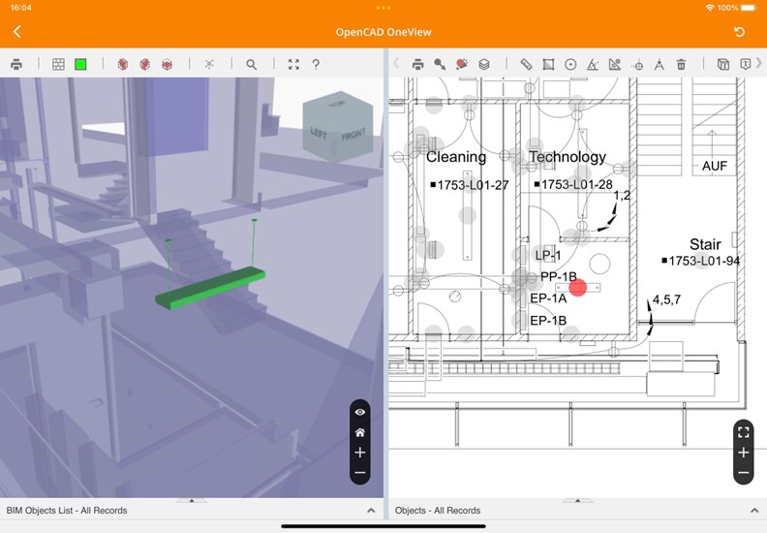
Digital Work Specific
Reset password functionality
Recording video and voice memos
Color icons added to checklists and activities
Visualization in Attached comments and documents on checklists with a counter
Ability to update license in user group
Set default values for fields in Screen Designer for Digital Work
Hyperlinking similar to desktop
Proof of delivery
NFC scanning
Favorites
Digital Home Work Screen
Dataspies for Digital Work configuration
Easier to change user group’s license type
Set a default tab order
Markup feature on iOS
Multi-field search
OpenCad and OpenBIM tabs

Slide 44
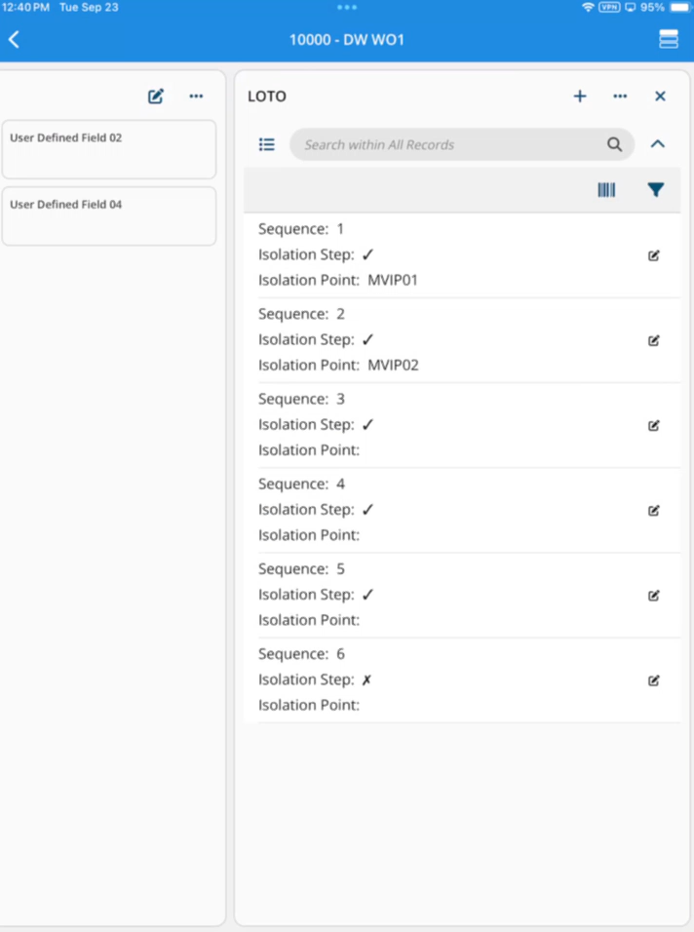
Mobile Offline Specific
Log accomplishments
Copy booked labor
Checklist enhancements (last meter reading, follow up based on install parameter, line expansion)
SSO support
Permit to Work/LOTO
Support for workflows

Slide 45
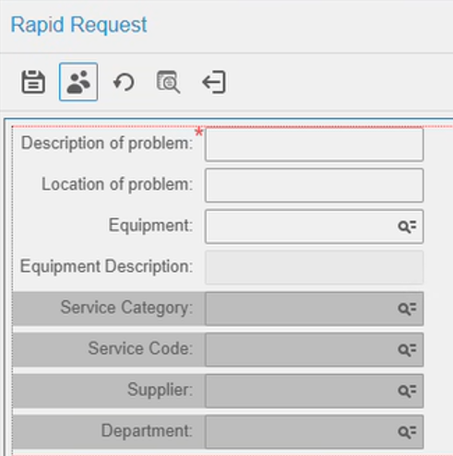
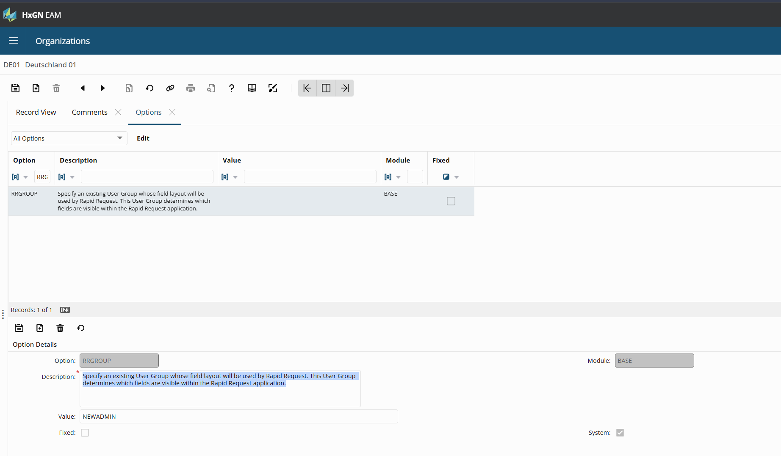
Rapid Request Specific
New Org option RRGOUP enables user group specific screen design

Slide 46
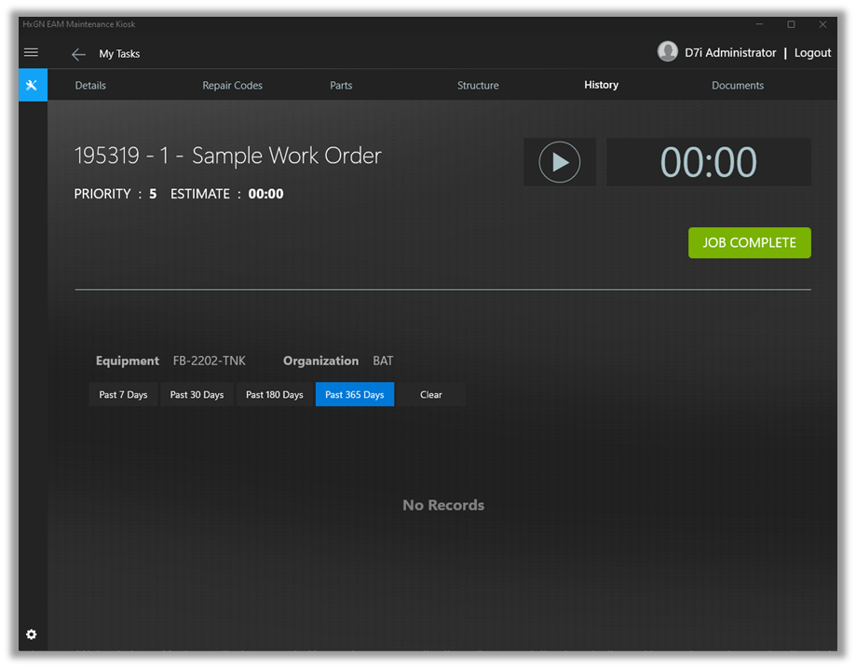
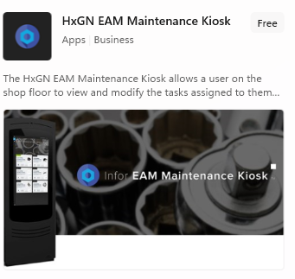
Maintenance Kiosk
Can now access equipment history

Slide 47



EAM Lite User
restricted access to specific features within EAM, allowing administrators to limit user permissions The Lite User will have access to a maximum of 3 chosen screens; plus the Workflow Approval, Equipment Overview 360, Organization Overview 360, and Start Center screens; and all reports.
Jock department has 35 users that could benefit from accessing EAM for light use
Parts
Work Orders
Assets
Reports
Overview (Dashboard)
Mohawk department has 15 users that could benefit from accessing EAM part data
Parts
Reports
Overview (Dashboard)
Scoot Gang has 10 users that could benefit from viewing assets and running reports
Assets
Reports

Slide 48
Agenda
40 mins
Training
Overview 360
Business Intelligence
15 mins
Informational
Part Catalog Requests
Root Cause Analysis
Mobile Updates
Documents & Document Requests
5 min Break
40 mins
Training
Workflow Approvals
Equipment Revisions
15 mins
Informational
Email Notifications
Customer Surveys
Equipment Type
Proof of Delivery
RCM Classic
Calibration
5 min Break
40 mins
Training
Contractor Portal
Dynamic Checklist
15 mins
Informational
Bulletins
Tech Studio
WO Dispatching

Slide 49


Approval Workflow
Sequential
Parallel - All
Parallel - Any
Approvers can only approve in the provided sequence, all must approve.
All approvers must approve for the workflow event to be approved.
Only a single approval is required to approve the workflow event.
APPROVED
REJECTED

Slide 50
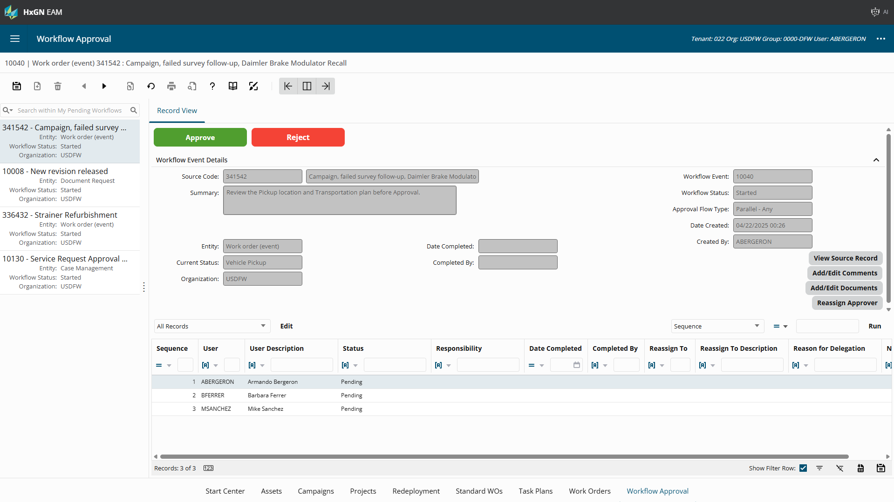
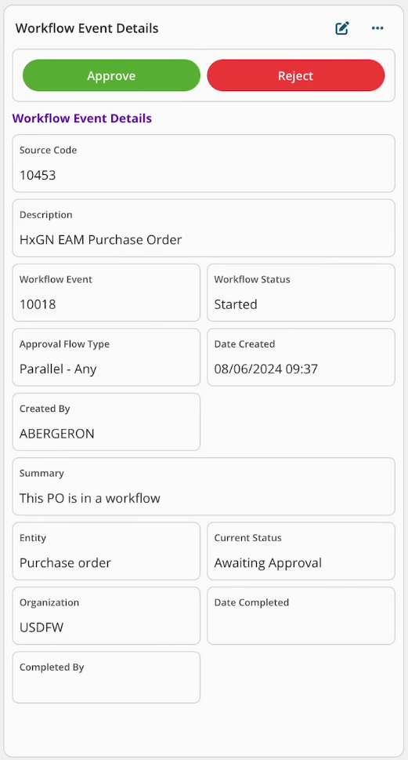
Workflow Approval
Module that allows an administrator to create an Approval Workflow Setup record that will systematically route records within HxGN EAM to a specific user, or group of users, for review.
The record is “locked” in its status until the reviewers either Approve or Reject the workflow.
The system will update the source record’s status when the workflow is completed, depending on the reviewers' responses.

Slide 51
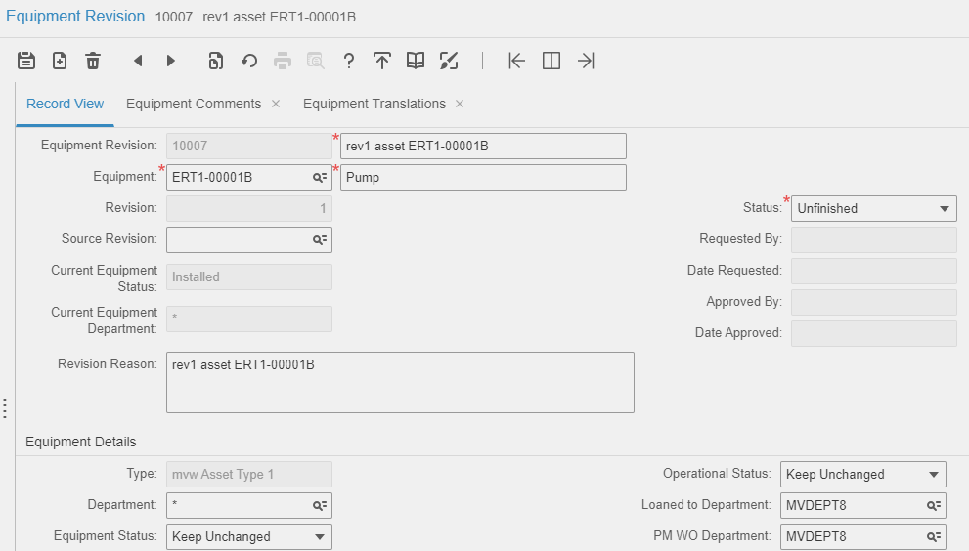
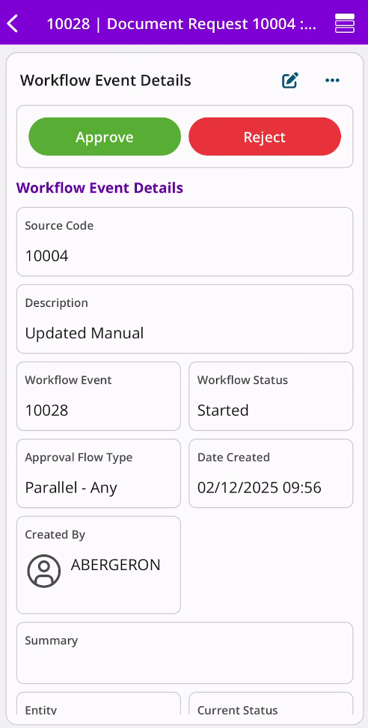
Equipment Revisions
Batch Updates
Parts Associated
Structure
(Parent Equipment only)
Batch Clear Fields
Comments
Translations
Documents
Calibrations
Custom Fields
Test Points

Slide 52
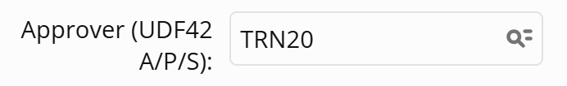
Exercise: Equipment Revisions
Positions screen → Create a position
Check the Equipment Revisions checkbox
Equipment Revisions → Create a new revision on your newly created asset
Option 1: Set Approver field on the Equipment Revision record to your user.
Option 2: Leave the Approver field blank
Submit revision to “Request Approval”
*********************Approval Workflow Triggered *********************
3. Approve your Equipment Revision
Equipment Revisions | Approval Workflow tab
Approval Workflow screen
Note: cancel the submitted approval from the Equipment Revisions | Approval Workflow tab
4. Observe your approved changes on the Position screen

Slide 53
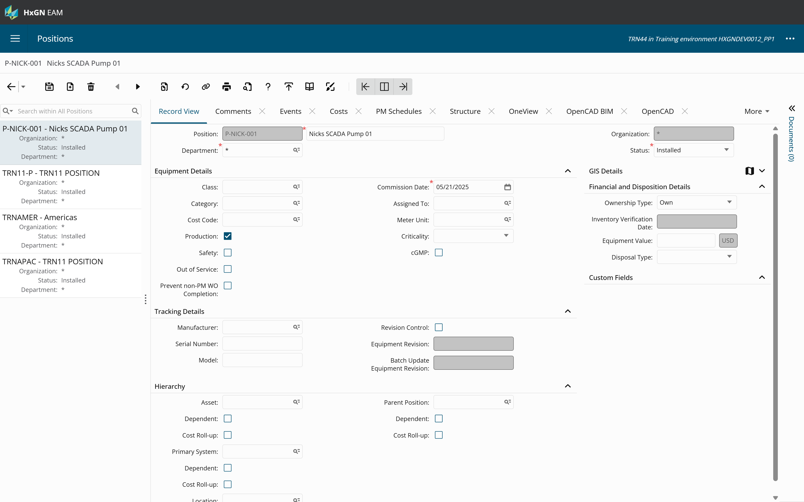

Slide 54
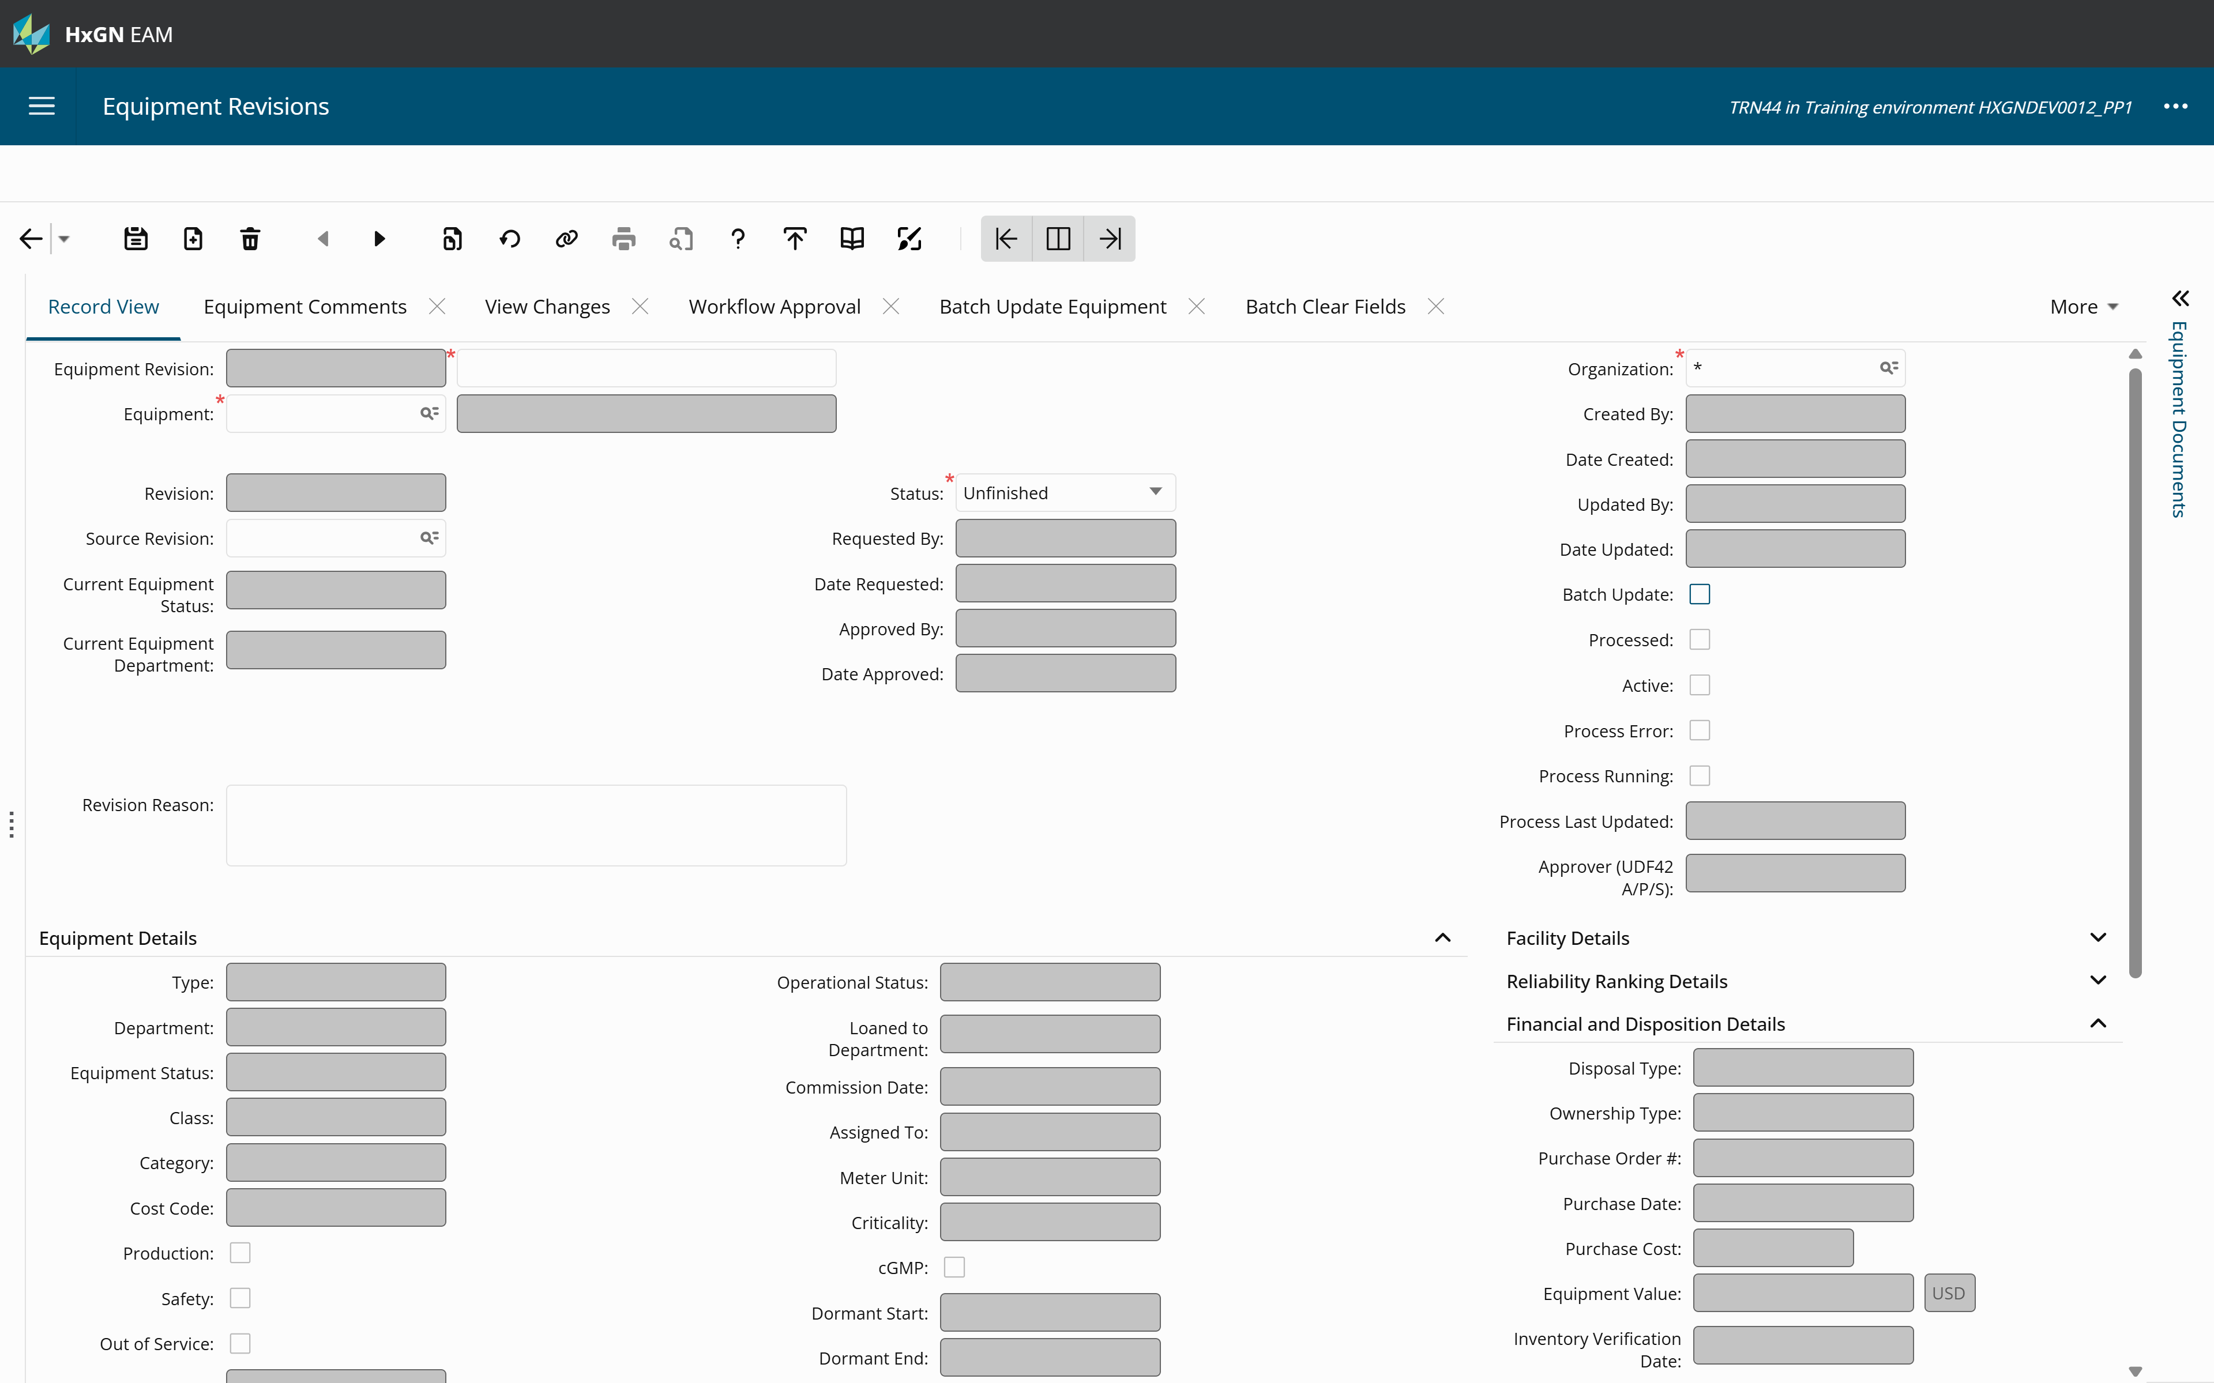

Slide 55
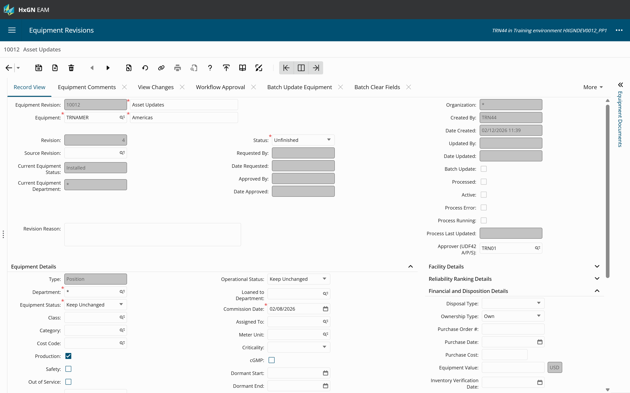

Slide 56
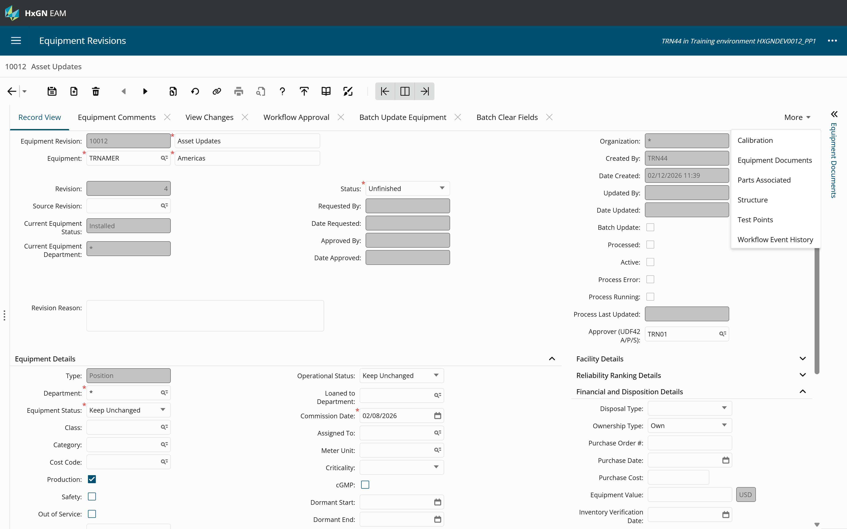

Slide 57
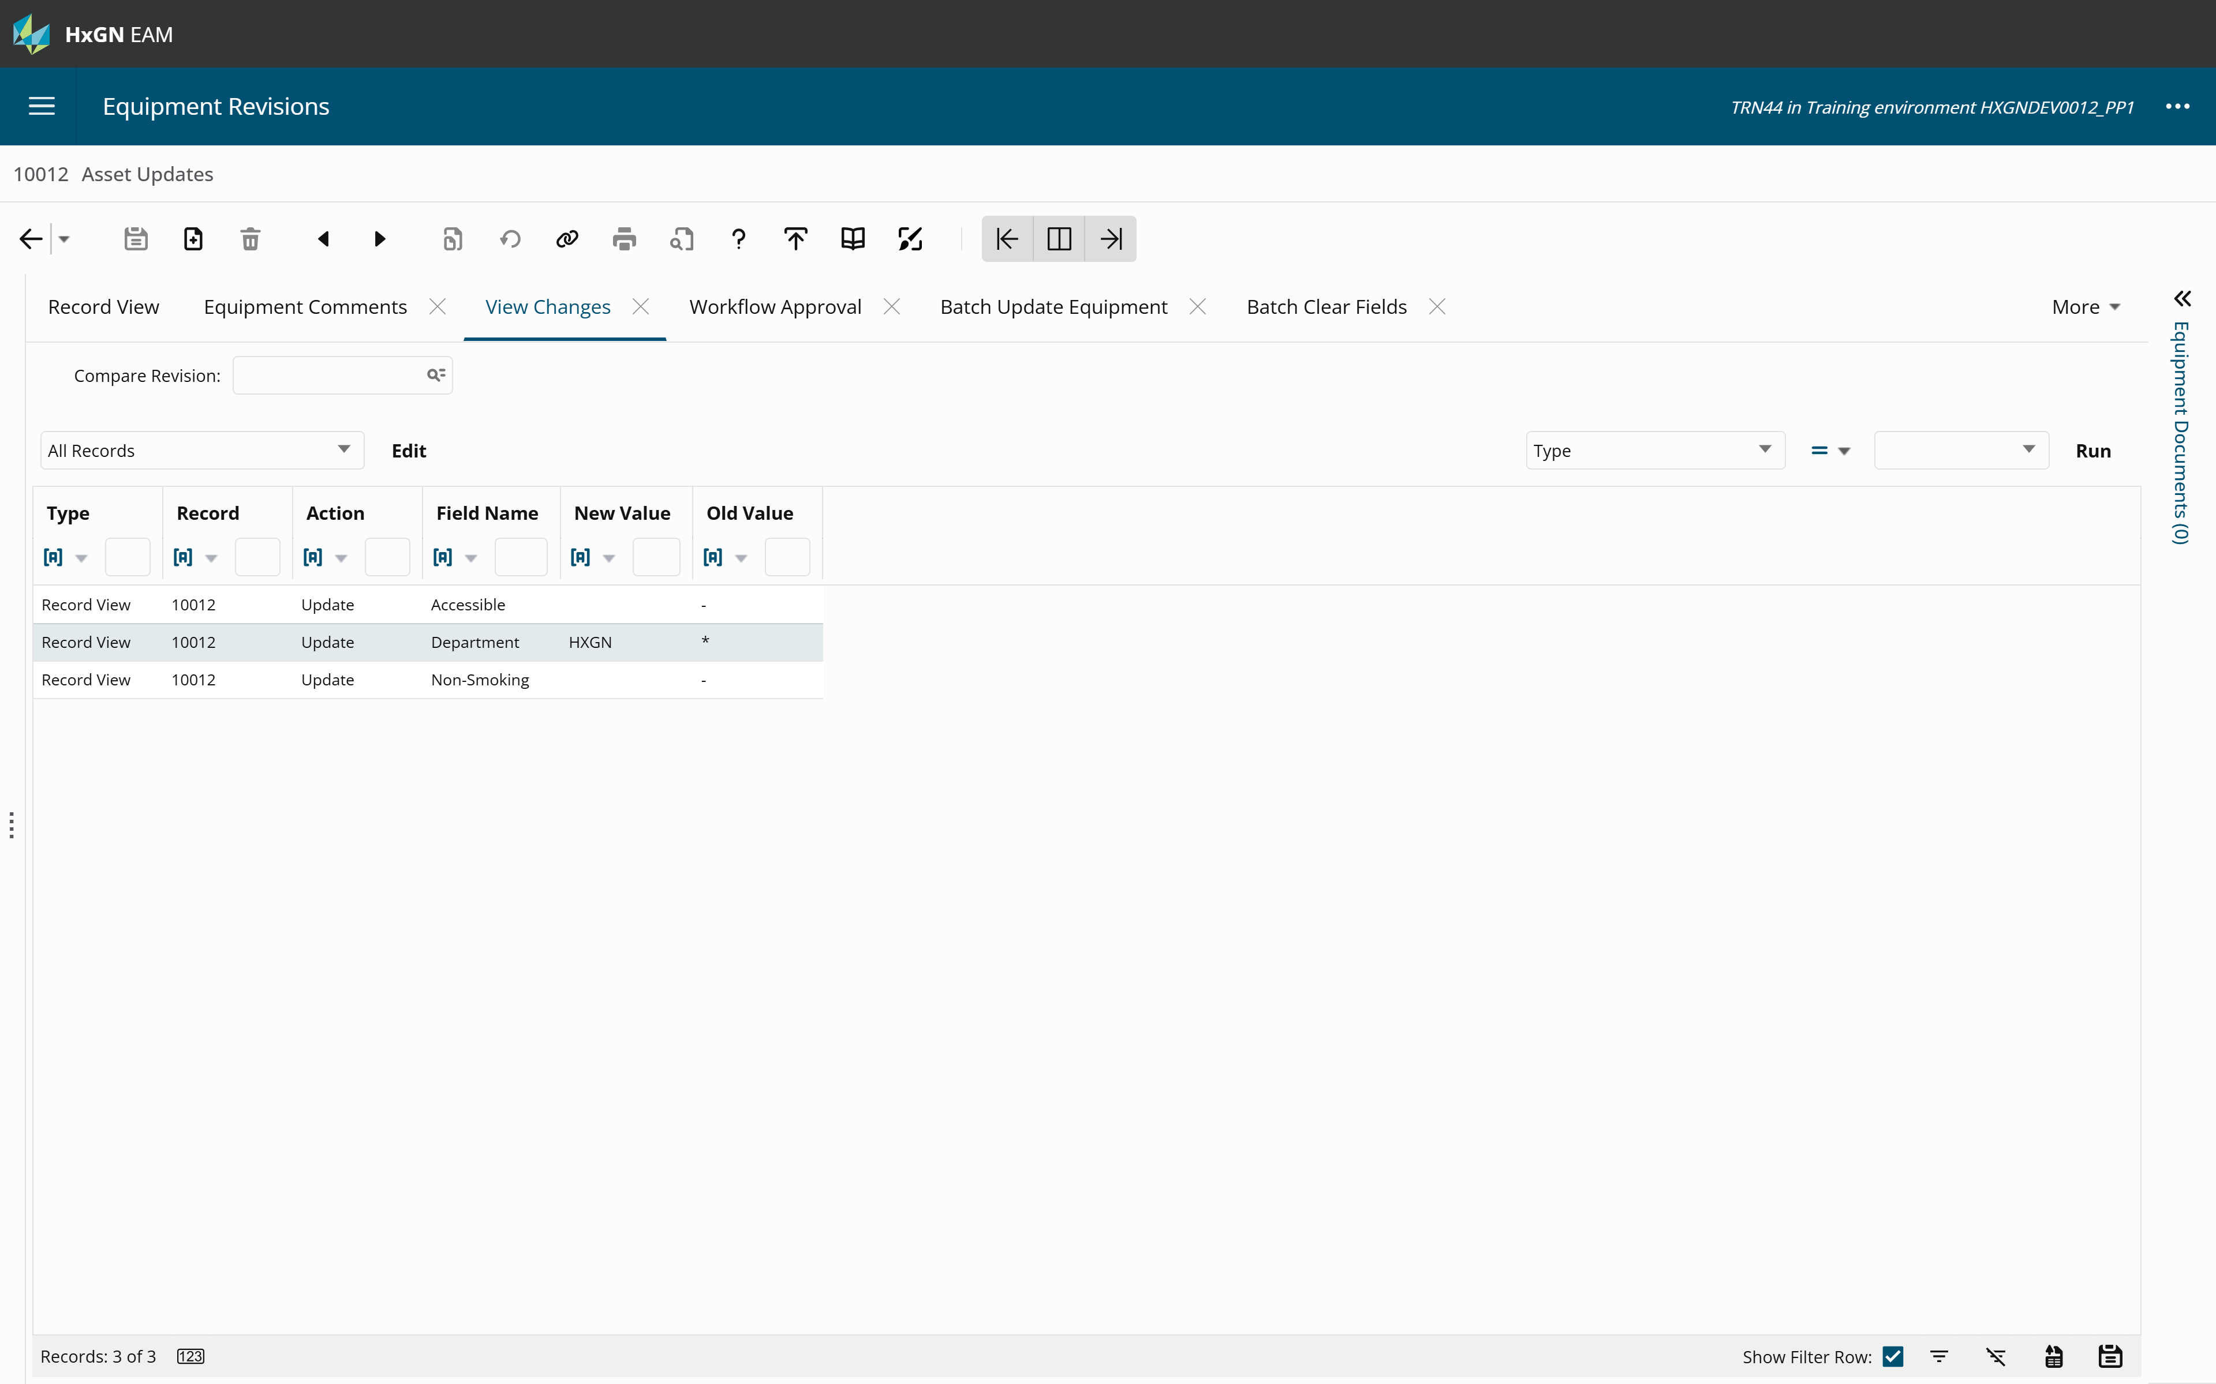

Slide 58
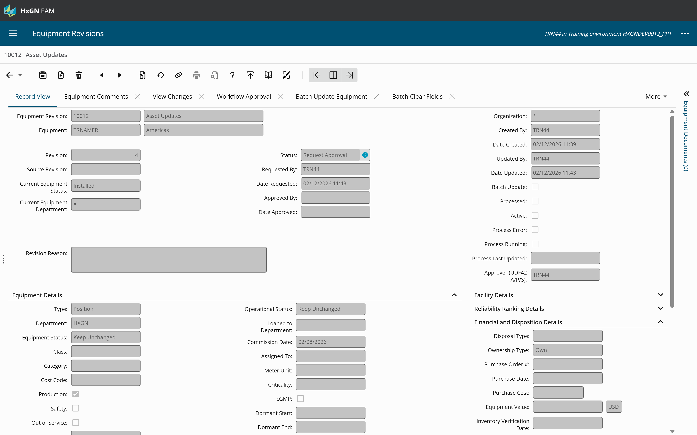

Slide 59


Slide 60


Slide 61


Slide 62


Slide 63


Slide 64


Slide 65


Slide 66


Slide 67


Slide 68
Agenda
40 mins
Training
Overview 360
Business Intelligence
15 mins
Informational
Part Catalog Requests
Root Cause Analysis
Mobile Updates
Documents & Document Requests
5 min Break
40 mins
Training
Workflow Approvals
Equipment Revisions
15 mins
Informational
Email Notifications
Customer Surveys
Equipment Type
Proof of Delivery
RCM Classic
Calibration
5 min Break
40 mins
Training
Contractor Portal
Dynamic Checklist
15 mins
Informational
Bulletins
Tech Studio
WO Dispatching

Slide 69



Email Notification

Slide 70


Customer Survey
Trigger and send surveys from Service Requests and Work Orders, having the results linked to the source record.
What’s New?
Send the link for the Survey access either through Databridge Pro oran EAM email template trigger.

Slide 71


Equipment Type
What’s New?
The system allows you to change the equipment Type.
The right-click option called Change Equipment Number is now called Change Equipment Number or Type.
Change just the Equipment Code, the Type or both.
Still limited to staying within the system types. For example, assets can not become positions.

Slide 72


Proof of Delivery
What’s New?
Specify a custom report to print when accessing the proof of delivery option from a work order

Slide 73
RCM Classic
Risk Assessment
FMECA
Risk Analysis
Classic RCM
Functions
Functions
Functions
Functions
Functional Failures
Failure Modes
Functional Failures
Functional Failures
Failure Consequences
Failure Consequences
Failure Consequence
Failure Modes & Failure Effects
Failure Modes
Failure Consequences
Functional Failure
Control Strategies
Failure Finding Intervals
RCM Templates can be developed and linked to a particular asset type. The template supports planning the RCM tree and failure mitigation. Approved templates can be applied to existing assets. Templates are also designed to support different RCM methods as well as single failure modes to be applied to an existing RCM tree.

Slide 74


Classical RCM
Control Strategy and Failure Finding interval

Slide 75

Classical RCM setup

Slide 76


Calibration
What’s New:
CALTZERO: behavior of test points precision of trailing zeros
CALRPREC: behavior of precision of device readings
Mobile Calibration for Offline / Online

Slide 77
MTBF
What’s New:
Additional grouping options have been added to the report parameters.
The user can now choose between 3 options via a Sort By lookup:
Standard Grouping (Default Behavior)
Number of Failures per Grouping
Average Number of Days Between Failures per Grouping

Slide 78
Agenda
40 mins
Training
Overview 360
Business Intelligence
15 mins
Informational
Part Catalog Requests
Root Cause Analysis
Mobile Updates
Documents & Document Requests
5 min Break
40 mins
Training
Workflow Approvals
Equipment Revisions
15 mins
Informational
Email Notifications
Customer Surveys
Equipment Type
Proof of Delivery
RCM Classic
Calibration
5 min Break
40 mins
Training
Contractor Portal
Dynamic Checklist
15 mins
Informational
Bulletins
Tech Studio
WO Dispatching

Slide 79

Contractor Portal – New Checklist tab
Notes:
Tab 2 - MK - BCAMPBELL

Slide 80
Dynamic Checklist
What’s new:
Dynamic checklist items (lines) only appear on the checklist when another checklist item is answered, and that answer meets a defined condition
No need for technicians to answer (or even see) checklist items that are not relevant
Field technicians and their supervisors
Why is it better:
Who does this benefit:

Slide 81
Dynamic Checklist details
Conditions depend on the type of checklist item. They may be Yes, No, OK, Repair Needed, > 100, between 200 and 300, etc. ​
Questions can be nested
Multiple conditions can be defined
Examples: Yes/No
Yes- answer 5-10
No- answer 11-15
Values
If less than 10 answer 3-5
If greater than 10 answer 6
If the condition is not met, or the triggering checklist item is not answered yet, dynamic checklist items remain hidden
Works on all Checklist tabs (WO Activities, Case Management, Nonconformities, Operator checklists and LOTO)

Slide 82
Example

Slide 83
Dynamic Checklist- How to set it up
Define your checklist items and dynamic relationships
Create ALL checklist items on the Checklist Tab of the Task Plan screen
Note: to make it easy to track, consider logical sequence numbering
Define the dynamic checklist conditions on the “Dynamic Checklist Condition” tab
Think if this, then this
4. Link the conditional tasks to the dynamic task on the “Dynamic Checklist “ tab

Slide 84
Practical Application
Worksheet has a checklist already defined
Add sequence numbers to worksheet
Log into system
Create new task plan. Name it TEST## (Where ## is your user number)
Create checklist items (Checklist tab)
Define dynamic checklist conditions (Dynamic checklist conditions)
Link checklist items (Dynamic Checklists)
7. Test checklists. Create WO with 1 activity, link task plan to WO activity. Review

Slide 85
Agenda
40 mins
Training
Overview 360
Business Intelligence
15 mins
Informational
Part Catalog Requests
Root Cause Analysis
Mobile Updates
Documents & Document Requests
5 min Break
40 mins
Training
Workflow Approvals
Equipment Revisions
15 mins
Informational
Email Notifications
Customer Surveys
Equipment Type
Proof of Delivery
RCM Classic
Calibration
5 min Break
40 mins
Training
Contractor Portal
Dynamic Checklist
15 mins
Informational
Bulletins
Tech Studio
WO Dispatching

Slide 86
Bulletins
What’s new:
New Bulletin functionality lets administrators create bulletins, identify recipients, notify users of new bulletins requiring their acknowledgement, and track users who have acknowledged them
Why is it better:
Bulletins provide administrators a centralized method for notifying users of planned upgrades, emergency maintenance, system updates, and other important alerts
Who does this benefit:
Administrators

Slide 87

Bulletins- Install Parameters
New install parameter – BULLOGIN
https://docs.hexagonppm.com/r/en-US/HxGN-EAM-Bulletins/12.1.1/1409002

Slide 88

NEW- Bulletin pop up
Acknowledge button for users to acknowledge the bulletin
Users can not close the popup if there are any Critical messages to acknowledge

Slide 89


NEW- Bulletin Notification Icon

Slide 90

New- Bulletin History
This is for the USER to review their personal bulletin history
If the message is modified or deleted by the administrator, the message will be deleted from the bulletin history

Slide 91
NEW – Bulletin Setup Screen
Bulletin Setup screen with 3 key tabs
Status of bulletin
Start and End date
Critical selection box
TAB – Messages
Defines the information that is displayed in the bulletin
Supports plain text or HTML
Supports colors, graphics and hyperlinks
TAB- Recipients
Defines who gets the message
Can be individuals or User Groups
TAB – Acknowledgments
Shows who and when a message was acknowledged

Slide 92
HxGN EAM Tech Studio – Python Framework
HxGN EAM 12.0.1
Tech Studio
Tech Studio is a commercial product built to package together new features.
Python Framework
Constraint Optimizer
…
Entitlements include Constraint Optimizer for Activity Dispatch and Investment Planning, along with the new Python Framework.
Flex Python
Activity Dispatch
Python Studio
Investment Planning
Available for all Cloud customers
HxGN EAM
Priced in line with existing add-on modules

Slide 93
Scheduling vs Dispatching
Scheduling
Done at WO Activity level
Can be done in various ways
Directly on WO
WO Daily Scheduling
Time driven
Geographic component not required
Dispatching
- Done at WO Activity level
- Can be done in various ways
GIS WO dispatch
Optimized dispatching
Priority driven
Has a geographic component

Slide 94

Work Order Activities
Optimized dispatch Process
Dispatch bucket
It's just a data spy

Slide 95


Supervisor Dispatch Overview
Supervisor Manual WO Dispatch*
Dispatch Feedback Notifications
Tools
Dispatch WO Sequence
Shift Dispatch
Dynamic Dispatch
Process
Constraint optimizer
Notes:
* Actual Screen in EAM is “GIS Map WO Dispatch”

Slide 96
Things to consider
Requires tech studio license
Must have google maps license
All equipment must have a location
WO activities cannot be time scheduled

Slide 97
Overview 360
Stuff

Slide 98
Enter Header
Add text or image

Slide 99
Enter Header
Add text or image
Add text or image

Slide 100
Title With Image

Slide 101
Enter Heading
Click icon in box to the left to add image. Intended to fill entire side.

Slide 102
Enter Heading
Click icon in box to the right to add image. Intended to fill entire side.

Slide 103
Timeline or Flow
Enter Text Here
Enter Text Here
Enter Text Here
Enter Text Here
Description
Description
Description
Description

Slide 104
Enter Header
Enter Text Here
Enter description
Enter Text Here
Enter description
Enter Text Here
Enter description

Slide 105
Enter Heading
Use bolded green text to emphasize text in a block. Continue text in regular weight and color.

Slide 106
Enter Heading
Steps or Topics
Steps or Topics
Steps or Topics
Steps or Topics
Enter a long or short description. Box will adjust length automatically.
Example
Description
Enter a long
or short
description.
Box will
adjust the length
automatically.
Example of
different description
length.

Slide 107
Agenda
40 mins
Training
Overview 360, Business Intelligence
15 mins
Informational
Part Catalog Requests, Documents & Requests, Root Cause Analysis
5 min Break
40 mins
Training
Workflow Approvals, Equipment Revisions
15 mins
Informational
Email Notifications, Customer Surveys, MTBF, Proof of Delivery, RCM Classic, Calibration
5 min Break
40 mins
Training
Contractor Portal, Dynamic Checklist
15 mins
Informational
Bulletins, Tech Studio, WO Dispatching

Slide 108
Agenda
Training Block 1 – Dashboards (Barbara) – 40 minutes (20/20) | Training Block 2 – (James) Approvals & Requests – 40 minutes | Training Block 3 (Phill) 40 minutes
Overview 360s Business Intelligence ** Exercise (BI) | Workflow Approvals (setup screen) Equipment Revisions** Exercise (equipment revision) | Contractor Portal and Dynamic Checklists** Exercise (Dynamic Checklists)
Informational Block 3 (Phill) Optimized Dispatch - 15 | Informational Block 1 – (Barbara) - 15 | Informational Block 2 – (James) - 15
Bulletins Tech Studio (COS (AIP/Dispatch) + Python Studio) WO Dispatching (desktop and mobile) | Part Catalog Requests Documents / Document Requests Root Cause Analysis Mobile updates | Email Notifications and Customer Survey MTBF and Proof of Delivery RCM Classic Calibration (desktop and mobile)
Training Block 1 – Visualization
Bulletins
Overview 360s
Business Intelligence
Exercise
Training Block 2 –
Approvals & Requests
Documents / Document Requests
Workflow Approvals
Equipment Revisions**
Part Catalog Requests
Exercise
Training Block 3
Contractor Portal and Dynamic Checklists**
Email Notifications and Customer Survey
Informational Block 2
Calibration (desktop and mobile)
Root Cause Analysis
Informational Block 1
Tech Studio
WO Dispatching (desktop and mobile)
5 min Break
5 min Break

