Slide 1
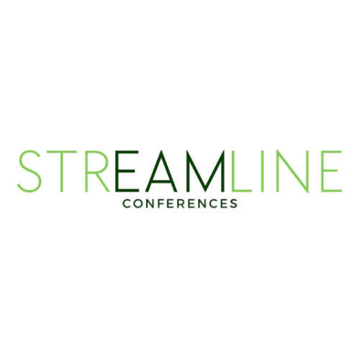
Hexagon Alix (AI)
Nash Patidar
Sr. Product Owner
Hexagon

Slide 2
Agenda
Hexagon Alix
What is Hexagon Alix
What’s New
New Capabilities and Enhancements
Use Cases
Practical applications on how to use Alix today
Look Ahead
Alix Roadmap

Slide 3

Hexagon Alix
Addressing the needs of our customers
Hexagon Alix is an enterprise AI-powered chat assistant that acts as a digital worker, making it easier for users to interact with EAM and related products. Designed for high-security environments
What Alix Does for You:
Find answers fast – skip searching product manuals and documents; get accurate responses instantly
Guide You Step-by-Step – troubleshooting, workflows, and product features explained clearly
Understand Your Files & Images – ask questions or extract info from PDFs, Word, Excel, PowerPoint, TXT, images and diagrams
Improved user experience – provides EAM users with an intuitive, easy-to-use assistant that enhances overall satisfaction.
Multi-Language Support:
English, French, German, Spanish, Italian, Portuguese, Thai, Indonesian, Arabic, Hindi and Tagalog
Safeguards:
Not connected to the internet
Robust guardrails ensure secure, compliant use and prevent access to harmful, illegal, or inappropriate content.
Notes:
HxGN Alix is hexagons Gen AI digital Assistant
Its primary purpose is to provide real time insights by responding to hexagon product and industry knowledge base.
Currently it has been integrated within our other solutions such as EAM, Python Studio and Databride Pro, so you can launch Alix from withing the application and interact with it.
With a plan to expand to other products.
What you see on the right here is an example on how alix interacts with an EAM user for product and related industry questions.
HxGN Alix, is built from the ground up using open-source LLM, and avoid Commercial LLMS for various reasons.
Commercial LLMs are prone to a greater degree of Hallucinations.
Hallucinations are when AI’s generate false or inaccurate information which can mislead a user.
Building from the ground up allows us to have greater control on hallucinations and place certain safe guards in place. To prevent them,
One such safe guard is not having access to the internet.
Other safeguards include not responding to questions that may cause harm or unrelated to the organization
e,g asking questions about the stock market
e.g
Safe Guards
Enhanced security and privacy protections
Intellectual property safeguards
Controls on specialized or restricted advice
Restrictions on competitor-related searches
Prevention of harmful or prohibited content, including:
Criminal activity
Sexual and child exploitation
Weapons and violence
Hate, self-harm, and sexual content

Slide 4
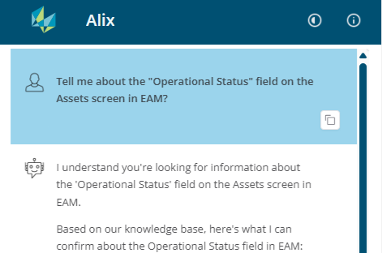
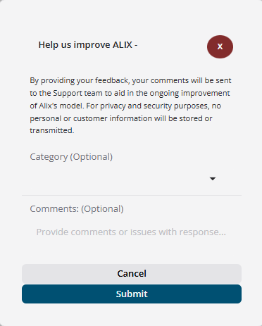
Hexagon Alix
What’s New
UI Enhancements
Clear visual separation between AI assistant and user messages.
Enhancing Alix Through Feedback - The user interface has been updated to allow users to optionally provide feedback on responses through a thumbs up, thumbs down icon to support continuous improvement.
IMPORTANT TO NOTE: - On user provided feedback, for privacy and security purposes, no personal or customer information will be stored or transmitted.
Only the comments will be sent to the development team to aid in the ongoing improvement of Alix's model.
EAM

Slide 5
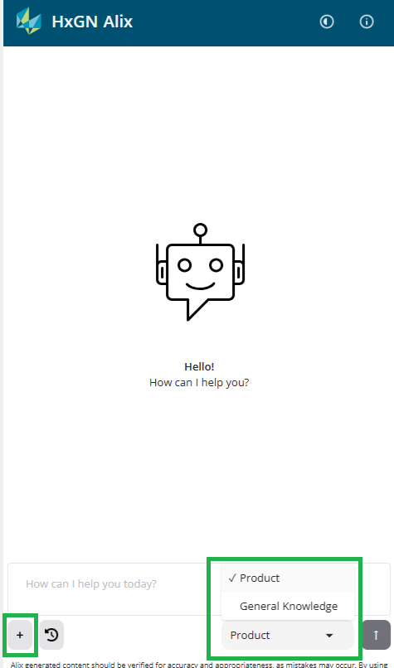
Hexagon Alix
What’s New
Other UI Enhancements
Upload Attachment (PDFs, Word Docs, spreadsheets, images)
Add Images for analysis
Summarize, translate and analyze documents
Explicit Knowledge Section
Defaults to EAM knowledge to ground response
Users can optionally switch to Alix general knowledge via dropdown or natural-language request
Citing Knowledge Sources
What’s the Value?
Enhanced intelligence and accuracy
Deeper product knowledge access
Stronger ethical standards
Continuous improvement through feedback
Build confidence and enable verification

Slide 6
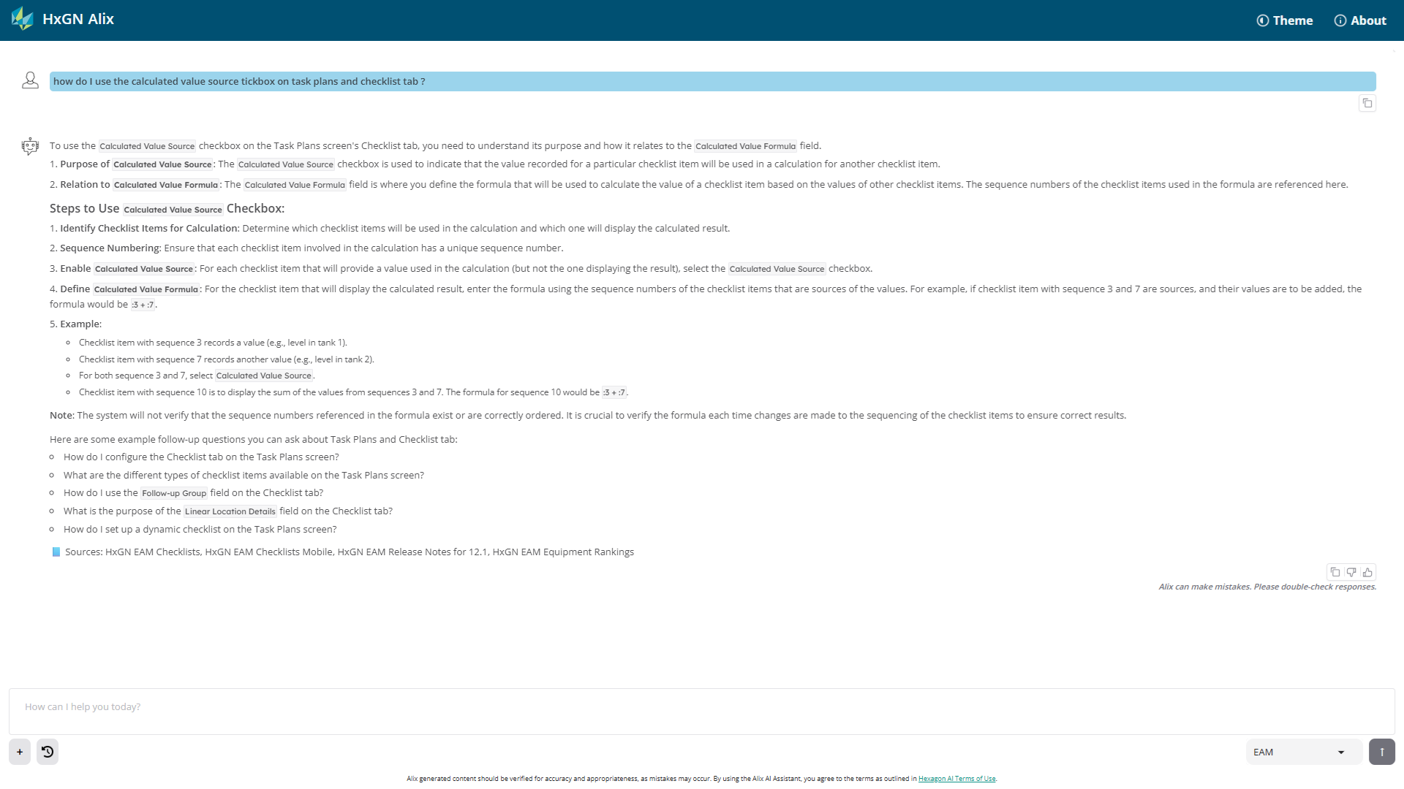
Hexagon Alix
Product Knowledge Access

Slide 7
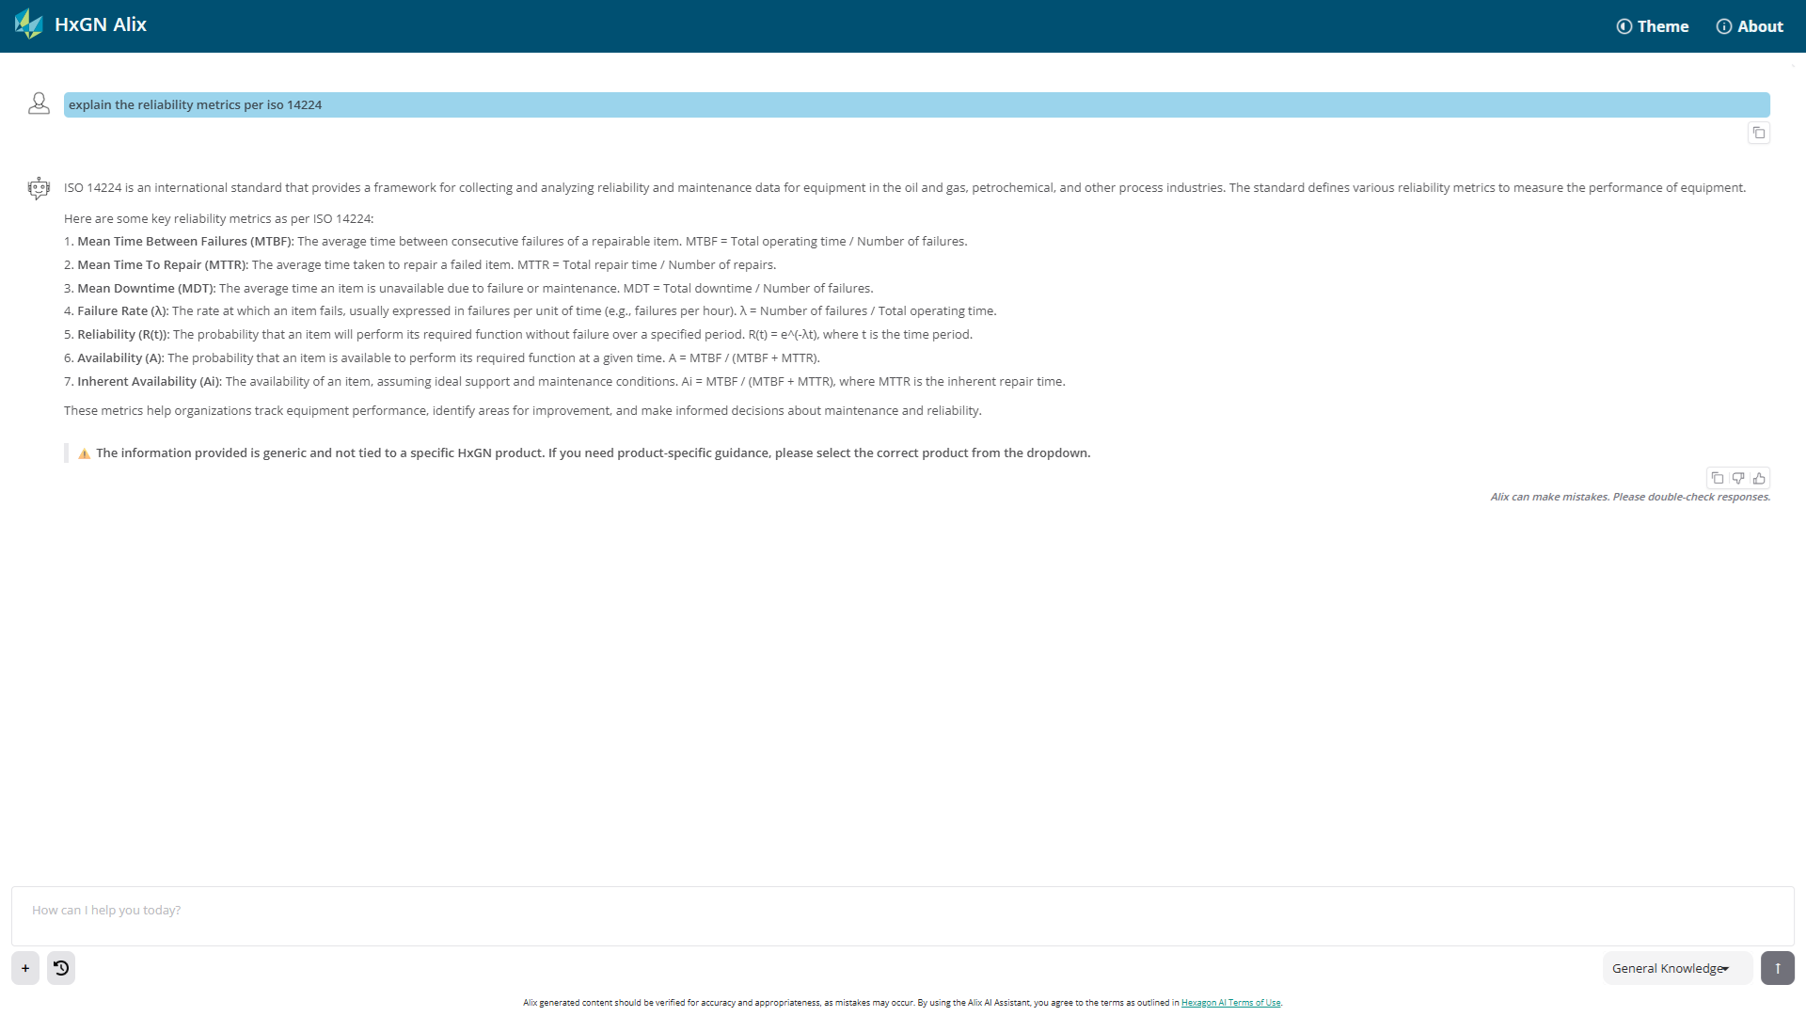
Hexagon ALiX
General Knowledge Access

Slide 8
Demo – Alix and Asset Onboarding
EAM

Slide 9
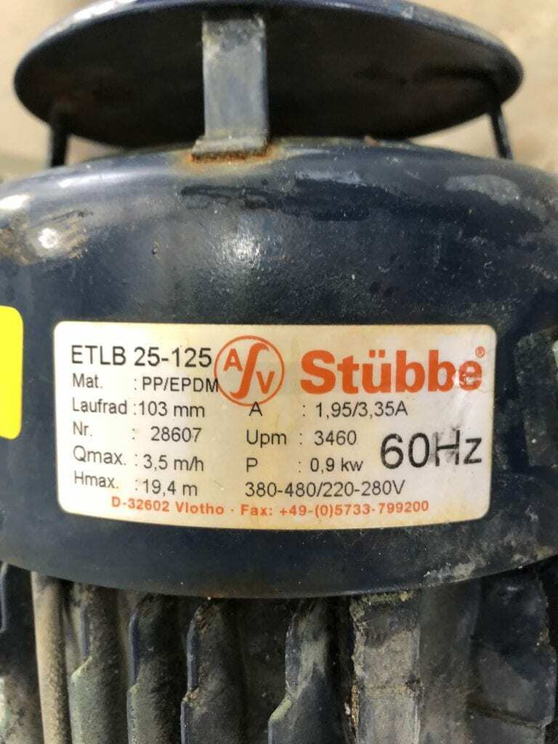
Hexagon Alix
Use Case : Asset Onboarding
Establish a complete, standardized, and reliable asset record for acquired assets.
Challenges
Asset data is missing, outdated, or inaccurate
Fixing the data manually would take a lot of time and effort
Maintenance manuals are large, unstructured documents that are difficult and time-consuming to search, extract PM plans, and identify parts lists.
Solution
Leverage ALiX to read equipment nameplates from photos and build accurate asset records.
Enable AI to parse, index, and understand manual content (procedures, safety steps, parts, limits)
Outcome
Accelerates onboarding with standardized asset records in the EAM
Improved reliability, maintenance and compliance

Slide 10
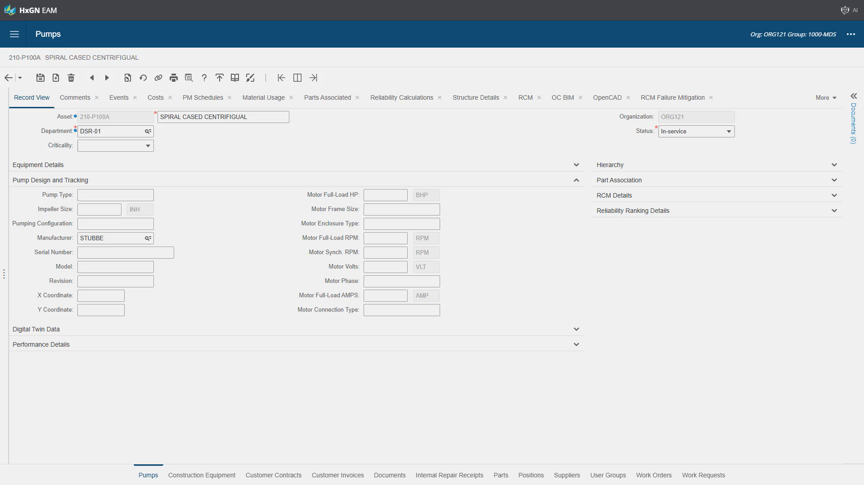

Slide 11
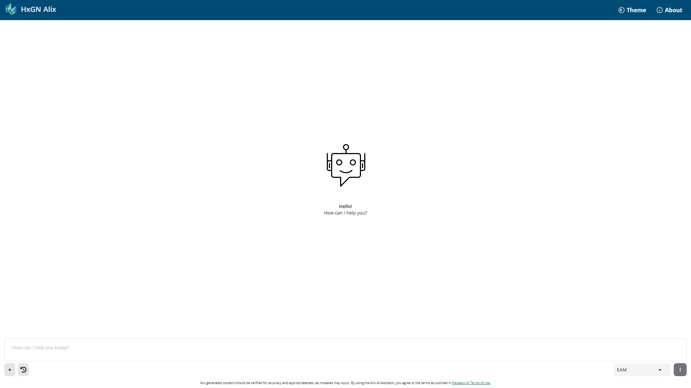

Slide 12
Demo – Alix and Databridge Pro
EAM

Slide 13
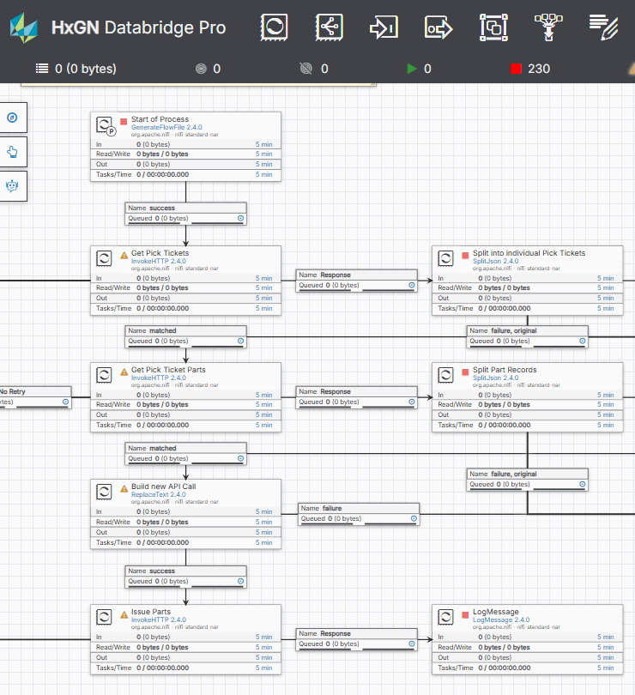
Hexagon Alix
Use Case : Accelerate Analysis and Troubleshooting
Leverage AI to rapidly interpret, validate, and troubleshoot complex data flows and expressions in Databridge Pro, reducing analysis time and improving development efficiency.
Challenges
Flow files can be complex and difficult to interpret
Troubleshooting or onboarding new team members requires manual review of flow definitions
Solution
Enable ALiX to parse and understand processors, connections, properties and flow logic
Allows users to ask natural language questions to summarize and validate flow behavior
Outcome
Reduced troubleshooting and analysis time for engineers
Improved onboarding and knowledge transfer across teams

Slide 14
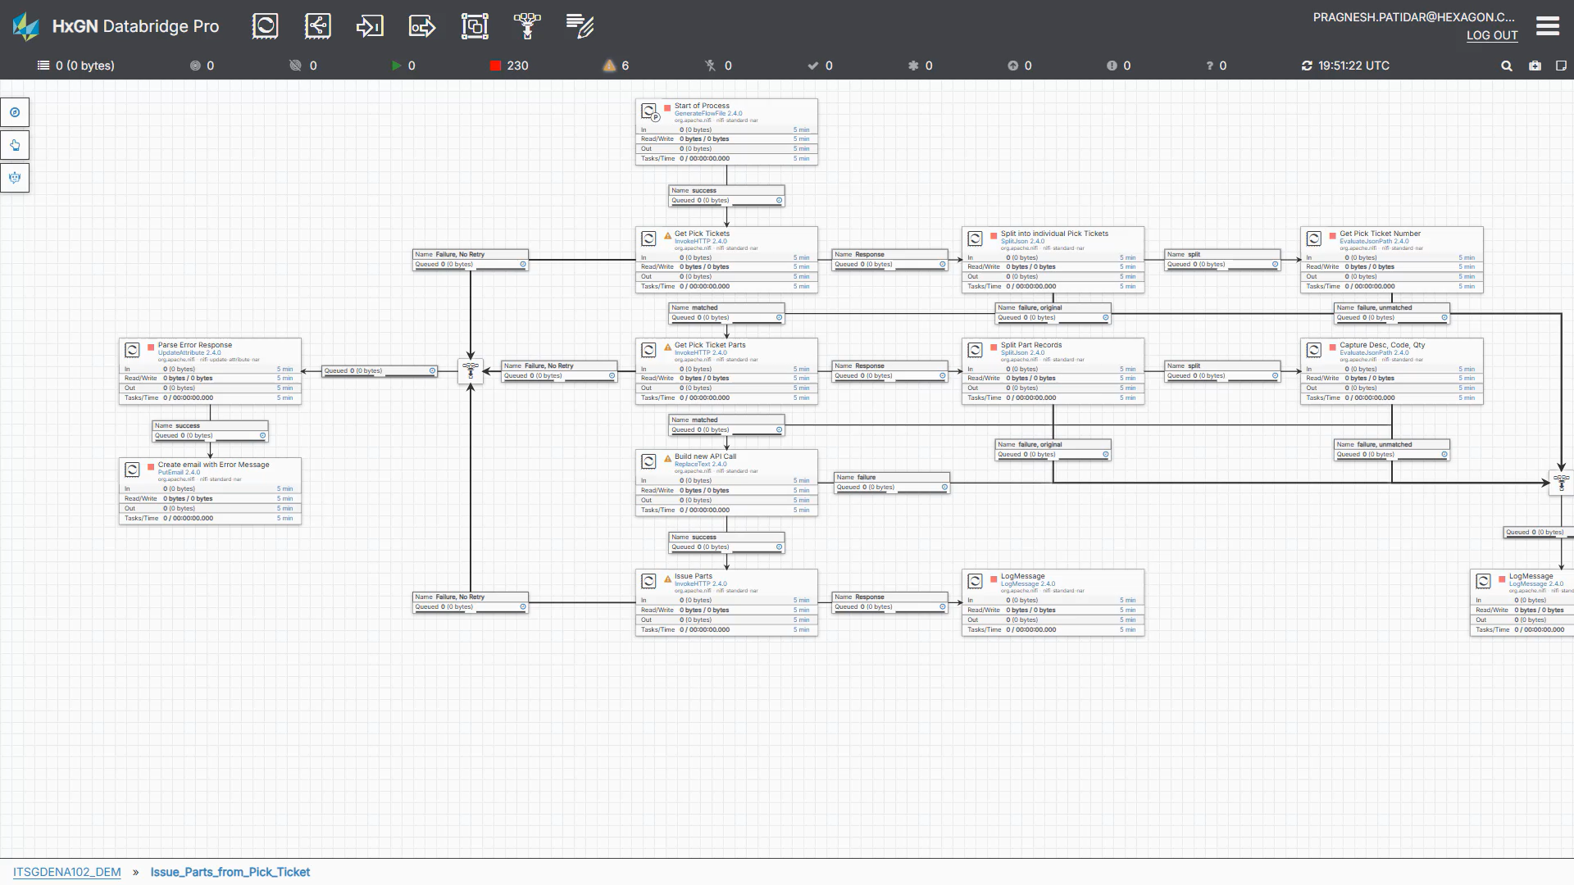

Slide 15
Agenda
Hexagon Alix
What is Hexagon Alix
What’s New
New Capabilities and Enhancements
Use Cases
Practical applications on how to use Alix today
Look Ahead
Product Architecture and Roadmap

Slide 16

Hexagon Alix
Digital Assets AI Assistant
$
Data Security & Privacy
Safety & Effectiveness
Cost
Accessibility
Crucial to protect sensitive information, prevent unauthorized access, and maintain user trust
Surprise bills related to unpermitted, unknown, or unauthorized usage
Bad actors or incorrect information can endanger your workers and operations
Limited multilingual capability can restrict adoption
Notes:
When continue to evolve and developAlix, we chose these 4 core guiding principles in developing it.
First is Data Security and privacy – Ensure we protect and secure, hexagons and our customers data.
Be Cost conscience – computing cost for AI can be cost prohibit , so build on a model that is sustainable for the future
Next is Safety and Effectiveness – limit or eliminate any hallucinations,
Last Accessibility,- make it multilingual.

Slide 17
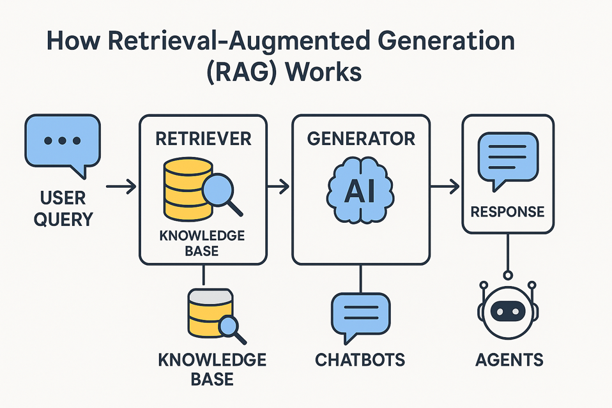
Focused Knowledge Strategy
Strategy to deliver GenAI at manageable cost.
Retrieval Augmented Generation (RAG)
Teaches the model what to know
Take all your products and specialized documents and place them in a sophisticated vector database (e.g., knowledge base).
When a question is asked, search the knowledge base for the specific information, send it to the LLM to make sense of all the information, and then provide the answer.
Fine-Tuning
Teaches the model how to behave
Example:
Format and tone of the response
Teach the LLM the unique product lingo.
e.g R5EVENTS = Work Orders
Notes:
Retrieval Augmented Generation (RAG)
Take all your products and specialized documents and place them in a sophisticated vector database (e.g., knowledge base).
When a question is asked, search the knowledge base for the specific information, send it to the LLM to make sense of all the information, and then provide the answer.
Fine-Tuning
”Adjust” the base training of the LLM to make it “tuned” to your specific needs. Example:
Change Infor EAM to HxGN EAM
Teach the LLM the unique differences between Pl/SQL and EAM’s Flex SQL

Slide 18
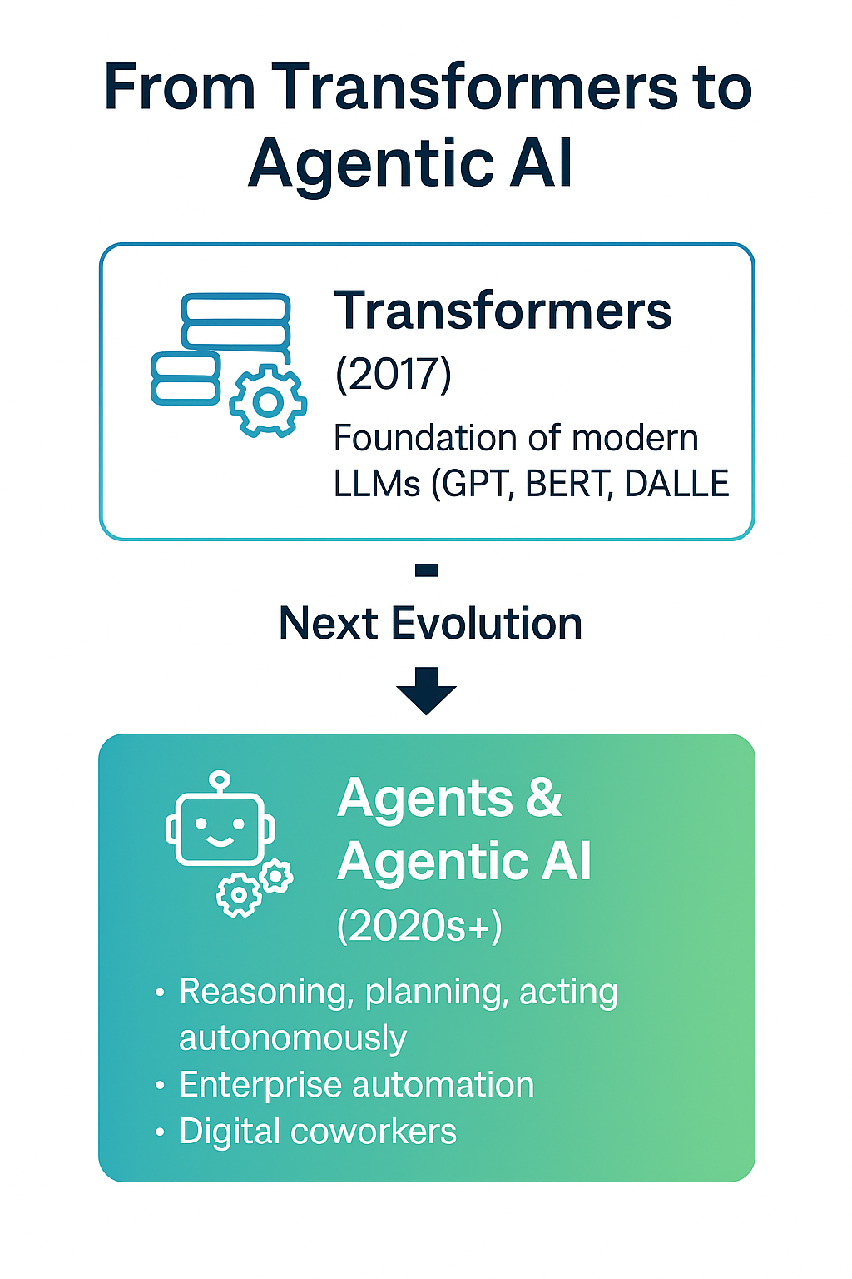
Agents and Agentic AI
Shaping the Next Wave of Intelligent Systems
From GenAI to Agentic AI
Shift from generating content → to reasoning, planning, and acting autonomously.
Core Capabilities of AI Agents
Reasoning: Break down complex goals into actionable steps.
Planning: Sequence tasks and adapt strategies dynamically.
Action: Execute across tools, APIs, and environments.
Learning: Improve from feedback and interactions.
Enterprise Opportunity
Agentic AI moves beyond “assistants” toward autonomous digital coworkers that integrate with business systems, tools, and data to deliver measurable outcomes.

Slide 19
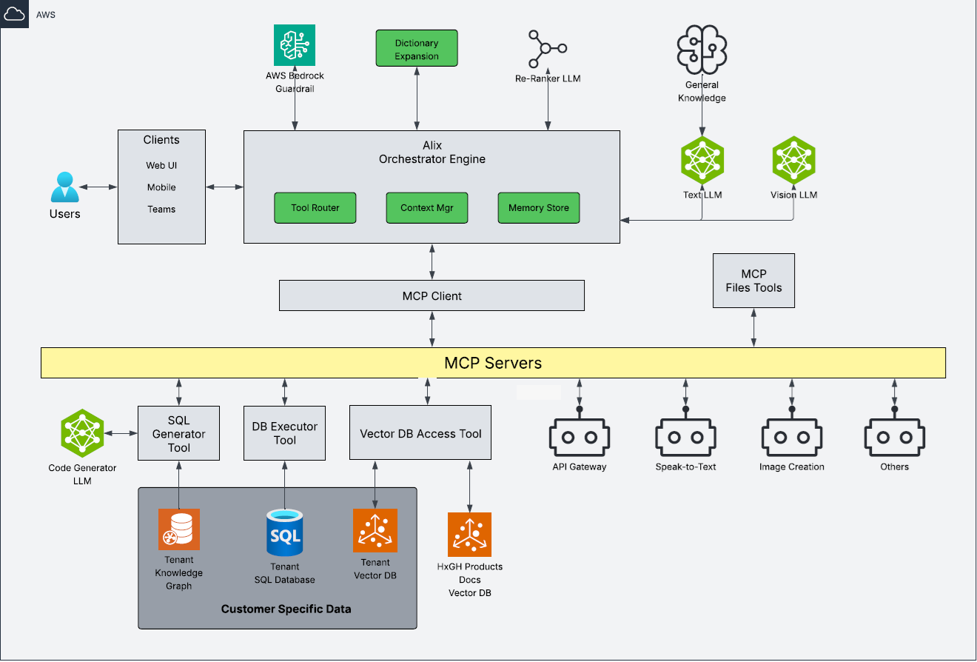
Hexagon Alix MCP Architecture – Agentic AI Services
EAM

Slide 20
HxGN EAM Alix
What’s Next - Read Access to Customer Database (12.3.1)
Natural Language Access to Asset Data
Users can easily obtain information about assets, such as status, history and performance, without needing technical skills or navigating screens
Use Cases:
Querying Asset Performance Metrics
“Which assets have the highest MTBF”?
Accessing Maintenance History
“When was the last annual inspection performed for Boiler B201”?
Locating Asset Metadata
“What is the operating temperature for valve V305”?
Persona:
Maintenance Technician
Asset Manager
Reliability Engineer
EAM
EAM

Slide 21
HxGN EAM Alix
What’s Next - Read Access to Customer Database (12.3.1)
Work Order Insights and Summarization
Turn raw work order data into actionable insights. Ask simple questions to get summaries, trends, and analysis of work activities to support smarter maintenance decisions
Use Cases:
Assessing Technician Performance
“Which technicians completed the most work orders last month, and how long did they take on average?
Extracting Failure and Repair Insights
“What were the most common failure types logged in recent work orders for A200 Packaging Line”?
Identify Recurring Maintenance Issues
“Which assets had repeated work orders in the last 90 days?”
Persona:
Maintenance Supervisor
Maintenance Manager
Reliability Engineer
EAM

Slide 22
HxGN EAM Alix
What’s Next - Read Access to Customer Database (12.3.1)
Inventory and Resource Analysis
Gain insights into spare parts inventory, material availability, and workforce resources using natural language. Quickly access stock levels, identify shortages and usage.
Use Cases:
Checking Spare Parts Availability
“Do we have any bearings for motor M400 in stock”?
Analyzing Inventory Trends
“What were the most frequently used spare parts in the last quarter”?
Forecast Resource Requirements
“How many man-hours are needed for scheduled maintenance in the next 30 days?”
Persona:
Maintenance Planner
Inventory Manager

Slide 23
HxGN EAM Alix
What’s Next - Read Access to Customer Documents (May 12.3.1)
Maintenance Assistance and Technician onboarding to SOPs
Provide instant access to customer-specific documents to support maintenance teams on customer-configured EAM system use, task execution, and consistent adherence to procedures
Use Cases:
Troubleshoot Support
“What does error code E45 mean for the compressor unit, model J25”?
New Training
“What’s the procedure for lockout/tagout on Asset A101?
Parts Identification and Usage Instructions
“How do I install the diaphragm on the dosing pump A456”?
Persona:
Maintenance Planner
Inventory Manager
EAM

Slide 24
Hexagon EAM Alix Roadmap
Looking Ahead at What’s Coming
Available Now
Next 12.3.1
Later 12.4
Foundational Technology Enhancements
LLM Optimization
Multimodal Capabilities
Smart Product Selections
Improved response structure and accuracy
Guided responses with verified sources
Strengthen ethical and policy guardrails
Enhancing Alix through continuous customer feedback
Context-Driven Intelligence
Customer Database Queries
Customer Document Queries
User Conversation History
AI-Generated File-Based Data Export
Voice to Text
Context-Driven Intelligence
Alix Task Execution
Screen Context Awareness
Alix Chat Hints
Image Rendering (Charts, Schematics)
Alix API for Python Studio
Alix for Mobile
This document is designed to communicate a perspective of likely R&D prioritization based on the current indicators of client demand. It will change both in scope and timing in response to industry demand, which is quite dynamic. Hexagon retains all decision rights as to what will be included in a particular release and does not make binding commitments outside of a written commercial contract
Notes:
Storing chat history is by user responsibly to ensure privacy and security. Purpose is to provide that continuity in conversation with Alix, in lieu if starting from scratch. You pick up where you left off.
Several advantages to chat history:
Less repetition – Show me the data as described before
Answers relevant to the topic – Alix remembers the context and what was discussed
Inventory optimization = demand forecasting and model to help determine optimal-sparts stocking levels, lowering working capital and maintain service level

Slide 25
Questions ?
Notes:
HxGN Alix is hexagons Gen AI digital Assistant
Its primary purpose is to provide real time insights by responding to hexagon product and industry knowledge base.
Currently it has been integrated within our other solutions such as EAM, Python Studio and Databride Pro, so you can launch Alix from withing the application and interact with it.
With a plan to expand to other products.
What you see on the right here is an example on how alix interacts with an EAM user for product and related industry questions.
HxGN Alix, is built from the ground up using open-source LLM, and avoid Commercial LLMS for various reasons.
Commercial LLMs are prone to a greater degree of Hallucinations.
Hallucinations are when AI’s generate false or inaccurate information which can mislead a user.
Building from the ground up allows us to have greater control on hallucinations and place certain safe guards in place. To prevent them,
One such safe guard is not having access to the internet.
Other safeguards include not responding to questions that may cause harm or unrelated to the organization
e,g asking questions about the stock market
e.g
Safe Guards
Enhanced security and privacy protections
Intellectual property safeguards
Controls on specialized or restricted advice
Restrictions on competitor-related searches
Prevention of harmful or prohibited content, including:
Criminal activity
Sexual and child exploitation
Weapons and violence
Hate, self-harm, and sexual content

