Slide 1

How to choose the right lubricant for peak equipment performance
Wesley Cash
Vice President of Services
Noria

Slide 2
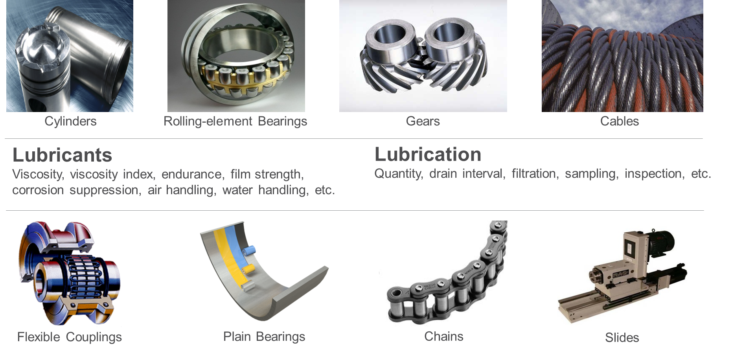
Machine Need Drives Lubricant and Lubrication Decisions

Slide 3
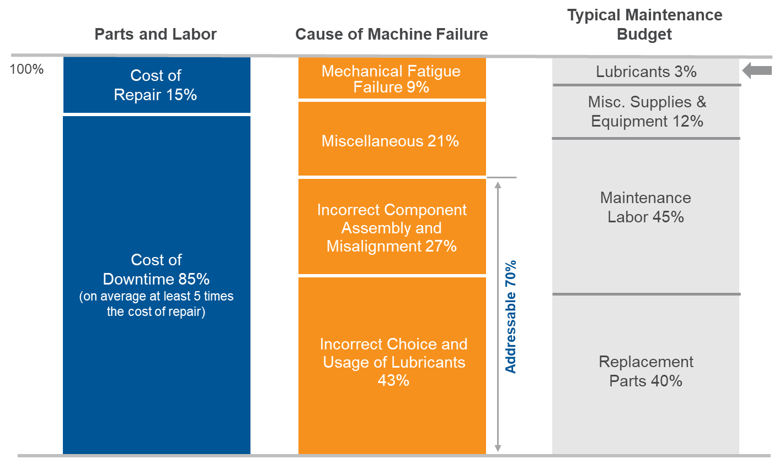
The Economics of Maintenance and Lubrication

Slide 4
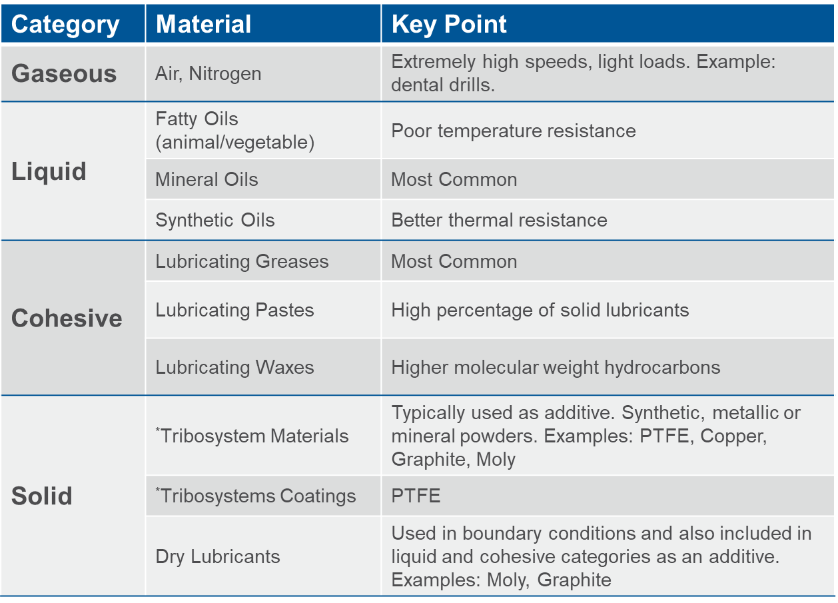
Lubricant Categories

Slide 5
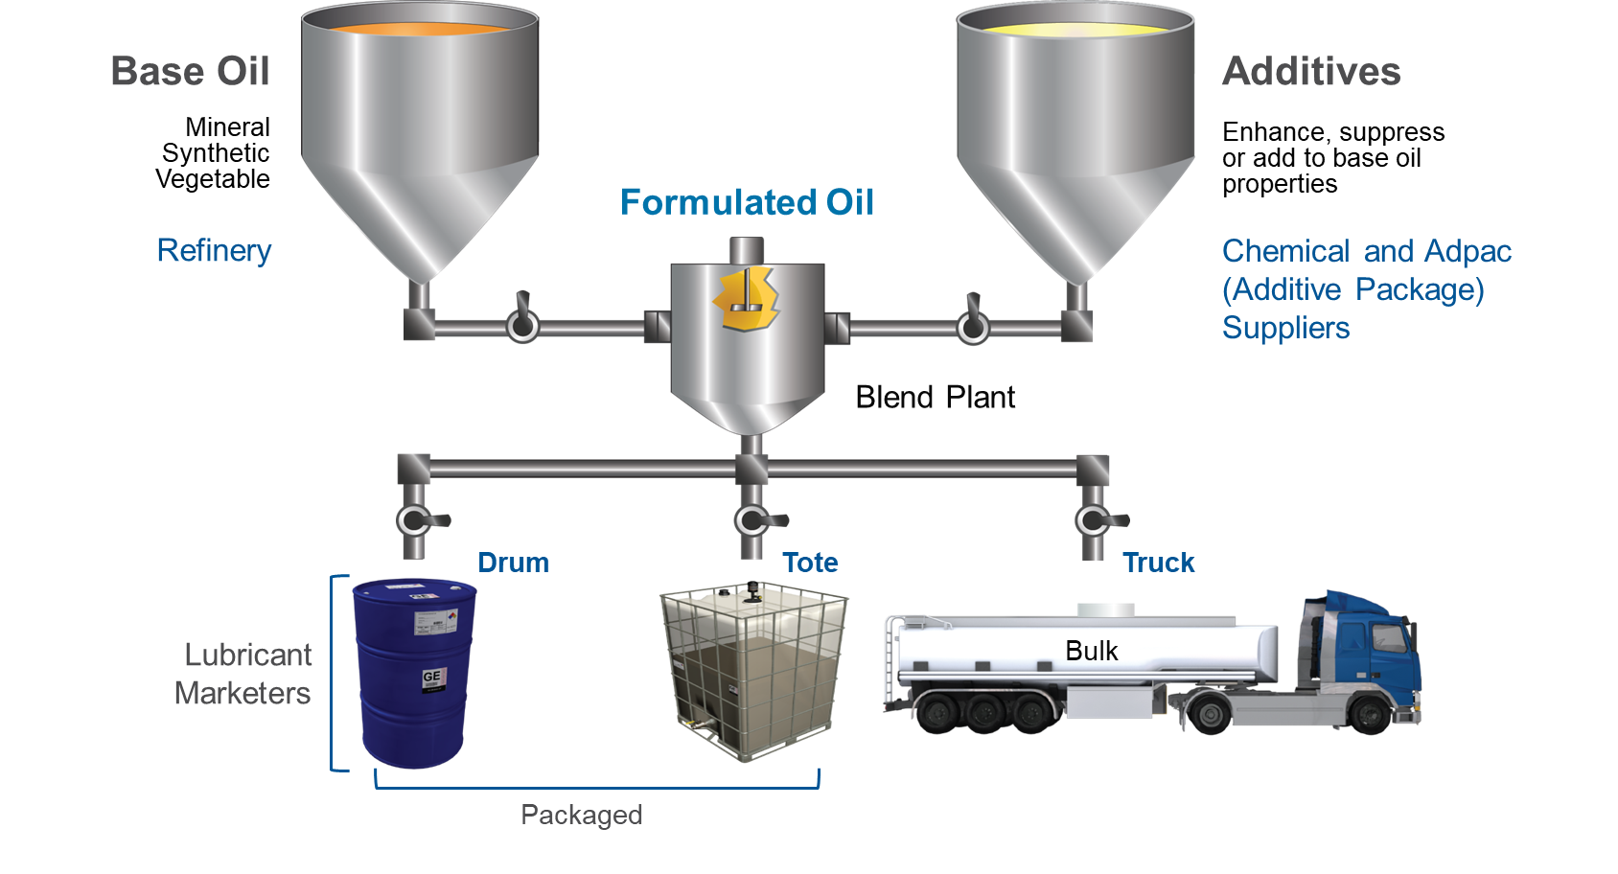
How Lubricating Oils are Formulated

Slide 6
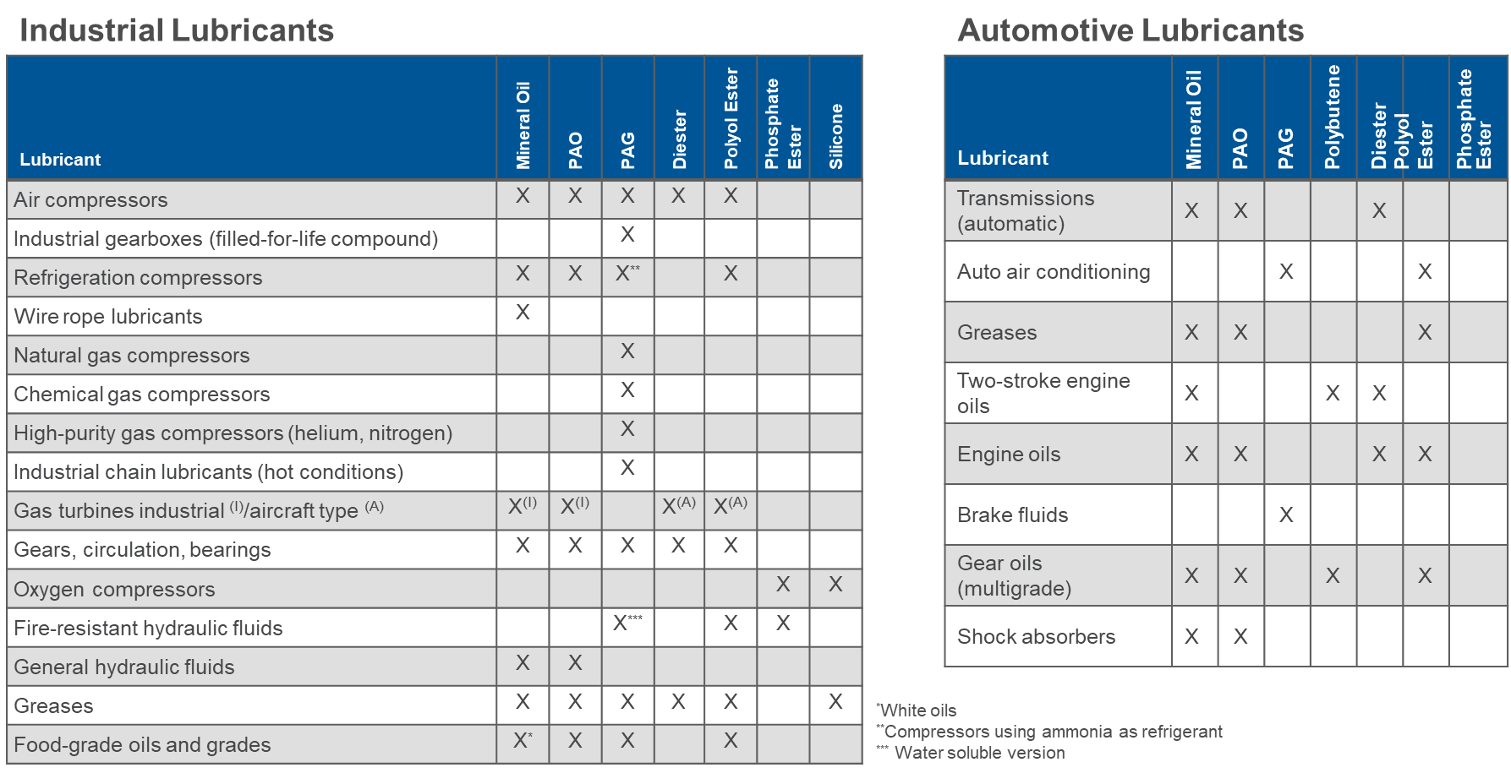
Lubricant Selection by Base Oil Type

Slide 7
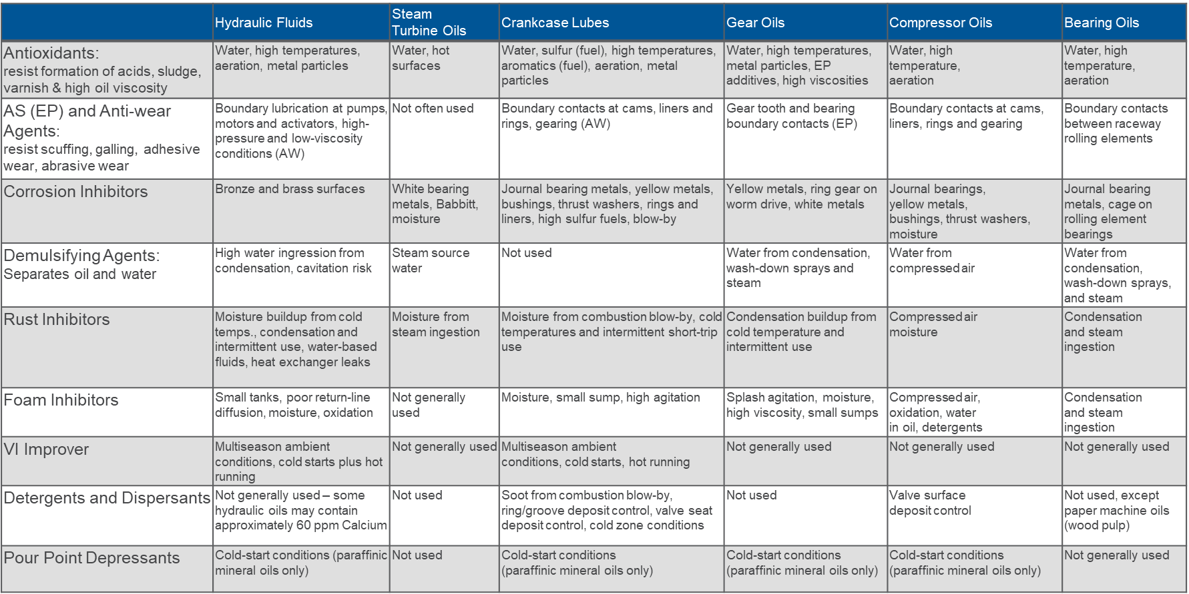
Machine Conditions Requiring Additives

Slide 8
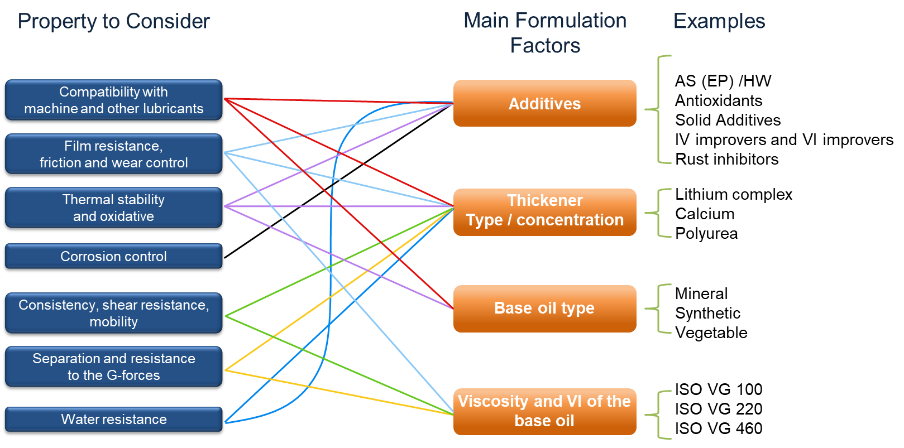
Important Factors When Selecting Grease

Slide 9
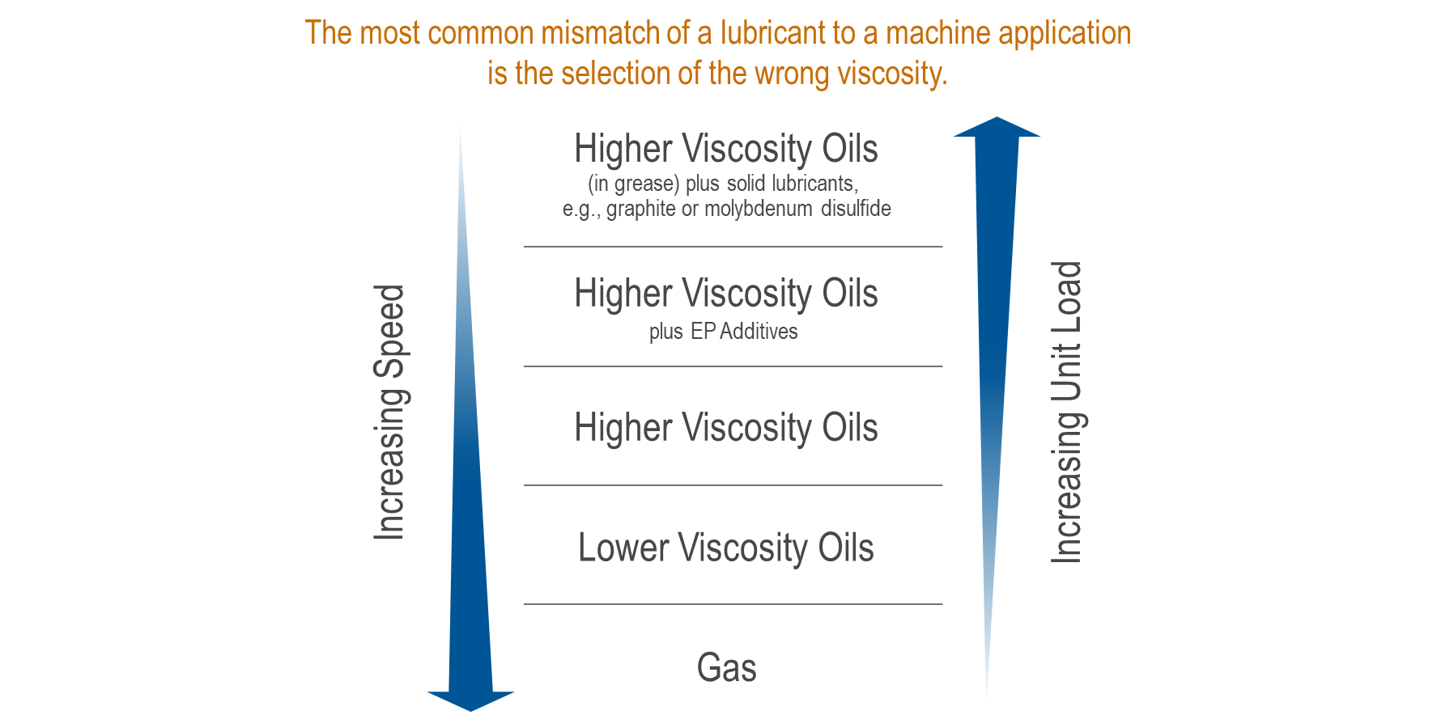
Speed & Load Effects on Lubricant and Viscosity Selection

Slide 10
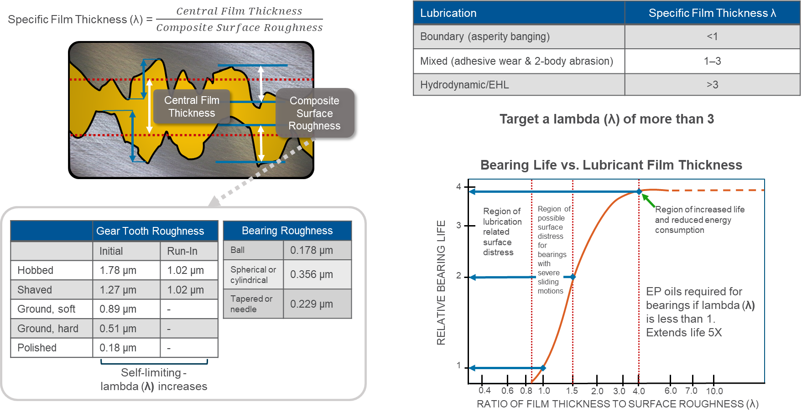
“Specific” Film Thickness – Lambda (λ)

Slide 11
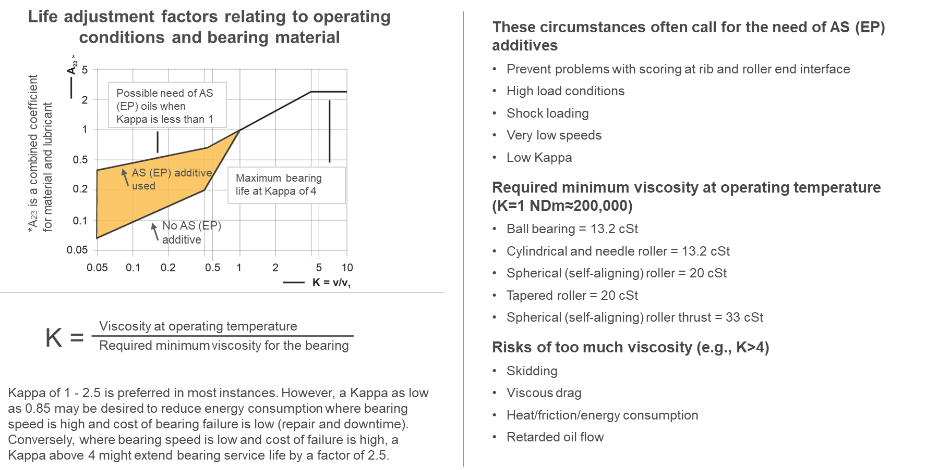
Kappa and the use of AS (EP) Additives with Bearing Lubes

Slide 12
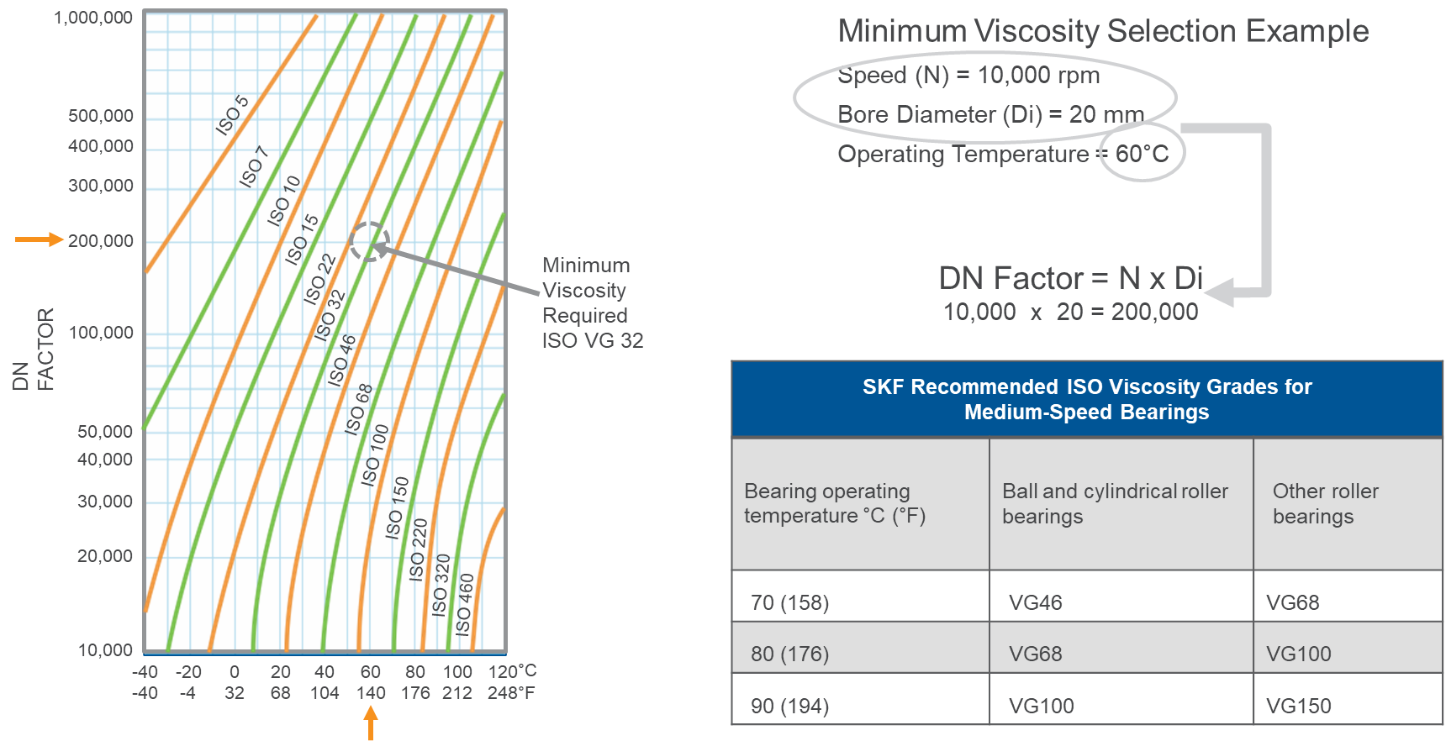
Minimum Bearing Viscosity Selection Using Speed Factor

Slide 13
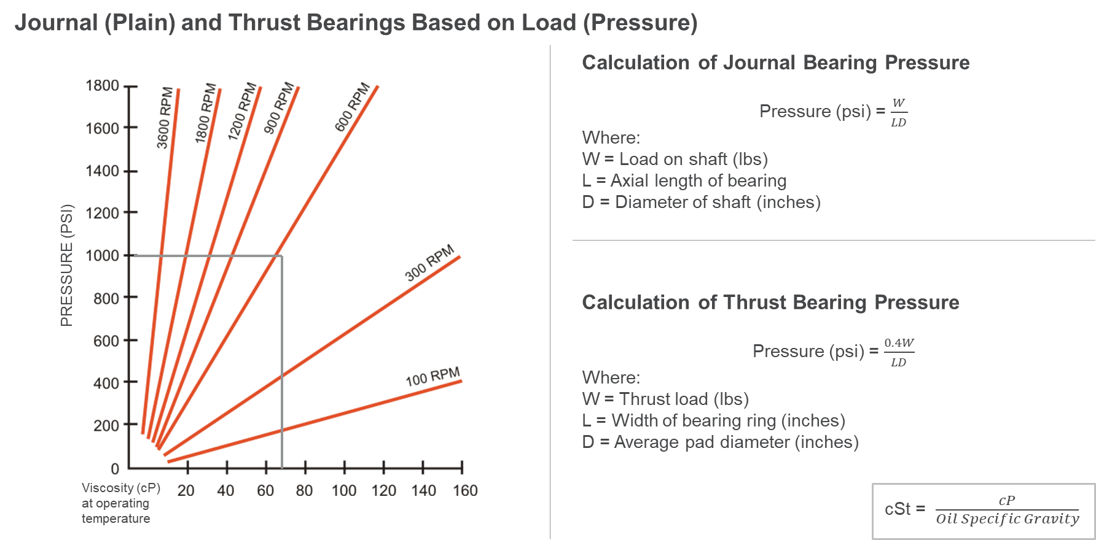
Viscosity Selection for Bearings

Slide 14
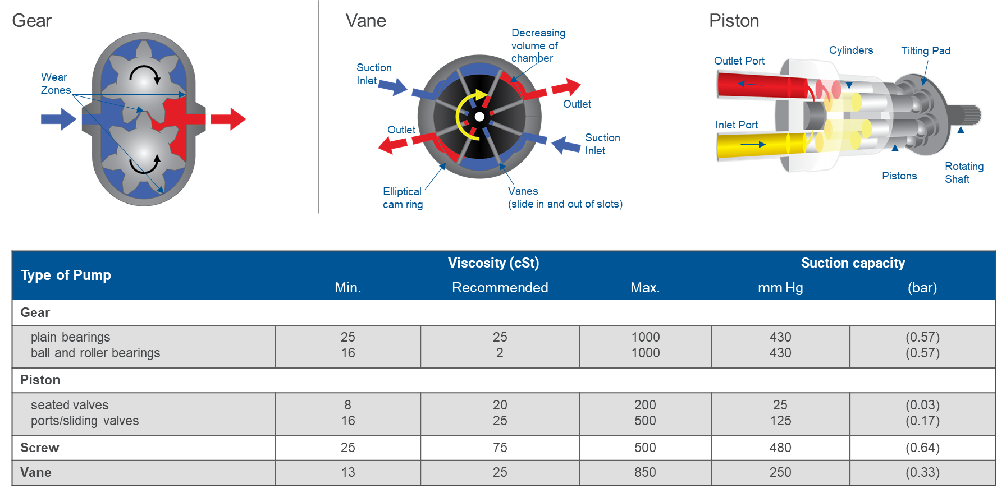
Hydraulic Fluids

Slide 15
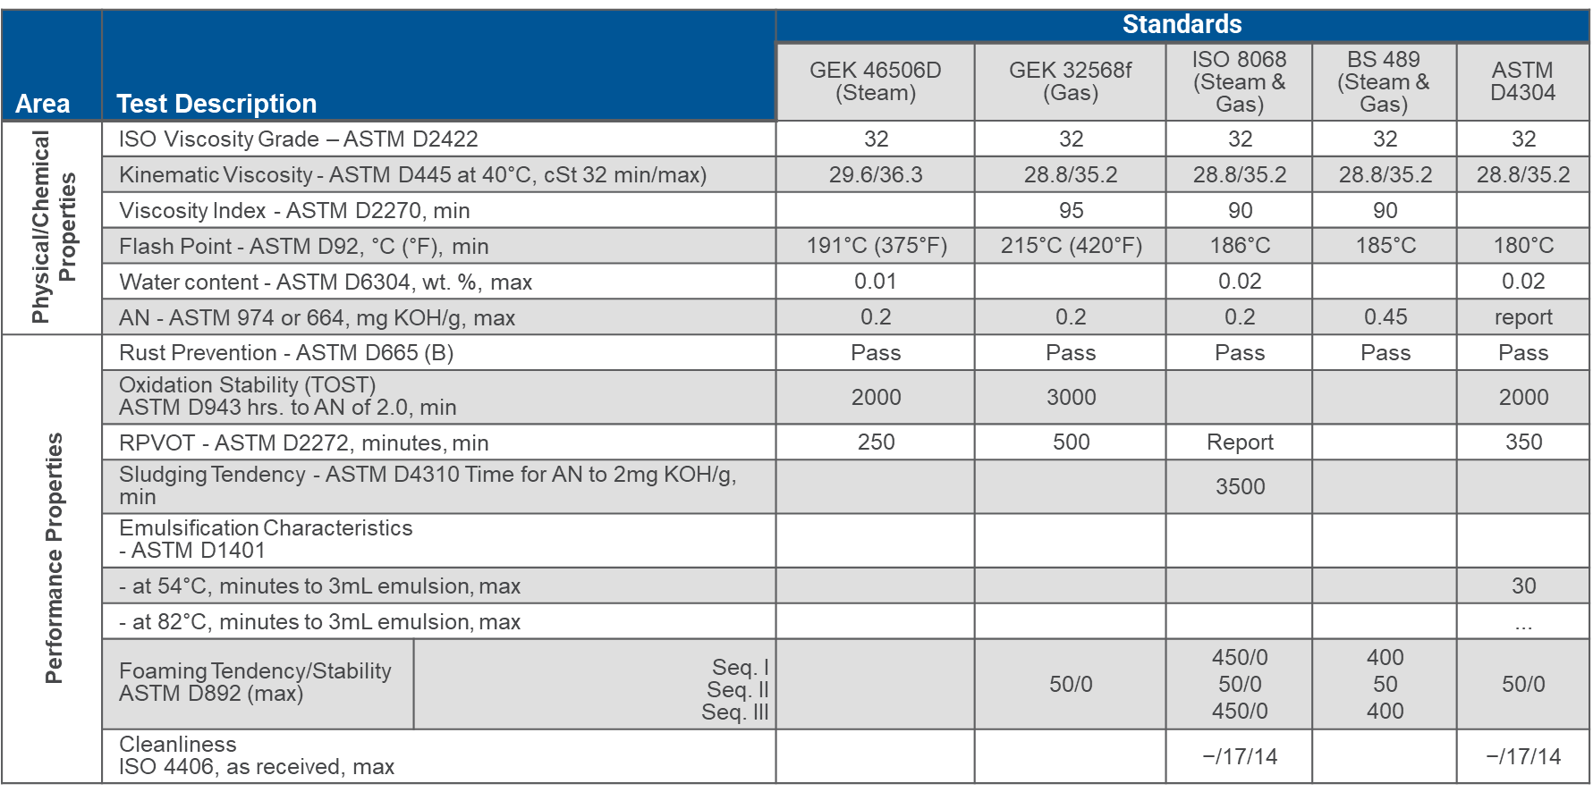
Typical U.S. and European Turbine Oil Requirements

Slide 16
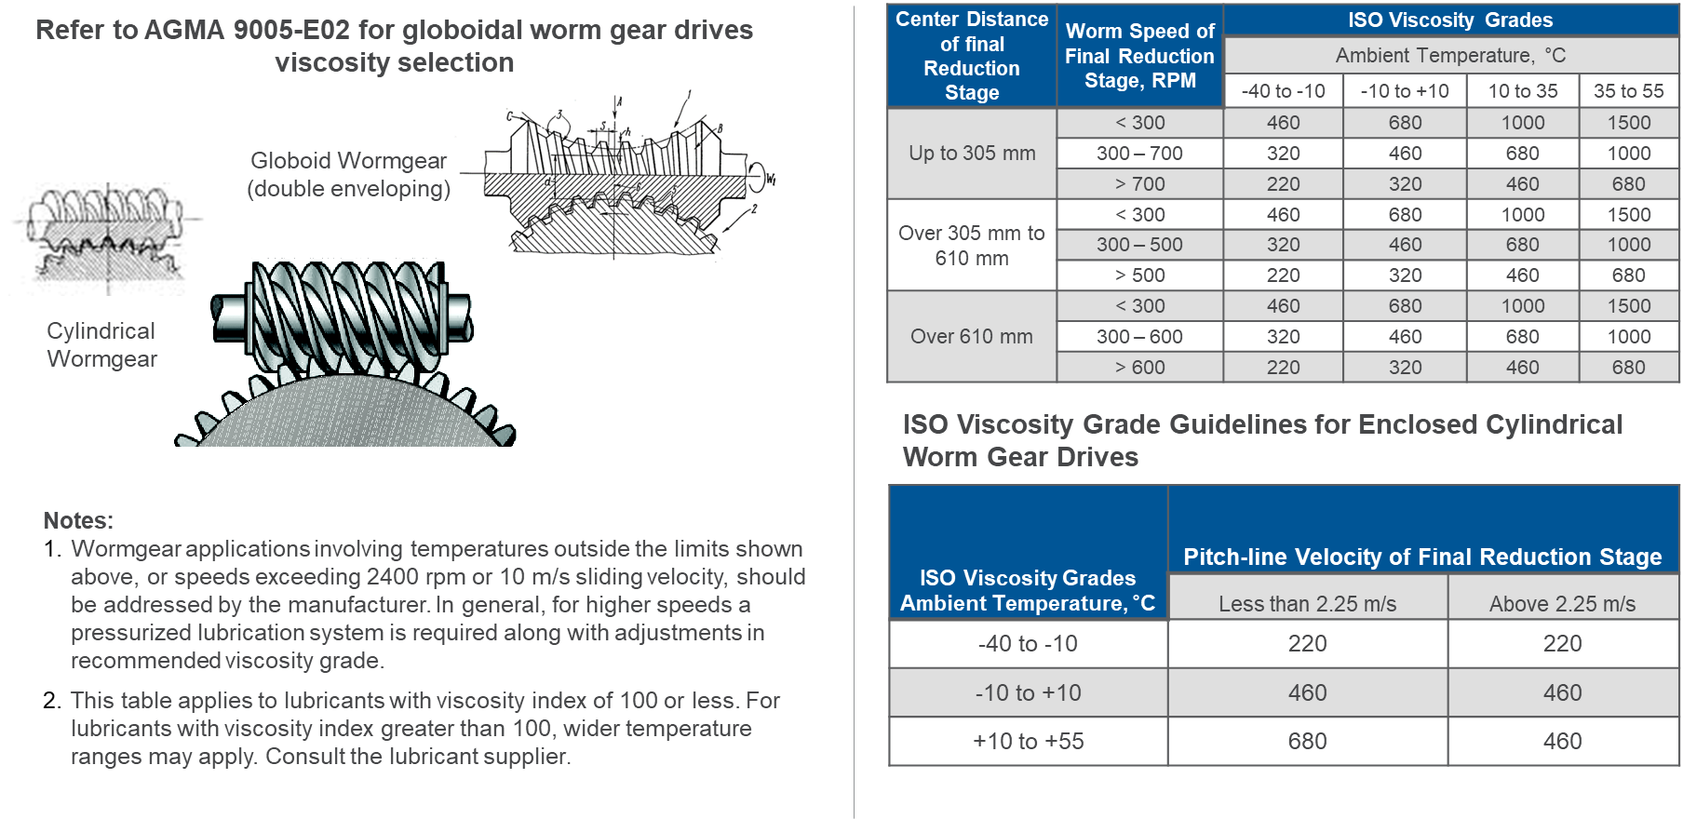
Wormgear Viscosity Selection

Slide 17
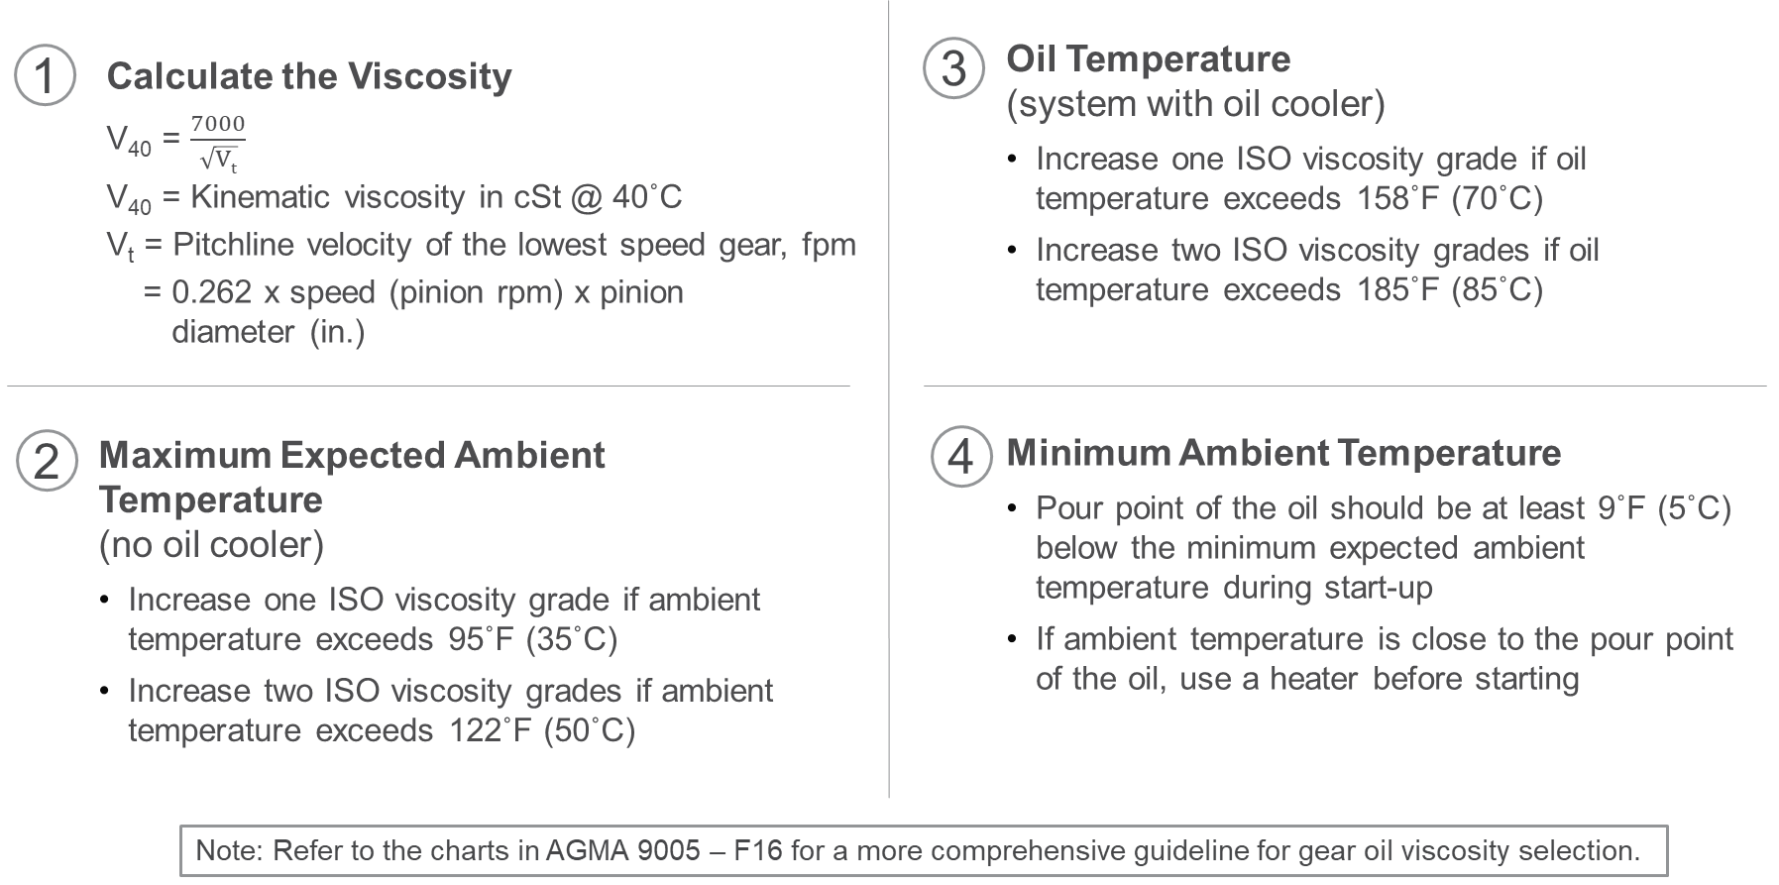
Selecting Lubricant Viscosity for Gear Oils

Slide 18
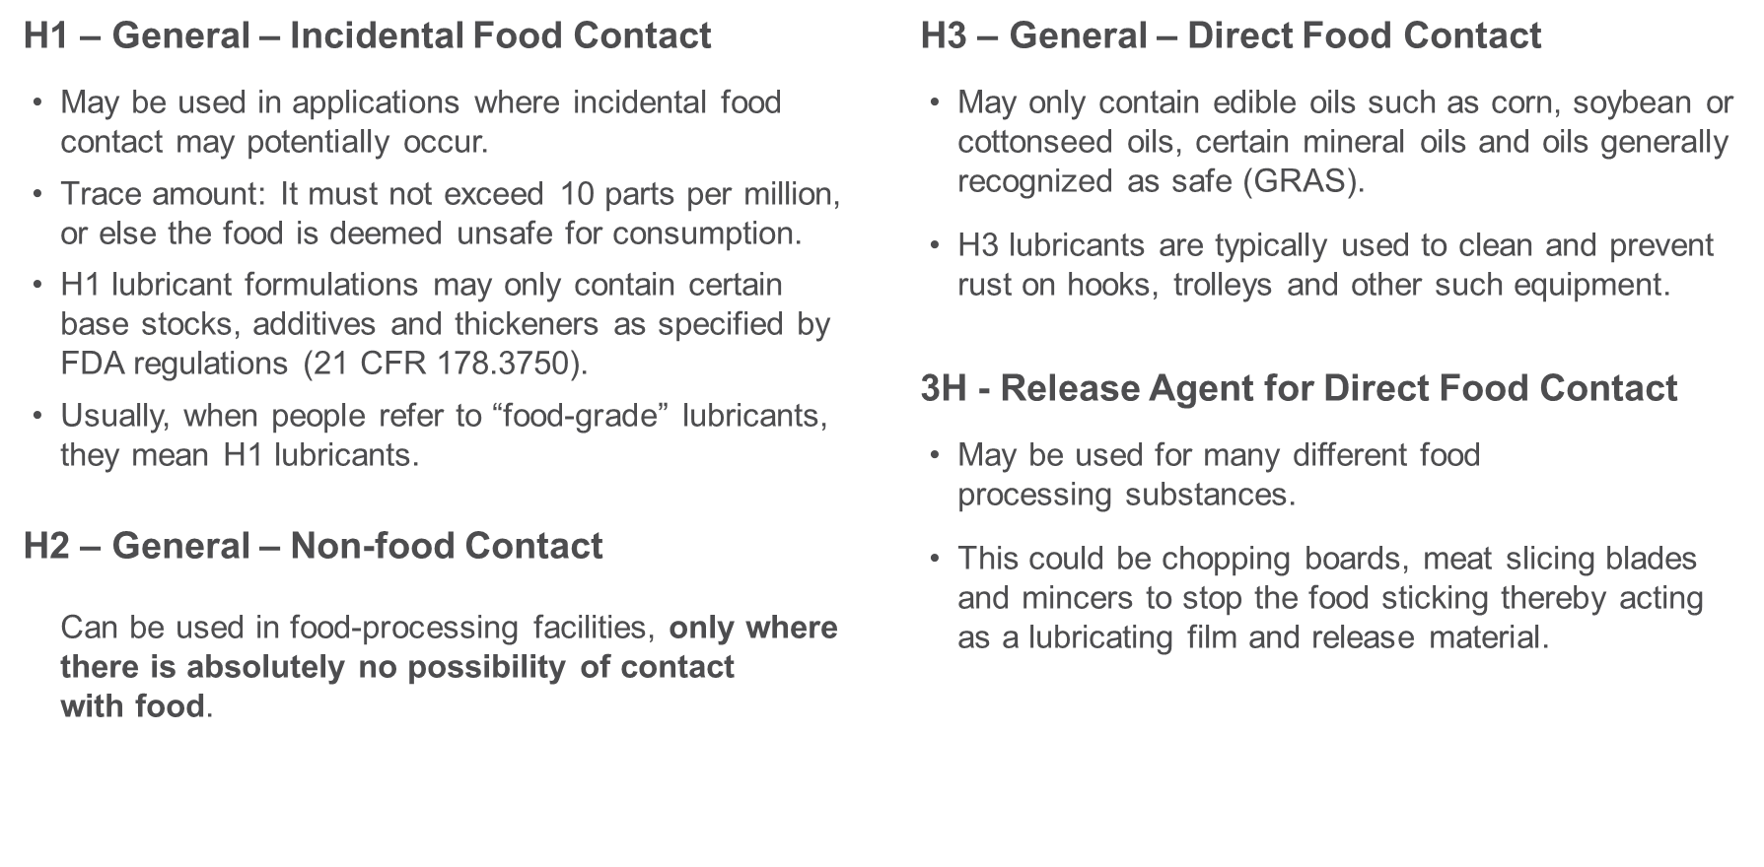
Food-grade Lubricant Classifications

Slide 19
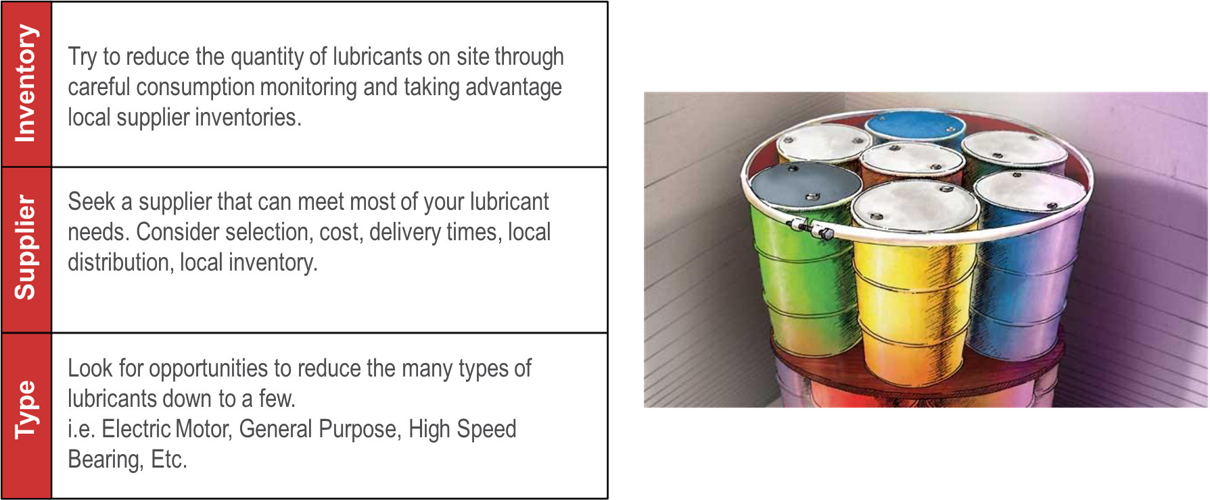
Lubricant Consolidation

Slide 20
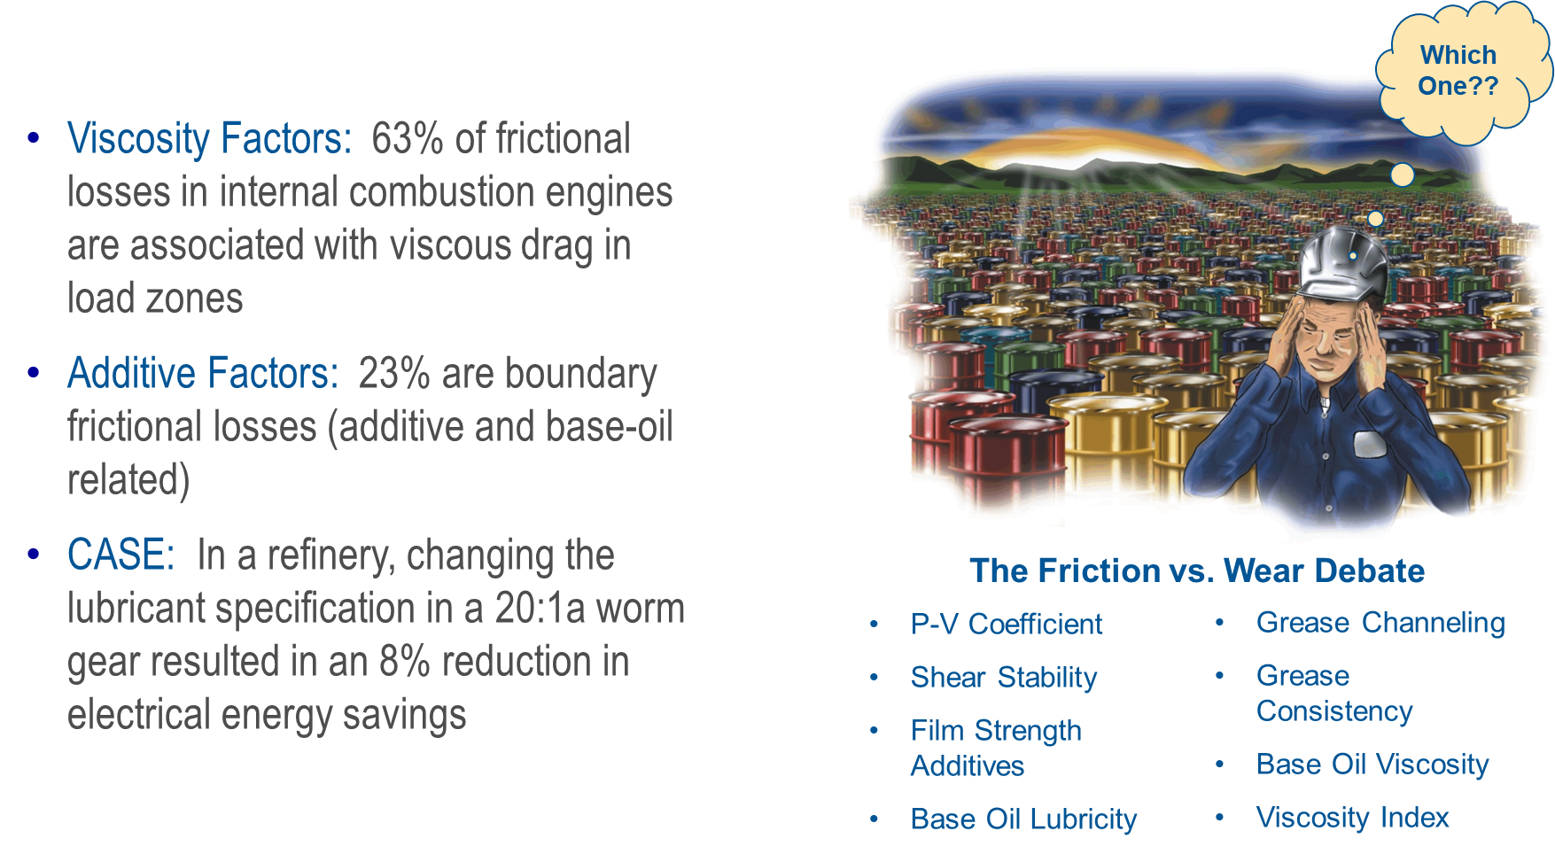
Energy-Conserving Lubricant Selection

Slide 21
Questions?
Thank you!
Wesley Cash
wcash@noria.com

