Slide 1

How to Effectively Select CBM Technologies
Howard W Penrose, Ph.D., CMRP, CEM, CMVP
President and Founder
MotorDoc LLC

Slide 2



President MotorDoc LLC, a Veteran Owned Small Business, Chair CIGRE-USNC A1 (Power Generation and Electromechanical Energy Conversion), IEEE PES grid working group, ACP clean energy systems standards chair, Convenor CIGRE A1.78 (ESA/MCSA project), IEEE PES standards group, Chair IEEE P1415, NEMA rail electrification standards committee, global leader in ESA/MCSA research and development, certified CMRP, CEM, CMVP, Industrial Engineering KWU, data science/AI/machine learning from Stanford University, University of Michigan, AWS and IBM. Life member MENSA.

Slide 3

Overview
Definitions
Asset Management
RCM Process
Technology Categories
CBM Selection Process

Slide 4
Definitions
Functional Failure: occurs when an asset is unable to perform a required function to the required performance standard as defined by the owner/user.
Reactive Maintenance: performed after a functional failure occurs.
Preventive Maintenance: performed at a fixed time or usage intervals to reduce probability of failure regardless of condition.
Condition-Based Reactive Maintenance: triggered by a condition alarm, but typically late in the failure curve, meaning the asset is already degraded and condition is essentially reactive but informed by condition.
Condition-Based Maintenance: based on evidence of need using inspections, tests or monitoring to detect potential failure early enough to avoid or plan the correction.
Predictive Maintenance: subset of CBM where measured condition data is used to predict future failure risk, remaining life, or optimal maintenance timing.
Proactive Maintenance: maintenance focused on eliminating the root causes of failure, not just detecting or repairing the failure mode.
Reliability-Centered Maintenance: structured PROCESS used to determine effective maintenance tactics to ensure assets continue to perform required functions at the required performance level in actual operating context.

Slide 5
Condition-Based Maintenance
RCM is a decision framework that determines best maintenance strategy at the time and resources.
CBM is an execution tactic that performs maintenance when condition data shows it is needed.
In RCM terms: CBM is an ‘On-Condition’ task.
RCM selects CBM when”
The failure is detectable
There is a useable P-F interval (potential failure to functional failure time)
The condition indicator is technically feasible and cost-effective
RCM may chose when CBM is not effective:
Time based PM, failure-finding, redesign, or run-to-failure depending on risk and consequences

Slide 6
What is Strategy and what are Tactics
R&M Strategy
R&M Tactics
The plan for how we will control operational risk and asset performance including how we decide what work matters most, where to focus resources and how success will be measured. Set by leadership.
Marching Orders and Goals
Define: what is success
The specific methods we deploy to execute the plan, such as RCM, CBM, PdM, inspections, precision maintenance, and corrective actions to prevent, detect, and respond to failure. Implemented by stakeholders.
The Battle / Actions
Define: how to accomplish it

Slide 7
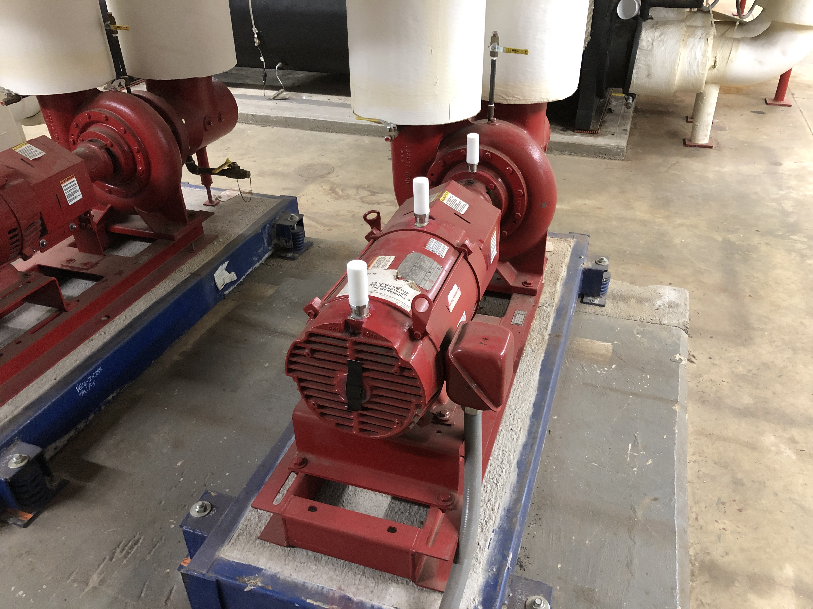
Maintenance Mindsets
All failures can and must be prevented. Risk avoidance is good maintenance.
Not all failures can or should be prevented. Risk management is good maintenance.
Pump and motor capable of 200 GPM
Output drops from 150 GPM to 140 GPM
What do you do?

Slide 8
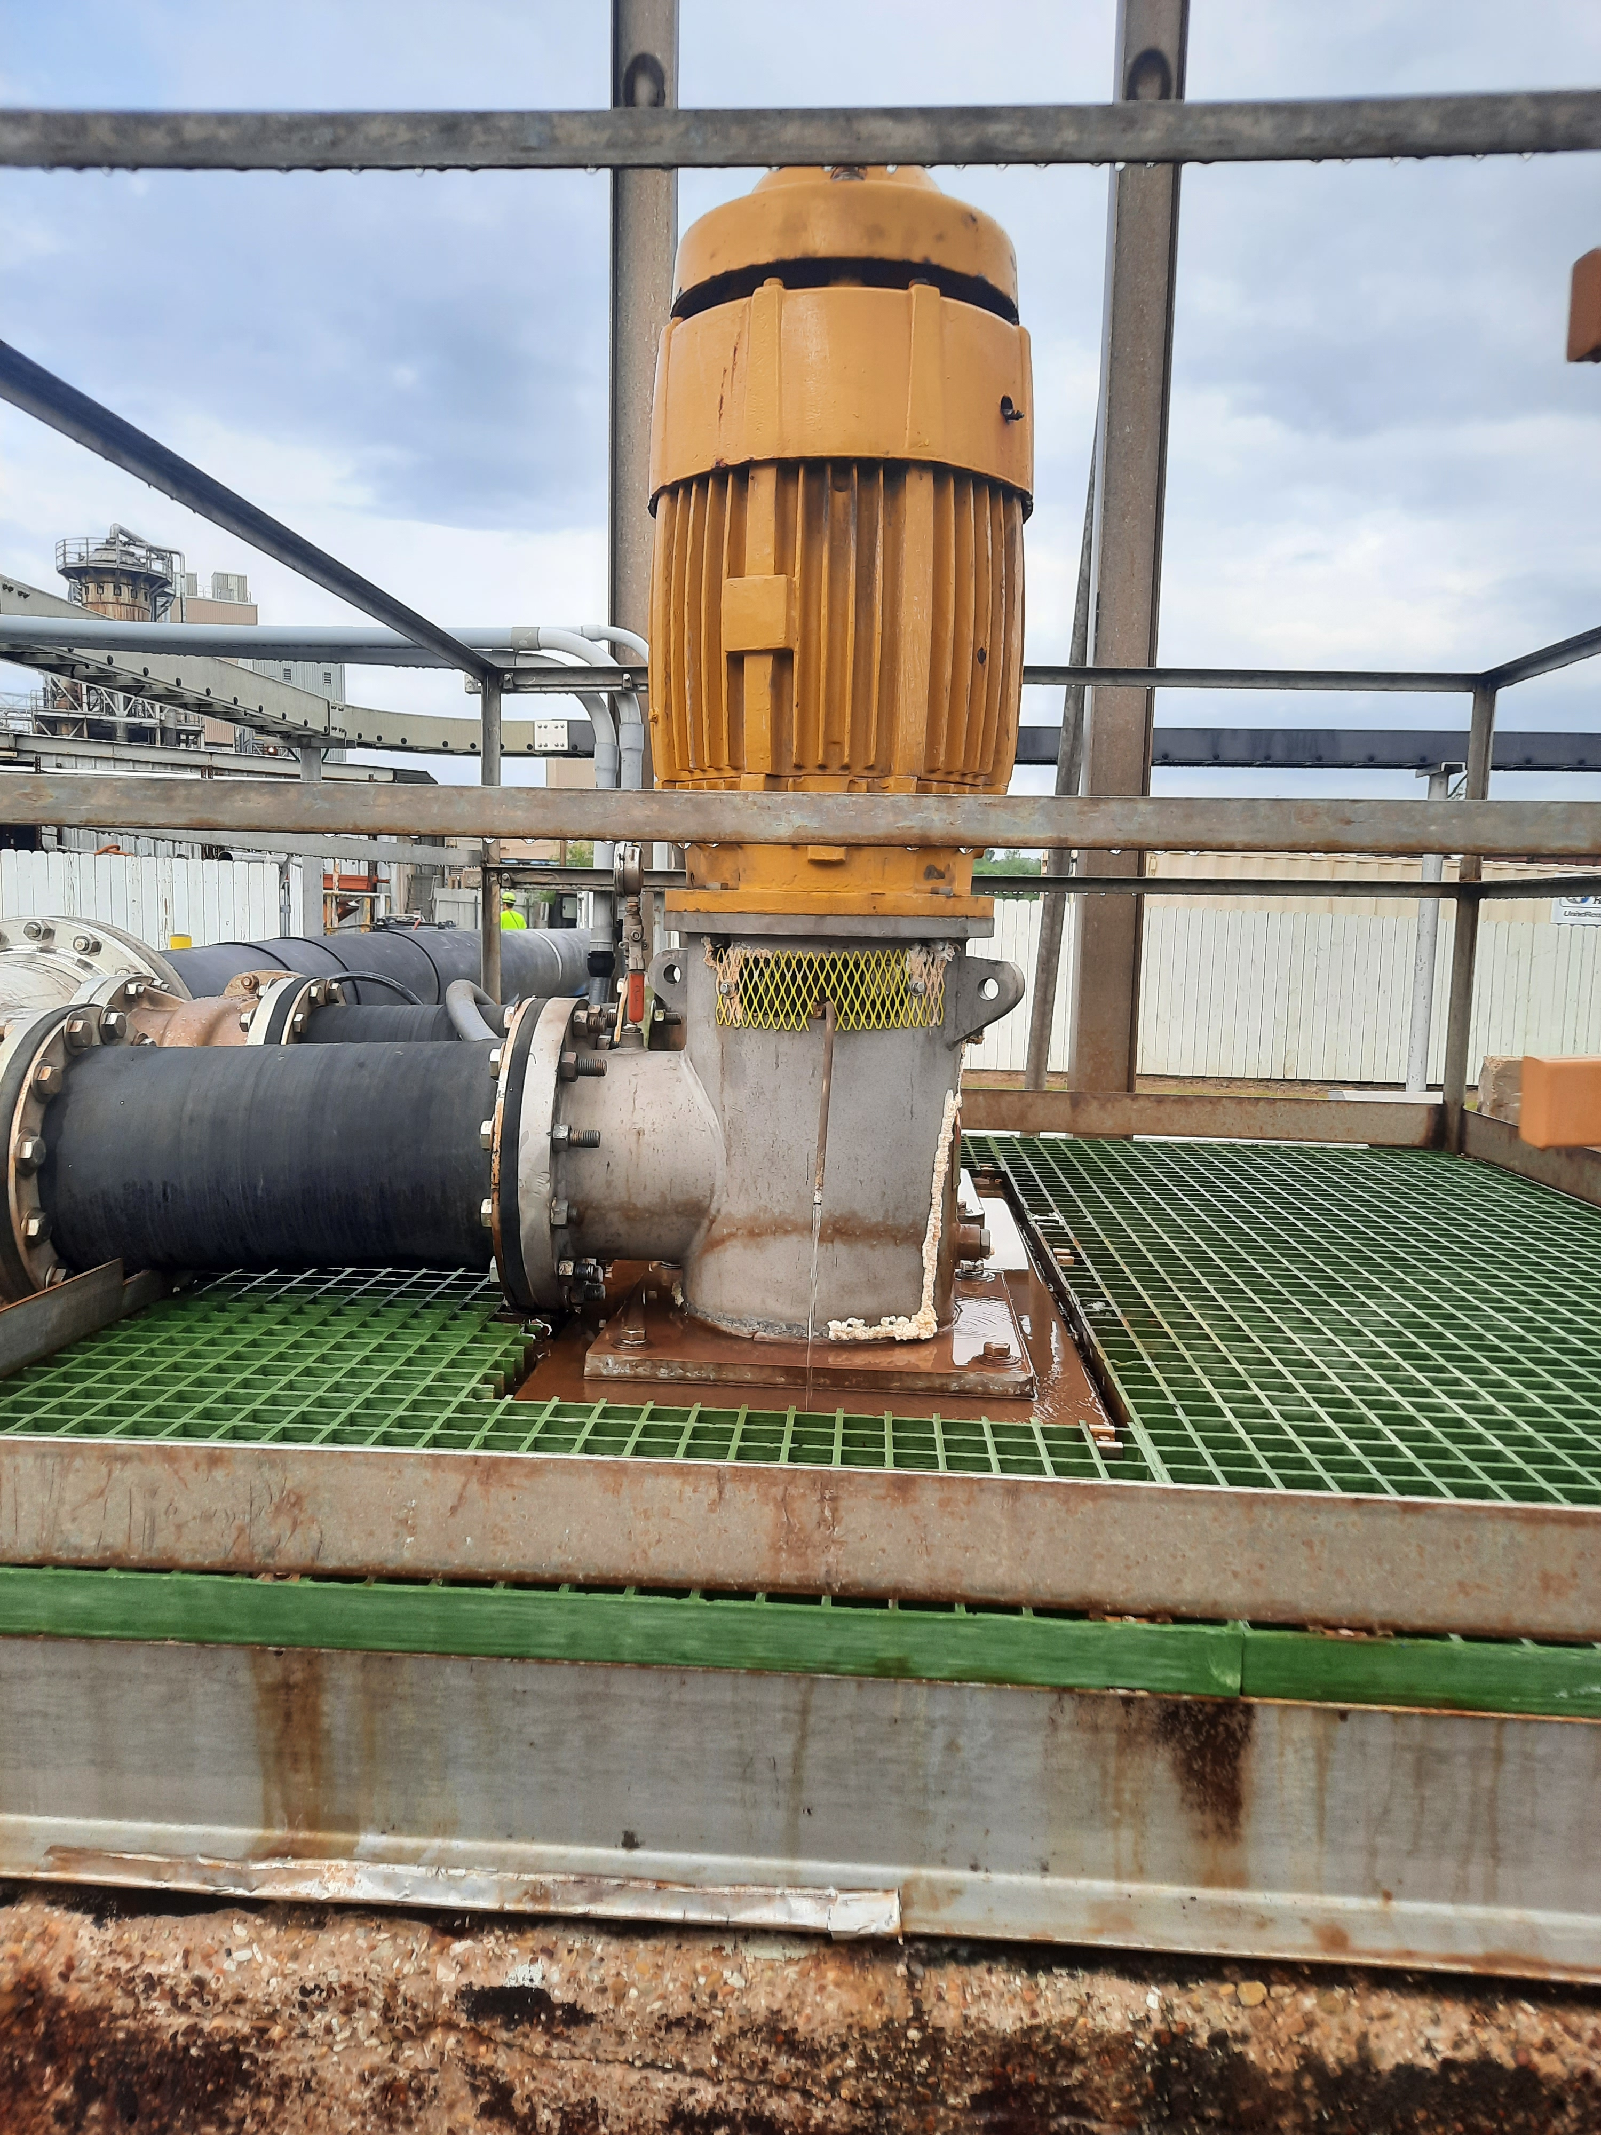
Risk of Failure
Every failure involves risk, but:
Not all failures have the same risk, and
Some failures are simply not worth preventing
Yep – some can be reactive or run to failure

Slide 9
Not all failures need to be prevented
where
P_{f} = Probability of failure
S_{f} = Severity of failure
Both severity and probability of
failure must be evaluated
objectively for best long-term
results.
“Risk” = P_{f} x S_{f}

Slide 10
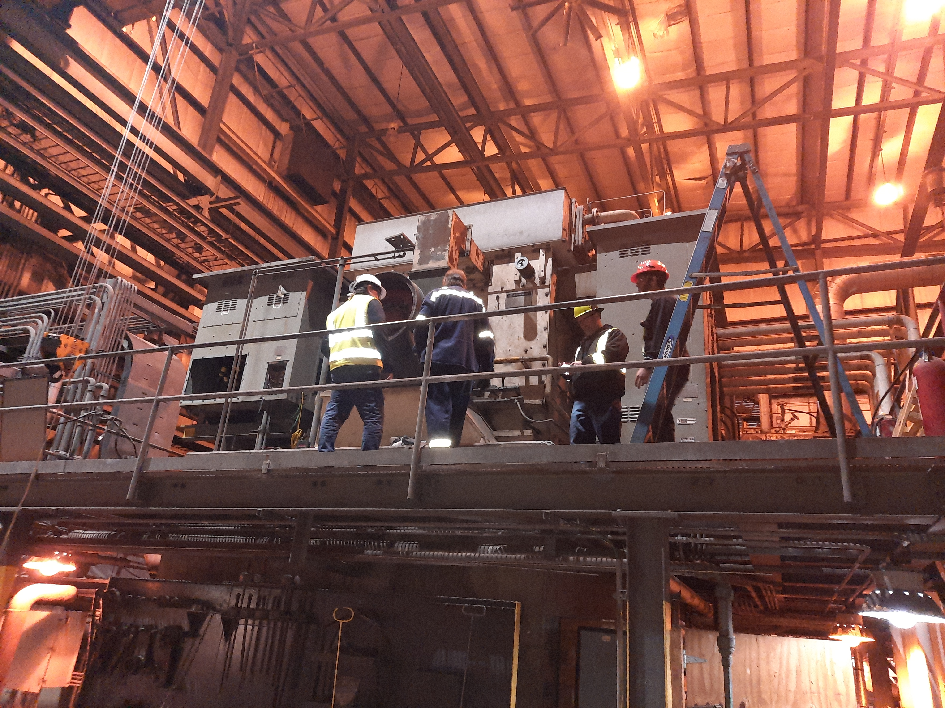
Maintenance Risk Management
A well-designed maintenance program uses the concept of risk to:
Assess the risk of failure on individual systems and equipment levels
Develop tasks to prevent failure on the basis of that risk assessment, and,
Allocate resources where they provide the greatest benefit.

Slide 11
Risk Assessment
Score | Probability (Frequency of Event) | Severity (Consequence of Event)
 |  | Safety | Mission | Economic
5 | Event will happen in normal operations | Any personnel safety consequence could result in death | Mission effectiveness is lost | No Score. Not equivalent to safety
4 | Event very likely to occur in time but not certain that occurance will happen in normal operations | May cause severe injury or severe occupational illness | Mission effectiveness is degraded | Repairs are required causing severe economic effects
3 | Event may occur in time | May cause minor injury or minor illness | No effect on mission but equipment failure causes system failure | Repairs may be required or deferred causing substantial economic effects
2 | Event can occur in normal operations but not likely | Probably would not effect personnel but still a violation of standards | No effect on mission but equipment failure causes system degradation | Repairs may be deferred causing limited effects
1 | Event should not occur in normal operations | No hazards will result from event occurring | No hazards will result from event occurring | No hazards will result from event occurring

Slide 12
Scorecard
5
5 | 10 | 15 | 20 | 25
4 | 8 | 12 | 16 | 20
3 | 6 | 9 | 12 | 15
2 | 4 | 6 | 8 | 10
1 | 2 | 3 | 4 | 5
Likelihood
Of Event
4
3
2
1
1
2
3
4
5
Consequence of Event
 | <4 | Trivial | Acceptable Risk: Change in frquency or to maintenance action is required
 | 4-6 | Low Risk | Change in frequency or modification of the maintenance action is preferred
 | 8-12 | Moderate Risk | Change in frequency or modification of the maintenance action is possible
 | 15-16 | Significant Risk | More detailed assessment required before changing frequency or maintenance action
 | >16 | Extreme Risk | Unacceptable risk. No change in frequency or maintenance action is acceptable

Slide 13
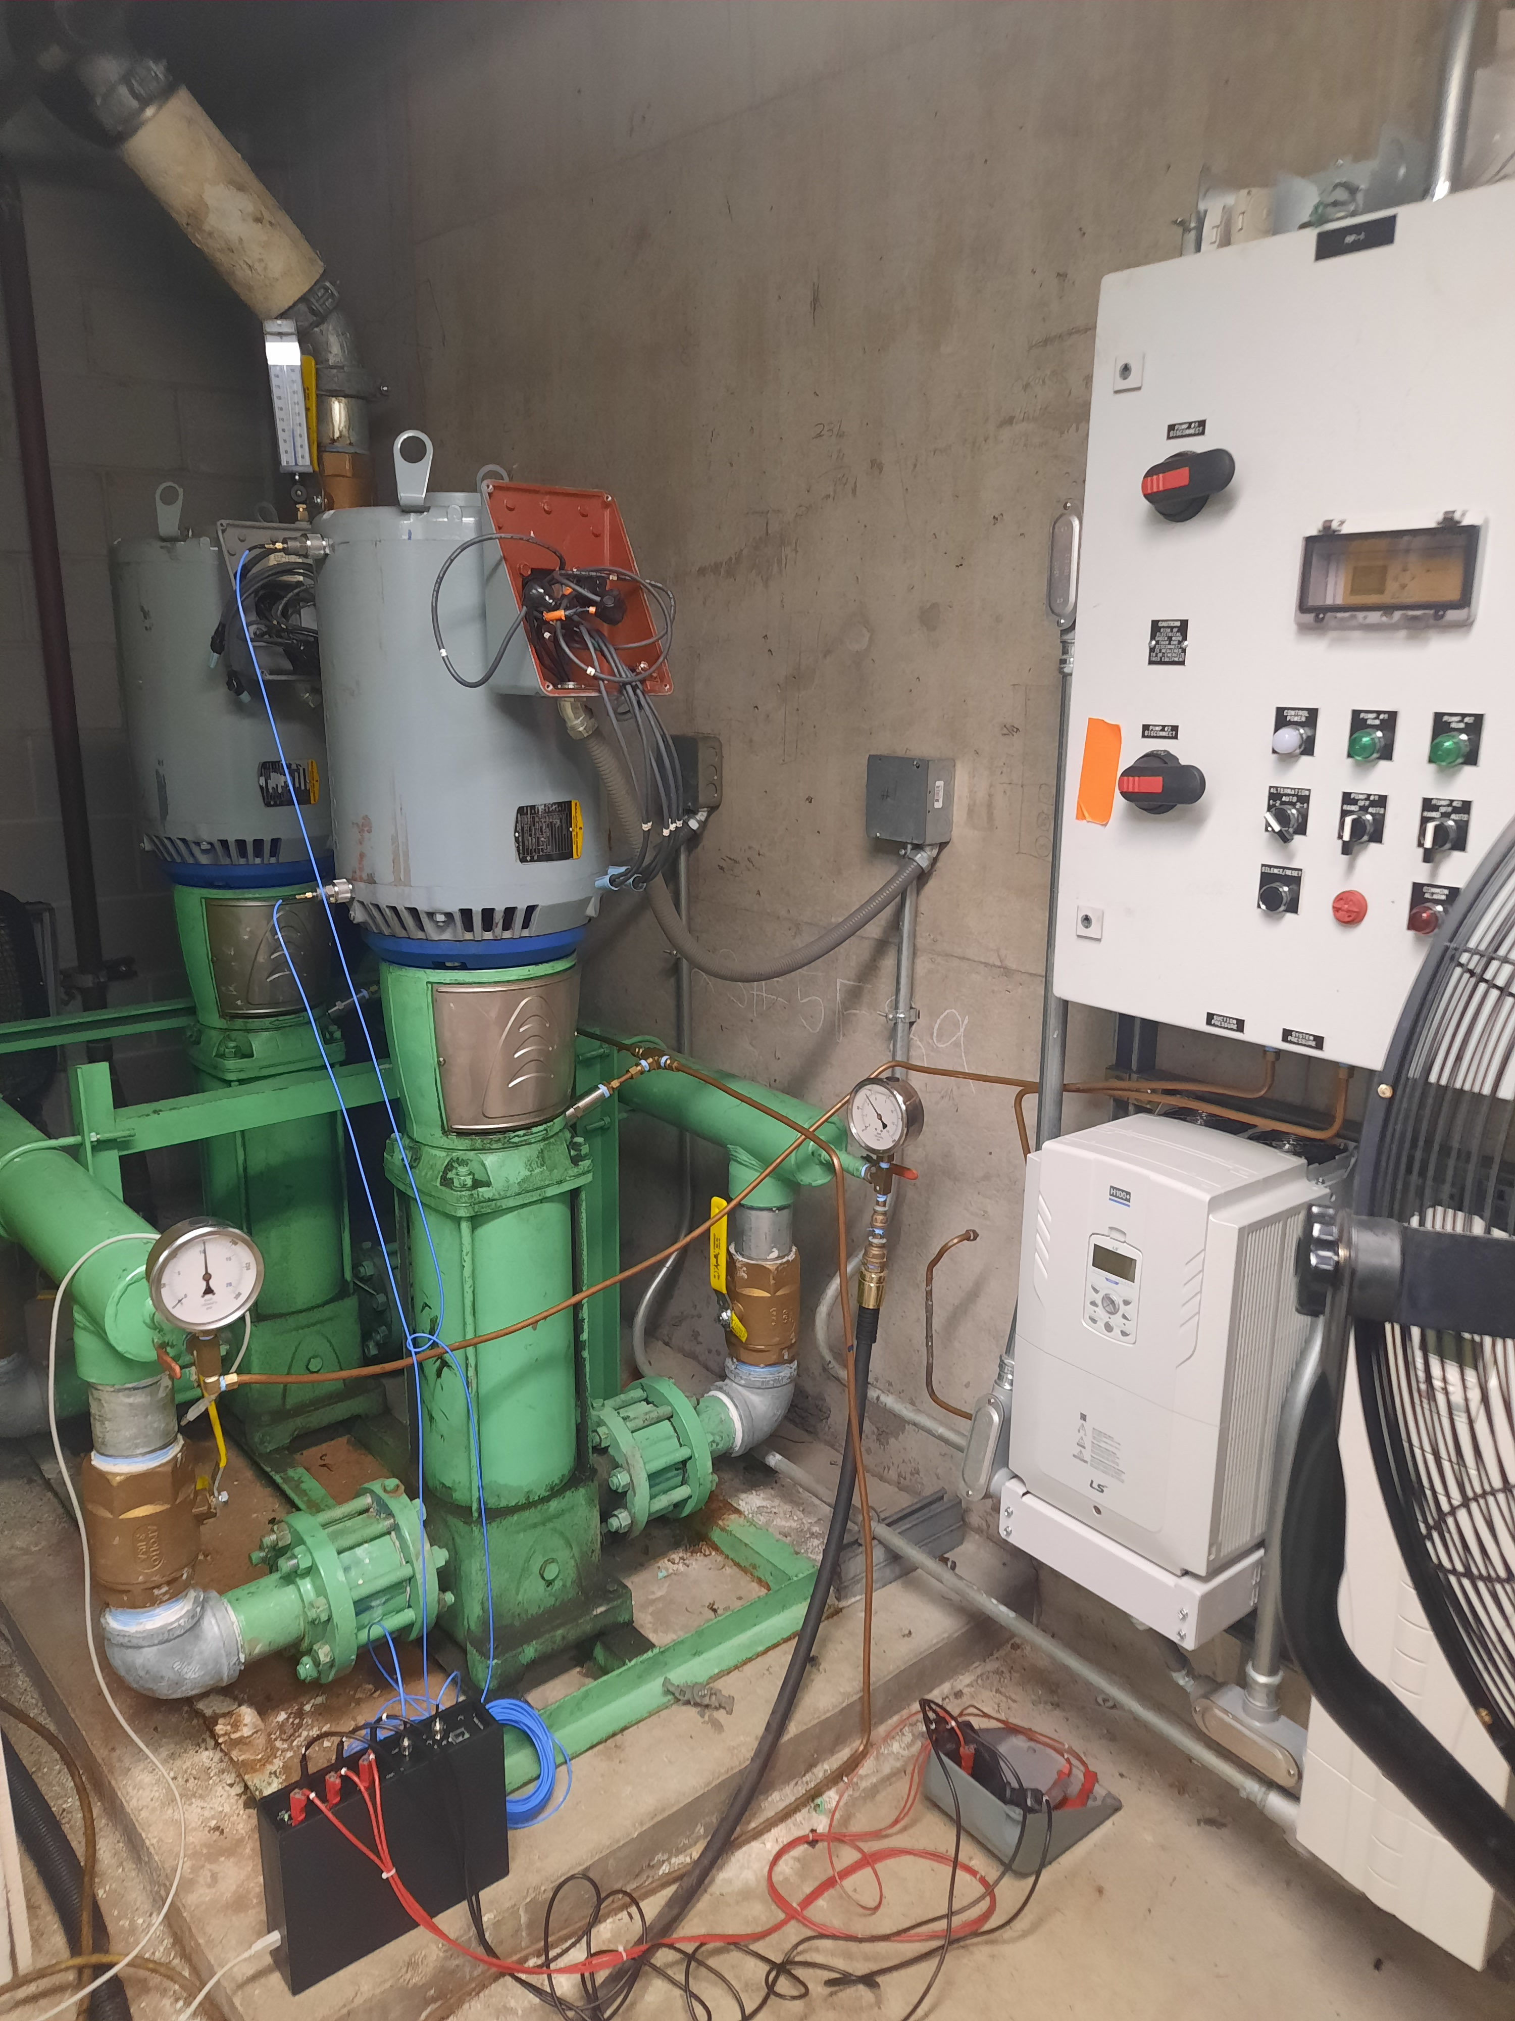
Three Maintenance Options
Restore lost or degraded functions by correcting unsatisfactory conditions (Corrective maintenance)
Minimize conditions that cause unacceptable degradation of functions (Preventive maintenance)
Eliminate a specific unsatisfactory condition by altering the design of the item (Alterative maintenance)

Slide 14
Dominant Failures
100
80
20% of all equipment
Accounts for 80% of all
Resources utilized.
60
Percent of Resources
40
20
0
100
200
300
400
500
600

Slide 15
Like Items Fail at Different Ages
Resistance
to Failure
( Rf )
A
Functional
Failure
B
Stress
_{B}
_{A}
0
1
2
3
4
5
6
7
8
9
10
11
12
13
Age (operating time, cycles, calendar time)

Slide 16
Condition-Directed Example (P-F Chart)
100%
A (New bearing installed)
•
•
B (Bearing temperature or vibration begins to increase)
•
P (Bearing vibration reaches alert threshold)
Resistance to failure
0%
•
F (Bearing fails)
Inspection Interval
ΔΤ
½(F-P)
Operating age (time T)

Slide 17
Maintenance Task Types
Task Condition Time Failure Servicing Lubrication
Directed Directed Finding
Action “Renew life” “Renew life” Determine Add/replenish Oil, grease
(restore or replace) (restore or replace) whether failure consumable or otherwise
based on measured regardless of has occurred. (e.g. windshield lubricate.
condition compared condition. washer fluid).
to standard.
Circumstance
Equipment Imminent Failure of off- Reduced level Accelerated
characteristic. wearout line or “hidden” of operating wear.
corresponds to function (e.g. consumable
failure mode. Safety/protective devices)
Typical Tasks
Diagnostic Test, Discard and Inspection, Top off fluid Lubricate
Material Condition replace with Functional
Inspection new item Tests

Slide 18
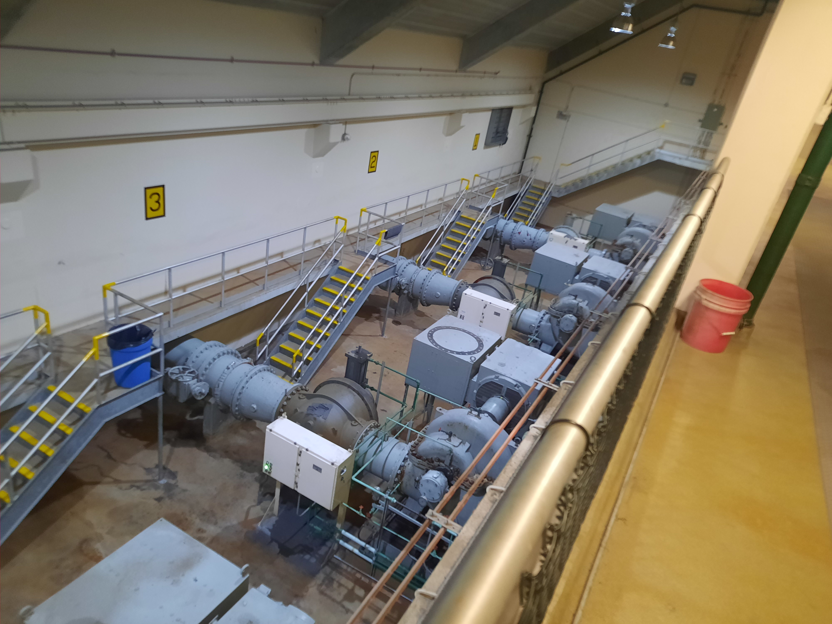
Maintenance Must Have Value to be Effective
Determining whether a task has value requires examining the failure consequences:
Safety
Production Capacity
Regulation
Everything Else
A task can be effective only if it reduces the risk of failure to an acceptable level. Other preventive tasks can be effective only if they are cost effective.

Slide 19
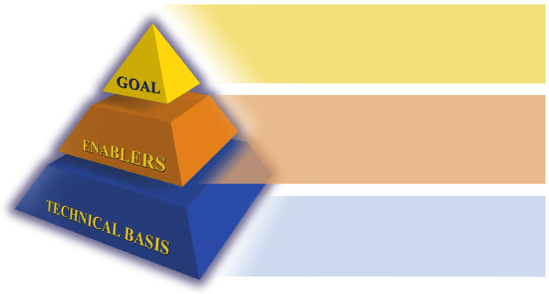
Purpose of Program
Improved Equipment Readiness and Optimized Maintenance
Visibility of material condition
Planning of future maintenance needs
Optimized and Effective Program!
Management Support
Classical RCM
Backfit RCM
Training
CBM Technologies
Personnel
Best Practices
RCM: Right Maintenance, Right Equipment , Right Time, for the Right Reasons

Slide 20
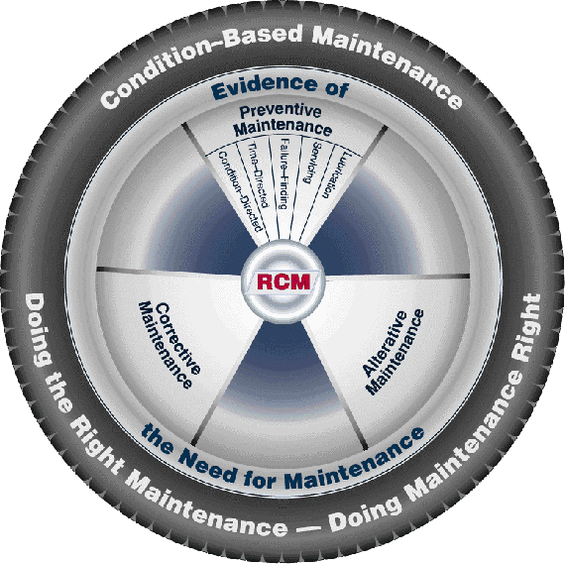
RCM is a Tactic for Development

Slide 21
Two RCM Processes
Initial PMS Development
(Classic Approach)
Interfaces
Risk Assessment
Risk Management
Age Exploration
Partitioning
FMEA
RCM Logic
Continuous Improvement
Failure Modes &
Effects Analysis
Requirement
Benefit
Task Value
Age Degradation
Applicability
Effectiveness
“Does Failure Mode Occur ?”
“Hardware Feels Better”
“Pays for Itself”
Maintenance Effectiveness Review (MER) - (“Backfit” Approach)

Slide 22
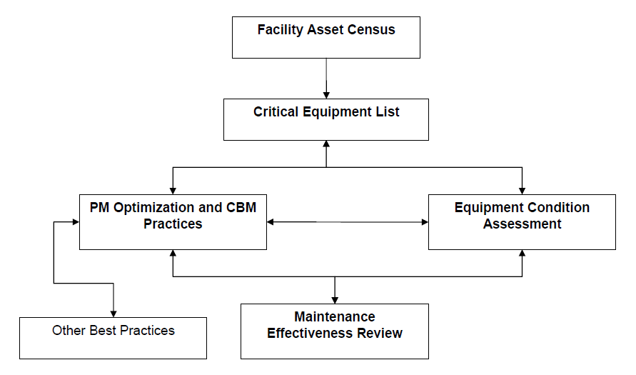
Asset Management Consideration

Slide 23
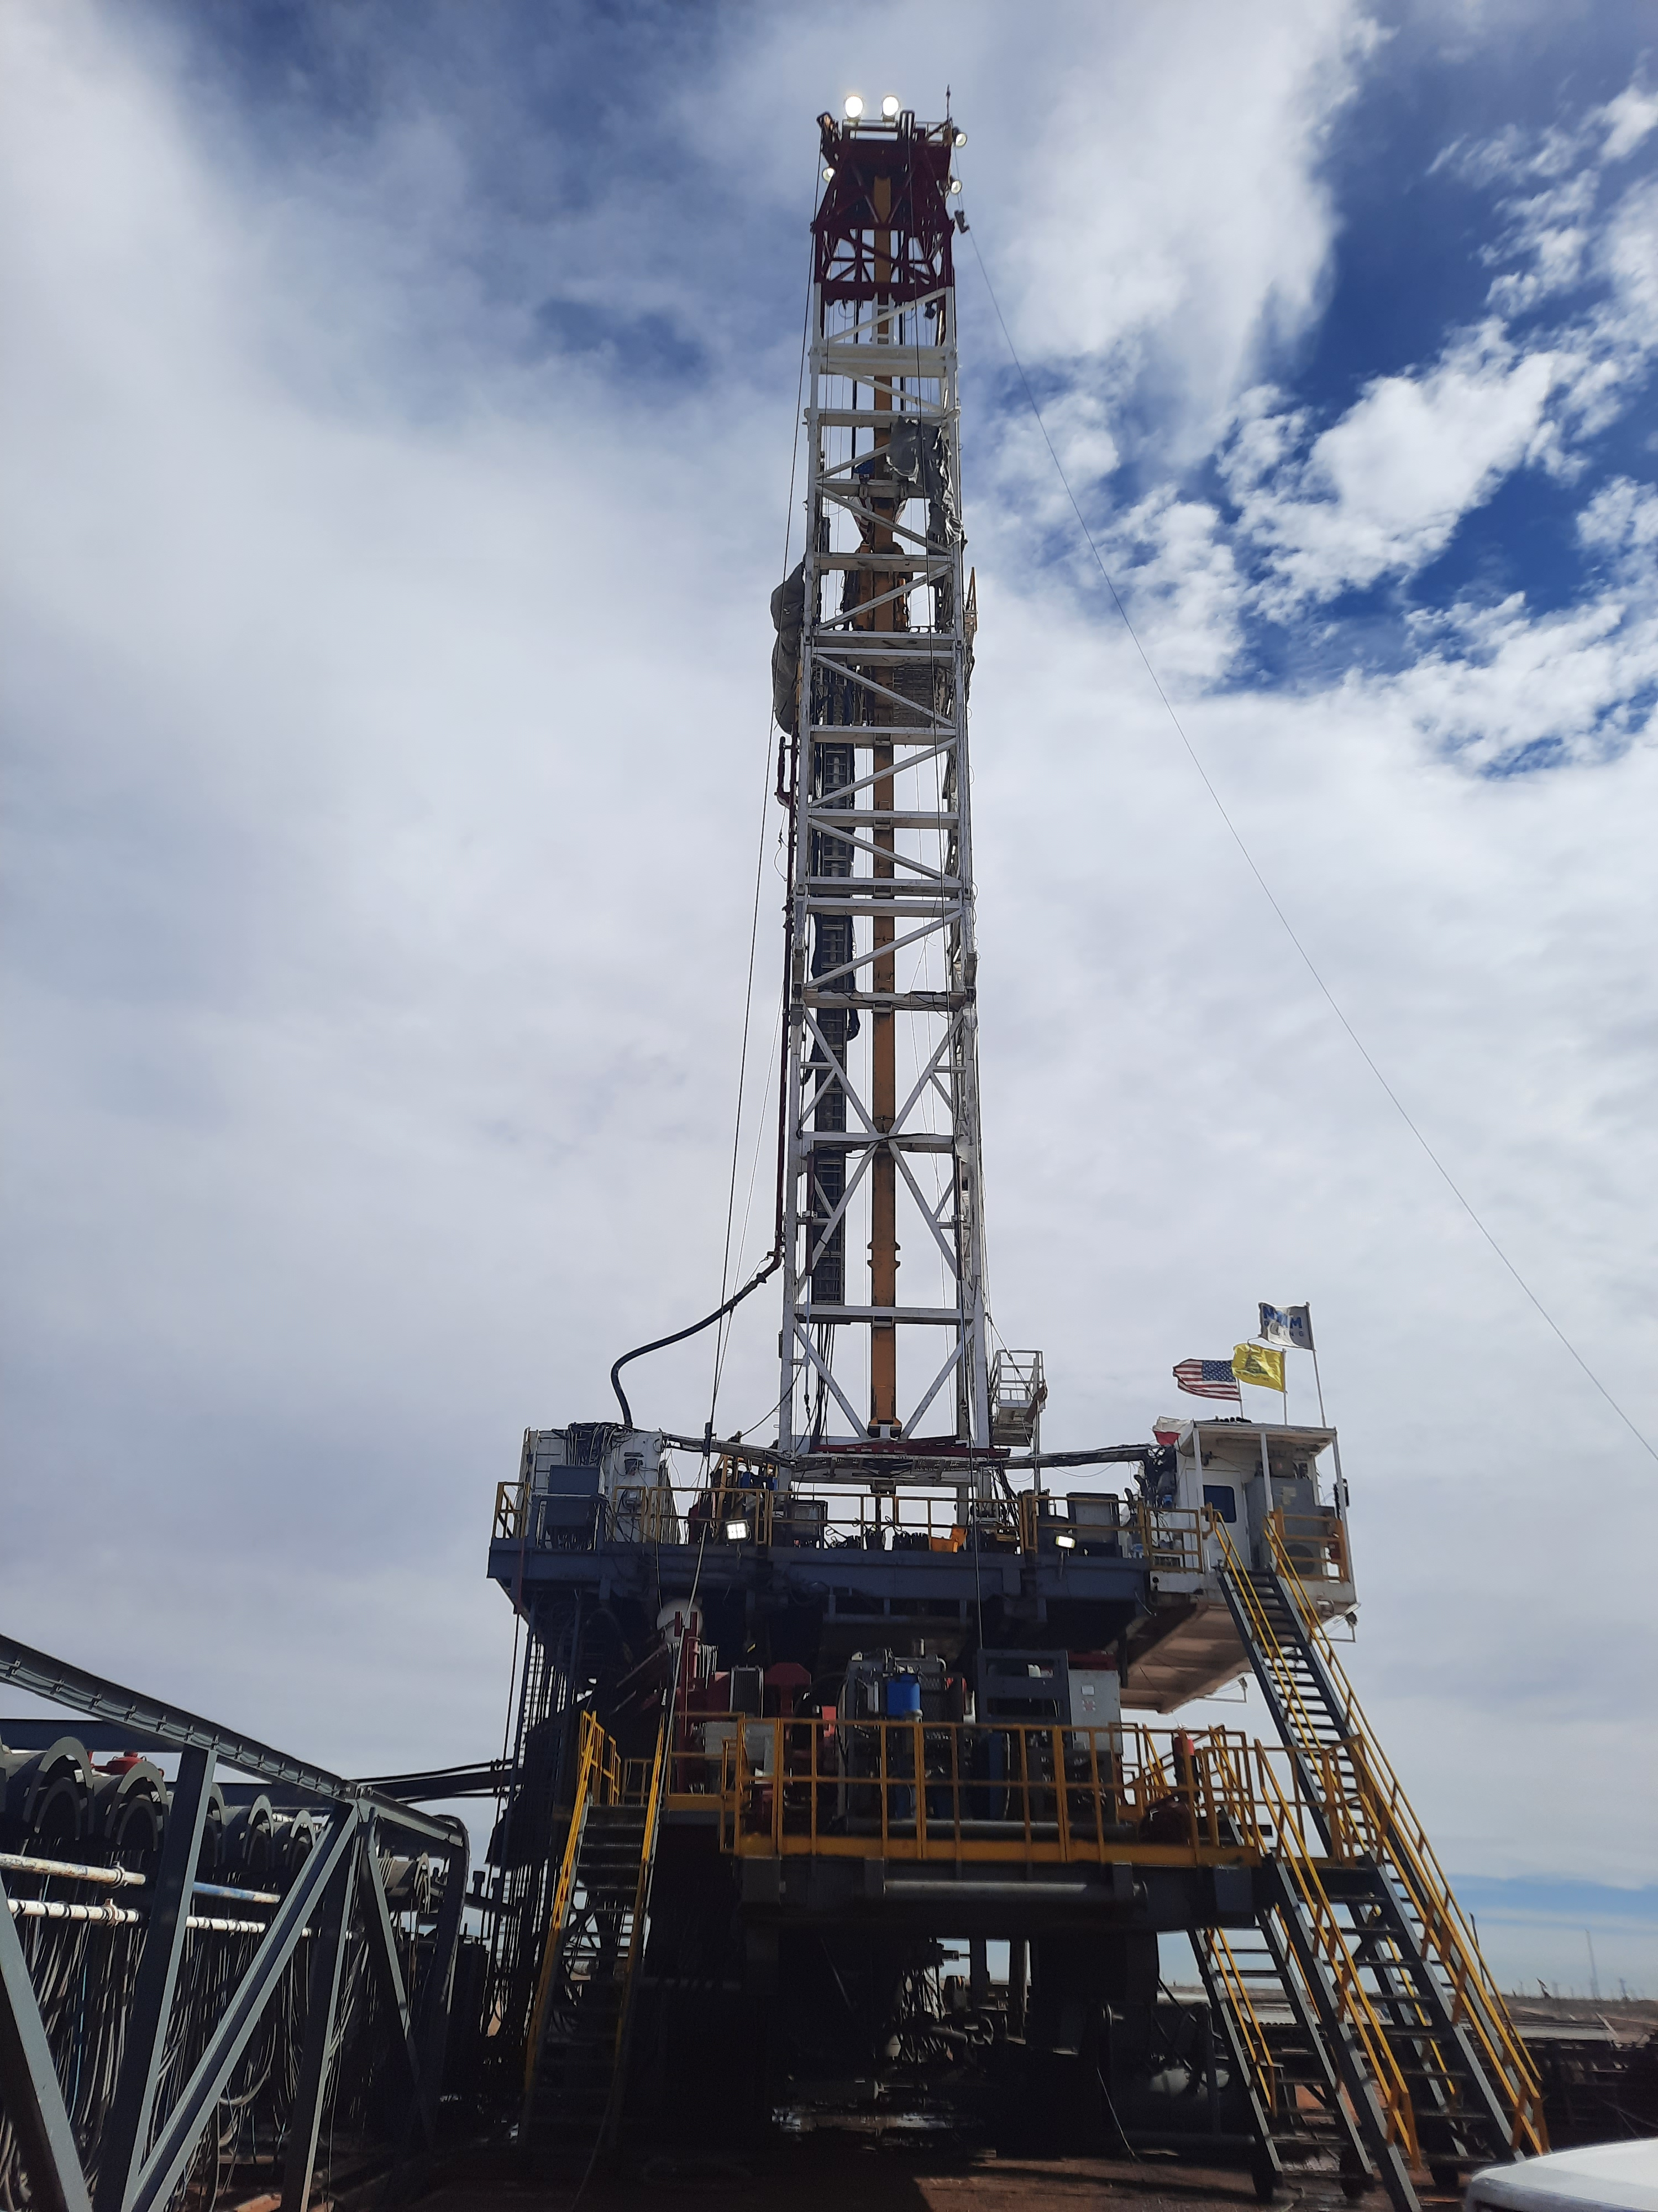
Program Development
Know your equipment – Equipment Census
Determine Criticality of Systems
Personnel Safety
Law/Regulation
Production
Expense to Repair/Replace
Other

Slide 24
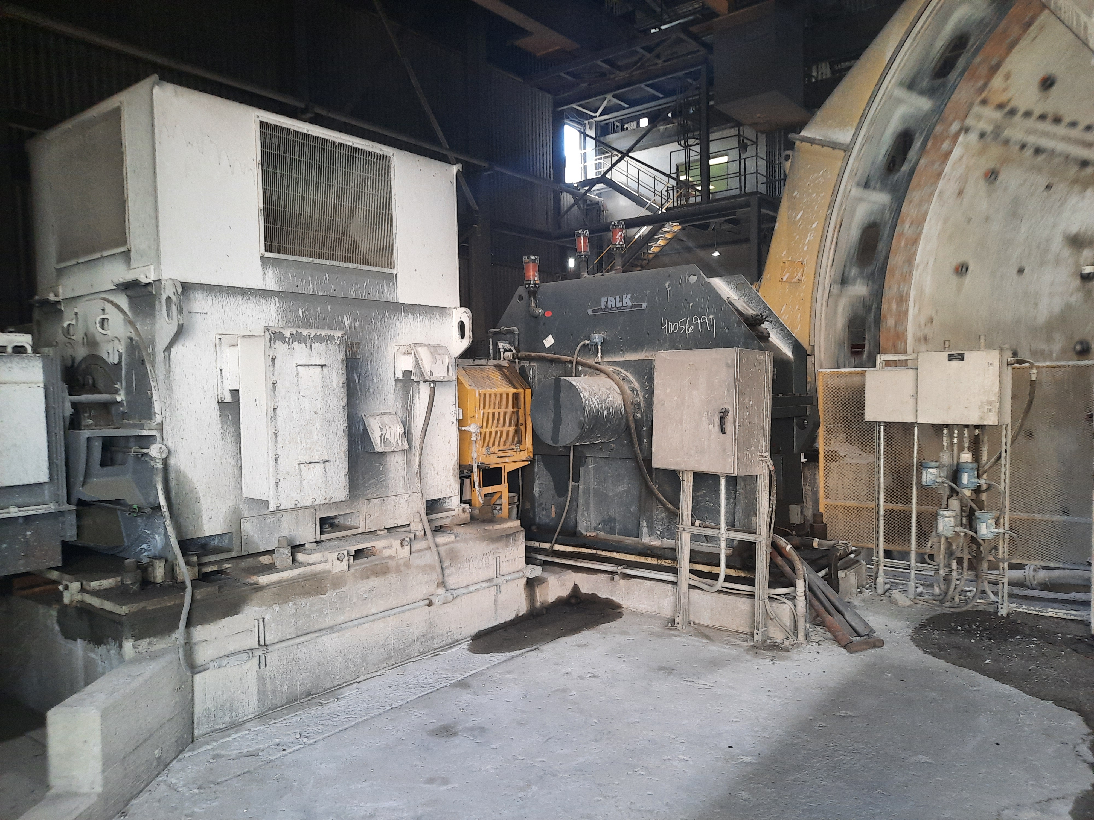
Program Development
Determine Existing Condition of Critical Equipment
Gap Analysis of Implementing Program
PM Optimization – Start by reducing obviously redundant or unnecessary PM’s

Slide 25
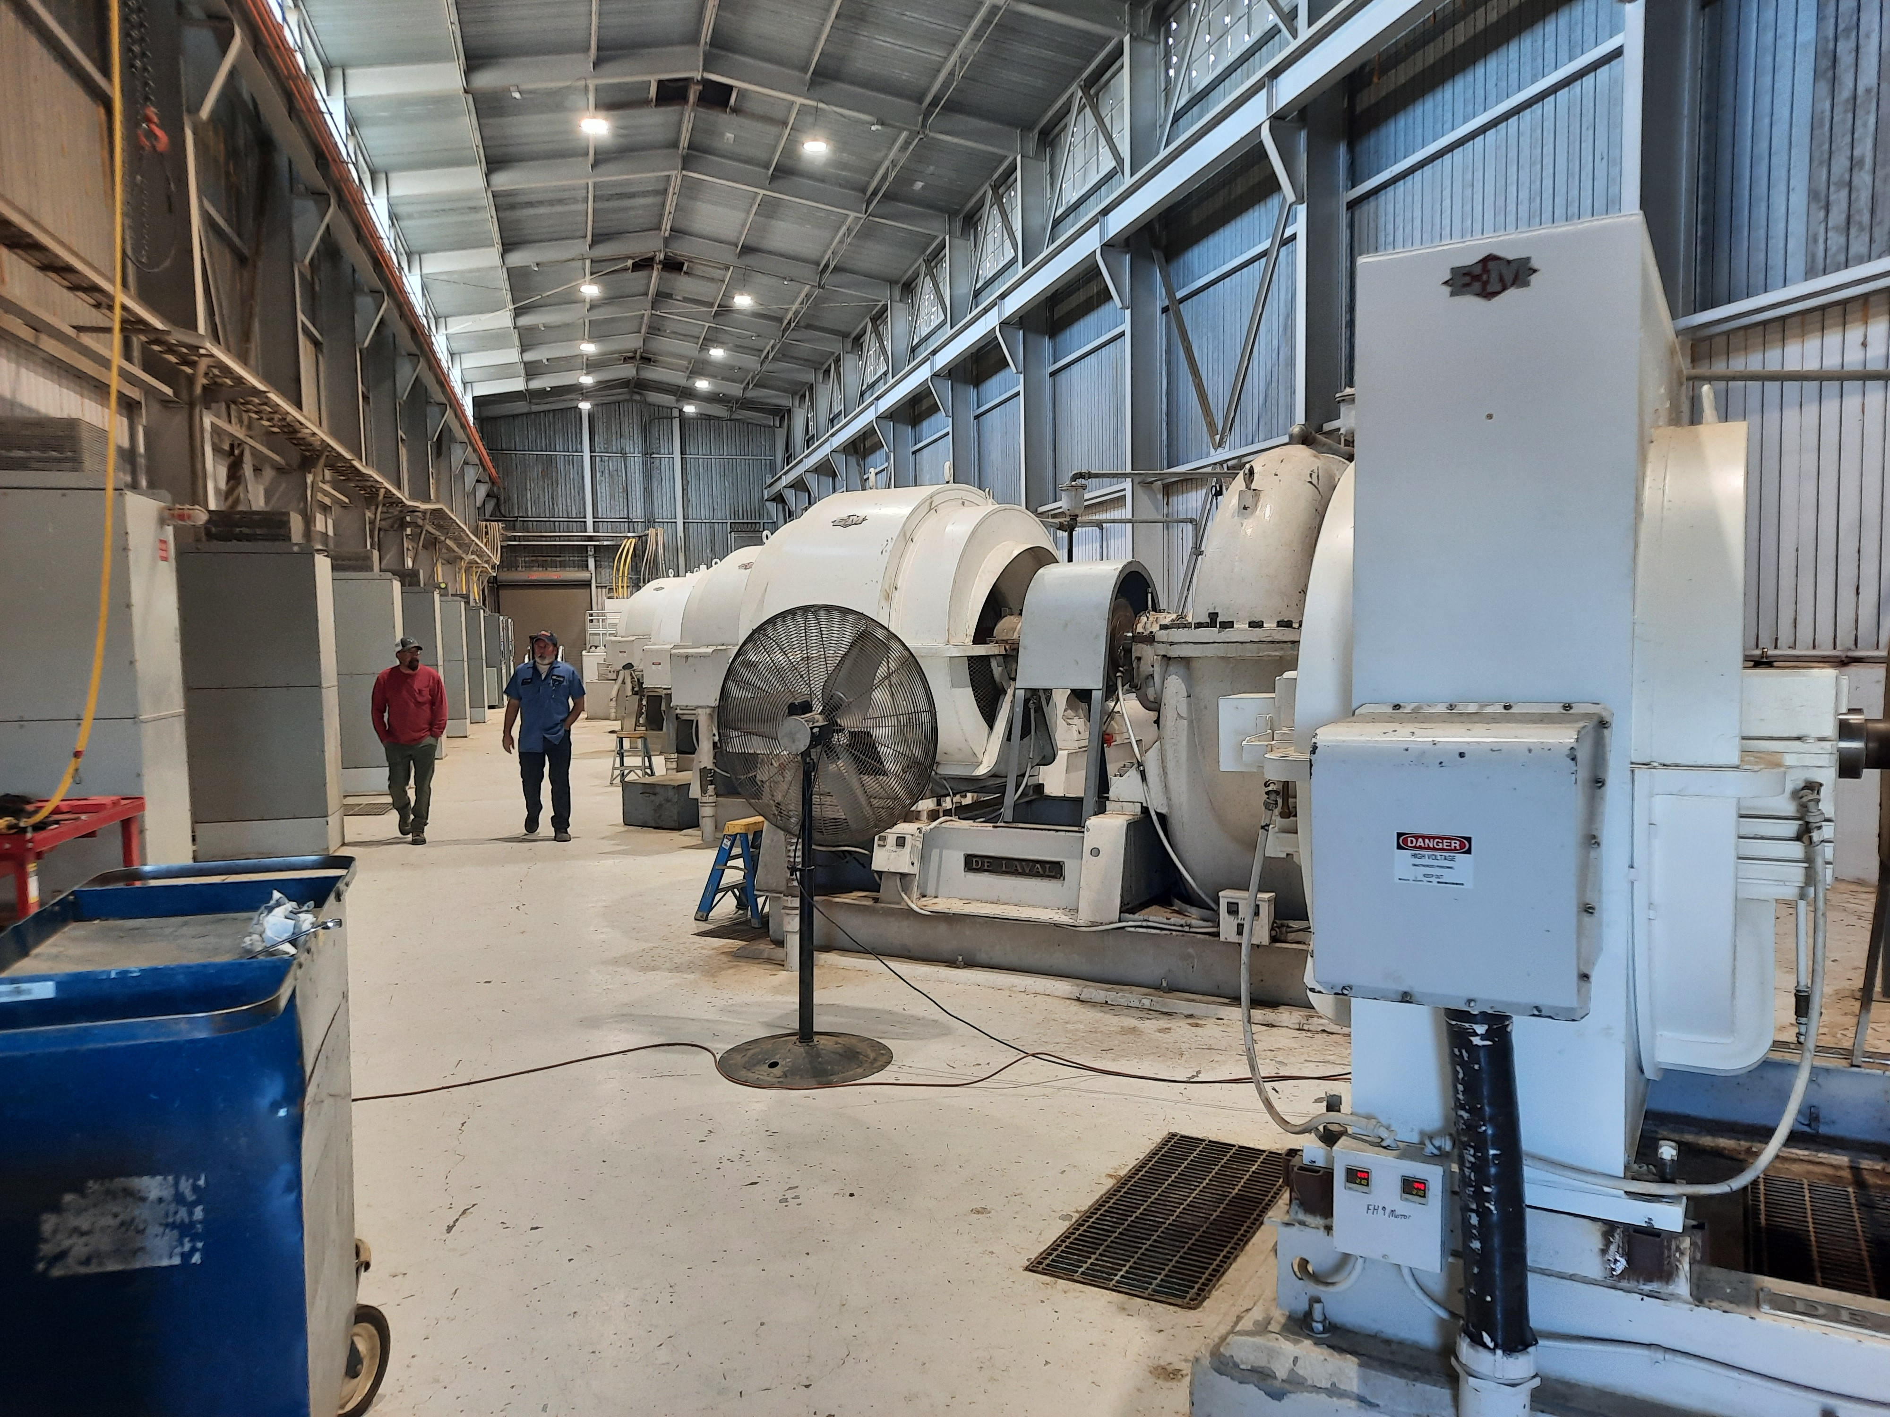
Program Development
Develop Maintenance Tactic (ie: RCM)
Understand the functions required
Understand what constitutes a functional failure
Understand the failure modes
Understand the failure effects
Understand the failure consequences and risk
What proactive tasks and intervals can detect or prevent
What can be done should a task not be identified.
Maintenance Effectiveness Review (Continuous Improvement)

Slide 26
RCM Questions
What are the functions and associated desired standards of performance of the asset in its present operating context (functions)?
In what ways can it fail to fulfill its functions (functional failures)?
What causes each functional failure (failure modes)?
What happens when each failure occurs (failure effects)?
In what way does each failure matter (failure consequences)?
What should be done to predict or prevent each failure (proactive tasks and task intervals)?
What should be done if a suitable proactive task cannot be found (default action)?

Slide 27

The Process
Perspective: view of the system function depend on perspective
Establish boundaries:
Interfaces (in and out)
Components within boundary
Parameters that measure performance of the functions and what values deliver satisfactory reliability and performance MUST be known and identified.

Slide 28

Failure Modes and Effects Analysis
What failures interrupt equipment function?
What are the effects of those failures?
Functional Failure: When a system or subsystem ceases to provide a required function; whether that function is active, passive, evident, or hidden.
Failure Mode: The specific condition causing a functional failure (often best described as the condition after failure). This can include shorted winding, failed bearings, or other condition.
Failure Cause: the condition that precipitates the failure mode:
Grit or water in machinery lubrication oil
Improper bearing clearances
Excessive cycles
What maintenance is intended to prevent.

Slide 29
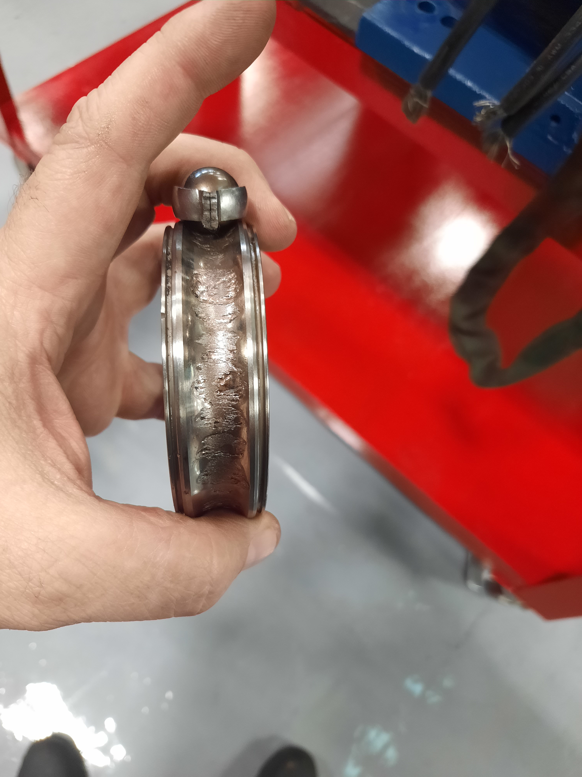
FMEA Continued
Failure Effects: The consequence of a failure mode. Examining the effects of each failure assists in determining the importance of preventing that specific failure and failure mode.
Examine Failure Effects at 3 Levels:
Locally where the failure mode occurs
At the subsystem or system level
The end effect

Slide 30
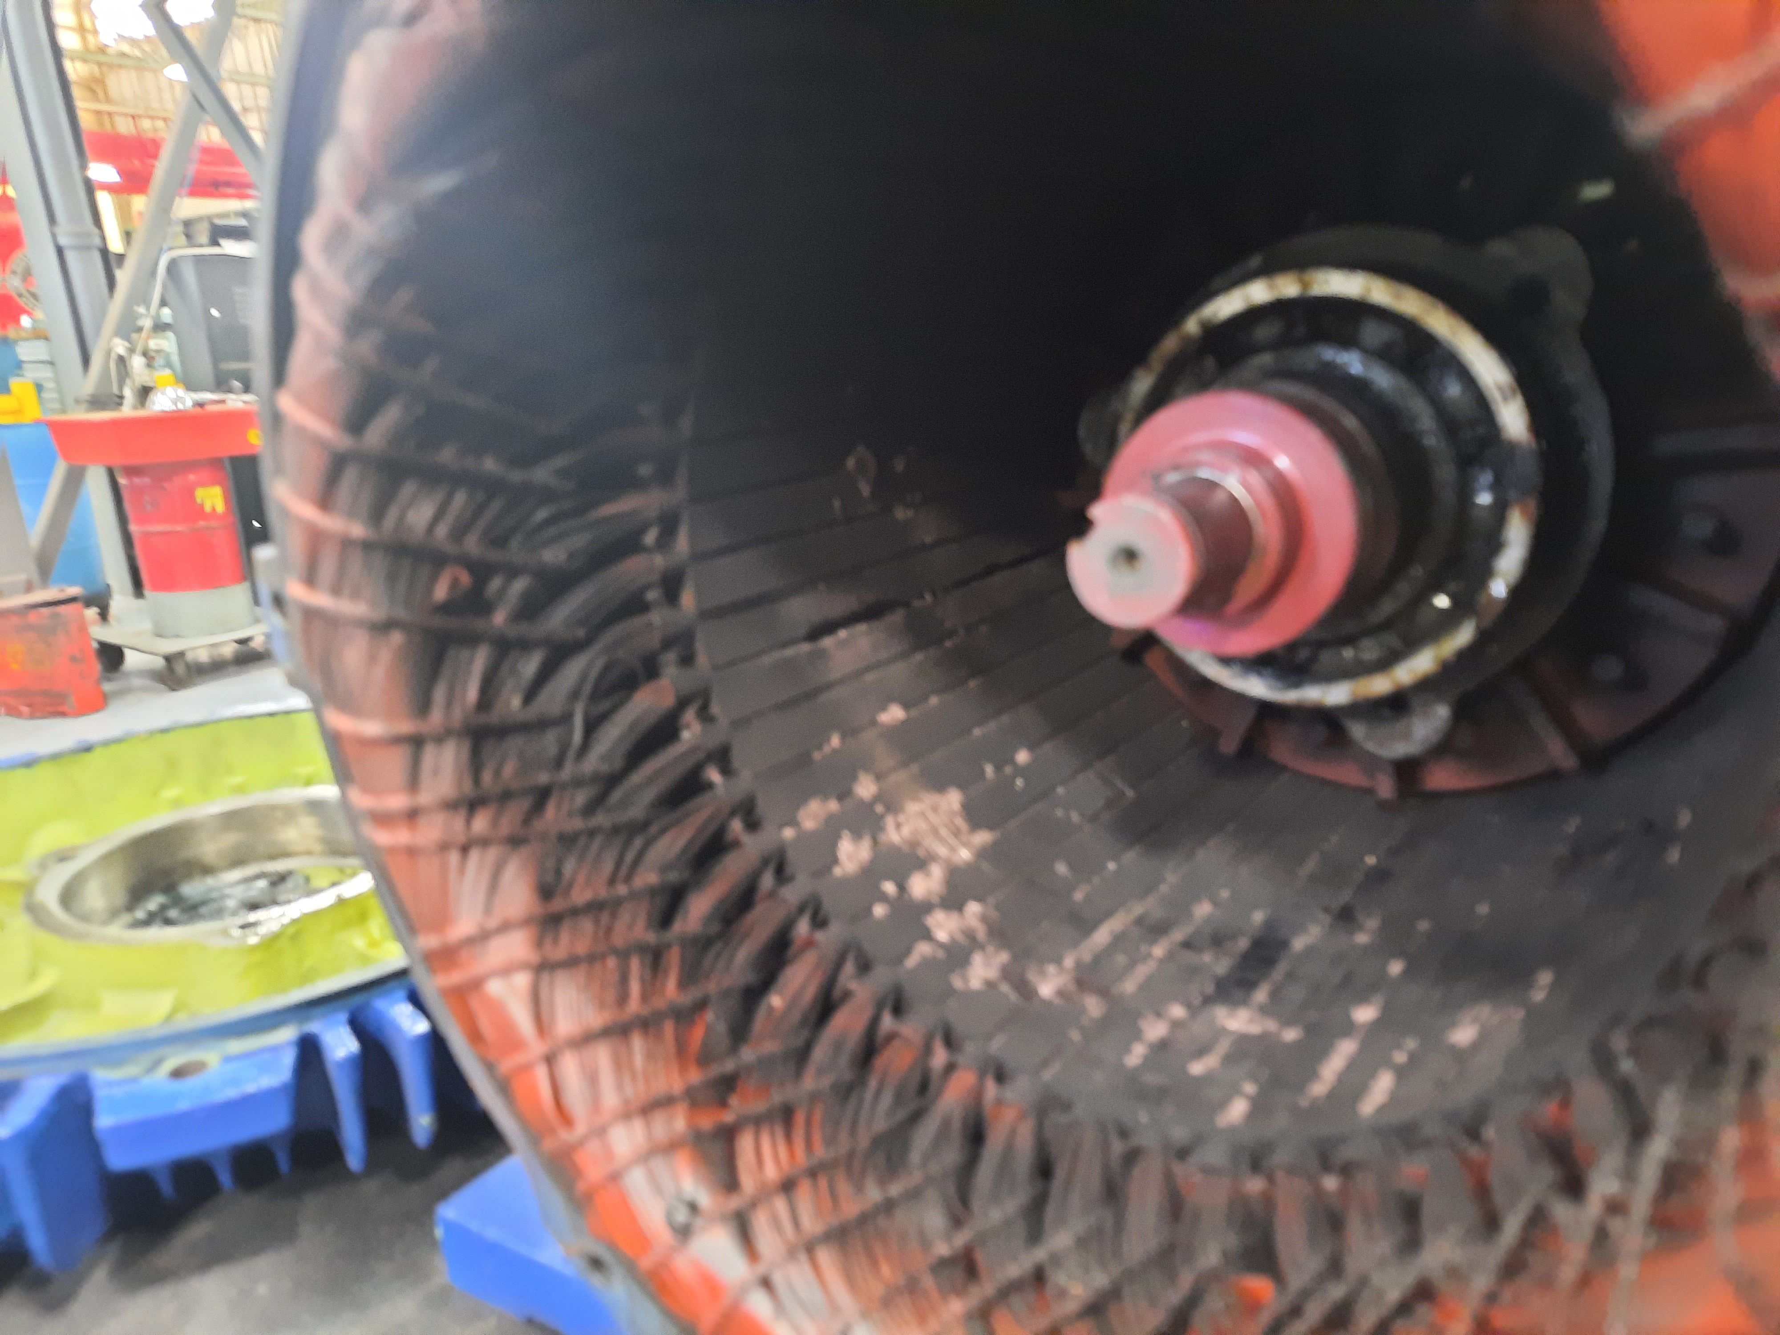
Failure Consequences
Safety – what are the safety impacts from the failure, if any. This solely refers to threats to life and limb of people – not equipment damage that does not threaten people.
Production/Mission – how does the failure impact production or mission?
Regulatory – what are the regulatory impacts such as emissions, etc.?
All Others – any defined as important – such as important to management, etc.

Slide 31
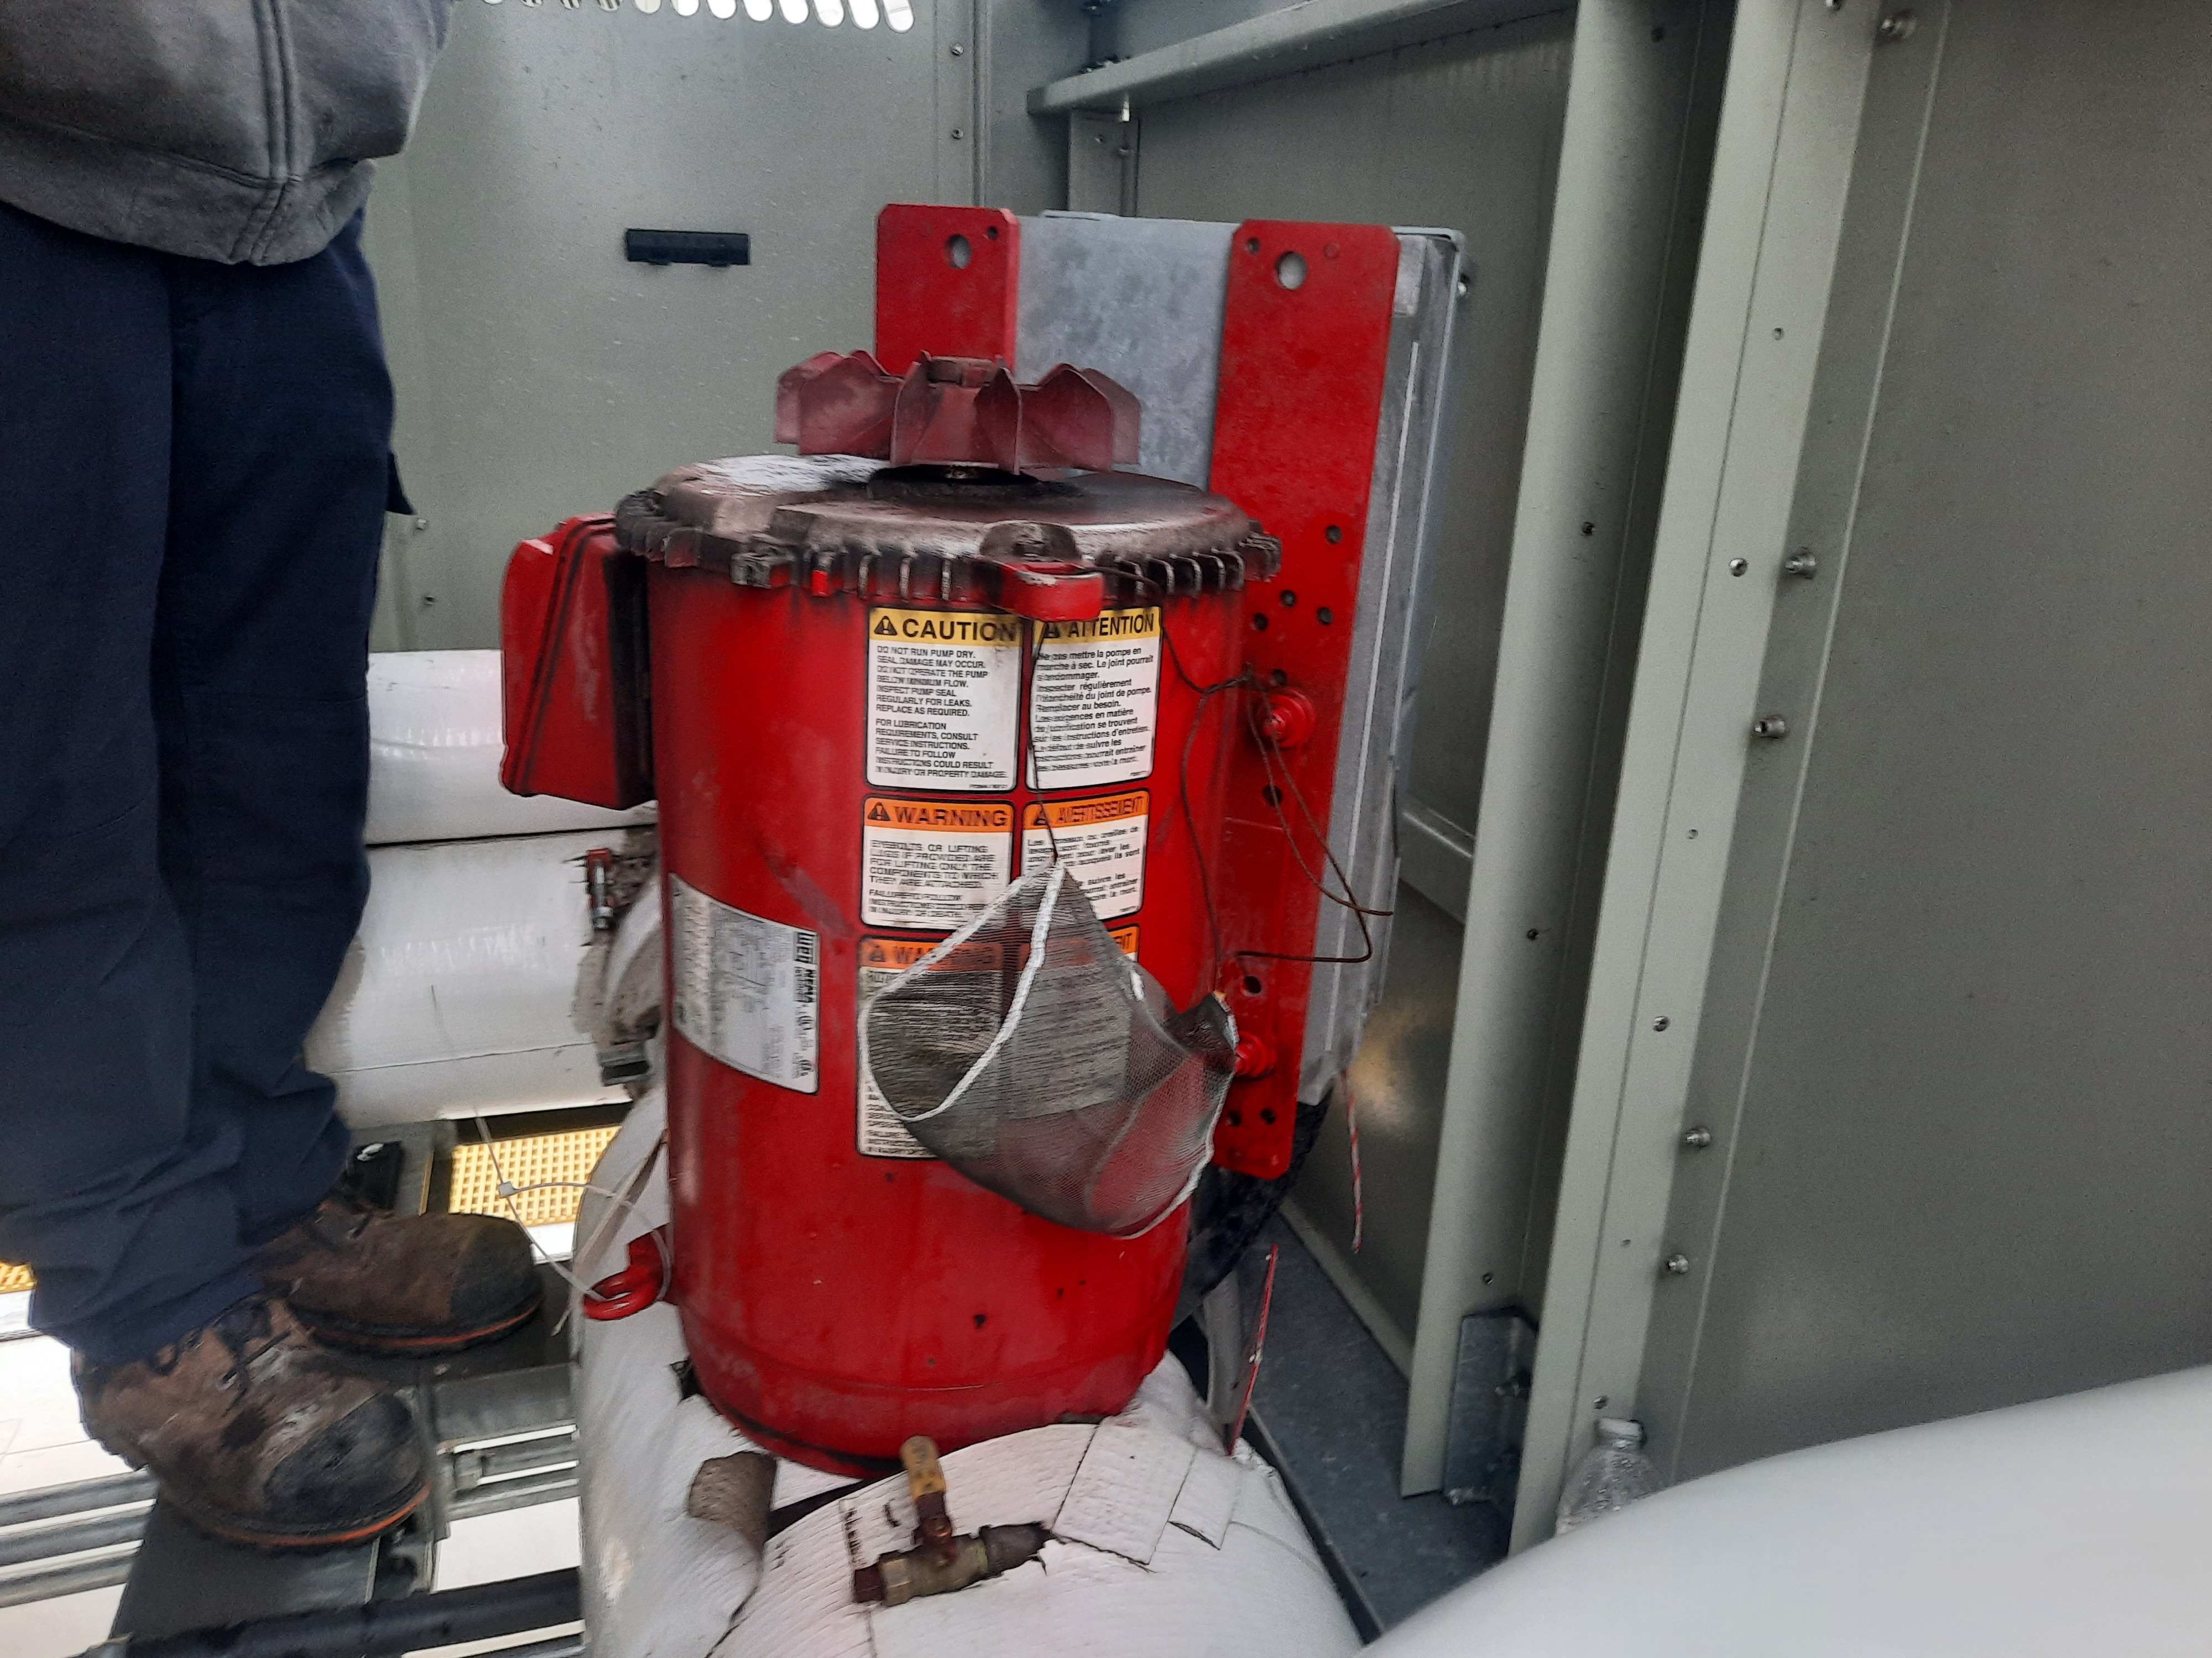
Consequences - Actions
Safety or Regulatory: to minimize, reduce the failure probability to an acceptable level regardless of cost (no cost influence).
Operational/Mission: reduce the risk of failure to an acceptable level. Reduce either severity or probability of failure.
All Others: the cost of performing the maintenance must be less than the cost of repair plus the cost of lost capability.
COST does not always refer to $$

Slide 32
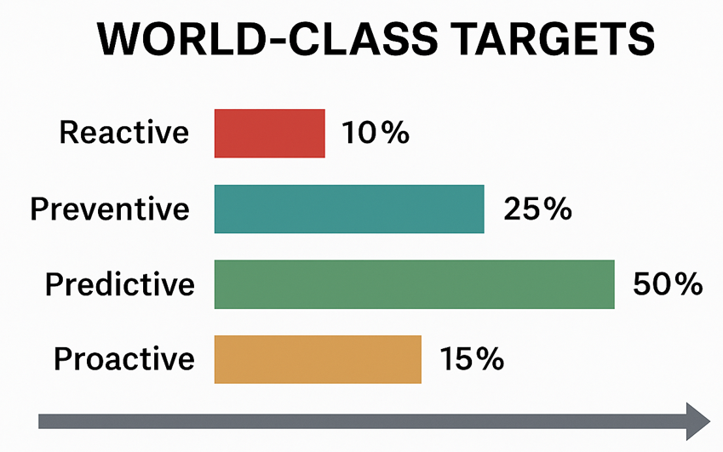
Goal (FEMP – Fed Facilities)

Slide 33
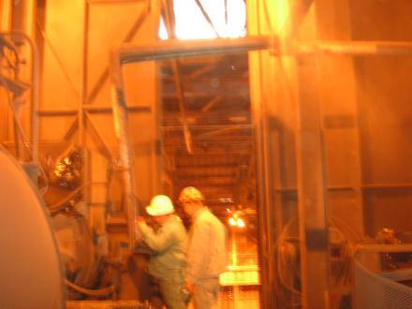
Time to Failure Estimation
Concepts Can Be Applied to Any Equipment
The Redundant Machine Myth
Using the P-F Curve To Select Best Analysis and Inspection Options
Risk of Failure, Estimation and Impact

Slide 34
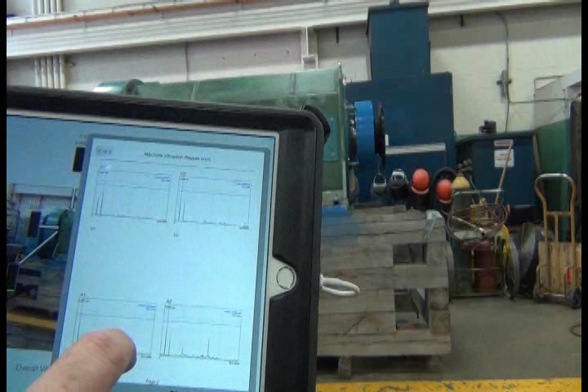
The Redundancy Myth
I do not have to maintain the system because it has redundancies (or a backup).

Slide 35
MTBF & Failure Rate
Example: 2 x 20 HP motor, 1750 RPM, and pump
In 40,000 hours of operation, each motor fails 3 times
MTBF = 40,000/3 = 13,333 hours
λ = 1/13,333 = 7.5 x 10⁻⁵
MTBF = Time/Failures
MTTR = Time/Repair
Failure Rate (λ) = 1/MTBF
Repair Rate (λ) = 1/MTTR

Slide 36

The Reliability Function
‘Probability of Survival’ for each
motor based on operating time.

Slide 37


Series and Parallel Reliability
Series Reliability
Parallel Reliability
2 Identical Systems
n Identical Systems

Slide 38
Redundant (Parallel) Systems
@ 13,000 hrs
One Motor = 40%
Two Motors = 63%
Three Motors = 79%

Slide 39
Review of P-F Curve (Reminder)
100%
A (New bearing installed)
•
•
B (Bearing temperature or vibration begins to increase)
•
P (Bearing vibration reaches alert threshold)
Resistance to failure
0%
•
F (Bearing risk of failure too high)
Inspection Interval
ΔΤ
½(F-P)
Operating age (time T)

Slide 40

Simple Method (Reliability Function)
ESA Detects A Bearing Fault.
Experience shows that the MTTR is normally 5 weeks of 24/7 operation before the bearings seize. A modified reliability function can be used to estimate the chance of survival. The analyst determines that the bearing stands about a 75% (D) chance of operating at the time of test based upon the severity of the fault. The MTTR from this point is 840 hours.
Experience for estimation is required!!
~30% survival at 840 hours

Slide 41
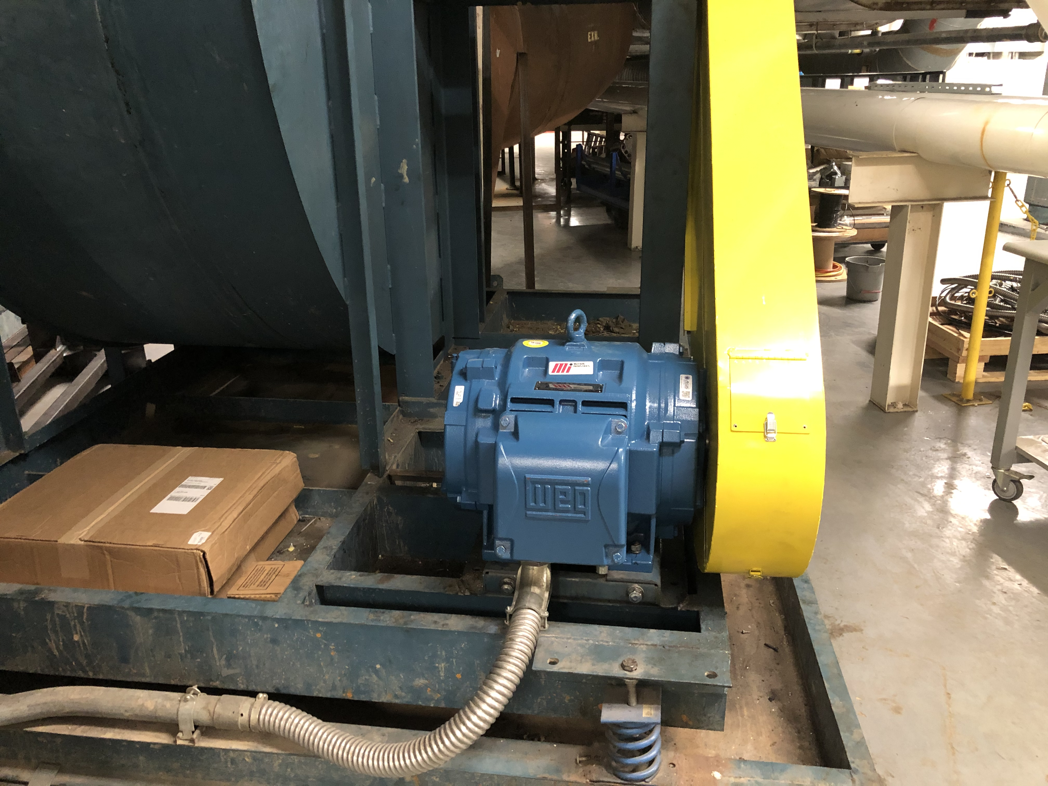
Example of Selection (Fan System)
Distribution System
Transformer Connections
Bus Connections
MCC
Connections
Contacts
Motor
Bearings
Winding Shorts
Couplings
Worn Sheaves
Worn Belts
Tension & Alignment
Fan
Bearings

Slide 42
Evaluation
System | Problems | Tech/Inspect | P-F Average
Distribution | Transformer Connections and Bus Connections | Infrared | 6 Months
MCC | Connections | Infrared | 6 Months
 | Contacts | Inspection | 6 Months
 |  | Voltage Drop | 3 Months
Motor | Bearings | Vibration | 3 Months
 |  | ESA | 1.5 Months
 | Winding Shorts | MCA | 3 Months
Coupling | Worn Sheaves, Belts and/or Tension/Alignment | Vibration | 3 Months
 |  | ESA | 2 Months
 |  | Inspection | 3 Months
Fan | Bearings | Vibration | 3 Months

Slide 43
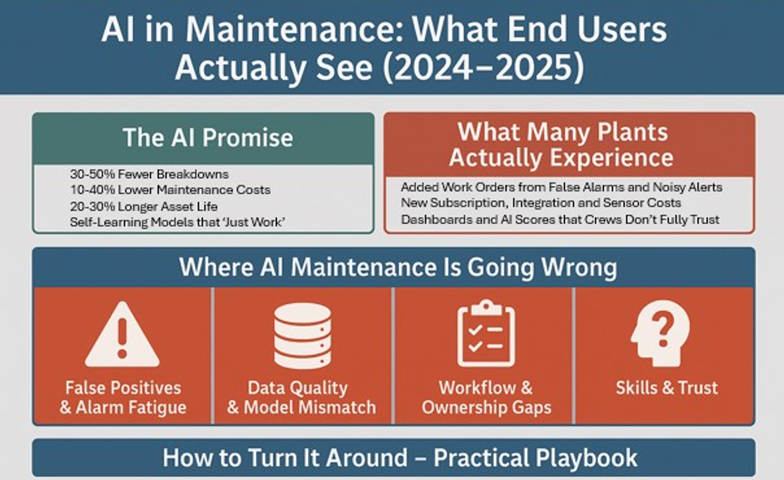
Additional Considerations

Slide 44
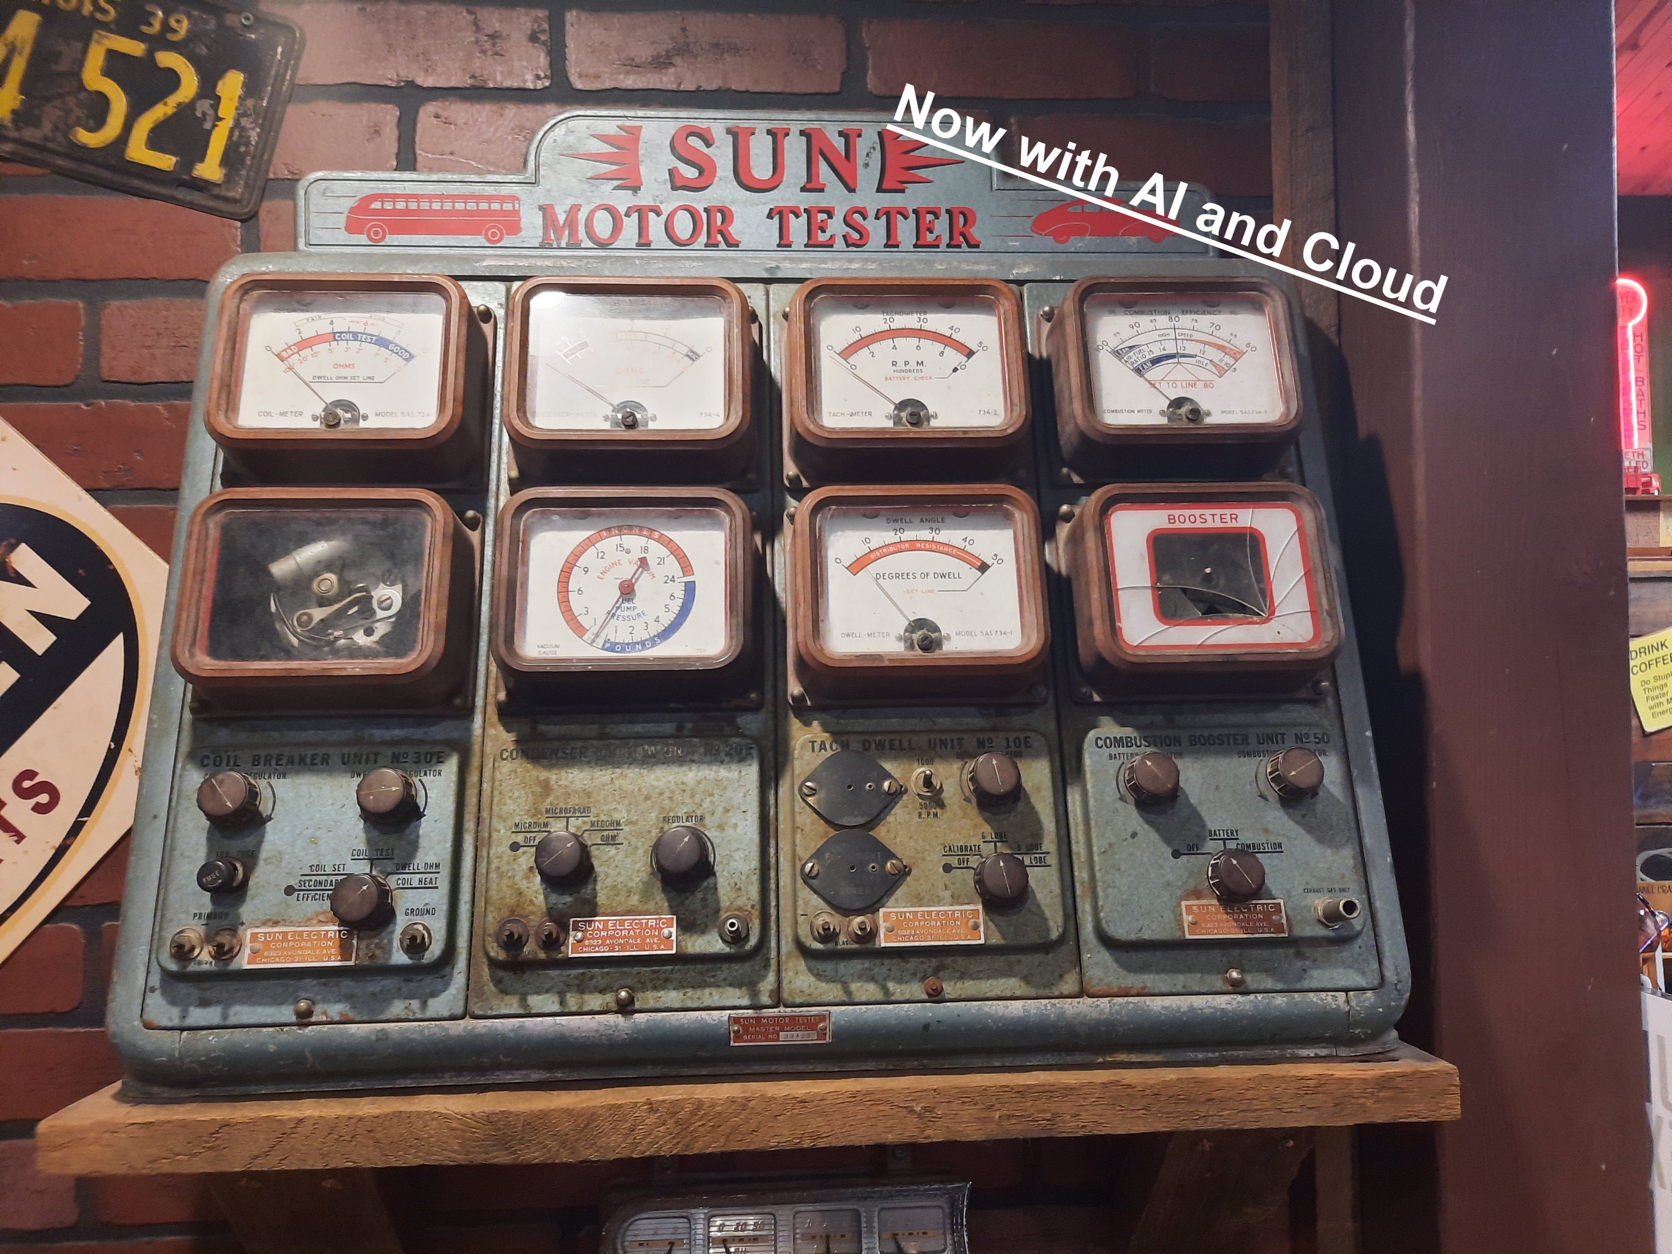
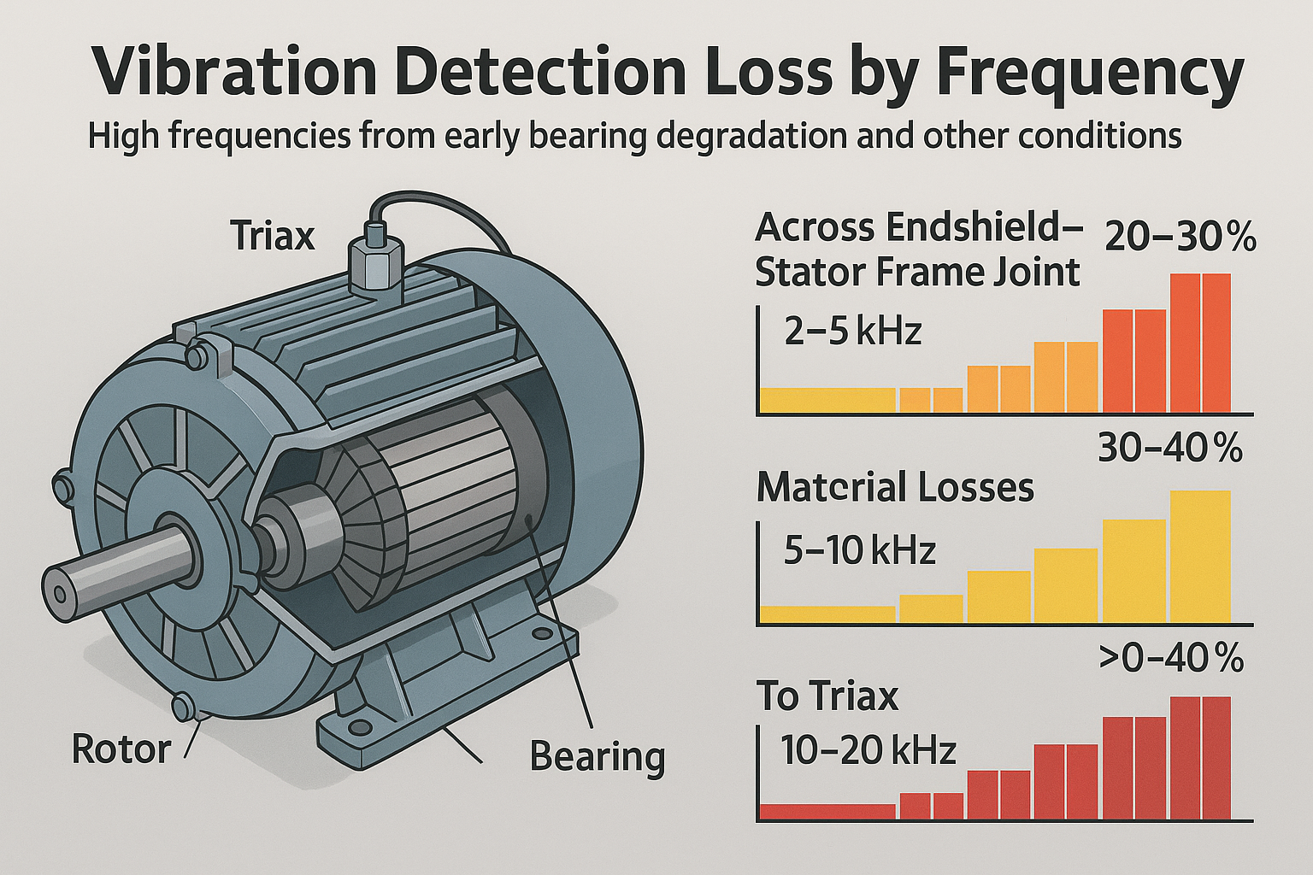
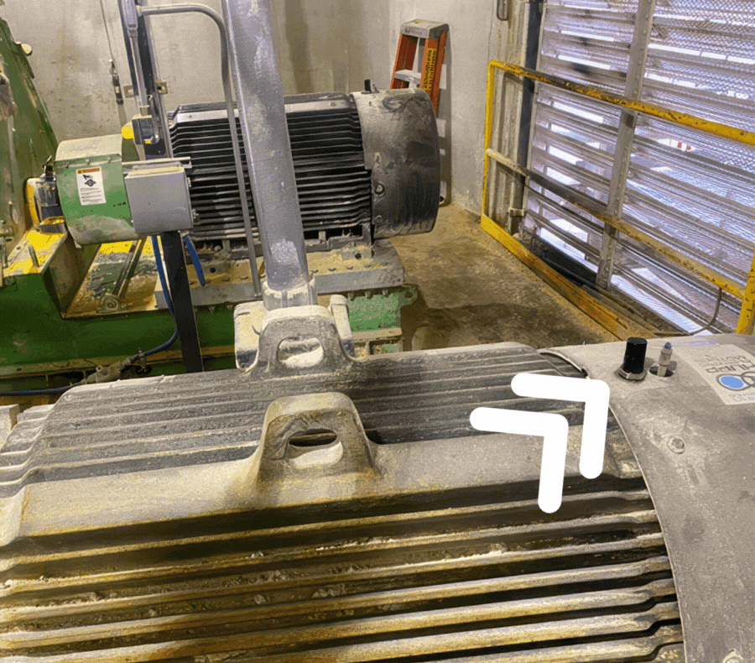
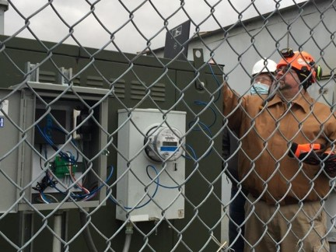
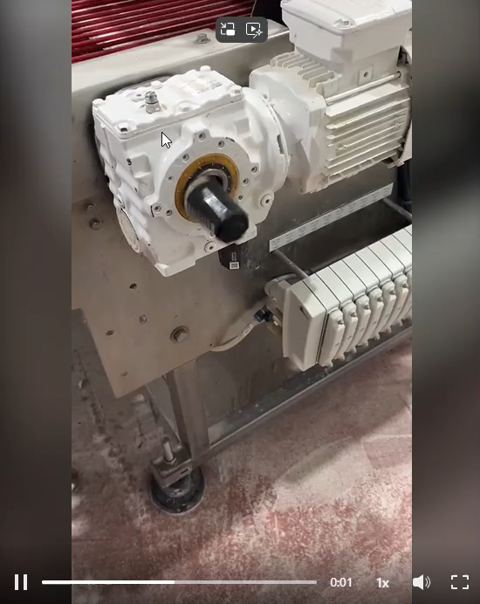
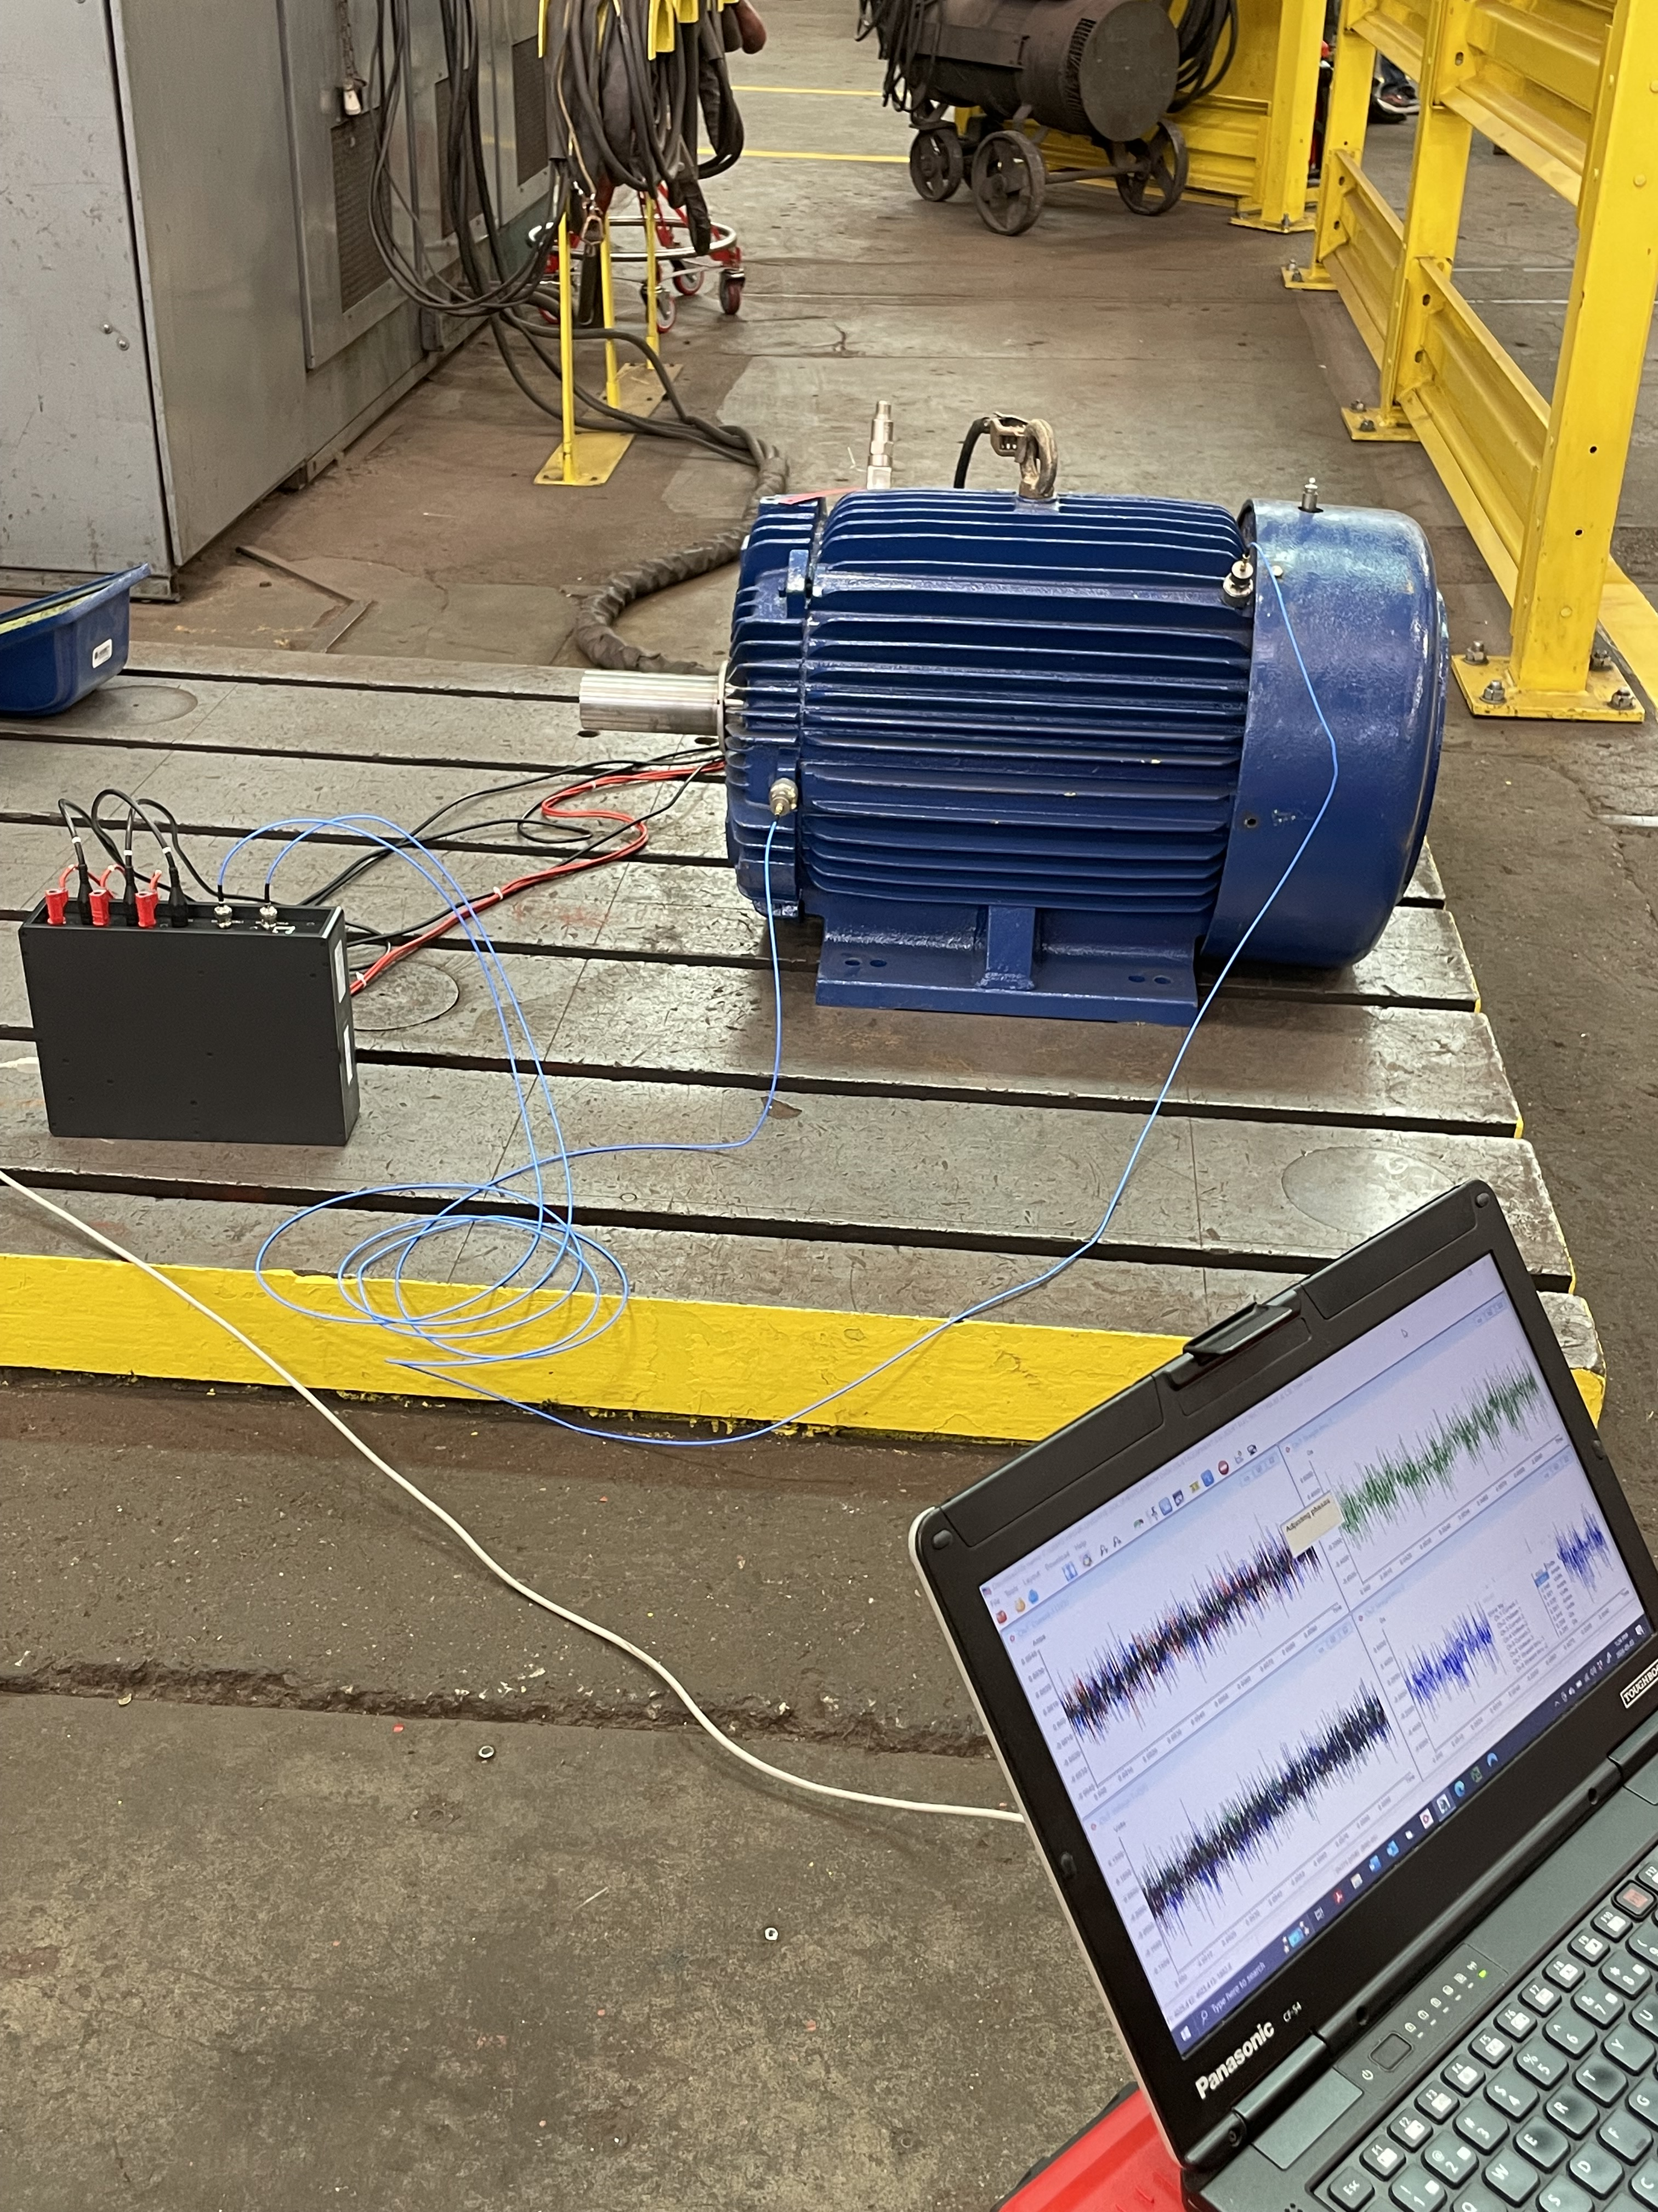
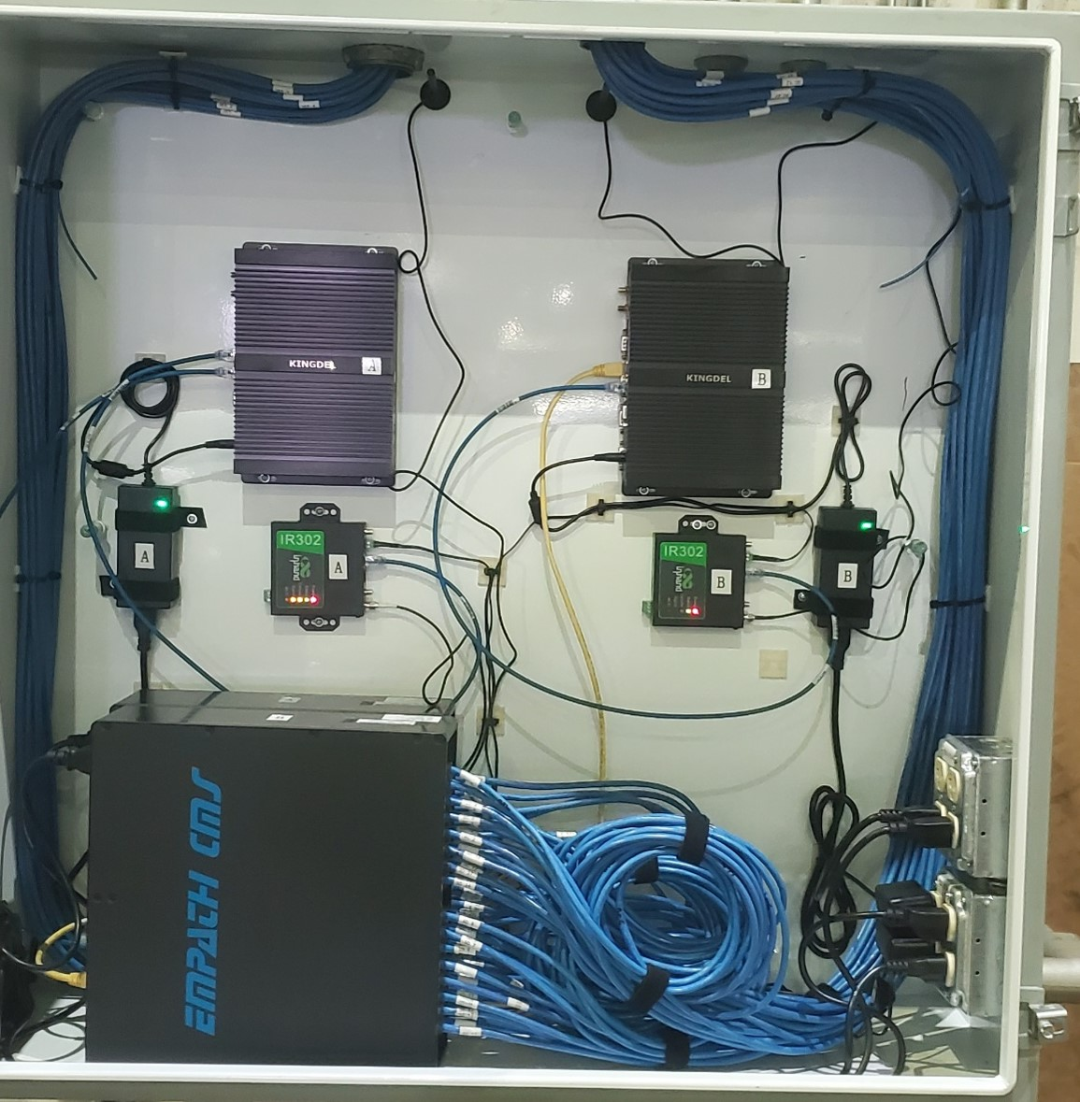
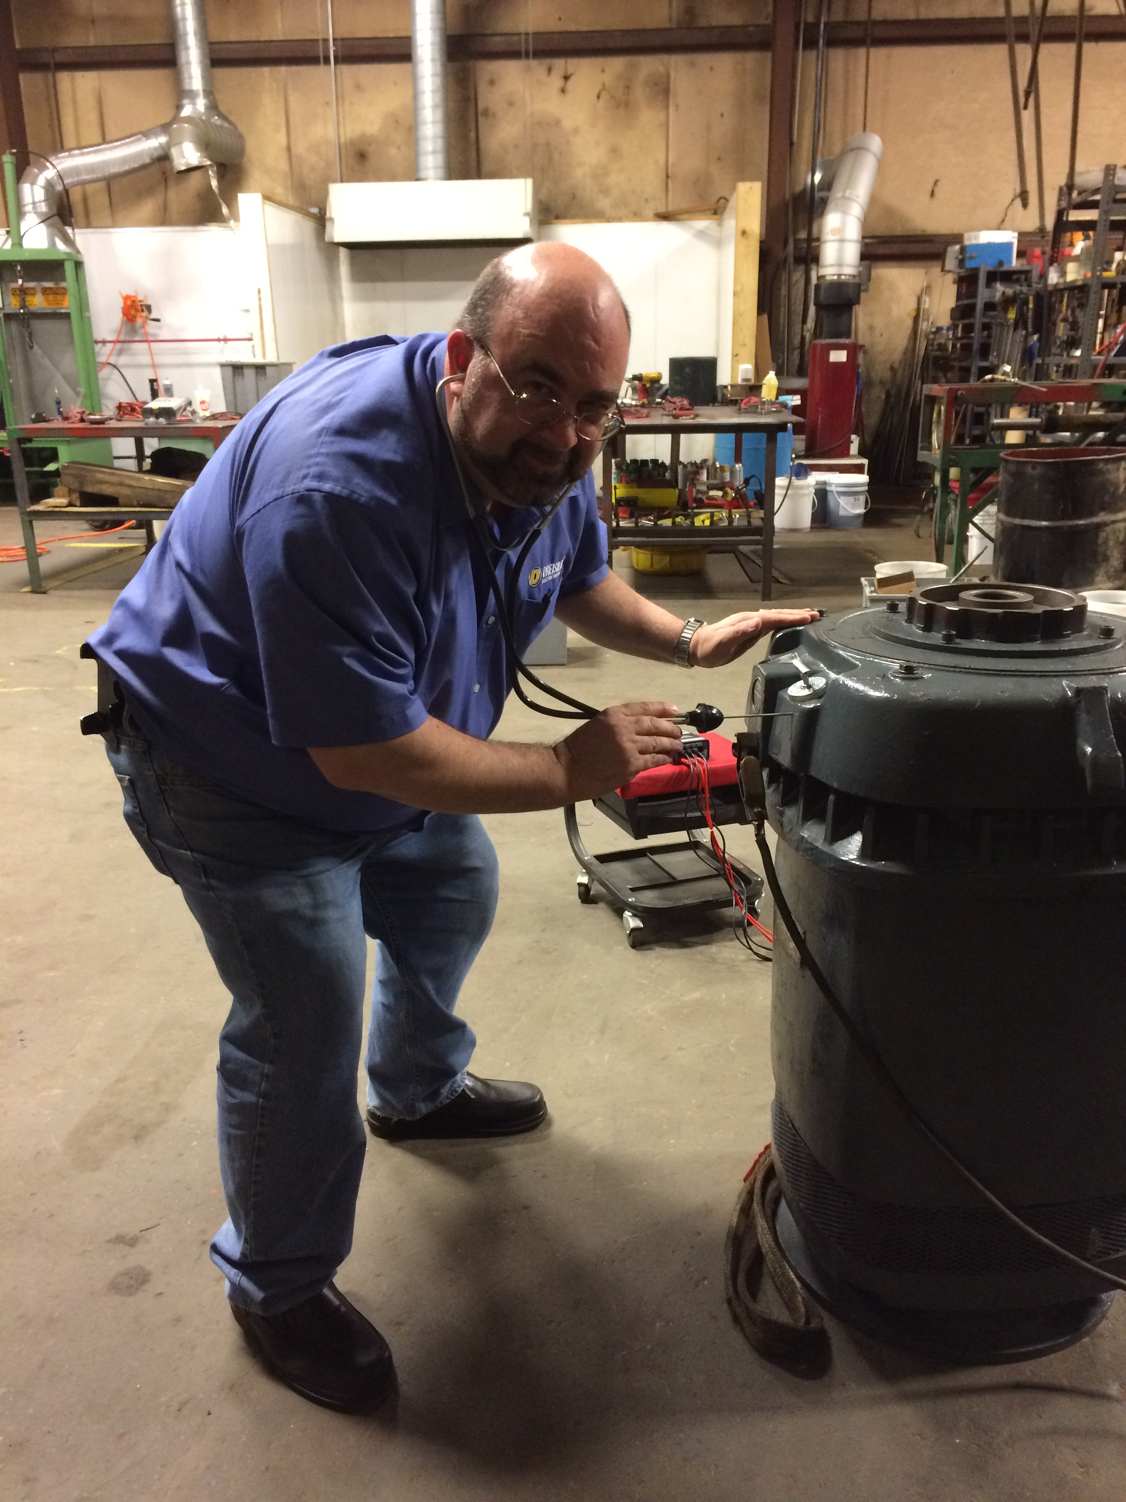
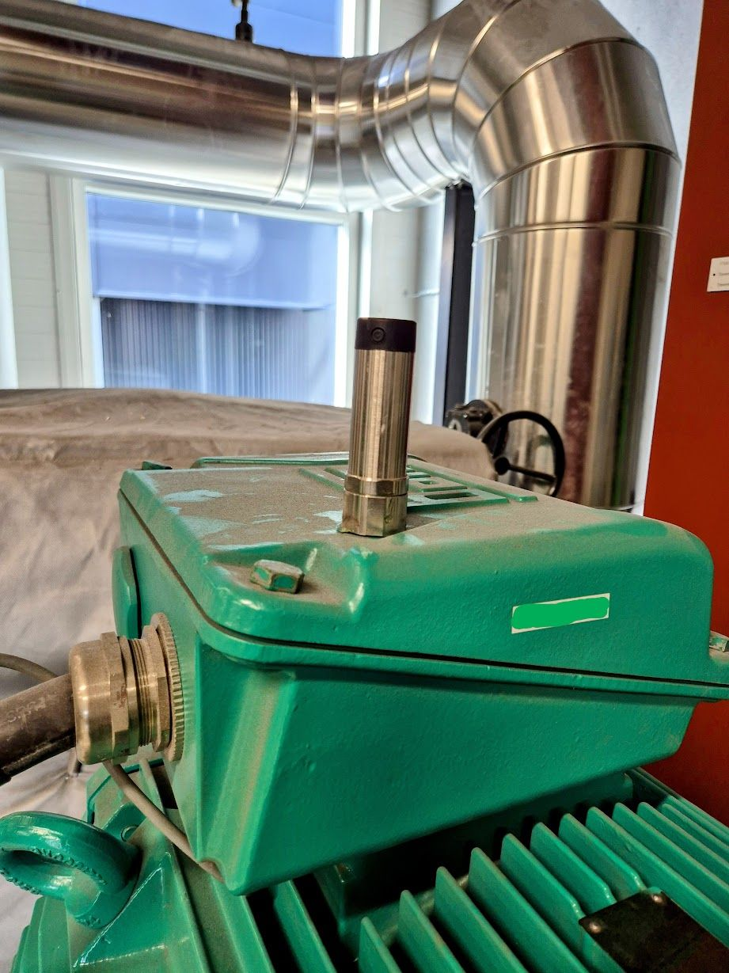
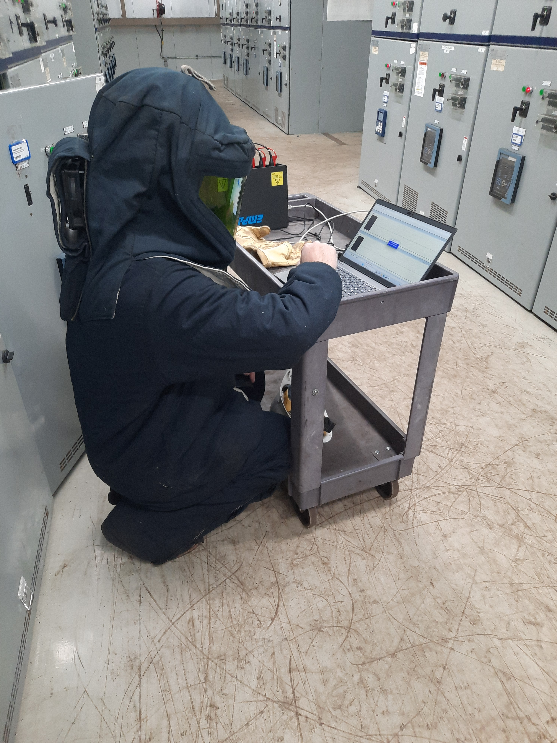
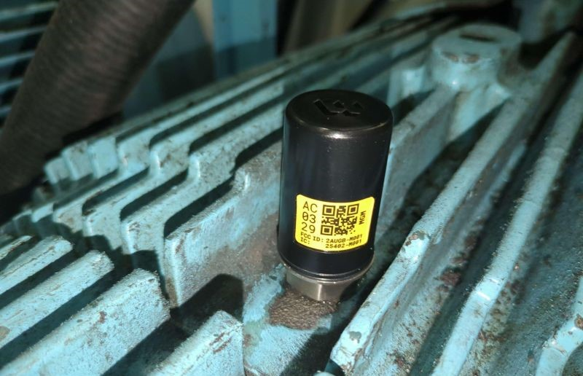
What We’re Seeing

Slide 45
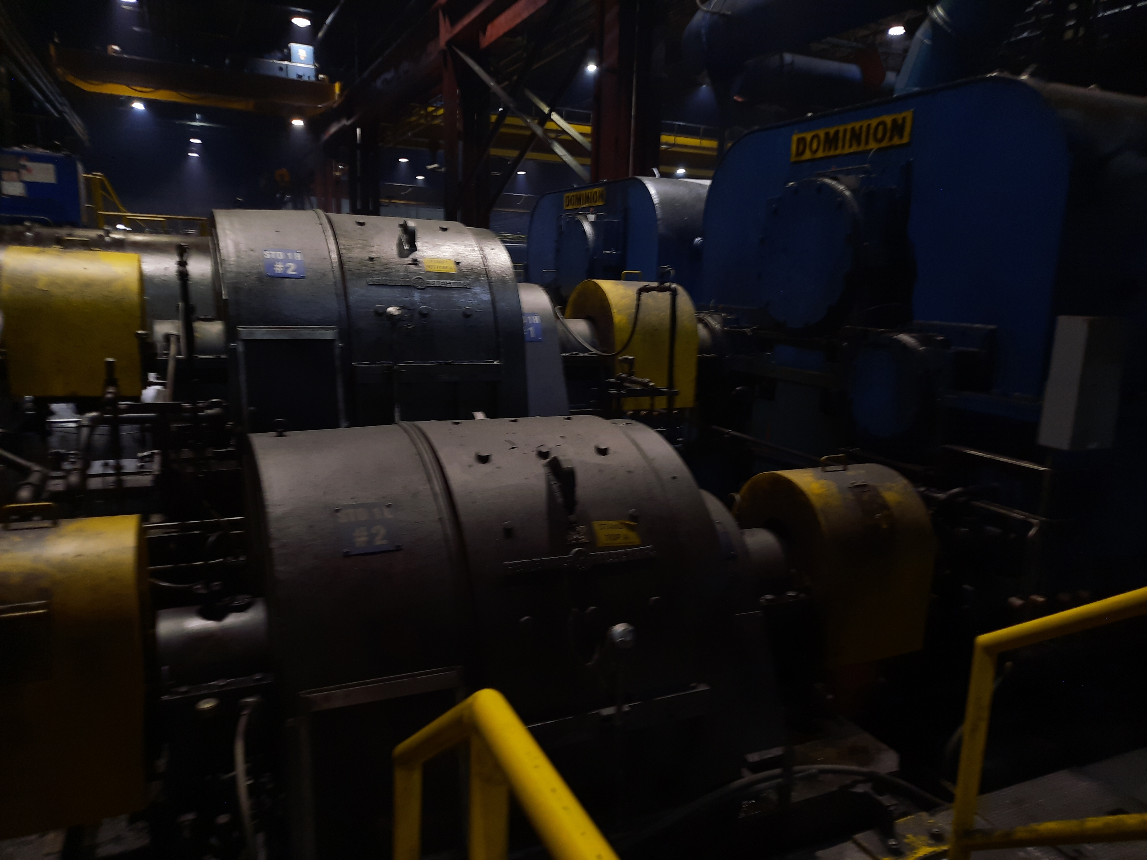
How to Successfully Apply
Don’t do everything and start small.
Have SMEs participate that are familiar with the system.
Understand that some technologies will require modification.
New tech is entering the industry – verify.
Independently review capabilities. Some claim CBM, but are CBRM.
Human in the Loop.
Data available for review by company personnel.
Internal training in the system(s), how they work and limitations.

Slide 46


