Slide 1

Integrations with Hexagon
Laura Gudde
Product Manager
Hexagon
James Sanwald
Manager, Pre-Sales
Hexagon

Slide 2
Outline
SECTION 1
What is Databridge Pro
SECTION 2
What’s new
SECTION 3
What’s Coming

Slide 3

What is Databridge Pro

Slide 4

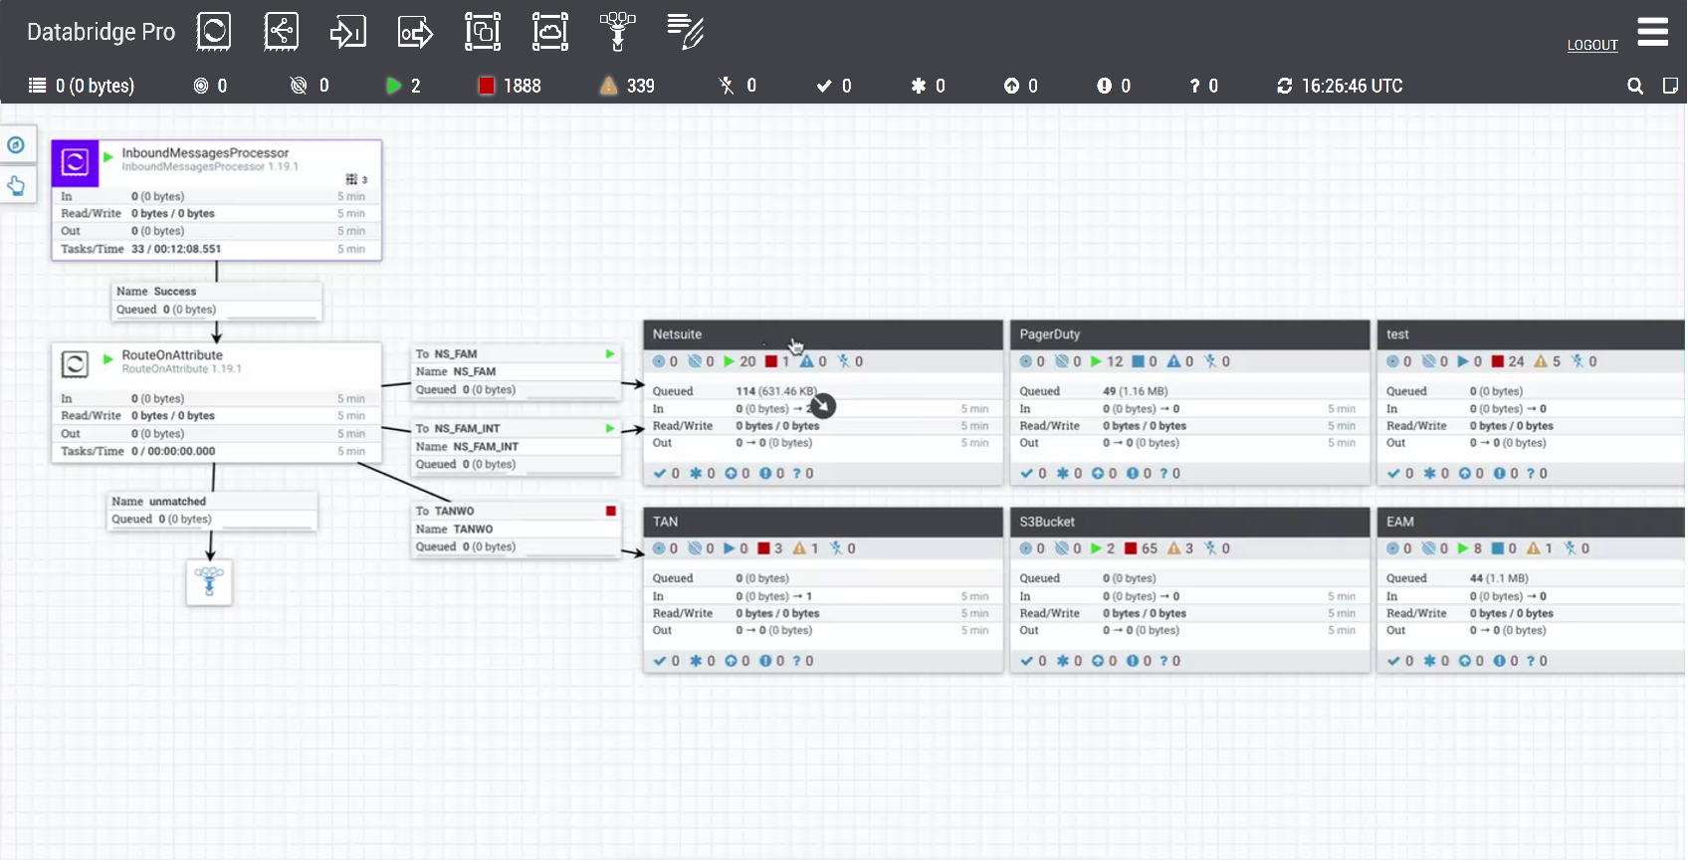
Databridge Pro / Powered by Apache NiFi
Extensive data transformation and connectivity
Highly configurable and automated
Robust data provenance visibility and monitoring
Drag-and-drop, graphical interface
Low-code/no-code configurations
Handle high data volume
Attribute persistence
Powered by Apache NiFi – Built on proven, secure, enterprise-grade open source for scalability and reliability

Slide 5
Databridge Pro
Multi-protocol Connectivity: ​
API-based: Rest/HTTPS, SOAP, OData​
Message-based: AMQP, MQTT​
Database: JDBC​
File-based: SFTP, FTP​
Security Framework:​
Authentication: OAuth 2.0, API Keys, Public/Private Keys​, Certificate-based
Transport Security: TLS/SSL encryption with certificate validation​
Data Security: Encryption at rest and in transit​
Built-in Connections
HxGN EAM: BODs (Inbound/Outbound), Data Lake Upload (DLU)
Data Lakes: Snowflake, Azure DataLake, Azure Blob Storage, Google BigQuery
Data Storage: AWS S3, Google Cloud Storage, Dropbox, Box
Databases: DynamoDB, MS SQL, PostgreSQL, Oracle, Generic
Data Streaming: Azure EventHub, Kafka, Kinesis, MQTT, AMQP
Notification: SMTP-Email, Slack, Amazon SNS
Other: Inbound Message, OSI PI, Groovy Scripting, Workday Reports, Salesforce

Slide 6
HxGN Databridge Pro
Other Clouds
Hexagon AWS Cloud
Third-party
Applications
Third-party
Applications
Databridge Pro
Hexagon
Applications
Inbound Message
REST API
Inbound Queue
Hexagon
Applications
Hexagon
Applications
Hexagon
Applications
Third-party
Applications
Data Flows
Third-party
Applications
Third-party
Applications
Built-in Connections
(varying)
Processors
Controller Services
Process Groups
Ports
Cloud Connector Broker
Key / Certificate Vault
Parameters & Context
On-Premise
Third-party
Applications
Monitoring
Other
Third-party
Applications
Hexagon
Applications
Alix
Data Provenance
Log Files
User Management
Databridge Pro
Cloud Connector (DCC)
Pull/Push
(HTTPS)
Bulletins
Password Policies
Settings
Third-party
Applications
Third-party
Applications
Third-party
Applications

Slide 7
FlowFiles
Dataflow Studio
FlowFile
Attributes
3rd Party
Apps/
Systems
Content
HxGN EAM
Flowfile Provenance show the flow file history
Flowfile lineage tracks history on changes made to the flowfile attributes (metadata) and content

Slide 8

Processors
Listen / Pull
Publish
3rd Party
Apps/
Systems
HxGN EAM
FlowFile
Route
Transform
Extract

Slide 9
J5 to EAM integration
HxGN EAM
J5
HxGN EAM is the system of record for:
Assets
Work Orders
Case Management
Systems with Hierarchy
Operational Areas
J5 is the system of record for:
Rounds
Logbook
Shift Handover
Structure linked
Positions & parent hierarchy
Assets & Asset Areas
Work Request
Request, Comments, X,Y
Logbook – Work Request
Status
Hexagon’s j5 is an Operation Management Solution that enables facilities to document and manage the execution of safety-critical industrial processes. HxGN j5 leverages shift, operator round, personnel, safety, maintenance and process information and makes it visible and viable to users across the entire organization.

Slide 10
AKMS to EAM integration
HxGN EAM
AKMS
HxGN EAM is the system of record for:
Assets
Work Orders
Case Management
Document Management
Documents
(AKMS Metadata)
Procedures
AKMS is the system of record for:
Content
Completions
Synchronize Content Metadata
Link Documents AKMS Type To
Equipment
Task Plan
Create Completion Document (e.g
Equipment,Work Order)
Content Ref, Work Order Number
Completions
Completion Number, Status,
AKMS is a procedure management system built with consistency and control in mind. This solution doesn't only store your documents, it lets you easily manage and govern the critical operational content your field workers use every day. This integration will bring about easier designing of policies and activities into EAM

Slide 11
SDx to EAM integration
HxGN EAM
SDx
HxGN EAM is the system of record for:
Assets
Work Orders
Case Management
Positions
Tags
SDx is the system of record for:
As-designed & As-built drawings
Design data
Stub Object
Position
Tag Infomap
Jump Interface on Position & Tag
Asset data exists in SDx before it reaches EAM. Following the project lifecycle, the project files are sent in by EPC’s to the Owner Operator. SDx orchestrates that communication. SDx is then used by the Owner Operator to do red lining, mark-ups, reviews and versioning. You can work with multiple projects and multiple external vendors with data security between projects. Once there is an as-built, this data is ready to transition to HxGN EAM.

Slide 12

What’s new

Slide 13
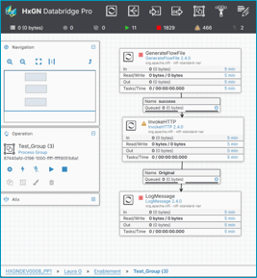
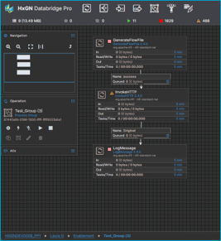
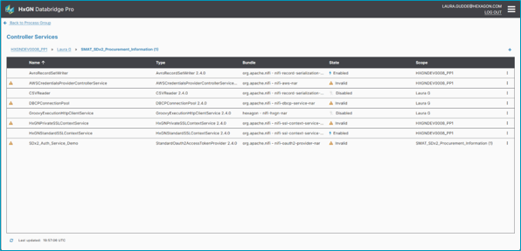
Databridge Pro
User Interface
What's New?​
Full-screen windows from Global Menu – canvas and all actions accessed through centralized navigation.​
Enhanced canvas with improved drag-and-drop, clearer flow visualization, and better status indicators.​
Dark mode and light mode appearance settings.​​
What's the Value?​
Streamlined navigation and modern interface reduce clicks and time to complete tasks.​
Accommodates personal preferences and different lighting environments with dark/light mode.​​

Slide 14
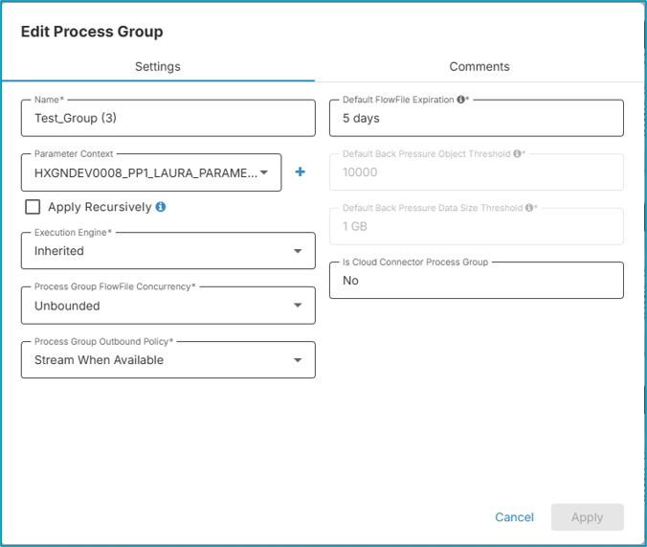
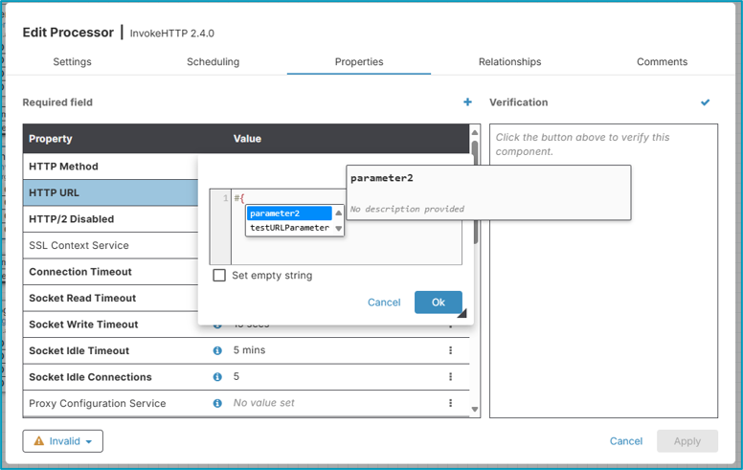
Databridge Pro
Parameter Contexts
What's New?​
Parameters use the #{parameter} syntax in supported fields.​
Parameters support storing and reusing of sensitive values.​
Users can create Parameter Contexts as needed and link them to Process Groups.​
Child groups inherit their parent’s Context.​
Child groups can also have their own unique Context.​​
​
What's the Value?​
Offers flexibility to define and link Parameters to specific Process Groups.​
Enables secure storage and reuse of sensitive or other values across components.​

Slide 15
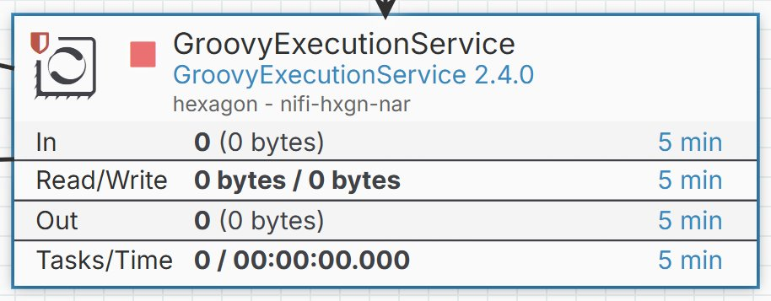
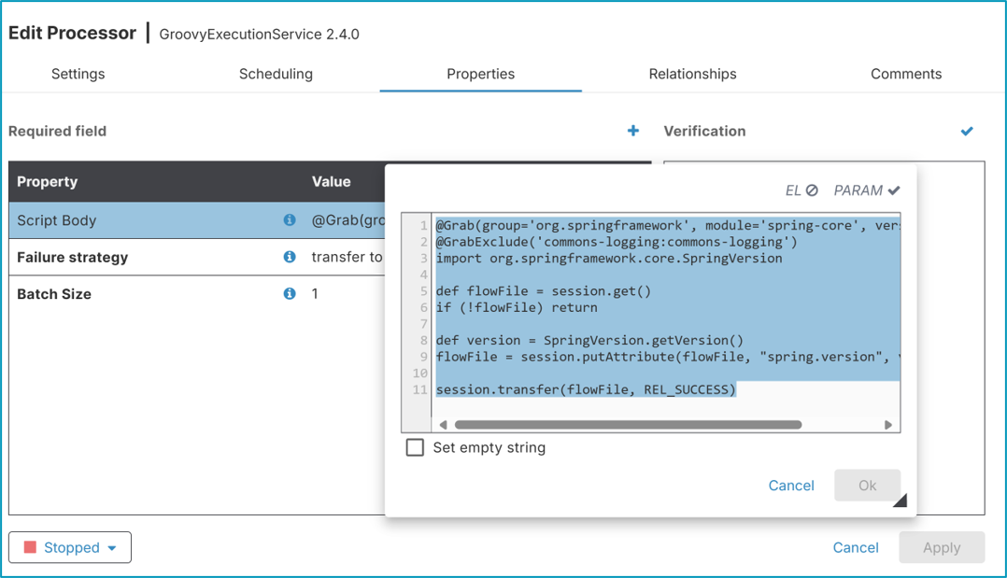
Databridge Pro
Groovy Scripting
What’s New?​
A new processor GroovyExecutionService
Connects to a scripting service in an isolated environment.
Allows batching to improve performance (Batch Size property)​
​​
What’s the Value?​
Offers access to a broader range of libraries, while still maintaining certain necessary restrictions.​

Slide 16
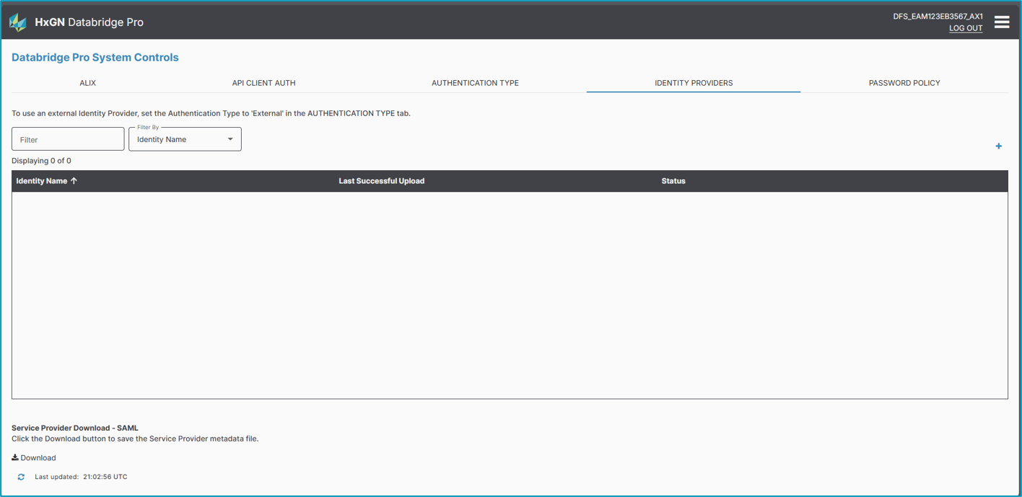
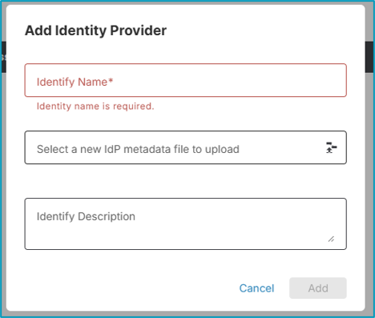
Databridge Pro
Identity Provider
What’s New?​
Configure an external Identity Provider for single sign-on.
Automatic redirection at login to external authentication server.
Seamless integration with enterprise SAML 2.0 compliant identity providers.​
​
What’s the Value?​
Eliminates the need to maintain separate passwords for Databridge Pro.​
Leverages enterprise-grade security and password policies from the organization’s identity provider.

Slide 17
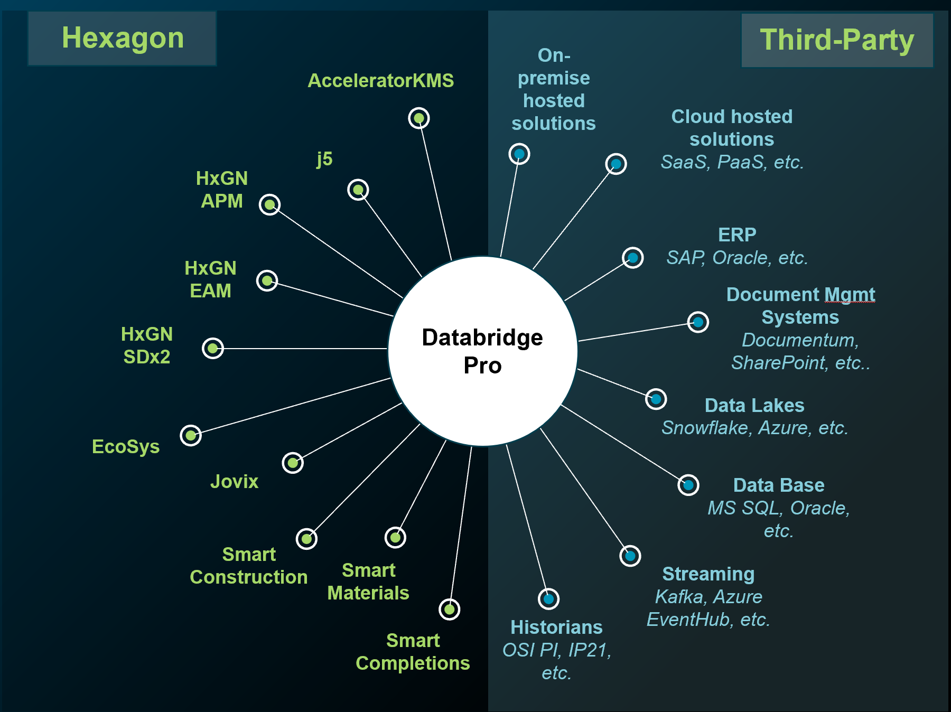
Databridge Pro
Strategic Role
What’s New?
Databridge Pro is now the official integration tool for Hexagon ALI
Enable seamless, scalable, and traceable data movement.
Integrate natively with other components in suite.
Align with modern IT strategies.

Slide 18

What’s Coming

Slide 19
What’s Coming | Databridge Pro
Framework & Interface Upgrade
User interface modernization, dark mode, performance optimizations, and removal of legacy variables.
Parameter Context Management
Create custom Parameter Contexts to organize parameters eliminating the constraints of a single default context.
Support External Identity Provider (Single Sign-On)
Enable enterprise Single Sign-On, leveraging your external identity provider for seamless, secure access.
Data Flow Version Control
Track, manage, and promote data flow versions across tenant environments.
Cloud Connector (DCC) Flow Management
Streamline on-premises deployments by enabling template import between Cloud tenants.
Improvements to EAM BOD, Data Lake, and Endpoints connections
Enable flexible EAM connectivity, allowing Databridge Pro to connect to any EAM tenant.
Cloud Connector (DCC)
Automated Data flows
Enable automated download of DCC flow definitions to on-premises DCC instances, including sensitive property values.
Repository Maintenance
Eliminate disk space issues with automated repository cleanup, preventing file accumulation that could halt Cloud Connector operations.
System Announcements/Alerts
Stay informed with timely, in-app announcements about maintenance windows, new features deprecations, and other important information.
NOW
NEXT
LATER
This document is designed to communicate a perspective of likely R&D prioritization based on the current indicators of client demand. It will change both in scope and timing in response to industry demand, which is quite dynamic. Hexagon retains all decision rights as to what will be included in a particular release and does not make binding commitments outside of a written commercial contract.

