Slide 1

Leveraging Standardized Procedures
Matt Costa
Solution Architect
Hexagon
James Sanwald
Manager Pre-Sales
Hexagon

Slide 2


2:14 PM – alarms cascade
Data center control room goes red
Cooling loop offline
Server temperatures climbing
Emergency protocols triggered
This wasn’t a failure of training or compliance – it was a failure of procedural governance.

Slide 3
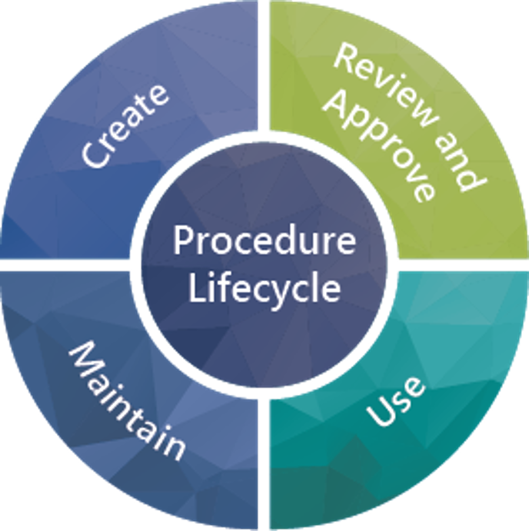
What is AcceleratorKMS to you?
Think of it this way:
EAM still defines what work needs to be done Work orders, PMs, and task plans stay exactly where they are.
AcceleratorKMS governs how the work is executed Checklists are replaced with procedures that are current, approved, and standardized.
Together, they eliminate outdated procedures at the point of work Technicians always execute the latest version, and execution data stays clean.
Procedures can now be associated directly to the asset Ensure the right instructions follow the equipment over it’s entire lifecycle.

Slide 4
Outline
SECTION 1
What Problems does an EAM-AKMS integration Solve?
SECTION 2
EAM-AKMS Integrated Solution Overview
SECTION 3
Applying the Capability
SECTION 4
Closing

Slide 5

What Problems does an EAM-AKMS integration Solve?

Slide 6
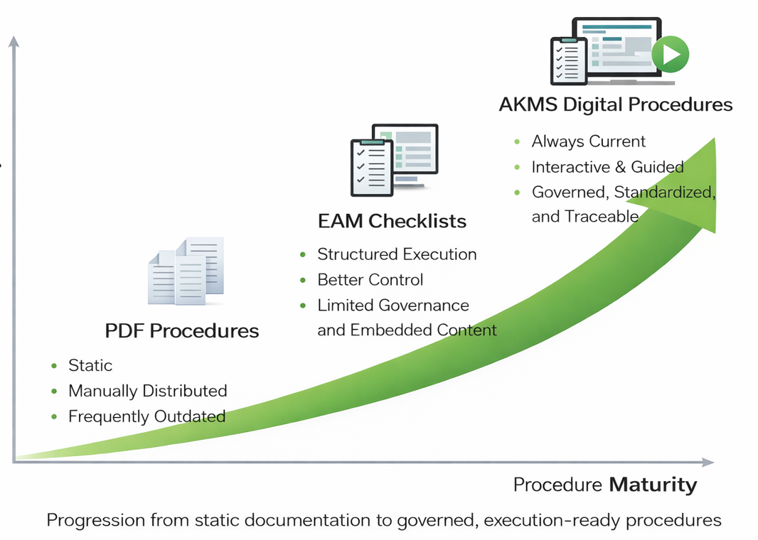
Digital Procedures in Maintenance
Technicians execute work using static documents (PDFs, binders) or EAM checklists
Static documents quickly become outdated and unmanaged
EAM checklists improve execution, but are not always current and lack rich, embedded guidance
Result: increased safety risk, manual effort, and avoidable downtime
How do we solve that problem?
Solution: Integrate HxGN EAM with AcceleratorKMS
AKMS delivers always-current, interactive digital procedures
Completed procedures become part of the asset history for traceability and improvement

Slide 7
How do customers do this today?
HxGN EAM
Paper-based or 3rd Party System
EAM Checklist
Inspections
Preventative Maintenance
Breakdown Work Orders
Repair/Replacement
Paper Procedures
Standard Operations
Start-up or Shutdown
Emergency Procedure
Turnaround Activities
LOTO Procedures

Slide 8

Business Challenges in Context
Execution of the Most Current Procedures
Ensures technicians can only execute the latest approved version of a procedure, eliminating the risk of outdated or superseded instructions being used in the field.
Management of Global and Site-Level Procedures
Enables centralized control of standard procedures with the ability to safely apply site-specific variations – without duplicating or fragmenting content.
Lack of Embedded Content Delivery
Addresses the gap in traditional checklists by embedding videos, reference documents, and contextual guidance directly at the point of task execution.

Slide 9
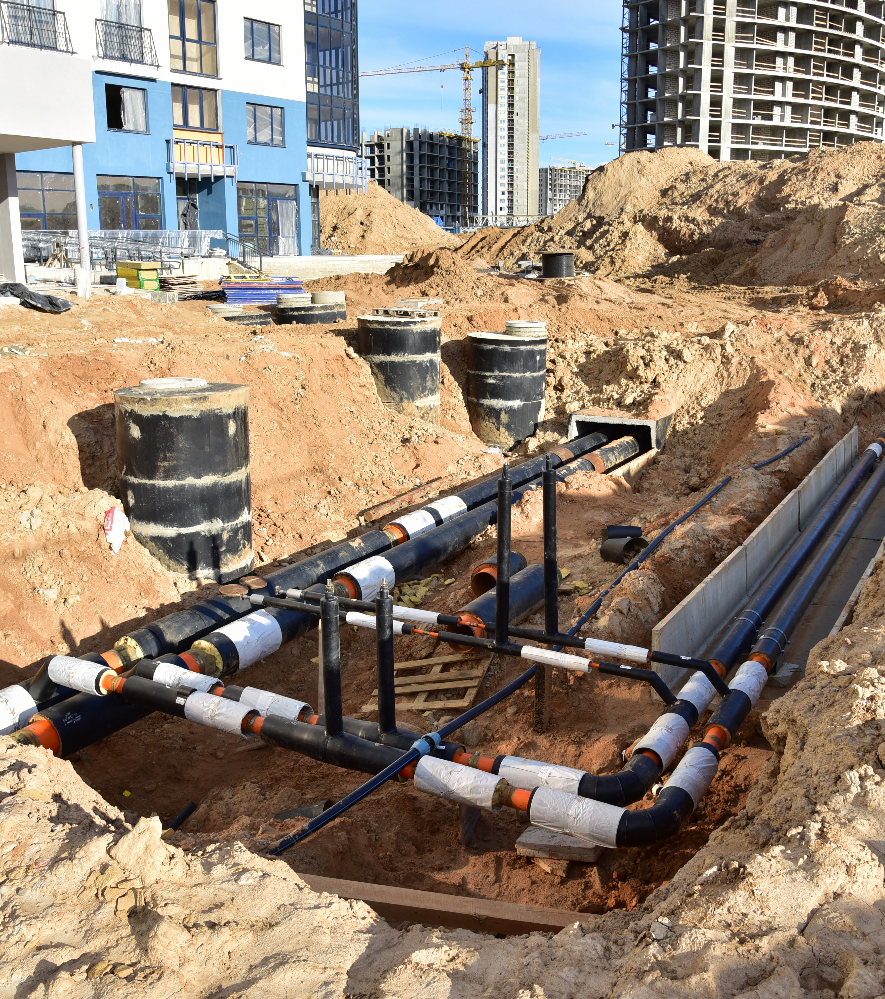
EAM-AKMS Integrated Solution Overview

Slide 10
High-level Data Flow
HxGN EAM
AKMS
Databridge Pro or DCC*
HxGN EAM is the system of record for:
Assets
Work Orders
Case Management
Document Management
AKMS is the system of record for:
Content
Completions
Documents
(AKMS Metadata)
Procedures
Synchronize Content Metadata
Link Documents AKMS Type To
Equipment
Task Plan
Content Ref, Work Order Number
Create Completion Document (e.g.
Equipment, Work Order)
Completions
Completion Number, Status,
*Integration via Databridge Cloud Connector (DCC) typically requires services support

Slide 11
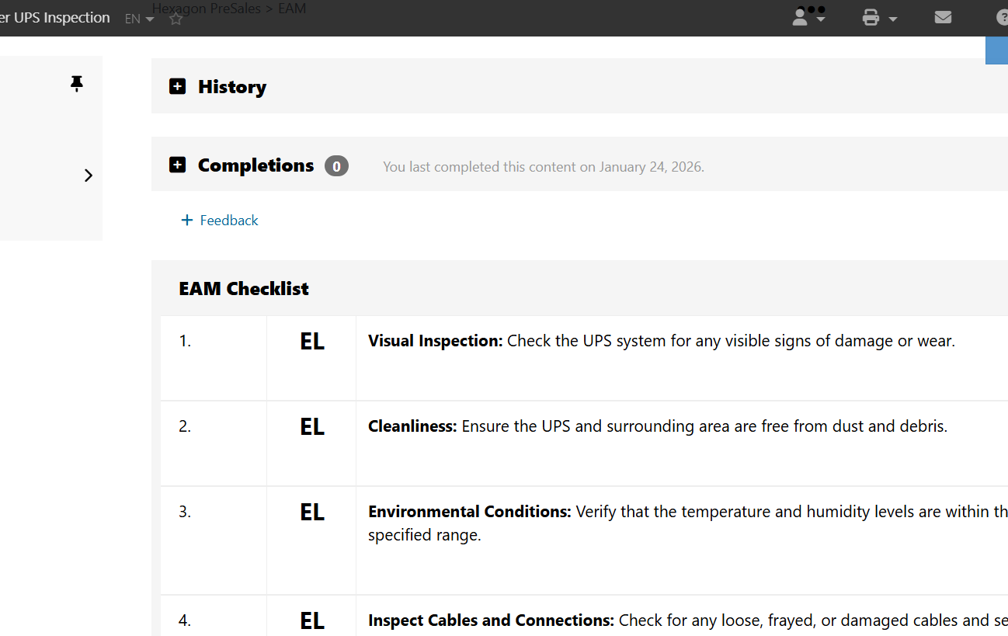
Live Demo

Slide 12

Applying the capability

Slide 13
From “Everything” to the “Right Things”
How to Decide What to Digitize First?
Not every task plan needs to be digitized
Start where risk, variability, and change are highest
Focus on procedures where failure has consequences
What Belongs in AKMS?
Safety-critical or risk-sensitive tasks
Tasks with frequent revisions or engineering change
Procedures requiring judgment, validation, or sequencing
Tasks with embedded references (drawings, videos, specs)
Procedures executed inconsistently across sites

Slide 14
How to implement your procedures & execution data
Enterprise-Wide Procedure Management
Use-Case-Driven Procedure Management
Track all your procedures in one system
Procedures are all centrally managed and suppling subscribers with the latest versions
Scalability and Longevity
Asset Focused versus Operational Guidance
Adjusts execution location dependent on outcome requirements

Slide 15


Use Case Driven Procedure Storage Decisions
Consideration
Integration & Workflow
Compliance & Documentation
Complexity & Detail
Purpose and Context
Part of enterprise knowledge management?
Triggers Work Orders or ties into asset lifecycle?
Training or SOP documentation focused?
Regulatory, audit, or compliance traceability required?
Embedded rich content required: diagrams, images, video?
Requires readings, measurements, pass/fail data capture?
Operational guidance or knowledge transfer?
Asset or Maintenance specific?

Slide 16
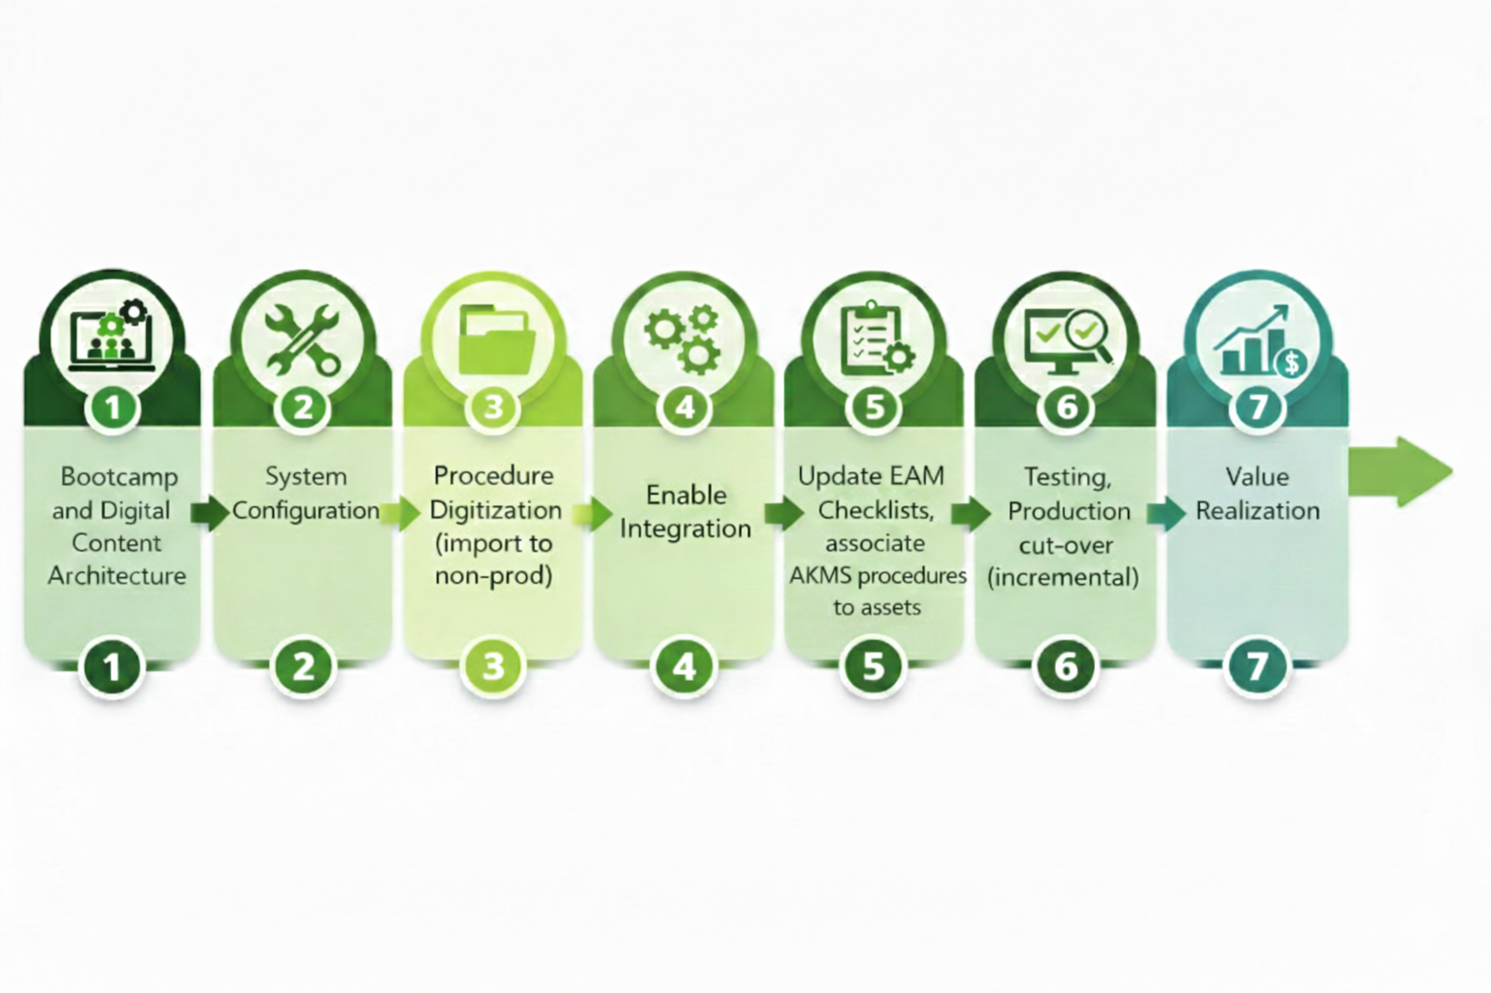
Implementation Pathway

Slide 17

Closing

Slide 18
Operational Challenges → Value Drivers → Measurable Outcomes
Eliminates manual WO activity maintenance while ensuring technicians always execute the latest approved procedures.
1,648 hours saved per year
Ability to evaluate procedure execution efficiency across organization and identify areas of under efficiency and areas for improvement.
Reduced procedure execution time by 10%
Improved Technician utilization by ~5%
For complex task execution requiring enhanced capabilities (multimedia, conditional logic, process flow, etc.) focused on driving consistency, accuracy and safety.
For improved procedures, QA Rejection percentage decreased by 1%
Procedure Currency
Standardization
Execution Clarity

Slide 19
Value Proposition and Select Customer Successes
ACHIEVE HIGHER RELIABILITY
42%
of unscheduled downtime is due to operational human error*
ACCELERATOR AUTHORING
91.7%
reduction in procedure authoring time required – leveraging our patented Accelerator Authoring technology and methods**
REDUCE SME RESOURCE REQUIREMENTS
68%
reduction in SME time required to review, approve and maintain technical accuracy of procedures**
END USER ACCEPTANCE
267%
increase in procedure use – true testament to field acceptance and adoption, workplace culture change and operator engagement**
PLCM
CYCLE TIME
25%
reduction in cycle time on end to end (initial procedure request to publish) procedure lifecycle management process.**
TRANSPARENCY AND ACCOUNTABILITY
99%
increased procedure adherence to compliance through real-time tracking and integrated operator feedback**
KNOWLEDGE AT YOUR FINGERTIPS
7.1%
improvement in wrench time due to easy-to-access single source of knowledge**
COMPLIANCE
READY
80%
reduction in time to generate compliance reports on procedure usage, PSM compliance, review and approvals, etc.**
Procedure Accelerator (AcceleratorKMS) enables your procedures to be more than just a paper on the glass
* ARC – Procedural Automation, Automation World, February 2011
** Select client study results

Slide 20
Where do AcceleratorKMS Clients Find Value?
Document Administration
Safety & Incident Reduction
Operational Efficiency
~ 75% Savings
~ 20% Impact
~ 30% Impact
Speed development and review/approval administration while reducing costs.
Improve accuracy, consistency, and accessibility.
Free administrators to focus on more important tasks like quality content and training.
Automated change workflows improve visibility and accountability of reviewers, approvers, and action owners.
Maintain a safe workplace for employees and community.
Reduce incident risk and associated economic losses.
Improve regulatory compliance, reducing citations and associated penalties.
Constant state of audit readiness with automatic activity tracking.
Improve procedure-specific training and proactively manage workforce competency development.
Execute tasks more effectively and consistently with quality procedures and access to supporting reference.
Collaborative mobile procedure execution drives engagement.
Continuous improvement via field feedback loop and data analytics to drive accountability, innovation, and efficiency.

Slide 21
“
Only the one who does not question is safe from making a mistake.

