Slide 1

Lost in the Store
The Importance of Data Governance

Slide 2
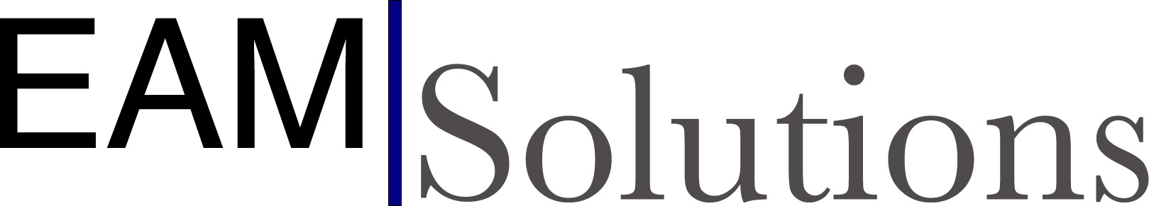
About Me and EAM Solutions
Bennet Creed, Vice President of Business Development
Started with CMMS/EAMS in 1997
Worked with hundreds of customers across North America
Specialist in implementing EAM
EAM Solutions was founded in 2009
Managed by veteran EAM consultants
Channel Partner, Alliance Partner, Authorized Reseller
Experts in HxGN EAM and add-on components

Slide 3

You know what it’s like to be lost…
Wandering around the forest, trying to get your bearings
Goblins are everywhere
Disorganized storage
Parts can’t be found
Missing or inconsistent data in EAM
Our maintenance tech just needs a bearing
He can’t find it
He has trouble even making a requisition to buy one
Notes:
This is a story about a maintenance technician who just needs a part to complete his work order.
Everyone here knows what it’s like to be lost. You don’t know where you are, and you can’t find your bearings. Just like our maintenance technician. He just needs a bearing.
The store is a forest – like in any good story or fairy tale, the forest can be a dark and foreboding place, full of goblins. And he needs to go deep into the forest to get his job done.
He walks into the storeroom and parts are everywhere – stacked in crooked bins, left in shipping boxes, and scattered across tables and carts. So, he decides to look the part up in EAM.
He can’t find the part because there’s not enough data in EAM. Or the data are inconsistent. Mixed up part numbers, useless part descriptions, inaccurate bin locations – and worse, six records finally do come up when he’s looking for that specific bearing.
So our maintenance tech – who has been trained in using EAM – follows the next logical step. He creates a Part Requisition. “I can’t find it, so I’m going to buy it.”
But when he selects a part record for the requisition, there’s no default supplier, and no pricing information comes into the part line. And no part record matches what he really wants.
So what now?
He clicks the Action menu button and selects “Create Part”. He puts in a random price and submits his requisition. And he hopes for the best. And that’s how our story begins.
This is a bad case scenario, but a common one. Even with integration to an ERP package, we find maintenance techs just leaving notes on a buyer’s desk and putting work off until they can find the part.

Slide 4

The Consequences
Short Term
Equipment downtime
Backlog of work orders
Team frustration
Work-arounds outside of EAM
No record keeping
Long Term
Inaccurate stock, valuation, and TCO information
Failed purchasing processes
Nothing to report on the GL
Notes:
What are the consequences? Short term, you get equipment downtime – and probably production loss or unhappy customers. Incomplete work orders start to stack up. Maintenance and operations start getting frustrated and create their own work-arounds to get parts – so nothing really gets recorded in EAM.
In the long run, you end up with inaccurate stock levels, bad store valuation, no Total Cost of Ownership on equipment – and an MRO purchasing process that just failed. There’s nothing to report to the General Ledger.

Slide 5

The Goblins in the Story
Parts are just ordered as needed
No part costs for asset TCO
Non-value-added downtime looking for parts
Over or under stock on the shelf
Impossible to analyze what you have
Taxes and valuation impossible
No sharing between Stores
No consistent numbers or bin labels
Notes:
Our maintenance technician really doesn’t think about these business consequences. He just needs to get the job done. And the little goblins are there. Every store has at least one villain, and our villains include:
Parts are ordered as needed
No TCO on assets
Downtime because of so much time spent looking for parts, or ordering parts
Overstocked or understocked – and you don’t know which
Impossible to analyze what you have
Taxes and valuation become a guessing game
No part sharing between company Stores
No consistent part numbers or bin labels
Your villains are keeping you Lost in the Store.
And our maintenance tech? He just needs a part to finish his work.

Slide 6

Why do we say the tech is “Lost”?
Without standards, you lose your way
Without consistency, you can’t analyze what you have
Without data, you can’t locate what you need
You need a Guide to help in the Store
Notes:
Without data standards, you start to lose your way. Your first steps into this forest are okay – you can get what you need. The deeper you go into the store, the less you can find, or the longer it takes you to get what you need.
No one can analyze what you have, what’s been spent, or even what you need. Data are incomplete or inconsistent – and without part transactions you can’t analyze usage or spend.
I’m just grabbing what I need, or doing last-minute ordering – and this could be going on every day.
Without good data, or even complete records, you won’t find parts. The parts may be in the store, but just not recorded, notated, put away, or even visible.
What does our maintenance technician need? He needs a guide to help him find his parts.
In every good story, there’s a guide. There’s someone or something to help you find your way, and to keep you going. Think of Yoda, or Shifu from Kung Fu Panda.

Slide 7

Data Governance is Your Guide
The Technician needs a Guide
No more Grab-n-Go
He needs a system and directions
The Guide gives us what we need
Visibility
Knowledge
Control
Spoiler Alert!
Notes:
Our guide is Data Governance, and specifically a Data Governance Guide.
I know, you’d like a guy in a beard with a staff, or someone with mystical powers. But Data Governance is going to help us win in this story.
This is a document that defines the what and the how of MRO and spare parts inventory management.
With the Data Governance Guide, you develop a system that allows Visibility, Knowledge, and Control. There’s a set of words to hang onto.
You get Visibility into what you have through well-defined and consistent records. This may take a bit of work on a white board, but you put together a system of Part Identifiers, Descriptions, and Attributes.
This will require a discovery process – which means, you need a team to walk through your store and find out what you have – and what you really need.
Once parts and part records are consistent, you get Knowledge. Now you can analyze what you have – raw numbers, valuation, reorders, and suppliers. You get rid of what you don’t need and focus on what you do need.
Now you have a path to follow in the forest. The Guide is getting you to what you need.
Finally, you maintain the system through Control. You need to have processes in place to manage part transactions, from receiving and stocking, through usage, counting, and even scrapping. Consistent processes give you control over your MRO.
Spoiler Alert! Our maintenance technician will soon be able to find what he needs without making a blind requisition using a temporary part number.
And all of this starts with the Data Governance Guide and ends with the processes to support the Guide.

Slide 8
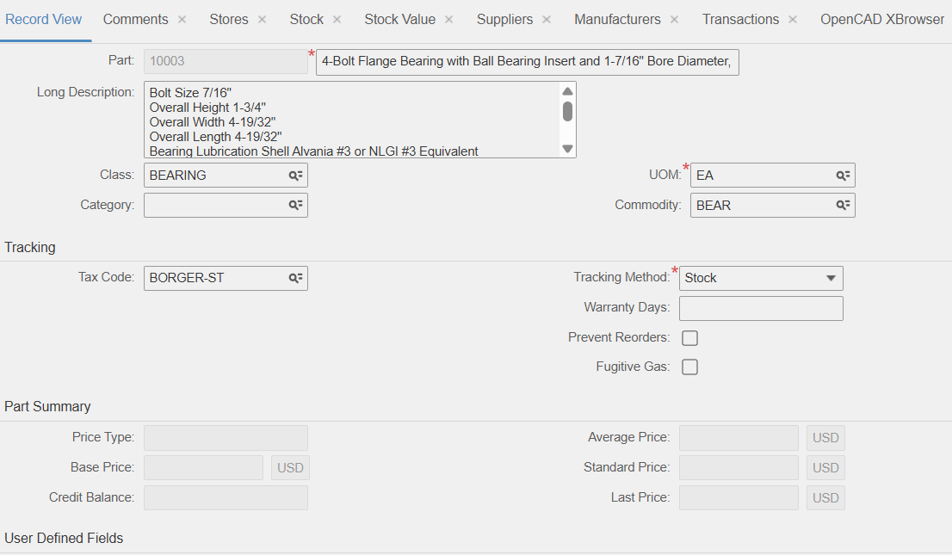
Standards in HxGN EAM
The Part ID and Description
Stores and Bins
Supplier and Manufacturer information
Class and Commodity Codes
Business Processes with EAM Functions
Stocking
Receipts and Returns
Issues and Restock
Transfers
Purchasing
Notes:
Now, how do we relate this back to Hexagon EAM? What’s on the shelf needs to be accurately represented in EAM. I’ve been places where good inventory management was on paper, and EAM was just “extra”. We need to make EAM the source of Knowledge in this story.
You start with your Part ID. Set a standard for a company part number. This could be auto-numbering, smart numbers, or your own set of sequential numbers. Sometimes this is the industry standard model, like on bearings. Other times you need to use the vendor catalog number because the part is unique.
Decide if each store has a unique numbering system, or if the part numbers are Global to your company or organization. There’re arguments for both ways.
Work on your part descriptions. You can search and sort by Description, and this one field can help someone locate what they need. How are these two bearings different? Look at the two description fields. Is this the right sized lamp? Check the specs in the Description, or even the Long Description field.
Now where do you keep your parts? It’s time to get organized. Develop a system, like Row-Rack-Bin, to track your parts. Maybe you need to set up zones for part classes. For one example, a 5-S system can also help you out – Sort, Systematize, Shine, Standardize, Sustain.
Add Supplier Catalog information. Vendor information needs to be added to part records – and this can be a daunting task. You need the possible vendors, their catalog information, and primary supplier designations. The Supplier Catalog may take some time to compile and upload, but in the long run you save time when looking for parts, and when buying the right part.
Class and Commodity codes will help you search for part records, and this could help with integration to an ERP or purchasing system.
Finally, put together the Control through standard business processes. These may include – and are certainly not limited to:
Stocking
Receiving and Supplier Returns
Issues and Returns
Physical Inventory
Transfers
Purchasing
Scrapping
If you can develop a system where basic stock keeping processes become normal, then you can sustain your Data Governance.

Slide 9

But you still need to help the Technician…
Create a Data Governance Guide – this is the Guide in the Store
Discover what you have
Remove what you don’t need
Identify and Label
Enforce your inventory processes
Notes:
The overall point of the story: You want to help your technician find what he needs in the store.
How do you start with this journey in our story?
You need to create the Data Governance Guide for your inventory. This begins with a discovery process – you’ll have to go into the store to see what you have and start making a list. You may also need to research what parts you have to keep on hand to meet demand – such as PM Schedule cycles, or those emergency parts that could shut down your facility.
Get rid of the parts and part records you don’t need. This is just noise that gets people lost in the store. Get rid of the noise. The noise will confuse anyone looking for parts in this forest.
Once you’re down to just what you need, then sort and systematize. Label racks, bins, cabinets, and even parts, as needed. Find out what you don’t have and get those on the shelf.
Follow your Guide in numbering, describing, classifying, and labeling parts. Stick with it – get a team and get it done.

Slide 10

The Obvious Part
Update or modify Part IDs and Descriptions
Add part attributes to describe what you have
Load Suppliers and Manufacturers
Set Safety Stock levels
Enforce your inventory processes
Notes:
This next part may seem a little obvious, but it can be a problem.
Make sure you have data in EAM. Often that’s the one step people miss – loading data.
Modify or create Part IDs based on your new standard
Update part descriptions – like “Noun, Noun, Adjective”, or some type of consistent pattern
Add Class codes that make sense for your organization and your reporting needs
Load Suppliers and Manufactures to Part records
Go through the effort to load Safety Stock levels – Min/Max or Reorder Points
Implement part transaction processes in EAM – this gives you a real history of usage

Slide 11

Training and Sustaining
It’s easy to put processes in place, but it’s hard to get everyone following new processes
Anyone affected by MRO and spare parts needs training
Teach Data Governance and Inventory Processes
Sustain through set policies and OCM
You need Visibility, Knowledge and Control
Notes:
Now it’s time to Train and Sustain. Good records and good processes will fail over time – unless you get everyone on board with the system.
Who do you train? Really, anyone affected by your MRO or spare parts inventory. That include store management, maintenance, operations, technology, accounting, purchasing – anyone who has an interest in keeping up with your inventory stock, quantities, transactions, and valuation.
What do you teach? Start with the Data Governance Guide. Get everyone on board with your new standards. Now bring up the steps in your processes. I recommend graphic flowcharts with steps, arrows, responsibilities, and what not.
How do you sustain? This gets into the realm of Organizational Change Management, or OCM. Set up a standing meeting to talk about inventory and progress in updating the store. Set up quarterly reviews of your stock data and your inventory processes. Set goals to help better control inventory and processes.
This goes back to Visibility, Knowledge and Control.

Slide 12

The Hero in Our Story
Villain – what gets us lost, the little Goblins
Who needs help – the maintenance department
Guide – the Data Governance Guide
Hero – that’s YOU!
Notes:
In the end, we know the maintenance technician is our protagonist. We know who the villains are in the storeroom. We also know we need a guide – the Data Governance Guide. But who is the hero of the story?
You are the hero. You stepped up to help maintenance and store operations. You pushed to develop a standard, like the Data Governance Guide. You want good results from improved store operations:
Accurate cost and quantity analysis
Purchasing cycles from how the parts are actually used
Lower purchasing costs
Lower shipping costs because you have what you need
Satisfied customers, because equipment has more uptime than downtime
And our maintenance tech? He can now go into the store, find what he needs, and have it issued to a work order in EAM in short time. Consumables now have safety stock levels for reorders, and common parts are available on demand. Requisitions are easier to create because the requisitioner can see part numbers, suppliers, and pricing.
This story has a happy ending because you took the time to focus on Data Governance.

