Slide 1

Overcome Reactive Chaos by Upping Your Planning and Scheduling Game
Jeff Shiver CMRP, ARP-ELR, CPMM, CRL, MLT-1, & RCM2/3
Managing Principal
People and Processes, Inc.

Slide 2
On a scale of 1-5 (low to high), how would you rate
your site’s Planning and Scheduling?

Slide 3
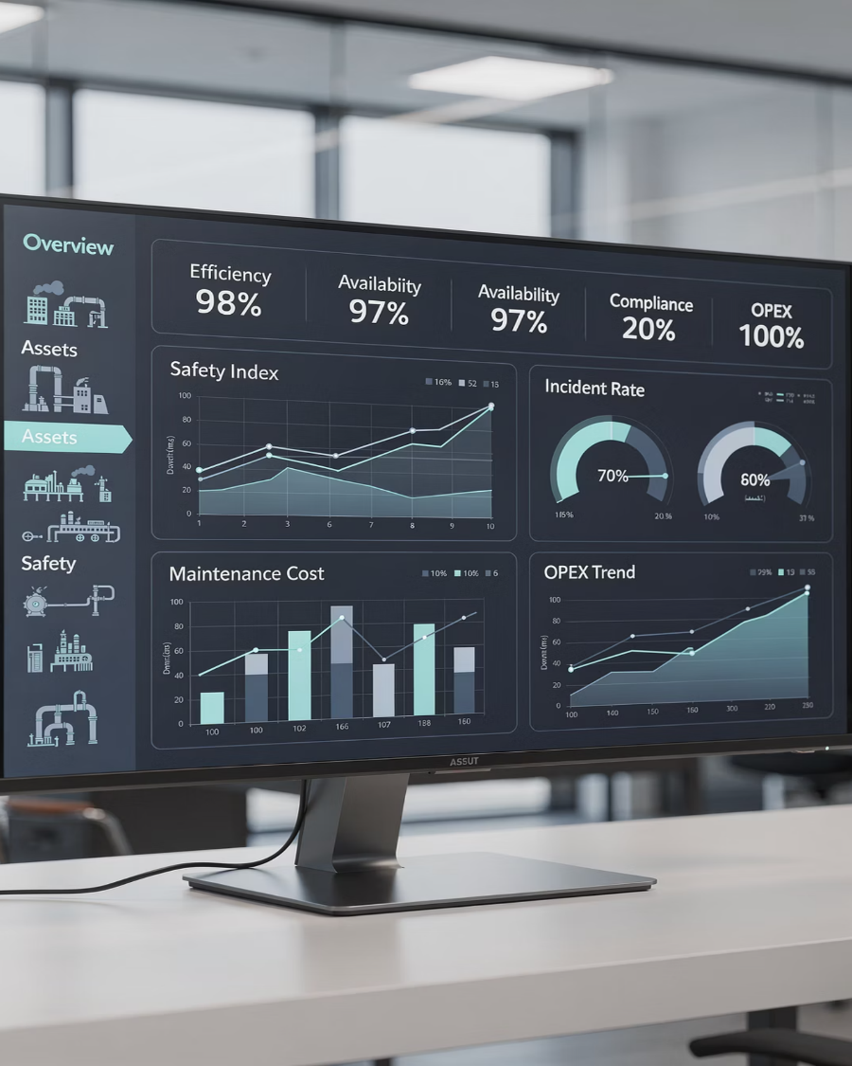
Why Planning & Scheduling Matter
Craft efficiency – Elimination of barriers and frustrations
Prevent the introduction of new “defects”.
Bring order to the chaos.

Slide 4









What "Good" Maintenance Planning and Scheduling Looks Like
Clear Roles and Responsibilities
Planners Planning
Backlog Management
Planners not "expediters"; supervisors not "firefighters" every day
Detailed reusable job plan library, planner accuracy,
providing Technicians a “headstart” at a minimum,
and leveraging a precision maintenance approach
Clear processes, consistent reviews, and
segregated backlog trending
From studies, only about 10% of planners are utilized effectively
Stable Weekly Schedule
Actionable Metrics
Optimized Performance
Minimal break-ins, strong PM compliance, credible backlog
Feedback loop for continuous improvement to Planning
Schedule Compliance 85-90%
Labor utilization 100%
PM Compliance 95%
Planner accuracy ± 10-15%
Better uptime, lower overtime, reduced costs, and
optimized MRO inventory

Slide 5

Common Failures
Typical problems:
Clear processes, consistent reviews, and
segregated backlog trending
No clear roles, planners doing everything except planning, reactive culture, schedule constantly blown up, Operations not providing equipment access..
Siloed Maintenance–Operations–MRO–Engineering
with poor communications.
Better uptime, lower overtime, reduced costs, and
optimized MRO inventory

Slide 6
Core Principles of Planning & Scheduling
01
02
03
Separate planning from execution
Planning before scheduling
Protect the frozen weekly schedule
04
05
Prioritize based on risk and business impact
Continuously improve using feedback loop

Slide 7
Defining Roles & Responsibilities
Clarify key roles:
Planner, Scheduler (can be same person in small sites), Supervisor, Craft, Operations coordinator, MRO.
Show a simple RACI or bullets:
Who owns planning and the creation of reusable job plans
Who owns the weekly schedule
Who approves break-ins
Who owns backlog quality

Slide 8
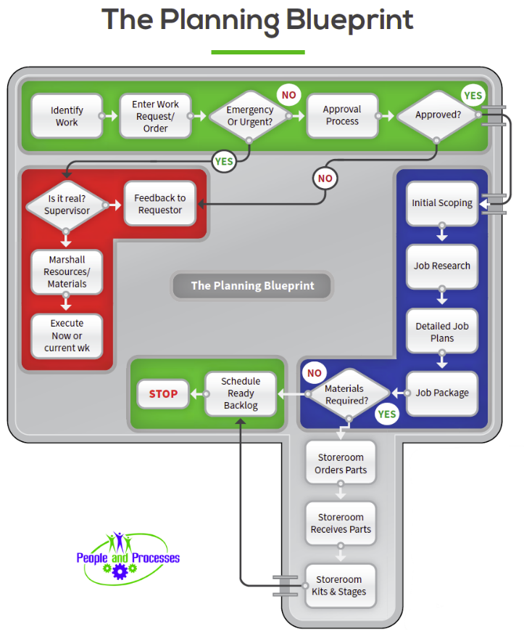




The Planning Process (Work Identification to Ready Backlog)
Work identification
Screening
Priority & risk assignment
Job scoping
Estimating
Materials/tools/LOTO
"Ready to schedule"

Slide 9
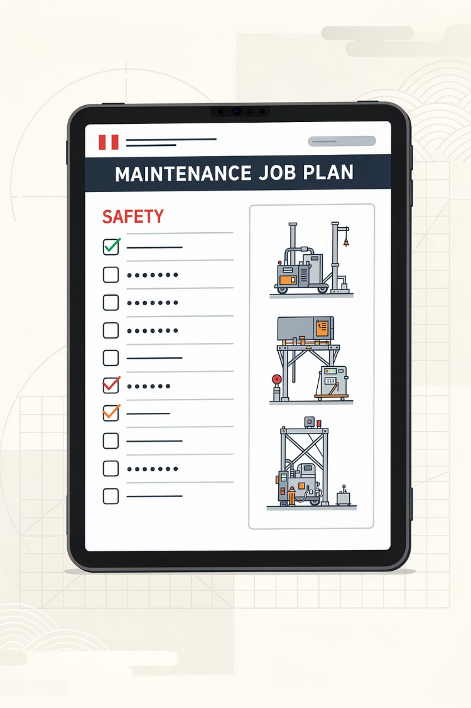
Building Quality Job Plans
Elements of a high-quality job plan:
Clear scope, task steps, safety/LOTO, duration and crew estimate, skills, materials, special tools, QA checks, history, feedback.
Precision specifications to prevent new defects.

Slide 10
Effective Scheduling: Weekly & Daily
Weekly Schedule
Daily Schedule
Workload vs. capacity, frozen at a defined time gate with
Operations agreement
Manages minor adjustments and emergent work without
destroying the week

Slide 11

Partnering with Operations
(Breaking the Silos)
Mechanisms to make Production a true partner:
Weekly maintenance–operations meeting, agreed priority rules, shared KPI targets, and a "no surprises" rule on downtime.
Operations Gatekeeper
Understanding the business case

Slide 12
Integrating the MRO Storeroom
The Problem
Key Practices
Weak storerooms undermine planning: Unavailable spares, wrong data, long lead times, and last-minute scrambling.
Linking BOMs to assets, setting min/max levels, using reservations/parts kitting, and aligning purchasing with the planning horizon inside the EAM.

Slide 13






Using Data & KPIs to Drive Behavior
Recommend a focused KPI set:
Schedule compliance
PM compliance
Emergency work percentage
Ready backlog quality
Labor Utilization
Rework rate
Use EAM analytics and reporting to review, discuss, and improve process discipline,
not to punish individuals.

Slide 14
Governance, Standards, and Workflows
Documented Standards
Governance - Audits
Stressing the need for documented standards:
Process to Audit
Work types, priority codes, planning and scheduling procedures, approval workflows, and data quality rules in the system.
Periodic reviews of backlogs, KPIs, and process adherence

Slide 15
Change Management & Culture
Address the human side:
Move from a reactive "hero culture" to rewarding a disciplined, system-driven culture.
Practical tactics:
Coach supervisors, involve crafts in improving job plans (feedback loop), celebrating schedule compliance and reduced emergencies, and using success stories from within the plant.
Validate that the PM’s truly add “value.”

Slide 16

90-Day Roadmap
Provide a concrete, time-bound action plan:
Last 30 days
Next 30–60 days
Review results, refine, and roll out to more areas; align with EAM insights as they are available.
First 30 days
Pilot an improved weekly schedule with one production area, start kitting with storeroom, define KPIs.
Clarify roles, draft planning/scheduling standards, clean up basic EAM data (priorities, codes).

Slide 17

Wrap-Up & Commitment
To recap the central message in a few sentences: robust planning and scheduling is a deliberate, cross-functional system, not a software feature. It is the hub of a proactive maintenance function and must be supported by management.
What are the two changes that you will commit to implement on your return to the plant?
JShiver@PeopleandProcesses.com
LinkedIn: https://www.linkedin.com/in/jeffshiver/

