Slide 1

Start, Structure, Succeed: Developing a Water Asset Program in Hexagon EAM
Jesus Suarez and Amanda Jones
Tucson Water

Slide 2
Agenda
Condition Assessment at Tucson Water
Lead up to September 2024
Pieces of the Puzzle
Assessments
Evaluation & Next Steps
Notes:
Amanda

Slide 3

Check, mate!
Condition Assessment at Tucson Water
Notes:
Sonny
Department Stats
TW serves 800K customers a across 420 sq. mile service area
Last year average daily demand of 113MGD (Average = 89MGD)
4500 miles of distribution/transmission network
350 of which are TM >16” potable and reclaim
44 reservoirs and storage tanks
130 distinct booster stations (zone lifts)
120 prvs
188 active wells (300 total)

Slide 4

Pre-EAM Methodology
Linear Assets
VodaAi*
Large Diameter Pipeline Condition Monitoring (2006-Present)*
Vertical Assets
Reservoirs
Pressure Tanks
Boosters/PRVs
*Ongoing programs
Notes:
Sonny

Slide 5
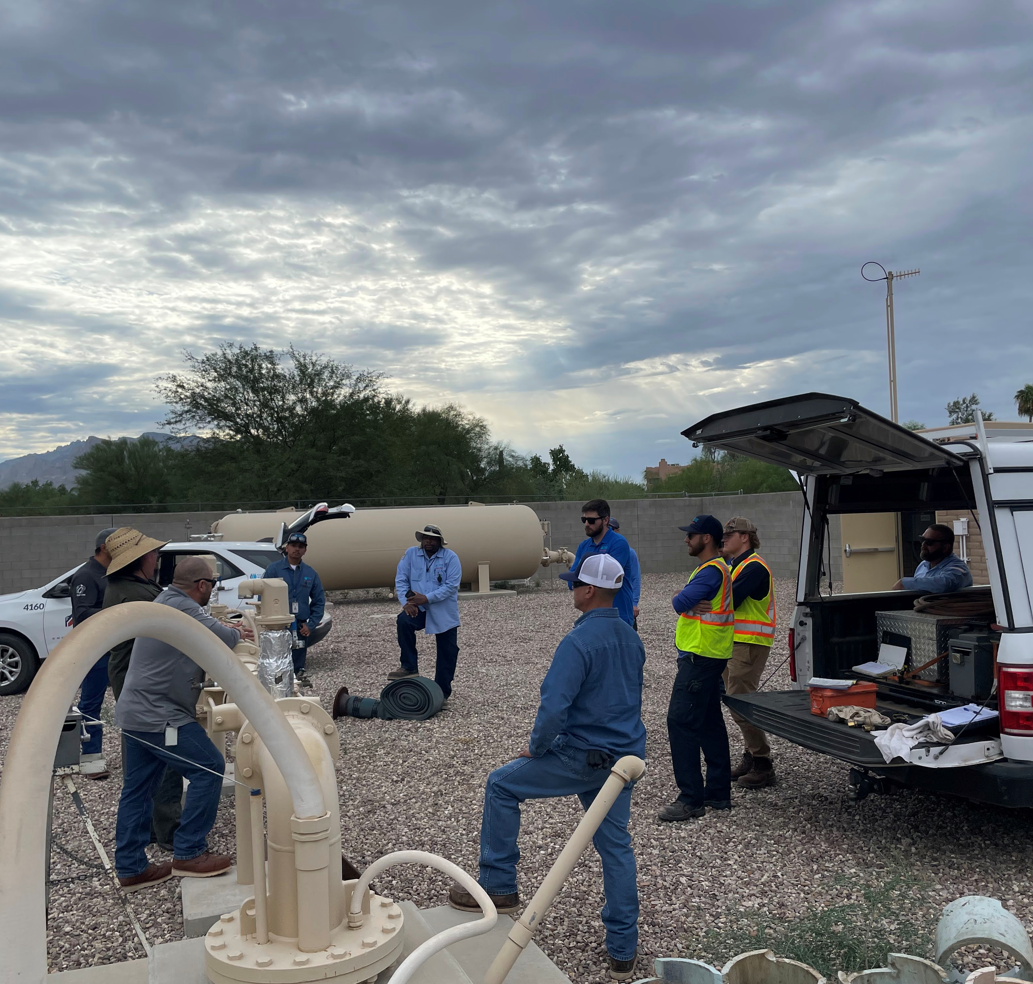
Goals
Use the EAM module to measure the condition of our assets
Leverage our in-house knowledge, skills & abilities
Connect to other asset work (work orders, PMs, etc.)
Centralize the condition information
Standardize the condition collection process
Expand the overall use of EAM
Set us up for RCM (inform design, operation, maintenance)
Notes:
Sonny

Slide 6
Prepping Pros
Leading up to the new approach
Notes:
Sonny

Slide 7
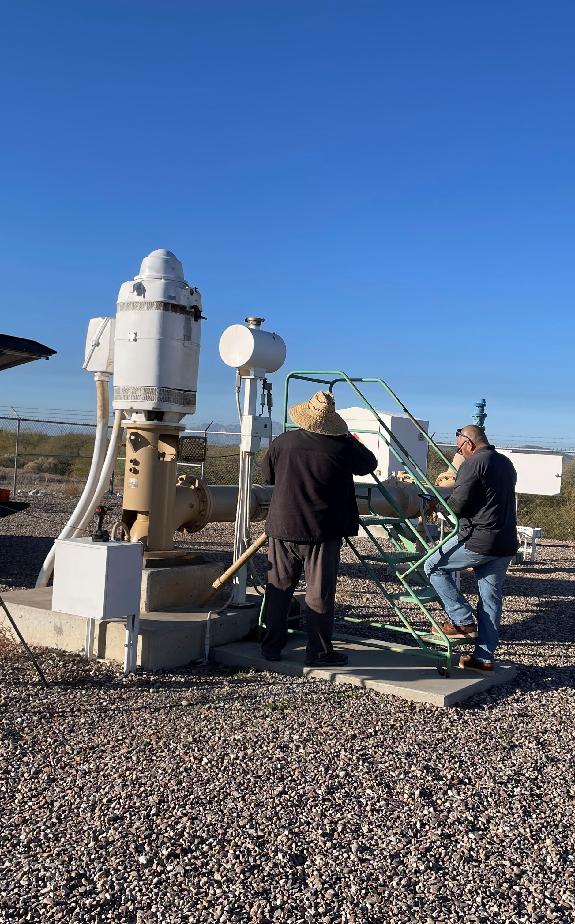
Asset Class Identification
How many classes?
90 Total Asset Classes
35 Potential Assets
3 Asset Classes for POC
Pump, Motor, Well
How did we decide on these three?
Class Criticality
High Volume Failures (pump/motor)
Aging Infrastructure (deep wells)
Notes:
Sonny
For context, TW has approx. 1M assets in EAM
-
- 35 asset classes that we could/want to assess
- POC was focused on 3 distinct asset classes (including 9/13 categories)
- example – motor booster / motor well
- example – centrifugal, vertical turbine, submersible
Motor/pump failures (1 year from start)= 15% motors 10%pumps ~800 ea
Average deep well age = 34 (1953 oldest…still producing)

Slide 8
PoC Timeline
September 2024
Project starts
October 2024
Project team initial workshop
December 2024
Begin requirements gathering
June 2025
Completed requirements
July 2025
Testing
August 2025
Training
August – December 2025
Completion of Proof of concept
Notes:
Sonny

Slide 9
Some Assembly Required
SMEs and Configuration
Notes:
Amanda

Slide 10
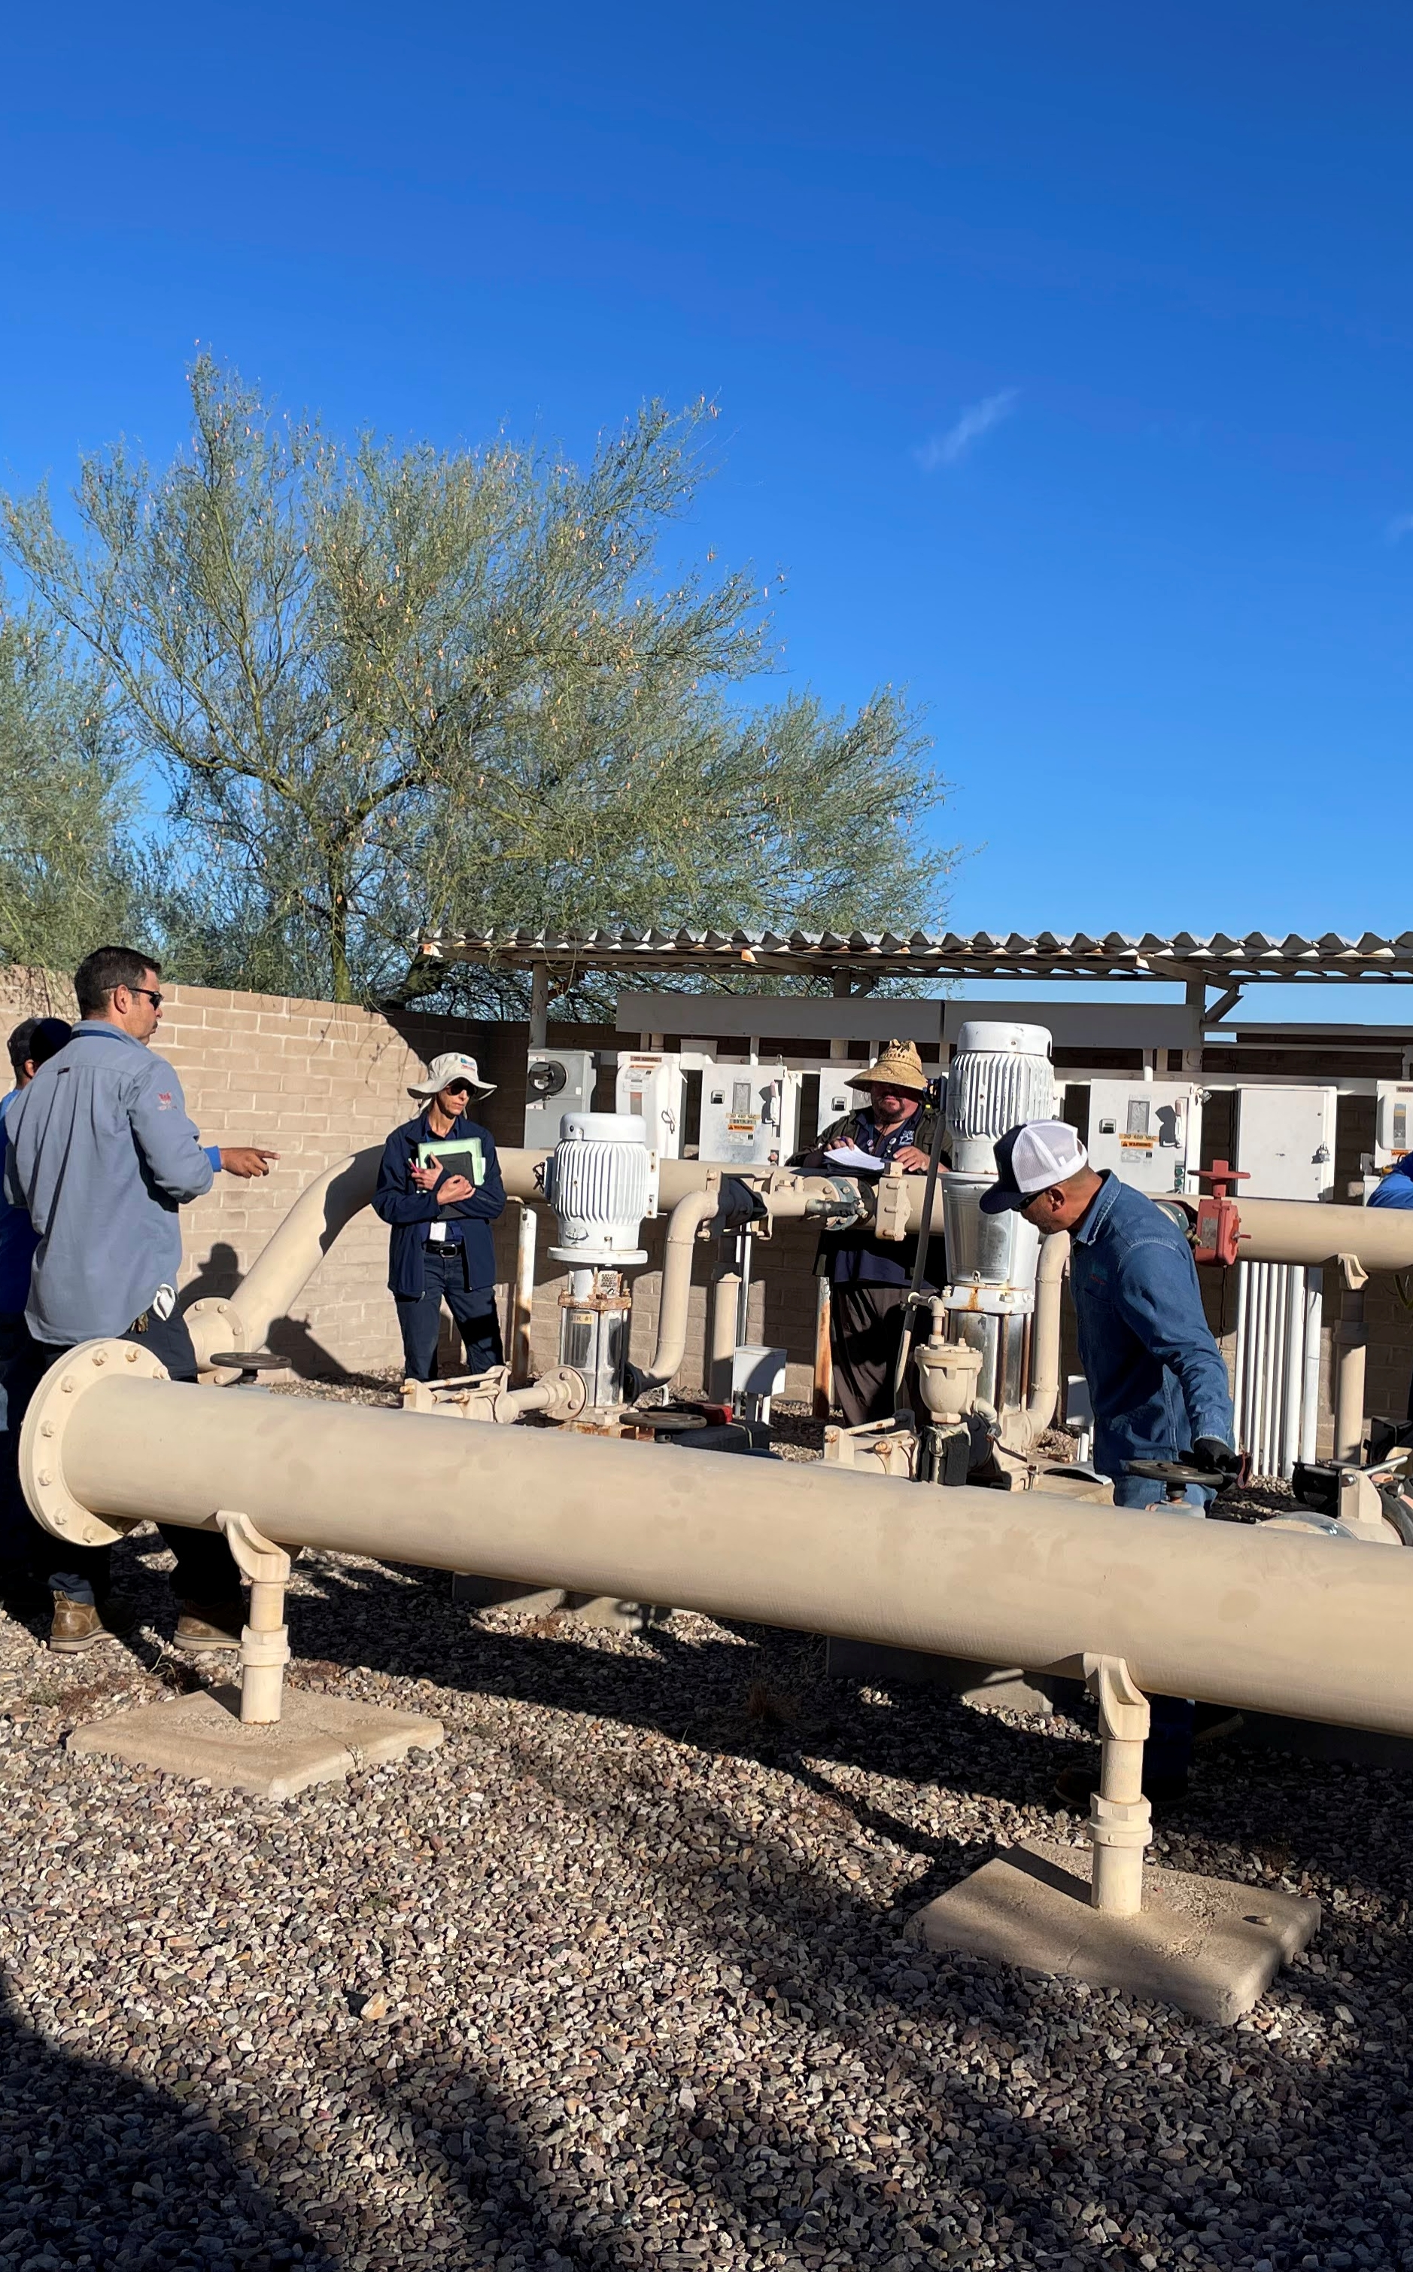
Subject Matter Experts
Trades
Well Maintenance
Instrumentation and Controls
Electricians
Project Managers
Hydrologist
Utility Technicians
Planner/Scheduler
Others
Source Water
System Operations
System Planning
Planning & Engineering
EAM Sys Admin
Notes:
Amanda

Slide 11
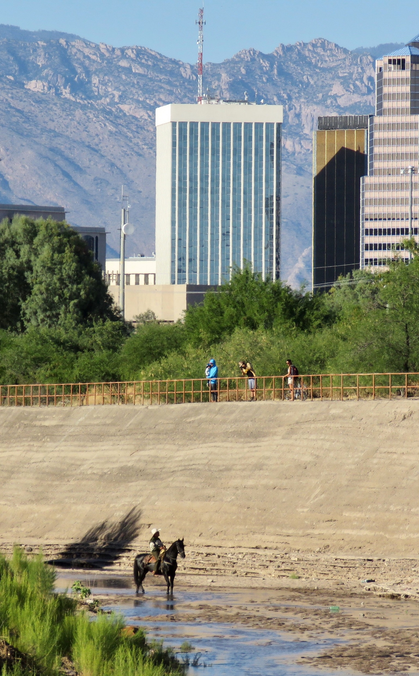
Equipment Ranking Components
Decay Curves
Useful Life
Performance Formulae
Assessment Survey
Questions
Answers
Weights
One-time creation
Decay curves
Based on asset class/category
Assessments
Based on single fields
Useful life
Based on system data
Performance formulae
Notes:
Amanda

Slide 12
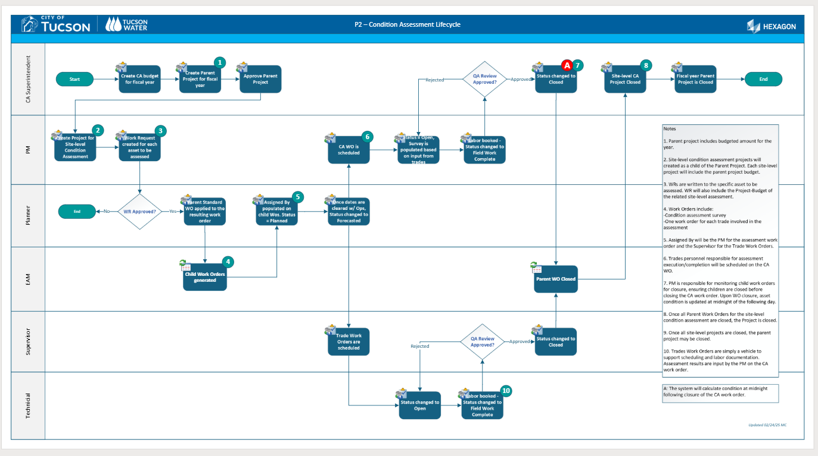
Workflow
Notes:
Amanda

Slide 13
Measure Twice, Assess Once
How we measured success
Notes:
Amanda

Slide 14
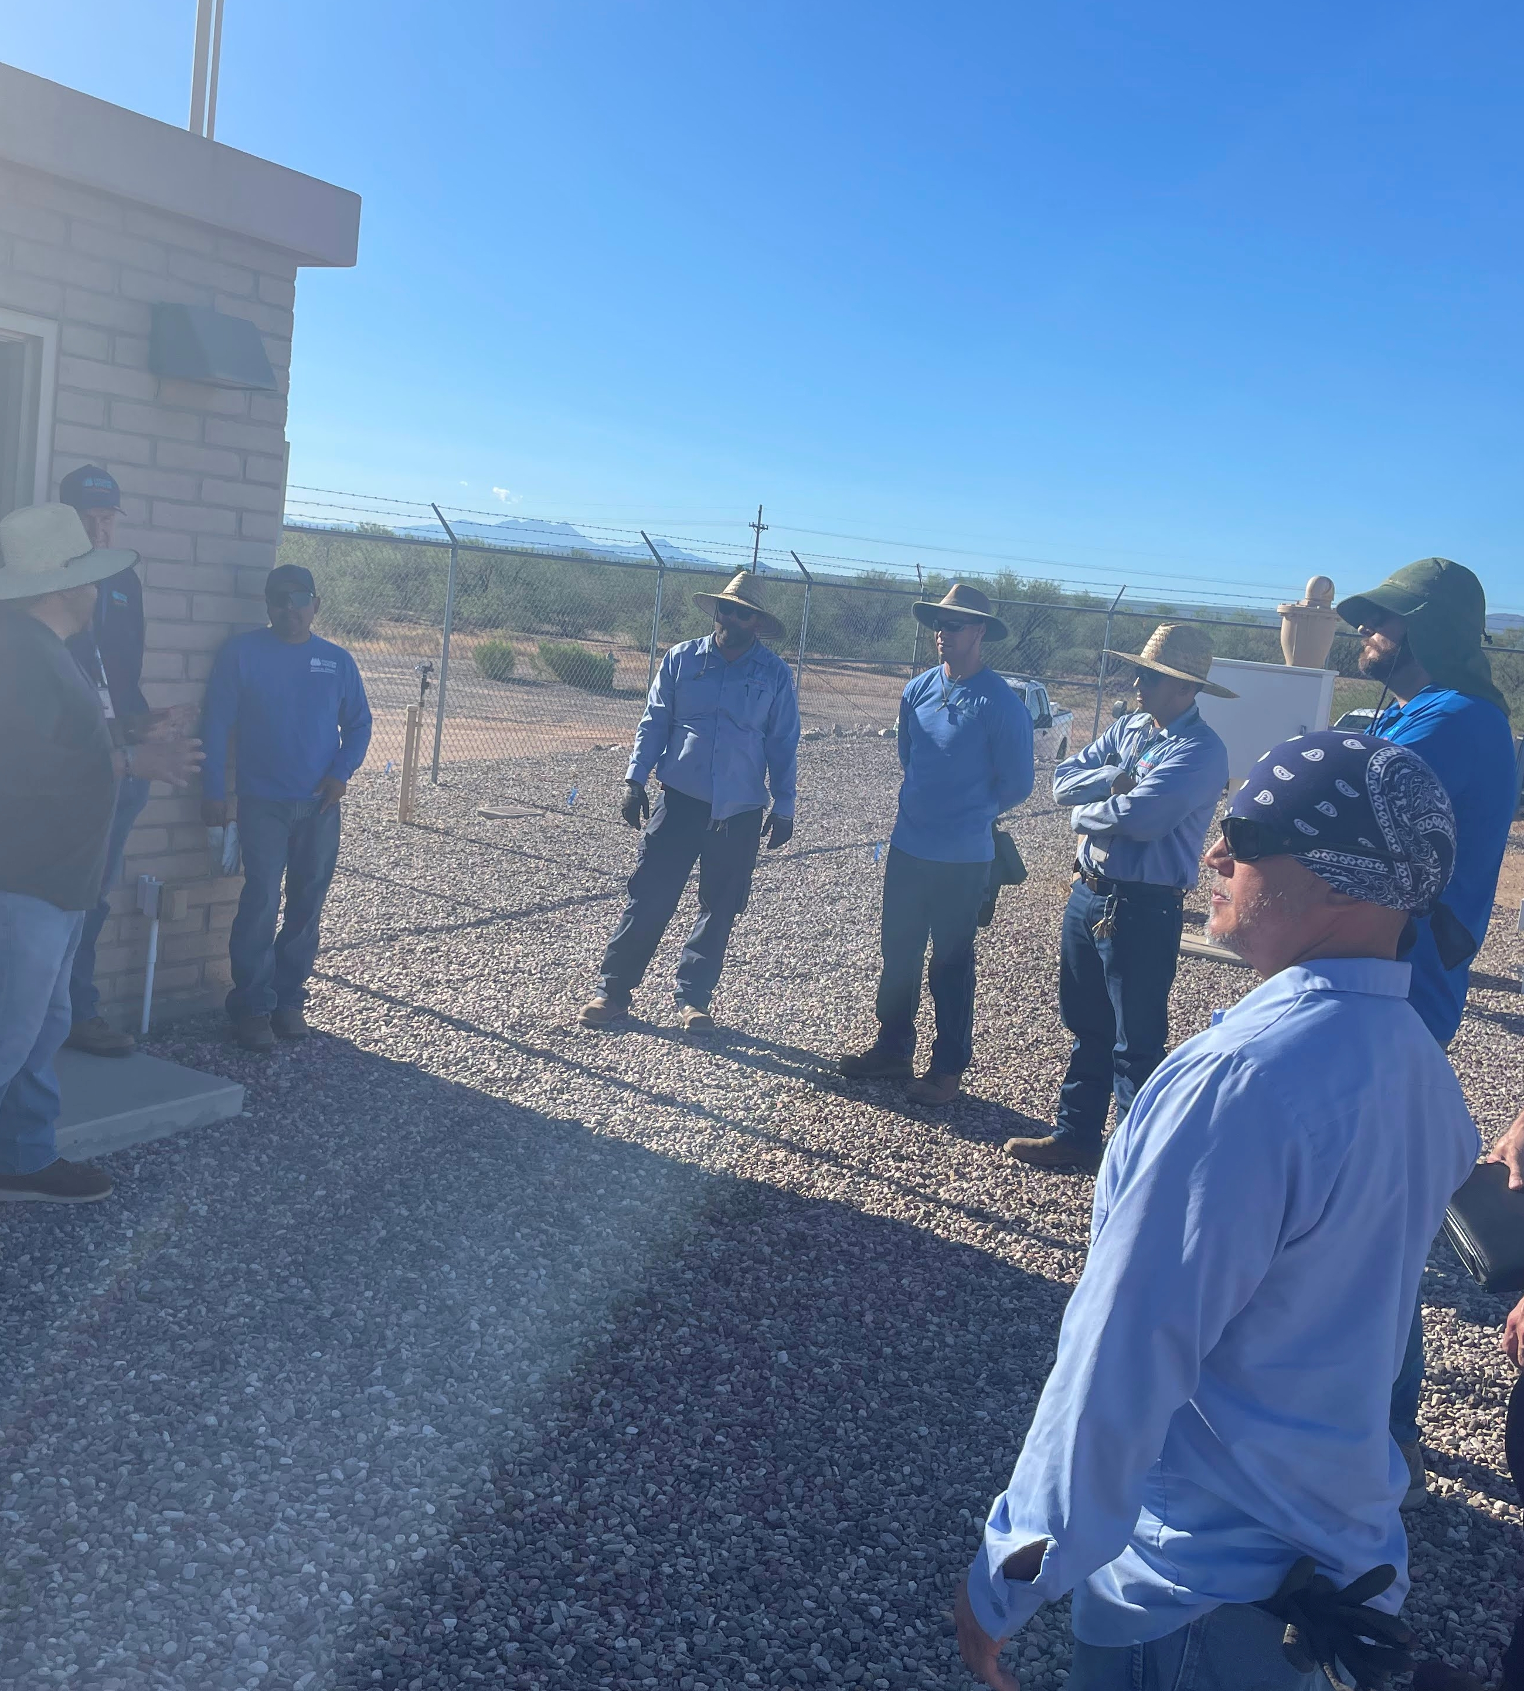
Assessments
Completed between July and December 2024
Eight categories
Three classes
36 assets
Seven sites
Three well sites
Four booster sites
Six trades
Approximately 200 work orders
One Planner/Scheduler
Digital Work Application
On-site survey
Notes:
Amanda

Slide 15
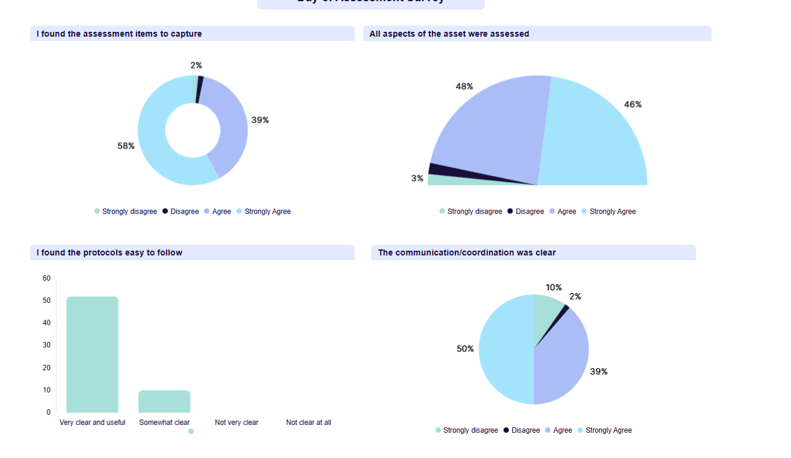
Dashboard
Notes:
Amanda

Slide 16
Let’s Go!
Next steps and further implementation
Notes:
Sonny

Slide 17
Upcoming Events & Next Steps
Gap Analysis Completed
Incorporate suggestions
Leadership Input and Direction
February 2026
Operations & Methodology Review
March 2026
Expand the Equipment Ranking Module
Departmental Data Use
Notes:
Sonny

Slide 18
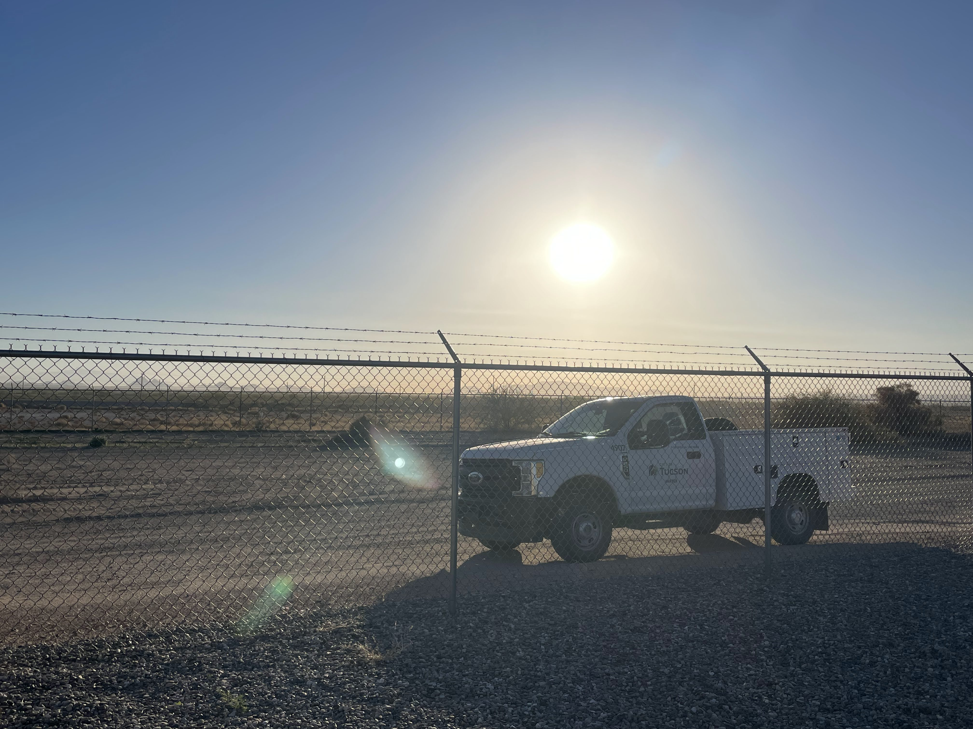
Thank you!

