Slide 1

The Adaptive Advantage People Are Your Greatest Asset
Rebekah Prather
Lead Facilitator
Circle Squared Solutions, LLC

Slide 2
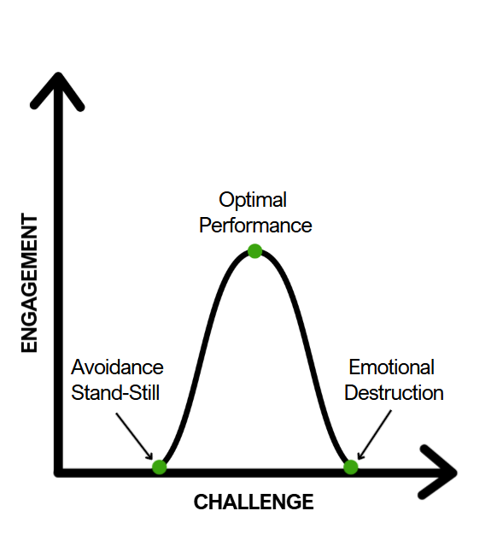
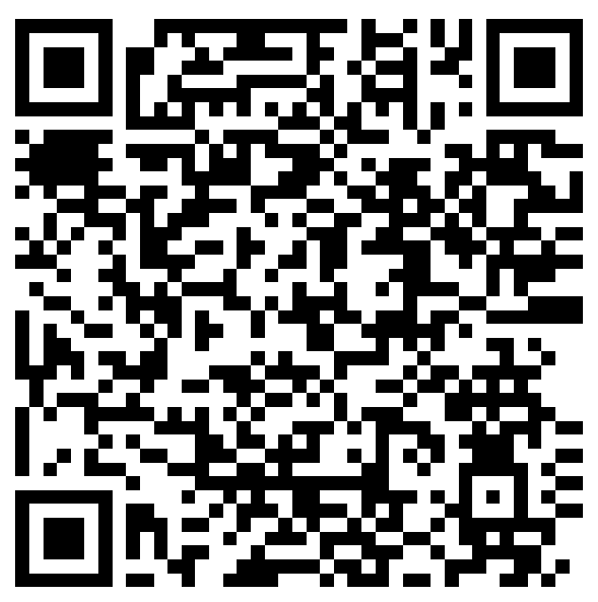
Maintenance Matters Too Much Damages. Too Little Dulls.
Scan for Free Workbook!

Slide 3
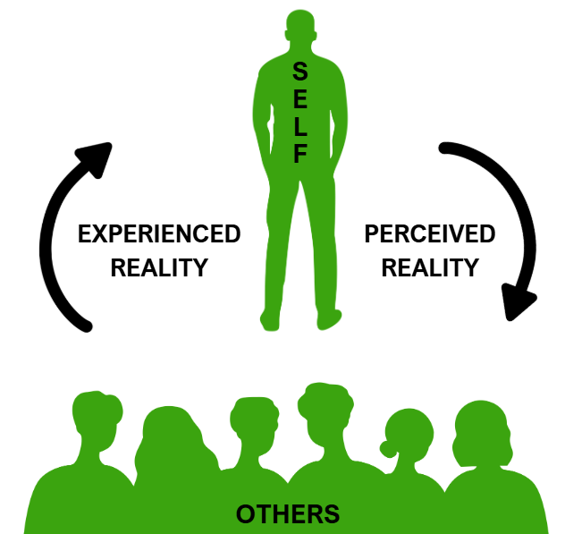
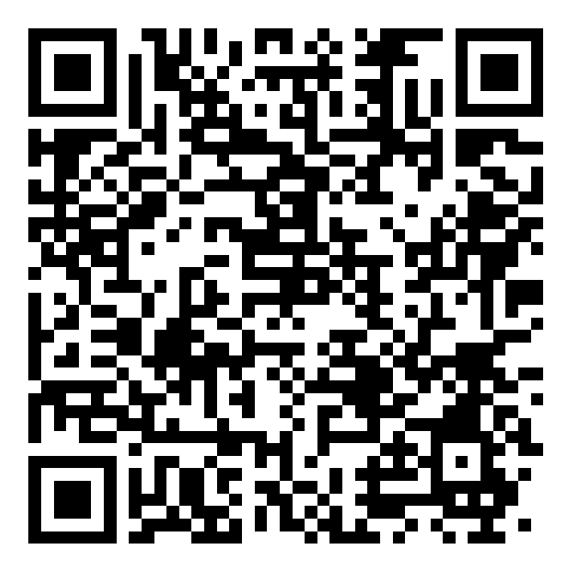
Every Breakdown Holds The Blueprint For Breakthrough.
Scan for 90-Day Planner Discount!

Slide 4
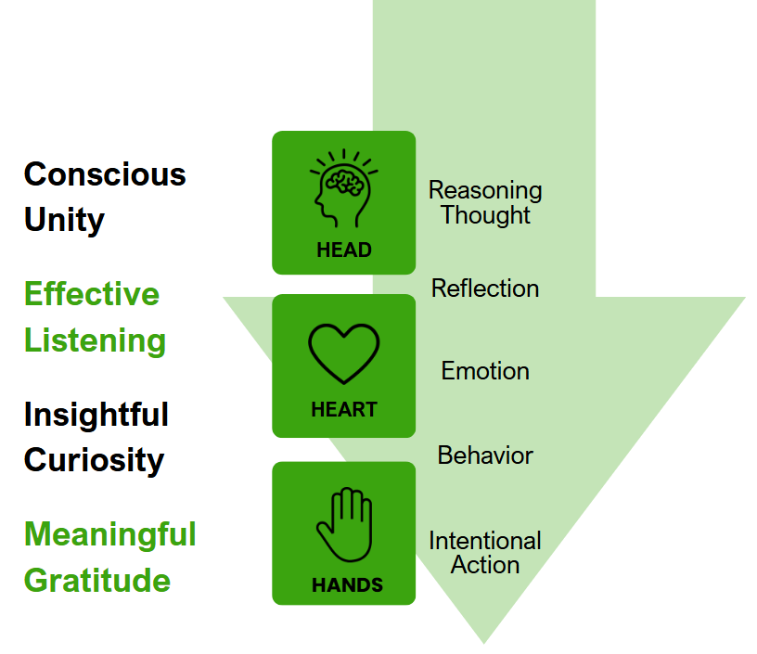
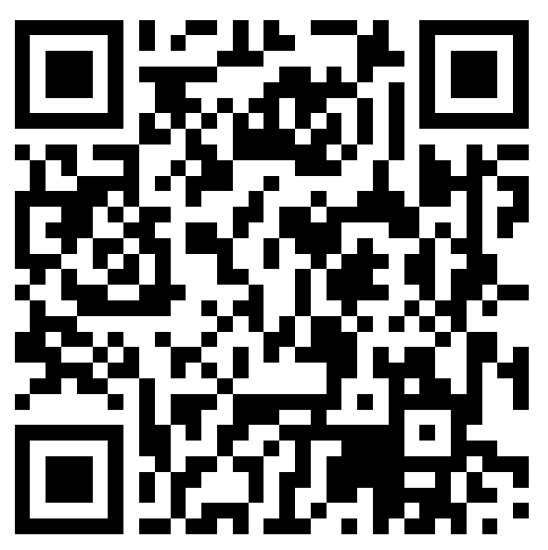
Principles of Humanity Turn Connection Into Alignment.
Scan for Printable Values!

Slide 5
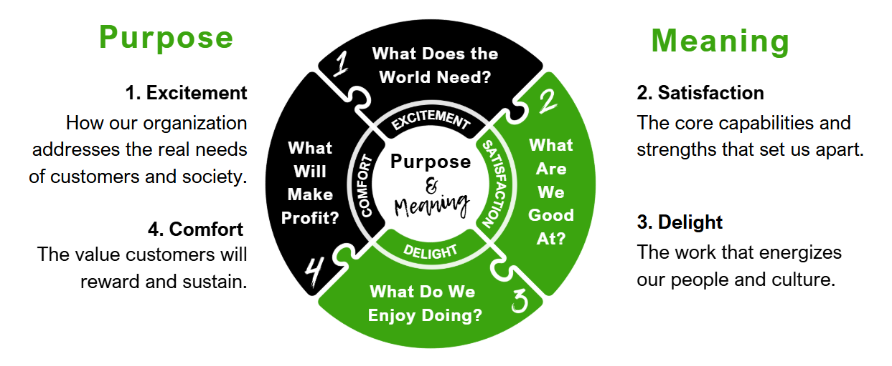
Alignment Streamlines Growth

Slide 6
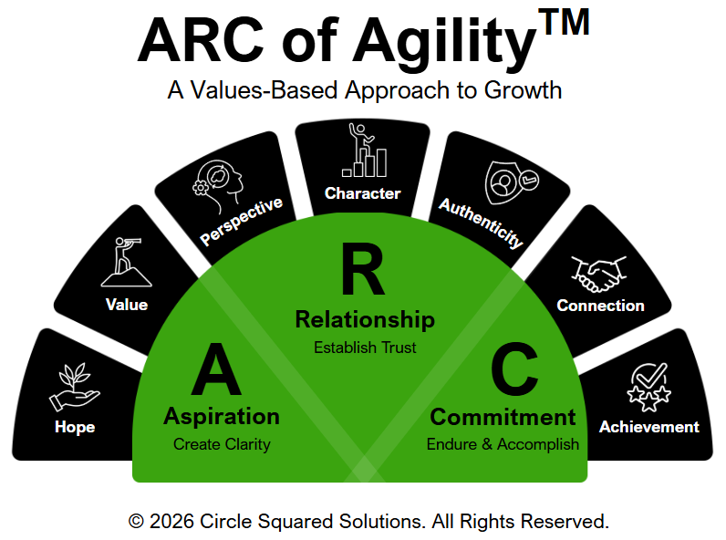
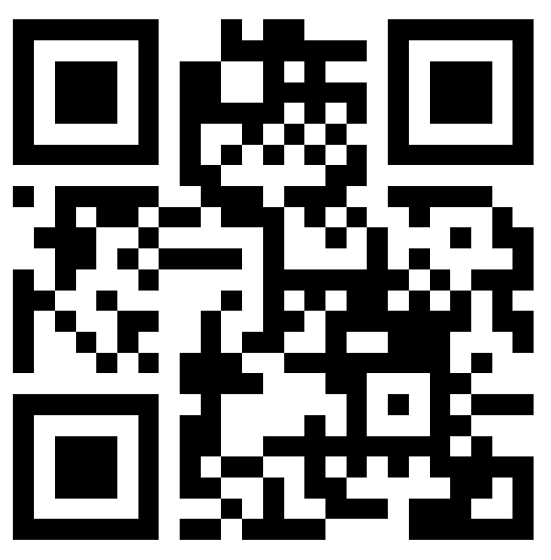
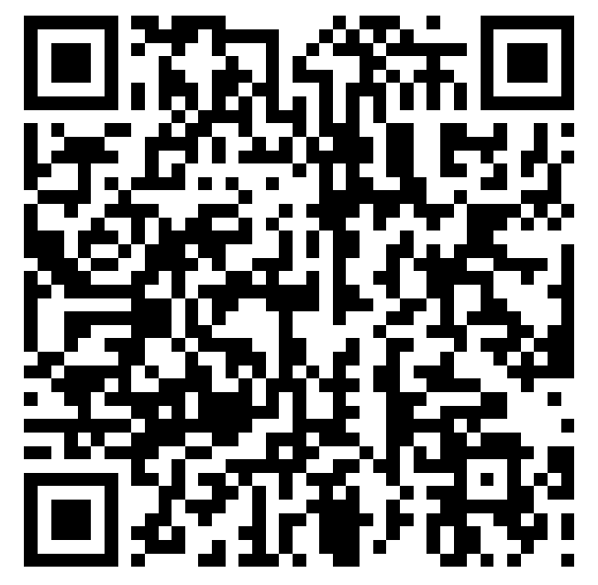
Enter Header
Add text or image
Scan for Contact & Resource Links!
Help Improve Today’s Session!

