Slide 1
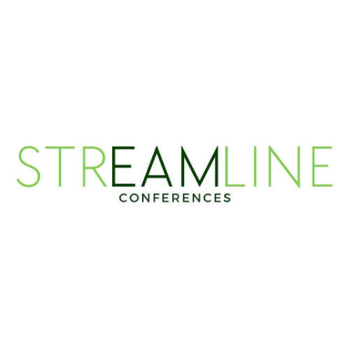
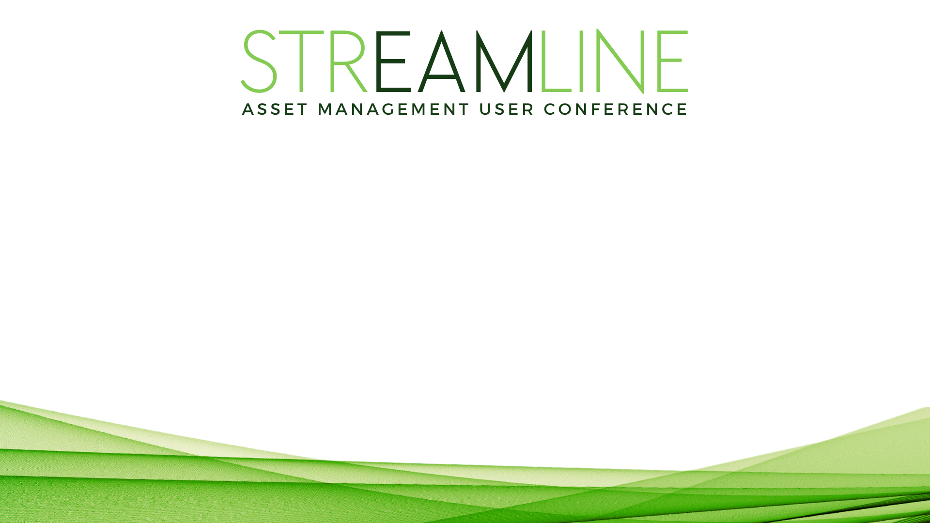
The Evolution of Asset Collection: Augmenting Human Expertise with AI
Billy Holder, CFM
Founder, CEO
Project Aidra

Slide 2
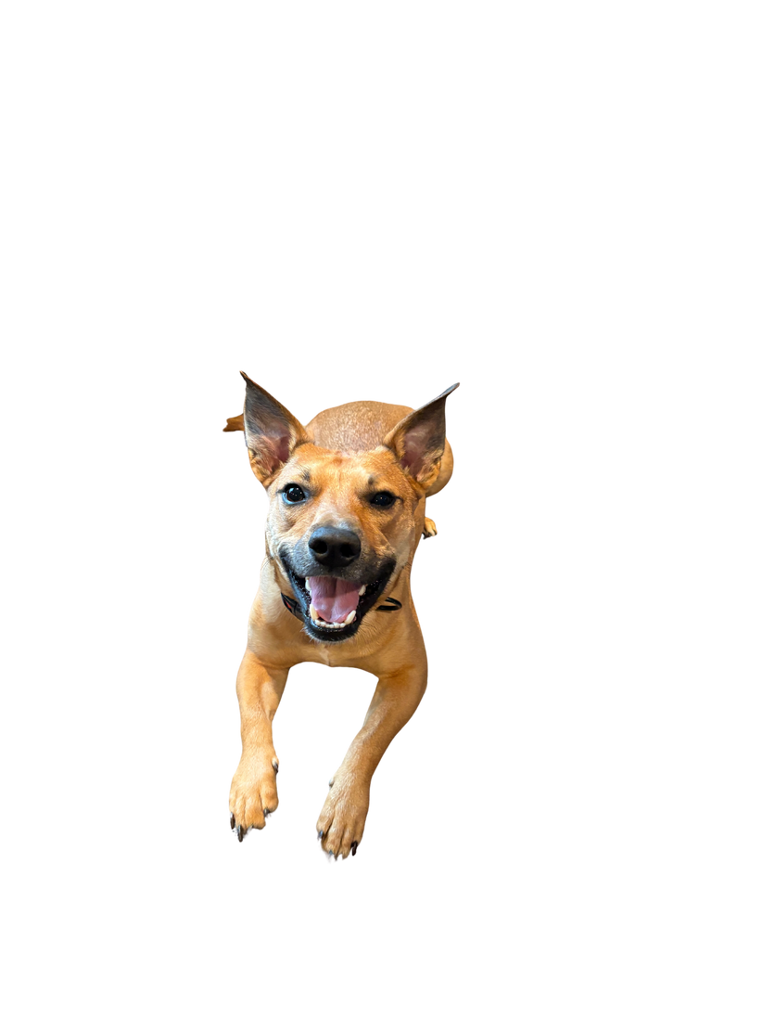
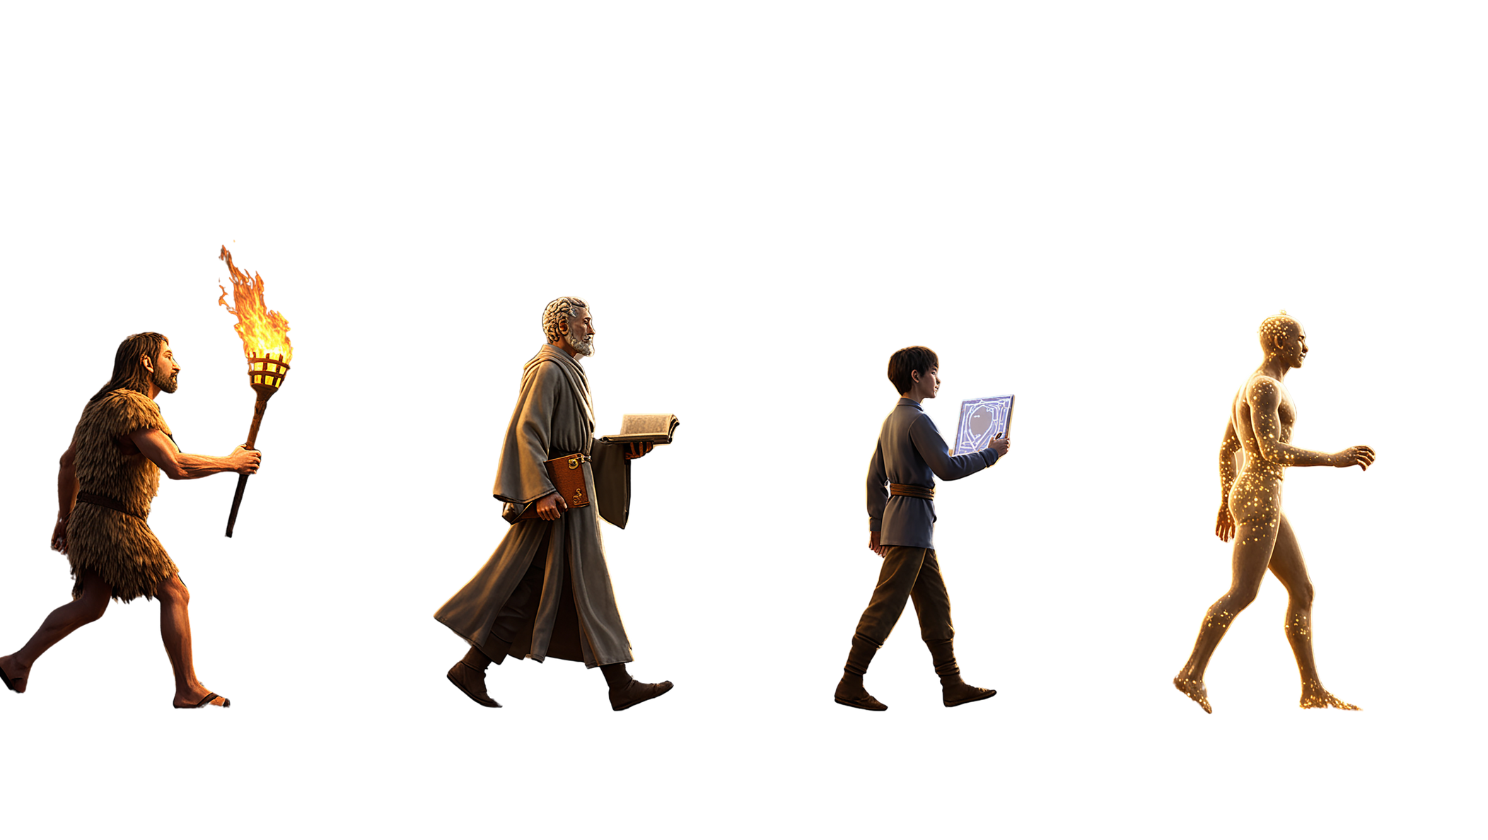
The Evolution of Asset Collection: Augmenting Human Expertise with AI
NEXT Stage: Artificial Intelligence
Billy Holder - Founder CEO Project Aidra LLC
With Bailey - Chief Morale Officer
Notes:
We've seen a lot over the years- from punch cards, pen and paper- to typewriter carbon copies, to electronic dot matrix printed- to spreadsheets, and now digital form inputs...
But these all had one thing in common- the manual capture of Asset Data. Someone had to go out and right down the asset data / take a picture of it, and then copy it over into another system. And there were always mistakes. Missed assets, and never once was there an accurate description of the condition and functional readiness of the asset.
Ive lived this pain along side you all for nearly 30 years- As a builder, a maintainer, manager and operator-
Im Billy Holder I help teams save time using technology. —At Project Aidra we empower the the human in the loop with super speed and intelligence.
We believe the human is the most important part of the built environment. And we should do what we can to empower them with technology to be better, faster, and smarter.
But I wasn't always interested in technology.
Before I was a founder, before I was a CFM, before I understood that Facilities Management was even a profession—I was a carpenter building houses in south Louisiana.
Today - I want to share what's possible today and tomorrow with the Next evolution in Asset management.
And how you can be AI-volution ready.

Slide 3

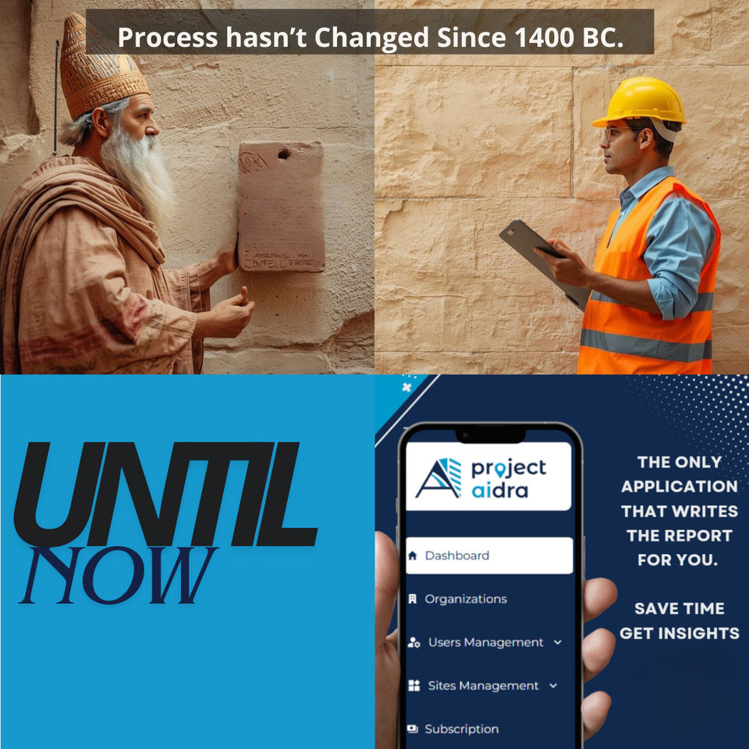

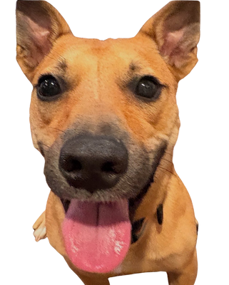
The Evolution
of ASSET Collection
Let's Get Aligned - Assets & AI Defined
The Sobering Data - McKinsey's AI Readiness Study
The Great Divide - 99% Stuck vs 1% Succeeding
Your Roadmap - How to Actually Get Started
Proof Points - 3 Real Facility AI Wins
Q&A - Your Turn to Drive
For the last 3400 years; we just changed the tool we used to suffer.
Notes:
""Before we dive in, let me give you a roadmap of where we're headed today. I want to make sure we're all speaking the same language and that you leave here with actionable insights.
First, we're going to get aligned on definitions.
What do I mean when I say 'Asset'? What do I mean when I say 'AI'? Because in our industry, these terms get thrown around a lot, but they mean different things to different people.
Second, we'll look at some sobering research from McKinsey
They've done extensive work on AI readiness across industries, and the results might surprise you. We'll explore why this matters specifically to facility professionals and what it means for your competitive position.
Third, we'll talk about the massive gap forming between organizations that are successfully implementing AI and those that are stuckin digitization purgatory.
Fourth, we'll get practical
I'll give you a framework for how to actually get started with AI - not theoretical concepts, but a step-by-step approach based on real implementations.
And finally, we'll look at three real-world examples
Not case studies from Silicon Valley, but actual deployments in facilities like yours, with measurable impact from the boots on the ground all the way up to the C-suite.
Then we'll open it up for your questions.
(Pause, look around room)
My goal isn't to sell you on AI - it's to give you the knowledge and framework to make informed decisions about your organization's future. By the end of this session, you'll know exactly where you stand and what your next steps should be.
Let's start with the fundamentals..."

Slide 4


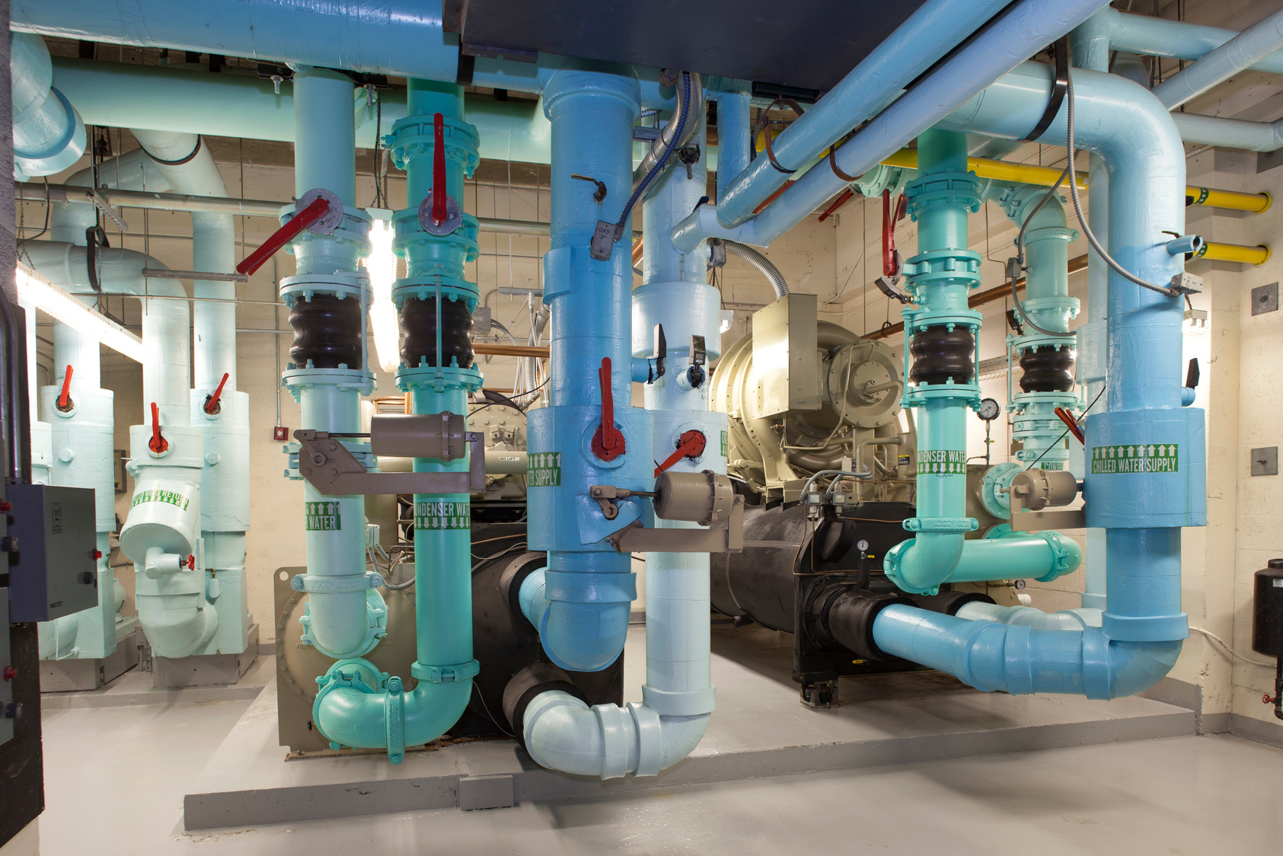

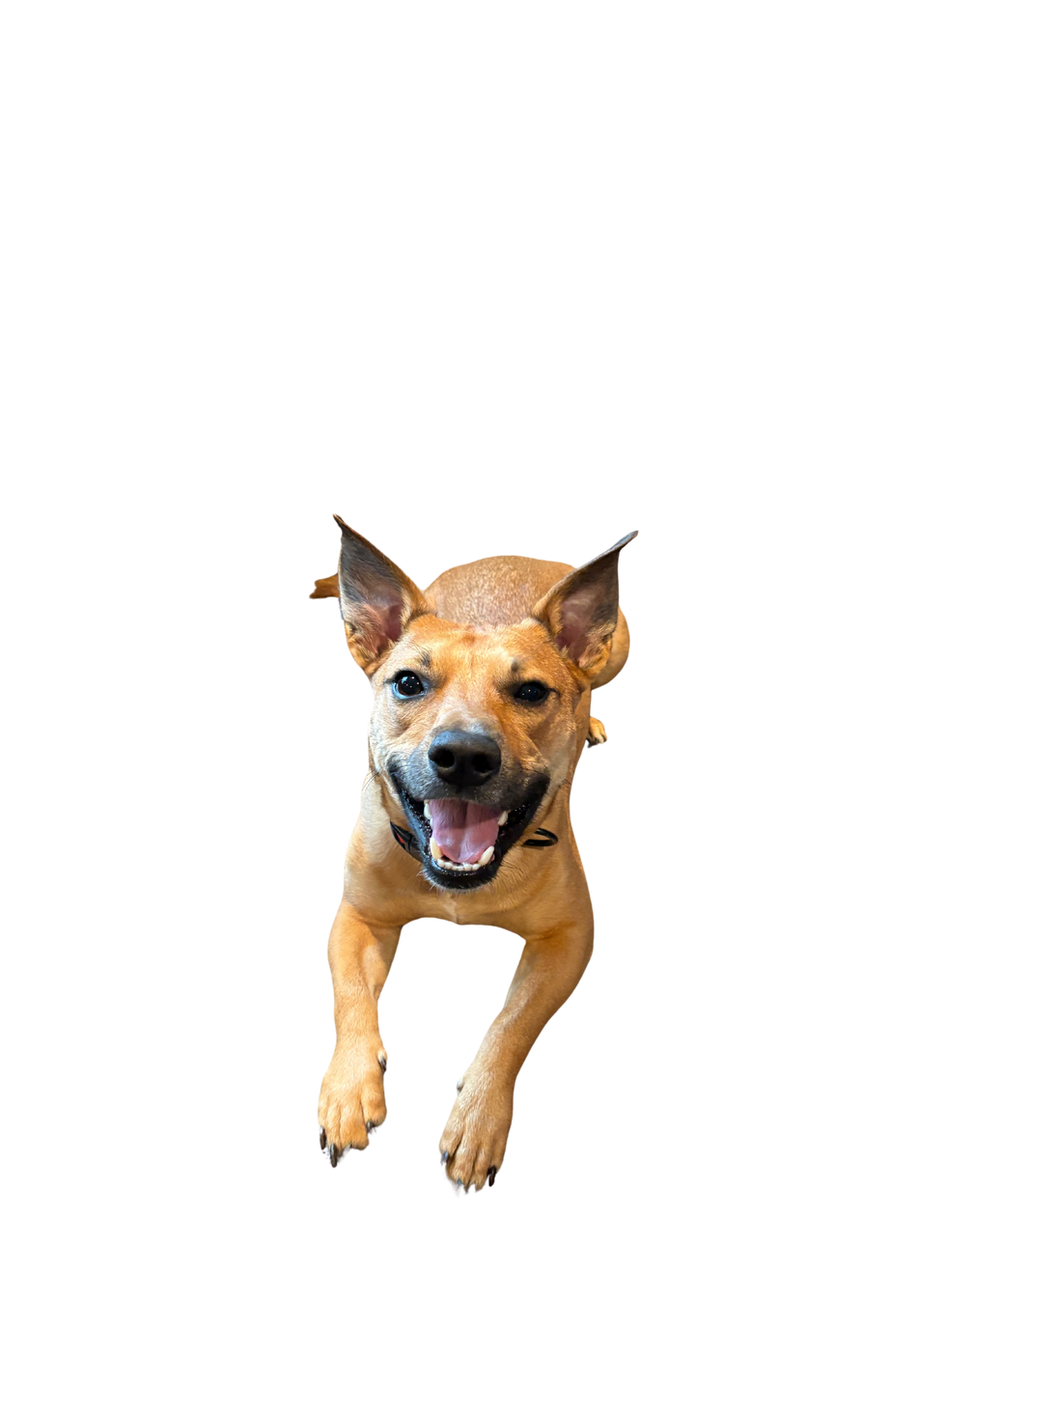
ASSET???
What’s That?
Assets are defined in different means by different standards organizations
ISO 55000
ASTM (PCA/condition)
NFPA
SMRP
Operational definition: anything you’d miss, pay to replace, or must maintain to deliver your mission.
Notes:
Assets- What are they? Really and truly - It depends .... right.
W have All these organizations that define an asset-
ISO ASTM NFPA< and a host of others out there
But I think we can all agree that anything an organization deploys capital toward in order to maintain and operate can be defined as an asset.
In that - A building and its functional components are often referred to as assets.
When we think of assets - we likely think more granular- Chillers, Boilers, Air Handlers, switchgears, pumps, generators, motors, and systems....
the high dollar high impact components that ensure the organization has what it needs to operate.
Operational definition: anything you’d miss, pay to replace, or must maintain to deliver your mission.

Slide 5

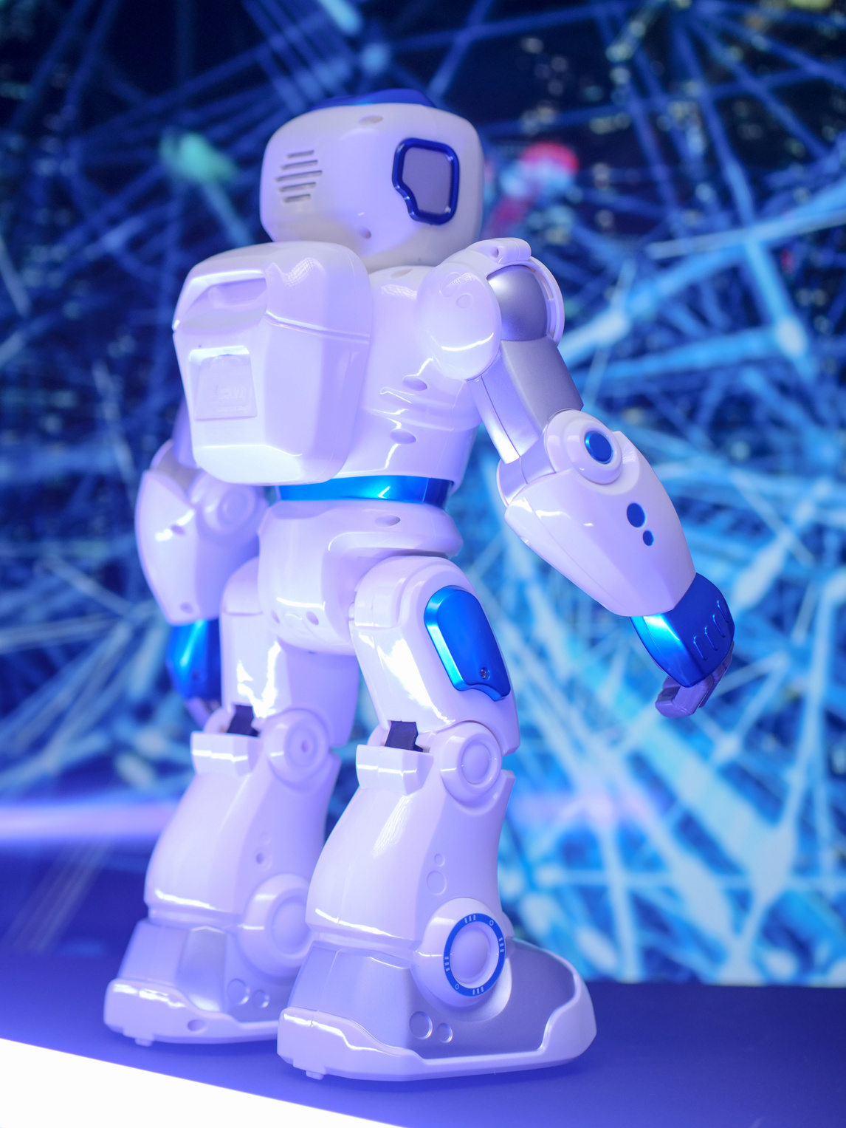


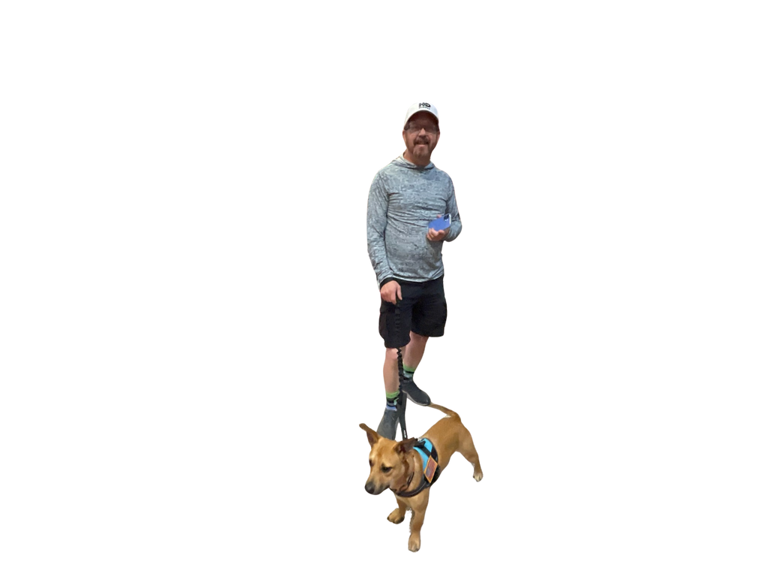

What is
Artificial Intelligence
The simulation of human intelligence processed by machines.
It’s Not Magic. It’s Math.
Notes:
"At teh start I told you AI was the next evolution - so quick poll...
Who has a good handle on what AI is and how it works?
Thats great- For the rest of you - 2 years ago- I didnt know either- so no shame and no judgement.
What is AI?
Is it the Terminator? Is it magic?"
Even though is seems to do things "Automgaically"
Its not magic- Its math and a lot of it.
In basic terms
It’s simply a computer doing things that used to require a human brain."
Its not going to take your job, at least not if I have anythgin to do about it. And its not going to take over the world. We hope.
What we are talking about today is a way to make our jobs simplier and put us back in the roles we were hired to do .
to stop the Technican having to be a data entry clerk, and Admin and get them back to doing the preventative an predictive work that matters.
,Meanwhile the managment team get the insights to ask the c suite for the things they need, with the data required to answer the questions. BEFORE THE FAILURE
It augments our ability and makes us Better, faster , Smarter than we were before. And helps us do things we didnt think possible yesterday.
I am proof of that.

Slide 6
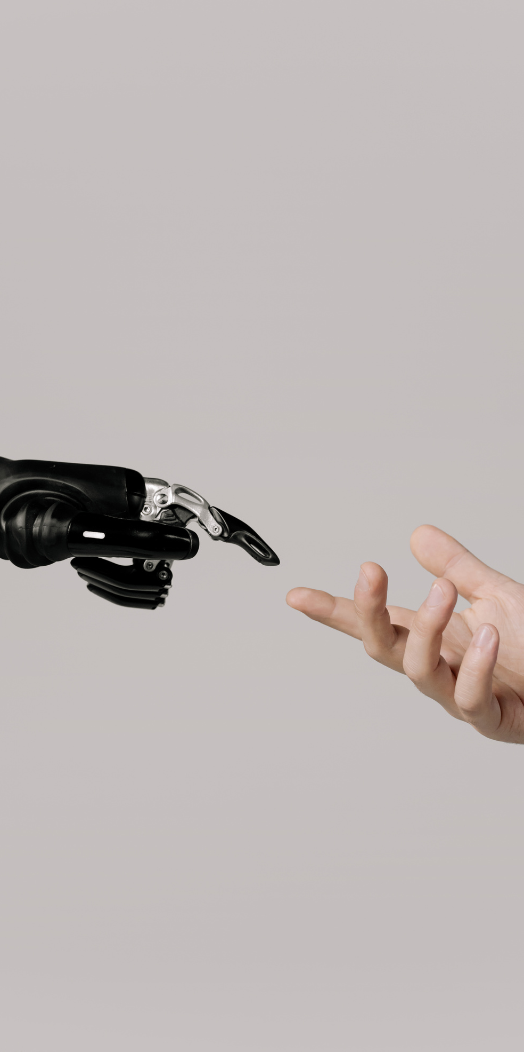


Language
01
Fluent in Human - Can Read and Write Can Hear and Speak
Types
of AI
Vision
02
Understands Context Can SEE
Interprets visual Data
There are 4 types of AI we commonly interact with in the world.
Predictive ML
03
Listens- Predicts Learns Anticipates
Agentic - Action based
04
Can think Acts Autonomously
Self Reinforcement
Uses other systems and tools.
Notes:
4 types of AI that are common and prevalant today Languange- Does anyone in the room use Chat GPT or some other LLM personally or professional? How about a AI based Note taker like Otter, or One of those built in to a meeting platform?
I use all of them everyday.
Thats a Language LLM - Its Fluent in Human being - no matter you language ( for the most part) It has the ability to read, write, do math, code, and even make music.
The next is Vision based AI - Has anyone ever used the Google lens feature to identify a part, or leaf, or maybe a safety system that identifies hazards in the workplace.
.. Yep vision AI - it can see and understand visual context- this was the impetus for what we are talking about today -
Next- I imagine many of you have some ort of ai software that monitors equipment, occupancy, or tempetures and adjusts accordingly?
This is powered therough Predictive Machine Learning - or ML- its also how AI gets smarter - or dumber-
Last but not leats is the most recent adn a very powerful AI ... Agentic . Agentic from the root Agent- meaning to have self reliance- This is the "Scary AI " that can act autonomously, and use other tools. It tyrpically combines the other 3 for its use and calls on what it nees to complete the tasks required.
Has anyone used Agents in their workflow ?
I have several that I use on a regular basis.
Well thats the big 4 - very high level but I want you tho keep these in mind as we go through today and think about which ones are at work in the scenerios we discuss. how would you deploy it to solve the problem and what do you think the outcomes would be.

Slide 7
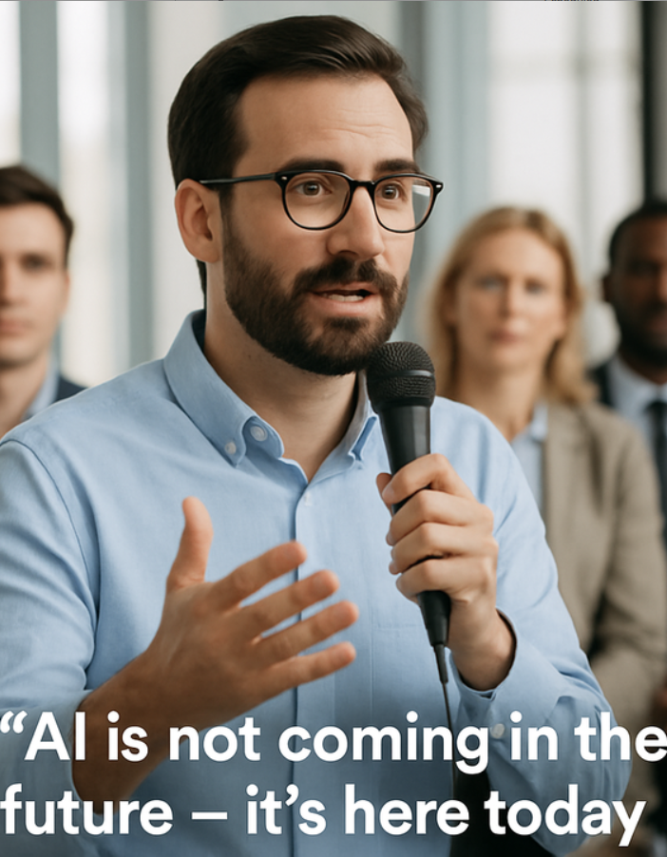



Why AI
Matters Today
Efficiency and Productivity
Only 1% of all companies are AI mature
AI automates the data capture, and the documentation, saving time and resources while reducing human workloads and providing consistent, relevant, actionable insights.
McKinsey studies show most large companies arent ready for full scale AI deployment
Notes:
SO now we have a undersatnding a base line of Assests, and AI - but why does it matter?
Well, let me say something you probably didnt expect to hear for a guy like me. The founder of an AI company-
Most of the AI out there - isnt ready to be deployed at scale. Its fluff and we have availabe for our buildings, hasnt caught up to where we are. and the ones that are - are so good at what they do - they drive results faster and the companies that are deploying them adn tearing away from the rest of the field.
Some of the companies sponsoring this event are deploying amazing tools in AI and robitics that do amazing things, and other copamnies liek Project Aidra, Voxel, ELORA are solving niche use cases to empower companies to have better data to make better decisions today for a better tomorrow.
But no matter how good any
AI tool out there is - Most companies aren't ready fo an AI deployment - Not on the grand scale of ' Lets it fix my business"
In fact -
"McKinsey’s data shows only 1% of companies have actually reached 'AI Maturity'—where technology drives real outcomes."
"The other 99%? We are stuck in 'Digital Purgatory' or Pilot process iteration" .
They dont evlove the process to something better- they just change the medium from which they work --- they dont fundementally change the process, or methods.
The only way to improve somethign it to think abotu it differnetly. _ Horse and Buggy- to Automobile
Bicycle to Airplane - Airplane to Rocket ship.
Major technological advances didnt come from companies saying - what if we jsut did the same thing - but we turn the thing sideways_

Slide 8



The 99% Reality
01
Unplanned Downtime
⚠️ 11% revenue lost (Siemens 2024) Manual gaps → Reactive fixes
02
Poor Capex Timing
⚠️ Deferred maint. → 20-40% shorter asset life (McKinsey) Subjective scoring → Over-replace viable assets
Few are mature. Many pay the price.
03
Compliance Risk
⚠️ 30% reactive maint. (SMRP) → Audit failures- No audit trails → Fines & shutdowns.
Notes:
"Now let's talk about what it actually costs to stay stuck in that 99%. Its isnt a bad thing it doesnt mean your company isnt ready- it means quite the oppsite actually. You are ready- ready to take the next step in you revolution.
Heres what the 99% deal with on a regular basis.
- You know this feeling. It's 6 AM Saturday morning. Your phone rings. 'The chiller's down.' Your weekend plans are gone, your team is scrambling, and you're calling contractors at emergency rates.
Why did it happen? Because three weeks ago, your tech wrote 'Unit looks okay' on the inspection report. But 'okay' to someone who's been doing this for 20 years vs 2 years means different things.
This needs a new bearing in about 2 weeks, Ill order one. vs I can hear it struggling, but it's still running.'
To the database, 'okay' means 'perfect condition.'
Siemens says this costs 11% in lost revenue.
I say it costs your sanity and your family time. Your teams family time.
It costs your budget-
Same situation You came in you go it up and running but its a short term fix to a big problem . That chiller now needs to have a compressor replaced-
You go to the COO - ' we need $40,000 fix the chiller Compressor has a bearing thats lockign up... We got it going but its not going to last
..'
'Didn't we just inspect that last month?'
'Well, yeah, but...'
That conversation usually ends with - Alright - but were going to have to take the money from somewhere else in the operations budget.
McKinsey says assets fail 20-40% early without good data. What that really means is instead of planning for a $5,000 replacement next year, you're writing a $40,000 emergency check this month.
AI tools can tell us when these failures are going to happen- Thermal imagin analyis isnt just for NFPA requirements anymore- Its a diagnostic tool that any Technician can yuse t
And now we take it to the next step -
You go back and try to find that inspection - the PM log - only to discover that while it was scheduled- and its in the CMMS- the notes dont shy anythign other than - Running OK at time of inspection _
You talk to the tech - Come to find out - He pencil whipped the PM because he had 10 other work orders that day and he didnt actually get to it - but it was due.
Now you have a reactive fix that was potentially a preventable failure.
SMRP says 30% of work is reactive firefighting. When you're fighting fires, you're not documenting. And when the failure shows up, 'I think we checked it' wont fly.
(Pause here)
What if
None of this happened because instead of reactive firefighting and OKay diagnostics, You had a tool, that could help document the issues consistently, provide deeper context regardless of the assessors knowlesdgelevel. and kee trachk of deficencies , cost and over time to help plan repairs and replacements before failures happen.
Thanks where 1 % live.

Slide 9

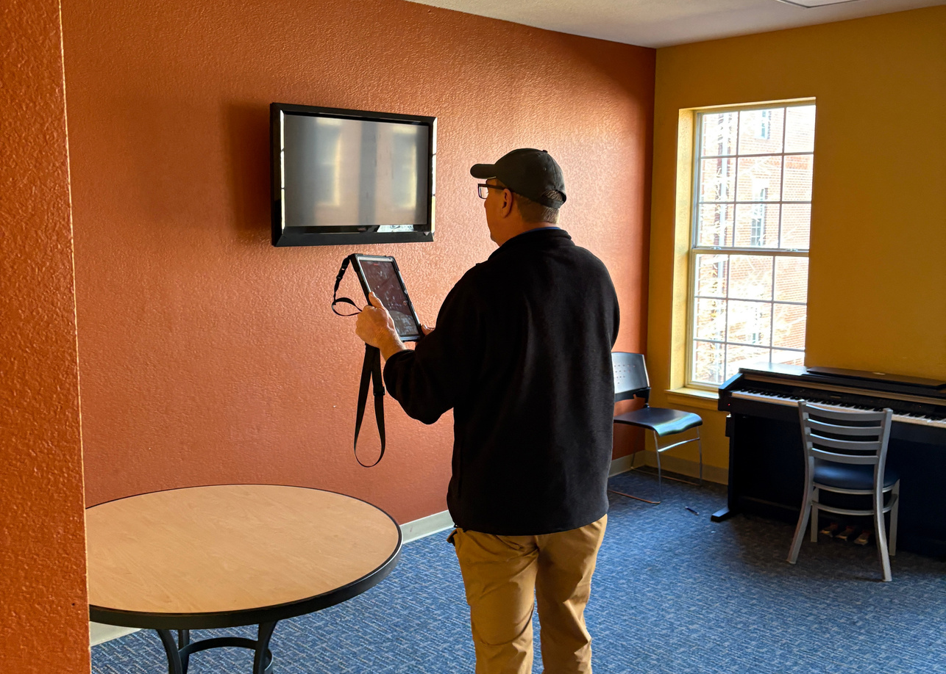
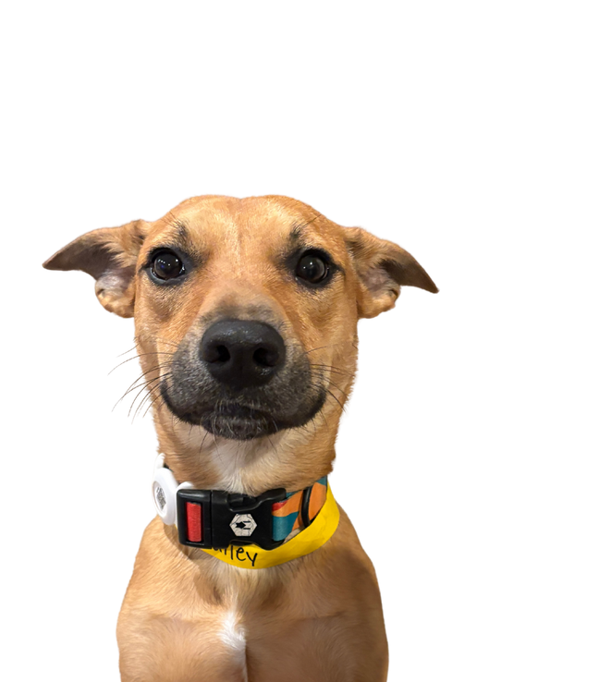
The 1%
Mature and Future Ready
01
$1.4 Trillion Saved
✅ Global top 500 cos. reclaim 11% revenue (Siemens 2024)
02
Labor Redeployed
✅ 85% time saved = Shift to Predictive Maintenance = Asset life ↑20-40%
03
Capex + Compliance Wins
How are mature companies moving forward with AI- And what have they gained?
✅ Better Documentation = Intelligence Driven Decisions
Notes:
"So what's the difference between the 99% and the 1%? It's not luck. It's not bigger budgets. It's having the right tools.
The companies reaching this level aren't using better clipboards. They're using AI solutions that change the fundamental mechanism of how facility data gets captured.
(Point to slide)
The 1% have cracked the code on three things:
First: They've eliminated the Labor Tax.
While the 99% are still paying their experts to be typists, the 1% use AI to capture data instantly.
IN this case the tool - reads the nameplate, documents the deficiency, and populates the system - no human transcription required. That's how they reclaim 85% of inspection time.
Second: They've freed their people for real work.
When you're not burning hours on paperwork, where does that time go? To the preventive maintenance that actually prevents failures. To the strategic work that extends asset life The 1% aren't just more efficient - they're more effective.
Third: They have audit-ready documentation without the pain.
Here's what compliance looks like with AI: Every inspection automatically generates visual evidence with timestamps, GPS coordinates, and consistent reporting. No more scrambling during audits. No more 'I think we checked it.' Just defensible documentation that keeps you compliant and operational.
(Transition)
And that brings us to the question: What does that actually look like in practice? Let me show you..."
This positions AI solutions as the bridge to the 1%, setting up your product demo perfectly.

Slide 10
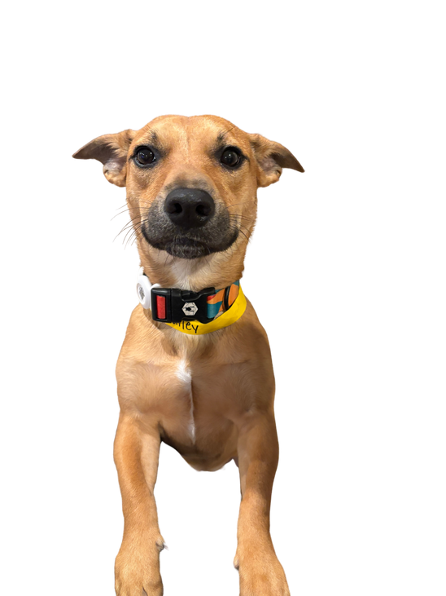

Timeline or Flow
1
2
3
4
ASSESS The Problem
INTEGRATE &
PLAN
UPSKILL
Scale
Enter Identify
the Specific Problem you want to solve.
API-first
EAM / CMMS
Device Agnostic
Standards Based
Upskill the team
AI is a junior employee not a magic 8Ball
Continuous Learning
leads to AI advantage
AI should be a tool used to empower the organization as a whole.
Notes:
"So, we’ve looked at the risks of standing still and the results of moving forward. The question always becomes: 'Where do I start?'
Maturity in facility management isn’t something you buy off the shelf. It’s something you build through a structured approach. Based on the same principles we used to transform portfolios
here are the four essential steps to success.
Step 1: Identify the Problem.
In our industry, we have a bad habit of looking at a new piece of technology and saying, 'How can I use that?'
I’m asking you to flip that.
Focus on the WHAT before the HOW.
Is your biggest pain point an Inventory Gap? Do you have 'Ghost Assets' you’re paying insurance on but can’t find? Or is it Asset Condition Ratings—are you guessing at your 5-year Capex plan because you don't actually know the health of your boilers?
Be specific. If you try to 'fix everything,' you’ll fix nothing. Pick one specific problem and solve it until it’s dead. The technology is just the vehicle; you have to pick the destination first.
Step 2: Integration as a Primary Goal.
I see this happen all the time: An organization buys a great tool, they get great data, and then that data gets trapped in a PDF filed away on a server. Data integration is critical.
If your data can’t talk to your EAM, or your budget software, or your work order system, it is essentially useless. It becomes another 'digital silo.' The goal of the 1% is to eliminate manual data importation. When the data flows seamlessly into the systems you already use, you aren't just 'collecting information'—you’re creating Efficiency Gains that save days of manual work every week.
Step 3: Train Your Team—The Human in the Loop.
This is the most important concept in this entire presentation. AI is not a replacement; it’s an apprentice.
You have to treat an AI solution like a Junior Employee. It’s incredibly fast and it has a perfect memory, but it doesn't know what you know. It doesn't have 30 years of industry experience.
By keeping a 'Human in the Loop,' you are guiding the AI. You are providing the context it lacks. You are taking the 'expertise' in this room and using it to train the tool. When you empower your team to see themselves as the 'mentor' to the technology, you move from 'Fear' to 'Ownership.'
Step 4: Build a Continuous Learning Loop.
No employee is perfect on their first day. Why do we expect technology to be?
You have to build a system where you train and retrain. When things don't go as planned—and in facilities, something always goes sideways—you have to have a feedback loop to retrain the system.
Just like you would coach an employee who made a mistake, you refine the AI until it becomes competent. Once it’s competent, you upskill. You move it to the next task. This adaptability is what keeps your organization resilient as the technology—and your facility needs—evolve.

Slide 11
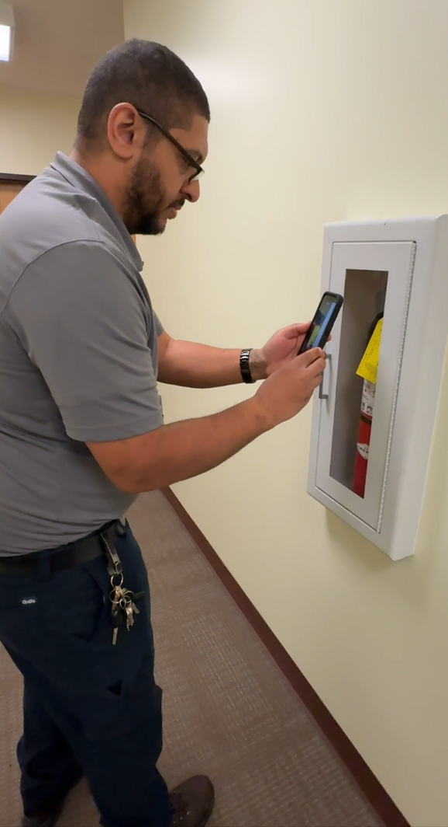
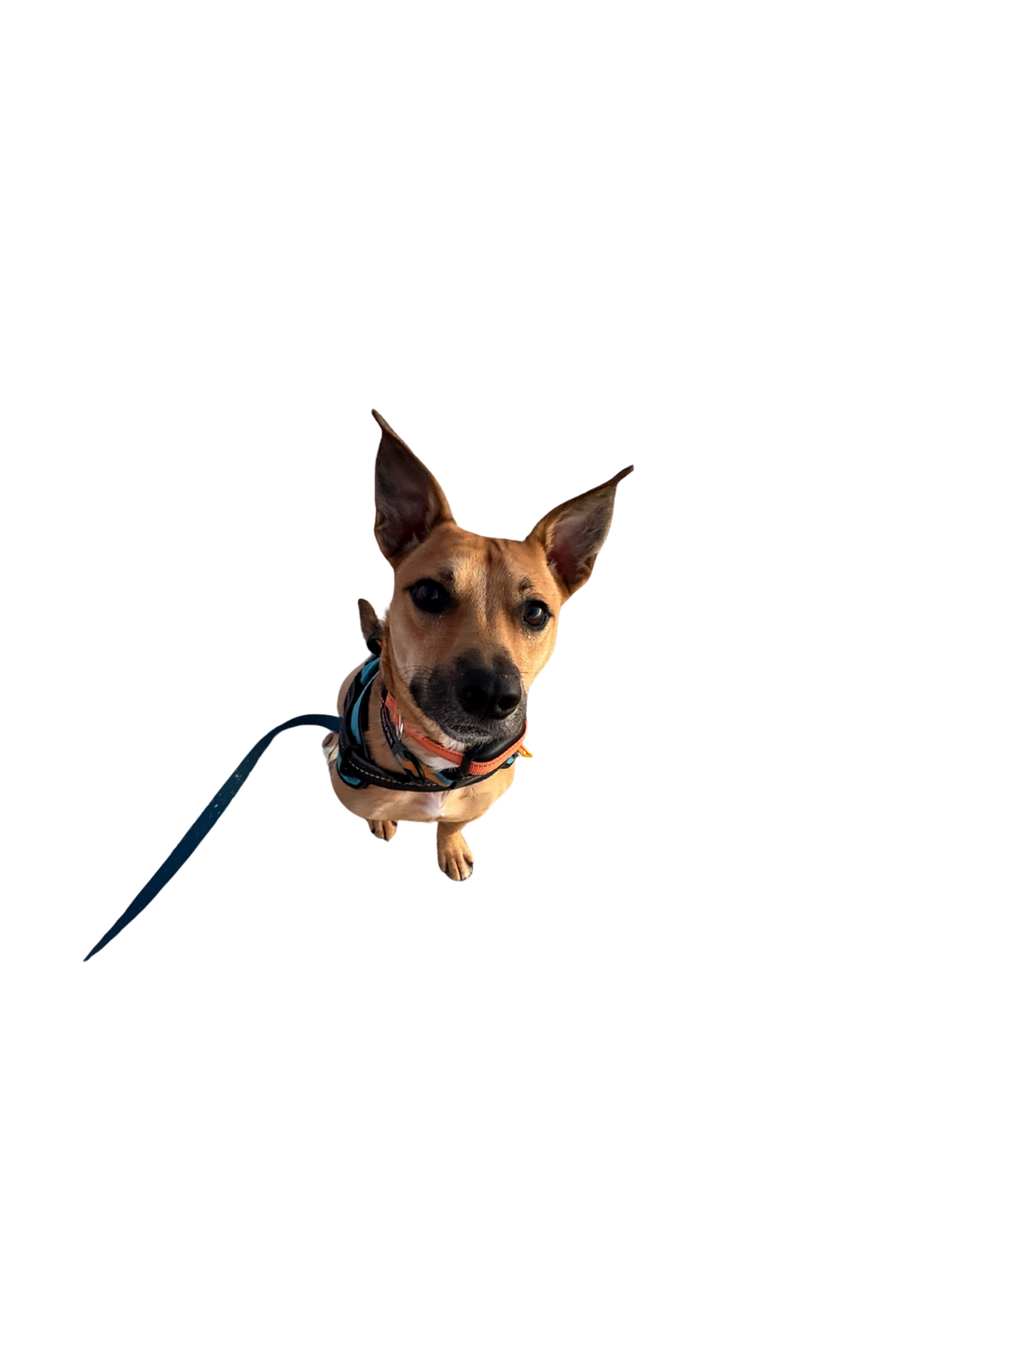
Real-World
Applications of AI
Asset Data Capture
01
Fast, Comprehensive, Accurate collection of Asset Data- Down to the load capacity
Thermal Image Analysis
02
Deficiency identification faster than human diagnosis
Condition Assessment Reporting
03
Real-time condition assessment and deficiency reporting
Notes:
By now you are probably asking - ok well what does that look like- How can I make this work?
AI isn't sci-fi—it's an everyday FM with superpowers.
Meet Andrew- Andre is a Facility Manager at a university . He manages 13 buildings and about 130K sq feet. its housing and ther are about 1200 Beds he is responsibile for - he has a team of 4.
ANdrew is using AI tool to capture and reprt on
01: **Asset Inventory **—Video + voice turns walks into complete inventories. AI reads nameplates, identifies locations, pulls serials/models Date of Manufacture.
Tech adds condition and functional readiness-
Its done when the inspection is - the report is finished. No re writing form your notes log- no more referencing photos from your phone 3 days after the site walk--- its done when you are.
Asset Health - Those Motors, and pumps- Chillers Switchgears-
02: **Thermal Image Analysis** —FLIR cams spot invisible issues: hotspots, insulation fails, loose connections.
Get the data in nearly real time - Cover the NFPA 70B inspection documentation requirements, and Have a cost ready for that repair ask before you walk into the VP of Business and ask for the fix.
Capital Planning- All the information above acan be used in building better capital plans.
Keeping up to date with your inventory- its age, its condition, and plan better- fail less, and More complete Data leads to longer planning cycles.
Combined with accurate maintenance logs from your CMMS- the information can be combined and lead to better decisions, Predictable budgets, fewer breakdowns, and longer life cycles.

Slide 12


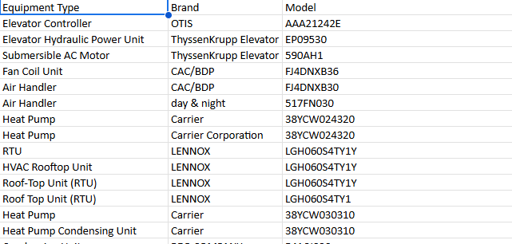
A Case Study
in Asset Capture
with AI
70K Sq FT Facility
01
A client used a cell phone to capture data plates. Uploaded them to the platform
02
Over 100 Assets
AI read the data plate, inventoried the Assets,
and created a full inventory log for the acquisition.
Weeks of work in 4 hours
03
Single user capture. Scaling the human to
be better, faster, stronger.
Notes:
Brent Ward - From Left Coast Facility Consulting reached out as he had a 70K Sq Foot facility in San Diego Calif. He was going to have 3 days to complete an Acquisition inspection of the facility. A Multi Building religous campus.
He was mostly alone except for the security team. Brent has been in the FM world a long time and has been doing this for a while. His process was solid and easy to replicate. He estimated 2 days of data capture and planned an extra just incase- and for time to meet with the owner- etc.
Now his data capture went so quickly he was able to provide other insights - to the owner - electrical load issues, structural and more that were not in his scope but became value add for the client- helping show his value
It took him all of ~ 4 hours to capture over 100 Data plates - and when finished- the report was also done- a full narrative PDF and a CSV with the asset inventory - a task that would have taken
"If I did that manually it would have taken me weeks to track down every unit and then research all the information I needed"
He found operational units over 40 Years old. In good working condition because of the care and maintenance that had been preformed.
Still the recommendation to replace was made for energy efficiency and refrigerant compliance.
This is just one example of many we have from how AI can augment the human, provide value, and return the labor - so you can do what matters.

Slide 13
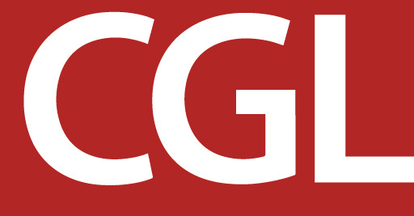
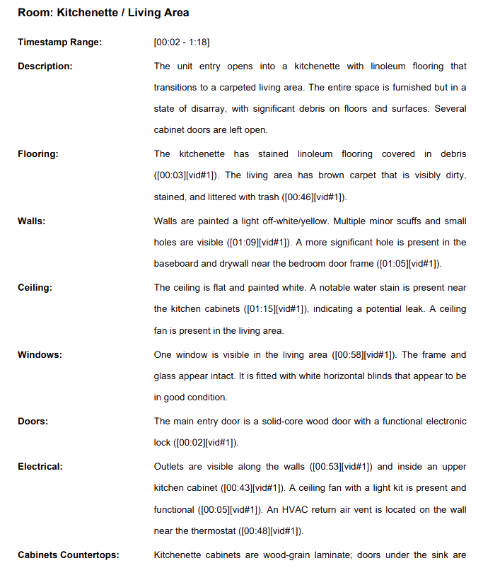
A Case Study
Continual Condition
Assessments
9000 Bed 5 campus Portflio
01
A client used a cell phone to capture video on apartment move out.
02
Limited staffing - Manual process
Existing process routed work to 3 people and cost 6-8 labor hours per room.
Time saved = Units Turned faster
03
2 Mins video capture - 5 minuet processing time = 1 person.
Notes:
I want to move from theory to reality. Let’s look at a high-volume, high-stakes example: Student Housing.
I was working with a client managing a 9,000-bed portfolio across 5 campuses. In this world, we live and die by 'The Turn.' You have a massive influx of students moving out, and a massive influx moving in, with a tiny window of time in between.
The Old Way (The Grind):
Before we implemented this, their process was a textbook '99%' nightmare. To inspect a single apartment, the work was routed through three different people.
The inspector in the field.
The coordinator in the office.
The manager for final approval.
Total cost? 6 to 8 labor hours per room.
Think about that math on a 9,000-bed portfolio. That isn't just a 'process'—that is a logistical wall that stops growth and burns out every employee it touches. It was manual, it was slow, and because it was so tedious, the data was often thin.
The New Way (Peripheral Intelligence):
We changed the 'HOW.' We told the team: 'Don’t worry about the paperwork. Just walk the room and record a 2-minute video on your cell phone.'
We used the phone they already had in their pocket—no specialized hardware required.
2 Minutes of video capture in the field.
5 Minutes of processing time.
1 Person instead of three.
The Output (The 'Junior Employee' at Work):
Look at the right side of the screen. This is what the AI—that 'Junior Employee'—produced from a 2-minute video.
It isn't just a list; it’s contextual reporting.
It identified the stained linoleum and the specifically 'visibly dirty' brown carpet. It spotted the minor scuffs on the walls and the significant hole in the baseboard.
But look at the 'Ceiling' section. It found a water stain near the kitchen cabinets and flagged it as a 'potential leak.'
In the old manual process, a tired tech probably misses that stain. They’re looking at the trash on the floor. But the AI doesn't get tired. It caught a 'Capex Risk' (a leak) that could have cost thousands in mold remediation or subfloor damage if it hadn't been flagged during that 2-minute walk.
The Result: Units Turned Faster.
By reclaiming those 6 to 8 labor hours per room, we didn't just 'save time.' We increased the velocity of the entire operation. Units were turned faster, which means revenue was protected and the team wasn't crushed under a mountain of paperwork.
This is what happens when you move from 'The Grind' to 'The 1%.' You stop being a data-entry company and you start being a high-performance Asset Management team."

Slide 14
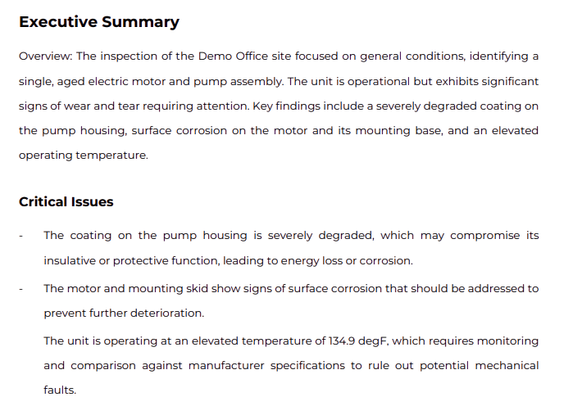
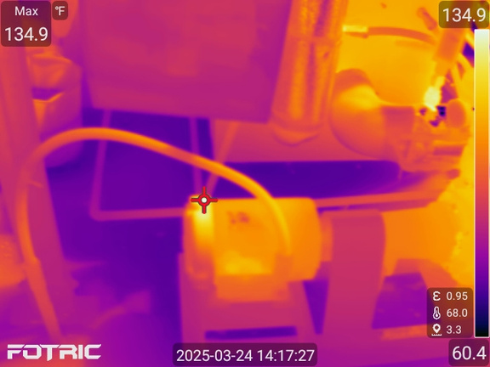
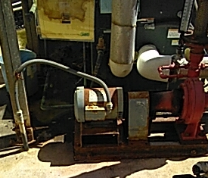
Part Asset Data Part Asset Health
01
Our client used a thermal camera to capture panels and motors.
02
Deficencity Reports with Data
AI read the image and returned fault identification
and temperature readings.
Service Recomendations
03
Diagnosis and recommended service - costs, and trades required.
Notes:
We’ve looked at the high-volume 'Turn' in student housing. Now, let’s look at high-complexity mechanical health.
This is a case study in Thermal Image Analysis. Now, for years, we’ve used thermal cameras to find hotspots in panels or motors. But usually, that data is trapped in the camera, or it requires a specialized thermographer to spend hours writing a report.
Point 1: Part Asset Data, Part Asset Health.
How many in the room are aware of the new NEC adoption of the NFPA 70 B&E requirement.
Look at the image on the bottom right. A technician snaps a regular photo for identification, and a thermal image for health. At this stage, it’s just data. But when that data is processed through Peripheral Intelligence, it becomes an Executive Summary.
Point 2: Deficiency Reports with Data.
The AI—our 'Junior Employee'—reads the thermal image and does the 'heavy lifting' that used to take hours of manual research.
Look at the 'Critical Issues' in that report excerpt. The AI didn't just see a 'hot' image. It returned a specific temperature reading: 134.9 degrees Fahrenheit.
But here is the 'Intelligence' part: It doesn't just give you a number; it gives you Context.
The AI cross-references that temperature against manufacturer specifications. It identifies that the coating on the pump housing is 'severely degraded' and identifies surface corrosion on the motor and mounting base. It tells you why 134.9 degrees is a problem for this specific aged electric motor.
Point 3: Service Recommendations & The 'Action' Phase.
This is where we move closer to the EAM/EAP Readiness.
In the 99%, a tech might see a hot motor and say, 'We should keep an eye on that.' In the 1%, the system provides a Diagnosis and a Recommendation.
It identifies the trade required (likely an electrician or a pump specialist) and provides the estimated cost for repair before the failure occurs. This is the 'Goldilocks' Window of maintenance. We aren't replacing a dead pump for $50,000; we are servicing a hot pump for $2,500.
The Takeaway:
When you combine thermal data with Computer Vision, you aren't just 'looking' at equipment anymore. You are performing a Health Scan of your entire portfolio. You are identifying the 'silent killers'—the corroded housings and the overheating motors—before they become an emergency work order in your system.
This is the transition from 'Subjective Opinion' to 'Objective Asset Stewardship.' It’s how you protect the budget and ensure the facility is operating at peak efficiency.

Slide 15
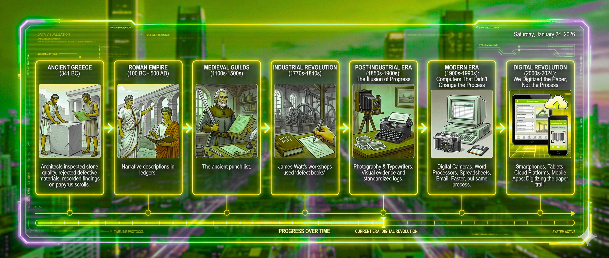
DATA COLLECTION TIMELINE
Notes:
"Before we wrap up, I want to leave you with something bigger than technology, bigger than facilities management, bigger than any of us individually.
(Gesture to timeline)
What you're looking at isn't just a timeline of tools - it's the story of human civilization itself.
3,400 years ago, Greek architects carved inspection notes into stone. They were the first humans to systematically document the condition of what they built.
2,000 years ago, Roman engineers filled ledgers with narrative descriptions. That's why the Pantheon still stands.
500 years ago, Medieval guild masters created the first 'punch lists' - documenting defects and repairs.
250 years ago, James Watt's workshops kept 'defect books' for steam engines - the birth of mechanical asset management.
(Pause, look around the room)
For 100 years, we've had better tools - photography, typewriters, computers, smartphones. But notice what never changed?
(Point to each era)
The mechanism. A human seeing something, processing it, and manually recording it. From papyrus scrolls to iPads, the fundamental process remained identical.
(Pause for effect)
Until now.
Today, for the first time in 3,400 years, we can change the mechanism itself. AI sees the defect. AI processes the condition. AI records the data. No human transcription required.
(Look directly at audience)
You're not just deciding whether to buy new software. You're deciding whether to be part of the first fundamental breakthrough in human knowledge capture since civilization began.
Your great-great-grandfather used the same basic process you're using today. The question is: Will your great-great-grandchildren say the same thing about you?
(Pause)
The Greeks started this journey 3,400 years ago. You get to finish it.
Thank you."
Then transition to Q&A:
"Now, I'd love to hear your questions about how we make this transition together."

Slide 16
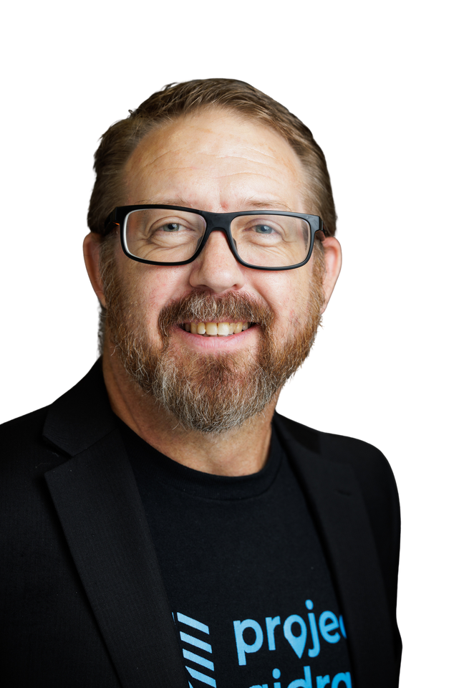
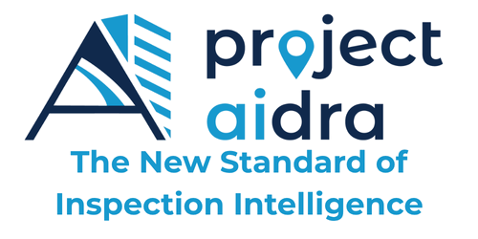
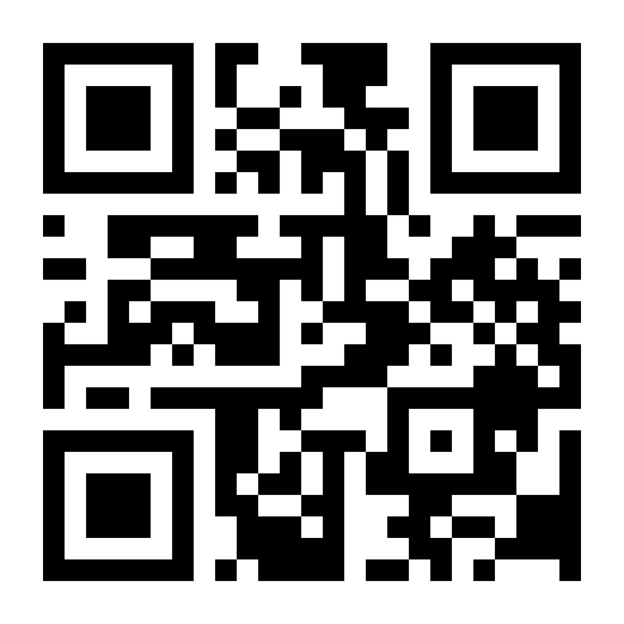
Let’s Evolve and become the Stewards of Tomorrow
Billy Holder, CFM
Founder & CEO Project Aidra LLC
Bailey
Chief Morale Officer
Project Aidra LLC
Notes:
We have spent the last hour walking through a century of history. We’ve seen the tools evolve, but we’ve also seen the burden stay the same.
As we close, I want to bring this back to the core theme: Evolution.
Everything we have discussed today—the 85% time reduction, the move from 'Subjective Notes' to 'Visual Evidence'
Project Aidra 2026 Sales Playbook - Official (1).pdf
, and the 4-step path to maturity—it all leads to one singular shift in our profession. We are moving from a world where we manage Paperwork to a world where we manage Intelligence.
The CGL Evolution
When I was at CGL, we took the first step in that evolution. We had 9,000 rooms and a manual process that was hemorrhaging 8 hours of labor per room. We didn't have AI yet, so we evolved by standardizing. We used QR codes and digital forms to kill the 'Transcription Trap.' It worked. By July 2025, we had consistent operations across five campuses.
But even then, we were still the 'Middleware.' We were still the ones doing the heavy lifting of interpreting every photo and typing every deficiency.
The Next Step
What you’ve seen today in these case studies—the Thermal Analysis that finds a $2,500 fix before it becomes a $50,000 failure, and the '2-minute turn' video—that is the next stage of our evolution.
In the 99%, the limit of your success is the limit of your human capacity. You are only as good as the notes your tiredest tech can write on a Friday afternoon.
In the 1%, you have evolved beyond that limit. You have 'Peripheral Intelligence'—an extra set of eyes that doesn't get tired, doesn't miss the water stain on the ceiling, and knows exactly what temperature that motor should be running at.
Project Aidra 2026 Sales Playbook - Official (1).pdf
Closing the Hour
The evolution of the built environment isn't about the machine taking over. It’s about the machine taking over the grind.
When we identify the 'WHAT' before the 'HOW,' when we prioritize integration into our EAM and EAP systems, and when we keep the 'Human in the Loop' to guide the AI junior employee, we aren't just making a 'tech change.' We are making a Strategic Step Forward.
Project Aidra Sales Manual v1.1 — October 12, 2025 (1).pdf
My goal for you today wasn't to show you a 'neat software.' It was to show you that the 'Slab to C-Suite' journey is now a data-driven path. We have the research, we have the results, and now, you have the roadmap.
Let's stop spending our energy on the transcription. Let’s start spending it on the Stewardship of our assets.

Slide 17


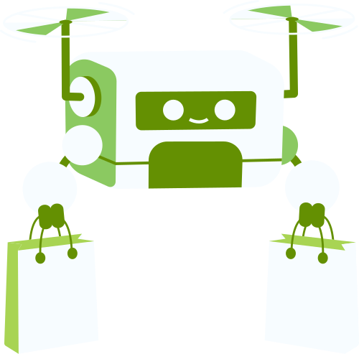
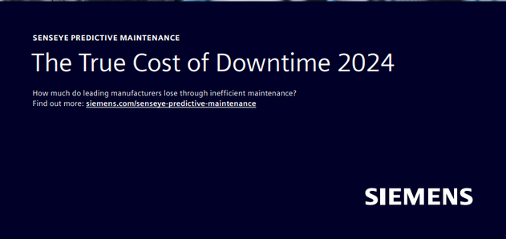

Source Page

