Slide 1
True Cost of Maintenance What Management Doesn’t See
Andy Gager CMRP, CPIM, CAMA2
COO
AMG International Consulting

Slide 2
Outline
SECTION 1
Introduction
SECTION 2
CASE STUDY – Who Rules The Roost?
SECTION 3
Impact of Maintenance Planning. Scheduling, & Kitting
SECTION 4
CASE STUDY – True Cost of Maintenance

Slide 3

Why Are We In Business?
$
Selling Price
Margin / Profit
Cost of Goods Sold

Slide 4
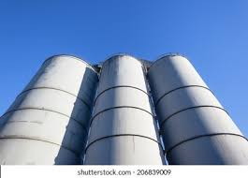
Organizations Are Set-Up For Conflict!
OPERATIONS
MAINTENANCE
SUPPLY CHAIN

Slide 5
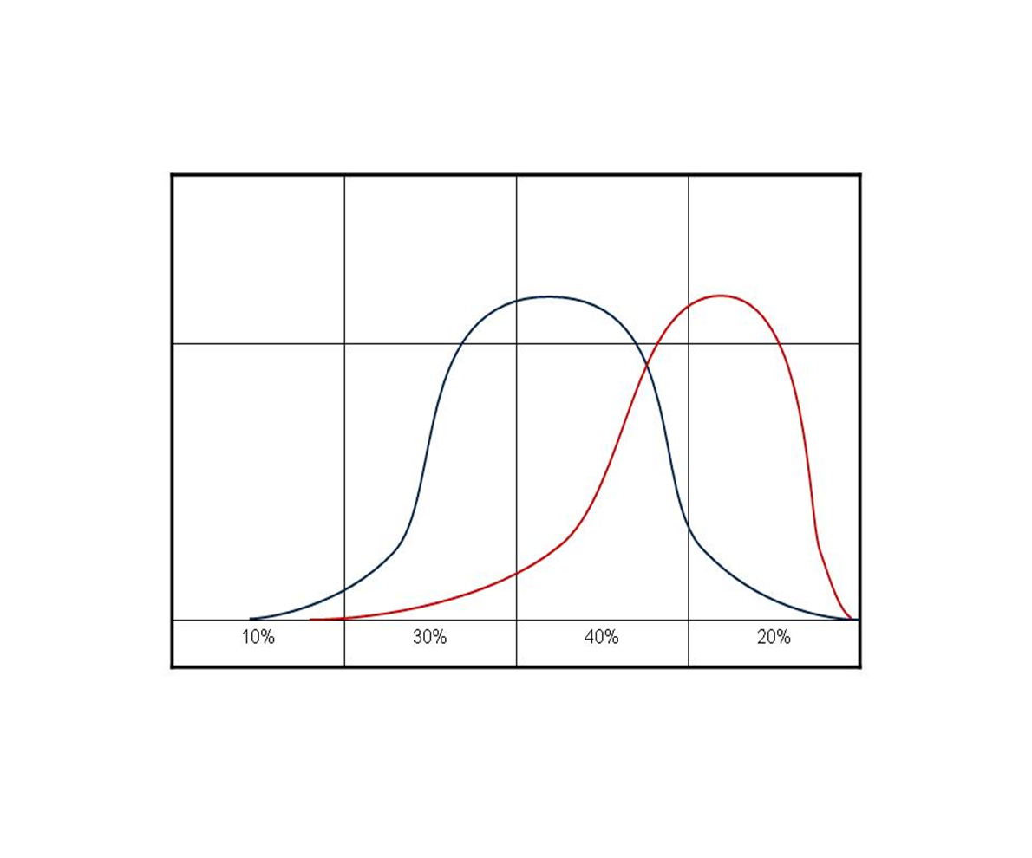
Typical Workforce Demographics
20% Superstars
40% Soldiers
30% Rookies
10% Bottom Feeders
80 %- 90% of Supervisors time, and efforts are applied to the bottom 10%

Slide 6
Things To Think About…
The average maintenance operation experiences at least 30%-33% waste each year
18% of a typical technician’s time is spent looking for tools or parts
24% - 26% is walking to and from the job site
Reactive Maintenance typically costs 3-4 x more than planned activities
74% of equipment failures are caused by inadequate operation
63% of maintenance activities are self-induced
58% of a typical storeroom inventory has not been touched in over 3-years
Of the remaining 42% inventory, 60% of that is overstocked
Average time a Supervisor “Actively” supervises their team – 10%-5%

Slide 7
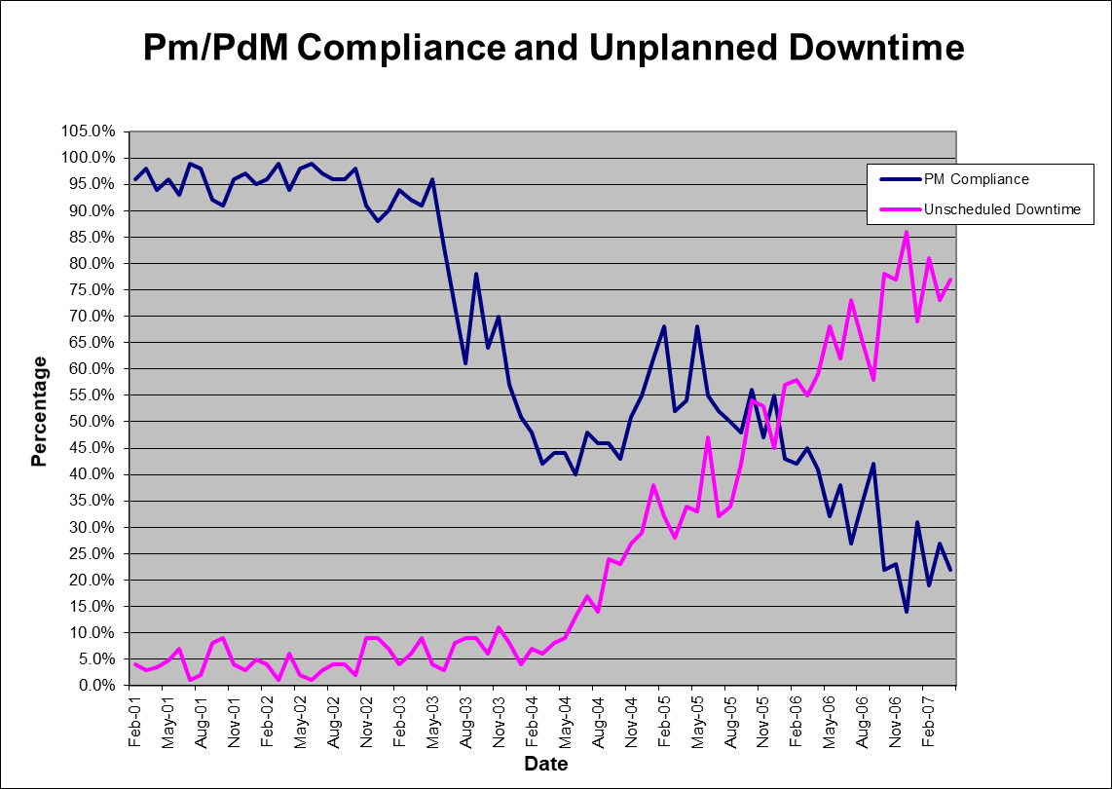
CASE STUDY

Slide 8
Do The Right Things Leads To Great Results
Repair expenses increase by 30% in the first 12–18 months
Expenses then decline 50%–70% below original levels after 24-30 months
Equipment breakdowns decline 50%–60% (MTBF)
Equipment downtime declines 60%–80% (MTTR)
Availability increases 10%-20%
Spare parts inventories decline 20%–35%
Kelly, C.D. “Leadership for Change: Developing a Reliability Improvement Strategy”, Society of Maintenance & Reliability Oct . 1995

Slide 9
Planning, Scheduling, Kitting
Planning & Supervision has the most profound effect on
timely and effective accomplishment of maintenance work
Doing it right the first time
Are You Fixing it or working on it?
For every hour of effective planning, the typical return is three hours in maintenance labor time saved or an equivalent savings in materials and utilization

Slide 10
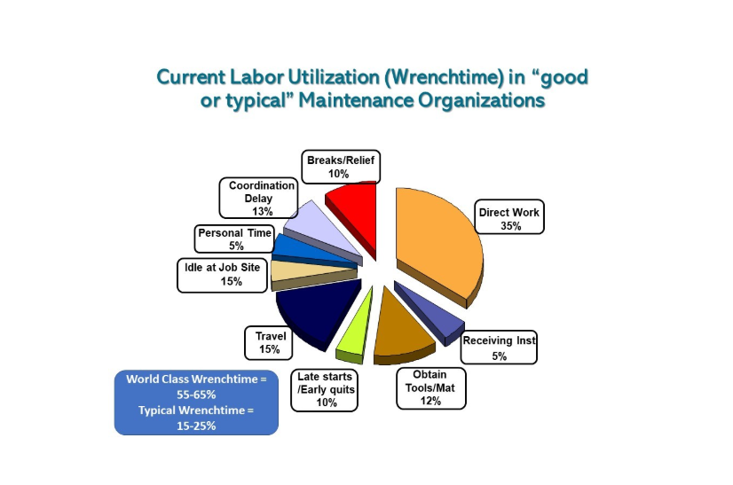
Current Utilization Of Maintenance Tech
The only means to improve this is through Planning, Scheduling, & Kitting planned work
Day in the Life of a Proactive Maintenance Planner | Ricky Smith

Slide 11
Maintenance Planner Time Allocation
Study on Allocation of Proactive Planner’s Time
Planning Elements
Percentage of Time
Job Investigation
24.4
Bill of Materials Preparation
18.3
Follow-Up
6.5
Plan Development
25.6
Standard Data Application
12.7
Personal and Miscellaneous
12.5
There is a differences between what time they believe is being allocated vs. what actually happens

Slide 12
CASE STUDY
Assumptions:
22 technicians
$62.32 average hourly rate (fully burdened)
Overtime averages 18%
Manager, Supervisor, Storeroom Personnel, and one Engineer
Supporting staff are included in the maintenance budget
Work week is 5 x 8
Each Tech averages 3 weeks PTO, 0 Sick Days, and this site averages 4% absenteeism
Each technician plans their own jobs
No process in place for Kitting & Staging planned work

Slide 13
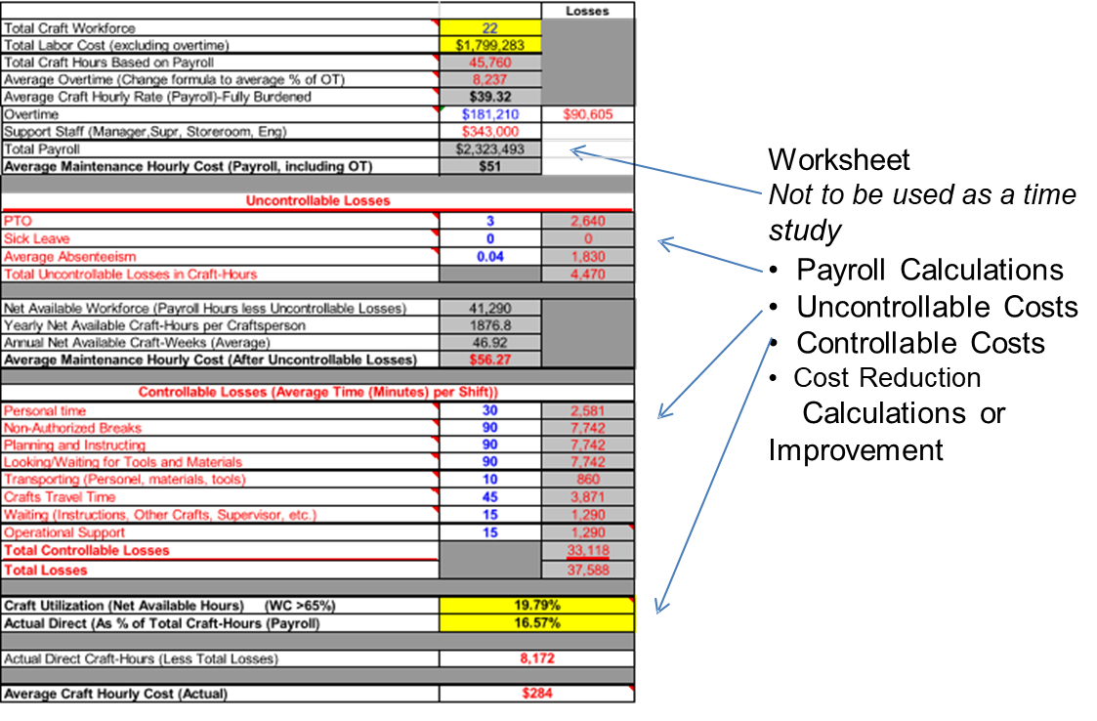
TRUE COST OF MAINTENANCE

Slide 14
Q&A
Thank You!
Andy Gager CMRP, CPIM, CAMA2
AMG International Consulting
agager@amgintlco.com
919.280.5790
www.amgintlco.com

