Slide 1



Unlocking Integration Flexibility with DB Pro
Integration capabilities and examples
February 2025

Slide 2
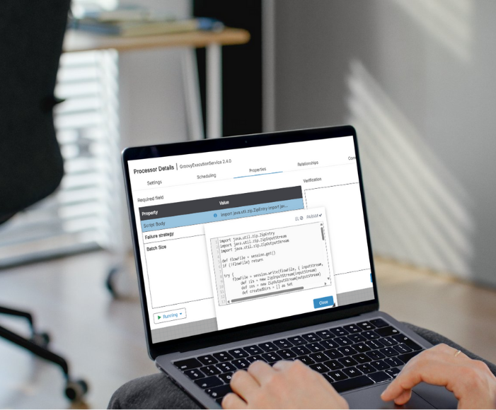


Why use Databridge Pro?
Go beyond point-to-point file processing
Centralize and orchestrate integrations at scale
Increase flexibility, resiliency, and visibility across data flows

Slide 3



What does DB Pro Unlock?
Authentication Flexibility
Support for standard and non-standard authentication flows
Easier handling of token refresh, headers, and secrets
True Integration Orchestration
Not limited to processing one file at a time
Coordinate multi-step workflows across systems
Built-In Cloud & Transaction Support
Native connectors for popular cloud services
Common transaction patterns handled out of the box

Slide 4


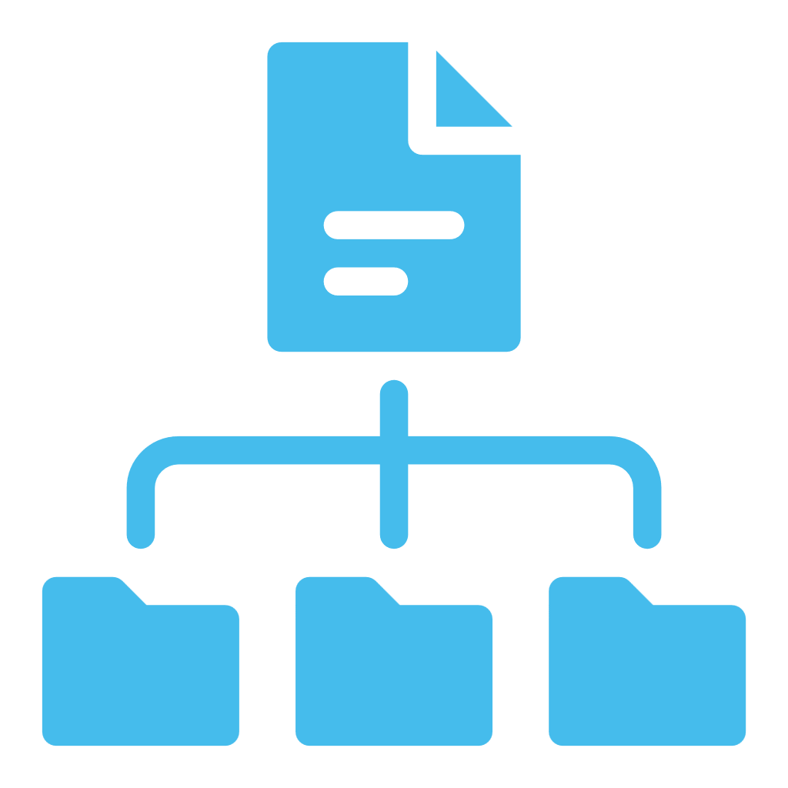

Capability Examples
Forward EAM Datalake data anywhere
Real-World Use Cases
Combine and transform files into structured payloads
Handle complex authentication and scheduling natively

Slide 5

Send Data Anywhere
Authentication Flexibility
Forward data to public cloud destinations
Send directly to on-prem or private cloud databases
Eliminate unnecessary middleware hops

Slide 6

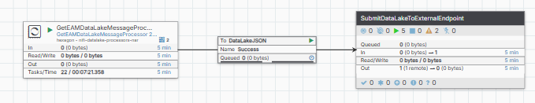
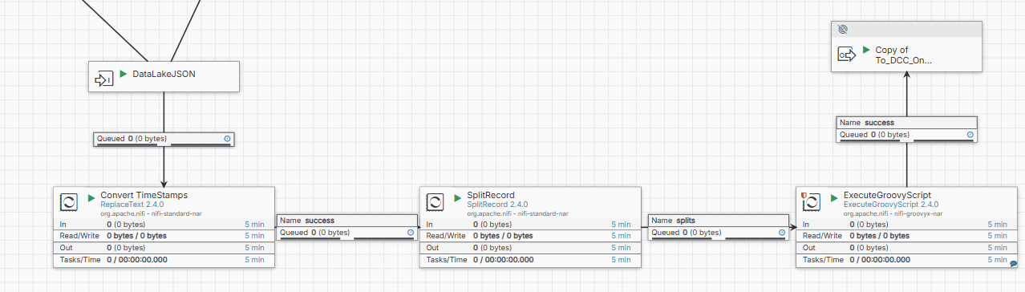
DataLake Flow

Slide 7
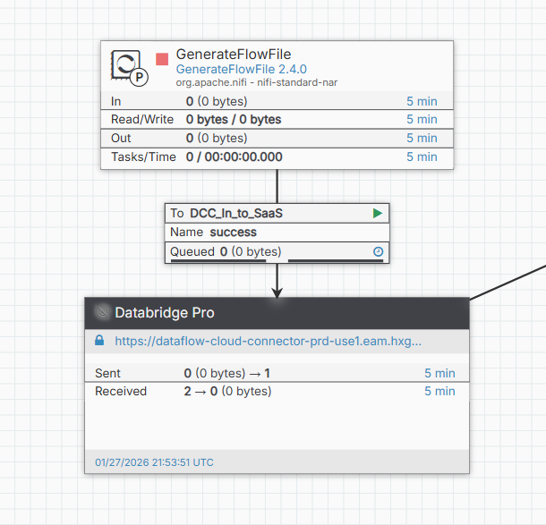
“Heartbeat” Flowfile

Slide 8
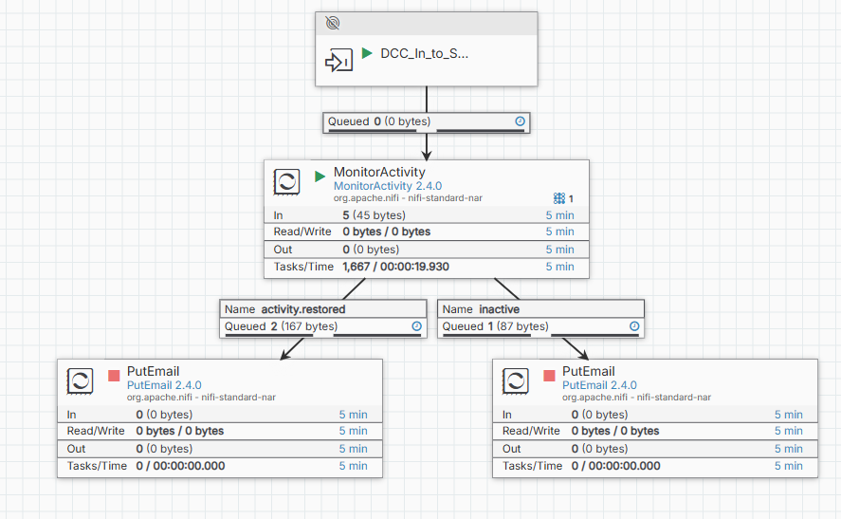
“Heartbeat” Response From Connector

Slide 9

Payload Creation & File Management
Multi-File to Single Payload
Combine multiple inbound files into one output
Create structured compressed archives
Supported formats: ZIP, TAR, GZ, and more

Slide 10
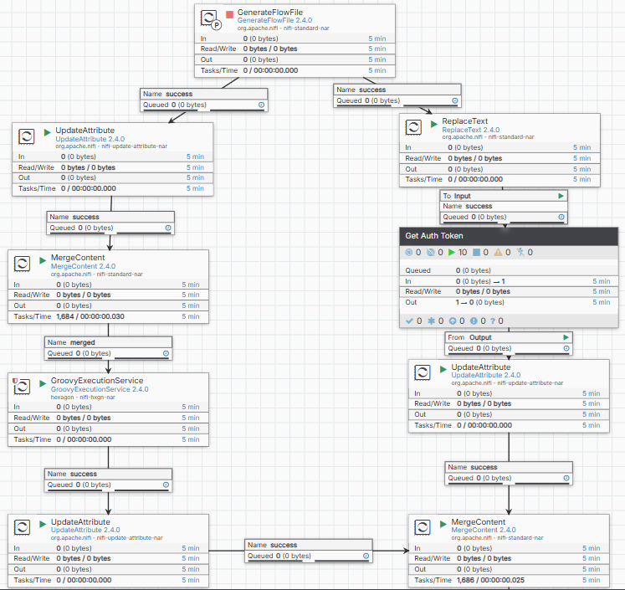
ZIP File Flow

Slide 11
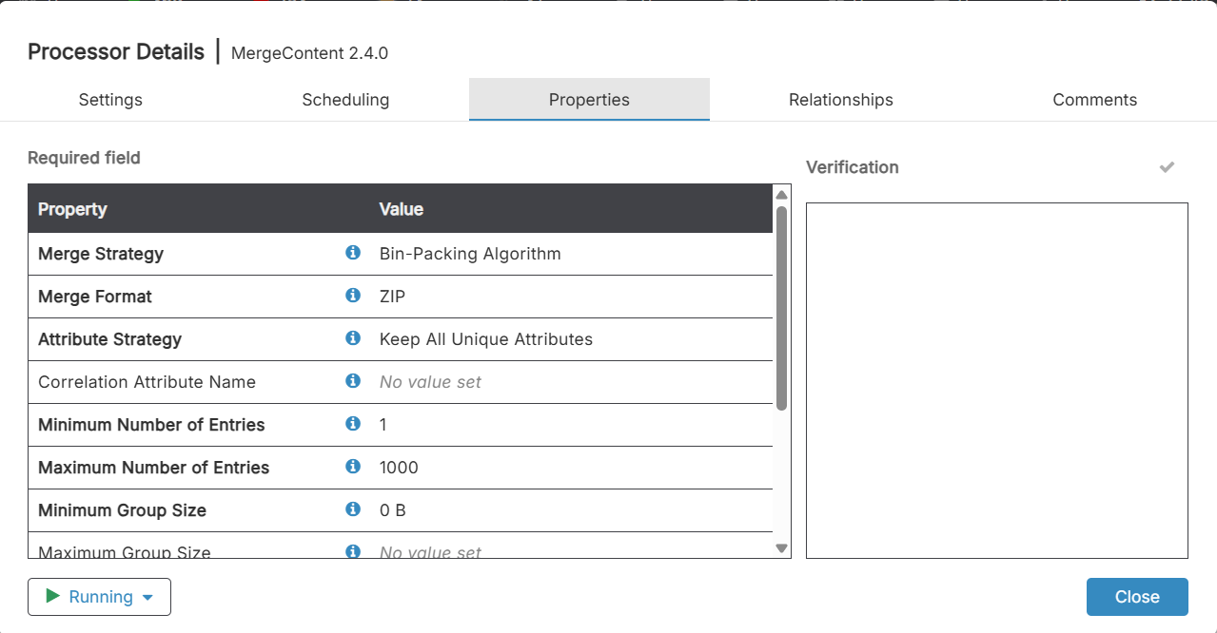
Merge into ZIP

Slide 12
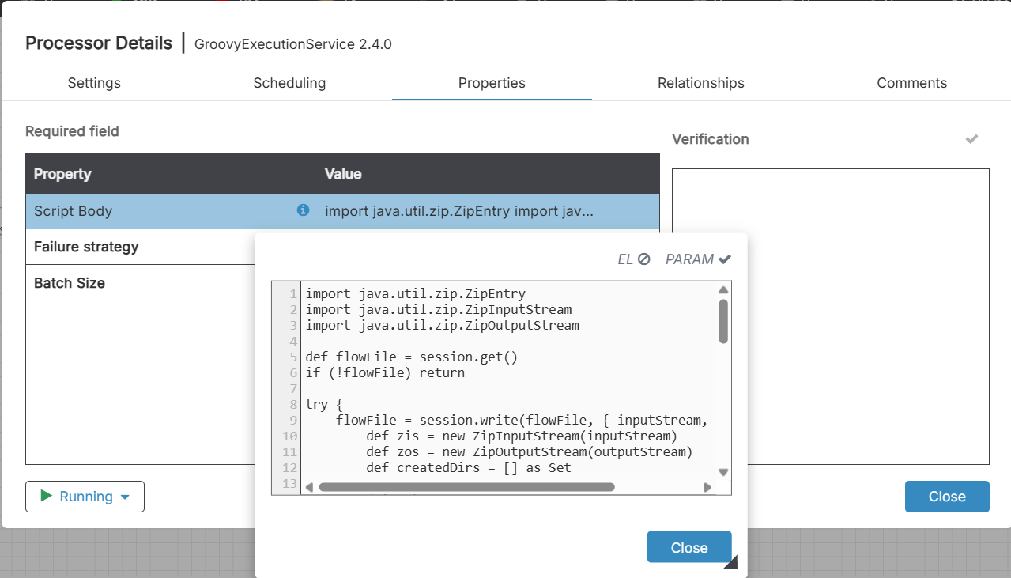
Groovy Script

Slide 13
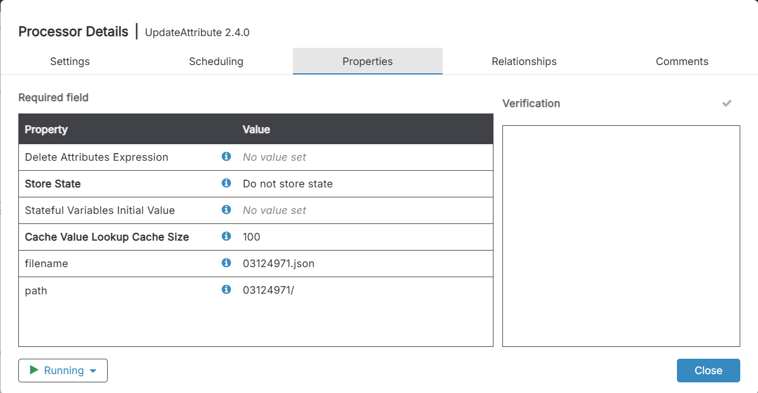
Filename and Path

Slide 14

Advanced Authentication Scenarios
Process Group–Driven Auth Flows
Build multi-step or non-standard authentication logic
Retrieve and store access tokens dynamically
Merge tokens into downstream data flows seamlessly

Slide 15
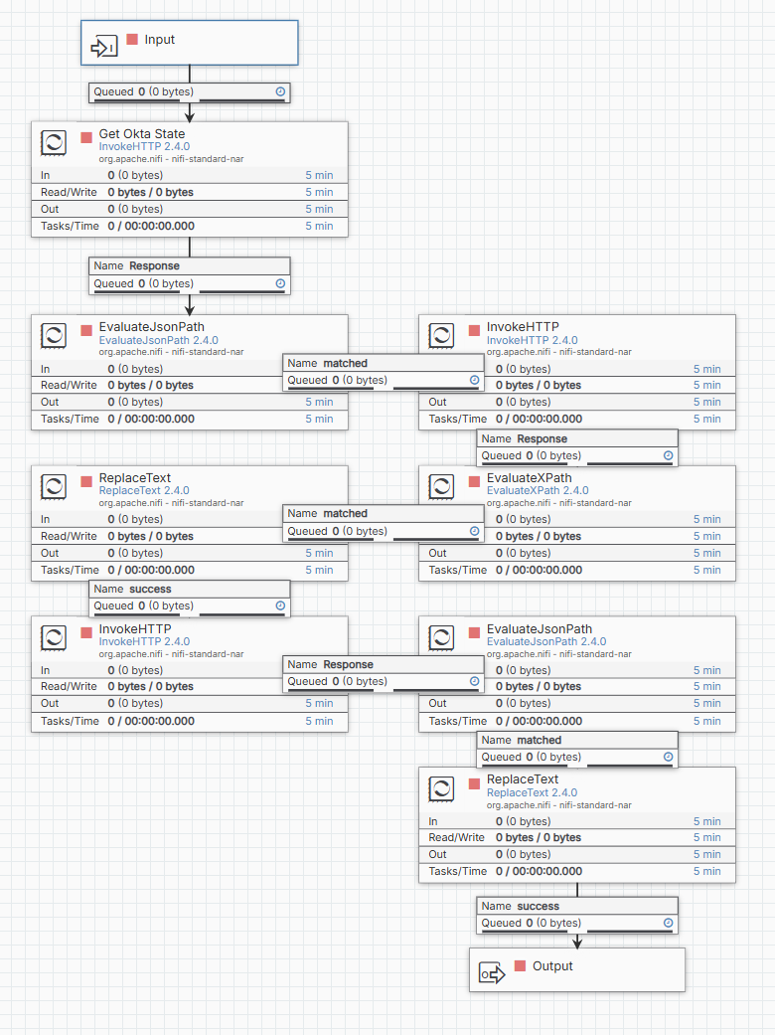
Token Retrieval

Slide 16

Scheduling, Reliability & Flow Control
Native Scheduling
Pull or push data on a defined schedule
Cron-based scheduling built in
Resiliency & Control
Automated retries to handle failures
Throttle payload flow rates
Conditional routing based on partner responses

Slide 17
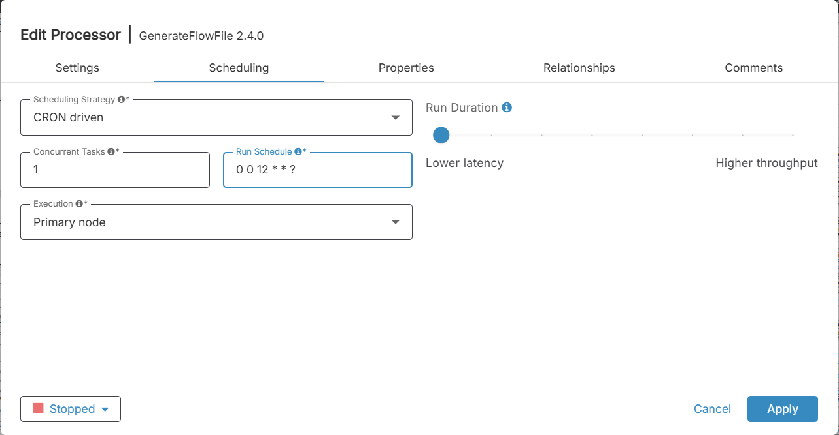
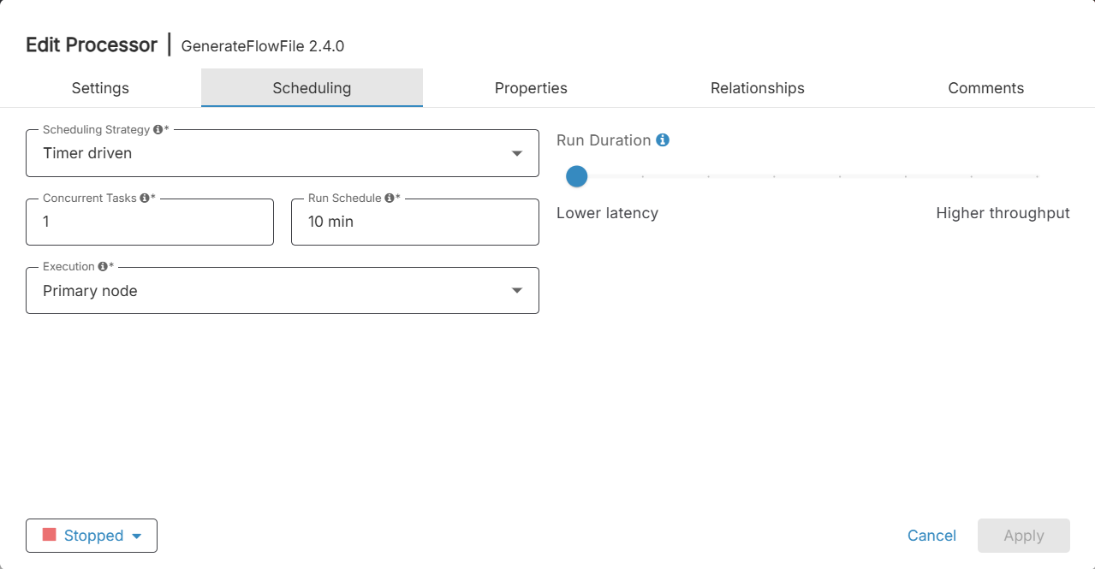
Scheduling (Timer & CRON)

Slide 18
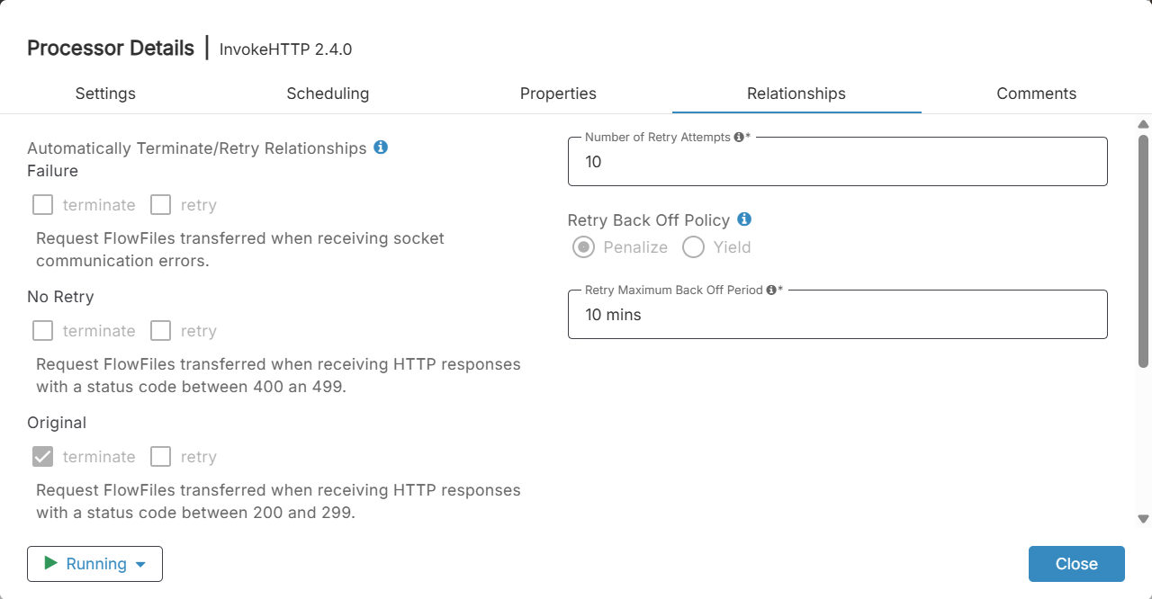
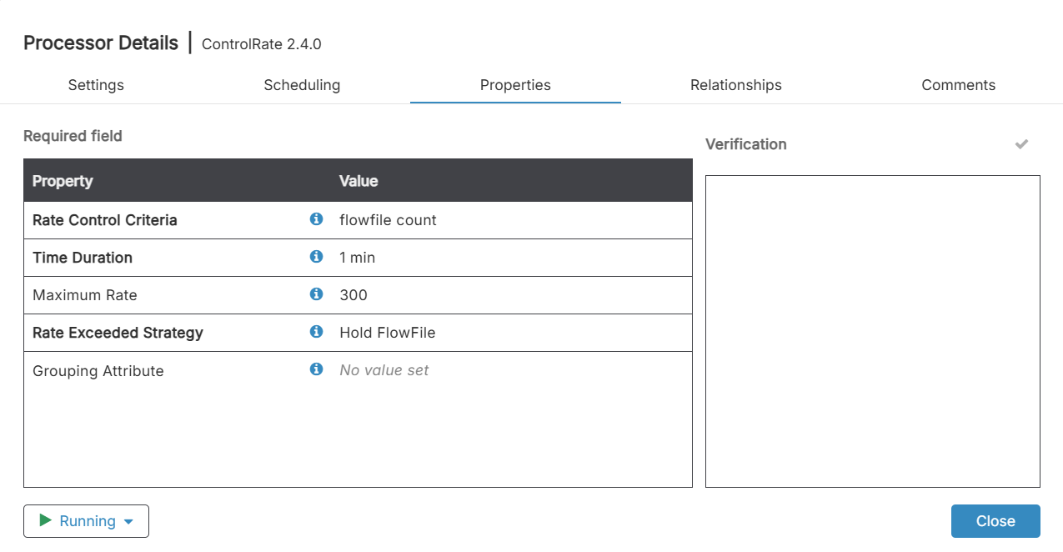
Automated Retries and Control Flows

Slide 19
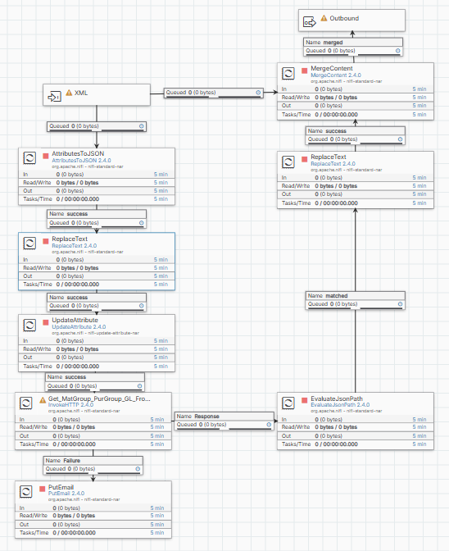
Grid Call Example

Slide 20
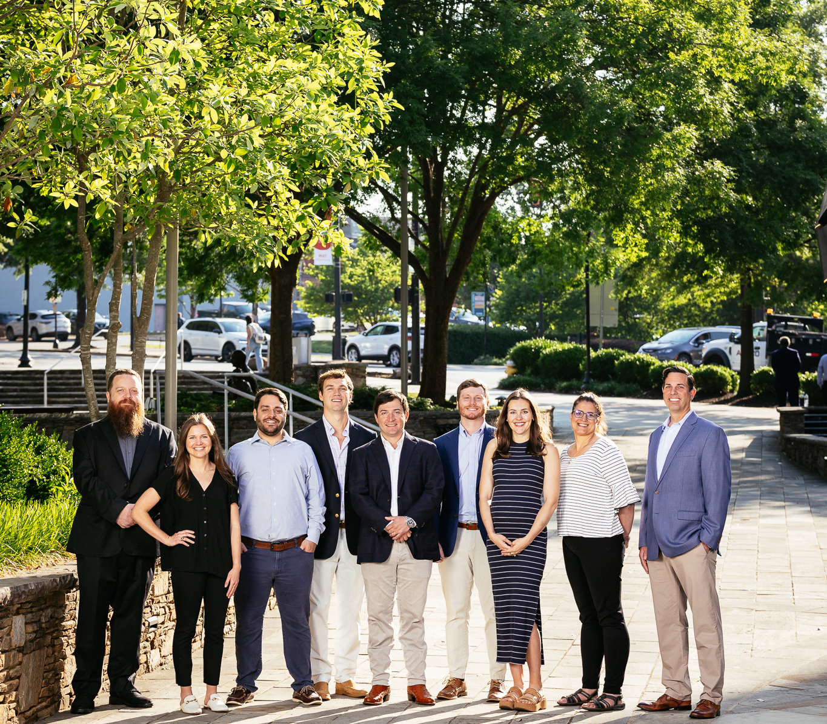



How We Help Our Clients
Enterprise-grade integration orchestration
Cloud-native, scalable, and extensible
Designed for complex, real-world integration challenges

Slide 21


Key Takeaways
Databridge Pro unlocks far more than file movement
Handles complex auth, orchestration, and transformations
Future-proof platform for evolving integration needs

Slide 22

Thank you
info@tech-wheelhouse.com

