Slide 1
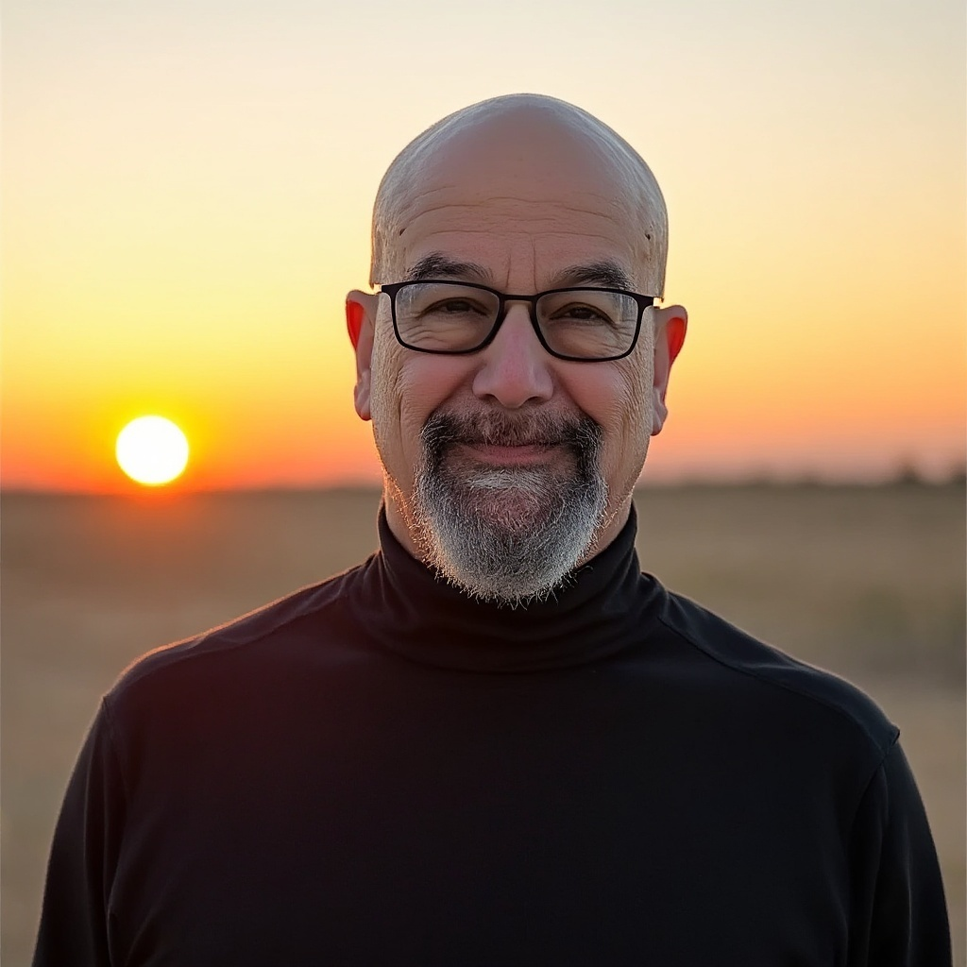
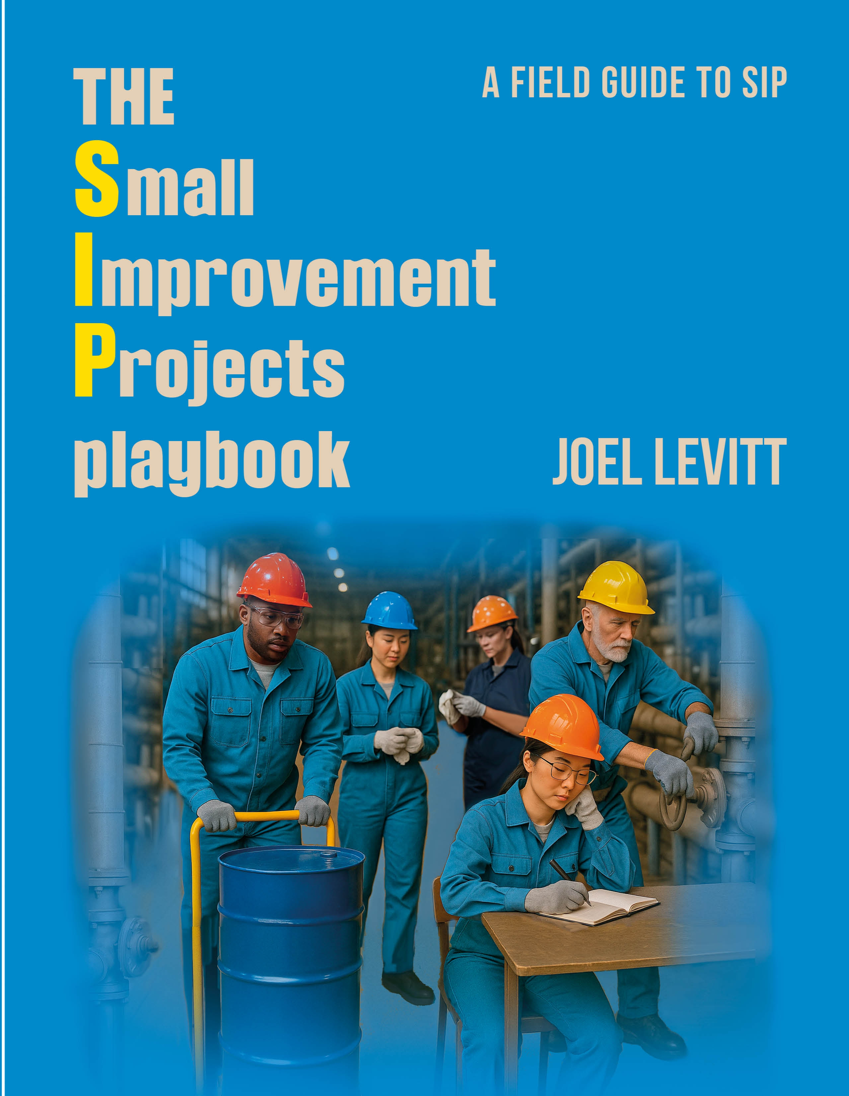
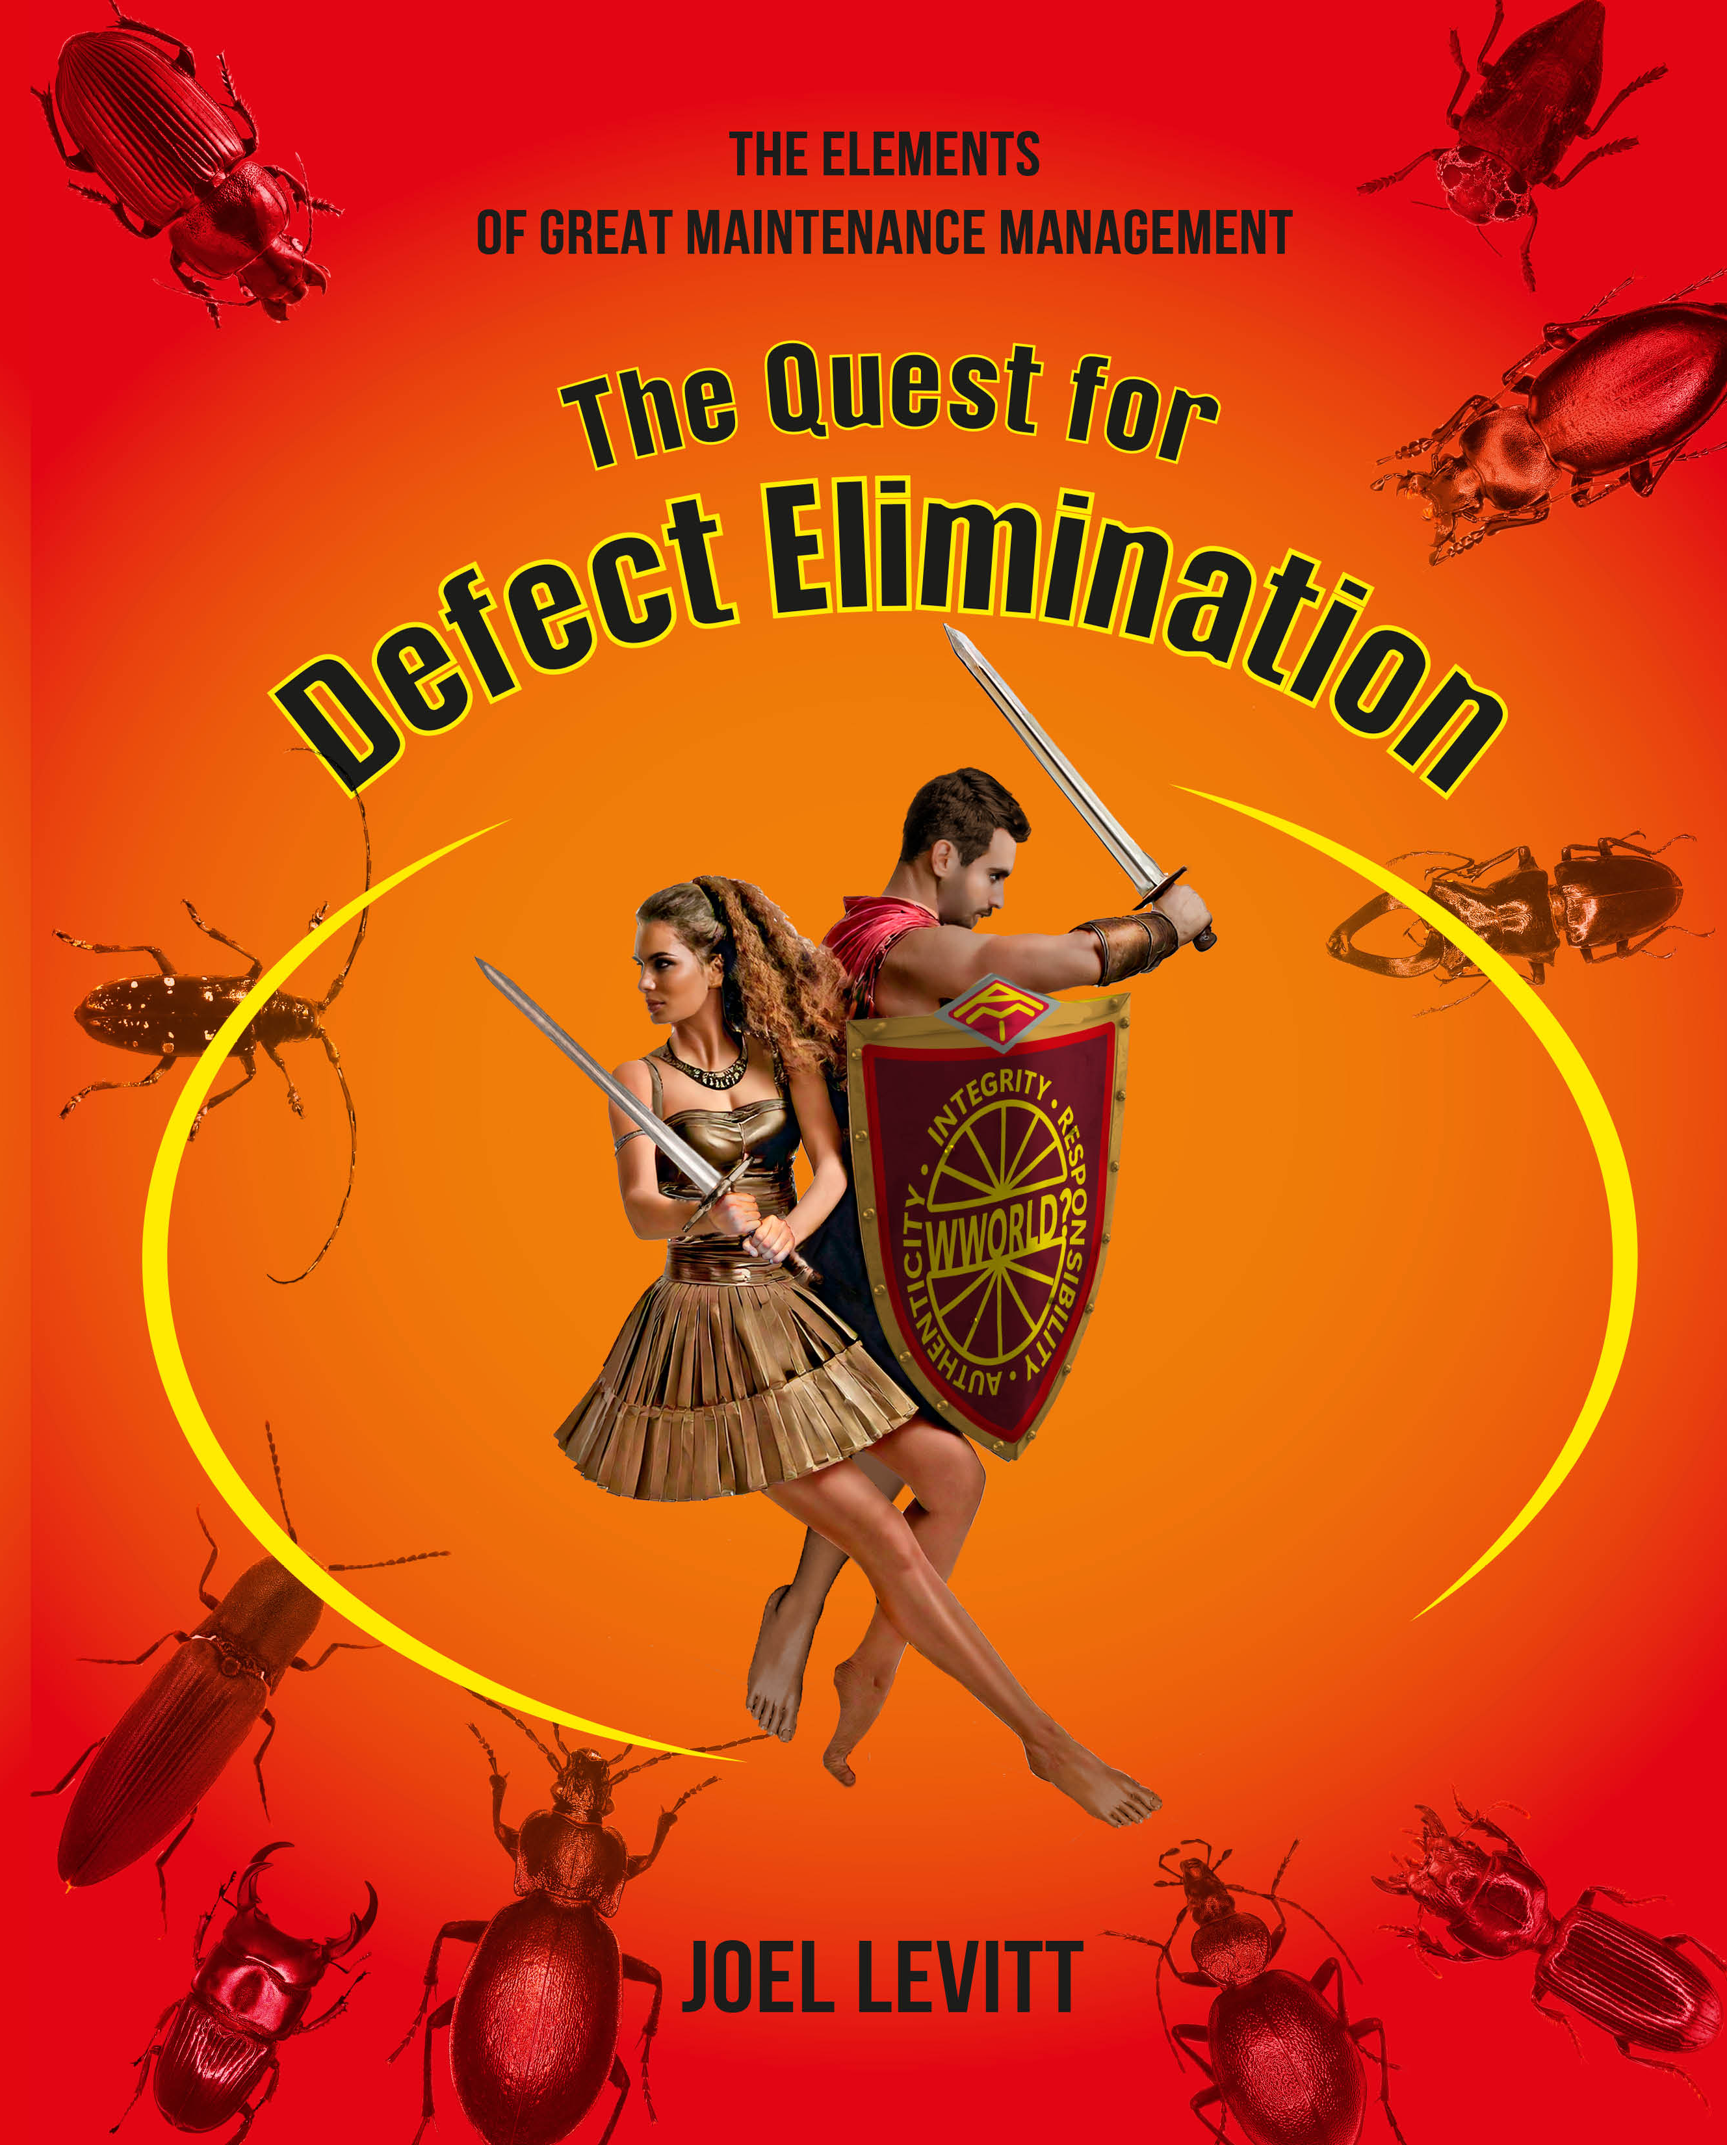
Using Small Improvement Projects to Transform Maintenance
Your speaker and author Joel Levitt CMRP, CMPP, CRL

Slide 2
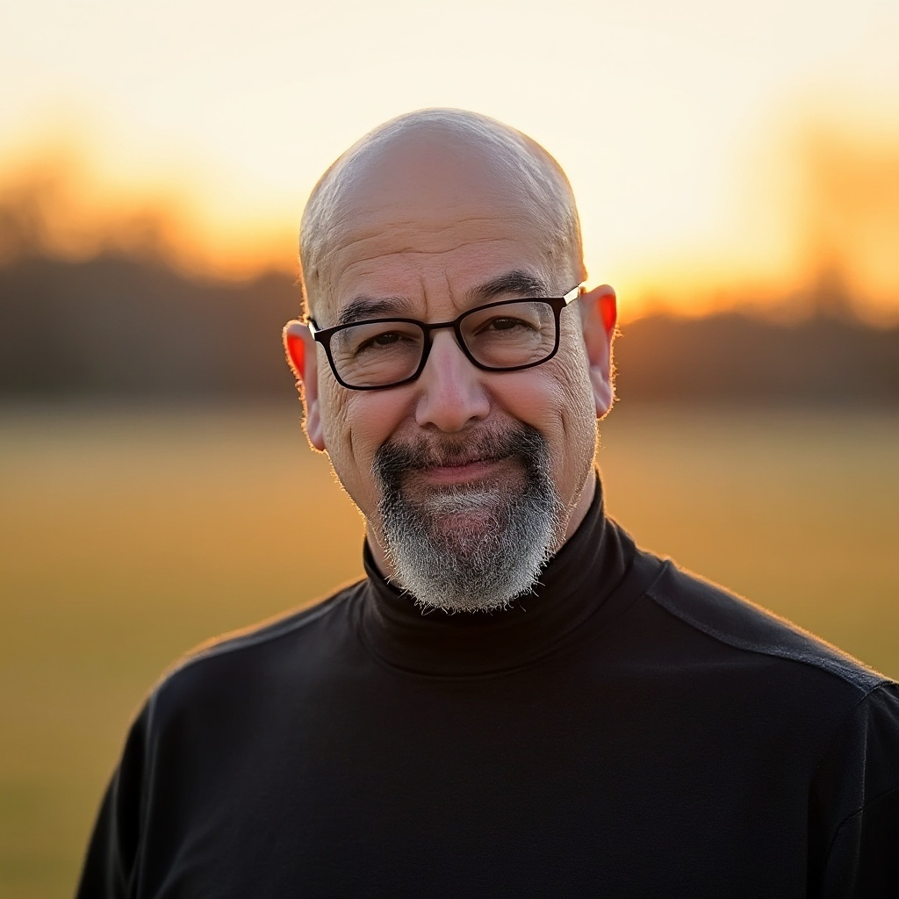
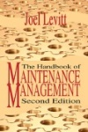

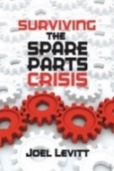

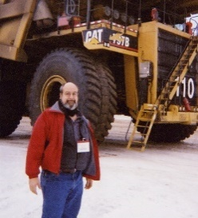


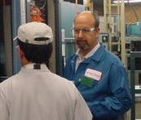
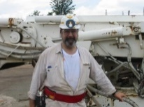
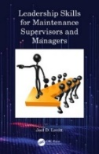
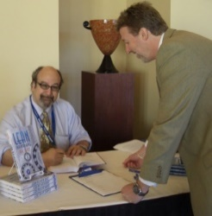
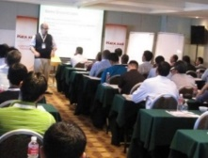
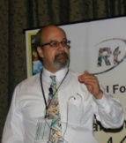

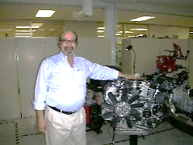
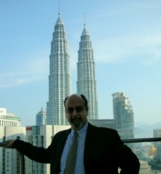

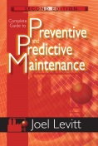
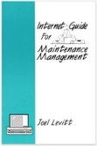
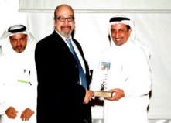

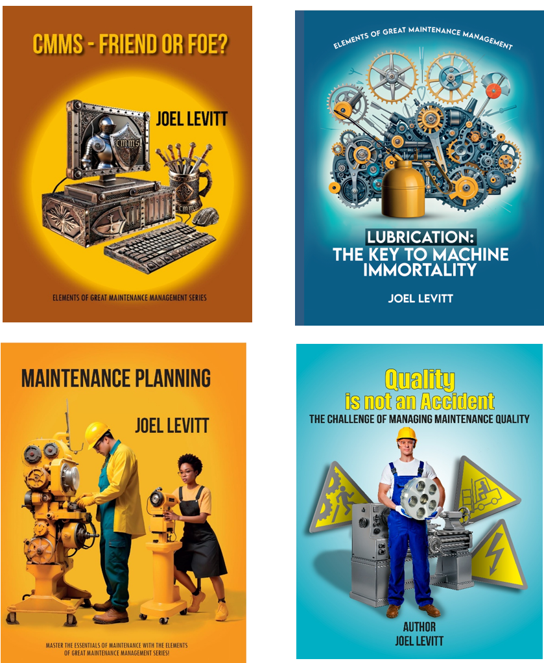
Let me Introduce Myself.
Joel Levitt
CMRP, CRL, CPMM, Prosci Certified Change Management Practitioner
President – Springfield Resources since 1980
Past Director for International Projects, Life Cycle Engineering
Past Director of Reliability Projects, Reliabilityweb.com
Over 35 years of global maintenance management and reliability consulting experience.
Working with such global corporations as:
Alcoa, Toronto Airport, Newfoundland Hydro, GE, Iron Ore of Canada, US Steel, City of Edmonton, Syncrude, ARAMCO, Lockheed, SABIC, ADCO, BP, Exxon, BHP, Malawi Power, CISCO, General Motors, Mercedes Benz, Pepsi, Abbotts, US Coast Guard, US Army, US Navy…
Author of 21 books, plus 2 collaborations and 200+ articles
Trained 20,000 maintenance professionals in 550+ sessions in 43 countries
Favorite charity: Kiva.org, micro lenders to small businesses worldwide
(c) 2014 Joel Levitt www.LCE.com
2
2
2
Elements of Great Maintenance Management
Books: http://www.MaintenancePublishing.com
Notes:
Since 1980 Mr. Levitt has been the President of Springfield Resources, maintenance consultants in a wide variety of industries including pharmaceuticals, oil, airports, hospitals, high tech manufacturing, school systems, government, etc. Springfield Resources has worked in highly regulated, unregulated, union and non-union environments.
Joel Levitt while on a break from teaching in Kuala Lumpur. Petronas Towers in background
Prior to SRC, Levitt was a senior consultant at Computer Cost Control Corp. There he designed computerized maintenance management systems for organizations including FedEx, United Airlines, JFK Airport, BFI, etc. He designed, installed and serviced a complete automation system with rack controls, accounting, and inventory controls for BP North America’s 30,000-barrel/day-oil terminal.
His teaching style is noted for its humor and plain straight talking. Students should expect to be introduced to a great deal of material, real-life examples, successful practices from around the world, and have a good time as well.

Slide 3
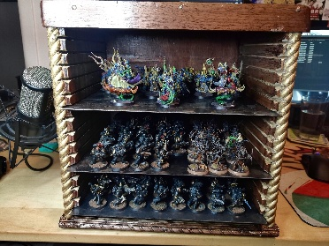
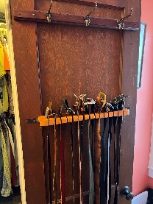
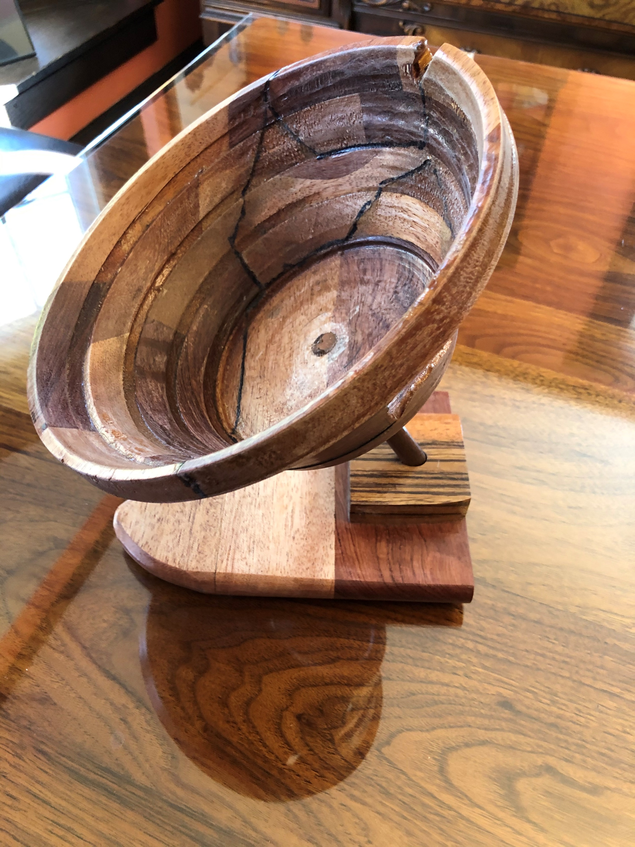
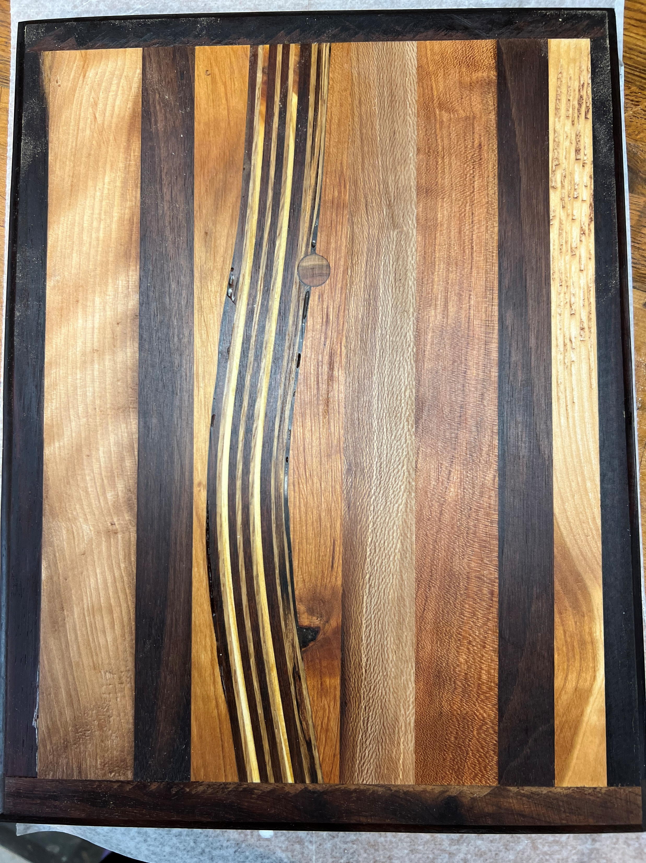
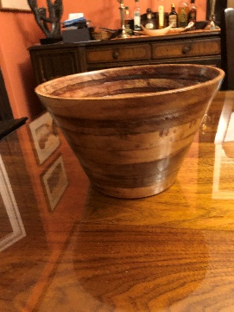
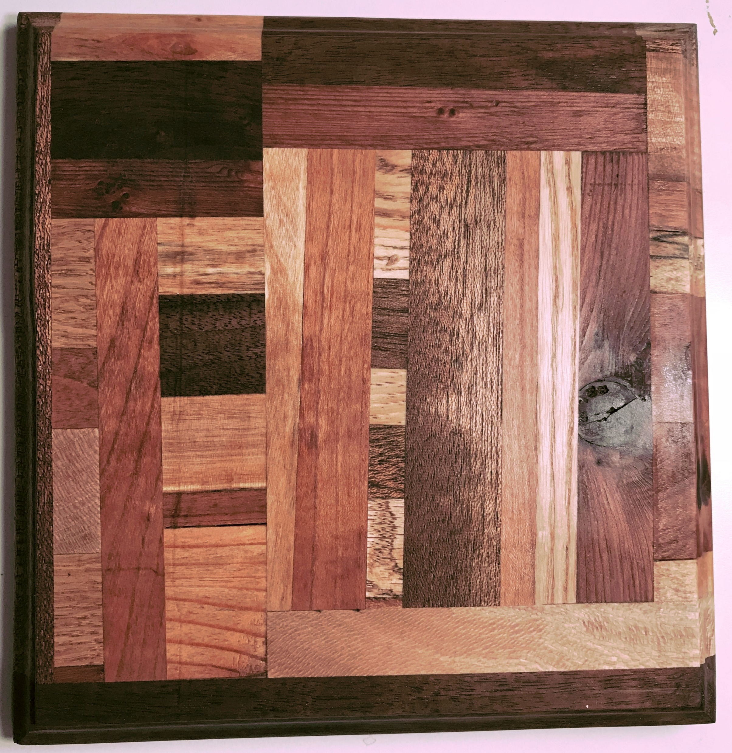
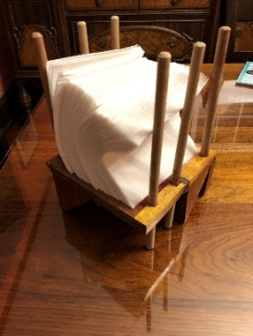
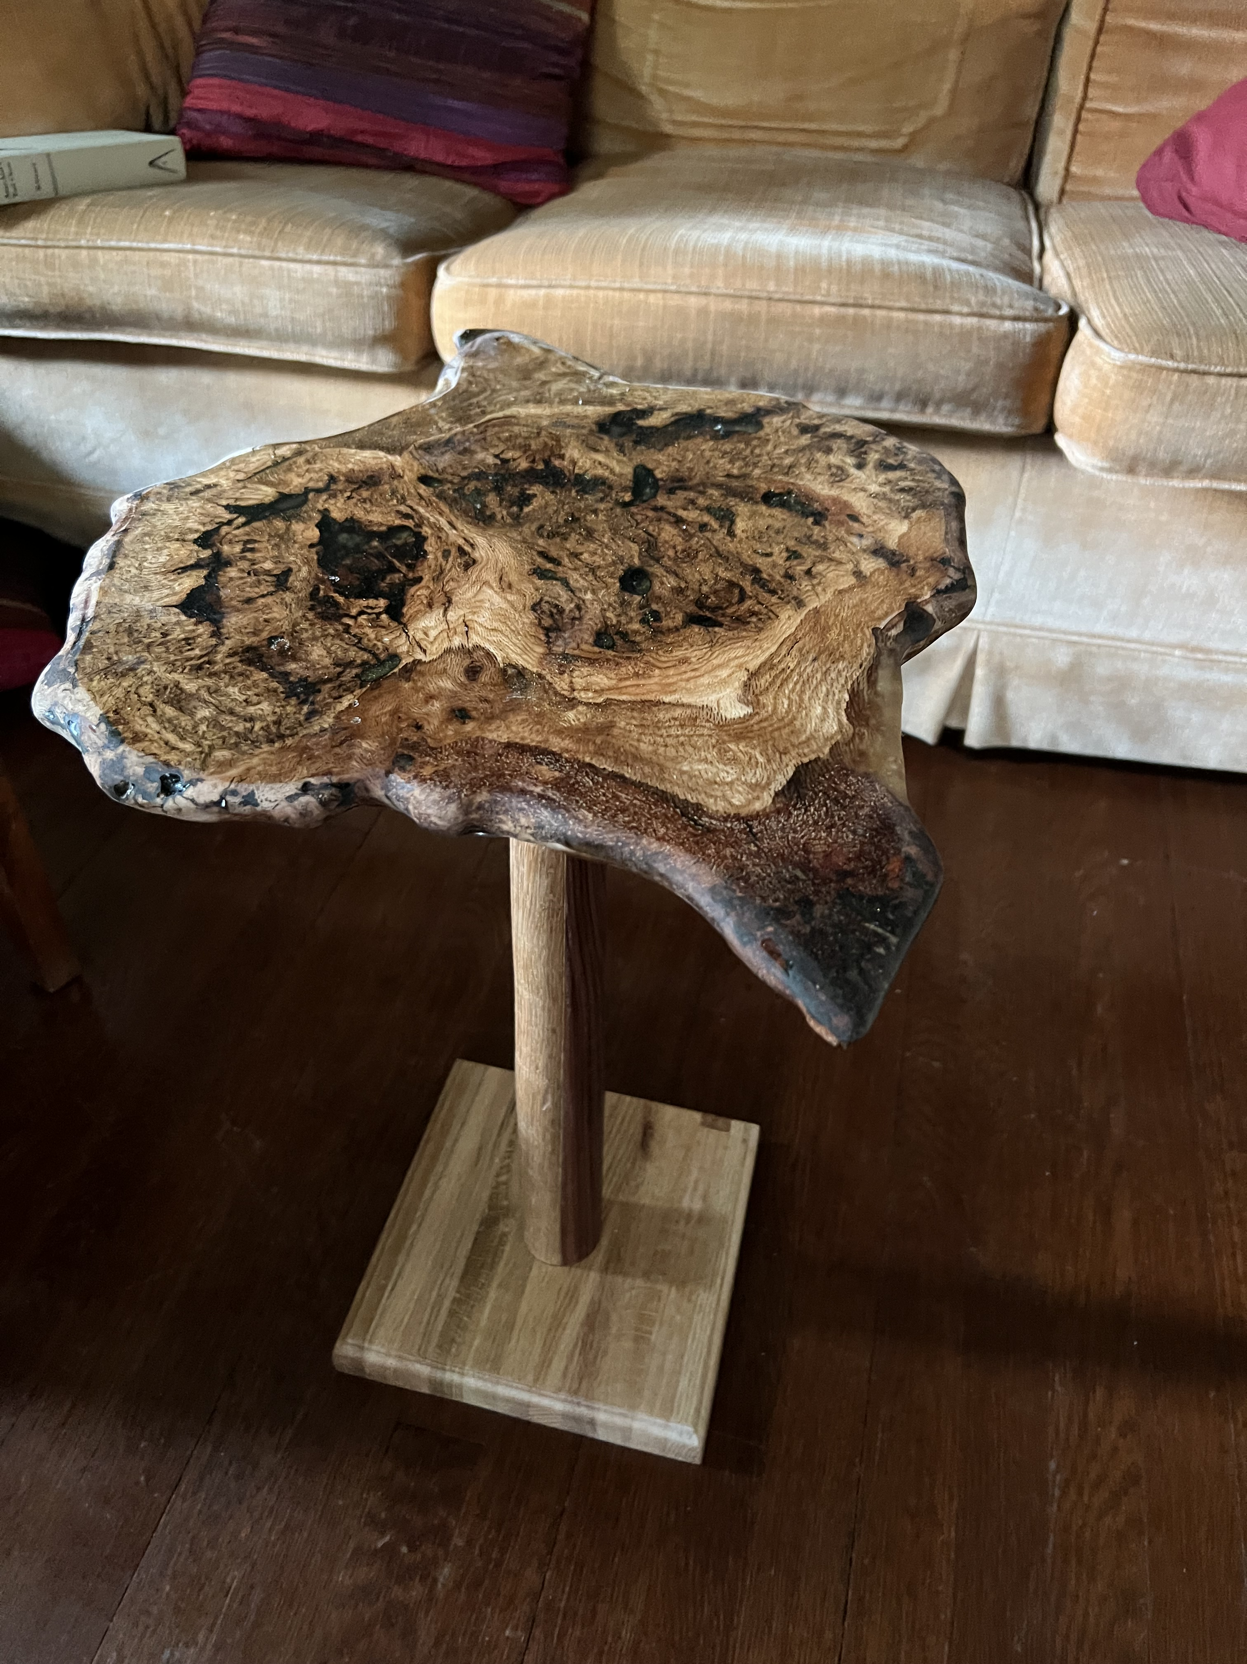
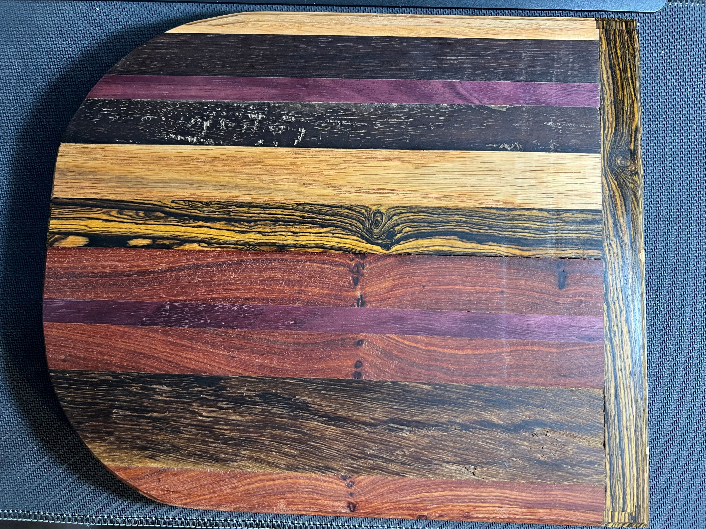
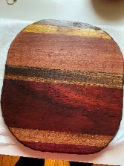
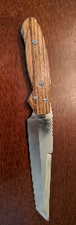
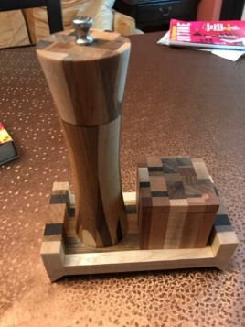
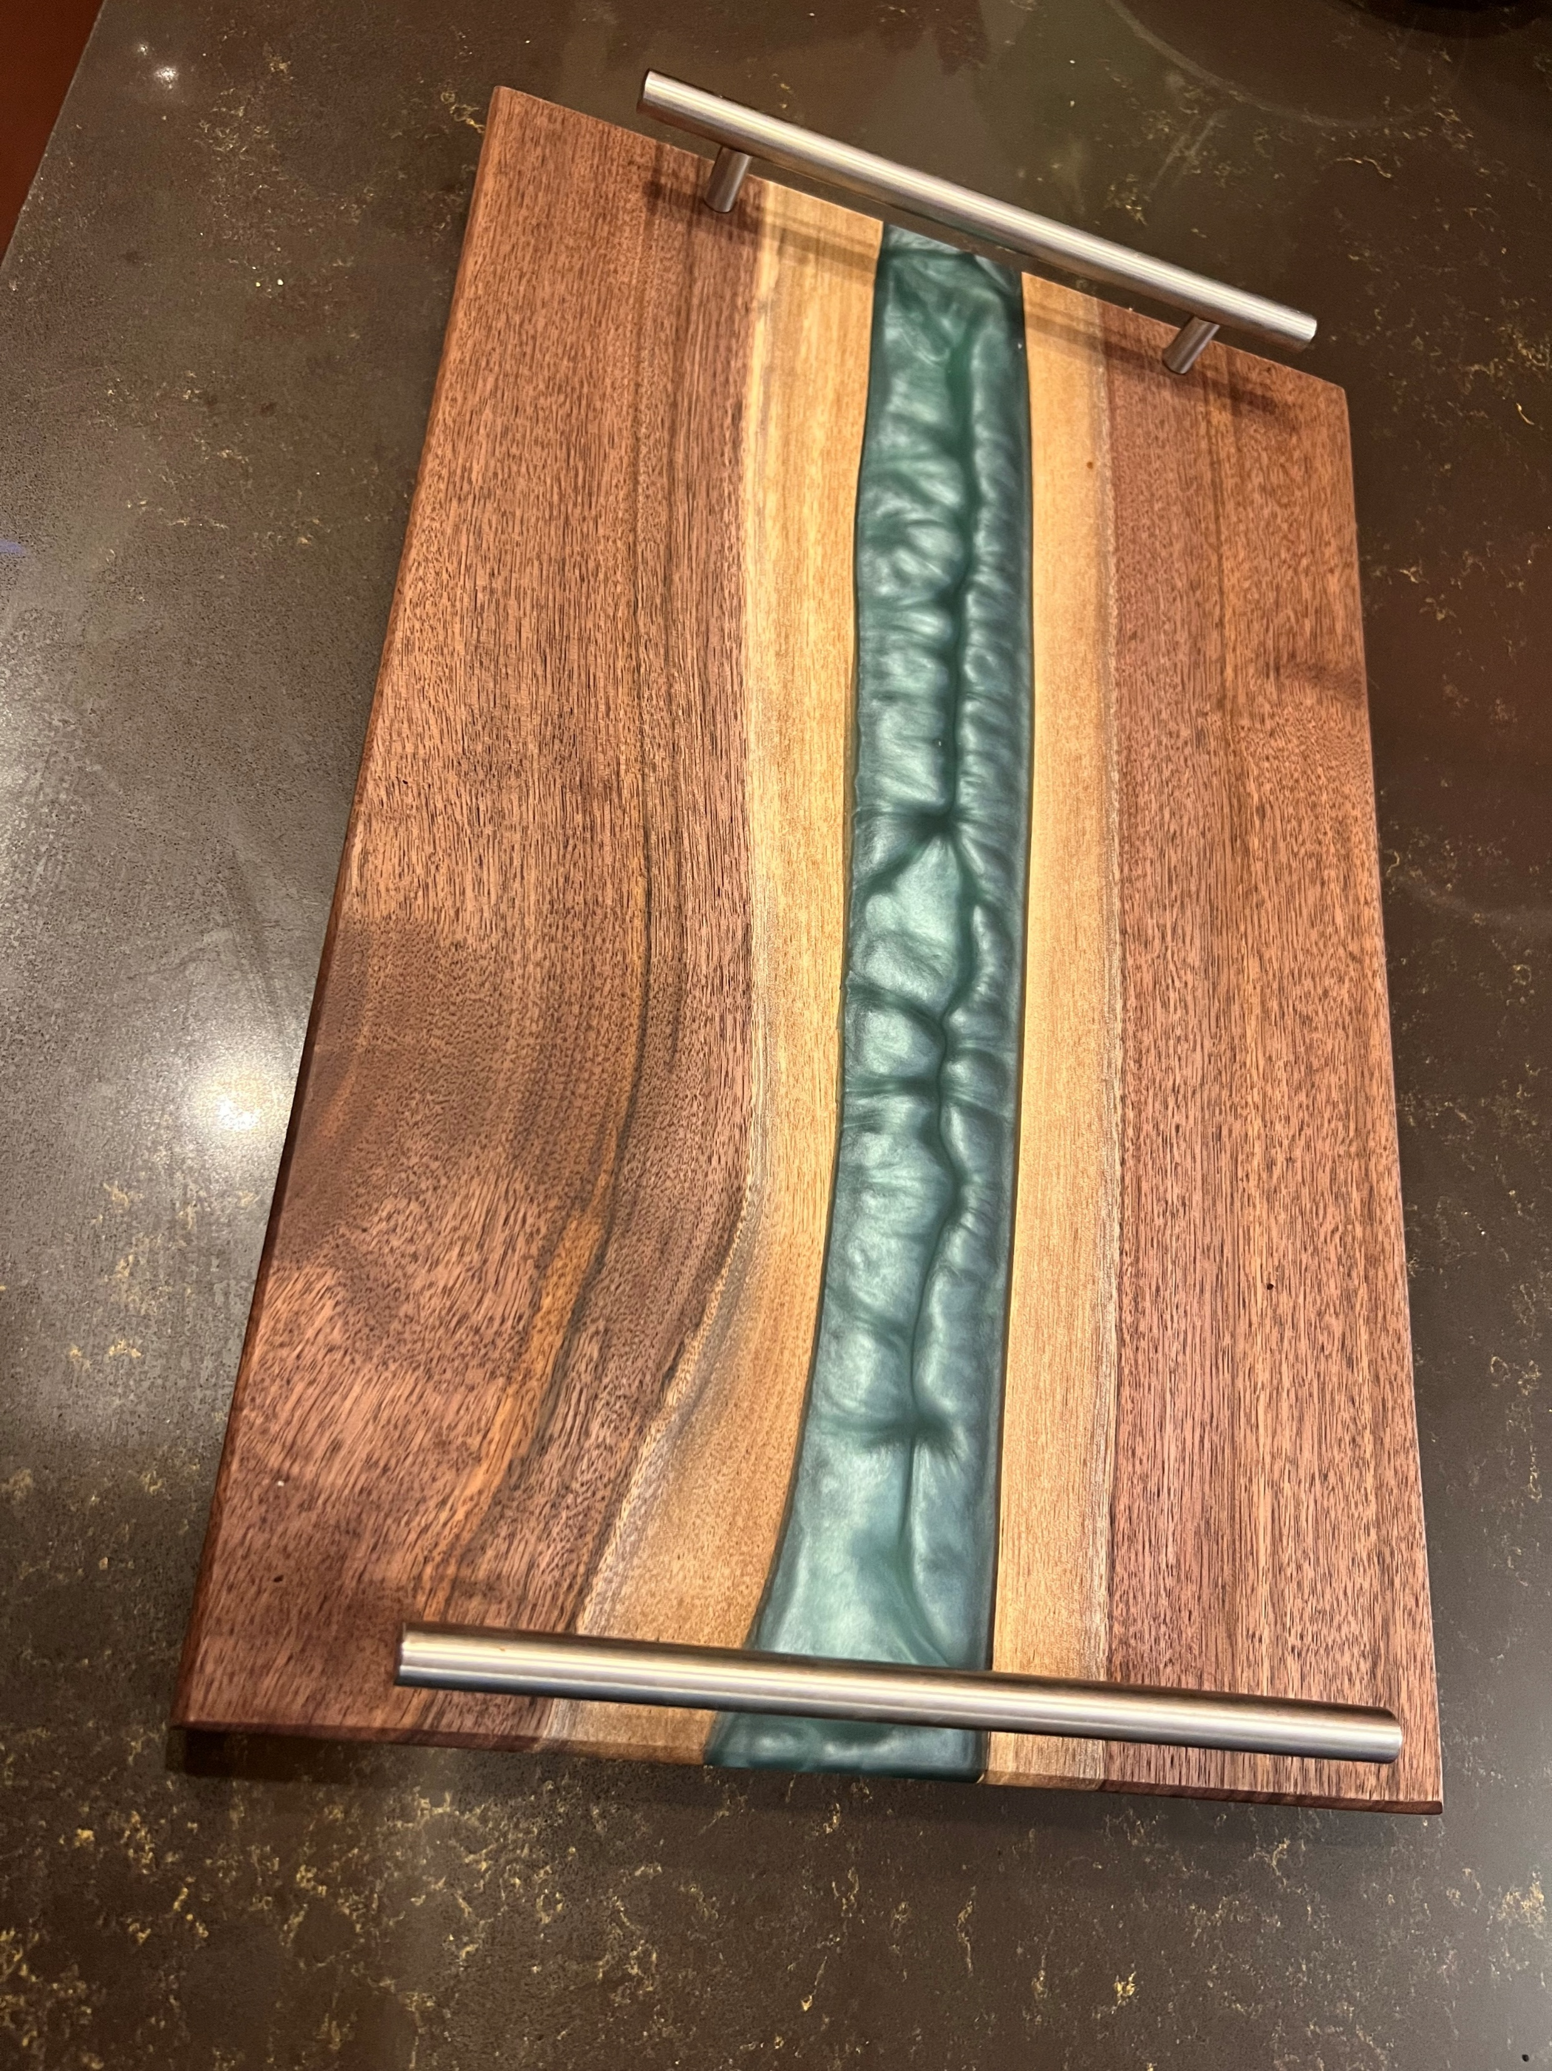
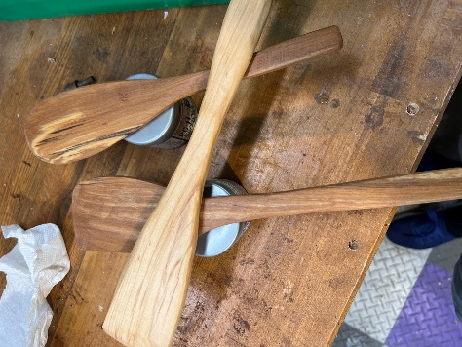
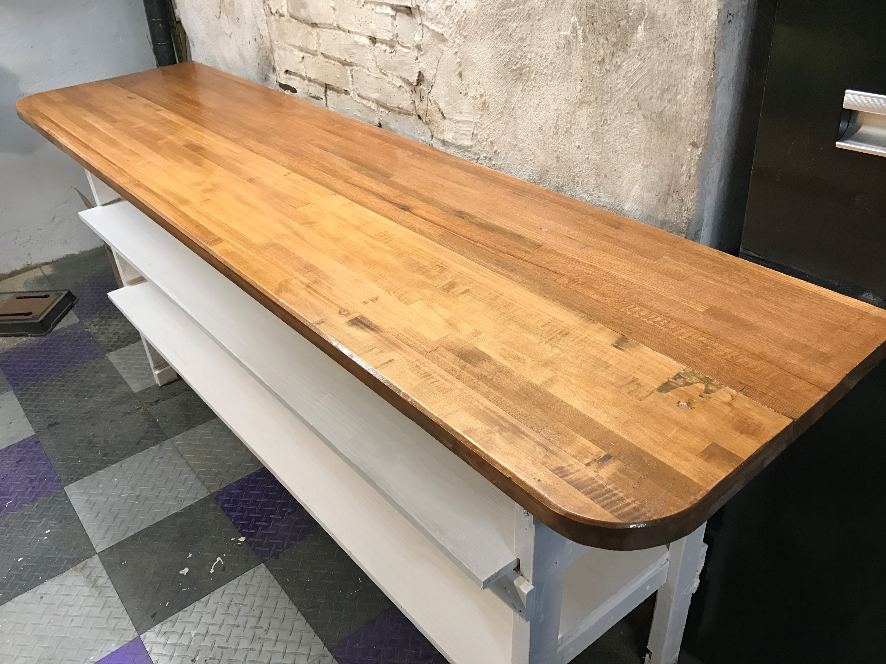
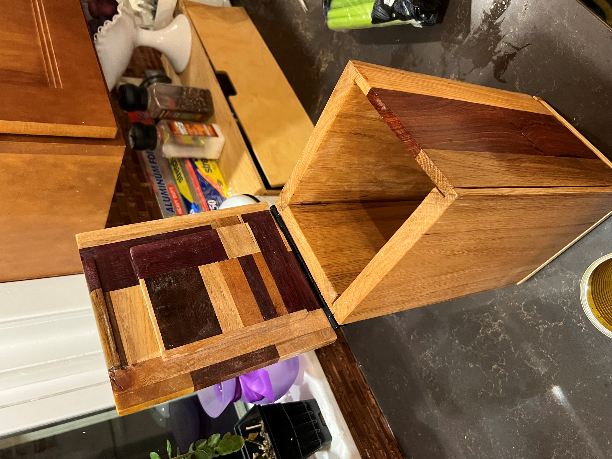
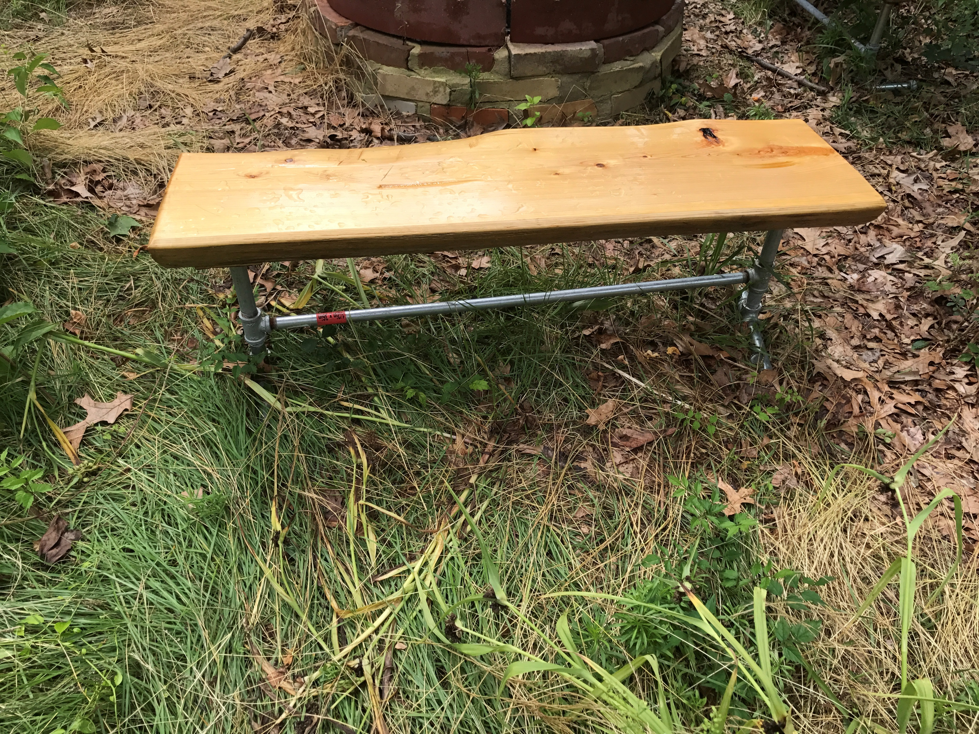
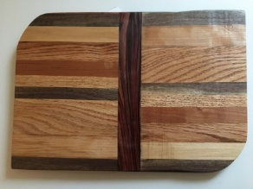
One hobby- writing books about reliability and maintenance
Another hobby, Woodworking

Slide 4
Comic books?
This short discussion is based on two works
And
“A Small Improvement Project (SIP) is an activity that removes a problem, eliminates a defect, fixes damage, cleans up and organizes an area, makes work easier, reduces the need for maintenance, improves production, quality, or safety.”

Slide 5
DRIVING RELIABILITY THROUGH DAILY MAINTENANCE IMPROVEMENTS
Reliability isn’t built in a day—but it is built day by day. In most plants, the biggest gains don’t come from sweeping overhauls or expensive new systems—they come from small, focused improvements made consistently.
This webinar will show you how to harness the power of daily improvements to drive measurable reliability gains.
You’ll learn where to find hidden defects, how to engage your team in proactive actions, and why small projects can have a transformative impact on asset performance, cost, and culture.

Slide 6
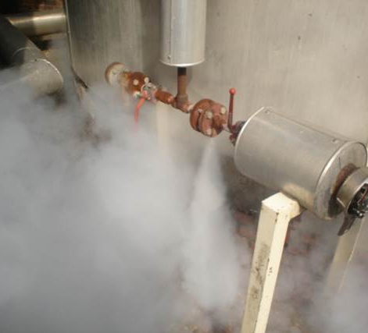
Topics for this event
What is a SIP
What is a defect?
Where to look for SIPs?
Why do this
Why these actions transform organizations
Basic actions
Choosing projects
Rules for SIPs
Building your SIP team
Selling the idea
Set-up
Steam leak
Execution
Sustain

Slide 7
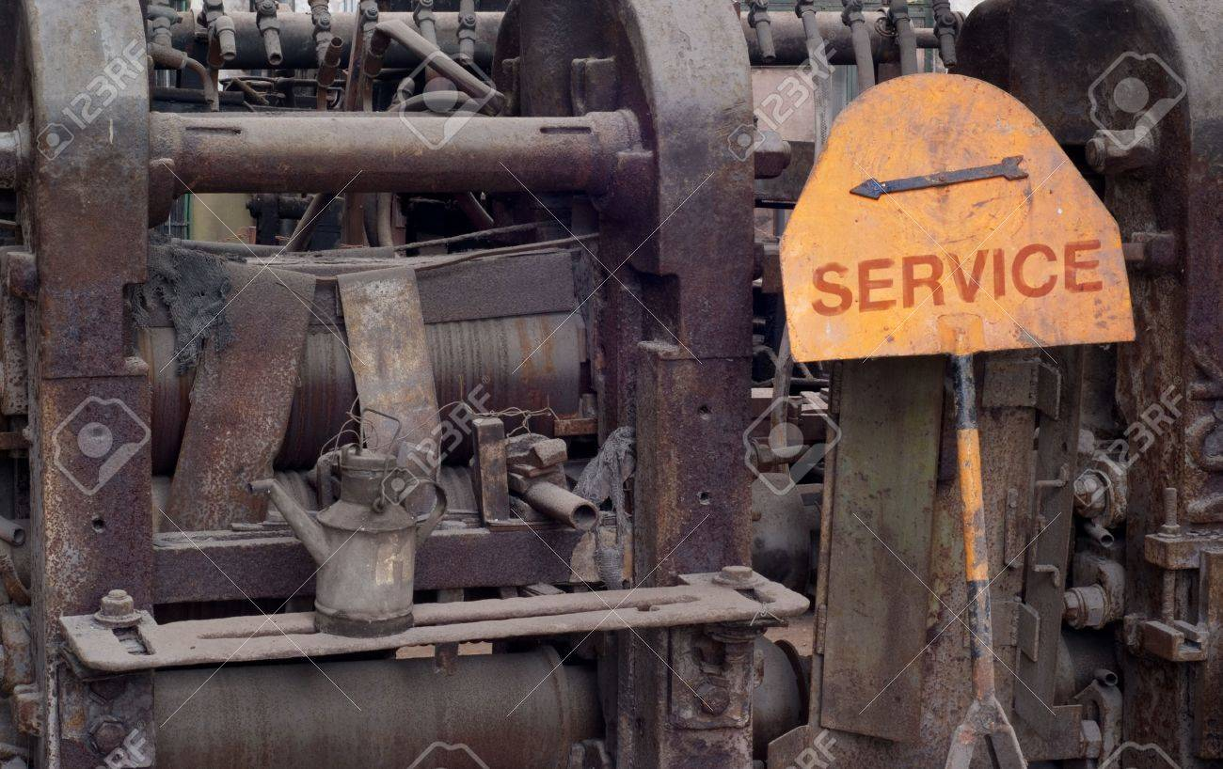
What is a Defect?
Why do we call them SIPs? To Sip is to drink a liquid in small amounts, usually less than a mouthful. This approach is precisely how we need to view improvement projects.
This is fundamental
A defect is anything that erodes value, reduces production, compromises HSE, or creates waste

Slide 8

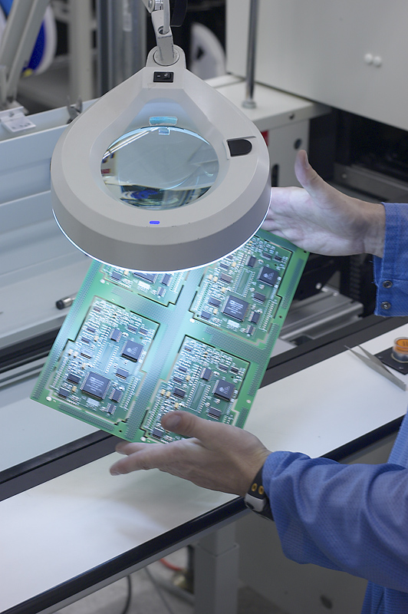
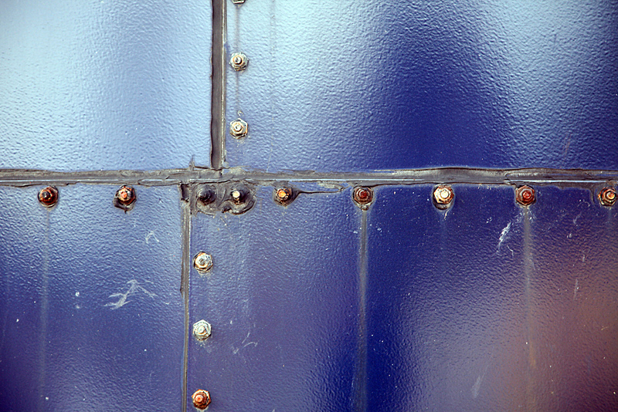
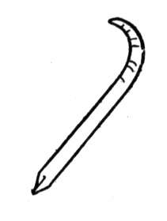
Projects come is all sizes and causes
Some are the result of temporary repairs
Some are the result of bad raw materials
Some are the result of issues with craftsmanship
Some are the result of defective materials

Slide 9
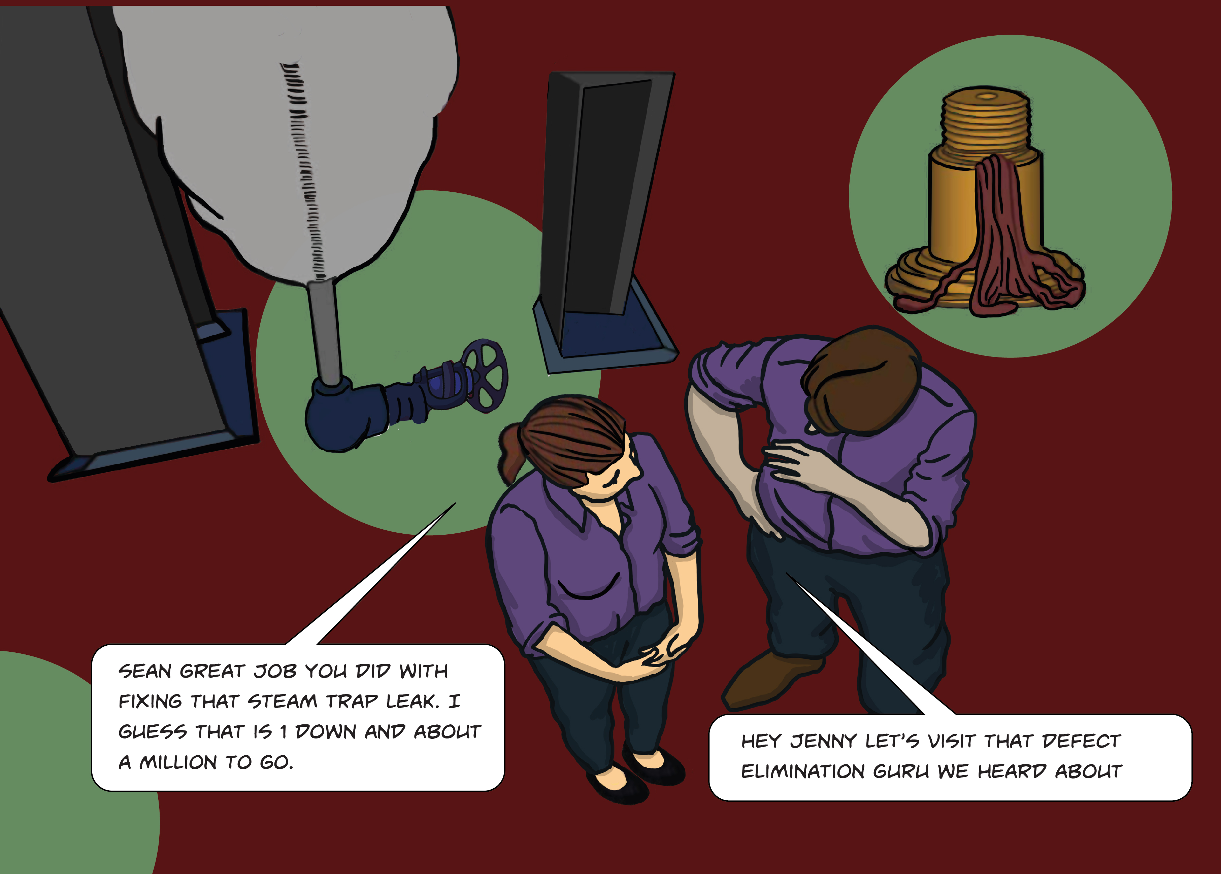
Why bother?
It eventually means less maintenance work!
Better quality products
Better yield from raw materials
Improved Uptime
Higher reliability with fewer machine breakdowns.
Longer equipment life
Higher energy efficiency
Have fun and develop new skills

Slide 10

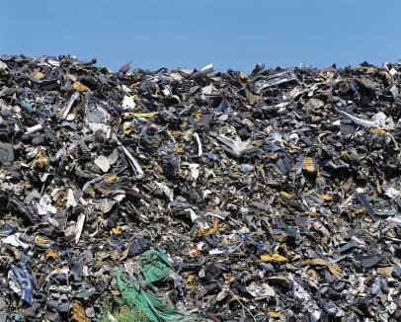
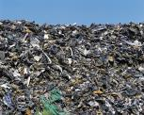

HERE IS ALL YOU NEED TO KNOW
SMALL pile of Defects
BIG pile of Defects

Slide 11
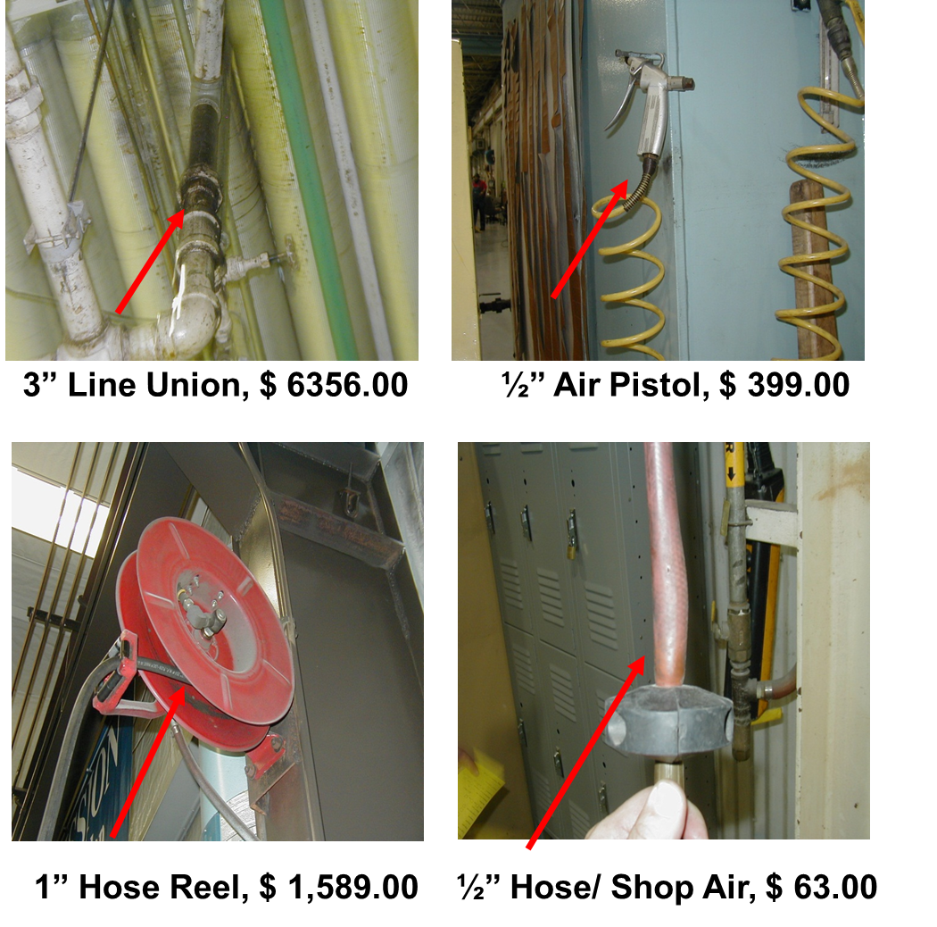
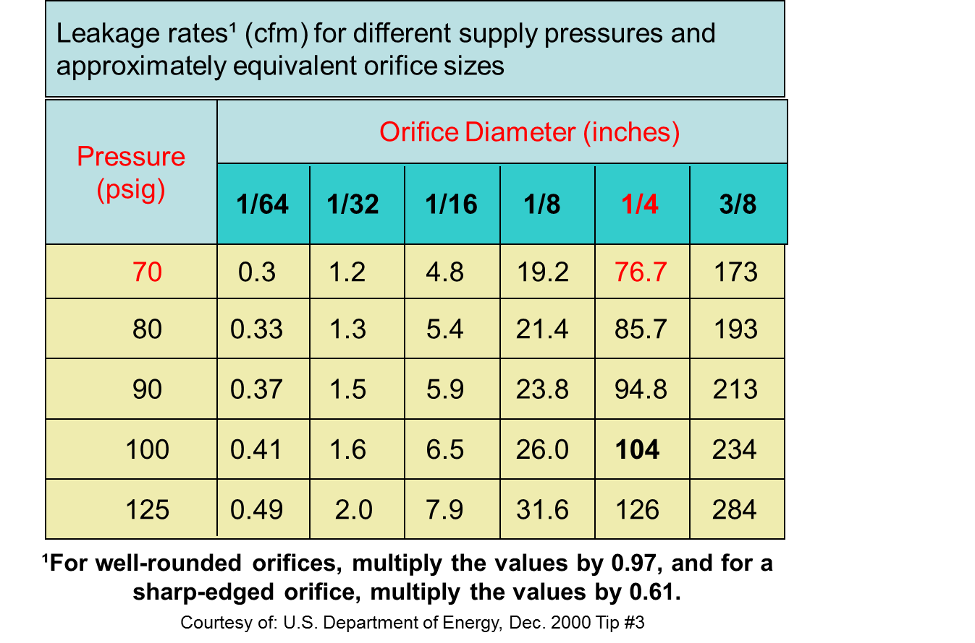
Example of a Quick SIP win: Using Ultrasound to detect compressed air leaks

Slide 12
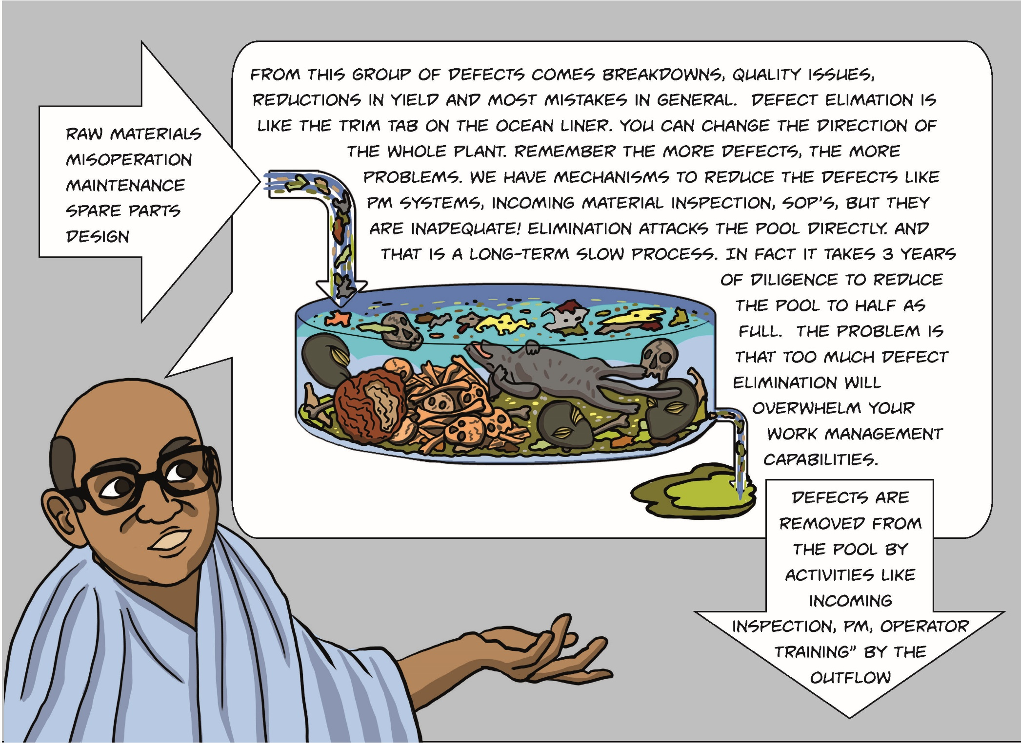
Cesspool hanging over your head
You have a giant pool of things ready to poison your maintenance and operation.
Defects are flowing in faster than you are removing them.

Slide 13
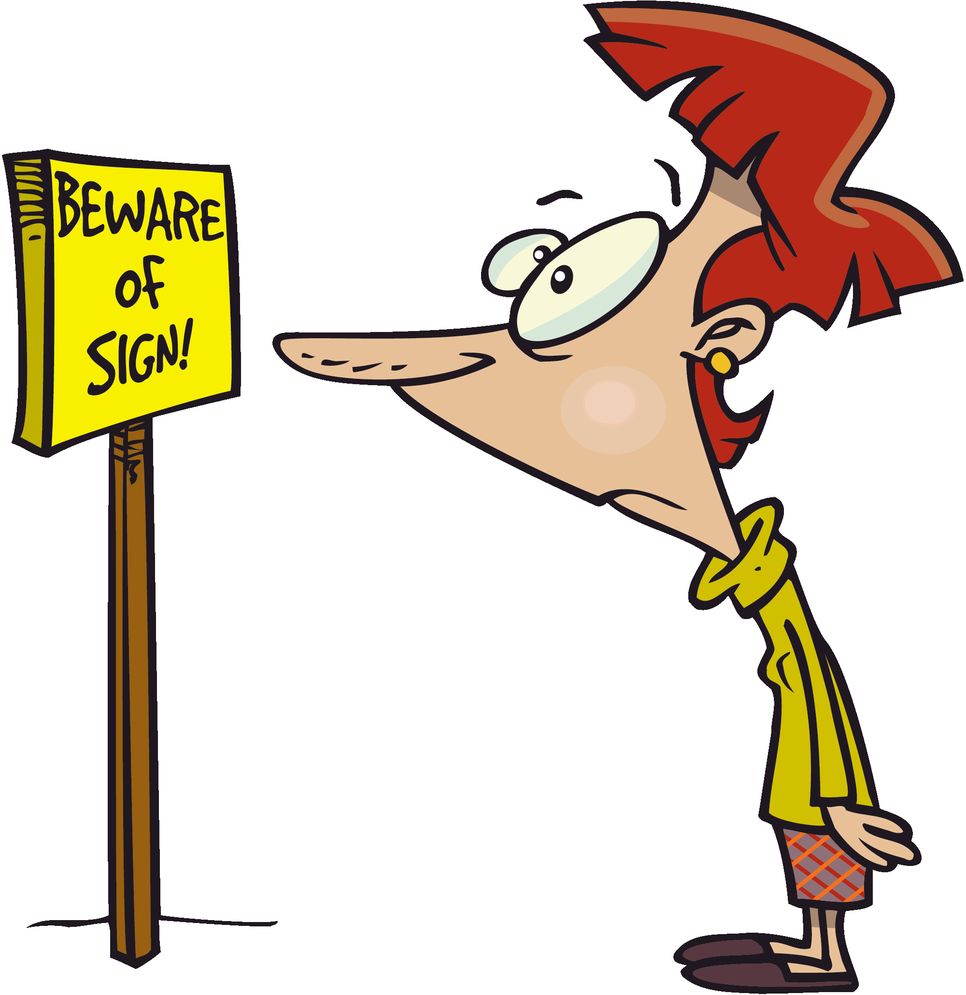
One Psychological bias affects everyone: Normalization of Deviance
Normalization of deviance is when people repeatedly accept a lower standard of performance until that lower standard becomes the “norm”.
We normalize dirt, debris, junk, abnormal operation, bad workmanship, etc.
We are wired to normalize the defect!
Makes it tough to see what is right in front of your nose!

Slide 14
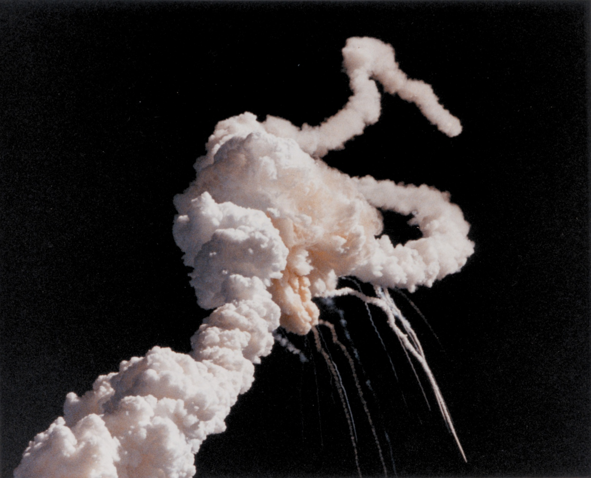
Normalization of Deviance and the Challenger accident
The NASA team accepted a lower standard of performance on the solid rocket booster O-rings until that lower standard became the "norm".
They had become so comfortable with seeing occasional O-ring damage, the original standard, in which ANY O-ring damage was defined as intolerable deviance, was marginalized.
Colonel Mike Mullane, NASA Astronaut,
Damaged “O” rings were normalized and accepted

Slide 15
How does “Normalization of Deviance” impact us?
In your plant, you don’t see disorder
During maintenance work, we don’t see bad habits
In your office, the debris, whatever it is, is invisible.

Slide 16

Manage your SIP micro-projects
Devote about 30-60 minutes a week
Focus on the obvious ones that lend themselves to simple solutions
Set up a CMMS work order category for SIP
Save the work orders and add a narrative for future presentations
Charge all labor and materials to work orders
OK to be members of different teams and work on different defects
Be alert for too much SIP! < 1%

Slide 17


START HERE, RIGHT NOW: There is a whole class of defects that do not need any fancy introduction!
DIYF: Defects that are In Your Face

Slide 18

DIYF-These- These are defects that are In Your Face Ouch!
You ALL have DIFY!
You trip over them
Get you dirty when you touch them
Are eyesores
Cover up what you are looking for
You must clean up after
Are wasteful IN YOUR FACE!
They are easy, easy, easy
Notice dirt everywhere.
Notice missing Fire Extinguisher

Slide 19

There are lots of places to look for opportunities for SIPs
Everywhere you can imagine, and in every activity you do.

Slide 20

Every maintenance activity offers opportunities for SIPs.
Breakdowns
Corrective work
Maximo
Work management
Machine design
Planning and scheduling
PDM and PM
Projects
Purchasing
RCA
RCM
Shutdowns
Stores
Supervision and Management

Slide 21

Brainstorm lists
Complaints
Disruptions (any kind)
Parts Usage
Parts that consume the most money (Yearly)
Repetitive Jobs
Jobs with Max Hours
Most expensive jobs
You can make tons of other lists!

Slide 22

Example TOP PART NUMBERS BY USAGE
What happens when you do a SIP to figure out how you can reduce usage?
Fewer breakdowns means:
Less disruption
Part cost savings
Reduced labor usage
Fewer Parts free up money and space
Part usage can point to defects in:
Machine Design
Craftsmanship
Operation
Raw Materials

Slide 23

The Leap from a list item to a potential project you have to be:
Creative
Ability to make a mistake and learn
Have Knowledge or know who does
Have some time, resources
Fun

Slide 24

STOP- Don’t get caught by unintended consequences!
When you do a SIP, make darn sure 2 or 3 new Defects don’t spring up to replace them

Slide 25
Great SIP projects follow some rules
Projects always use action language.
Eliminates the source of the problem
Reduces waste
Increases knowledge
High Probability of Success
Least (no) money invested
Tools and materials readily available.
Doable within 90 days
Shortest cycle for payback

Slide 26



Go after Low Hanging Fruit first!
Remember the DIYF
Defects in your face

Slide 27


Starting and Execution
No matter how small the SIP, keep a log of everything you start.
Log entry:
Date,
Team members,
What are you planning to do?
What results do you expect?
What did you do? Did you finish?
If not, why not (narrative)
What was the result?
Time spent and any money spent
(include any scrounged stuff)
Keep records
Get help from vendors
Stay honest
Repeatability
Census (Size of opportunity)
Volume 1
Logbook
SIP- (Small Improvement Projects)
Start date:
End date:

Slide 28



Build your team slowly of people interested in SIP projects
Get some wins under your belt

Slide 29
Gradually, continue to build your team. Focus on your successes.

Slide 30

Thank you very much for your attention.
Instructor Joel Levitt, holding an eagle after a traditional dinner in Kyrgyzstan
Stay in touch, Joel D Levitt
JDL@Maintrainer.com,
Contact me on: LinkedIn: www.linkedin.com/in/joel-levitt-maintenance

